Slide 1
Representation of the terrestrial carbon cycle in Earth System models: problems and solutions
Iain Colin Prentice
AXA Chair of Biosphere and Climate Impacts
Imperial College London
with contributions from:
Trevor Keenan (LBNL)
Rebecca Thomas (Imperial)
Han Wang (NWAFU)

Slide 2
Two questions posed to the CO₂ community
Is the land a sink for anthropogenic CO₂?
Is it caused by CO₂ fertilization?

Slide 3
Two questions for carbon cycle science
Is the land a sink for anthropogenic CO₂?✔
Is it caused by CO₂ fertilization?✔
(though this attribution is still contested by some)

Slide 4
One more question
What is the future of the land carbon sink?

Slide 5
One more question
What is the future of the land carbon sink? ???

Slide 6
The current state of the art
Future projections diverge
Many land properties are not well captured
Major differences in process representations – historical legacy?

Slide 7
The current state of the art
Future projections continue to diverge
Many land properties not well captured
Major differences in process representations – historical legacy?
  Vast increase in observations since the 1980s (CO₂ and other tracer concentrations, local CO2 and λE fluxes, plant data compilations, raised-CO₂ experiments, remotely sensed data, palaeodata...)

Slide 8
Land models are going nowhere, very fast
They are neither coherent nor transparent
“Improvement” = adding new processes and parameters
          instead of re-examining the old ones
Observations used almost exclusively for “benchmarking” model outputs
        instead of exploring and testing model processes

Slide 9
21st century land C uptake in models: no agreement and no convergence
2001 2007 2013
Prentice et al. (2015) Atmospheric Chemistry and Physics

Slide 10
Primary production and latent heat flux in models: mostly outside the accepted range
Prentice et al. (2015) Atmospheric Chemistry and Physics

Slide 11
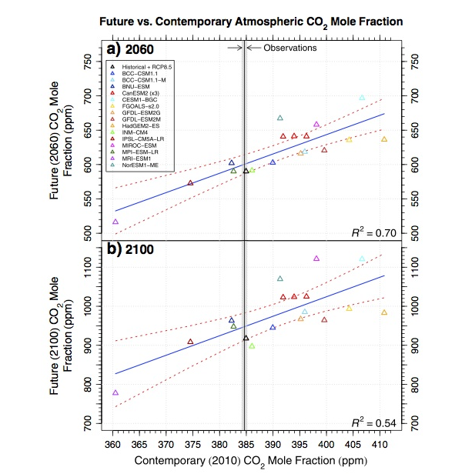
CO₂ uptake:
too little – most ESMs overpredict present CO₂
Hoffman et al. (2014) Journal of Geophysical Research

Slide 12
✖
IAV and tropical
temperatures:
adding the N cycle
messed up the C cycle
OBS
Wenzel et al. (2014) Journal of Geophysical Research

Slide 13
CO₂ seasonal cycle in the northern atmosphere: amplitude predicted poorly, amplification too small
Thomas et al. (2016) Geophysical Research Letters

Slide 14
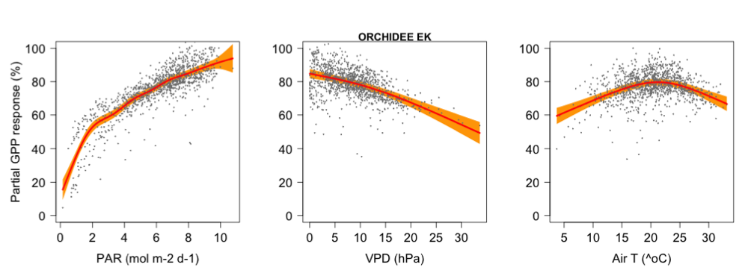
Responses of weekly GPP to drivers
OBS
TF Keenan (in prep.)

Slide 15
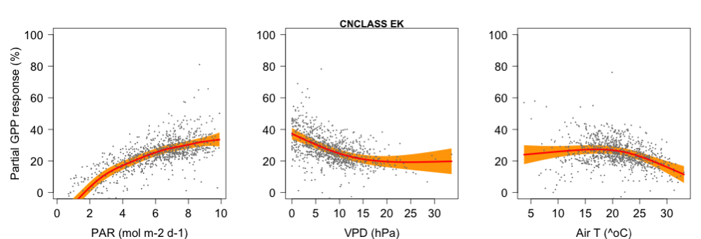
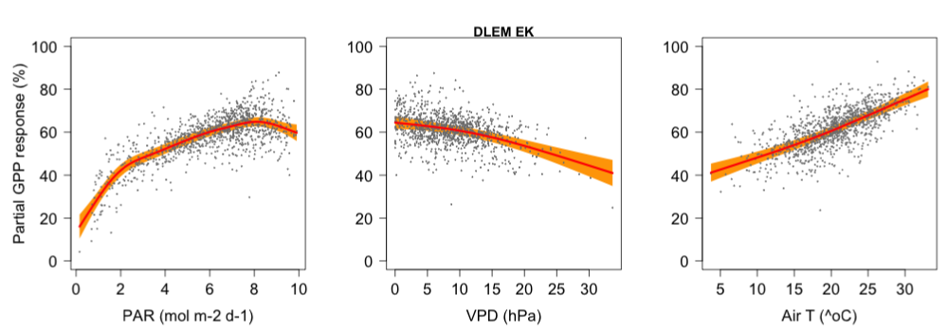
Responses of weekly GPP to drivers
TF Keenan (in prep.)

Slide 16
We can (and should) do much better!
Formulate hypotheses about individual processes
Make quantitative predictions
Use data extensively, to provide tests

Slide 17
What hypotheses?
Natural selection => predictability in biological systems
Optimality criteria => many testable predictions involving acclimation and adaptation
Aim for simpler process representations, fewer parameters, anaytical tractability

Slide 18
What controls the c_{i}:c_{a} ratio?
CO₂ inside the leaf (c_{i}) < CO₂ in the air (c_{a}) during the day
Ratio (χ) is the “exchange rate” between carbon gain and water loss
Indexed by the stable carbon isotope ratio (δ¹³C)
Least-cost hypothesis: χ minimizes the sum of the unit costs of maintaining carbon-gain and water-loss capacities
  Wright et al. (2004) American Naturalist
  Prentice et al. (2014) Ecology Letters

Slide 19
Least-cost hypothesis for the regulation of χ
  Problem: to minimize
  a (E/A) + b (V_{cmax}/A)
  leading to
      χ ≈ ξ/(ξ + √D)
      where
      ξ = √(bK/1.6a)
      K = K_{C} (1 + O/K_{O})
      a = r_{s}h²ρ_{s}η/2(Δψ)k_{s}ρ_{w}
      b = constant
Prentice et al. (2014) Ecology Letters

Slide 20
Consequences
χ is (almost) independent of c_{a} and PAR, but responds to other drivers:
    ⬆ with growth temperature (K_{c}, K_{o},η)
    ⬇ with vapour pressure deficit (D)
    ⬇ with elevation (O, D)

Slide 21
response of ln {χ/(1 – χ)} to drivers
        predicted from δ¹³C data
        temperature (K) 0.054 0.052 ± 0.006
        ln vpd –0.5 –0.55 ± 0.06
        elevation (km) –0.08 –0.11 ± 0.03
Wang et al. (2017) Nature Plants (in press)

Slide 22
Wang et al. (2017) Nature Plants (in press)

Slide 23
What controls V_{cmax}?
Capacity for CO₂ fixation – master variable for land carbon cycling
Co-ordination hypothesis: V_{cmax} is just sufficient to use the light absorbed by the leaf (no more, no less)
  Chen et al. (1993) Oecologia
  Haxeltine & Prentice (1996) Functional Ecology
  Dewar (1996) Annals of Botany
  Maire et al. (2012) PLOS One

Slide 24
Co-ordination hypothesis for the regulation of V_{cmax}
  Equate the enzyme- and light-limited rates of photosynthesis (for average daytime absorbed PAR, I_{abs})
  A_{C} = V_{cmax} (c_{i} – Γ*)/(c_{i} + K)
  A_{J} ≈ φ₀ I_{abs} (c_{i} – Γ*)/(c_{i} + 2Γ*)
  leading to
  V_{cmax} ≈ φ₀ I_{abs} (c_{i} + K)/(c_{i} + 2Γ*)
Dong et al. (2017) Biogeosciences

Slide 25
Consequences
V_{cmax} varies inversely with χ, and also depends on light and temperature:
  ⬆ in proportion to PAR (Ι_{abs})
  ⬆ with growth temperature (K >> Γ*), but less steeply than the “instantaneous” response shown by lab measurements

Slide 26
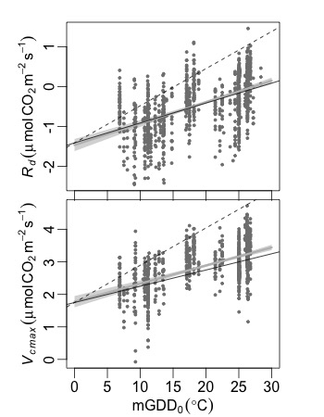
Leaf respiration (R_{d}) and V_{cmax} versus growth temperature
H Wang et al. (in prep.)

Slide 27
Some other predictions (also correct)
higher V_{cmax} in dry environments
higher V_{cmax} at high elevations
  first observed: Körner & Diemer (1987) Functional Ecology
  explained: Wang et al. (2016) New Phytologist
slightly lower V_{cmax} at elevated c_{a} (‘down-regulation’)

Slide 28
What controls the light use efficiency (LUE) of gross primary production (GPP)?
GPP is total CO₂ uptake by plants – the basis for life on land
Monteith equation: GPP = LUE × fAPAR × IPAR (well supported by data) underlies “LUE models”, with fAPAR from satellite data
We can explain it as a consequence of the co-ordination hypothesis. So now we can predict LUE:
  with no “plant functional types” (except C₃ and C₄ plants)
  no discontinuities at biome boundaries
  a realistic response to CO₂
  all in contrast with existing LUE models, e.g. MODIS GPP

Slide 29
A universal LUE model for GPP
where
and
φ₀ = 0.085
c* = 0.41
β = 146
Wang et al. (in press) Nature Plants

Slide 30
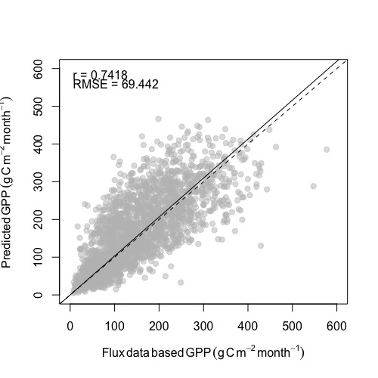
Global data-model comparison of monthly GPP
Wang et al. (in press) Nature Plants

Slide 31
Data-model comparison of CO₂ effects
Comparison with Ainsworth & Long’s (2005) meta-analysis of FACE experiments (≈ 200 ppm CO₂ enhancement):
 | meta-analysis | model
Light use efficiency | 12.2 ± 9 % | 15.2 %
Water use efficiency | 54.3 ± 17 % | 55 %
Stomatal conductance | –20.0 ± 3 % | –15.0 %
Wang et al. (in press) Nature Plants

Slide 32
Next steps?
  ESA project: https://terra-p.vito.be/
Diurnal cycle, diffuse light effects
Effects of soil chemistry
From GPP to NPP to BP
C allocation, nutrient demands, role of mycorrhizae
Evolutionary stable strategies
From leaf C to fAPAR => “closing the loop”
Life forms and phenological strategies
Competition and co-existence
Next-generation land model, with a much stronger theoretical and empirical basis than current models

