Slide 1
Determining the Groundwater Potential for Agricultural Use on Sloping Soils in Ethiopian Highlands
Debebe L. Yilak, Seifu A. Tilahun, Petra Schmitter, P. Nakawuka, Temesgen Enku, Tibebu Kassawmar, and Tammo S. Steenhuis.
10th Alexander von Humboldt Conference 2015
Water-Food-Energy River and Society in the Tropics
EGU Topical Conference Series | Addis Ababa | Ethiopia | 18–20 November 2015

Slide 2
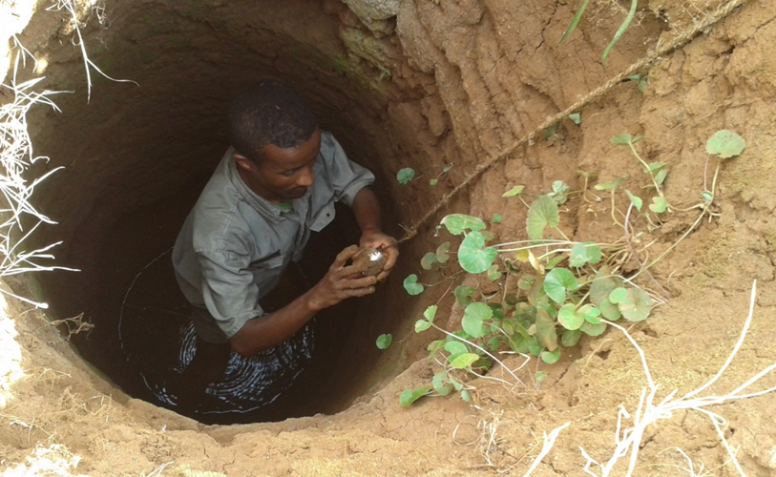
Content
INTRODUCTION
STUDY AREA
METHODOLOGY
RESULTS AND DISCUSSION
CONCLUSIONS

Slide 3
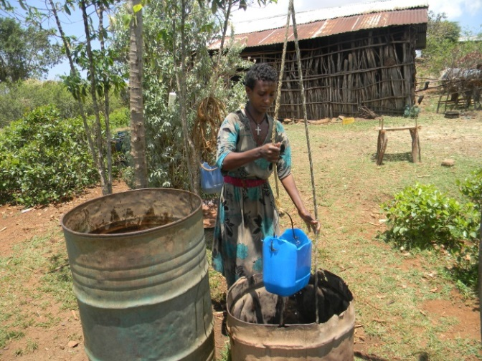
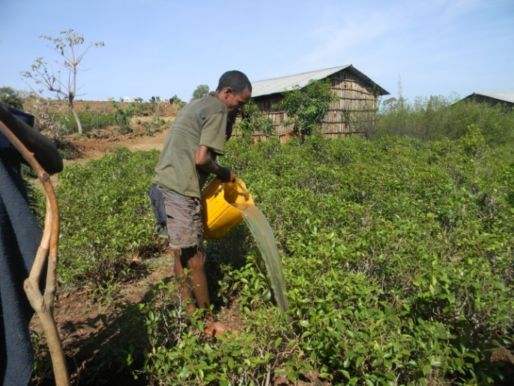
INTRODUCTION
Household irrigation is encouraged for poverty alleviation
Household dry season irrigation is increasing
Ethiopian highlands are not flat
Sustainable groundwater use and recharge is not known for sloping soils in Ethiopia
use
So understanding sloping aquifers is
critical for sustainable groundwater use

Slide 4
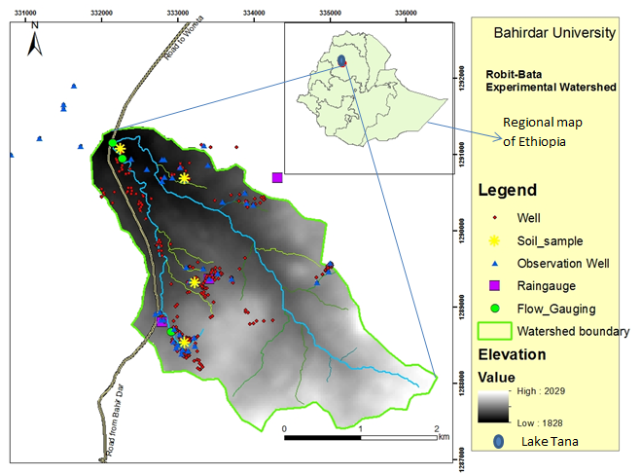
ROBIT BATA
Robit-Bata (911 ha)
Watershed located at the south of Lake Tana,
300 hand dug wells
Well depth: 3 – 15m
Vegetables and cash crops grown by dry season irrigation

Slide 5
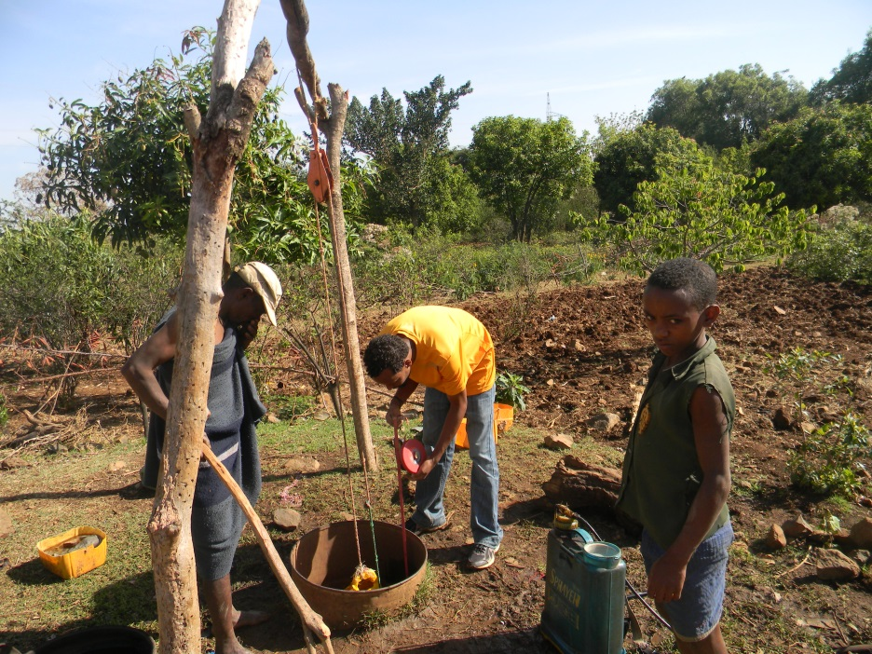
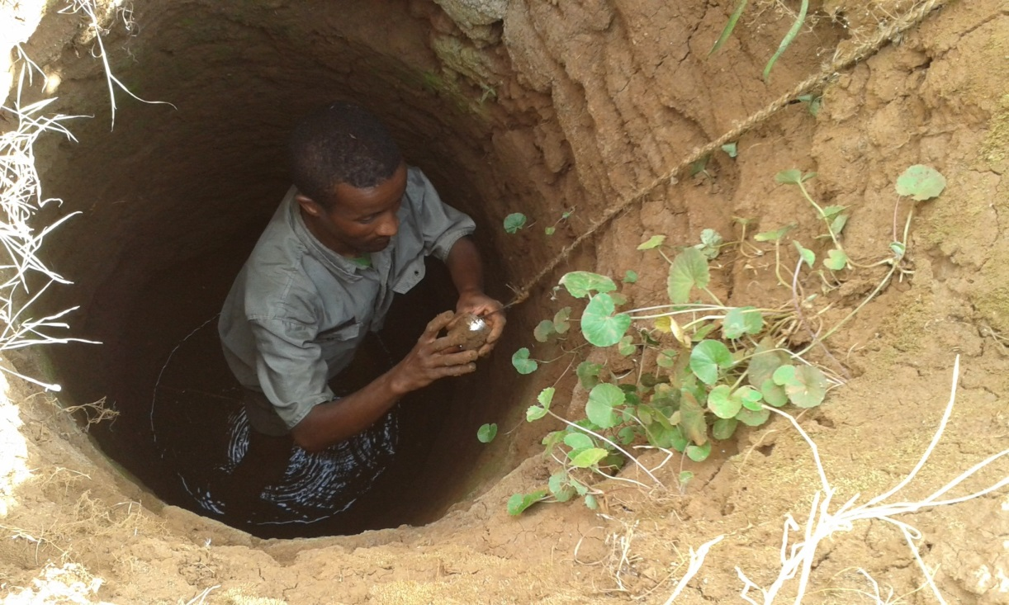
MATERIALS AND METHODS: DATA
Since 2014 we collected
Storm stream flow and base flow
Weekly groundwater level data at 50 wells
Rainfall (manual and recording)
Soil Data from the four wells
Bulk density ($ρ_{b}$)
Drainable porosity

Slide 6
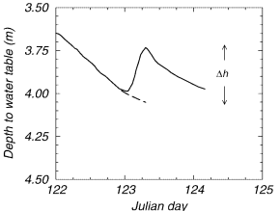
Calculation of Recharge
Recharge $R=S_{y}∗{∆h}/{∆t}$
where
${∆h}/{∆t}$weekly groundwater table rise
$S_{y}$ specific yield
Δh

Slide 7
Results: Observed groundwater data
In rainy monsoon phase
Bottom slope - shallow water table (2-4 m)
Upslope - deeper water table

Slide 8
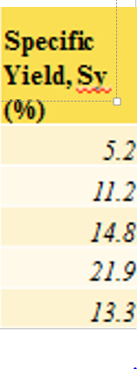
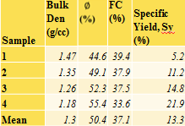
Aquifer characteristics
Highly weathered rock at upslope areas
Slightly weathered rock at middle slope, and
Transported clay loam soil at the bottom

Slide 9
Results: Water level

Slide 10
Results: Recharge
Recharge – Rainfall relation
Generally recharge follows rainfall distribution
Apparent recharge at bottom of hill is greatest due to interflow in sloping aquifer from upland areas
The maximum recharge rate occurs at the middle of the rainy phase (during highest rainfall period)

Slide 11
Date | Monthly average
 | water level rise, mm | Recharge, mm | Rainfall , mm
May, 2014 | 828 | 110 | 133
Jun, 2014 | 745 | 99 | 219
July, 2014 | 1072 | 142 | 250
Aug, 2014 | 1337 | 177 | 502
Sept, 2014 | 565 | 752 | 264
Oct, 2014 | 59 | 8 | 178
Nov, 2014 | 63 | 84 | 1
Dec., 2014 | 121 | 16 | 0
Jan, 2015 | 19 | 2 | 0
Total |  | 640.0 | 1550
Areal average recharge estimated by Thiessen polygon
Average annual water level rise was 4.7m,
Annual average recharge was 640mm
41% of the annual rainfall
Other months are dry & No recharge
.

Slide 12
RESULTS: Agricultural Implications
Depth to water table depends on slope position
Water accumulates at bottom of hill due to interflow.
Wells at top of hills are dry for most of the rainless period
Irrigated areas (with Chat) concentrated near rivers

Slide 13
CONCLUSIONS
The annual average recharge was 640mm, which is 41% of the annual rainfall
Most of recharge accumulates in low lying areas and is source for baseflow.
Most of watershed runs out of groundwater during dry monsoon phase
All water tables recover during rainy phase

Slide 14
Thank you!

