Slide 1
Numerical simulations of tornadoes in complex urban landscape
Val Jewtoukoff, Paul Markowski, Yvette Richardson, Mike Kinzel
The Pennsylvania State University, Pennsylvania, USA

Slide 2
Context
Previous methods (Wurman et al. 2007) to estimate damage potential of a tornado on major population center are limited
Lack the influence of the structures on the tornado flow
Solution: simulate numerically the interaction between structure and tornado (Lewellen 2014)

Slide 3
Motivation
Can this interaction be modeled with a novel approach?
Realism? How much more complexity can we add to this problem?
Impact on more complex urban landscapes
Preliminary experiments!

Slide 4
Outline
Methodology
Tornado on isolated “buildings”
Tornado in complex urban landscape
Summary and perspectives

Slide 5
Methodology (CM1-StarCCM+)
idealized LES simulations of tornado vortex with CM1 (Bryan & Fritsch 2002) with heat source and sink added (Markowski & Richardson 2014)

Slide 6
CM1
Same method used for outflow surge study:
Poster 5
Possibility to control tornado parameters: intensity, motion speed…

Slide 7
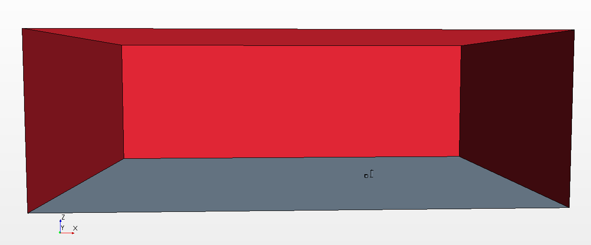
One-way nesting in StarCCM+
Δx ~10 m “in general”
~1 m near walls
+ vertical stretching
Feed (u, v, w), T, p
LES simulation with Star (Finite Volume commercial CFD code; CD-Adapco 2014)
Can include structures
Can use real complex CAD landscapes
Examples shown will be indestructible buildings
1 km
buildings
IC, BC
2 km
3 km

Slide 8
Outline
Methodology
Tornado on isolated “buildings”
Tornado in complex urban landscape
Summary and perspectives

Slide 9
Tornado on isolated structures
Output every 1 s
15 m/s
EF3 tornado
“buildings”: 10 m high cube + 30 m high cylinder
750 m

Slide 10
(all the animations have been degraded and rescale compared to the original presentation to meet size requirements – one of the animations has simply been deleted)

Slide 12
Outline
Methodology
Tornado on isolated “buildings”
Tornado in complex urban landscape
Summary and perspectives

Slide 13
Tornado on complex urban landscape
15 m/s
EF3 tornado
Pennstate
Park Forest suburb
750 m
1000 m

Slide 16
Using volume rendering…

Slide 17
Pressure on buildings

Slide 18
Outline
Methodology
Tornado on isolated “buildings”
Tornado in complex urban landscape
Summary and perspectives

Slide 19
Summary
Novel approach to simulate tornado with structures: CM1-StarCCM+
Opportunity to better understand the interaction between tornado and structures: sensitivity tests (different tornadoes, different geometries), angular momentum
Better way to estimate stress on structures

Slide 20
Perspectives
Possibility to include breaking (by coupling with an engineering finite element code) and better understand how building collapse occurs
Applicability to real major population centers that could potentially get hit (Chicago, St Louis, Dallas…)

Slide 21
Thank you!

