Slide 1

Potential of stereoscopic imagery based on Meteosat Second Generation satellites
Ján Kaňák¹, Ľuboslav Okon¹, Martin Setvák², Márta Diószeghy³, Vesa Nietosvaara⁴
¹Slovak Hydrometeorological Institute, Jeséniova 17, Bratislava, Slovakia
²Czech Hydrometeorological Institute, Na Šabatce 2050/17, 143 06 Praha 412-Komořany, Czech Republic
³Hungarian Meteorological Service, H-1024 Budapest, Kitaibel Pál u 1, Hungary
⁴EUMETSAT, Eumetsat Allee 1, D-64295 Darmstadt, Germany
ECSS 2017, Pula, Croatia
18 – 22 September 2017

Slide 2
Content
(C1) Historical notes about satellite stereoscopic imagery
(C2) General notes about stereoscopic vision principles
(C3) Meteorological satellites and possible coupling of data for dual 3D observations
  (C3.1) MFG (Meteosat 5, 7)
  (C3.2) MSG and other GEO satellites (Meteosat 8, 9, 10, Goes, Himawari)
  (C3.3) Considerations about optimal satellite positions and scan strategy
(C4) Visualisation stereoscopic methods for satellite imagery
  (C4.1) 3D displays
  (C4.2) Anaglyph imagery
  (C4.3) Possible satellite input imagery (RGB products)
(C5) Cloud top height estimation methods
  (C5.1) NWCSAF CTH
  (C5.2) VIS cloud shadows
  (C5.3) Dual satellite parallax shifts
  (C5.4) Evaluation of paired CTH measurements
  (C5.5) Possibilities of automatic evaluation of parallax shifts
(C6) List of selected meteorological cases
  (C6.1) List of features observed in MSG 3D imagery
  (C6.2) Examples from European regions
  (C6.3) Examples from Central Africa regions
(C7) Conclusions
(C8) Notes to demo presentation software MSG Case Viewer

Slide 3
Historical notes about satellite stereoscopic imagery
(C1)
Stereoscopic imagery is quite old and well-known method used for studies of planets of solar system, Moon orography, and various 3D - modelling in biology, geomorphology, human medicine, … in meteorology
In meteorology stereoscopic imagery was available already in 1970th, when pair of GOES-E/W satellites was available
In 1980th various quantitative methods of stereoscopic data were developed – image remapping and display, cloud top and base height measurements, height contouring, 3D-cloud geometry
Dual satellite stereoscopic cloud top measurements depend only on precision of geometric relationships of visible cloud particles
IR cloud top estimations depend on cloud emissivity, ambient temperature, lapse rate, local thermodynamic equilibrium
Cloud emissivity and air temperature profiles is rather complicated to estimate to obtain real cloud top height values e.g. when using NWCSAF CTH or other similar algorithms
Stereoscopic data therefor can be used for validation of other methods of CTH estimation and as a supplementary information
Stereo imagery is also useful as essential material for visual cloud fields analyses
Main assumption: 2D resolution of satellite image, space distance of satellites and common imaging instrument parameters are necessary conditions for visual 3D perception and quantification of vertical layering of atmosphere and clouds

Slide 4
Historical notes about satellite stereoscopic imagery
(C1)
1980-1988 GOES-4 at 135°W and GOES-5 at 75°W common operations, orbit distance 60° over equator
1995-2004 GOES-8 at 75°W and GOES-9 at 135°W common operations, orbit distance 60° over equator
2001-2011 GOES-11 at 135°W and GOES-12 at 65°W common operations, orbit distance 70° over equator
2006-2007 Meteosat-7 and Meteosat-5 common operations over Indian ocean, orbit distance 6.5° over equator
2008 – RSS operations started with MSG-1, stereoscopic imagery available thanks to coupling MSG-1 & 2 every 15 minutes, orbit distance 9.5° over equator
2016 – unique constellation of MSG-1 and MSG-3 satellites, stereoscopic imagery available thanks to coupling MSG-3 at 0°E MSG-1 at 41.5°E every 15 minutes, orbit distance 41.5° over equator – optimal distance for 3D cloud observations
  Time synchronous scans of full Earth disk
  Same imaging instruments with perfect geo-referencing
  High resolution of HRV channel for precise stereoscopic effect

Slide 5
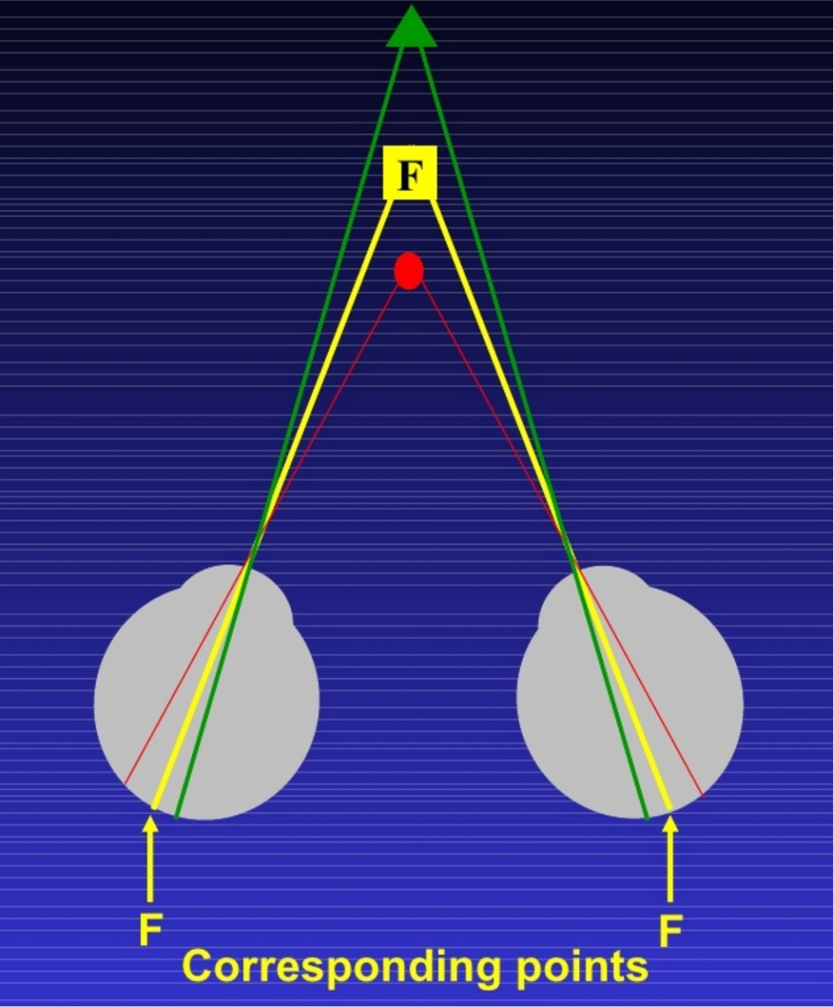
General notes about stereoscopic vision principles
(C2)
Binocular vision results in two slightly different images projected to the retinas of the eyes. The differences are mainly in the relative horizontal position of objects in the two images. These positional differences are referred to as binocular disparities. Disparities are processed in the visual cortex of the brain to yield depth perception. While binocular disparities are naturally present when viewing a real 3-dimensional scene with two eyes, they can also be simulated by artificially presenting two different images separately to each eye using a method called stereoscopy.
LEFT image RIGHT
Bigger viewing angle -> stronger 3D-effect

Slide 6
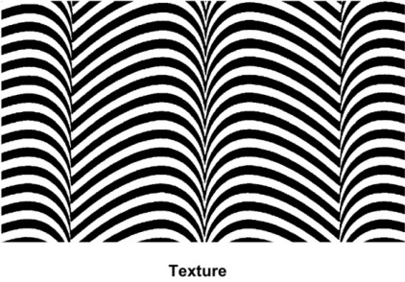
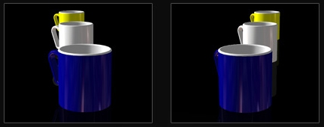
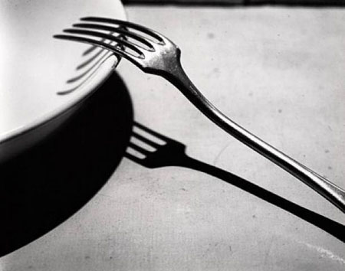
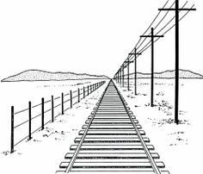
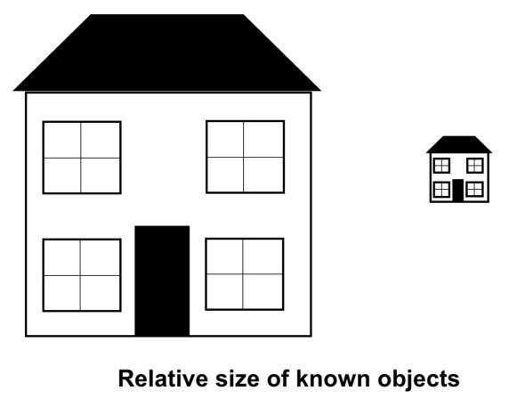
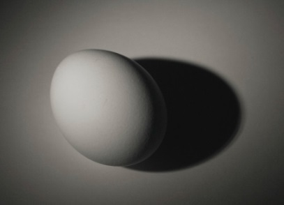
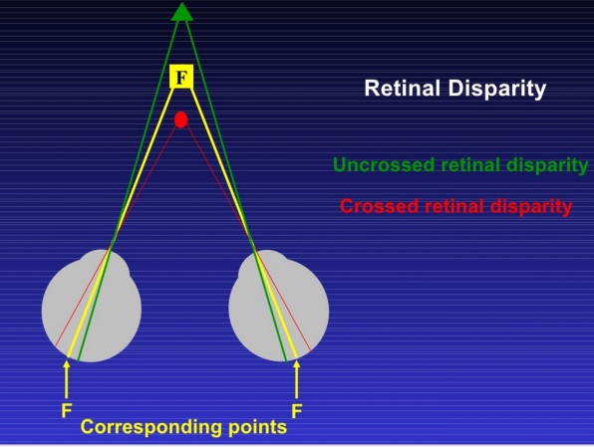
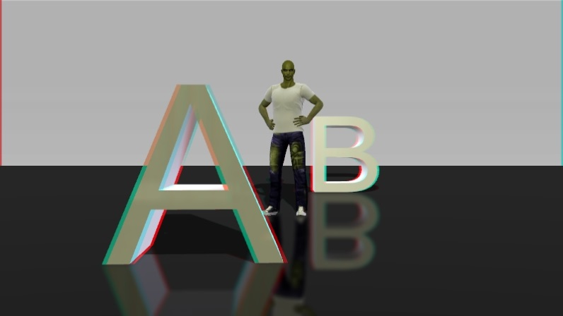

Stereoscopic vision possibilities
Single eye (monocular view):
(C2)
Surface texture:
Motion Parallax:
There are several principles of depth perception by human eyes and brain:
Motion parallax of objects in space
Relative size of distant objects
Light and shadow effects on objects
Geometric perspective from 3D to 2D coordinate systems
2D surface textures creating illusion of 3D
These effects can be greatly improved by having two eyes spatially separated = RETINAL DISPARITY
In this presentation we will show how RETINAL DISPARITY can be used to observe cloud space distribution by geostationary satellite couples properly located in space
Light and shadows:
Geometric perspective:
Relative size:
Near
Far
Far
Egg shape
Near
Two eyes spatially separated (binocular view):

Slide 7
Meteorological satellites and possible coupling of data for dual 3D observations
(C3)

Slide 8
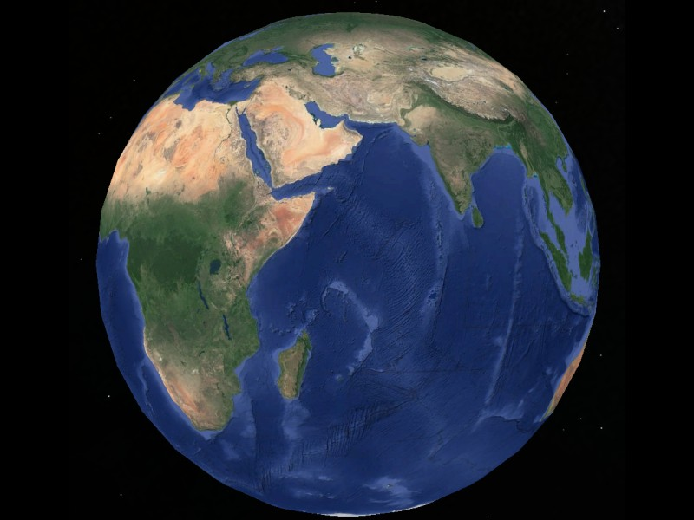
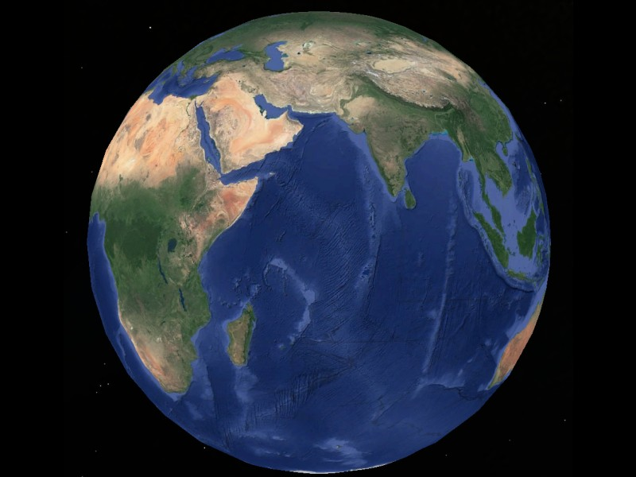
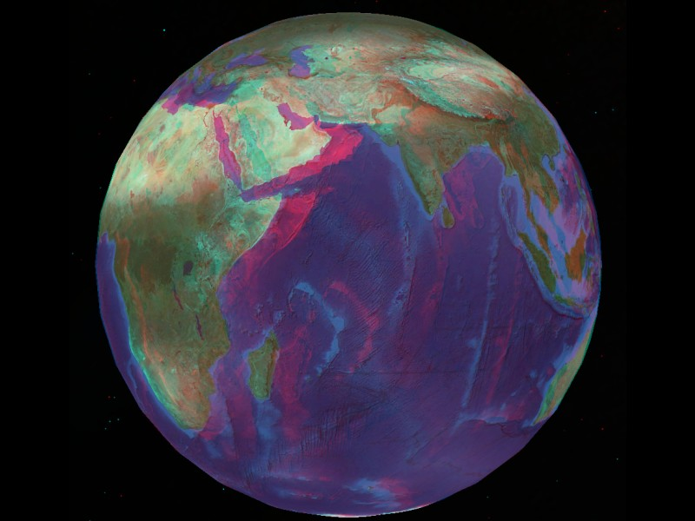
Meteosat first generation satellites
(C3.1)
MVIRI instrument with 3 spectral channels and 5 or 2.5 km resolution
Meteosat 5 IODC at 63E from June 1998 – April 2007
Meteosat 7 IODC at 57E from December 2006 to March 2017 (drift of satellite from 10 to 57E during August-November 2006)
  Overlapping operational period from December 2006 to April 2007
Meteosat 7, 57°E
Meteosat 5, 63°E
Meteosat 7&5 3D-anaglyph

Slide 9
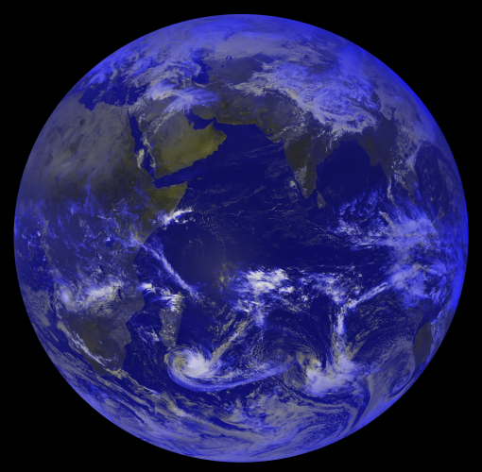
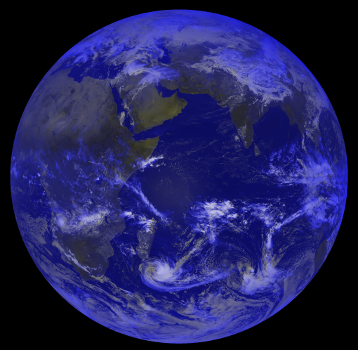
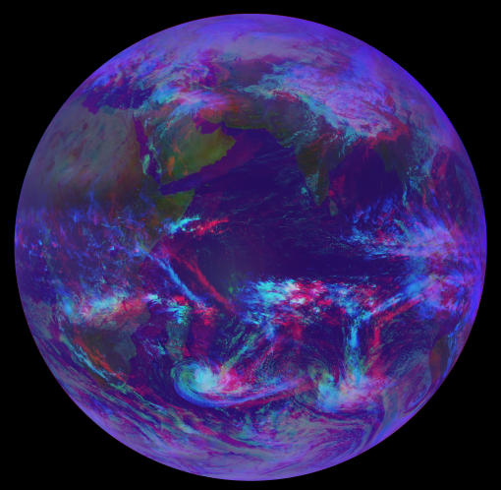


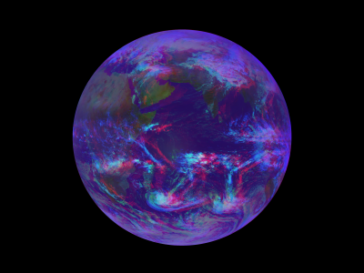
Meteosat first generation satellites
(C3.1)
In this case the Earth surface spherical shape can be only observed.
Atmosphere layer is too thin against pixel resolution for measurable parallax shifts of clouds.
Meteosat 7, 57°E 1.3.2007 09:00 UTC
Meteosat 5, 63°E 1.3.2007 09:00 UTC
3D-anaglyph 1.3.2007 09:00 UTC

Slide 10
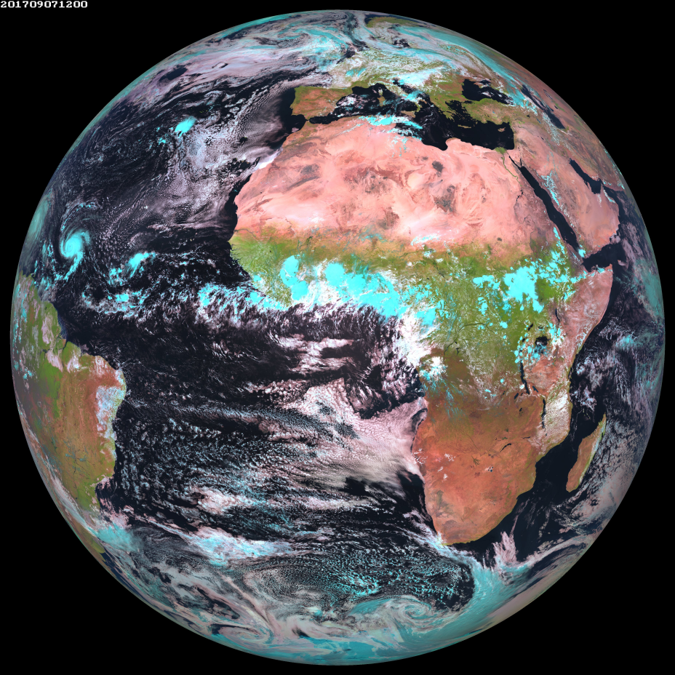
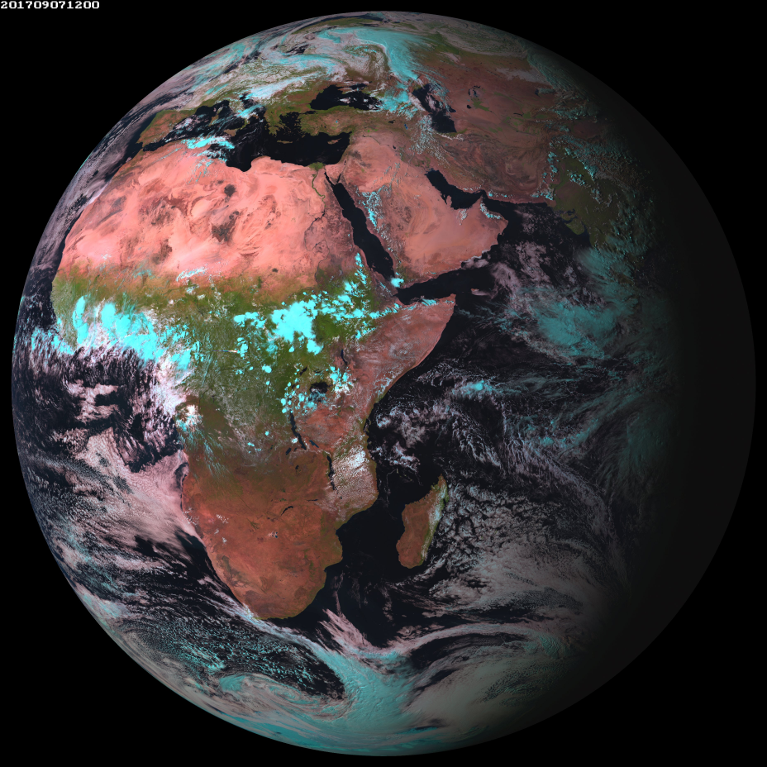
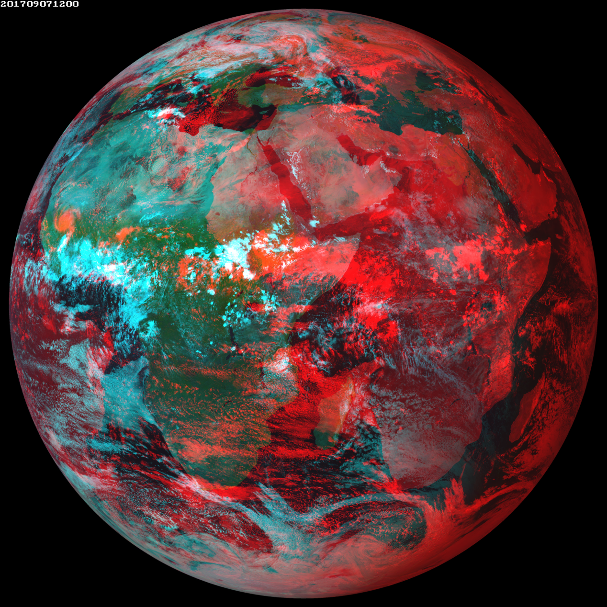

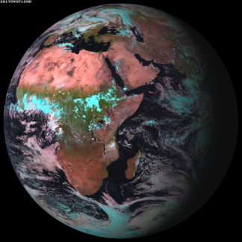

Meteosat second generation satellites Basic service and IODC
(C3.1)
In this case Earth spherical shape can not be observed. Instead smaller regions must be re-projected into planar map
and then images are prepared for 3D view. Anaglyph from full earth disk does not have a sense.
Meteosat 10, 0°E 7.9.2017 12:00 UTC
X
Meteosat 8, 41.5°E 7.9.2017 12:00 UTC
3D in GEOSAT
View projection
DOES NOT have sense
3D-anaglyph Met 8 & 10, 7.9.2017 UTC 12:00 UTC

Slide 11
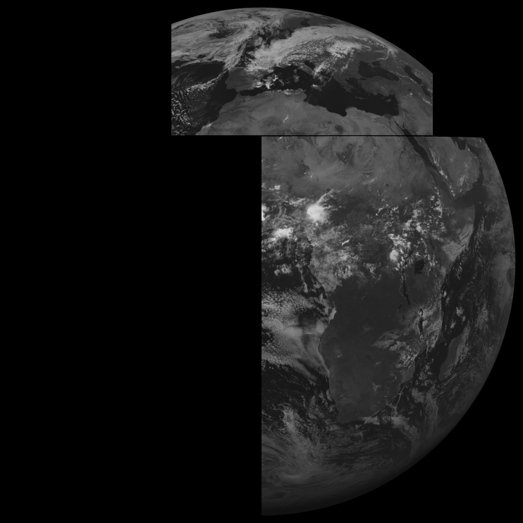
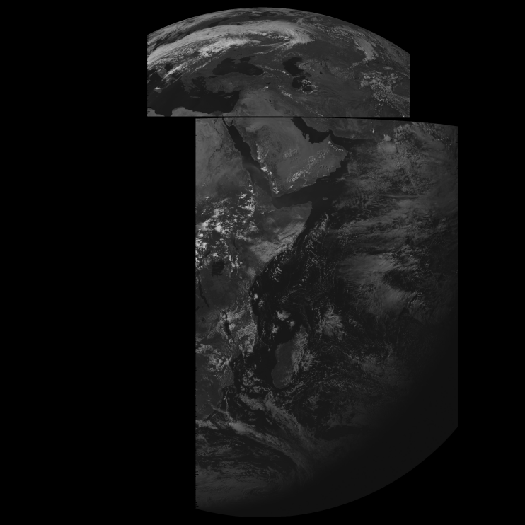
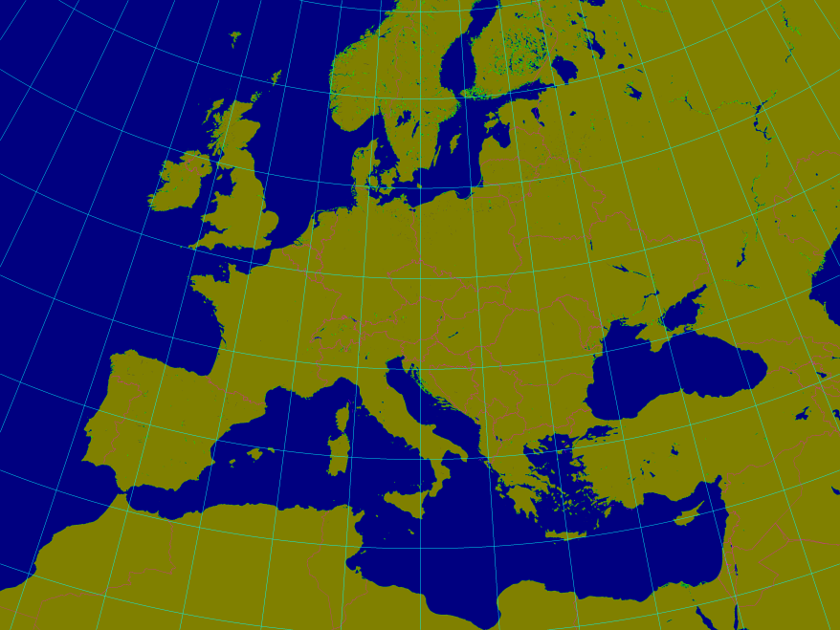
Considerations about optimal satellite positions and scan strategy
(C3.3)
MSG HRV channel provides much higher space resolution and mutual distance of satellites in space over Equator
is bigger. Thanks to these facts we are not limited to observe only the Earth surface shape, but we can point to
much more details.
The most important step is to re-project images from geo-sat view into some plane map projection common for
image data from both satellites.
Meteosat-10, 0°E
Meteosat-8, 41.5°E
Upper HRV window partial overlaps: 0:00-23:59UTC
Lower HRV window partial overlaps: 12:00-16:45UTC

Slide 12
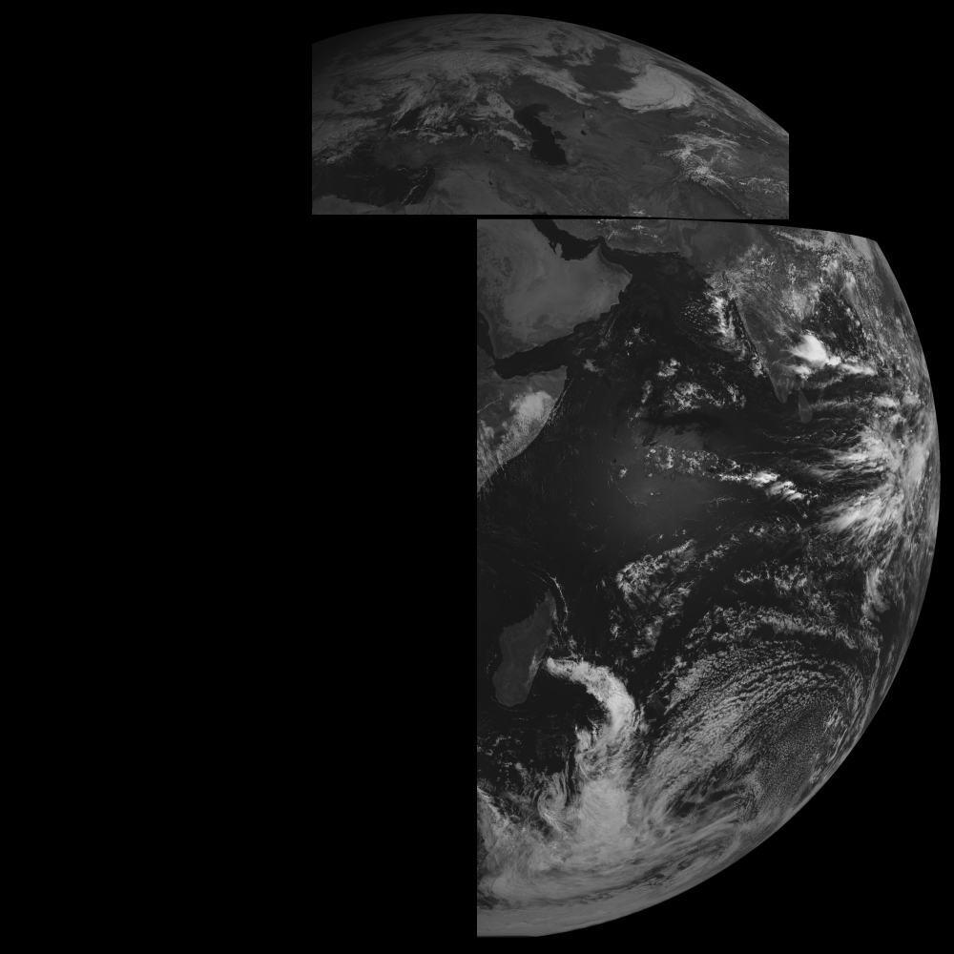
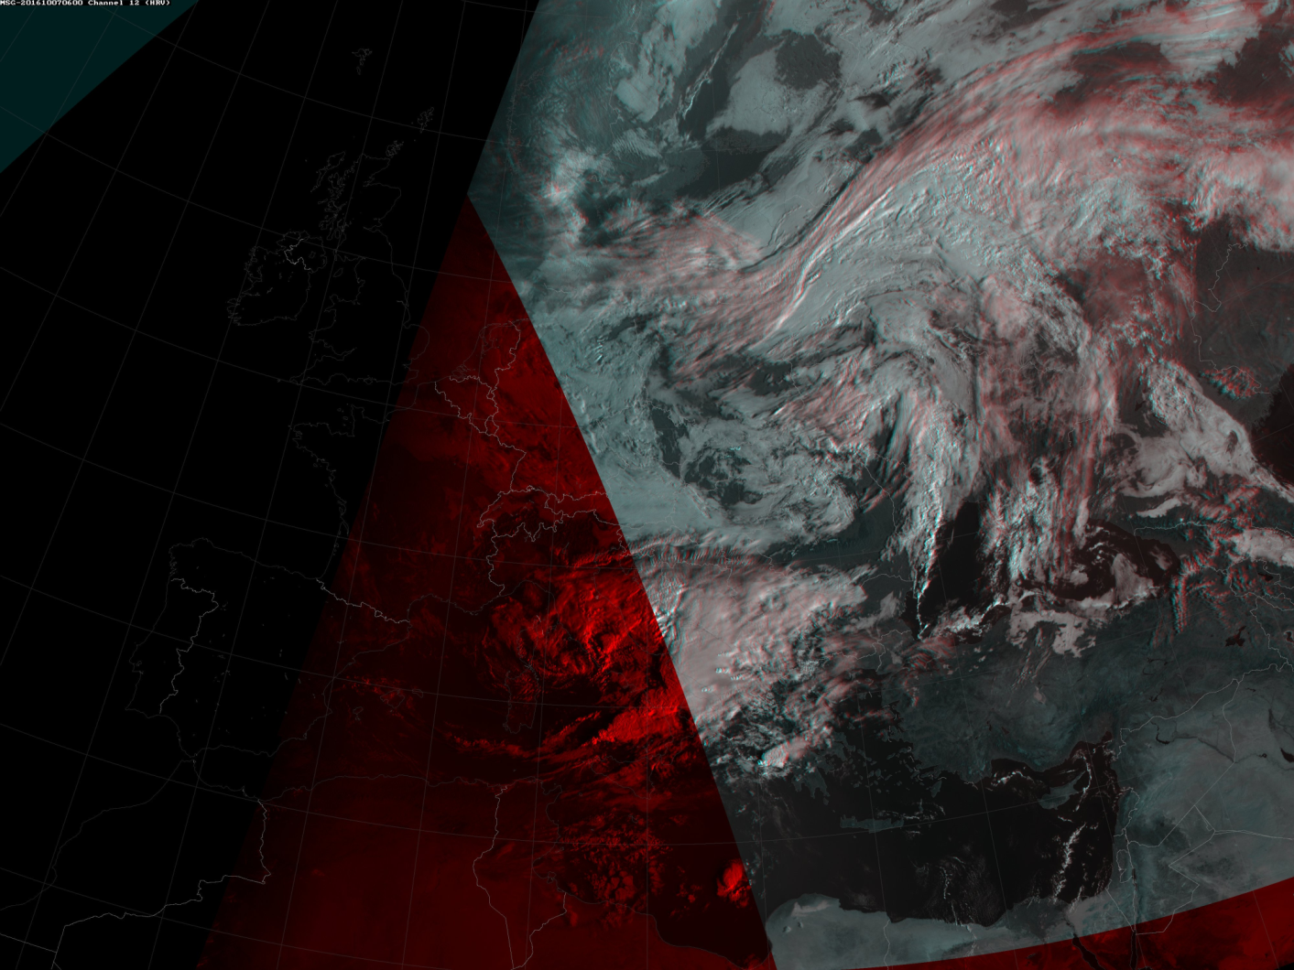
Considerations about optimal satellite positions and scan strategy
(C3.3)
Optimal settings for Left edge of
Upper HRV Window
Requirement for
optimal 3D view
over Central Europe was to shift upper HRV window more to the West.
EUMETSAT agreed with this requirements and thanks to discussions with users in some NHS’s interested in stereoscopic imagery we have better coverage also over western Europe
Morning
terminator
41E
0E
20E
Missing data
From Meteosat 8

Slide 13
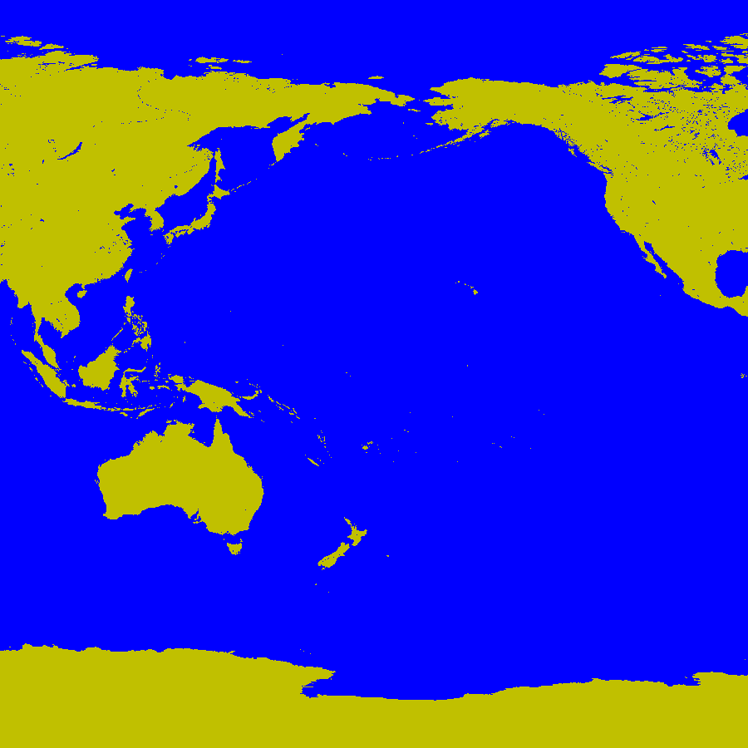
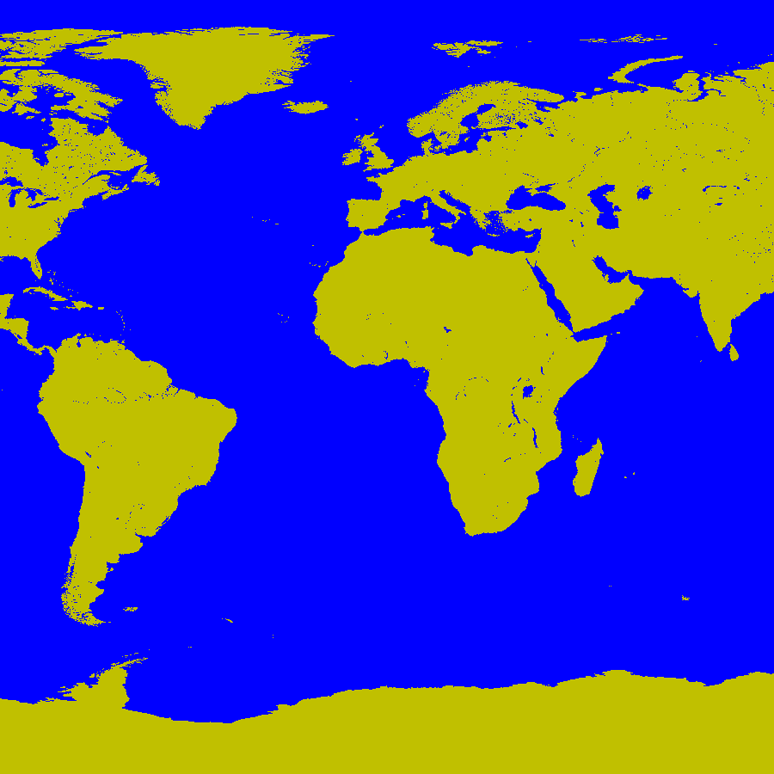
(C3.2)
MSG and other currently operated GEO satellites – MSG satellites highlighted in red:
-134.7°
-105 °
-76.2°
0°
9.5°
41.5°
74, 76°
140, 140.7°
-134.7°
-105 °
-76.2°
X
X
Meteosat-10
HIMAW-8,9
Meteosat-9
Meteosat-8
ELEKTRO-L
GOES-15
GOES-16
GOES-13
INSAT-4CR
GOES-15
GOES-16
GOES-13

Slide 14
(C4) Visualisation stereoscopic methods for satellite imagery
  (C4.1) 3D displays
  There are various technologies of 3D displays described here:
  https://www.ncbi.nlm.nih.gov/pmc/articles/PMC4269274/
  Definition:
  Main aim of 3D displays is to project without change of image quality two independent images (from Left and Right cameras) in the way that each eye of observer will see corresponding (left and right) image only without misleading or confusion our human visual system.
  Practical realization is quite complicated and usually expensive but enabled using latest electronical equipment's:
  color displays which can synchronize polarization glasses
  Displays with set of spherical lenses
  Array of projectors with set of mirrors and holographic screen
  … and many other
  Therefore we prefer more simple technical solutions like ANAGLYPH Method →NEXT slides

Slide 15
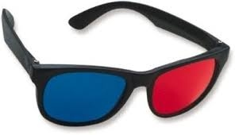
(C4) Visualisation stereoscopic methods for satellite imagery
  (C4.2) Anaglyph imagery
Source: http://www.3dtv.at/Knowhow/AnaglyphComparison_en.aspx
[ ] = [ ][ ]+[ ][ ]
R_{a}
G_{a}
B_{a}
L₁₁ L₁₂ L₁₃
L₂₁ L₂₂ L₂₃
L₃₁ L₃₂ L₃₃
R_{left}
G_{left}
B_{left}
R₁₁ R₁₂ R₁₃
R₂₁ R₂₂ R₂₃
R₃₁ R₃₂ R₃₃
R_{right}
G_{right}
B_{right}
Examples:
1 0 0
0 0 0
0 0 0
0 0 0
0 1 0
0 0 1
Full Color anaglyph:
0 0.7 0.3
0 0 0
0 0 0
0 0 0
0 1 0
0 0 1
Optimized Color anaglyph:
0.3 0.6 0.1
0 0 0
0 0 0
0 0 0
0.3 0.6 0.1
0.3 0.6 0.1
Gray anaglyph:
Notes:
//Program Anaglyph.c written by Ján Kaňák, © 2016
#include <stdio.h>
unsigned char bmh[54];
unsigned char bmL[3000][4000][3];
unsigned char bmR[3000][4000][3];
unsigned char bmA[3000][4000][3];
//unsigned char raw[3000][4000][2];
int main(int argc, char *argv[])
{
FILE *f;
int i,j;
int R=2; //index R do bmp
int G=1; //index G do bmp
int B=0; //index B do bmp
int Version=5;
if(argc==5) Version=atoi(argv[4]);
f=fopen(argv[1],"rb");fread(bmh,54,1,f);fread(bmL,3*3000,4000,f);fclose(f);
f=fopen(argv[2],"rb");fread(bmh,54,1,f);fread(bmR,3*3000,4000,f);fclose(f);
for(i=0;i<3000;i++)
{
for(j=0;j<4000;j++)
{
if(Version==1){ //True anaglyph:
bmA[i][j][R] = 0.299 * bmL[i][j][R] + 0.587 * bmL[i][j][G] + 0.114 * bmL[i][j][B] + 0.000 * bmR[i][j][R] + 0.000 * bmR[i][j][G] + 0.000 * bmR[i][j][B];
bmA[i][j][G] = 0.000 * bmL[i][j][R] + 0.000 * bmL[i][j][G] + 0.000 * bmL[i][j][B] + 0.000 * bmR[i][j][R] + 0.000 * bmR[i][j][G] + 0.000 * bmR[i][j][B];
bmA[i][j][B] = 0.000 * bmL[i][j][R] + 0.000 * bmL[i][j][G] + 0.000 * bmL[i][j][B] + 0.299 * bmR[i][j][R] + 0.587 * bmR[i][j][G] + 0.114 * bmR[i][j][B];}
if(Version==2){ //Gray anaglyph:
bmA[i][j][R] = 0.299 * bmL[i][j][R] + 0.587 * bmL[i][j][G] + 0.114 * bmL[i][j][B] + 0.000 * bmR[i][j][R] + 0.000 * bmR[i][j][G] + 0.000 * bmR[i][j][B];
bmA[i][j][G] = 0.000 * bmL[i][j][R] + 0.000 * bmL[i][j][G] + 0.000 * bmL[i][j][B] + 0.299 * bmR[i][j][R] + 0.587 * bmR[i][j][G] + 0.114 * bmR[i][j][B];
bmA[i][j][B] = 0.000 * bmL[i][j][R] + 0.000 * bmL[i][j][G] + 0.000 * bmL[i][j][B] + 0.299 * bmR[i][j][R] + 0.587 * bmR[i][j][G] + 0.114 * bmR[i][j][B];}
if(Version==3){ //Color anaglyph:
bmA[i][j][R] = 1.000 * bmL[i][j][R] + 0.000 * bmL[i][j][G] + 0.000 * bmL[i][j][B] + 0.000 * bmR[i][j][R] + 0.000 * bmR[i][j][G] + 0.000 * bmR[i][j][B];
bmA[i][j][G] = 0.000 * bmL[i][j][R] + 0.000 * bmL[i][j][G] + 0.000 * bmL[i][j][B] + 0.000 * bmR[i][j][R] + 1.000 * bmR[i][j][G] + 0.000 * bmR[i][j][B];
bmA[i][j][B] = 0.000 * bmL[i][j][R] + 0.000 * bmL[i][j][G] + 0.000 * bmL[i][j][B] + 0.000 * bmR[i][j][R] + 0.000 * bmR[i][j][G] + 1.000 * bmR[i][j][B];}
if(Version==4){ //Half Color anaglyph:
bmA[i][j][R] = 0.299 * bmL[i][j][R] + 0.587 * bmL[i][j][G] + 0.114 * bmL[i][j][B] + 0.000 * bmR[i][j][R] + 0.000 * bmR[i][j][G] + 0.000 * bmR[i][j][B];
bmA[i][j][G] = 0.000 * bmL[i][j][R] + 0.000 * bmL[i][j][G] + 0.000 * bmL[i][j][B] + 0.000 * bmR[i][j][R] + 1.000 * bmR[i][j][G] + 0.000 * bmR[i][j][B];
bmA[i][j][B] = 0.000 * bmL[i][j][R] + 0.000 * bmL[i][j][G] + 0.000 * bmL[i][j][B] + 0.000 * bmR[i][j][R] + 0.000 * bmR[i][j][G] + 1.000 * bmR[i][j][B];}
if(Version==5){ //Optimized anaglyph:
bmA[i][j][R] = 0.000 * bmL[i][j][R] + 0.700 * bmL[i][j][G] + 0.300 * bmL[i][j][B] + 0.000 * bmR[i][j][R] + 0.000 * bmR[i][j][G] + 0.000 * bmR[i][j][B];
bmA[i][j][G] = 0.000 * bmL[i][j][R] + 0.000 * bmL[i][j][G] + 0.000 * bmL[i][j][B] + 0.000 * bmR[i][j][R] + 1.000 * bmR[i][j][G] + 0.000 * bmR[i][j][B];
bmA[i][j][B] = 0.000 * bmL[i][j][R] + 0.000 * bmL[i][j][G] + 0.000 * bmL[i][j][B] + 0.000 * bmR[i][j][R] + 0.000 * bmR[i][j][G] + 1.000 * bmR[i][j][B];}
}
}
f=fopen(argv[3],"wb");fwrite(bmh,54,1,f);fwrite(bmA,3*3000,4000,f);fclose(f);
}

Slide 16
(C4) Visualisation stereoscopic methods for satellite imagery
  (C4.3) Possible satellite input imagery (RGB products)
  3D monitors – there are no limitations of image types
      Gray scale
      True Color images
      RGB and false color images
  Anaglyph imagery with anaglyph glasses – strong limitations concerning colors
      Gray scale is the best
      RGB composites only with strongly limited set of colors
      Some people can have problems with retinal color disparity

Slide 17
3D color anaglyphs from RGB composites: 4.10.2016 10:45 UTC
(C4.3) Possible satellite input imagery (RGB products)
Natural Colors RGB:
Natural Colors anaglyph:
Colors in anaglyph are OK
The colors in anaglyph image are partially preserved.
The image is viewable with red-cyan anaglyph glasses!

Slide 18
3D color anaglyphs from RGB composites: 4.10.2016 10:45 UTC
(C4.3)
(C4.3) Possible satellite input imagery (RGB products)
Airmass RGB:
Airmass anaglyph:
Colors in anaglyph are OK
The colors in anaglyph image are partially preserved.
The image is viewable with red-cyan anaglyph glasses!

Slide 19
3D color anaglyphs from RGB composites: 4.10.2016 10:45 UTC
(C4.3)
(C4.3) Possible satellite input imagery (RGB products)
Day Microphysics RGB:
Day Microphysics Color anaglyph:
Colors in anaglyph are INVERTED
Colors in anaglyph are completely different!
Projection is possible only using special 3D color displays.
Viewing using anaglyph glasses is limited.

Slide 20
3D color anaglyphs from RGB composites: 4.10.2016 10:45 UTC
(C4.3)
(C4.3) Possible satellite input imagery (RGB products)
24-hour Microphysics RGB:
24-hour Microphysics Color anaglyph:
Colors in anaglyph are INVERTED
Colors in anaglyph are different, mainly red clouds!
Projection is better using special 3D color displays.
Viewing using anaglyph glasses is limited.

Slide 21
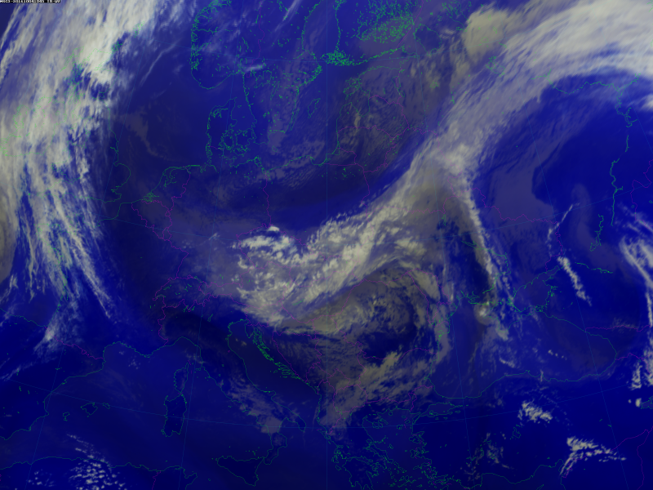
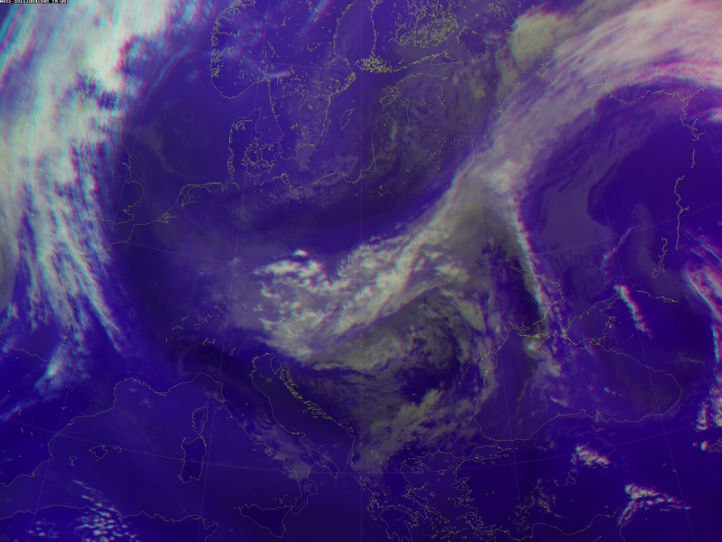
3D color anaglyphs from RGB composites: 4.10.2016 10:45 UTC
(C4.3)
(C4.3) Possible satellite input imagery (RGB products)
IR-WV RGB composite:
IR-WV Color anaglyph:
Colors in anaglyph are OK
Colors in anaglyph are identical to RGB composite colors.
Viewing using anaglyph glasses is recommended.

Slide 22
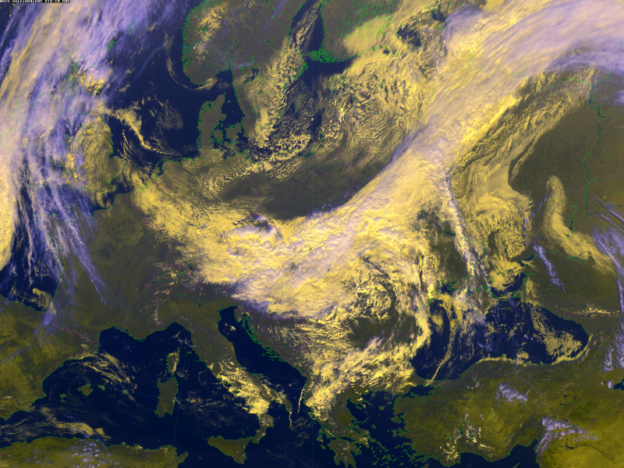
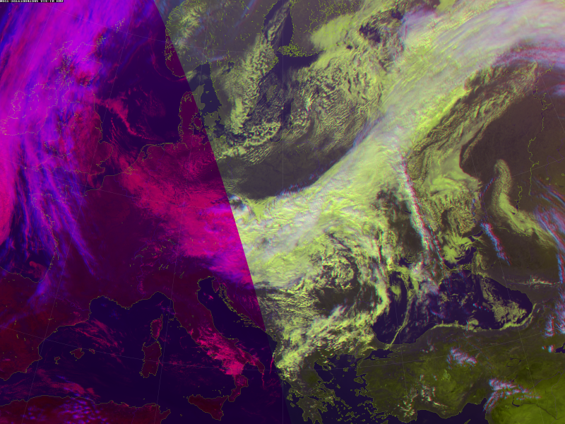
3D color anaglyphs from RGB composites: 4.10.2016 10:45 UTC
(C4.3)
(C4.3) Possible satellite input imagery (RGB products)
VIS-IR RGB composite:
VIS-IR Color anaglyph:
Colors in anaglyph are OK
Colors in anaglyph are similar to RGB composite colors.
Viewing using anaglyph glasses is recommended.

Slide 23
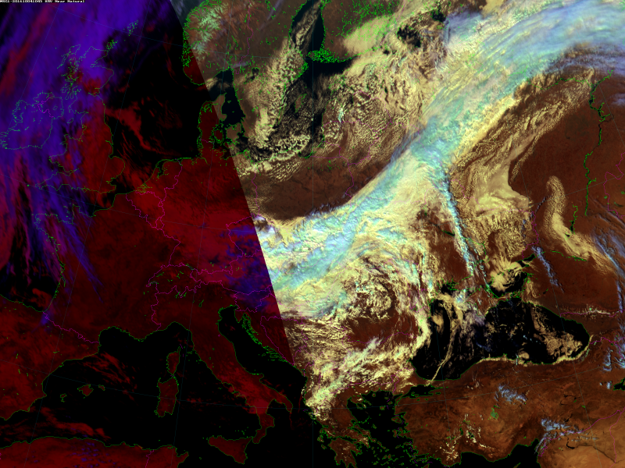
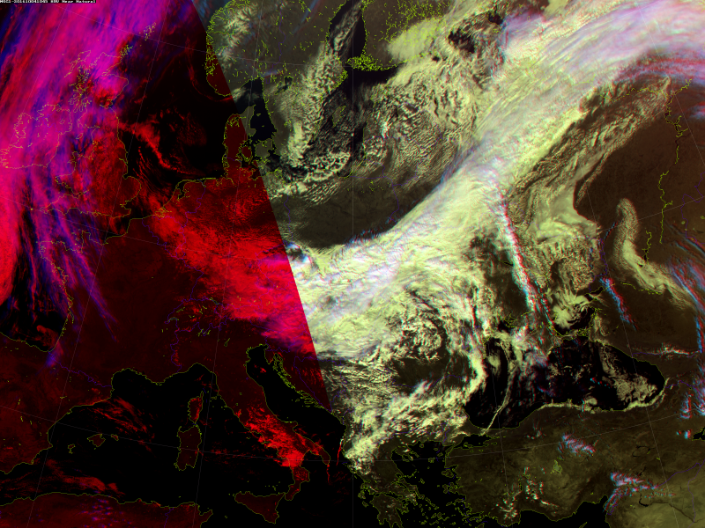
3D color anaglyphs from RGB composites: 4.10.2016 10:45 UTC
(C4.3)
(C4.3) Possible satellite input imagery (RGB products)
HRV-IR-NIR RGB composite:
HRV-IR-NIR Color anaglyph:
Colors in anaglyph are OK
Colors in anaglyph are similar to RGB composite colors.
Viewing using anaglyph glasses is recommended.

Slide 24
3D color anaglyphs from RGB composites: 4.10.2016 10:45 UTC
- evaluation of RGB composites applicable as anaglyph images:
(C4.3)
(C4.3) Possible satellite input imagery (RGB products)
RGB composite – image type | Applicability of anaglyph method
Single channel gray scale | YES
Natural Colors | YES
Airmass | YES
Night/Day Microphysics | NO
Day Solar | NO
Ash | NO
Dust | NO
IR-WV | YES
VIS-IR | YES
HRV-IR-NIR | YES

Slide 25
(C5)
Cloud top height estimation methods
(C5.1) NWCSAF Cloud Top Height product
Based mainly on atmosphere temperature, humidity vertical profiles and cloud radiances of IR channels of different cloud types – clearly physical approach
(C5.2) VIS cloud shadows length measurements
Based on observations and measurements of the length of cloud shadows, calculation of Sun position and cloud top – optical and geometric approach
(C5.3) Dual satellite cloud parallax shifts
Based on complementary geometrical information from two satellites observing the same cloud from different points in space – clearly geometric approach

Slide 26
(C5)
Cloud top height estimation methods
(C5.1) NWCSAF Cloud Top Height product
the SAFNWC program package was developed by the Satellite Application Facility Support to Nowcasting and Very Short Range Forecasting (NWCSAF)
for the Cloud Top Temperature and Height (CTTH) product IR brightness temperatures are compared to simulated IR brightness temperatures
simulations use NWP temperature and humidity profiles and radiative transfer model (RTTOV)
method depends on Cloud Type (e.g. semi-transparency correction) and not available for fractional clouds
*****
In the present study SAFNWC program version 2016 was used, temperature and humidity profiles were taken from ECMWF forecasts
*****
Source / further information: http://www.nwcsaf.org/scientific-documentation

Slide 27
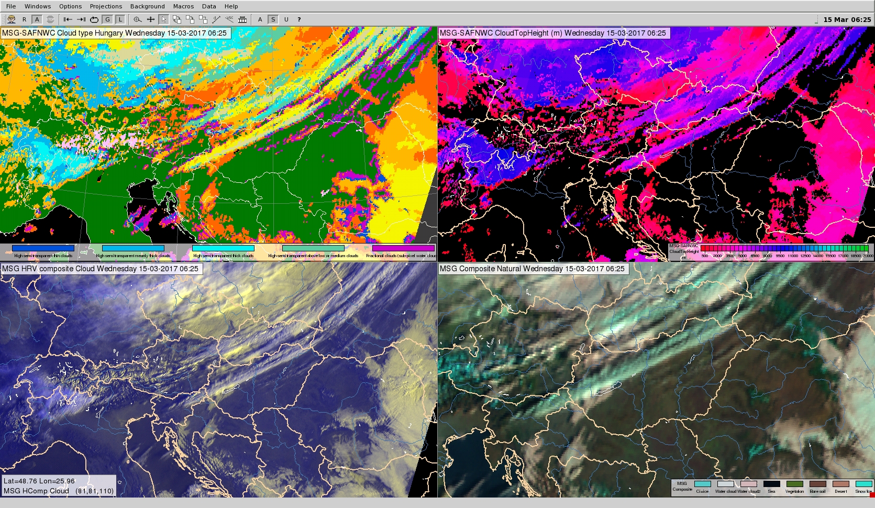
(C5.1) NWCSAF Cloud Top Height product, example 15.03.2017 06:25UTC
SAFNWC Cloud Top Height
SAFNWC Cloud Type (input)
HRV Cloud RGB composite ( for comparison)

Slide 28
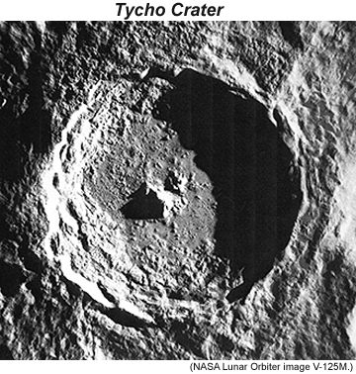
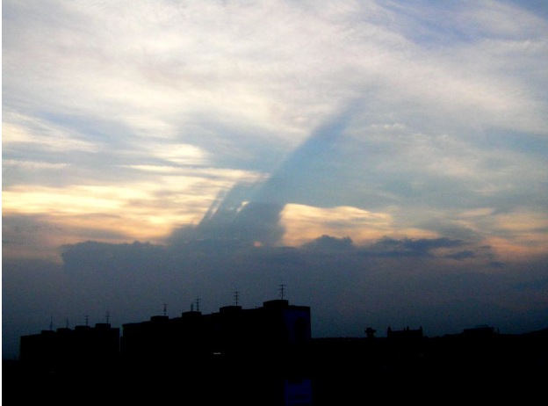
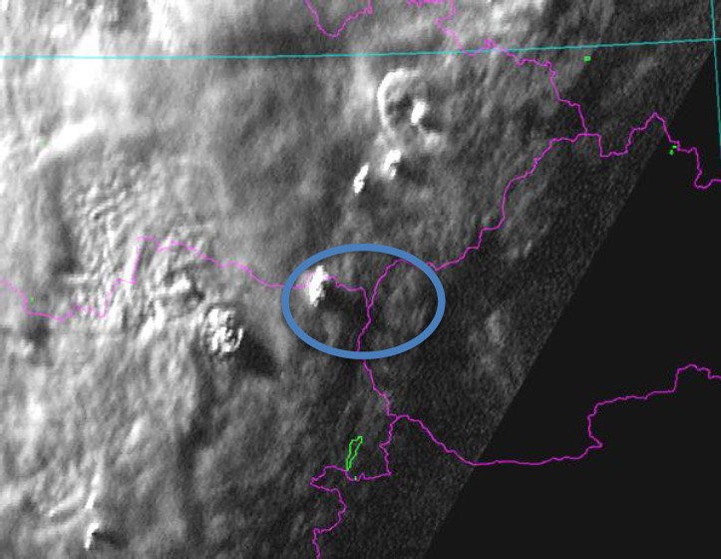
(C5)
Cloud top height estimation methods
(C5.2) VIS cloud shadows length measurements
Estimation of geometrical cloud top heights:
Well known method for estimation of object height using measuring shadow length
MSG channel 12 (HRV)
31.5.2005 18:15 UTC
Method equivalent to crater’s depth measurement
Photo: Ján Kaňák, 31.5.2005 18:19UTC, Bratislava, NW - view

Slide 29
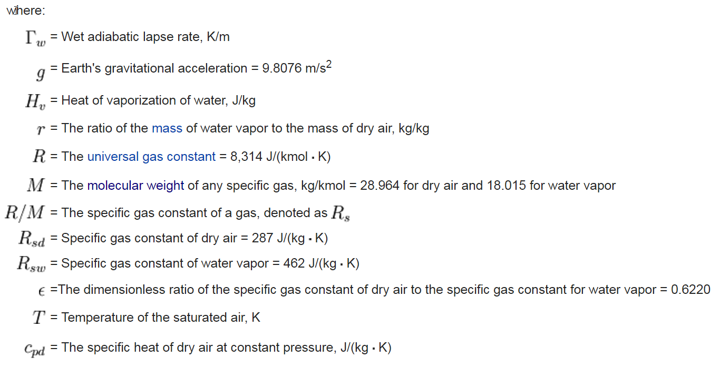
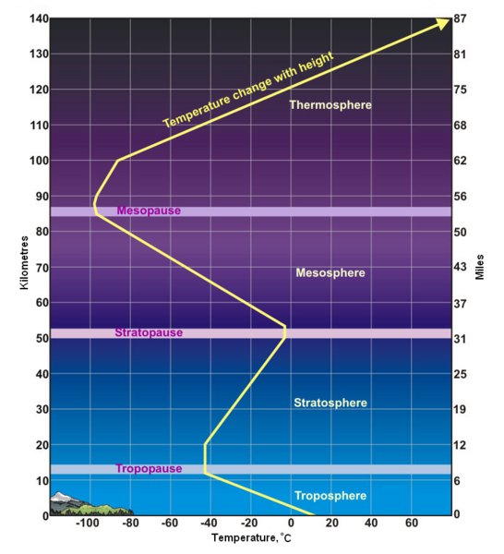
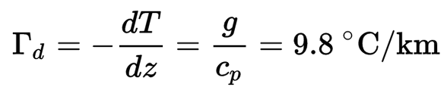
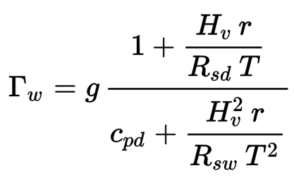
(C5)
Cloud top height estimation methods
(C5.2) VIS cloud shadows length measurements for OT lapse rate estimation:
For comments, if necessary:
Detection of tropopause overshooting storm tops (OT)
and estimation of their interior temperature gradient Γ :
Dry adiabatic lapse rate or
temperature gradient:
Height in atmosphere [m] | Wet Lapse Rate [K/km] (Temp. gradient)
0 to 11000 | -6.5
11000 to 20000 | 0.0
20000 to 32000 | 1.0
32000 to 47000 | 2.8
47000 to 51000 | 0.0
51000 to 71000 | -2.8
71000 to 85000 | -2.0
(constant value)
Wet-adiabatic lapse rate or
temperature gradient:
Vaporization heat
Dry air
Specific heat
-depends on (T)emperature and mixing (r)atio of water and dry air
Water vapor
In tropopause value of lapse rate is zero. But we measure non-zero value for some OTs. The air inside OT comes from lower tropospheric layers and is influenced by its interior physical processes. Real value of OT lapse rate connected with processes inside updraft – precipitation and latent heat generated by condensation of water vapor.

Slide 30
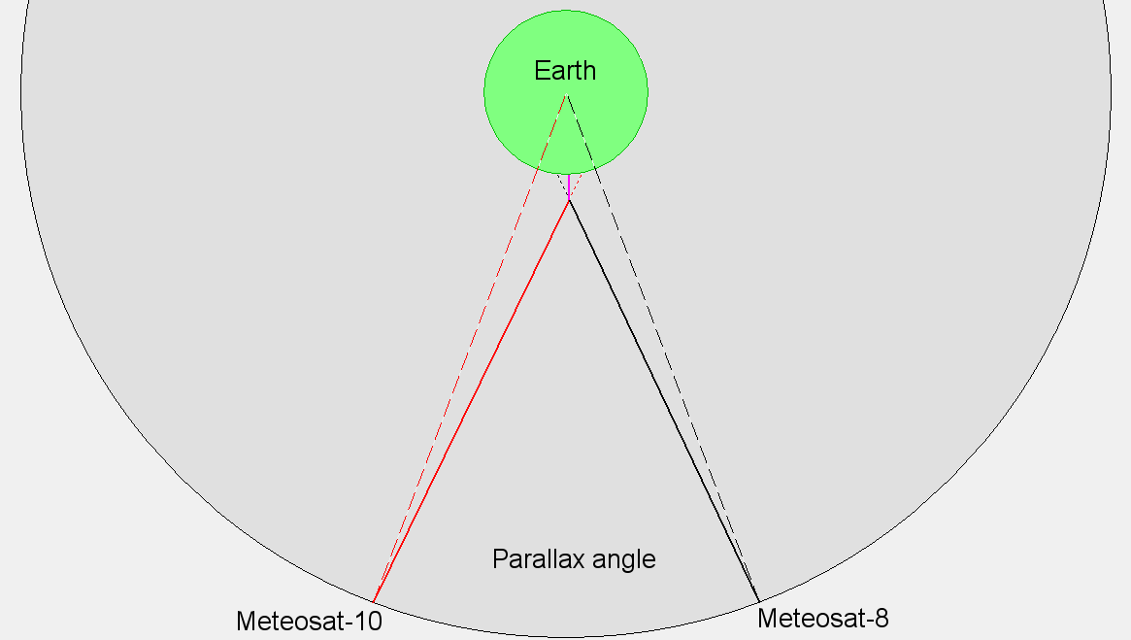
(C5)
Cloud top height estimation methods
Dual satellites parallax – simplified scheme above equator:
(C5.3)

Slide 31
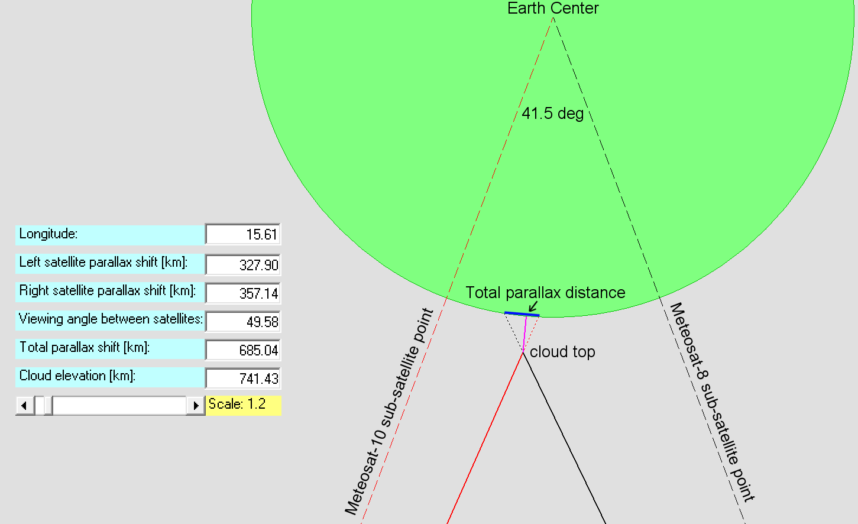
(C5)
Cloud top height estimation methods
Dual satellites parallax – simplified scheme above equator:
(C5.3)
2-satellite
longitude
difference
Measured:
Calculated:
49.6 deg
2-satellite
viewing
angle of
observed cloud

Slide 32
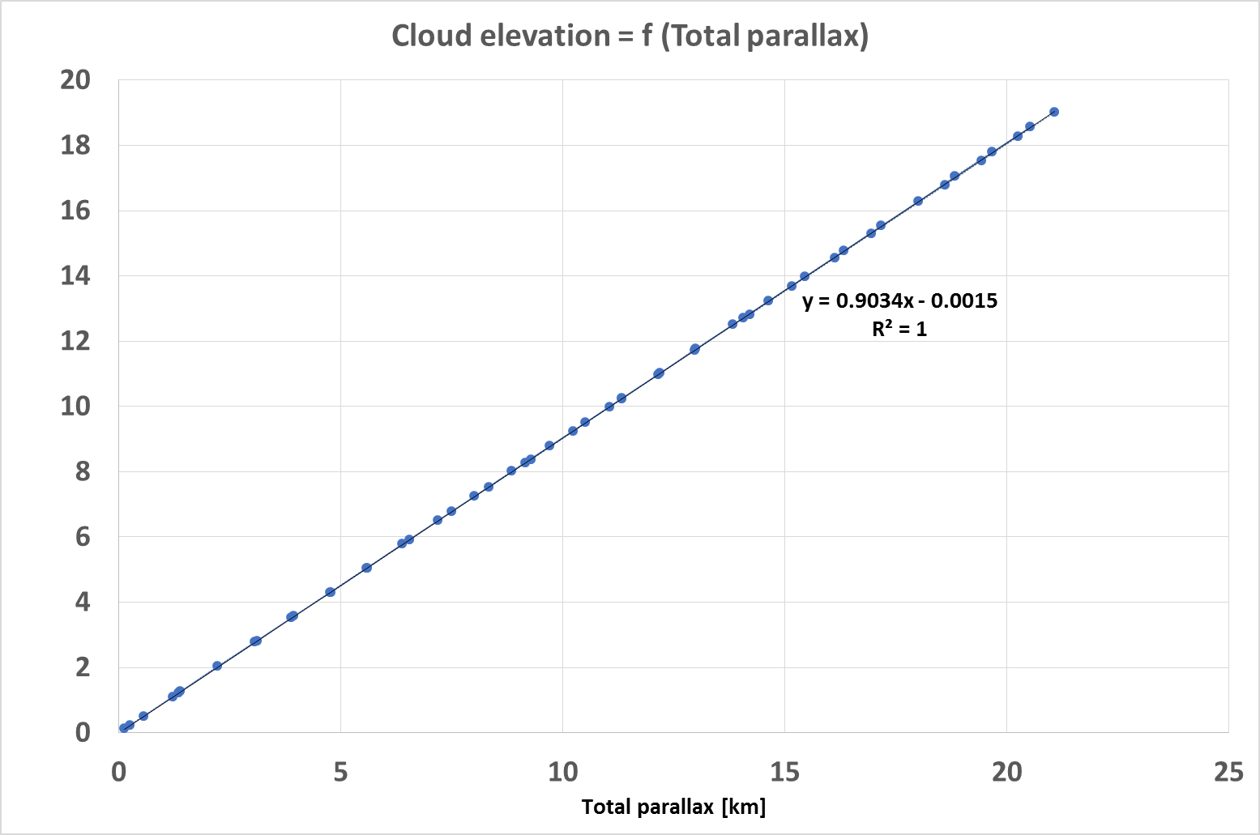
(C5)
Cloud top height estimation methods
Dual satellites parallax – simplified scheme above equator:
(C5.3)

Slide 33
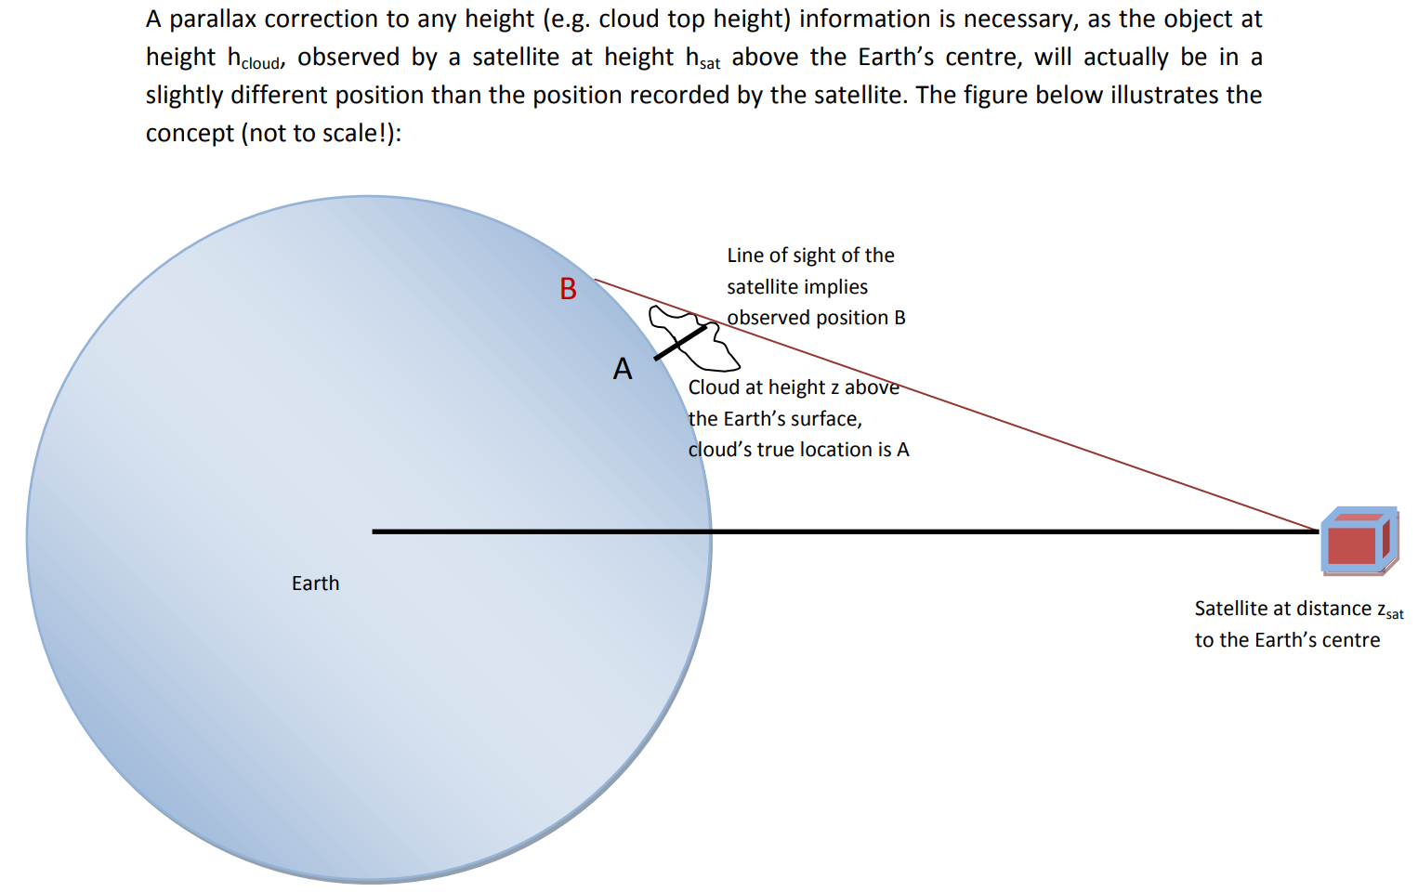
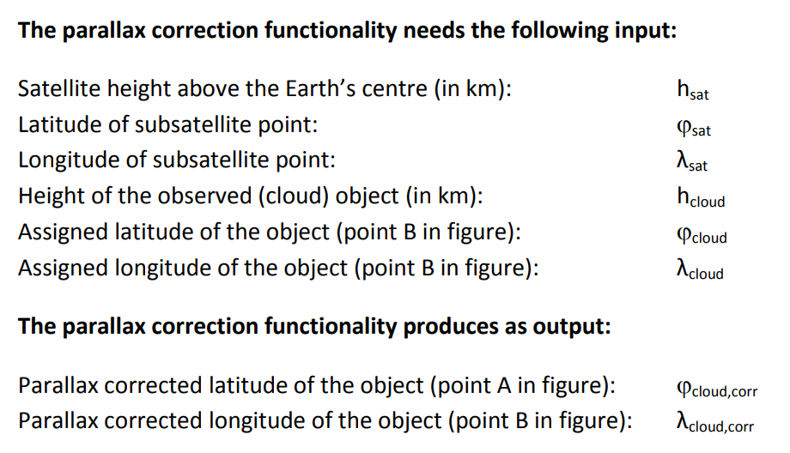
Dual parallax measurement and cloud top estimation based on dual MSG satellites observations can be done according following steps:
(C5.3)
Source: EUMETSAT and CWG, by Marianne Koenig
https://www.essl.org/cwg/res/parallax/DescriptionOfTheParallaxCorrectionFunctionality.pdf

Slide 34
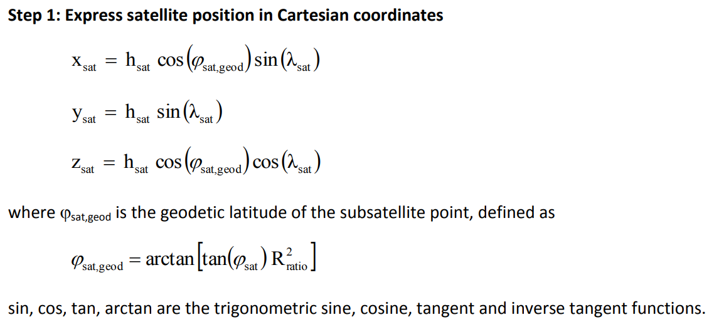
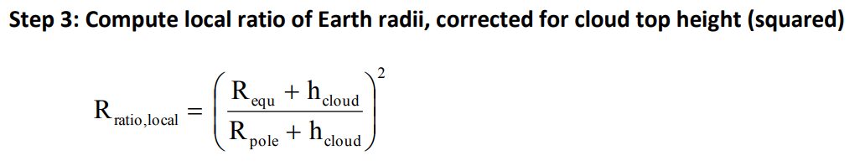
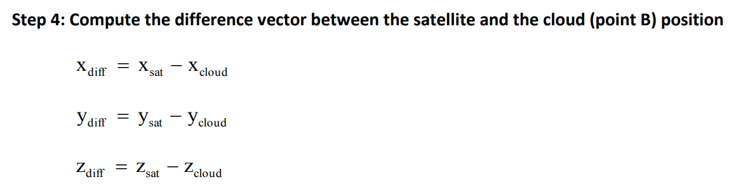

Dual parallax measurement and cloud top estimation based on dual MSG satellites observations can be done according following steps:
(C5.3)
Source: EUMETSAT and CWG, by Marianne Koenig
https://www.essl.org/cwg/res/parallax/DescriptionOfTheParallaxCorrectionFunctionality.pdf

Slide 35



Dual parallax measurement and cloud top estimation based on dual MSG satellites observations can be done according following steps:
(C5.3)
All equations were implemented into
SHMU ViewMSGProc software for
estimation of cloud parallax shifts!
Source: EUMETSAT and CWG, by Marianne Koenig
https://www.essl.org/cwg/res/parallax/DescriptionOfTheParallaxCorrectionFunctionality.pdf

Slide 36
Dual parallax measurement and cloud top estimation based on dual MSG satellites observations can be done according following steps:
(C5.3)
Selection of cloud by some significant detail:
  left or right edge (e.g. frontal cloud fields)
  bright or dark spot (e.g. OT of storm, OT shadows)
  cloud centers (e.g. narrow striped wave clouds)
Labeling / indication of relevant cloud spot positions in left and right satellite image (e.g. using anaglyph picture and red-cyan glasses)
Calculation of exact coordinates for selected point:
  Left(Lat, Lon)
  Right(Lat, Lon)
Construction of flowlines between satellite and selected point in the image: couple of lines for left and right satellites
Identification of intersect point for this couple of lines
Calculation of intersect point coordinates and height above the Earth surface using parallax correction numerical procedure
Note: Flowline in this context is line connecting satellite in space with the point at Earth surface,
to which cloud top is projected. Real cloud top is laying on this line over the surface, on position
defined by parallax shift. For exact estimation of this position dual satellite view is needed.

Slide 37

Dual parallax measurement and cloud top estimation based on dual MSG satellites observations can be done according following steps:
(C5.3)

Slide 38

Dual parallax measurement and cloud top estimation based on dual MSG satellites observations can be done according following steps:
(C5.3)
Examples of real data obtained by Parallax Measurement Tool:
Minimum of each curve represents
(close) intersect point of flowlines.
More precise detection of corresponding
cloud points on Earth surface => lover
minimum of lines distance.
Cloud height is equivalent to the
elevation of this minimum distance.

Slide 39

Clouds over Greece 5.2.2017 07:00 UTC
Measured height values: 10.1, 8.0, 7.0, 2.7, 6.7 km
(C5.3)
Examples of real data obtained by Parallax Measurement Tool:

Slide 40











(C5.4)
Evaluation of paired CTH measurements
Precision of NWCSAF CTH method depends on:
Precision of cloud mask
Correct classification of cloud types
Estimation of proper cloud transparency
Measurement of radiances, BT
Precision of Parallax Cloud Top method depends on:
Image resolution
Absolute value of parallax shift
Absolute value of cloud top height
Shape of cloud
Proper identification of cloud edges

Slide 41
(C5.4)
Evaluation of paired CTH measurements

Slide 42



(C5.4)
Evaluation of paired CTH measurements
Main result:
± 0.5 km 39%
± 1.0 km 60%
40% of cases with
Error > ± 1 km

Slide 43
Basic assumptions of proposed method:
(C5.4)
Identification of certain cloud reference point is subjective and must be done in image pair from both satellites
Method can be used for cloud edges, narrow stripes, small details like OT, waves. Not suitable for stratiform (smooth) large-scale cloud fields
It is not easy to recognize the same object in cyan and in red colors in anaglyphs, better way is switching between left and right full color images
These facts bring errors to estimation of coordinates in map projection
Most critical is short distance between left and right reference points in case of very low clouds, but for high clouds results are acceptable (HRV better then other channels)
Two lines connecting satellites and cloud reference points at surface theoretically intersect in cross-point. But in practice they evade in space and we can find just their minimum distance instead of cross-point.
More precise estimation of coordinates -> implicates more reliable estimation of cloud top height

Slide 44

(C5.5)
Possibilities of automatic evaluation of parallax shifts
HRV Image line data in brightness interpretation from left and right satellites:
Single objects and their parallax shifts are evident, but question is:
How to identify single objects in imagery and how to calculate parallax shifts?

Slide 45

(C5.5)
Possibilities of automatic evaluation of parallax shifts
How to identify single objects in imagery and how to calculate parallax shifts?
Numerical calculation like line correlation and covariance method can be useful.
Problem is that cloud edges can differ in left and right image and shifts of cloud centers are not detectable because
of very smooth cloud top surfaces.
R = Right cloud edge
L = Left cloud edge
Image line correlation output:
Image line covariance output:
L
R
R
Clouds
R
R
L
R
Clear air

Slide 46
(C6) List of selected meteorological cases
Cases over central Africa
Cases over Europe
Strong convection and storms
Frontal cloud layers
Wave clouds
Clouds near mountains
Storms and gust fronts
Heavy rain events
Cloud top heights
Satellite combinations
Storms and overshooting tops
Storms and plums
Fog low clouds and snow
Various RGBs in 3D
Contrails
Meteosat-7 and Meteosat-5 full disk anaglyphs
Cirrus plumes over storm anvils
Overshooting tops in different phases
Ship waves atop of storm
Measurements of cloud top height
Mediterranean storms
Wave clouds over Scandinavia
Fog low clouds cirrus and snow
Tilted frontal clouds layers
Network of contrails and shadows
Caucasian mountains
Storms over Tunisia
Morning Alps
Developed storms with wide spread anvils
Two gust fronts below developed storm cloud
Cb Anvils over shallow convective clouds
Multiple overshooting tops
Cb clouds with extremely extended anvils and plumes
Decaying Cb creating a hole in the cloudiness
Squall line from strong storm outflow
Storms in central and south-east Europe
Cold front passing the central Europe
Smoke from Portugal forest fires
Squall line over Hungary
Strong storms formed in central Europe
Complex of storms near the Black Sea
Heavy rains in south Slovakia
Comparison MSG3-MSG2 and MSG3-MSG1 3D
Color anaglyphs created from various RGB
Different types of Anaglyphs
Zadar storm with heavy rains

Slide 47
















Slide 48










(C6.2)
Case_20161119_North_Europe
The slope of the frontal areas over Scandinavia:

Slide 49


(C6.2)
Case 20161124 tilted frontal cloud layer
Frontal cloud field, top of which is tilted according acting air mass boundaries.

Slide 50



(C6.2)
Case 20161204 Shadow based Cloud top Height Measurements

Slide 51


(C6.2)
We can find different tilted cloud tops, e.g. in Area A without cloud/shadows textures, in Area B with help of cloud shadows.
Case 20161215 Caucasian Mountains

Slide 52


(C6.3)
Stereoscopic imagery from MSG-1 & MSG-3 over central Africa is limited to short time period of the day, because lower HRV windows from both satellites cover this region simultaneously only from 12:00 to 16:45 UTC.
Case_20161024_Africa

Slide 53

(C6.3)
Stereoscopic imagery from MSG-1 & MSG-3 over Croatia captured severe storms with number of updrafts evidenced by OT detections (dark dots with red circles).
This huge precipitation event is typical by sucking warm and very humid air out of volume around.
Case_20170911_Zadar
Storm produces
outflows which
can be detected
and monitored
by satellite
imagery
Storm Up-drafts
Storm is sucking
warm and very humid air from this area which is hidden for satellite instruments

Slide 54

(C6.3)
Stereoscopic imagery from MSG-1 & MSG-3 over Croatia captured severe storms with number of updrafts evidenced by OT detections (dark dots with red circles).
This huge precipitation event is typical by sucking warm and very humid air out of volume around.
Case_20170911_Zadar

Slide 55
(C7)
CONCLUSIONS
The main messages of this presentation:
Satellite images play very important role in weather analyses and forecasting
Raw images from single satellite channels contain partial information only
There are various opportunities of image processing and image combinations with the aim to put more qualitative information together into one image
Some satellite constellations provide additional possibilities how to enhance our view from space into the atmosphere to monitor cloud formations
it is up to us to use these options effectively

Slide 56
Thanks for your attention!

Slide 57
(C8)
Notes to demo presentation software MSG Case Viewer
Software for automatic or interactive presentation of selected cases
Functions for image shift, zoom, shrink, animation
More then 30 selected cases with short descriptive texts
Two image frames for quick visual comparison of different image products
Original purpose – selection of satellite images and preparing the case studies
Final purpose - automatic presentation of prepared image materials

