Slide 1
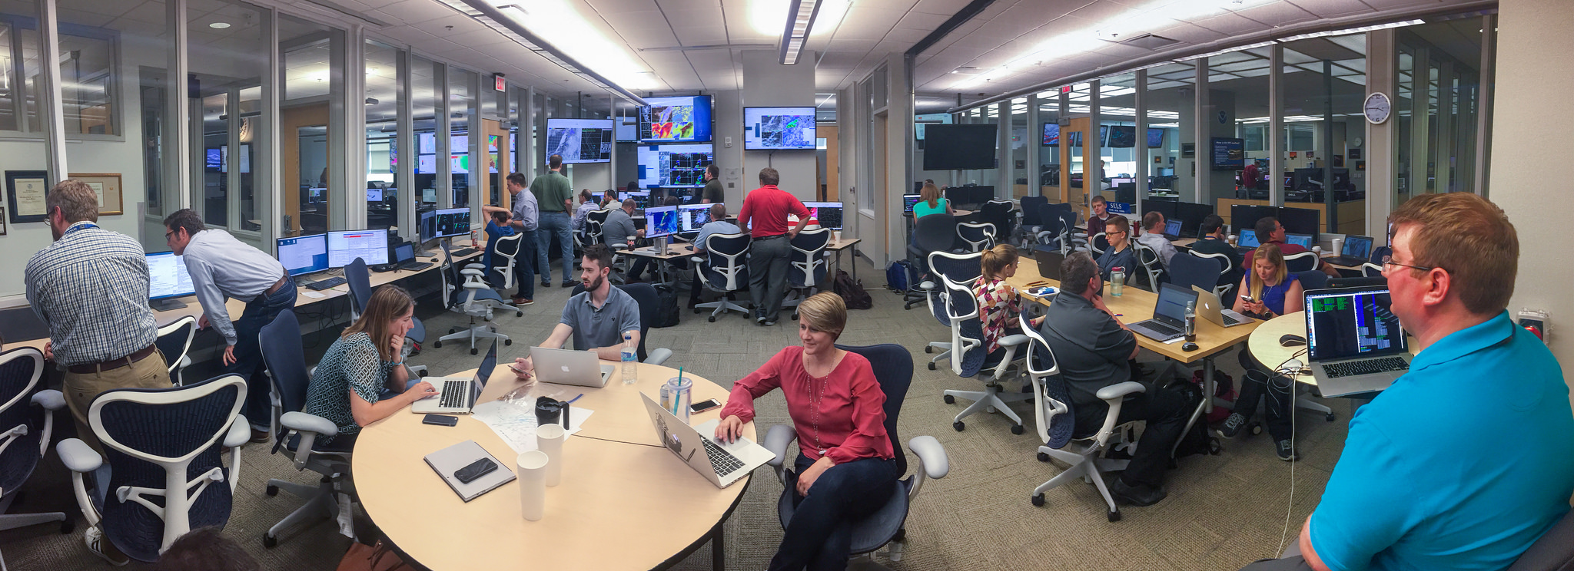
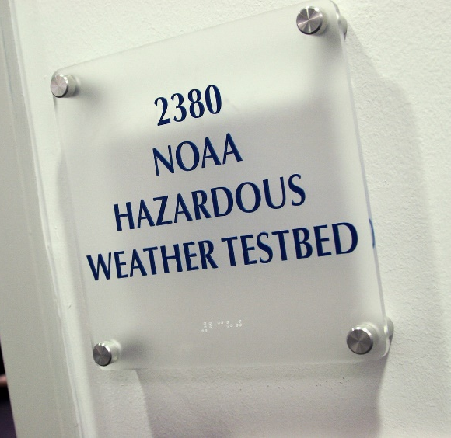
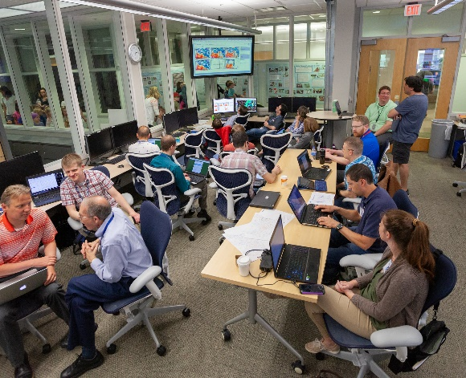
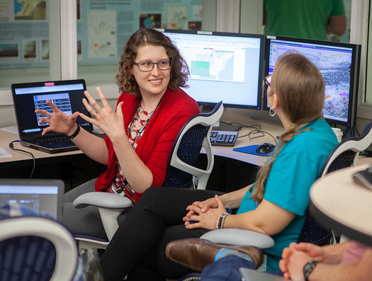
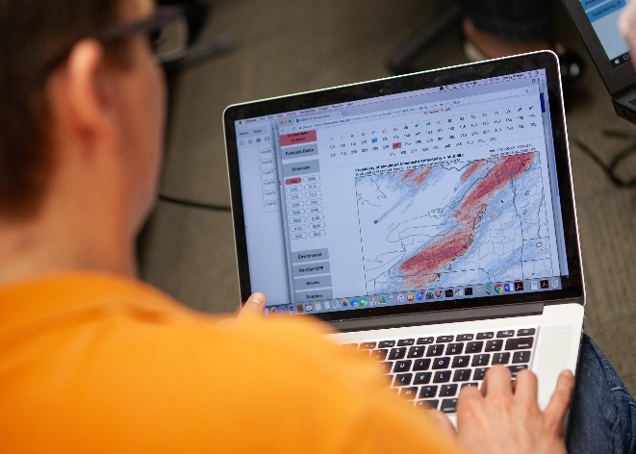
The 2019 NOAA/Hazardous Weather Testbed Spring Forecasting Experiment
B. T. Gallo^{1,2}, A. J. Clark^{3,4}, I. L. Jirak², A. R. Dean², K. H. Knopfmeier^{1,3}, B. Roberts^{1,2,3}, L. J. Wicker³, M. Krocak^{1,4}, P. Skinner^{1,3}, J. Choate⁵, P. Heinselman³, K. A. Wilson^{1,3}, J. Vancil^{1,2}, K. Hoogewind^{1,3}, N. Dahl^{1,2}, R. Clark III^{1,2}, G. J. Creager^{1,3}, T. Jones^{1,3}, J. Gao³, Y. Wang^{1,3}, S. R. Dembek^{1,3}, and S. J. Weiss²
¹ Cooperative Institute for Mesoscale Meteorological Studies, OU
² NOAA/NWS/Storm Prediction Center
³ NOAA/OAR/National Severe Storms Laboratory
⁴ School of Meteorology, OU
⁵ University of Illinois at Urbana-Champaign

Slide 2
What is the Hazardous Weather Testbed?
Specifically designed testbed space for practitioners and researchers to come together
Accelerates the transfer of research to operations
Home of annual Spring Forecasting Experiments and many other experiments throughout the year
Norman WFO
SPC
Experimental Warning Program
Experimental Forecast Program

Slide 3
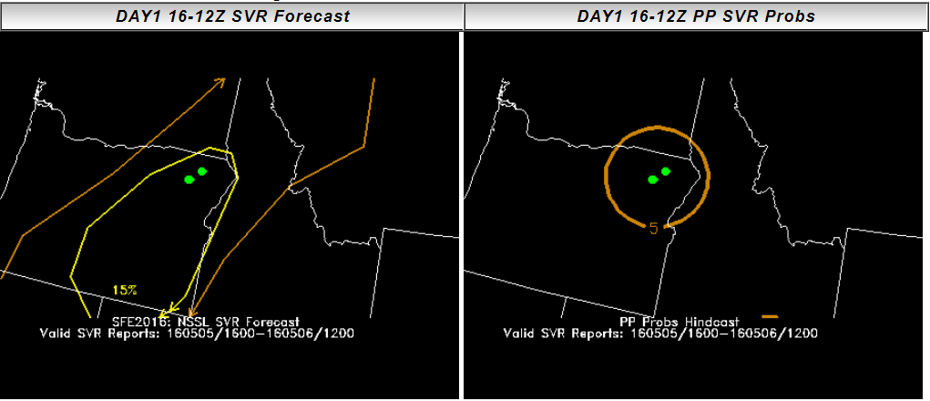
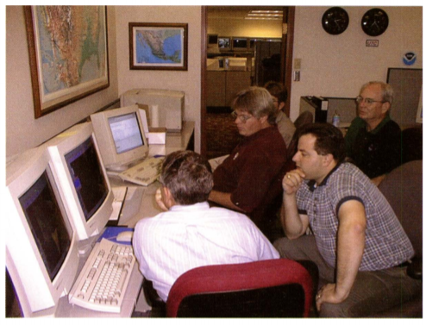
The Spring Forecasting Experiment
Annual experiment that formally occurred starting in 2000
Emphasis on R2O ↔ O2R problems
Experiment occurs realtime
Time pressures to issue products
No one knows the answer in advance
Marginal → High end cases covered
New tools demonstrated to forecasters

Slide 4
The 2019 Spring Forecasting Experiment
The Innovation Desk
Drew probabilistic “total severe” forecasts and timing guidance for current and next day
Evaluated:
HRRRv3 vs. HRRRv4 vs. UK Met Office Guidance
Deterministic FV3-based guidance
Nested vs. Stand-Alone Regional (SAR)
Physics parameterizations
The Warn-on-Forecast System compared to a time-lagged HRRR system
Created short-term probabilistic forecasts of total severe using the Warn-on-Forecast System
The Severe Hazards Desk
Drew probabilistic individual hazard coverage forecasts for current and next day
Drew conditional intensity forecasts for hazards
Evaluated:
CLUE ensemble subsets
HREF configurations
Mesoscale Analyses
Hail guidance
Updated coverage and conditional intensity forecasts using the Warn-on-Forecast System

Slide 5
The Community Leveraged Unified Ensemble (CLUE): Year 4
Inspired by the international UCAR Model Advisory Committee to provide evidence-based decision making for design of a future operational convection-allowing ensemble.
Models contributed to HWT since 2007
Goal: Design HWT experiments to provide more controlled datasets that can be better utilized to inform configuration of near-future operational systems
Contributors agreed on a set of model specifications, post-processing methods, and data formats.
See July 2018 BAMS article for more details on thought process behind the CLUE
Image courtesy A. Clark
2017: 2 FV3 (CAPS and GFDL)
2018: 14 FV3 (CAPS, GFDL & NSSL)
2019: 22 FV3 (CAPS, GFDL, NSSL, EMC & GSD)

Slide 6
2019 CLUE Experiments
(1) Stochastic Physics Perturbations: HRRRE uses stochastic parameter perturbations (SPP) applied to land-surface, PBL, and microphysics. HRRRE-nospp run by NSSL with SPP turned off. Goal: Determine if SPP results in practical forecast differences.
2) UM physics configurations: Two 12-member ensembles from UK Met. One uses operational physics suite from MOGREPS-UK and the other uses a development suite tuned for tropics. Goal: Compare physics suites & gauge skill against US systems.
3) FV3 Physics Sensitivities: CAPS provided SAR-FV3 members that used the same ICs/LBCs, but different physics. Three microphysics, three PBL, and two land-surface models tested using Common Community Physics Package. Goal: Gauge skill and quantify sensitivities in SAR FV3.
4) Global-with-nest vs. SAR FV3: EMC ran global FV3 config w/ high-res nest over the CONUS & SAR-FV3 config w/ ICs/LBCs from the GFS. Goals: Compare SAR-FV3 performance to global-with-nest. Determine if LBC errors in SAR-FV3 cause degradation at later hours.
5) HRRRv3 vs. HRRRv4 vs. gsd-sarfv3: HRRRv4 is last implementation of HRRR w/ WRF-ARW. Subsequent versions will use SAR-FV3 once skill $≥$HRRRv4. HRRRv3 was compared to HRRRv4 and SAR-FV3 was compared to HRRRv4. Goals: Gauge skill of HRRRv4 and GSD-SARFV3 relative to the current operational HRRR.**NOTE: Configuration changes had to made during experiment and gsd-sarfv3 was only available toward end of experiment.
6) Data assimilation comparisons: Several ensembles used EnKF-based DA (e.g., OU/CAPS, NCAR and OU/MAP). Most controlled comparison: OU/MAP ran two ensembles that shared a control member w/ ICs generated from GSI-based hybrid EnVar where ensemble covariance and storm scale static covariances combined. In one ensemble, ensemble member ICs generated from re-centered GSI EnKF analyses, in other, ICs generated by re-centering the 0000 UTC GEFS analyses around the control member. Goal: Find out which DA techniques work best.

Slide 7
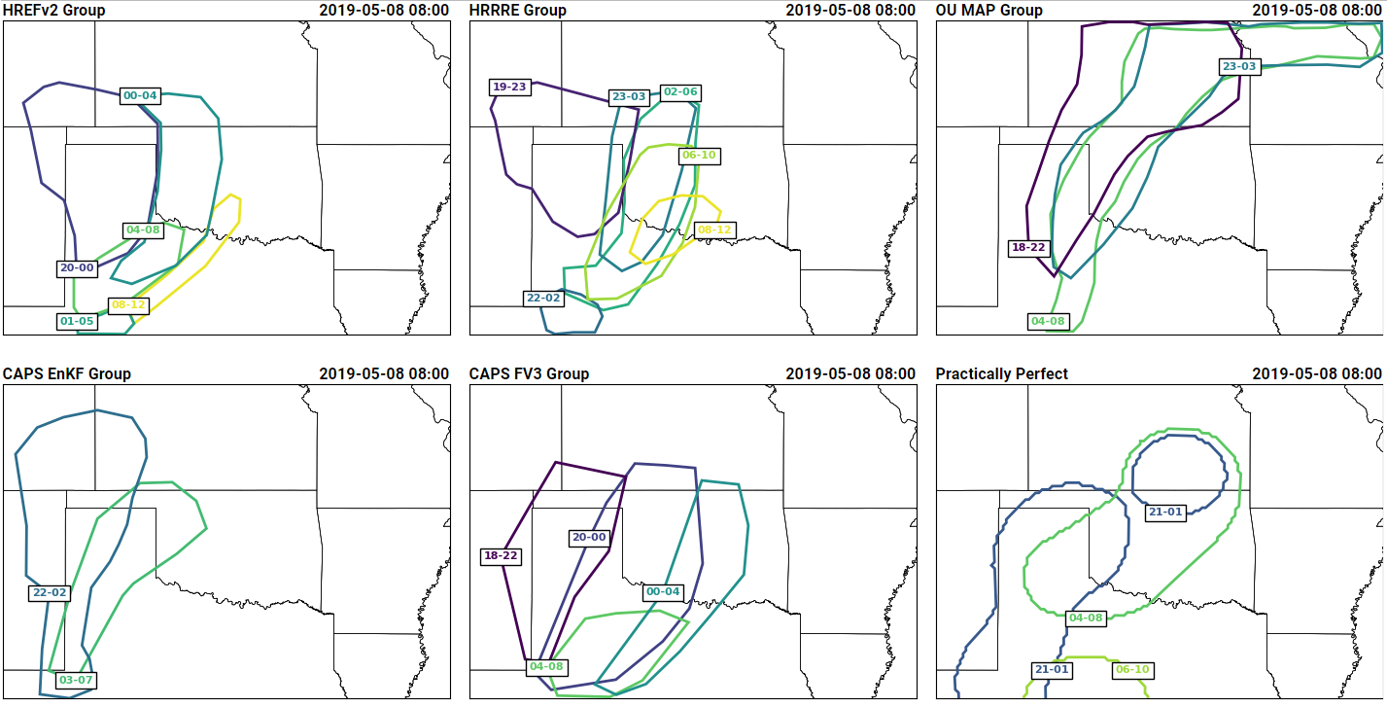
Experimental Forecast Products: Innovation Desk
At a given point, 90% of reports will occur within a 4-h window
Krocak and Brooks 2019, in review
Potential Severe Timing Areas (PSTs)
Timing product aimed at Emergency Managers
Emergency managers experiment ran concurrently for 2 weeks
Realtime feedback loop between forecasters and EMs

Slide 8
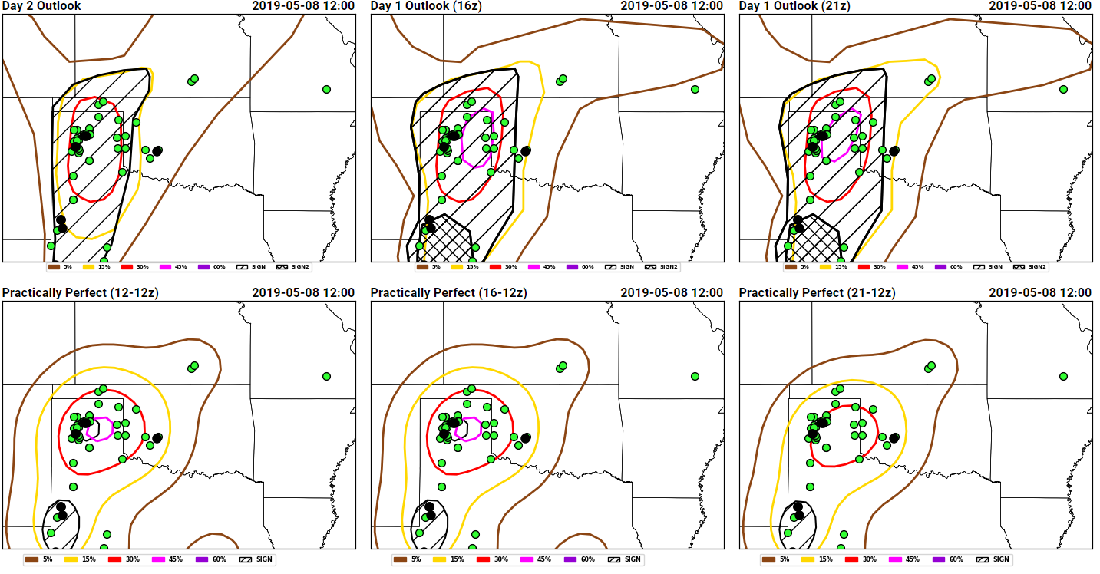
Experimental Forecast Products: Severe Hazards Desk
Probabilistic coverage forecasts
Mirroring current SPC operations, but with experimental data
Conditional intensity products
Work done by R. Clark
Within distribution of reports, how many will be significant?
Reflect convective situations such as:
Few, intense storms
Widespread low-end severe

Slide 9
Experimental Model Evaluations Framework
Composite
Reflectivity
Updraft
Helicity
Assign subjective ratings (1-10)

Slide 10
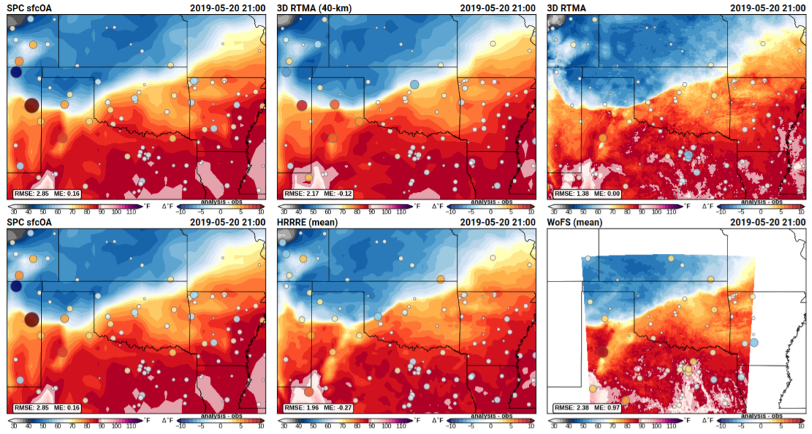
Mesoanalyses and Storm-Scale Analyses Evaluations
Tested new, high-resolution mesoanalysis (3D-RTMA) compared to current, 40 km
Also tested coarsened RTMA compared to high-resolution
Participants narrowly preferred the high-resolution information in the 3 km model
Storm scale analyses were rated as “somewhat useful” most of the time

Slide 11
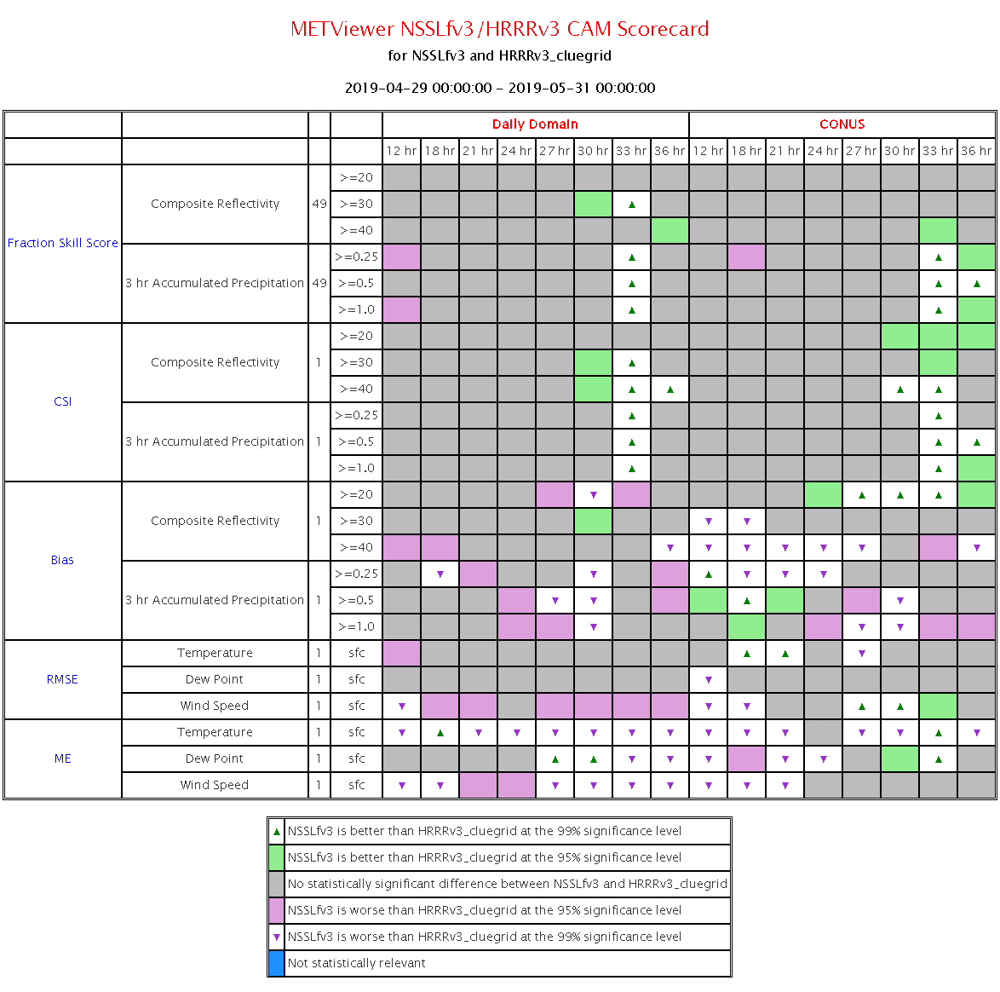
Objective Verification: The CAM Scorecard
Collaboration with the Developmental Testbed Center (DTC)
Focus on variables important to severe weather forecasting
Composite reflectivity
Accumulated precipitation
Surrogate severe
Temperature, dewpoint, wind speed
Evaluated for the full CONUS and the daily domain of interest
NSSL-FV3 SAR has improved nocturnal precipitation compared to current operational HRRRv3 (fcst hrs 33 and 36)

Slide 12
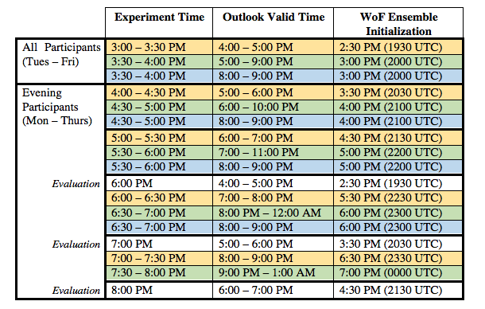
The WoFS Evening Activity
Two forecasters came in at ~11:30 AM and stayed until 8:00 PM
Goal: test WoFS capability throughout many initializations
Three types of outlooks issued
Evaluation of WoFS via surveys
Web analytics data captured
Analysis of data underway!
Short
Long
Targeted
Notes:
Also tested the impact of a WoFS training activity

Slide 13
Preliminary Result Highlights (CLUE and non-CLUE)
Contact:
burkely.twiest@noaa.gov
For more results, see our Summary Report at: https://hwt.nssl.noaa.gov/sfe/2019/docs/HWT_SFE_2019_Prelim_Findings_FINAL.pdf
Explored providing enhanced conditional intensity information and timing information
Majority of participants state that issuing conditional intensity forecasts was “neither difficult nor easy”, “easy”, or “very easy”
HREFv2.1 was once again the highest subjectively rated ensemble, showing the challenge for a single-core, single-physics system to match the utility of a multi-model, multi-physics system
Stochastic physics did not provide a practical improvement over a single-physics approach for severe weather forecasting
Stand-Alone-Regional FV3 performed similarly to a global-with-nest configuration (both run by EMC)
Subjective ratings revealed that FV3 reflectivity forecasts were often comparable to operational CAMs, and the best performing deterministic FV3 forecast was the NSSL SAR, which received average subjective ratings that were very similar to HRRRv3.

