Slide 1
Improving hail nowcasting with machine learning Hélène Barras^{1,2}, Shruti Nath², Ulrich Hamann², Loris Foresti², Alessandro Hering², Daniele Nerini², Joel Zeder³, Urs Germann², Olivia Martius¹ 1 Mobiliar Lab for Natural Risks, Oeschger Centre for Climate Change Research and Institute of Geography, University of Bern, Bern Switzerland 2 Division for Satellite, Radar and Nowcasting, MeteoSwiss, Locarno-Monti, Switzerland 3 Institute of Atmospheric and Climate Sciences, ETHZ, Zurich, Switzerland
European Conference on Severe Storms, Kraków, 06.11.2019
Notes:
Thunderstorm warnings
3: severe thunderstorm, warning time 0-2 hours; 90-120kmh winds, 2-4cm hail and 30-50mm/h
4: very severe thunderstorm, warning time 0-2hours; >120kmh winds, >4cm hail and >50mm/h
“it is not currently possible to predict or give several hours’ warning of the strength, timing and location of severe thunderstorms.”

Slide 2
Starting point before our study
Thunderstorm cells are identified by radar with adaptive reflectivity thresholds.
At the moment: With increasing storm severity, hail is considered more likely
Forecasters do their own ingredient based evaluation whether hail is possible/likely and also check whether crowd-sourced hail reports were made in the previous hours
With today’s technology we can try to give them a hand!
2

Slide 3
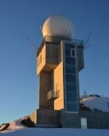
Flowchart of COALITION-3 adapted to hail
Motion Vectors calculated with optical flow (pySTEPS)
Future TRT cell position
T+5,10,…,45min
9
Swiss radar
COSMO/ ECMWF
39
Hail nowcasting for T+5, +10, … +45min
historic
TRT cell position
T-45,40,…,5min
3
NWC-SAF
MSG/ SEVIRI
14
Multi-sensor TRT cell history
T-45,40,…,5min
6
Lightning
6
Metadata

Slide 4
Constructing our training&test data set visualized
For all thunderstorms in summer 2018:
Example of a radar tracked thunderstorm (TRT)
All statistics along the background flow up to +45 min to train our supervised learning models
12 statistics from all available variables
(sum, mean, median, max, min, several percentiles)
All statistics along the background flow up to -45 min

Slide 5
Method: defining the predictand that should be modeled
Using the two radar-based hail algorithms
POH (probability of hail; measures the distance between H₀ and ET45)
and MESHS (maximum expected severe hail size; uses H₀ and ET50) ≠ MESH
Foote et al. (2005) based on Waldvogel et al (1979) Joe et al. (2004) based on Treloar (1998)
Radar-based categories (POHMESHS): | 0 = “no hail” (POH <= 10, MESHS = 0) 1 = “small hail” (POH > 10, MESHS = 0) 2 = “large hail” (MESHS ≥ 2cm)
Goal: To nowcast hail with a lead time of up to 45 minutes
Further information on methods:
previous presentation by Ulrich Hamann et al. (ECSS2019-165)
poster by Nath et al. (on Thursday afternoon at P42; ECSS2019-166)
or ask later

Slide 6
RESULTS

Slide 7
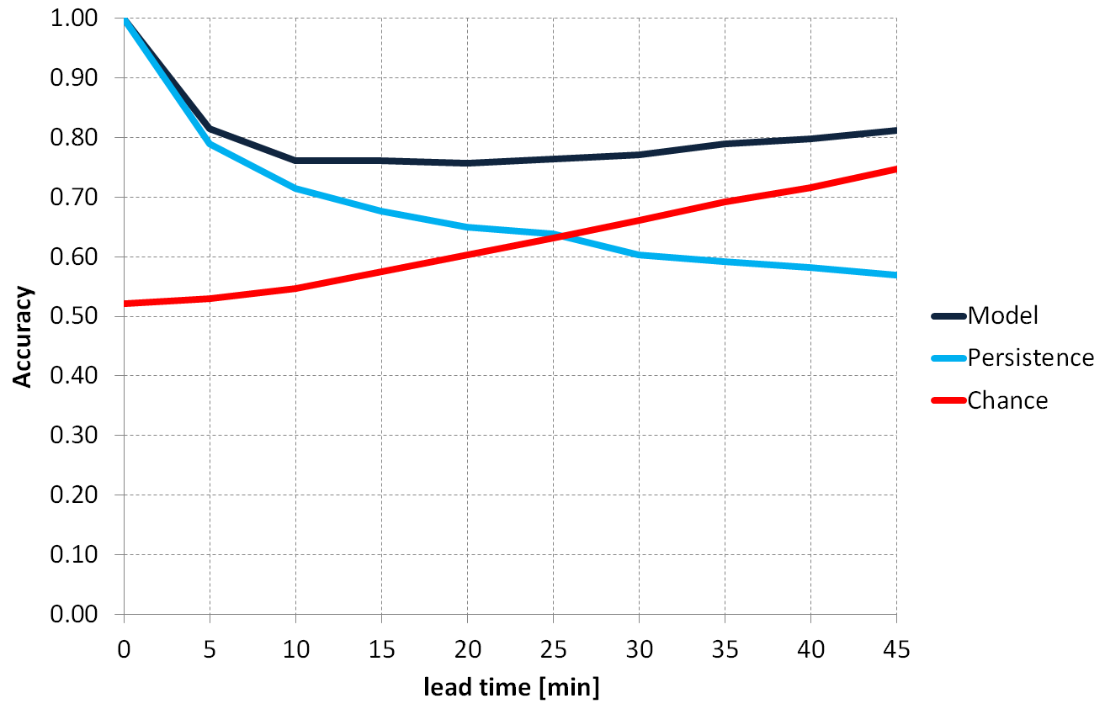
Accuracy of these hail nowcasting models
No Information Rate

Slide 8
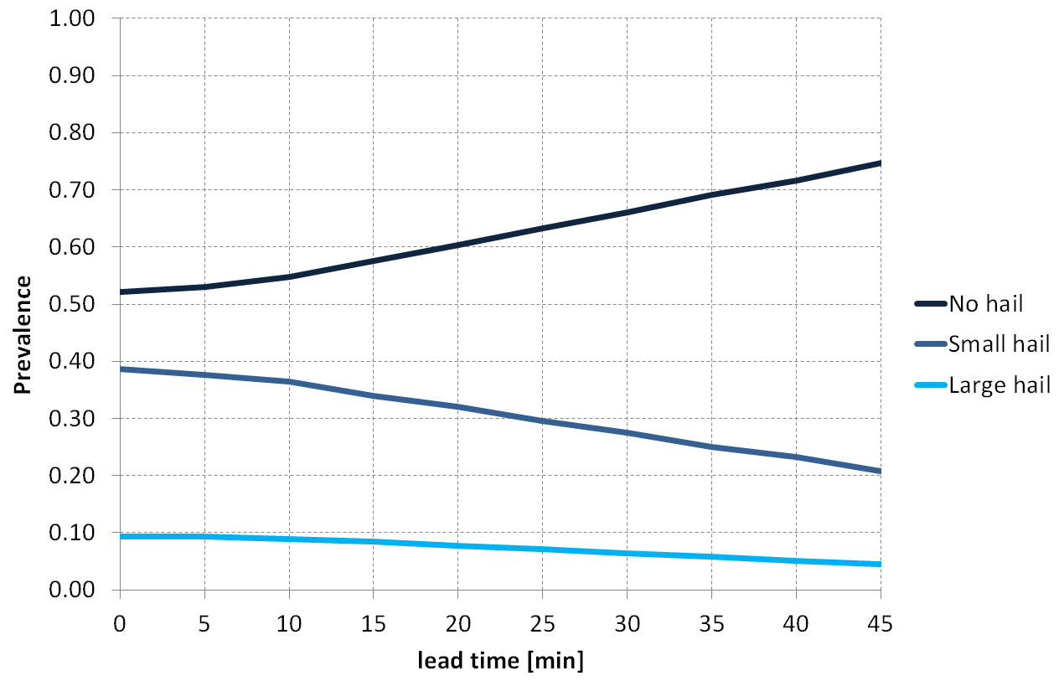
Prevalence

Slide 9
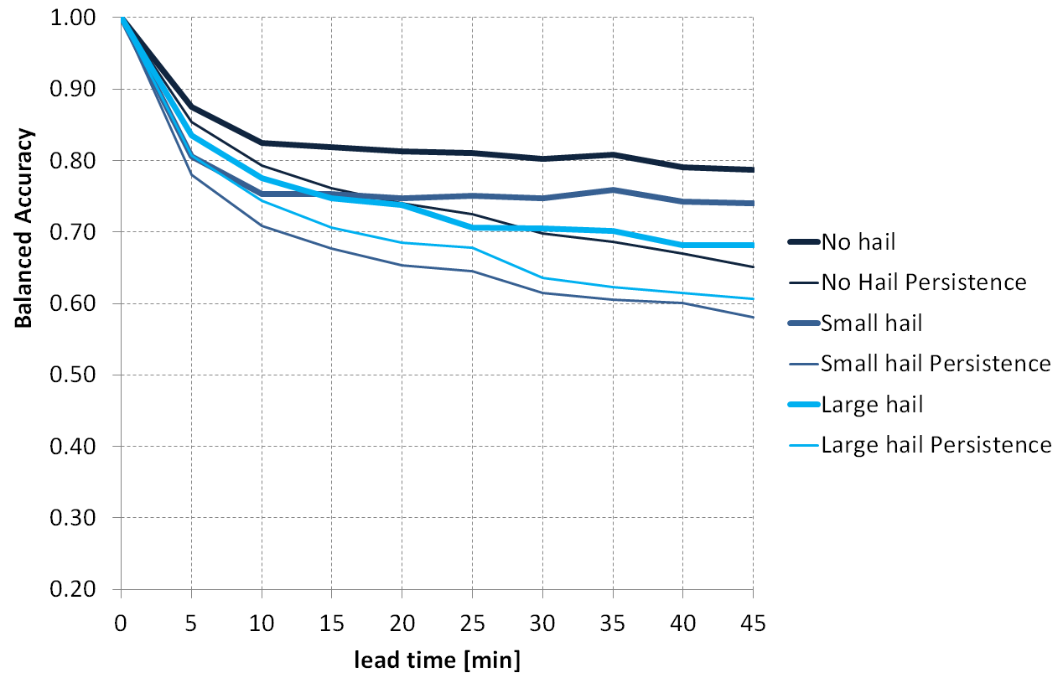
Balanced Accuracy
Balanced Accuracy actually decreases almost monotonically
“No hail” has best scores
For +5 and +10min, “large hail” has a better balanced accuracy than “small hail”
At higher lead-times, “small hail” predictions are better than “large hail”

Slide 10
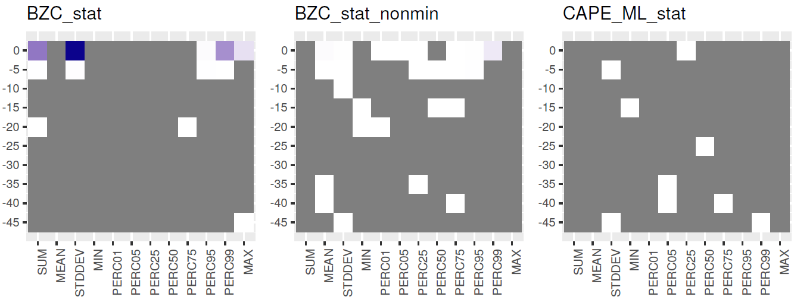
The 1000 most important features for a +5min nowcast
Probability of Hail (nonzero)
Probability of Hail
CAPE ML
Which time step?
Which statistic?

Slide 11
The 1000 most important features
+5min: POH, ET45
+25min: ET45, POH, ET20, (CAPE_ML, CAPE_MU, cloud depth, cloud glaciation)
+45min: ET45, POH, CAPE_ML, CAPE_MU, PV@300hPa, cloud depth, cloud glaciation, SLI, rain rate, CIN_MU, VIL, Topographic Aspect, V-Flow
Generally:
The larger lead-time, to more variables have relatively large gain
For variables from the COSMO model: most often the statistic STDDEV (standard deviation)
Cloud glaciation and topographic aspect: much more statistics and time points within first 1000 than other variables

Slide 12
CONCLUSION and OUTLOOK

Slide 13
Conclusion
Hail nowcasting (3 classes: no, small and large hail):
Skill is present even for a +45min prediction further improvement is maybe possible usability of nowcast depends on user needs
Accuracy “improves” at +45min because of increase in number of “no hail” samples; Balanced accuracy shows that actually the model skill monotonically decreases with time
For short lead-times fewer variables are needed (and the opposite)

Slide 14
Outlook
What about using the crowd-sourced reports? (as mentioned in the abstract)
At the moment, the models using crowd-sourced reports as a predictand are too volatile (some seem to have skill but it is unclear why → more work is needed)
Further plans:
Add another summer of data (summer 2019) for further validation and training (let’s see if the models still agree)
Do further tests by training models for particular situations such as “north of the Alps” and “south of the Alps” or “only when hail initiates”

Slide 15
Thank you! questions and comments are very welcome

Slide 16
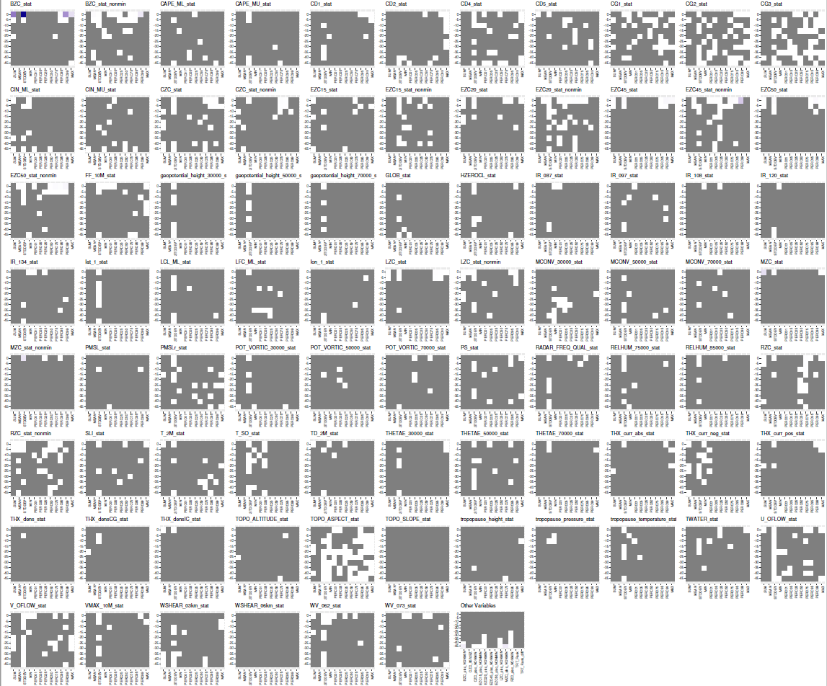
+5

Slide 17
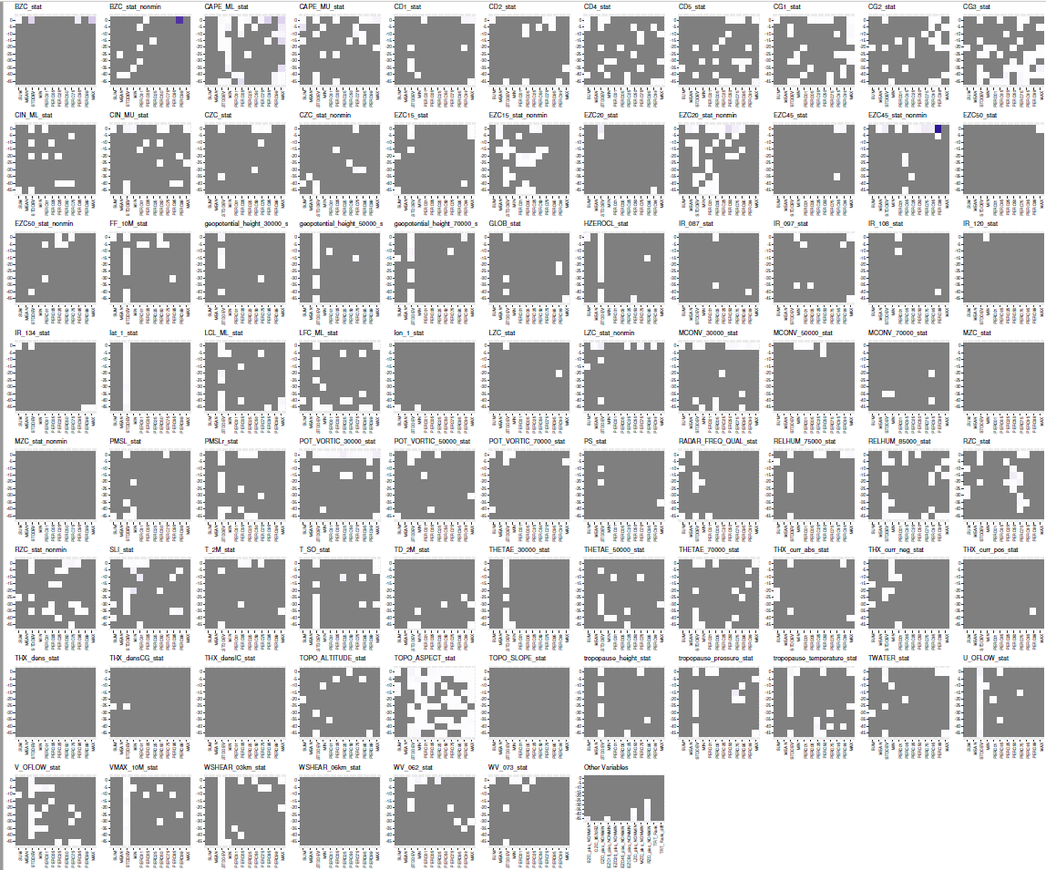
+45

