Slide 1
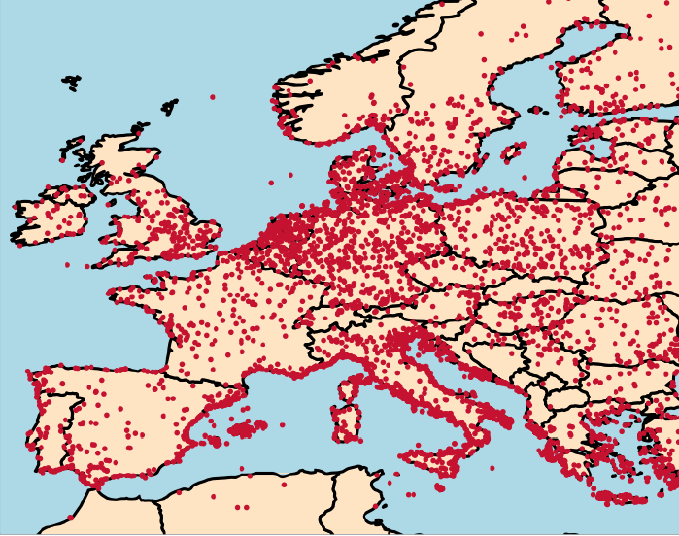
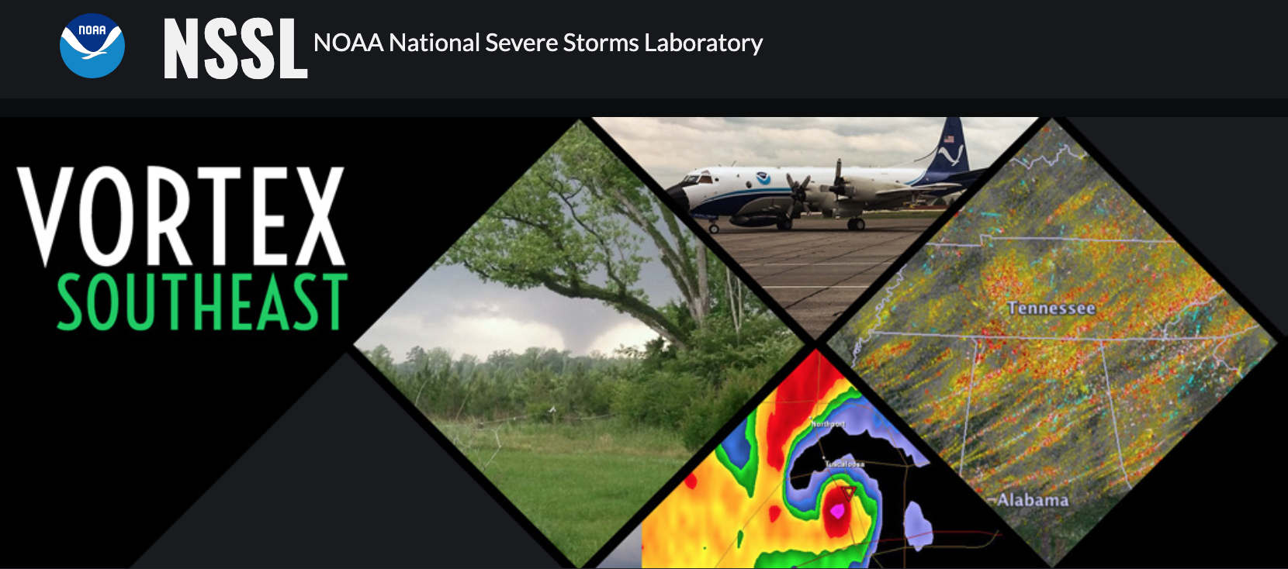

How Mountains Alter Quasi-linear Convective System Dynamics and Tornado Potential
Kelly Lombardo, Fan Wu, and Adisen Fenrich
The Pennsylvania State University, Pennsylvania, United States
11th European Conference on Severe Storms, Bucharest Romania
(Grieser and Haines 2020)

Slide 2
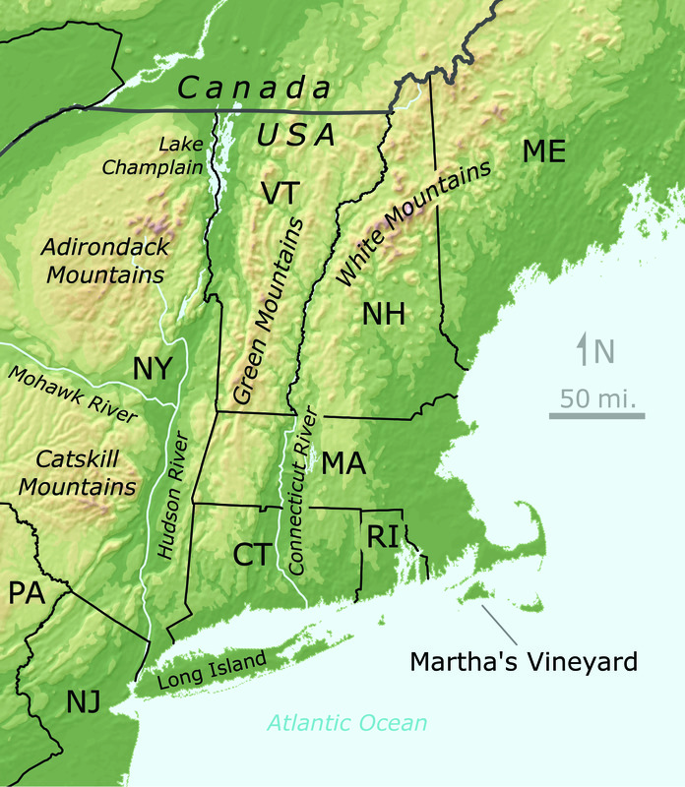
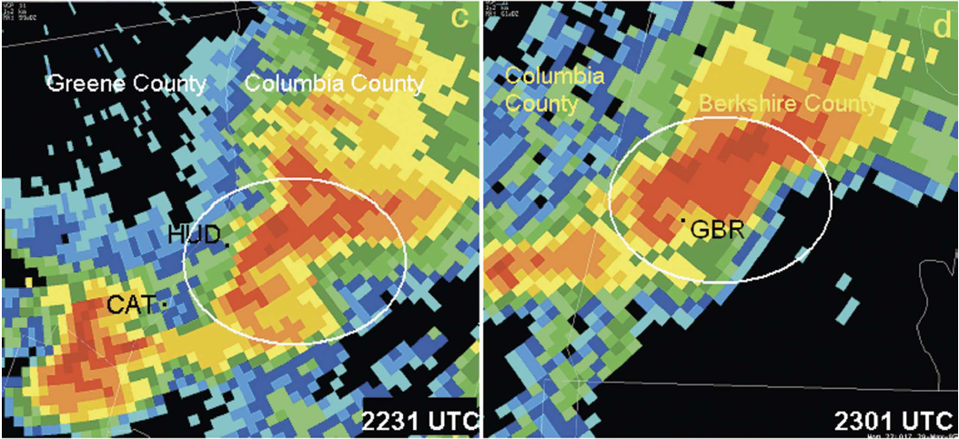
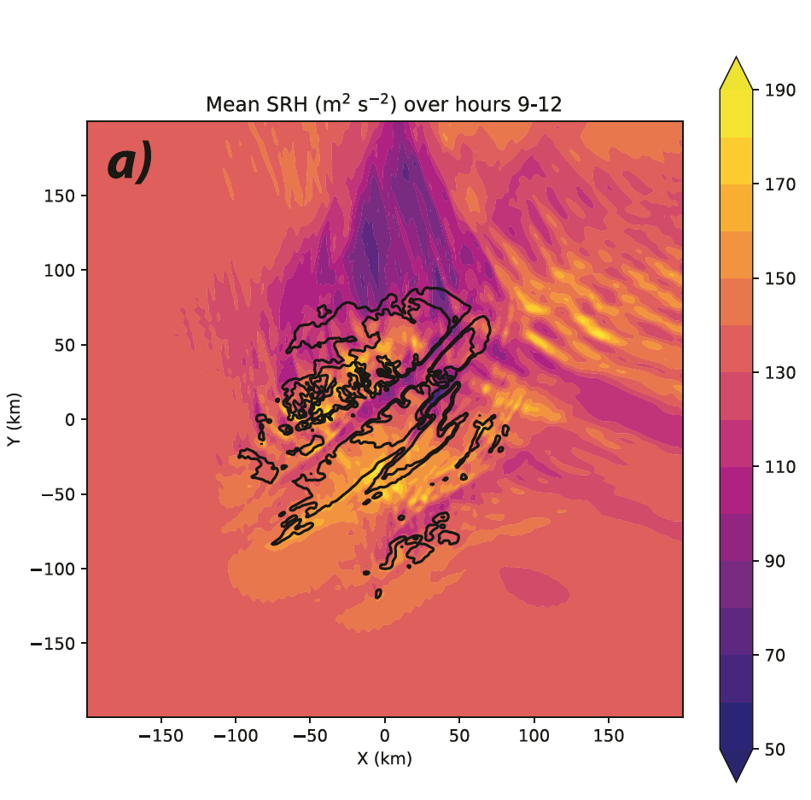
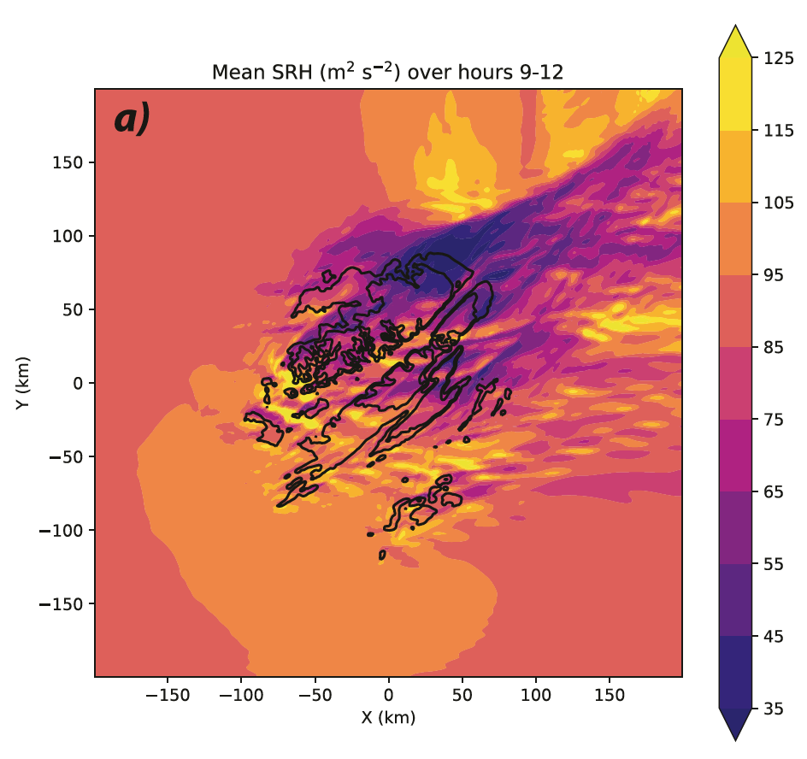
Mountains Modify the Local Environment
Mountains can produce localized enhancements in
low-level vertical wind shear, 0-1 km storm-relative helicity, streamwise vorticity
instability through low-level moisture transport or vertical motion
Such mountain-induced modifications have the potential to influence deep convective storm tornado development
mountains
mountains
S flow
SW flow
Katona and Markowksi (2021): Idealized numerical experiments showed larger storm relative helicity over plateau tops and smaller in the valley (though flow direction dependent)
Bosart et al. (2006): Terrain channeling of low-level flow within the New England mountain valleys (United States) increased supercell tornado potential within the valley, Great Barrington F3 tornado
Washington Post

Slide 3
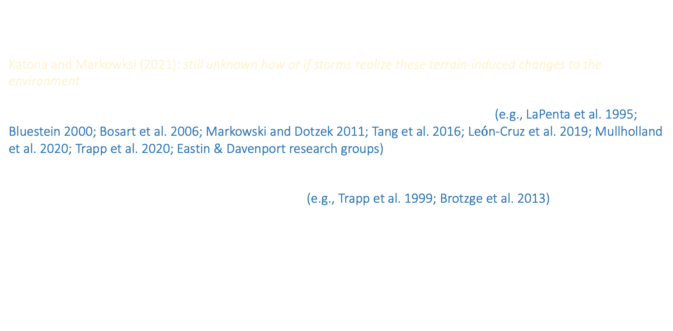
Relationship Between Terrain & Tornadoes is Unclear
While evidence suggests that terrain-induced environment perturbations may impact tornado potential, the relationship between the two remains unclear
Katona and Markowksi (2021): still unknown how or if storms realize these terrain-induced changes to the environment
Majority of studies have focused on the impact of terrain on supercell tornadogenesis (e.g., LaPenta et al. 1995; Bluestein 2000; Bosart et al. 2006; Markowski and Dotzek 2011; Tang et al. 2016; Le$\acute{o}$n-Cruz et al. 2019; Mullholland et al. 2020; Trapp et al. 2020; Eastin & Davenport research groups), rather than tornadogenesis associated with quasi-linear convective systems
Predicting QLCS tornado development is challenging (e.g., Trapp et al. 1999; Brotzge et al. 2013), so any identified relationships between terrain and QLCS tornadogenesis may offer predictability guidance
We investigate the relationship between mountains and QLCS tornado potential
Washington Post

Slide 4
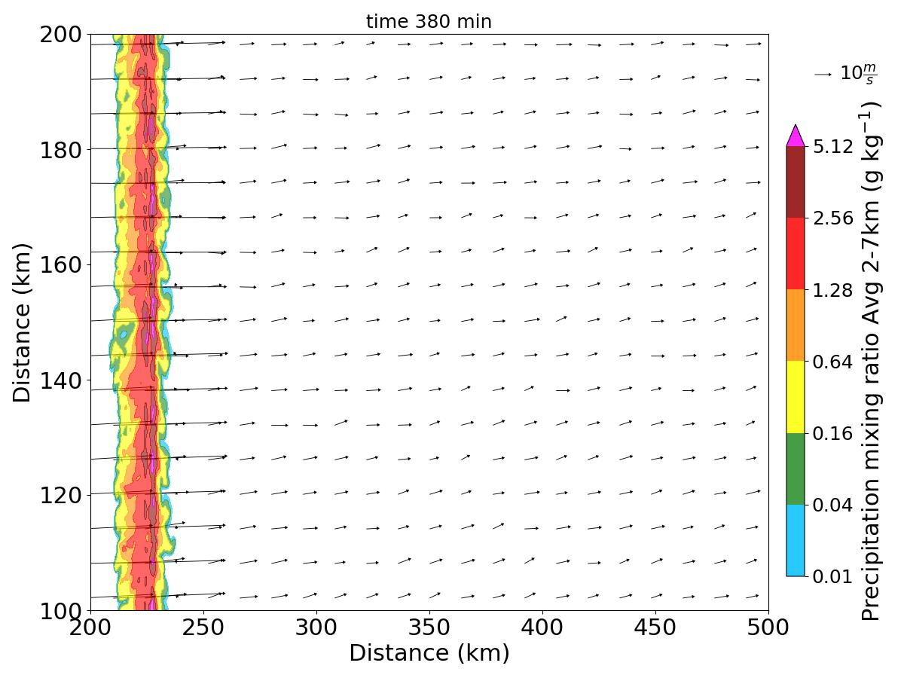
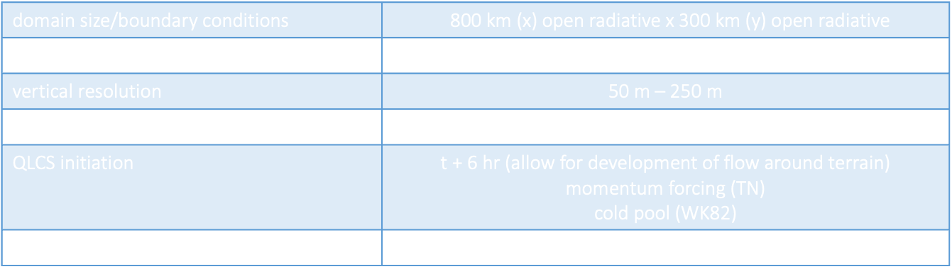
Idealized Numerical Experiments Systematically Quantify Potential
3D CM1 simulations (Bryan and Fritsch 2002)
domain size/boundary conditions | 800 km (x) open radiative x 300 km (y) open radiative
horizontal resolution | 200 m
vertical resolution | 50 m – 250 m
lower boundary | free slip
QLCS initiation | t + 6 hr (allow for development of flow around terrain) momentum forcing (TN) cold pool (WK82)
random $θ$ perturbations | +/- 0.2 K (full domain at t = 0)
Mountains are included in the numerical simulations, with different structures and locations
Mountain heights and valley widths are informed by southeastern US terrain characteristics, in support of NSF VORTEX-SE project
Storms are initiated in the left side of the domain and move to the right
plateau
top
Washington Post

Slide 5
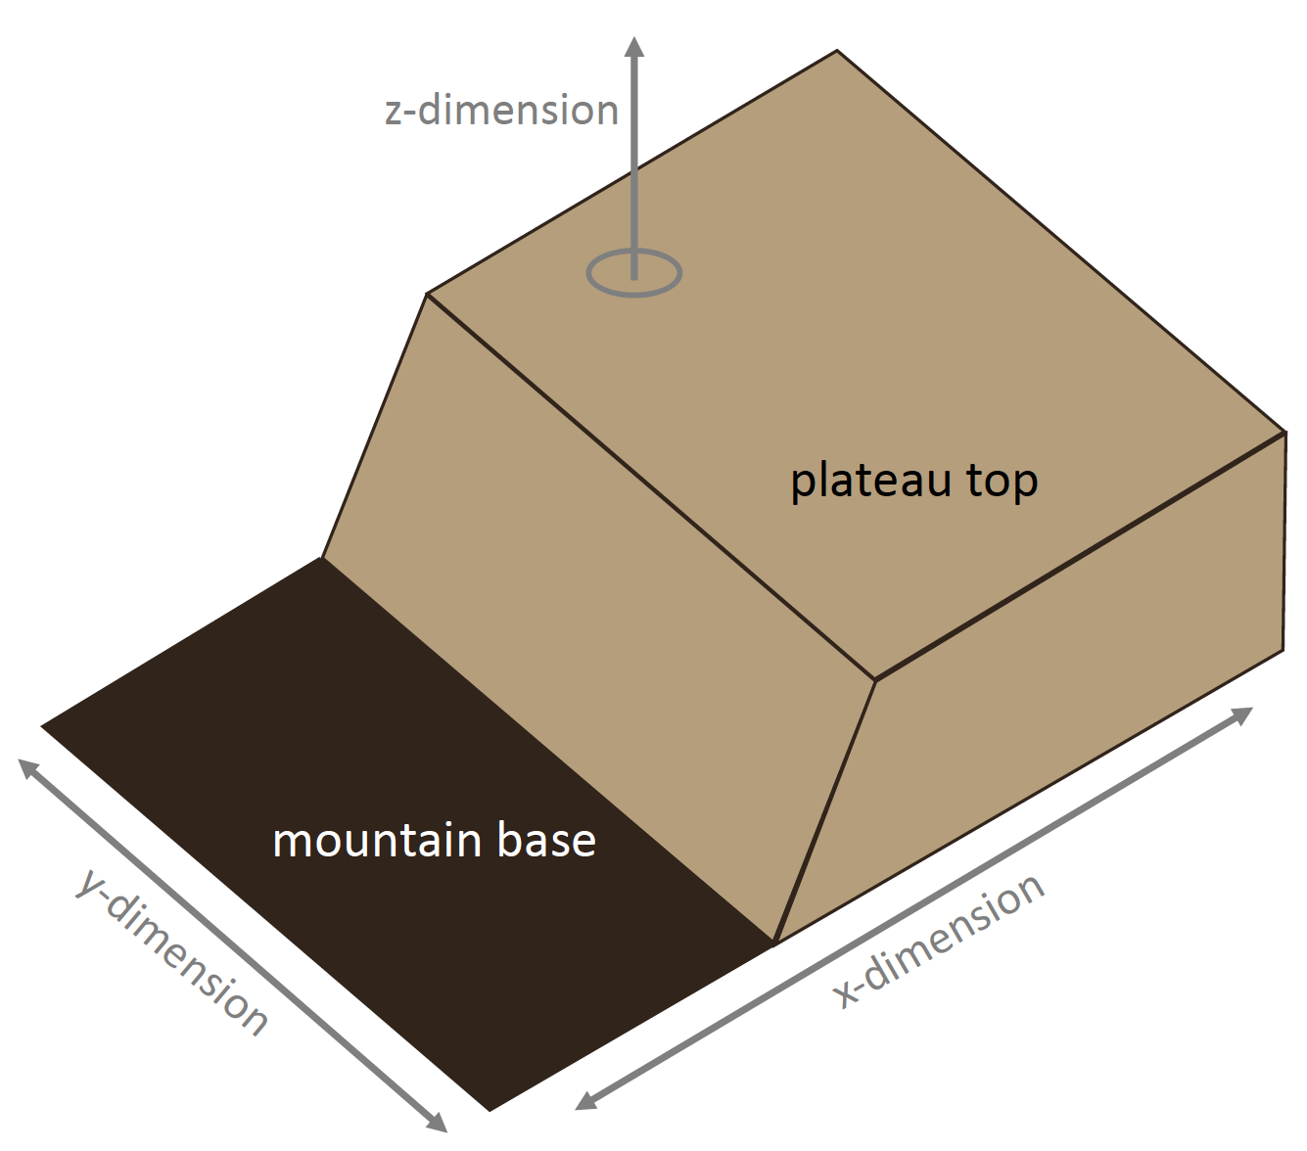
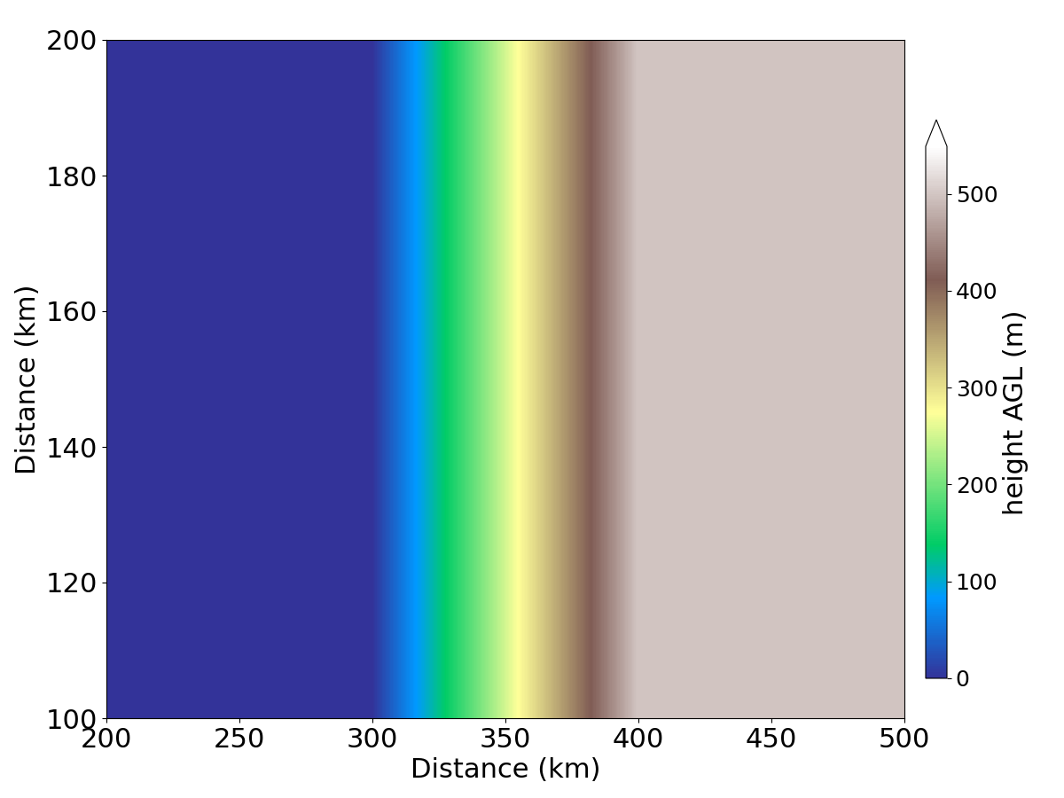
Include Mountain with a Flat Top & Sloped Side (Plateau) on Right
3D rendering of right plateau
2D plan view of surface of elevation (m, shaded)
Elevated plateau top in right side of domain
MCS initiated over the sea-level mountain base
Mature MCS moves upslope
y-dimension
sea level
500 m
x-dimension
Washington Post

Slide 6
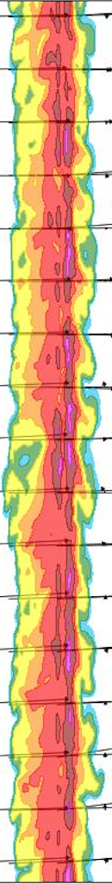
Include Mountain with a Flat Top & Sloped Side (Plateau) on Right
3D rendering of right plateau
2D plan view of surface of elevation (m, shaded)
Elevated plateau top in right side of domain
MCS initiated over the sea-level mountain base
Mature MCS moves upslope
y-dimension
sea level
500 m
x-dimension
Washington Post

Slide 7
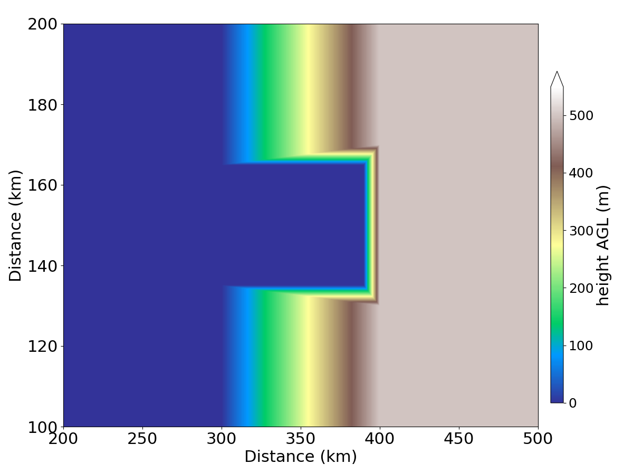
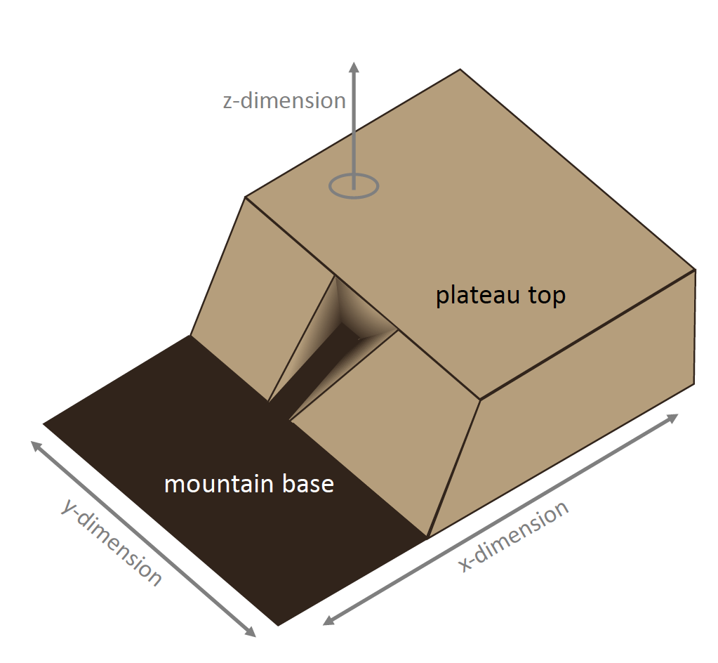
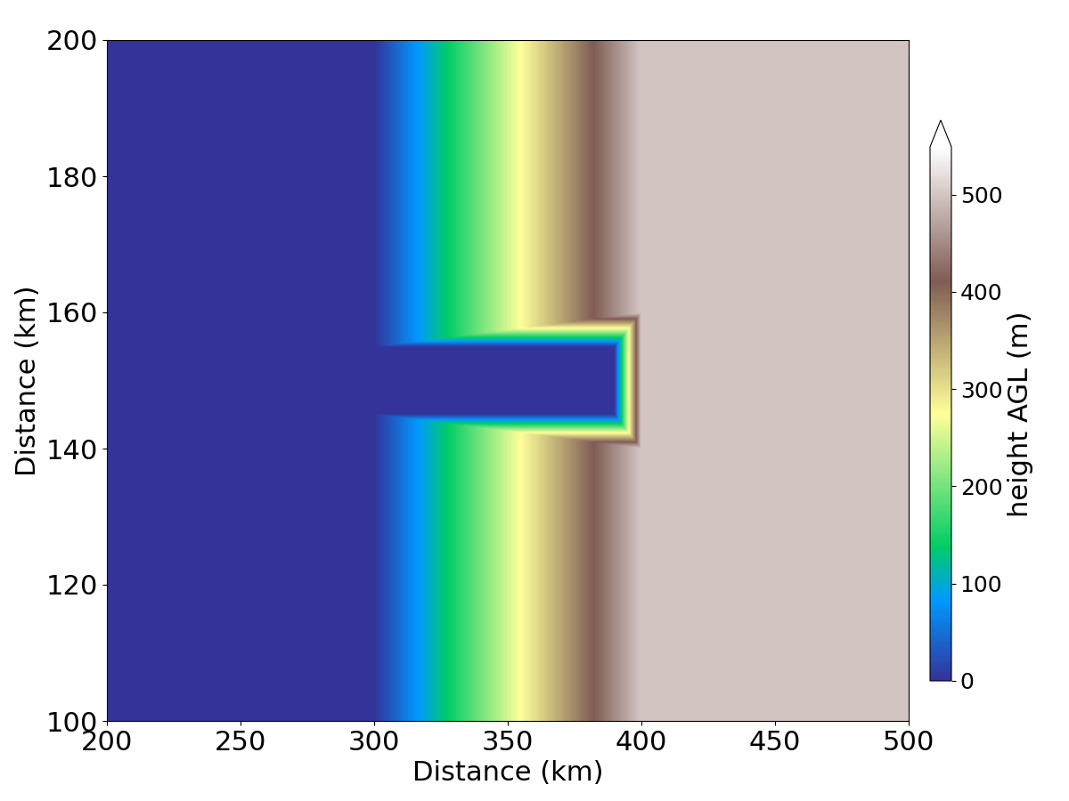
Include Mountain with a Flat Top & Sloped Side (Plateau) & Valley
3D rendering of right plateau with valley
valley slopes taper down over
10 km horizontal distance
30 km
wide valley
y-dimension
Elevated plateau top in right side of domain
Valley included within mountain slope
MCS initiated over the sea-level mountain base
Mature MCS moves upslope
10 km
wide valley
y-dimension
Given the impact of mountain heterogeneities on the local environment, we also include valleys within the broad mountain slope
Washington Post
x-dimension

Slide 8
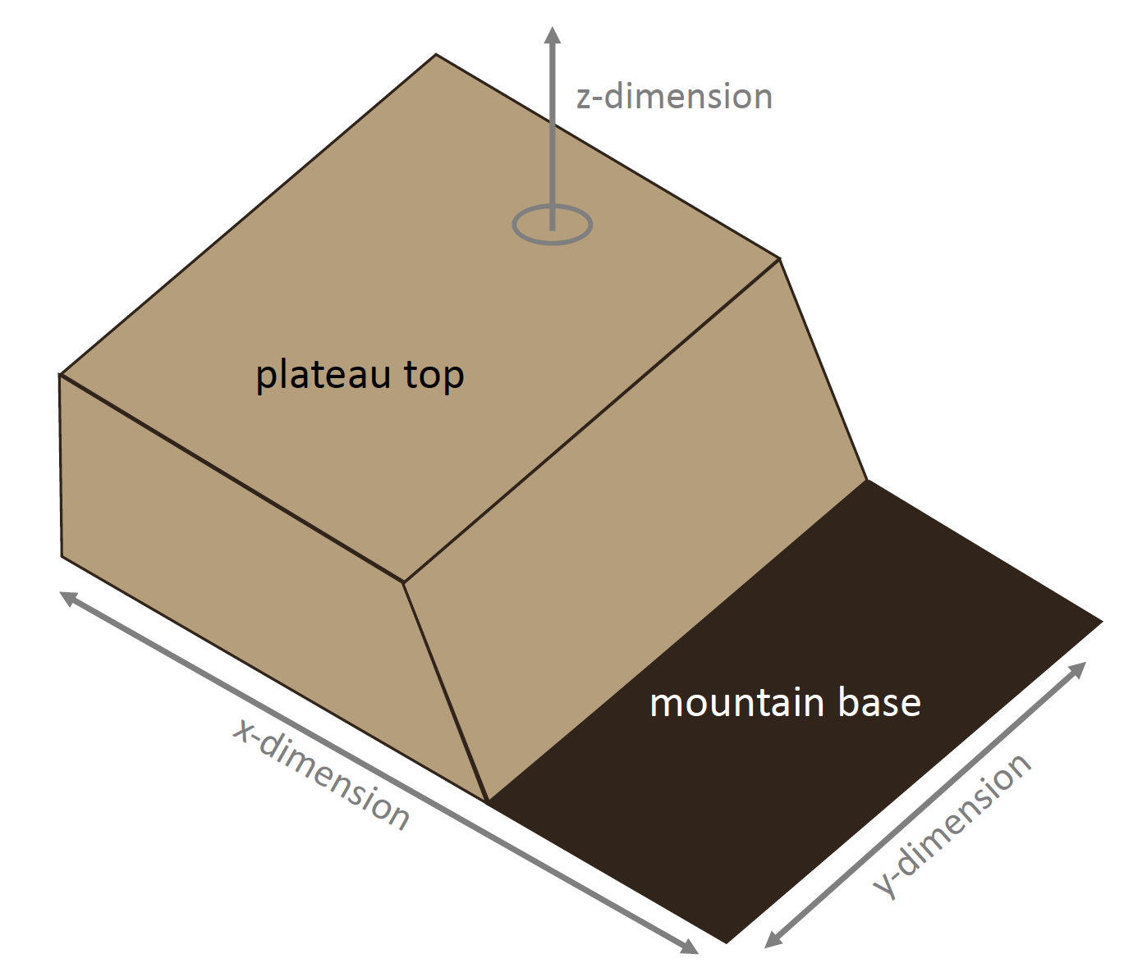
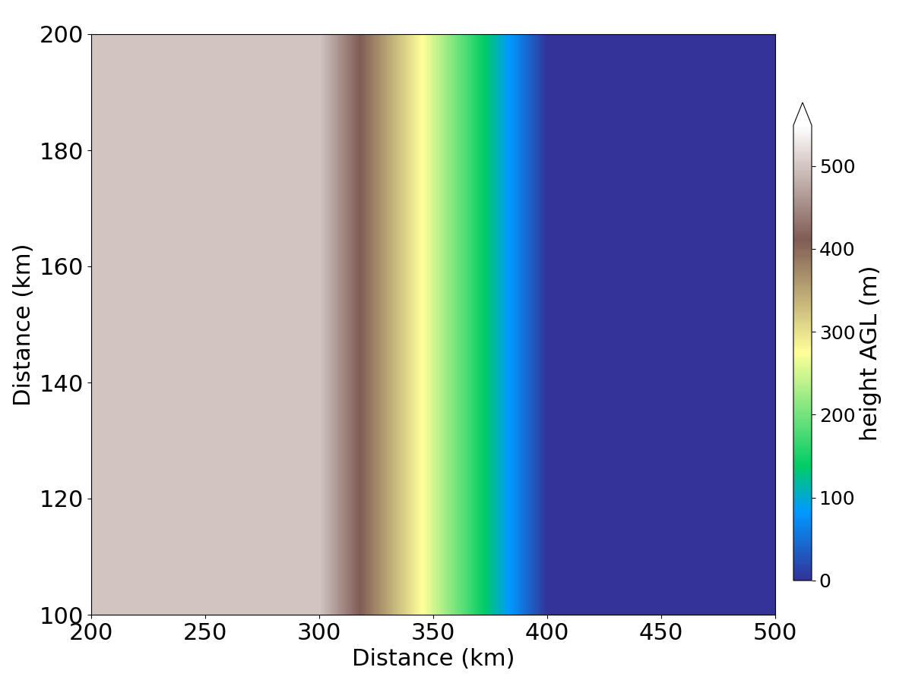
Include Mountain with a Flat Top & Sloped Side (Plateau) on Left
3D rendering of left plateau
2D plan view of surface of elevation (m, shaded)
Elevated plateau top in left side of domain
MCS initiated over the elevated plateau top
Mature MCS moves downslope
y-dimension
500 m
sea level
x-dimension
Washington Post

Slide 9
Include Mountain with a Flat Top & Sloped Side (Plateau) on Left
3D rendering of left plateau
2D plan view of surface of elevation (m, shaded)
Elevated plateau top in left side of domain
MCS initiated over the elevated plateau top
Mature MCS moves downslope
y-dimension
500 m
sea level
x-dimension
Washington Post

Slide 10
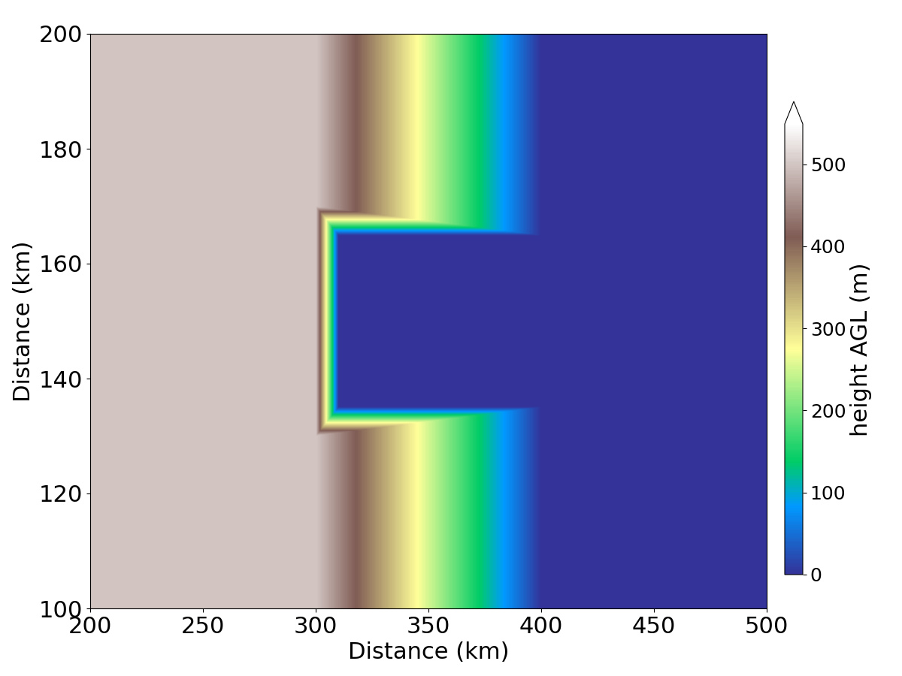
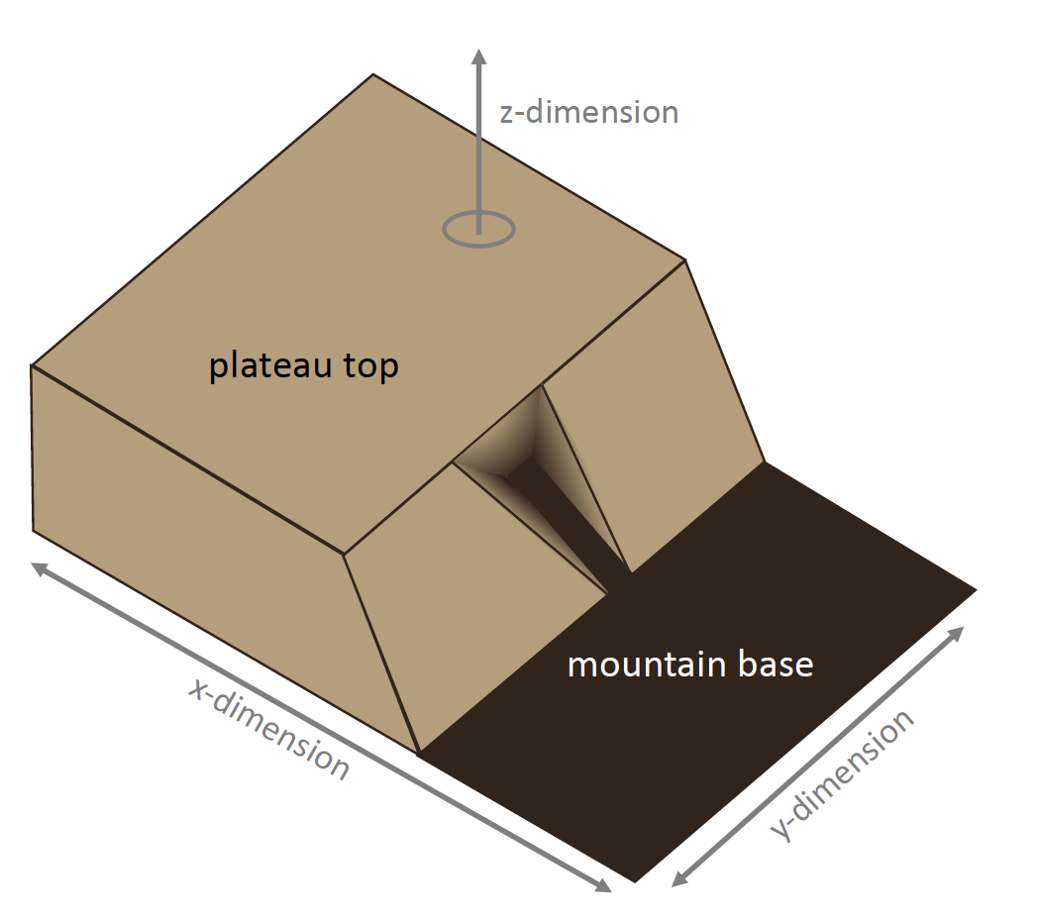
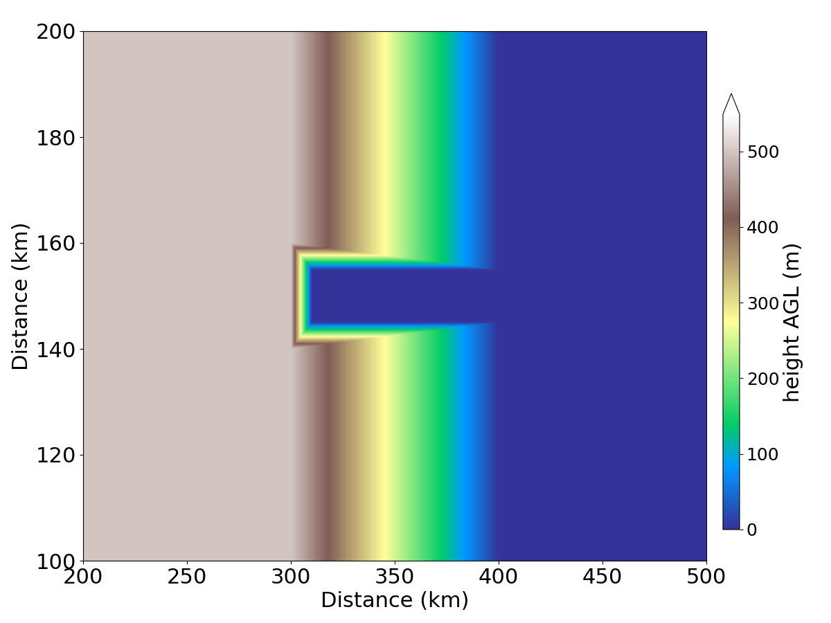
Include a Mountain with a Flat Top and Sloped Side (Plateau) & Valley
3D rendering of left plateau with valley
30 km
wide valley
y-dimension
Elevated plateau top in left side of domain
Valley included within mountain slope
MCS initiated over the elevated plateau top
Mature MCS moves downslope
10 km
wide valley
y-dimension
Washington Post
x-dimension

Slide 11
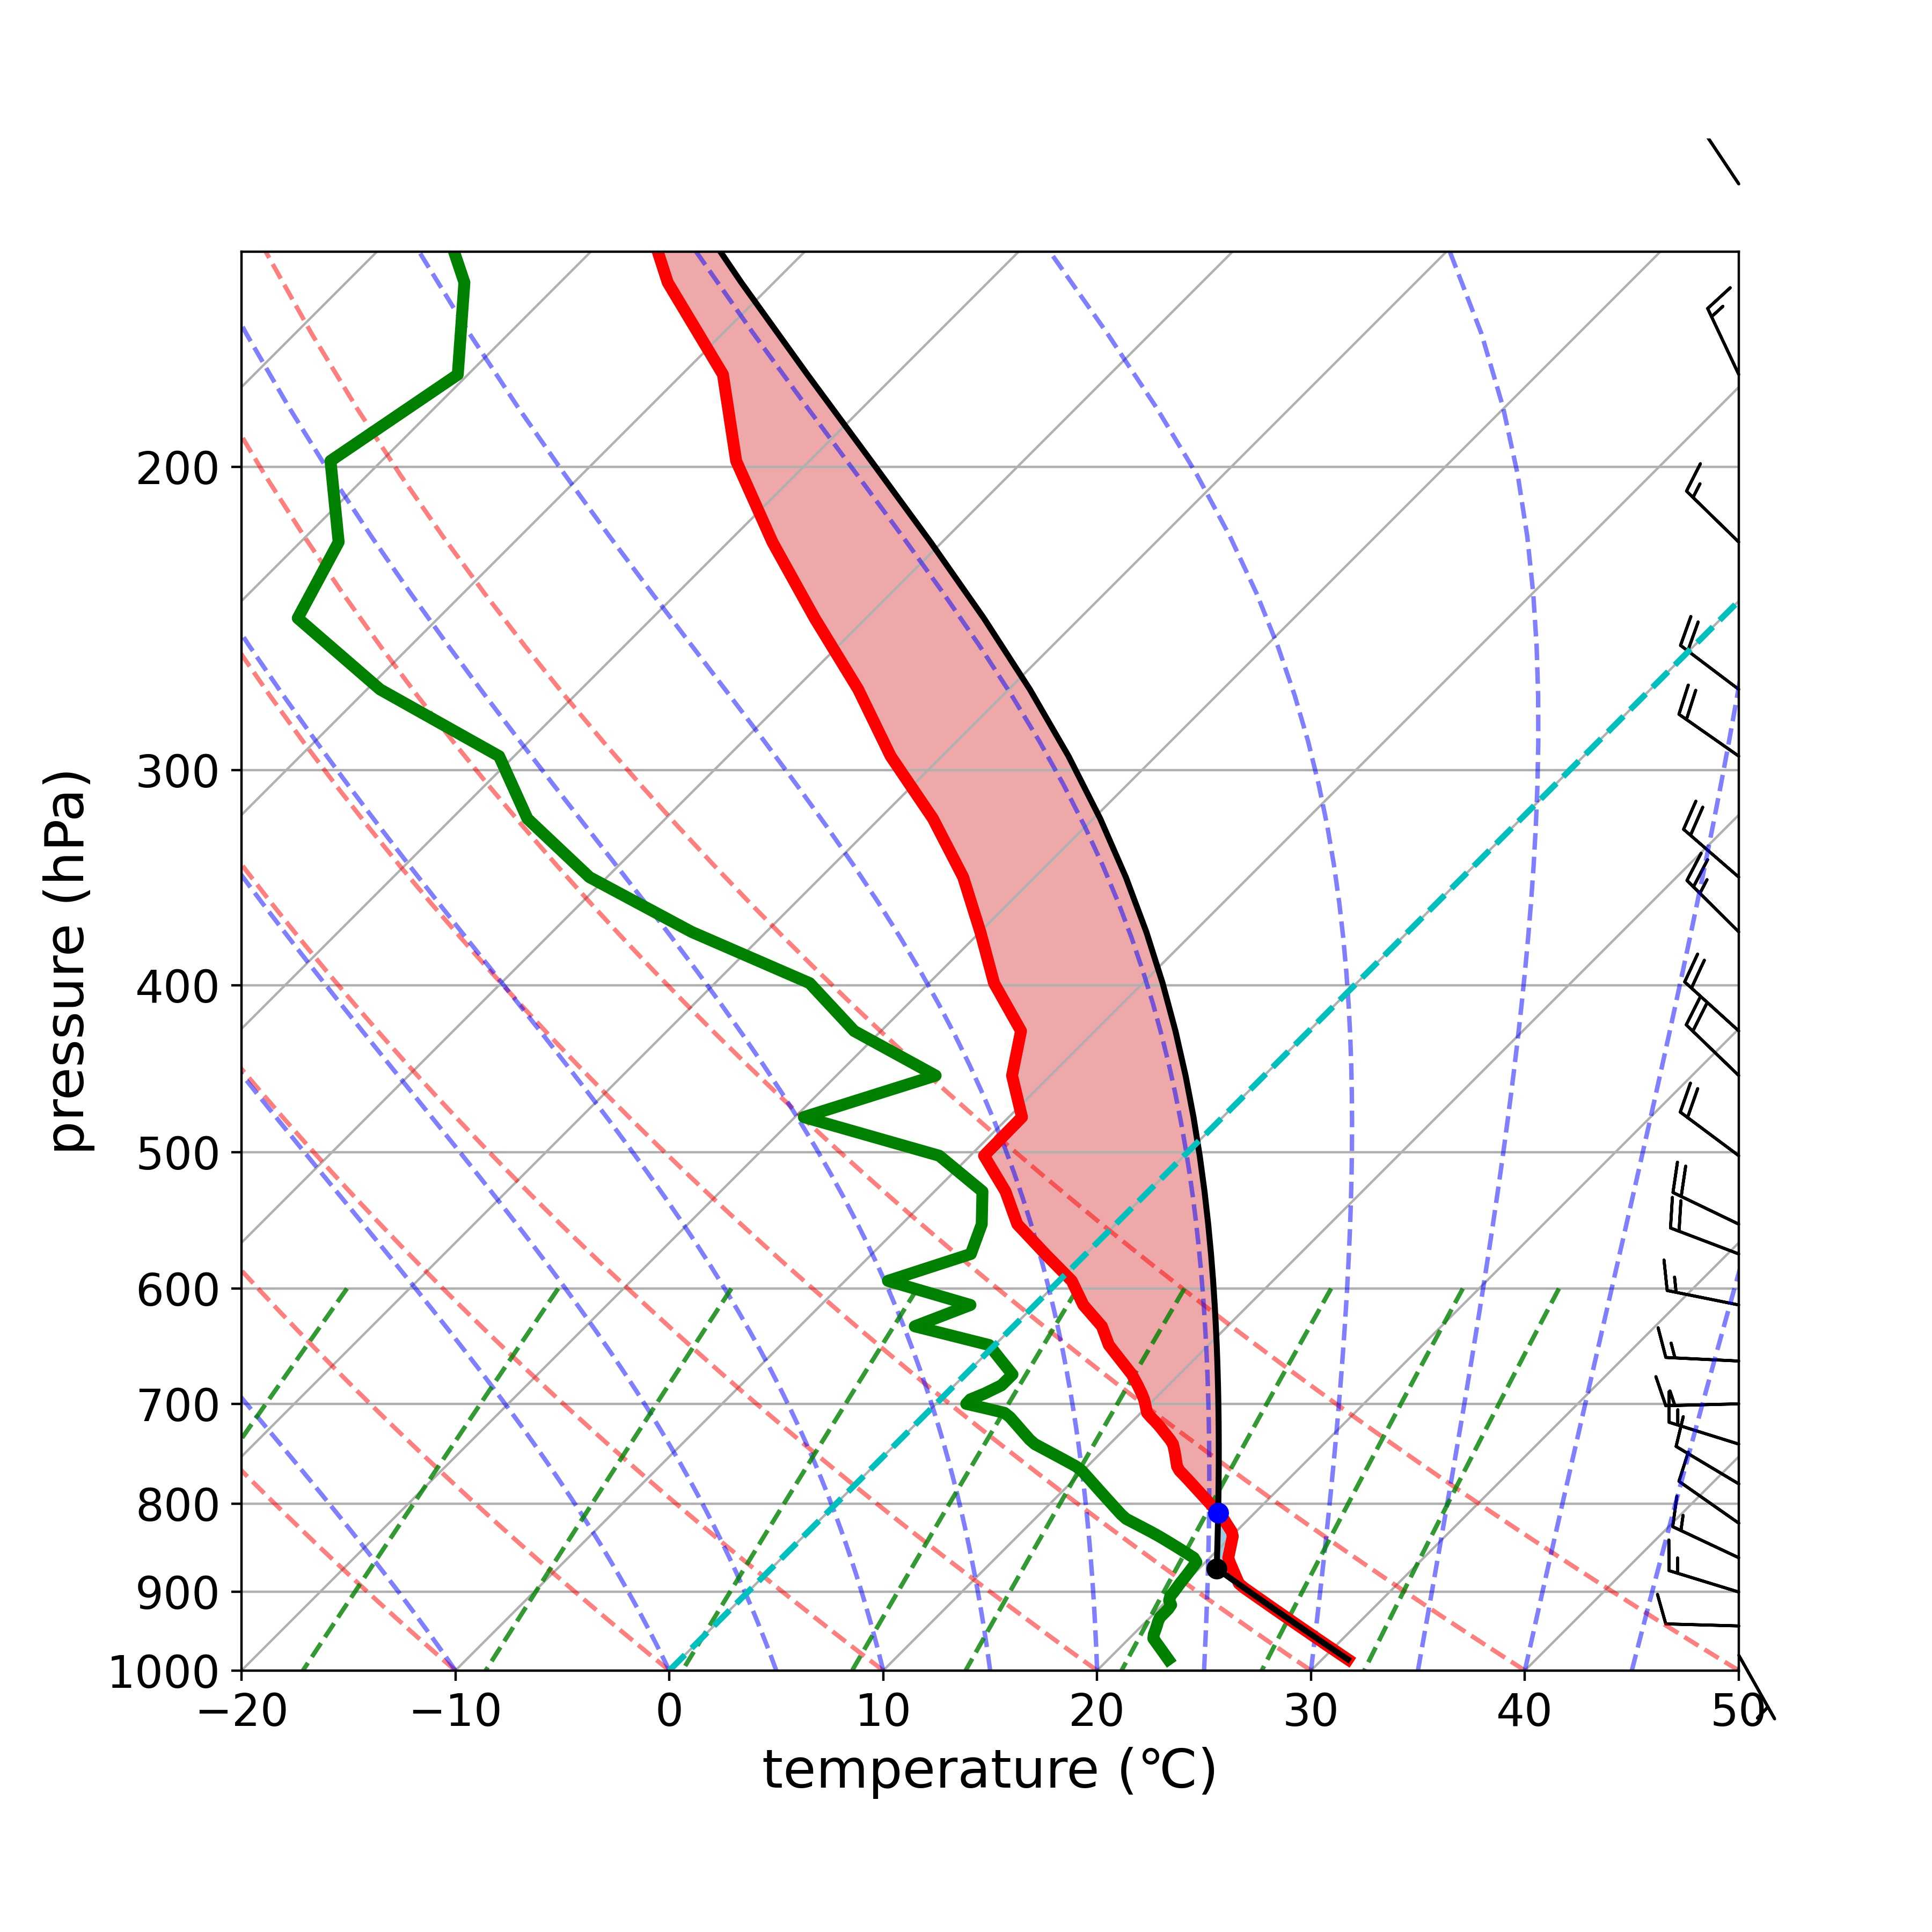
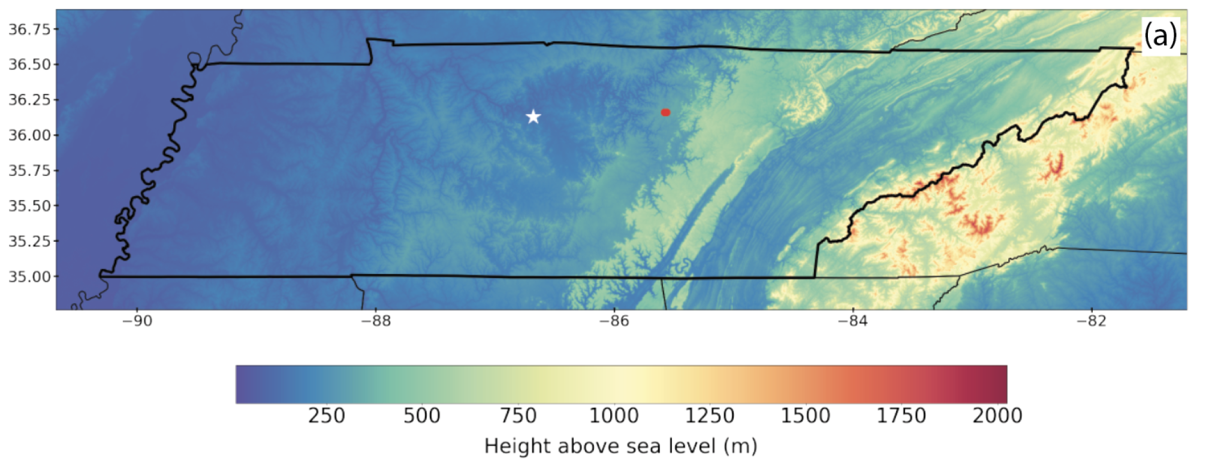
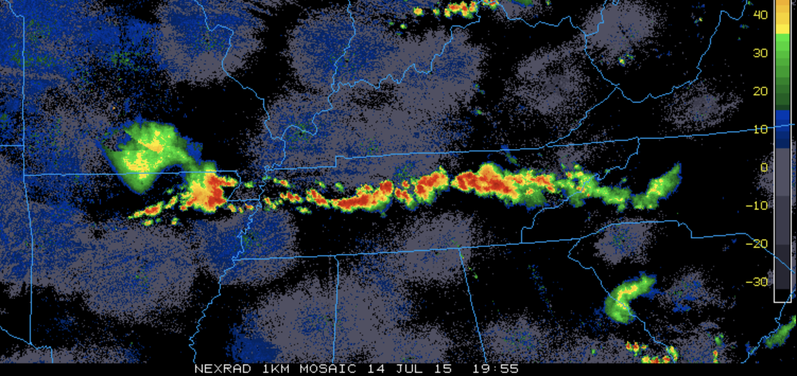
Initialized with: Observed Sounding
Observed sounding from QLCS tornado event in southeast US (in support of VORTEX-SE)
0-1 km shear value is near climatological median for QLCS EF0 tornadoes; 0-6 km shear is 25th percentile for EF0 QLCS tornadoes (Thompson et al. 2012)
Observed sounding used in simulations
tornado (EF1) 1846 UTC
tornado 1952, 2004 UTC
sounding
“mixed-out”
1200 UTC Nashville TN
14 July 2015
SBCAPE 3229 J kg⁻¹
SBCIN -14 J kg⁻¹
0-1 km 13 m s⁻¹
0-6 km 18.5 m s⁻¹
Tennessee
radar reflectivity from event
Tennessee
Washington Post
ocean

Slide 12
Initialized with: WK82 Thermodynamic + Idealized Hodographs
WK82 thermodynamic base-state
Systematically quantify QLCS tornado potential with respect to hodograph shape and vertical wind shear magnitude
0º curvature
90º curvature
180º curvature
Observed TN
Vertical wind profiles that support numerical QLCS tornadoes, from Marion and Trapp (2021) idealized modeling study of QLCS tornadoes
Base state profile | 0-1 km shear (m s⁻¹) | 0-2.5 km shear (m s⁻¹) | 0-6 km shear (m s⁻¹)
0º curvature | 10 | 25 | 30
90º curvature | 14 | 26 | 30
180º curvature | 10 | 25 | 25
180º curvature | 8 | 20 | 20
Observed TN | 12.3 | 10.2 | 18.2

Slide 13
Initialized with: WK82 Thermodynamic + Idealized Hodographs
WK82 thermodynamic base-state
Systematically quantify QLCS tornado potential with respect to hodograph shape and vertical wind shear magnitude
0º curvature
90º curvature
180º curvature
Observed TN
Retain the same 0-1 km & 0-2.5 km vertical wind shear magnitudes as for the 0º curvature profile, but increase hodograph curvature to 180º
Base state profile | 0-1 km shear (m s⁻¹) | 0-2.5 km shear (m s⁻¹) | 0-6 km shear (m s⁻¹)
0º curvature | 10 | 25 | 30
90º curvature | 14 | 26 | 30
180º curvature | 10 | 25 | 25
180º curvature | 8 | 20 | 20
Observed TN | 12.3 | 10.2 | 18.2

Slide 14
Initialized with: WK82 Thermodynamic + Idealized Hodographs
WK82 thermodynamic base-state
Systematically quantify QLCS tornado potential with respect to hodograph shape and vertical wind shear magnitude
0º curvature
90º curvature
180º curvature
Observed TN
Reduced 0-1 km & 0-2.5 km vertical wind shear magnitude to eliminate mountain-induced convection during the model spin-up period
Base state profile | 0-1 km shear (m s⁻¹) | 0-2.5 km shear (m s⁻¹) | 0-6 km shear (m s⁻¹)
0º curvature | 10 | 25 | 30
90º curvature | 14 | 26 | 30
180º curvature | 10 | 25 | 25
180º curvature | 8 | 20 | 20
Observed TN | 12.3 | 10.2 | 18.2

Slide 15
TN Observed Environment
mountains can impact QLCS precipitation evolution
Washington Post
ocean

Slide 16
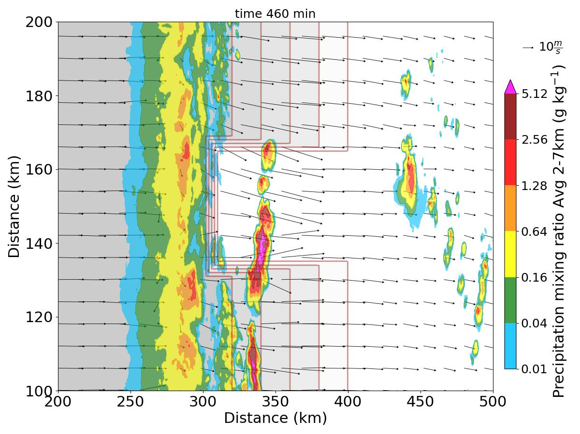
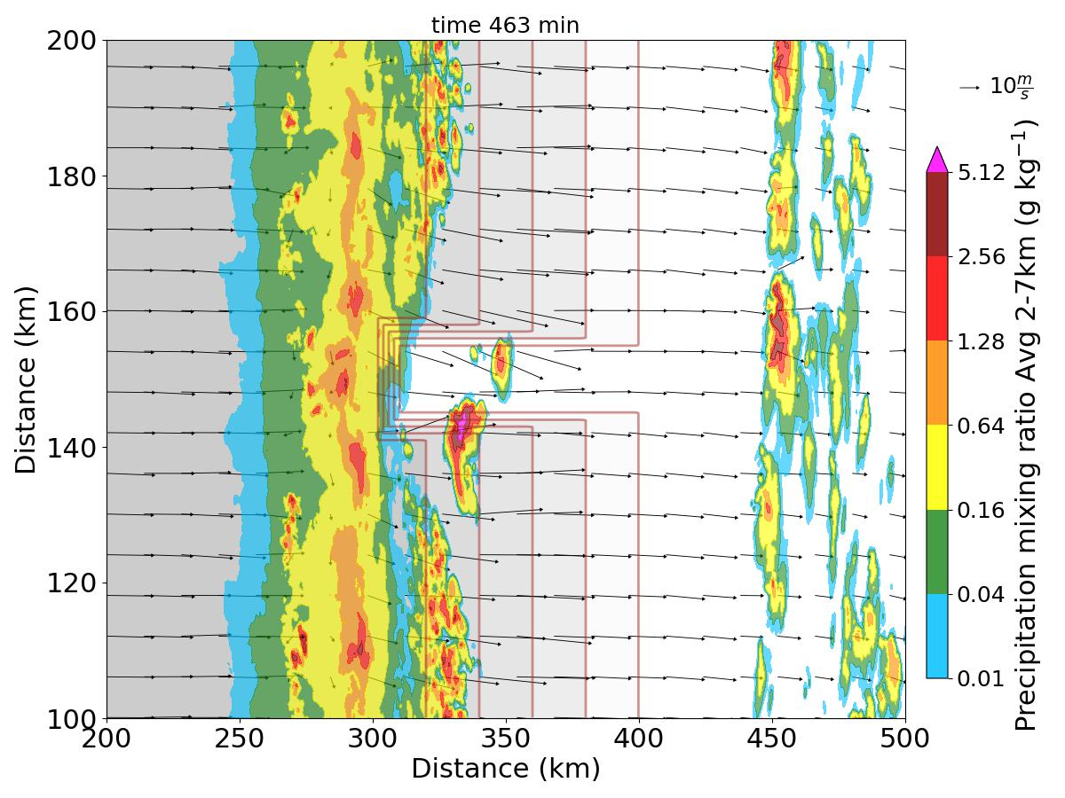
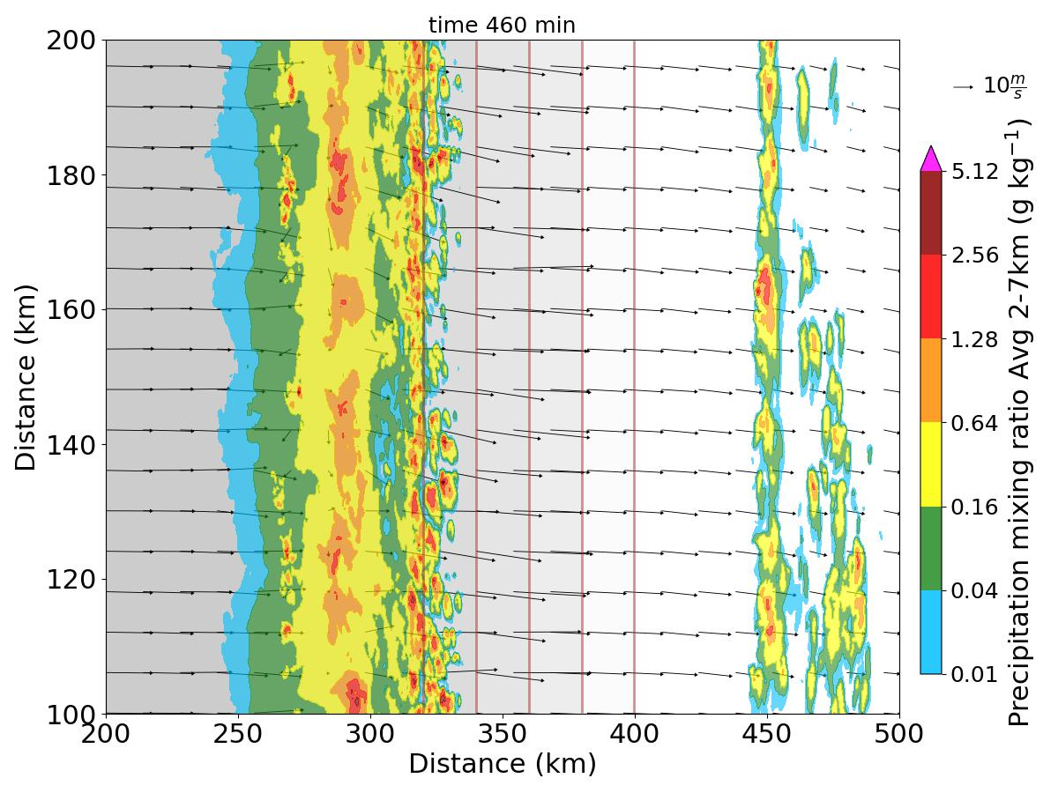
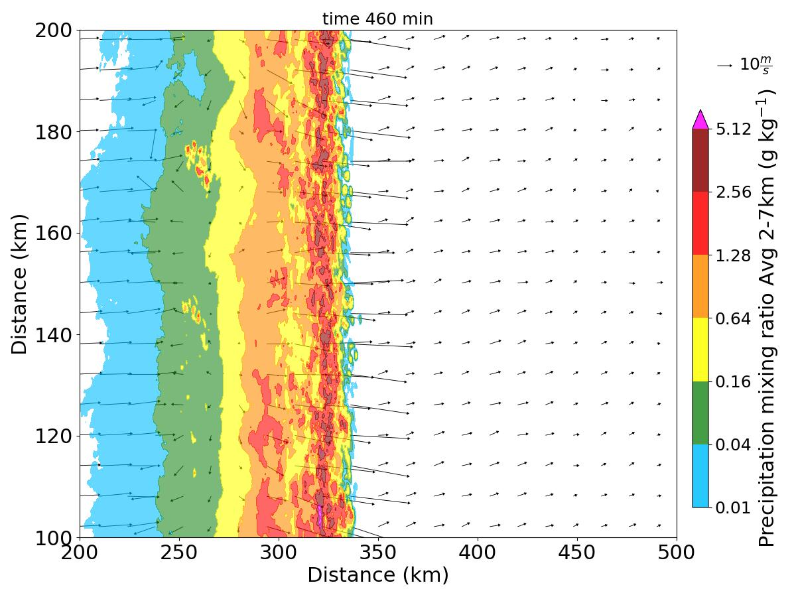
CI and Most Intense Precipitation Within Valley for Downslope Storms
2-7 km avg precipitation mixing ratio (shaded), wind lowest model level, terrain (gray shading)
Is this convection associated with an increased QLCS tornado potential?
downslope with
30 km valley
CI within the valley
downslope with 10 km valley
CI within the valley
plateau
sea level
plateau
sea level
downslope with
no valley
weakening over the slope
no mountain
robust QLCS
plateau
sea level

Slide 17
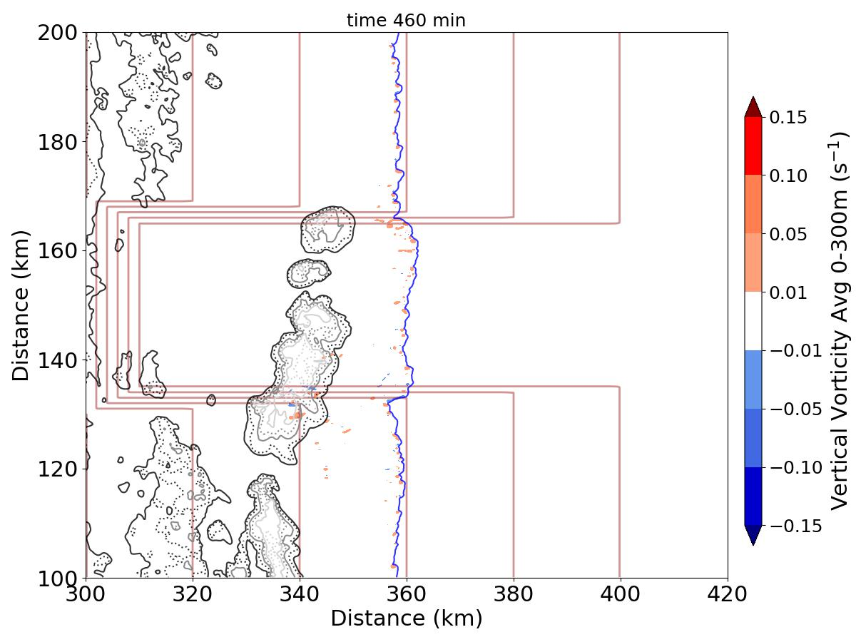
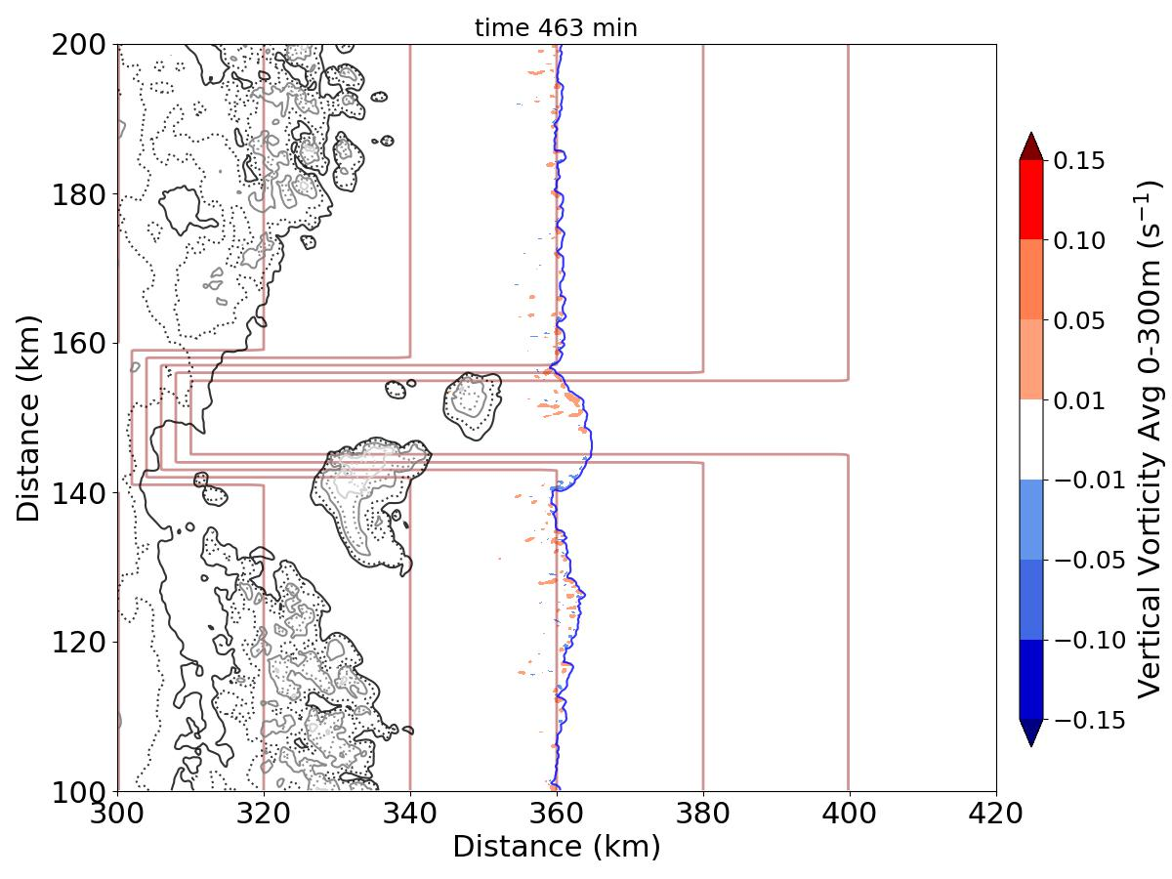
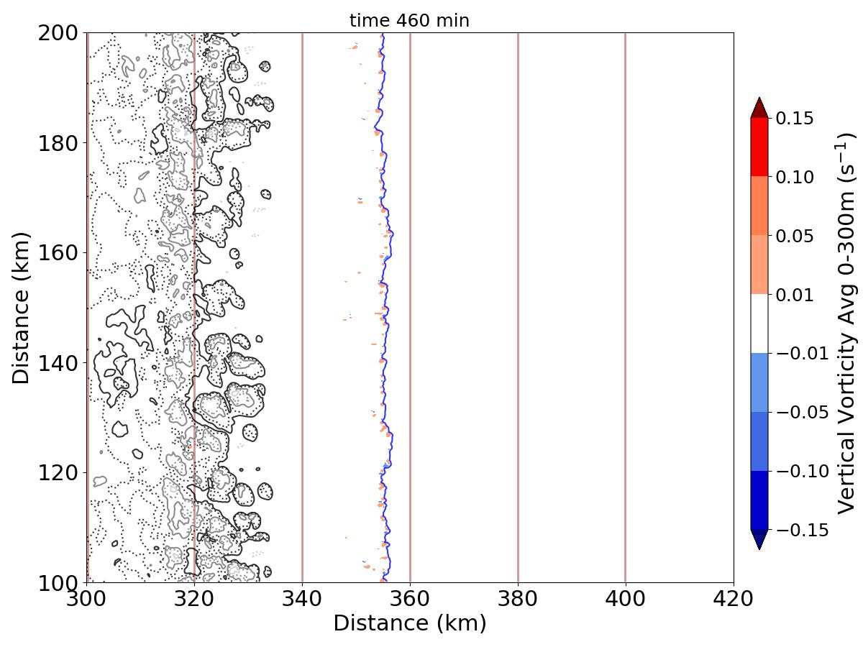
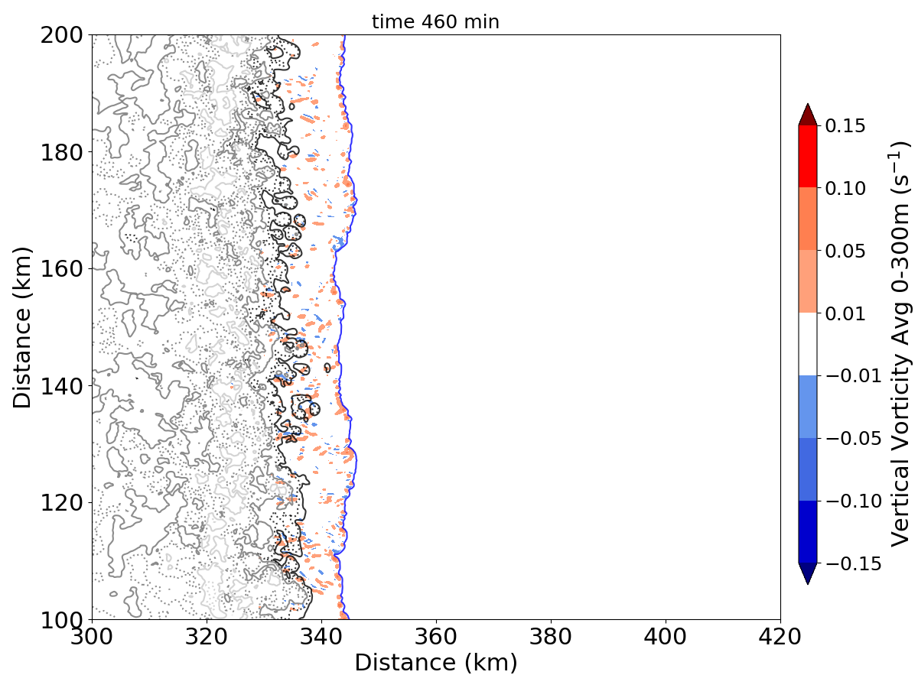
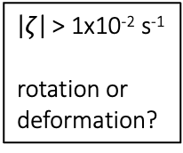
Vertical Vorticity Associated with Convection in 30 km Wide Valley
0-300 m avg vertical vorticity (shaded), prcp mixr (black contour), B (-0.01 m s⁻² blue), terrain (brown)
$\left|ζ\right|$ > 1x10⁻² s⁻¹
rotation or
deformation?
no vertical
vorticity
Is this vertical vorticity associated rotation or deformation?
downslope with
30 km valley
vertical vorticity in developing cell
and along cold pool front
downslope with 10 km valley
vertical vorticity along cold pool front only
valley
valley
downslope with
no valley
vertical vorticity along cold pool
front only
no mountain
vertical vorticity along and behind cold pool front

Slide 18
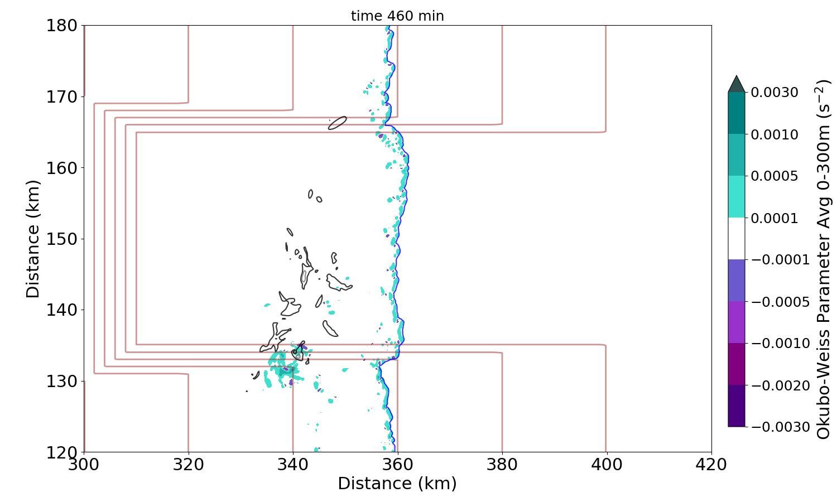
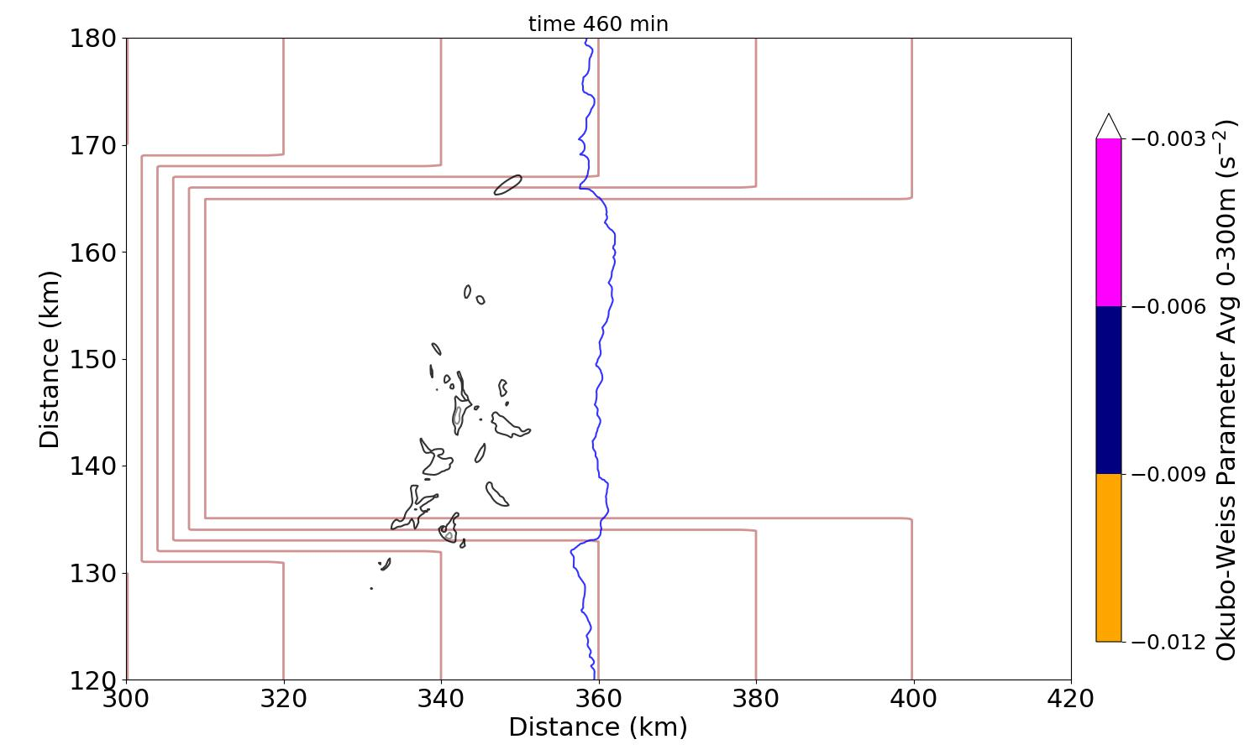
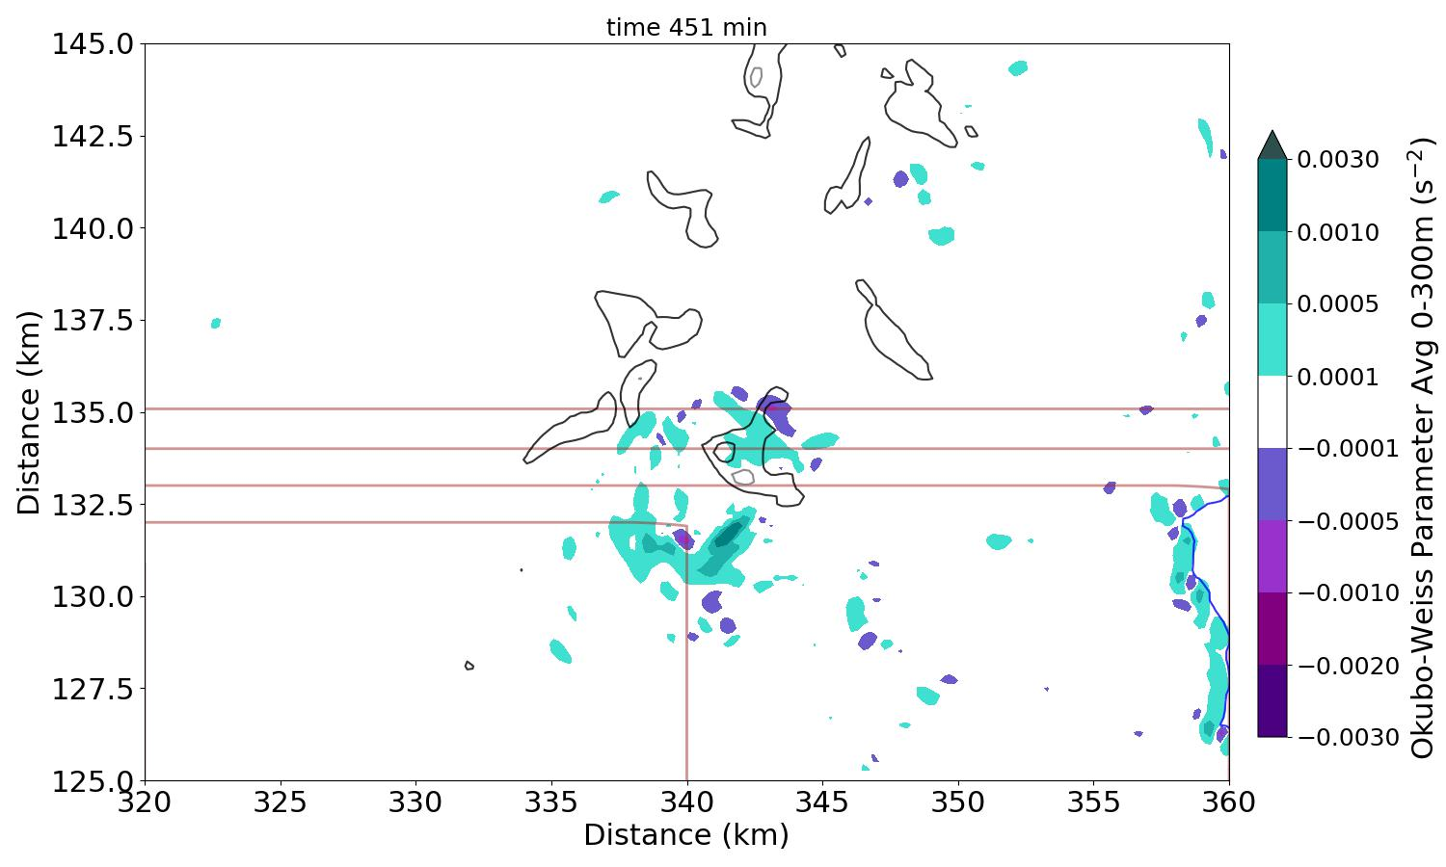

Okubo-Weiss Number Can Help Identify Tornado-line Vortex Circulation
Okubo-Weiss identifies regions of rotation and deformation
$$D^{2}−ζ^{2}$$
OW < 0 indicates circulation center
TLV OW threshold value < -1x10⁻² s⁻², often coupled with w_{2km} > 10 m s⁻¹
(Markowski et al. 2011; Murdzek et al. 2020; Marion and Trapp 2021)
downslope with
30 km valley
valley
0-300 m avg Okubo-Weiss (shaded), B (-0.01 m s⁻² blue), 2 km ascent (black, every 5 m s⁻¹) terrain (brown)
OW -0.1x10⁻² s⁻²
w 5 m s⁻¹
mountain slope
valley
valley
downslope with
30 km valley
downslope with
30 km valley
valley wall
mountain slope
mountain slope

Slide 19
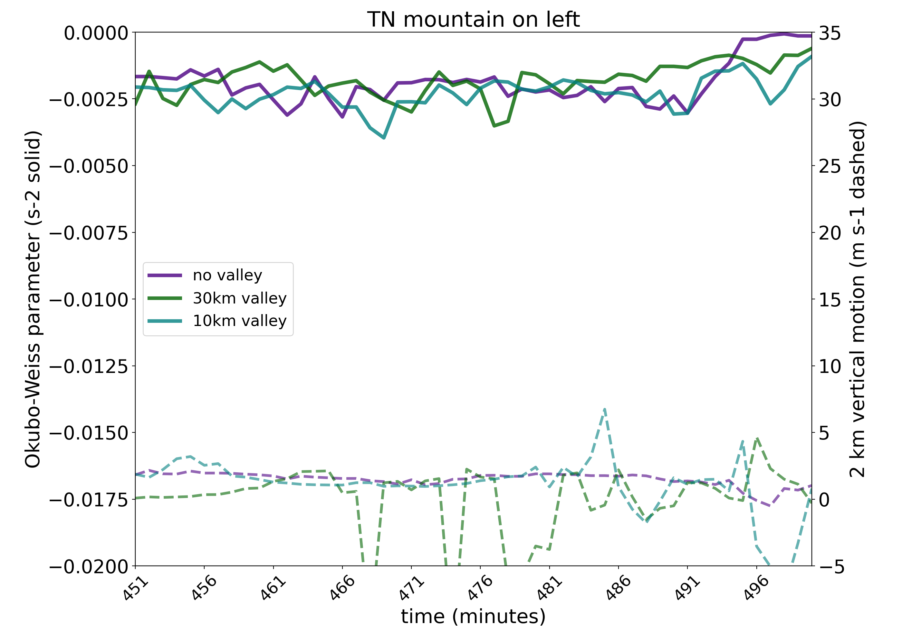
No Clear Evidence of Enhanced Tornado Potential during Downslope
Time series as storms move over mountain slope and valley; Analysis domain is 300 – 400 km in x-dimension and 135 – 165 km in y-dimension (focus on center of domain to include valleys)
Minimum Okubo-Weiss values are only near
-0.25 x 10⁻² s⁻² and the collocated 2 km vertical motion values are below 5 m s⁻¹
solid line O-W
dashed line 2 km vertical motion
time series of minimum Okubo-Weiss parameter at lowest model level & 2 km vertical motion at that location

Slide 20
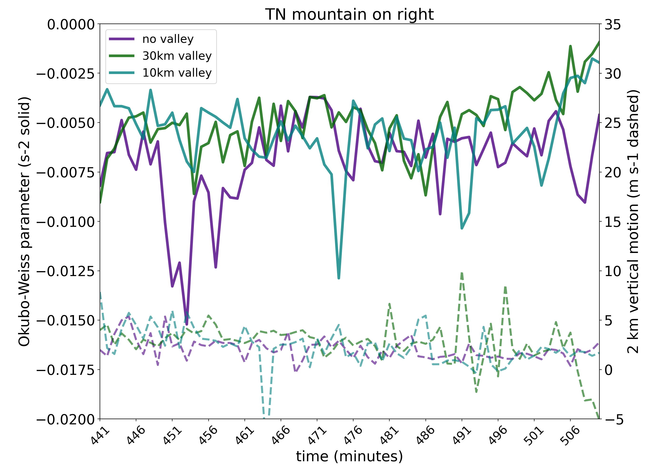
Upslope Moving Storms May Have an Increased Tornado Potential
Time series as storms move over mountain slope and valley; Analysis domain is 300 – 400 km in x-dimension and 135 – 165 km in y-dimension (focus on center of domain to include valleys)
Minimum Okubo-Weiss values are only near
-0.25 x 10⁻² s⁻² and the collocated 2 km vertical motion values are below 5 m s⁻¹
Minimum Okubo-Weiss values approach -1.5 x 10⁻² s⁻² but the collocated 2 km vertical motion values are still
below 5 m s⁻¹
solid line O-W
solid line O-W
dashed line 2 km vertical motion
dashed line 2 km vertical motion
time series of minimum Okubo-Weiss parameter at lowest model level & 2 km vertical motion at that location

Slide 21
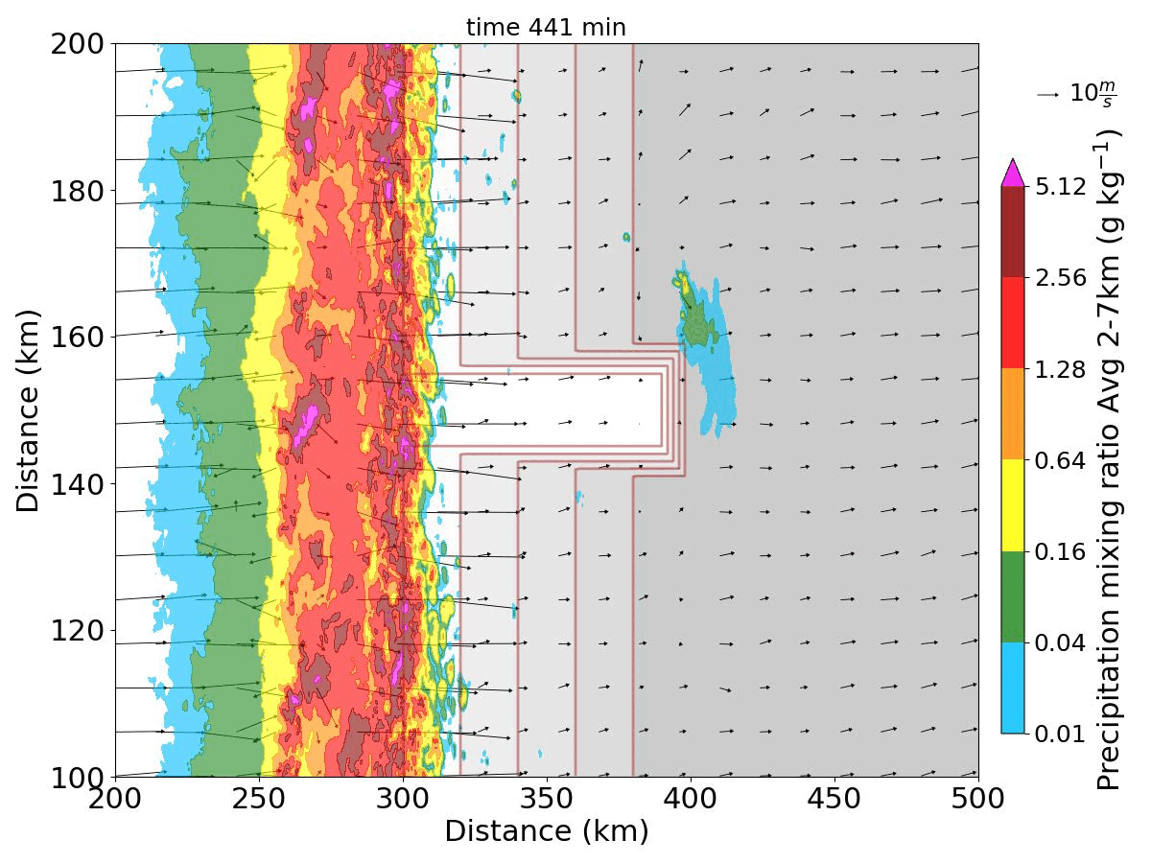
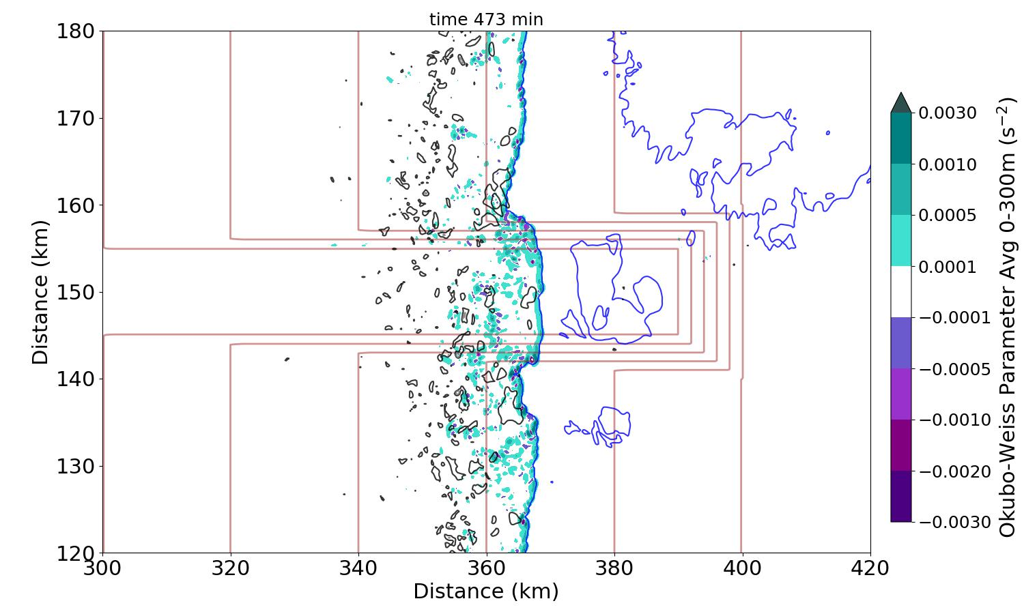
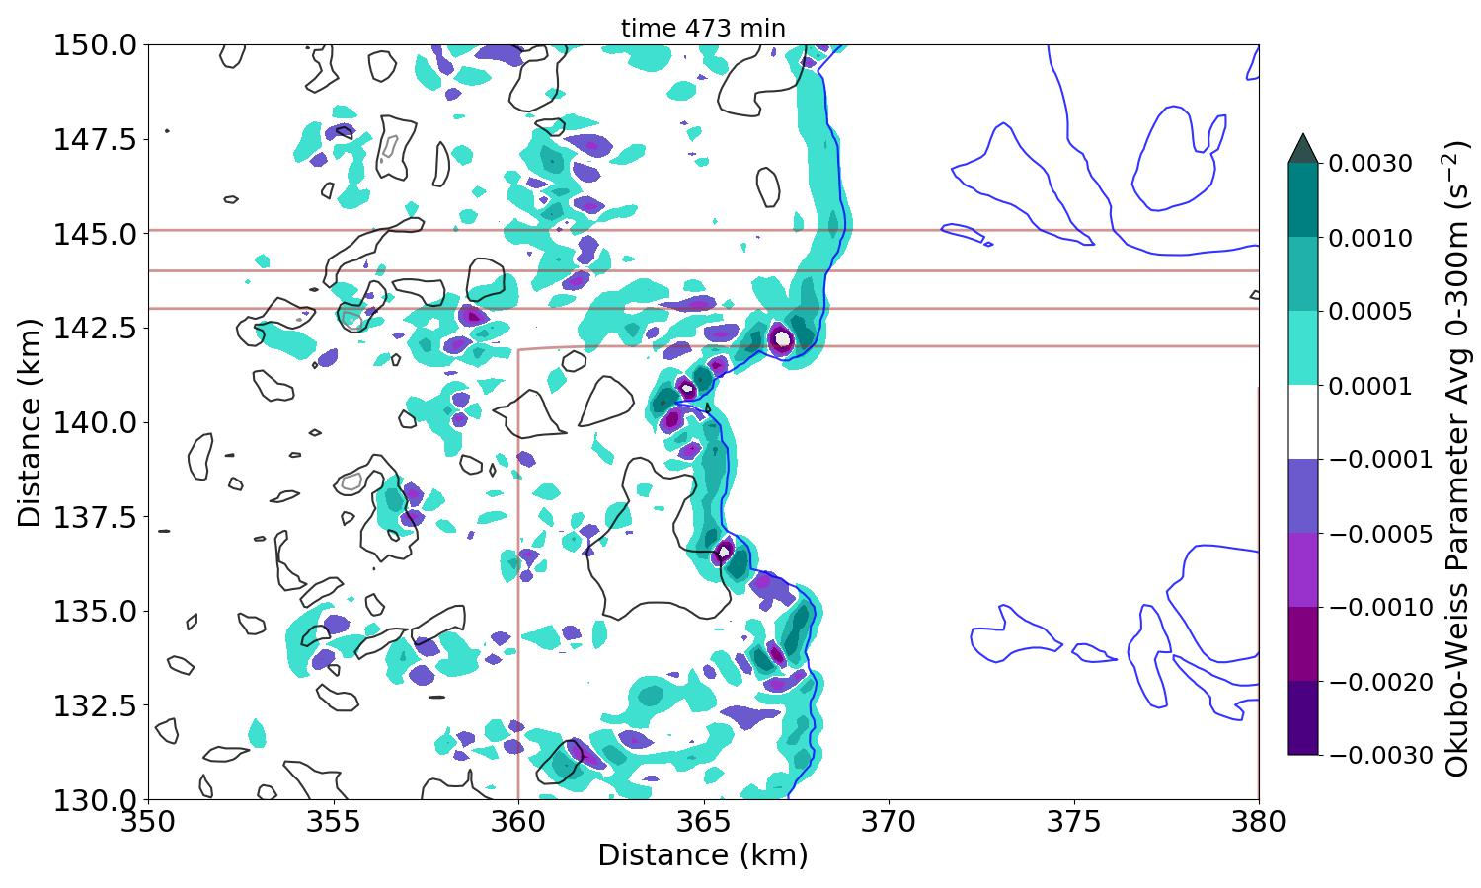
Decrease in Okubo-Weiss Associated with Cold Pool Acceleration
Okubo-Weiss minimum circulation centers form along the valley wall
Layer-averaged 0-300 m Okubo-Weiss values are below -0.3 x 10⁻² s⁻², but they form along the cold pool gust front away from the vertical motion
valley
sea level
plateau
0-300 m avg Okubo-Weiss (shaded), B (-0.01 m s⁻² blue), 2 km ascent (black, every 5 m s⁻¹) terrain (brown)
bowing of QLCS
in valley
valley
valley wall
upslope with
10 km valley
valley
upslope with
10 km valley
mountain slope
valley wall
mountain slope

Slide 22
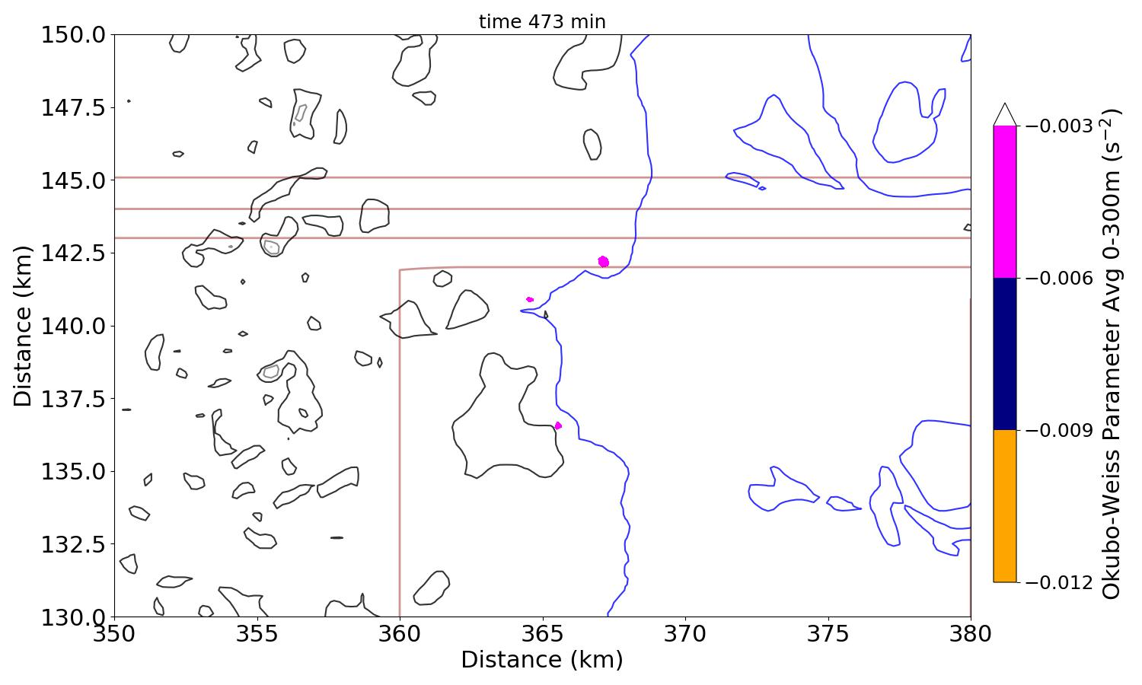
Decrease in Okubo-Weiss Associated with Cold Pool Acceleration
Okubo-Weiss minimum circulation centers form along the valley wall
Layer-averaged 0-300 m Okubo-Weiss values are below -0.3 x 10⁻² s⁻², but they form along the cold pool gust front away from the vertical motion
0-300 m avg Okubo-Weiss (shaded), B (-0.01 m s⁻² blue), 2 km ascent (black, every 5 m s⁻¹) terrain (brown)
bowing of QLCS
in valley
multiple centers
valley
valley wall
upslope with
10 km valley
valley
upslope with
10 km valley
mountain slope
valley wall
mountain slope
5 m s⁻¹ updraft

Slide 23
Vertical Wind Shear Experiments
Washington Post
ocean

Slide 24
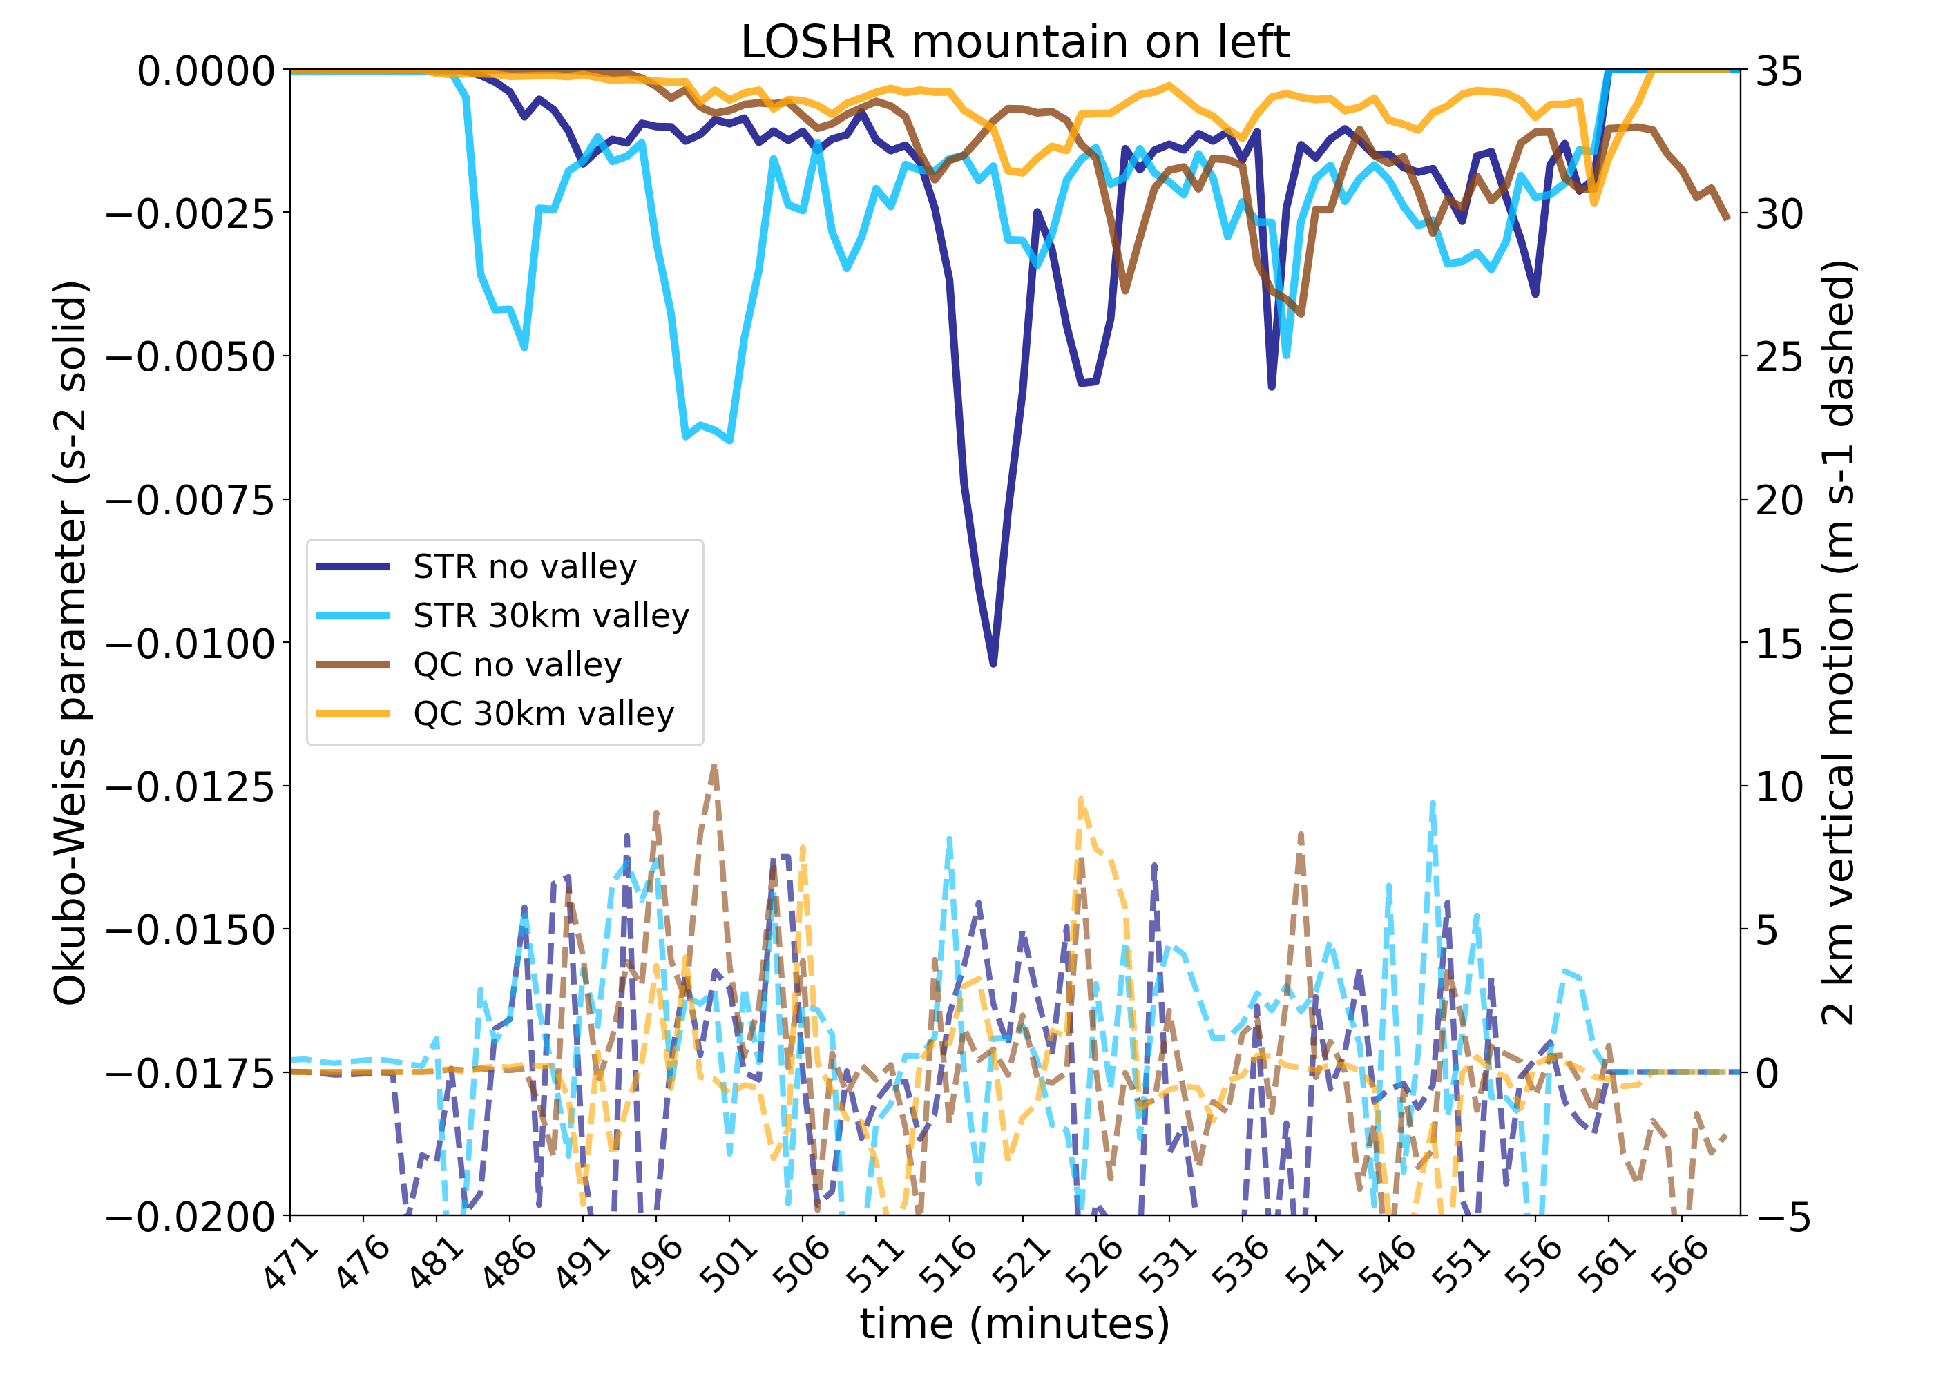
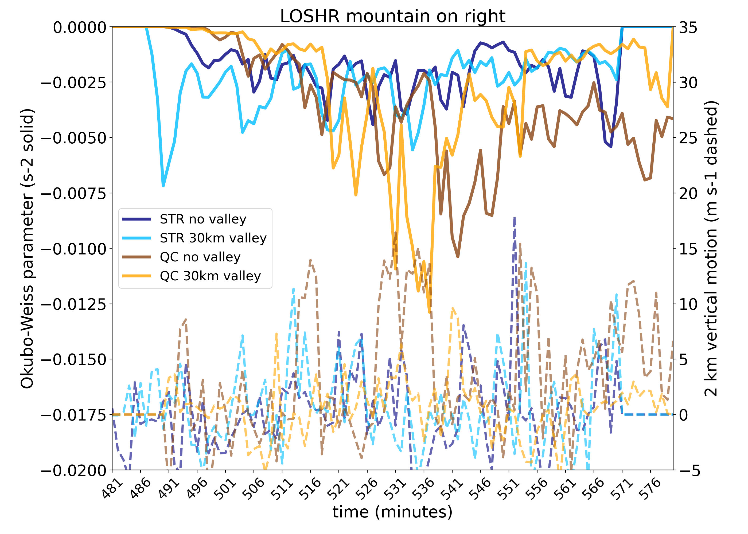
Minimum Okubo-Weiss Circulation Sensitive to Hodograph Curvature
For the straight hodograph with no curvature, Okubo-Weiss values are below -0.5x10⁻² s⁻² as the QLCSs descend the mountain slope, though the collocated 2 km ascent is small
Without curvature, O-W magnitudes are larger as storms descend the mountain slope
With curvature, Okubo-Weiss values are below -1.0x10⁻² s⁻² as the QLCSs ascend the mountain slope; 2 km vertical motion exceeds 10 m s⁻¹, though not collocated with O-W minima
With curvature, O-W magnitudes are larger as storms ascend the mountain
solid line O-W
solid line O-W
dashed line 2 km vertical motion
dashed line 2 km vertical motion
time series of minimum Okubo-Weiss parameter at lowest model level & 2 km vertical motion at that location

Slide 25


Closing Thoughts
Do mountains and valleys systematically enhance the potential for QLCS tornadogenesis?
Maybe.
Mountains impact the evolution of QLCSs, favoring the development of bowing lines/bookend vortices in some environments (may increase tornado potential)
From our experiments, the development of minimum Okubo-Weiss circulation centers may suggest that
tornado potential may increase for storms that ascend a mountain in environments with curved hodographs
tornado potential may increase for storms that descend a mountain in environments with straight hodographs
However, circulation and vertical motion values indicating the presence of tornado-like vortices are not found in our experiments thus far (analysis still ongoing)
Future work will assess if the above hypothesis is physically reasonable and if the physical processes are quantifiable
Thank you!
lombardo@psu.edu
@kannlombardo

