Slide 1
Toy statistical models applied to tornado forecasting
Harold Brooks
NOAA/NSSL
Harold.brooks@noaa.gov
@HEBROOKS87

Slide 2
Rationale
Help understand the “system”
Make simple predictions about changes
For yes/no, signal detection theory has been useful
Weight of evidence for binary decision via thresholding
Visualize on ROC, Performance diagrams

Slide 3
Signal detection theory
d'
d’ is a measure of
“science”, “technology”

Slide 4
Weight of evidence
d'

Slide 5
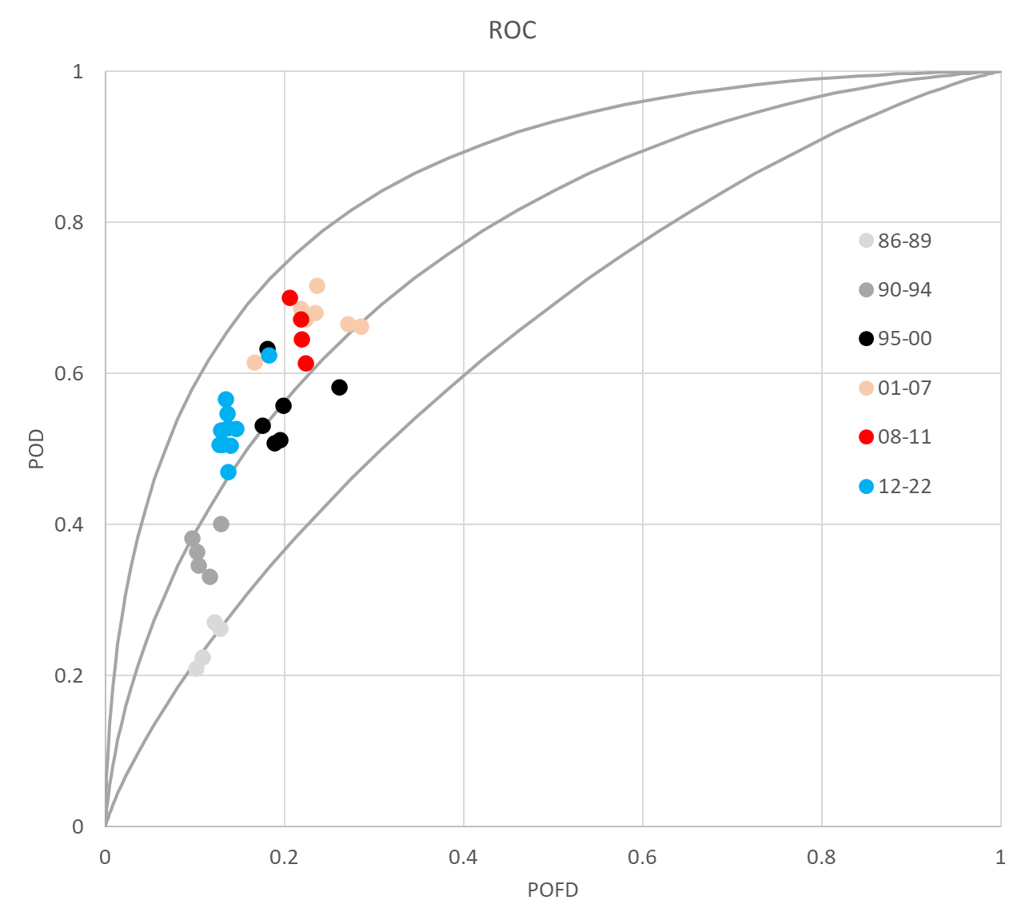
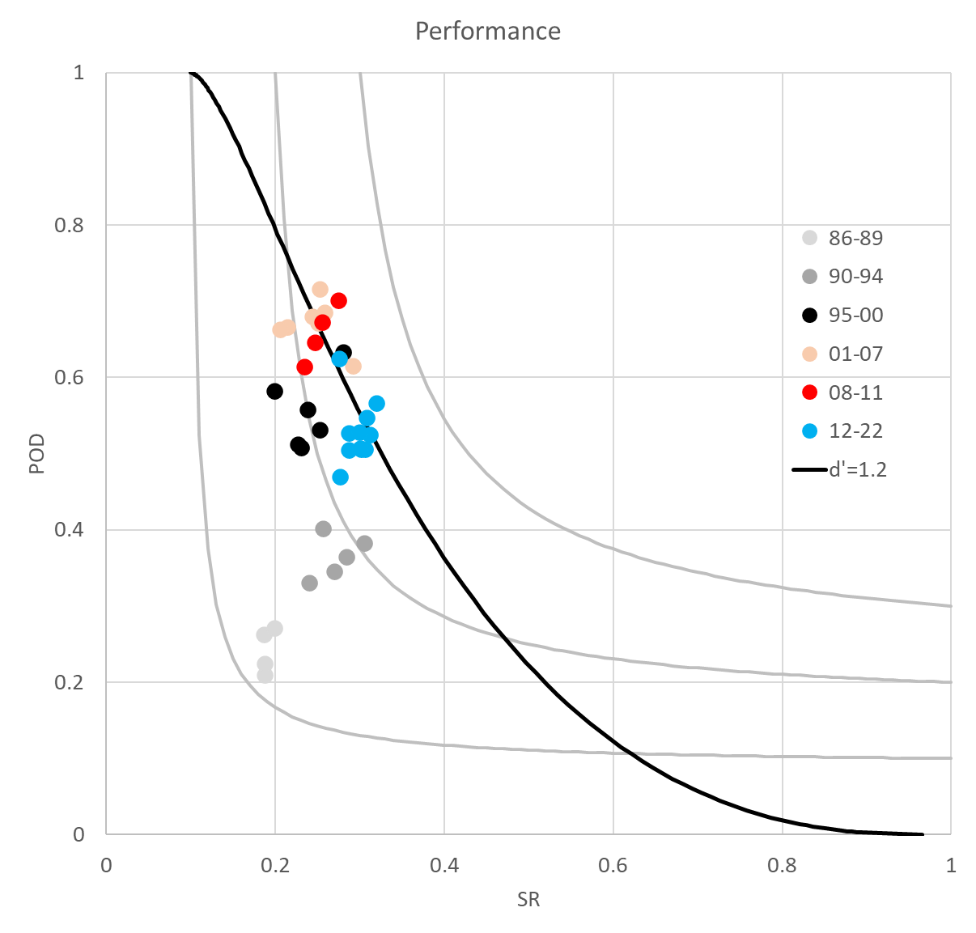

Slide 6
Trying to get probabilistic
Looking to future
Works with value-maximizing decision problems
SDT can’t directly separate distribution of forecasts and probability of event given forecast value

Slide 7
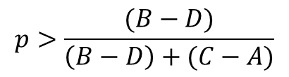
Simple Decision Rule
 |  | Event
 |  | Y | N
Forecast | Y | A | B
 | N | C | D
$$p>\frac{(B−D)}{\left(B−D\right)+(C−A)}$$
Misclassification Cost Ratio. Act if true
Current NWS warnings perform as if assuming this is 0.18

Slide 8
Two components
Generate distribution of forecasts from beta distribution

Slide 9
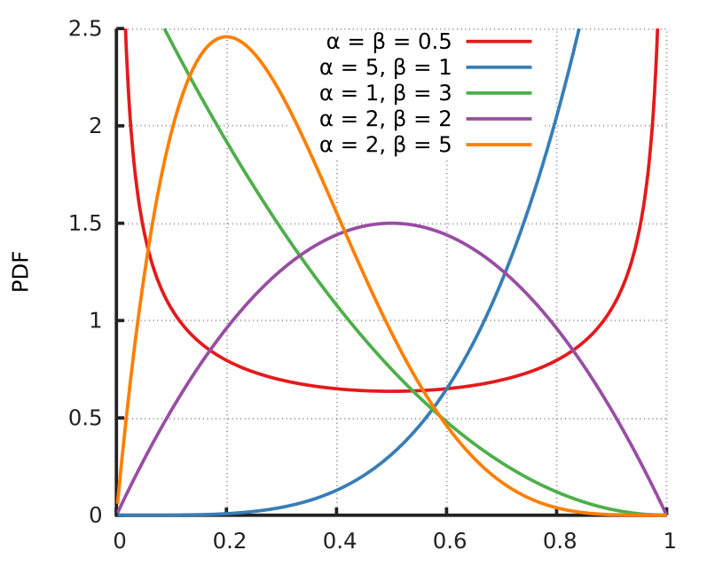

Slide 10
Two components
Generate distribution of forecasts from beta distribution
Event probability (p) modelled as p=f^{x}
Comes from examination of probabilistic rare event forecasts
Infinite number of lines, constrain by recent performance
Base rate of tornado|warning decision ~0.1

Slide 11
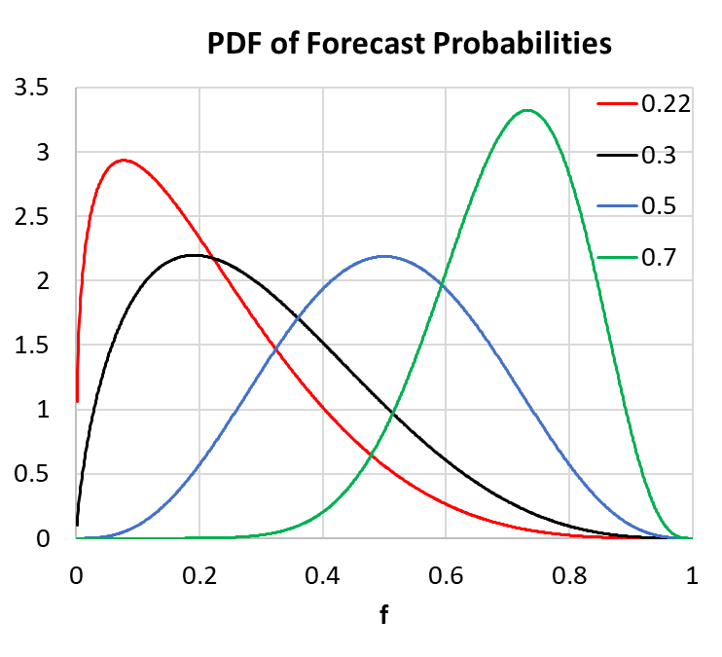
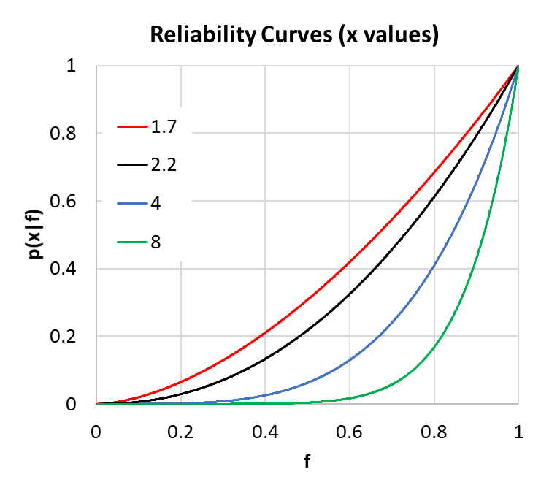

Slide 12
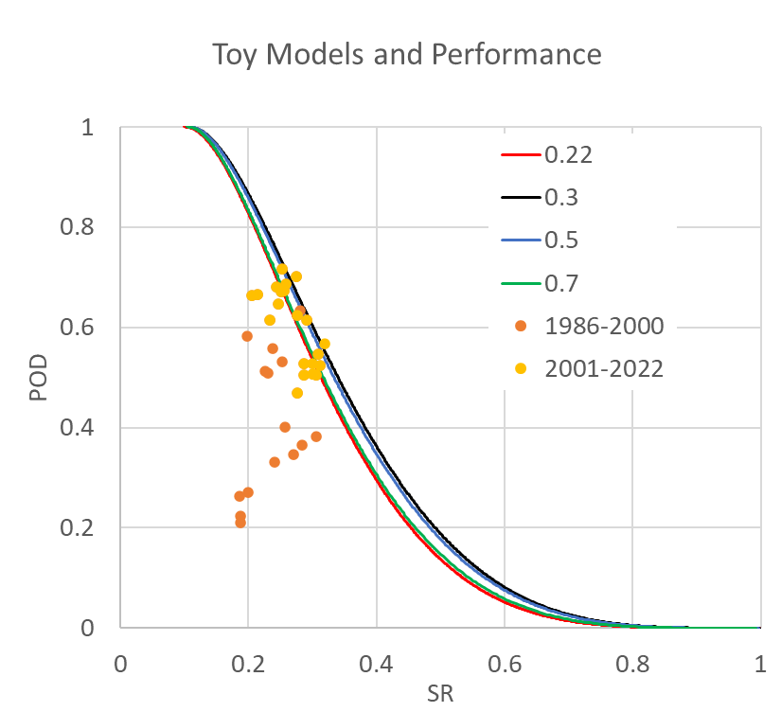

Slide 13
What do we currently look like?
Probability of tornado|warning = ~0.3
Howard et al. survey of business decisions implied they act like 0.75
Beta with mode near 0.19, x=2.2 comes closest
Maps back to a simple SDT model with d=1.21 and r (ratio of no variance to yes variance) of 1.12

Slide 14
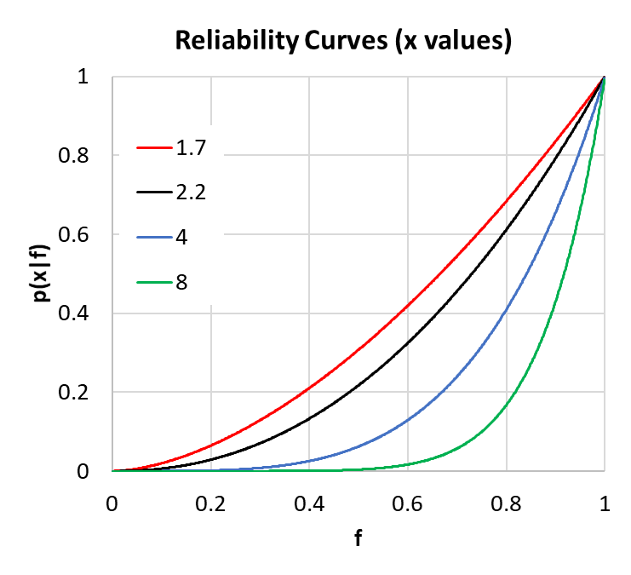
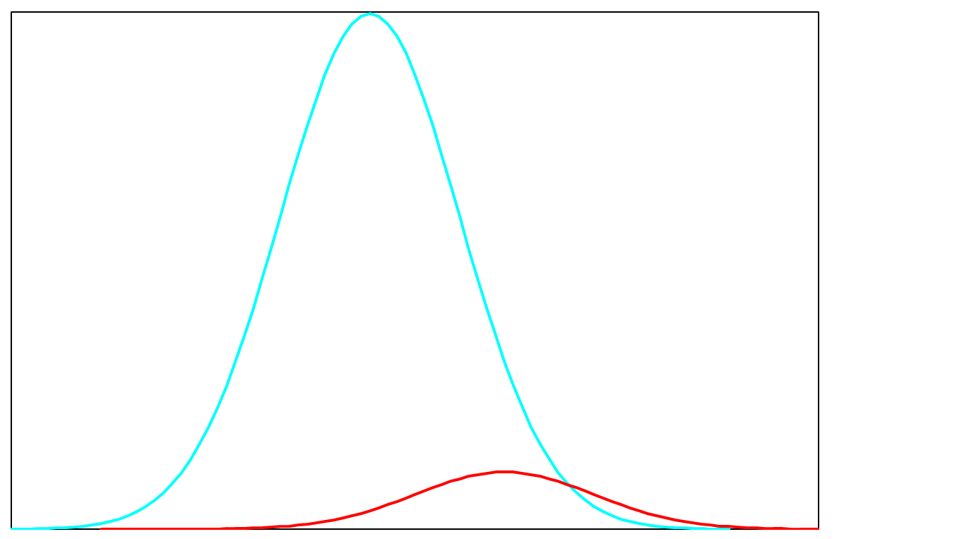
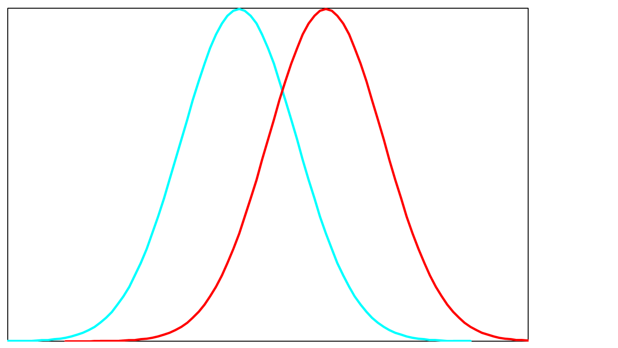
Different decision problems
Low base rate
(Bayesian prior)
High base rate
(Bayesian prior)

Slide 15
Implications
Probabilistic won’t change many decisions (most probability is above user “protect” threshold)
Experiments that have high prob (~0.8-0.9) warnings are very different than current practice

