Slide 1
On the Use of Helicity in Tornado Forecasting 11th ECSS (May 8-12 2023 Bucharest)
Robert Davies-Jones
Emeritus, National Severe Storms Laboratory
bobdj1066@yahoo.com

Slide 2
Theory & forecasting
In supercell theory, rotation & propagation are linked: "dynamically induced vertical pressure gradients ... force an updraft to propagate continuously toward a particular flank, thus allowing it to become well correlated with the vertical vorticity on that flank." (JAS 2000, p. 1453)
STP is a skillful tornado forecast parameter
It varies with storm-relative winds
Relies on predicted storm motion = a mean wind vector + a propagation vector (Bunkers et al., W&F 2000, p. 68)
Plugging storm motion formula into STP formula ➔ STP = mean-wind + propagation parts. In tornado situations, theory says propagation part should be significant. Is it?

Slide 3
Some definitions: Significant Tornado Parameter STP
STP < 1 predicts storms are nontornadic
Mean STP for supercells with significant tornadoes is 3.4
Dynamic STP = STP with thermodynamic factors =1 (to study just effects of dynamics)

Slide 4
Dynamic STP?
Dynamic STP = 0.01 SRH(0,1) x 0.05 BWD
Storm-relative helicity is
where c is storm motion vector &
is vorticity vector (90° left of shear)

Slide 5
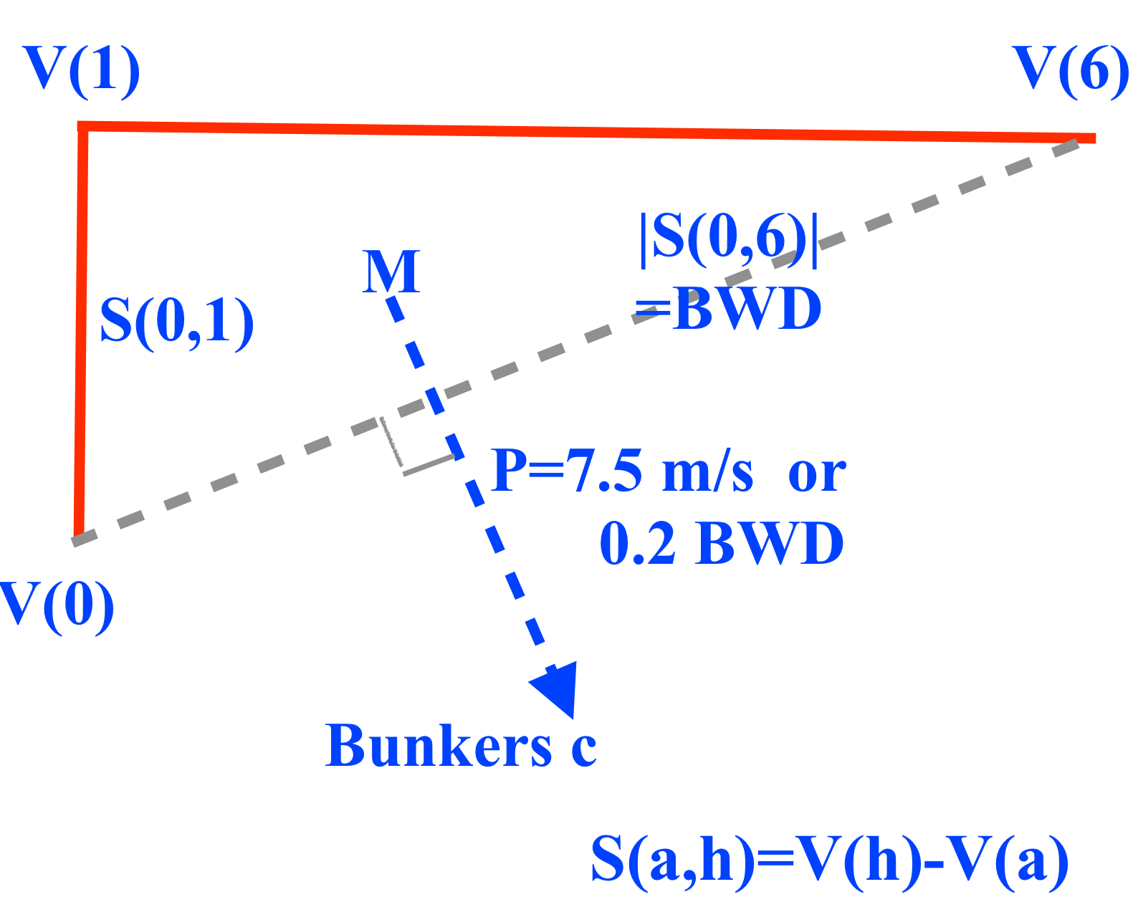
(amended)

Slide 6
Bunkers propagation P & storm motion c for RM?
Propagation away from mean wind is
where is mean wind from 0 to 6 km AGL
Deviation from mean wind is
Storm-relative wind decomposes into V' & –P:

Slide 7
Amended storm motion
To make |P| scale invariant (scale with size of hodograph), set |P| ~0.2 BWD, not 7.5 m/s
Amended storm motion is
Amended propagation vector is
For BWDs herein (35-38 m/s), 0.2 BWD = 7 to 7.6 (close to 7.5) & amended storm motion does not change conclusions

Slide 8
Mean-wind (MWH) & propagation helicity (PH)
Insert c formula into SRH formula
MWH is SRH if storm moved with mean wind
SRH(a,h) = MWH(a,h) + PH(a,h)
Layers add: SRH(0,h) = SRH(0,a) + SRH(a,h)
MWH(0,1) can dominate PH(0,1)
Since BWD is independent of c, STP also decomposes into MWH & PH parts

Slide 9
Formula for PH
Performing integration in the PH term results in
Substituting for P & specifying layer ➔
When S(0,6) is ⊥ to S(0,1), PH(0,1) is zero.
2 proximity & 7 idealized hodographs show that PH(0,1) < MWH(0,1) in tornado situations

Slide 10
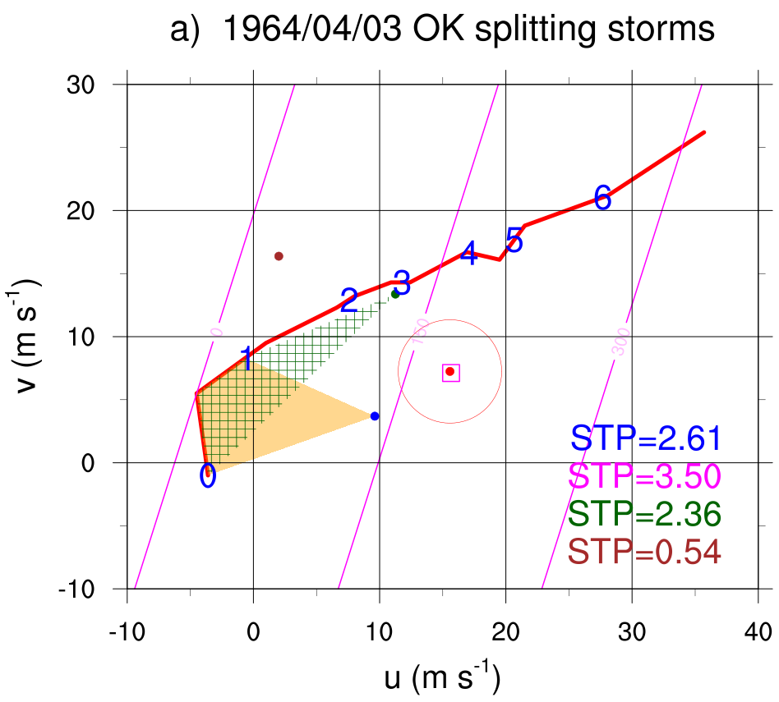
bent hodograph in proximity of violent short-track (9 km) tornado
circle is Bunkers
mean absolute
error (4 m/s)
LM
orange: SRH(0,1)
green: MWH(0,1)
magenta: helicity
contours H(c)
MW
B
BWD= 38 m/s
RM
right mover
Bunkers
mean wind
> 0
left mover
surface ϖορτιχιτψ more
streamwise for RM
0
150
300

Slide 11
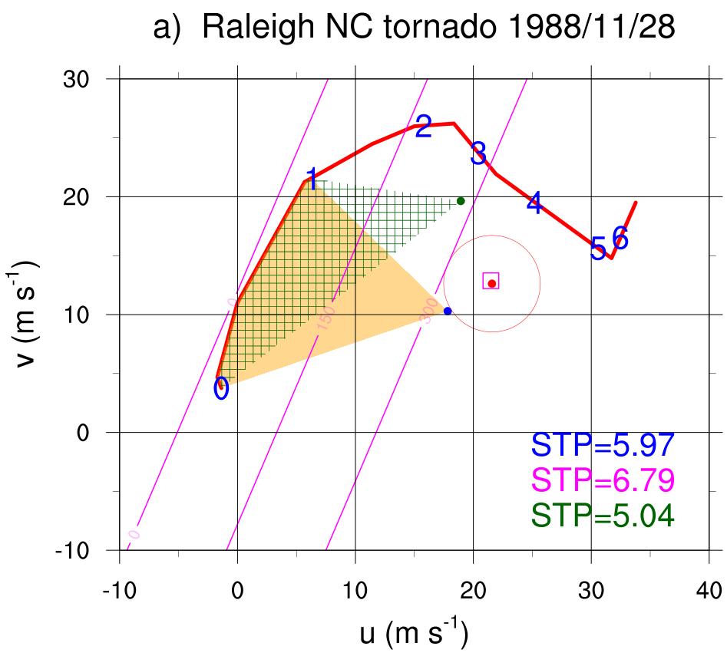
long-track (133 km) violent tornado; ~semicircular hodo from 0 to 5 km
MW
B
RM
BWD=36 m/s
RM
Bunkers
MW
0
150
300
surface ϖορτιχιτψ more
streamwise for RM

Slide 12
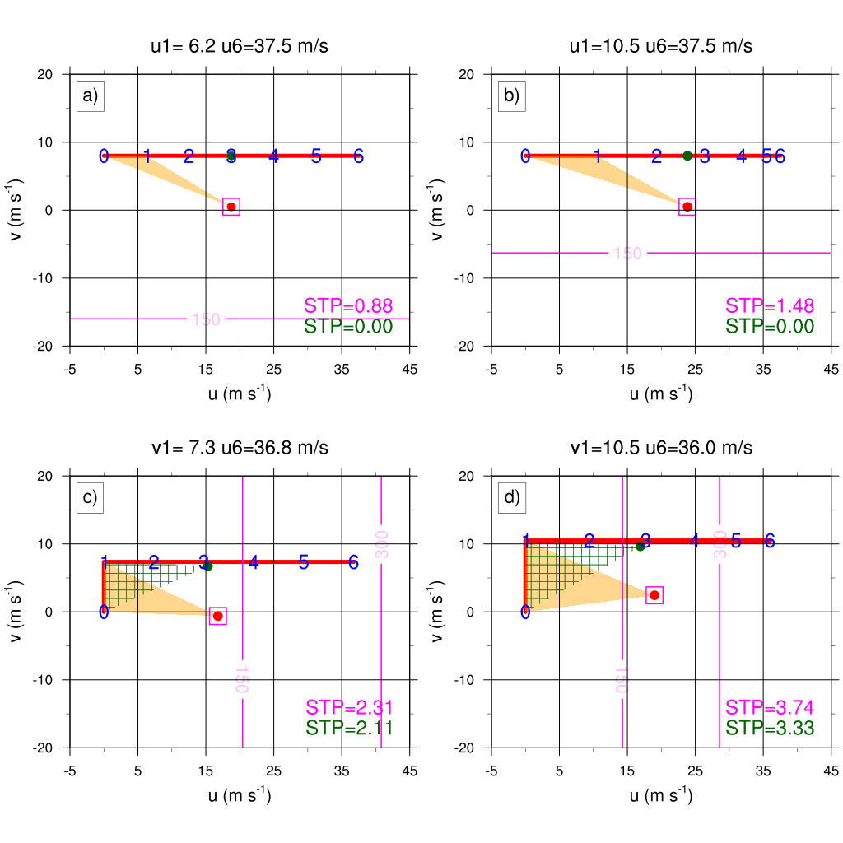
straight, S(z) constant
straight, S(z) decreasing
least SRH (0,1)
& STP
surface ϖορτιχιτψ more
streamwise for RMs
90° bend at 1 km, |S(z)| constant
90° bend at 1 km, |S(z)|decreasing
most SRH(0,1)
& STP
BWD = 37.5 m/s

Slide 13
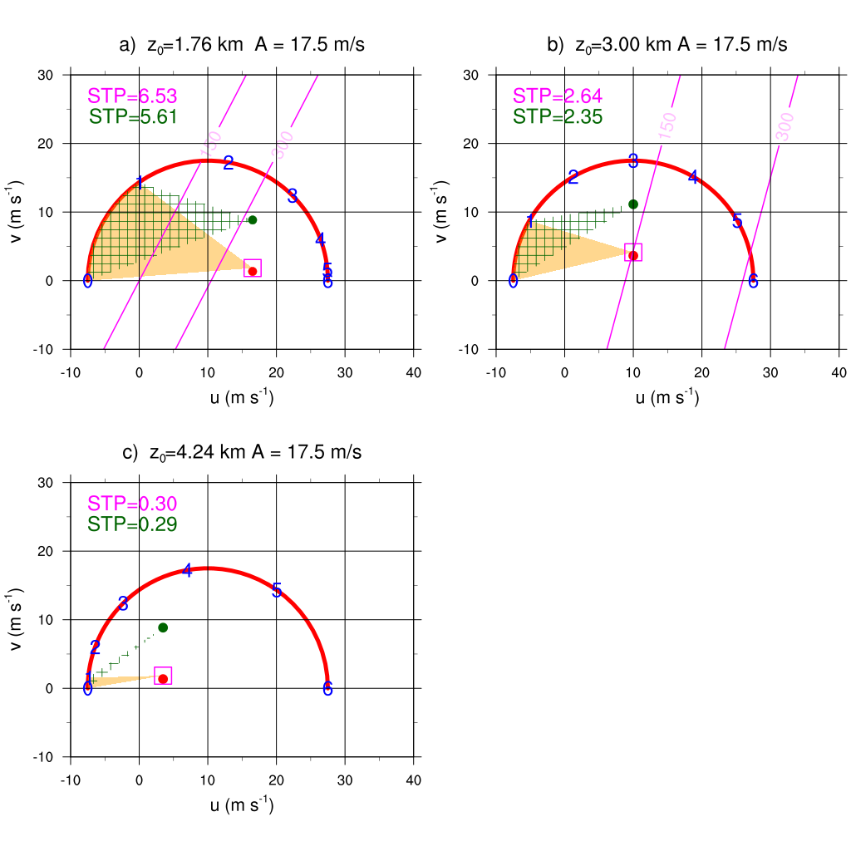
SRH density
uniform
with height
Most STP.
Most SRH
density near
ground
0 – 6 km semicircles
BWD = 35 m/s
|S(z)| decreasing
|S(z)| constant
|S(z)| increasing with z
Least STP.
Least SRH
density near
ground
surface ϖορτιχιτψ more
streamwise for RMs

Slide 14
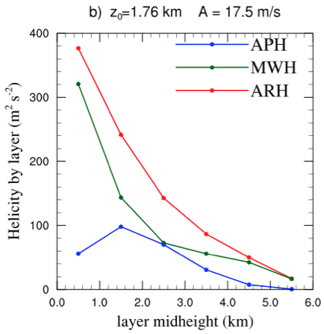
HELICITIES BY LAYERS
(0-1, 1-2, ... , 5-6 km)
for semicircle hodo with decreasing shear
PH < MWH
SRH
Most helicity is in 0-1 layer.
Most of this is MWH.
0-1
1-2
2-3

Slide 15
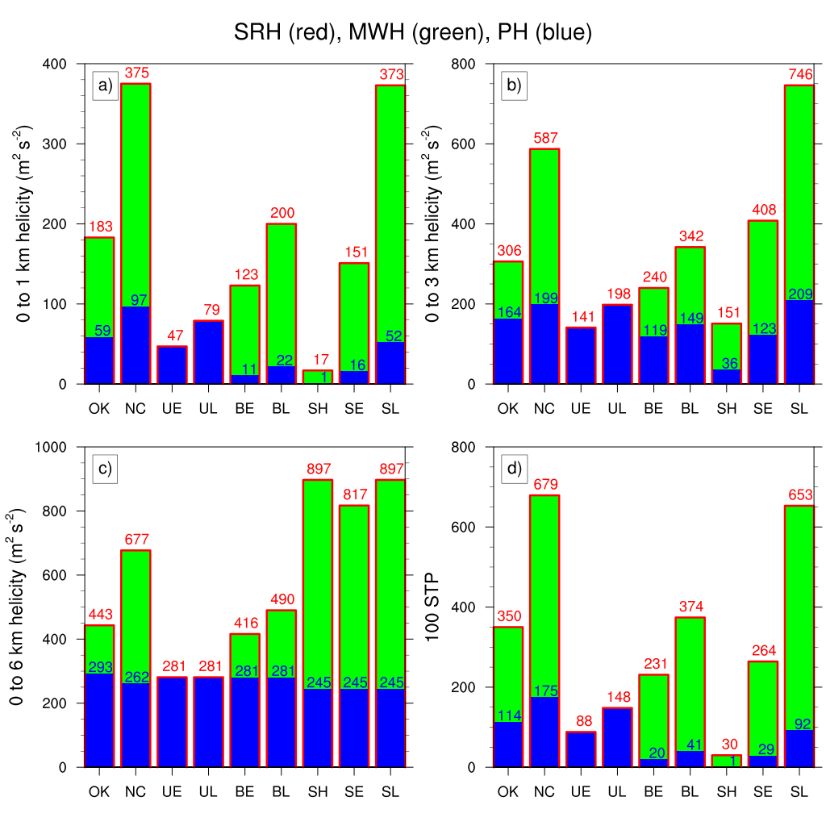
COMPILATION
9 HODOGRAPHS
0 - 1 km
0 - 3 km
PH(0,1) =
0.2 S(0,1)•S(0,6)
is small.
PH (blue) << MWH (green)
Exception is MWH = 0 for straight hodo
0 - 6 km
100 STP
[similar to a)]
PH(0,6) =
0.2 BWD²
is substantial.

Slide 16
SUMMARY 1
MWH dominates PH in tornado situations
Since I hardly vary BWD, dynamical STP is determined by SRH(0,1) = MWH(0,1) + PH(0,1)
For proximity, bent & semicircular hodographs, MWH(0,1) >> PH(0,1). Updrafts would be helical even without propagation.
For semicircles, MWH(0,h) >> PH(0,h) for all h
For bent hodos, MWH >> PH below bend [& MWH << PH above bend]
For unreal straight hodographs (no Ekman layer), MWH = 0 & updraft rotation depends only on PH

Slide 17
SUMMARY 2
STP predicts the following tornado threats:
Hodograph-shape effect :
Straight = low risk,
Bent = moderate risk,
Semi-circular = high risk.
Shear-profile effect: For hodographs with same shape & BWD, threat increases with concentration of shear magnitude in lowest 1 km
But STP fails to predict anticyclonic updraft rotation of left mover (STP should be –ve)

Slide 18
SUMMARY 3
Is Bunkers propagation represented in STP?
No! Because, in tornado situations, P is nearly || to S(0,1) & STP is then insensitive to prop. speed |P|
Two propagation effects not represented in STP:
Propagation helicity PH(0,h) is more significant for deeper layers than (0,1). SRH over a deeper layer would make STP < 0 for left mover as expected.
Propagation typically makes horizontal vorticity at z = 0 more (less) streamwise for right (left) mover

