Slide 1


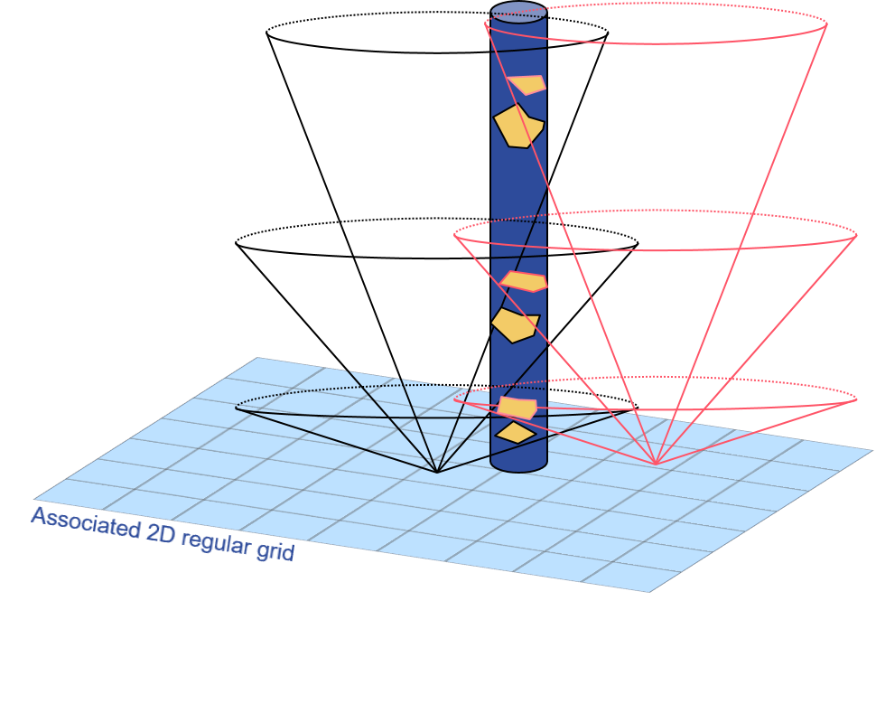
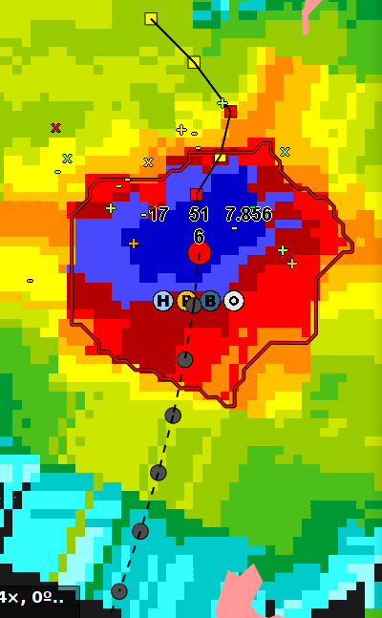
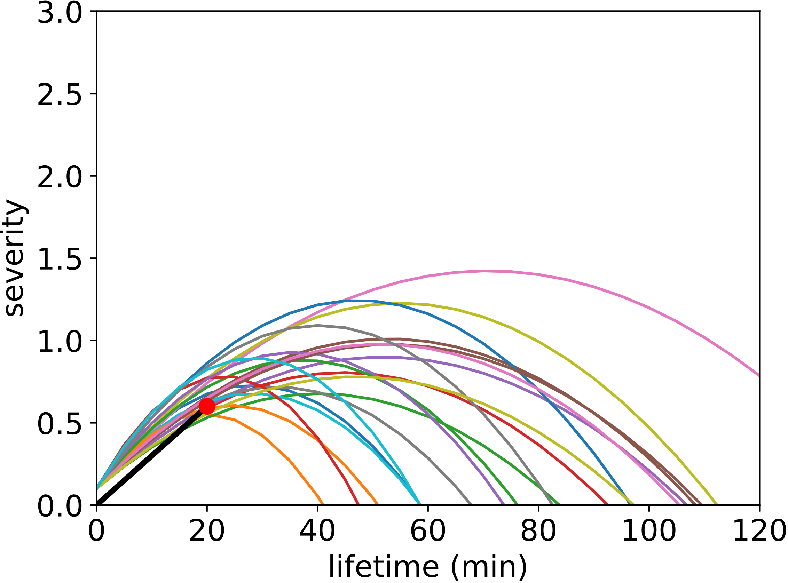
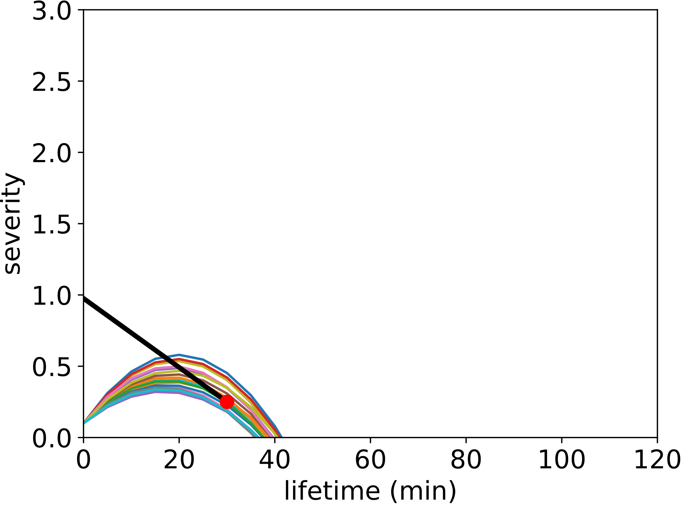
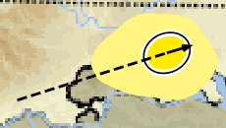
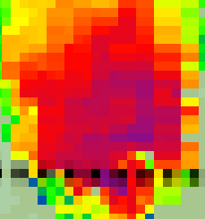
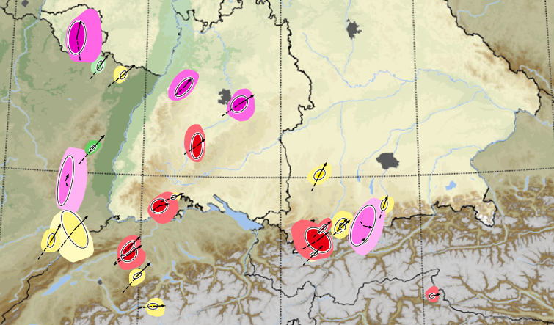
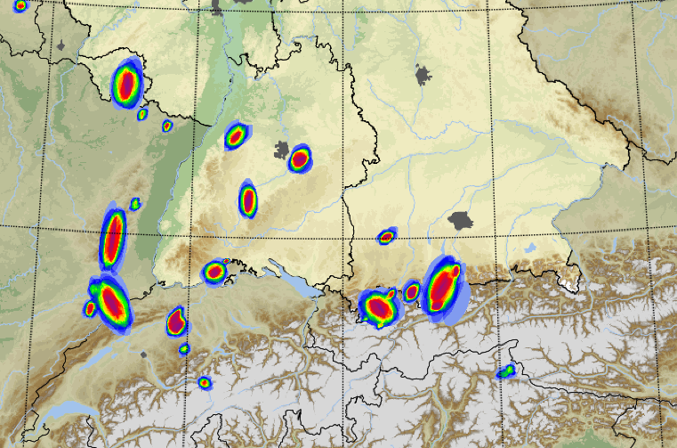
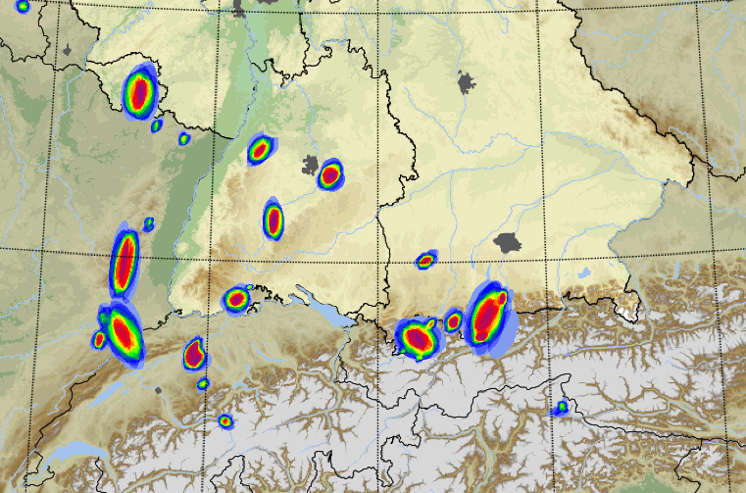
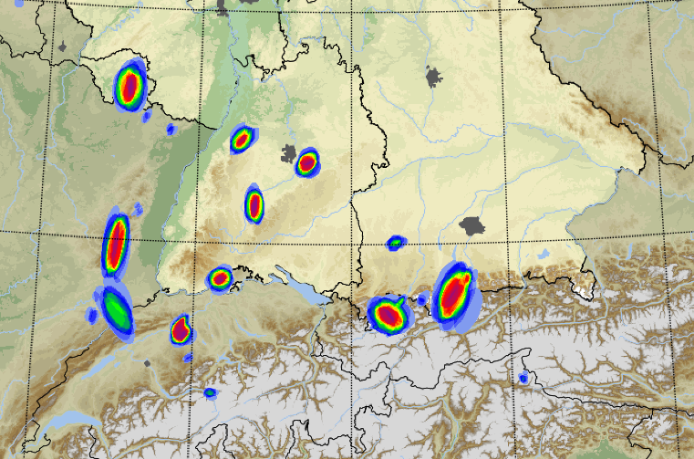
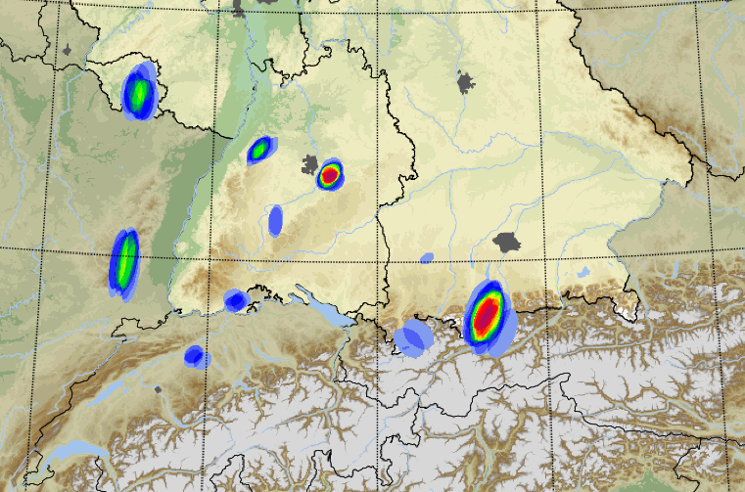
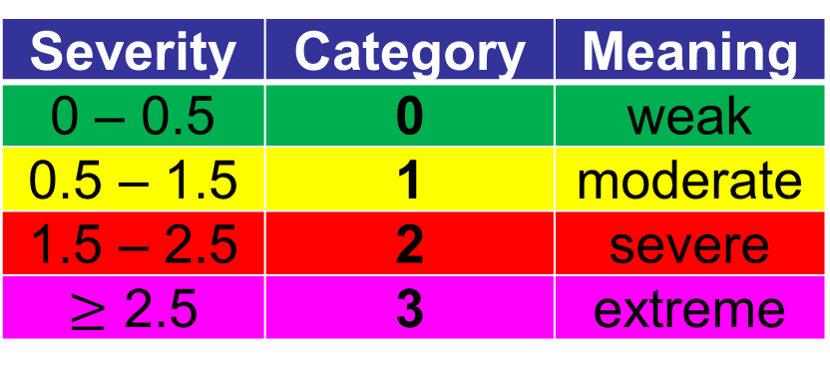

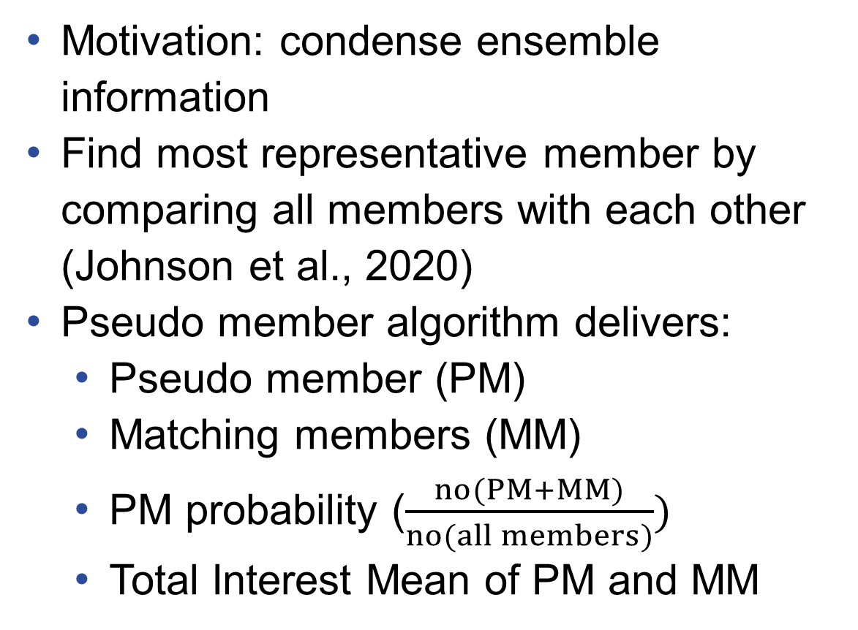
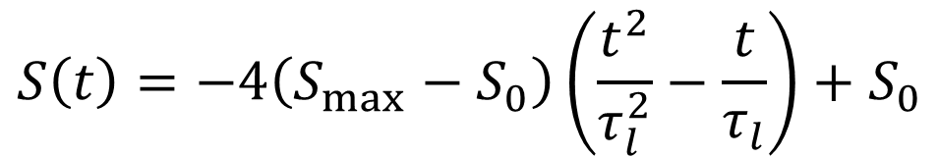
11th European Conference on Severe Storms (ECSS)
Bucharest, Romania
8 – 12 May 2023
Object-Based Ensemble Prediction System KONRAD3D-EPS
Lukas Josipović, Gregor Pante, Isabel Schnoor, Andreas Brechtel, Ulrich Blahak
Seamless INtegrated ForecastiNg sYstem
Pilot project to integrate numerical weather prediction (NWP) and nowcasting techniques into a new ensemble-based forecasting system
Focus on severe summertime convective events
Forecast range up to 14 hours
At Deutscher Wetterdienst (DWD), convective cells are detected and tracked by KONRAD3D. This radar-based algorithm predicts future storm positions up to 1 hour forecast time by extrapolating the current cell advection. Storm intensification or weakening predictions are not included until now. Here, we aim at extending KONRAD3D towards an EPS in order to predict cell life cycles and capture nowcast uncertainties.
www.dwd.de/sinfony
Introduction and Objectives
Correction of Nowcast of Redetected Cells
Object-Based Nowcasting
Deterministic object detection, tracking and forecasting system
Uses 3D volumetric radar data (10 elevations and near surface scan)
3D storm characterization with attributes regarding geometry, intensity, movement, hydrometeors, lightning
Short-term forecast of future positions by extrapolation of cell movement
Ensemble-Kalman-Filter Correction
Applied for cell position and movement
According to Hunt et al. (2008)
With covariance inflation (Li et al., 2009)
Trend Fitting of Parabolas
Applied for maximum severity and lifetime
Fitting parabolas to the observed severity trend of the last 15 min
(a)
(b)
Figure 1: Schematic illustration of KONRAD3D vertical structure and cell polygon including cell severity and warn flags for hail, gusts, and heavy rain.
Figure 5: Fitting severities to observed trends (black lines). Currently observed severity indicated by red dot. Examples for:
intensification.
weakening.
Deficiencies
No forecasts of storm intensification or weakening until now
Nowcast uncertainties not captured
Objective
Ensemble prediction of cell life cycles with regard to nowcast uncertainties in positions, movement, intensity and lifetime
Pseudo Members
Motivation: condense ensemble information
Find most representative member by comparing all members with each other (Johnson et al., 2020)
Pseudo member algorithm delivers:
Pseudo member (PM)
Matching members (MM)
PM probability ($\frac{no(PM+MM)}{no(all members)})$
Total Interest Mean of PM and MM
Cell track between observed and predicted position
Predicted pseudo member position
Observed position
Predicted cell motion
Ensemble Initialization
Convex hull around the matching members
Figure 6: Schematic of PM illustration in KONRAD3D-EPS. Colors indicate PM severity, lightness of PM and convex hull indicates PM probability, length of motion arrow indicates cell speed.
Cell Position, Movement, Severity
Output of KONRAD3D as ensemble mean
Statistically tuned observation variances for assessment of uncertainty
Lifetime, Maximum Expected Severity
Fitting theoretical probability density distributions to empirical distributions of lifetime and maximum expected severity
Draw members from those distributions
20 ensemble members per cell in total
Visualization
Figure 2: Stochastic ensemble of cell positions of a detected KONRAD3D cell.
(a)
(b)
severity ≥ 0
severity ≥ 1
lifetime (min)
maximum severity
Figure 3: Empirical (grey bars) and theoretical (red lines) PDFs for:
lifetime (Log-normal)
maximum expected severity (Gumbel)
Figure 7: Pseudo members of convective cells.
S Germany, June 30th, 2022, 1510 UTC
+ 30 min forecast time.
severity ≥ 2
severity ≥ 3
Forecasts up to 120 min in steps of 5!
Update frequency: 5 min!
Figure 8: Cell cover probabilities depending on their severity. S Germany, June 30th, 2022, 1510 UTC + 30 min forecast time.
Prediction of Cell Attributes
Verification
Assumptions
Cells move with constant speed
Life cycle of cell intensity is parabolic
Noise added to cell predictions to simulate random disturbances
Cell Severity
Severity prediction is main goal of KONRAD3D-EPS
KONRAD3D cell severity depends on:
Cell-based VIL
Vertical extent of Z_{h} $≥$ 55 dBZ
Heavy Rain Potential
Max. Z_{h} of cell
Cell mass:$\log_{10}\left(\int_{V_{cell}}{Z_{h}}dV\right)$
Init. with normal distributions
Init. with fitted distributions
→ Precise estimation of initial distributions has large impact on quality of nowcast results!
Cell lifetimes (min)
Figure 9: Difference of KONRAD3D-EPS predictions and KONRAD3D observations:
cell lifetime.
maximum estimated severity.
This EPS-version used EnKF for parabola correction!
Figure 4: Mean temporal development of convective cell severity from April to September 2019.
$$S\left(t\right)=−4\left(S_{max}−S_{0}\right)\left(\frac{t^{2}}{τ_{l}^{2}}−\frac{t}{τ_{l}}\right)+S_{0}$$
Outlook
max. and init. severity
lifetime
Severity | Category | Meaning
0 – 0.5 | 0 | weak
0.5 – 1.5 | 1 | moderate
1.5 – 2.5 | 2 | severe
$≥$ 2.5 | 3 | extreme
Evaluations @ Testbed 2023 and @ DWD
Combination with simulated convective cells (see poster P29 of Schnoor et al.!)
Use of ML to exploit environmental conditions (see poster P1 of Josipović et al.!)
Development of probabilistic warning flags for gusts and hail
Deutscher Wetterdienst, Remote Sensing Application Development
Lukas Josipović, Lukas.Josipovic@dwd.de

