Slide 1


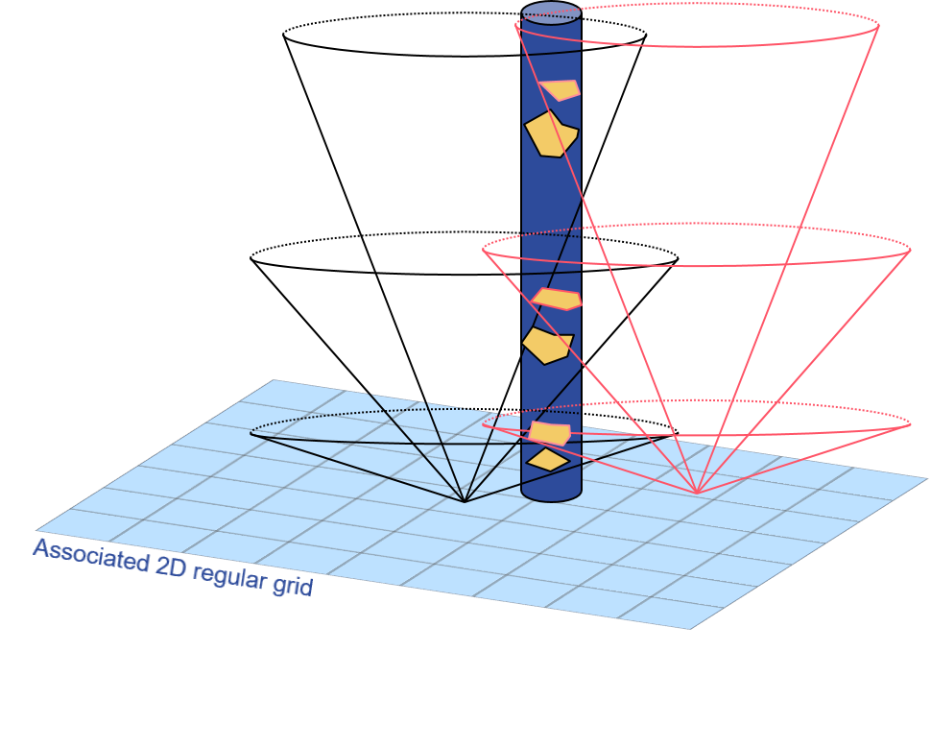
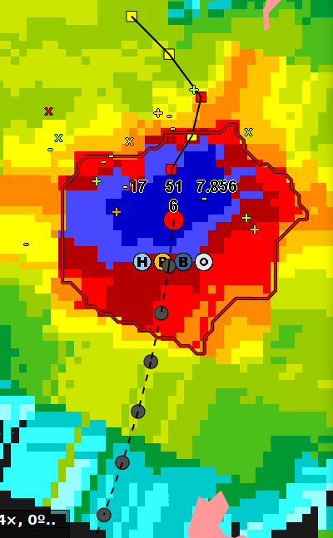
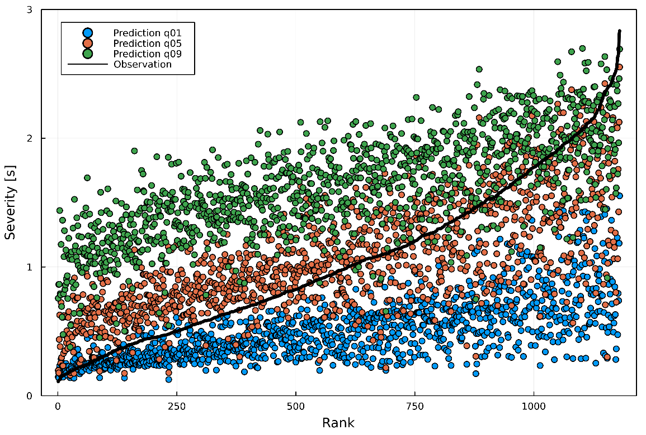
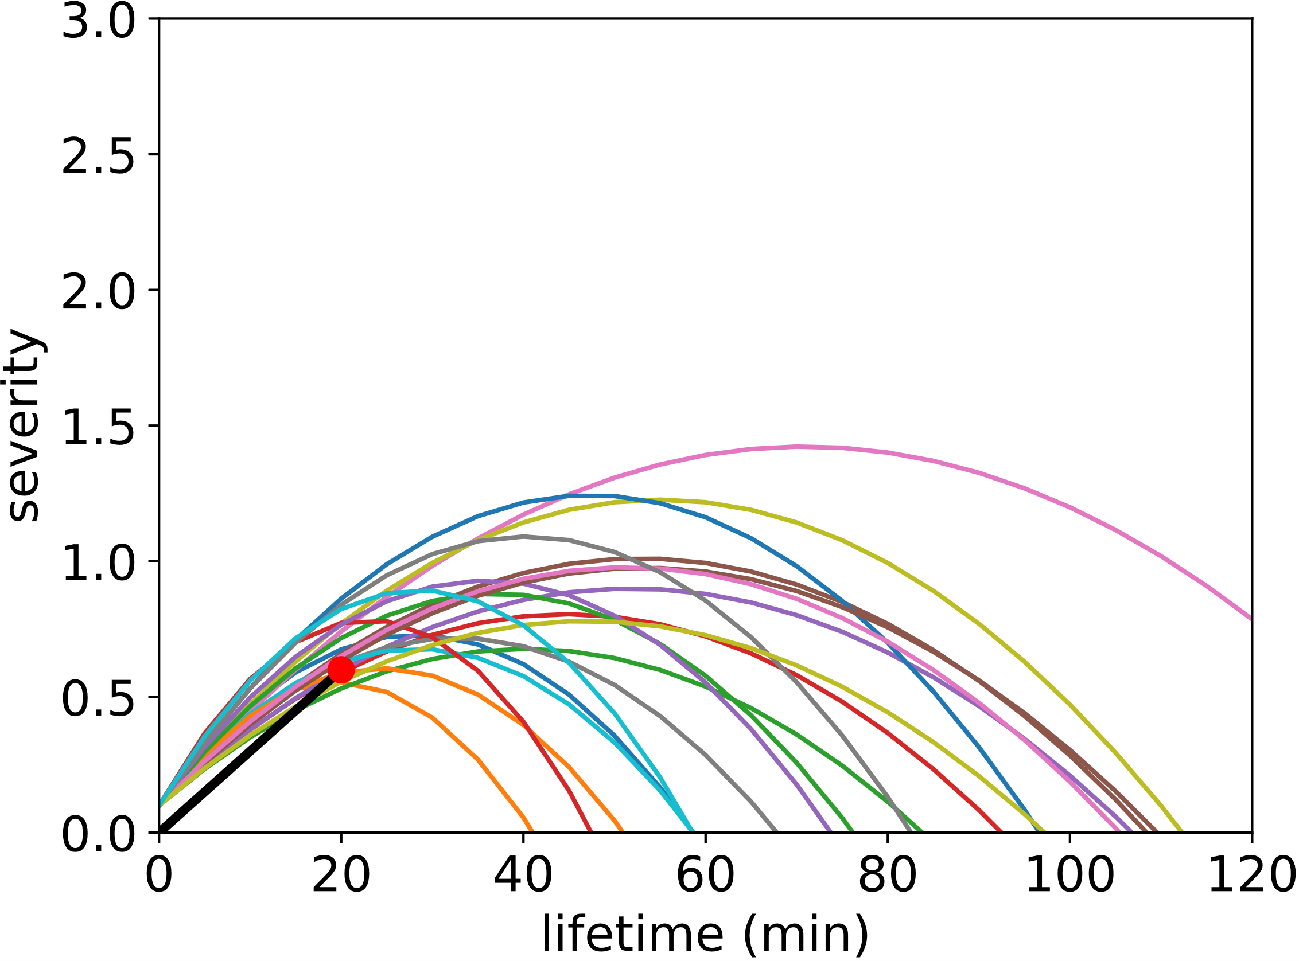
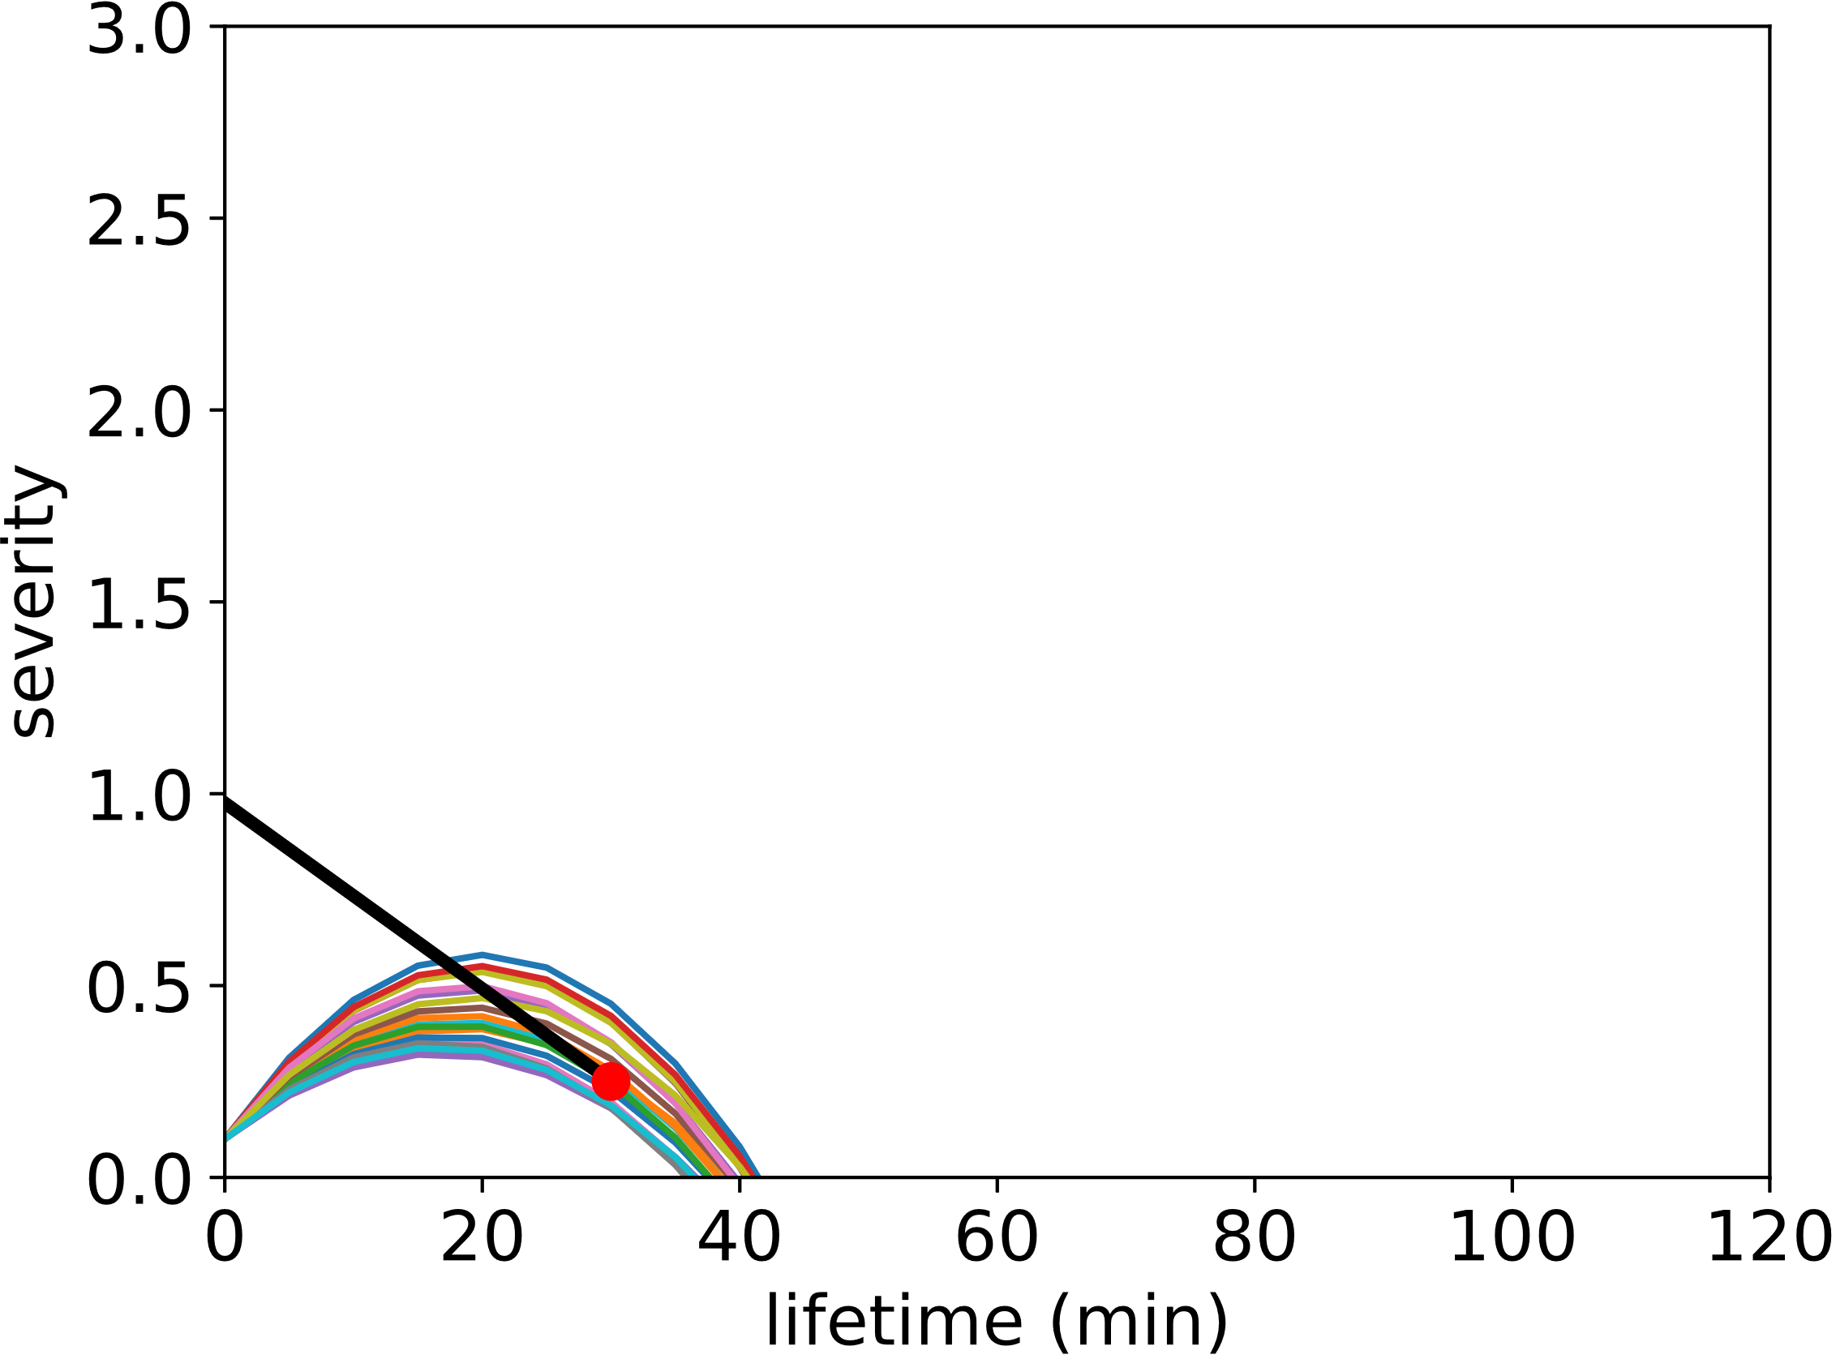
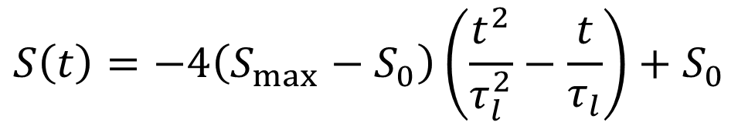
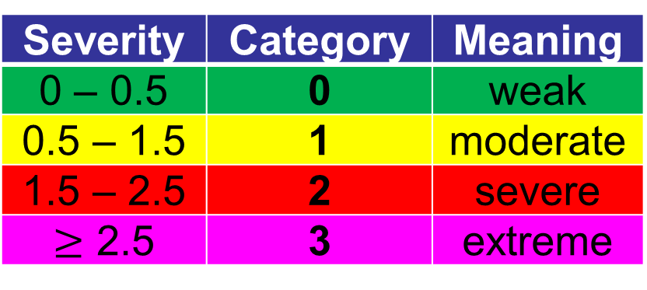

11th European Conference on Severe Storms (ECSS)
Bucharest, Romania
8 – 12 May 2023
Estimation of storm life cycle by machine learning to enhance ensemble nowcasting of cells
Lukas Josipović, Christian Berndt, Ulrich Blahak
Seamless INtegrated ForecastiNg sYstem
Pilot project to integrate numerical weather prediction (NWP) and nowcasting techniques into a new ensemble-based forecasting system
Focus on severe summertime convective events
Forecast range up to 14 hours
At Deutscher Wetterdienst (DWD), convective cells are detected and tracked by KONRAD3D. This radar-based algorithm predicts future storm positions up to 1 hour forecast time by extrapolating the current cell advection. Storm intensification or weakening predictions including uncertainties are provided by the ensemble prediction system KONRAD3D-EPS. Here, we aim at extending this EPS with Machine Learning (ML) methods to use storm properties from recalculation data to improve nowcasts.
www.dwd.de/sinfony
Introduction and Objectives
Machine Learning Procedure
Object-Based Nowcasting
Deterministic object detection, tracking and forecasting system
Uses 3D volumetric radar data (10 elevations and near surface scan)
3D storm characterization with attributes regarding geometry, intensity, movement, hydrometeors, lightning
Short-term forecast of future positions by extrapolation of cell movement
Methodology
Prediction after 0, 15, 30, 45, 60 min during life-cycle
Random Forest (RF), Gradient Boosting (GB), Quantile Regression
10-fold cross validation (CV) to assess prediction performance
Target Variables
Lifetime of singular cells (cells with splits and merges excluded)
Maximum expected severity of singular cells
Predictors
Recalculation of KONRAD3D from May 2016 to December 2021
Storms linked to NWP data (ICON-EU) to consider convective environment
Approximately 100 cell attributes used as predictors
Figure 1: Schematic illustration of KONRAD3D vertical structure and cell polygon including cell severity and warn flags for hail, gusts, and heavy rain.
Deficiencies
No forecasts of storm intensification or weakening until now
Nowcast uncertainties not captured
Objective
Ensemble prediction of cell lifecycles with regard to nowcast uncertainties in positions, movement, intensity and lifetime
Machine Learning Results
Lifetime
Poor cross validation scores
Minor improvement compared to constant mean value prediction
Maximum Expected Severity
Better cross validation scores
Improvement compared to persistence forecast
Large prediction uncertainty requires the use of quantile regression
Direct classification of categorical severity delivers similar results
Example: 26th August 2022
Figure 4 shows 10%, 50%, and 90% quantile predictions with respect to corresponding observations
Quantile Regression Gradient Boosting (QR-GB) delivers a larger uncertainty for events with higher severity
Prediction uncertainty is plausible
Large lifetime uncertainty (not shown)
Table 1: CV results for lifetime prediction
Age | Method | MAE | NRMSE | R2
0 | Random Forest | 12.440 | 0.810 | 0.033
15 | Random Forest | 13.373 | 0.560 | 0.117
30 | Random Forest | 14.680 | 0.413 | 0.153
0 | Gradient Boosting | 12.164 | 0.805 | 0.047
15 | Gradient Boosting | 13.129 | 0.556 | 0.128
30 | Gradient Boosting | 14.427 | 0.410 | 0.166
0 | Constant Average | 12.583 | 0.824 | 0.000
15 | Constant Average | 14.422 | 0.596 | -0.001
30 | Constant Average | 16.320 | 0.449 | -0.001
KONRAD3D-EPS
Ensemble Initialization
Calibrated observation variances of cell position, movement, severity
Univariate parameterized distributions fitted to lifetime and maximum expected severity
Generation of 20 ensemble members
Assumptions for Prediction of Storm Properties
Constant cell movement
Parabolic life cycle (see formula below and Fig. 2)
Correction of Predicted Storm Properties
Ensemble Kalman Filter applied to correct predictions of position and movement
Trend of observed severity (past 15 min) used to update predictions of lifetime and maximum expected severity
Table 2: CV results for maximum future severity prediction
Age | Method | MAE | NRMSE | R2
0 | Random Forest | 0.255 | 0.319 | 0.471
15 | Random Forest | 0.261 | 0.345 | 0.526
30 | Random Forest | 0.261 | 0.322 | 0.570
0 | Gradient Boosting | 0.253 | 0.316 | 0.480
15 | Gradient Boosting | 0.259 | 0.342 | 0.533
30 | Gradient Boosting | 0.260 | 0.320 | 0.575
0 | Persistence | 0.406 | 0.518 | -0.140
15 | Persistence | 0.279 | 0.382 | 0.418
30 | Persistence | 0.276 | 0.354 | 0.481
More information on KONRAD3D-EPS @ poster P18 of Josipović et al.
Life Cycle Model
Figure 4: Evaluation of Maximum Expected Severity: prediction after 15 min for quantiles 0.1, 0.5 and 0.9
Definition and Correction of Severity Parabola
$S\left(t=0\right)=S\left(t=τ_{l}\right)=S_{0}$
$S\left(t=\frac{τ_{l}}{2}\right)=S_{max}$
Outlook and Open Questions
$$S\left(t\right)=−4\left(S_{max}−S_{0}\right)\left(\frac{t^{2}}{τ_{l}^{2}}−\frac{t}{τ_{l}}\right)+S_{0}$$
max. and init. severity
lifetime
Future Work: Integration of Machine Learning Life Cycle Prediction in KONRAD3D-EPS
Should we use ML predictions from QR-GB for maximum expected severity?
How to integrate those predictions in the parabola life cycle model?
ML predictions only for initial uncertainty of maximum expected severity?
Should we keep drawing lifetime values from univariate parameterized distributions as shown @ poster P18 (Josipović et al.)?
Which kind of ML prediction should we prefer: regression or classification?
Figure 2: Mean temporal development of convective cell severity from April to September 2019.
(a)
(b)
Severity | Category | Meaning
0 – 0.5 | 0 | weak
0.5 – 1.5 | 1 | moderate
1.5 – 2.5 | 2 | severe
$≥$ 2.5 | 3 | extreme
Figure 3: Fitting severities to observed trends (black lines). Currently observed severity indicated by red dot. Examples for (a) intensification (b) weakening.
Deutscher Wetterdienst, Remote Sensing Application Development
Lukas Josipović, Lukas.Josipovic@dwd.de

