Slide 1

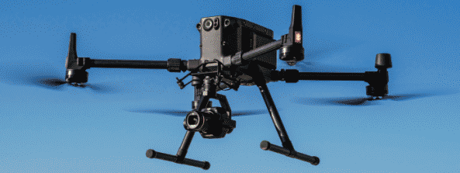
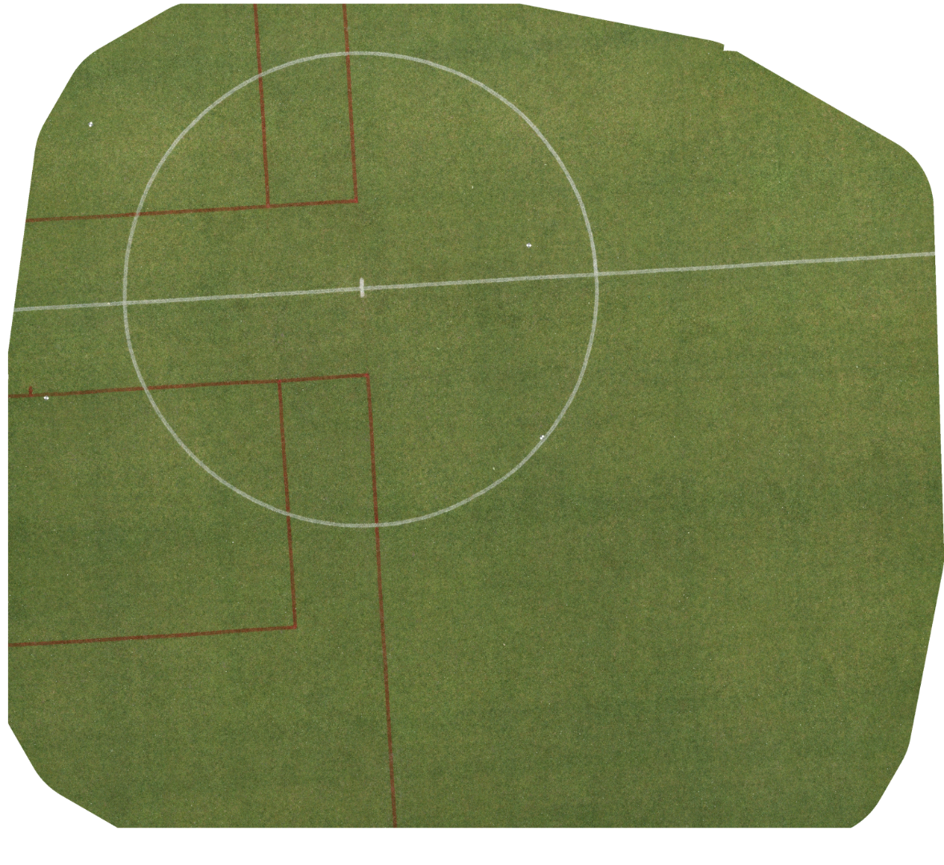
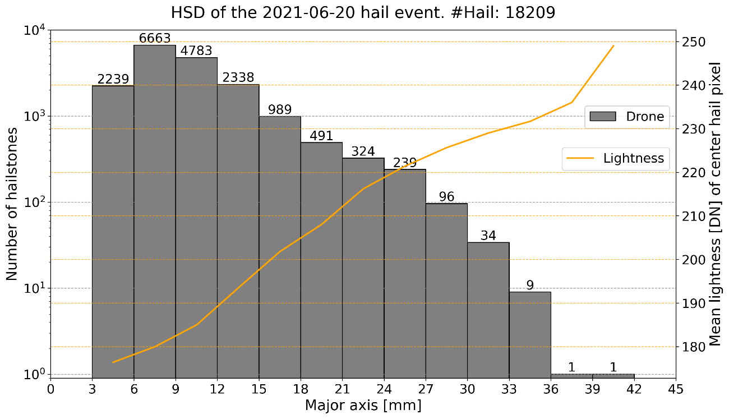
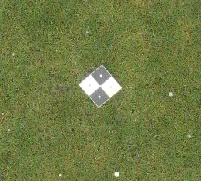
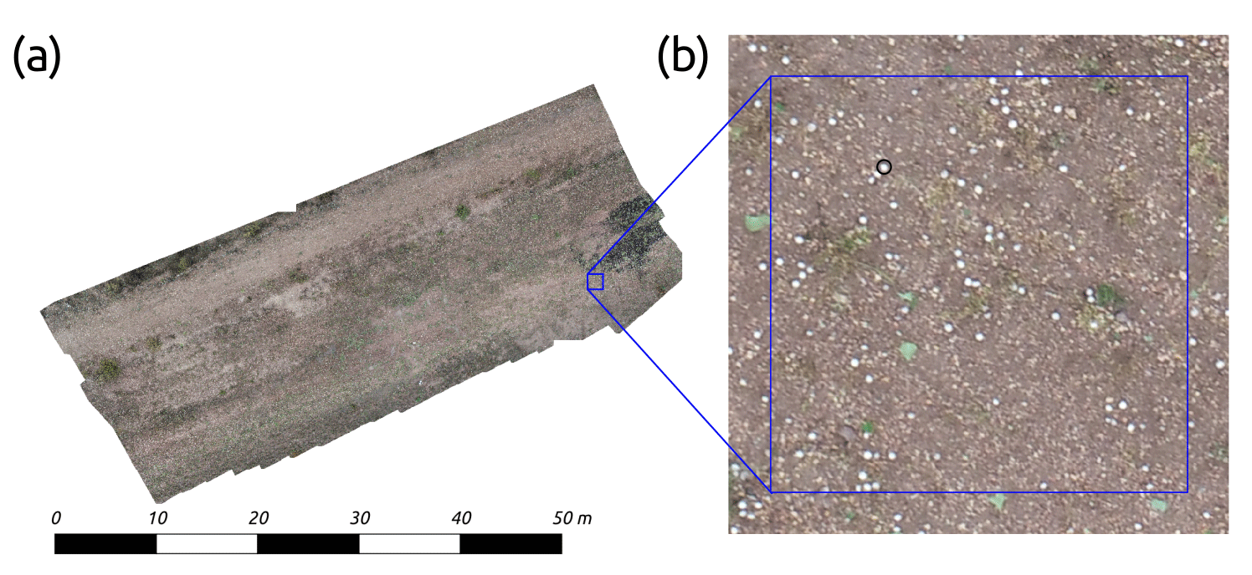
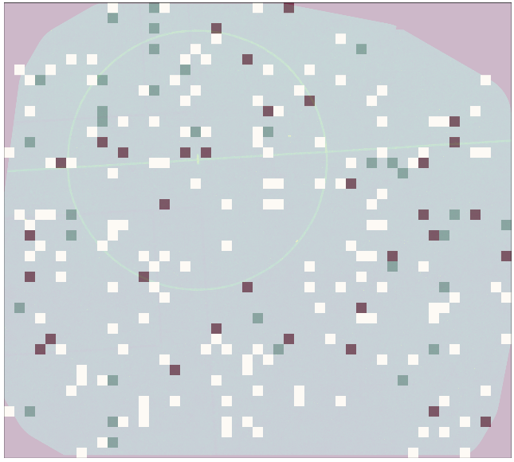
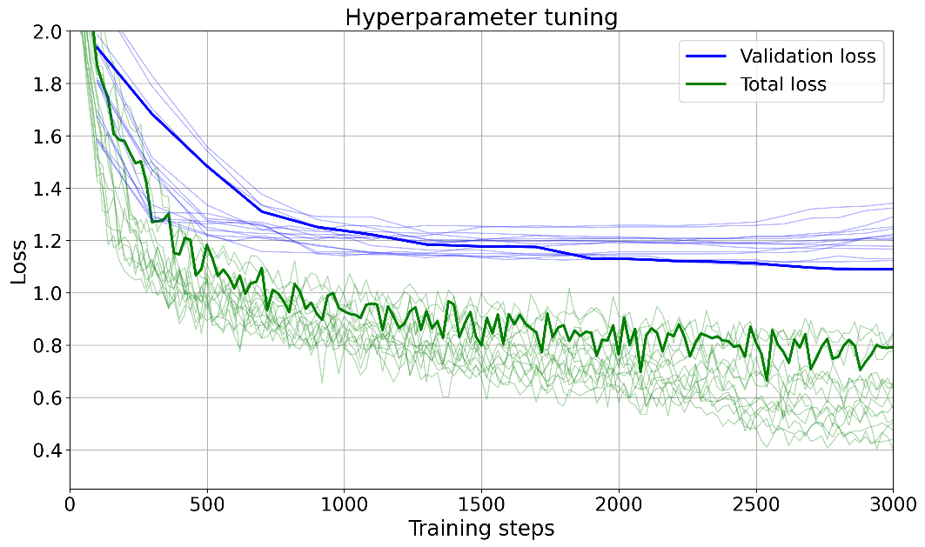
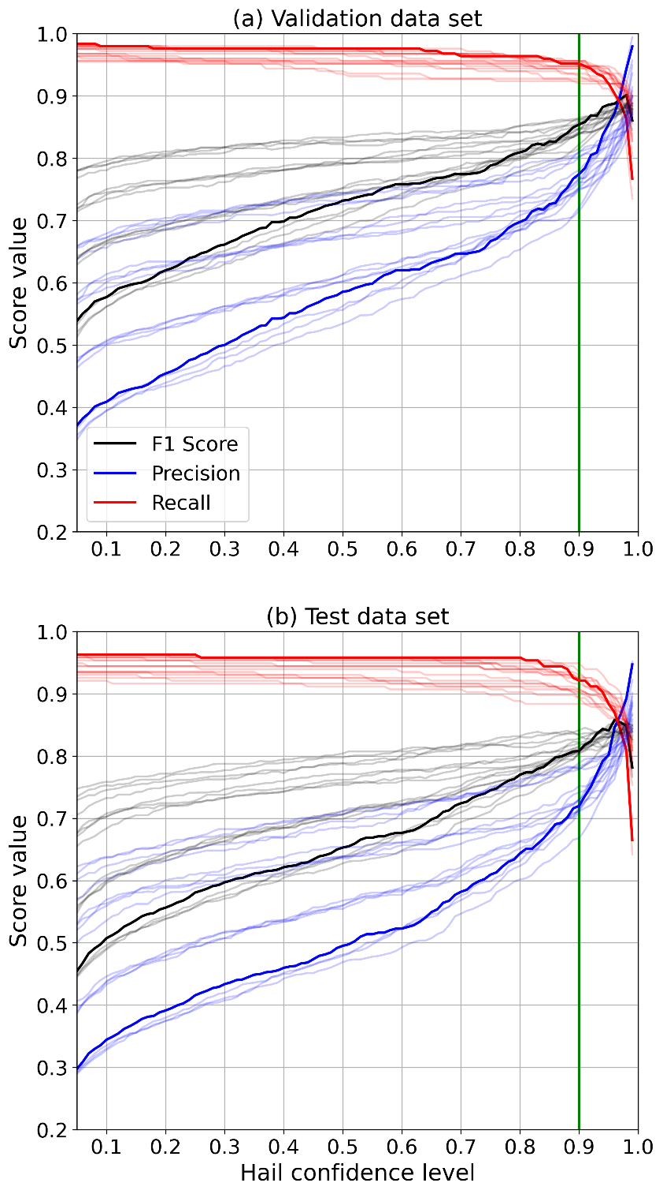
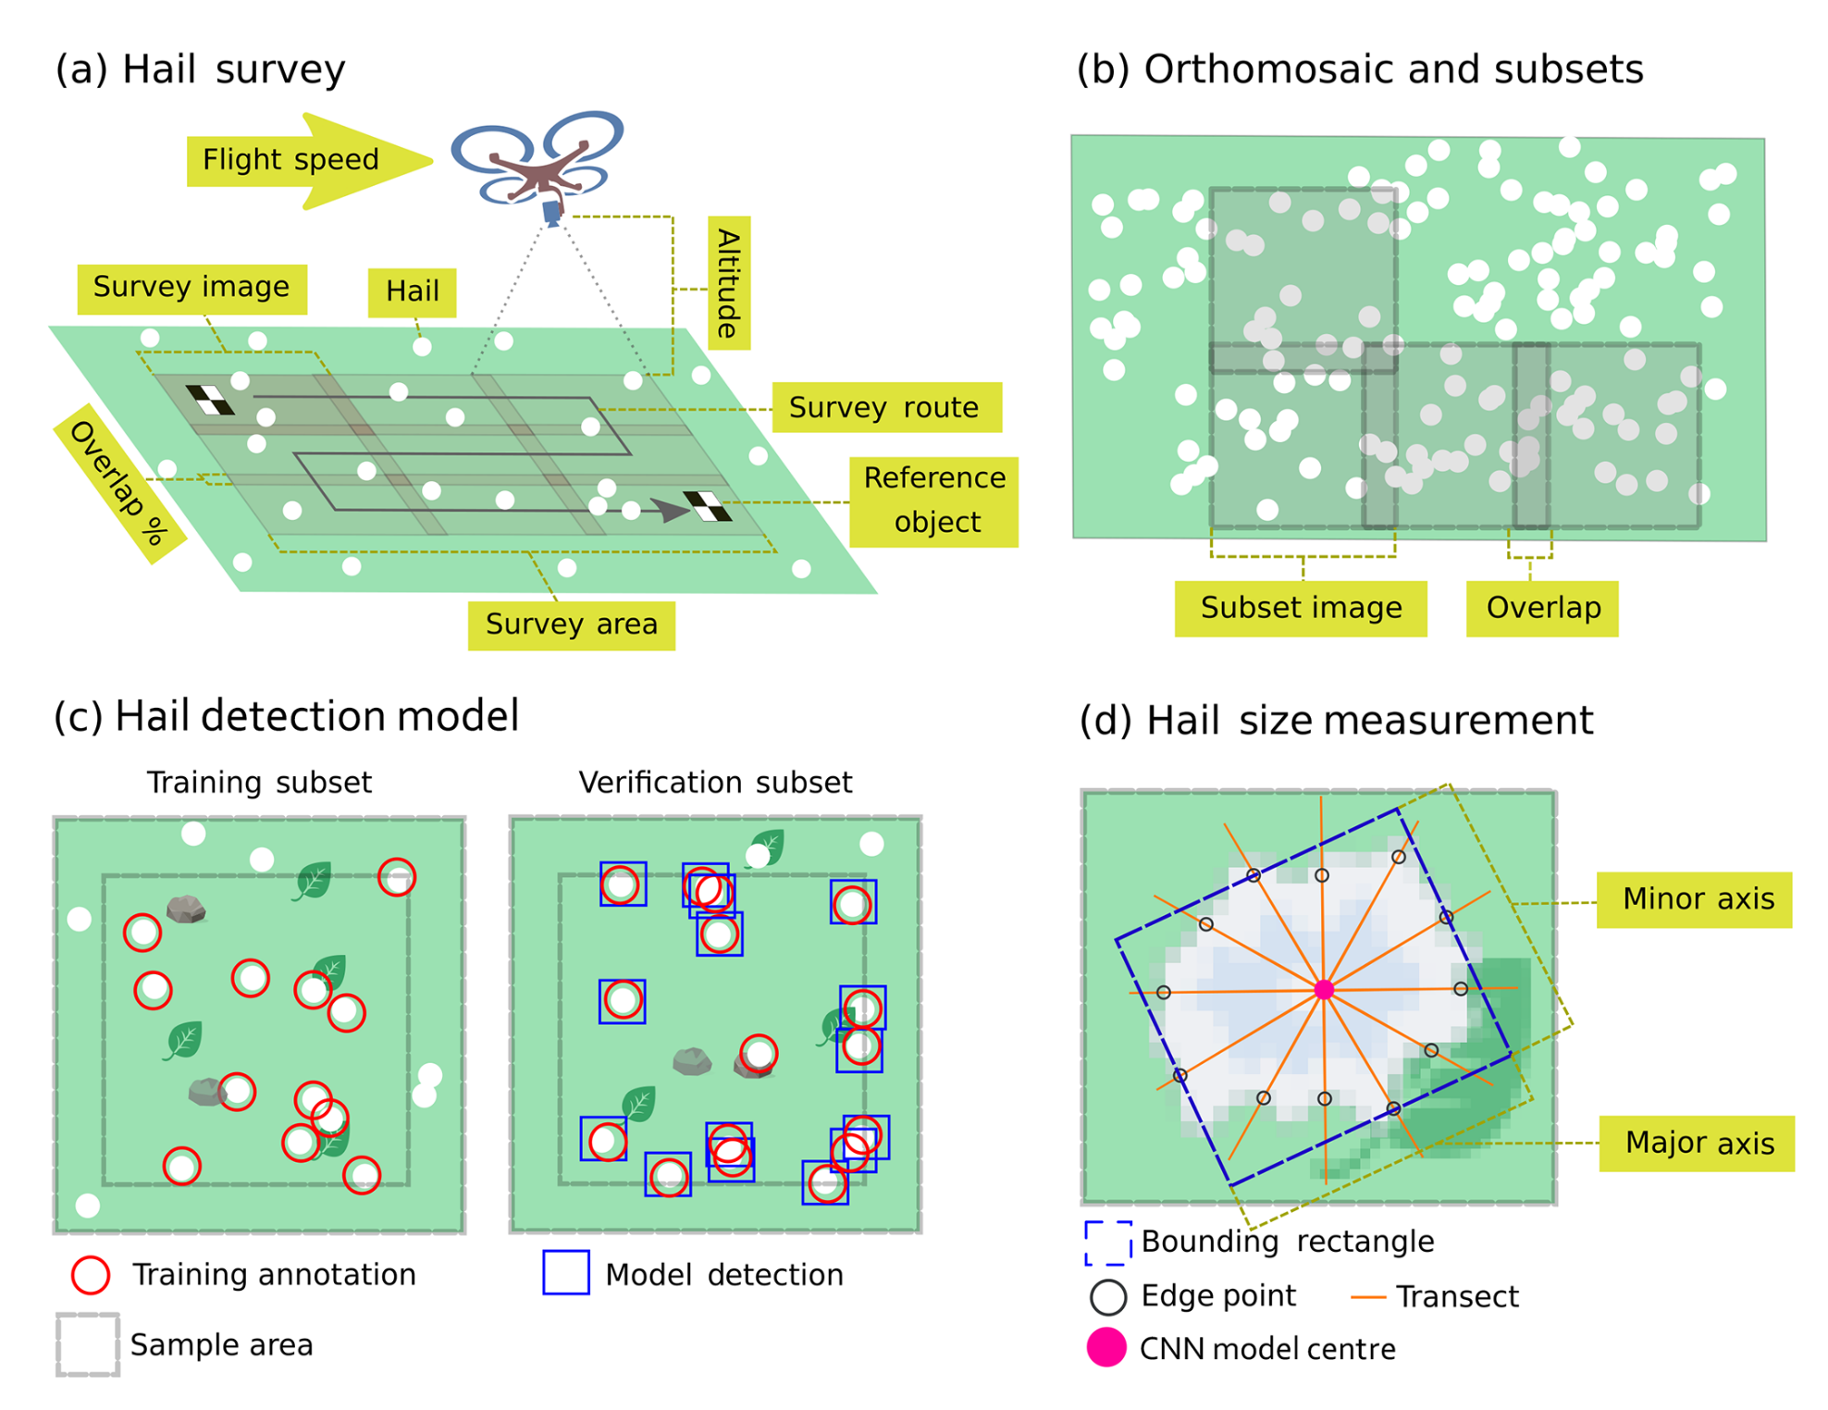

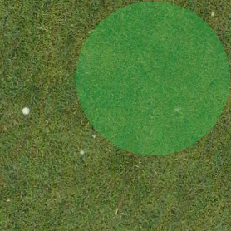
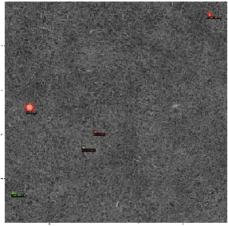


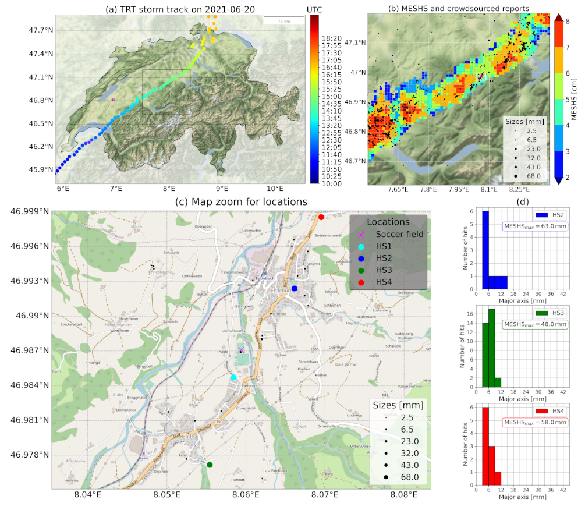
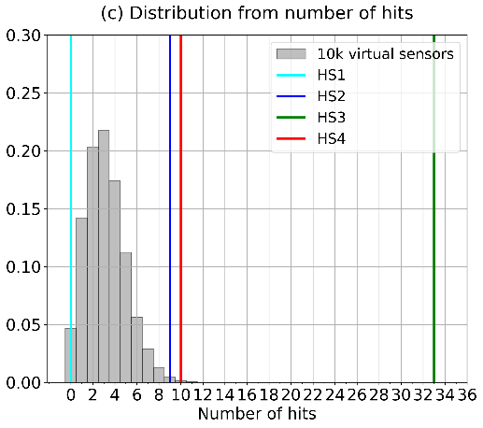
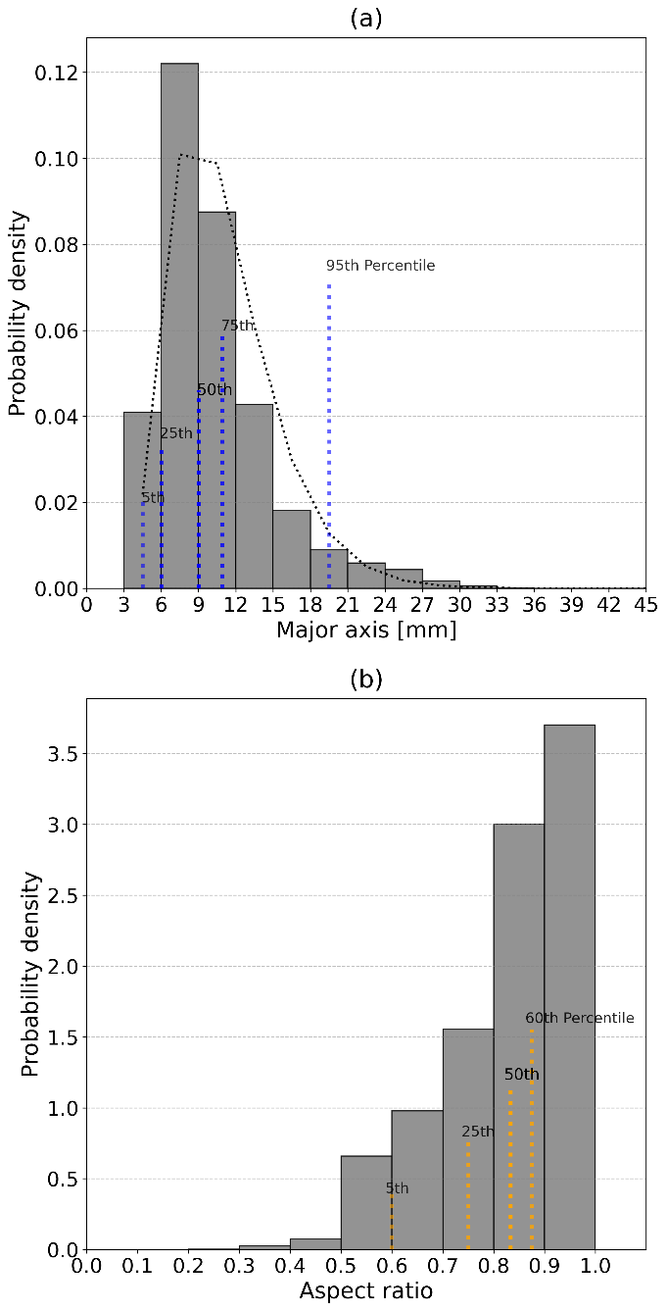
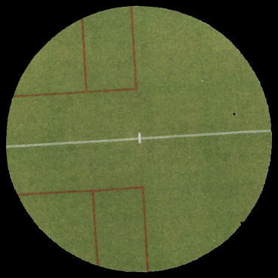
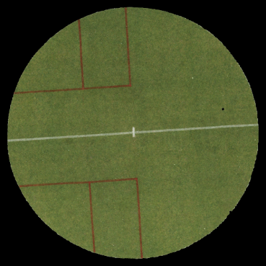
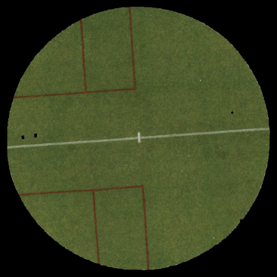
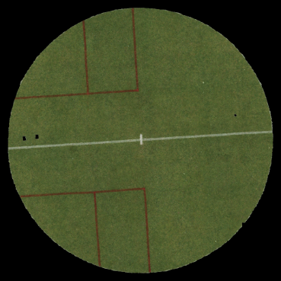
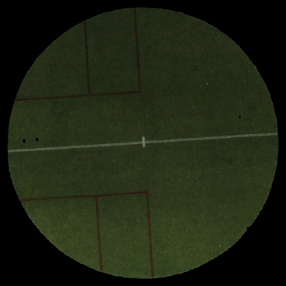
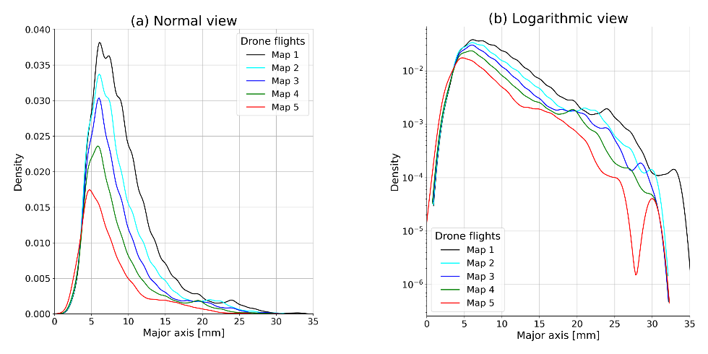
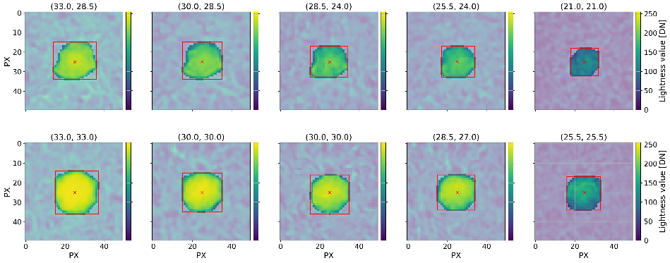
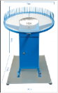
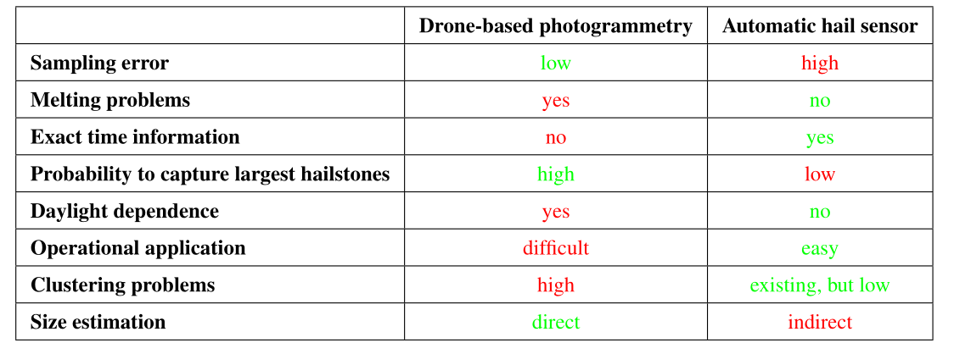



Drone-based hail observations and the retrieval of the hail size distribution after a supercell passage in summer 2021 in Switzerland
Martin Lainer¹, Killian P. Brennan², Jérôme Kopp³, Samuel Monhart¹, Daniel Wolfensberger¹, Alessandro Hering¹, and Zaira Schauwecker¹
¹Federal Office of Meteorology and Climatology MeteoSwiss, Locarno-Monti, Switzerland
²Institute for Atmospheric and Climate Science, ETH Zurich, Zurich, Switzerland
³Oeschger Centre for Climate Change Research and Institute of Geography, University of Bern, Switzerland
DJI Matrice 300RTK
Flight altitude: 12 m (a. g.)
GSD: 1.5 mm/px
Robust retrieval of a hail size distribution (HSD, D_{max} = 39 mm, D_{med} = 9 mm) based on a large population of >18000 hail stones observed on an area (soccer field) of 750 m² from a supercell hail event in central Switzerland on 20 June 2021.
Motivation
Research questions
Current methods to observe hail have strong limitations regarding the reconstruction of the full HSD of a storm. For example, automatic hail sensors can only partially capture the HSD due to their limited observational area (Kopp et al., 2023) and crowdsourced data only provide information about the largest hailstones.
Drone-based photogrammetry combined with deep-learning approach (Mask R-CNN) can provide additional information about the HSD.
How does the retrieved HSD compare to hail sensor and radar-based observations (MESHS – Maximum Expected Severe Hail Size)?
What is the estimated sampling error of hail sensors for this event?
How can the HSD degrading by melting on the ground (drawback of the drone-based method) be estimated?
Scientific background
AI-based hail detection
Soderholm et al. (2020) – Quantifying hail size distributions from the sky – application of drone aerial photogrammetry
Image tile data sets
Scores on training, validation and testing
Figure placeholder
Training (150)
Validation (33)
162 cm
Test (33)
Analyzed area: 340 m²
Flight altitude: 10 m above ground
Ground sampling distance: 2.7 mm/px
~16 000 classified hailstones
Image tile selection (random) for training and validating the MASK R-CNN model.
Total of 16 runs with hyperparameter combinations:
Evaluation results on validation data set (confidence: 0.90) for AP (average precision):
Total manual hail annotations:
Training dataset: 937
Validation dataset: 249
Test dataset: 215
LR
0.0001
0.00025
Gamma
0.1
0.5
Batch size
128
256
0.0005
0.001
Lightness conditions for edge detection in HSL color space:
Example validation tile
Model prediction
Sensor area:
0.2 m²
 | mAP | AP50 | AP75
Bbox | 53.1 | 93.4 | 54.8
Segm | 55.5 | 92.5 | 61.9
75 cm
Comparison of results
HSD decay by melting
Stormtrack, MESHS, hail sensor observations and sampling error estimation
Drone-based hail photogrammetry
Soccer middle circle photogrammetry mapping area: 263 m²
Degrading HSD by melting
Figure placeholder
Figure placeholder
14:37:59 - 14:41:19
14:43:06 -14:46:25
14:47:39 - 14:50:59
14:52:07 - 14:55:27
14:56:38 - 14:59:56
Figure placeholder
Gamma distribution
10000 virtual sensors on orthophoto
#3925
#3077
#2511
#1962
#1411
Probability of no-hit event: 4.7 %
45 hailstones > 30 mm (on orthophoto) → Probability for a sensor to record such a large hailstone is only 0.3 %
The degrading of the hail size distribution by melting could be monitored during 18.5 min by performing 5 consecutive drone-based photogrammetry flights, covering the soccer middle circle area.
Melting rates approximation: 0.3–0.5 mm min⁻¹
Ground temperatures between 17°C and 18°C.
Air temperatures between 19°C and 21°C.
0.2 m²
KDEs of the degrading hail size distribution within the soccer middle circle due to melting on the ground (top). Examples of 2 hailstone size evolution during the captured melting process with 5 drone flights (bottom).
Pros and cons
Storm track (a) of the 2021-06-20 supercell with colored time information. Plot (b) shows information on radar derived MESHS (Maximum Expected Severe Hail Size) and crowdsourced hail size reports (black and different sized circles for 6 size categories with bin centers at 2.5, 6.5, 23, 32, 43 and 68mm corresponding to the MeteoSwiss app categories. In (c) the detailed locations of the soccer field and the 4 nearest automatic hail sensors (HS1, HS2, HS3 and HS4) are given. The histograms in (d) show the recorded HSDs from the automatic hail sensors together with the daily maximum MESHS value at the sensor locations.
Probability density distributions from the drone-based hail ob-servations. In (a), the major axis length and in (b), the aspect ratio length is shown. The vertical dashed lines indicate the positions of the particular percentiles.
A combination of hail data from different applications (drone, hail sensor and crowdsourced) that observe the same hail fall event improves the reconstruction of the complete HSD of such an event and also helps to frame the individual limitations.
References
Soderholm et al.: Quantifying hail size distributions from the sky – application of drone aerial photogrammetry, Atmos. Meas. Tech., 13, 747–754, https://doi.org/10.5194/amt-13-747-2020, 2020.
Kopp et al.: How observations from automatic hail sensors in Switzerland shed light on local hailfall duration and compare with hailpads measurements, Atmos. Meas. Tech. Discuss., https://doi.org/10.5194/amt-2023-68, in review, 2023.
Acknowledgement
We thank the Swiss Insurance Company La Mobilière for funding the automatic hail sensors network and making the hail sensor data available for research investigations. We want to acknowledge the fruitful scientific exchange with Joshua Soderholm (Australian Bureau of Meteorology) about drone-based hail photogrammetry.
Publication:
Lainer et al.: Drone-based photogrammetry combined with deep-learning to estimate hail size distributions and melting of hail on the ground, Atmos. Meas. Tech., submitted, 2023.
Martin Lainer, PhD
martin.lainer@meteoswiss.ch
https://www.linkedin.com/in/mlainer

