Slide 1


Severe Weather Impact Database and Impact-based Forecasts by Utilizing Machine-Learning Technology
A-J Punkka | matti kämäräinen
PROJECT TEAM @FMI: HAIKONEN, JOKINEN, KARHUNEN, KORPELA, LÁNG-RITTER, LAURILA, NYMAN, PEKKINEN, SIRVIö

Slide 2
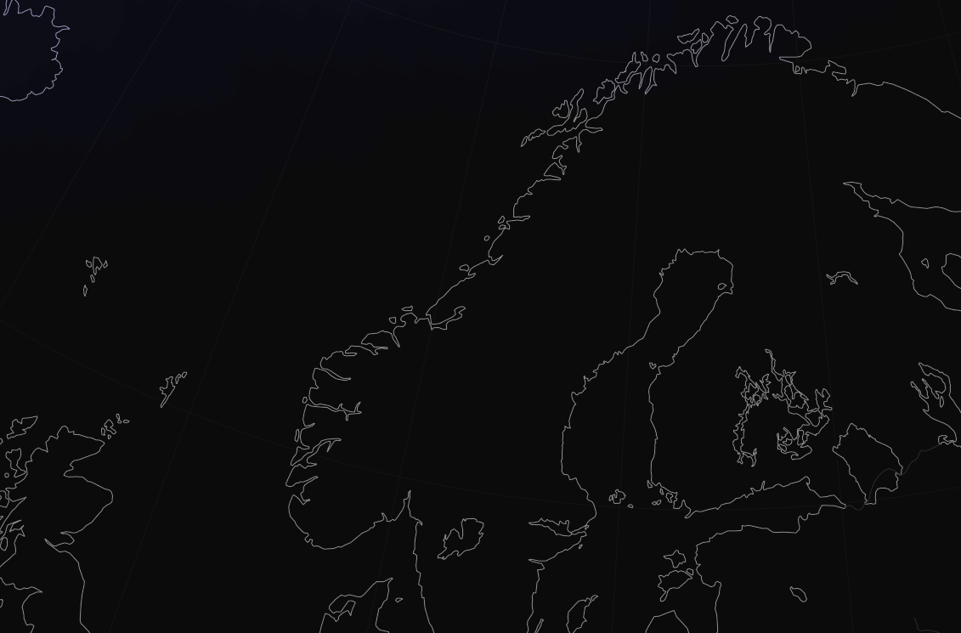
Have you ever wondered why comprehensive multisectoral weather impact databases are next to non-existent…?
LOW CO-OPERATION
BARRIERS
Concept of comprehensive security enhances multisectoral co-operation
DATA AVAILABILITY
#5 in Global Open Data Index (okfn.org)
DATA FORMATS
#7 in Digital Competitiveness Ranking (imd.org)
#2 in Global Corruption Index (globalriskprofile.com)
DATA QUALITY AND TRUST
#5 in World Press Freedom Index (rsf.org)

Slide 3




PROJECT GOALS
Search, collect and ”normalize” high-quality impact datasets and build a database for these data.
Negotiate with the data owners to make as many datasets as possible open for everyone.
Develop next-generation impact-based forecasts which are derived from the stored impact data.
Organize a pilot period during which the new products are tested in realtime.

Slide 4



IMPACT DATASETS AND IMPACT DATABASE
●◌◌◌◌
DATA | VOL | TIME SERIES LENGTH | LENGTH | COVERAGE
WIND DAMAGE CLEARANCE | 130k | ----------o | 22 yrs | NATIONAL
WILDFIRE FIGHTING EVENTS | 63k | ----------o | 22 yrs | NATIONAL
TRAFFIC ACCIDENT CLEARANCE | 281k | ----------o | 22 yrs | NATIONAL
MARITIME RESCUE OPS | 11k | ---o | 7 yrs | NATIONAL
LAKE-AREA RESCUE OPS | 1.0k | ---------o | 20 yrs | NATIONAL
ROAD TRAFFIC ACCIDENTS | 1.1M | -----------o | 24 yrs | NATIONAL
PEDESTRIAN SLIPPING ACCIDENTS | 78k | --------o | 17 yrs | NATIONAL
FLOODING DAMAGE REPORTS | 4.2k | ----------o | 21 yrs | NATIONAL
AIRPORT OPERATION DISRUPTIONS | 0.3k | ---o | 8 yrs | LOCAL
ELECTRICITY SUPPLY BLACKOUTS | 1.3M | o | 2 yrs | NATIONAL
ELECTRICITY CONSUMPTION | 3.5k | o | 1 yr | NATIONAL
TRAIN TRAFFIC DISRUPTIONS | 210k | --o | 6 yrs | NATIONAL
ROAD MAINTENANCE | 27M | --o | 6 yrs | NATIONAL
10+ HIGH-QUALITY DATASETS 30M+ INDIVIDUAL IMPACT EVENTS MULTIPLE DATASETS WITH NATIONAL AND MULTIYEAR COVERAGE LOCATION AND TIME OF OCCURRENCE STORED FOR EACH EVENT. INTENSITY AND REASON OF THE EVENT OPTIONAL PARAMETERS.

Slide 5
CREATING IMPACT FORECASTS WITH GRADIENT BOOSTING TECHNIQUE
◌●◌◌◌
Historical weather forecasts
Historical impact data
New weather forecasts
Forecasts of impact data
IMPACT DATA FOR MODELLING | TIME SERIES LENGTH | LENGTH
WIND DAMAGE CLEARANCE | ----------o | 22 yrs
FOREST FIRE FIGHTING EVENTS | ----------o | 22 yrs
ROAD TRAFFIC ACCIDENTS | -----------o | 24 yrs
PEDESTRIAN SLIPPING ACCIDENTS | --------o | 17 yrs
Supervised learning
Prediction
Gradient boosting
model
Gradient boosting model
ECMWF HRES weather forecasts used both for fitting and for the real-time forecasting of the weather impacts
County-level spatial aggregation was applied to the impact data before fitting the gradient boosting machine learning models

Slide 6
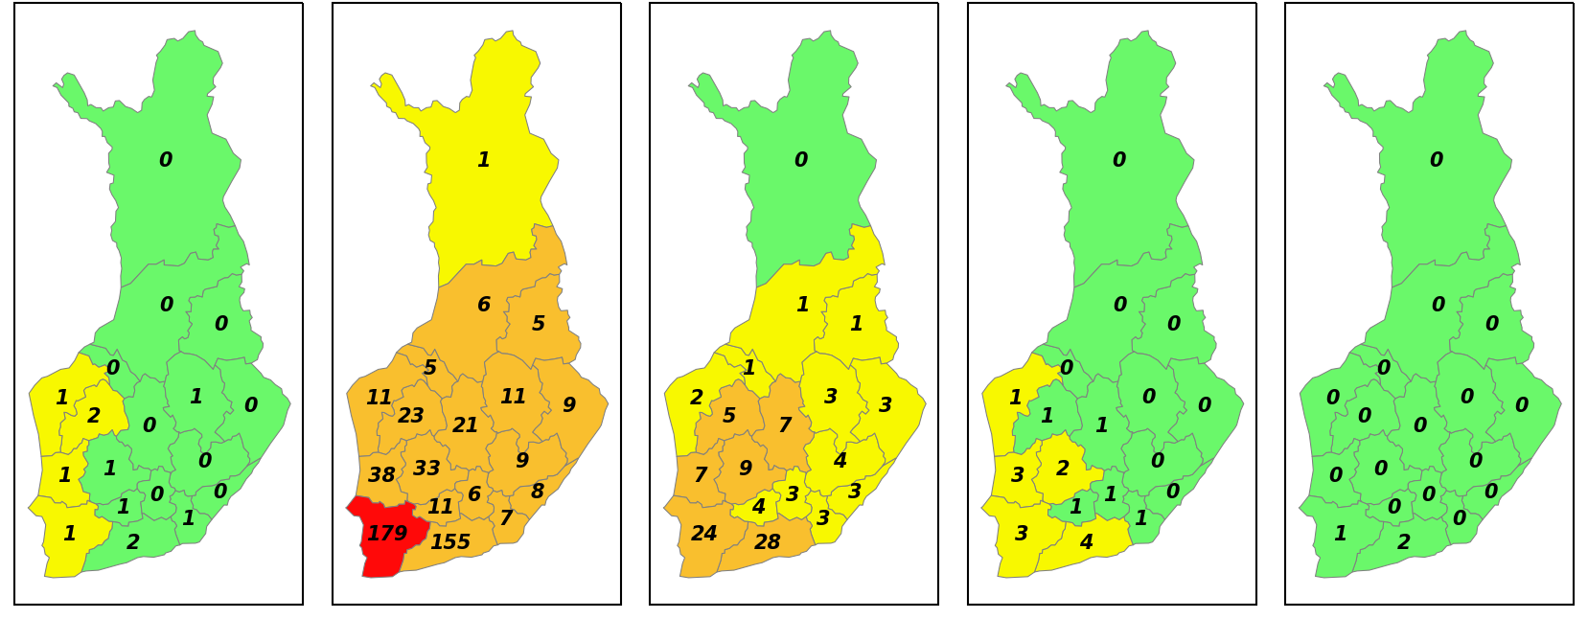
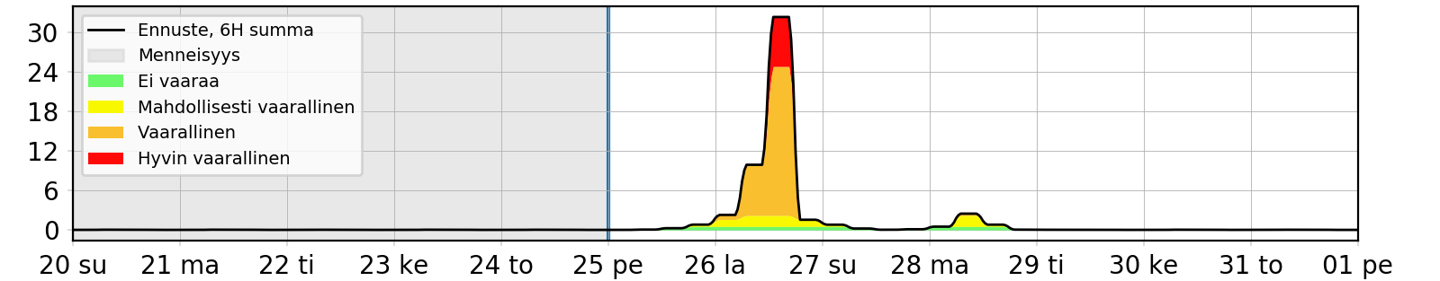
WARNING-LIKE VISUALIZATION FOR NEW PRODUCTS
◌●◌◌◌
Results in counties are visualized as warning maps and as time series
New forecasts are produced twice daily
Quantitative skill analysis shows clearly useful performance for lead times up to seven days
Most important challenges for the method:
Impacts of thunderstorms
Forecasts of the least populated counties
UPPER: Forecasted numbers of storm damage clearance tasks for 25–31 March 2022. LOWER: Time series product shown for the most impacted county.

Slide 7
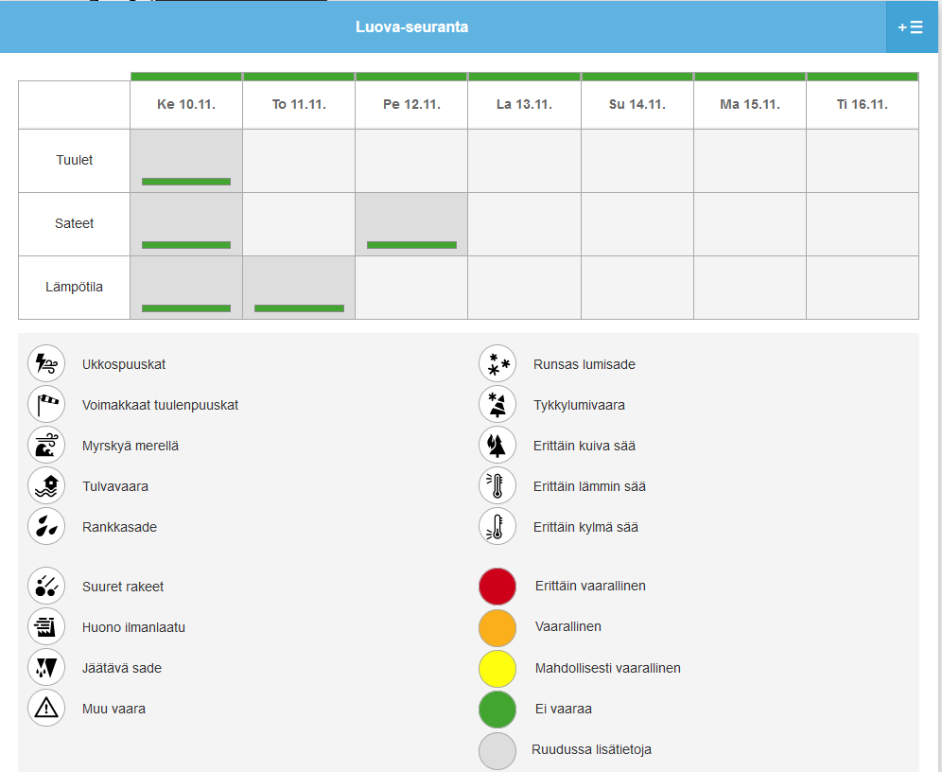
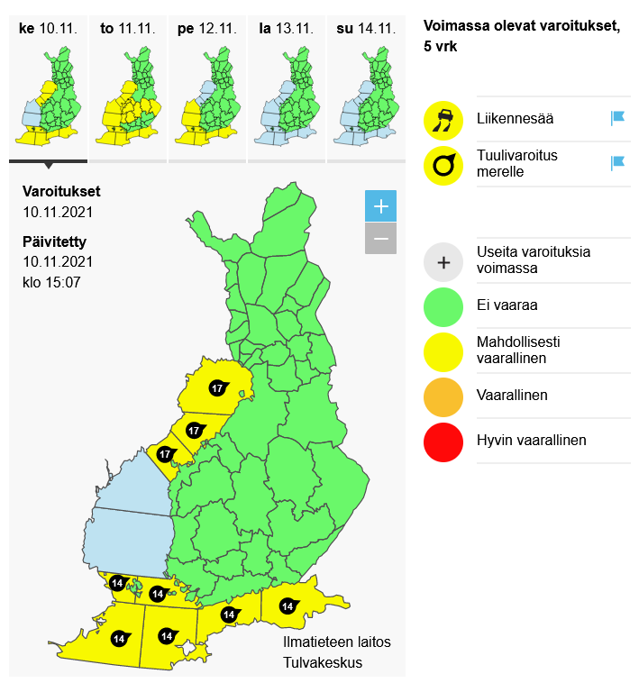
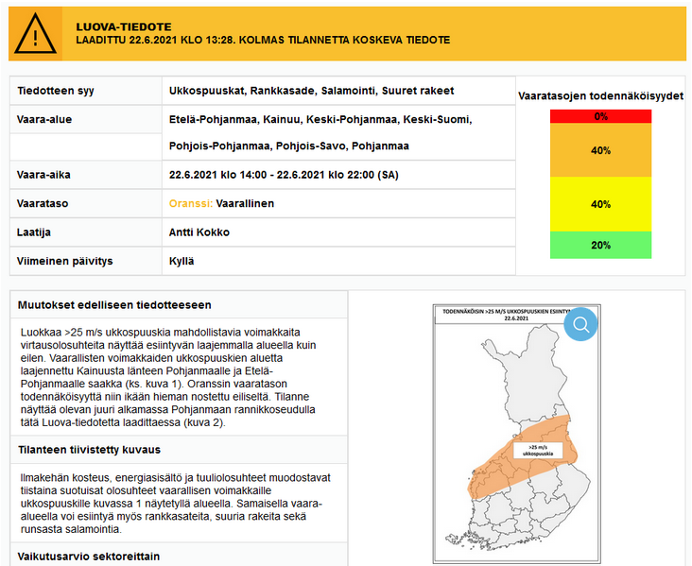
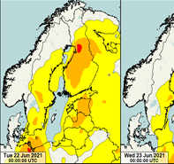
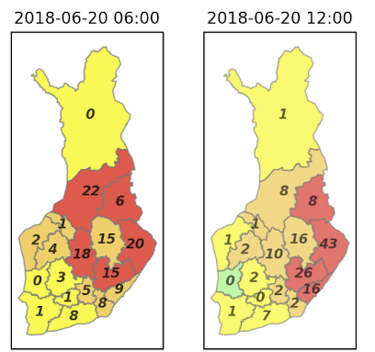
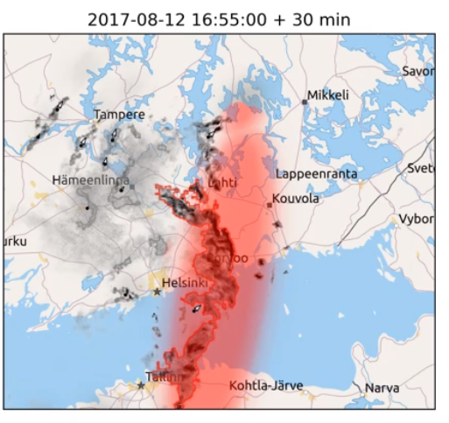
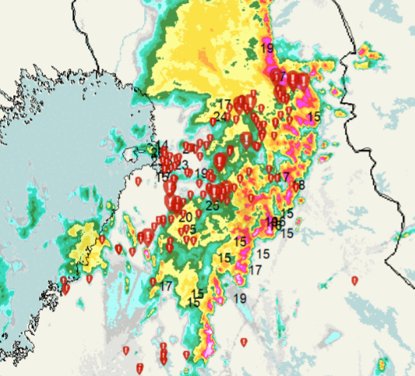

REALTIME PRODUCTS AVAILABLE FOR PILOT USERS
◌◌●◌◌
SEVERE WEATHER EARLY SIGNALS
WEATHER WARNINGS
SEVERE WEATHER OUTLOOK
ML-BASED IMPACT FCST
TAMIR SVR T-STORM NOWCASTING PRODUCT
OBS-IMPACT DATA COMBOS
POSTPROCESSED FCST PARAMETERS
LEAD TIME 5D 3D 1D

Slide 8

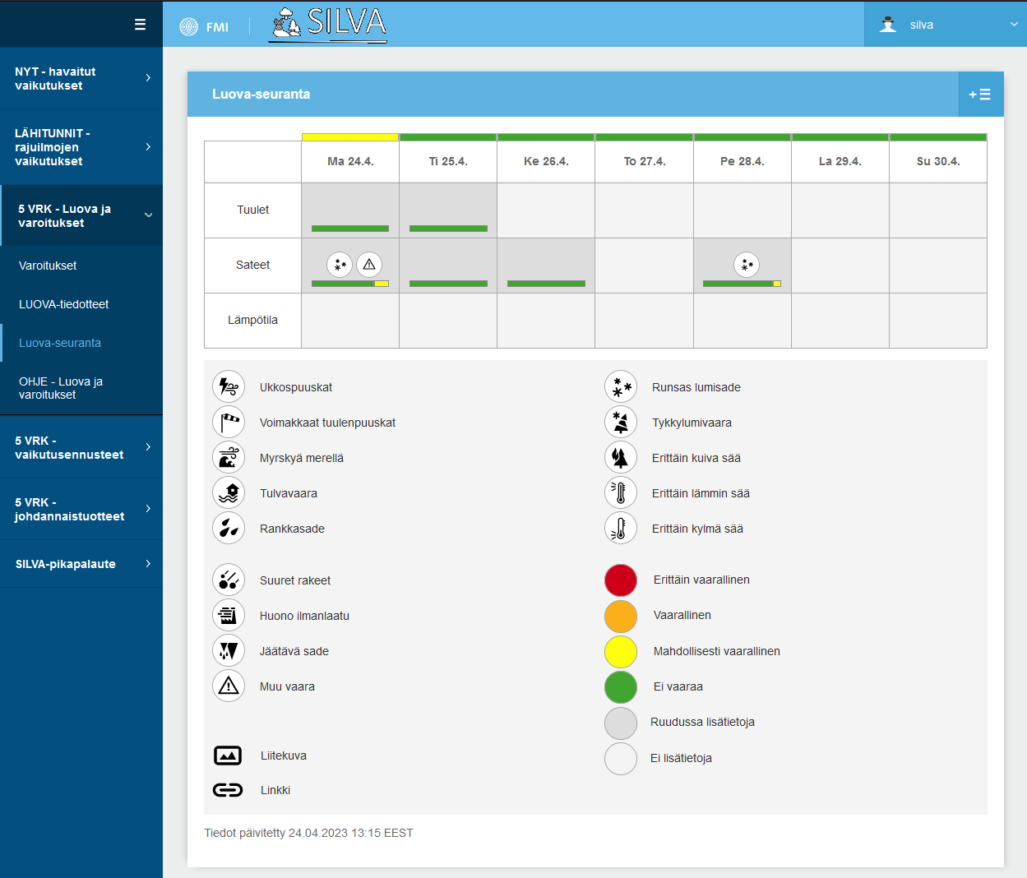

”… BUT ORGANIZING A PILOT AND ENGAGING END-USERS IS BURDENSOME…” PILOT PHASE (APR2022 … NOV2022)
◌◌●◌◌
REALTIME PILOT PRODUCT FOLDER AVAILABLE 24/7 IN A CUSTOMER PORTAL PILOT USER GROUP: ~30 ORGANIZATIONS FROM 6 SECTORS (energy, rescue dep’s, insurance, road traffic, aviation, rail traffic) 10 REAL-TIME BRIEFINGS GIVEN WITH AVERAGE LENGTH OF 28 mins AND 25 PARTICIPANTS
(blizzards, svr t-storms, forest fires, heavy rains, windstorms)

Slide 9
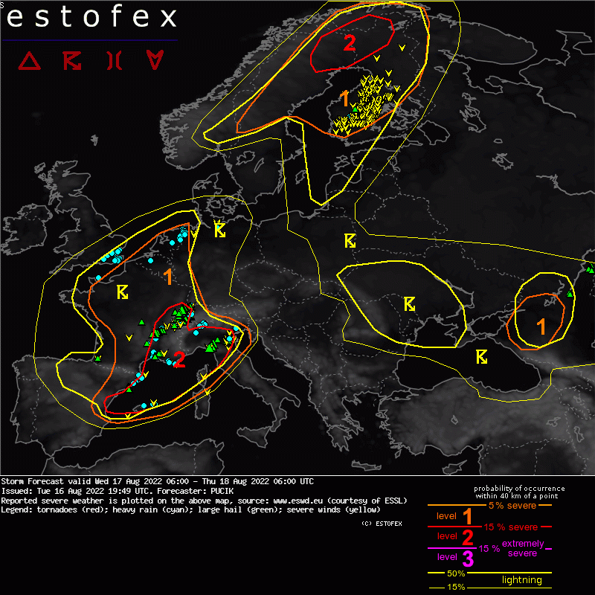
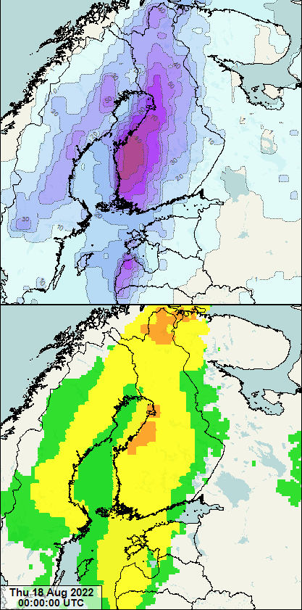
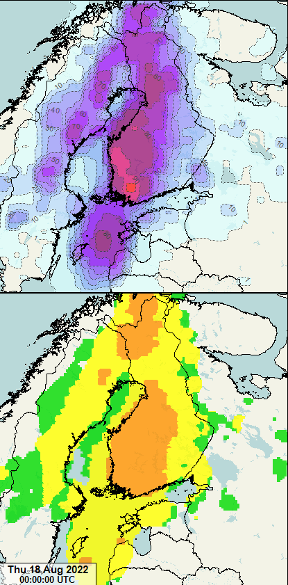
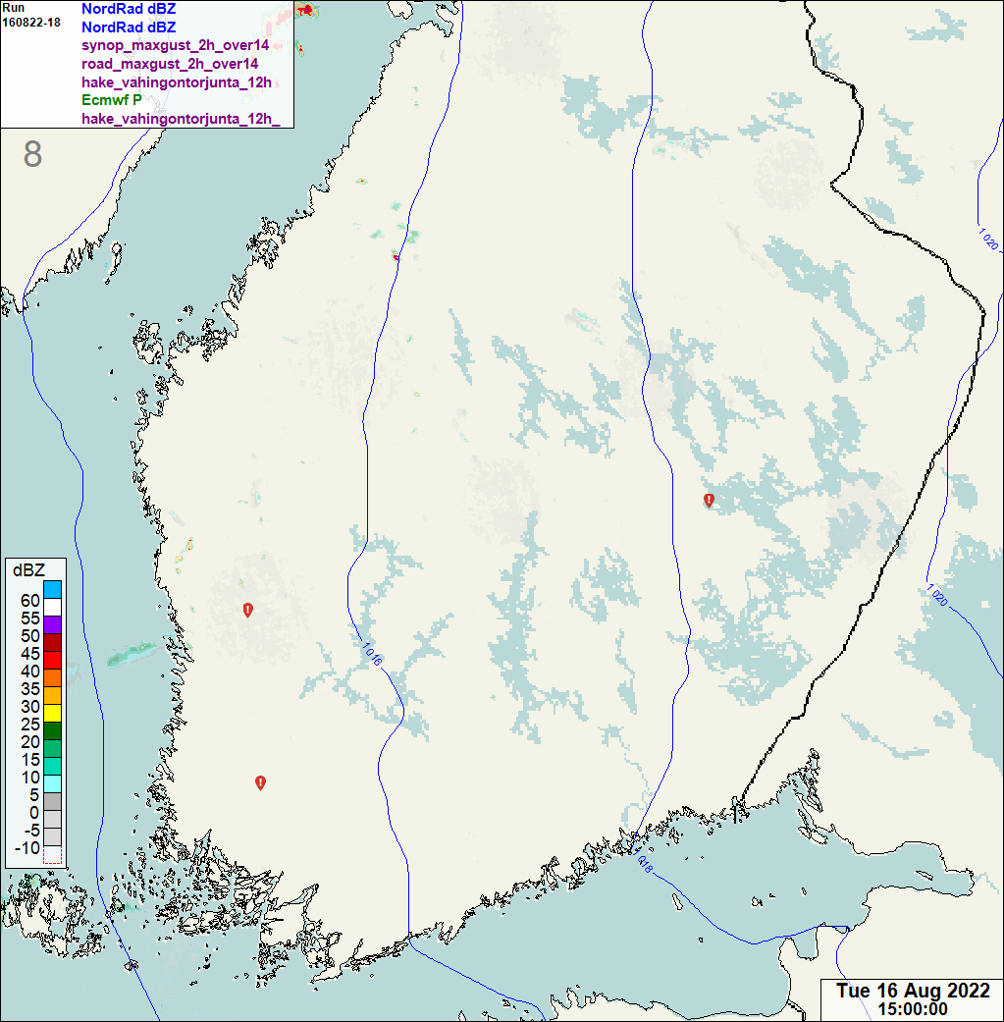
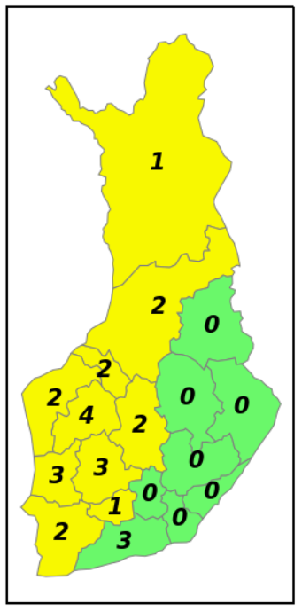
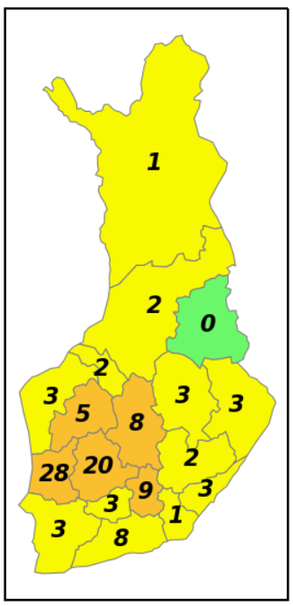
SEVERE THUNDERSTORM CASE 17 Aug 2022
◌◌◌●◌
SEVERE THUNDERSTORM DAMAGE POTENTIAL (MUCAPE + EFF. DL SHEAR)
# OF WIND DAMAGE TASKS UNDERFORECAST IN MOST THUNDERSTORM CASES (this case: fcst 150 vs obs 300)
FEEDBACK FROM RESCUE DEP’s: IMPACT FORECASTS ARE USEFUL IN THE EARLY PREPARATION PHASE WHEN UTILIZED IN CONJUNCTION WITH OTHER PRODUCTS.
ISSUED @ 15 AUG 00Z ISSUED @ 17 AUG 00Z
CAPPI dBZ COMPOSITE | WIND DAMAGE CLEARANCE TASKS | 15 m/s+ WIND GUSTS
EXPECTED # OF WIND DAMAGE CLEARANCE TASKS

Slide 10



SUMMARY AND USER FEEDBACK
◌◌◌◌●
4.0
GENERAL SCORE FOR THE PROJECT
(scale 1…5)
SCORE FOR FURTHER DEVELOPMENT POTENTIAL
POSITIVE OBSERVATIONS
Products in wintry conditions good in quality
Further operational use of products endorsed
Further development projects wanted
DEVELOPMENT EFFORTS NEEDED
Longer test phase required
More tailored impact forecasts needed
Frequency of yellow-level signals should be lower
Impact fcsts for thunderstorms should be finetuned
UNIQUE IMPACT DATABASE CREATED
10+ high-quality nation-level datasets 30M+ individual impact events NOVEL IMPACT-BASED AND IMPACT-RELATED PRODUCTS DEVELOPED
Post-processed fcst parameters Obs-impact combos ML-based tailored impact fcsts COMPREHENSIVE PILOT PHASE
8-month pilot period
30 organizations involved 10 realtime briefings
4.3
More information: ari-juhani.punkka@fmi.fi | matti.kamarainen@fmi.fi

