Slide 1
Guidelines for Satellite-based Nowcasting in Africa
Estelle De Coning, WMO
Vesa Nietosvaara, EUMETSAT
Notes:
Title slide template 2 of 2 with presentation title/information on the right. Please choose between slide 1 or 2 for the title slide and delete the other.

Slide 2
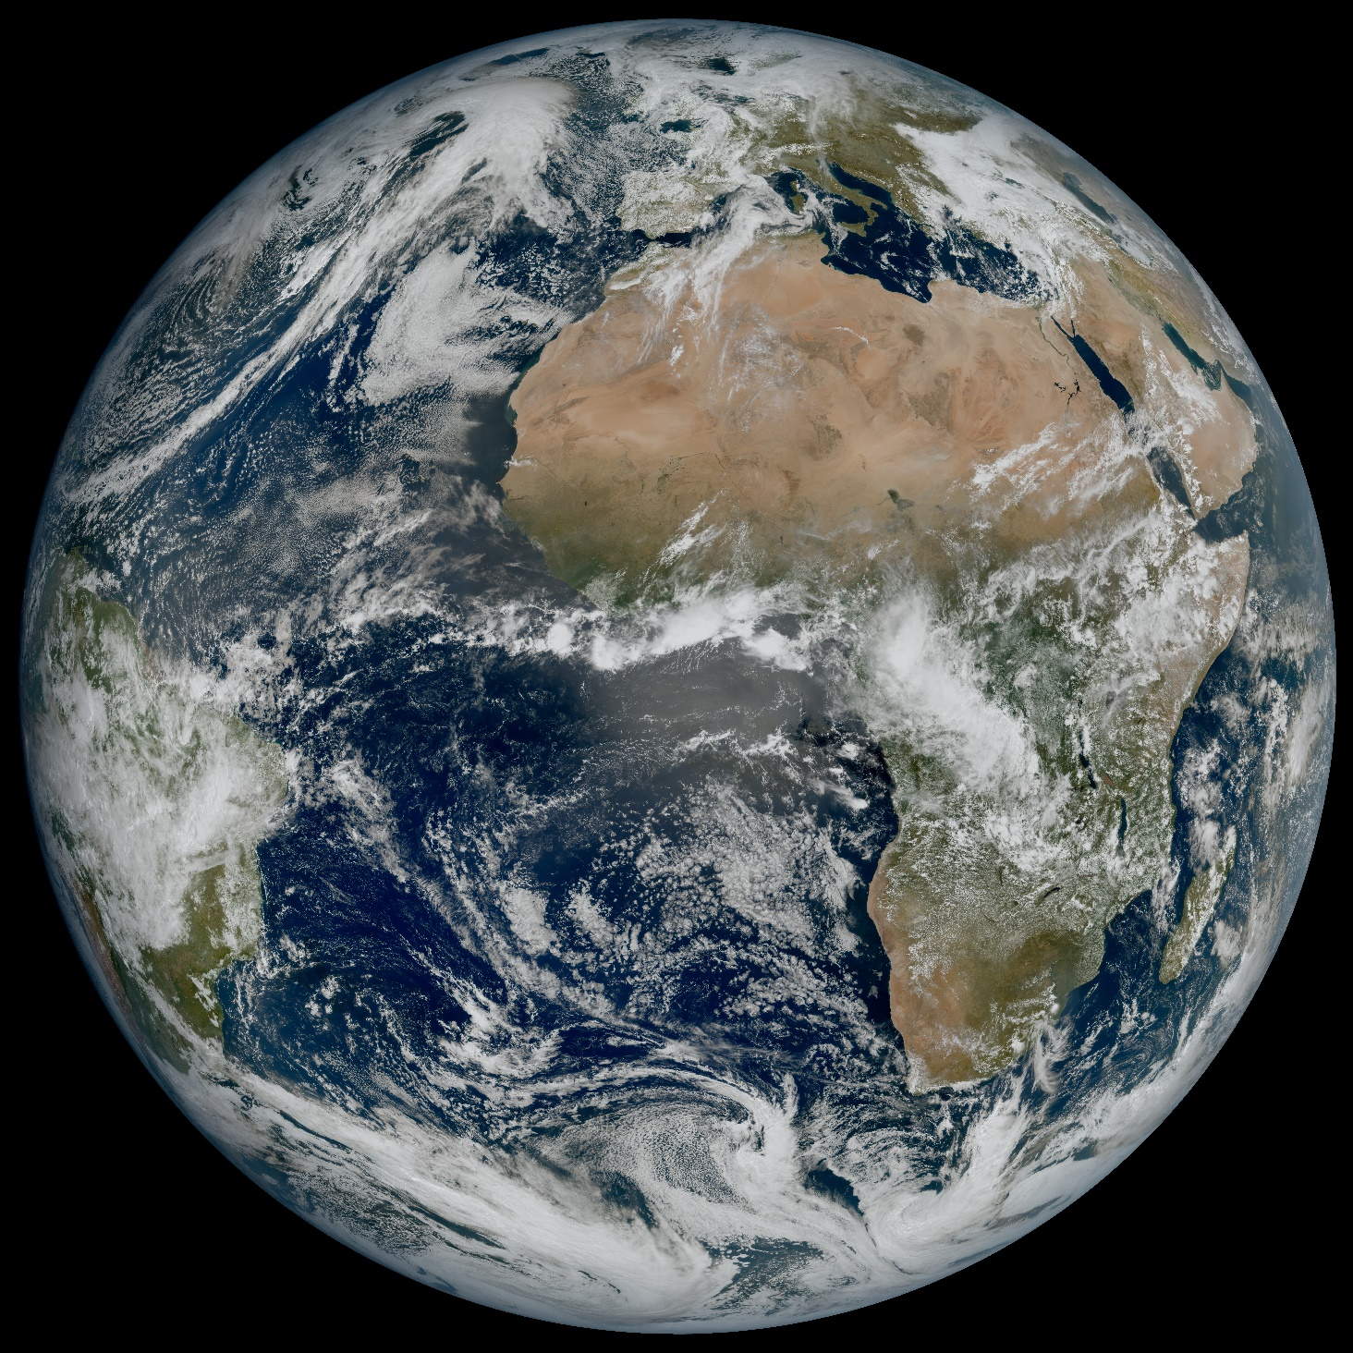
Motivation for Guidelines
Africa is big…
…and many regions and people in Africa regularly suffer from weather-related hazards.
Underutilization of nowcasts and reliable weather forecasts.
Economical challenges and poverty make the continent a priority for the development of nowcasting.
Timely warnings help in taking action.

Slide 3

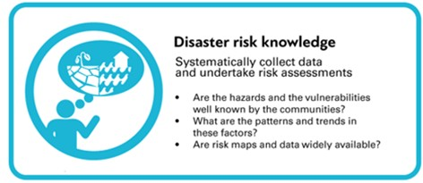
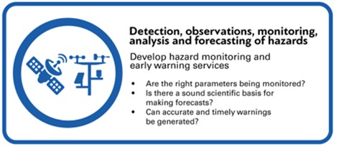
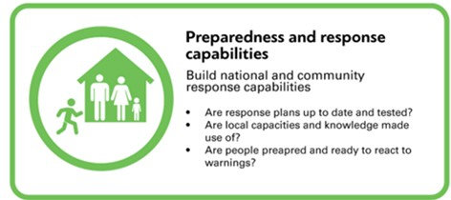
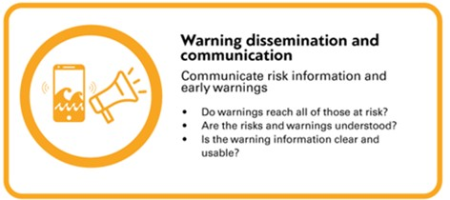
WIDER CONTEXT
UN/WMO: “People least responsible for climate change suffer most from extreme weather”…
“…Early warnings are efficient and cost-effective form of climate adaptation”

Slide 4
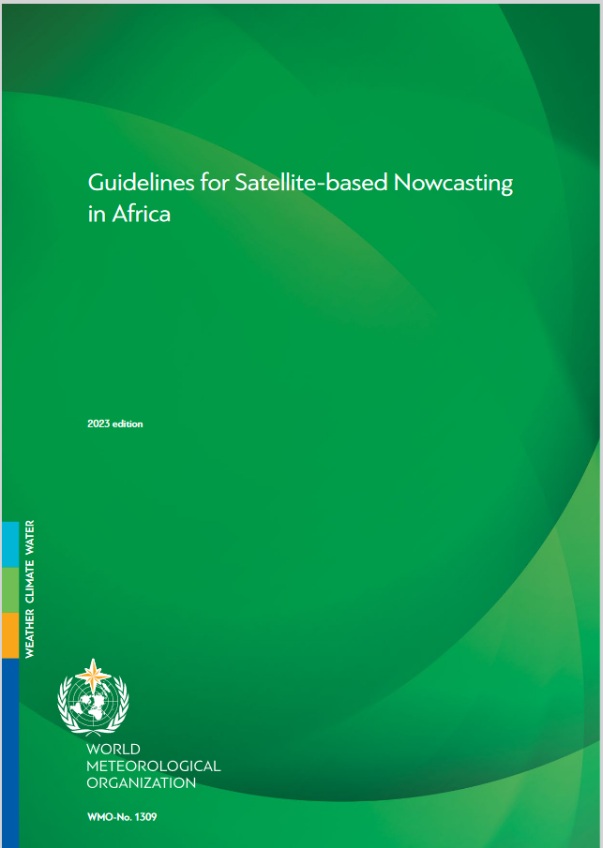
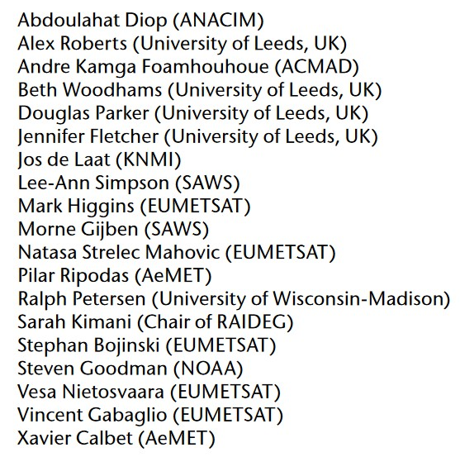
Nowcasting Guidelines
Guidelines for the implementation of a range of satellite nowcasting options;
Coincides with the advent of the Meteosat Third Generation (MTG) satellite system.
Recommendations to help facilitate near-term implementation, capacity development and sustainability of services over time.
Can be used to create templates and roadmaps for the establishment and maintenance of nowcasting functions in African countries.

Slide 5
DATA FOR NOWCASTING
Observations…
… are the backbone for Nowcasting
… in Africa…
Great variety of observation density depending on regional capacity.
Satellite observations hugely mitigate this imbalance.
Together with NWP they are the most critical tools to provide nowcasts.
… are improving
New satellite generations will very soon further enhance the capabilities of applying new nowcasting services in Africa.
Numerical weather prediction
Surface observations
Upper air observations
Radar
Lightning detection
Satellite

Slide 6
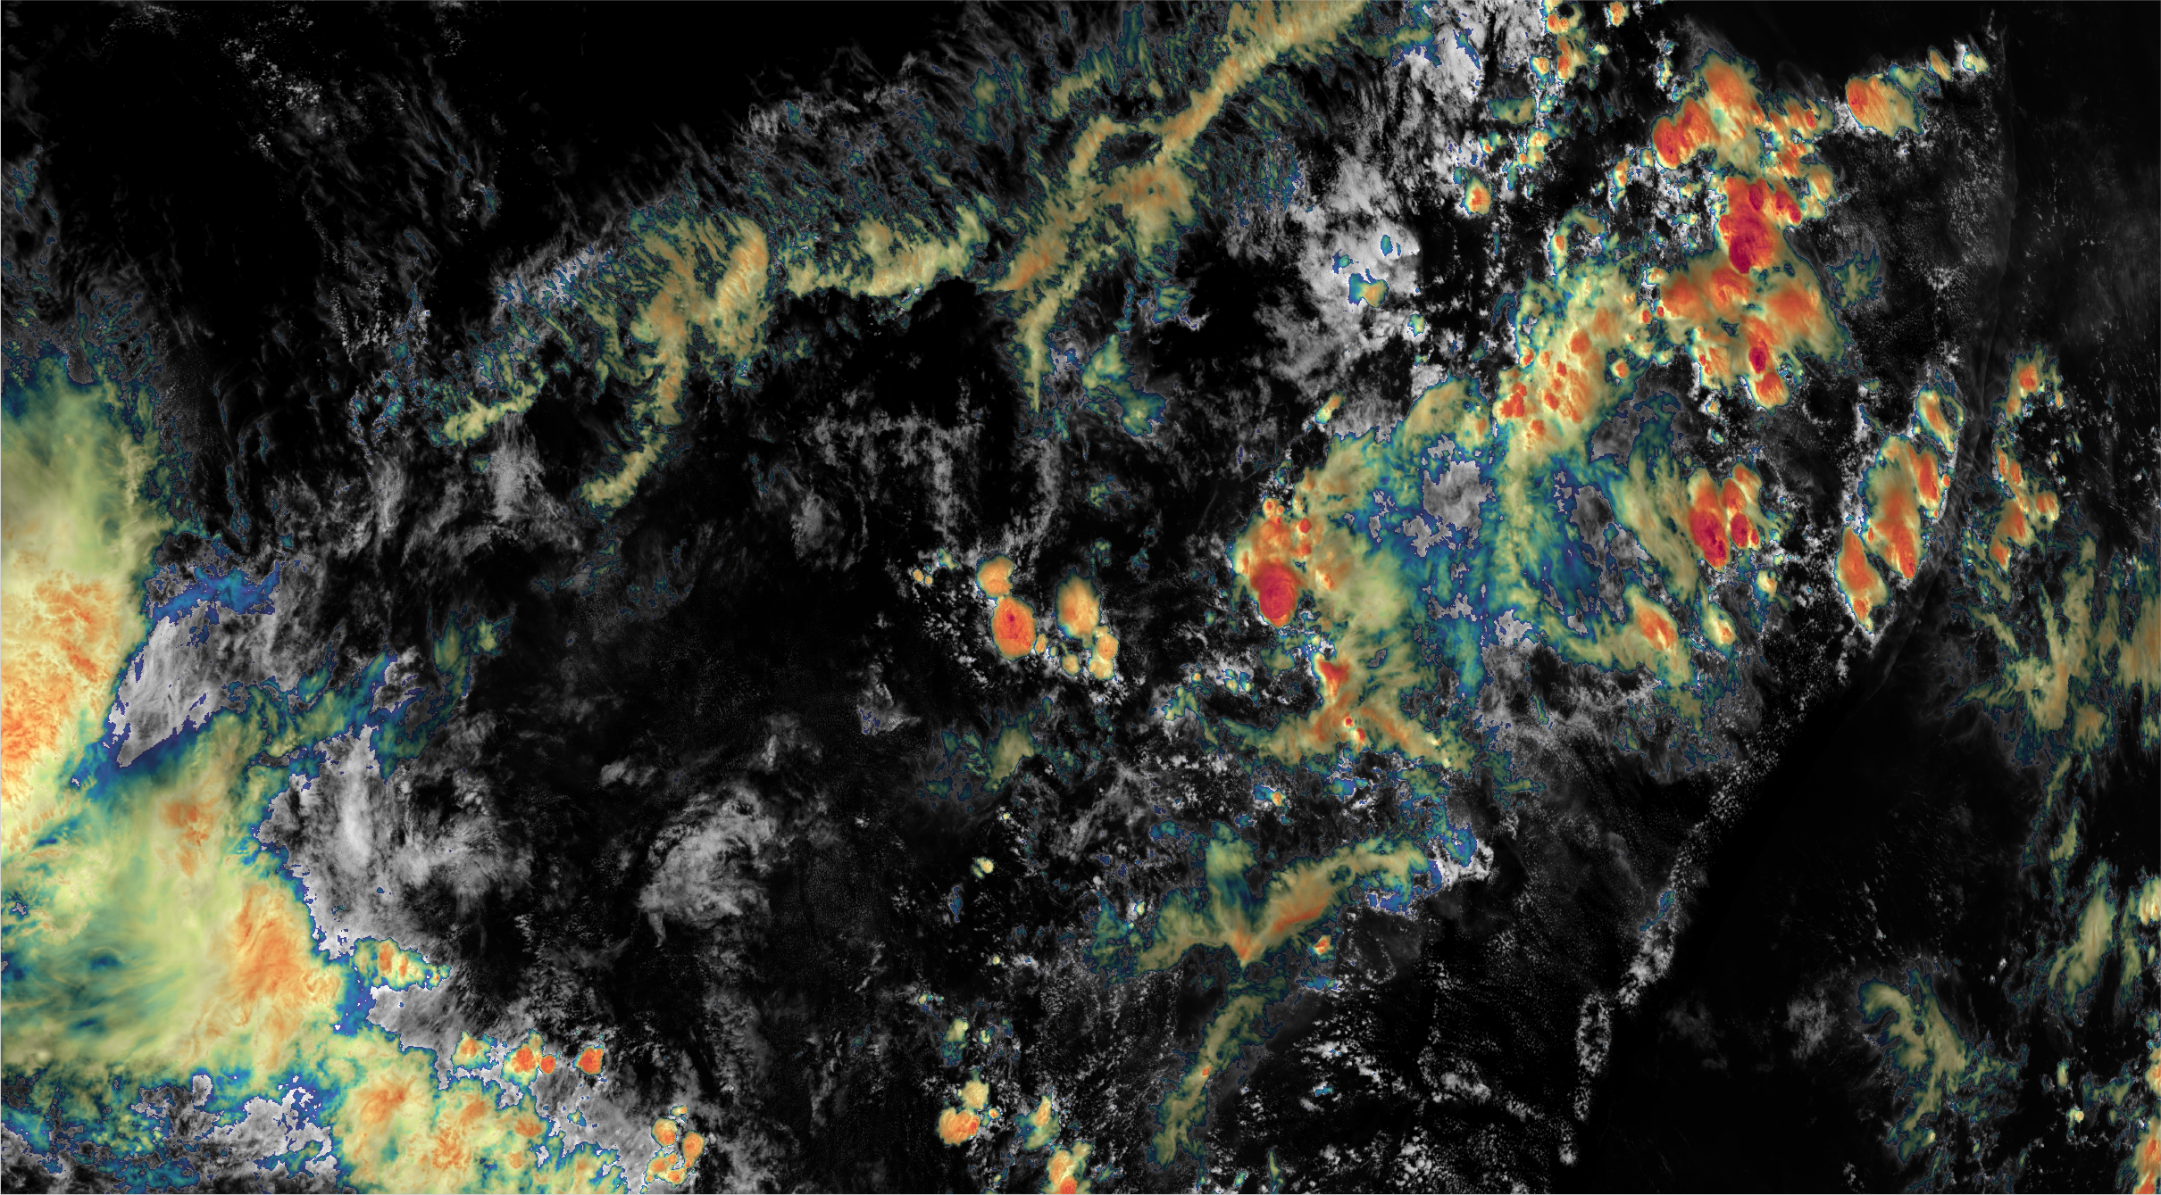
Satellite capabilities for nowcasting in Africa
In data-sparse regions an invaluable tool for nowcasting
Essential for providing operational nowcasting services
Geostationary satellites provide excellent spatial and temporal coverages.
Storm tracking
Rainfall estimates
Instability indices
Extrapolated nowcasts
Need for advanced nowcasting systems to assist the operational meteorologists (NWC-SAF)

Slide 7
Timeliness
Nowcasting highly dependent on rapidly updating information
Near-real-time observations critical:
Weather radars every 5-10 minutes
MSG satellite every 15 minutes
MTG every 10 minutes;
lightning detection systems in a matter of seconds.
Stable communication links and rapid processing of nowcasting products is essential.

Slide 8
Current and upcoming Methodologies
The development of nowcasting applications, algorithms, and methods is evolving rapidly through:
expanding earth observation observational capacity
new satellite instrumentation and measurement techniques
increased possibilities for advanced and massive data processing
the incorporation of new analysis techniques, AI/ML
improving understanding of atmospheric phenomena.
It is vital for the user community to be an active partner in this development

Slide 9










Application example
Early Warnings for Southern Africa: WISER-EWSA

Slide 10

Overview of WISER Early Warnings for Southern Africa (WISER-EWSA)
Duration: 2.5 years, Jan 2023-June 2025
2 mill GBP
2 forecasting testbeds, February 2024 (Zambia) and February 2025 (TBC).
Short-range forecasting and nowcasting (0-48 hours).
Focussing on marginalised groups.

Slide 11
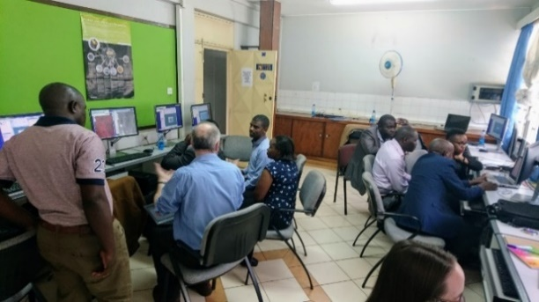
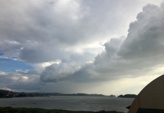
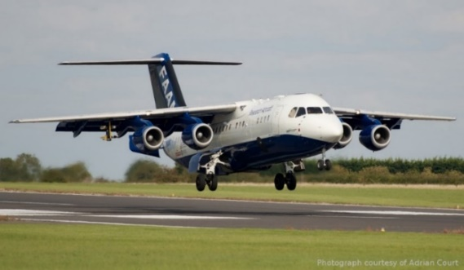


Weather Forecast Testbeds, Feb 2024 and Feb 2025
We will perform testing in real time of forecasting & nowcasting.
Forecasters, researchers and users will co-produce solutions, in preparation for the events.
Forecasters and researchers jointly create forecasts.
We use real-time observations and explore their value.
We evaluate methods from a user perspective.
We generate new Standard Operating Procedures for user-focussed forecasting and nowcasting.
Modelled on the SWIFT Weather Forecast Testbeds.
See Fletcher et al. BAMS 2023

Slide 12
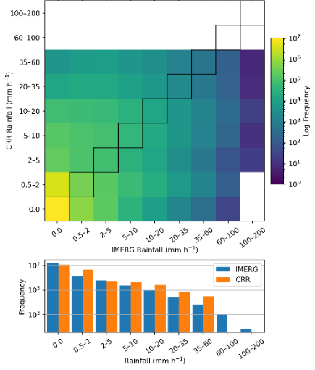
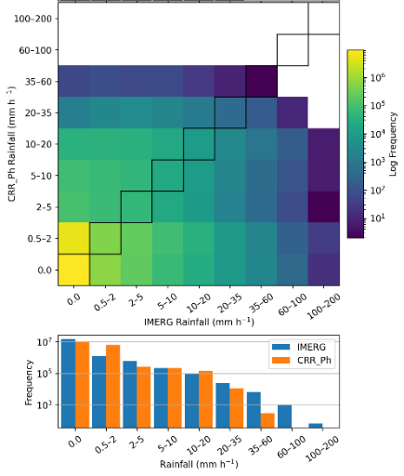
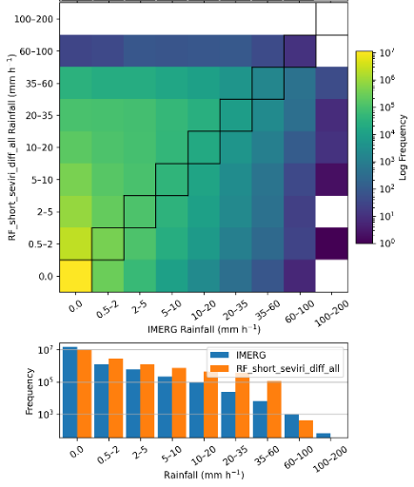
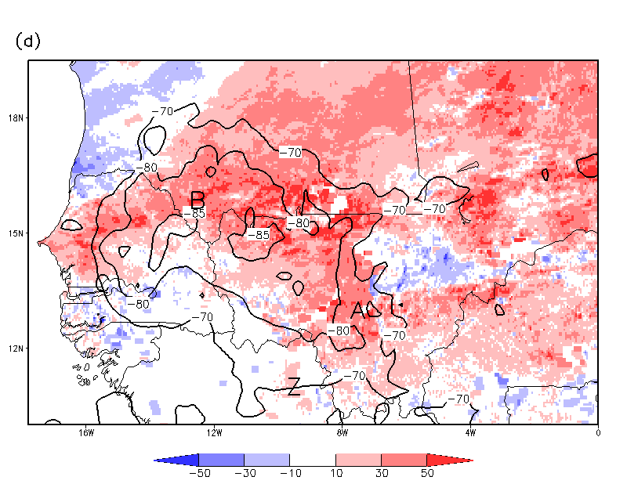
New products and their verification
New sources of information: Land surface temperature anomalies (Taylor et al, 2022, Env. Res. Lett.)
New rainfall retrieval: Random forest (AI/ML) vs NWCSAF CRR product (Pickering et al, in prep)

Slide 13
Thank you!
edeconing@wmo.int
vesa.nietosvaara@eumetsat.int

