Slide 1


Postprocessing Global AI Weather Prediction Models for Severe Weather Forecasting
Dr. Aaron J. Hill^{1,3} and Evan White¹ ¹School of Meteorology, University of Oklahoma
³NSF AI Institute for Research on Trustworthy AI in Weather, Climate, and Coastal Oceanography (AI2ES)
White and Hill (2025, in review): Severe weather forecasts from artificial intelligence weather prediction models. Artificial Intelligence for the Earth Systems
12th European Conference on Severe Storms Utrecht, Netherlands
17 November 2025

Slide 2
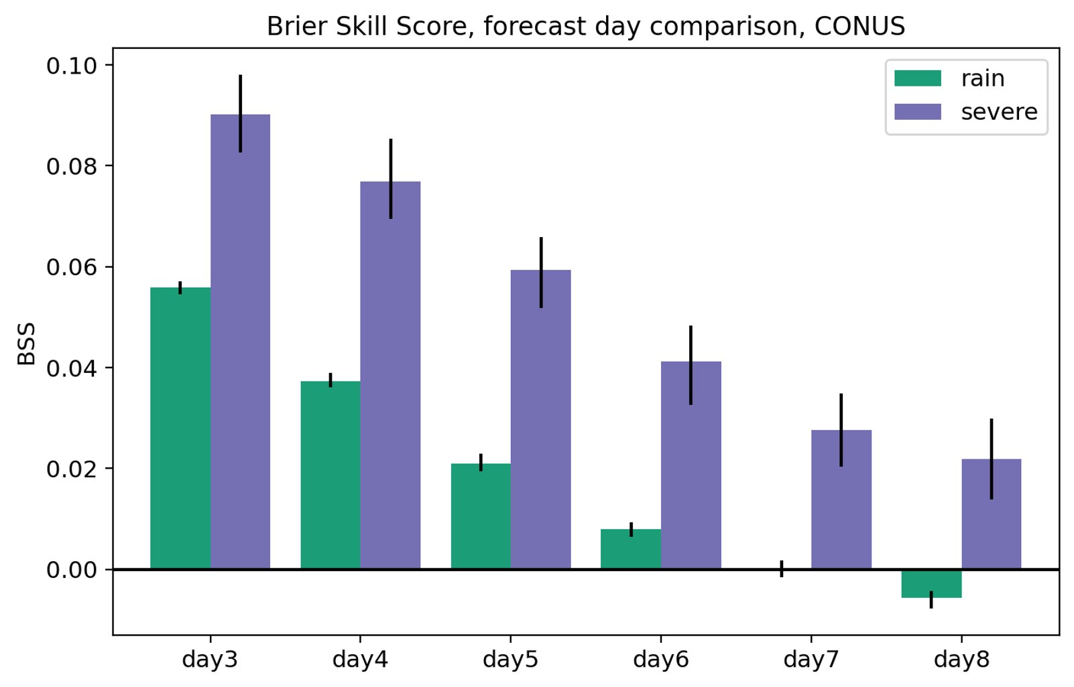
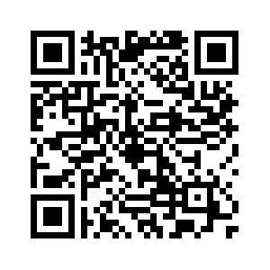
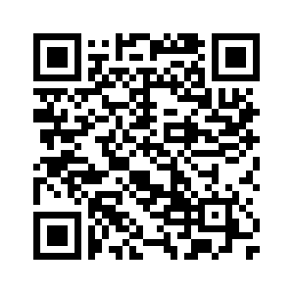
AI is changing how we forecast severe weather
New probabilistic guidance is improving integrated decision support services
Mimicking current operational products provides an *easy framework to assess value in the operational forecast process
ML-based prediction systems outperform their human-based outlook counterparts, particularly at day 3 and beyond
There is value in mining existing model outputs to generate hazard predictions!
GEFS-MLP System
Days 1-3
Days 4-8
Hill et al. 2020
Hill et al. 2023

Slide 3
We have new global prediction systems
AI has taken root in our traditional physics-based modeling paradigm as well
GraphCast, PanguWeather, FourCastNet, AIFS, FuXi, Aurora, STORMER, and on and on
Outside of just a few AI-based prediction models, convective weather hazards are still at scales much lower than the model forecast resolution
E.g., WoFSCast, Flora and Potvin (2024); HRRRCast, Abdi et al. (2025)

Slide 4
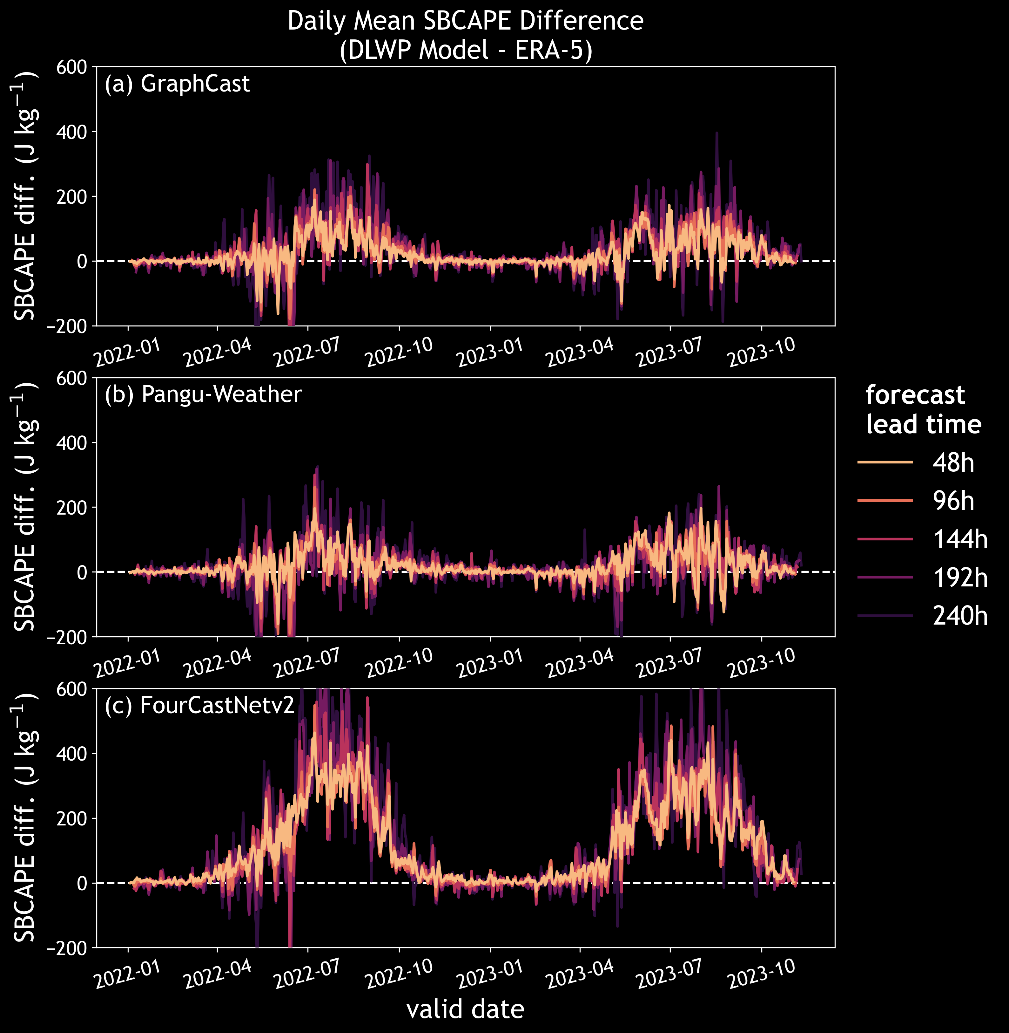
Predicted convective environments have instability and moisture biases
Models exhibit substantial bases in convective parameters like CAPE (FourCastNet v2) but others only seasonally (GraphCast during summer)
Mazurek et al. 2024

Slide 5
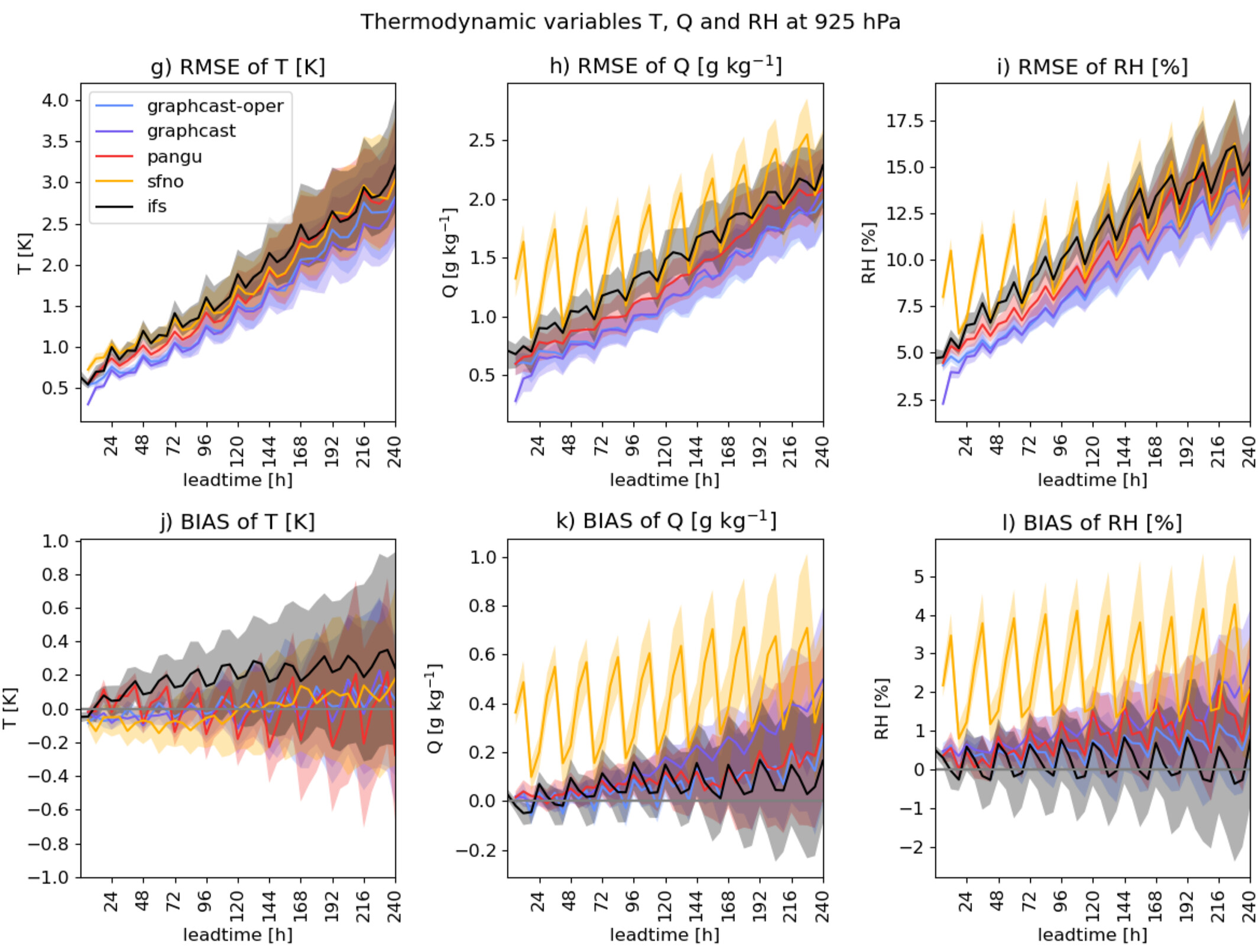
Predicted convective environments have instability and moisture biases
Models exhibit substantial bases in convective parameters like CAPE (FourCastNet v2) but others only seasonally (GraphCast during summer)
Often substantial biases in moisture variables that increase with lead time
FourCastNet with notably poor bias statistics for q and RH
BUT! Comparable environments with ECMWF IFS
Feldmann et al. 2024

Slide 6
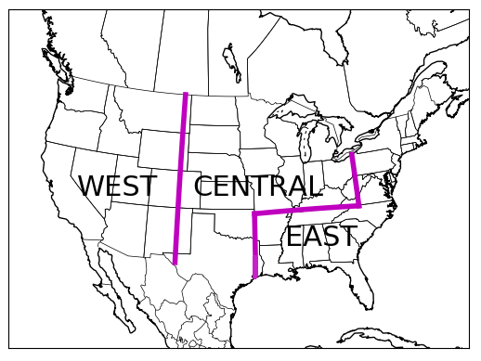
AI-MLP Approach
Data: PanguWeather, GraphCast, FourCastNet deterministic forecast output over 24-hour periods, GFS/GEFS initialized
Use a variety of atmospheric fields as predictors, train random forest models over 3 geographical regions
We use ~2 years of training (1/1/2022-10/31/2023)
Local storm reports define the historical observations
Probabilistic forecasts mimic the SPC Convective Outlook categories/definitions at days 1-3 (i.e., individual hazards)
Individual hazards out to day 8
Limited testing over 1/1/2024-12/31/2024
Predictor Variables
MLCAPE, MLCIN
MUCAPE, MUCIN
SBCAPE, SBCIN
Precipitable Water
2m Temperature
10m U and V winds
MSLP
1000-500 hPa Shear
0-3km SRH
0-1km SRH
AI-MLP: White and Hill (2025, in review)

Slide 7
Consider different input arrangements
Combined AIWP-RF
PanguWeather-RF
Pangu
Pangu
RF
Forecast
FourCast
Median
RF
Forecast
Deterministic
GraphCast
“Poor man’s” ensemble

Slide 8
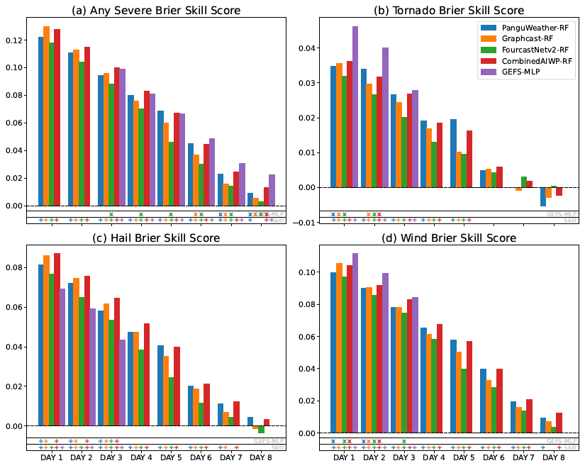
Prediction Skill and Reliability
Short-term hail forecasts are the only ones to beat the GEFS-MLP
Individual hazard skill beyond day 3
Any severe forecasts skillful out to 7-8 days

Slide 9
Prediction Skill and Reliability
Good reliability for “any severe” forecasts out to day 6

Slide 10
Prediction Skill and Reliability
Sharp drop off in reliability for extended tornado forecasts

Slide 11
Prediction Skill and Reliability
Hints at some underpredictions for hail and wind hazards, overpredictions for tornadoes

Slide 12
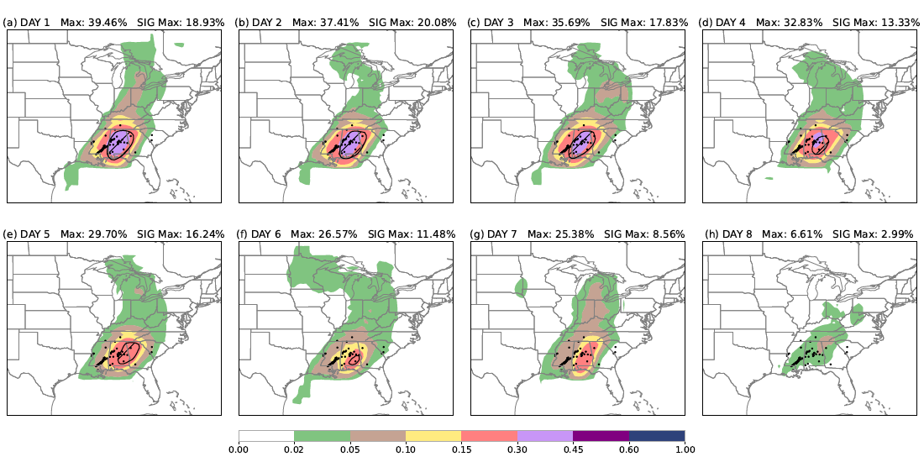
16 March 2025 – PanguWeather-RF
PanguWeather-RF Day 1-8 Tornado Forecasts
Significant tornado probabilities in black contours
Skill signal out to day 8
Limited aggregate skill

Slide 13
Extend predictability with “ensembles”
Ensemble of Random Forests (ENS-RF)
Ensemble of categorical outlooks
GEFS 1
Pangu
RF
Mean
Forecast
GEFS 30
Pangu

Slide 14
16 March 2025 – Day 8 ENS-RF
PanguWeather
ENS-RF
Tornado Forecasts

Slide 15
Extend predictability with “ensembles”
Ensemble of AIWP (ENS-AIWP)
Mean of AIWP outputs
GEFS 1
Pangu
Mean
RF
Forecast
GEFS 30
Pangu

Slide 16
Extended prediction skill to days 7 and 8
Both ensemble methods extend “any-severe” skill
Hail and wind prediction skill enhanced day 6 and beyond -> predictability limit for deterministic AIWP environments?

Slide 17
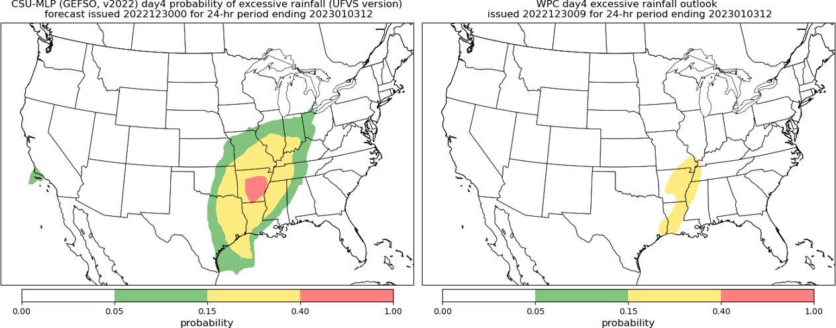
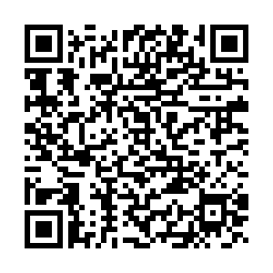
Summary and Discussion
AI-MLP forecasts are competitive with operational GEFS-MLP systems → many opportunities to improve and enhance (e.g., longer training, derived variables, ensemble predictions, etc.)
AIWP models have environments supportive of convective hazards that can be exploited in machine-learning based post-processing systems
Skillful individual hazard forecasts out to nearly 8 days
AI-MLP quasi-real-time forecast graphics:
Contact with questions/comments: ahill@ou.edu

Slide 18
A look ahead:
Exploring predictor space
Extending training period through 2024 (i.e., 3 spring seasons)
Convective parameters not updated past June 2024
Train GEFS-MLP without precip (apples to apples)
Proper ML evaluation (i.e., hyperparameter tuning, explainable AI)

Slide 19
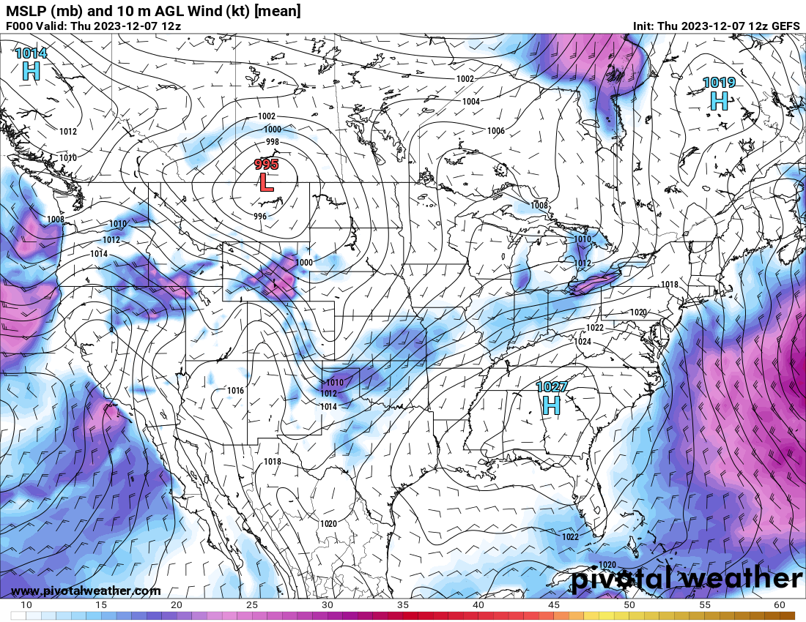
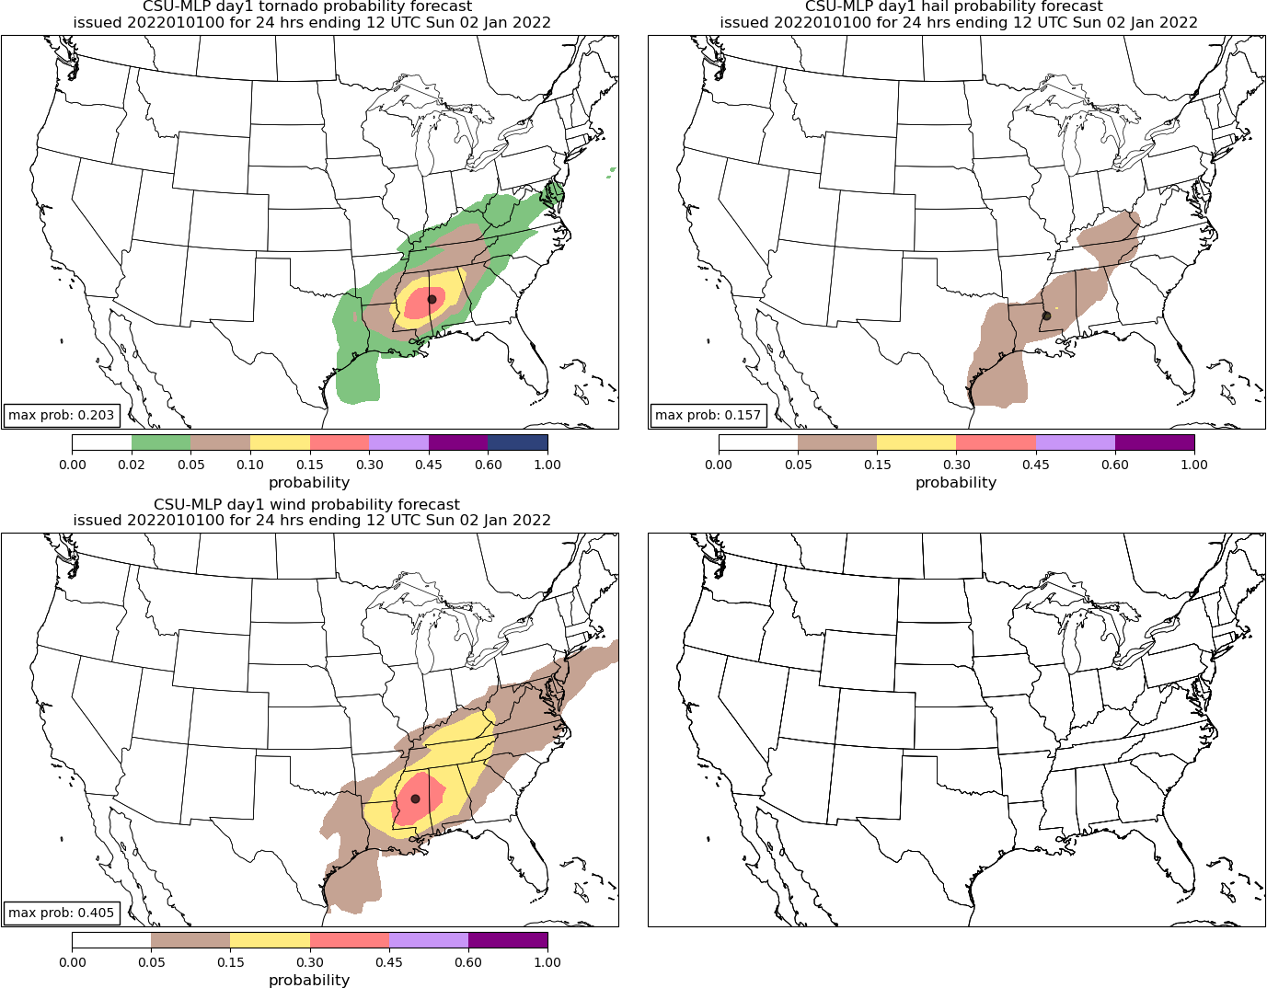
AI-MLP Prediction Workflow
Historical Events
Training Sample (2 years)
24 h forecast window
AI model
environmental parameters
CAPE
CIN
MSLP
Shear
etc.
Test Predictions
MODEL
Archived model predictors in test set

Slide 20
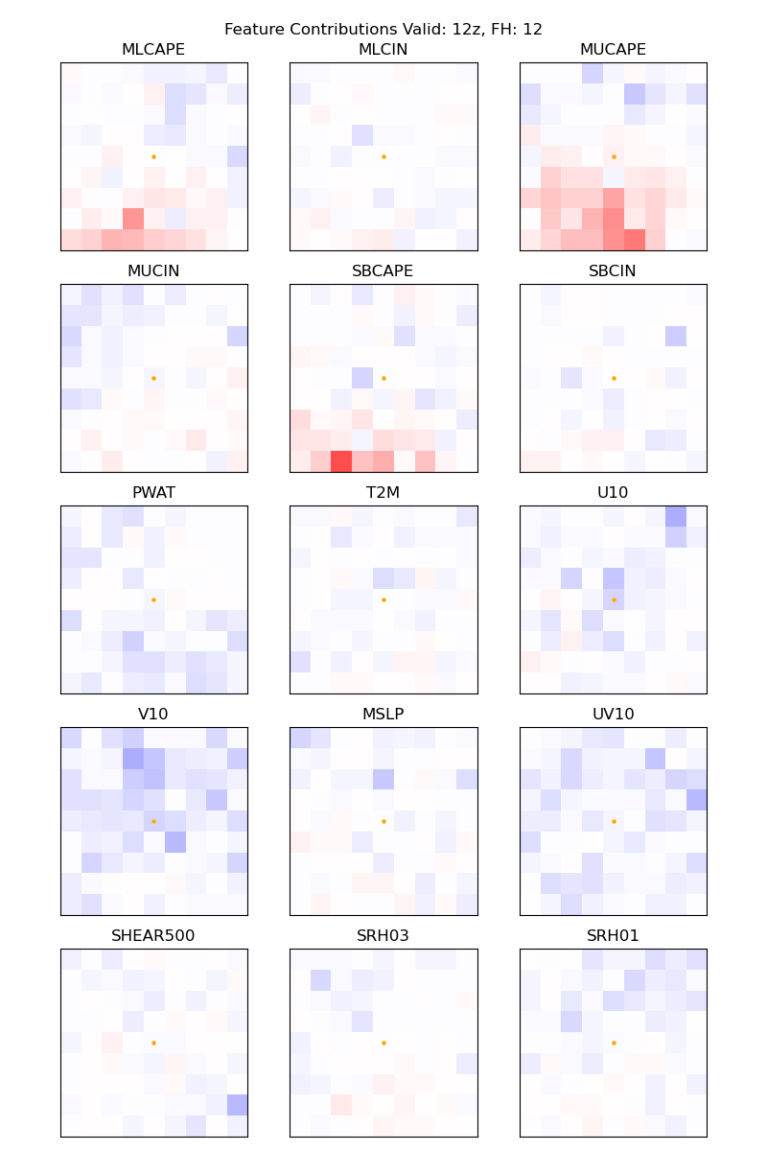
Explainability
Day-1 Tor feature contributions from GraphCast MLP
Local explainability with Tree Interpreter
(e.g., Mazurek et al. 2025)
How do features contribute to the final prediction?
Instability parameters earlier in forecast period and shear parameters post-00Z

Slide 21
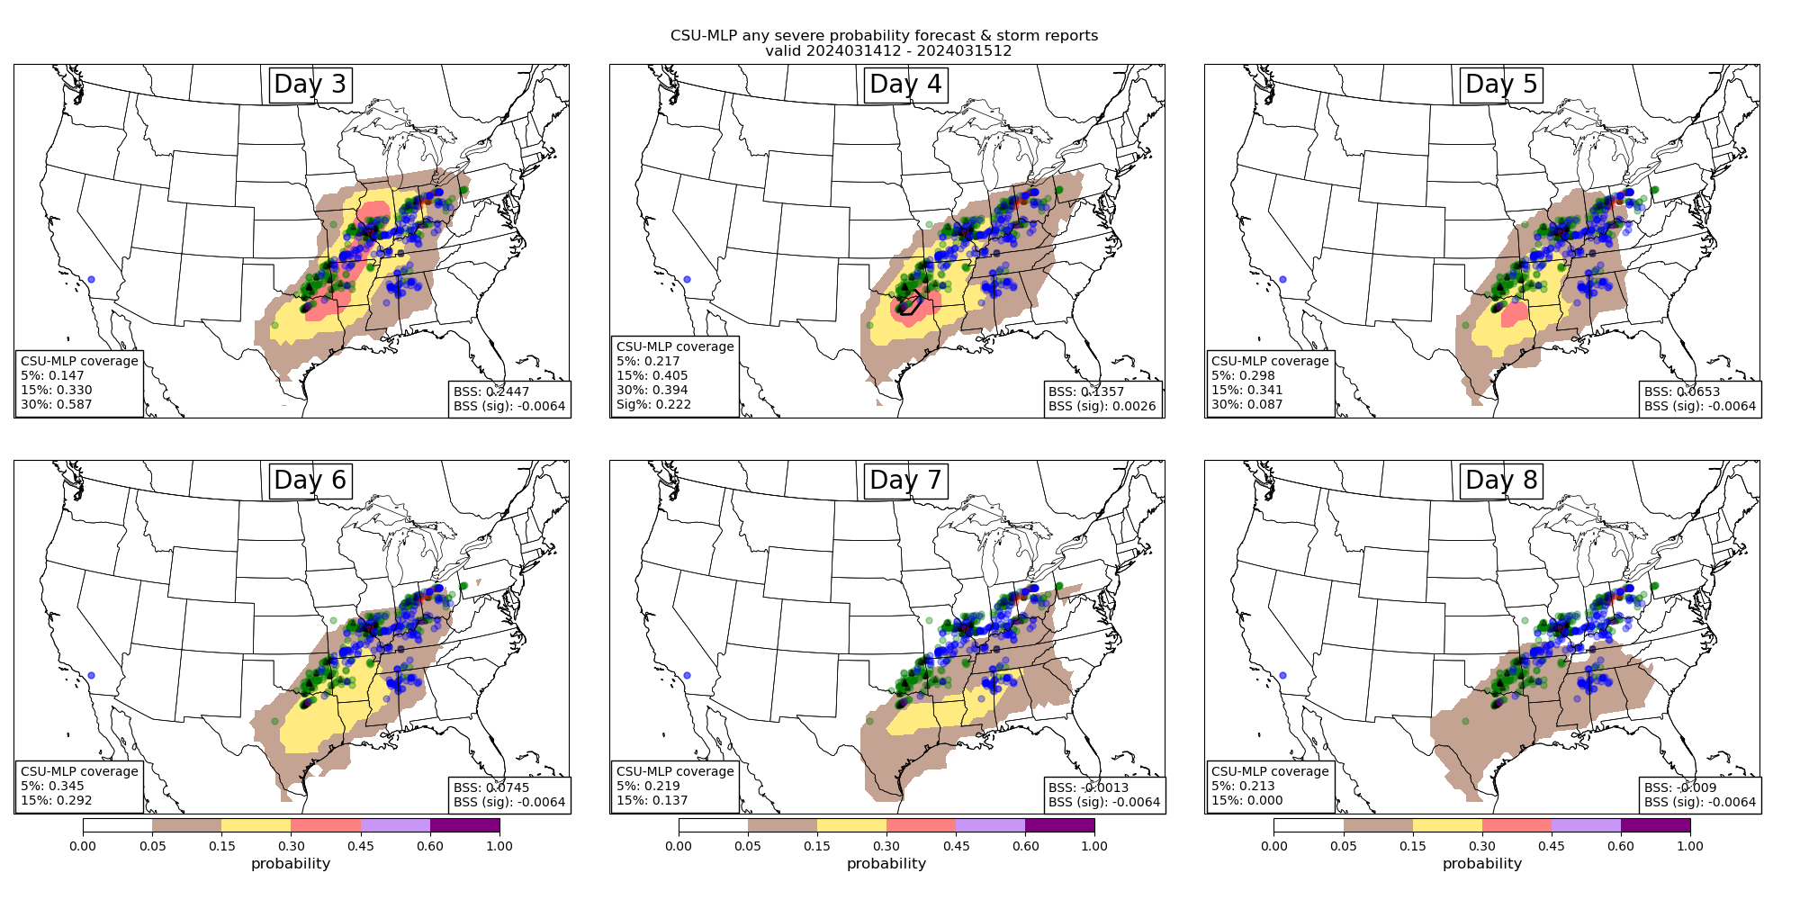
AI is changing how we forecast severe weather
Adding probabilistic guidance for improved integrated decision support services (IDSS)
Mimicking current operational products provides an *easy framework to assess value in the operational forecast process
Y
Days 3-8 any hazard forecasts valid 12 – 12 UTC 14 – 15 March 2024
Hill et al. 2020
Hill et al. 2023

Slide 22
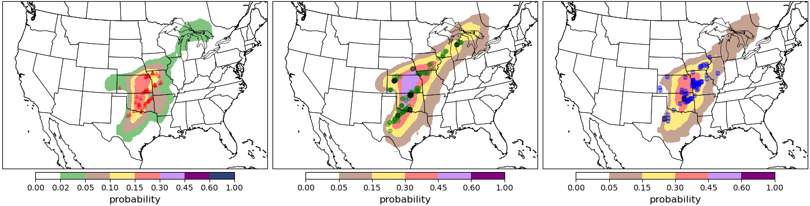
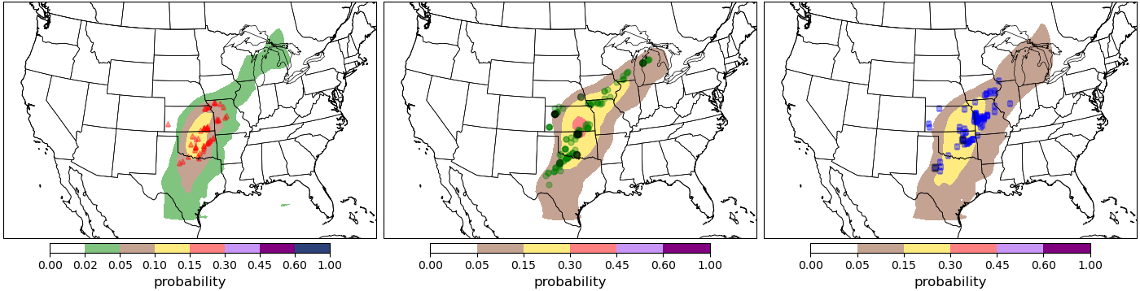
27 April 2024 – Central OK
GEFS-MLP
TOR
HAIL
WIND
Pangu MLP

Slide 23
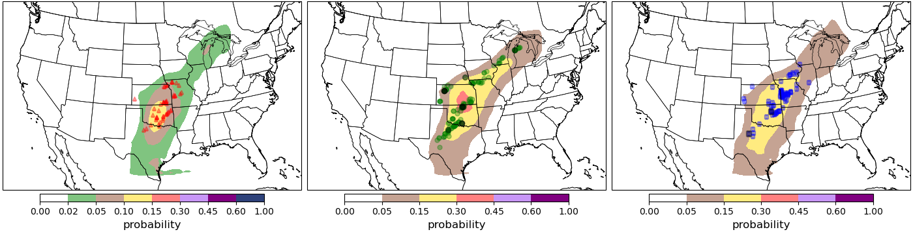
27 April 2024 – Central OK
GEFS-MLP
TOR
HAIL
WIND
GraphCast MLP

Slide 24
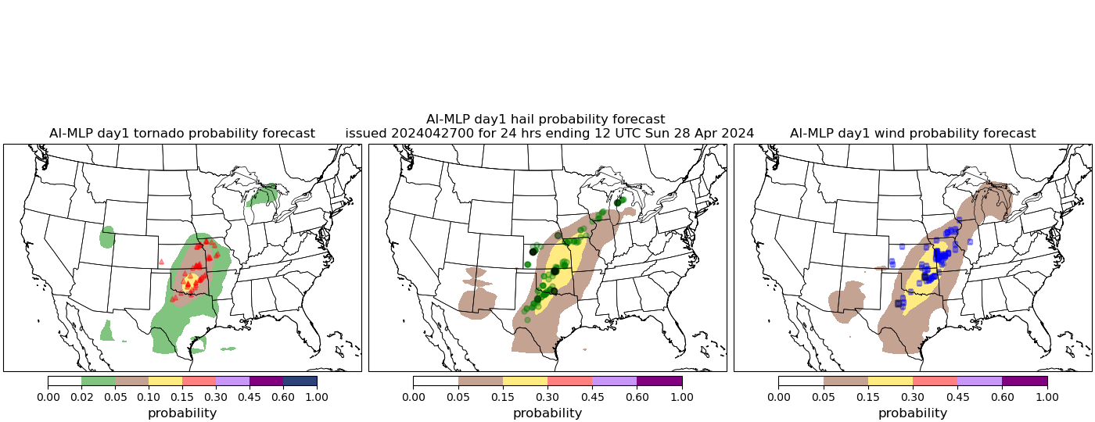
27 April 2024 – Central OK
GEFS-MLP
TOR
HAIL
WIND
FourCast MLP

Slide 25
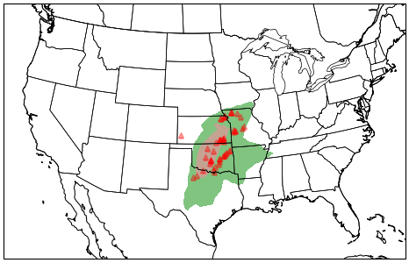
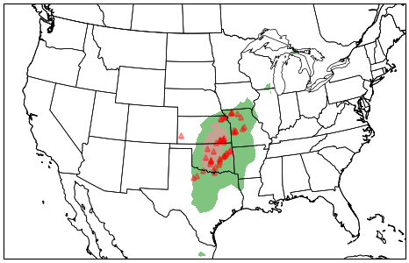
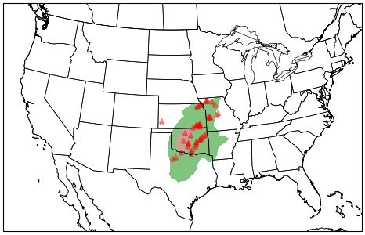
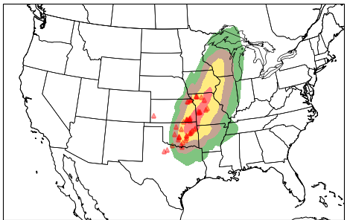
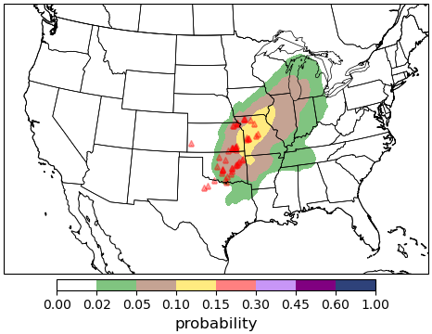
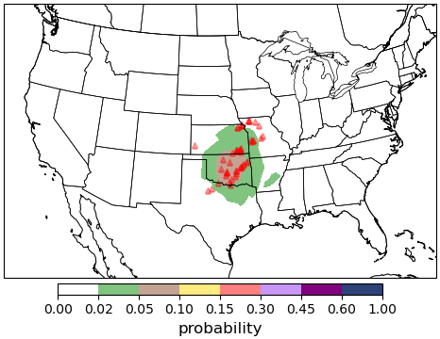
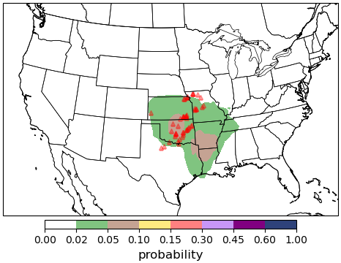
FourCast MLP
27 April 2024
TOR Forecasts
Day 1
Day 2
Day 3
Day 4
Day 5
Day 6
Day 7
Day 8

Slide 26
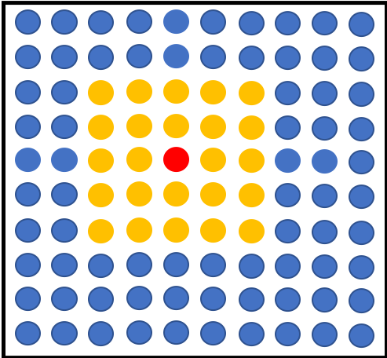
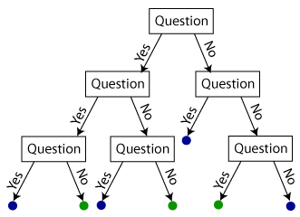
Random Forest Primer
Forecast point
Random Forests (RFs; Breiman 2001) trained on environments from numerical weather prediction models and historical observations of convection hazards
RFs: A series of questions that determine
environmental conditions favorable for hazards over a large sample
Forecasts constructed to mimic operational outlook products – “first-guess” forecasts, 24-hour probabilistic predictions of a hazard
T > 20 C?
…..
CAPE > 500 J/kg?
Probability of Hazard
50%

Slide 27

Can we extract hazard forecasts from AI systems?
Hypothesis: In a similar way to the GEFS-MLP, severe weather relevant environments and ingredients from global AI models can be used to generate outlook-scale hazardous weather forecasts → AI-MLP White and Hill (2025, in review)
Question: Ultimately, what value do these AI models hold for severe weather forecasting applications?
https://m.media-amazon.com/images/M/MV5BZjQwNGMxNmMtNDc5Ny00ODA1LTk5MzAtZDRkMzQ3NDE5ZmE5XkEyXkFqcGc@._V1_.jpg

Slide 28
Skillful hazard predictions out 6-7 days
ML-based prediction systems outperform their human-based outlook counterparts, particularly at day 3 and beyond
Predictability also likely a function of hazard type – “excessive rainfall” is harder to define than tornado event (Hill and Schumacher 2021, Hill et al. 2024)
Other postprocessing systems: Sha et al. (2022, 2024); Sobash et al. (2020); Loken et al. (2020, 2022); Clark et al. (2025); Hua et al. (2025)
There is value in mining existing model outputs to generate hazard predictions!
Baseline: daily climatology

Slide 29
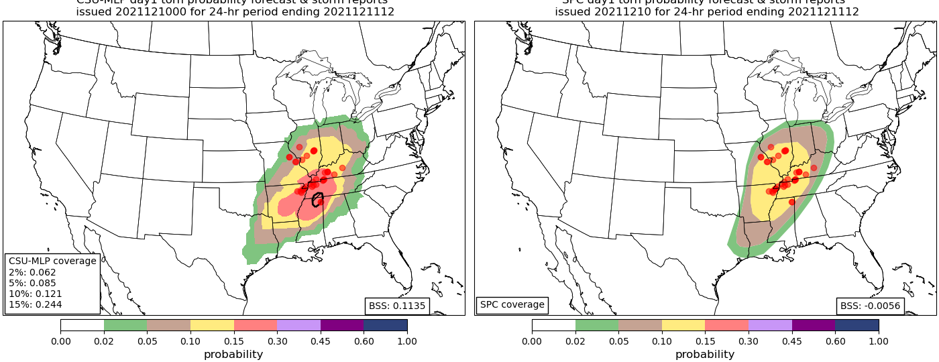
AI is changing how we forecast severe weather
Global Ensemble Forecasting System Machine Learning Probability (GEFS-MLP)
Storm Prediction Center Outlook
New probabilistic guidance is improving integrated decision support services
Mimicking current operational products provides an *easy framework to assess value in the operational forecast process
Days 1-3
Days 4-8
Day 1 tornado forecast valid 12 – 12 UTC 10 – 11 December 2021
Hill et al. 2020
Hill et al. 2023

Slide 30
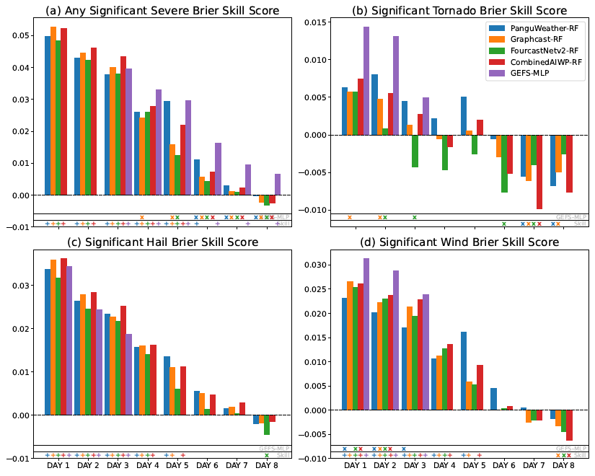
Prediction Skill and Reliability

Slide 31
Extended prediction skill to days 7 and 8

