Slide 1
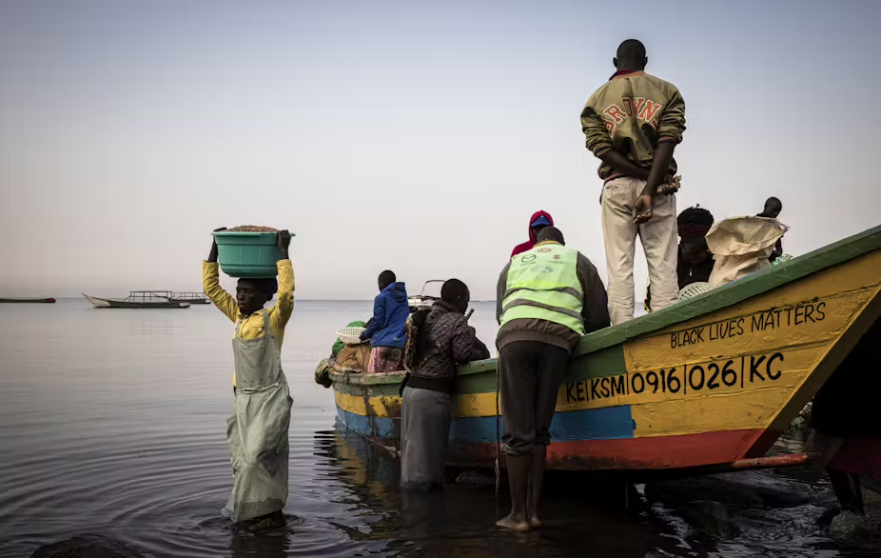

Your Title goes Here
FROM OBSERVATIONS TO ACTION: Enhancing Forecasting Capabilities Over Lake Victoria Through Radar Analysis And Regional Collaboration
Anna del Moral Méndez, C.D. Wirz, T.M. Weckwerth,
R.D. Roberts, and J. W. Wilson
NSF National Center for Atmospheric Research, and University of Illinois Urbana -Champaign
12th European Conference on Severe Storms- November 2025
SUBTITLE HERE
This material is based upon work supported by the NSF National Center for Atmospheric Research, which is a major facility sponsored by the National Science Foundation under Cooperative Agreement No. 1852977.

Slide 2
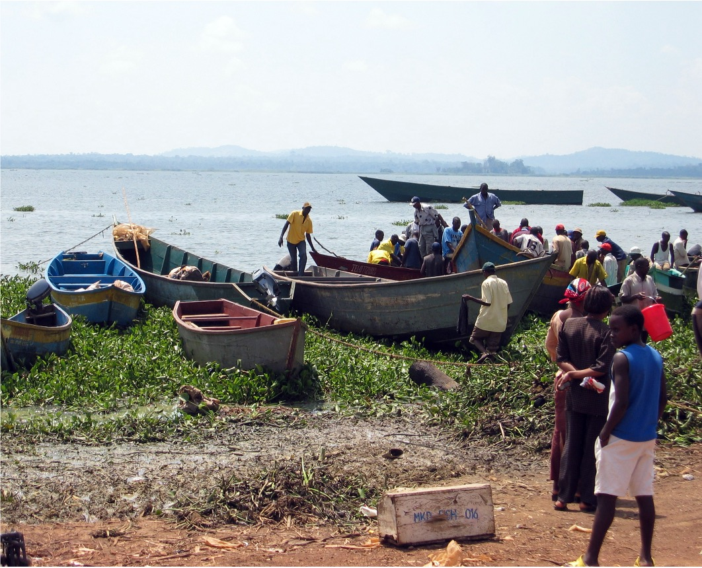
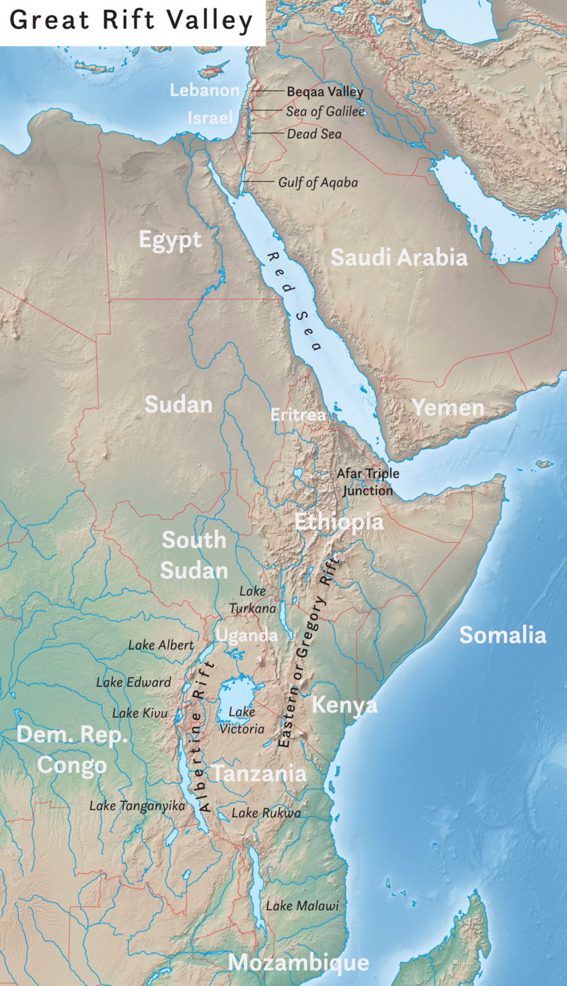
Some facts about Lake Victoria
Largest freshwater body in Africa (second biggest lake in the world after Lake Superior)
Nearly 85% of the water inflow and 15% of the water outflow in the lake is mainly caused by evaporation and rainfall instead of rivers.
Supporting life of > 5 million people
217,000 fishermen go out every day
Photo: sarahemcc/Wikicommons

Slide 3
The other face of Lake Victoria
Up to 1,500 fishers drown on Lake Victoria every year: ~ estimated 1,000 during severe weather
Fishers need to go deeper into the lake and fish at night for sardine-like omena (the Nile perch, a day catch, has been depleted)
Bad weather conditions: cause 42% of recent fisher drowning deaths
Other risk factors linked to drowning:
    No navigation systems/equipment; Storms overnight imply reduced or no visibility for anticipation or rescue crew operations; No lifejackets; Inability to swim; Non-motorized boats and/or poor boat maintenance; overload of vessels; Use of alcohol/drugs
Fishers are the main income source in their families: these tragic events put at risk the livelihoods of hundreds of thousands of family members, increasing vulnerability and poverty in the region.
Roberts et al. 2020; Rasolofoson et al. 2024; Atieno et al. 2017

Slide 4
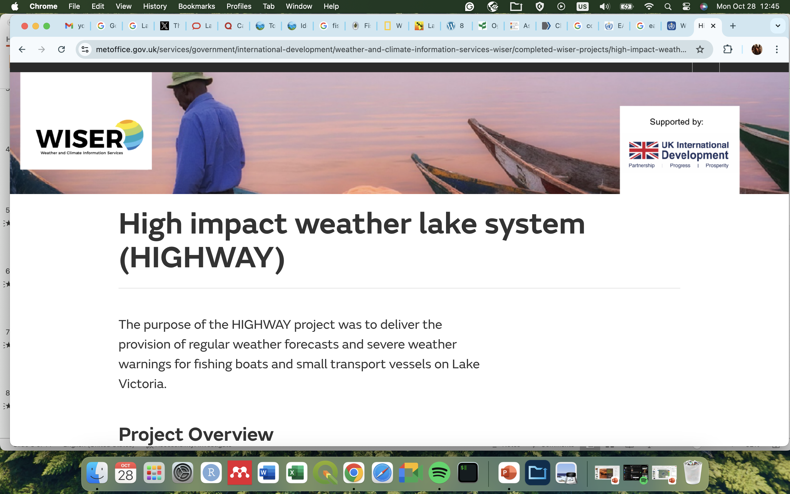
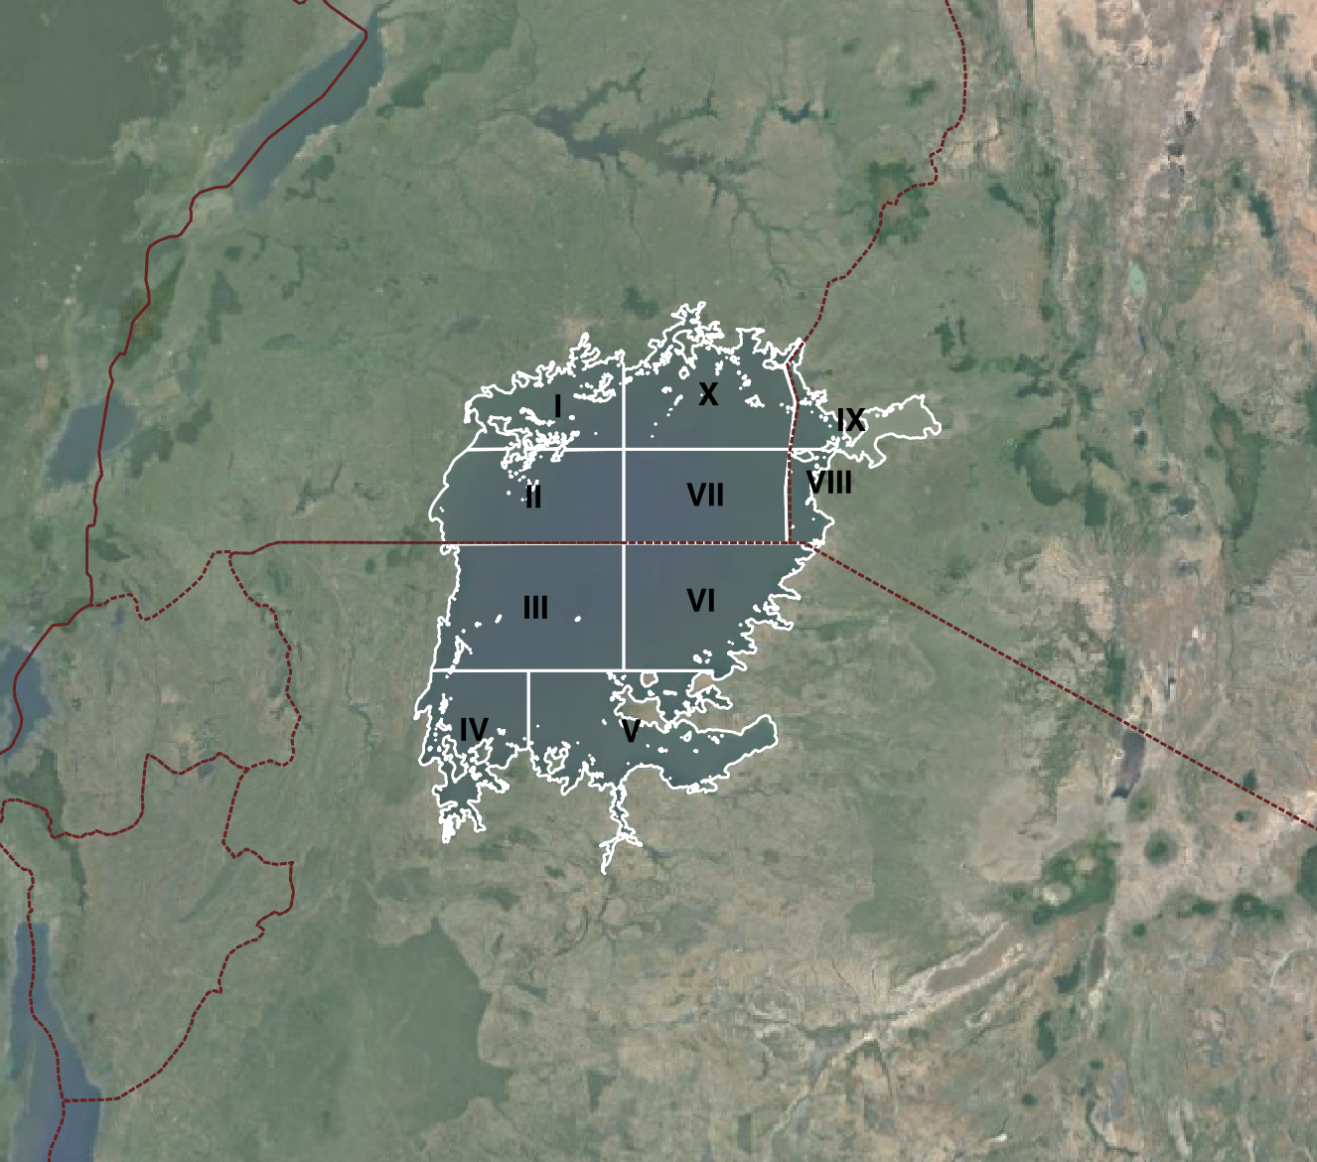
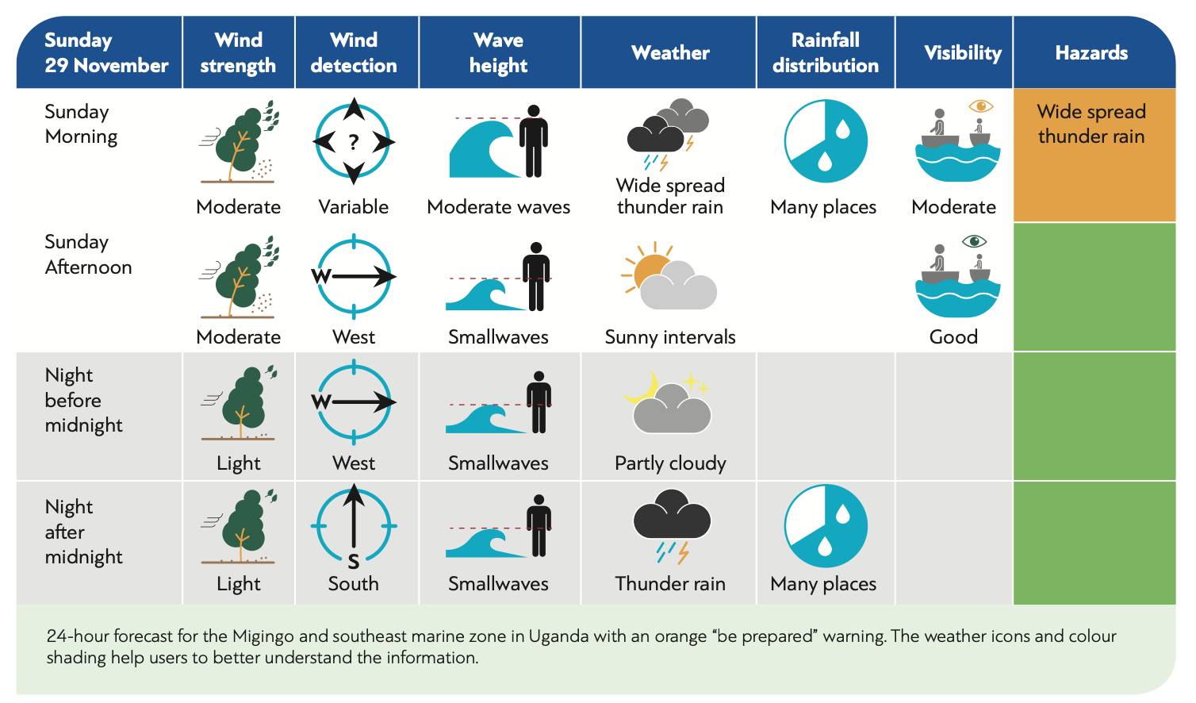
The high impact weather lake system (HIGHWAY) project
Uganda
Kenya
Tanzania
Rwanda
Uganda: I, II, VII, X
Tanzania: III, IV, V, VI
Kenya: VIII, IX
Burundi
Source: World Meteorological Organization (WMO) https://www.metoffice.gov.uk/binaries/content/assets/metofficegovuk/pdf/business/international/wiser/wiser0306_highway-project-flyer_en.pdf

Slide 5
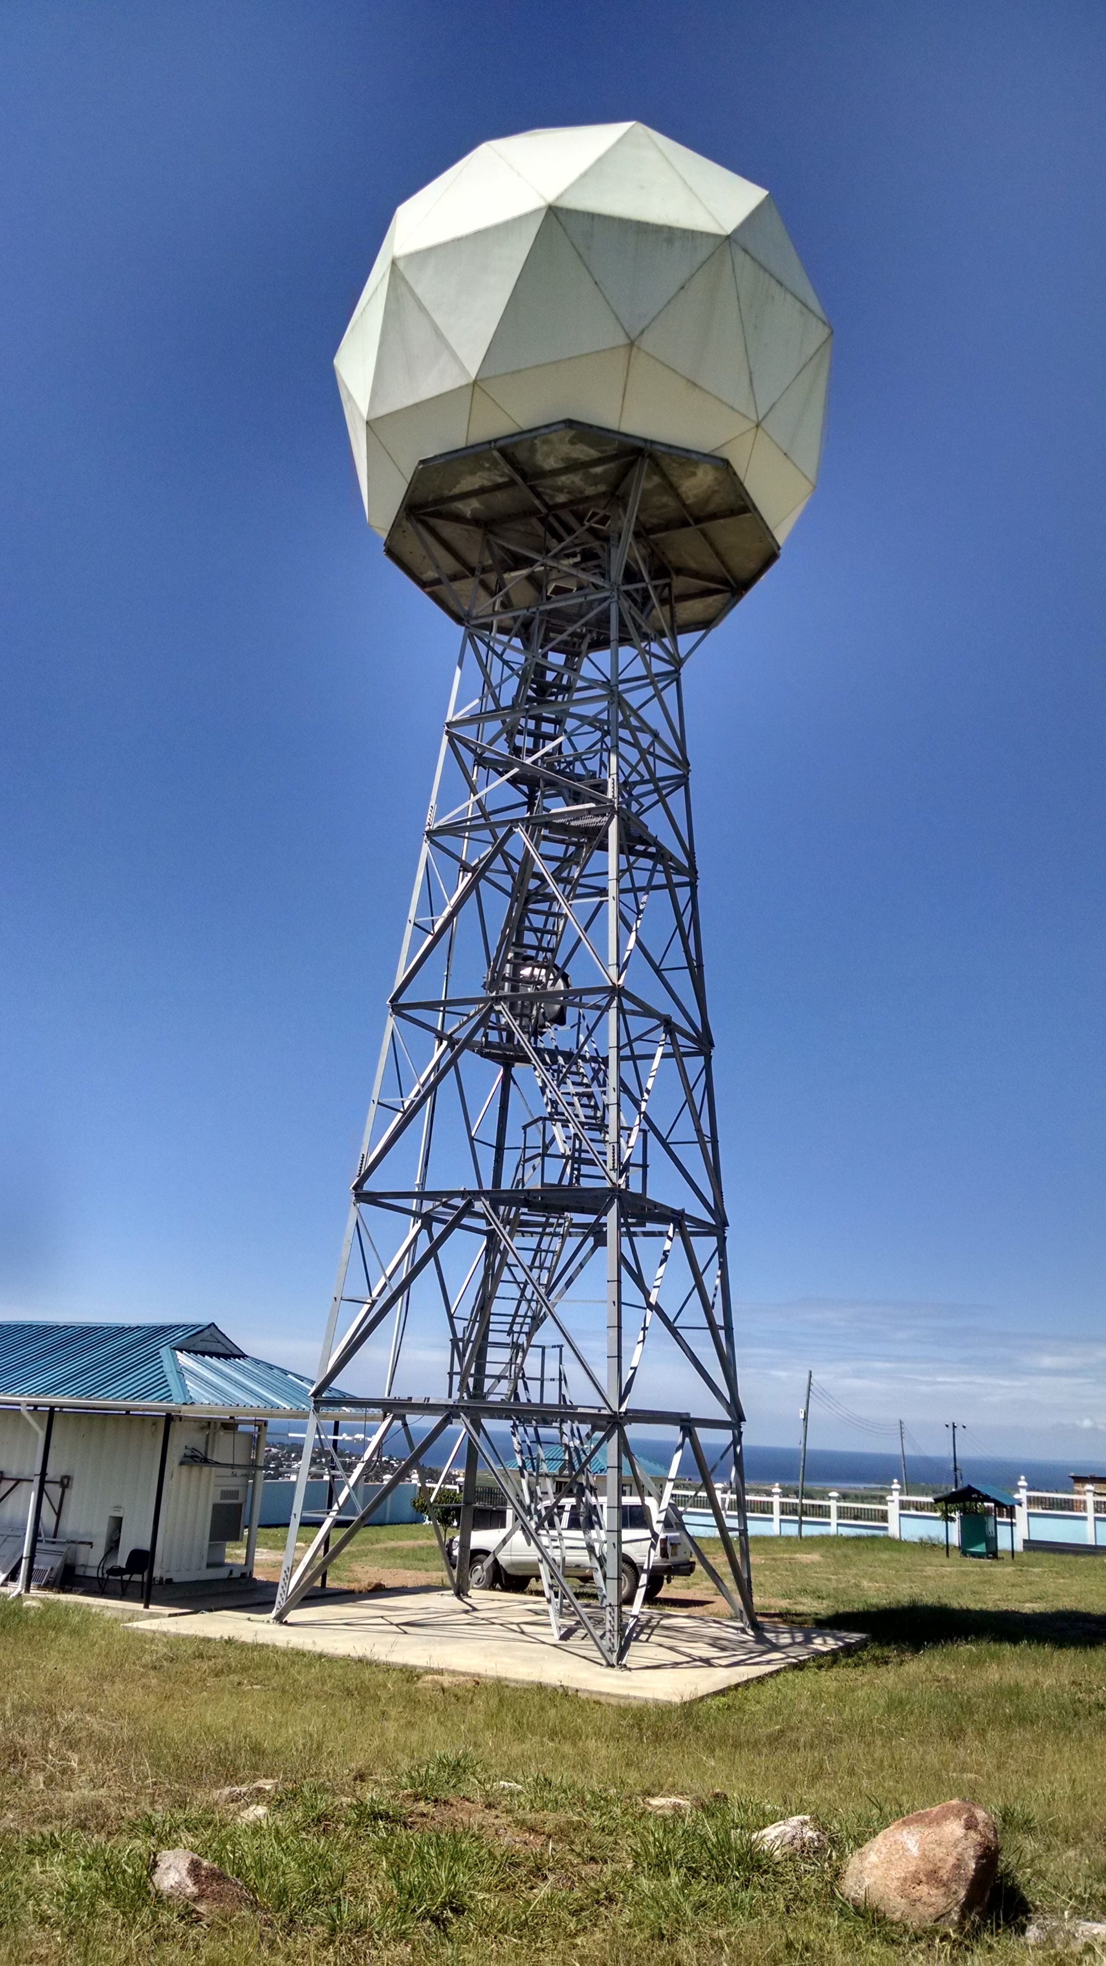
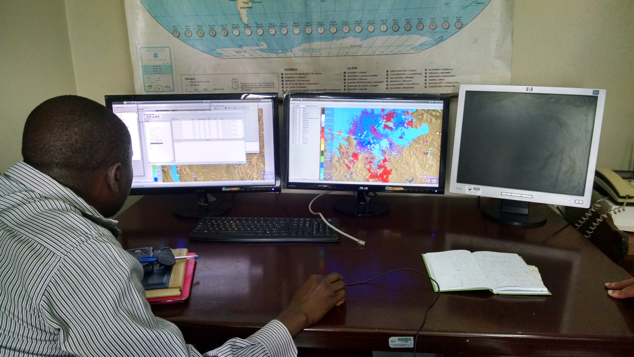
S-band Mwanza Radar
(Tanzania)
Elevation [m.a.s.l]: 1150
Manufacturer: Enterprise Electronics Corporation (EEC)
Wavelength [cm]: 10
Beamwidth [°]: 1
Gate width [km]: 0.125
Moments: Z, V, SW, ZDR, KDP*, 𝜌HV*
PRF [pulses s⁻¹]: Dual: High (1000)/Low (400)
Benedicto Katole, TMA
Pictures courtesy of R. Roberts
9

Slide 6
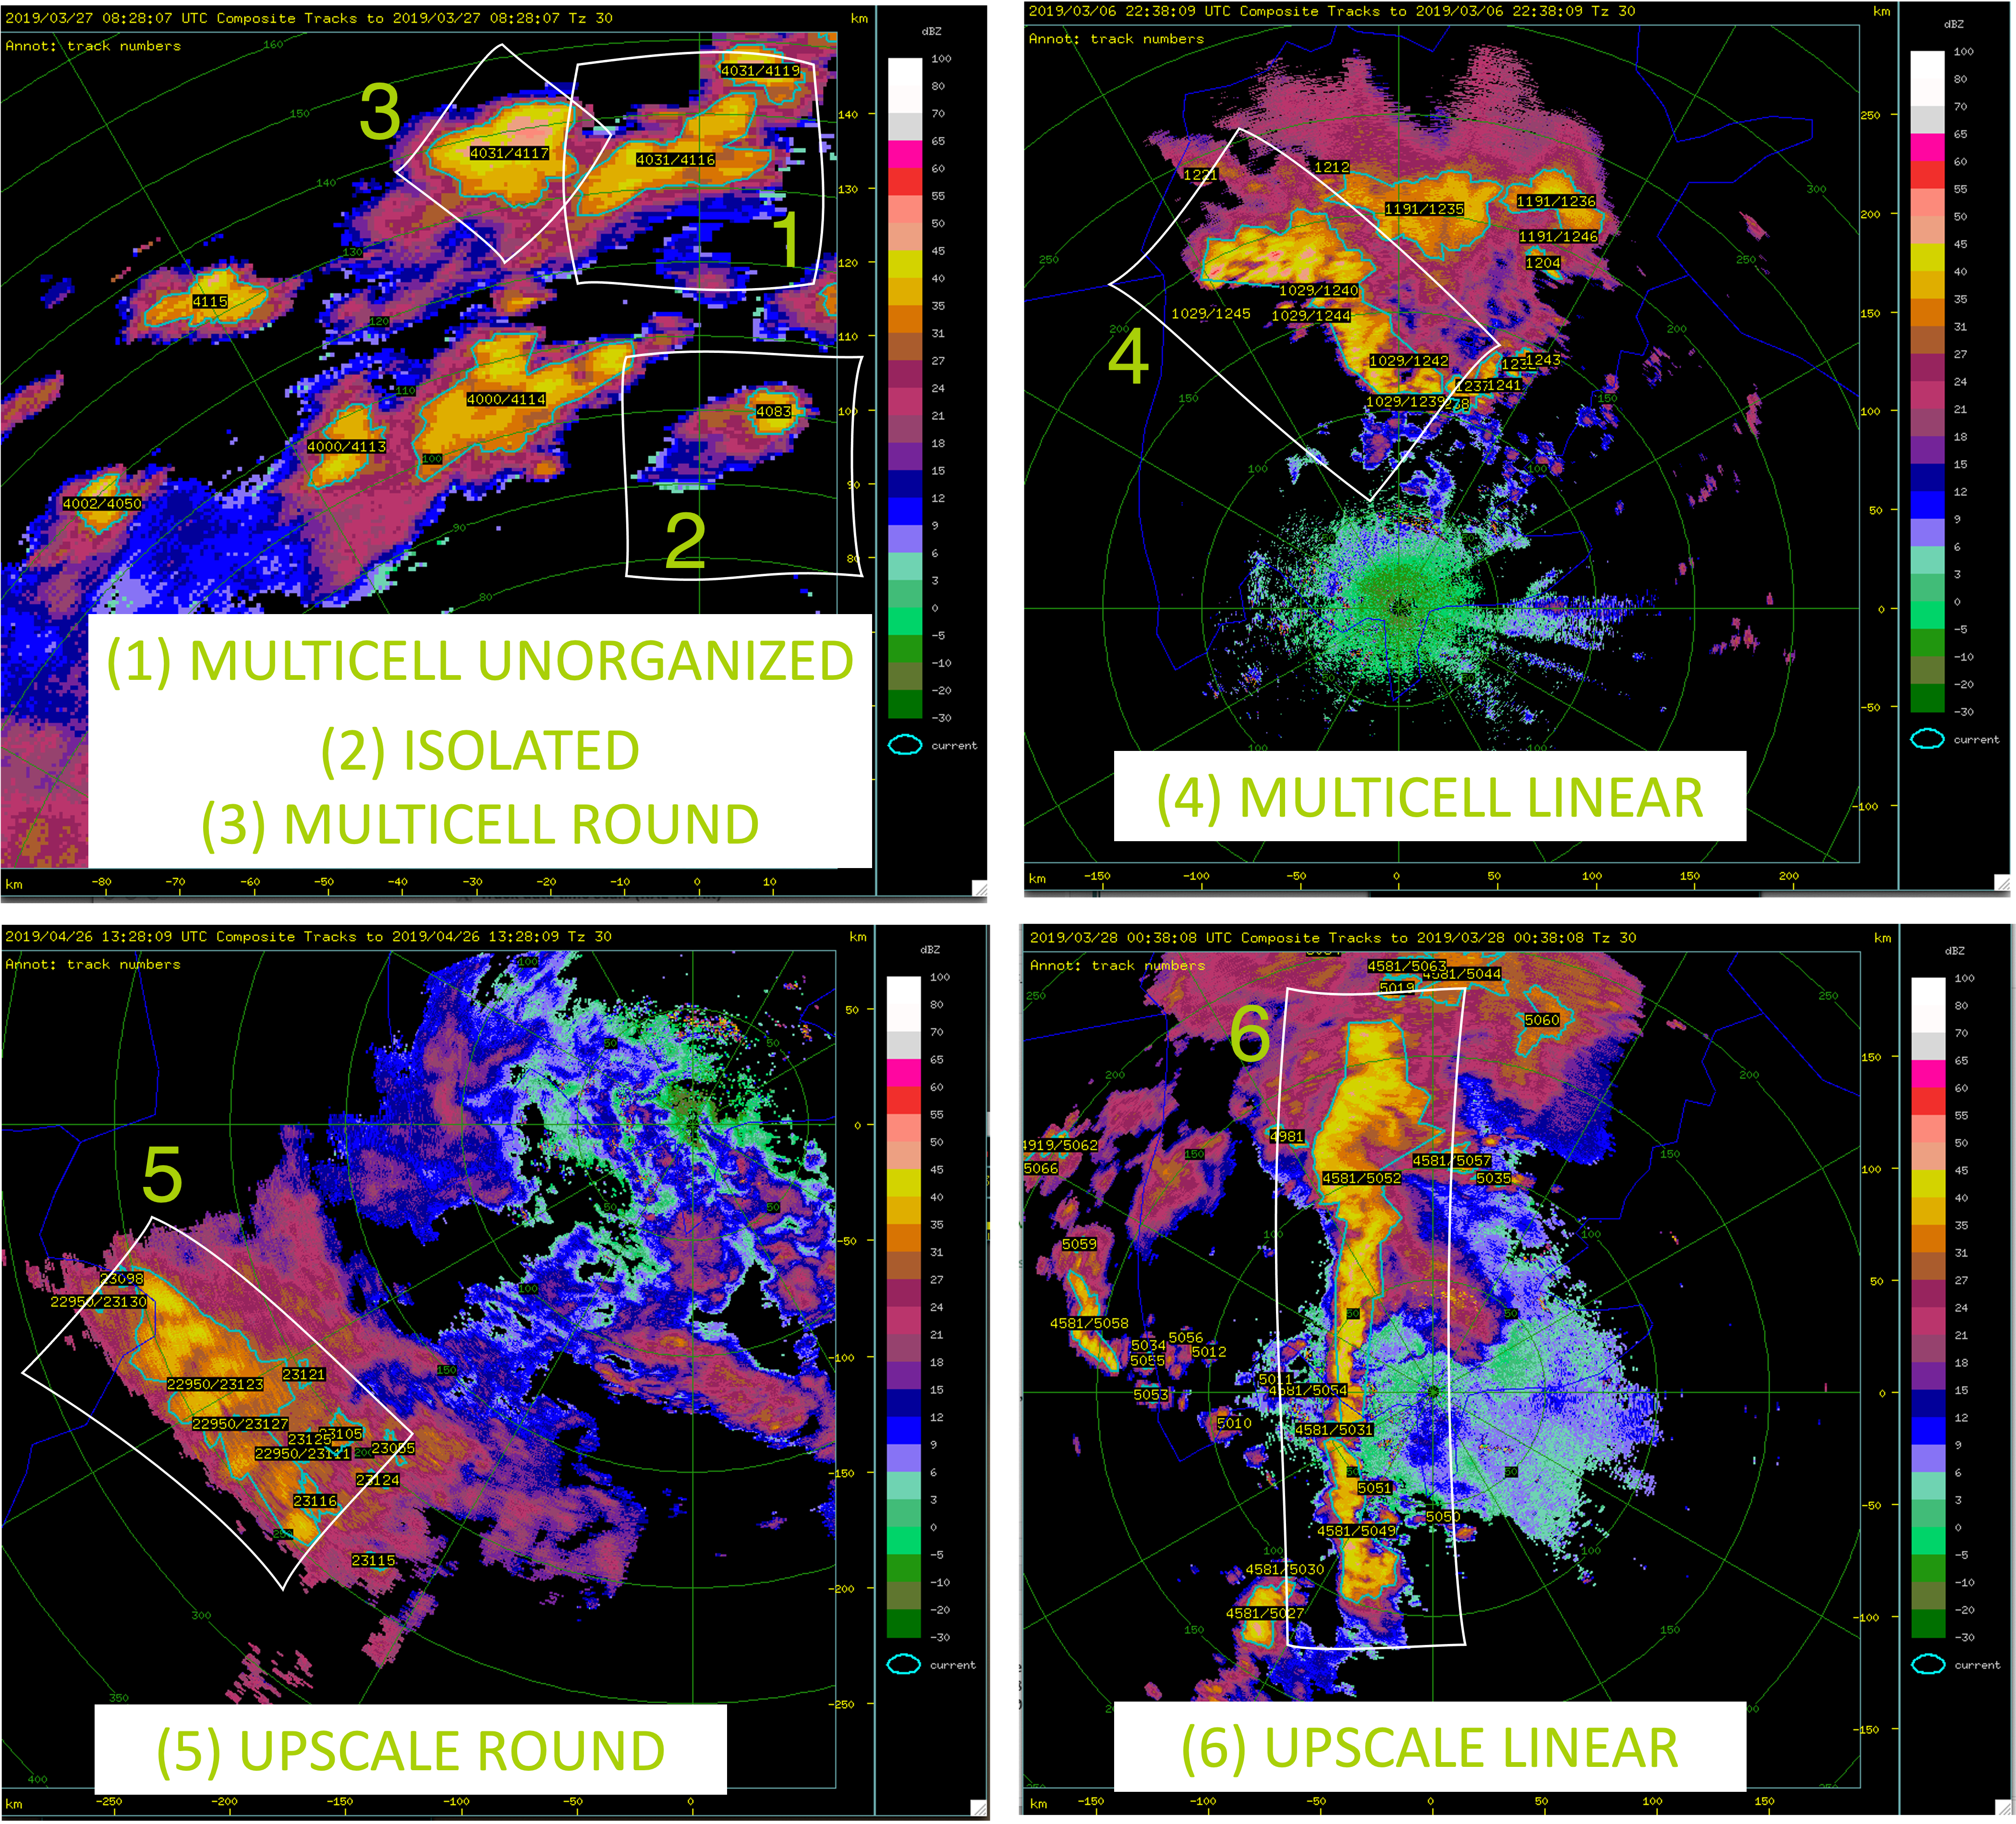
Convective mode classification
del Moral Méndez et al. (2023)
Storm ID and Tracking:
Thunderstorm Identification Tracking Analysis and Nowcasting algorithm (Dixon and Wiener 1993)
Six different type of complexes:
Major Axis
Ratio Major/ Minor axis
Max Reflectivity
Complex definition:
Maximum organization in operational timeslot
Stratification:
  Time of day
  Duration >6 h: short/long
  Lake sectors
  Wet season I (March-May) and II (Oct-Dec)
12
Notes:
Advance the knowledge of convective-scale dynamics over LVB with high-resolution observations
Improve the nowcasting of severe thunderstorms
To understand variability in thunderstorm initiation, intensification and evolution over LVB, using S-band dual-pol radar observations
To distinguish main convective-modes conducive to severe weather-related hazards (focused on strong convective winds)
To get a statistical analysis for a long period of time (shown in the results Oct-December period), we use the open-source Thunderstorm Identification and Tracking Algorithm TITAN, developed at NCAR. The NMHS offices have access to that software installed in their systems, but it is not currently being used due to the unfamiliarity with the software and its capabilities. So we hope our research can demonstrate how valuable the information from TITAN is, and that TITAN can be used to monitor and warn about the storms in real time.
We designed an automatic classification of the convective modes occurring on the Lake, based on morphological parameters, such as the major axis, the ratio of the major/minor axis and the maximum reflectivity. The classification contains 6 different modes from isolated storms to upscale modes (linear and round) and the label of the complex is given by the maximum organization found within the entire track. Other stratifications for our analysis hase been based on the duration of such complexes, the time of the day based on the operational forecast and the lake operational regionsl so our research outcome can be used in future nowcast efforts and match with the expertise of the forecasters of the region.

Slide 7
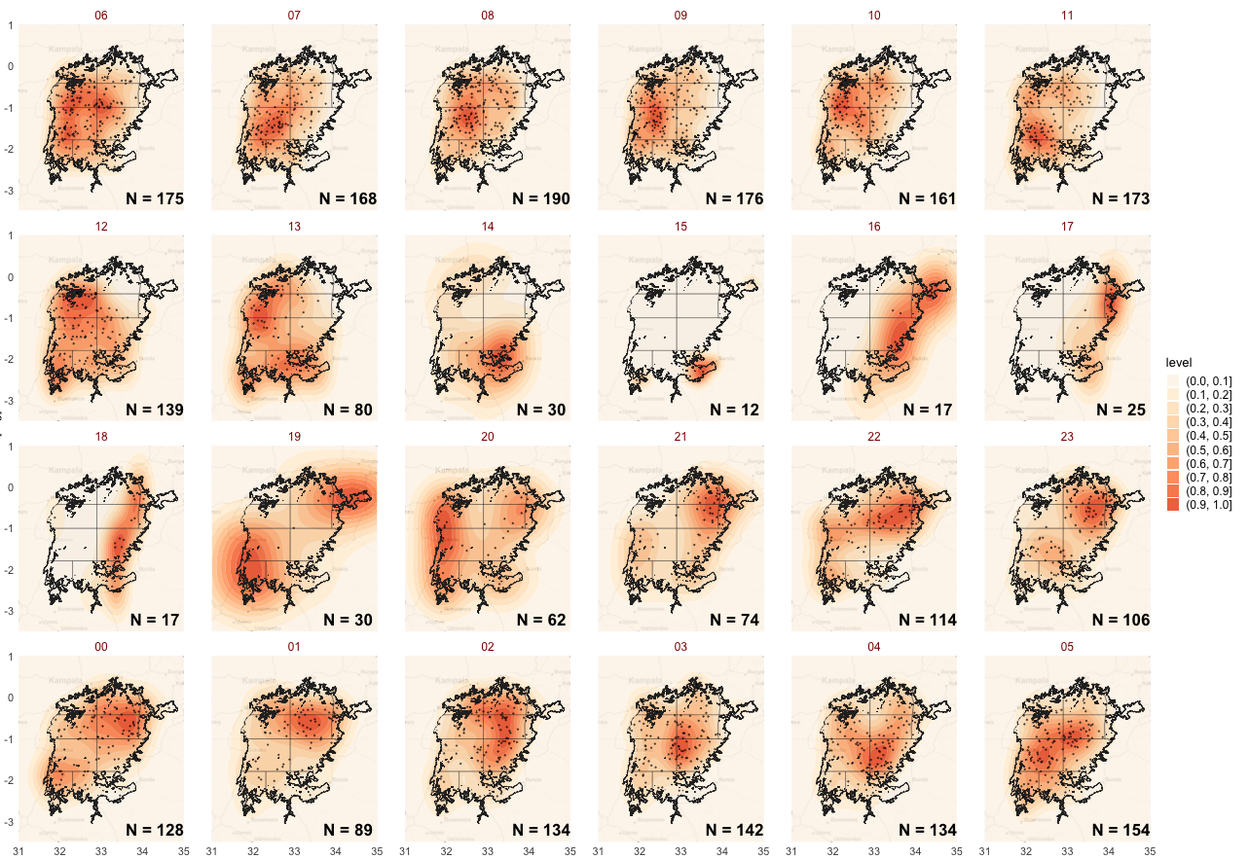
Results: hourly composites
ISOLATED
PERIOD: OCT-DEC
h (EAT)
h (EAT)
h (EAT)
h (EAT)
h (EAT)
h (EAT)
h (EAT)
h (EAT)
h (EAT)
h (EAT)
h (EAT)
h (EAT)
DEFINITION OF HOURS IN TIME SLOTS:
AFTERNOON: 12.00 - 17.59 EAT*
NIGHT BEFORE MIDNIGHT: 18.00 - 23.59 EAT
NIGHT AFTER MIDNIGHT: 00.00 - 05.59 EAT
MORNING: 6.00 - 11.59 AM EAT
*EAT = UTC +3h
h (EAT)
h (EAT)
h (EAT)
h (EAT)
h (EAT)
h (EAT)
h (EAT)
h (EAT)
h (EAT)
h (EAT)
h (EAT)
h (EAT)
del Moral Méndez, et al. 2023
Notes:
In order to match the operational forecasts time slots with the diurnal cycle, we analyze the spatial distribution of the isolated mode over the lake, since is the one with highest occurrences.
The picture shows the spatial distribution inside the lake perimeter, for each hour in local time (UTC+3).
Colors represent a spatial density distribution normalized to one, to be comparable between them, and the black dots represent the centroids of the storms on which that distribution is based. The lines on the lake represent the sectors.
CLICK: We can see how there’s a marked diurnal cycle over the lake, with first maximum between 22 and 03 Local time, with storms affecting the North Eastern and Center regions of the Lake, affecting mostly Kenya and Tanzania forecast sectors.
CLICK: A second more pronounced maximum is found around sunrise hours (+-3 h), with storms affecting the South western and western sectors, and for which the monitoring of Tanzania and Uganda is of major importance.
The minimum activity over the lake is found early in the afternoon. In this period, most of the storms are being formed outside the lake region usually in the Kenyan highlands.

Slide 8
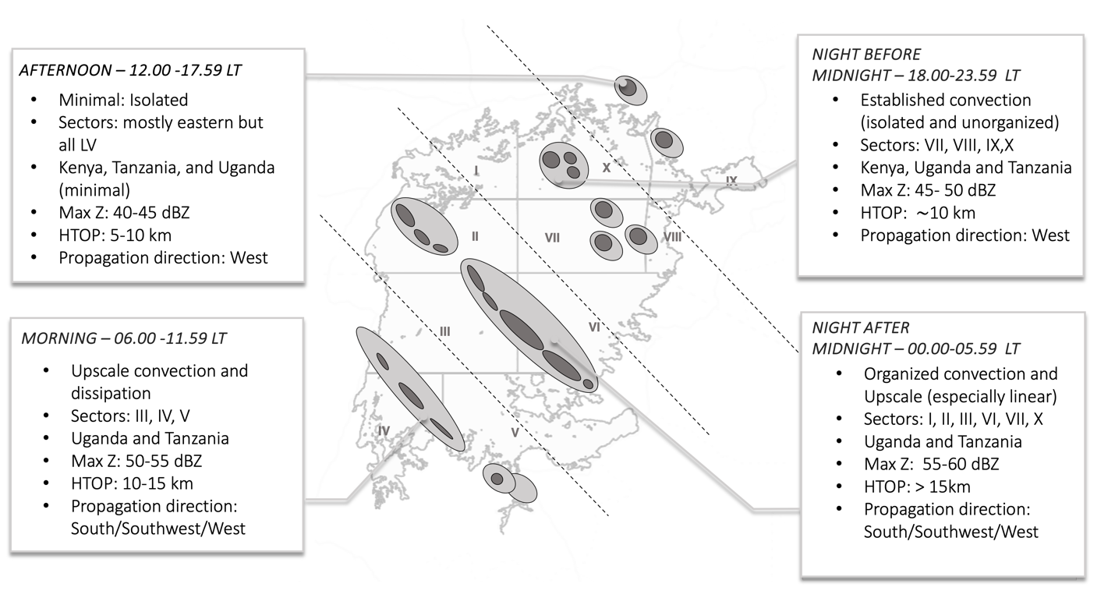
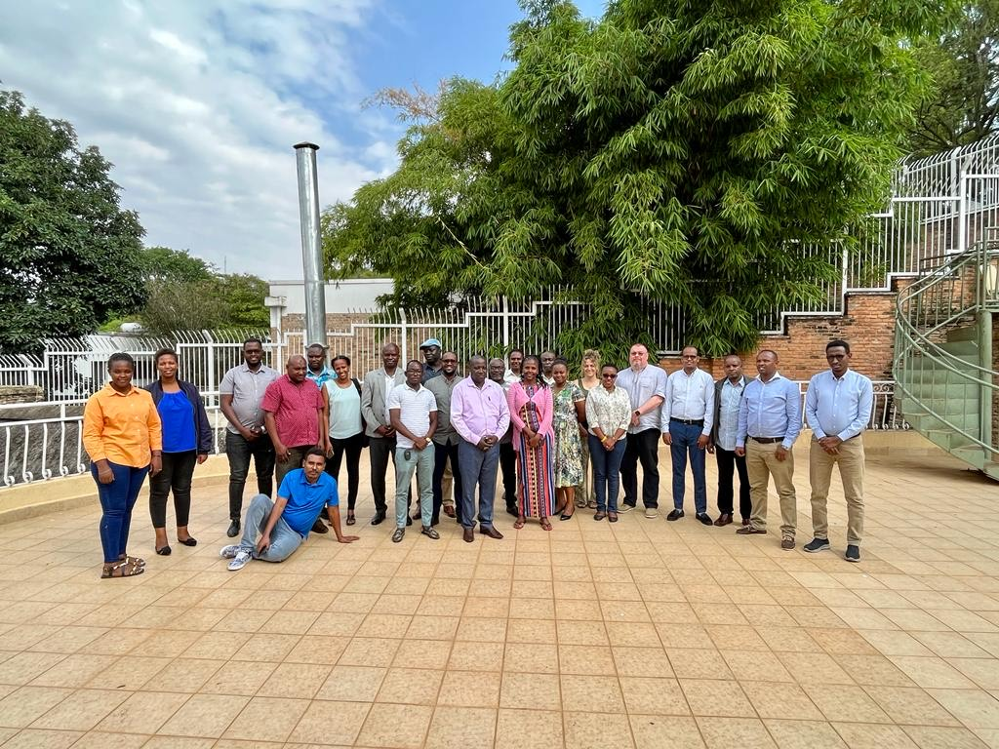
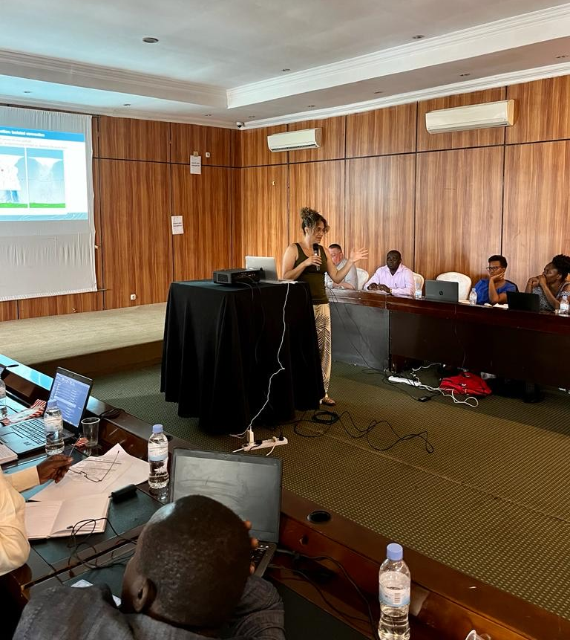
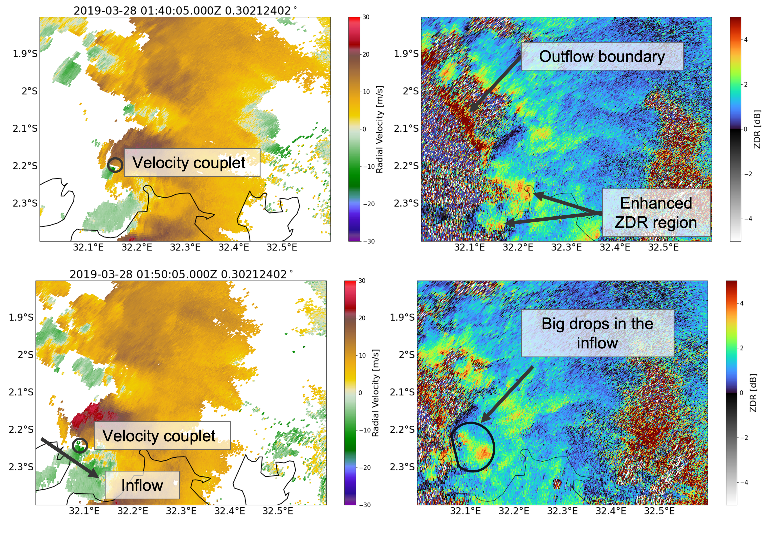
From science to training and engagement
CREWS/SWFP–Eastern Africa Training Workshop on Severe Weather and Impact-based Forecast and Warning Services
(Kigali, Rwanda, 13-23 June 2023, and Entebbe 2025 (online))

Slide 9
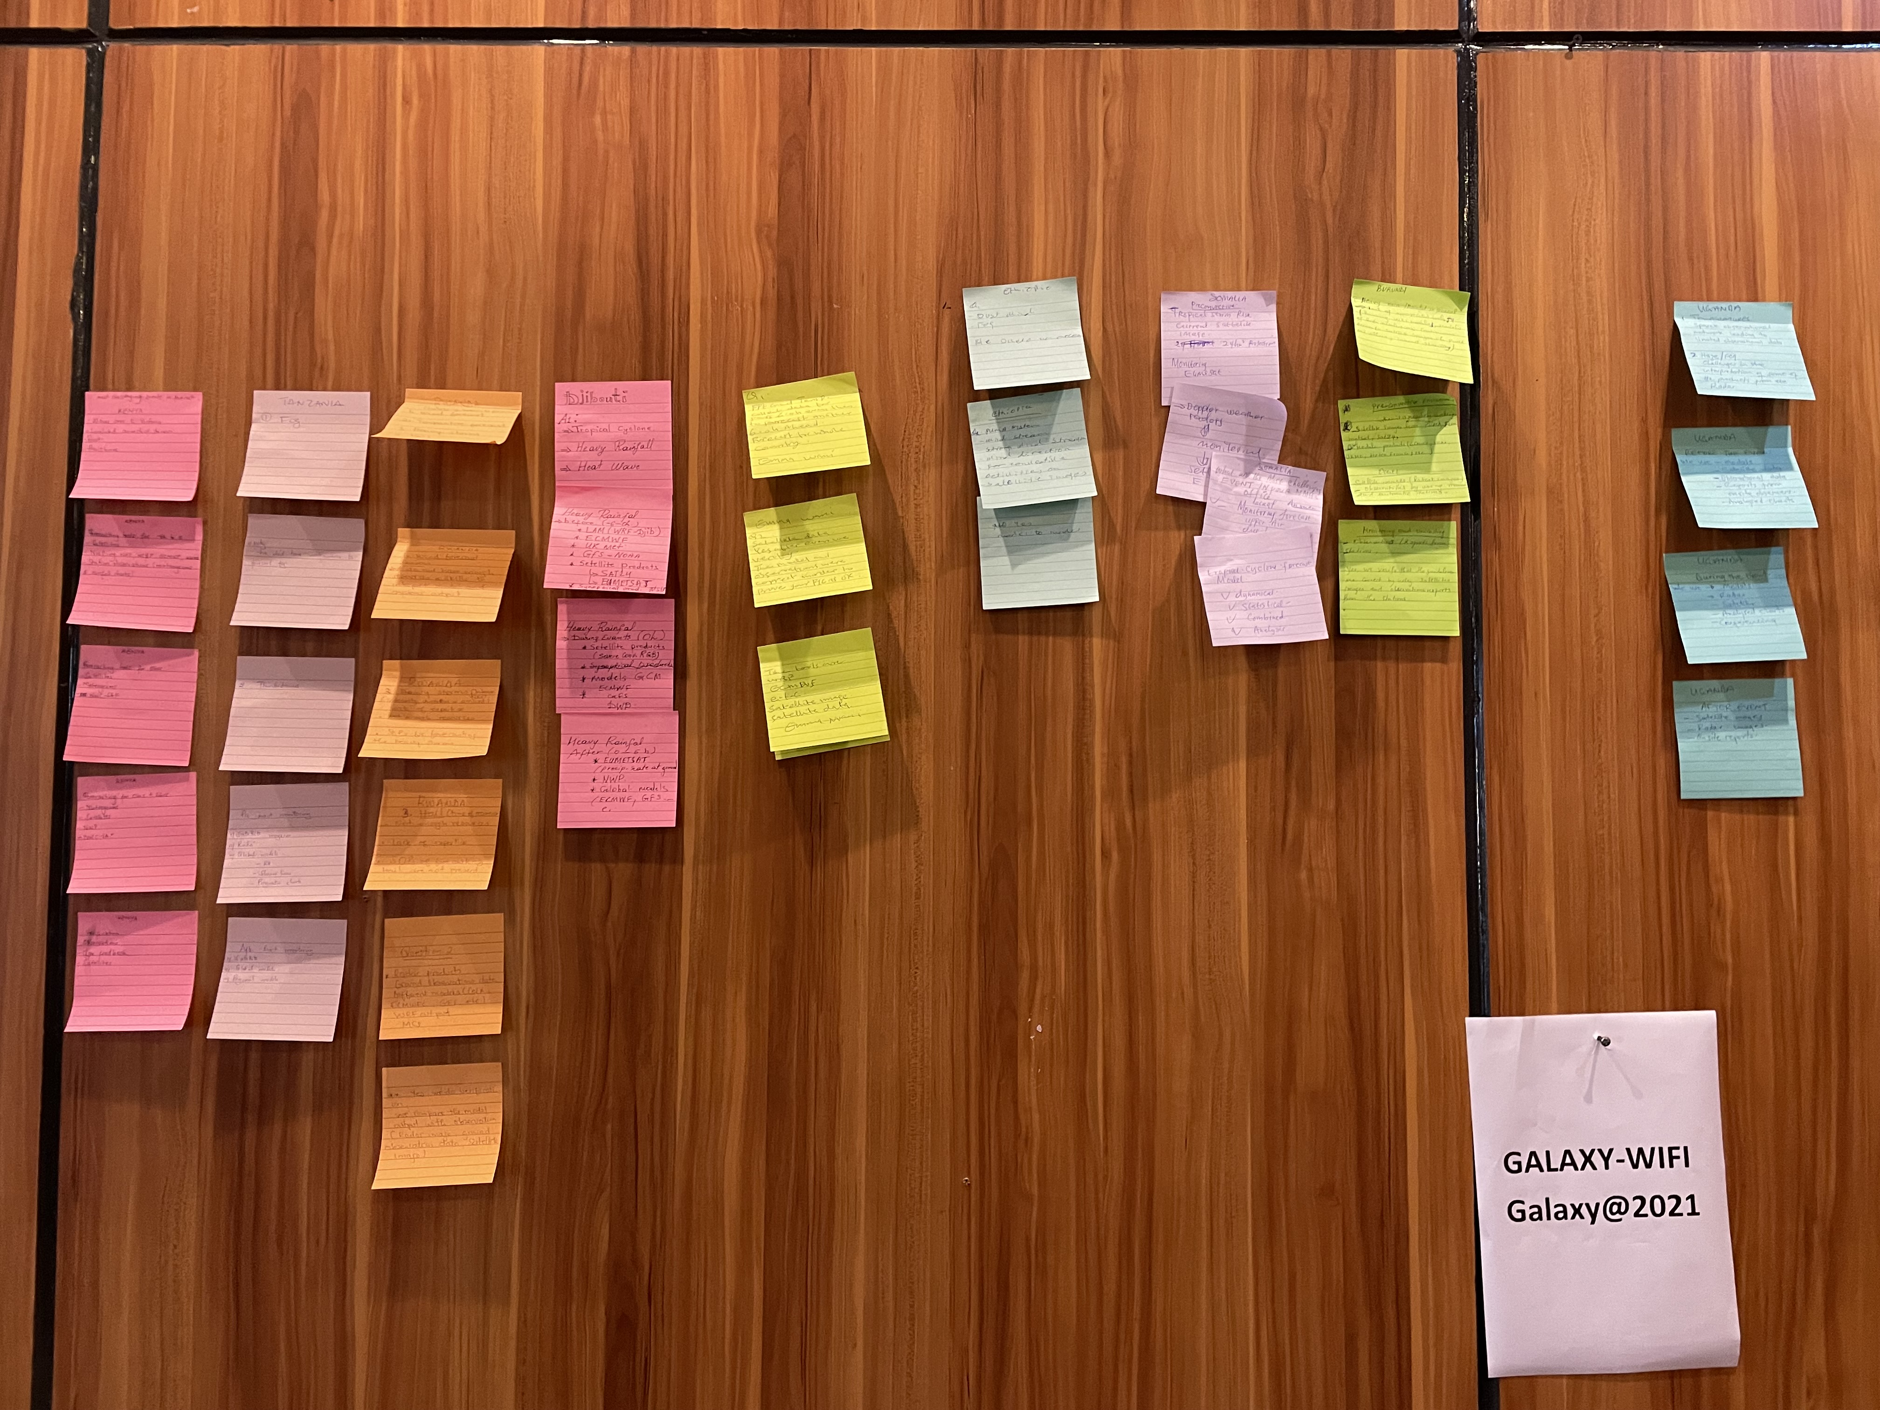
Fostering meaningful engagement and motivating the agenda of the current research
Interview protocol (ongoing):
1-hour recorded video 1-on-1 interview in English
Open questions covering 4 main themes: Met service organization, forecasting for challenging weather situations, risk communication and challenges, international collab. And capacity building ( 15 questions in total)
Understanding how to focus the training sessions according to the background knowledge, capacities, needs, and interests from the group

Slide 10
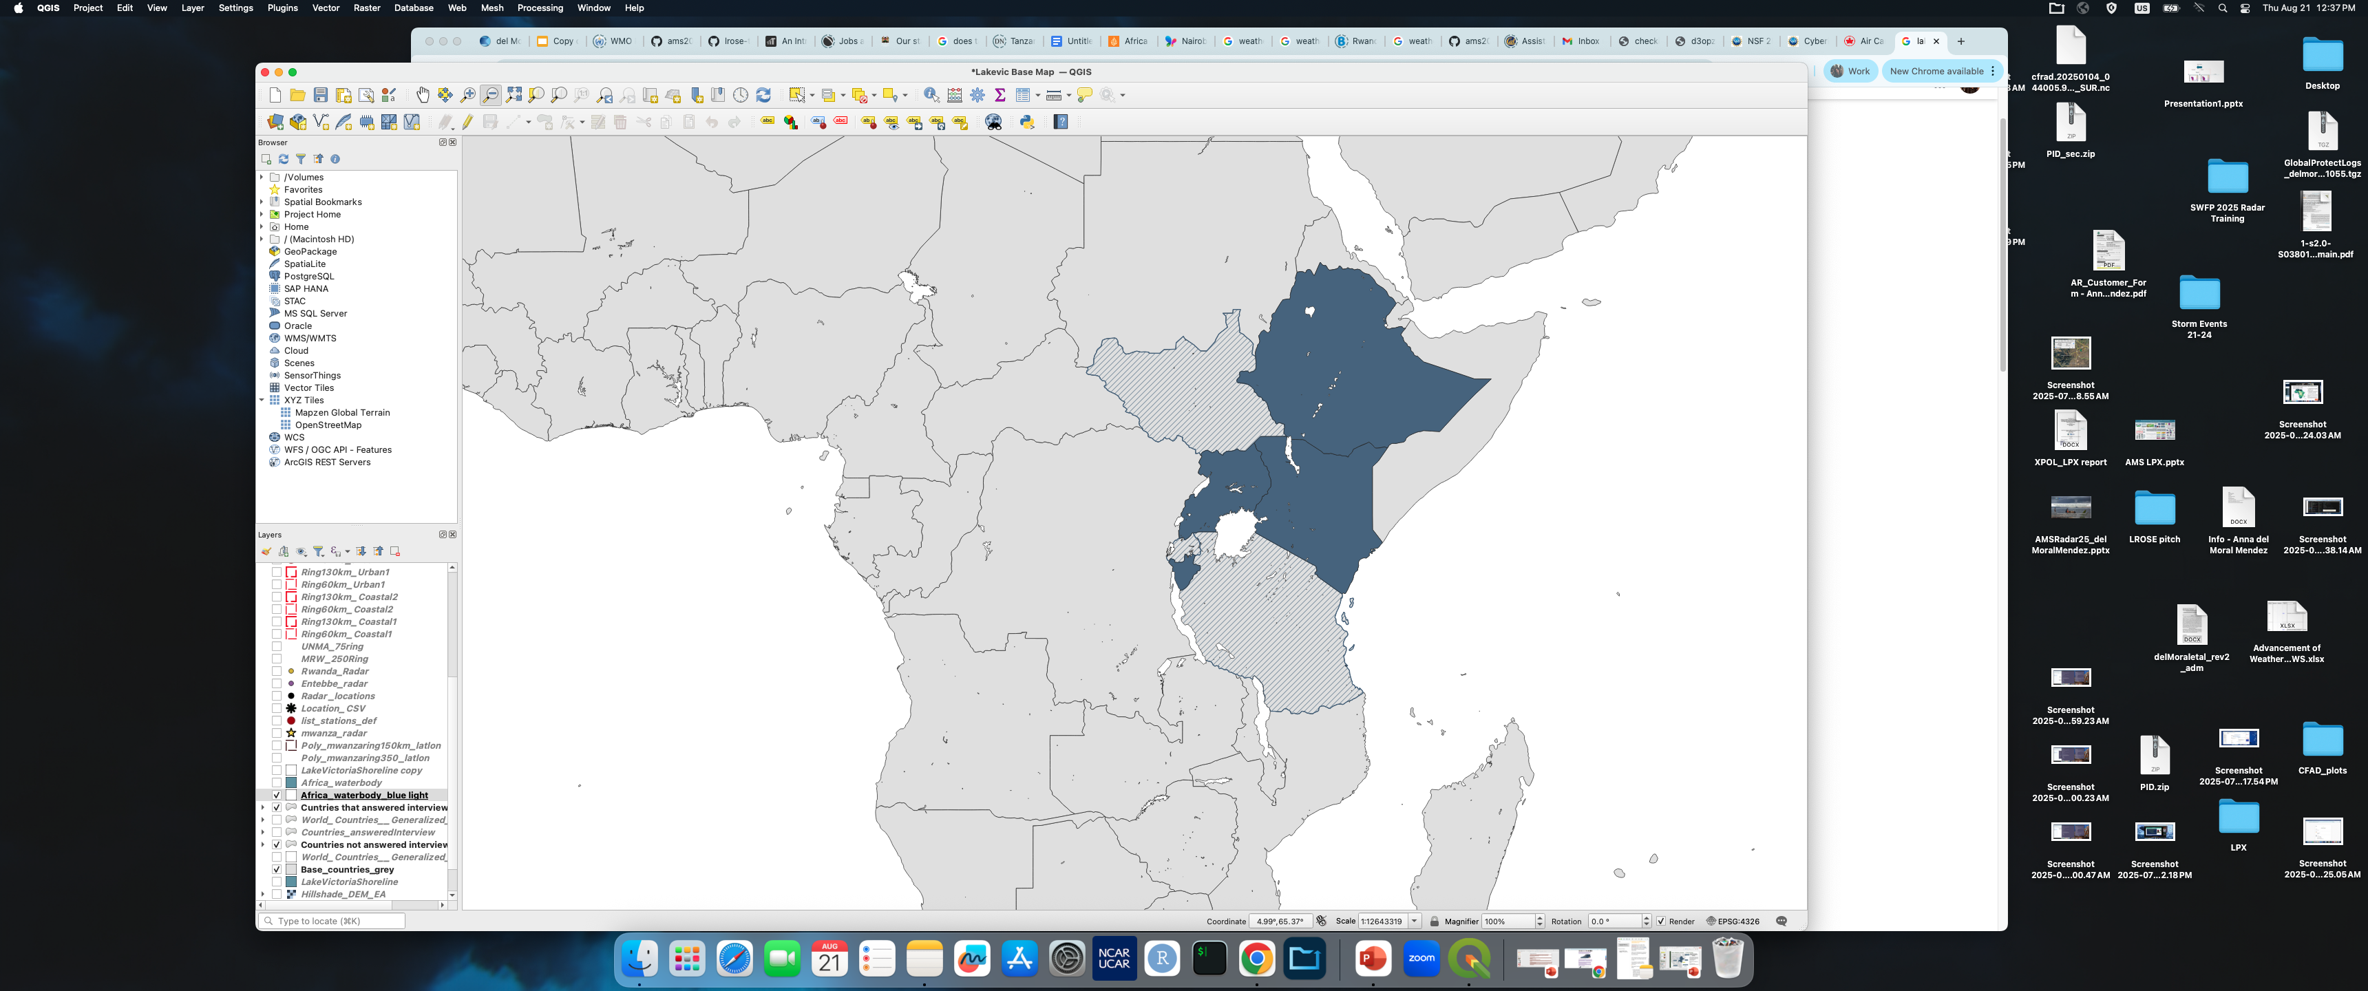
Data collection process… a long journey
Adaptation through the interview processes due to challenges:
Need to change the interview type to an open-question online survey (connectivity issues)
Need to add other languages
Need to explore other communication channels aside from e-mail
Build Trust, Trust, Trust!...
Ethiopia (2)
South Sudan
Kenya (1)
Uganda (1)
Rwanda
Responses to date
Burundi (1)
Future conversations
Tanzania

Slide 11
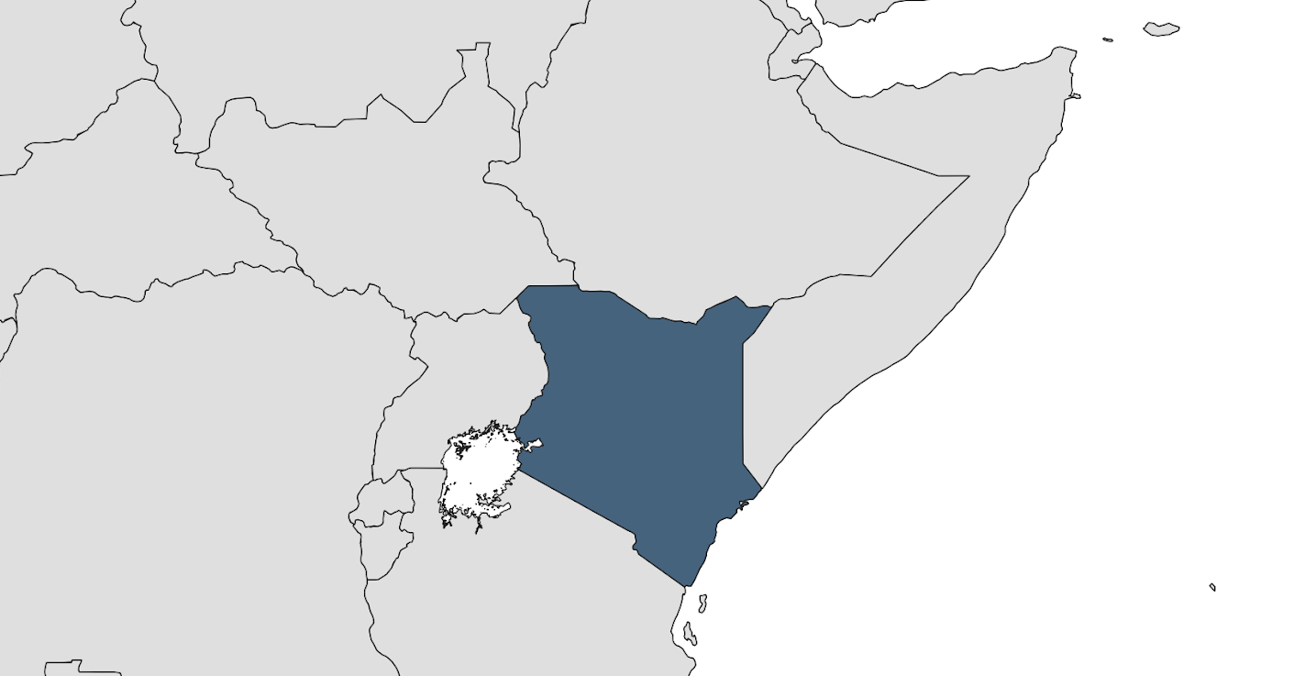
Risk Communication and Challenges
KENYA
Use of impact-based warnings
Forecasters work in shifts
The forecast is also tailored for different stakeholder sectors and Kenya regions
Main communication channels: WhatsApp, Radio (especially for seasonal forecasts), Social Media, Mailing lists, TV, and local newspapers.
Official languages: Swahili and English, but more than 68 languages are spoken in Kenya.
The Red Cross helps disseminate the official forecast to the county directors (regional offices), who will communicate it through local stations and languages.

Slide 12
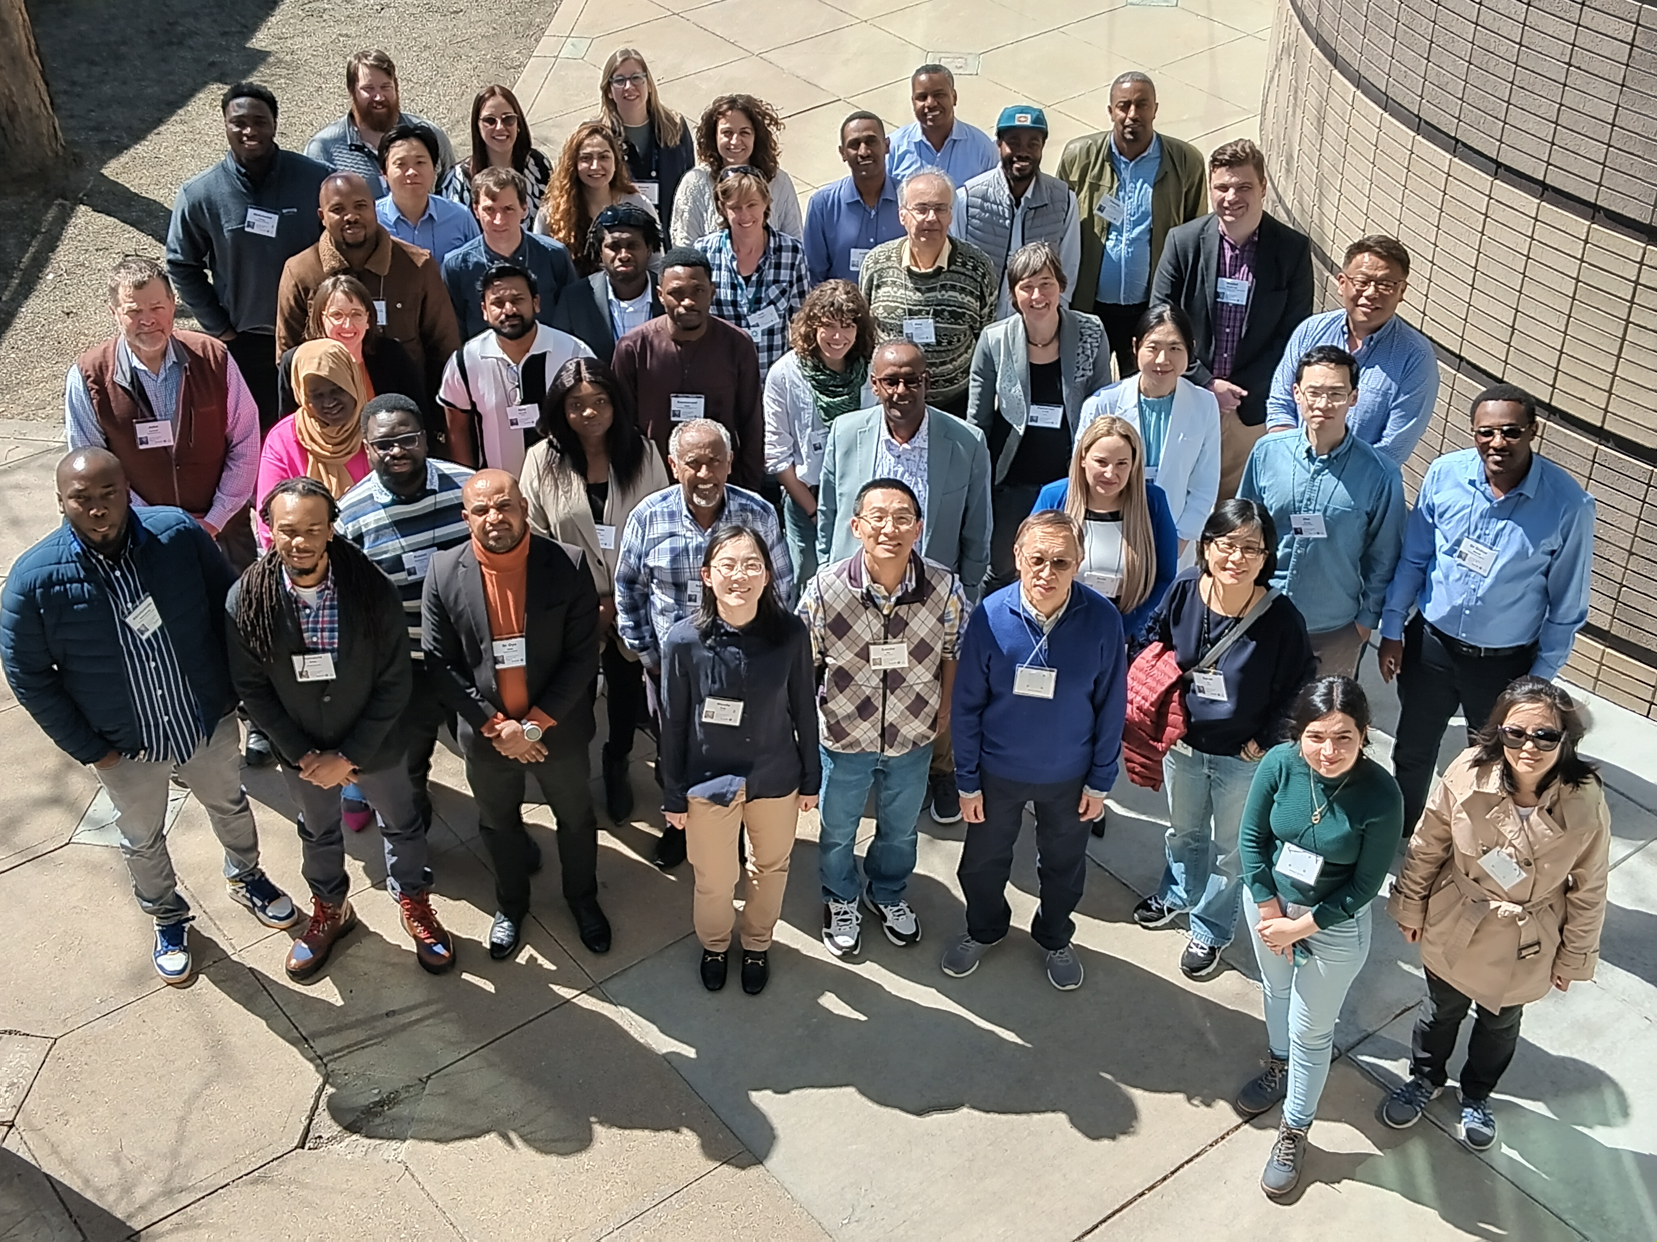
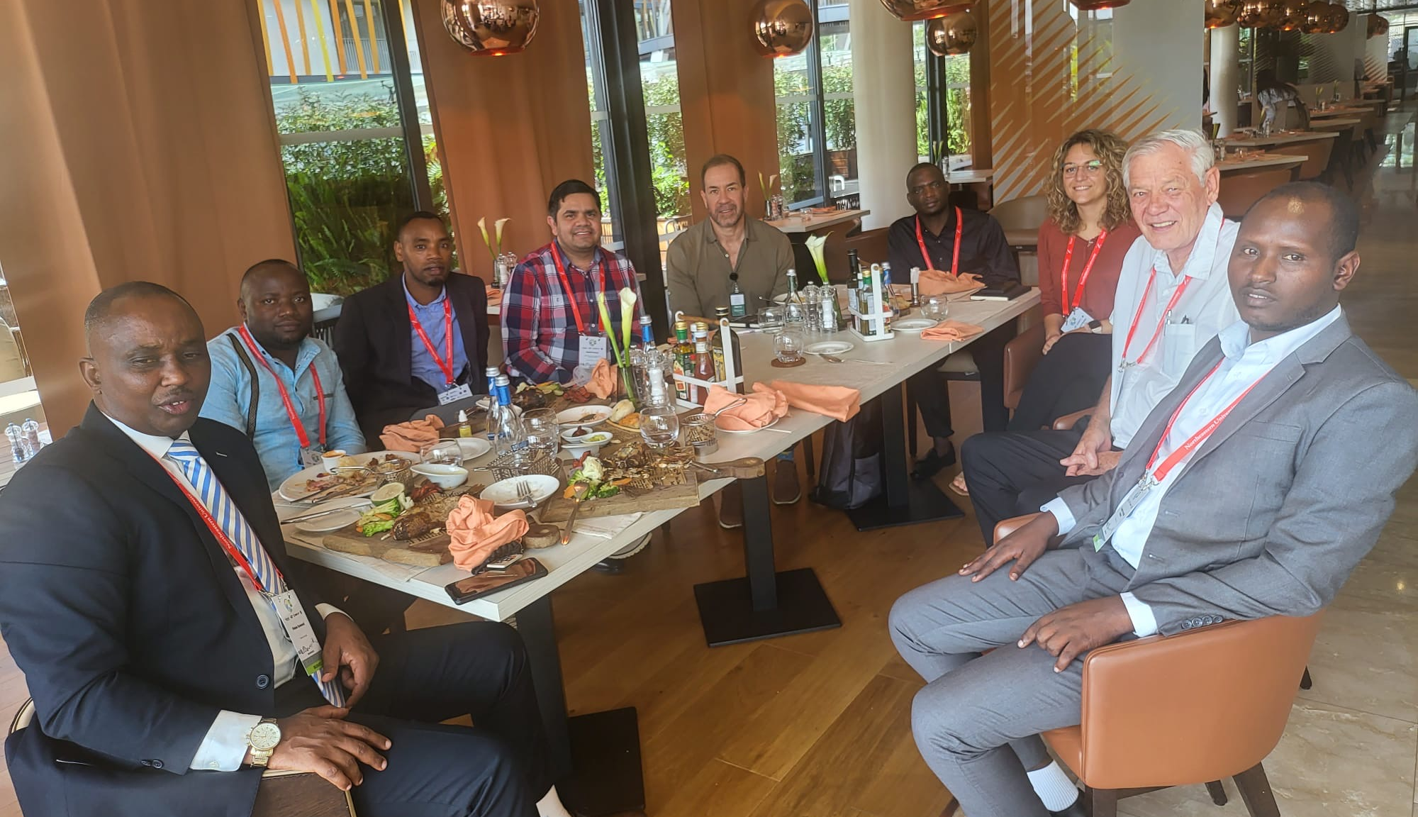
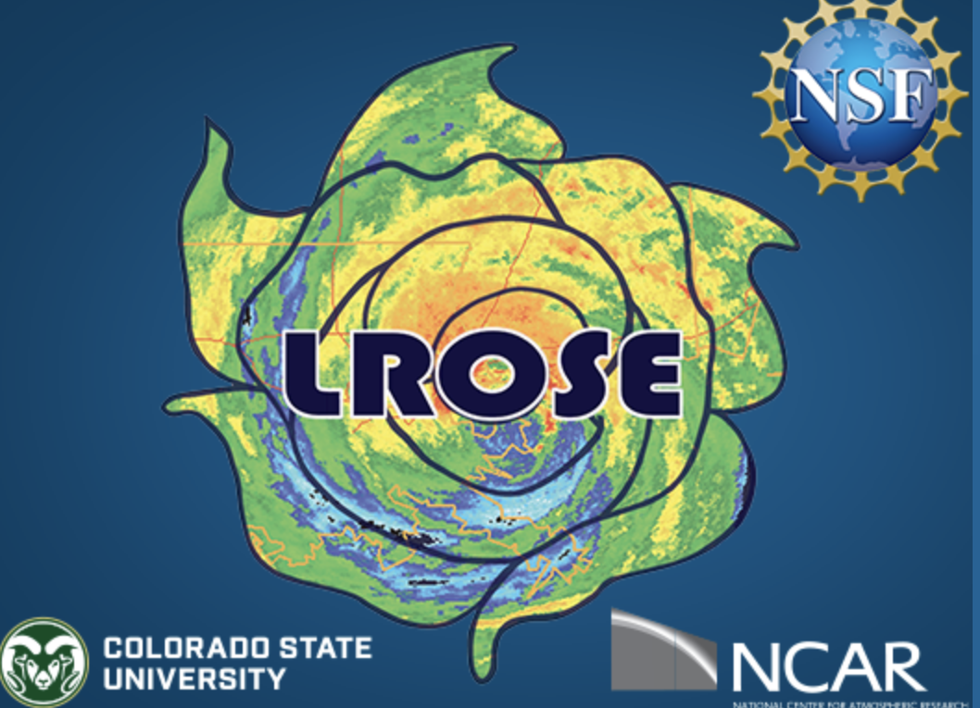

Supporting African-led research and capacity building
Fostering African-based and community-led research
Fostering partnerships beyond academia
Bridging the gap and approaching open software and
tools for operational services (e.g., with Meteo Rwanda, Egypt Meteorological Authority)
UCAR Africa Initiative Workshop
(March 2024)
Meteo Rwanda, NSF NCAR, and TomorrowNow.org meeting in Rwanda during the WWRPC 2023
Lidar Radar Open Software Environment (NSF NCAR – CSU)

Slide 13
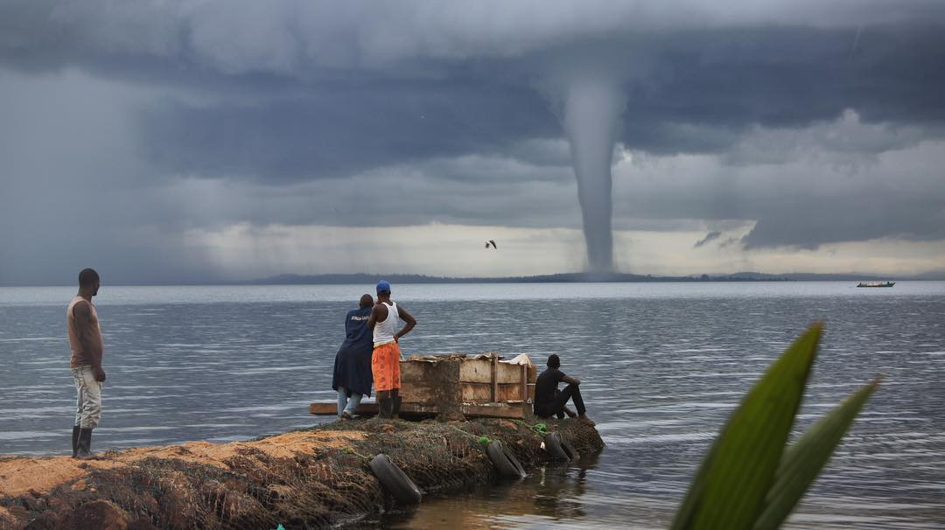
THANK YOU
“ […] conditions when dark clouds descend in the form of a tail and touch the water surface,” referred to locally as “Nsoke” (waterspouts) - Kiwanuka-Tondo, J. et al. (2019)
Photo: filiphellings/ X

