Slide 1

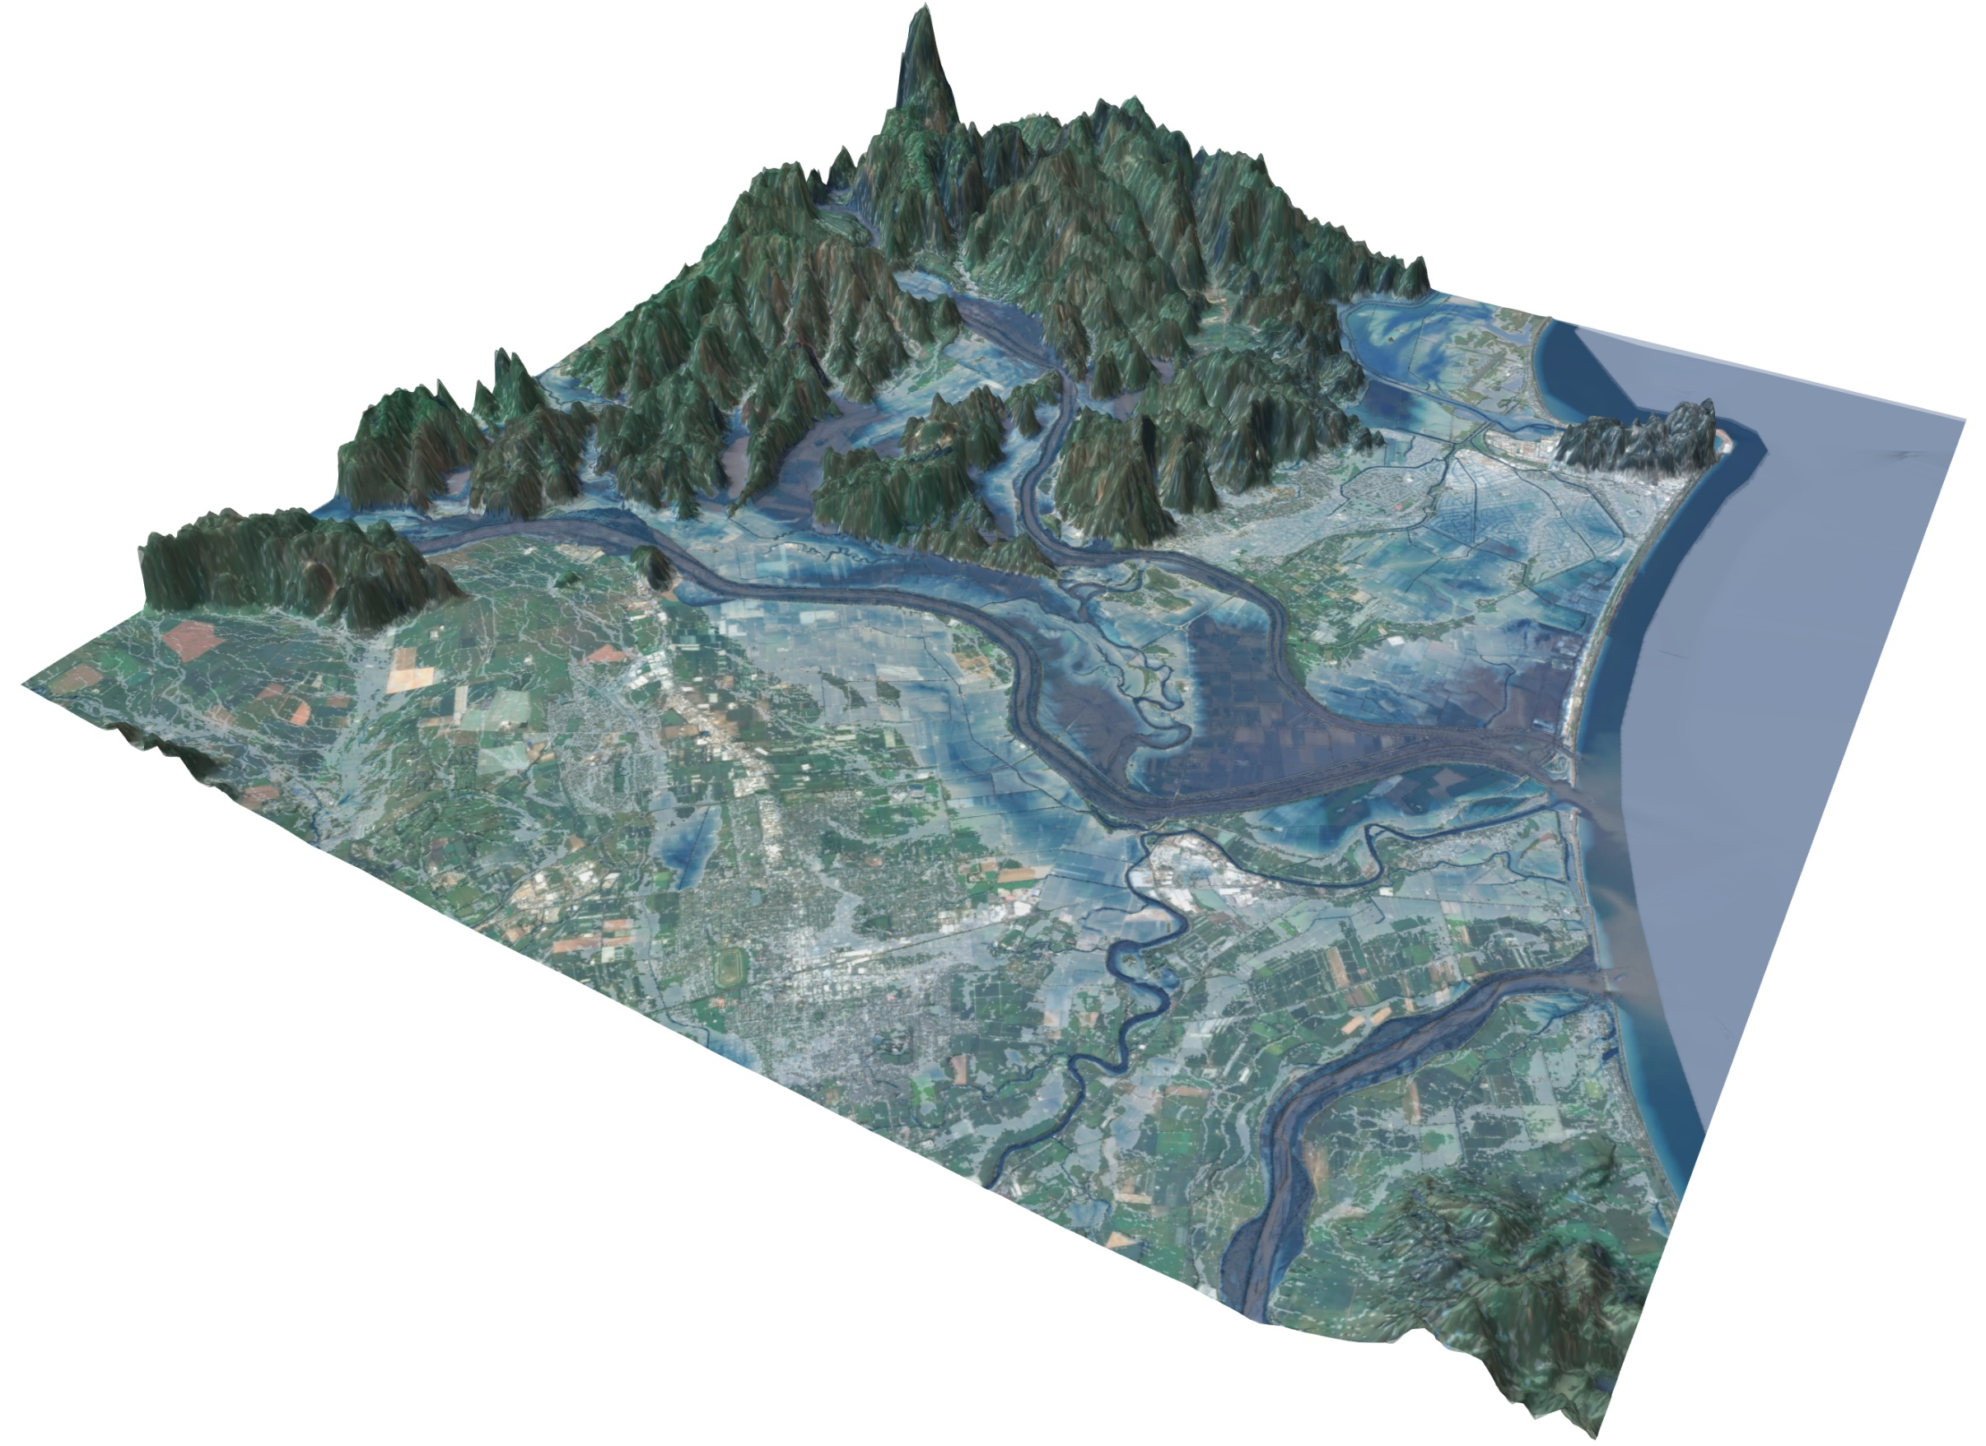

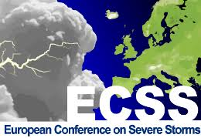
Inundation map interpolation from design storms under global warming using a national hydrodynamic model database in Aotearoa New Zealand
ECSS2025 12th European Conference on Severe Storms
Joë Pelmard¹, Alice Harang², Cyprien Bosserelle², Rose Pearson², Trevor Carey-Smith², Emily Lane², Luisa Hosse², Ryan Paulik², Shaun Williams², Conrad Zorn¹
¹ University of Auckland, New Zealand
² Earth Sciences New Zealand (ex-NIWA)

Slide 2
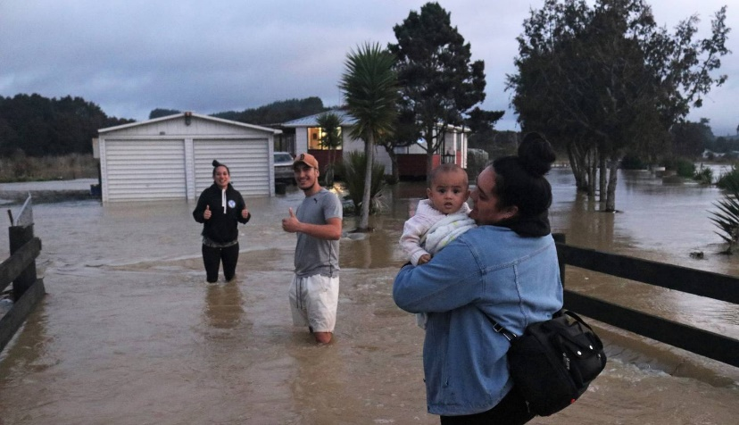
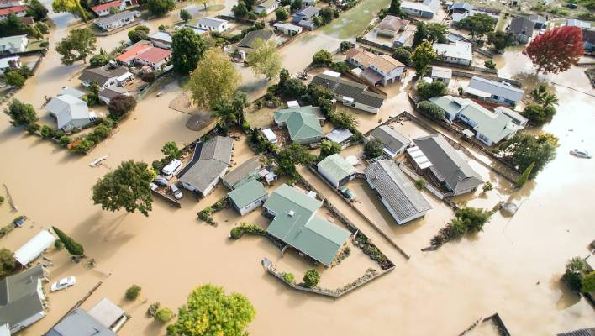
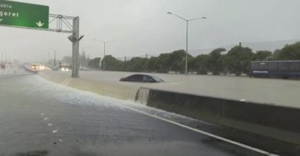
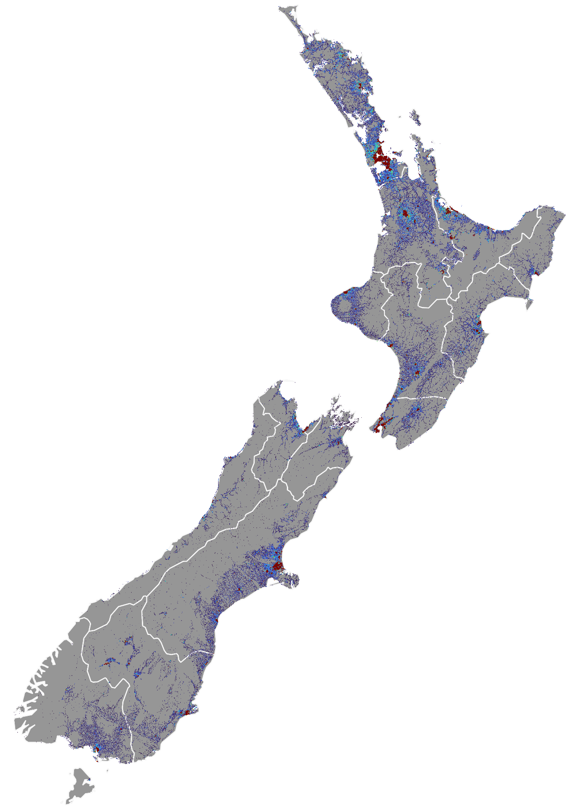
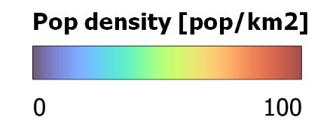
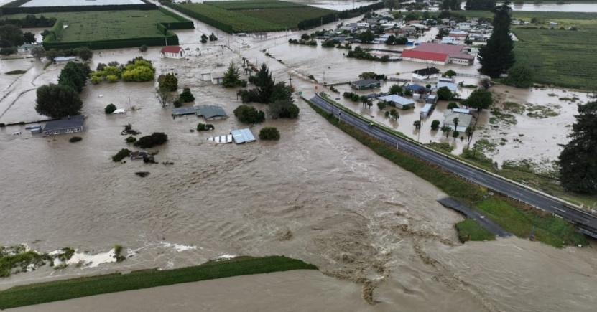
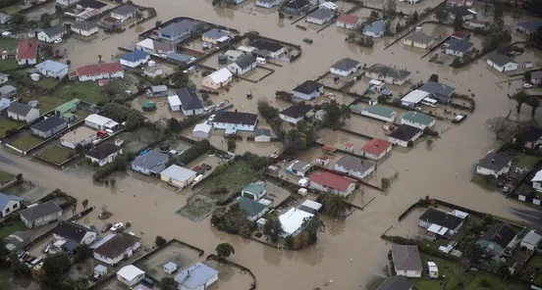
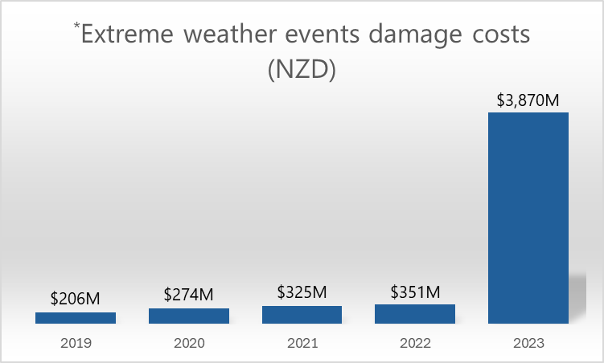
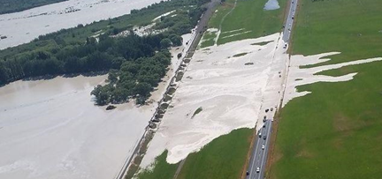
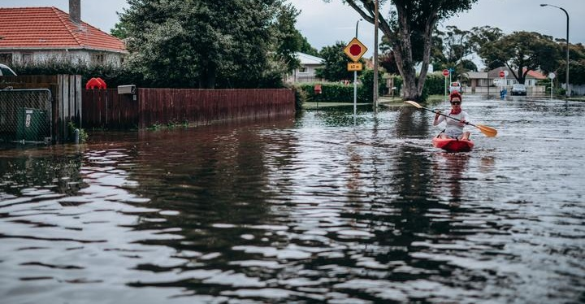
2020 Northland
04-2017 Edgecumbe
Cyclone Debbie
01-2023 Auckland Anniversary weekend floods
02-2023 Hawke’s Bay and Tairāwhiti
Cyclone Gabrielle
2021 Westport
2019 Rangitata
Driven by flood damages
Extreme weather events in Aotearoa
11-2020 Napier flooding
Notes:
Name = Tribute to an ancestor of Wairewa Rūnanga (local community) partner
. Funding figure: Centuries ago – After travelling from Eastern Polynesia to NZ SI, dug up major lakes with magical ko (digging stick) and filled them with water
Project also known as “Increasing flood resilience in Aotearoa New Zealand

Slide 3
Increasing flood resilience in Aotearoa
Mā te haumaru o ngā puna wai o Rākaihautū ka ora mō ake tonu
“By keeping the water of Rākaihautū safe the water will survive eternally”
Increasing flood resilience in Aotearoa
Notes:
Name = Tribute to an ancestor of Wairewa Rūnanga (local community) partner
. Funding figure: Centuries ago – After travelling from Eastern Polynesia to NZ SI, dug up major lakes with magical ko (digging stick) and filled them with water
Project also known as “Increasing flood resilience in Aotearoa New Zealand

Slide 4

Increasing flood resilience in Aotearoa
Increasing flood resilience in Aotearoa
Notes:
Name = Tribute to an ancestor of Wairewa Rūnanga (local community) partner
. Funding figure: Centuries ago – After travelling from Eastern Polynesia to NZ SI, dug up major lakes with magical ko (digging stick) and filled them with water
Project also known as “Increasing flood resilience in Aotearoa New Zealand

Slide 5
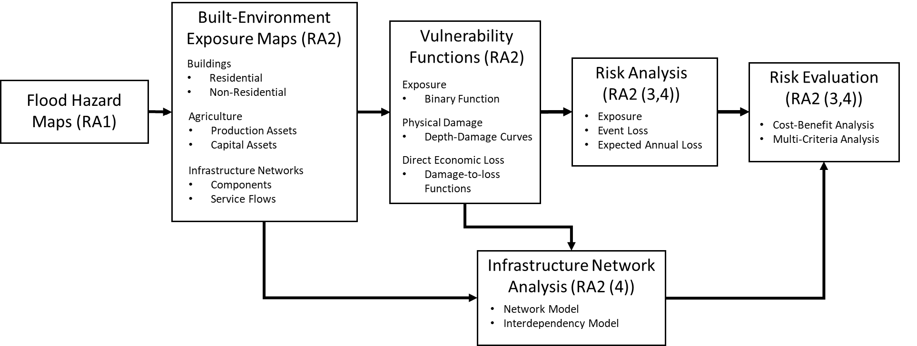
Increasing flood resilience in Aotearoa
National assessment of flood hazards
Increasing flood resilience in Aotearoa

Slide 6
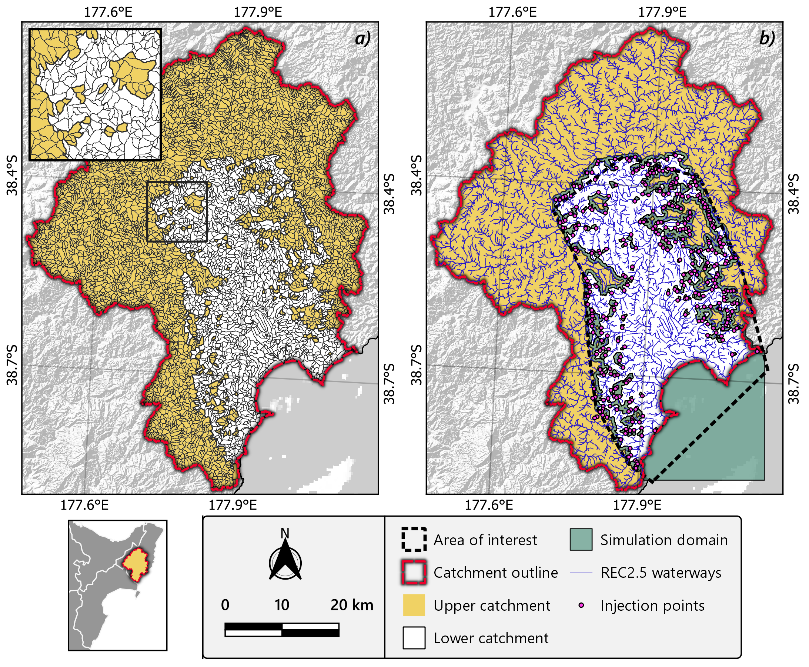
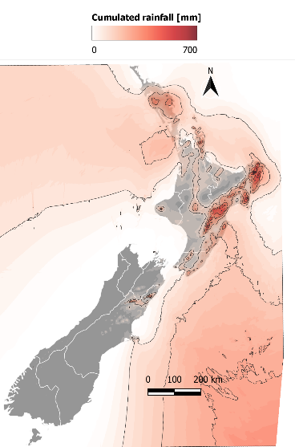
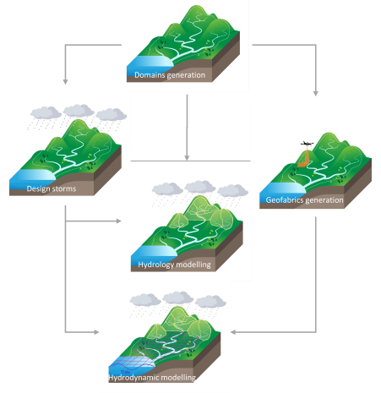
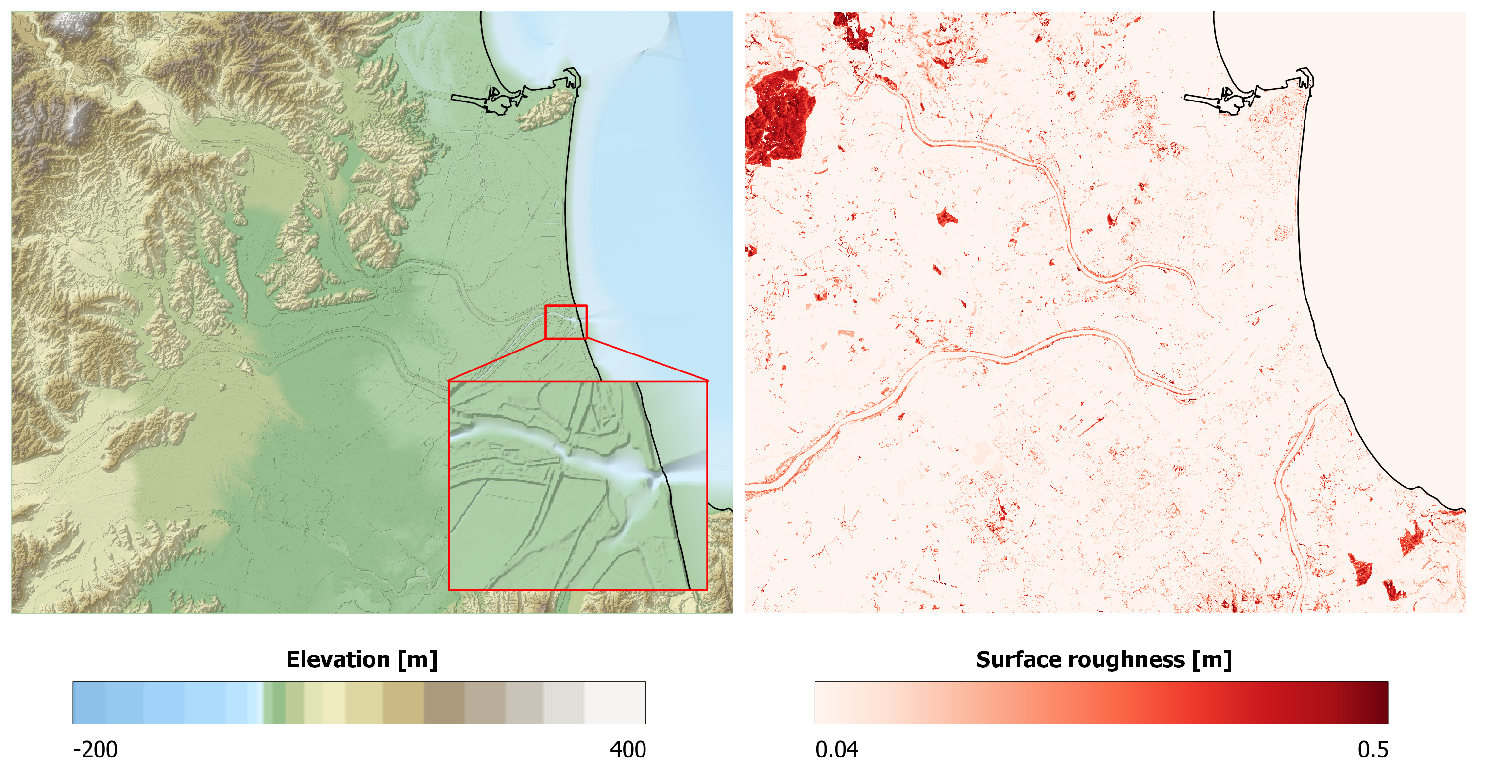
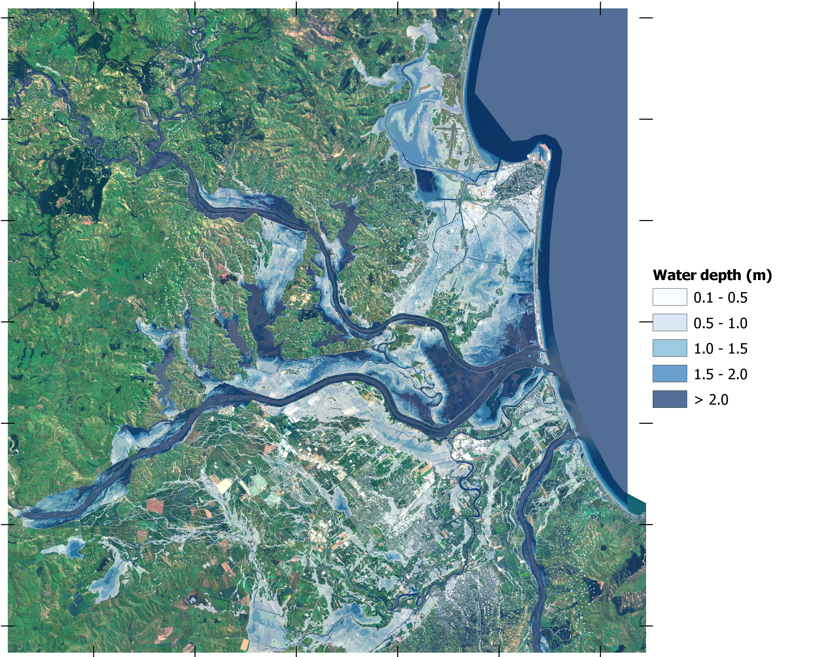
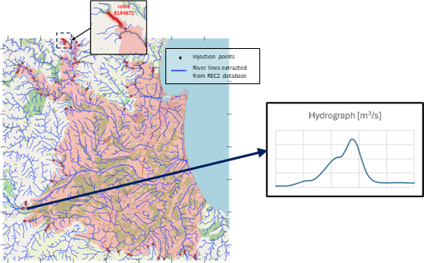
Multi-scale flood modelling framework
Multi-scale flood modelling framework

Slide 7
Framework validation – Extra Tropical Cyclone Gabrielle
13-14 Feb 2023 – Record breaking flood event
Rainfall exceeding 500mm over 24h
NZD $1.8B (€ 0.8B – 1B) estimated damage costs (Insurance Council of New Zealand)
11 loss-of-life, 2000+ damaged buildings
Nationwide disruptions of transport and communication networks
Full recovery timed in years
Framework validation – Feb 2023 extra tropical Cyclone Gabrielle

Slide 8
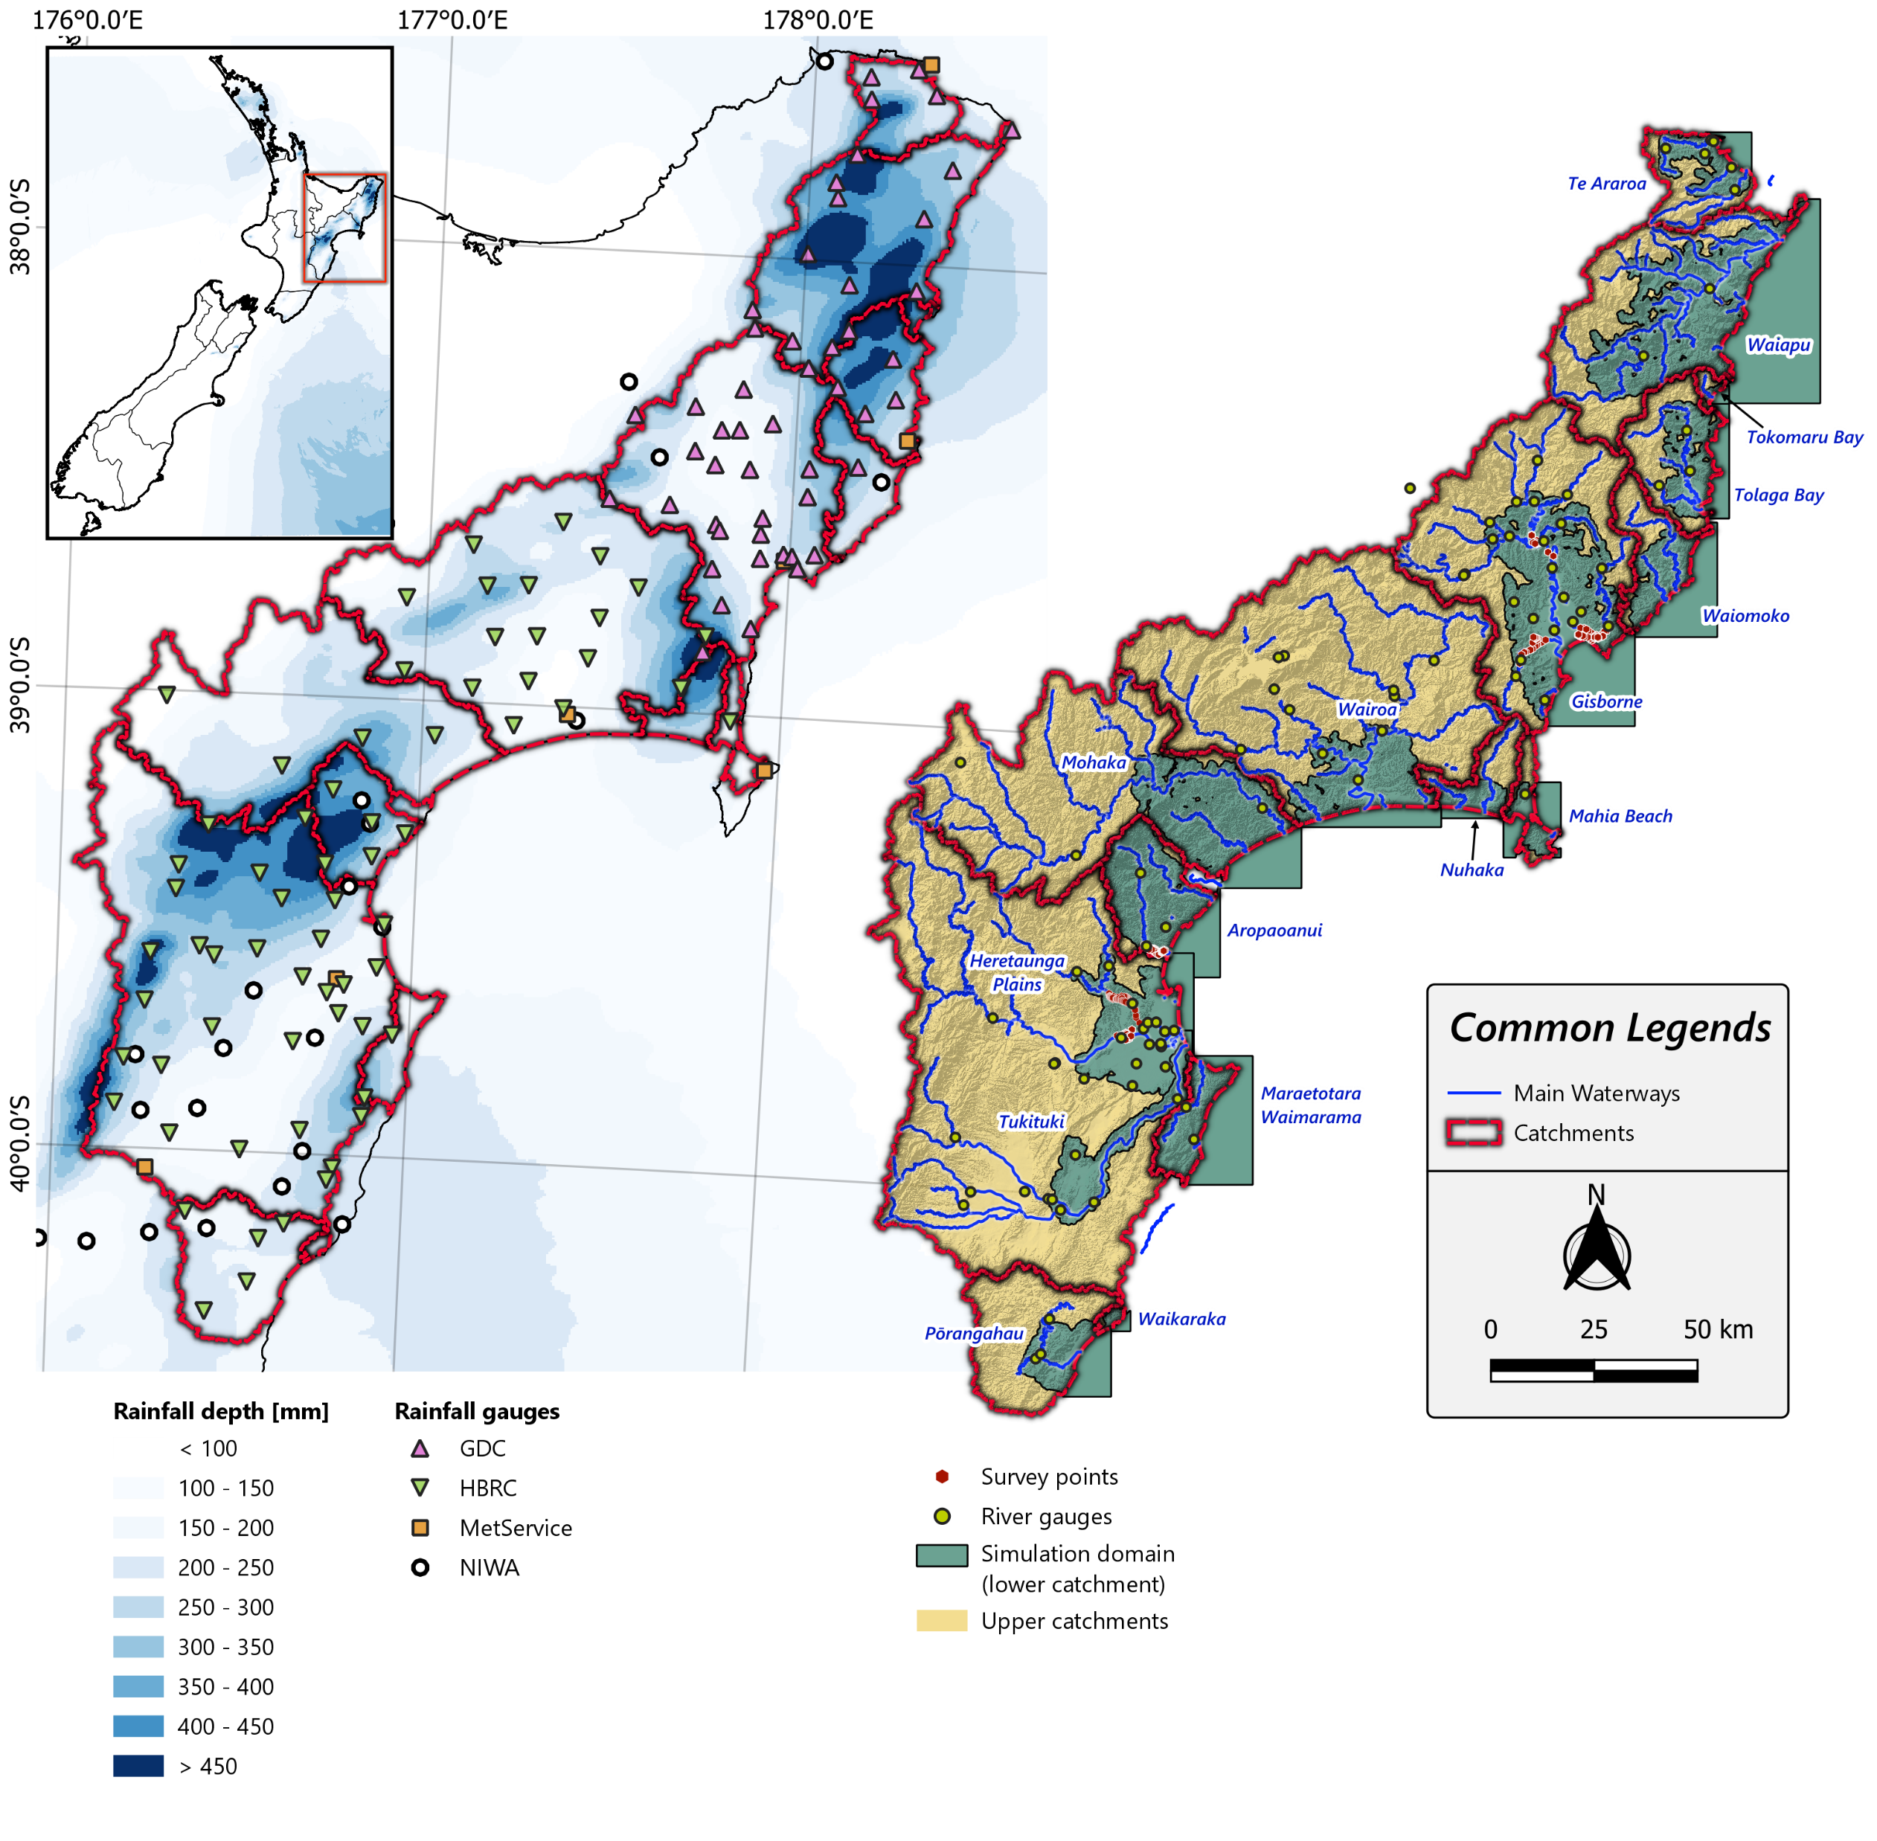
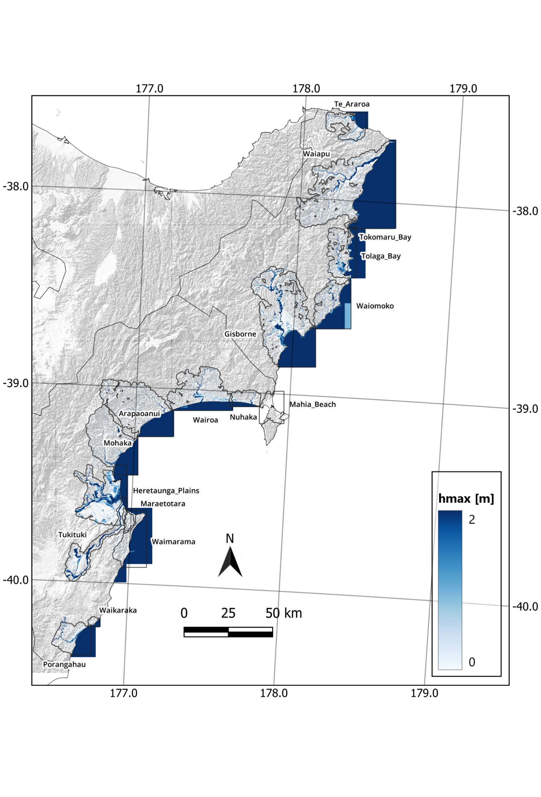
Framework validation – Extra Tropical Cyclone Gabrielle
Merged regional inundation maps
Framework validation – Feb 2023 extra tropical Cyclone Gabrielle

Slide 9
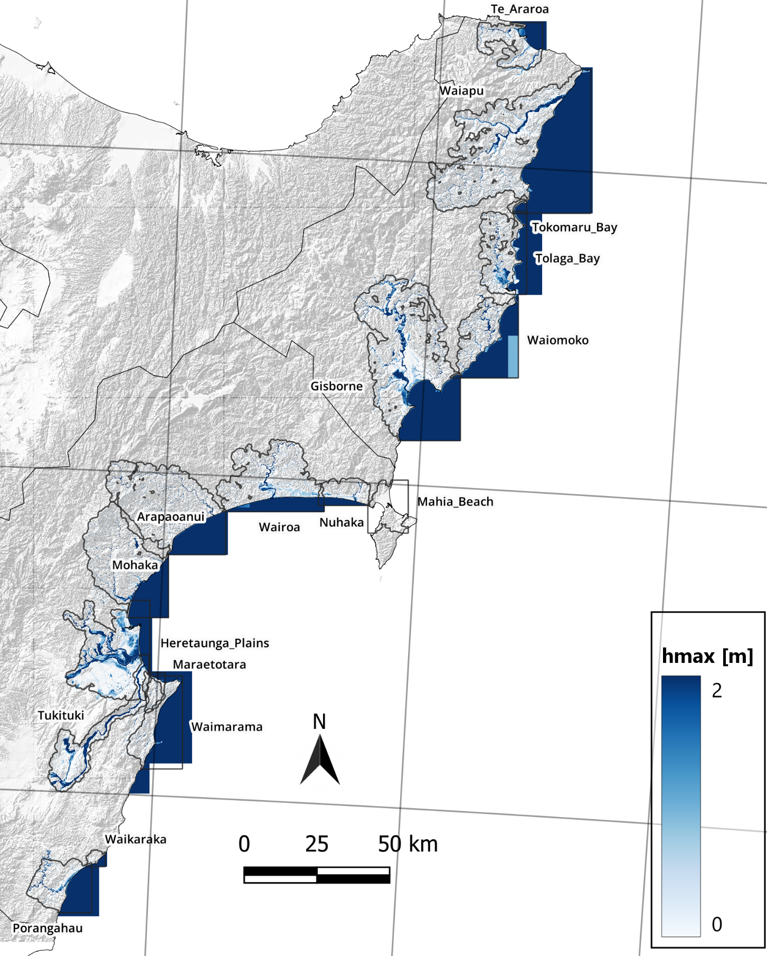
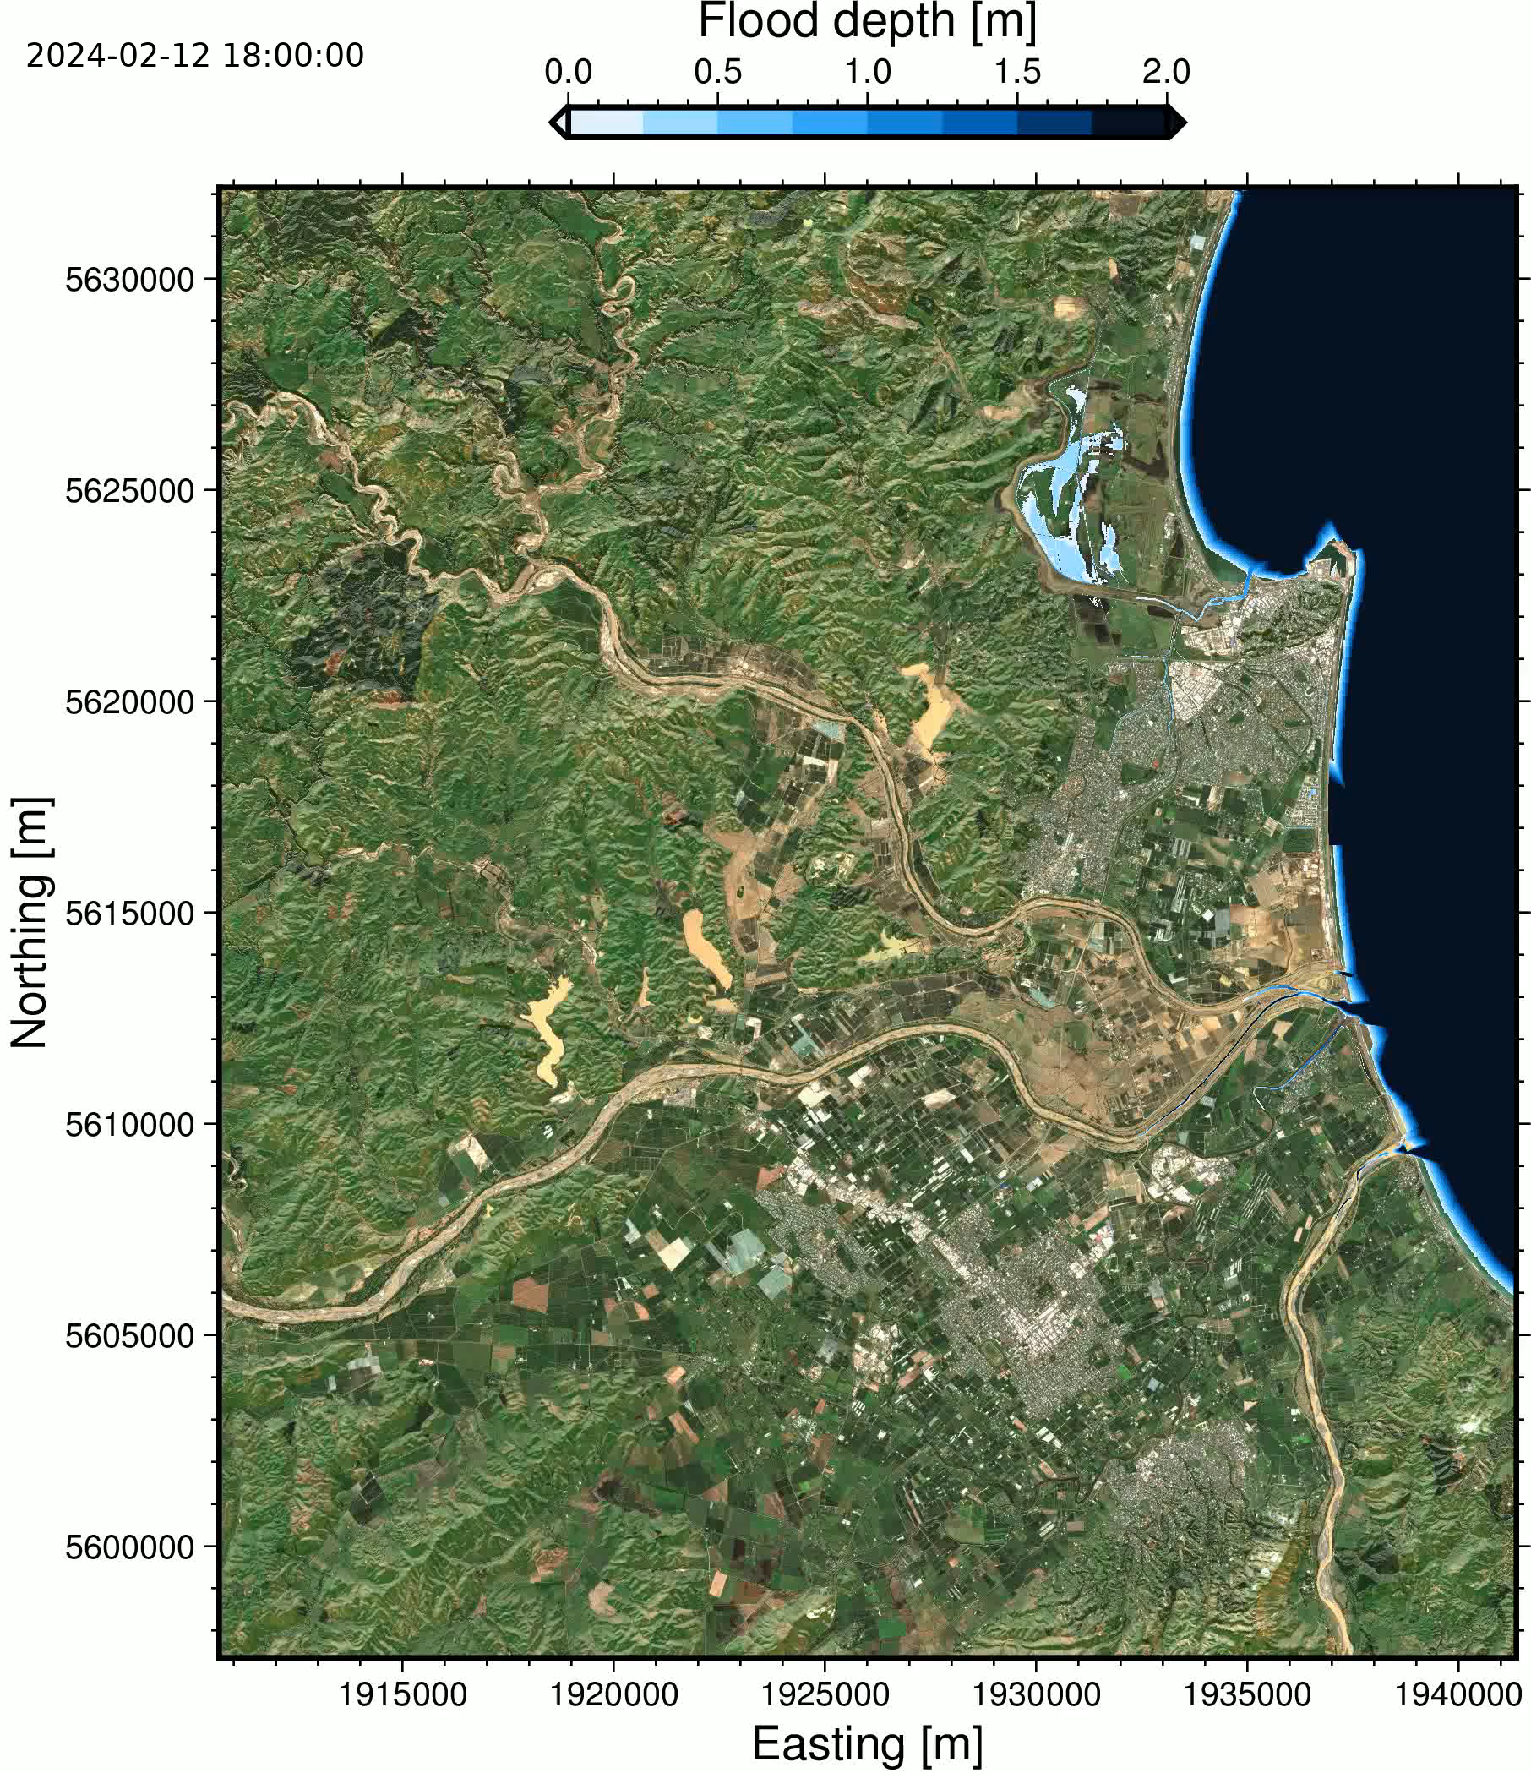
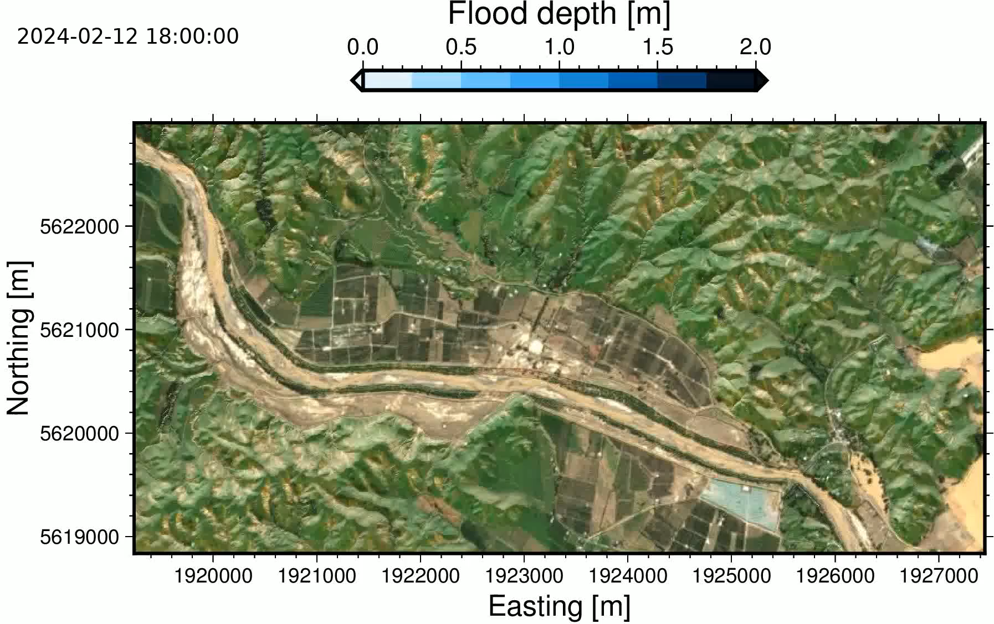

Qualitative spatial assessment – Flood extent
Framework validation – Feb 2023 extra tropical Cyclone Gabrielle

Slide 10
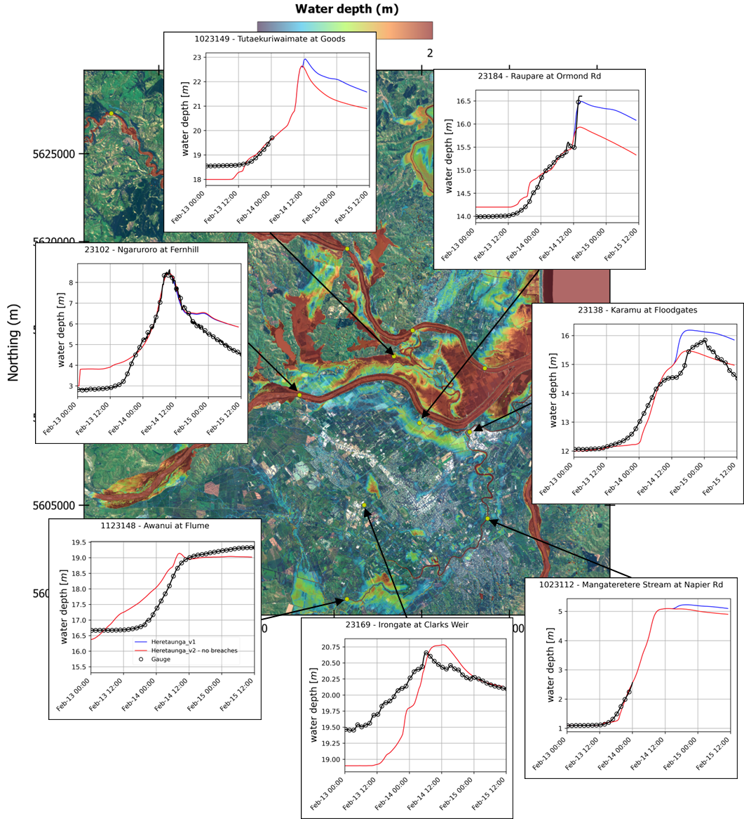
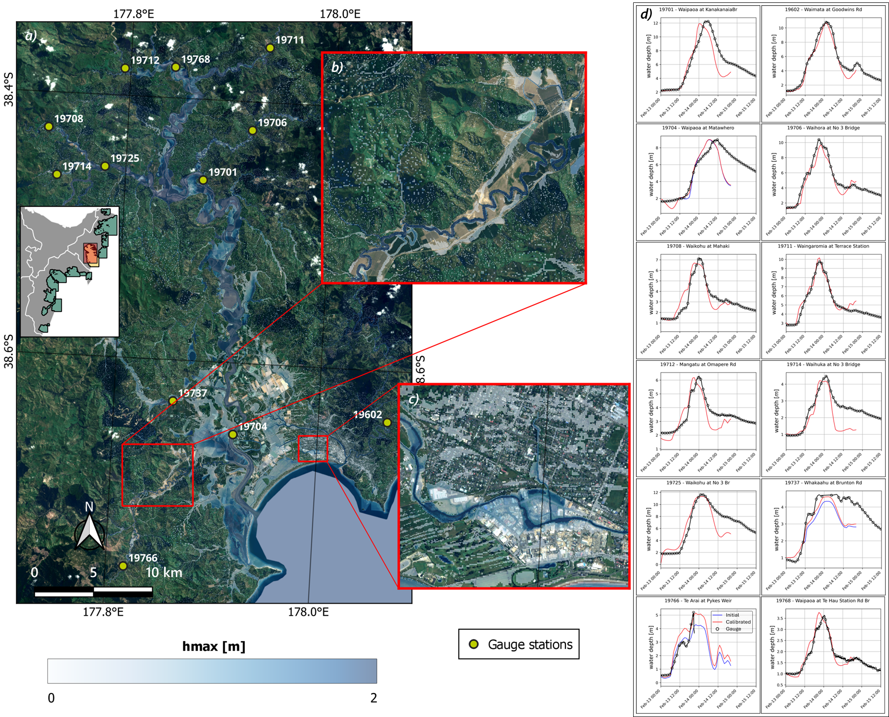
Temporal validation – Gauge records hydrographs
Framework validation – Feb 2023 extra tropical Cyclone Gabrielle

Slide 11
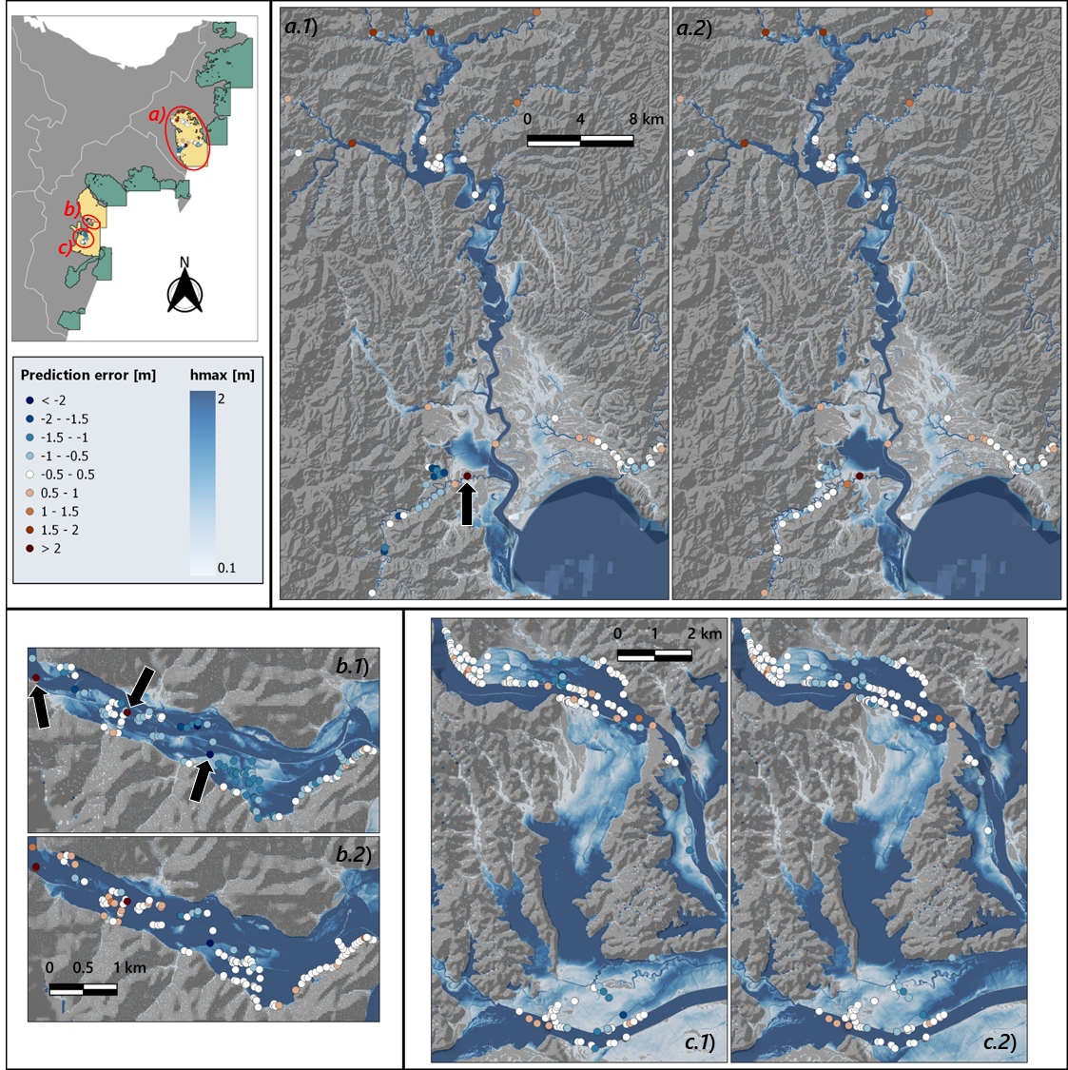
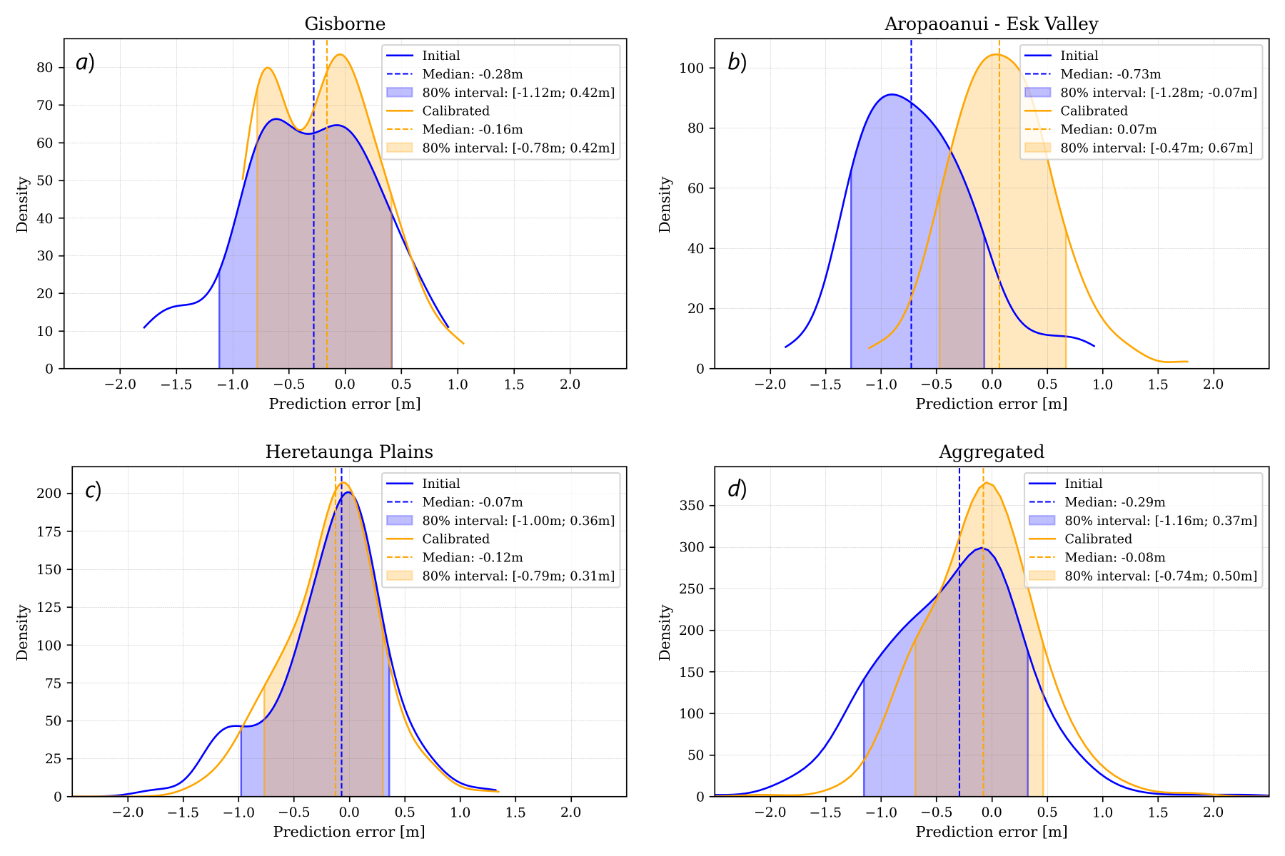
Quantitative assessment – high-water elevation surveys
Initial
Calibrated
Initial
Calibrated
Initial
Calibrated
Framework validation – Feb 2023 extra tropical Cyclone Gabrielle

Slide 12
Curated dataset on 100y return period design storm*
4m resolution curated dataset
Annual Recurrence Interval (ARI): 100y (1% AEP)
Climate warming: 0°C, +1°C, +2°C,+3°C
Sea level rise: 0m, +1.5m
Public facing visualisation portal
National flood hazard mapping

Slide 13
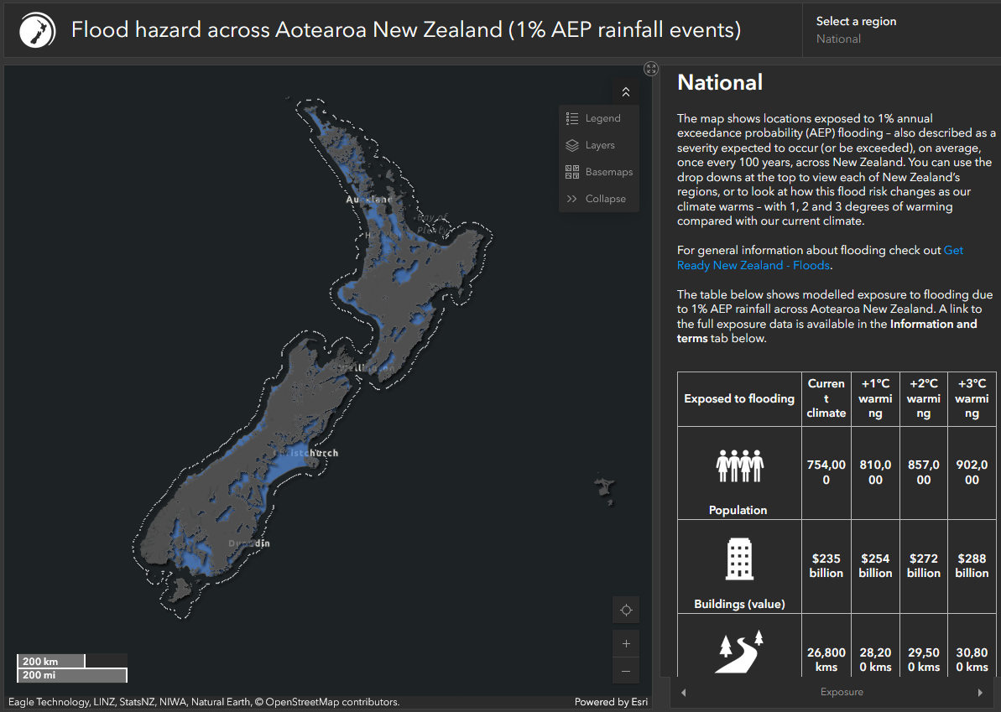
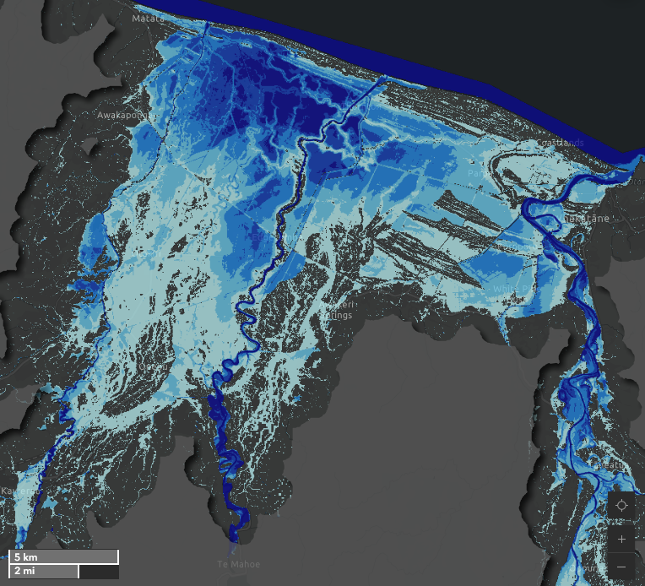
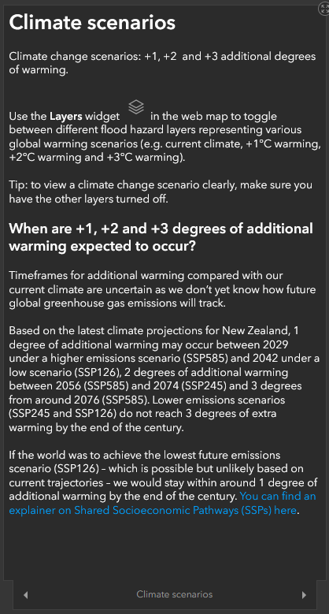
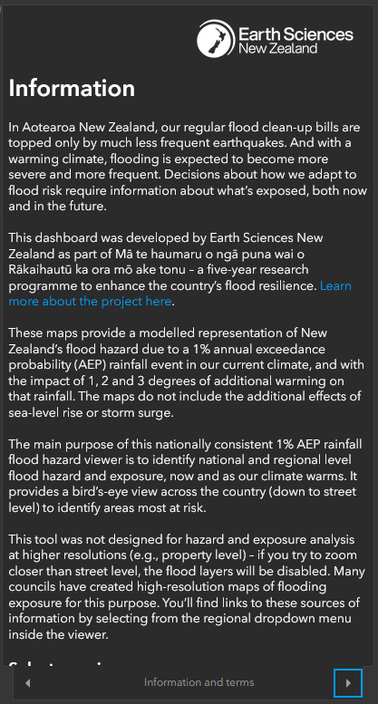
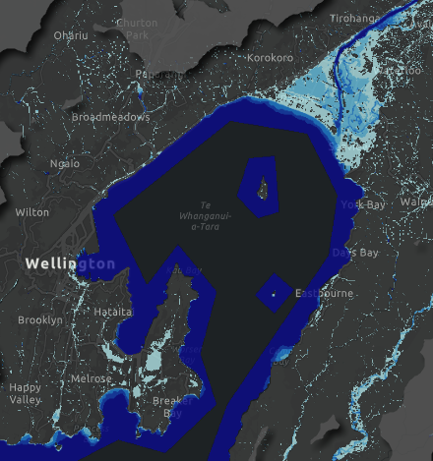
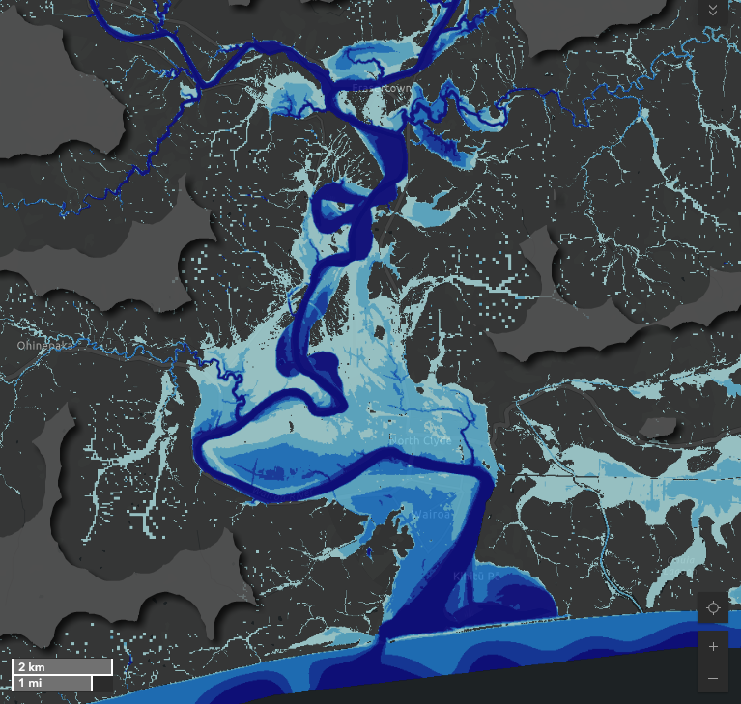
Curated dataset on 100y return period design storm*
*Data accessibility: https://niwa.co.nz/hazards/ma-te-haumaru-o-nga-puna-wai-o-rakaihautu-ka-ora-mo-ake-tonu
National flood hazard mapping

Slide 14
Risk assessment dataset
8m resolution systematic dataset
7 ARIs: 10y, 20y, 50y, 100y, 200y, 500y, 1000y
Minimal quality control
Intern dataset
Aggregated regional and nationwide risk and damage/cost assessment
Production time: 6 to 9 months
National flood hazard mapping

Slide 15
Reinterpreting current maps under future climate?
Leveraging existing datasets to gain insights into
Temperature warming projections: +1°C, +2°C, +3°C
Non-modelled ARIs
Rapid flood map estimates
Reinterpreting current maps under future climate?

Slide 16
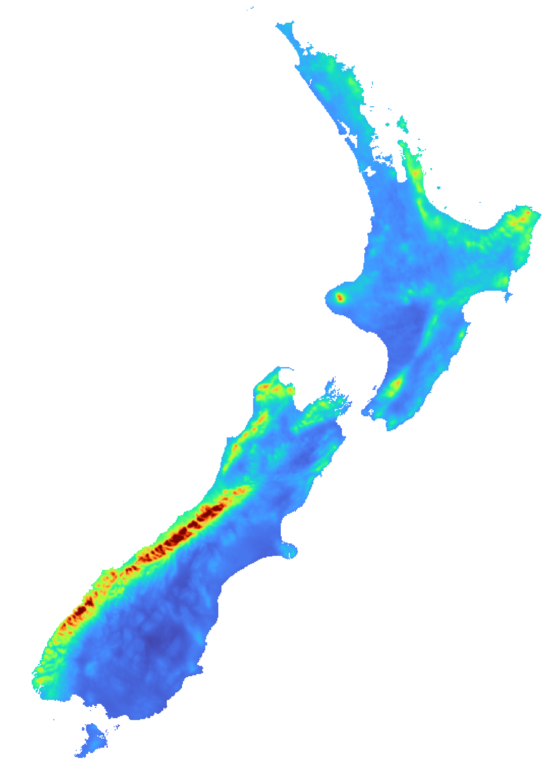
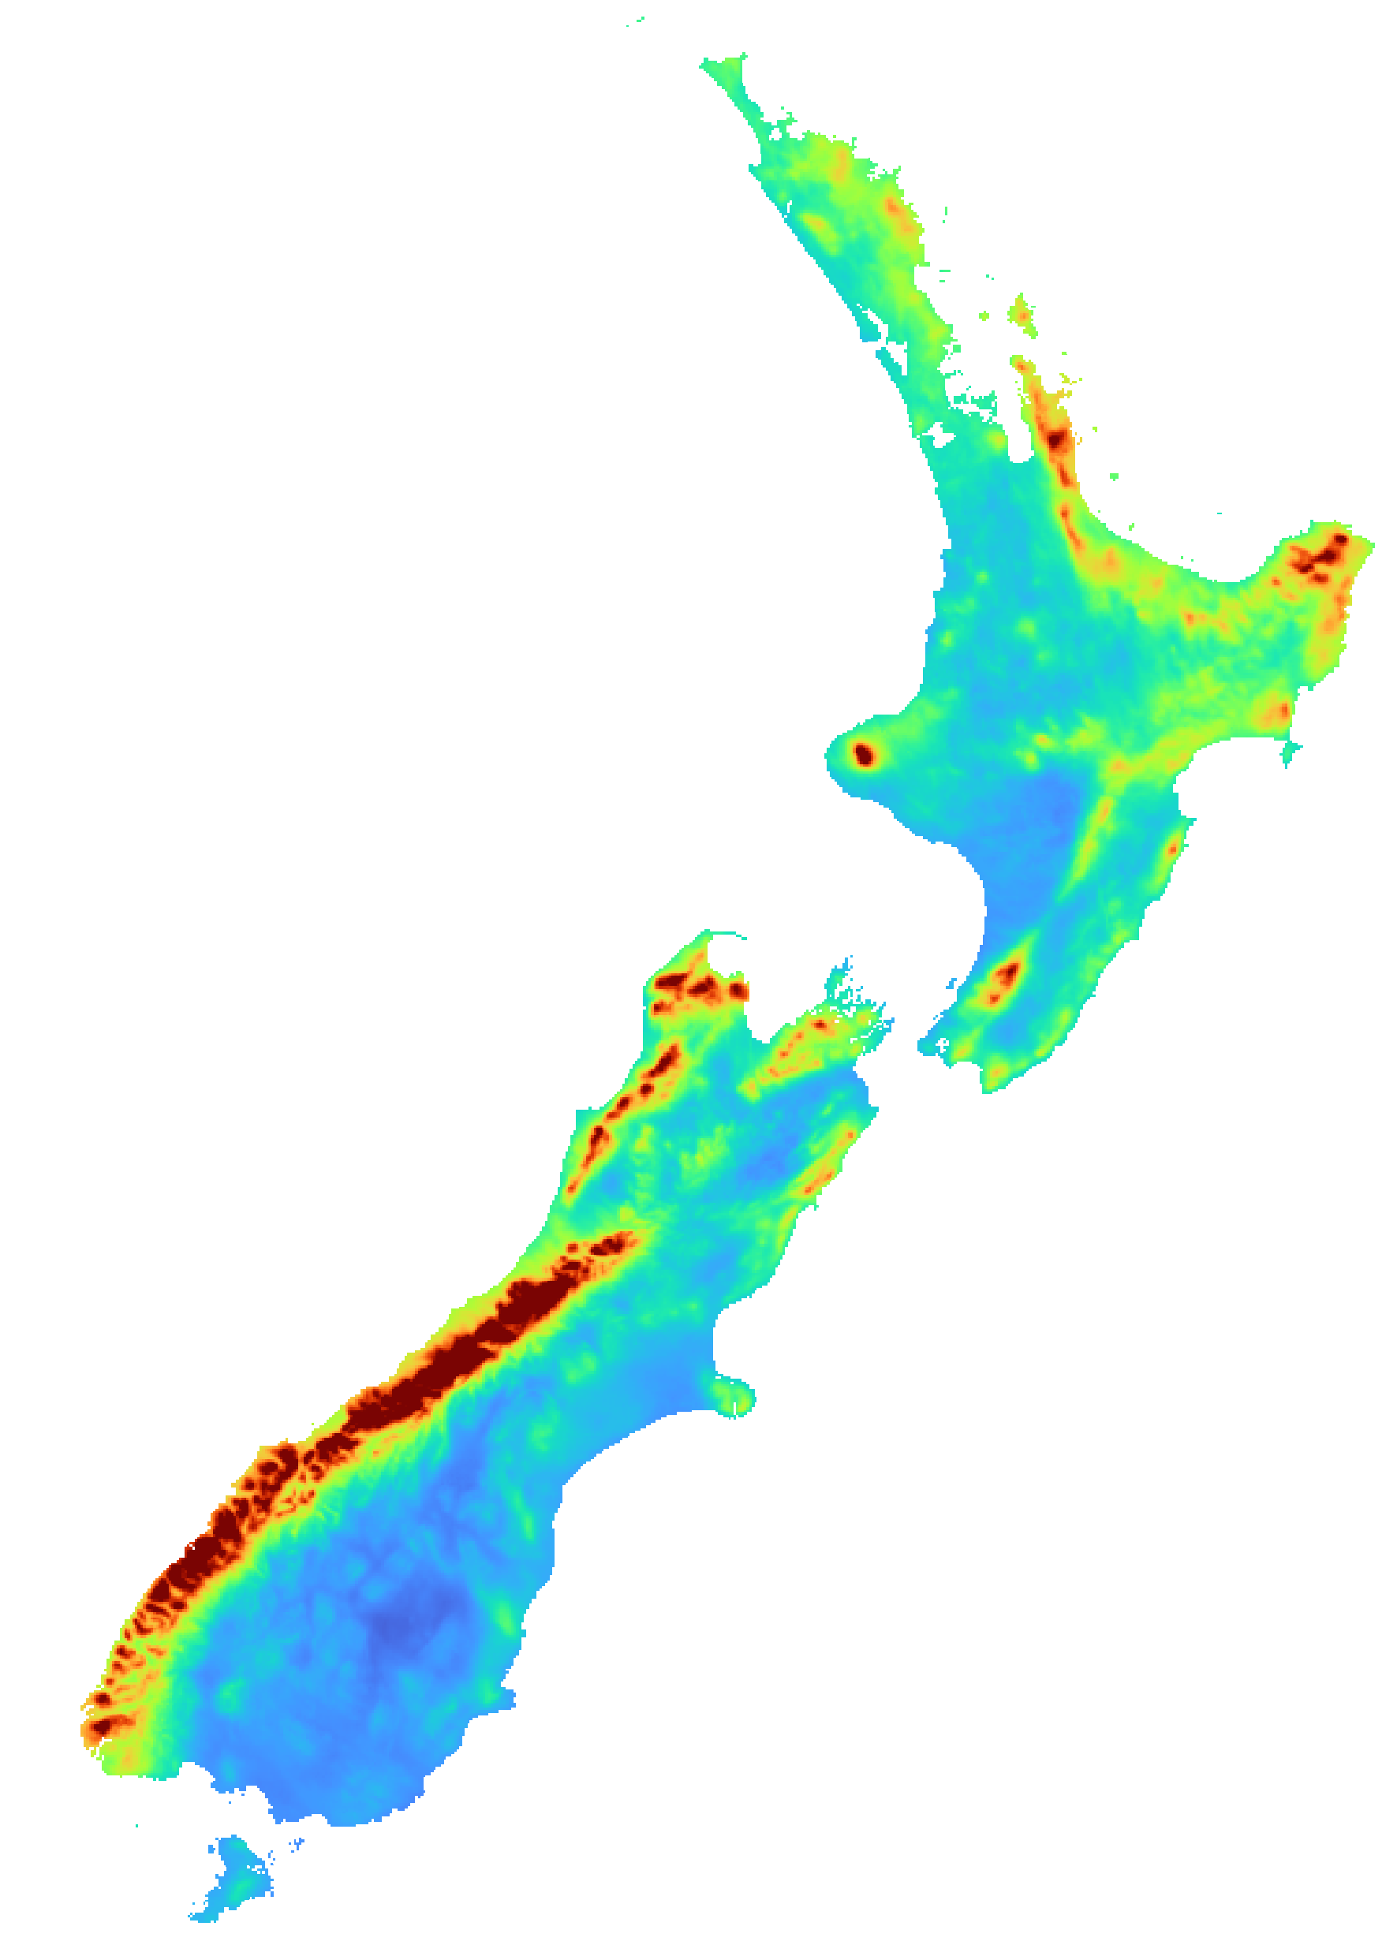
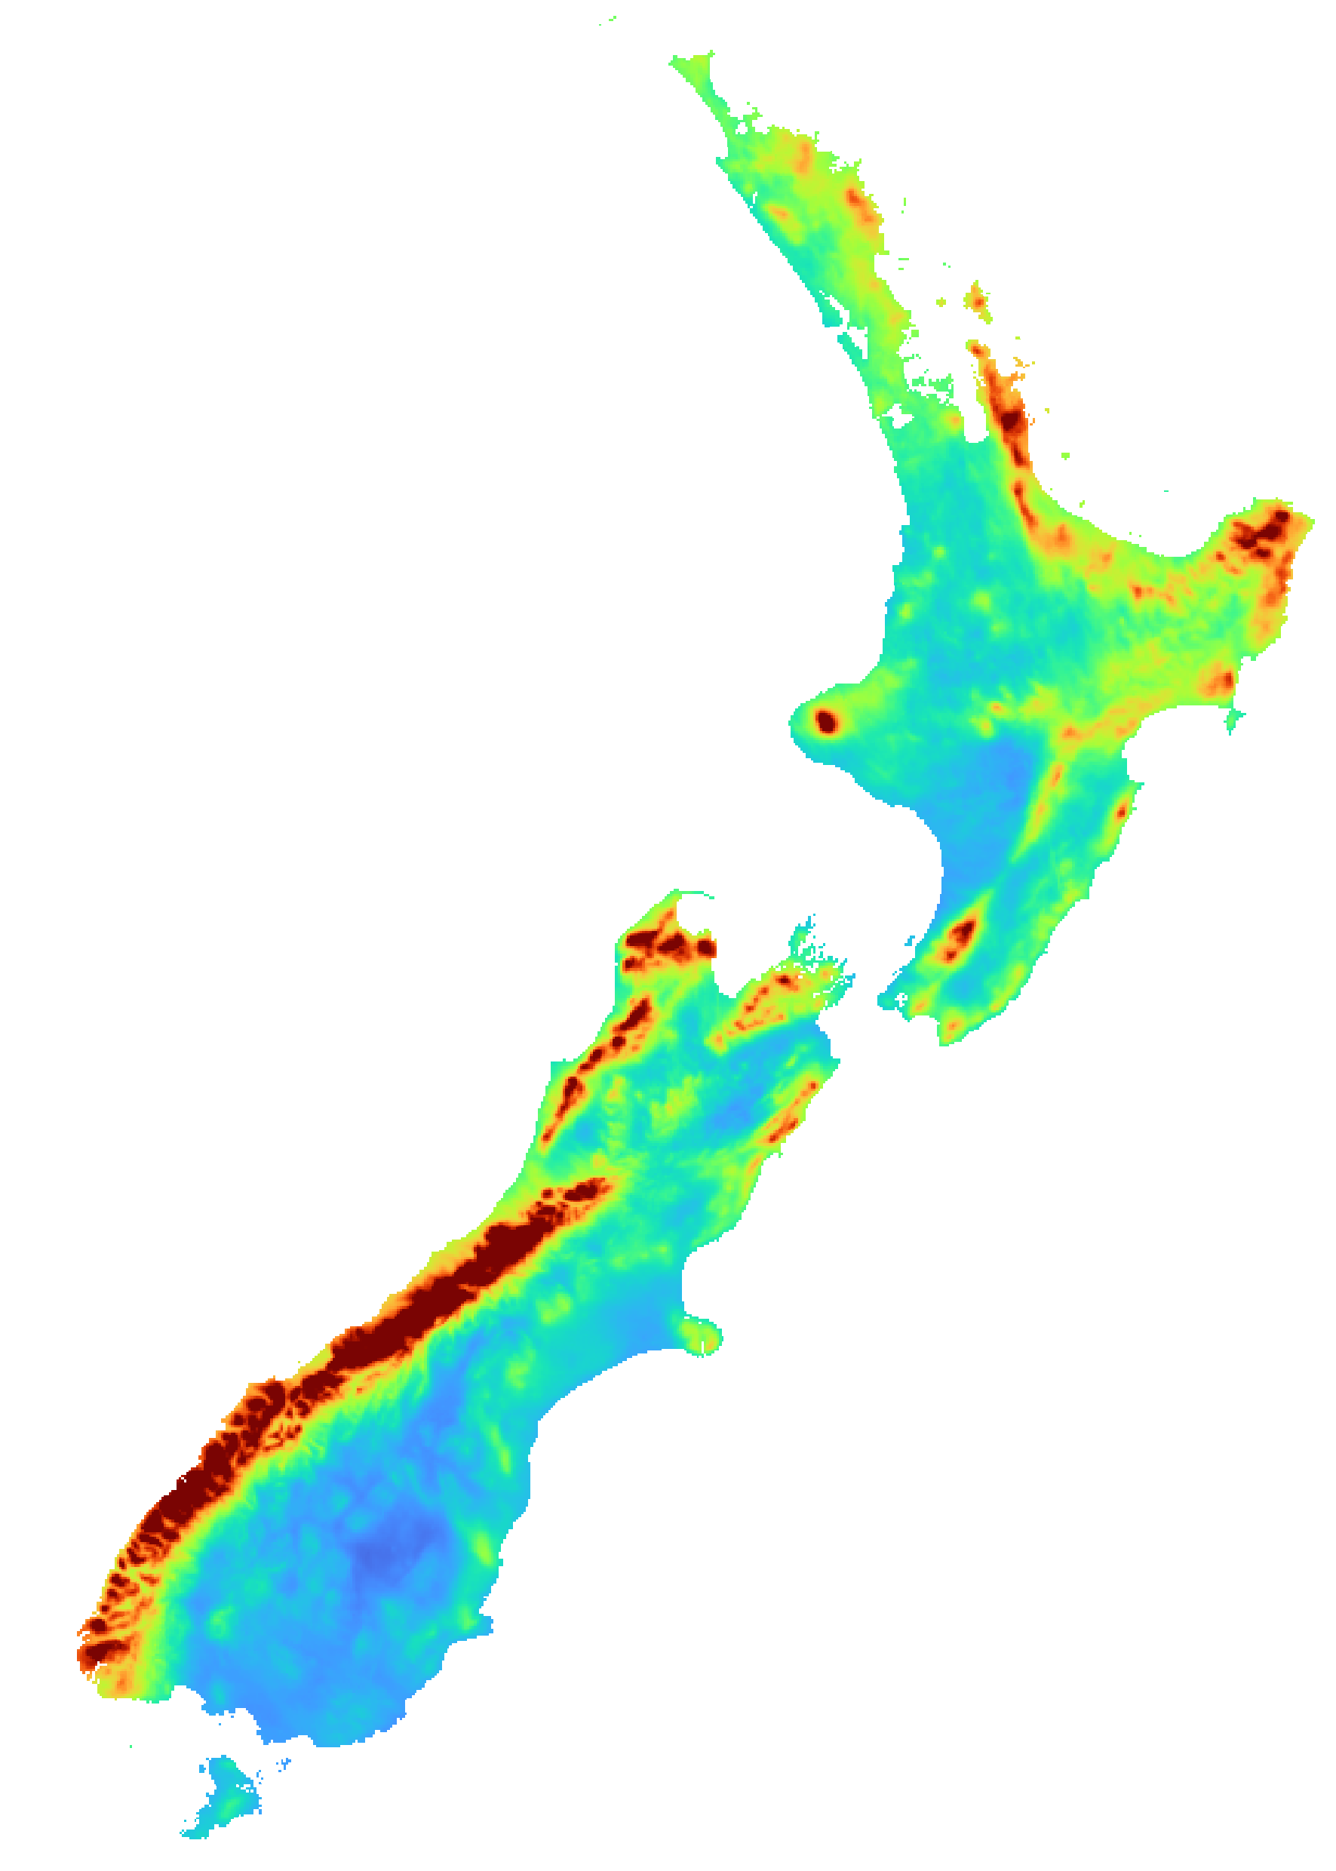
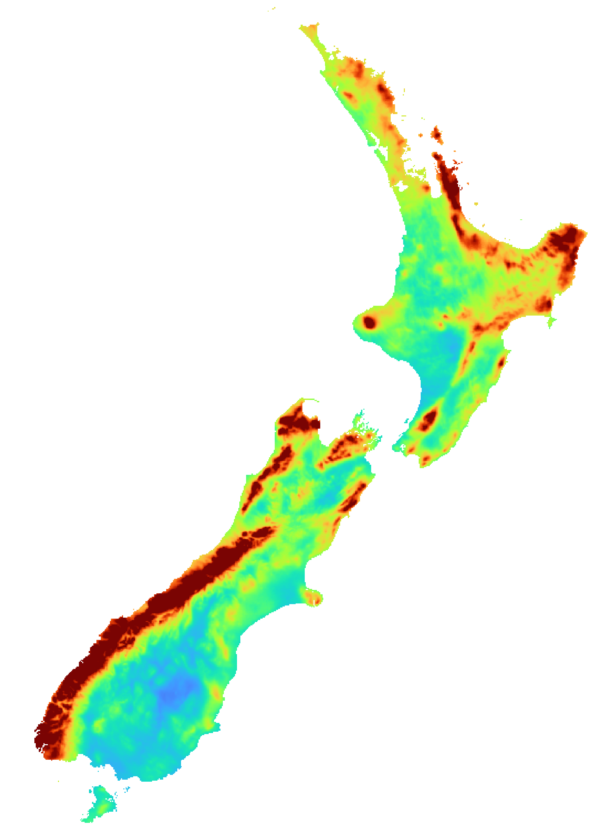
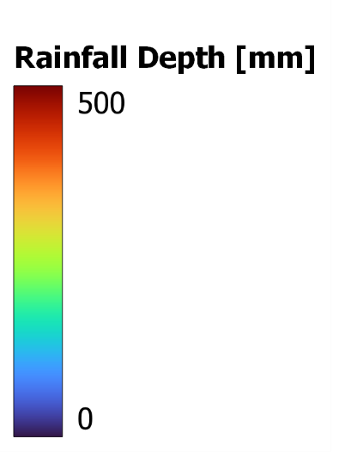

HIRDS v4.2 Design Storm*
* Online platform: https://hirds.niwa.co.nz
Depth-Duration-Frequency dataset
$$R=F\left(ARI,duration\right)$$
ARI 10yrs
ARI 50yrs
ARI 100yrs
ARI 500yrs
Dur ARI | 1hr | 2hr | 6hr | 12hr | 24hr | 48hr | 72hr | 96hr | 120hr
1.58yr
2yr
5yr
10yr
20yr
30yr
40yr
50yr
60yr
80yr
100yr
Reinterpreting current maps under future climate?

Slide 17
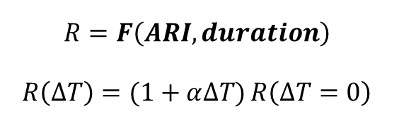
HIRDS v4.2 Design Storm*
* Online platform: https://hirds.niwa.co.nz
Depth-Duration-Frequency-Temperature dataset
$$R=F\left(ARI,duration\right)$$
$$R\left(∆T\right)=(1+α∆T)R\left(∆T=0\right)$$
ARI 10yrs
ARI 50yrs
ARI 100yrs
ARI 500yrs
Dur ARI | 1hr | 2hr | 6hr | 12hr | 24hr | 48hr | 72hr | 96hr | 120hr
1.58yr | 11.9 | 11.2 | 9.4 | 8 | 7 | 5.8 | 5.1 | 4.7 | 4.5
2yr | 12.2 | 11.7 | 9.8 | 8.5 | 7.2 | 6.1 | 5.5 | 5.1 | 4.8
5yr | 12.8 | 12.3 | 10.5 | 9.2 | 7.8 | 6.7 | 6.2 | 5.7 | 5.4
10yr | 13.1 | 12.6 | 10.8 | 9.5 | 8.1 | 7 | 6.5 | 6 | 5.7
20yr | 13.3 | 12.8 | 11.1 | 9.7 | 8.2 | 7.2 | 6.6 | 6.2 | 5.8
30yr | 13.4 | 12.9 | 11.2 | 9.8 | 8.3 | 7.3 | 6.7 | 6.3 | 5.9
40yr | 13.4 | 12.9 | 11.3 | 9.9 | 8.4 | 7.3 | 6.8 | 6.3 | 6
50yr | 13.5 | 13 | 11.3 | 9.9 | 8.4 | 7.4 | 6.8 | 6.4 | 6
60yr | 13.5 | 13 | 11.4 | 10 | 8.5 | 7.4 | 6.9 | 6.4 | 6
80yr | 13.6 | 13.1 | 11.4 | 10 | 8.5 | 7.5 | 6.9 | 6.4 | 6.1
100yr | 13.6 | 13.1 | 11.5 | 10.1 | 8.6 | 7.5 | 6.9 | 6.5 | 6.1
Reinterpreting current maps under future climate?

Slide 18
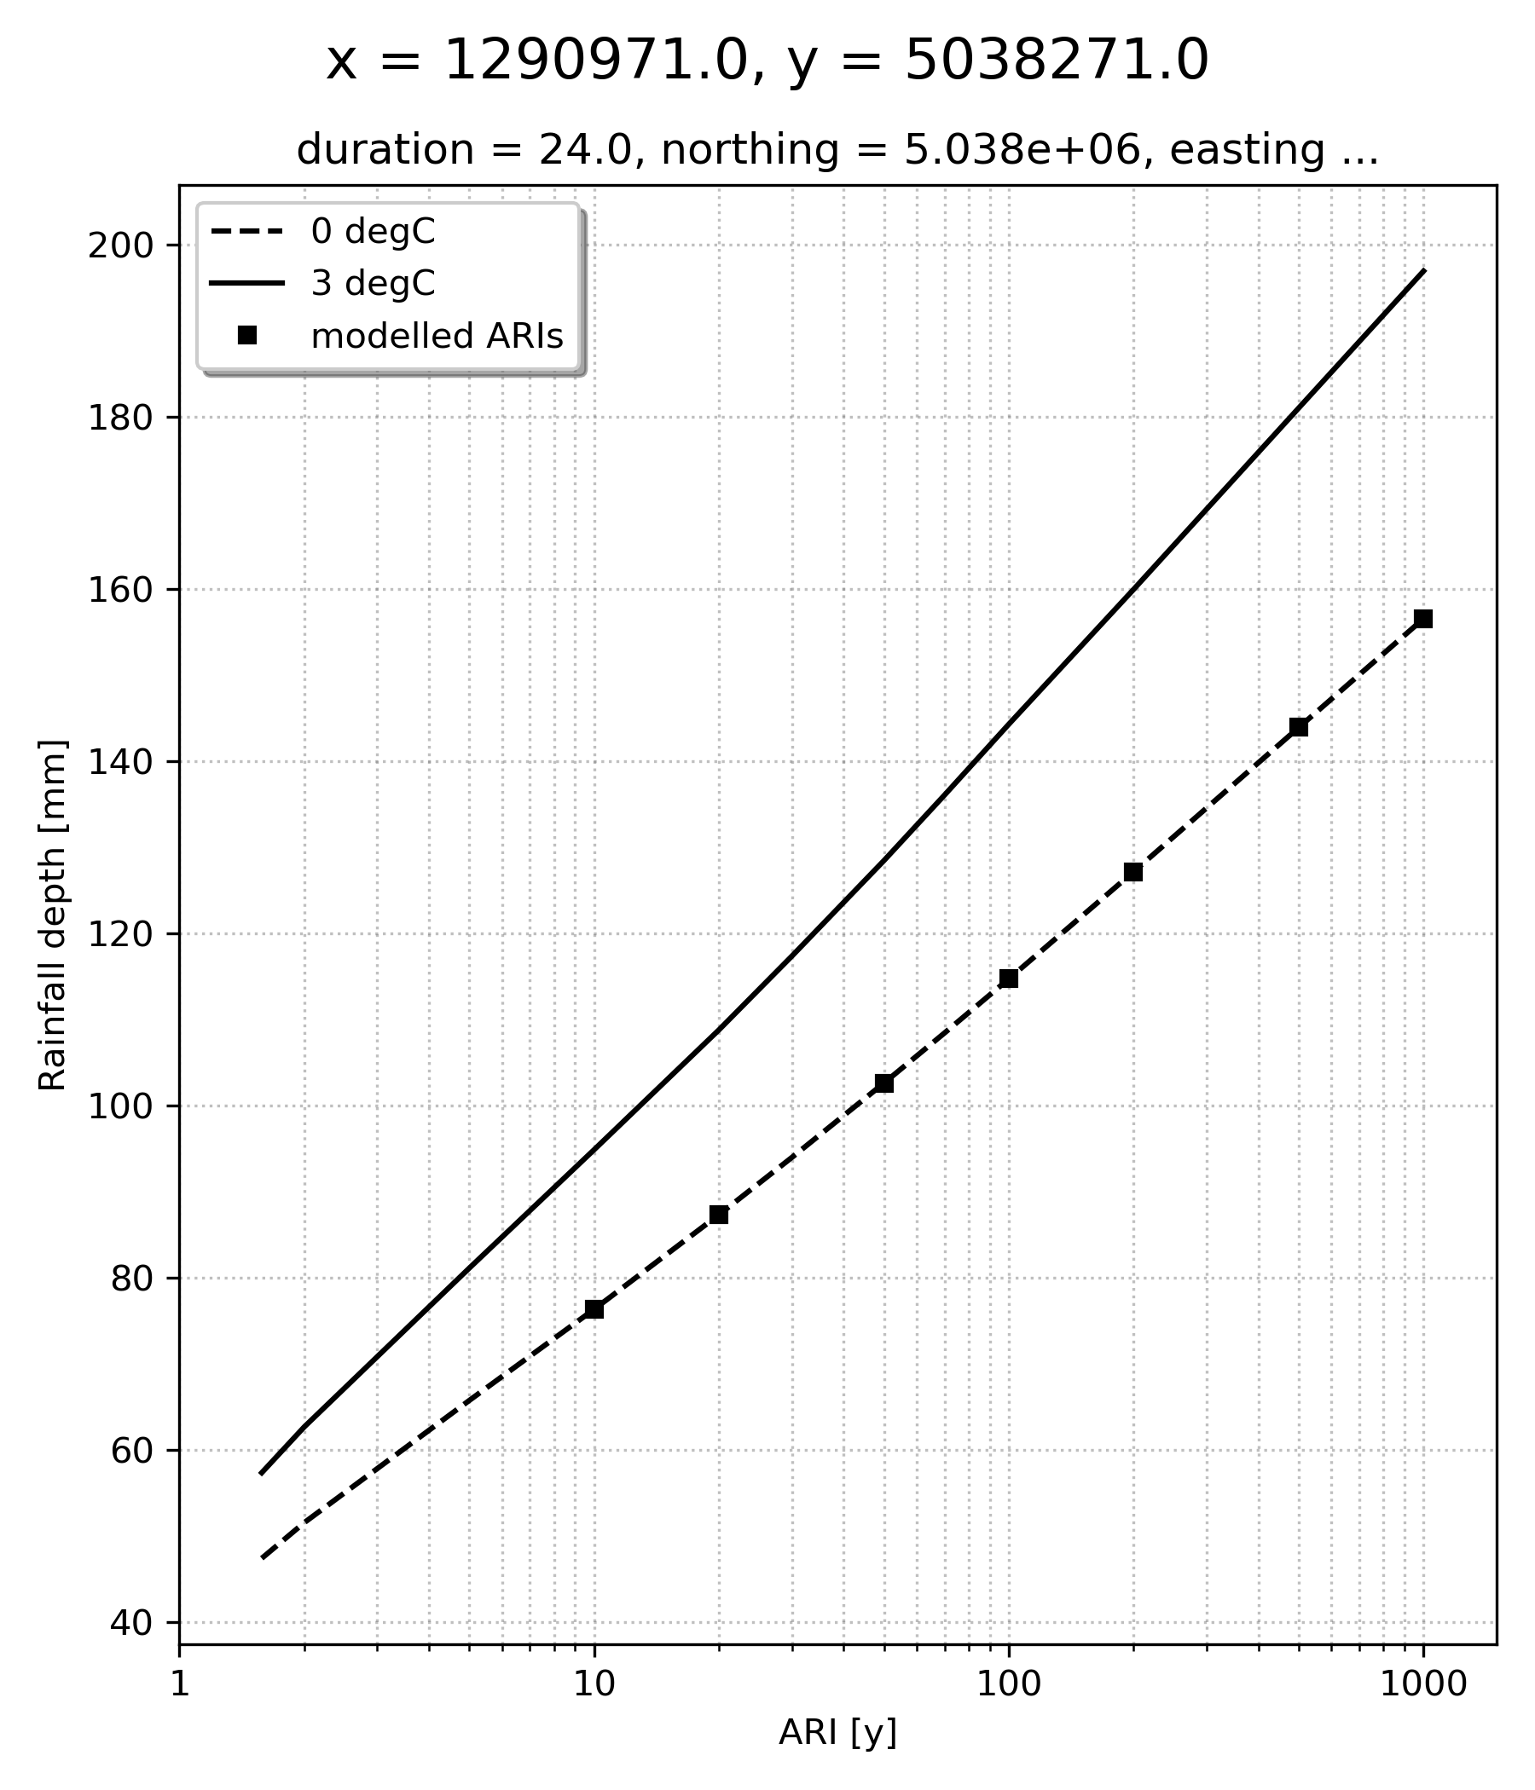
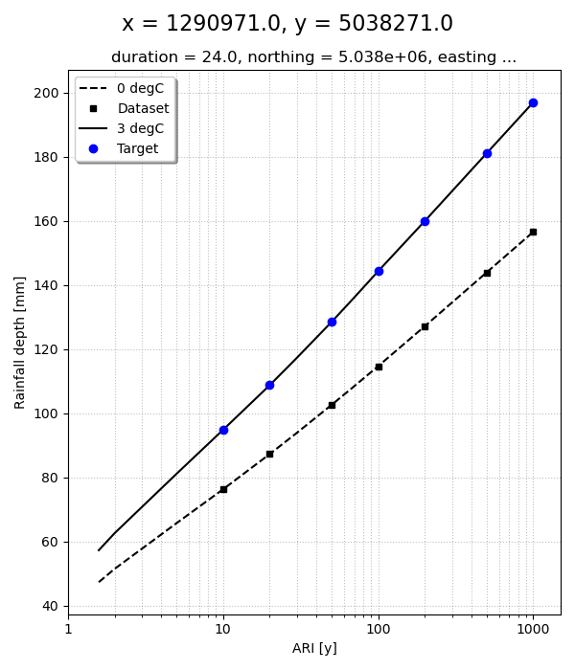
Conceptual framework
Target
[ ARI ; DT ]
Design storm
Database
Corresponding ARI_{0°C}
Inundation maps Database
Interpolated inundation map
Reinterpreting current maps under future climate?

Slide 19
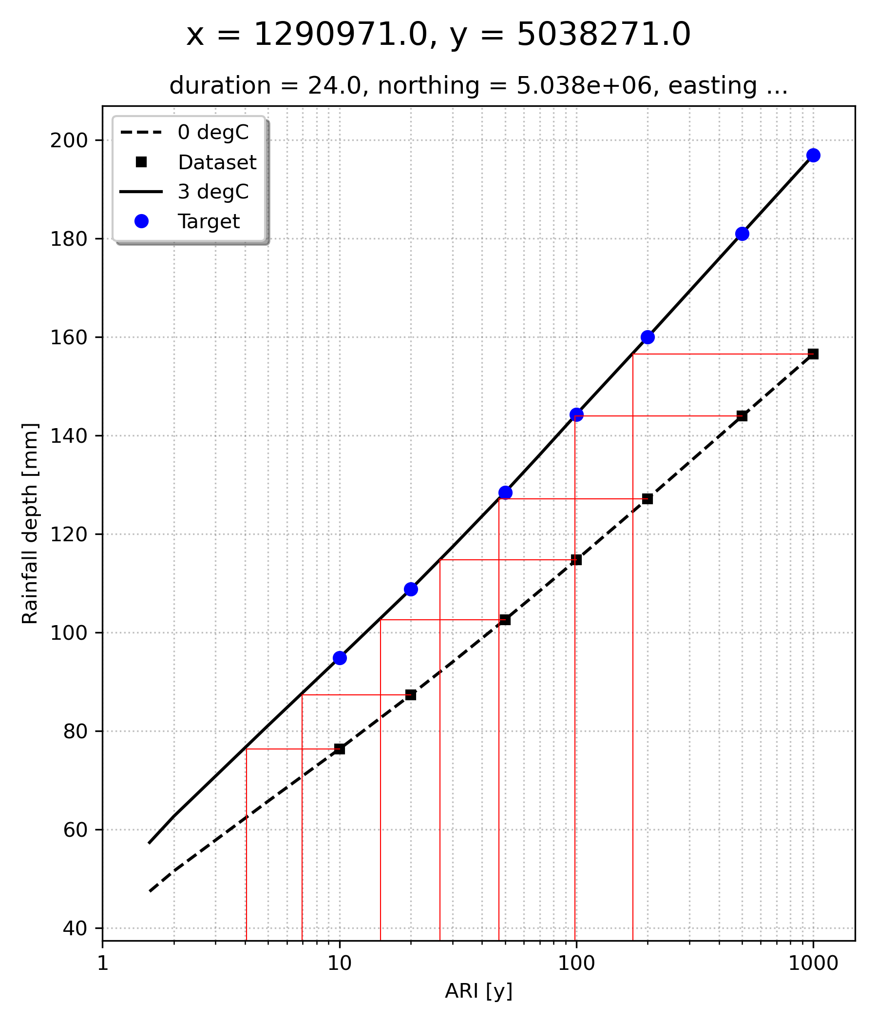
Conceptual framework
Equivalent
Reinterpreting current maps under future climate?

Slide 20
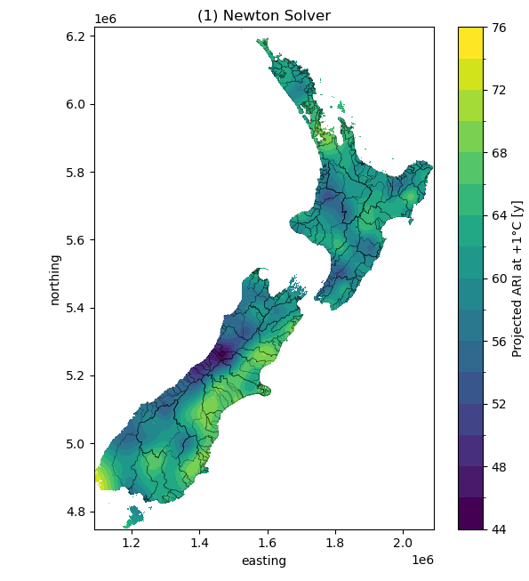
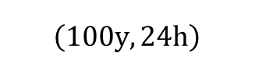

ARI projection under temperature warming
$$\left(100y, 24h\right)$$
Return period map under $+1°C$ projection
Reinterpreting current maps under future climate?

Slide 21
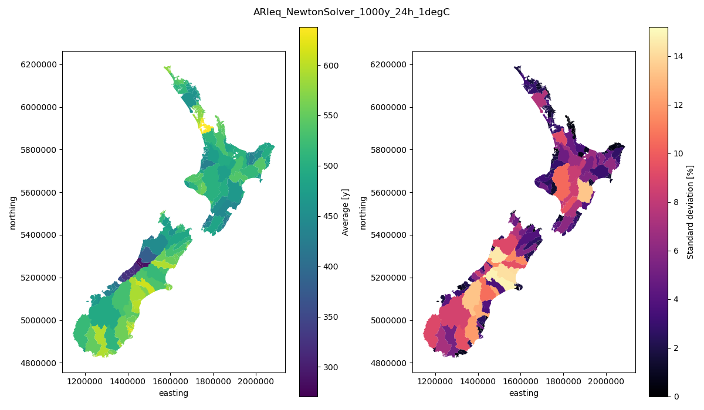
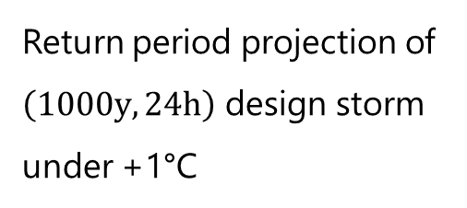
ARI projection under temperature warming
Aggregation over watersheds
Return period projection of $\left(1000y, 24h\right)$ design storm under +1°C
(1)
(2)
Reinterpreting current maps under future climate?

Slide 22
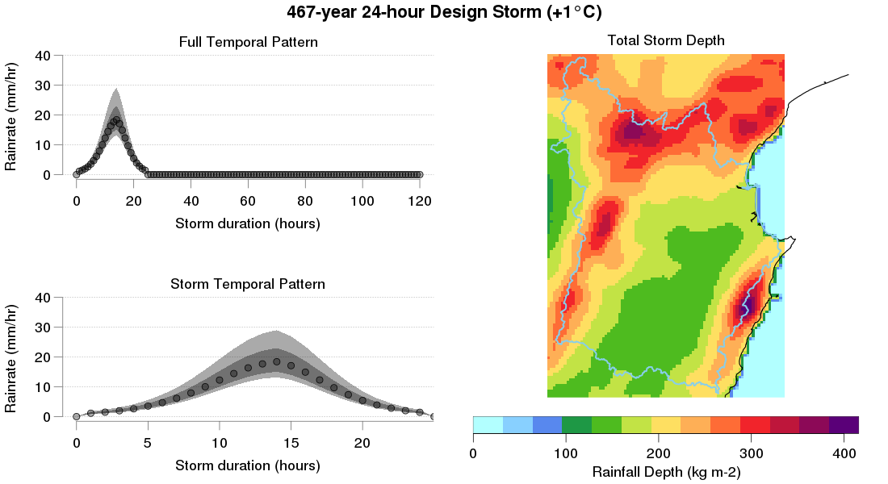
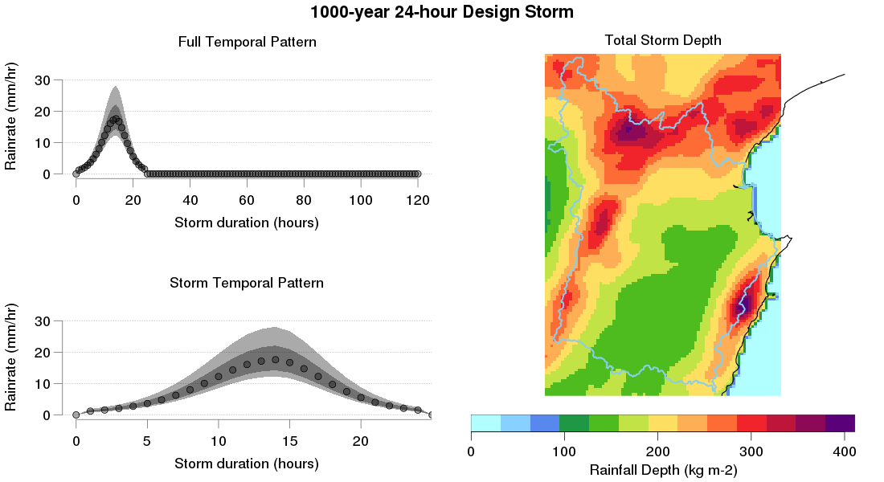
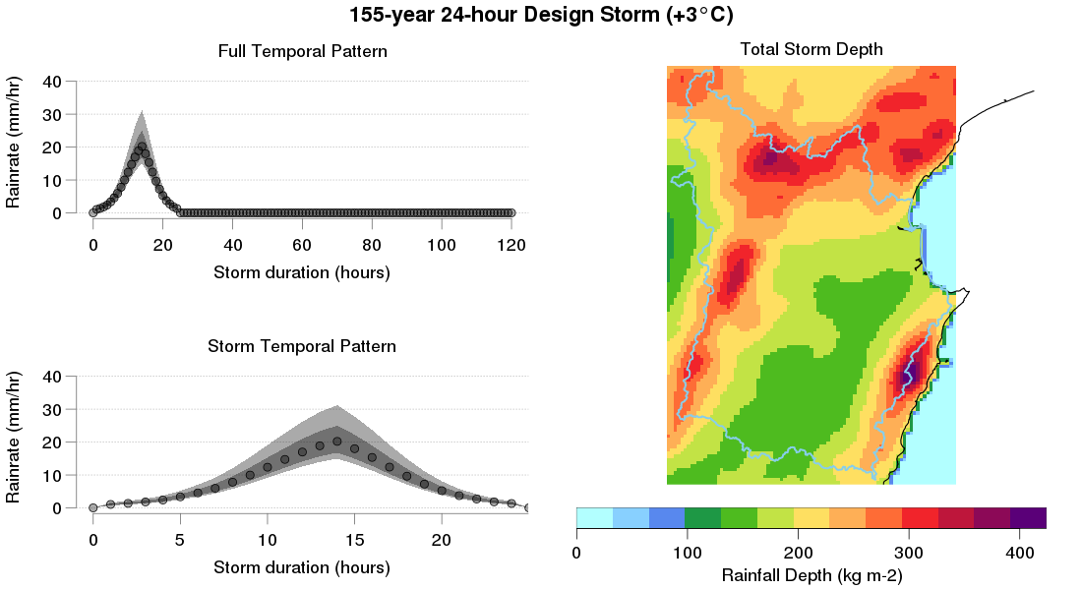
Return period projection under temperature warming
Heretaunga Plains
Reinterpreting current maps under future climate?

Slide 23




Return period projection under temperature warming
Heretaunga Plains
$$ARI=1000y; ∆T=0°C$$
$$ARI=467y; ∆T=+1°C$$
$$ARI=155y; ∆T=+3°C$$
Reinterpreting current maps under future climate?

Slide 24

Return period projection under temperature warming
Heretaunga Plains
$$ARI=1000y; ∆T=0°C$$
$$ARI=467y; ∆T=+1°C$$
$$ARI=155y; ∆T=+3°C$$
Reinterpreting current maps under future climate?

Slide 25



Return period projection under temperature warming
Rakaia
Reinterpreting current maps under future climate?

Slide 26




Return period projection under temperature warming
Rakaia
$$ARI=1000y; ∆T=0°C$$
$$ARI=534y; ∆T=+1°C$$
$$ARI=204y; ∆T=+3°C$$
Reinterpreting current maps under future climate?

Slide 27

Return period projection under temperature warming
Rakaia
Orographic contribution
$$ARI=204y; ∆T=+3°C$$
Rainfall runoff
Competing effects
Reinterpreting current maps under future climate?

Slide 28


Interpolation at unmapped ARI
3 main regression functions
Regression parameters stored at each pixel in netCDF
Instant reconstruction of the output map
$$h_{max}=F\left(ln⁡(ARI)\right)$$
Reinterpreting current maps under future climate?

Slide 29

Interpolation at unmapped ARI
Interpolation limitations and outliers
Marginal
Outlier
Monotone cubic spline | Best fit | Sensitive to outliers
Adaptative polynomial | Robust | Degrades with increased curvature in the data
Logistic | Less sensitive to local curvature | Not enough points for consistent parameters convergence
Reinterpreting current maps under future climate?

Slide 30


Interpolation at unmapped ARI
Simulation vs interpolation - $ARI=1000y; ∆T=3°C$
(1) Simulation
(2) Interpolation
(1) – (2)
Reinterpreting current maps under future climate?

Slide 31


Applications: Peak depth increase under temperature warming
100y event Peak depth increase under +1°C, +2°C, +3°C
+1°C
+2°C
+3°C
Reinterpreting current maps under future climate?

Slide 32
Conclusions and outlook
Comprehensive assessment of flooding under climate projections
Comparable estimates at low computational costs
Scalable framework for progressive database enhancement starting from worst conditions (ARI>500y)
Inclusion of sea-level rise enabling reconstruction of climate projection scenarios
Rapid forecast AI models training dataset
Framework upgrade: Streamline modelling of user-specified scenarios
Historical flood event database
Early warning and post-event emergency response
Flood events impact forecast
Major update of the design storm (pending funding application)

