Slide 1
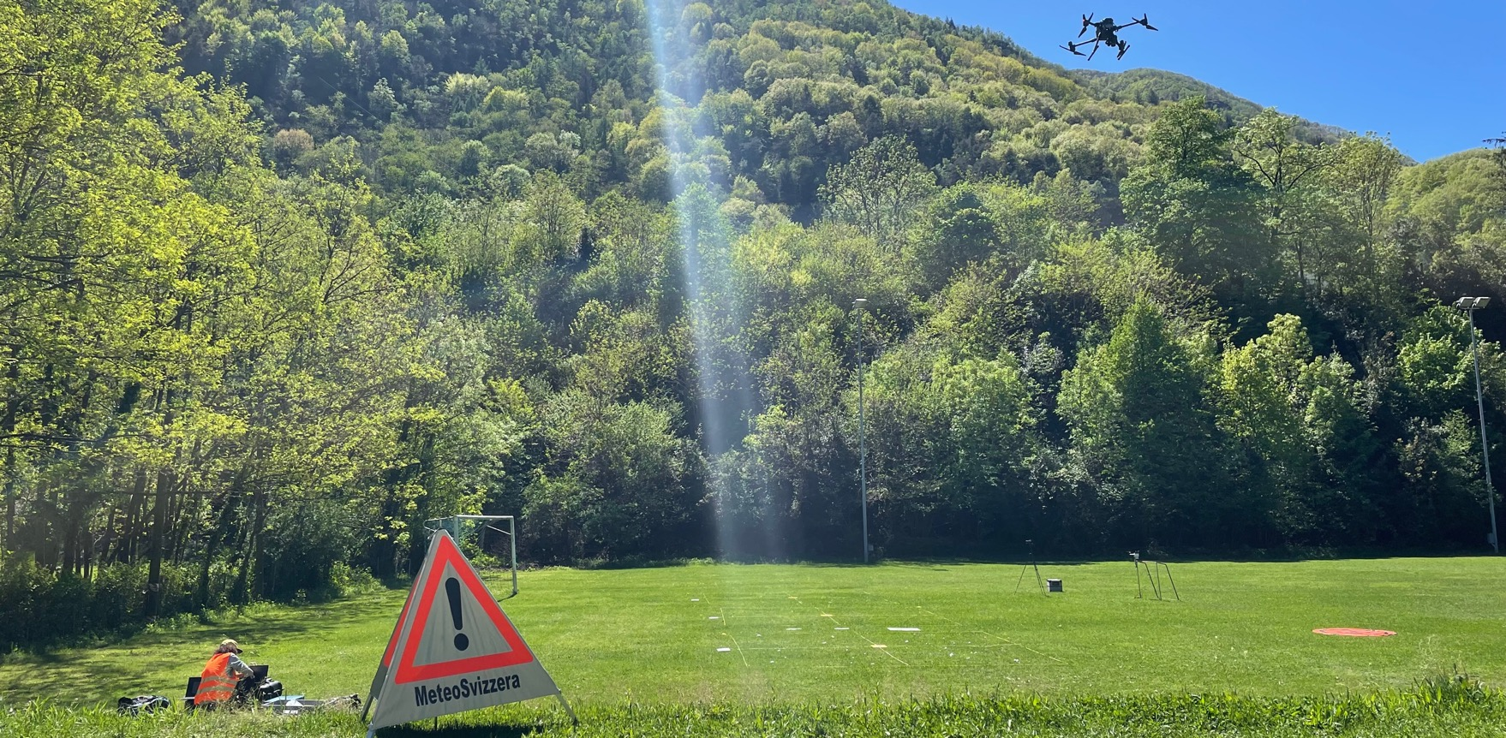
Performance assessment of drone-based photogrammetry coupled with machine-learning for the estimation of hail size distributions on the ground
Jannis Portmann, Martin Lainer, Killian P. Brennan, Marilou Jourdain de Thieulloy, Matteo Guidicelli, Samuel Monhart

Slide 2
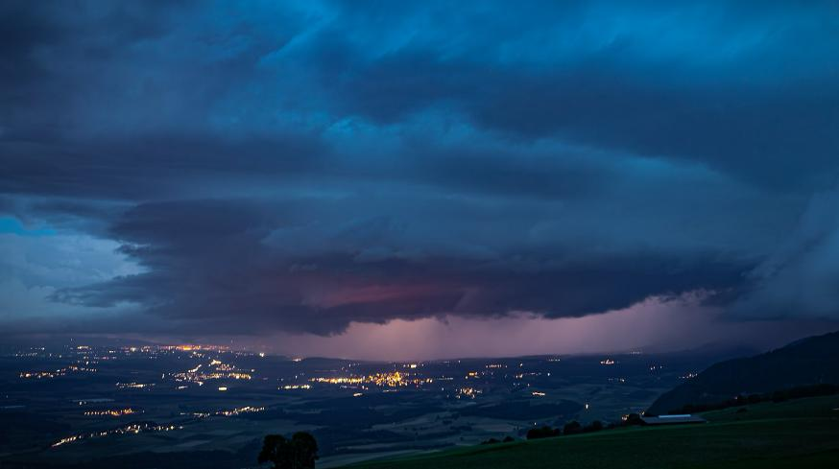
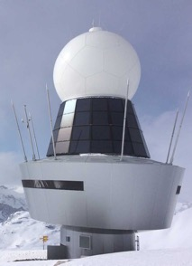

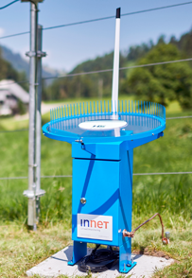



Motivation – Hail observation
Images:
MeteoSwiss,
Crosley via sturmforum.ch,
Manu Friederich
Radar
Ground obsertvations
Hail sensor
Photogrammetry
Crowd reports

Slide 3
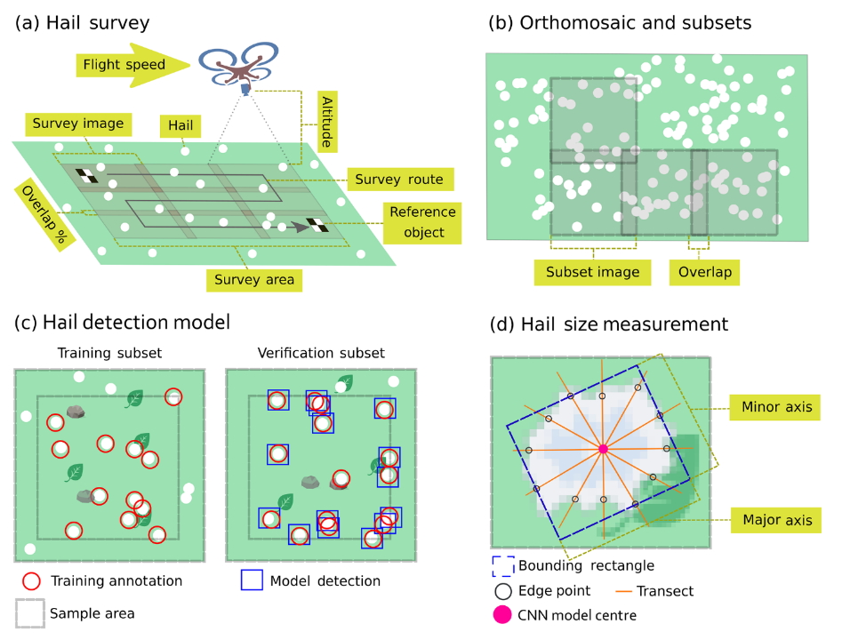
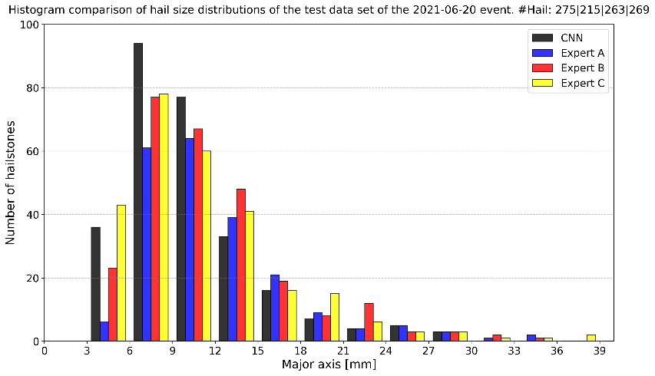
Motivation – Scientific background
Soderholm et al., 2020
Lainer et al., 2024
How representative are the retrived
hail size distributions (HSD)?
Experiments with synthetic hail
Comparison to real hail event

Slide 4
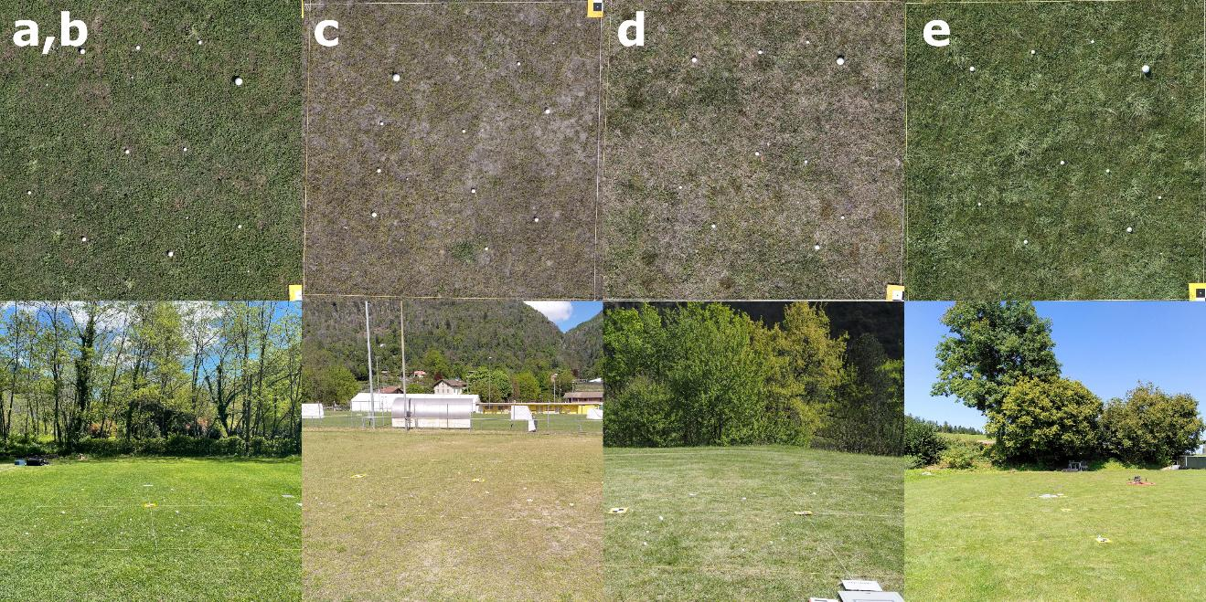
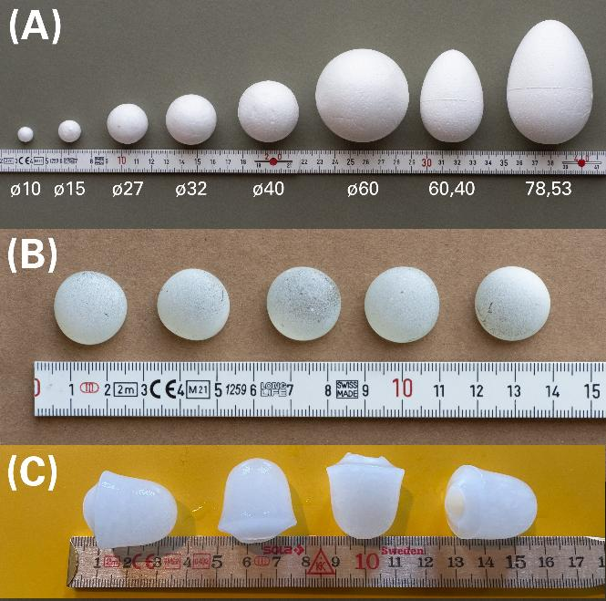
Experiments – Materials
Experiments with synthetic hail objects (EPS, glass, ice)
Various surfaces a-e
250 objects of each material placed
Spherical
Oval

Slide 5
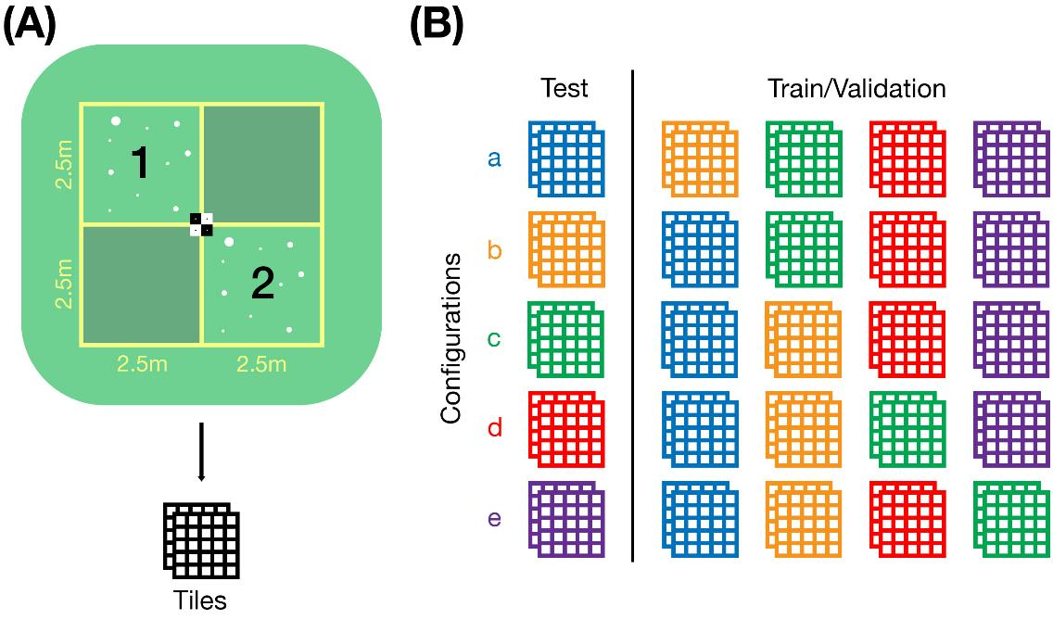
Experiments – Setup
Each quadrant split into 5x5 tiles of 600x600px (100px overlap)
Leave-one-out cross-validation (LOOCV)
One model trained per configuration
All tiles annotated
GSD: 1mm
Flight speed: 1m/s
Notes:
Configuration correspond to surface

Slide 6
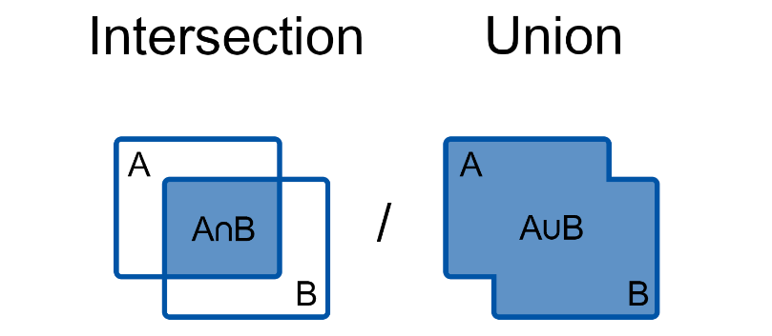
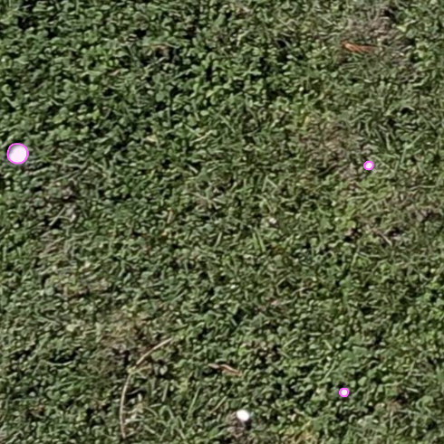
Detection of hail
Binary classification (hail or not hail) by custom trained ML model based on detectron2
Pixel mask (segmentation)
IoU > 0.5
Not all objects were visible, especially small EPS (10mm)
Annotations by 3 experts for comparison (cvat.ai)
Annotated tile
Intersection over union (IoU)
Hail
Undefined

Slide 7
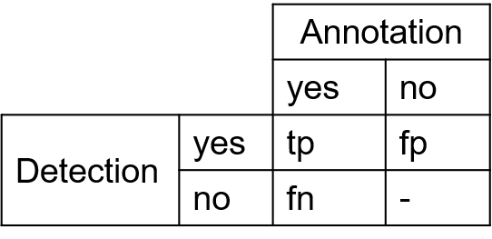
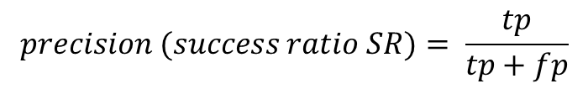
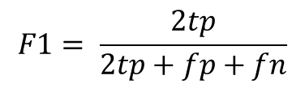
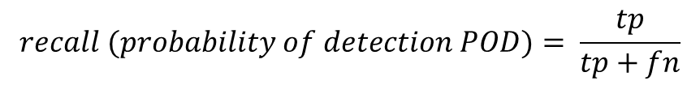
Detection scores
$$precision (success ratio SR)= \frac{tp}{tp+fp}$$
tp
fn
tp
$$recall (probability of detection POD)= \frac{tp}{tp+fn}$$
tp
fp
$$F1= \frac{2tp}{2tp+fp+fn}$$
= Annotation
= Detection (by CNN)
= Non-hail object
Notes:
Precision: How many of the detections were hail?
Recall: How many of the hail objects were detected?
F1: Harmonic mean

Slide 8
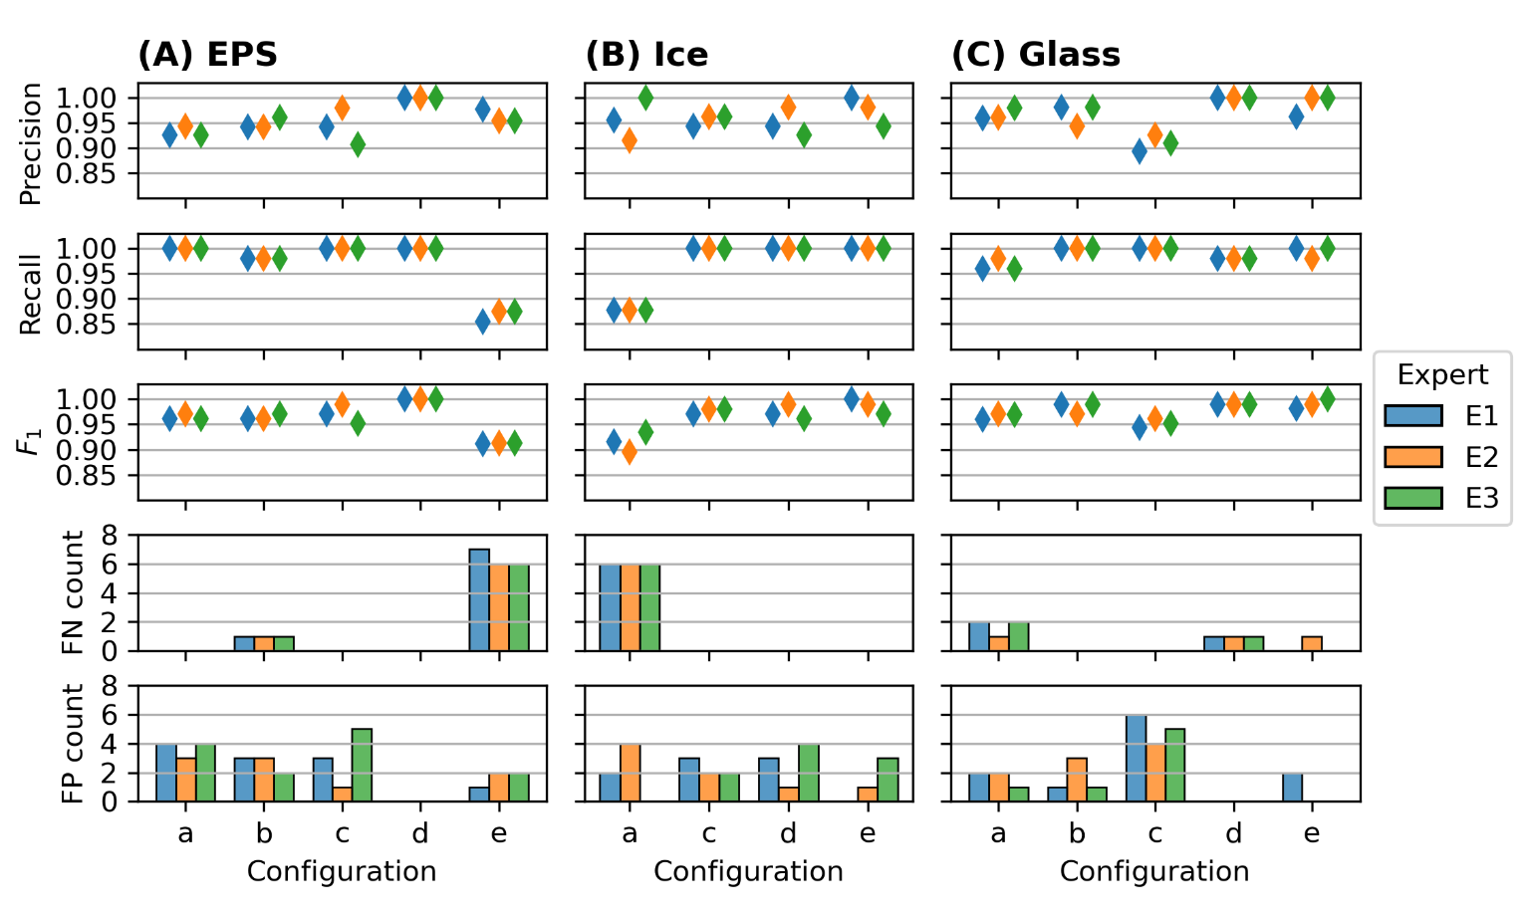
Results – Detection

Slide 9
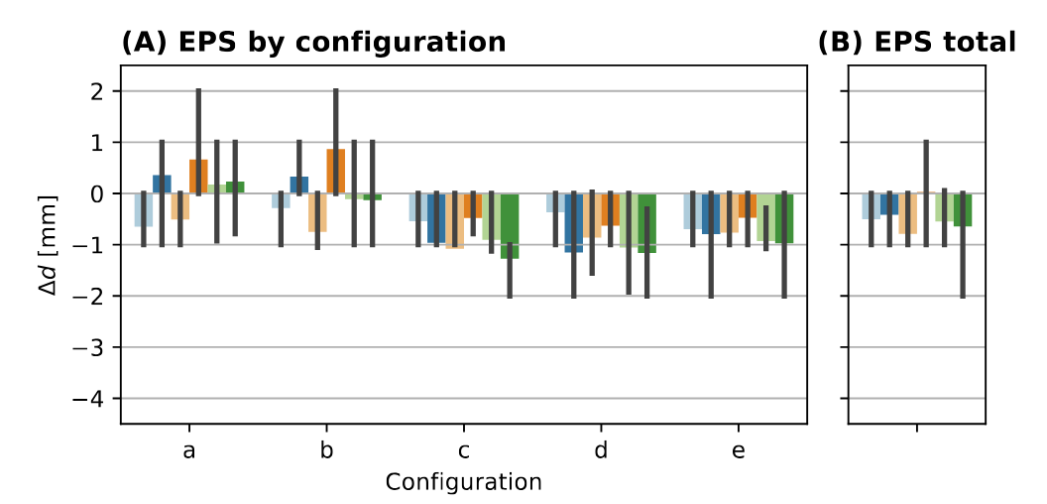
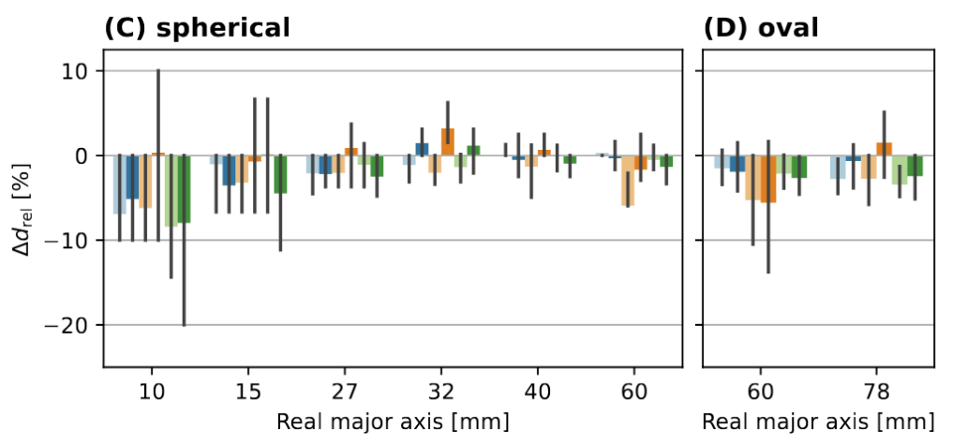

Size estimation – EPS
Only true-postives can be compared!
Bias tends to be small around -0.5mm
Relative bias largest for 10mm hail objects
Notes:
Focus on EPS, multiple sizes available
Comparison against 2 ground truths

Slide 10
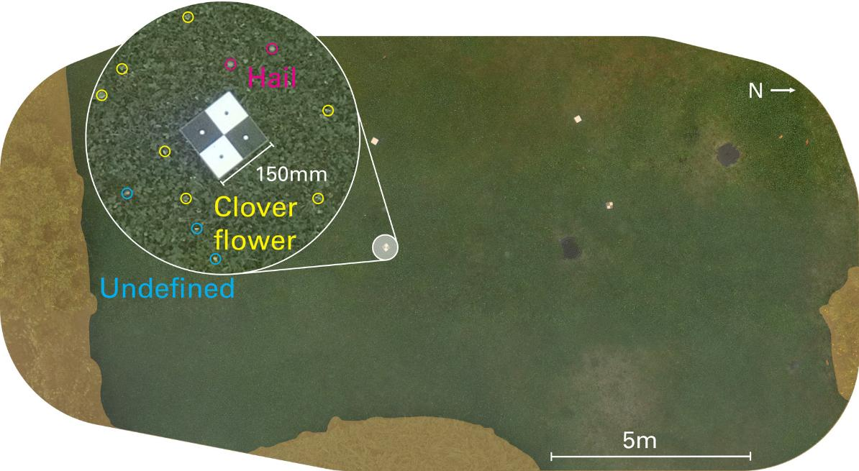
Real event 2022
Challenges during
annotation
June 28 2022 in Locarno, Switzerland
20min until flight
194.6m² of 220.2m² used
Crowd-reports 20-30mm
No ground-truth
Annotation of random tiles by the same 3 experts (train/val: 30, test: 10)
Mask unwanted areas

Slide 11
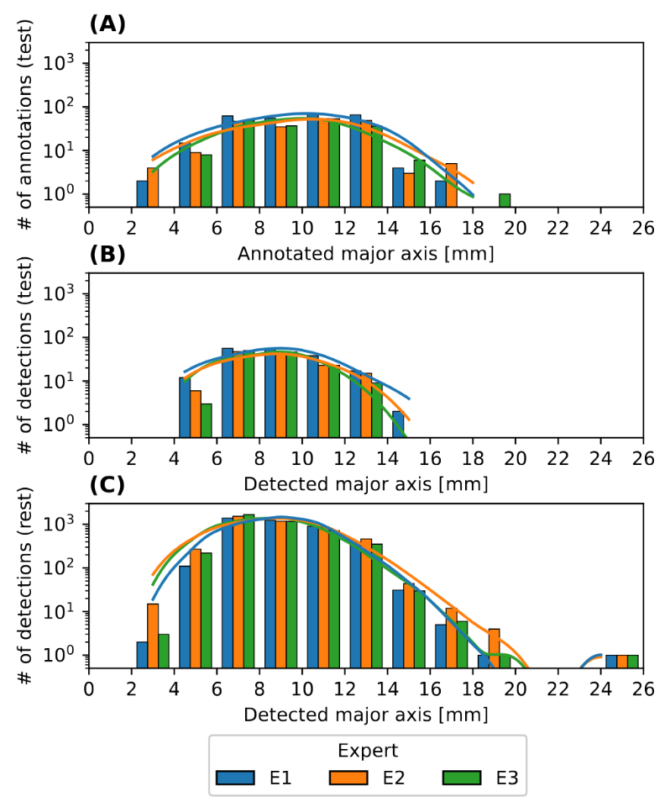
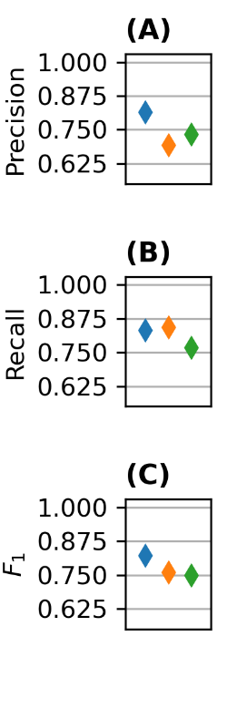
Real event – Results
Detection
HSD
Lowered scores compared to experiments
Still around 81% of hailstones correctly identified
Comparable to Lainer et al. (2024)
Similar ∆d to annotations as in experiments

Slide 12
Conclusion and outlook
Main findings
Large survey area allows for representative HSD estimation
Reliable detection of hailstones
Small bias under suitable conditions
Suitable for radar verification purposes
Outlook
Try to capture more events
Improve lighting solution
Use of available data

Slide 13
References
Ferrone, A., Kopp, J., Lainer, M., Gabella, M., Germann, U., & Berne, A. (2024). Double-moment normalization of hail size number distributions over Switzerland. Atmospheric Measurement Techniques, 17(24), 7143–7168. https://doi.org/10.5194/amt-17-7143-2024
Guidicelli, M., Ferrone, A., Ghiggi, G., Gabella, M., Germann, U., Berne, A. (in prep). Retrieval of the hail size number distribution from polarimetric radar data using the double-moment normalization.
Lainer, M., Brennan, K. P., Hering, A., Kopp, J., Monhart, S., Wolfensberger, D., & Germann, U. (2024). Drone-based photogrammetry combined with deep learning to estimate hail size distributions and melting of hail on the ground. Atmospheric Measurement Techniques, 17(8), 2539–2557. https://doi.org/10.5194/amt-17-2539-2024
Portmann, J., Lainer, M., Brennan, K. P., Jourdain De Thieulloy, M., Guidicelli, M., & Monhart, S. (2025). Performance assessment of drone-based photogrammetry coupled with machine-learning for the estimation of hail size distributions on the ground. Frontiers in Environmental Science, 13, 1602917. https://doi.org/10.3389/fenvs.2025.1602917
Soderholm, J. S., Kumjian, M. R., McCarthy, N., Maldonado, P., & Wang, M. (2020). Quantifying hail size distributions from the sky – application of drone aerial photogrammetry. Atmospheric Measurement Techniques, 13(2), 747–754. https://doi.org/10.5194/amt-13-747-2020

Slide 14
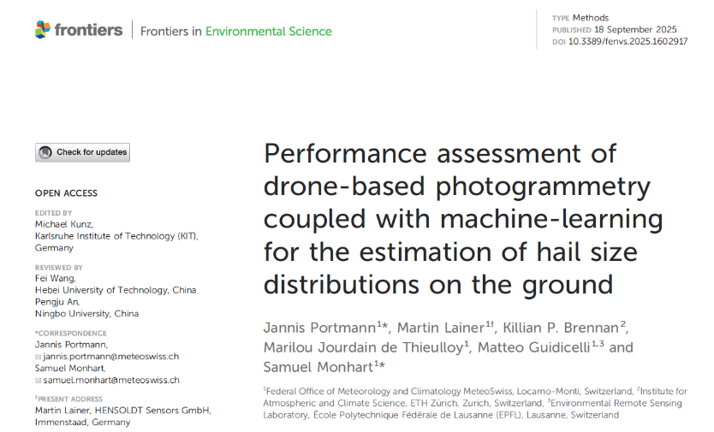
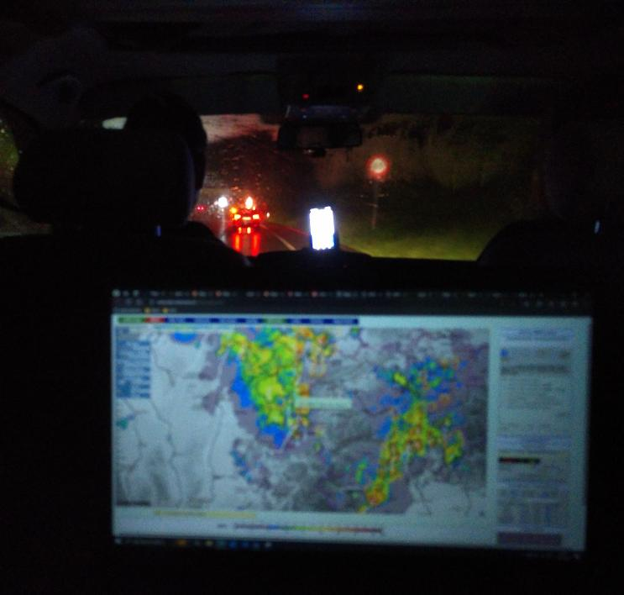

Publication
Portmann et al., 2025
Code on GitHub
Data on zenodo

Slide 15
Jannis Portmann
jannis.portmann@meteoswiss.ch
Samuel Monhart
samuel.monhart@meteoswiss.ch

Slide 16
ADDITIONAL SLIDES

Slide 17
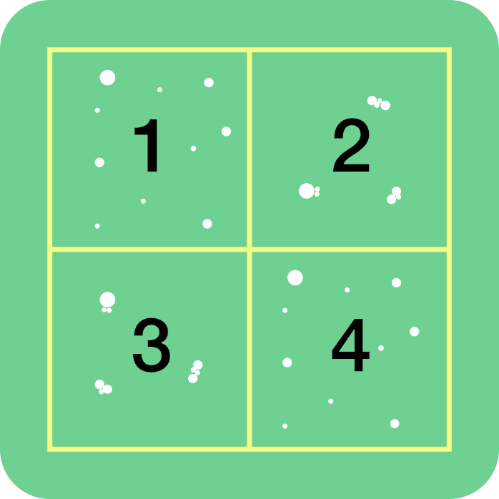
Cluster setup
Additional quadrants with hail objects arranged into clusters
Same size distribution as others
5m

Slide 18
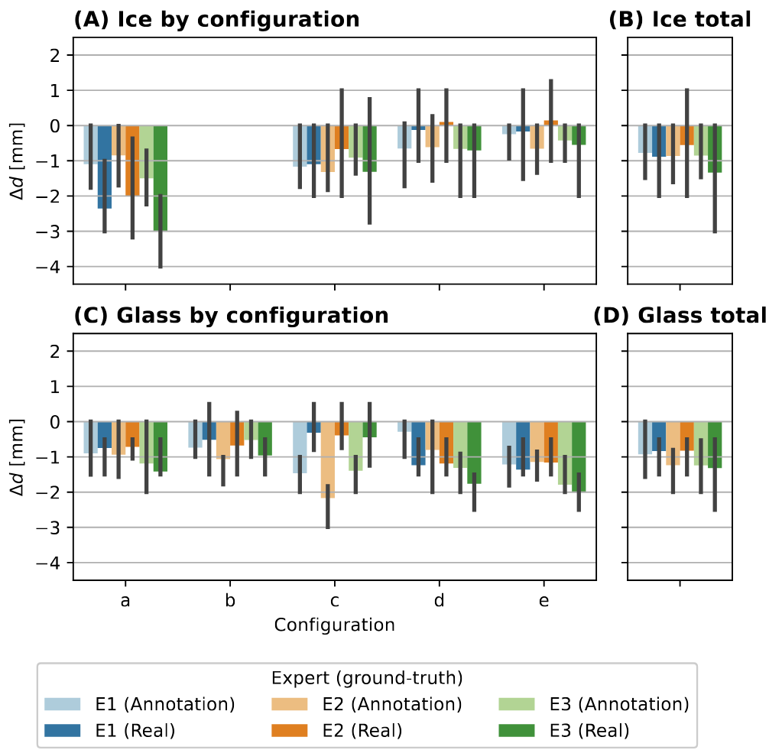
Size estimation – Ice and Glass
Slightly larger bias across all experiments, but comparable to EPS
Larger differences between experiments

Slide 19
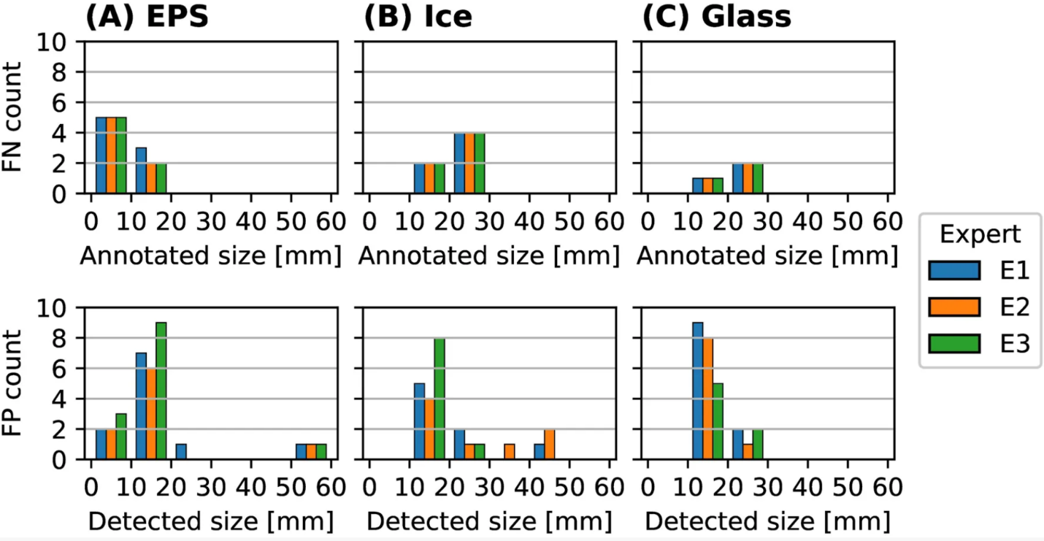
Distribution of FN/FP
FN are mainly small hail objects
FP tend to be also small
FP can also be large objects
Check manually

Slide 20

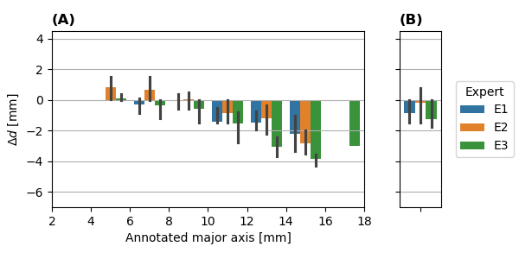
Real event – HSD
Crowd sourced reports around 20-30mm (max size)
Melting based on Lainer et al. (2024) around 10mm, but not directly applicable
Annotion distribution is wider than detected distribution
Bias larger for large hailstones
Bias in test set

Slide 21
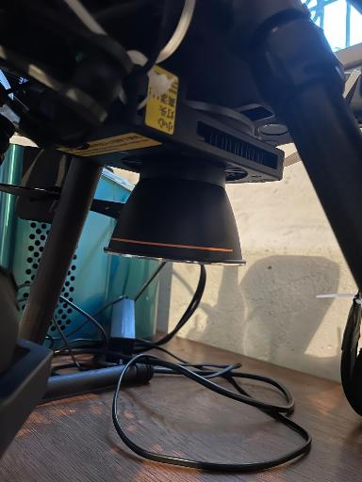
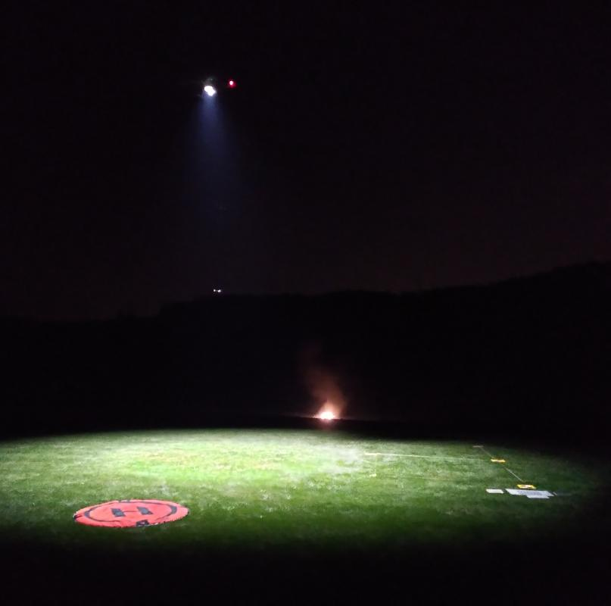
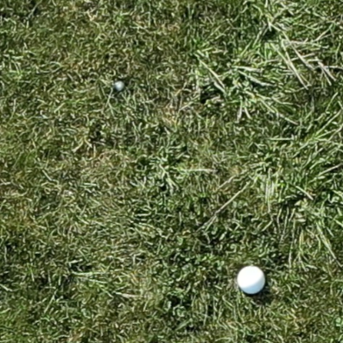

Experiences – Night flights
Drone
Light + cooler
100W output LED
Powered by power-bank on top of the drone via USB-C PD
Power input is currently unstable
Reduced quality, but still usable
Reflectivity of EPS vs real hail?
Reflector
Day
Night

Slide 22
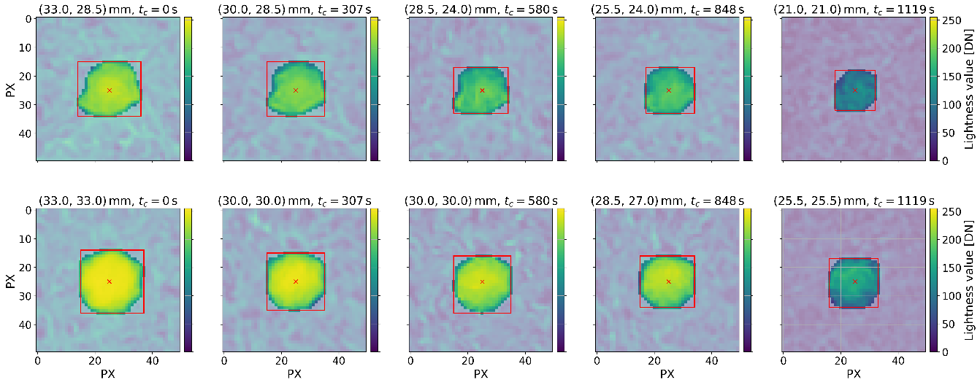
Melting on the ground
Melting experiments with ice cones
Multiple flights over the experimental setup were conducted
Representative for real hail?
Not yet analyzed
Melting of hailstones from Lainer et al. (2024):

