Slide 1




Timescales of Evolution for Supercell Updrafts and their Impact on Hail Trajectories
Lydia Spychalla, Matthew Kumjian, Kelly Lombardo, Joshua Soderholm, and Jannick Fischer
AGS-2410918

Slide 2
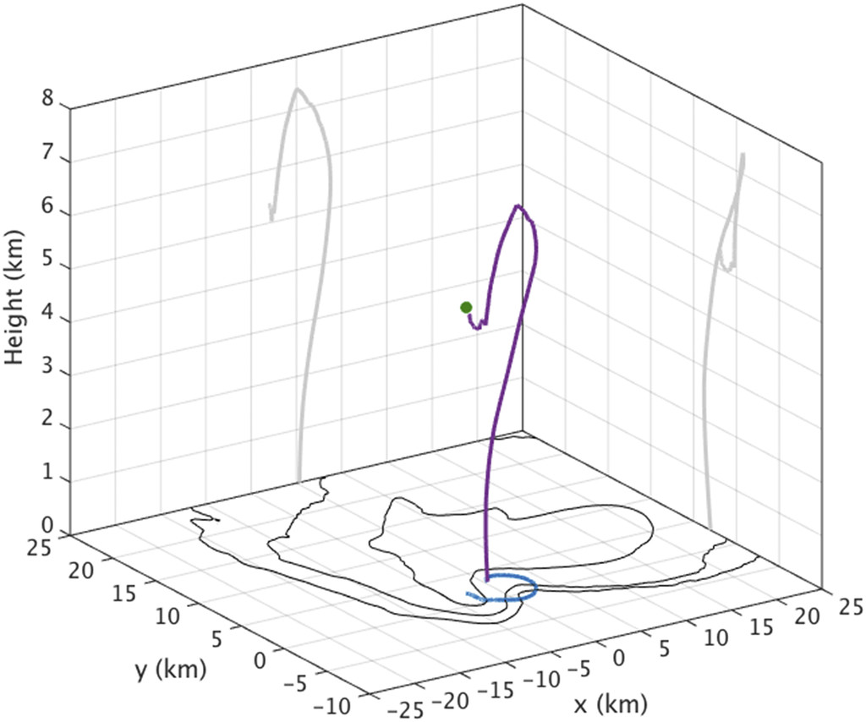
Introduction: Hail Trajectory Modeling The usefulness of hail growth stories
1
ECSS 2025 lks5850@psu.edu
Hail trajectory modeling is a useful tool to understand the processes of hail growth
We can know the full story of every hailstone from embryo to ground
Examining the growth history of individual hailstones in detail can reveal:
Regions of a storm in which hailstones grow
Storm features that are conducive or detrimental to hail growth
How the largest hailstones on earth might grow
Each trajectory tells a story that reveals truths about storm dynamics, hail growth, and their interactions
Example modeled hail trajectory from
Kumjian and Lombardo (2020)

Slide 3
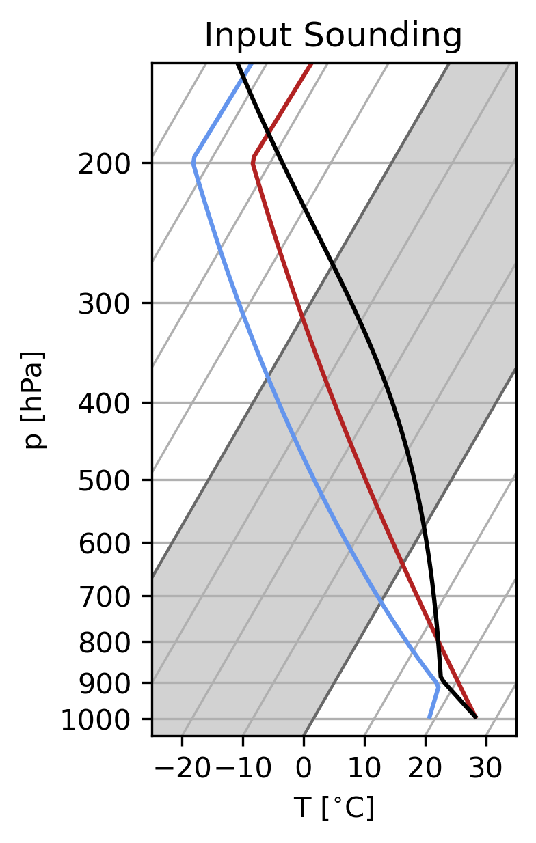
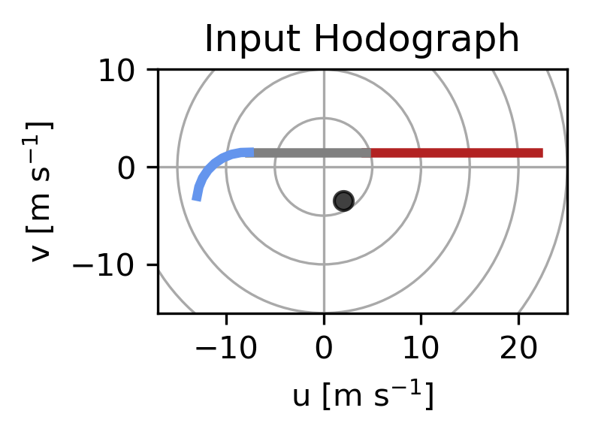
Methods Simulation Details
ECSS 2025 lks5850@psu.edu
2
CAPE = 2990 J kg⁻¹
CIN = -70 J kg⁻¹
LCL = 1.0 km
LFC = 2.0 km
z( 0˚C) = 3.8 km
z(-40˚C) = 9.1 km
CM1 simulation: (Bryan and Fritsch 2002)
Δx = Δy = 250 m, Δz = 125 m
NSSL 2-moment microphysics
Output Δt = 5 s
Modified Weisman-Klemp sounding
Quarter-circle hodograph
Hail model from Spychalla and Kumjian (2025)
CM1 simulation environment producing two long-lived supercells
We’ll zoom in on three hail trajectories:
Classic hail pathway
Alternative large hail trajectory
(showing the importance of updraft evolution)
Gargantuan-producing hail trajectory
(and why they’re so rare)
1-3 km
3-6 km
0-1 km
Shear_{0-1 km} = 6.3 m s⁻¹
Shear_{0-6 km} = 34.9 m s⁻¹
SRH_{0-1 km} = 81 m² s⁻²
SRH_{0-3 km} = 133 m² s⁻²

Slide 4
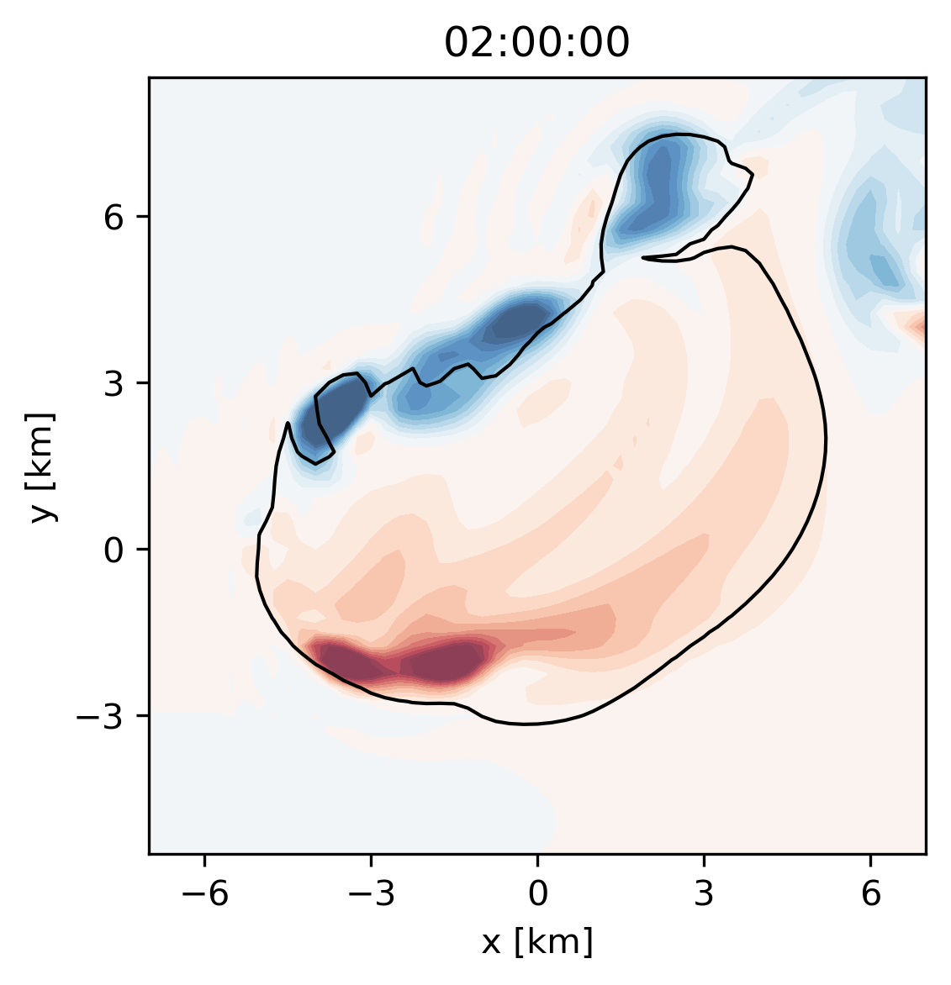
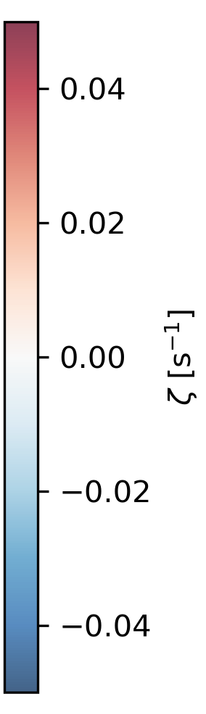
Trajectory 1: The classic hail pathway Browning and Foote (1967)
ECSS 2025 lks5850@psu.edu
3
Browning and Foote (1967) proposed a typical path for hailstones growing in [right moving] supercells:
Plan view of a supercell updraft at z = 6 km
Vertical Velocity contoured (10 m s⁻¹)
Vertical Vorticity shaded (+/-)

Slide 5
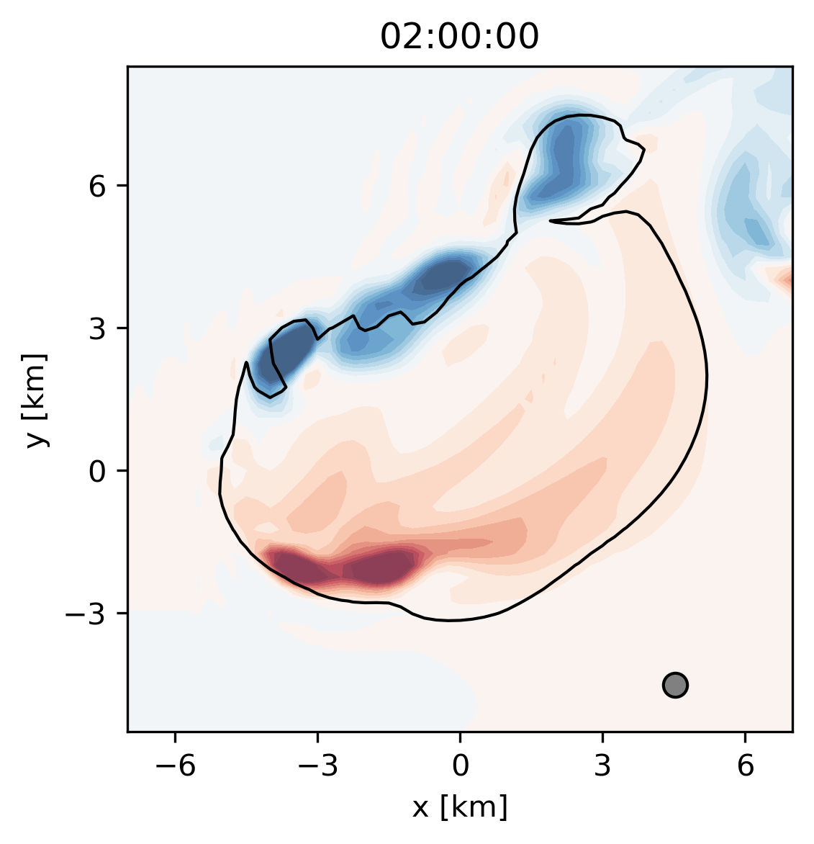
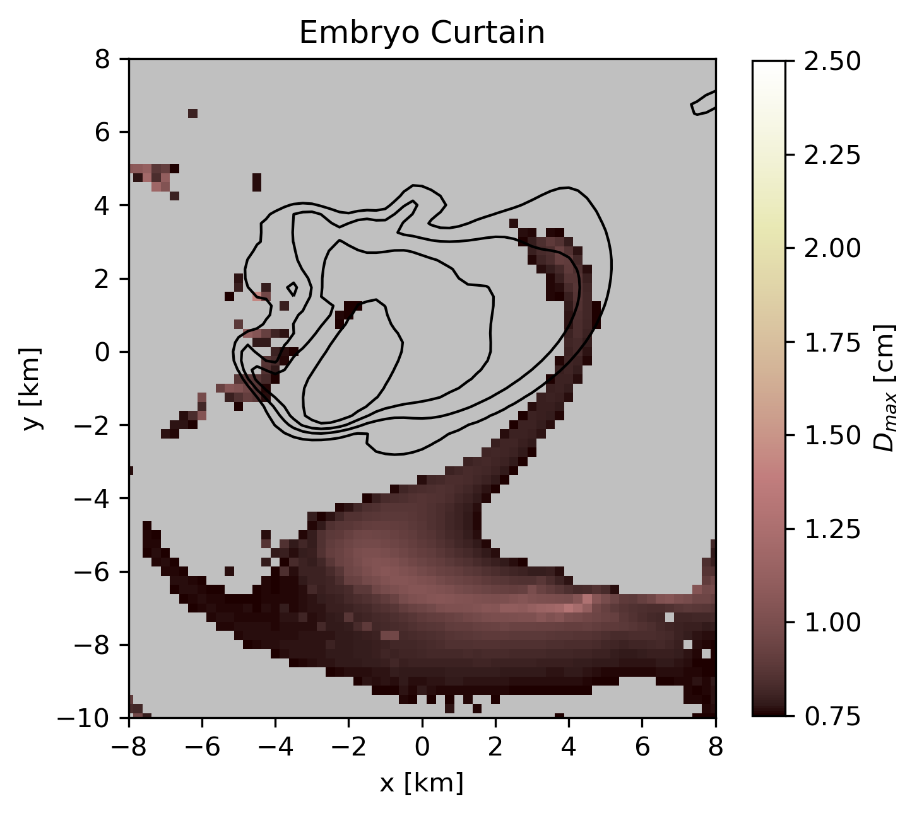
Trajectory 1: The classic hail pathway Browning and Foote (1967)
ECSS 2025 lks5850@psu.edu
3
Browning and Foote (1967) proposed a typical path for hailstones growing in [right moving] supercells:
Hail embryos originate from a broad “embryo curtain” south of the main updraft
Plan view of a supercell updraft at z = 6 km
Vertical Velocity contoured (10 m s⁻¹)
Vertical Vorticity shaded (+/-)

Slide 6
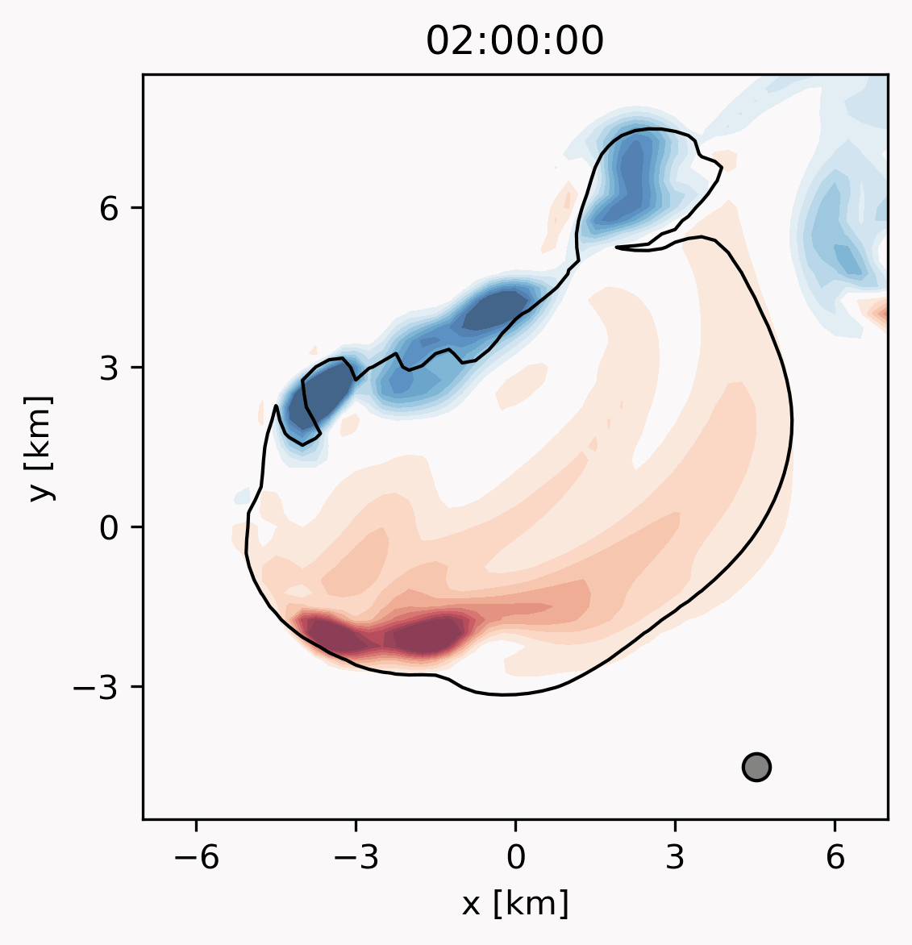
Trajectory 1: The classic hail pathway Browning and Foote (1967)
ECSS 2025 lks5850@psu.edu
3
Browning and Foote (1967) proposed a typical path for hailstones growing in [right moving] supercells:
Hail embryos originate from a broad “embryo curtain” south of the main updraft
Hail is grown through a simple cyclonic pass through the updraft
Hail remains balanced in regions of moderate vertical velocities
Often at the updraft edge
In this simulation, classical pathway produces small hailstones (D ≤ 1.5 cm)
Plan view of a supercell updraft at z = 6 km
Vertical Velocity contoured (10 m s⁻¹)
Vertical Vorticity shaded (+/-)

Slide 7
Trajectory 1: The classic hail pathway Hail Embryo Source Regions
ECSS 2025 lks5850@psu.edu
4
Classic pathway is broadly understood to be the typical mechanism by which hailstones grow
And be responsible for producing the vast majority of hailstones
e.g., largest corresponding hail embryo source region
Hail embryo can sometimes come from other regions
What other lesser-known growth pathways exist to produce large hailstones?
Vertical Velocity contoured (10 m s⁻¹)
Final size of hail embryos shaded

Slide 8
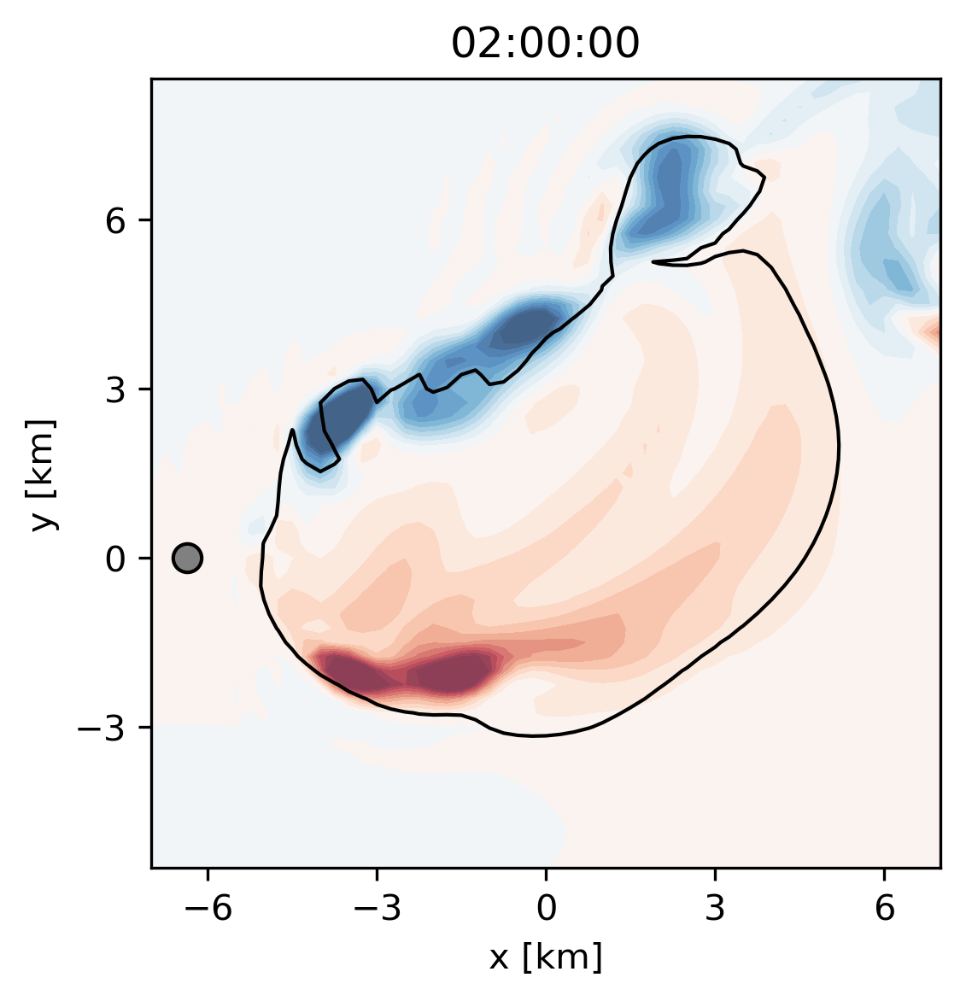
Trajectory 2: Hail in quickly evolving flow West-Flank Trajectory Pathway
ECSS 2025 lks5850@psu.edu
5
Follow a hail embryo originating just west of the updraft
Plan view of a supercell updraft at z = 6 km
Vertical Velocity contoured (10 m s⁻¹)
Vertical Vorticity shaded (+/-)

Slide 9
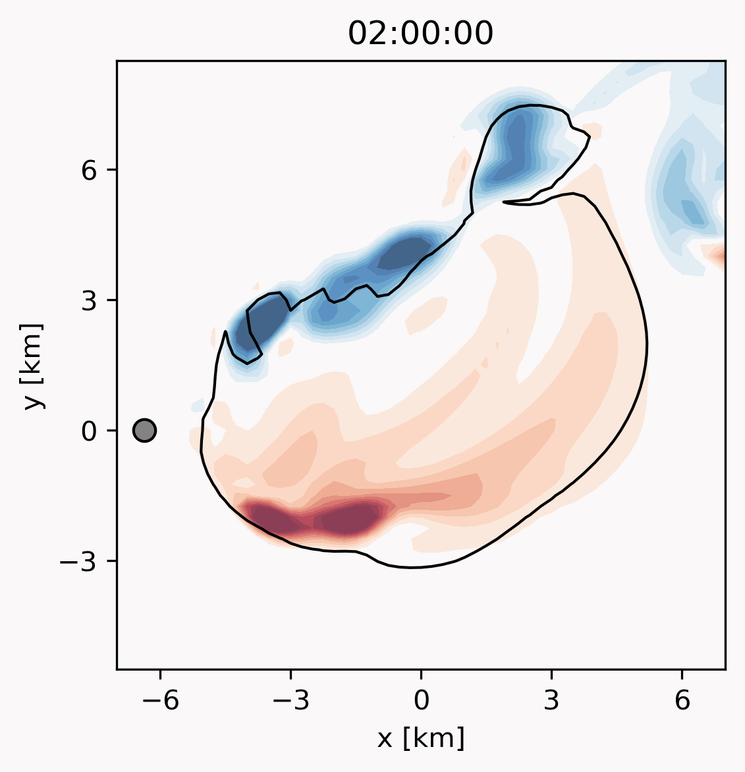
Trajectory 2: Hail in quickly evolving flow West-Flank Trajectory Pathway
ECSS 2025 lks5850@psu.edu
5
Follow a hail embryo originating just west of the updraft
Grows on the northwest side of the updraft in quickly evolving flow
This hailstone grows to a final size of D_{max} = 3.5 cm
More than double the size that we saw by the classical pathway
Damaging hail can grow by secondary mechanisms even if less common
Plan view of a supercell updraft at z = 6 km
Other studies finding alternate pathways leading to hail larger than the classical pathway: (Kumjian et al. 2021, Fischer et al. 2025)
Vertical Velocity contoured (10 m s⁻¹)
Vertical Vorticity shaded (+/-)

Slide 10
Trajectory 2: Hail in quickly evolving flow West-Flank Trajectory Pathway
ECSS 2025 lks5850@psu.edu
5
Follow a hail embryo originating just west of the updraft
Grows on the northwest side of the updraft in quickly evolving flow
This hailstone grows to a final size of D_{max} = 3.5 cm
More than double the size that we saw by the classical pathway
Damaging hail can grow by secondary mechanisms even if less common
Plan view of a supercell updraft at z = 6 km
Other studies finding alternate pathways leading to hail larger than the classical pathway: (Kumjian et al. 2021, Fischer et al. 2025)
Understanding secondary hail pathways is important
To understand secondary hail pathways:
We need to be thoughtful about temporal representation
Vertical Velocity contoured (10 m s⁻¹)
Vertical Vorticity shaded (+/-)

Slide 11
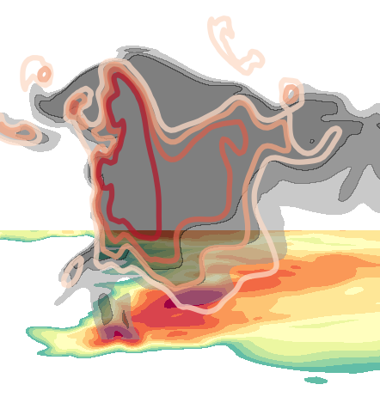
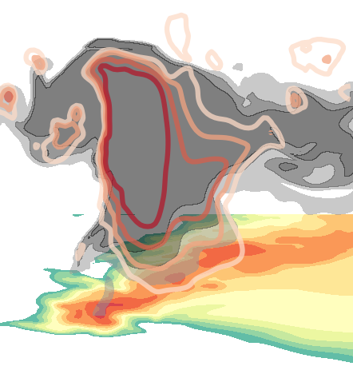
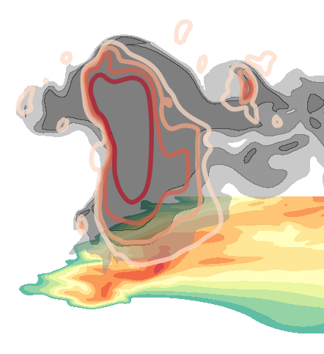
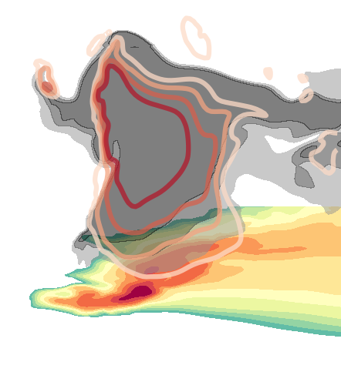
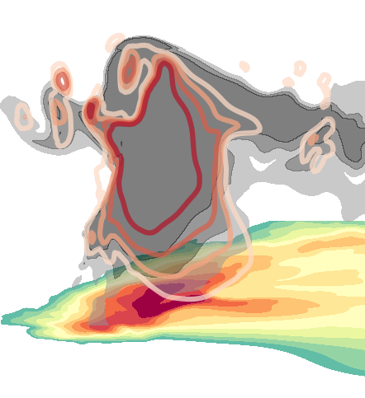
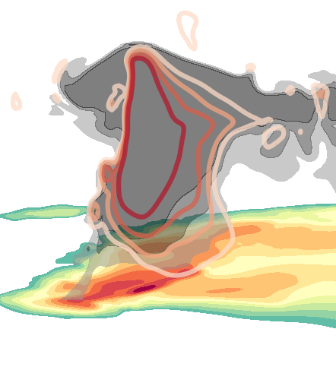
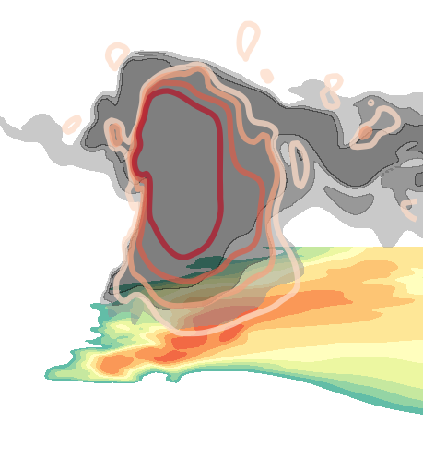
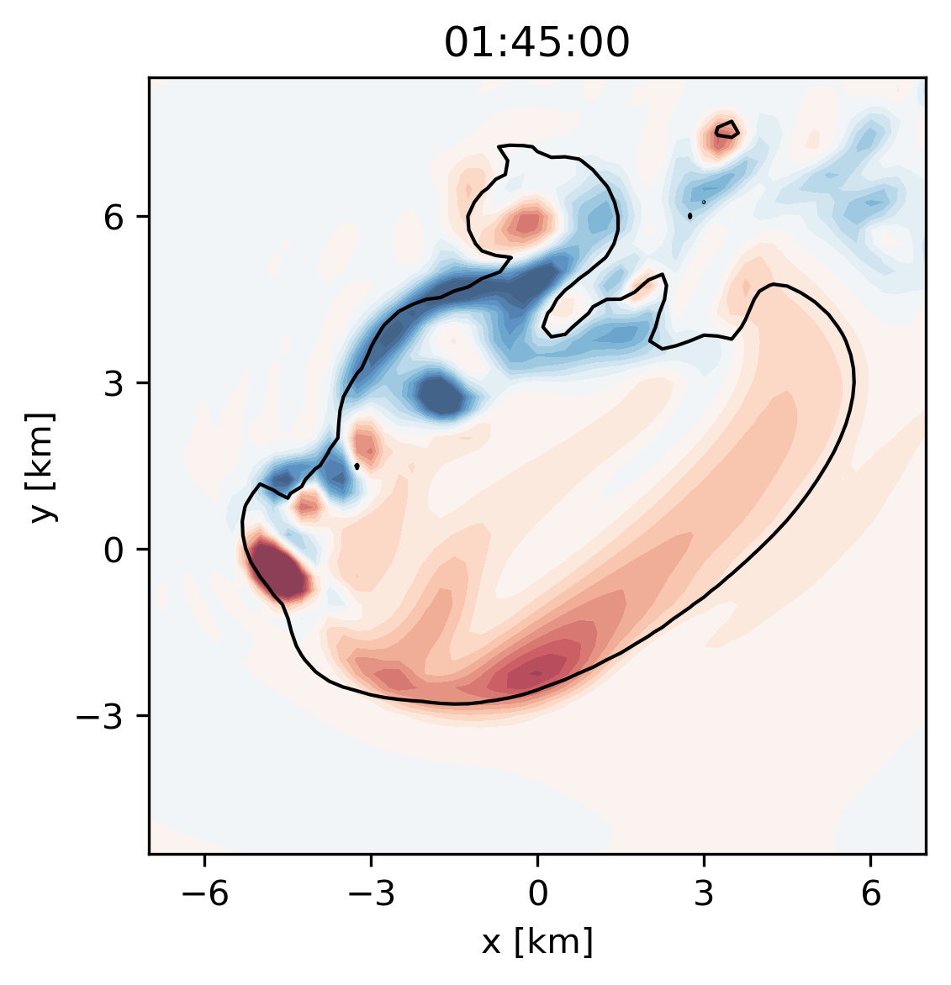
Trajectory 2: Hail in quickly evolving flow Importance of temporal representation
ECSS 2025 lks5850@psu.edu
6
How do we represent storms temporally for hail trajectory modeling?
Static fields
Compute hail trajectories in a frozen storm snapshot
Assumes the storm is steady-state
Used in historical and modern hail trajectory studies, (e.g., Nelson 1983, Kumjian et al. 2021)
t
Static
Static
Shaded vorticity with 10 m s⁻¹ updraft contour @ z = 6 km

Slide 12
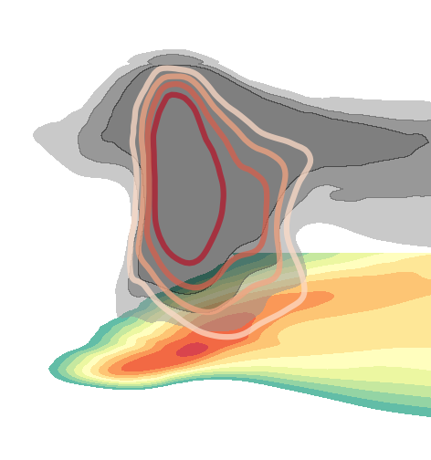
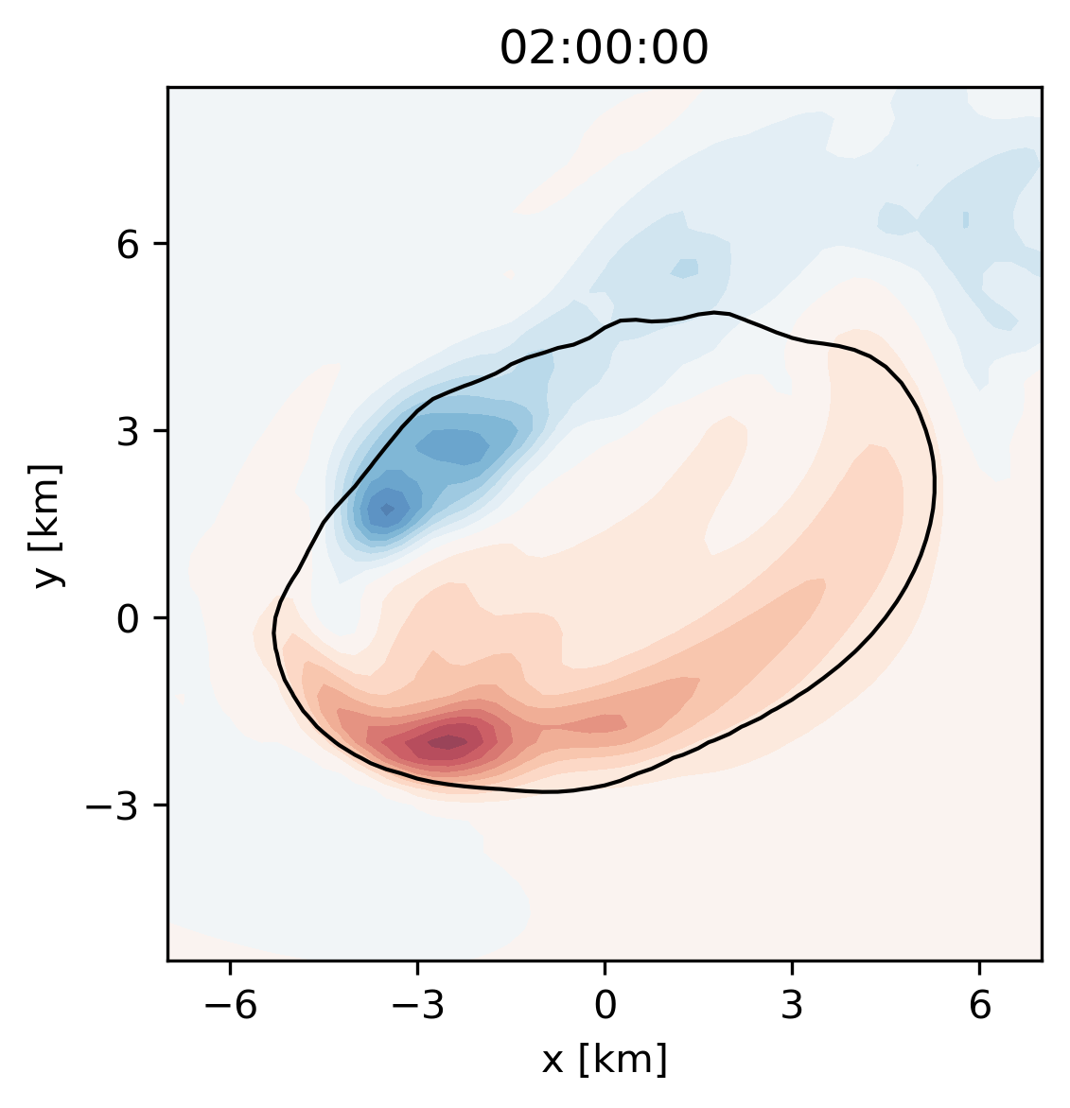
Trajectory 2: Hail in quickly evolving flow Importance of temporal representation
ECSS 2025 lks5850@psu.edu
6
How do we represent storms temporally for hail trajectory modeling?
Static fields
Composite fields
Captures time-invariant features of a storm
Used in environments-focused hail trajectory studies (e.g., Dennis and Kumjian 2017, Lin and Kumjian 2022)
t
Storm-centered spatial mean
Static
Composite
Composite
Static
Shaded vorticity with 10 m s⁻¹ updraft contour @ z = 6 km

Slide 13
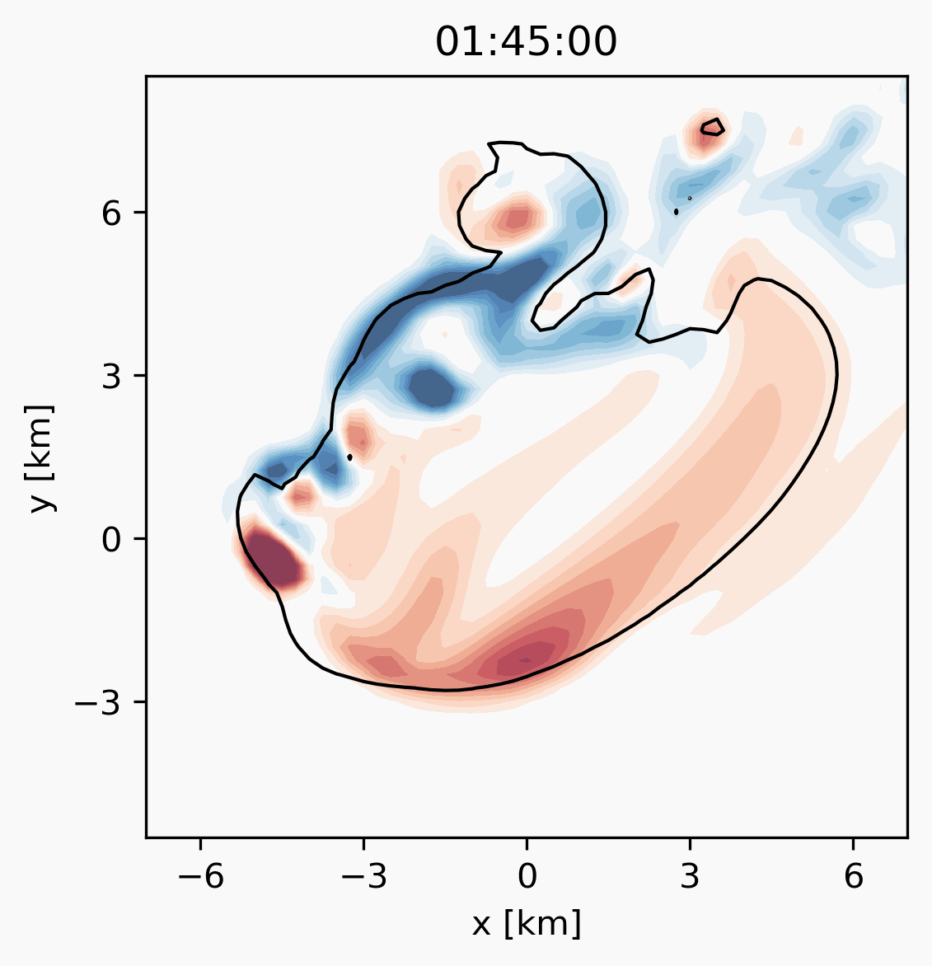
Trajectory 2: Hail in quickly evolving flow Importance of temporal representation
ECSS 2025 lks5850@psu.edu
6
How do we represent storms temporally for hail trajectory modeling?
Static fields
Composite fields
Evolving fields—here Δt = 5 sec
Most realistic, most computationally intensive, (e.g., Kumjian et al. 2021, Adams-Selin 2025)
t
Storm-centered spatial mean
Static
Composite
Evolving
Composite
Static
Shaded vorticity with 10 m s⁻¹ updraft contour @ z = 6 km
Notes:
**Add wind vectors to the vorticity plots**
Could be a place to throw in a comment about how composite and evolving are similar in the end --- be nicer to composite

Slide 14
Trajectory 2: Hail in quickly evolving flow Importance of temporal representation
ECSS 2025 lks5850@psu.edu
6
How do we represent storms temporally for hail trajectory modeling?
Static fields
Composite fields
Evolving fields—here Δt = 5 sec
Most realistic, most computationally intensive, (e.g., Kumjian et al. 2021, Adams-Selin 2025)
t
Storm-centered spatial mean
Static
Composite
Evolving
Varying
Composite
Static
Steady
Shaded vorticity with 10 m s⁻¹ updraft contour @ z = 6 km
Notes:
**Add wind vectors to the vorticity plots**
Could be a place to throw in a comment about how composite and evolving are similar in the end --- be nicer to composite

Slide 15
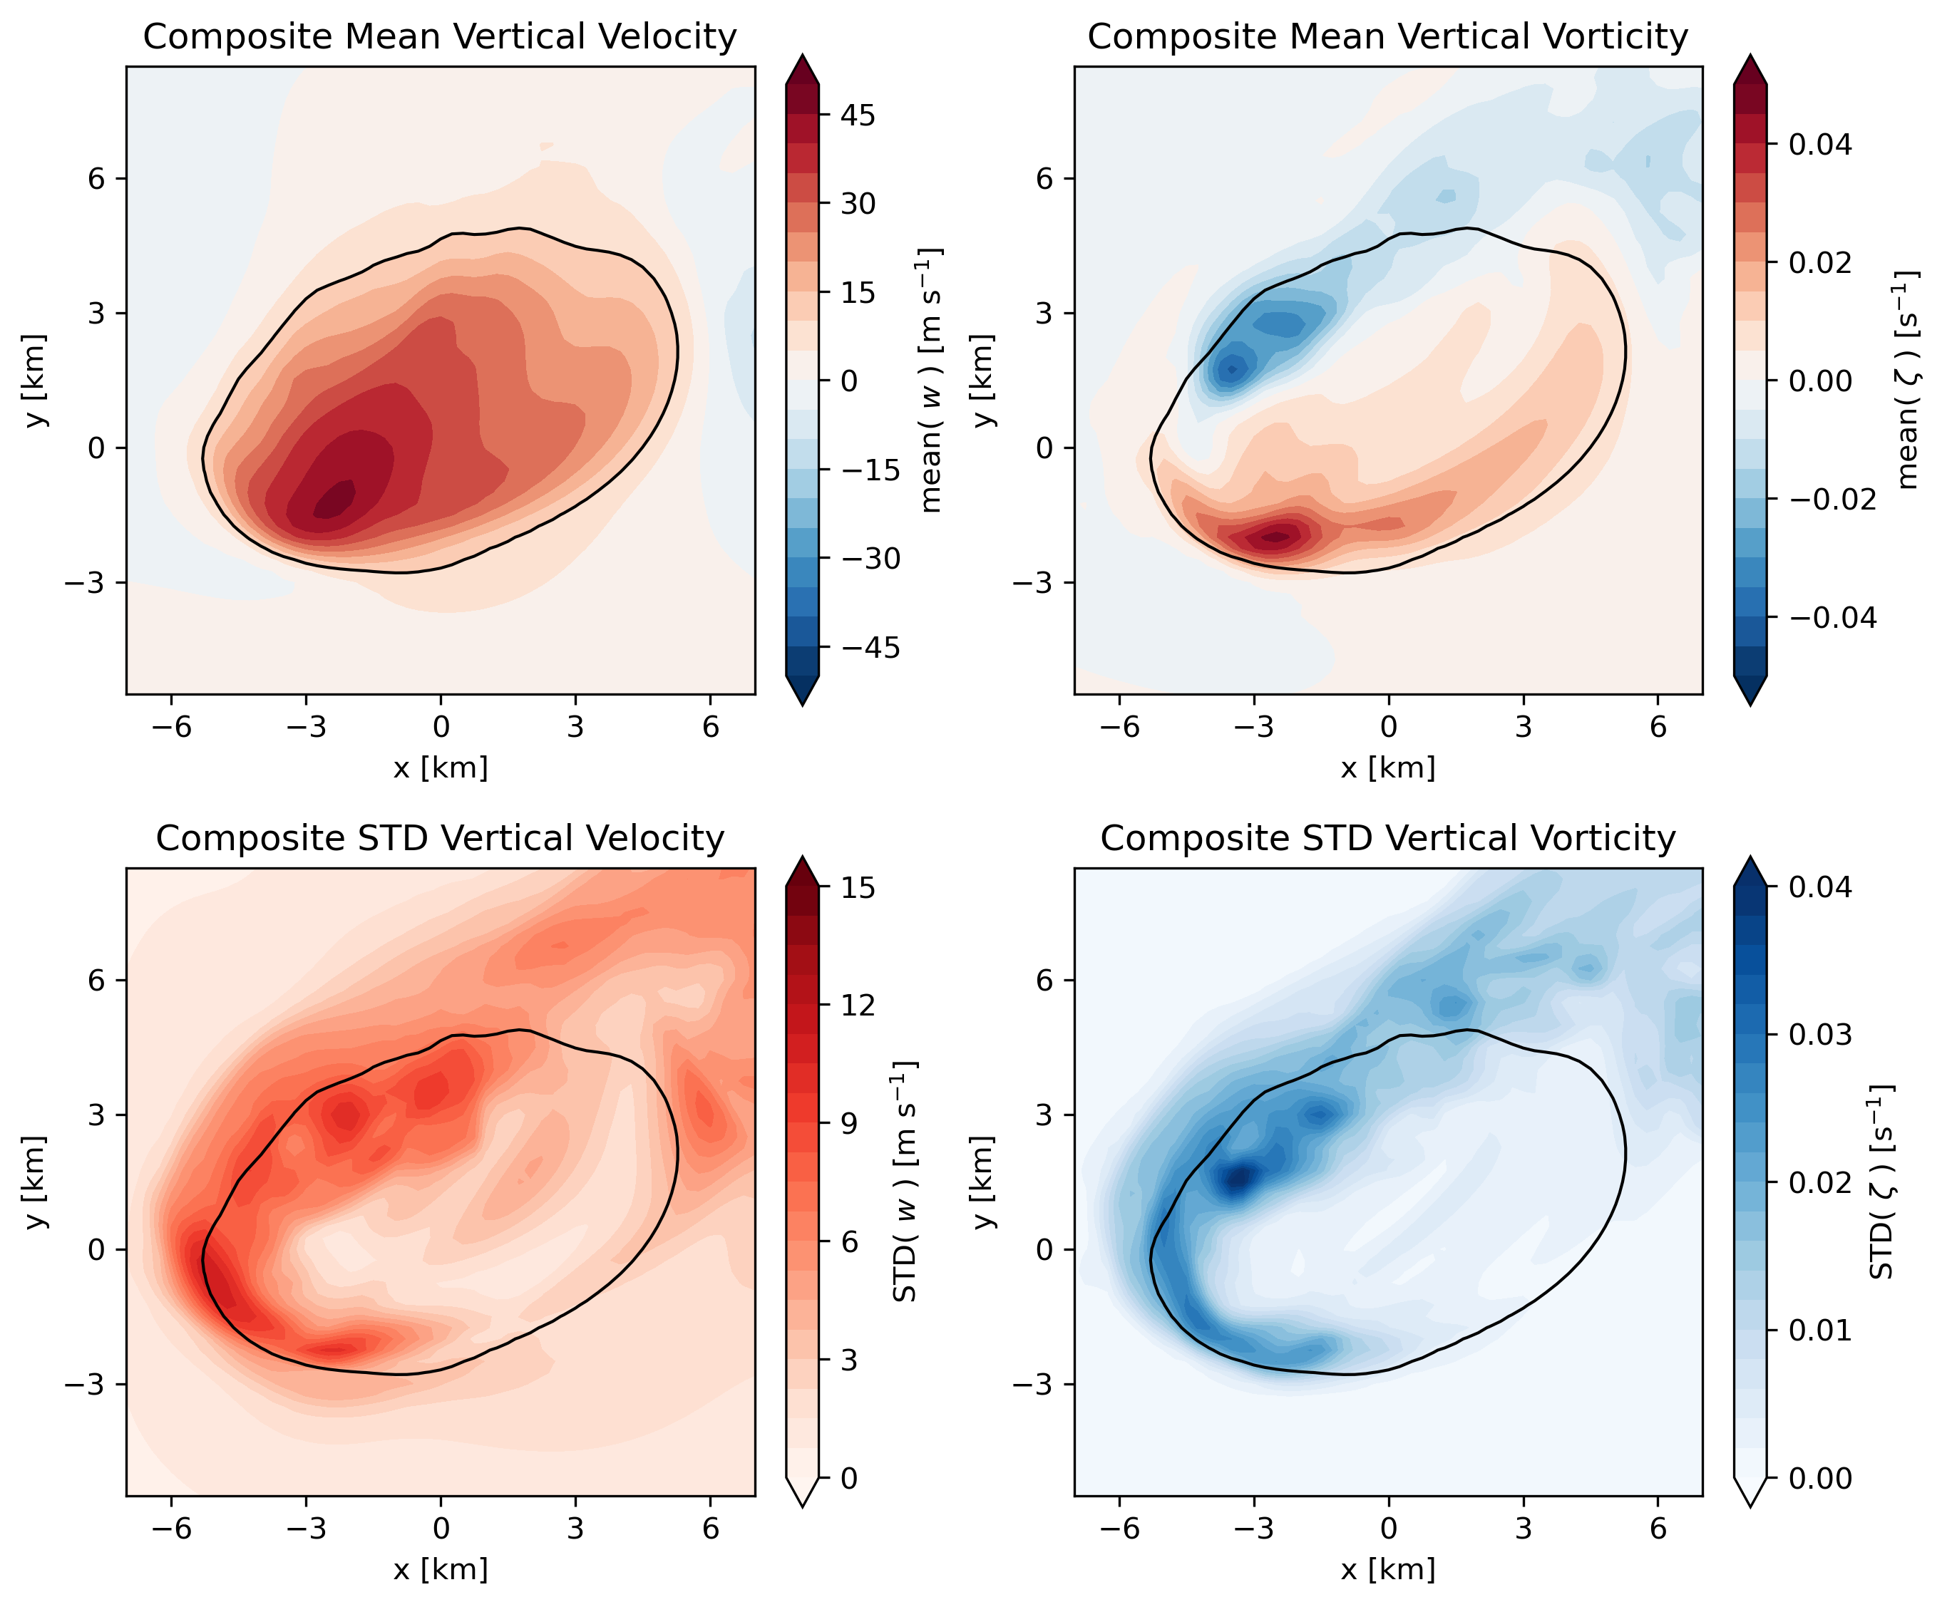
Trajectory 2: Hail in quickly evolving flow Importance of temporal representation
ECSS 2025 lks5850@psu.edu
7
Mean Vertical Velocity
Mean Vertical Vorticity
Let’s zoom in on the composite storm

Slide 16
Trajectory 2: Hail in quickly evolving flow Importance of temporal representation
ECSS 2025 lks5850@psu.edu
7
Mean Vertical Velocity
Mean Vertical Vorticity
Let’s zoom in on the composite storm
Standard deviations tell us what we smoothed away
Overlay trajectories on the composited fields
STD Vertical Velocity
STD Vertical Vorticity

Slide 17
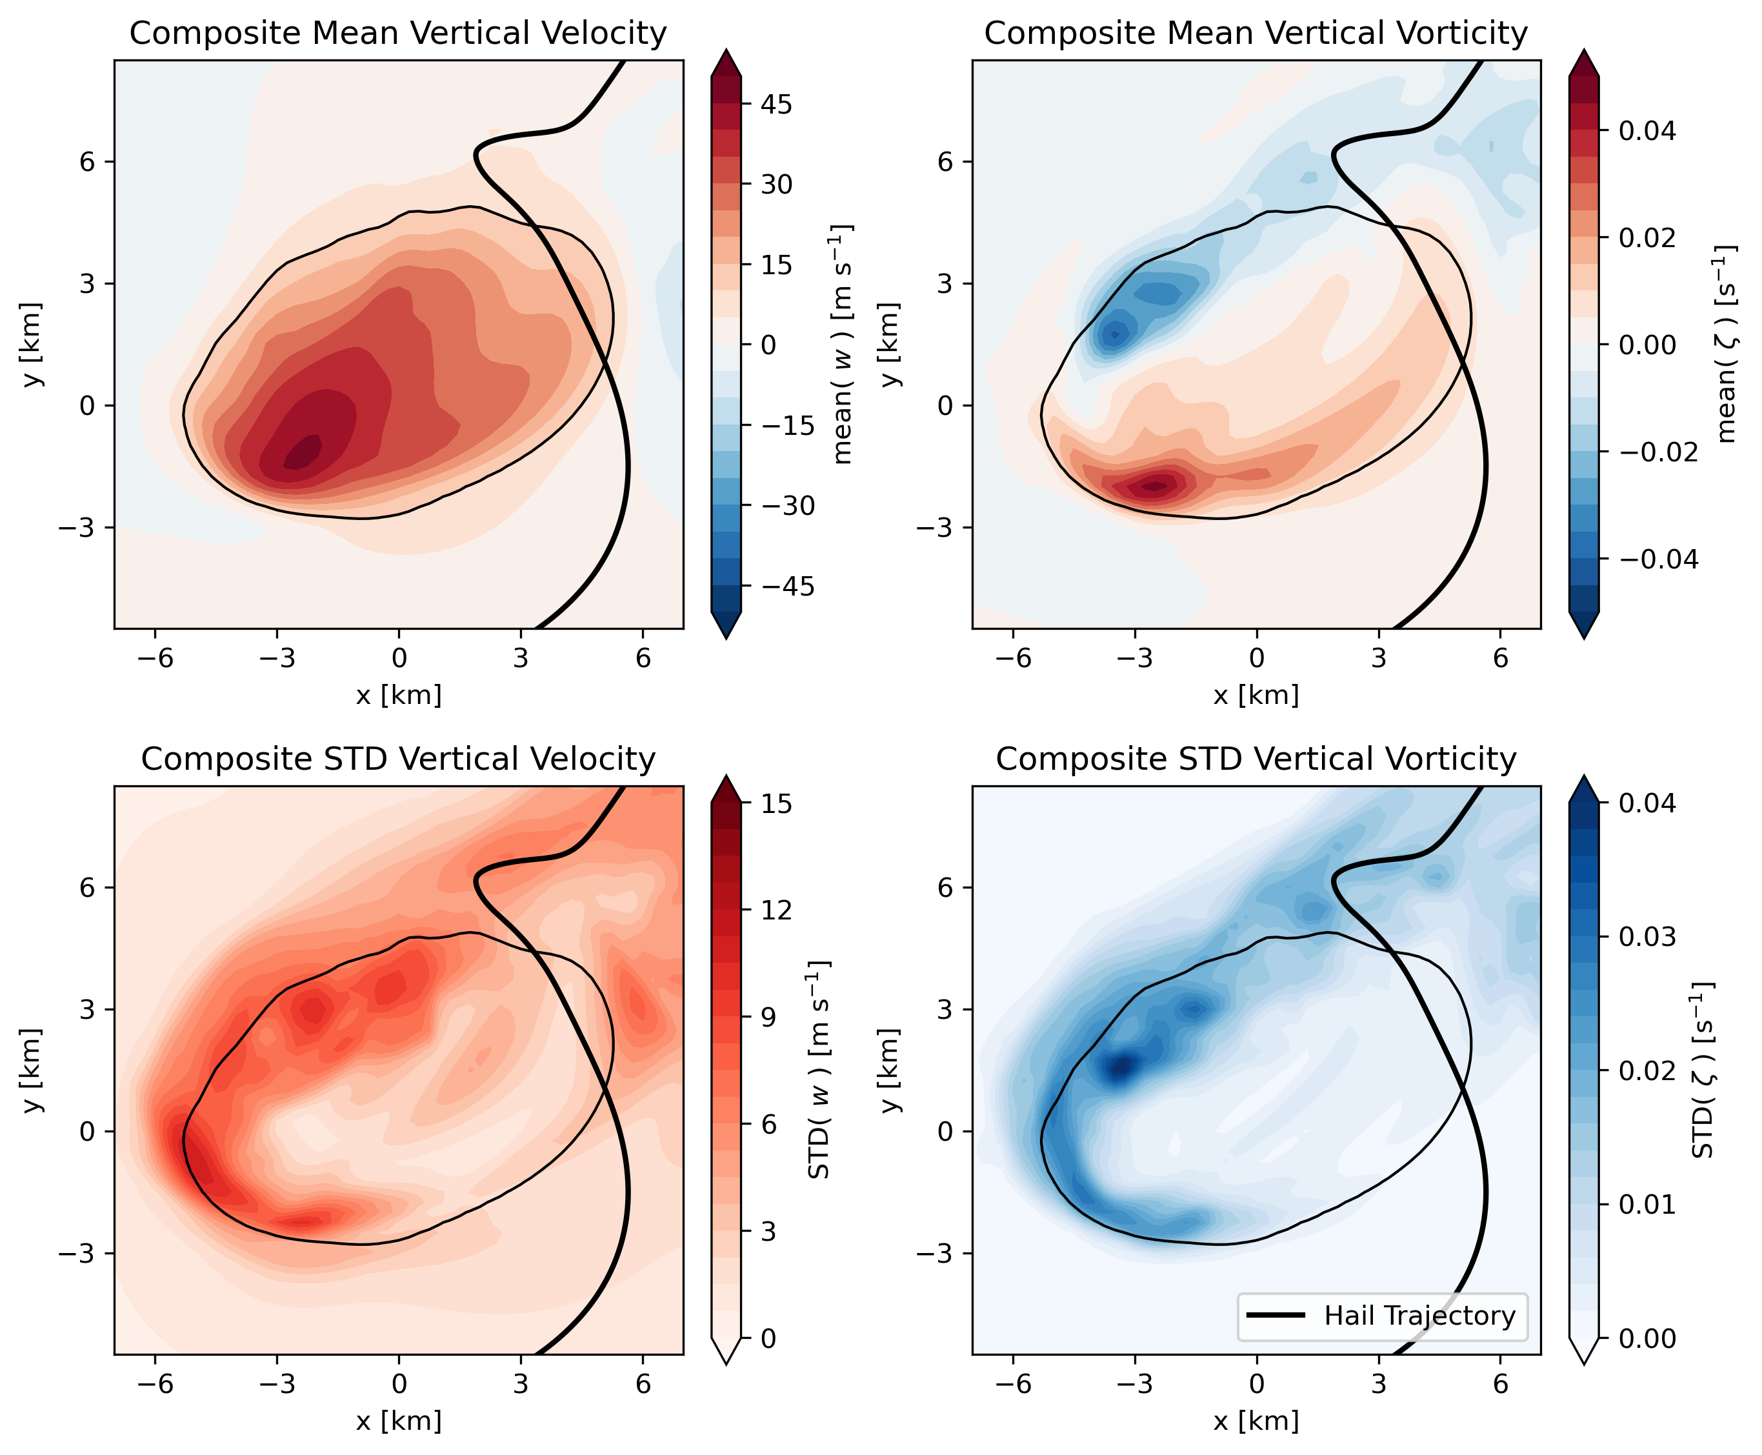
Trajectory 2: Hail in quickly evolving flow Importance of temporal representation
ECSS 2025 lks5850@psu.edu
7
Mean Vertical Velocity
Mean Vertical Vorticity
Let’s zoom in on the composite storm
Standard deviations tell us what we smoothed away
Overlay trajectories on the composited fields
Classic hail pathway does not experience much variability
STD Vertical Velocity
STD Vertical Vorticity

Slide 18

Trajectory 2: Hail in quickly evolving flow Importance of temporal representation
ECSS 2025 lks5850@psu.edu
7
Mean Vertical Velocity
Mean Vertical Vorticity
Let’s zoom in on the composite storm
Standard deviations tell us what we smoothed away
Overlay trajectories on the composited fields
Classic hail pathway does not experience much variability
West-flank trajectory lies in a region we’ve smoothed the most!
STD Vertical Velocity
STD Vertical Vorticity

Slide 19
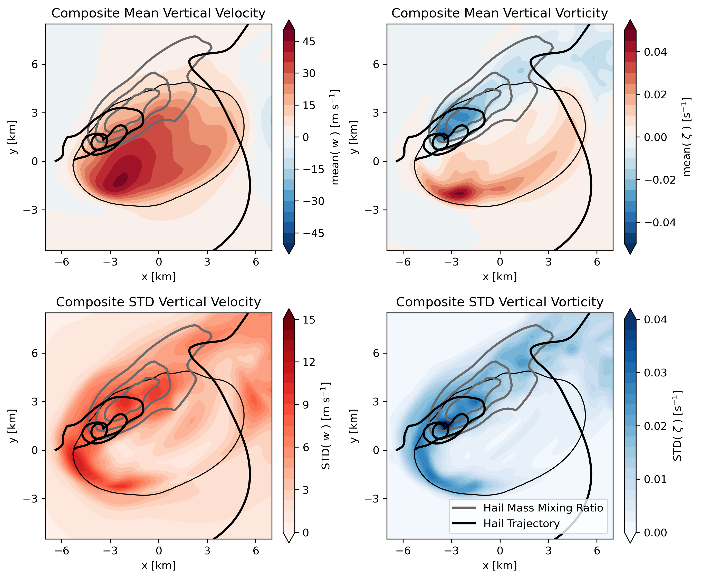
Trajectory 2: Hail in quickly evolving flow Importance of temporal representation
ECSS 2025 lks5850@psu.edu
7
Mean Vertical Velocity
Mean Vertical Vorticity
Let’s zoom in on the composite storm
Standard deviations tell us what we smoothed away
Overlay trajectories on the composited fields
Classic hail pathway does not experience much variability
West-flank trajectory lies in a region we’ve smoothed the most!
The greatest hail mass mixing ratios from our simulation also occur in the evolving regions
STD Vertical Velocity
STD Vertical Vorticity

Slide 20
Trajectory 2: Hail in quickly evolving flow Importance of temporal representation
ECSS 2025 lks5850@psu.edu
7
Mean Vertical Velocity
Mean Vertical Vorticity
Let’s zoom in on the composite storm
Standard deviations tell us what we smoothed away
Overlay trajectories on the composited fields
Classic hail pathway does not experience much variability
West-flank trajectory lies in a region we’ve smoothed the most!
Overlay hail mass mixing ratios from our simulation
STD Vertical Velocity
STD Vertical Vorticity
Takeaway:
Updraft variability exists that can impact hail production!
(Particularly for secondary hail pathways)

Slide 21
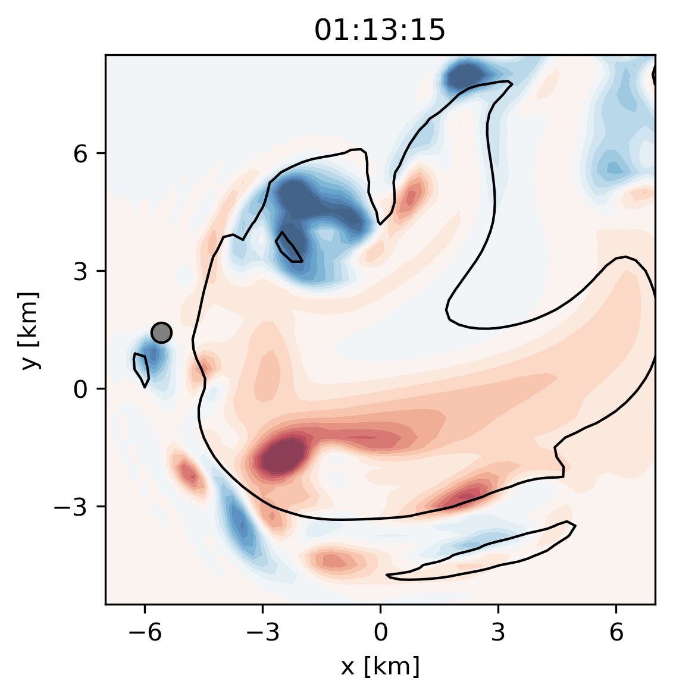
Trajectory 3: Growth of a gargantuan hailstone Two-Stage Pathway
ECSS 2025 lks5850@psu.edu
8
This third trajectory reaches gargantuan size (i.e., D ≥ 15 cm, Kumjian et al. 2020)
Largest hailstone in our simulations D_{max}=16 cm
Two-part growth:
Plan view of a supercell updraft at z = 6 km
Vertical Velocity contoured (10 m s⁻¹)
Vertical Vorticity shaded (+/-)

Slide 22
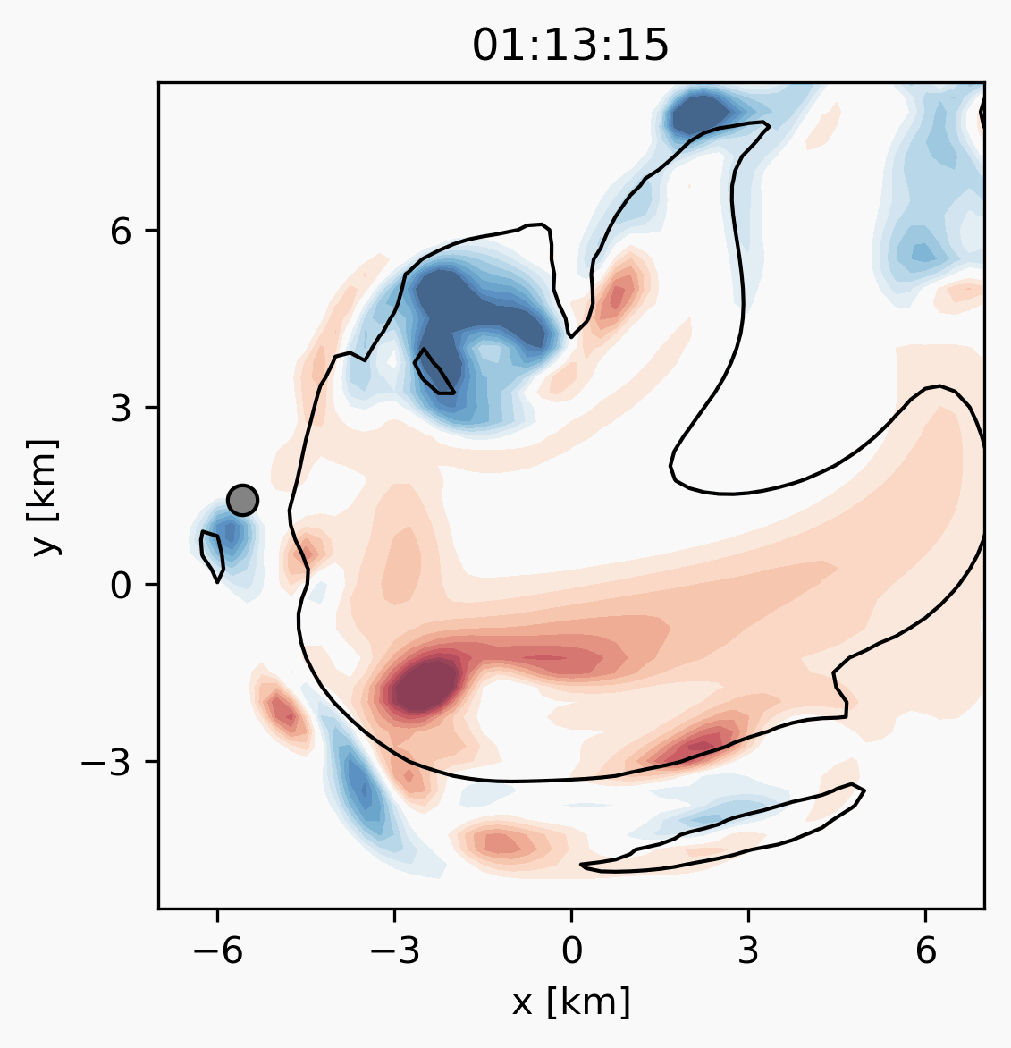
Trajectory 3: Growth of a gargantuan hailstone Two-Stage Pathway
ECSS 2025 lks5850@psu.edu
8
This third trajectory reaches gargantuan size (i.e., D ≥ 15 cm, Kumjian et al. 2020)
Largest hailstone in our simulations D_{max}=16 cm
Two-part growth:
Tight spiral on the outskirts of the updraft (25 min)
D_{init} = 0.5 cm, D_{t = 25 min} = 3.2 cm
Plan view of a supercell updraft at z = 6 km
Vertical Velocity contoured (10 m s⁻¹)
Vertical Vorticity shaded (+/-)

Slide 23
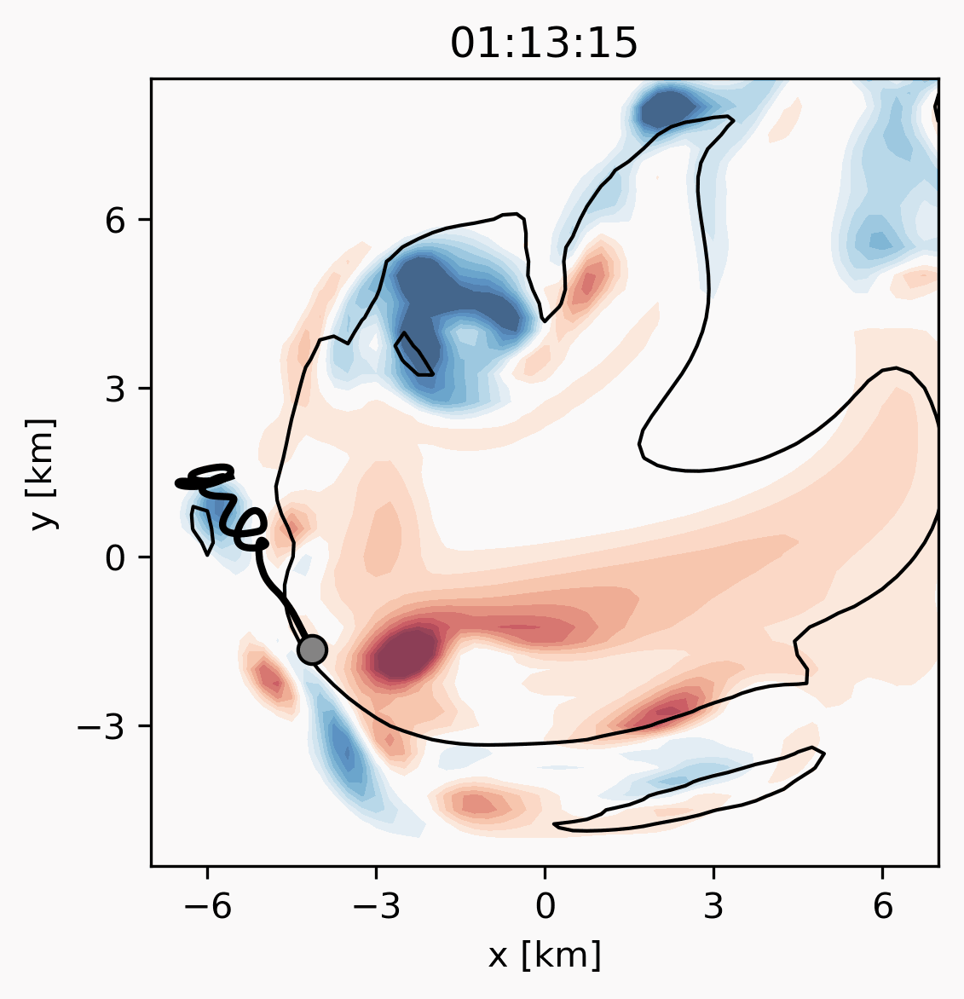
Trajectory 3: Growth of a gargantuan hailstone Two-Stage Pathway
ECSS 2025 lks5850@psu.edu
8
This third trajectory reaches gargantuan size (i.e., D ≥ 15 cm, Kumjian et al. 2020)
Largest hailstone in our simulations D_{max}=16 cm
Two-part growth:
Tight spiral on the outskirts of the updraft (25 min)
D_{init} = 0.5 cm, D_{t = 25 min} = 3.2 cm
Pass through the updraft core (20 min):
D_{t = 25 min} = 3.2 cm, D_{final} = 16 cm
Plan view of a supercell updraft at z = 6 km
Vertical Velocity contoured (10 m s⁻¹)
Vertical Vorticity shaded (+/-)

Slide 24
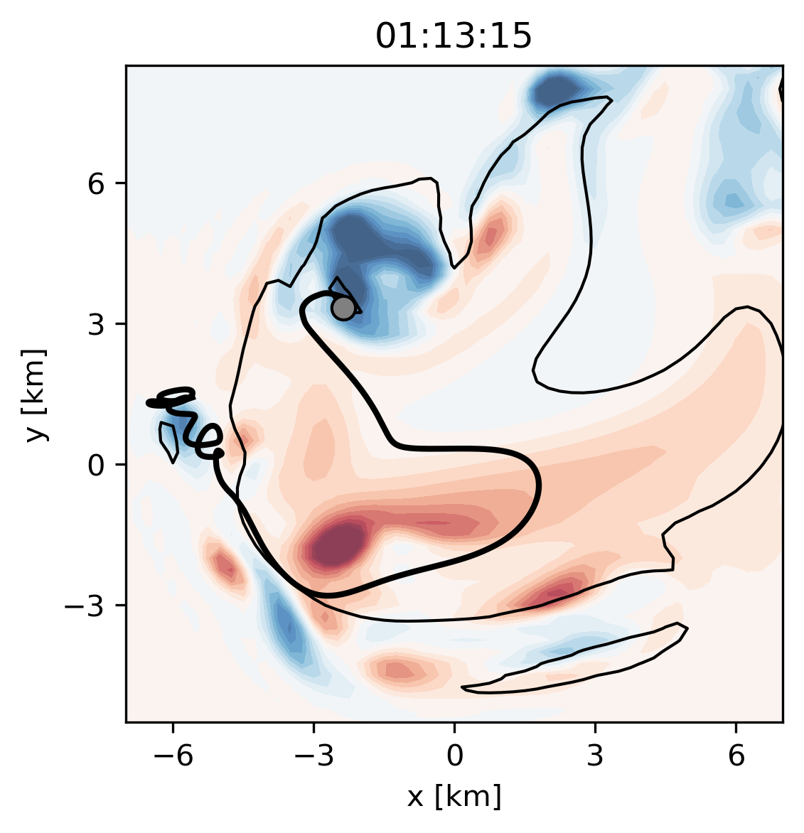
Trajectory 3: Growth of a gargantuan hailstone Two-Stage Pathway
ECSS 2025 lks5850@psu.edu
9
This trajectory was computed in static storm fields
Flow fields of stage 1 of hailstone growth would evolve quickly in a real storm
However, this trajectory teaches us the necessary pieces for gargantuan growth
Initial growth in moderate vertical velocities
A final plunge through the updraft core
We do see both pieces occur individually in evolving trajectories
But it is extremely rare to put both pieces together
Plan view of a supercell updraft at z = 6 km
Vertical Velocity contoured (10 m s⁻¹)
Vertical Vorticity shaded (+/-)
Notes:
Generalize to other studies that have found (alternate) mechanisms for multi-stage growth to
Soften the language of the second bullet point. Rare, but not never. Even say: we see this more commonly in static fields. We have seen this two-stage process in evolving storms, but rare, sensitive, and less-common

Slide 25
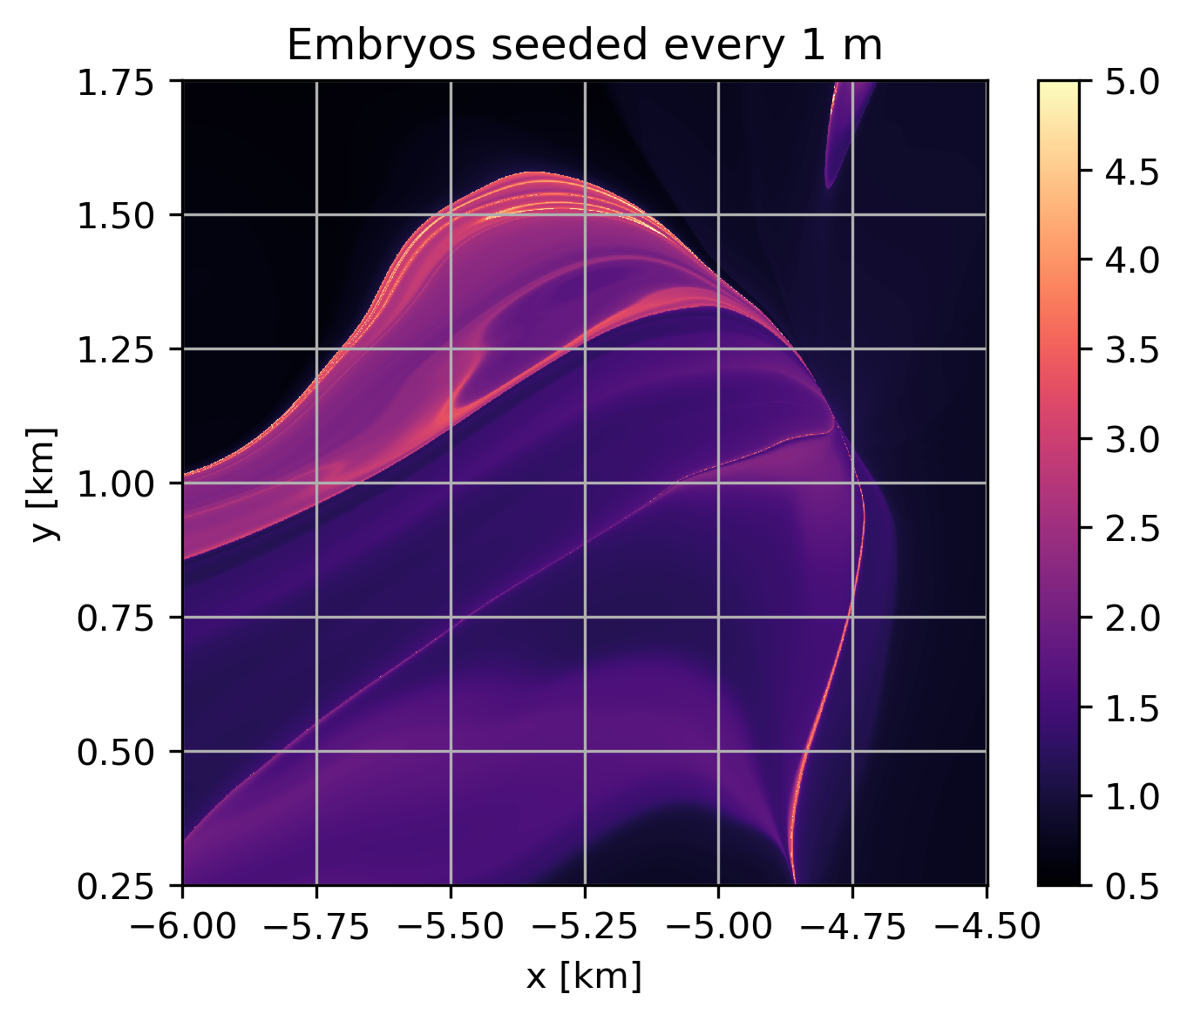
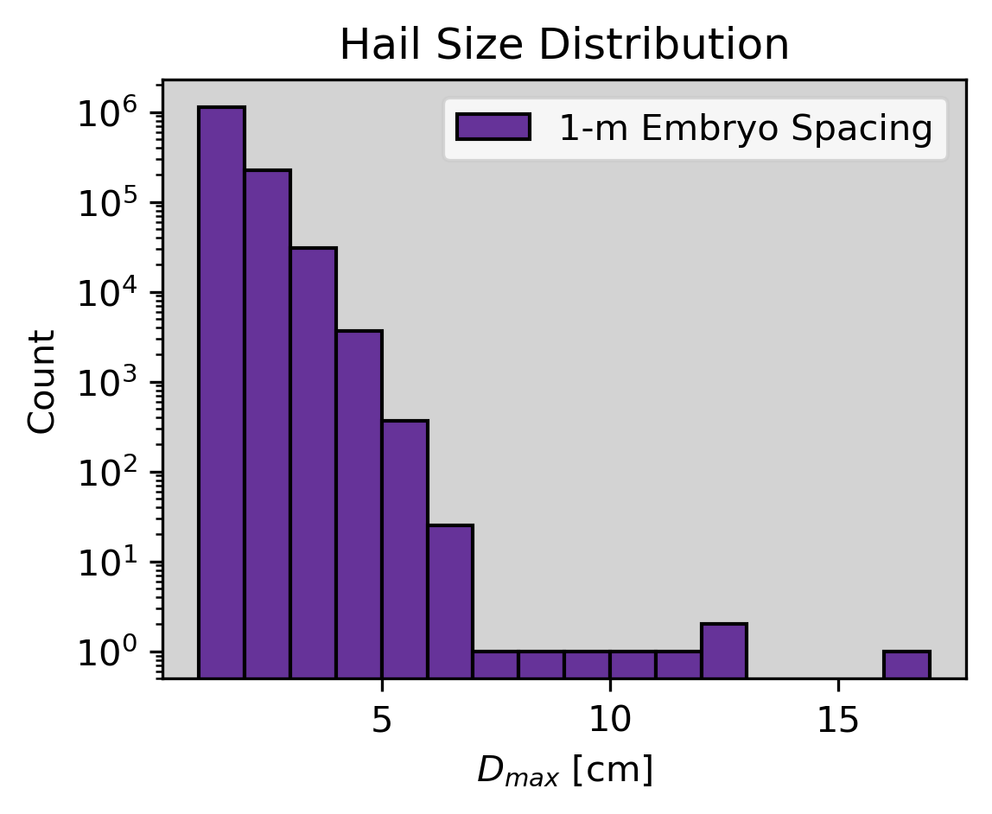
Trajectory 3: Growth of a gargantuan hailstone Pathway is extremely sensitive to initial location
ECSS 2025 lks5850@psu.edu
10
Seed 2 million hail embryos in a 0.5 km x 0.5 km region (spaced 1 m apart)
Typically, only one embryo is placed per 250-m grid cell (36 total)
Final sizes from each embryo location (spaced 1 m apart)
— CM1 Grid
D_{max} [cm]
Only 1 in 2 million took a gargantuan hail-producing trajectory!
Lots of variability on very small spatial scales!
Gargantuan Hail Embryo Location
Notes:
Add in the 1-mm stuff
Typo in hail size ditribution figures

Slide 26
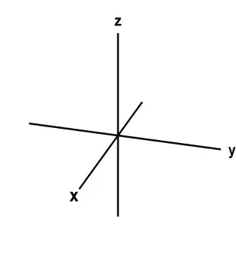

Trajectory 3: Growth of a gargantuan hailstone Pathway is extremely sensitive to initial location
ECSS 2025 lks5850@psu.edu
11
Even hailstones seeded just 1 mm away from the gargantuan hailstone take a different path
One grew to D_{max} = 16 cm
Three grew to D_{max} = [6-7] cm
Three grew to D_{max} ≈ 3.7 cm
Linear interpolation of the storm grid compounds spatial differences in time
Plan view of a supercell updraft at z = 6 km
1 mm
Vertical Velocity contoured (10 m s⁻¹)
Vertical Vorticity shaded (+/-)
Notes:
Freeze the animation first so that I
Typo in hail size ditribution figures

Slide 27
Trajectory 3: Growth of a gargantuan hailstone Pathway is extremely sensitive to stochastic tumbling
ECSS 2025 lks5850@psu.edu
12
1000 stochastically tumbling hailstones shaded by final size
Similar spread can also occur from allowing hailstones with identical initial conditions to tumble:
i.e., stochastic perturbations to fall speed and cross-sectional area (Spychalla and Kumjian 2025)
Vertical Velocity contoured (10 m s⁻¹)
Vertical Vorticity shaded (+/-)

Slide 28
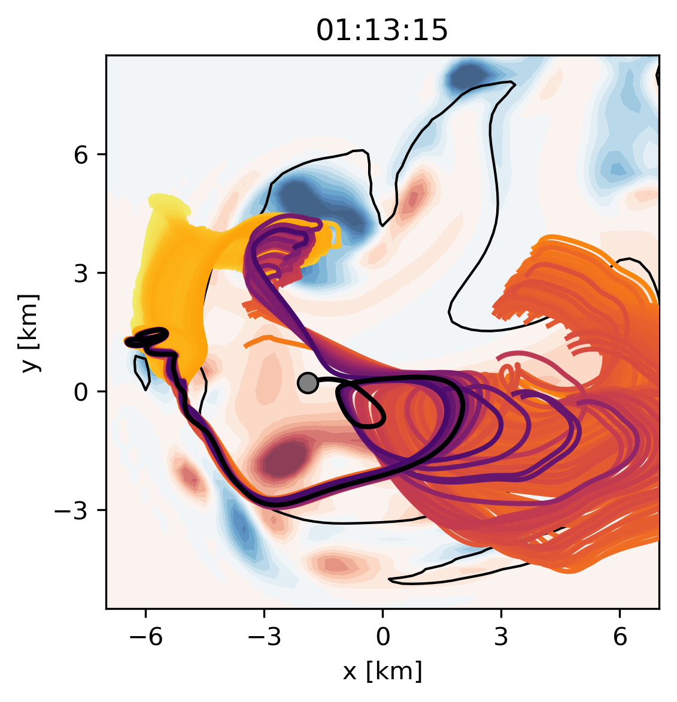
Trajectory 3: Growth of a gargantuan hailstone Pathway is extremely sensitive to stochastic tumbling
ECSS 2025 lks5850@psu.edu
12
1000 stochastically tumbling hailstones shaded by final size
Similar spread can also occur from allowing hailstones with identical initial conditions to tumble:
i.e., stochastic perturbations to fall speed and cross-sectional area (Spychalla and Kumjian 2025)
These tell a consistent story:
This gargantuan pathway is hard for hailstones to find
It is extremely sensitive to non-predictable factors like small-scale flow details or tumbling
Vertical Velocity contoured (10 m s⁻¹)
Vertical Vorticity shaded (+/-)

Slide 29
Trajectory 3: Growth of a gargantuan hailstone Pathway is extremely sensitive to stochastic tumbling
ECSS 2025 lks5850@psu.edu
12
1000 stochastically tumbling hailstones shaded by final size
Similar spread can also occur from allowing hailstones with identical initial conditions to tumble:
i.e., stochastic perturbations to fall speed and cross-sectional area (Spychalla and Kumjian 2025)
These tell a consistent story:
This gargantuan pathway is hard for hailstones to find
It is extremely sensitive to non-predictable factors like small-scale flow details or tumbling
Predictability contains two questions:
Do the storm fields allow gargantuan hail-producing trajectories?
Will a hailstone by chance take that trajectory?
Vertical Velocity contoured (10 m s⁻¹)
Vertical Vorticity shaded (+/-)

Slide 30
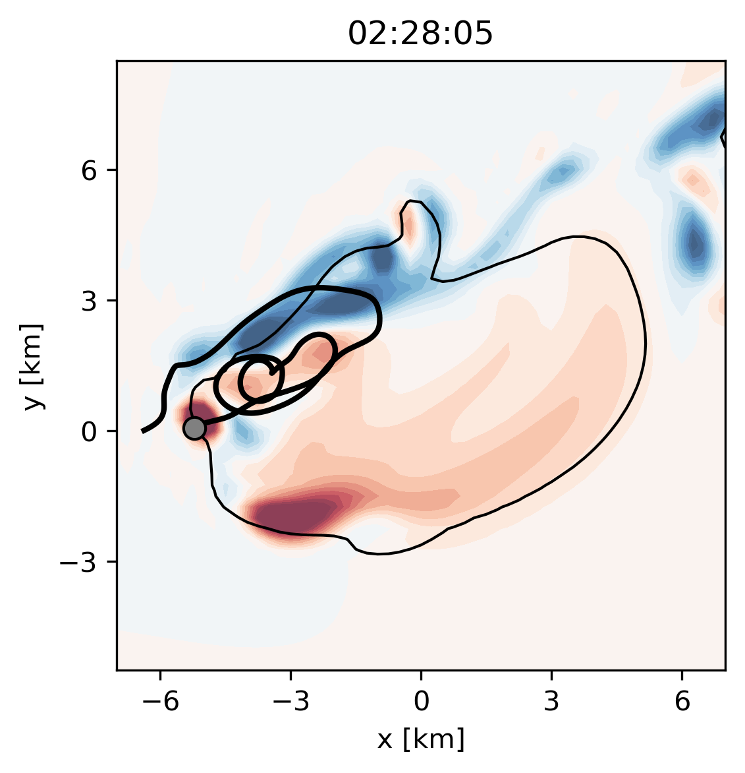
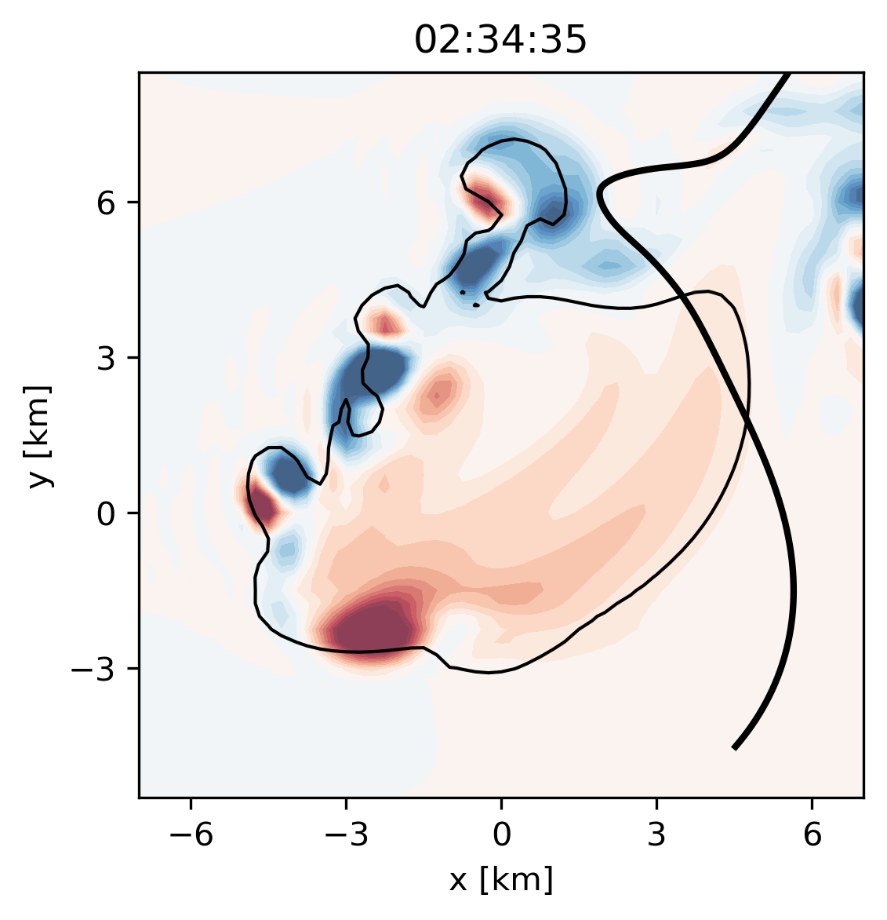
Summary
13
Secondary Hail Pathway
Classic Hail Pathway
We’ve examined three pathways for the growth of hail:
Primary hail growth trajectory
Likely produces the majority of hail
But not necessarily the largest hail
Secondary hail growth trajectories
Gargantuan Hail Pathway
Less common, but potentially large-hail producing
In this case, very related to quickly evolving flow features
One
Two
Gargantuan hail trajectory
Highly sensitive, subject to unpredictable factors like tumbling or flow details
lks5850@psu.edu

Slide 31
Takeaways
14
Secondary Hail Pathway
Classic Hail Pathway
Implications of multiple hail pathways:
Observed hail may come from a variety of potential pathways (like the classic or secondary hail pathways)
Gargantuan Hail Pathway
Future work could be done to explore environmental predictors and observational indicators of secondary pathways
Storm updrafts are variable
Studying this variability could help us better understand hail
The largest hailstone in a storm may come from unpredictable pathways
Sobering idea, but suggests the need to move away from a “maximum hail size” framework to other hail severity metrics
lks5850@psu.edu

Slide 33
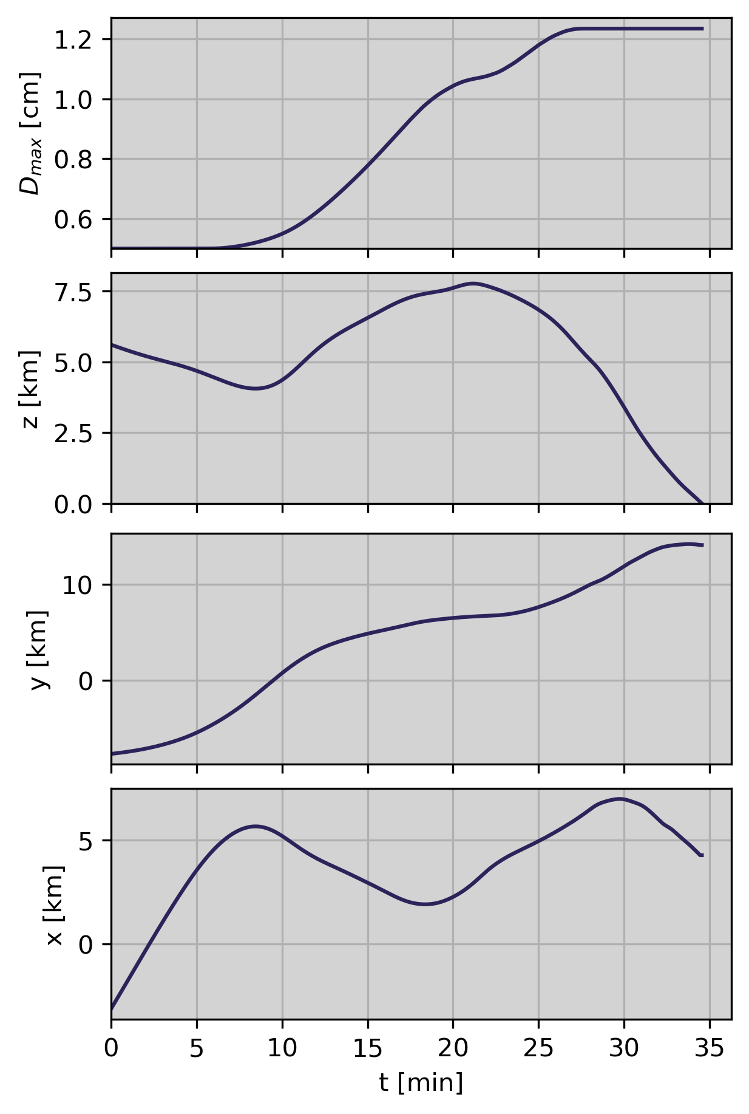
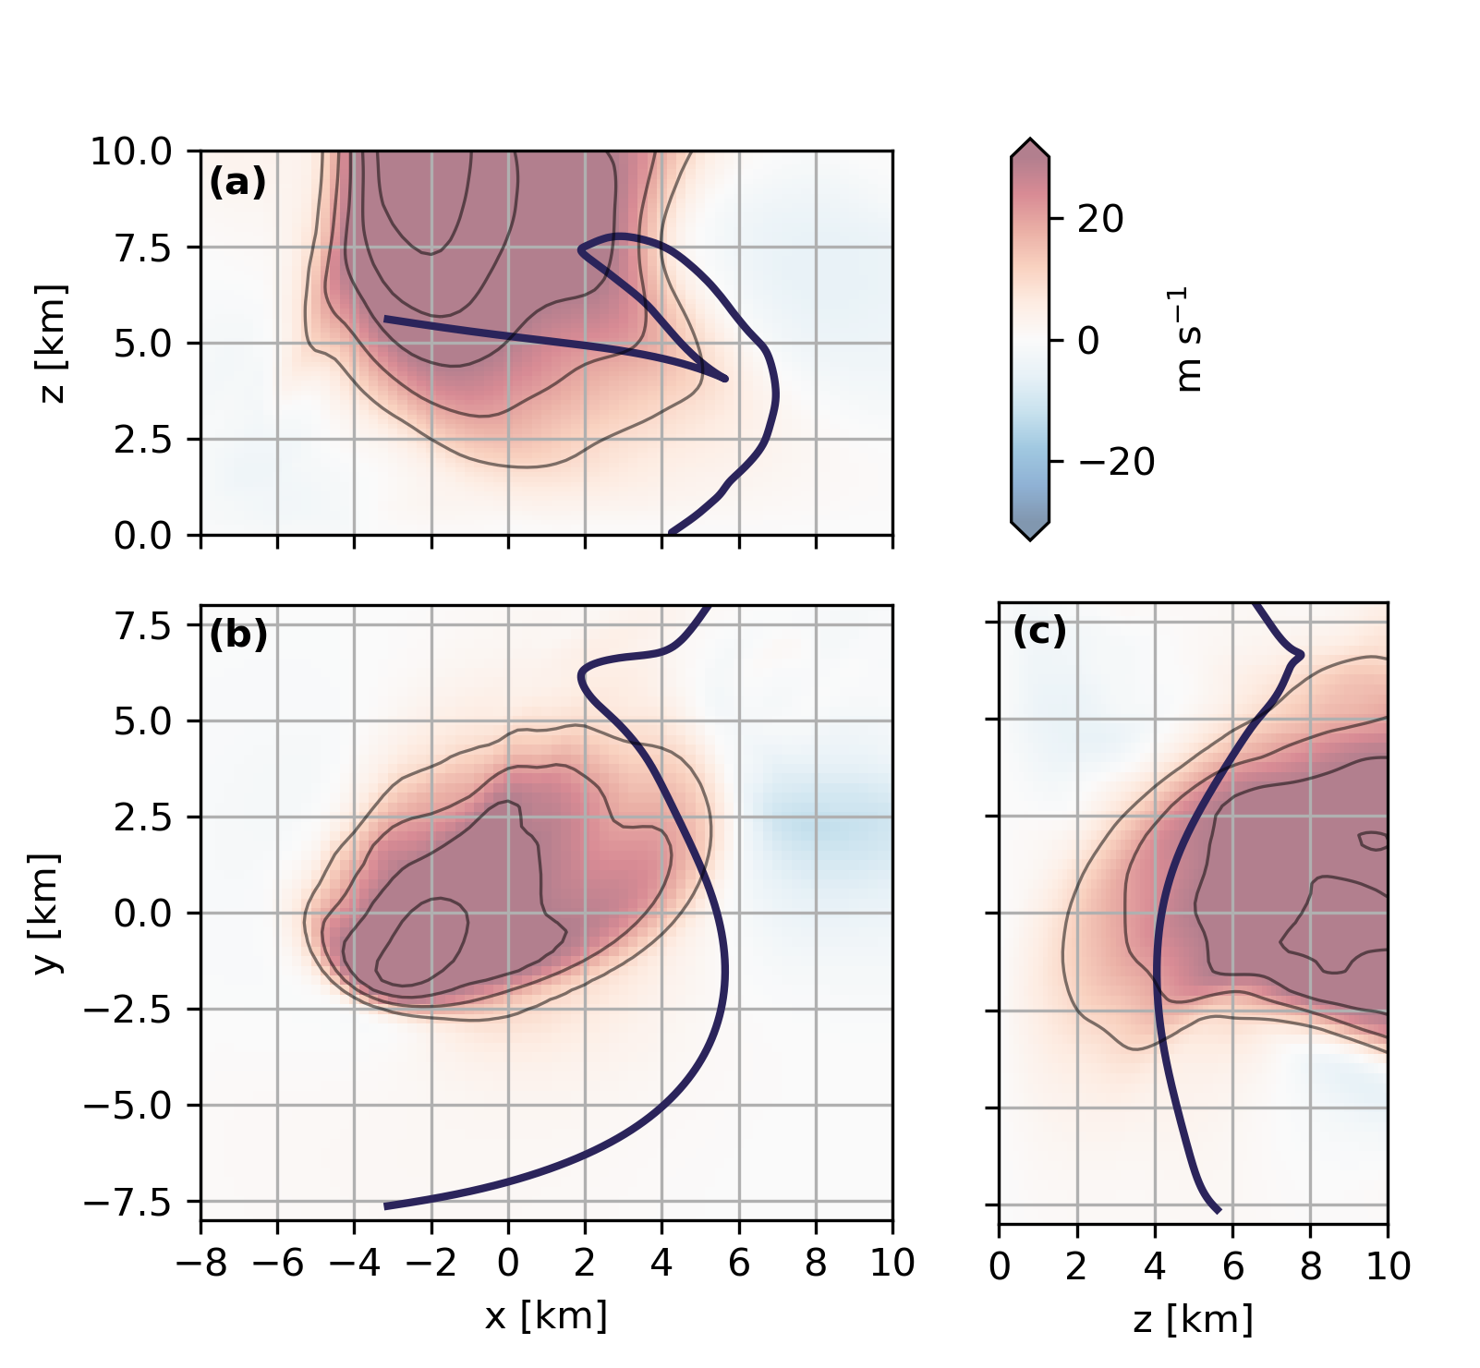
Trajectory Summary: Classic Trajectory
Size and Location Time Series

Slide 34
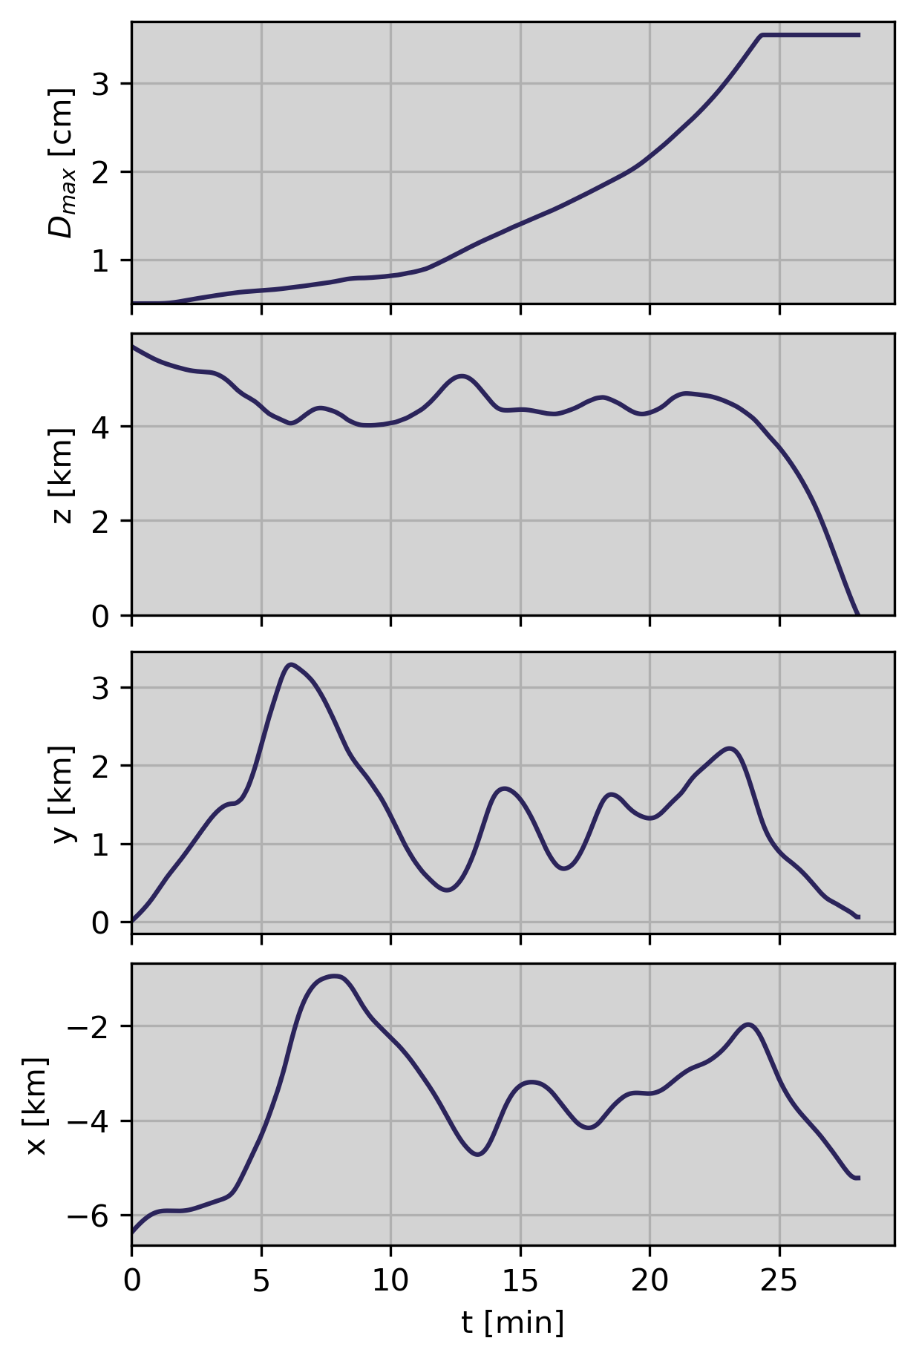
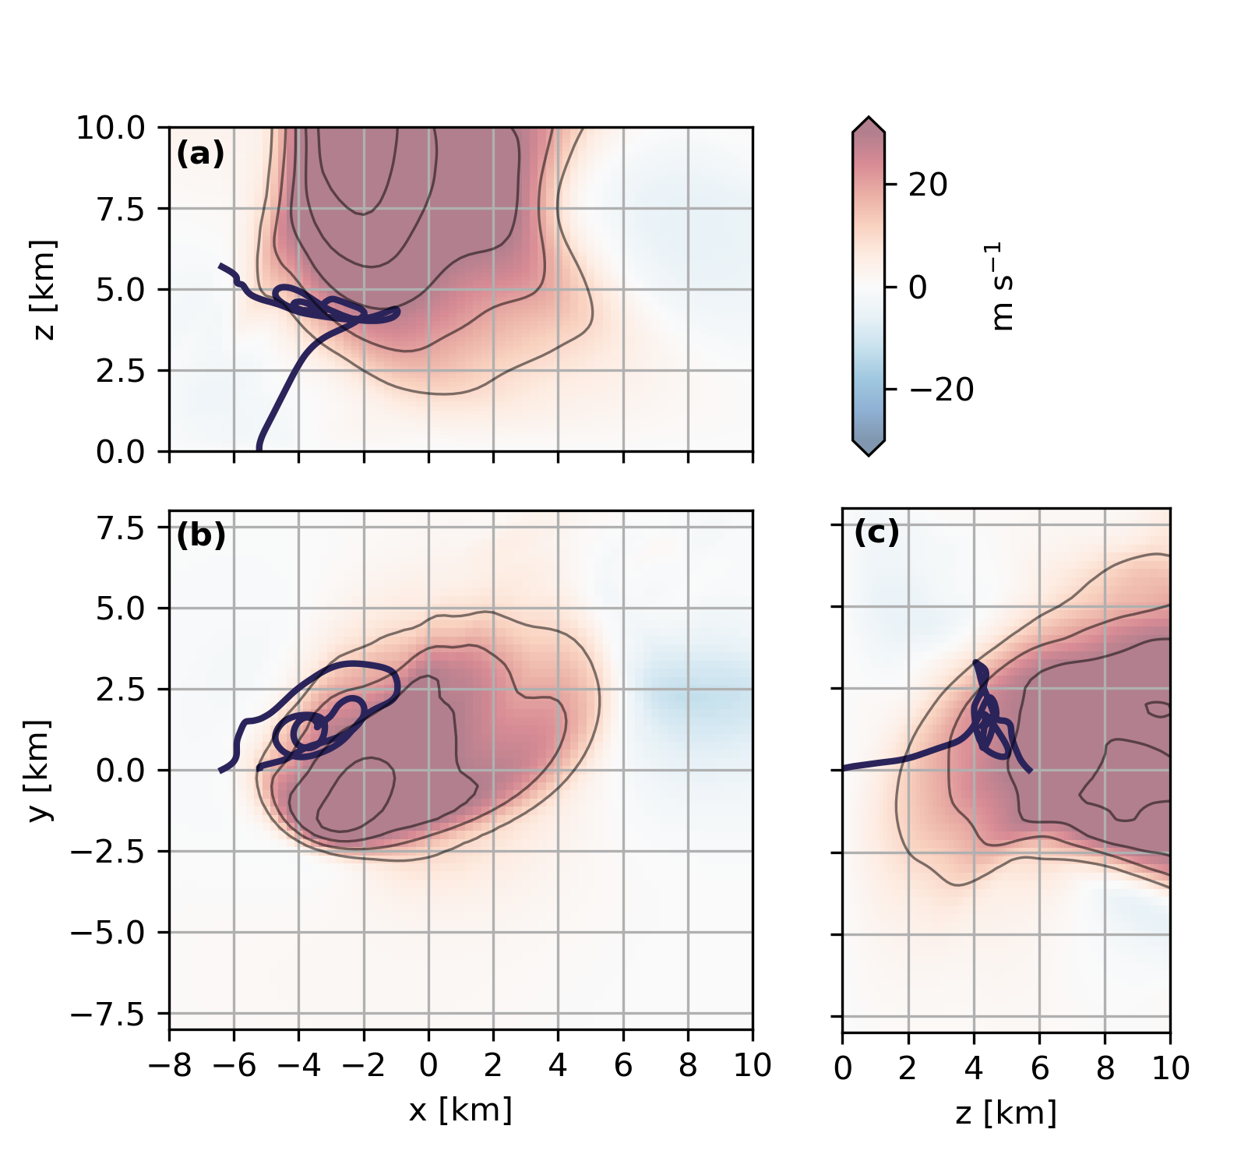
Trajectory Summary: West-Flank Trajectory
Size and Location Time Series

Slide 35
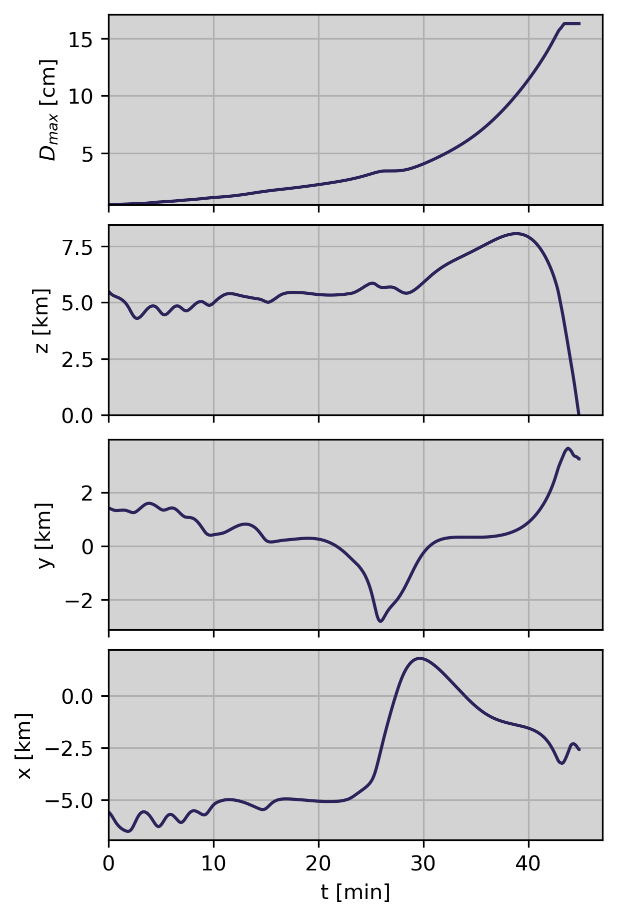
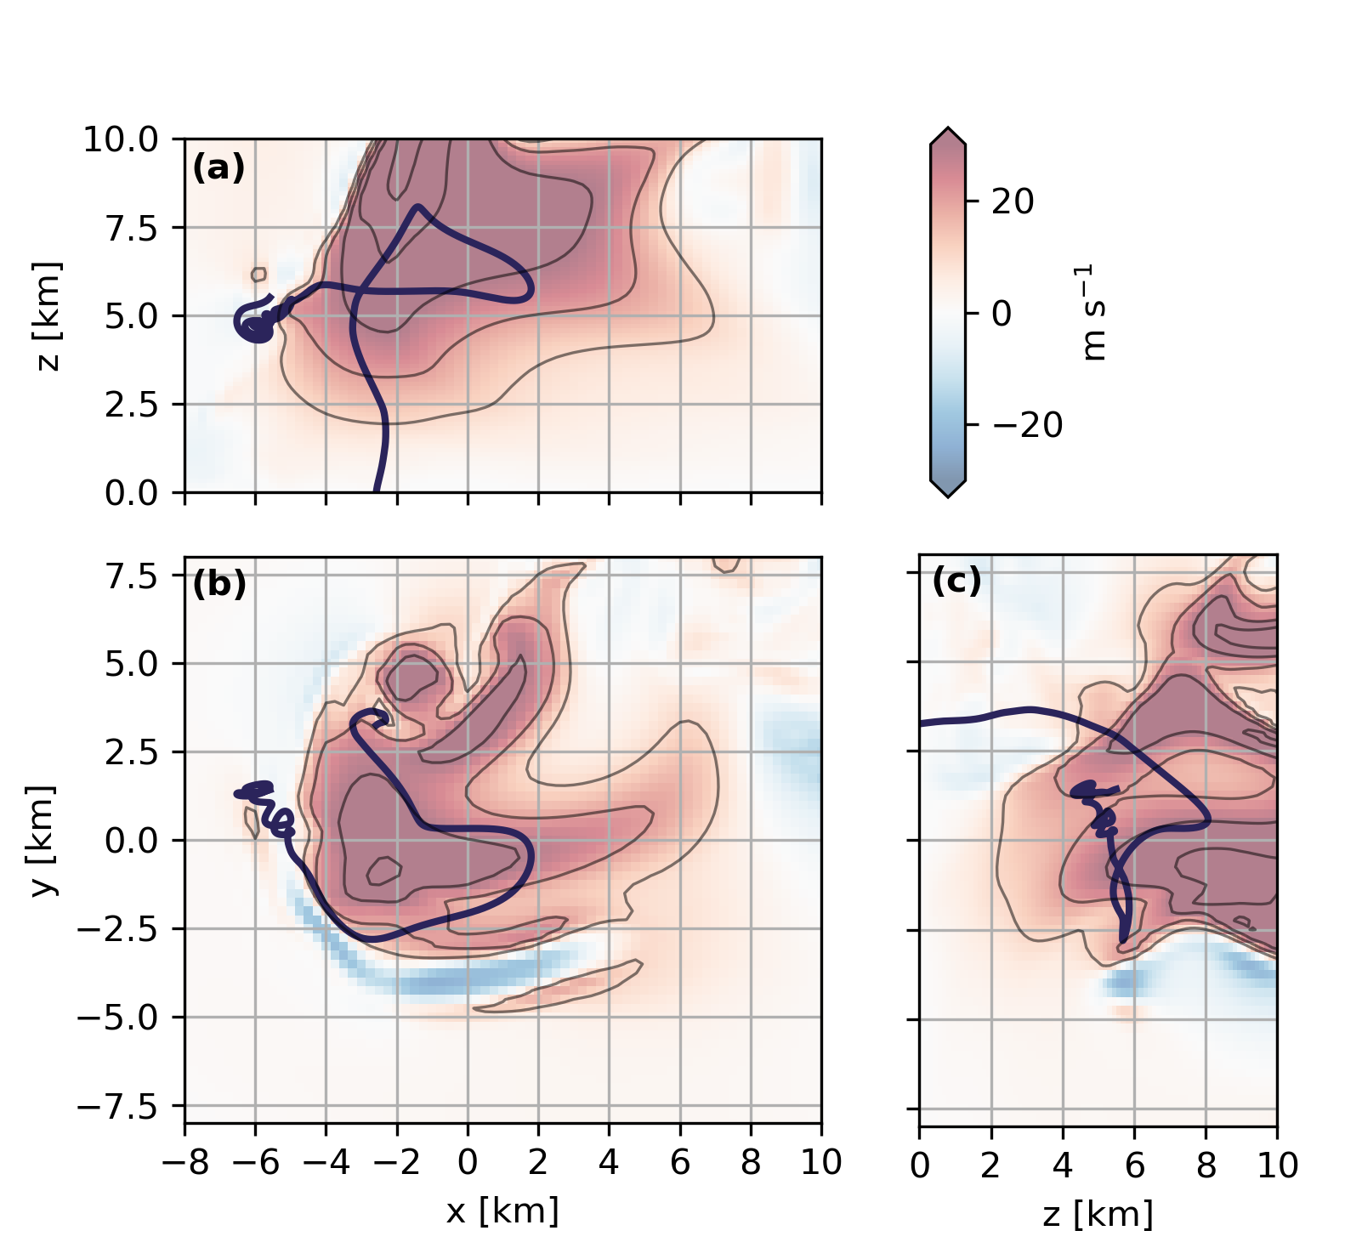
Trajectory Summary: Gargantuan Trajectory
Size and Location Time Series

