Slide 1


The sensitivity of hail production in supercell storms to the distribution of vertical wind shear
Kelly Lombardo and Matthew R. Kumjian
The Pennsylvania State University, United States
AGS-2410918

Slide 2
What We Know
Supercell flow fields impact the residence time of hailstones (Nelson 1983, Miller et al. 1988, Tessendorf et al. 2005, Dennis and Kumjian 2017, Kumjian and Lombardo 2020)
Longer residence time makes larger hailstones possible
These are sensitive to environmental instability and vertical wind shear → impact storm-relative winds (SRW) and storm flow field
In environments with larger CAPE:
supercell motion is more “off hodograph” → greater low-level SRW → wider updrafts → potentially longer residence times (Lin and Kumjian 2022)
hailstones may be prematurely ejected out of the optimal growth zone due to greater updraft speeds and larger storm-relative v (northward speed) around the mesocyclone (parcels ascending through hail growth zone experience less time decelerating in horizontal PPGF due to the negative p_{nl-d}’ on the southern part of the updraft)
Larger CAPE ≠ larger hail; there is an optimal intermediate range of CAPE (Lin and Kumjian 2022)
y
x
more CAPE
less CAPE

Slide 3
What We Know
Supercell flow fields impact the residence time of hailstones (Nelson 1983, Miller et al. 1988, Tessendorf et al. 2005, Dennis and Kumjian 2017, Kumjian and Lombardo 2020)
Longer residence time makes larger hailstones possible
These are sensitive to environmental instability and vertical wind shear → impact storm-relative winds (SRW) and storm flow field
In environments with larger CAPE:
supercell motion is more “off hodograph” → greater low-level SRW → wider updrafts → potentially longer residence times (Lin and Kumjian 2022)
hailstones may be prematurely ejected out of the optimal growth zone due to greater updraft speeds and larger storm-relative v (northward speed) around the mesocyclone (parcels ascending through hail growth zone experience less time decelerating in horizontal PPGF due to the negative p_{nl-d}’ on the southern part of the updraft)
Larger CAPE ≠ larger hail; there is an optimal intermediate range of CAPE (Lin and Kumjian 2022)
y
x
more CAPE
less CAPE

Slide 4
What We Know
Supercell flow fields impact the residence time of hailstones (Nelson 1983, Miller et al. 1988, Tessendorf et al. 2005, Dennis and Kumjian 2017, Kumjian and Lombardo 2020)
Longer residence time makes larger hailstones possible
These are sensitive to environmental instability and vertical wind shear → impact storm-relative winds (SRW) and storm flow field
y
Greater low-level SRW → wider updrafts (Warren et al. 2017; Peters et al. 2019, Kumjian and Lombardo 2020)
Larger deep-layer (0-6 km) u-shear increases low-level SRW → zonally elongated updrafts → allows larger residence time (Dennis and Kumjian 2017; Kumjian and Lombardo 2020)
Larger 0-3 km v-shear → meridionally elongated updrafts and faster mesocyclone northbound flow → reduced residence time (Kumjian and Lombardo 2020)
This is supported by environmental analyses (Nixon and Allen 2023).
larger SRW from u-wind
x
smaller SRW

Slide 5
What We Know
Supercell flow fields impact the residence time of hailstones (Nelson 1983, Miller et al. 1988, Tessendorf et al. 2005, Dennis and Kumjian 2017, Kumjian and Lombardo 2020)
Longer residence time makes larger hailstones possible
These are sensitive to environmental instability and vertical wind shear → impact storm-relative winds (SRW) and storm flow field
y
Greater low-level SRW → wider updrafts (Warren et al. 2017; Peters et al. 2019, Kumjian and Lombardo 2020)
Larger deep-layer (0-6 km) u-shear increases low-level SRW → zonally elongated updrafts → allows larger residence time (Dennis and Kumjian 2017; Kumjian and Lombardo 2020)
Larger 0-3 km v-shear → meridionally elongated updrafts and faster mesocyclone northbound flow → reduced residence time (Kumjian and Lombardo 2020)
This is supported by environmental analyses (Nixon and Allen 2023).
larger SRW from v-wind
x
smaller SRW

Slide 6
What Don’t We Know
Preserving the deep-layer (0-6 km) and low-level (0-2 km) shear, does the distribution of shear within the 2-6 km layer (across the mesocyclone) impact hail growth?
Will changes to the mid-level u-component winds impact the supercell flow field, updraft characteristics, and hailstone residence time?
Will changes to the mid-level v-component winds impact the supercell flow field, updraft characteristics, and hailstone residence time?
Yes, yes, and yes.

Slide 7
Idealized Numerical Experiments to Test Hypotheses
To Make the Supercells
Cloud Model 1 (Bryan and Fritsch 2002)
500 m x 500 m horizontal grid spacing
250 m vertical grid spacing
5-min output, 3-hr simulation
Supercells initiated with a warm bubble
Morrison double-moment microphysics (Morrison et al. 2005, 2009), large ice category prescribed as hail
To Make the Hail
Hail Growth Trajectory Model (Kumjian and Lombardo 2020)
2.5, 5, 7.5, 10 mm embryos seeded, each one per grid box in a 30 km x 30 km x 9 km cube around updraft
Trajectories run on static fields from CM1 output starting at 65 min to 180 min
Total of 13,767,700 hail trajectories for each experiment

Slide 8
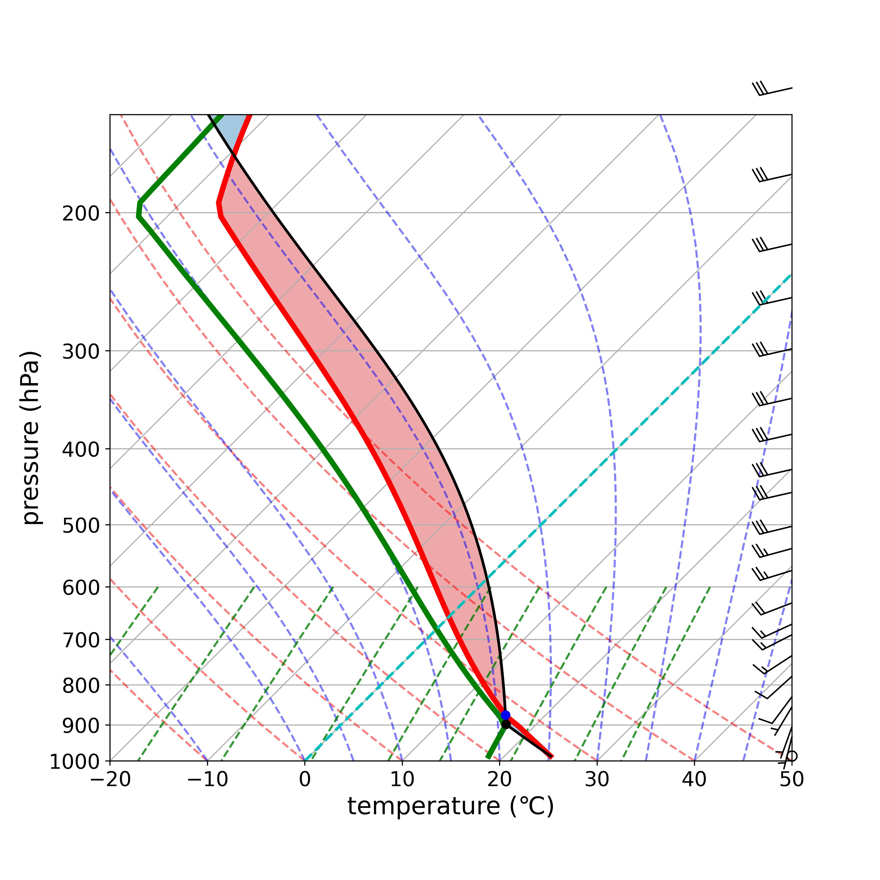
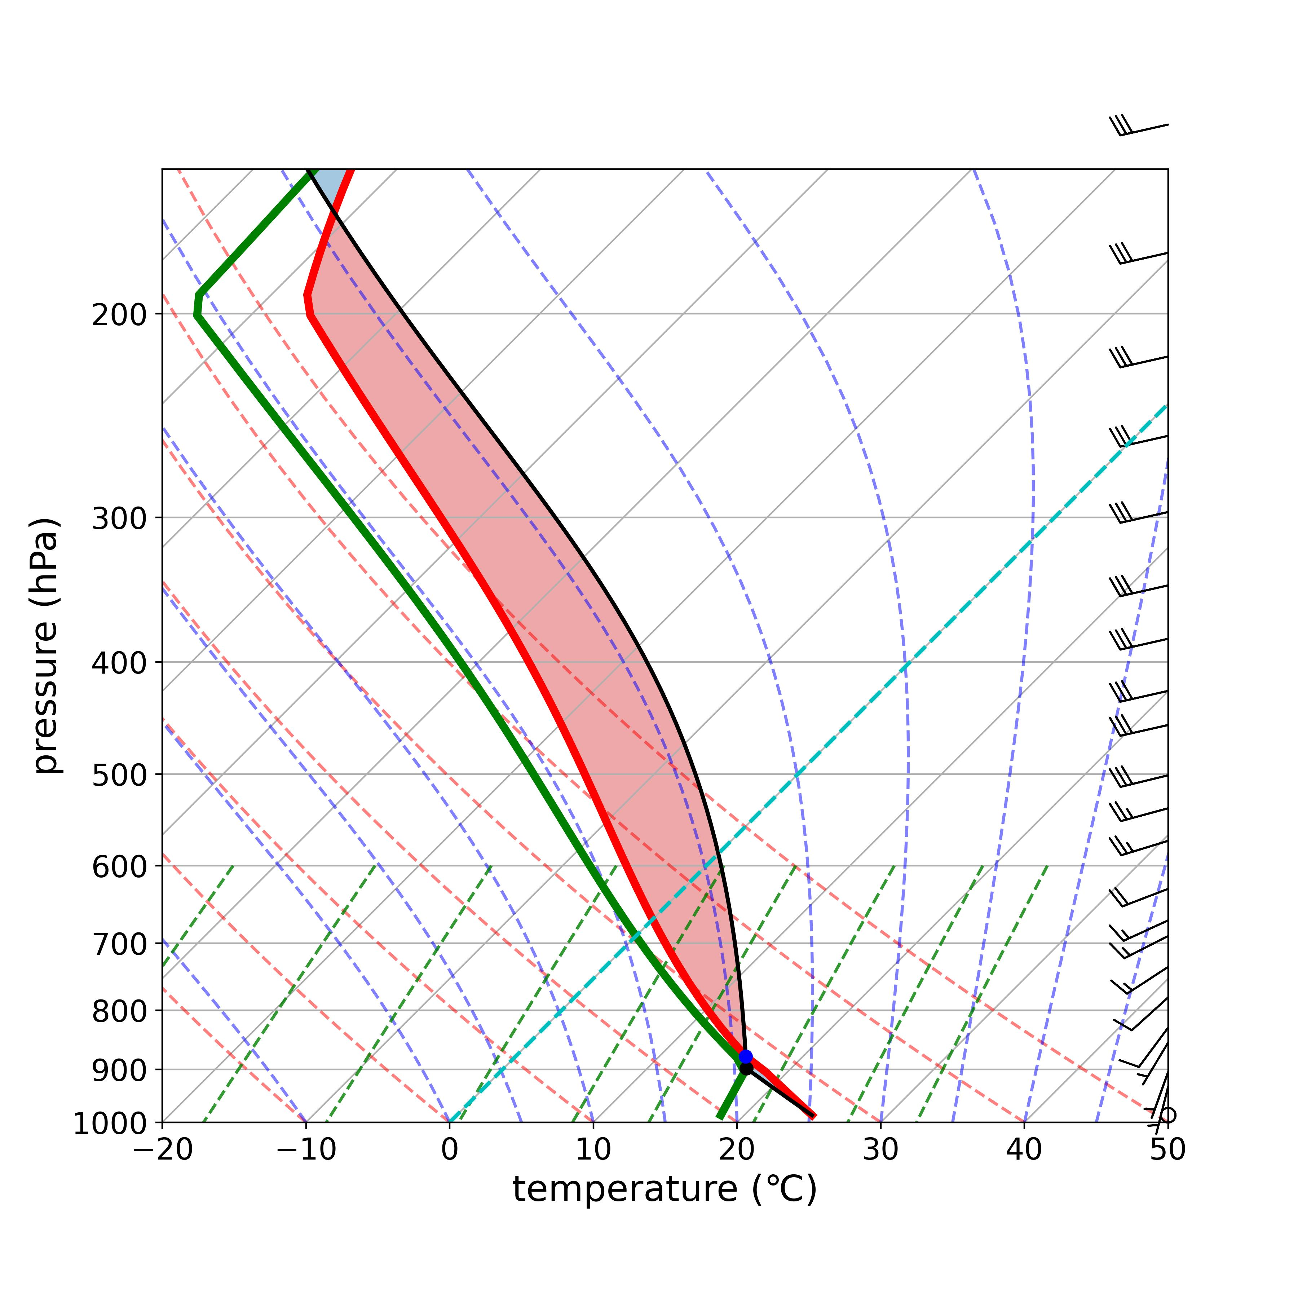

Base-State Thermodynamic Environment
Test several “optimal” SBCAPE values (Lin and Kumjian 2022)
Evaluate hail growth – wind distribution relationships across a range of instabilities, evaluate the robustness of the results
2000 J kg⁻¹
2500 J kg⁻¹
3000 J kg⁻¹

Slide 9
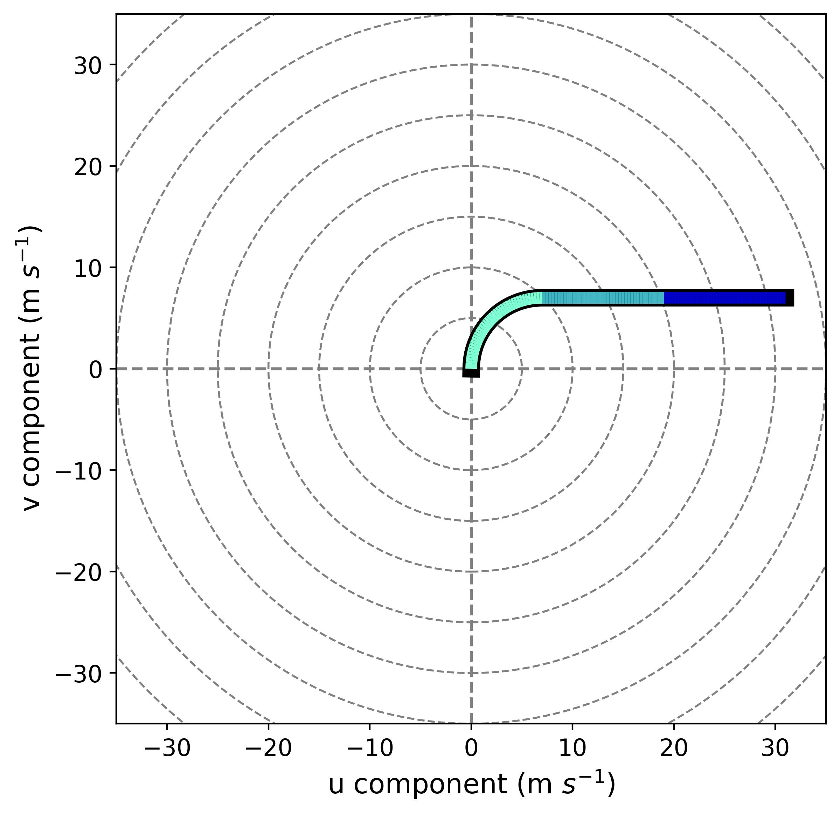
Base-State Wind (No Modification) Hodograph
2-4 km
Quarter circle from 0-2 km (Weisman and Rotunno 2000; Dennis and Kumjian 2017)
Between 2-6 km, u-component increases from 7 m s⁻¹ to 31 m s⁻¹
Vertical wind shear between 2-4 km and 4-6 km layers are the same: 12 m s⁻¹
Above 6 km, u-component fixed at 31 m s⁻¹
0-2 km
4-6 km
WIND SHEAR EXPERIMENTS:
Change winds only in 2-6 km layer, but preserve 2-6 km shear

Slide 10
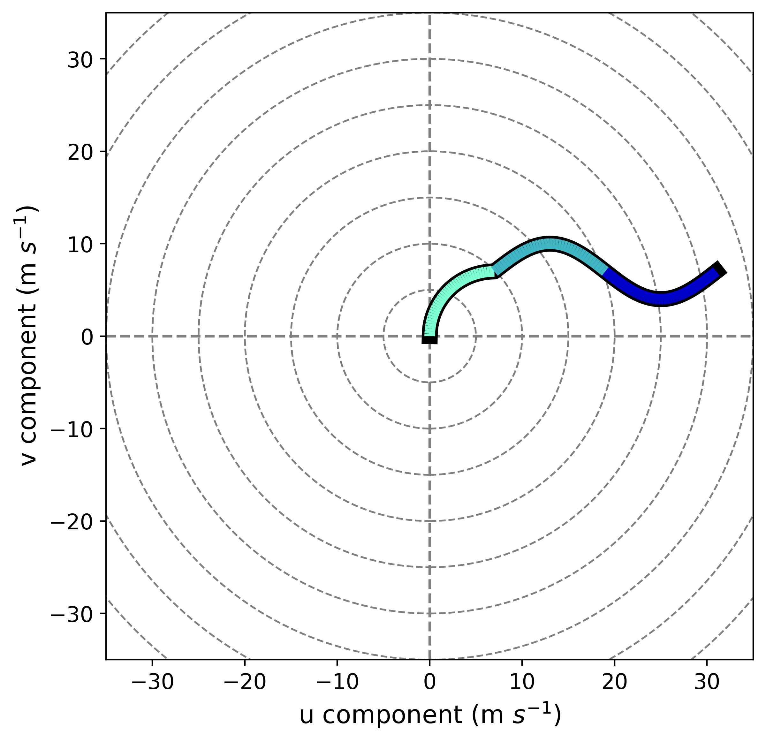
SINE /SINE REVERSE Experiments Target V-component of Wind
Impose a sine-curve-shaped perturbation
Hypothesis: Increased 2-4 km storm-relative v-component → stronger northbound winds in updraft → bad for hail?
SINE
SINE REVERSE
2-4 km
SINE REVERSE
4-6 km
+3 m s⁻¹ max v-perturbation at 3 km
-3 m s⁻¹ min v-perturbation at 5 km

Slide 11
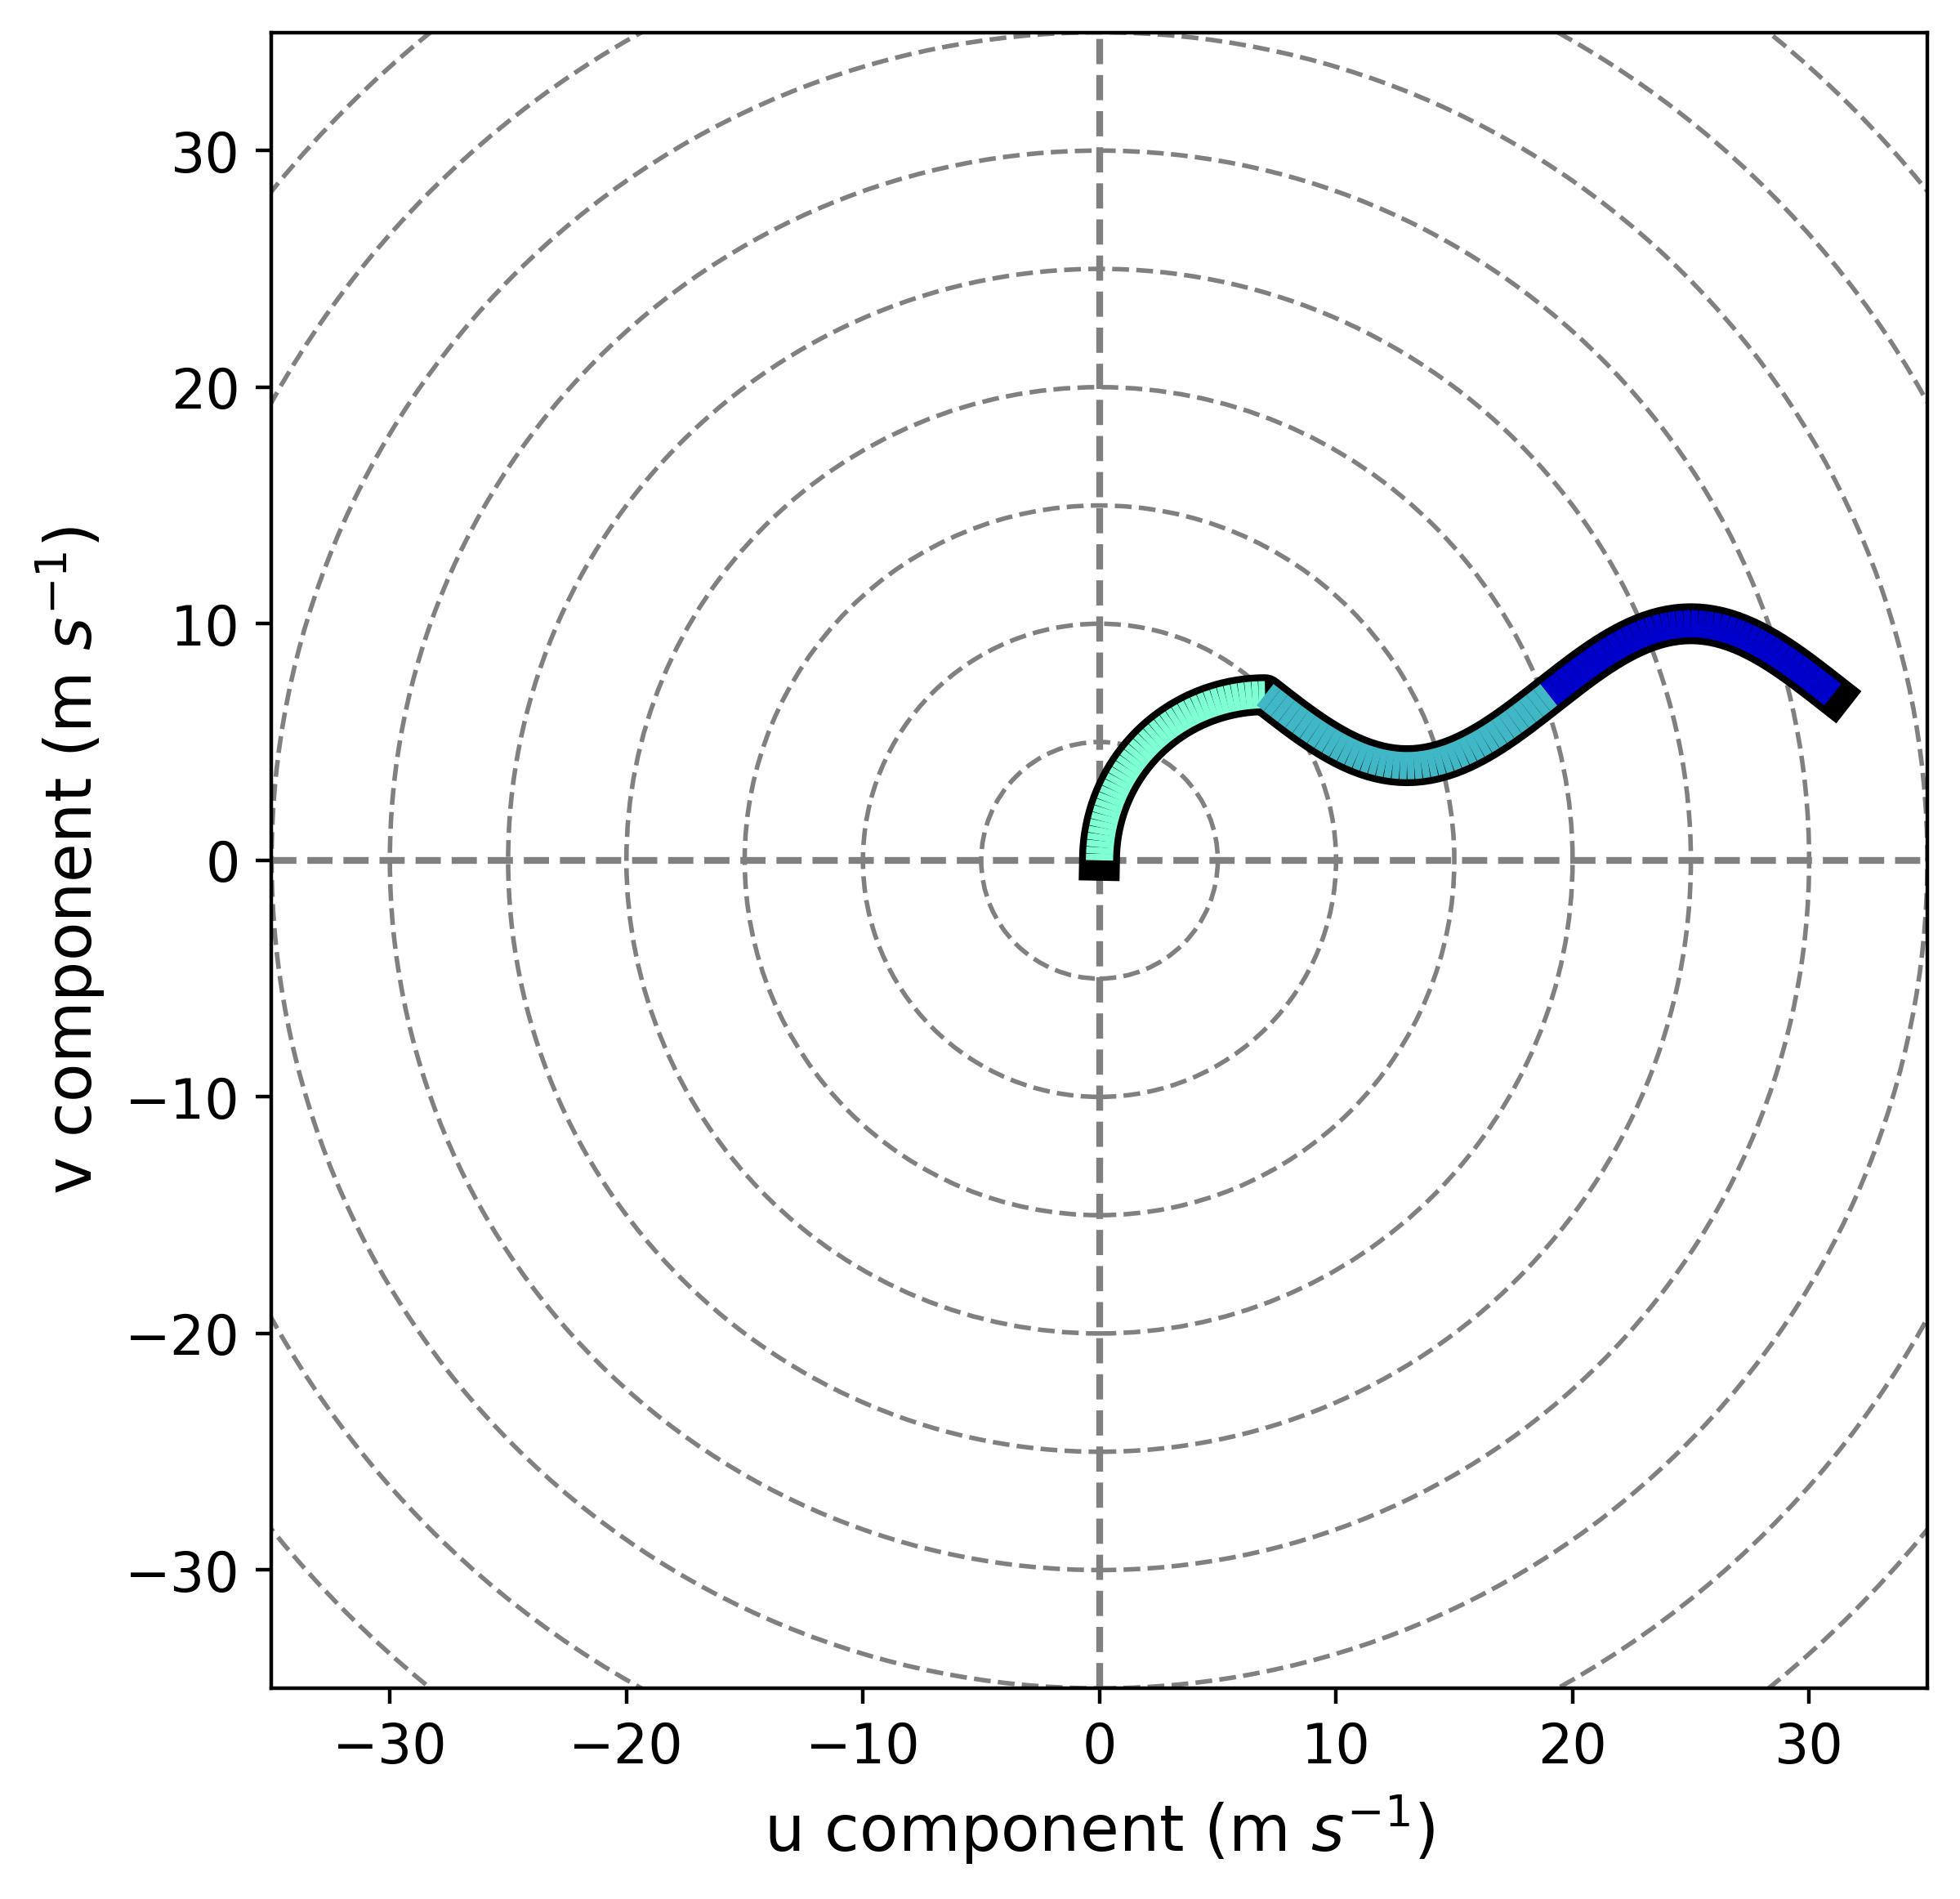
SINE /SINE REVERSE Experiments Target V-component of Wind
Impose a sine-curve-shaped perturbation
Hypothesis: Decreased 2-4 km storm-relative v-component → weaker northbound winds in updraft → good for hail?
SINE
SINE REVERSE
2-4 km
2-4 km
SINE REVERSE
4-6 km
4-6 km
+3 m s⁻¹ max v-perturbation at 3 km
-3 m s⁻¹ min v-perturbation at 5 km
-3 m s⁻¹ min v-perturbation at 3 km
+3 m s⁻¹ max v-perturbation at 5 km

Slide 12
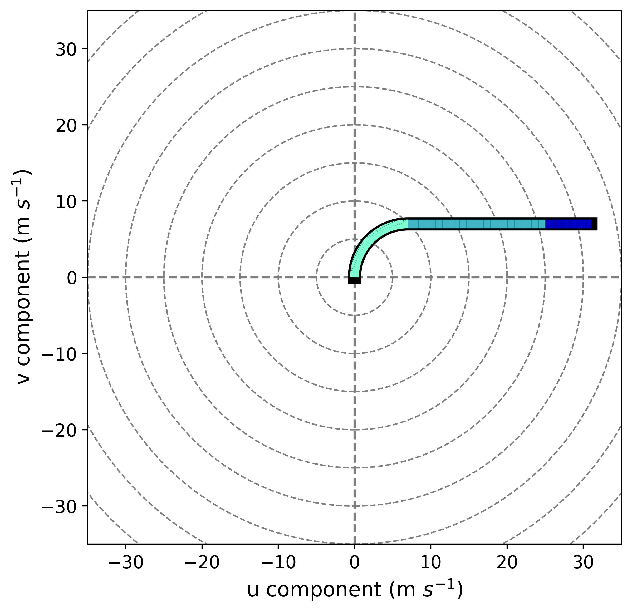
SLINKY 2-4 km / SLINKY 4-6 km Experiments Target U-component of Wind
Increase / Decrease u-shear over the layers
Hypothesis: Increased 0-4 km storm-relative winds → wider updrafts → good for hail?
SLINKY 2-4 KM
SINE REVERSE
2-4 km
SINE REVERSE
4-6 km
+3 m s⁻¹ u-shear in 2-4 km layer (15 m s⁻¹)
-3 m s⁻¹ u-shear in 4-6 km layer (7 m s⁻¹)

Slide 13
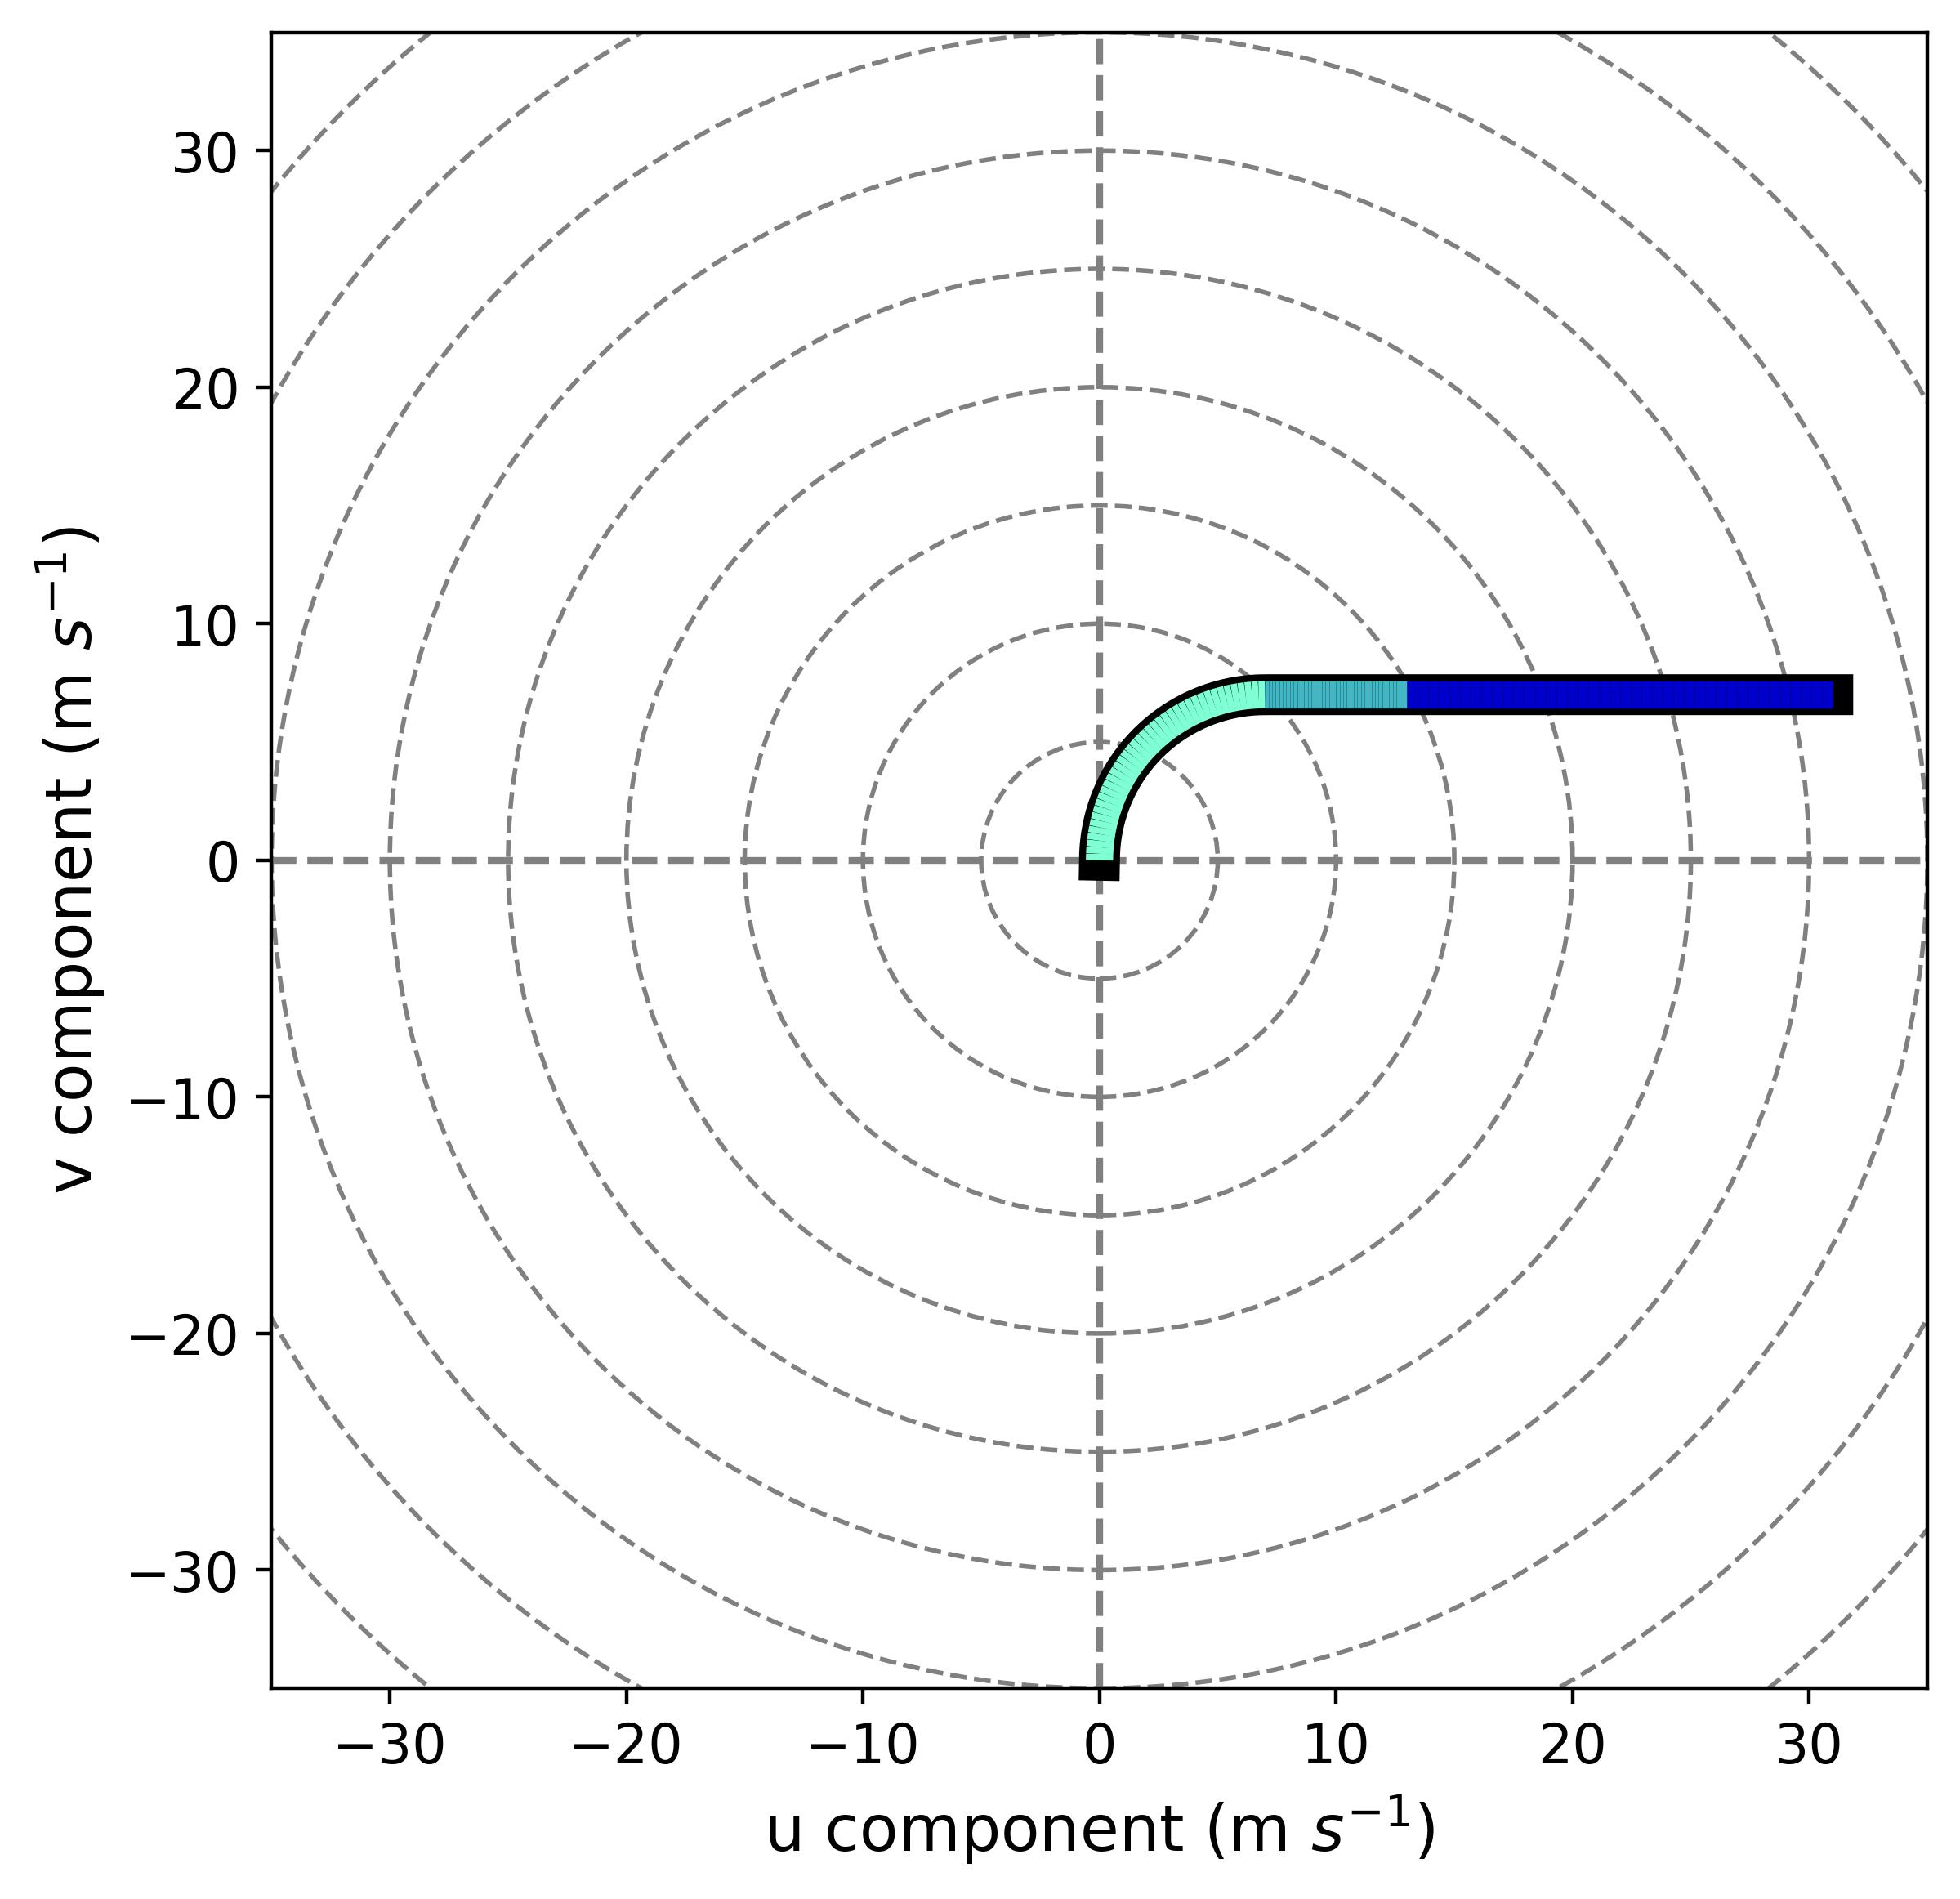
SLINKY 2-4 km / SLINKY 4-6 km Experiments Target U-component of Wind
Increase / Decrease u-shear over the layers
Hypothesis: Decreased 0-4 km storm-relative winds → narrower updrafts → bad for hail?
SLINKY 2-4 KM
SLINKY 4-6 KM
2-4 km
2-4 km
4-6 km
4-6 km
+3 m s⁻¹ u-shear in 2-4 km layer (15 m s⁻¹)
-3 m s⁻¹ u-shear in 4-6 km layer (7 m s⁻¹)
-3 m s⁻¹ u-shear in 2-4 km layer (7 m s⁻¹)
+3 m s⁻¹ u-shear in 4-6 km layer (15 m s⁻¹)

Slide 14



Slide 15

A Family Classic Since 1945!

Slide 16
SLINKY 2-4 km and SLINKY 4-6 km

Slide 17
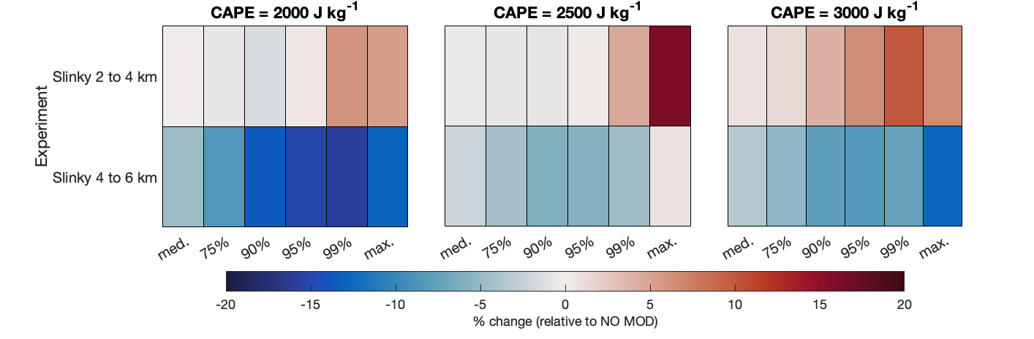
Increase in Hail Size for Larger 2-4 km U-Wind Shear (All CAPEs)
change in hail median, 75th percentile, 90th percentile, 95th percentile, 99th percentile, max sizes relative to the control (no modification)
SLINKY
2-4 KM
SLINKY 2-4 km is
more favorable for hail production
SLINKY
4-6 KM
SLINKY 4-6 km is
less favorable for hail production
blue = decrease in hail size
red = increase in hail size

Slide 18
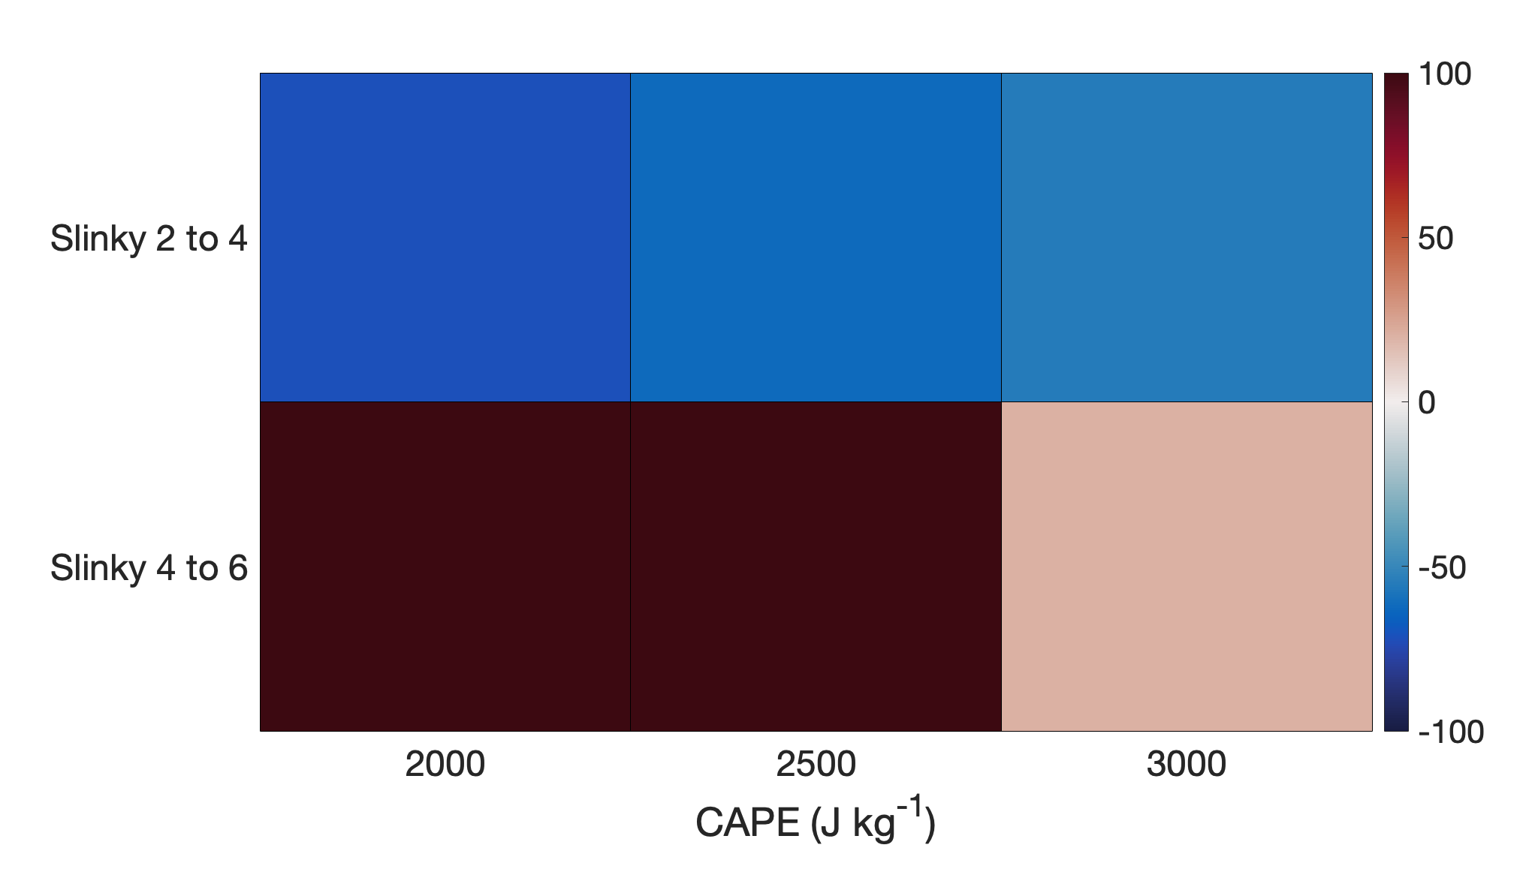
We Expect Changes in U, but V Also Changes
Though deep-layer shear is fixed, there are differences among the experiments in
predicted storm motion
actual storm motion
Bunkers motion (Bunkers et al. 2000) predicts changes in (only) storm u-motion for the sensitivity experiments as compared to control hodograph
Bunkers motion | u-component | v-component
No modification | 14.93 | -1.22
SLINKY 2-4 km | 16.90 | -1.22
SLINKY 4-6 km | 12.97 | -1.21
difference between actual storm v-motion
and Bunkers predicted v-motion
red = storm moves less southward than Bunkers
See deviations in v-motion, magnitude varies with CAPE
SLINKY 2-4 has larger negative v motion → moves southward (overall) faster
SLINKY 4-6 has smaller negative v motion→ moves southward (overall) slower
blue = storm moves more southward than Bunkers

Slide 19
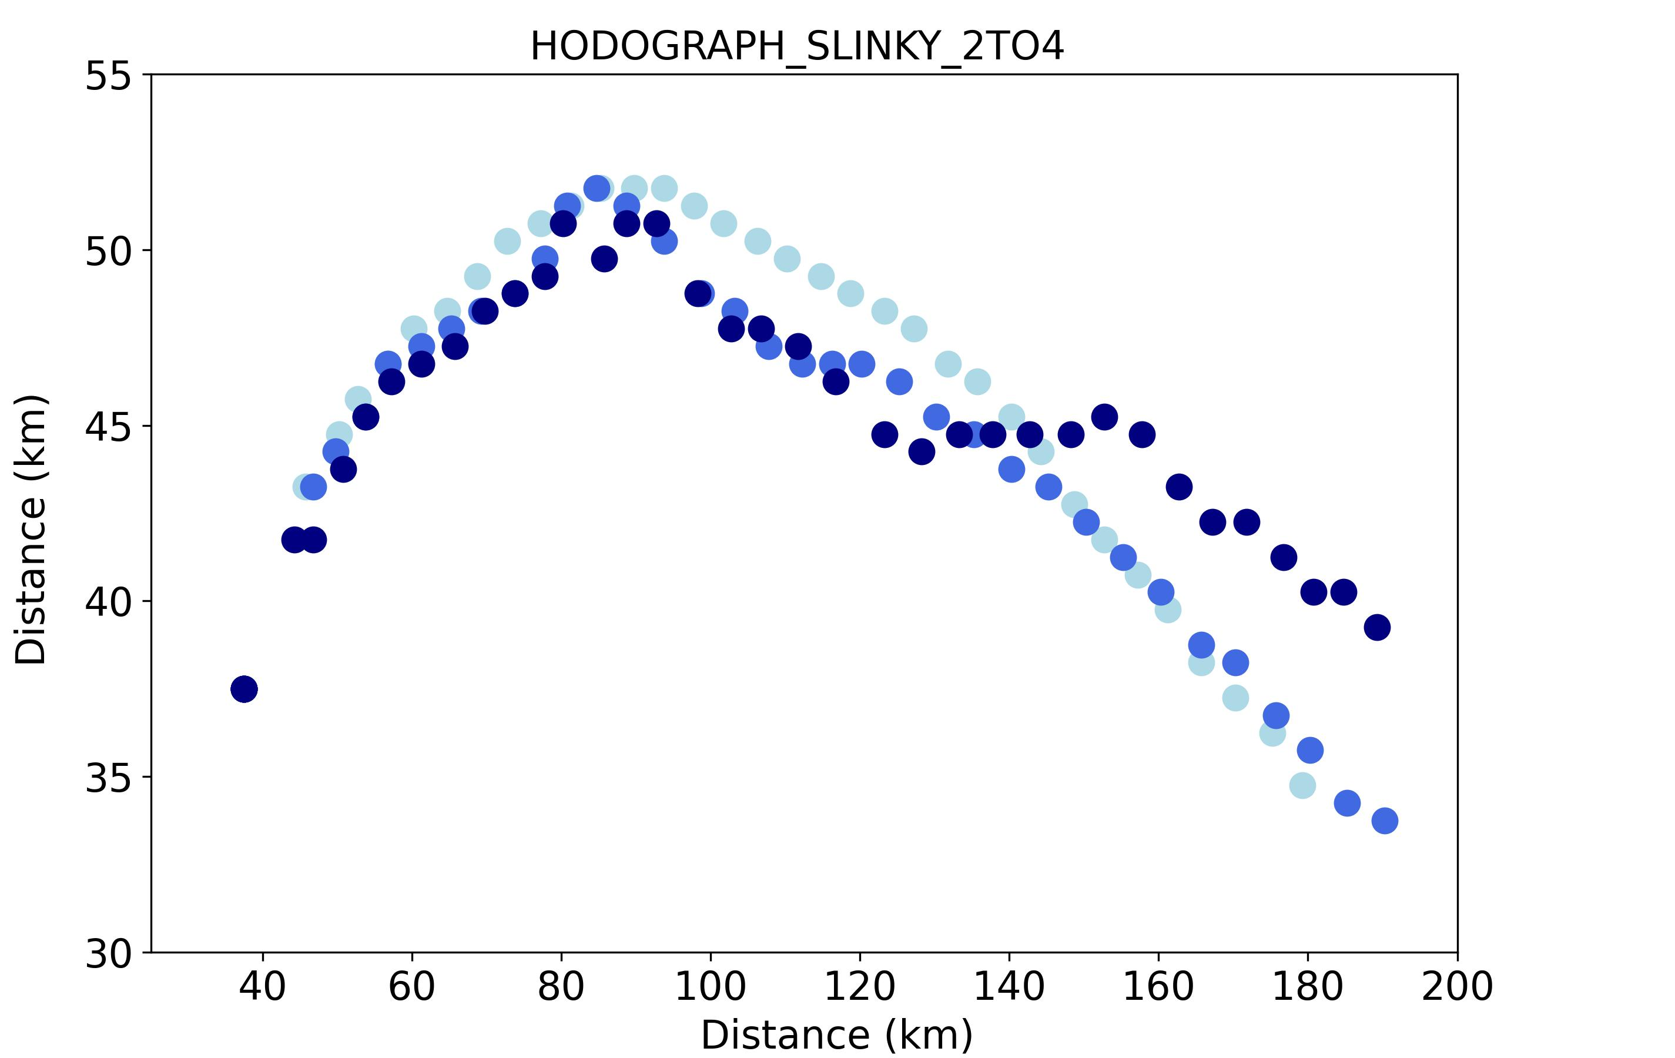
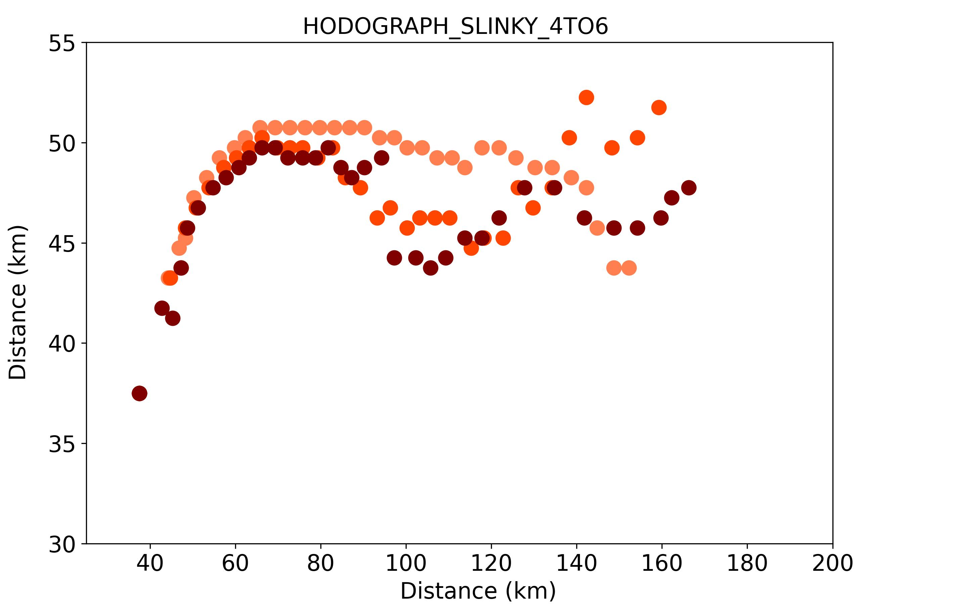
Differences in Motion Visible in Storm Tracks
Tracked storms (dots mark the location of the storm center every 5 min) based on smoothed 2-5 km average updraft helicity (center defined as mass-weighted updraft velocity within the UH area) - thanks to Lydia Spychalla for tracking software!
Create storm-relative 1-hr composites from 90 – 150 min using these locations
storm track with location every 5 minutes (lightest color = smallest CAPE, darkest color = largest CAPE)
SLINKY
2-4 KM
SLINKY
4-6 KM

Slide 20
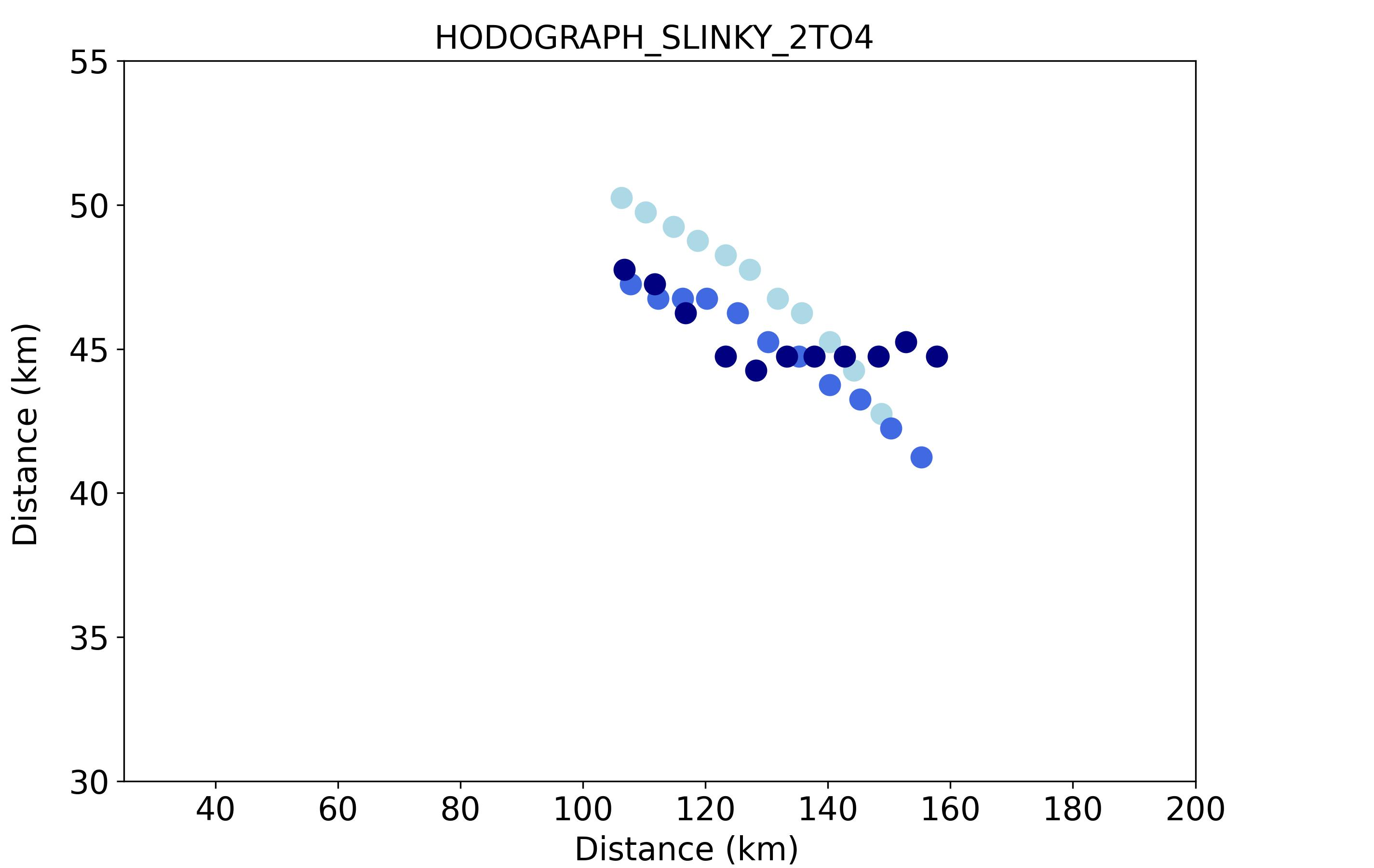
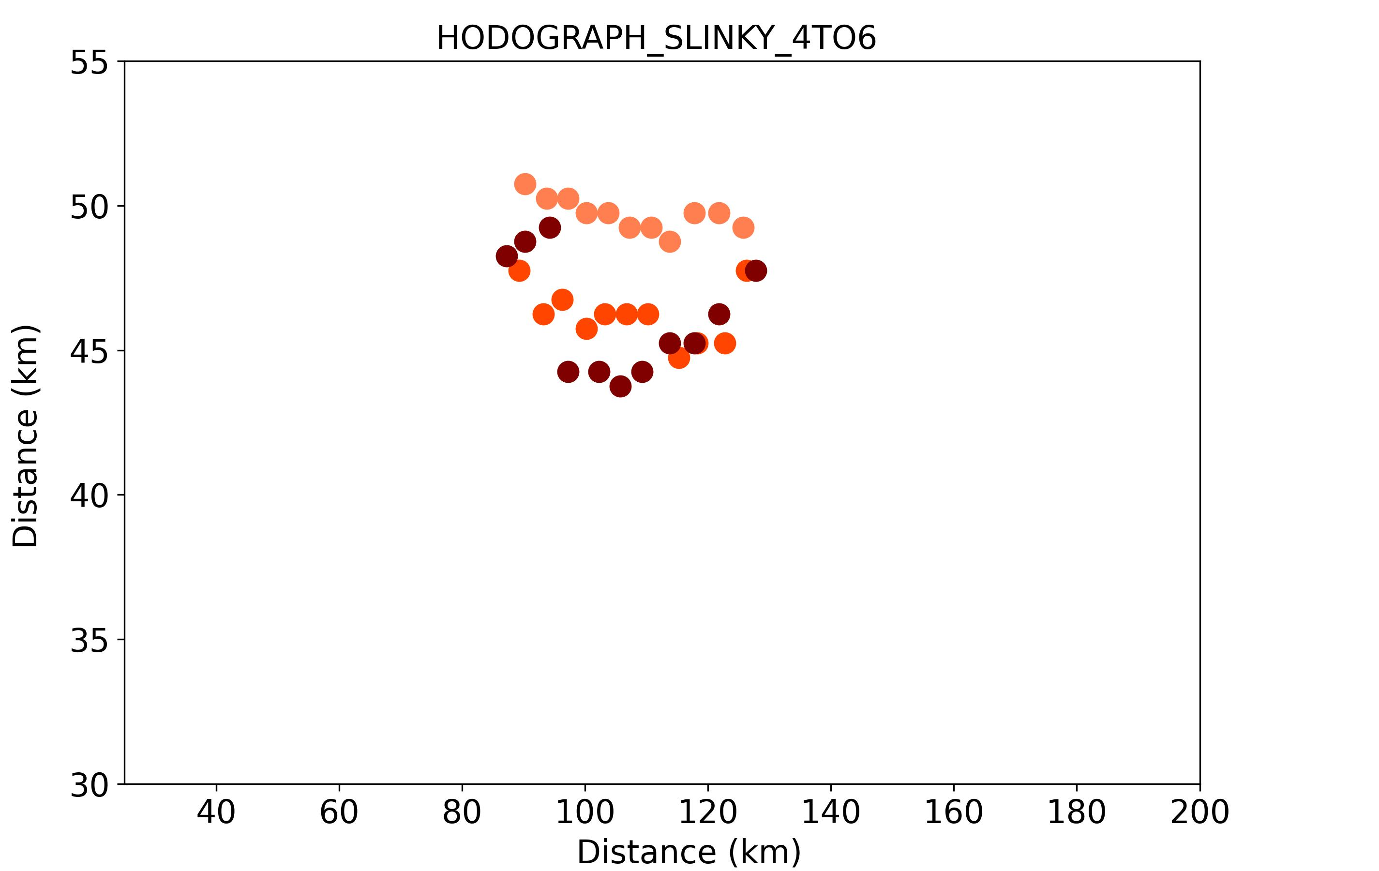
Differences in Motion Visible in Storm Tracks
Tracked storms (dots mark the location of the storm center every 5 min) based on smoothed 2-5 km average updraft helicity (center defined as mass-weighted updraft velocity within the UH area) - thanks to Lydia Spychalla for tracking software!
Create storm-relative 1-hr composites from 90 – 150 min using these locations
storm track with location every 5 minutes (lightest color = smallest CAPE, darkest color = largest CAPE)
SLINKY
2-4 KM
TRACK DURING
COMPOSITE TIME
WINDOW
SLINKY
4-6 KM
TRACK
DURING COMPOSITE TIME
WINDOW

Slide 21
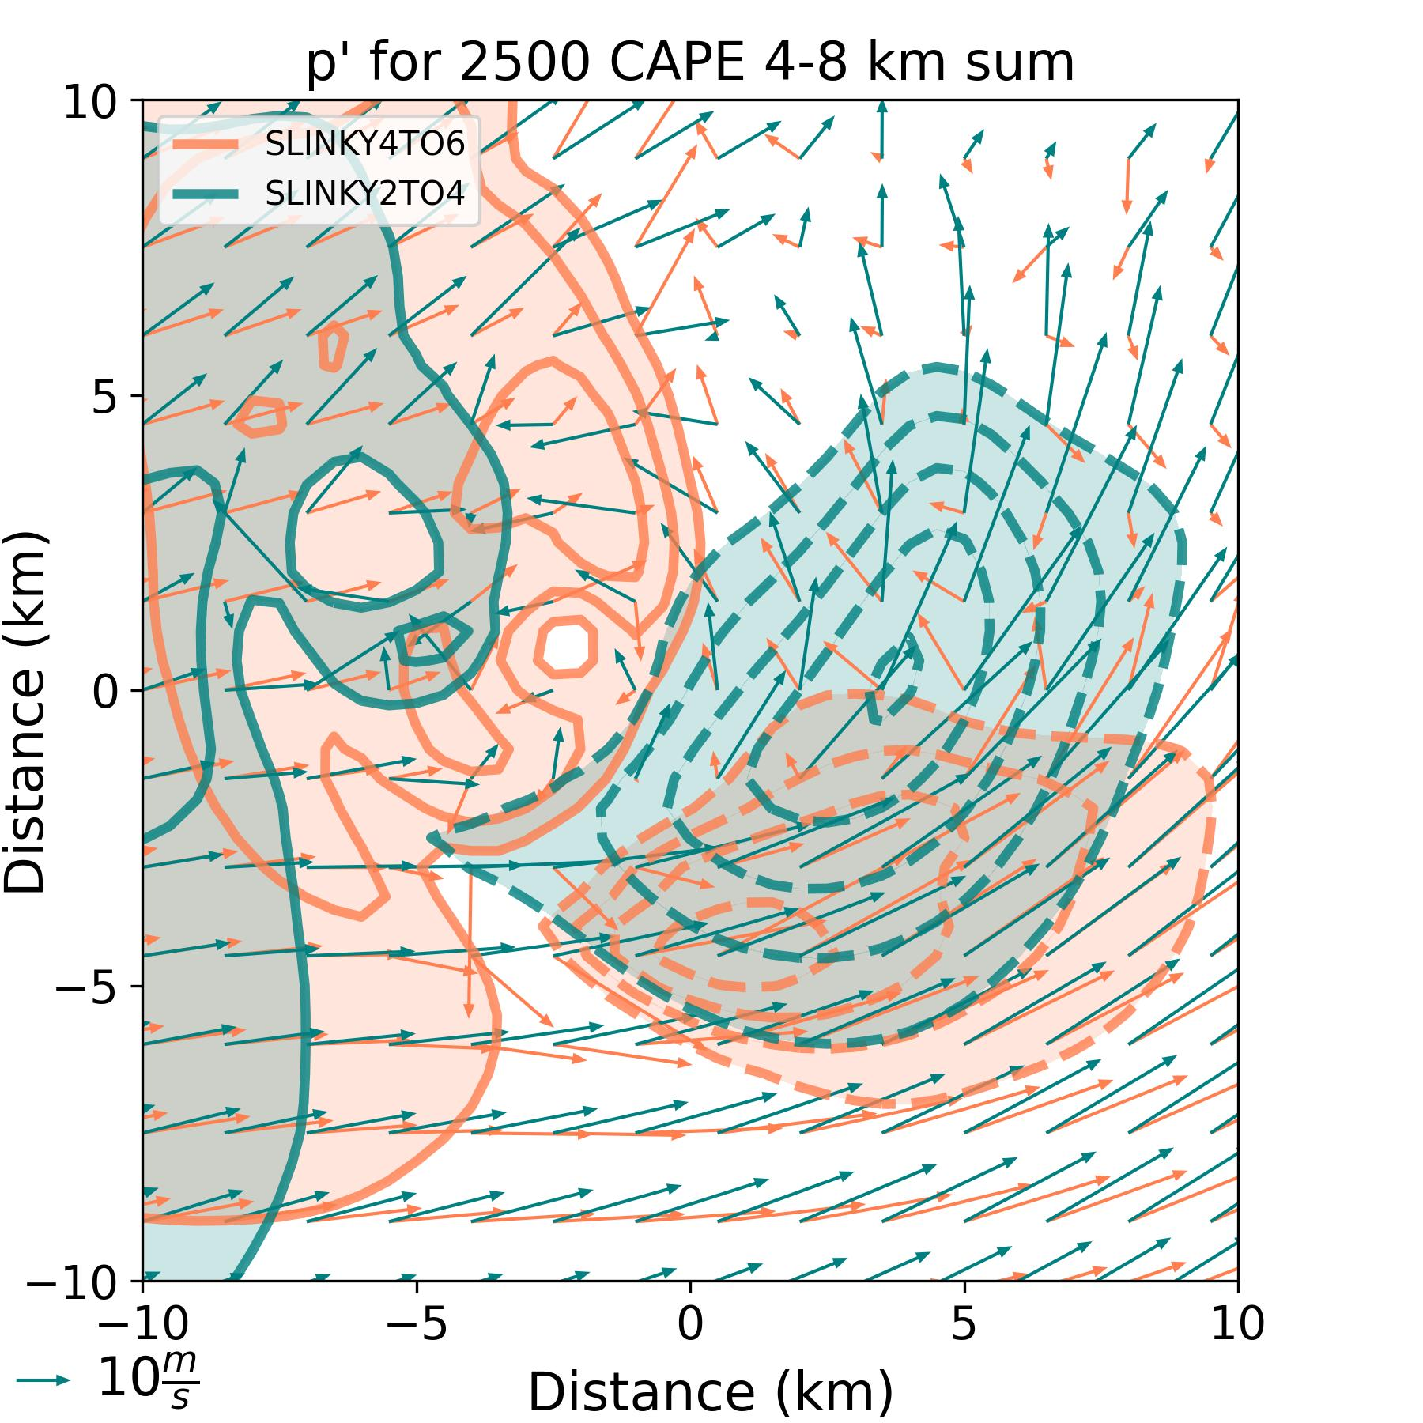
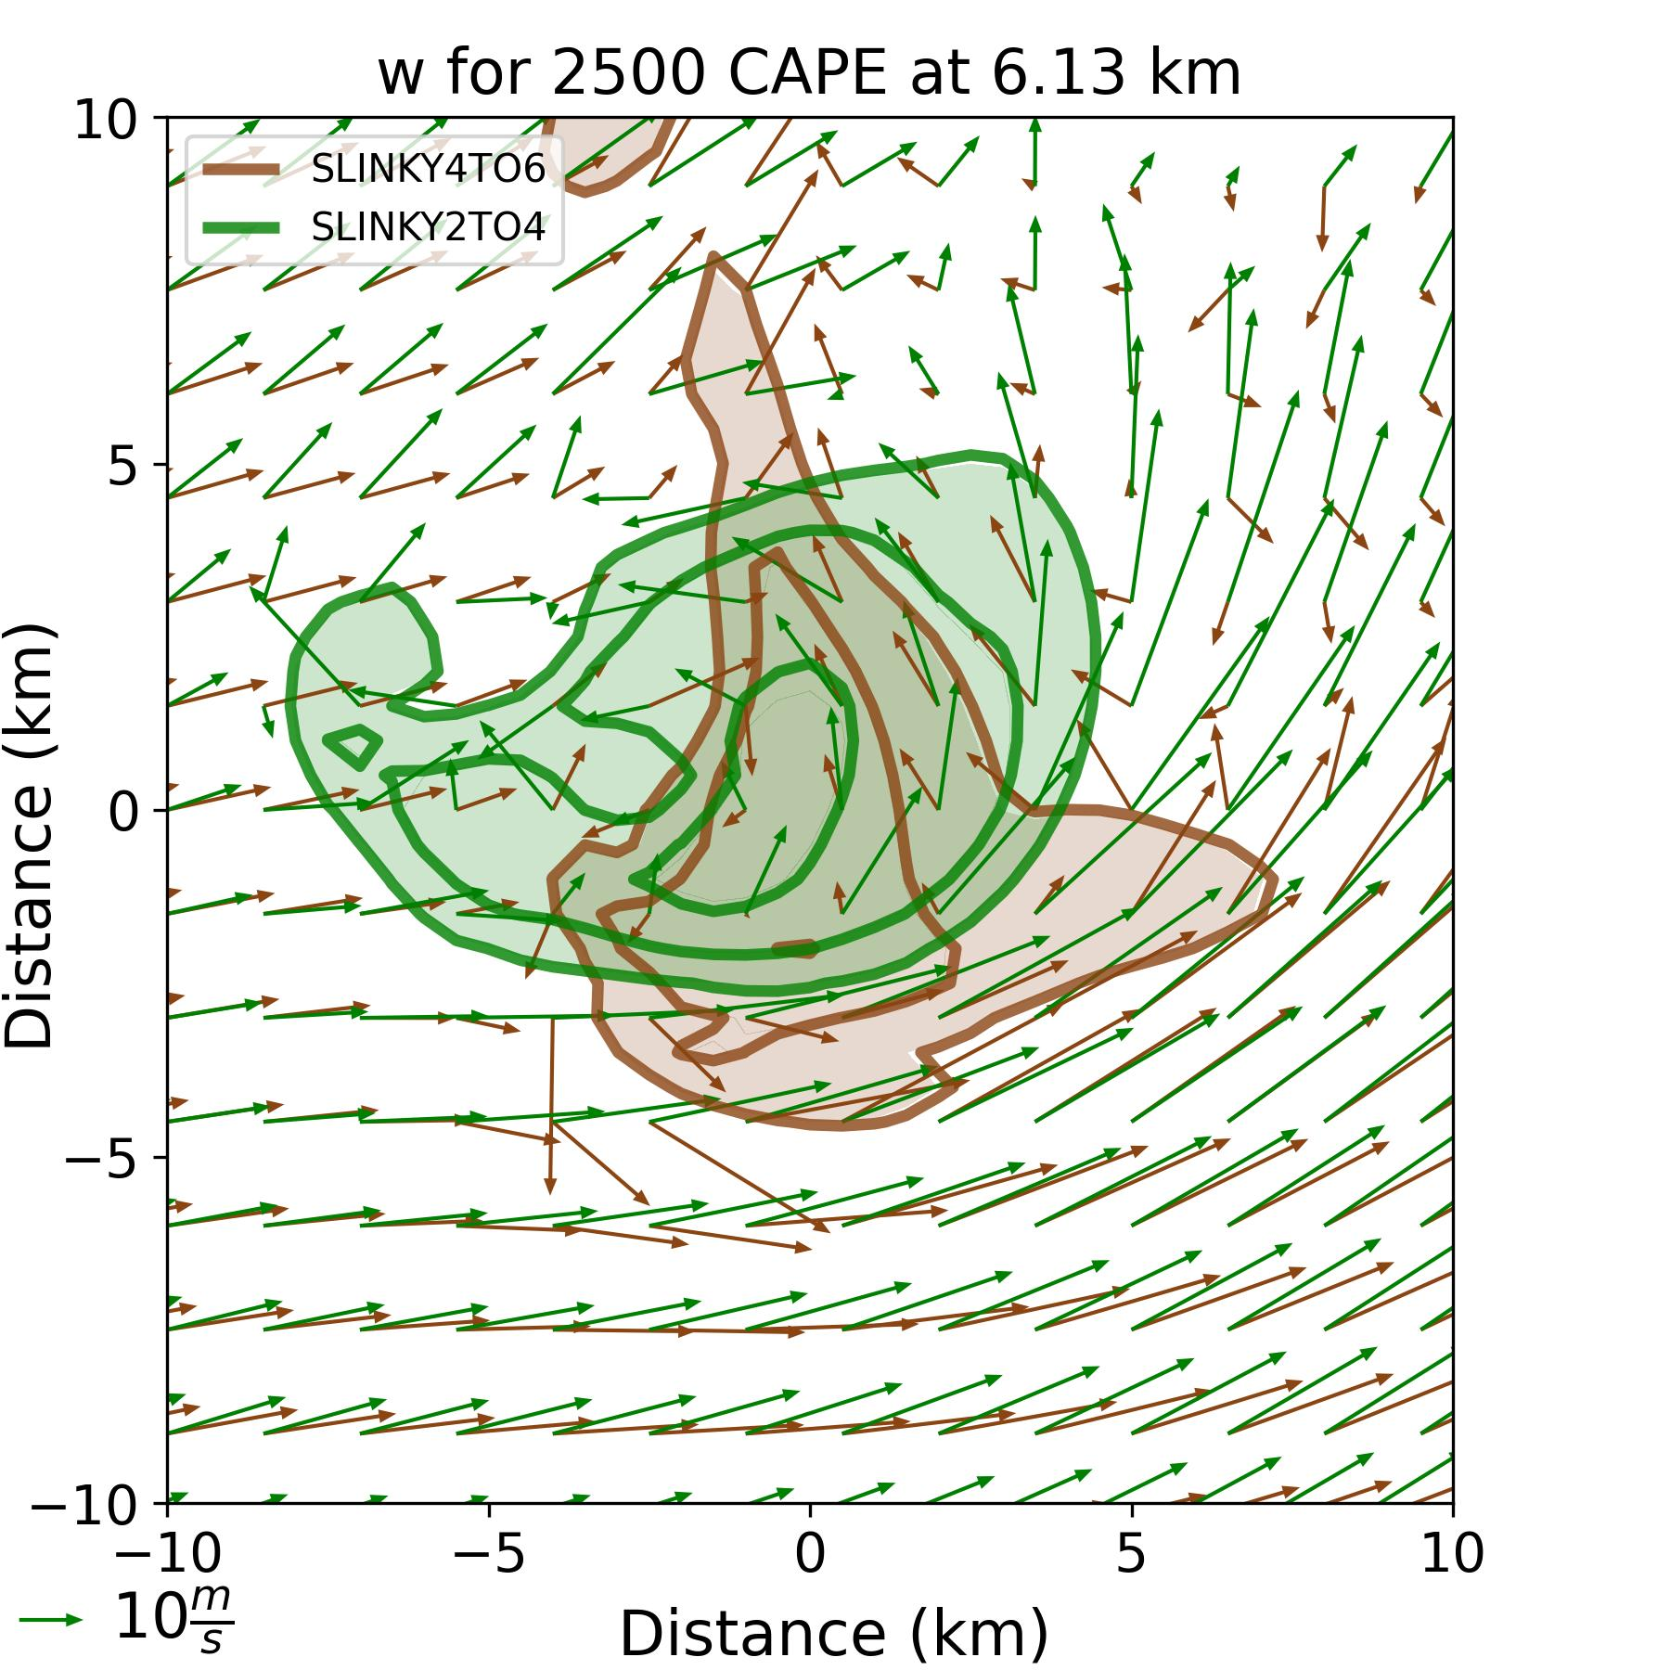
SLINKY 2-4 km Faster Southward Motion associated with Larger p’<0
SLINKY 2-4 km has larger area of p’< 0 and greater magnitude
(larger p_{nl-d}’ on the updraft southern flank due to larger vorticity)
SLINKY 4-6 km has smaller area of p’< 0 and smaller magnitude
SLINKY 2-4 km has larger
0-4 km SRW and v-SRW
w area and magnitude
SLINKY 4-6 km has smaller
0-4 km SRW and v-SRW
w area and magnitude
1-hr composite 4-8 km sum pressure perturbation (every 1 hPa)
and 6 km SRW for SLINKY 2-4 (teal) SLINKY 4-6 (orange)
1-hr composite 6 km vertical velocity (every 15 m s⁻¹)
and 6 km SRW for SLINKY 2-4 (green) and SLINKY 4-6 (brown)

Slide 22
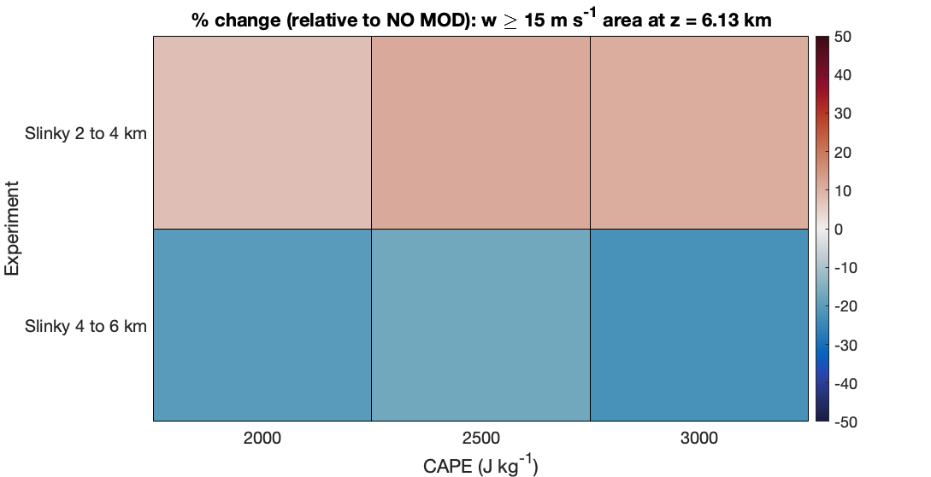
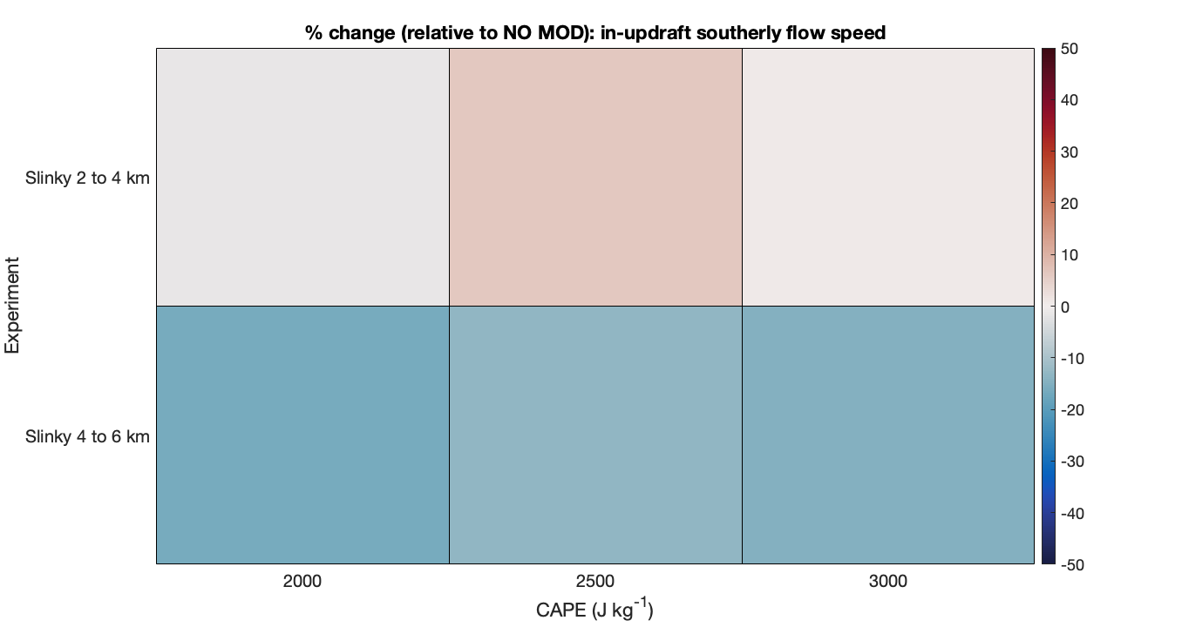
Larger Updraft Area Supports Greater Hail Production in SLINKY 2-4 km
change in updraft (>15 m s⁻¹) area compared to control (no modification storm)
SLINKY 2-4 km:
increase in updraft area +
smaller increase / minimal change in the in-updraft v-wind =
good for hail
SLINKY
2-4 KM
SLINKY
4-6 KM
2000 J kg⁻¹
2500 J kg⁻¹
3000 J kg⁻¹
red = increase
change in in-updraft v-wind compared to
control (no modification storm)
blue = decrease
SLINKY 4-6 km:
decrease in updraft area +
smaller decrease in the in-updraft v-wind =
bad for hail
SLINKY
2-4 KM
SLINKY
4-6 KM
2000 J kg⁻¹
2500 J kg⁻¹
3000 J kg⁻¹

Slide 23
SINE and SINE REVERSE

Slide 24
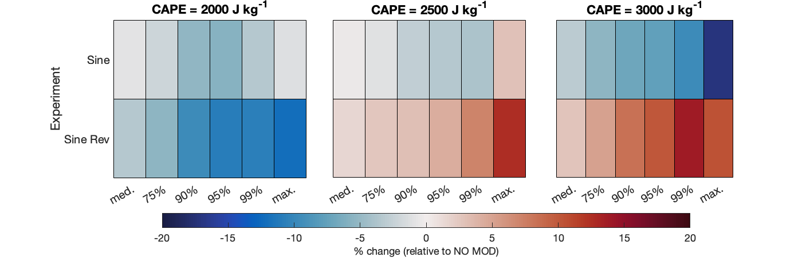
Tipping Point for SINE REVERSE, Dependent on CAPE
change in hail median, 75th percentile, 90th percentile, 95th percentile, 99th percentile, max sizes relative to the control (no modification)
SINE
SINE is
less favorable for hail production
SINE REVERSE
SINE REVERSE is
complicated!
low CAPE: less favorable for hail production than control
high CAPE: more favorable for hail production than control
blue = decrease in hail size
red = increase in hail size

Slide 25
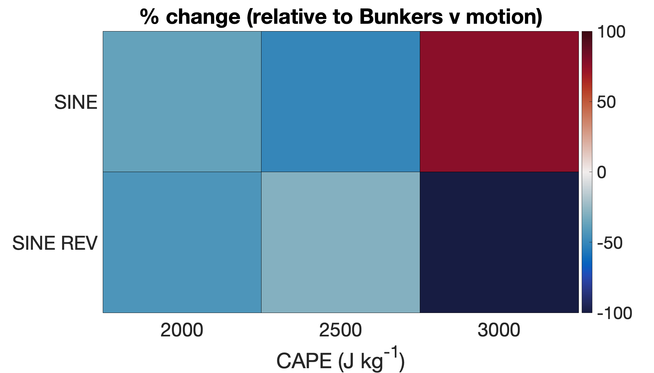
Predicted U and V Motion Similar Among Experiments
Bunkers motion | u-component | v-component
No modification | 14.93 | -1.22
SINE | 14.66 | -1.26
SINE REVERSE | 15.20 | -1.16
Bunkers motion (Bunkers et al. 2000) predicts minimal change in u-motion and v-motion for the sensitivity experiments as compared to control hodograph
difference between actual storm v-motion
and Bunkers predicted v-motion
red = storm moves less southward than Bunkers
See deviations in v-motion, magnitude and sign vary with CAPE
SINE has larger negative v, except for CAPE 3000 J kg⁻¹ → moves southward (overall) slower
SINE REVERSE had larger negative v, especially for CAPE 3000 J kg⁻¹ → moves southward (overall) faster
blue = storm moves more southward than Bunkers

Slide 26
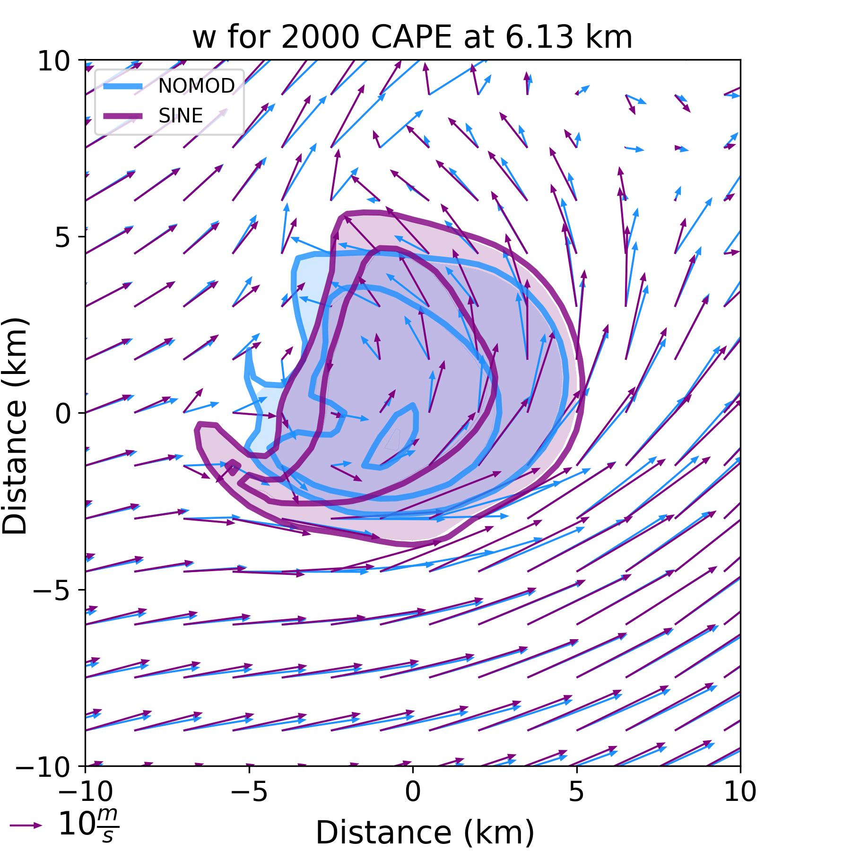
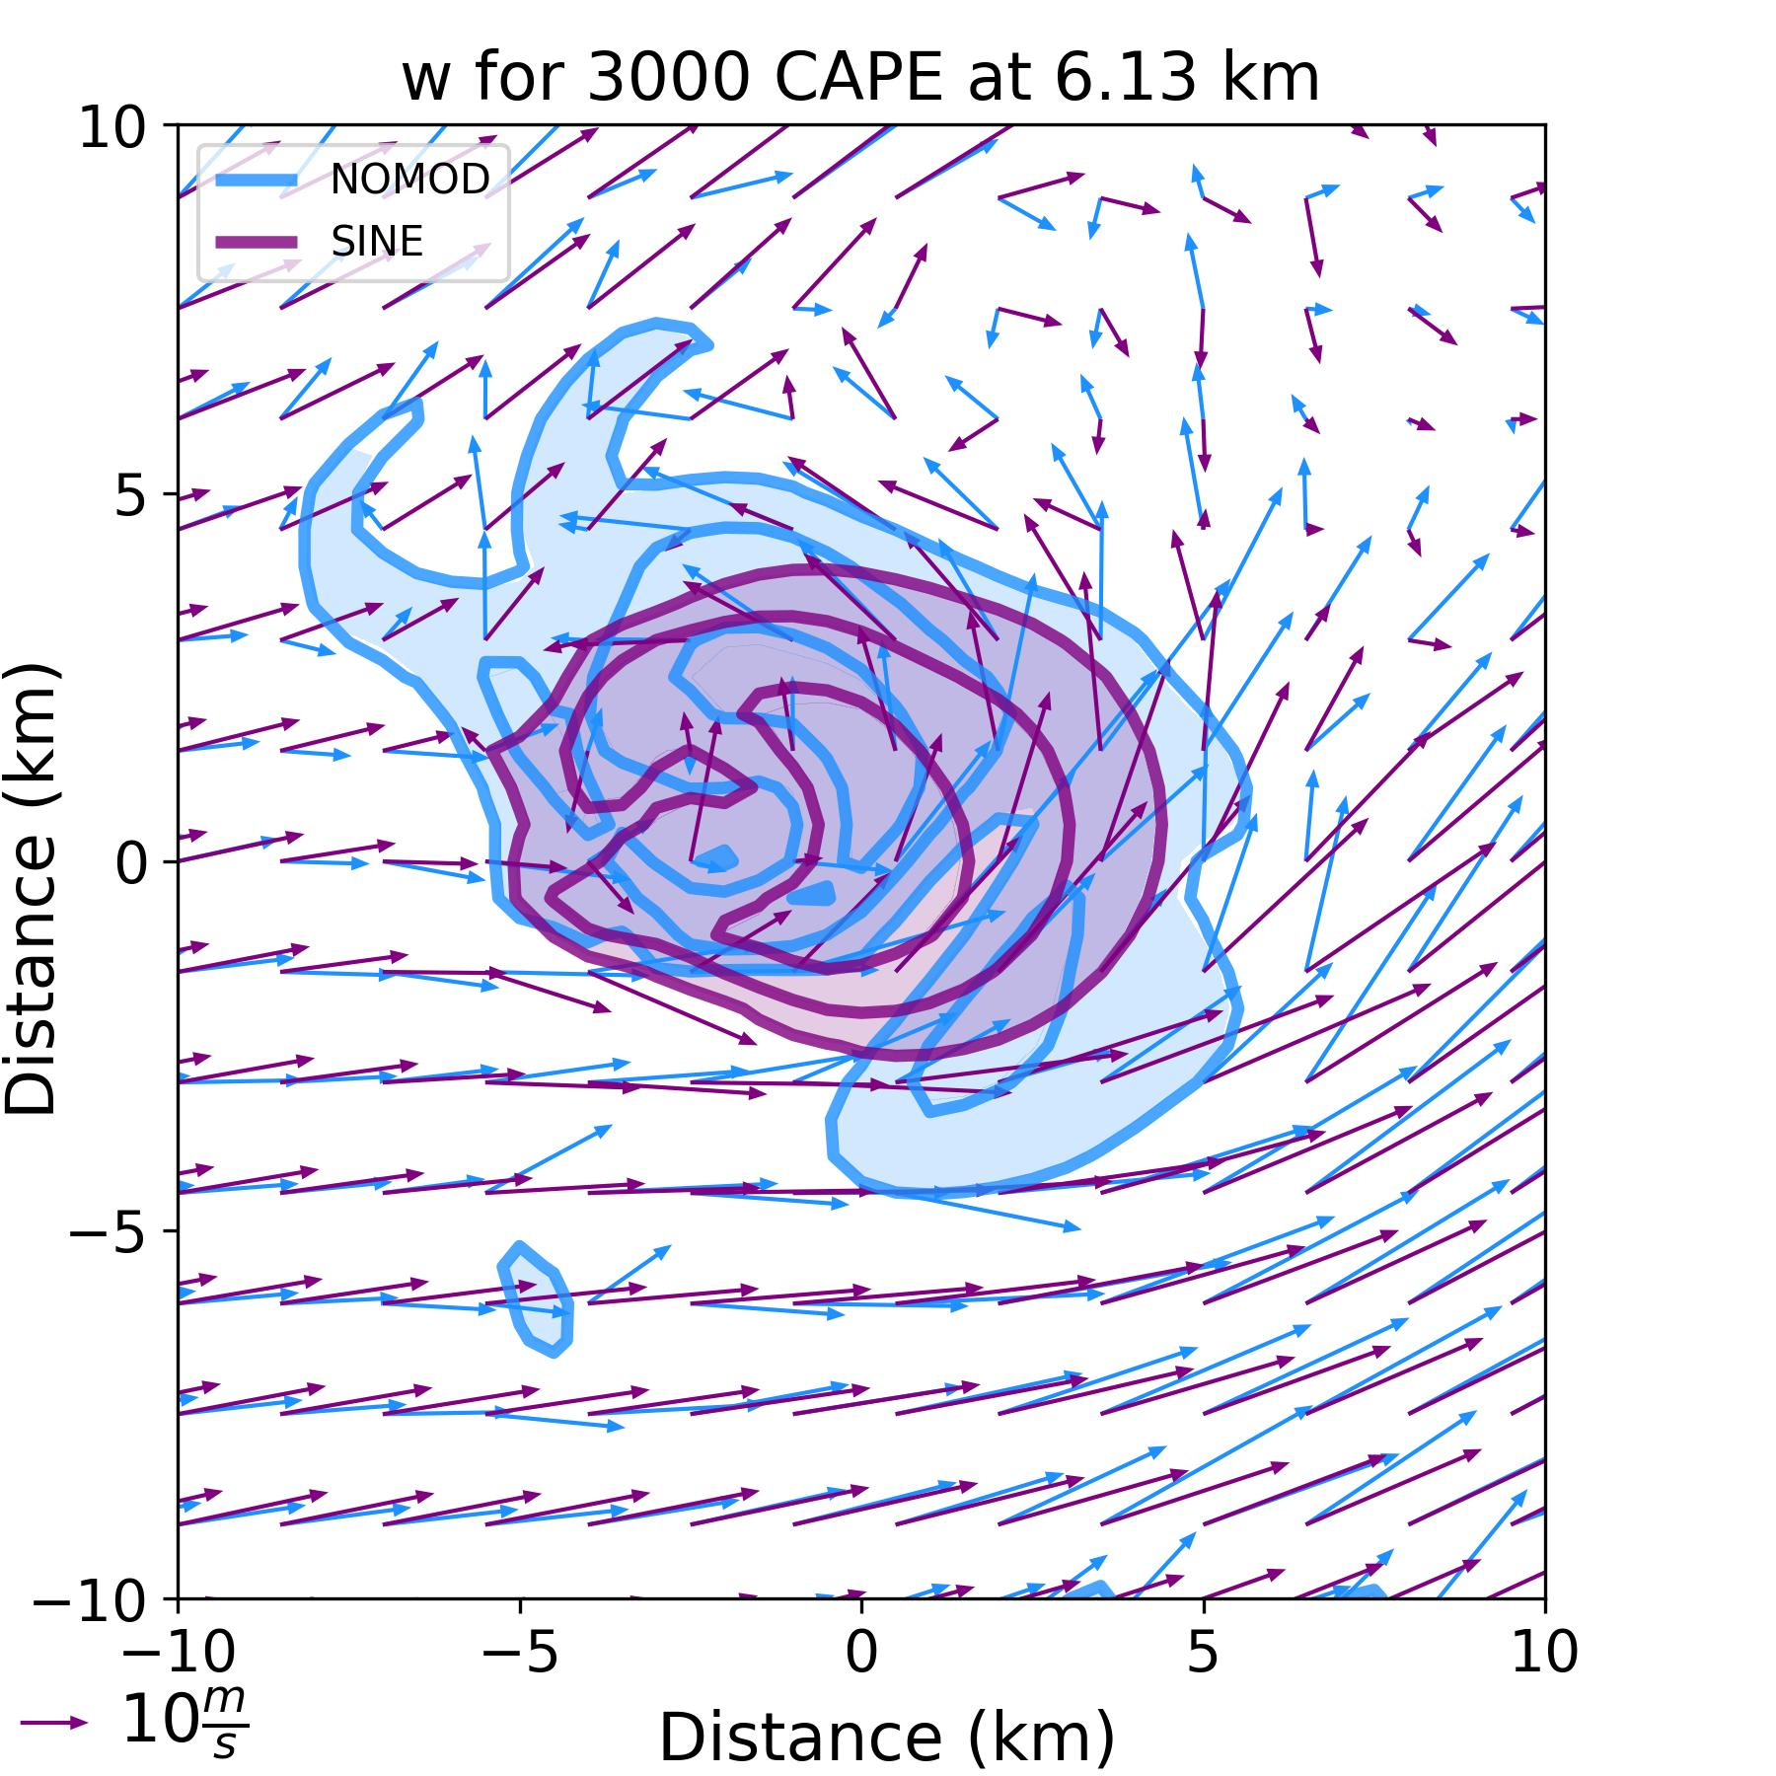
Larger Southward Motion Supports Wider Updraft for Lower CAPE
SINE EXPERIMENTS
In lower CAPE (2000 J kg⁻¹) environment, faster southward motion → larger 0-3 km SRW → wider updrafts
In higher CAPE (3000 J kg⁻¹) environment, slower southward motion → smaller 0-3 km SRW → narrower updrafts
Regardless of storm speed, both have larger in-updraft v-wind due to experiment design
1-hr composite 6 km vertical velocity (every 15 m s⁻¹) and 6 km SRW
for SINE (purple) & CONTROL (blue)
SINE hodograph
2000 J kg⁻¹
3000 J kg⁻¹

Slide 27
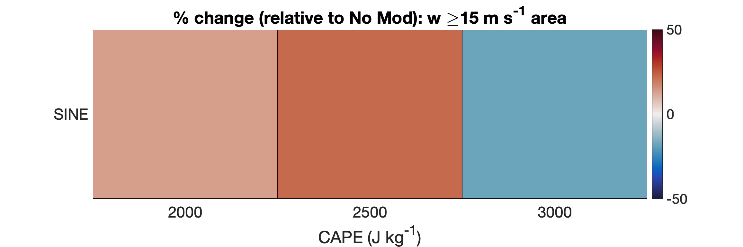
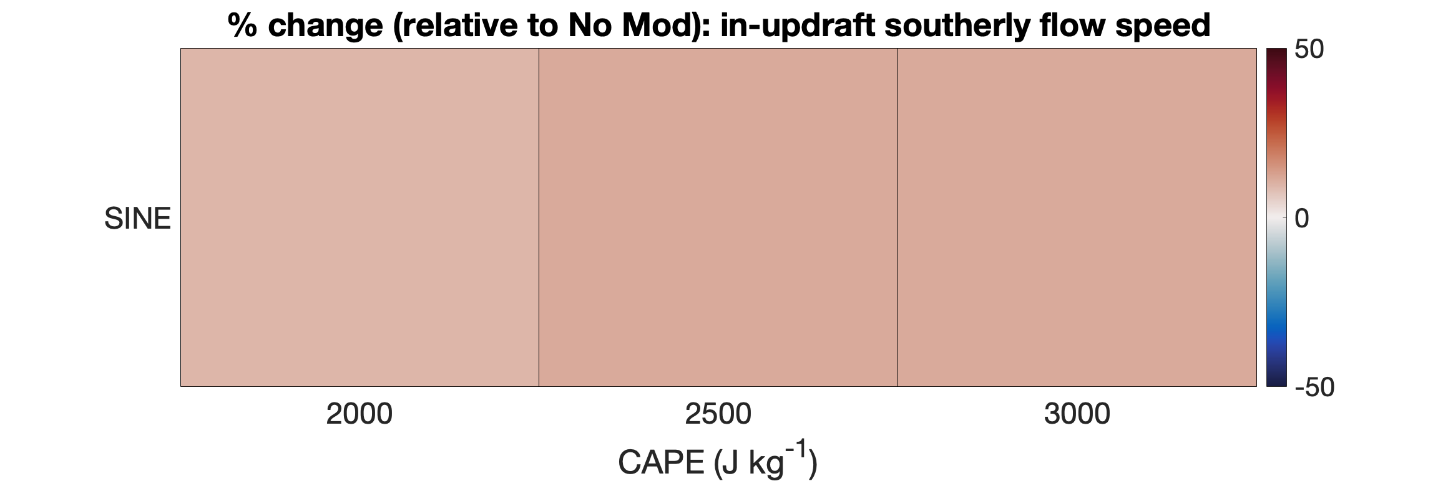
Larger In-Updraft V-Wind Suppresses Hail Production
change in updraft (>15 m s⁻¹) area compared to
control (no modification storm)
SINE 2000 J kg⁻¹:
increase in updraft area +
increase in the in-updraft v-wind =
bad for hail
red = increase
blue = decrease
change in the in-updraft v-wind compared to
control (no modification storm)
SINE 3000 J kg⁻¹:
decrease in updraft area +
increase in the in-updraft v-wind =
very bad for hail
SINE
REVERSE

Slide 28
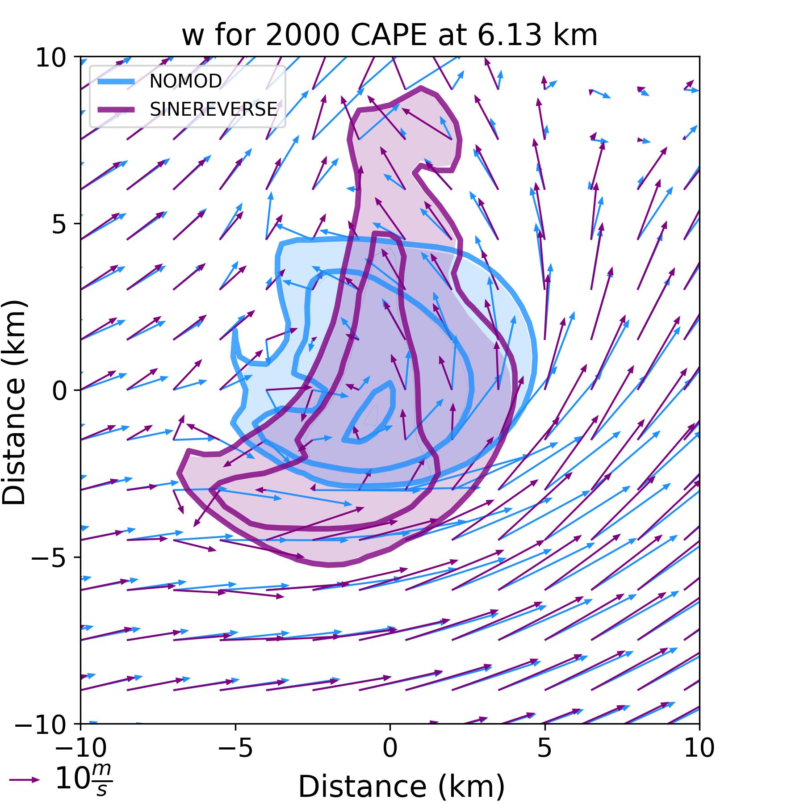
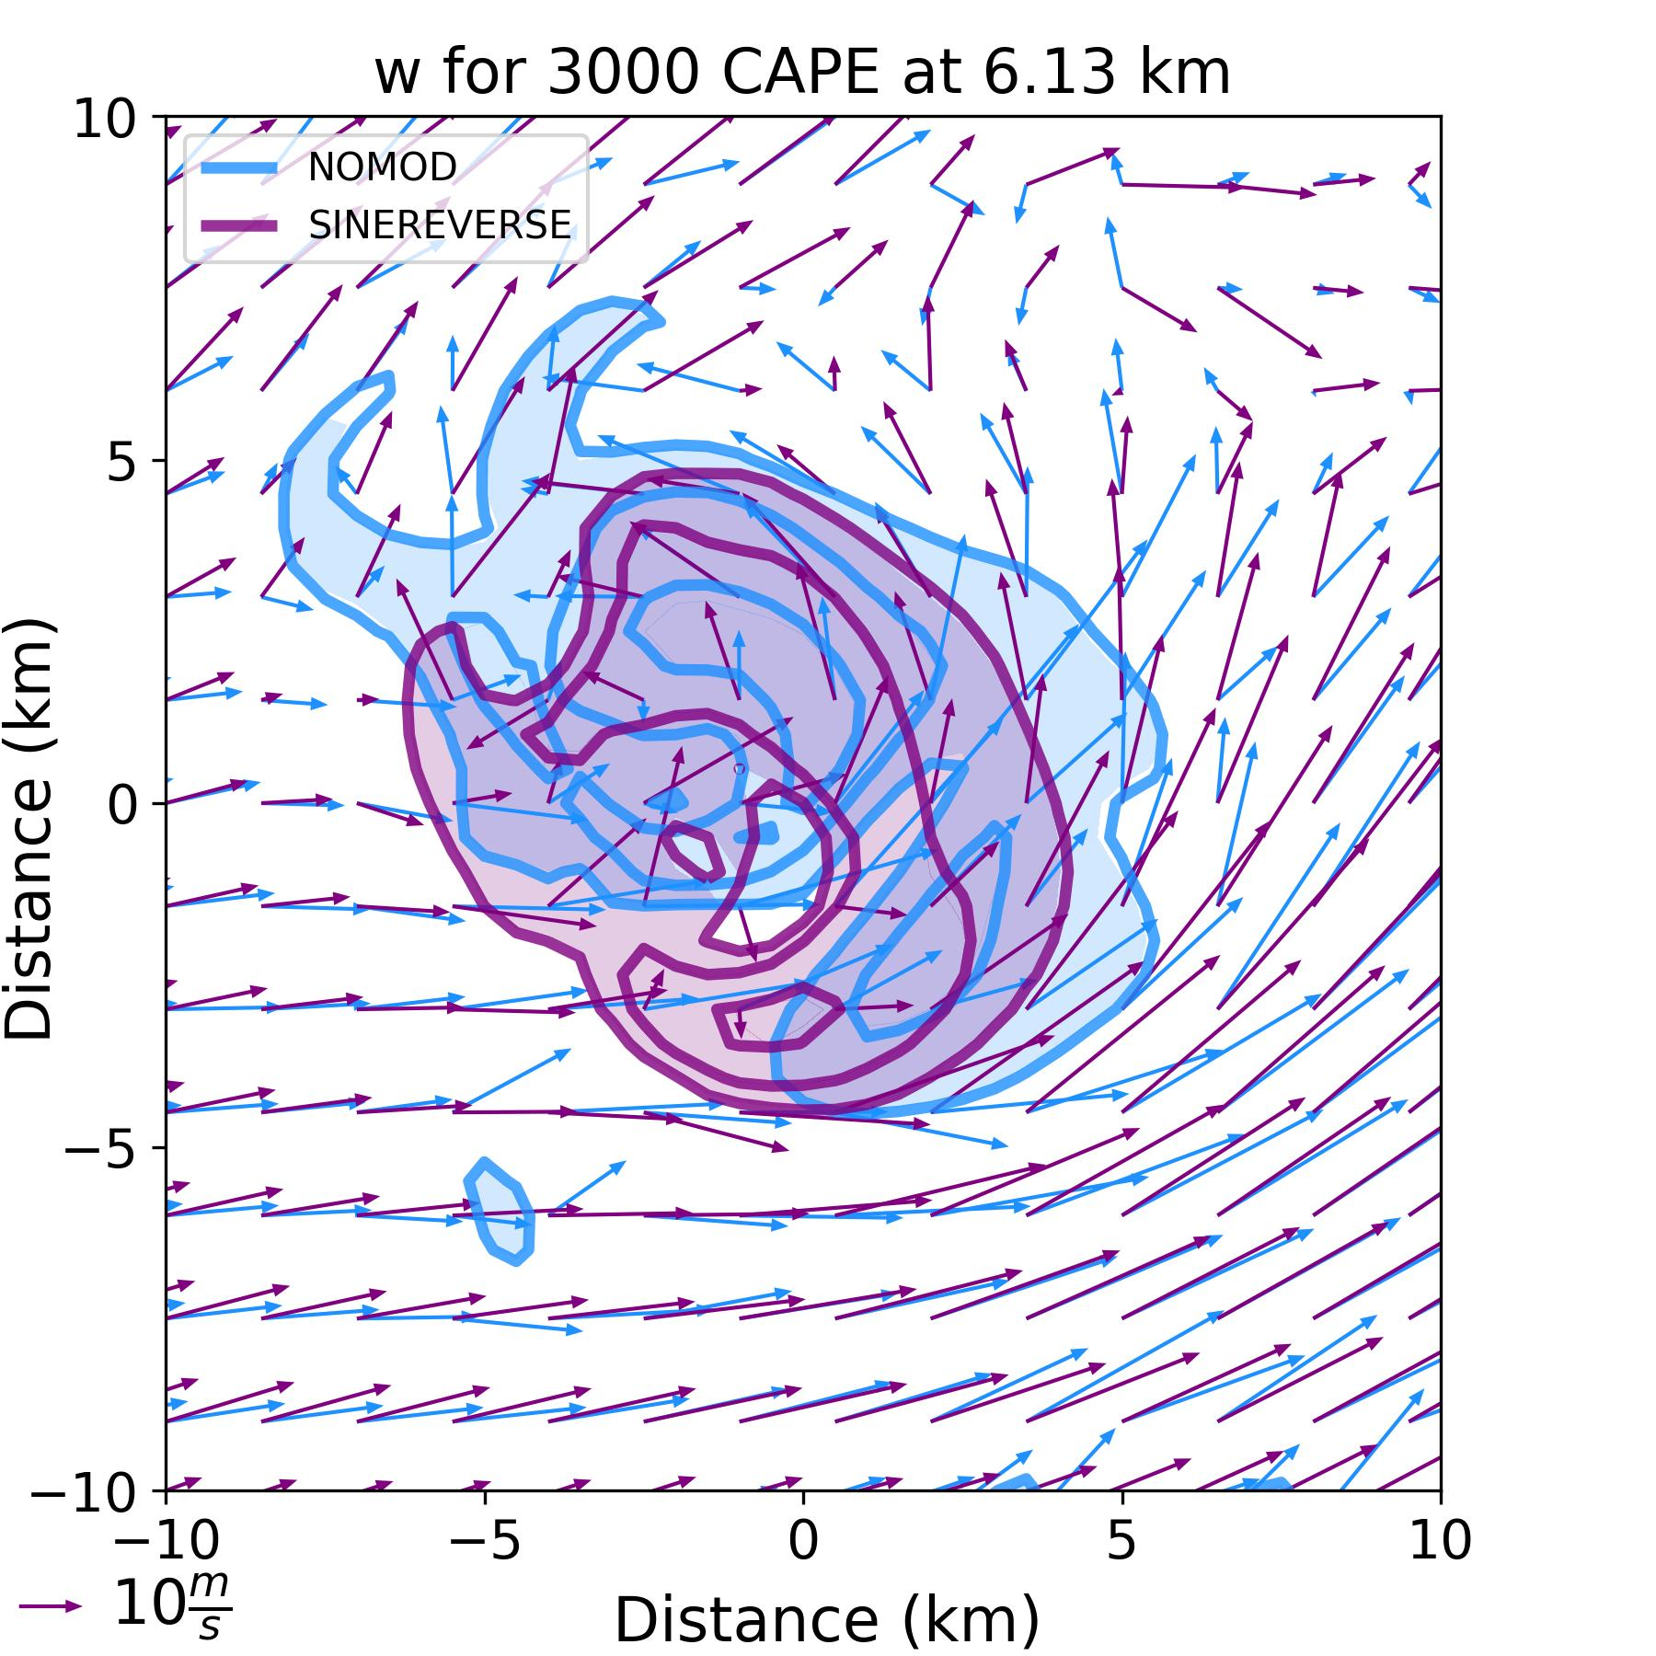
Reduced 2-4 km V-Wind Favors Hail Production
SINE REVERSE EXPERIMENT
In lower CAPE (2000 J kg⁻¹) and higher CAPE (3000 J kg⁻¹) environments, faster southward motion → larger 0-3 km SRW
lower CAPE (2000 J kg⁻¹) → wider updrafts
higher CAPE (3000 J kg⁻¹) → no change (possibly due to slightly smaller 0-3 km SRW magnitude?)
Regardless of speed of storm, both have smaller in-updraft v-wind due to experiment design
6 km vertical velocity (every 15 m s⁻¹) and 6 km SRW
for SINE REVERSE (purple) & CONTROL (blue)
SINE REVERSE hodograph
2000 J kg⁻¹
3000 J kg⁻¹

Slide 29
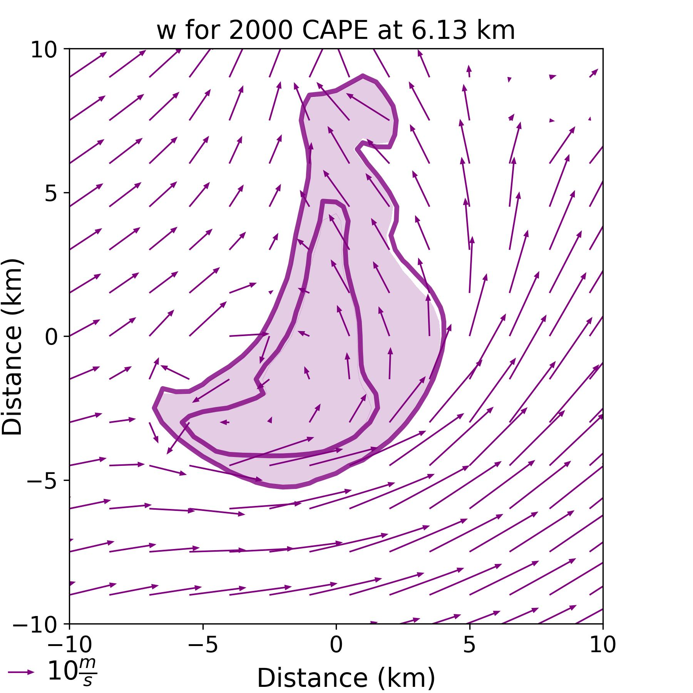
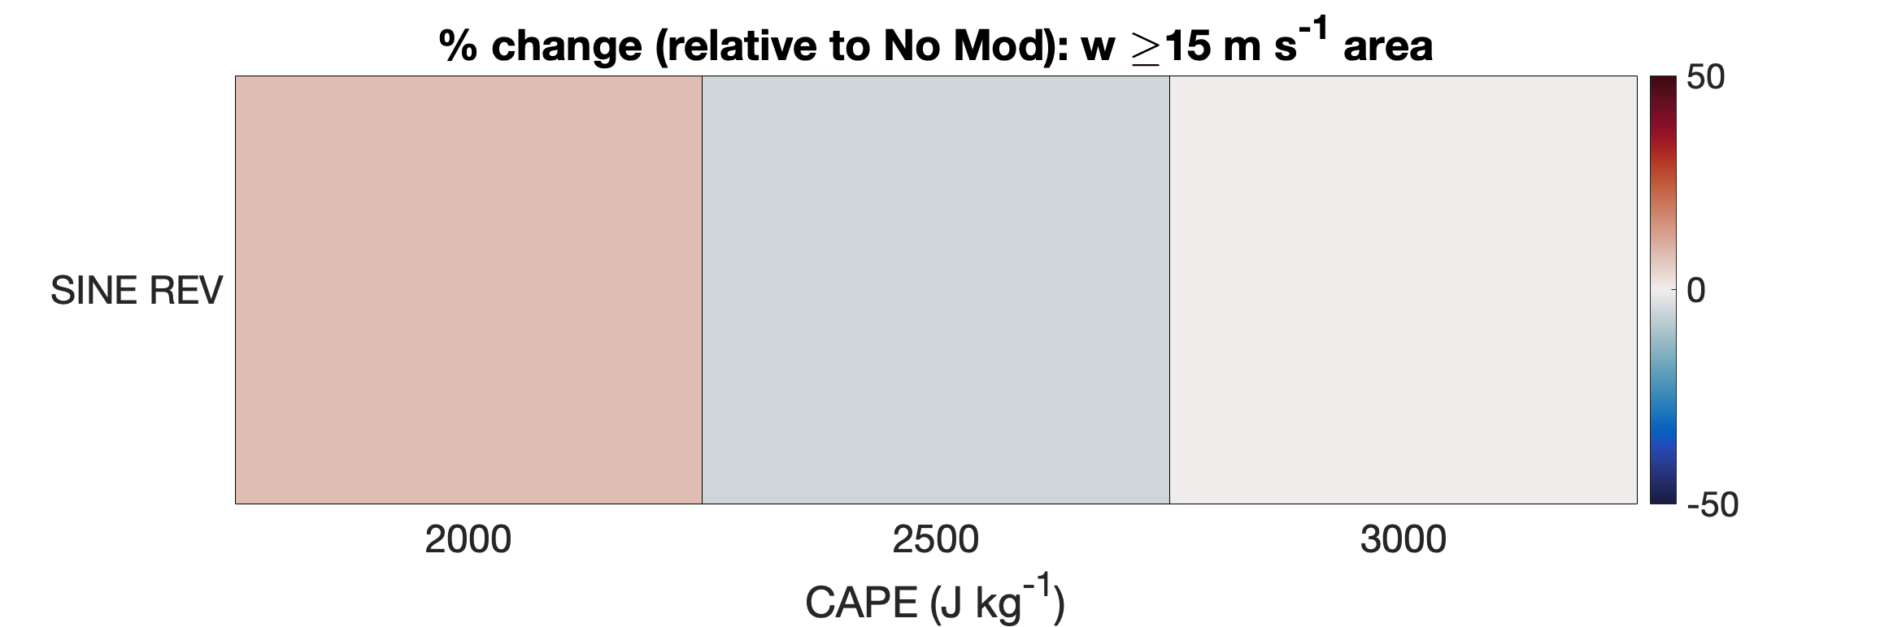
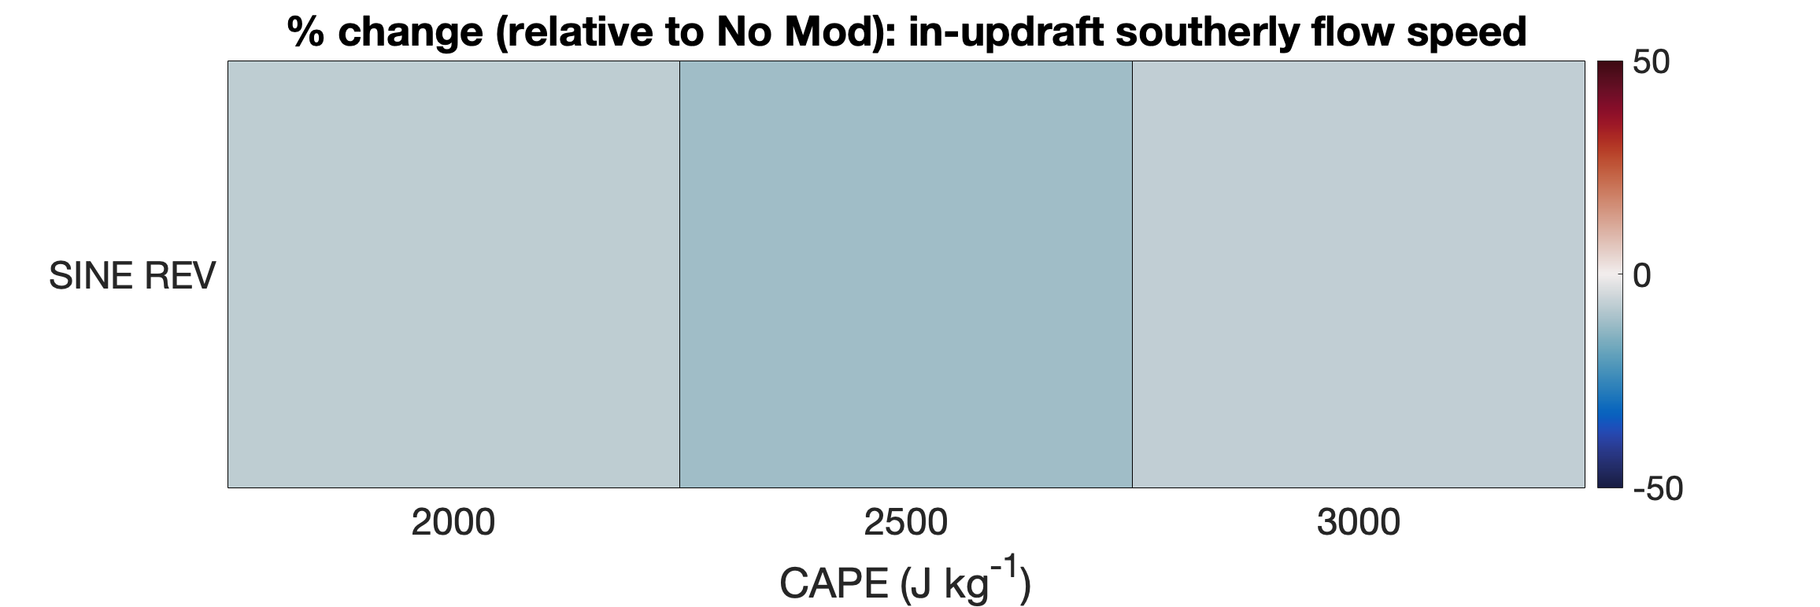
Updraft Size and Shape Matter
change in updraft (>15 m s⁻¹) area compared to
control (no modification storm)
SINE REVERSE 2000 J kg⁻¹:
increase in updraft area (but the shape is elongated) +
decrease in the in-updraft v-wind =
shape bad for hail
red = increase
blue = decrease
change in the in-updraft v-wind compared to
control (no modification storm)
SINE REVERSE 3000 J kg⁻¹:
minimal change in updraft area +
decrease in the in-updraft v-wind =
good for hail
SINE
REVERSE

Slide 30


Summary
SLINKY EXPERIMENTS: CHANGING THE U-SHEAR
Larger 2-4 km u-shear supports larger low-level SRW (faster southward storm motion) and wider updrafts
Increase in the in-updraft v due to larger p_{nl-d}’ not detrimental
Smaller 2-4 km u-shear supports smaller low-level SRW (slower southward storm motion) and narrower updrafts
SLINKY 2-4 KM
SLINKY 4-6 KM
SINE EXPERIMENTS: CHANGING THE V-SHEAR
Larger 2-4 km v-wind supports larger in-updraft v-wind
For storms moving more slowly southward, reduction in in-updraft v-wind cannot compensate for narrower updraft
Smaller 2-4 km v-wind supports smaller in-updraft v-wind
Reduced in-updraft v-wind not enough when updraft is less steady (low CAPE = wonky shape)
SINE
SINE REVERSE
lower CAPE
higher CAPE

