Slide 1



Object-based radar hail (-size) detection in Switzerland
scClim
Martin Aregger ^{1,2}, Olivia Martius ^{1,2}, Alessandro Hering ³ & Urs Germann ³
¹ Oeschger Centre for Climate Change Research, Bern, Switzerland
² Institute of Geography, University of Bern, Switzerland
³ MeteoSwiss, Locarno-Monti, Switzerland

Slide 2
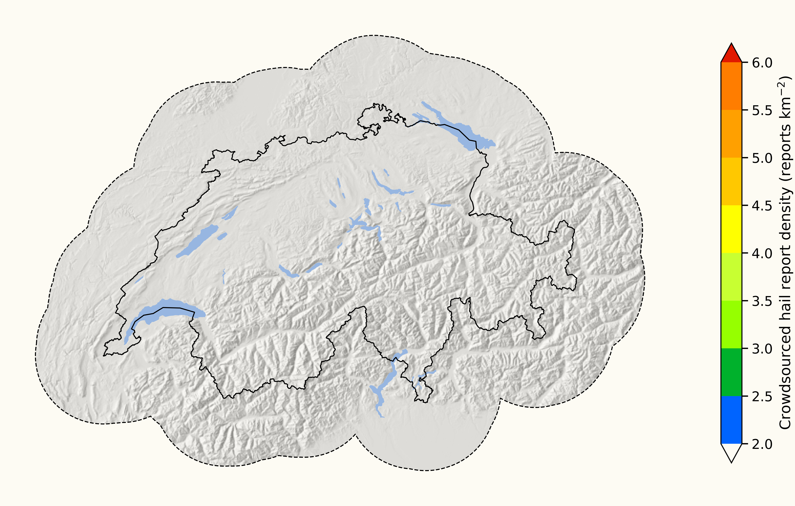
Why now?
Study Area

Slide 3
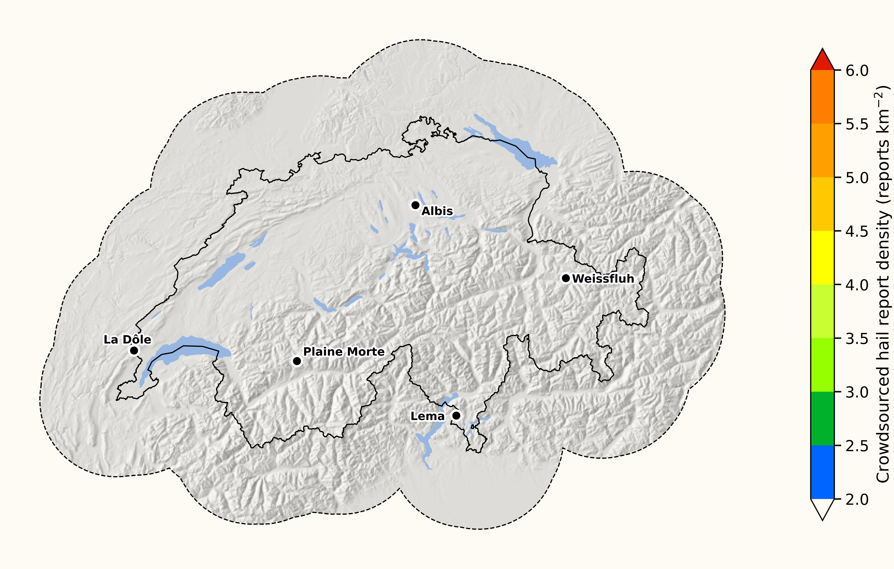
Why now? – Improved and more radars
Study Area
5 dual-pol radars vs 3 single-pol (2016)

Slide 4
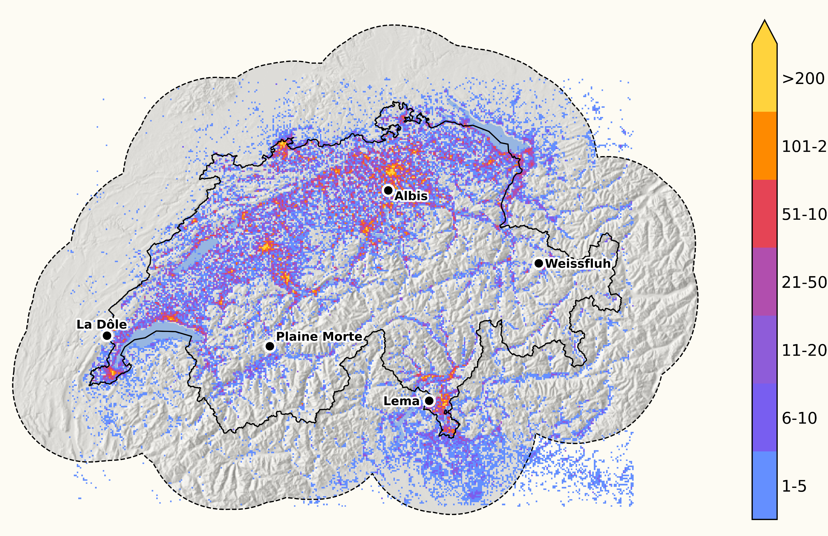
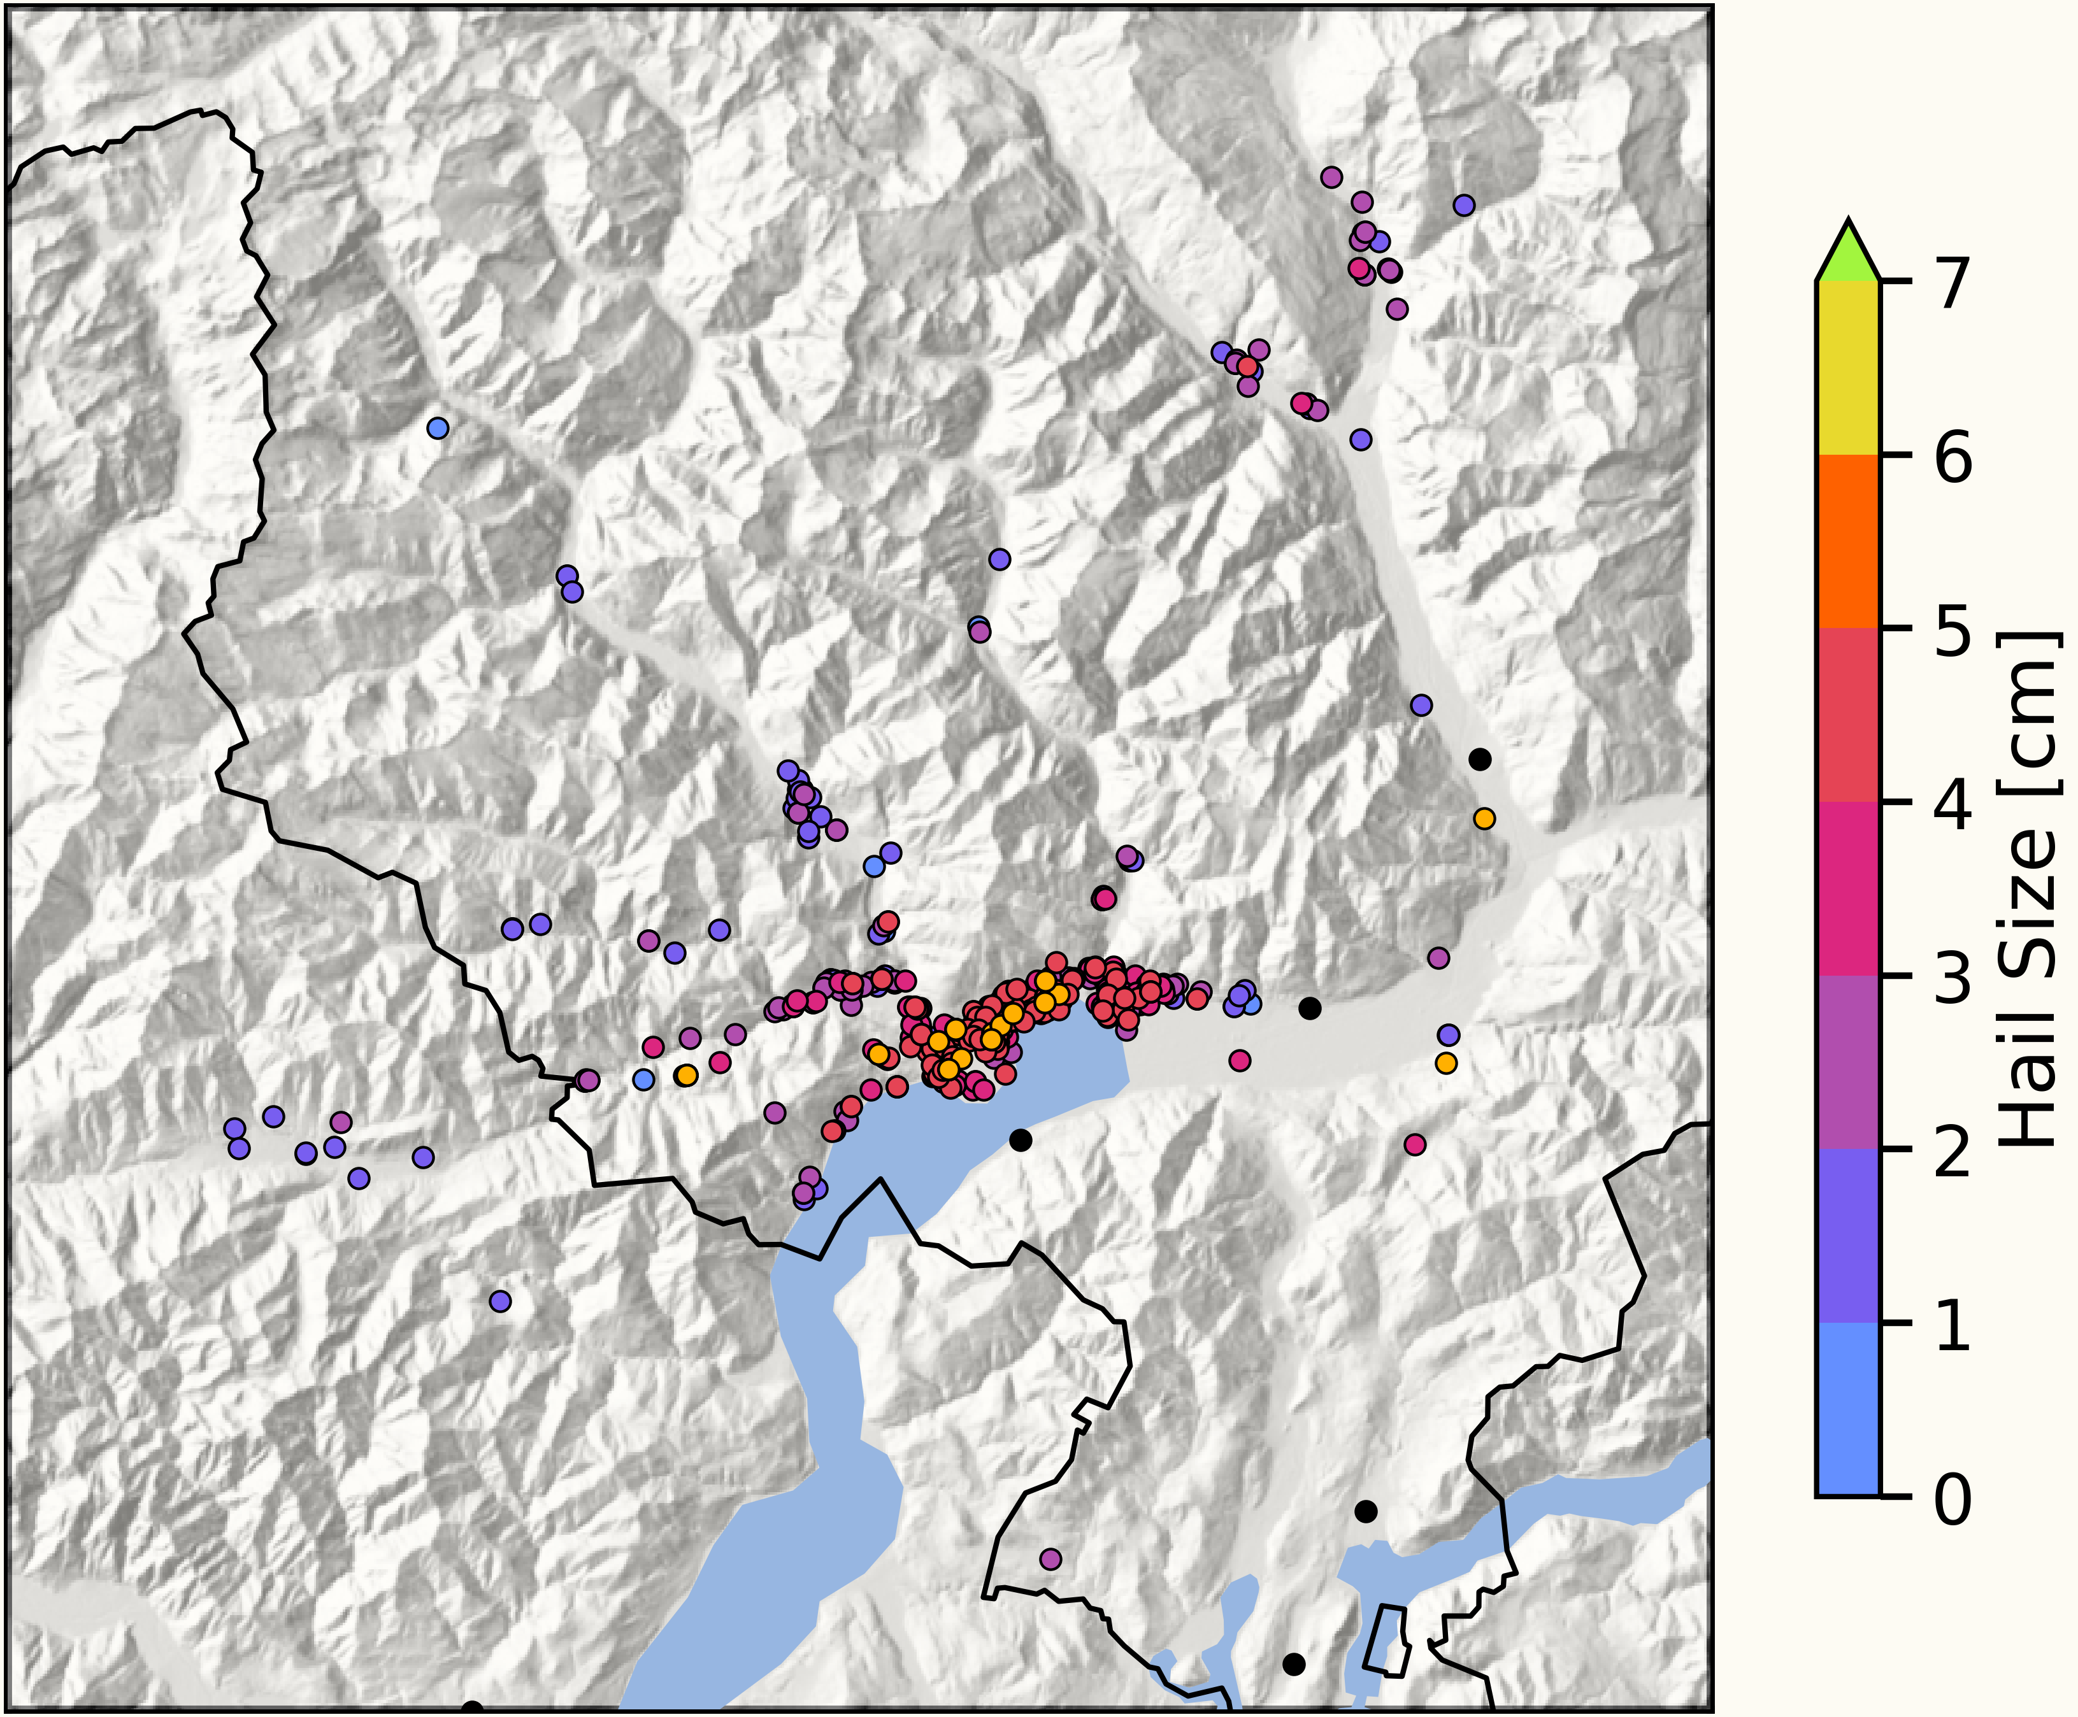
Why now? – Vastly more surface observations
Study Area
5 dual-pol radars vs 3 single-pol (2016)
Crowdsourced Reports
Reports per km²

Slide 5
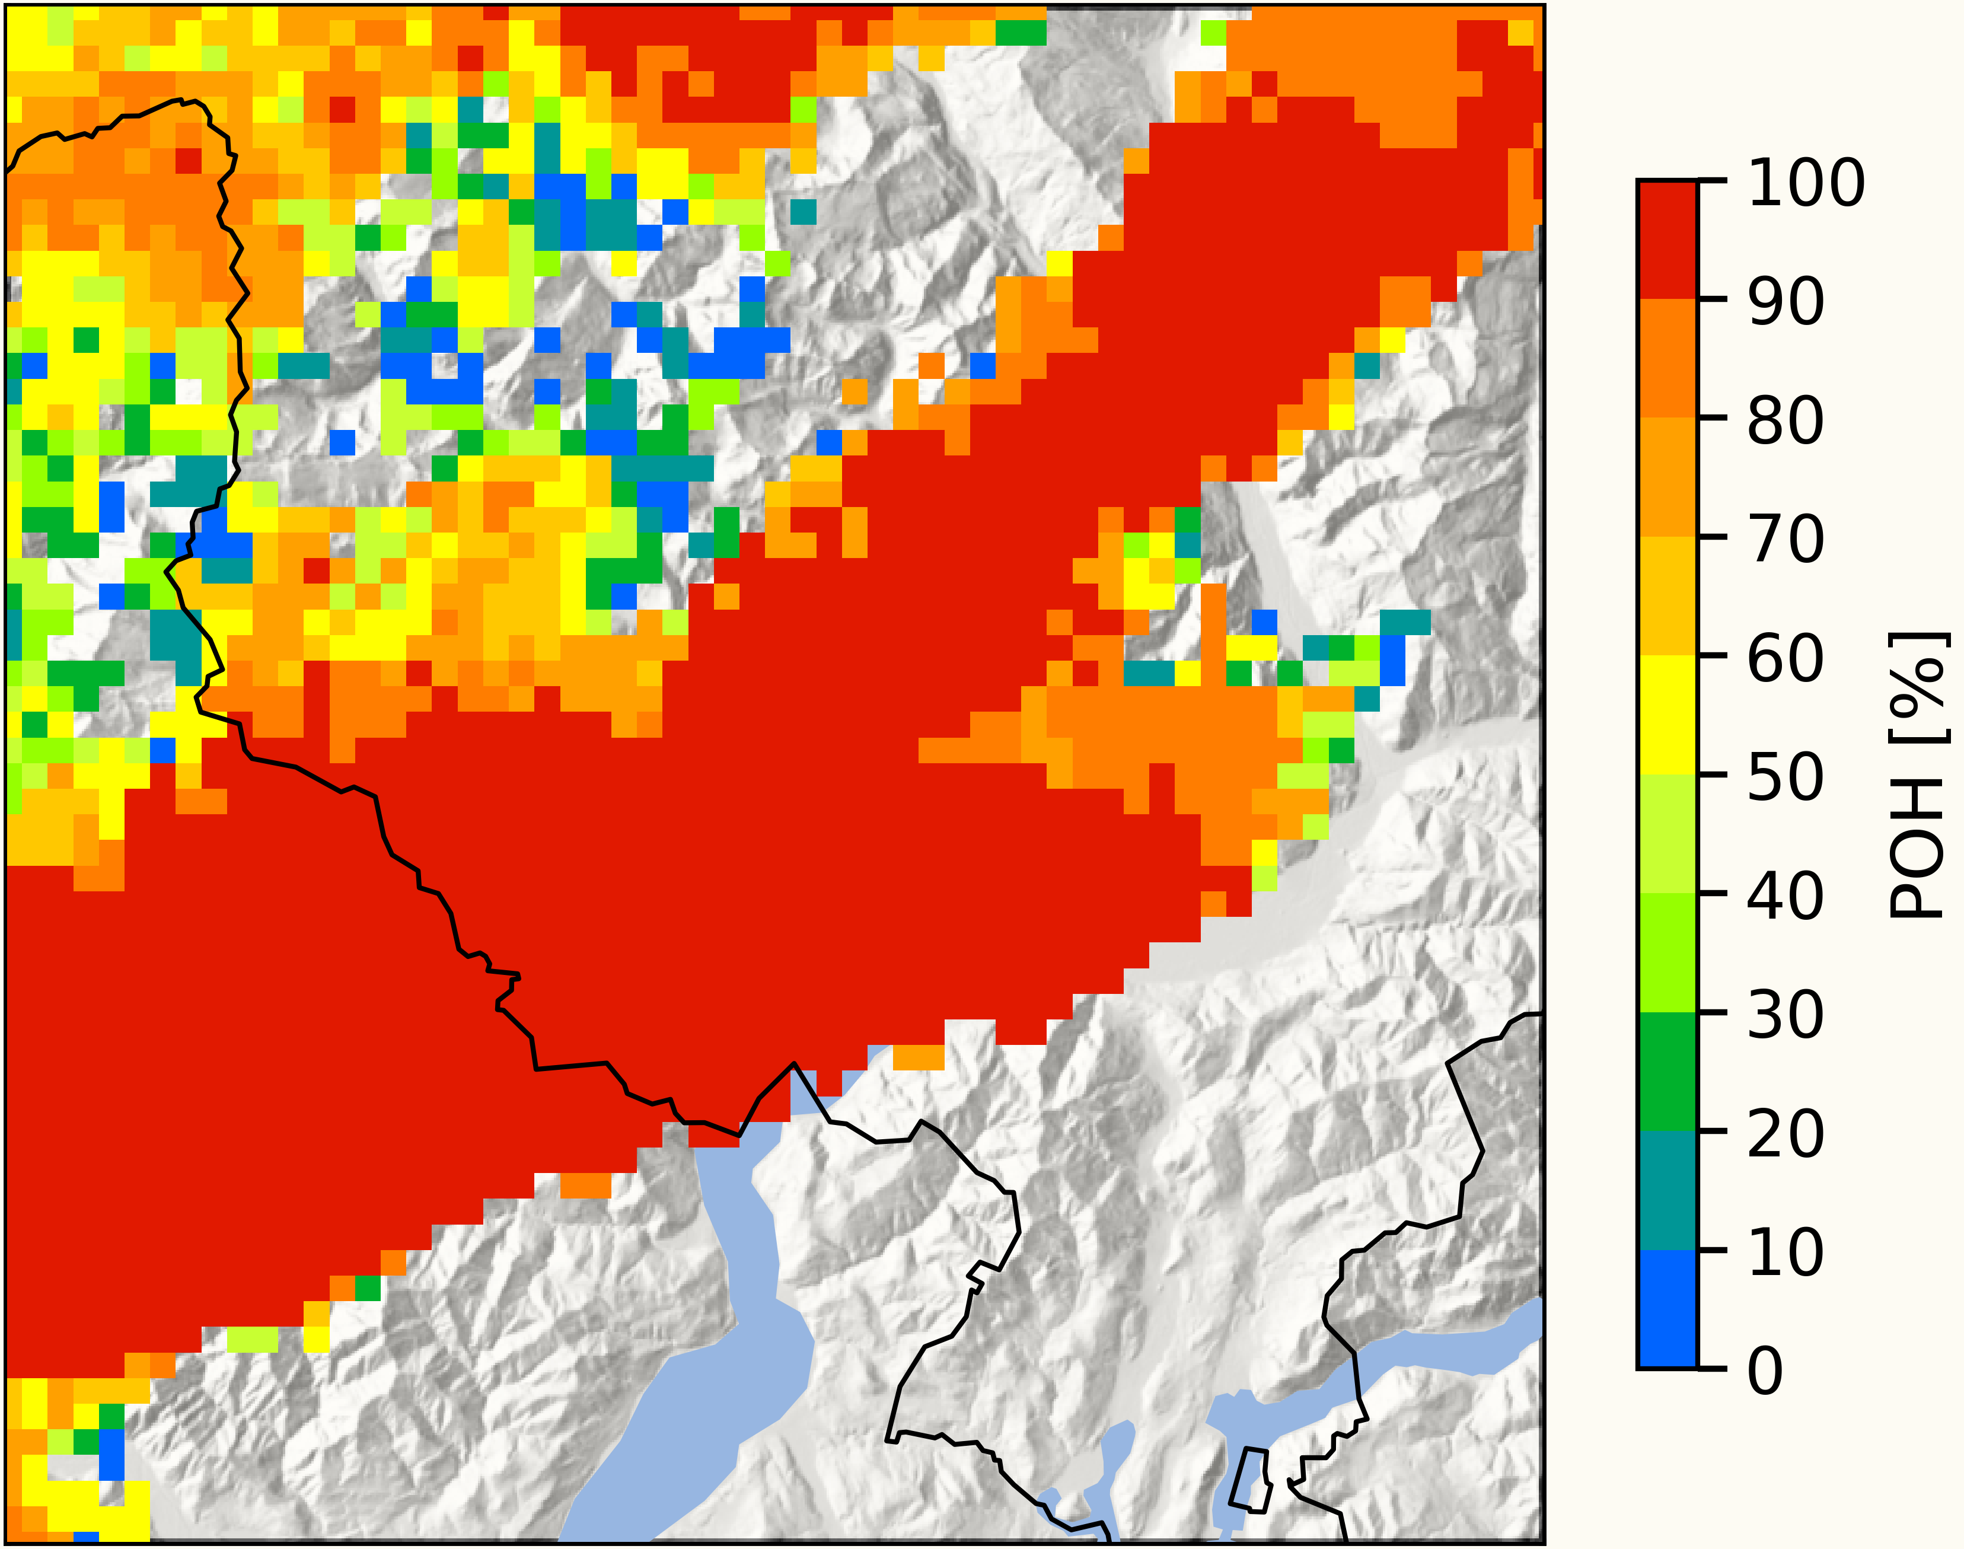
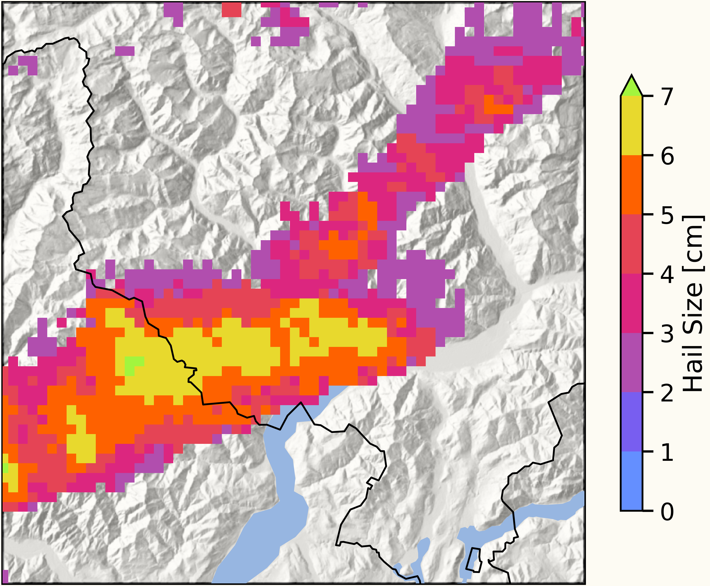
What is the status quo of radar-based hail detection in Switzerland?
Q: Can we improve hail detection and sizing compared to POH & MESHS
Probability of Hail (POH) (e.g., Joe et al. 2004)
Based on: EchoTop45 – height of H₀
25th of August 2023
5+ cm Hail
Maximum Expected Severe Hail Size (MESHS) (e.g., Treloar 1998)
EchoTop 50 – height of H₀

Slide 6
Which approach should we use?

Slide 7
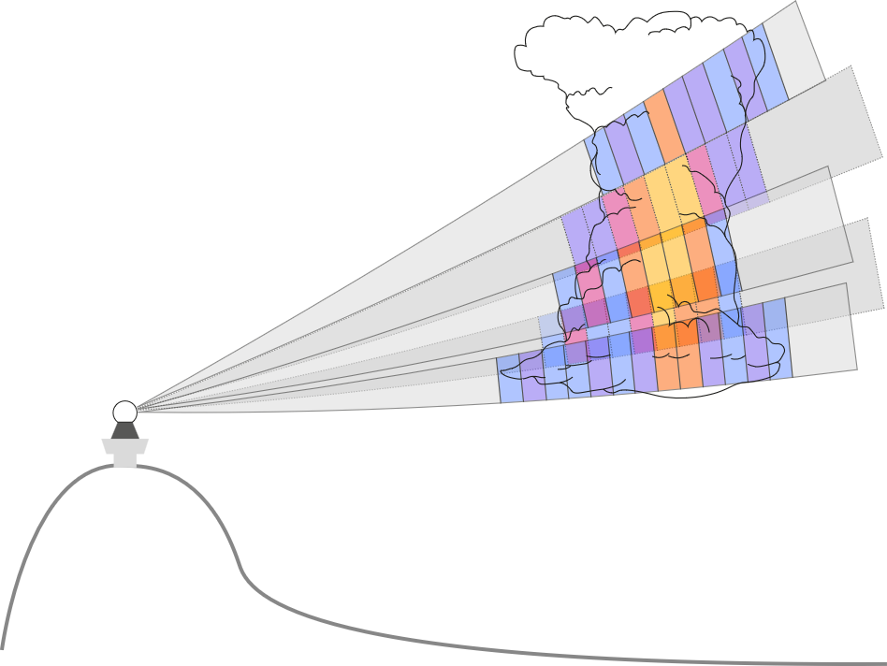
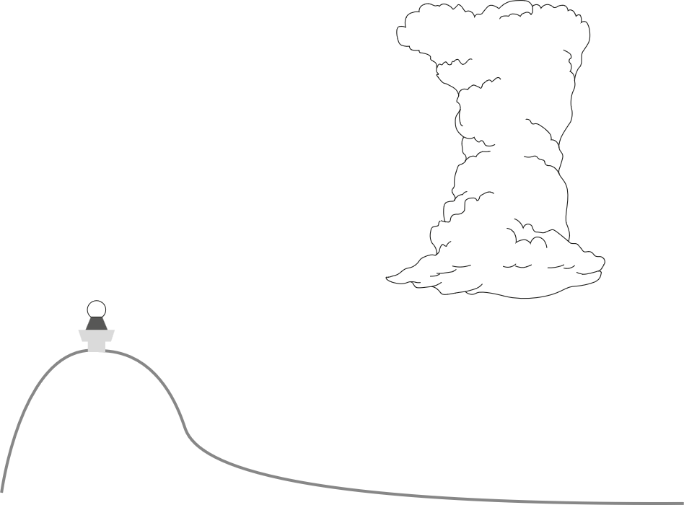
Which approach should we use?

Slide 8
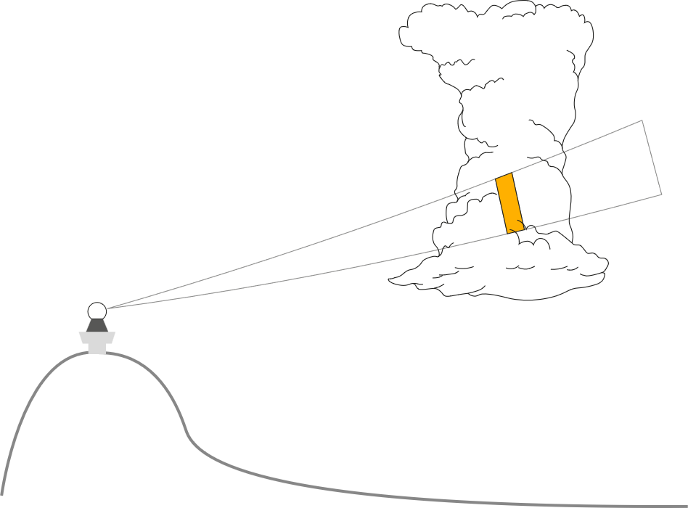
Direct detection of hail
Z_{H} > 55 dBZ
(e.g., Geotis 1963)
Z_{H}, Z_{DR}
Hail Differential Reflectivity (H_{DR})
(Aydin et al. 1986)
Z_{H}, Z_{DR}, K_{DP} , ρ_{HV}, T
Hydrometeor Classification (HC)
(Besic et al. 2016)
Notes:
Scattering simulations

Slide 9
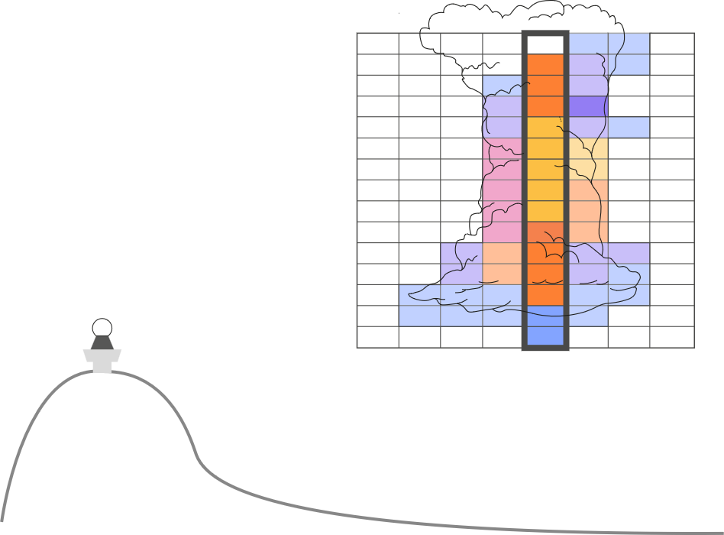
Indirect detection of hail
MESHS, POH, MESH, VIL
(e.g., Joe et al 2004, Witt et al. 1998)
Notes:
Scattering simulations

Slide 10

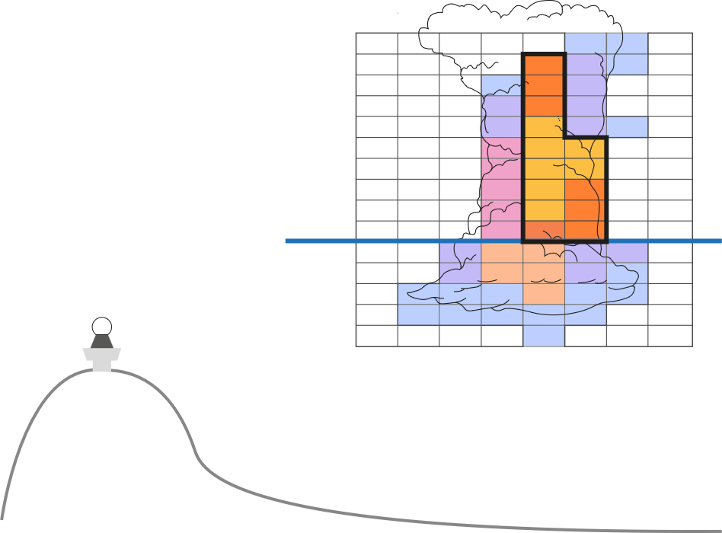
Indirect detection of hail
MESHS, POH, MESH, VIL
(e.g., Joe et al 2004, Witt et al. 1998)
Z_{DR} Column Characteristics
(e.g., Aregger et al. 2025)
Notes:
Scattering simulations

Slide 11

Indirect detection of hail
Data-driven approach:
Train Random Forest (RF) models
Use predictor importance methods
MESHS, POH, MESH, VIL
(e.g., Joe et al 2004, Witt et al. 1998)
Z_{DR} Column Characteristics
(e.g., Aregger et al. 2025)
Notes:
Scattering simulations

Slide 12
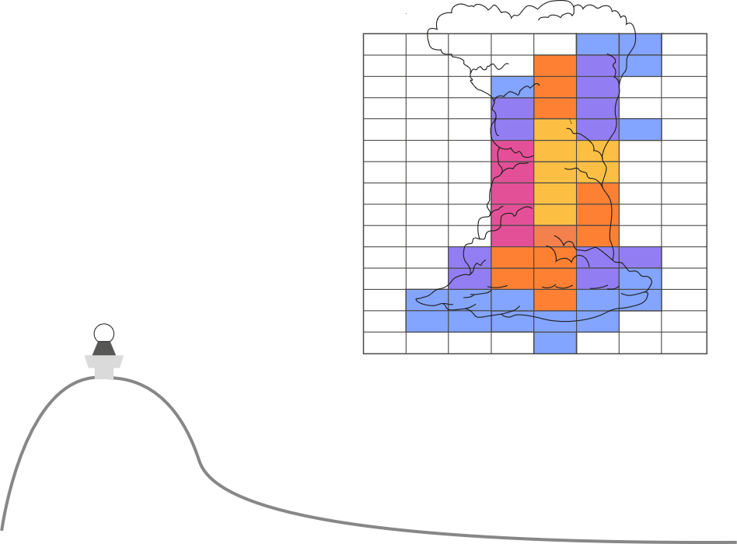
So what approach do we take?

Slide 13

So what approach do we take?

Slide 14

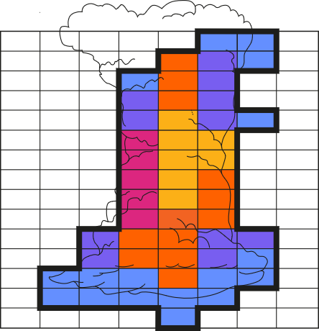
So what approach do we take?
Based on TRT-storm footprint (Hering et al. 2004,2008)

Slide 15
So what approach do we take?
~500 Predictors (extracted from 3D-radar composites)
Hail yes/no (from 270’000 reports)
Hail size
25’000 Hail yes/no samples
6000 Hail size samples
2 Random forests (RF)
RF_bool → Hail yes/no (classification)
RF_size → Hail size (regression)
Q: Which radar signatures are key for detection of hail(-size) on operational radar?
Q: Do the models learn meteorologically sensible links?

Slide 16
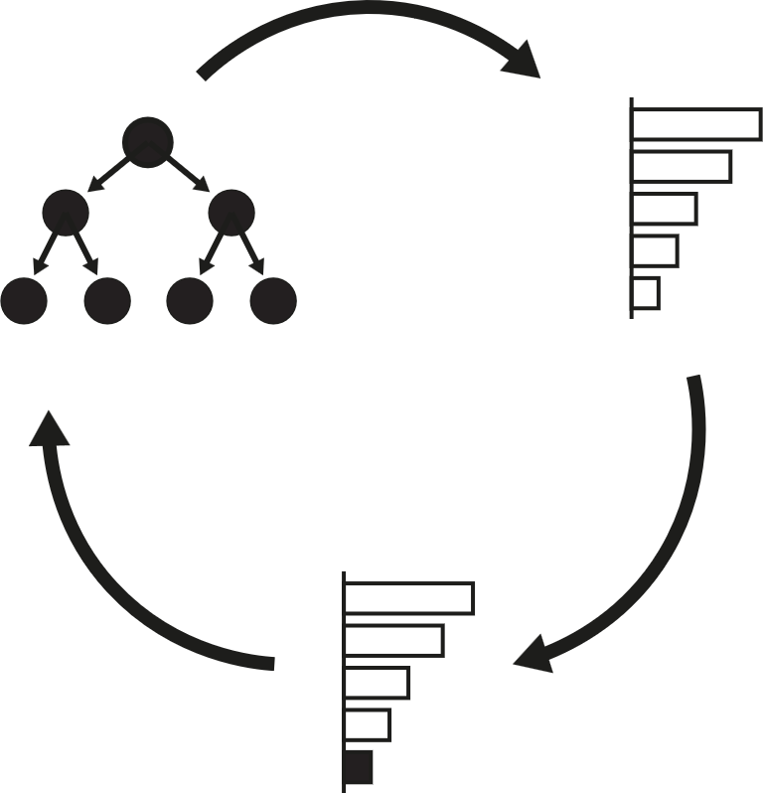
Recursive Predictor Elimination (RPE)
Train Forest
Permutation Importance
5-fold CV
Regular Hyperparameter Tuning
Result:
Performance vs. Predictor Count
Remove bottom 5%

Slide 17
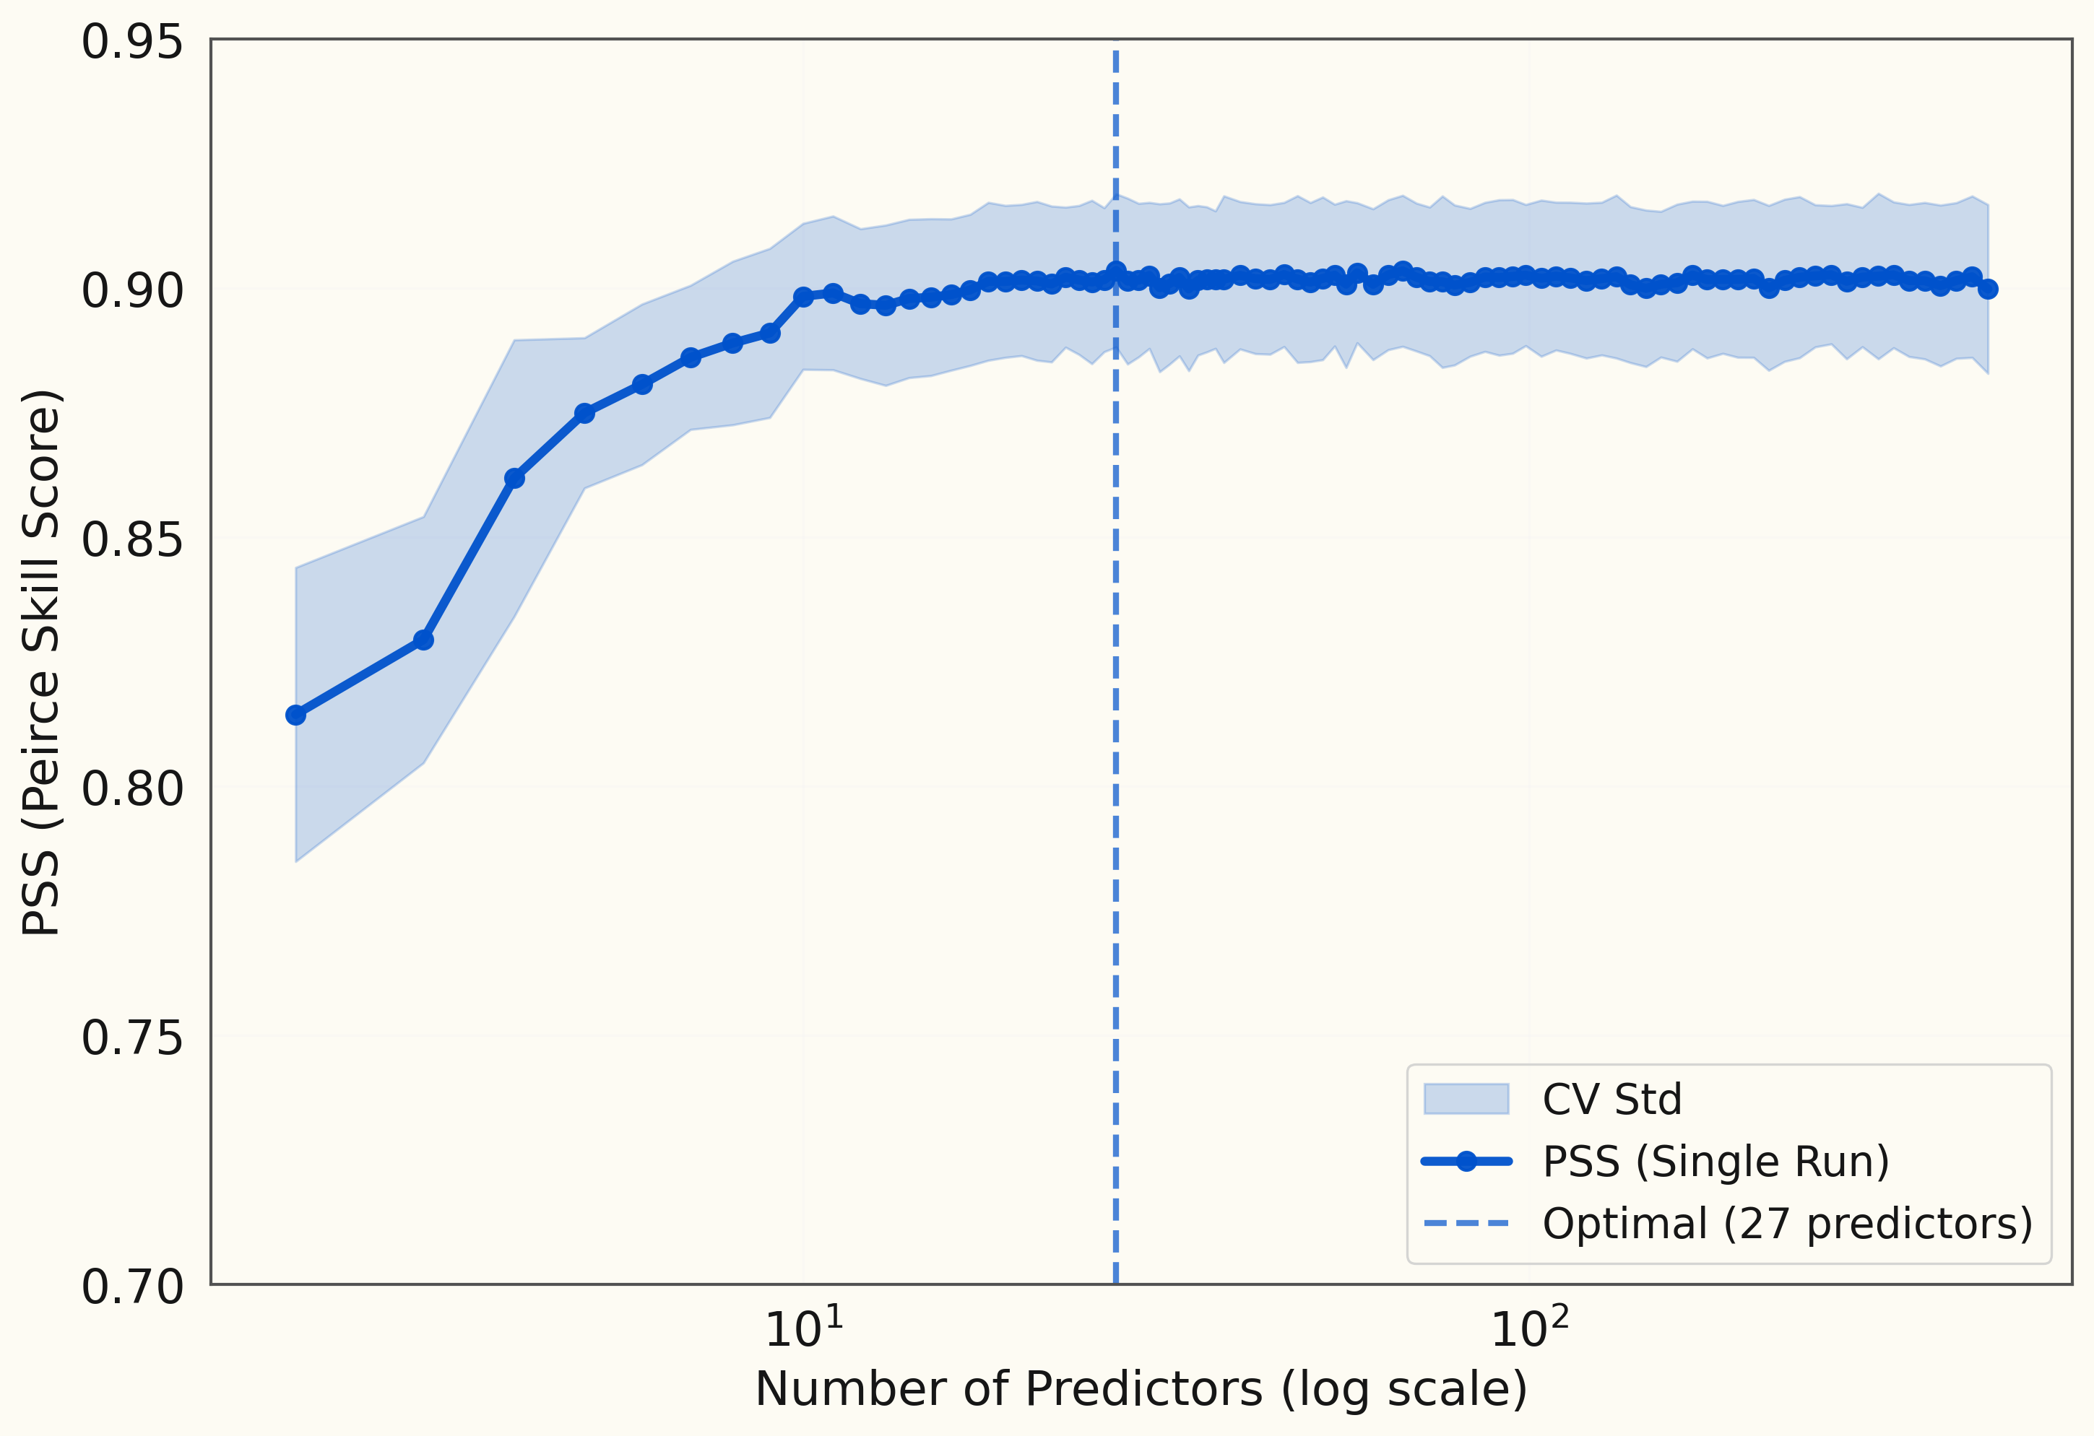
RPE: RF_bool - Training Performance
Q: Is this robust?

Slide 18
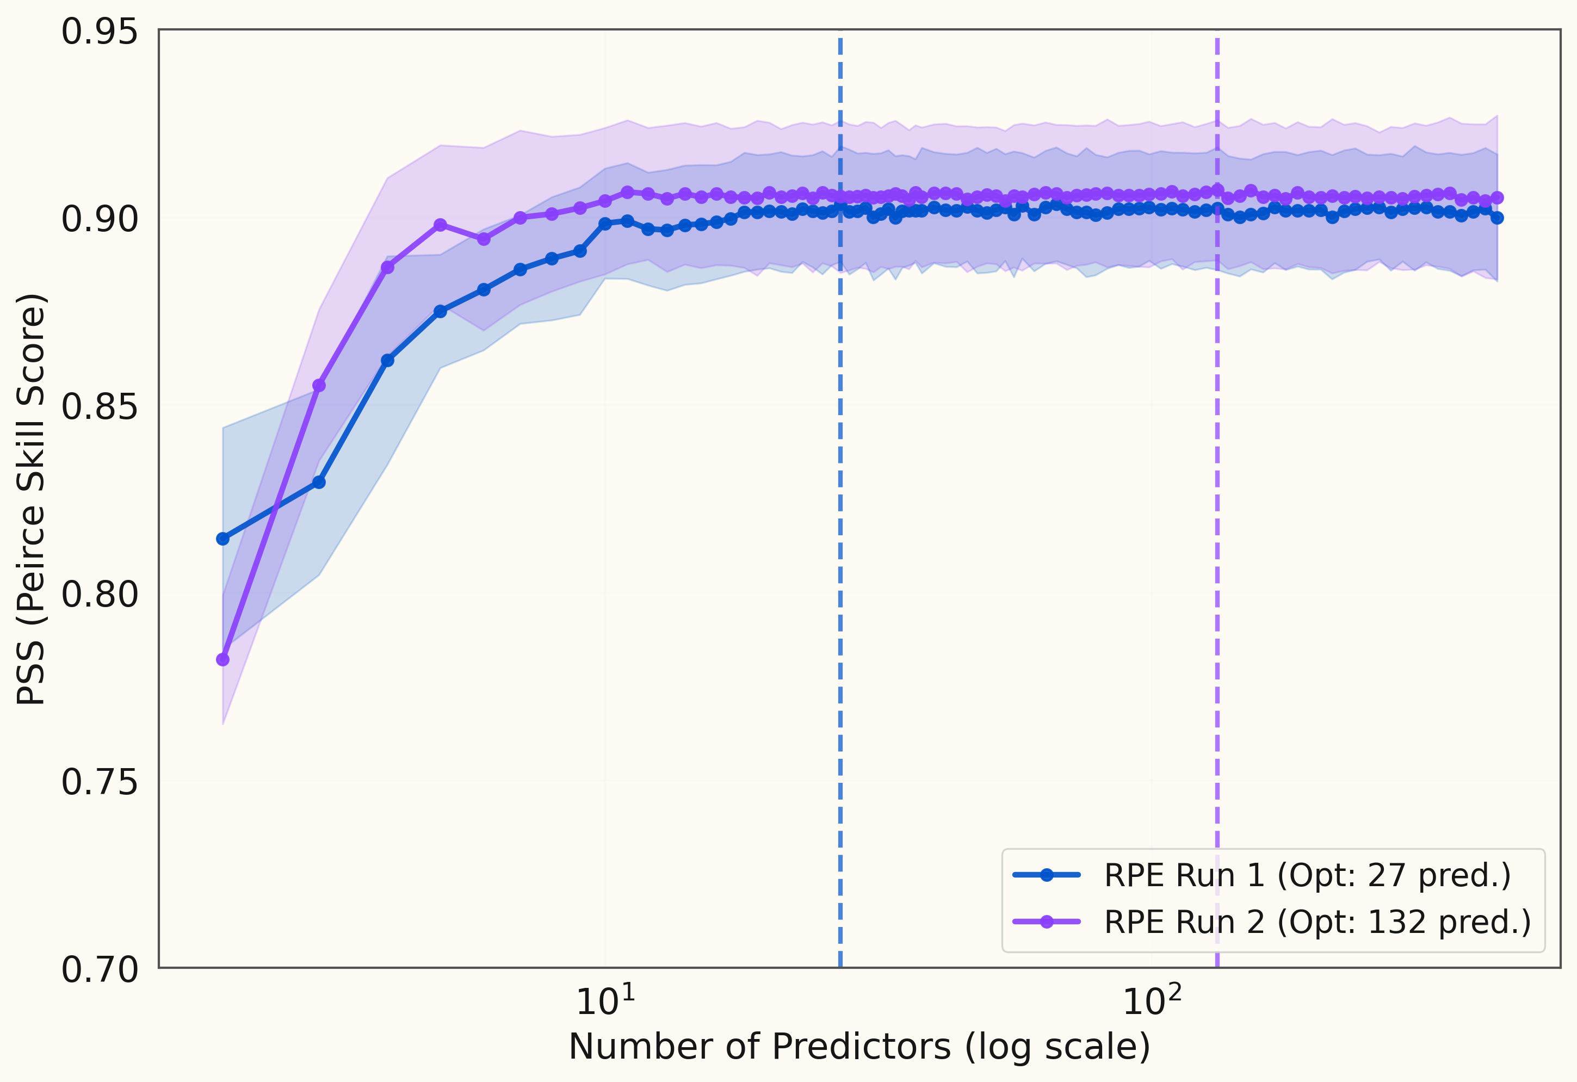
2 x RPE: RF_bool - Training Performance
Notes:
stabilize

Slide 19
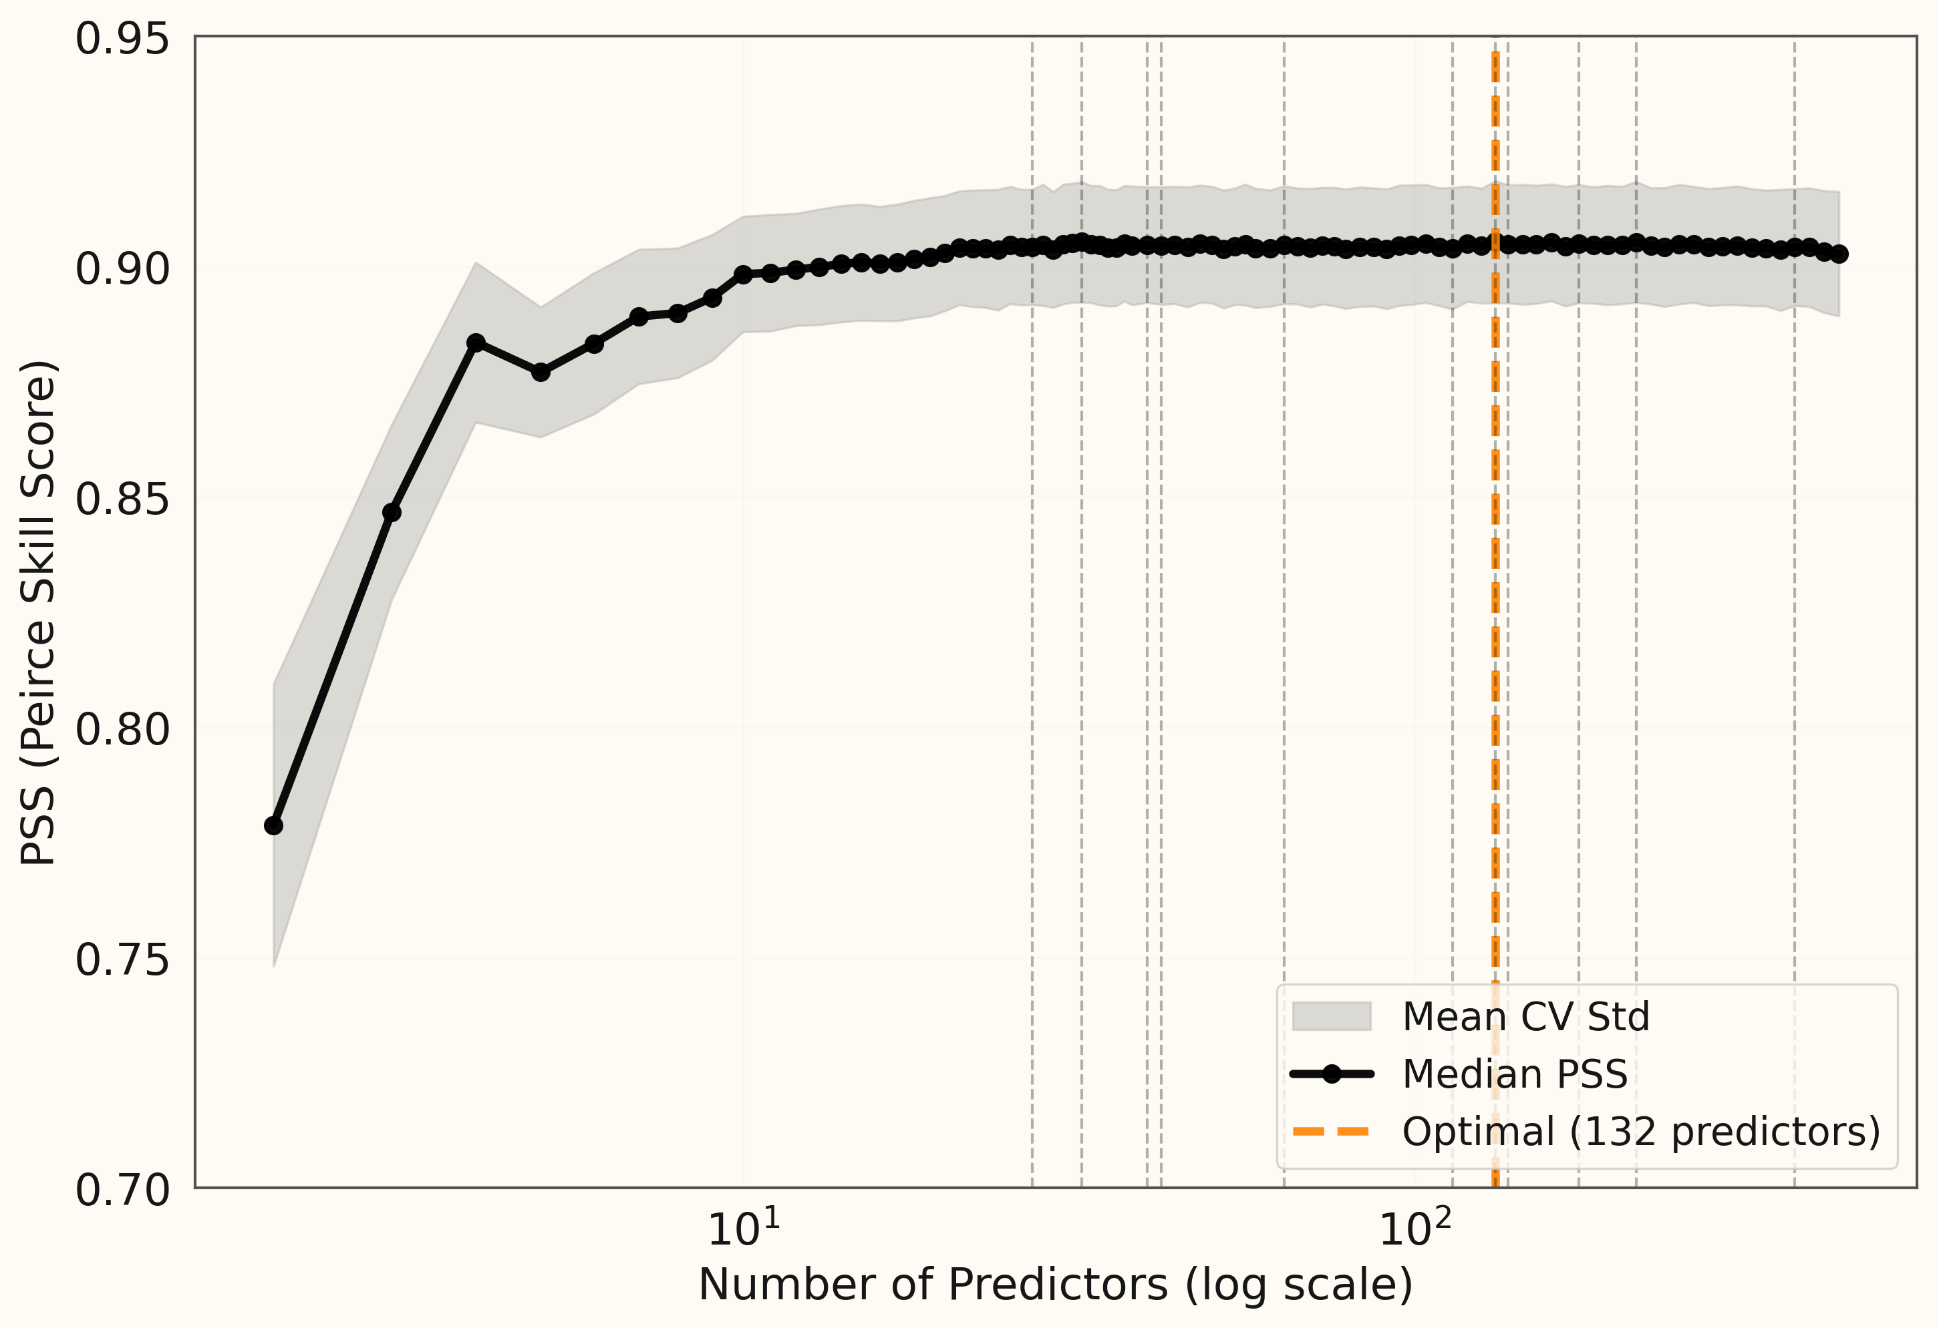
11 x RPE: RF_bool - Training Performance

Slide 20
11 x RPE: RF_bool - Training Performance
10 Predictors
99% of Optimal

Slide 21
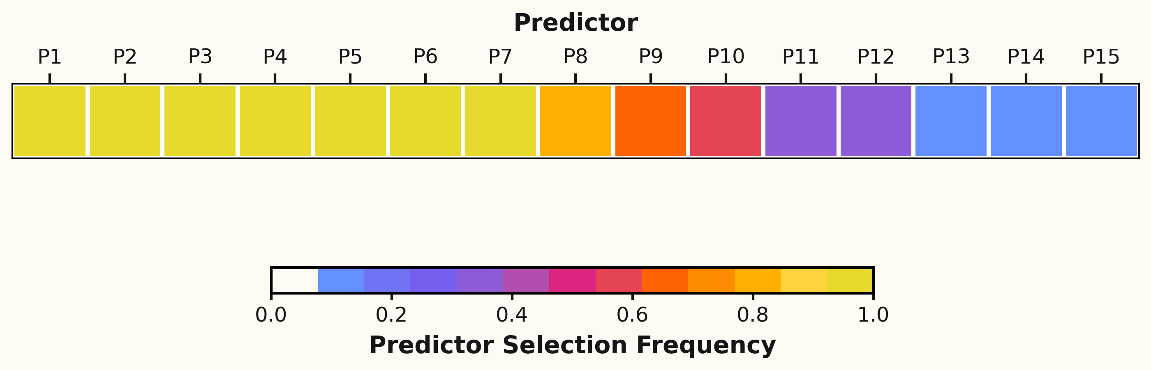
So which predictors are selected?

Slide 22
So which predictors are selected?
Train Final Model

Slide 23
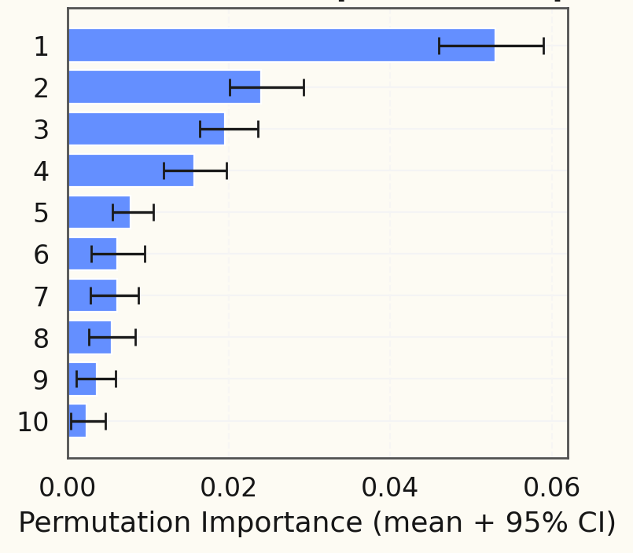
What has the model learnt?
Hail on the ground is associated with:
High volumes of Ice Hail HCA (Besic et al. 2016)
Higher mean values of ETD50
ETD50 = ET50 – H0 (MESHS basis)
Older Storms
Higher maximum values of HDR between H0 and 8 km

Slide 24
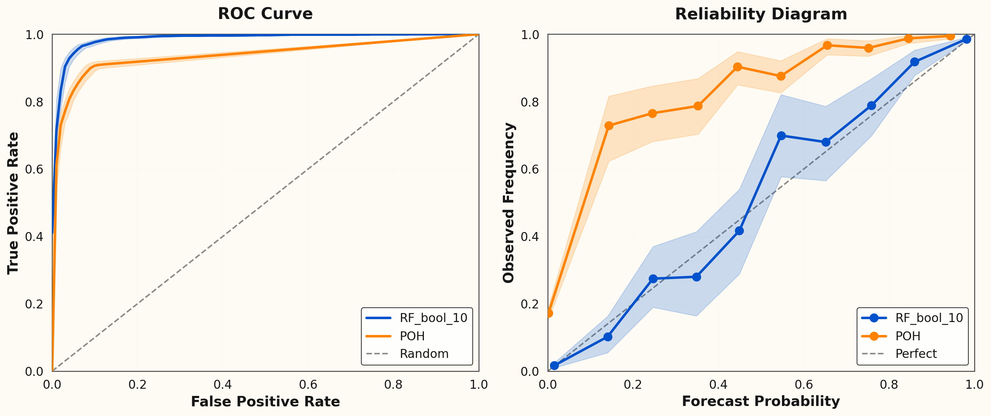
RF_bool Performance on test data (15%)
 | PSS | CSI
RF_bool_10 | 0.90 | 0.93
POH | 0.81 | 0.86

Slide 25
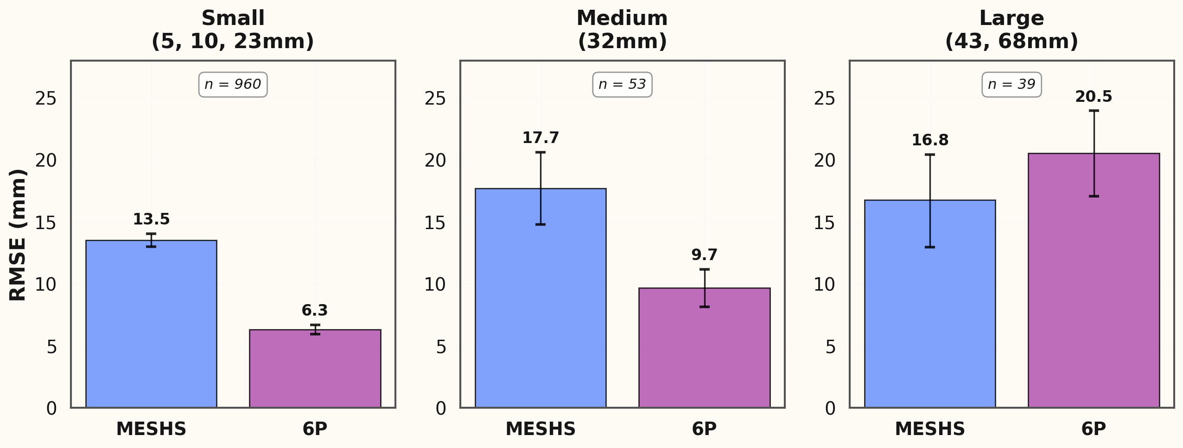
How does the RF_size perform on test data (15%)?

Slide 26
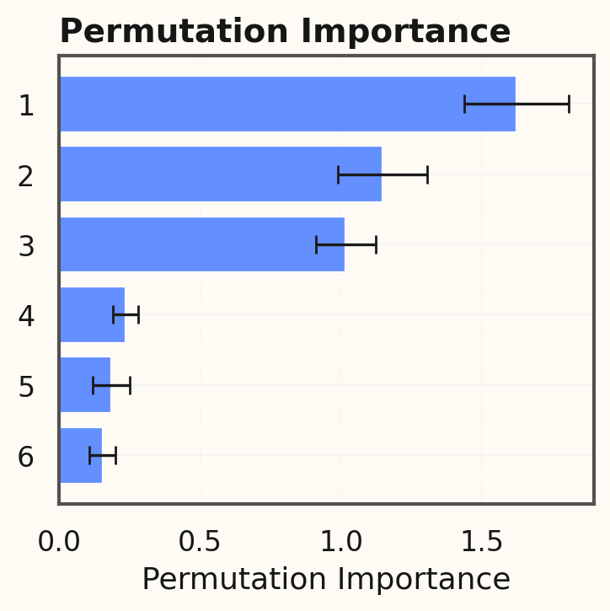
What has the model learnt?
Larger Hail is associated with:
Higher maximum values of ETD50
ETD50 = ET50 – H0 (MESHS basis)
Larger volumes of ρ_{HV} < 0.92 in Z_{H} > 40 dBZ
Higher maximum values of HDR between H0 and 8 km
Lower topography
Lower mean K_{DP}
Lower 75th percentile of Z_{H}

Slide 27
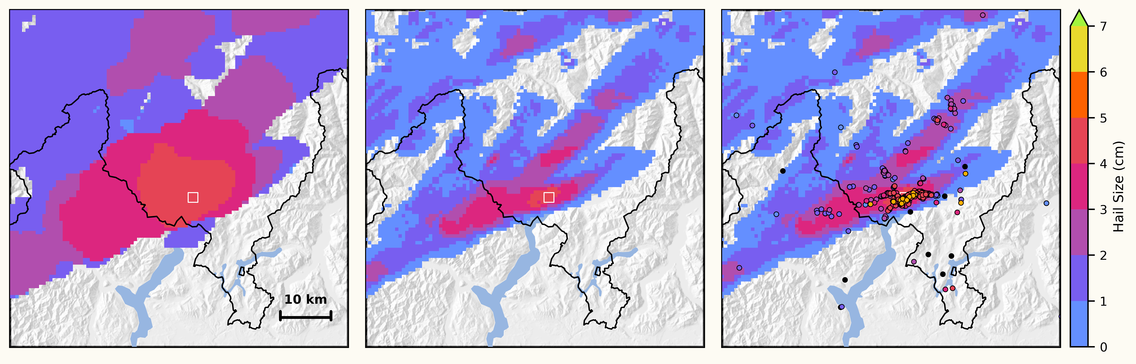
What can we do with it? From Objects to 2D-grids
“raw” cell footprints
Simple VIL based weighing
Q: Can we directly assimilate crowdsource data to get the best
guess hail size maps?
Q: Can we make the swath more realistic by including
horizontal wind information?

Slide 28
Key Takeaways:
Object-based approach has its merits.
Mix of direct and indirect hail predictors performs best
Mix of polarimetric measurables used
RPE approach gives us a robust predictor set.
More could be done with different ML architectures
Dataset available (martin.aregger@unibe.ch)
scClim

