Slide 1
The Summer 2024 Met Office Convection Nowcasting Testbed
Dan Suri, Matt Clark, Brian Golding, Katie Norman, and Rosie Nation
12th ECSS, Utrecht, Netherlands, November 2025

Slide 2
Background
Testbeds provide opportunity for scientists, developers and operational meteorologists to collaborate by applying new tools & techniques in a quasi-operational setting
At the Met Office, testbeds have been held annually since 2020, with the first testbed held in autumn 2013
In 2024, we focussed on the nowcasting of convection and related hazards in the UK, making use of two recently developed nowcasting tools:
  The PLUVIA cell tracker
  The PLUVIA mesoanalysis
Norman K., et al. (2024) The current status of PLUVIA and initial plans for its development as part of the Enhancing Nowcasting project. Space Applications and Nowcasting Technical Memo. 75. Met Office, Exeter. Pp. 62.

Slide 3
Aims of the 2024 nowcasting testbed
To expose the PLUVIA nowcasting tools to a wider ‘audience’ of operational meteorologists, to increase awareness of the tools and their capabilities
To test the utility of the PLUVIA nowcasting tools for the nowcasting of convective hazards (mainly heavy rain)
To seek feedback to help guide the future development of the PLUVIA nowcasting tools
To facilitate collaboration and strengthen links between scientists and operational meteorologists in the Met Office

Slide 4
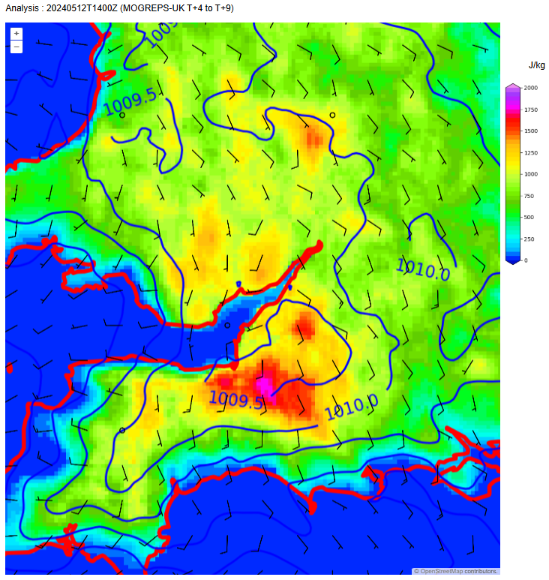
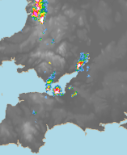
The PLUVIA nowcasting tools: mesoanalysis
Gridded analysis of surface variables (e.g., temp, dewpoint, pressure, wind) and some derived variables (e.g., SBCAPE, horizontal convergence)
Blends observations data from a variety of sources (including bias-corrected citizen weather station data) with model data using data assimilation techniques
Many stations contributing, therefore analysis can resolve more mesoscale detail than is possible when using official surface observations alone
Analysis-minus-model-background difference fields provide a convenient way of assessing where conditions are deviating from model expectations
L
SBCAPE (shading), MSLP (contours) and 10 m winds (barbs)

Slide 5
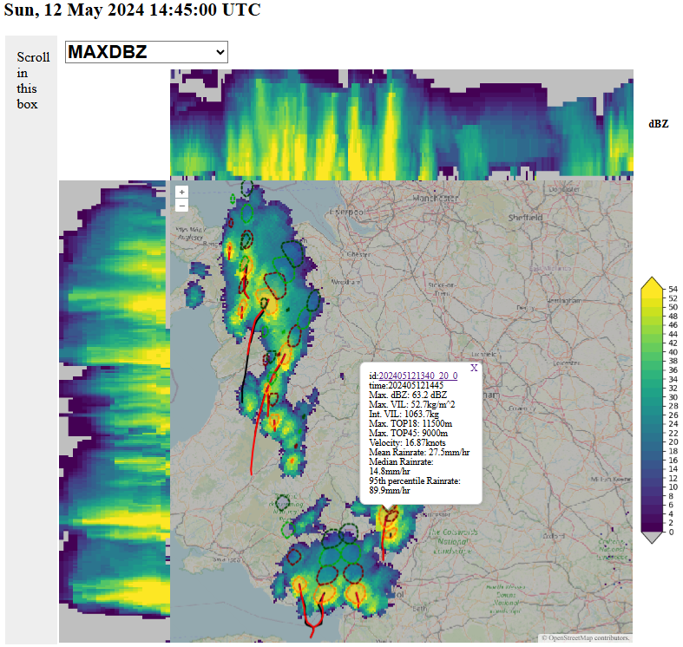
The PLUVIA nowcasting tools: cell tracker
An updated version of the Muñoz et al., (2018) method, which is itself based on TITAN (Dixon and Wiener, 1993)
Uses volumetric radar data to identify convective cell objects (where a VIL threshold is exceeded over a threshold number of contiguous 1 km pixels)
Matches the cell objects in subsequent radar volumes to form cell tracks
Provides a nowcast of expected cell locations over next 1 hour and an estimate of the forecast uncertainty using a Kalman filter
Plots timeseries of numerous radar and radar-derived parameters for each tracked cell object
N – S ‘side view' panel
12 km
0 km
12 km
0 km
E – W 'side view' panel
Muñoz, C., Wang, L.-P. & Willems, P. (2018). Enhanced object-based tracking algorithm for convective rain storms and cells. Atmospheric Research, 201, 144-158.
Dixon, M. & Wiener, G. (1993). TITAN: Thunderstorm Identification, Tracking, Analysis, and Nowcasting—A Radar-based Methodology. Journal of Atmospheric and Oceanic Technology, 10 (6), 785-797.

Slide 6
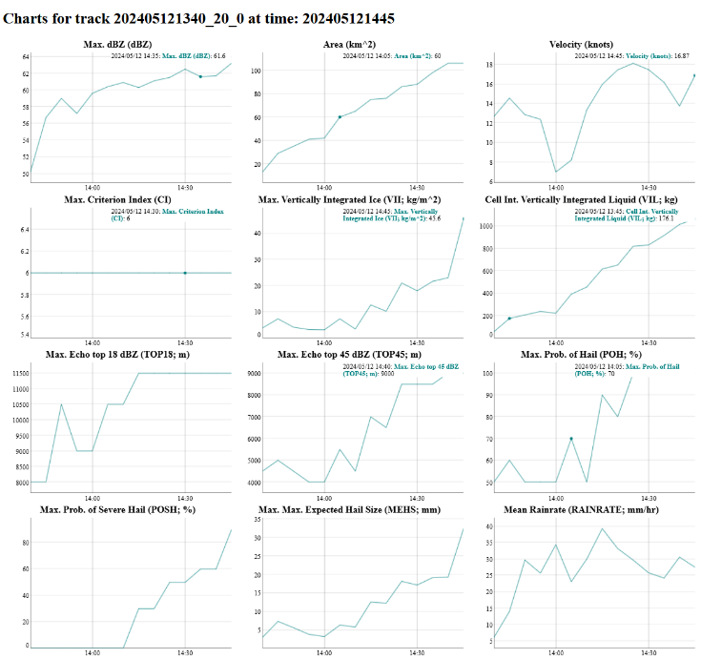
The PLUVIA nowcasting tools: cell tracker
An updated version of the Muñoz et al., (2018) method, which is itself based on TITAN (Dixon and Wiener, 1993)
Uses volumetric radar data to identify convective cell objects (where a VIL threshold is exceeded over a threshold number of contiguous 1 km pixels)
Matches the cell objects in subsequent radar volumes to form cell tracks
Provides a nowcast of expected cell locations over next 1 hour and an estimate of the forecast uncertainty using a Kalman filter
Plots timeseries of numerous radar and radar-derived parameters for each tracked cell object
Muñoz, C., Wang, L.-P. & Willems, P. (2018). Enhanced object-based tracking algorithm for convective rain storms and cells. Atmospheric Research, 201, 144-158.
Dixon, M. & Wiener, G. (1993). TITAN: Thunderstorm Identification, Tracking, Analysis, and Nowcasting—A Radar-based Methodology. Journal of Atmospheric and Oceanic Technology, 10 (6), 785-797.

Slide 7
Logistics
The testbed ran for 5 weeks from 17 June – 19 July 2024
Over 90 participants were involved, drawn from Met Office science and operational teams, with external attendees from 10 organisations (UK and overseas)
Experiments were designed by science leads in close collaboration with operational leads
4 operational meteorologists were recruited to lead the experiments during the testbed period and to help with analysis of the results (partly as a CPD activity)
Participants worked in small teams (2 – 3 people) with several teams working on the experiments in parallel
Results were collected mainly using Microsoft Forms
The testbed was held in-person at the Met Office, but remote participation was also supported (e.g., for overseas attendees)
We held a testbed social one evening each week for networking etc.

Slide 8
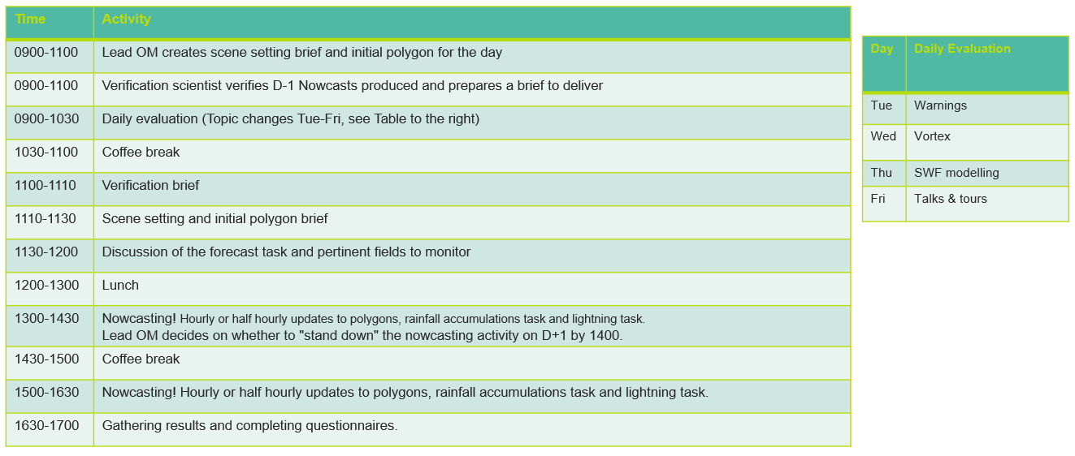
A typical testbed day

Slide 9
Experimental setup
Experiment 1: mesoscale areas at risk of convective hazards:
  The Lead OpMet defined a hazard of interest (generally 1-hr rainfall totals exceeding a given threshold) and delineated a risk area at the beginning of each testbed day (a polygon was drawn delineating the risk area)
  Participants were asked to refine this risk area, as appropriate, following analysis of all available data
  The activity was repeated once or twice through the day, until convection initiated, with teams refining their polygons as necessary following analysis of the latest available data
  Run as a data denial activity – half the teams had access to the PLUVIA nowcasting tools, half did not
  Contingency metrics were computed to assess the success or otherwise of the issued polygons from each team
Experiment 2: forecasting 1-hour rainfall accumulations at point locations:
  Once substantial convection had initiated (i.e., strong/deep enough for the cell tracker to identify cell objects)…
  Participants were asked to forecast 1-hour rainfall accumulations for a selected location under threat from an existing cell or cells, making use of the PLUVIA cell tracker and any other relevant information
  All teams had access to the PLUVIA nowcasting tools
  Aim was to understand our current capabilities for forecasting convective rainfall at point locations, in support of a proposed Emergency Alert System (EAS) extreme rainfall warning (Golding, 2023)
  Forecast and radar-observed rainfall totals were compared to assess the success or otherwise of the forecasts
Golding B. (2023) Summer 2023 evaluation of the emergency warnings concept, Space Applications and Nowcasting Technical Memo. 65. Met Office, Exeter. Pp. 42.

Slide 10
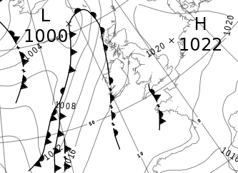
Results: overview
The testbed period was dominated by quiet weather with little convection of note over the UK
This resulted in a heavy reliance on ‘canned data’ (i.e., archived data from past events) which wasn’t ideal (chance of participants recalling the events, difficulties in accessing and visualising archived data in a format equivalent to that available in real time, etc.)
In practice, this limited our ability to perform robust quantitative analysis, e.g., of the added value provided by the PLUVIA nowcasting tools
Nevertheless, we gained useful qualitative insights and suggestions for refinement of the tools
Rule 1 of testbeds: you rarely get weather you’re looking for…!

Slide 11
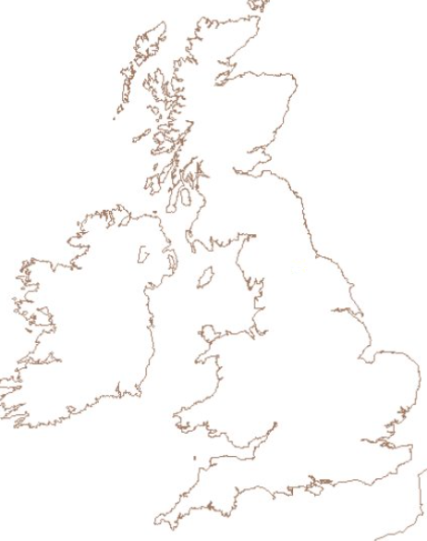
Headline results: Exp. 1
Hazard: 1-hr rainfall totals of 20 mm or more
Lead OpMet polygon
Team
polygon
Contingency metrics were computed from the results (see right)
No statistically significant differences in CSI between teams with and without access to the PLUVIA mesoanalysis
However, POD was higher for teams with access to the mesoanalysis
Results were highly variable from case to case
Subjective classification of convective types indicated that the added value of PLUVIA mesoanalysis was most evident in cases with stronger/more impactful convection
This probably relates to the fact that mesoscale features pertinent to initiation and evolution of convection (e.g., convergence lines) tend to be most evident in such cases
Few such cases in the testbed period, so the generality of these results is unknown
Metric | Definition
Hits | Grid boxes in team polygon within a 25 km radius of any grid box where the maximum 1-h rainfall accumulation exceeded threshold
Misses | Grid boxes in OpMet polygon, but outside team polygon, within a 25 km radius of any grid box where the maximum 1-h rainfall accumulation exceeded threshold
False alarms | Grid boxes within team polygon at > 25 km radius from any grid cell exceeding the 1-hour rainfall accumulation threshold
POD = total hits / (total hits + total misses)
CSI = total hits / (total hits + total false alarms + total misses)

Slide 12
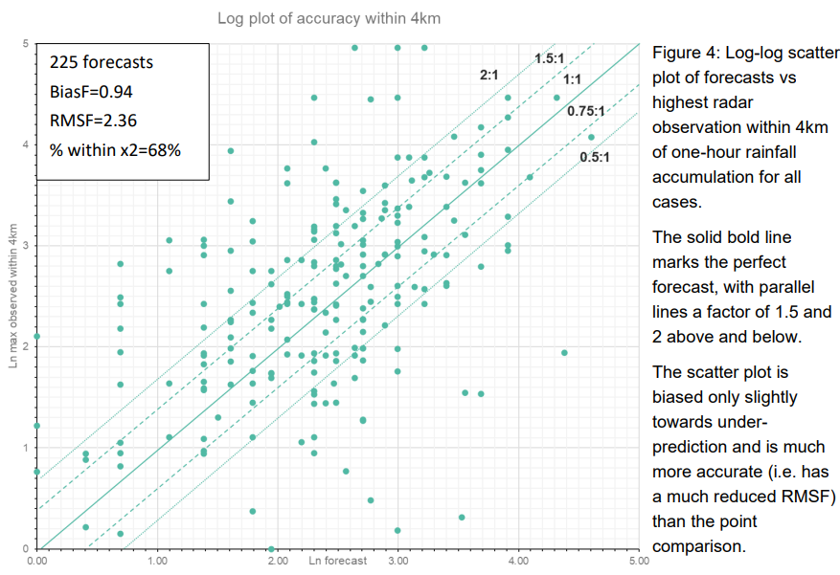
Headline results: Exp. 2
Forecast 1-hr rainfall accumulations were compared with radar-observed accumulations at the grid cell containing the selected point location, and at increasing radii around the point (from 2 – 10 km)
Best agreement was found in the comparison with maximum radar-observed accumulation within 4 km, suggesting this may be a realistic spatial scale for the proposed EAS extreme rainfall warnings
68% of forecast accumulations were within a factor of 2 of the maximum radar-observed accumulations within 4 km, with a mean fractional bias of 0.94
Exceedance of a 20mm rain accumulation threshold was forecast with a Hit Rate of 81% and a False Alarm Ratio of 12%. This is encouraging, but for a threshold that is too low to generally cause major flood impacts (therefore questionable applicability to the EAS extreme rainfall scenario).
Challenges reported by participants included:
  Anticipating development and evolution of cells (e.g., where multiple cells affected a location within 1 hour)
  Unreliable cell tracks in multicell systems
  Estimation of the effect of any hail contamination on radar-derived rainfall rates (e.g., no reliable way of determining whether occurring, and to what extent it is affecting rainfall rates, in any given case)
  Assimilating all the necessary information to make a forecast in a reasonable amount of time (e.g., estimating rainfall rates, dwell time of each cell at affected location, factors that could influence development/decay): in the operational environment, a higher degree of automation would likely be necessary, especially where there are multiple cells / areas of concern

Slide 13
Conclusions, lessons learned, future work
Qualitative results strongly suggest that the PLUVIA nowcasting tools were useful for convection nowcasting (e.g., ~90% of respondents rated the tools at least ‘somewhat useful’, with around half rating them ‘extremely useful’, in end-of-day surveys)
Quantitative insights were limited by the lack of strong/impactful convection during the testbed period
We succeeded in exposing the PLUVIA nowcasting tools to a wider set of operational meteorologists, which has subsequently resulted in increased operational use
In light of the episodic and sometimes infrequent occurrence of impactful convection in the UK, and following our experiences this year, we question whether testbeds are the optimal way of testing tools intended for use in such situations – an alternative might be to focus on a rapid response setup in which the experiments could be stood-up at short notice (possibly challenging, given operational commitments and rostering)
Operational implementation of the PLUVIA nowcasting tools continues at the Met Office, with planned future enhancements informed by feedback from the testbed

Slide 14
Planned enhancements
PLUVIA mesoanalysis:
  Sub-hourly updates
  Overlay of other observations e.g., radar data
  Nowcasts of analysed variables using Ensemble Forecast Adjustment
  Extension to 3D
PLUVIA cell tracker:
  Variable VIL threshold (to facilitate detection of weaker/smaller cells where relevant)
  Increased robustness to occasional radar dropouts (retaining tracks over missed scans)
  Improved handling of multicell storms and cell mergers / upscale growth
  Addition of recent radar rainfall accumulations and accumulation nowcasts
  Ability to view cross-sections on-demand
Other:
  Need to develop a reliable way of estimating / correcting for the impact of hail contamination on radar rainfall rates
  Need for an easier way of saving and displaying archived data (in same format as would be available operationally in real-time)

Slide 15
Questions
Dan Suri: dan.suri@metoffice.gov.uk
Matt Clark: matthew.clark@metoffice.gov.uk
Katie Norman: katie.norman@metoffice.gov.uk

