Slide 1


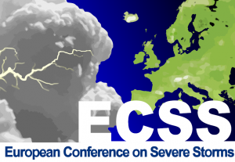
Flash floods in Croatia from 2012 till 2022
meteorological analysis
Klara Severić¹, Tanja Renko², Vinko Šoljan³, Maja Telišman Prtenjak⁴
¹Croatian Meteorological and Hydrological Service
²European Severe Storms Laboratory
³Croatia control
⁴Department of Geophysics, Faculty of science, University of Zagreb
Utrecht, November 2025
www.meteo.hr
12th European Conference on Severe Storms, Utrecht, Netherlands – 17 to 21 November 2025

Slide 2
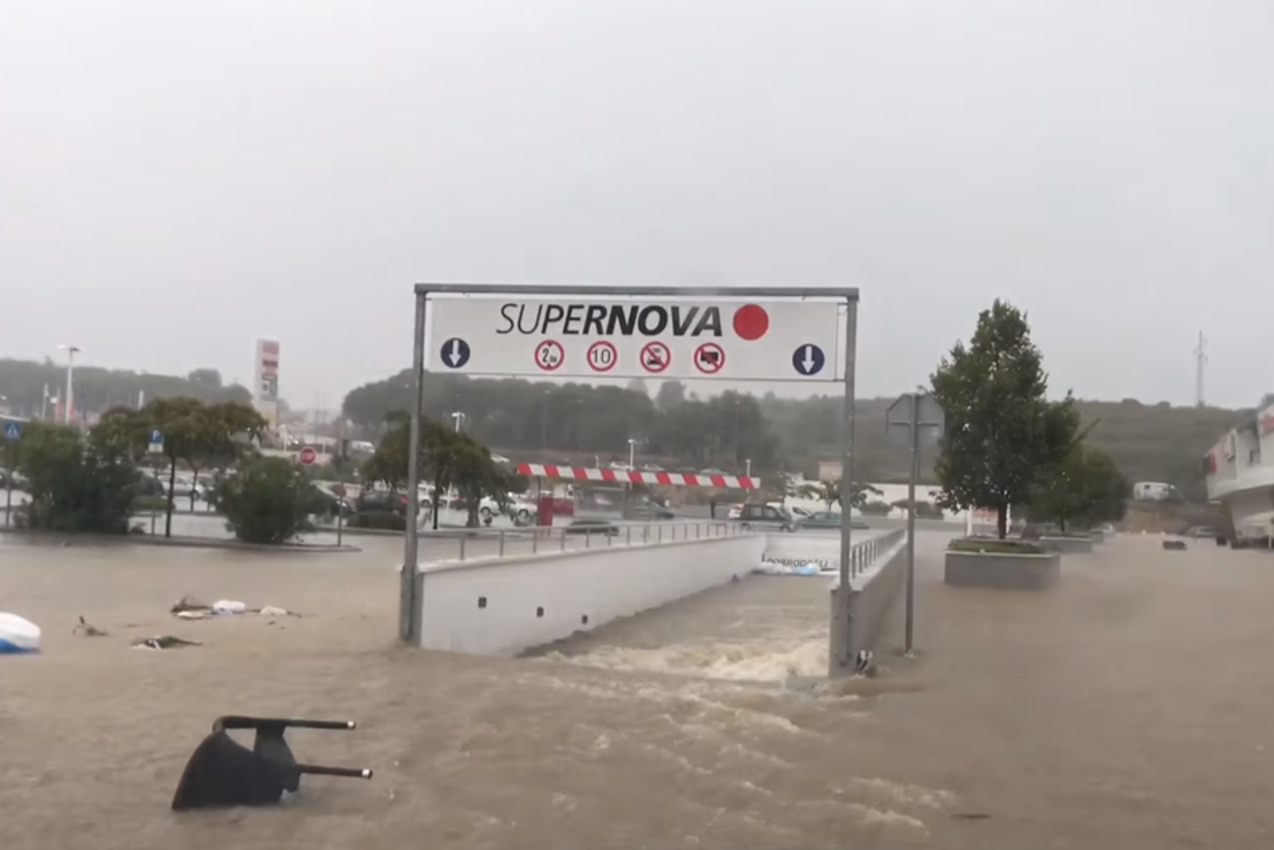

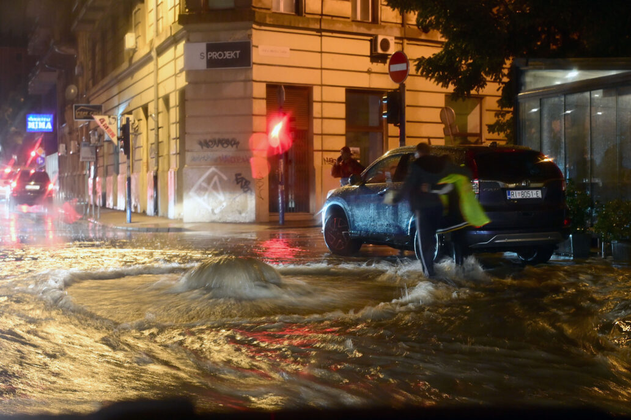

INTRODUCTION - Flash floods
Extreme hydrometeorological events
increasingly frequent and dangerous weather hazards
Ingredient-based methodology
combination of meteorological processes and hydrological factors
(a)
(b)
(c)
Fig. 1. Flash floods in Croatia: (a) Zadar, 2017, (b) Zagreb, 2021 and (c) Rijeka, 2022.
www.meteo.hr
12th European Conference on Severe Storms, Utrecht, Netherlands – 17 to 21 November 2025

Slide 3


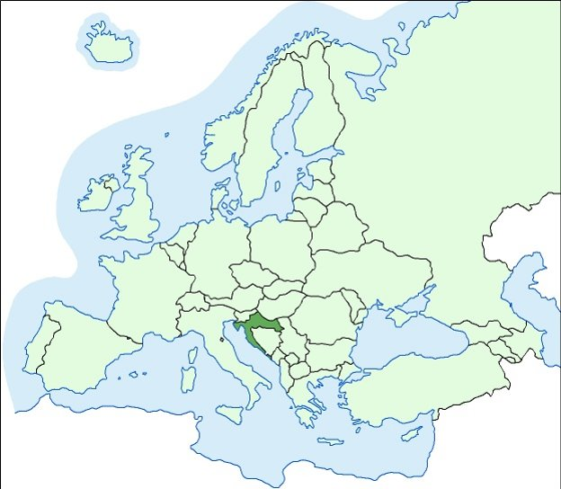
DATA AND METHODS
Research area: Republic of Croatia
Time period: 2012 – 2022
Data sources: media reports and bulletins of the Croatian Meteorological and Hydrological Service (DHMZ)
Additional verification: LINET lightning detection system
A total of 112 potential flash flood events were initially identified
After data verification, 97 events were confirmed
Fig. 2. Location of Croatia on the map of Europe.
Fig. 3. Climatological regions defined by DHMZ for weather warnings.
www.meteo.hr
12th European Conference on Severe Storms, Utrecht, Netherlands – 17 to 21 November 2025

Slide 4
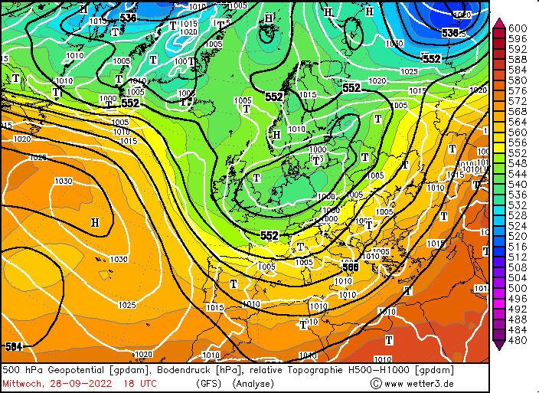
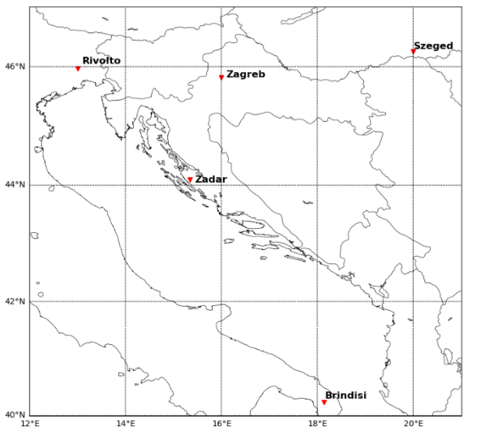
DATA AND METHODS
Synoptic analysis
Analysis of upper-level synoptic charts at the 500 hPa pressure level
Using archived data from DWD
Mesoscale analysis
Thermodynamic and kinematic parameters were calculated from selected and representative radiosonde measurements for a total of 87 cases
Fig. 4. Example of upper-level synoptic chart at the 500 hPa pressure level
Fig. 5. Locations of radiosonde measurements.
www.meteo.hr
12th European Conference on Severe Storms, Utrecht, Netherlands – 17 to 21 November 2025

Slide 5
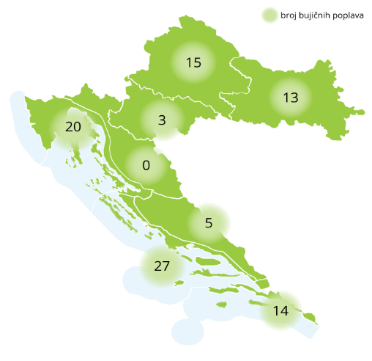
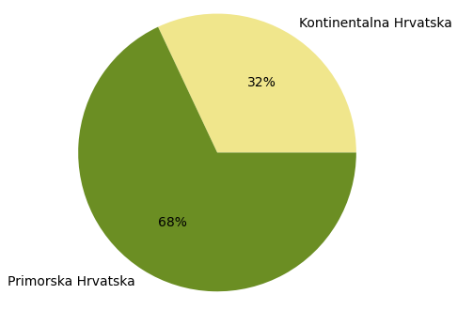
SPATIAL AND TEMPORAL DISTRIBUTION OF FLASH FLOODS
number of flash floods
Continental Croatia
Coastal Croatia
Fig. 6. Number of flash flood events by climatological regions.
Fig. 7. Percentage of flash flood events by geographical regions in Croatia.
www.meteo.hr
12th European Conference on Severe Storms, Utrecht, Netherlands – 17 to 21 November 2025

Slide 6
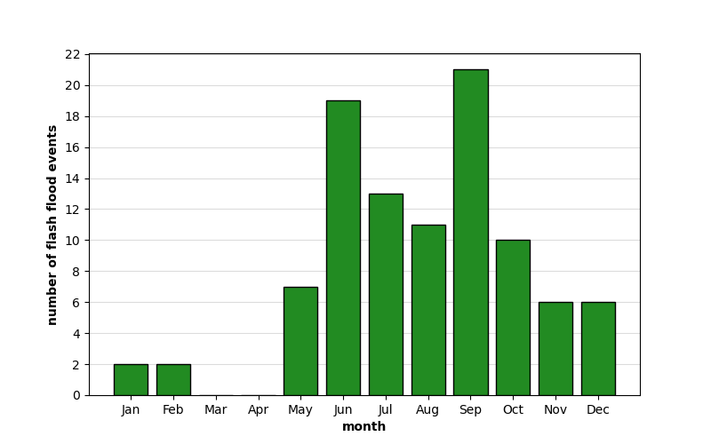
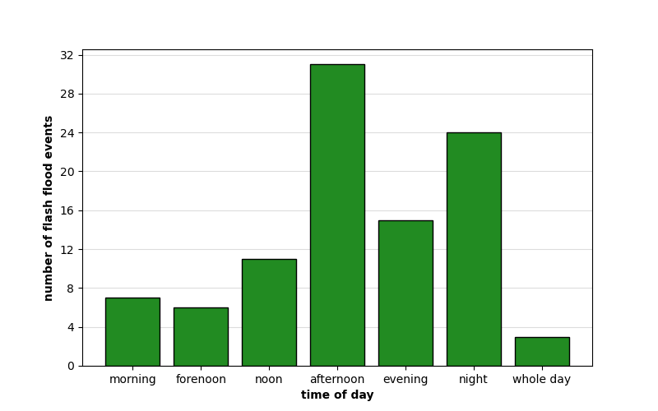
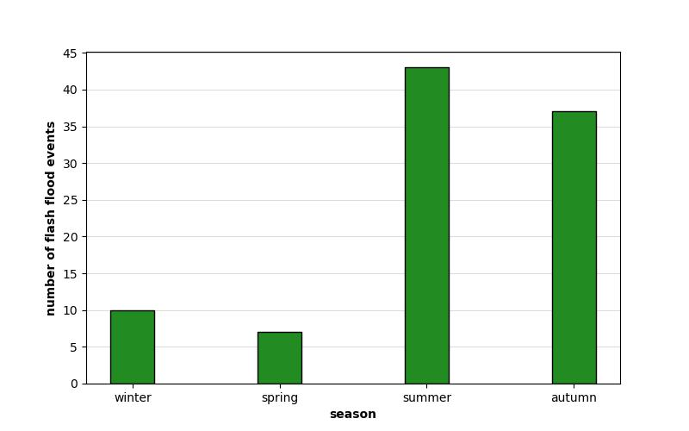
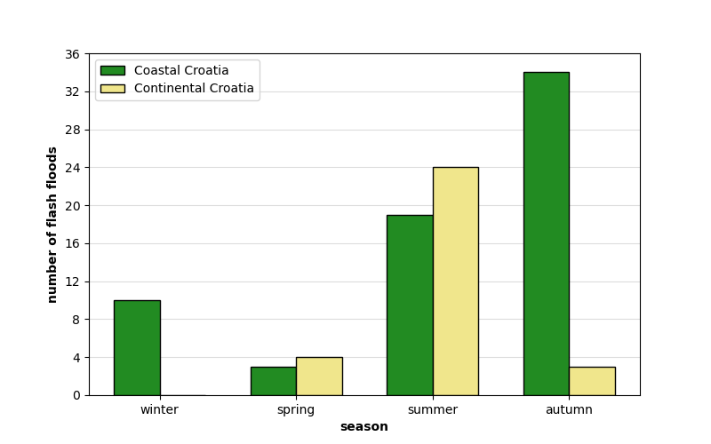
SPATIAL AND TEMPORAL DISTRIBUTION OF FLASH FLOODS
(a)
(b)
(c)
(d)
Fig. 8. Number of flash flood events by: (a) months, (b) time of day, (c) seasons, and (d) seasons and regions.
www.meteo.hr
12th European Conference on Severe Storms, Utrecht, Netherlands – 17 to 21 November 2025

Slide 7
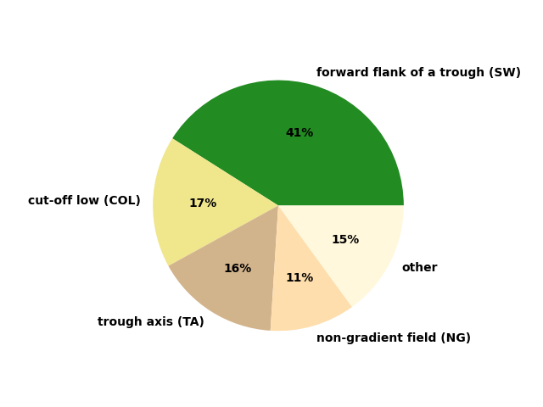
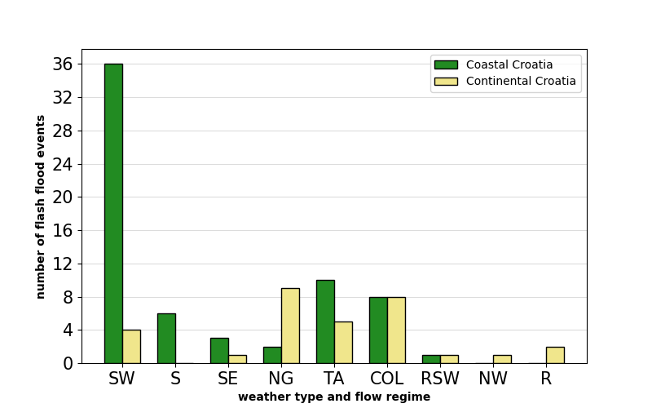
SYNOPTIC ANALYSIS
Fig. 9. Distribution of weather types and flow regimes at the 500 hPa pressure level during flash flood events.
Fig. 10. Number of flash flood events by regions, weather types, and flow regimes.
www.meteo.hr
12th European Conference on Severe Storms, Utrecht, Netherlands – 17 to 21 November 2025

Slide 8
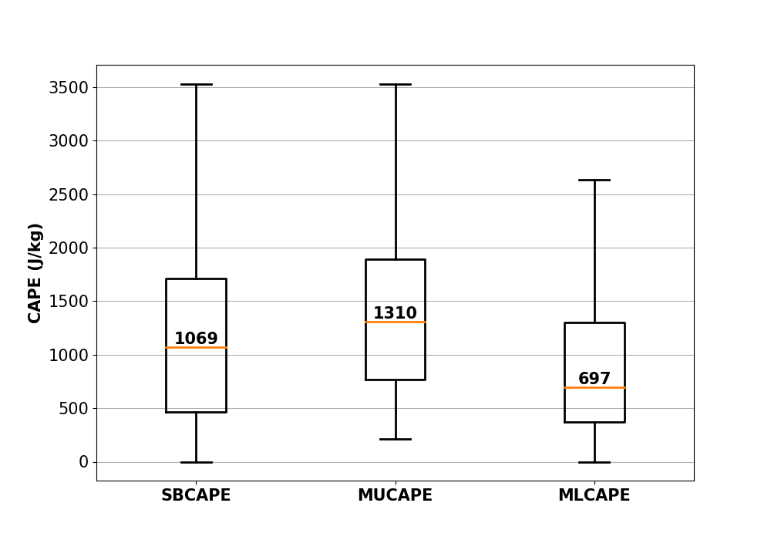
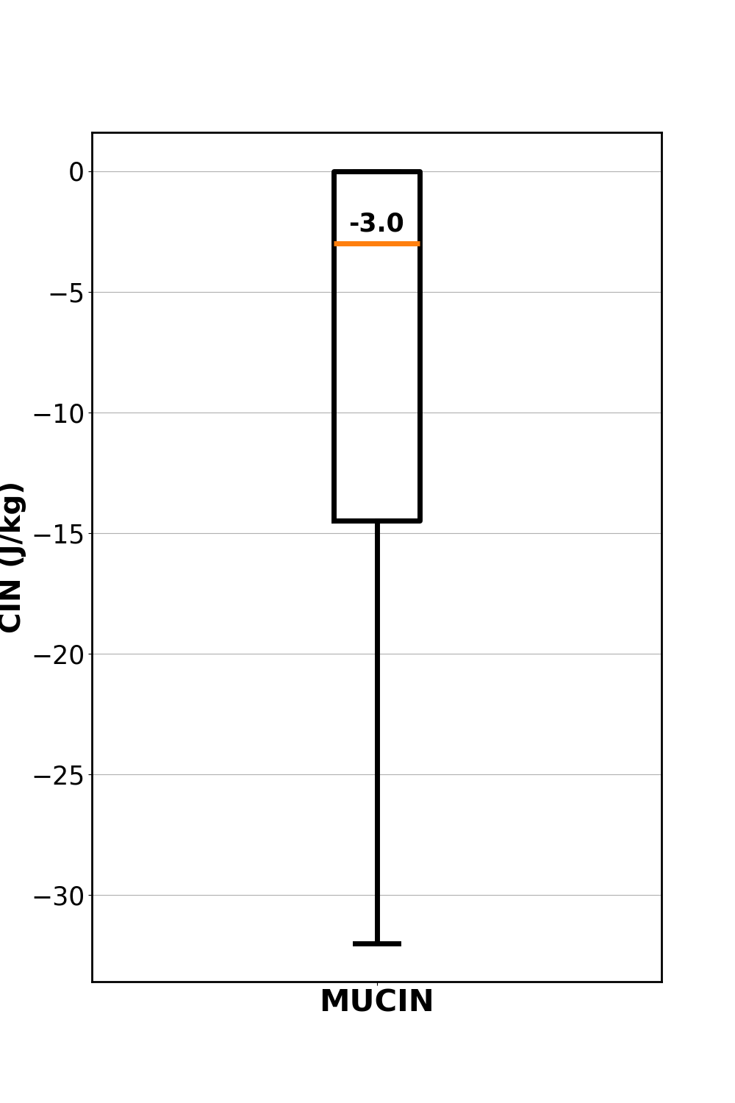
MESOSCALE ANALYSIS
(a)
(b)
Fig. 11. Boxplots representing the variability of (a) convective available potential energy (CAPE) and (b) convective inhibition (CIN).
www.meteo.hr
12th European Conference on Severe Storms, Utrecht, Netherlands – 17 to 21 November 2025

Slide 9
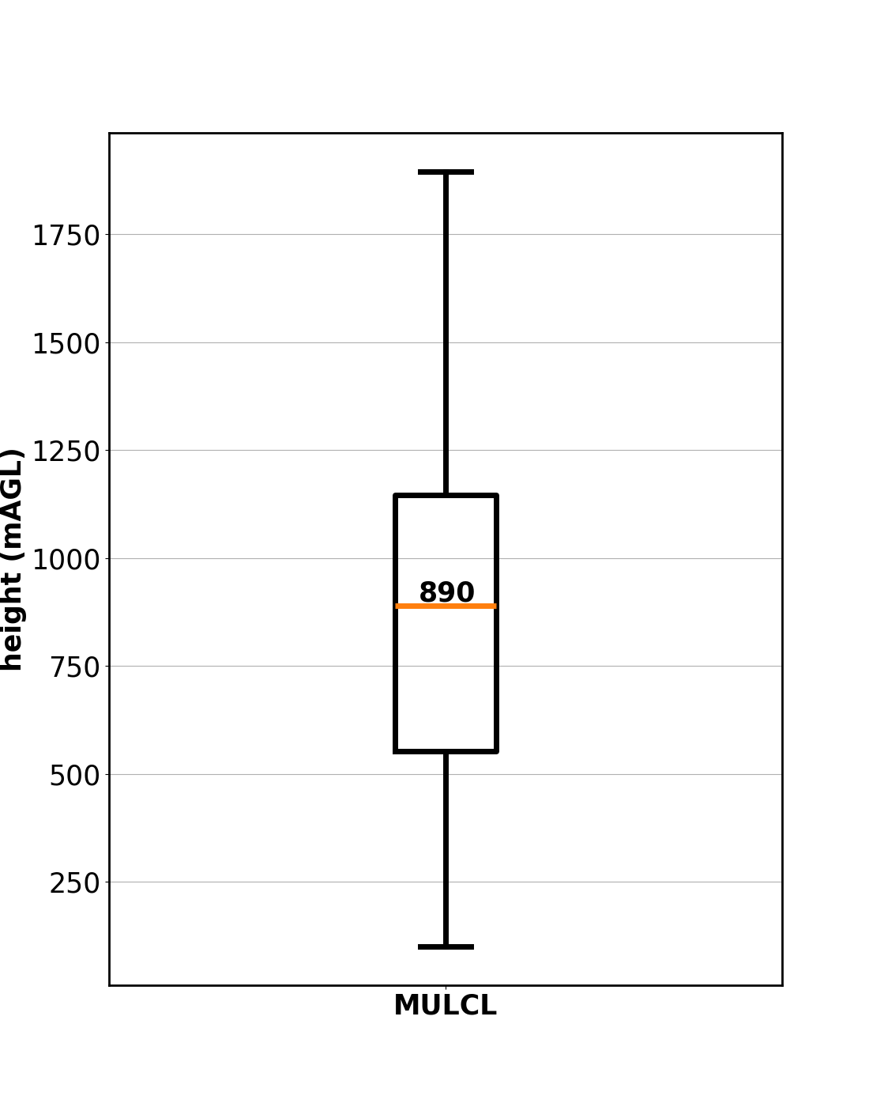
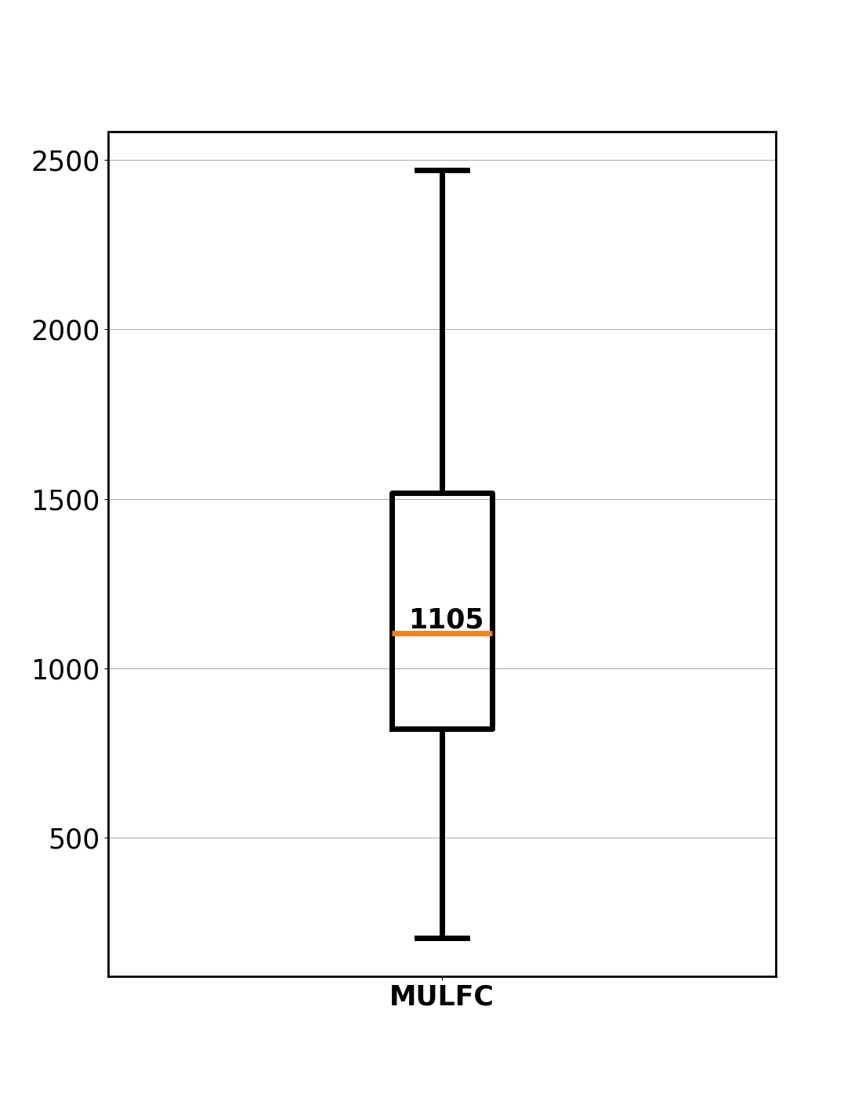
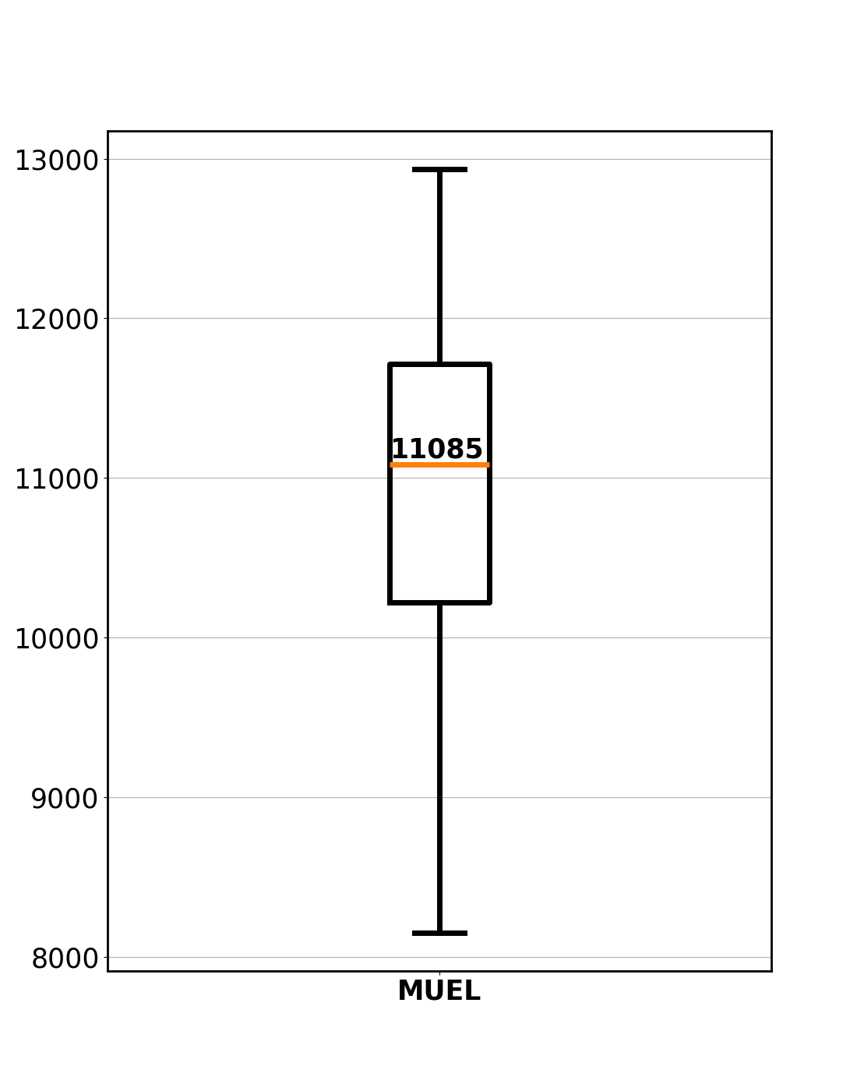
MESOSCALE ANALYSIS
(a)
(b)
(c)
Fig. 12. Boxplots representing the variability of (a) lifting condensation level (LCL), (b) level of free convection (LFC) and (c) equilibrium level (EL) .
www.meteo.hr
12th European Conference on Severe Storms, Utrecht, Netherlands – 17 to 21 November 2025

Slide 10
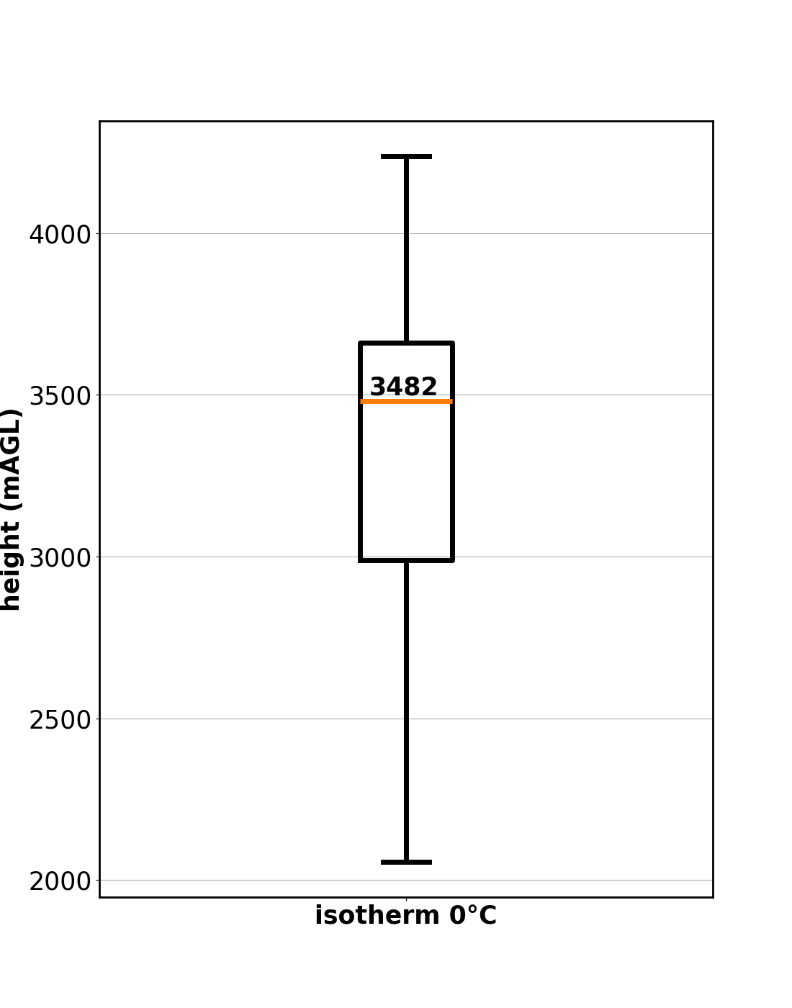
MESOSCALE ANALYSIS
Fig. 13. Boxplot representing the variability of 0°C isotherm height.
www.meteo.hr
12th European Conference on Severe Storms, Utrecht, Netherlands – 17 to 21 November 2025

Slide 11
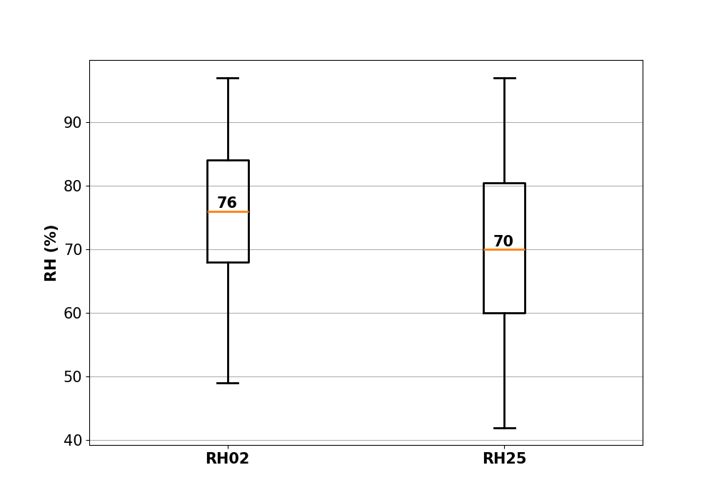
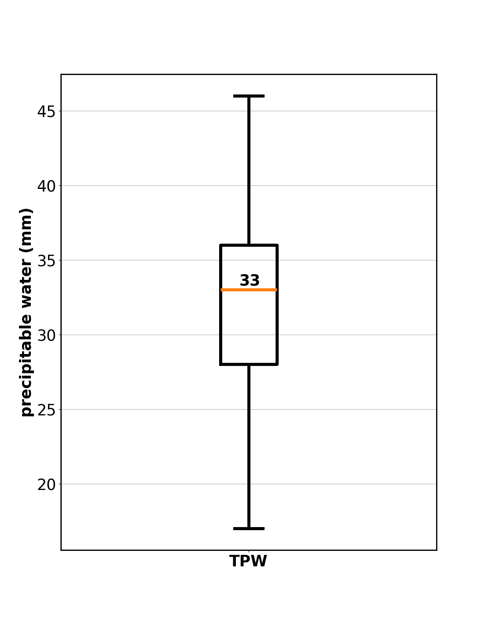
MESOSCALE ANALYSIS
(a)
(b)
Fig. 14. Boxplots representing the variability of (a) relative humidity (RH) in the layers 0-2 and 2-5 km, and (b) total precipitable water (TPW).
www.meteo.hr
12th European Conference on Severe Storms, Utrecht, Netherlands – 17 to 21 November 2025

Slide 12
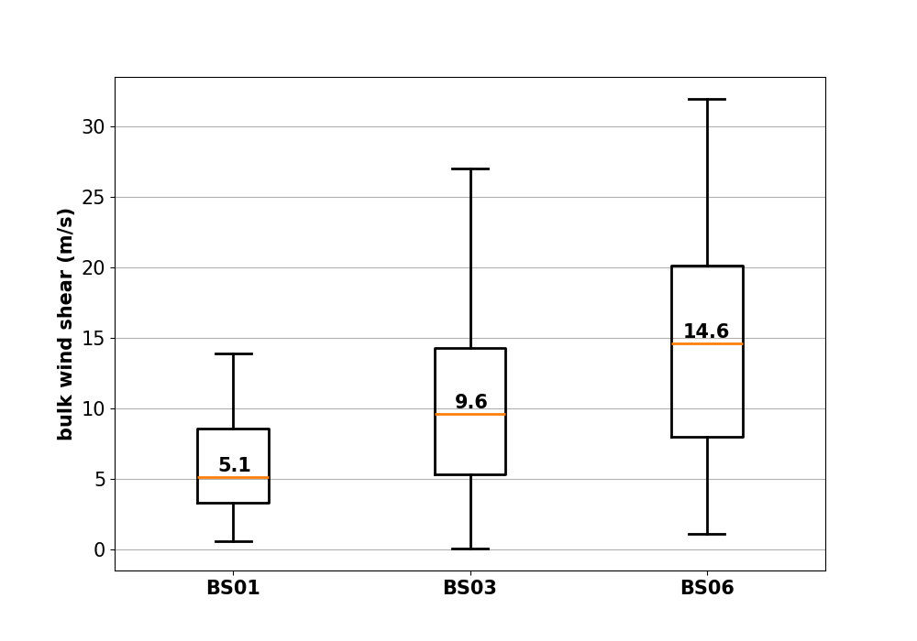
MESOSCALE ANALYSIS
Fig. 15. Boxplots representing the variability of bulk wind shear (BS) in the layers 0-1, 0-3 and 0-6 km.
www.meteo.hr
12th European Conference on Severe Storms, Utrecht, Netherlands – 17 to 21 November 2025

Slide 13
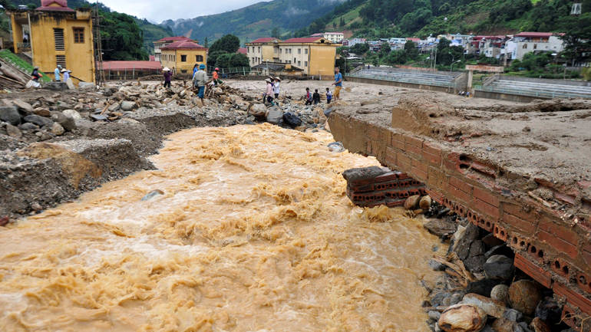
CONCLUSION AND NEXT STEPS
Improving operational forecasting – identifying key ingredients and processes that lead to flash floods
Spatial and temporal analysis – determining where and when flash floods are most likely to occur
Synoptic analysis – identifying the dominant weather type and flow regime (forward flank of a trough with southwesterly flow)
Mesoscale analysis
increased instability (moderate CAPE, low CIN)
high humidity (high RH, significant TPW, low cloud base, deep warm cloud layer)
moderate bulk wind shear – favorable for the development of mesoscale convective systems
Simultaneous analysis of meteorological parameters and hydrological models
www.meteo.hr
12th European Conference on Severe Storms, Utrecht, Netherlands – 17 to 21 November 2025

