Slide 1
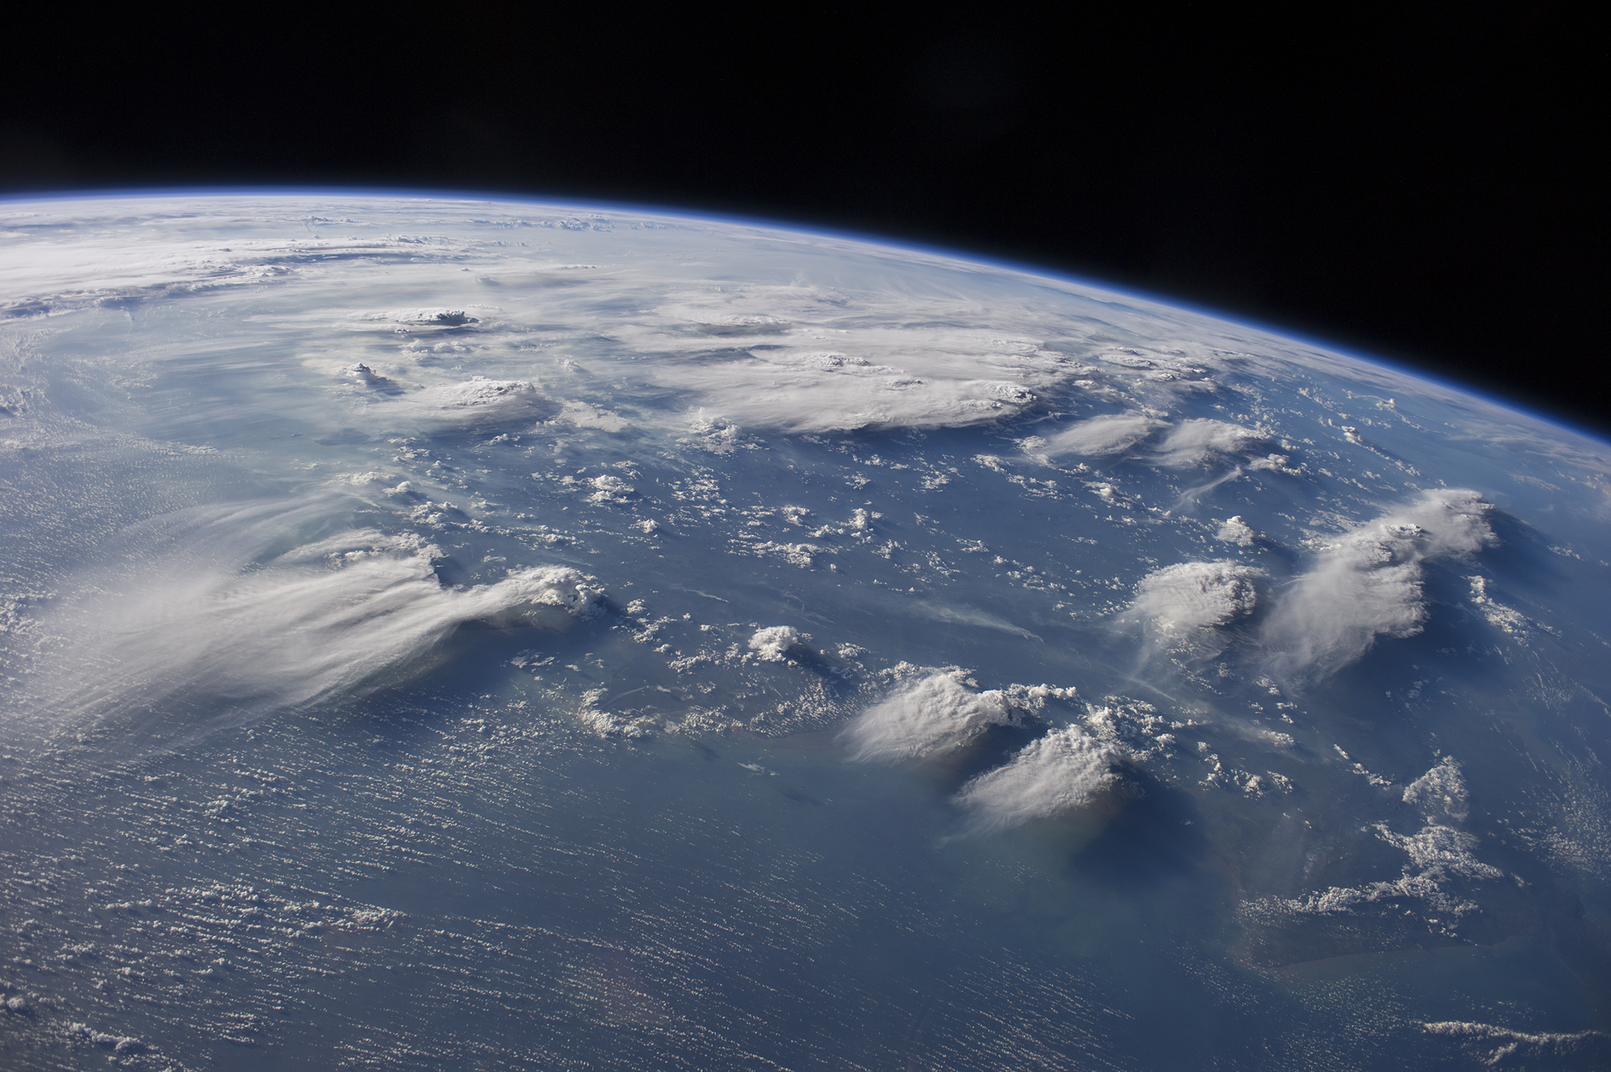


Satellite Multi-Sensor Perspective on Electrified Convection: EarthCARE and MTG-LI + GOES-GLM Synergy
Blanka Piskala, ESA – ESRIN, Italy
Johanna Mayer, Thorsten Fehr, Edward Malina, Daniele Gasbarra, Saskia Brose, Ondrej Nedelcev ECSS 2025

Slide 2
MOTIVATION & BACKGROUND
EarthCARE is a new satellite – first Doppler cloud radar in space
Brings a unique opportunity to look at clouds, aerosols, and dynamics in detail
Explore if EarthCARE measurements can describe or anticipate lightning activity
What I’ll show today
Quick overview of the EarthCARE mission and its instruments
How I combine EarthCARE with lightning sensors (MTG-LI, GOES-GLM)
A few case examples and research ideas

Slide 3

1 EarthCARE: MISSION OVERVIEW

Slide 4
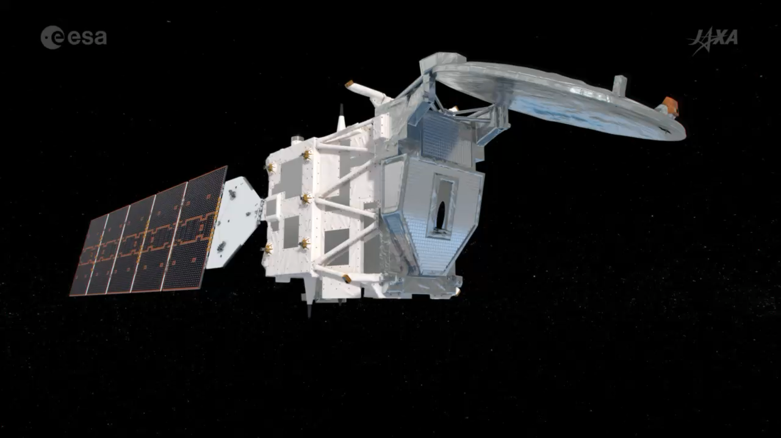
EarthCARE: MISSION OVERVIEW

Slide 5
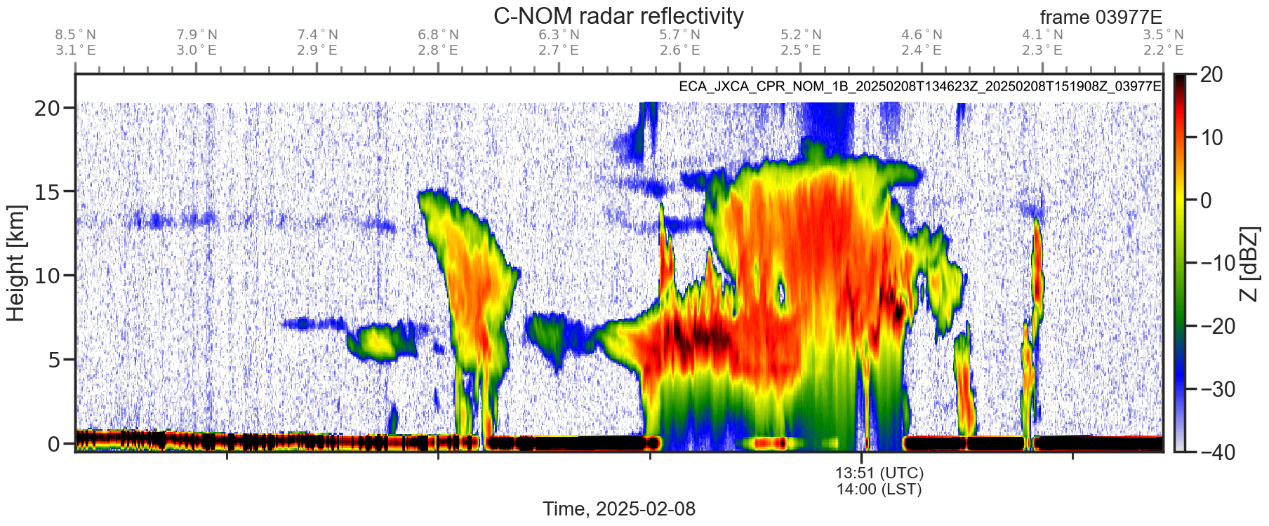
EarthCARE: MISSION OVERVIEW
EarthCARE CPR – Key Points:
94 GHz W-band Doppler Cloud Profiling Radar (λ ≈ 3 mm), PRF (~6–7 kHz)
Provides vertical profiles of reflectivity & Doppler velocity
Footprint: ~1 km along-track, 500 m vertical resolution
First Doppler cloud radar launched into space
Challenges: attenuation, multiple scattering, velocity folding - Nyquist limit ±5–6 m/s

Slide 6


2 COMBINATION WITH LIGHTNING SENSORS

Slide 7
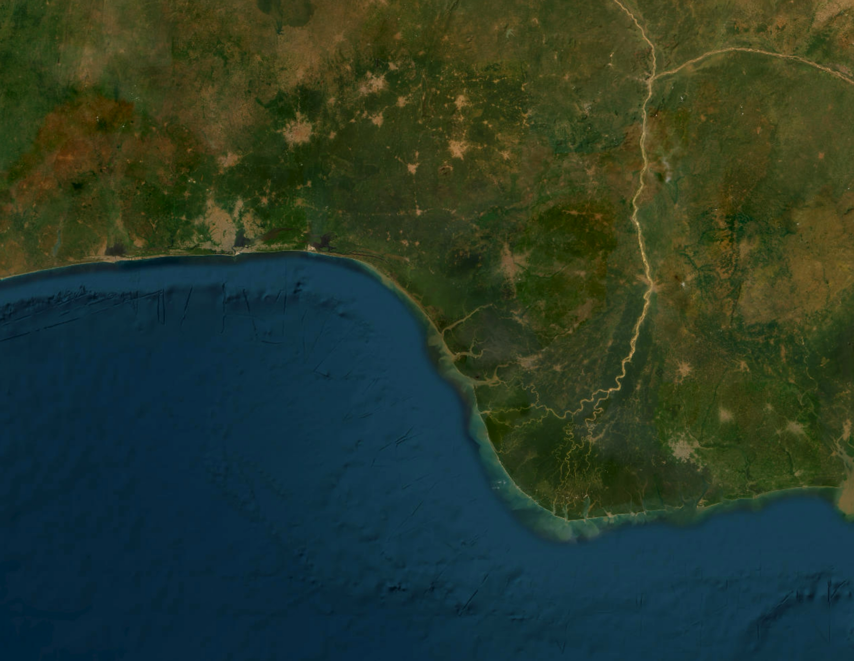
COMBINATION WITH LIGHTNING SENSORS
Spatial matching:
The geostationary satellites can introduce horizontal displacement errors (parallax) for lightning data due to the viewing geometry
Correction algorithms (based on Satpy and cloud height from EarthCARE) match the geostationary lightning detection with EarthCARE’s MSI
Temporal matching:
EarthCARE has a certain revisit time and narrow swath vs. geostationary continuous coverage
Identify overlapping time windows (within ±60 minutes) to capture simultaneous events and have reasonable information about the storm development

Slide 8
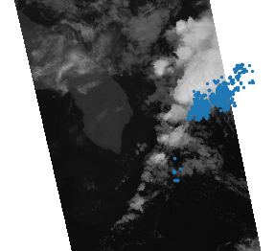
COMBINATION WITH LIGHTNING SENSORS
EarthCARE MSI + MTG-LI groups
2024/12/10 00:20
Challenges in EarthCARE–lightning matching:
Large viewing angle at higher latitudes → strong horizontal displacement
Parallax correction works only when the lightning comes from the upper cloud layer
When optical flashes reflect off lower clouds, the apparent position becomes unreliable
Ground-based networks could help to correct lightning locations

Slide 9
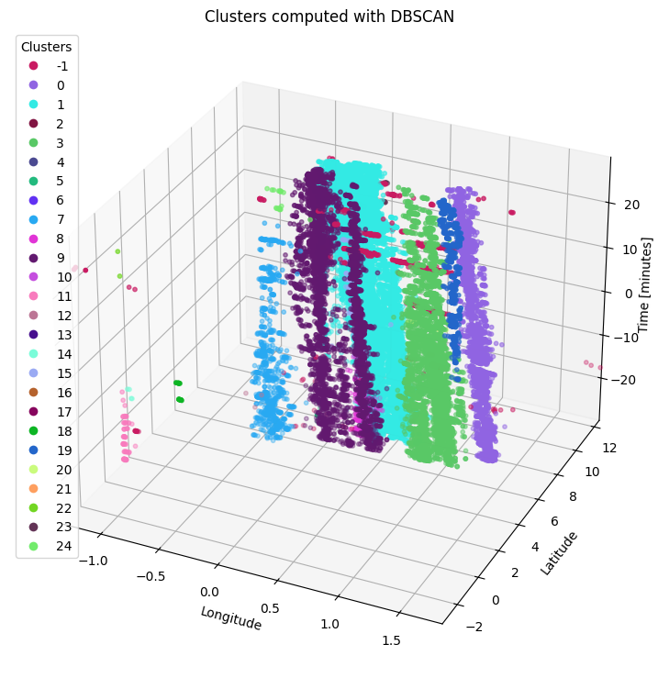
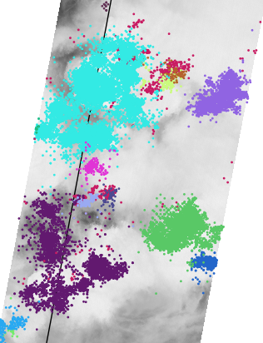
COMBINATION WITH LIGHTNING SENSORS
EarthCARE MSI + MTG-LI groups

Slide 10
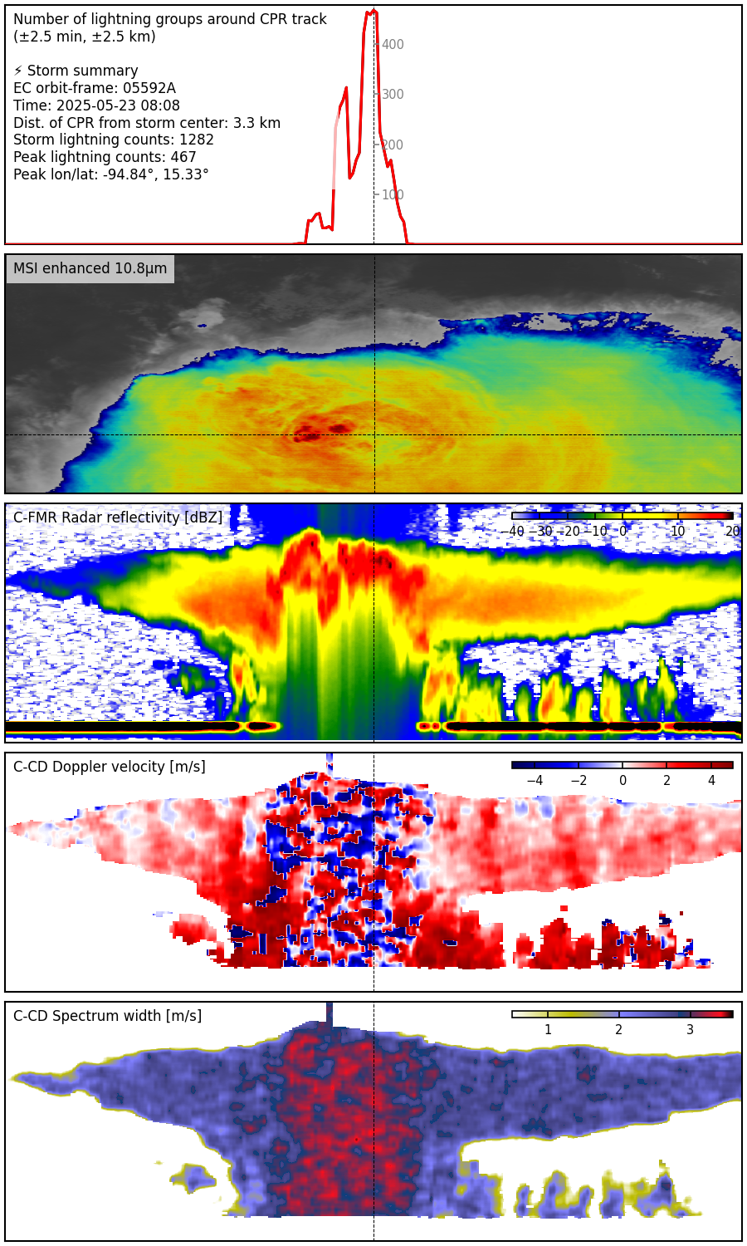
3 EXPLORING THE DATA

Slide 11
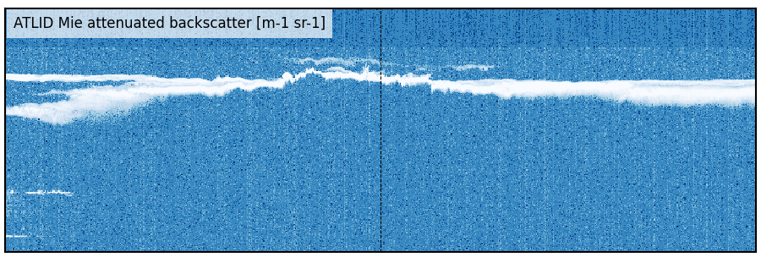
EXPLORING THE DATA
Case 1: Multi-sensor view of a convective storm
Geostationary lightning groups (±2.5 min; ±2.5 km around nadir)
MSI enhanced-IR image: overshooting tops clearly visible
CPR vertical slice: overshoot + upper cloud structure; strong attenuation & multiple scattering below
ATLID backscatter: cannot penetrate core, but reveals thin cirrus above the storm

Slide 12
EXPLORING THE DATA
Case 1: Multi-sensor view of a convective storm
Geostationary lightning groups (±2.5 min; ±2.5 km around nadir)
MSI enhanced-IR image: overshooting tops clearly visible
CPR vertical slice: overshoot + upper cloud structure; strong attenuation & multiple scattering below
ATLID backscatter: cannot penetrate core, but reveals thin cirrus above the storm
CPR Doppler velocity: absolute values fold in cores (Nyquist ±5–6 m/s), but the variability highlights turbulent, high vertical velocity regions

Slide 13
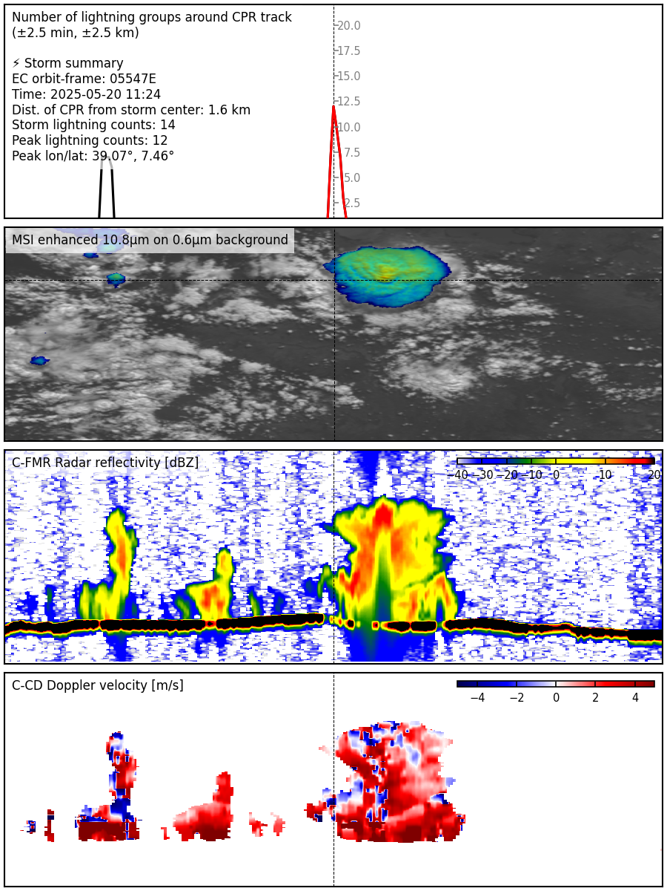
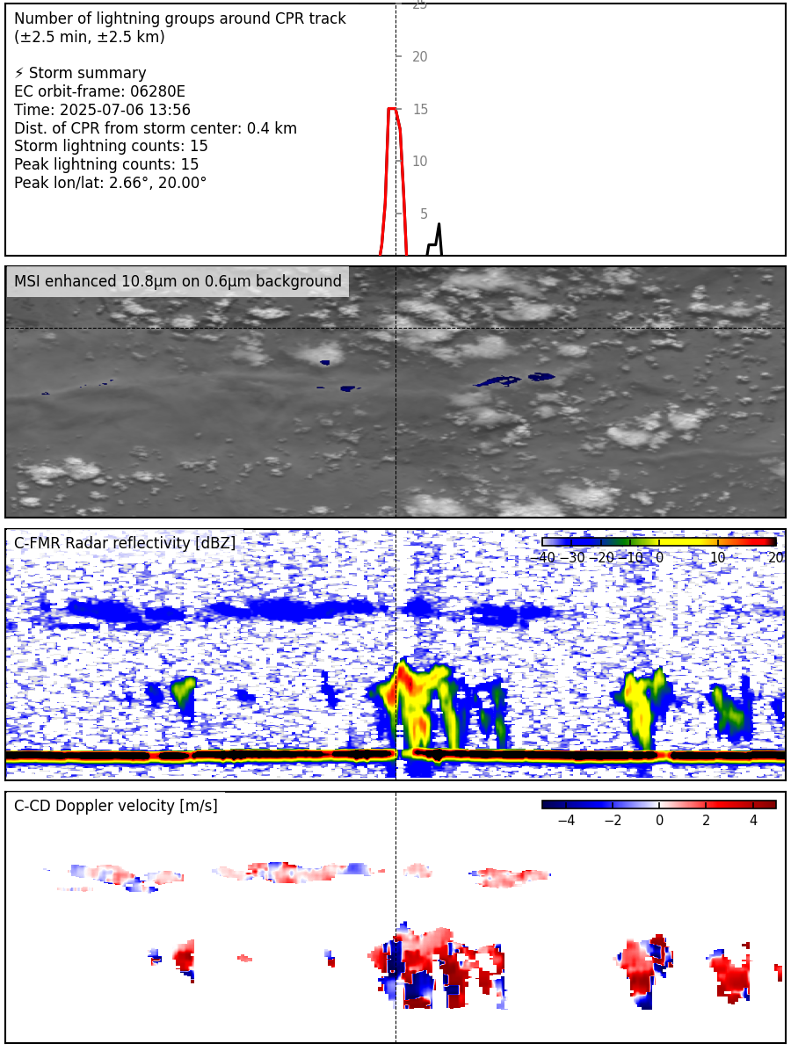
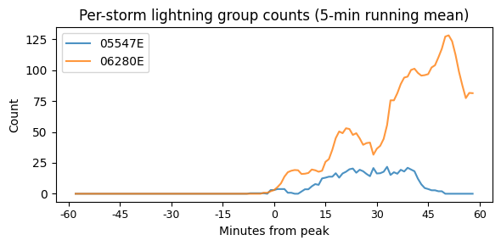
EXPLORING THE DATA
Case 2: Identifying storm life-cycle stage
Storm lifecycle stage (developing, mature, dissipating) is crucial for correctly interpreting EarthCARE observations
Lightning evolution (±1 hour) + clustering allows tracking each storm in time
Here: two storms in early development stage
Early-stage convection provides cleaner view of initial updraft conditions; Doppler velocities contain fewer foldings → easier to interpret / unfold

Slide 14
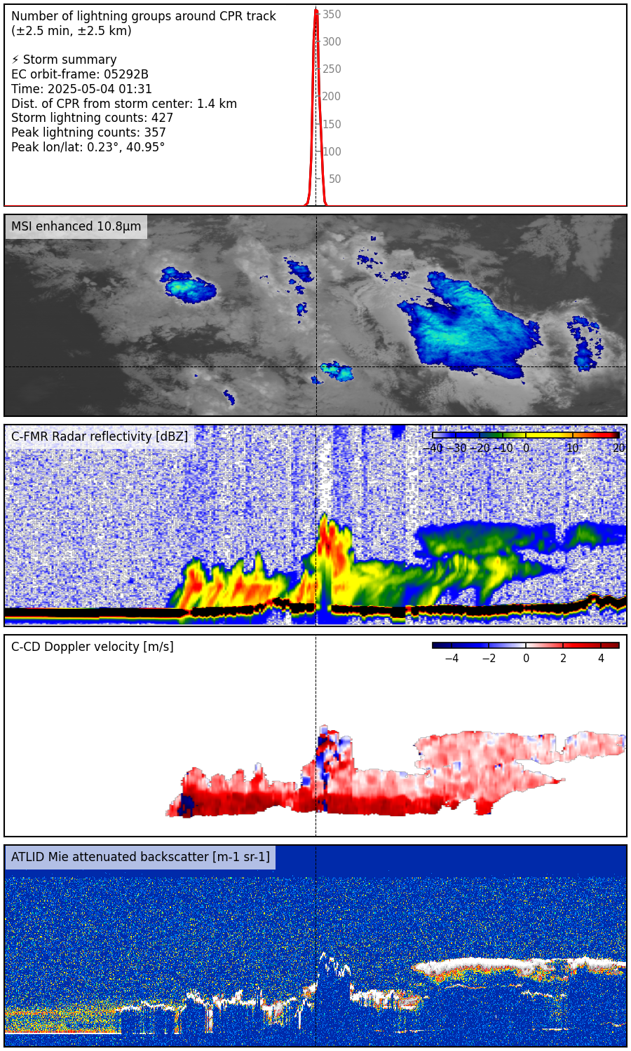
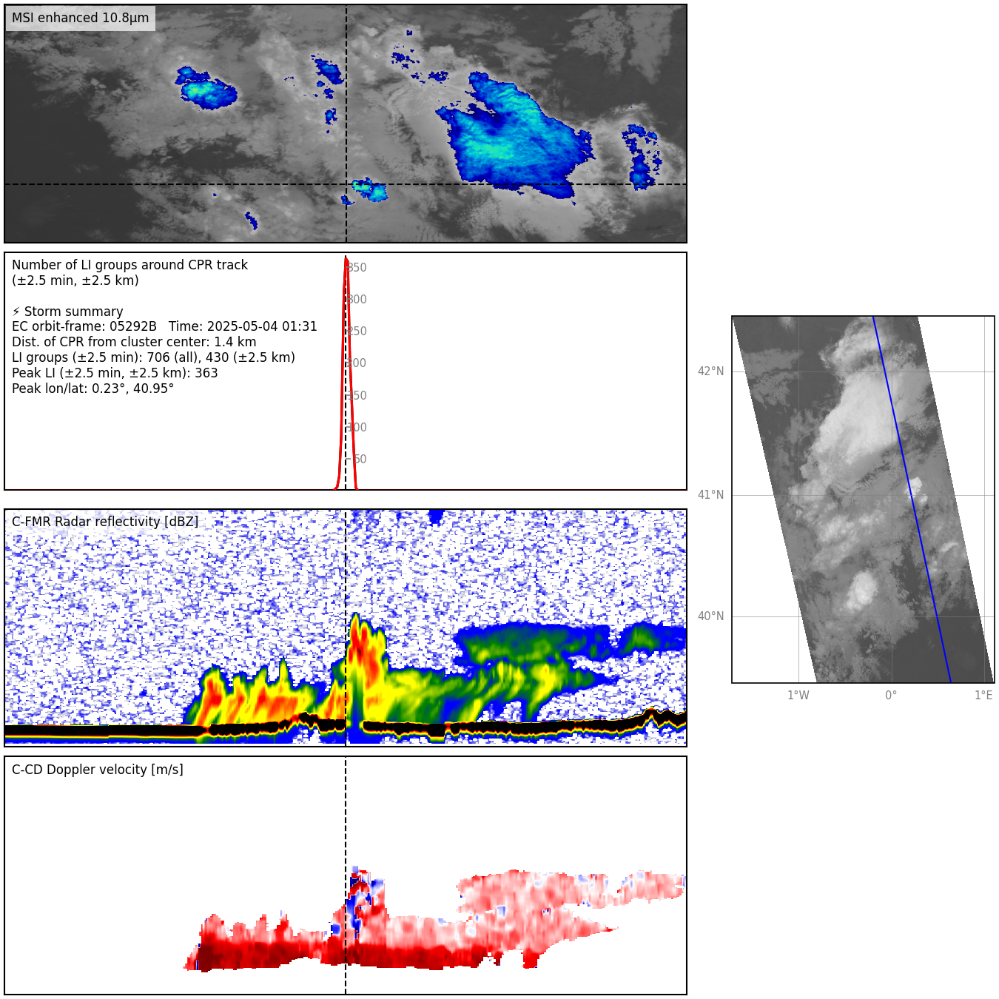
EXPLORING THE DATA
Case 3: Small storm over Spain
High number of lightning groups despite small storm size – possible influence of aerosol layer?
Surrounding environment classified as dusty smoke (EarthCARE target classification)
ATLID cannot see inside core, but shows aerosol layers around the storm
aerosol layer

Slide 15
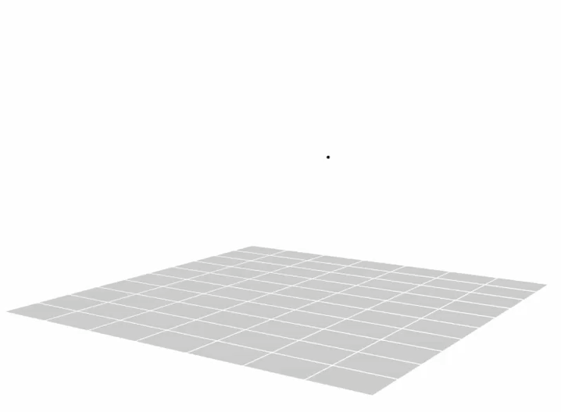
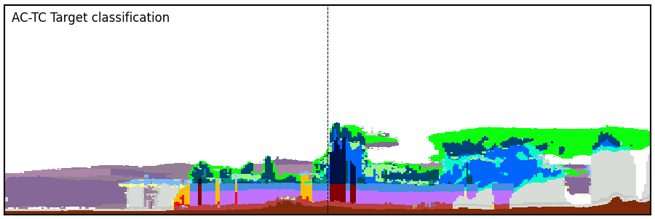
EXPLORING THE DATA
Case 3: Small storm over Spain
High number of lightning groups despite small storm size – possible influence of aerosol layer?
Surrounding environment classified as dusty smoke (EarthCARE target classification)
ATLID cannot see inside core, but shows aerosol layers around the storm
eLMA data provide 3D lightning source heights – enables direct comparison of lightning geometry with CPR dynamical features
dusty smoke

Slide 16
MAIN TAKEAWAYS
Developing an EarthCARE storm catalogue, ~400 storms so far; full-year processing ongoing
Opens new opportunities for multi-sensor studies of electrified convection
Current challenge: improving spatial collocation with geostationary lightning sensors
Catalogue will be publicly released and intended as a community resource
For more examples and comparisons → Poster P31

Slide 17
THANK YOU!
Blanka.Piskala@esa.int
Blanka Piskala, ESA – ESRIN, Italy
Johanna Mayer, Thorsten Fehr, Edward Malina, Daniele Gasbarra, Saskia Brose, Ondrej Nedelcev ECSS 2025

