Slide 1
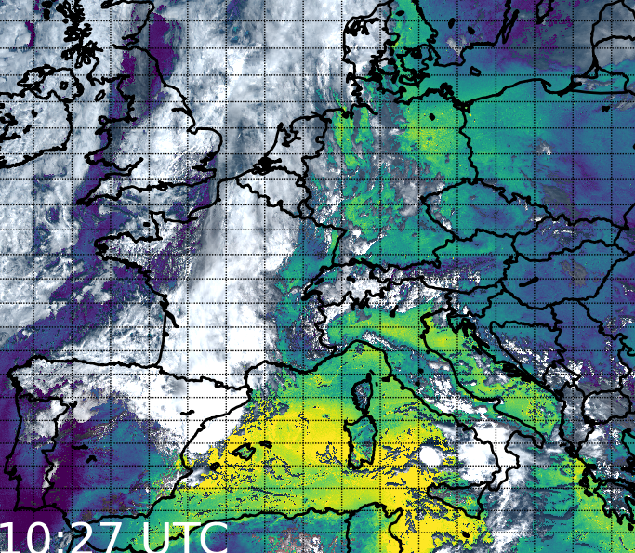



Exploring spatio-temporal distributions of MTG-FCI TCWV fields
in pre-convective environments
Cintia Carbajal Henken
Jan El Kassar & Rene Preusker
Freie Universität Berlin
ECSS Utrecht, Netherlands
18 November 2025
We acknowledge the use of the COWa software, supported by the Remote Sensing Products (RSP) division of EUMETSAT

Slide 2
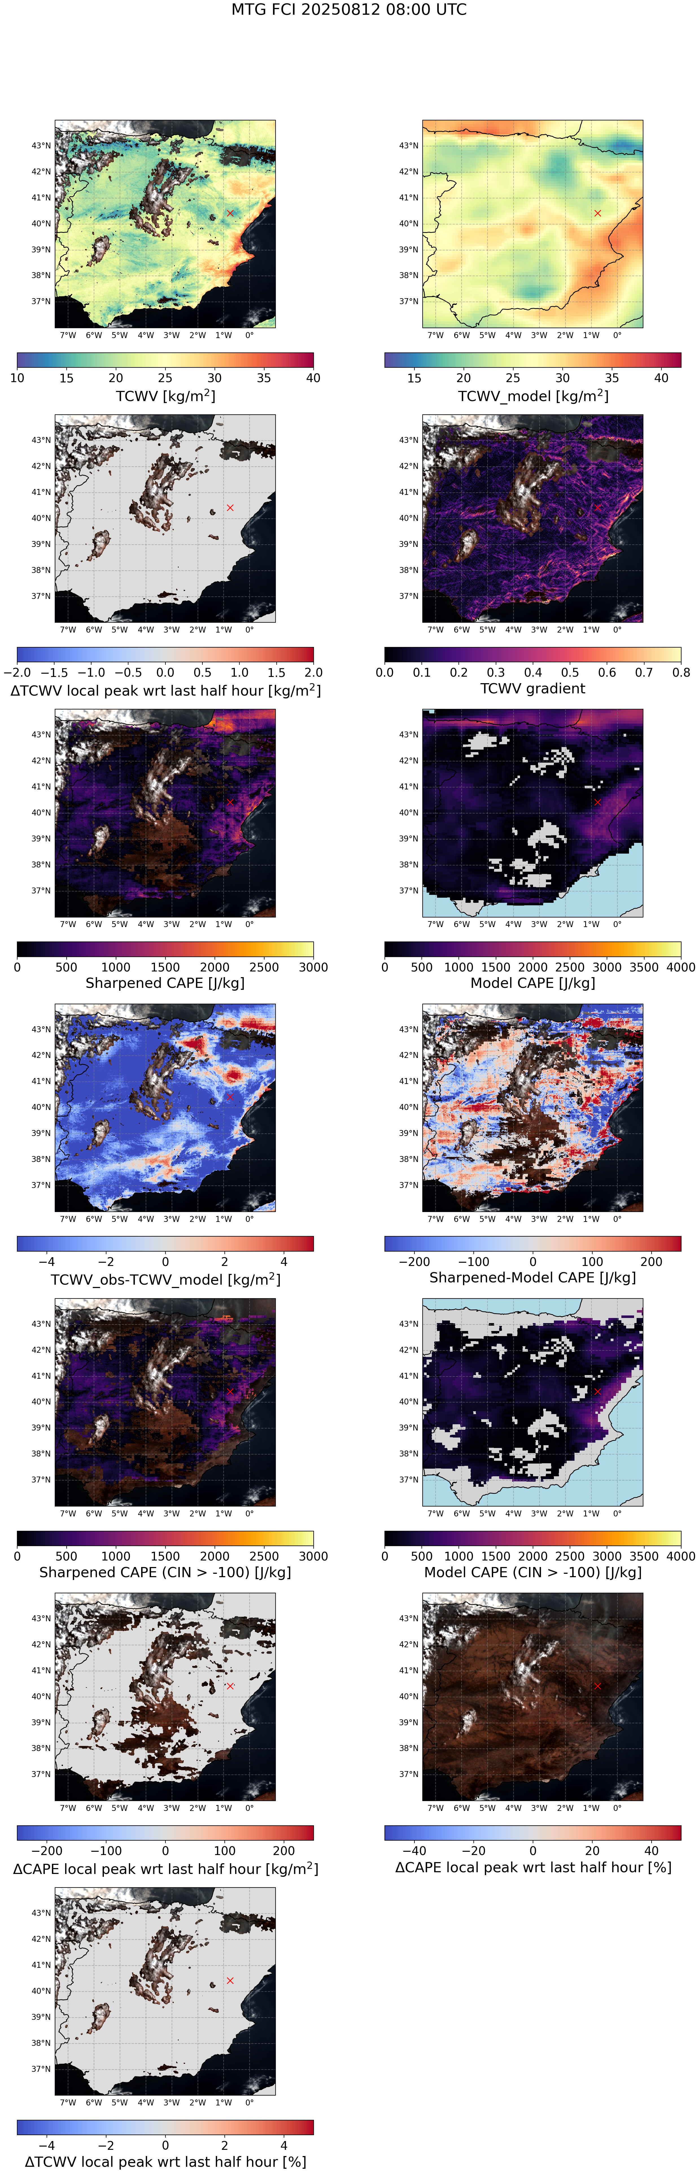
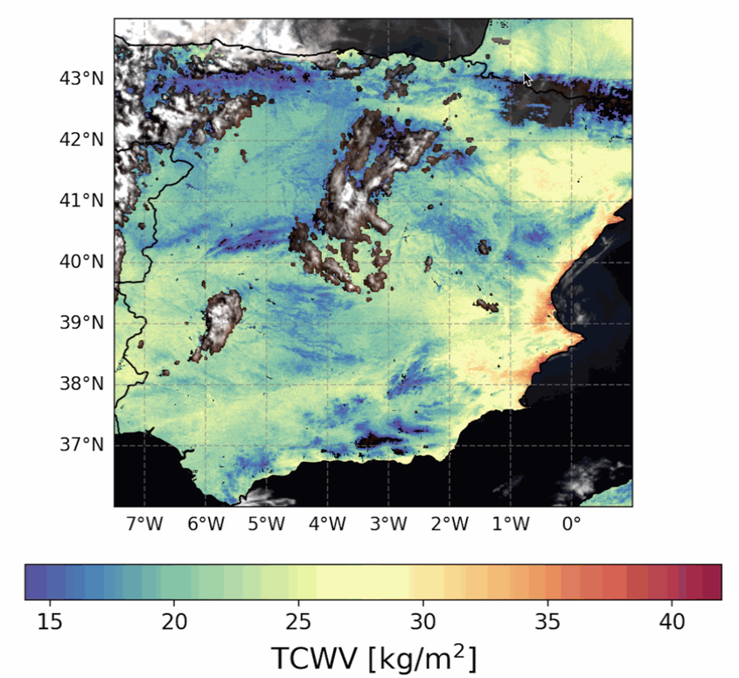
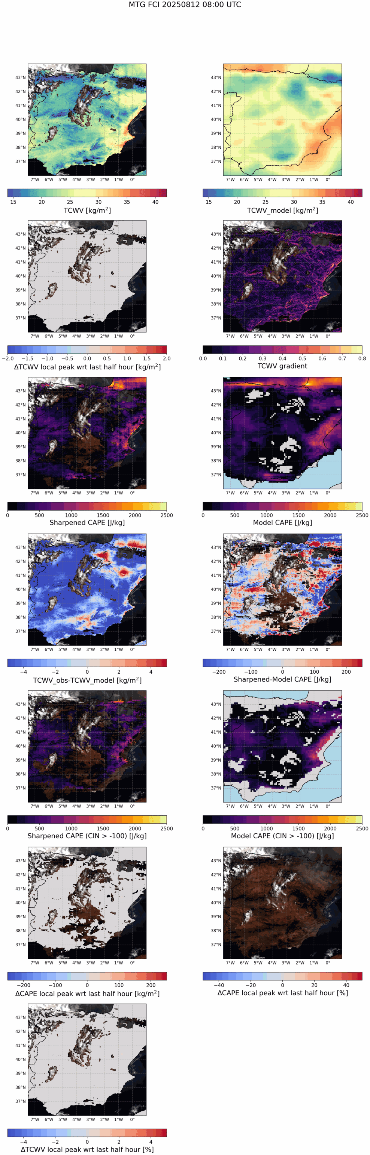
Water vapor: (in)visible fuel for convection
Before we have clouds, precipitation and associated severe weather, we have water vapor

Slide 3
Water vapor: (in)visible fuel for convection
Before we have clouds, precipitation and associated severe weather, we have water vapor

Slide 4
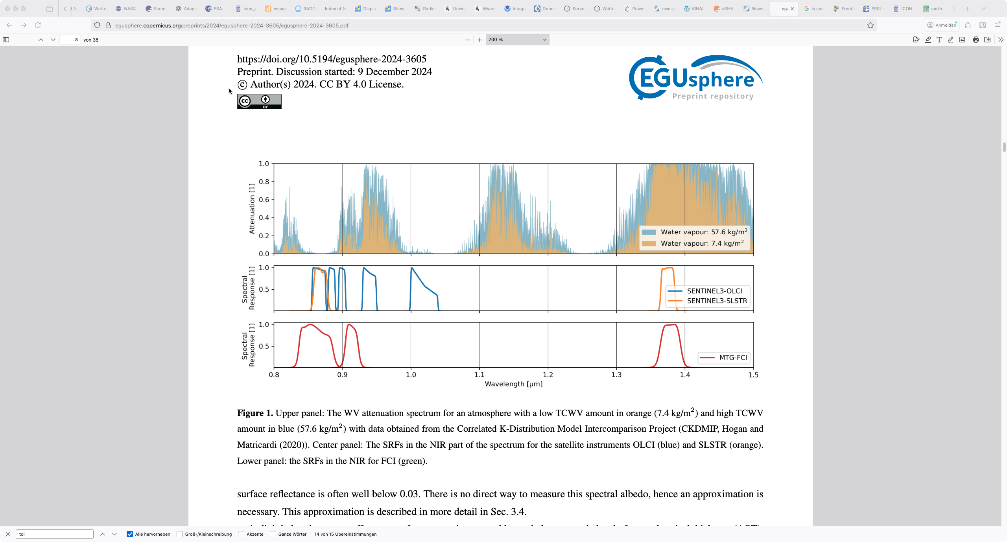
MTG FCI Near-Infrared measurements around 0.9 μm
more moisture
less moisture
Moderate water vapor absorption around 0.9 μm
MTG FCI TCWV retrieval framework based on well-established retrieval frameworks developed for instruments on polar-orbiting satellites; OLCI, MERIS, MODIS
Sentinel-3 A/B: OLCI
SLSTR
MTG FCI
Wavelengths [μm]
Image adapted from El Kassar et al., 2024

Slide 5
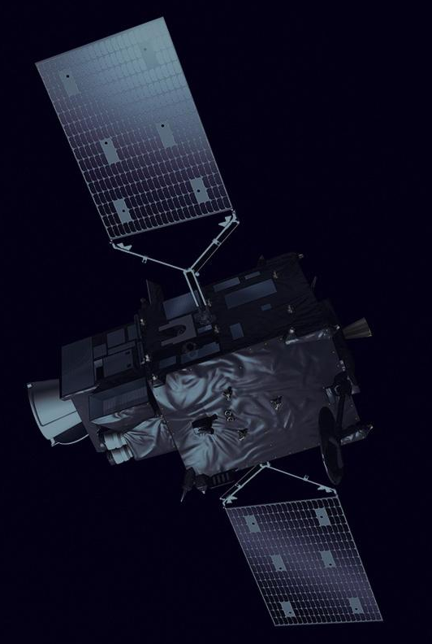
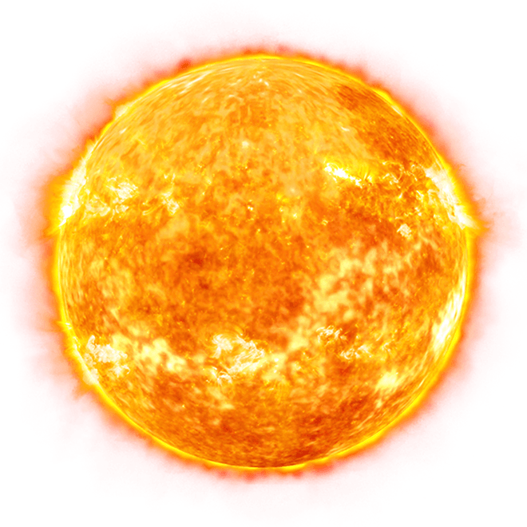

NIR TCWV retrieval principle
Image sources: EUMETSAT, stickpng.com, pngimg.com

Slide 6
NIR TCWV retrieval principle
measurement of amount of absorbed reflected solar radiance
Amount of water vapor
Image sources: EUMETSAT, stickpng.com, pngimg.com

Slide 7
NIR TCWV retrieval principle
Image sources: EUMETSAT, stickpng.com, pngimg.com

Slide 8
NIR TCWV retrieval principle
Viewing geometry θ_{sun}, θ_{sat}, ϕ_{rel}
Atmospheric profiles
Aerosol amount
Image sources: EUMETSAT, stickpng.com, pngimg.com
Surface reflectance

Slide 9
NIR TCWV retrieval principle
Viewing geometry θ_{sun}, θ_{sat}, ϕ_{rel}
Daytime & cloud-free
Above reflective surfaces
Atmospheric profiles
Aerosol amount
Image sources: EUMETSAT, stickpng.com, pngimg.com
Surface reflectance

Slide 10
NIR TCWV retrieval principle
Viewing geometry θ_{sun}, θ_{sat}, ϕ_{rel}
Daytime & cloud-free
Above reflective surfaces
Very low dependency on T and q atmospheric profiles
Sensitive to low-level moisture
El Kassar et al., 2024
Preusker et al., 2021
Atmospheric profiles
Aerosol amount
Image sources: EUMETSAT, stickpng.com, pngimg.com
Surface reflectance

Slide 11
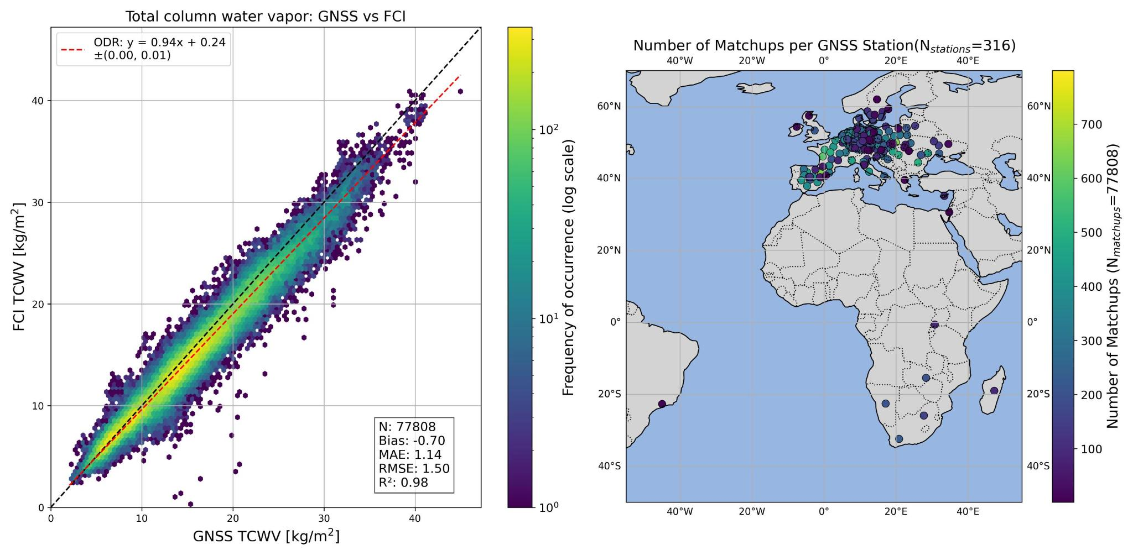
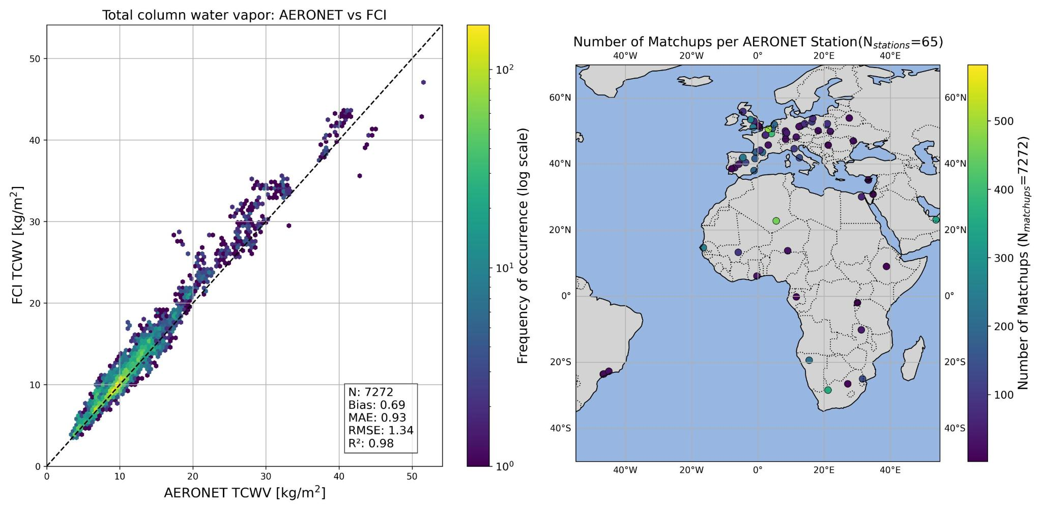
MTG-FCI TCWV validation studies
Validation with ground-based observations using GNSS and AERONET TCWV products:
Located within FCI disc, stations mainly in Europe
Months April-July
For spatial/temporal homogeneous & clear-sky conditions
GNSS
Bias < |1 kg/m²|
RMSE <= 1.5 kg/m²
Aeronet

Slide 12
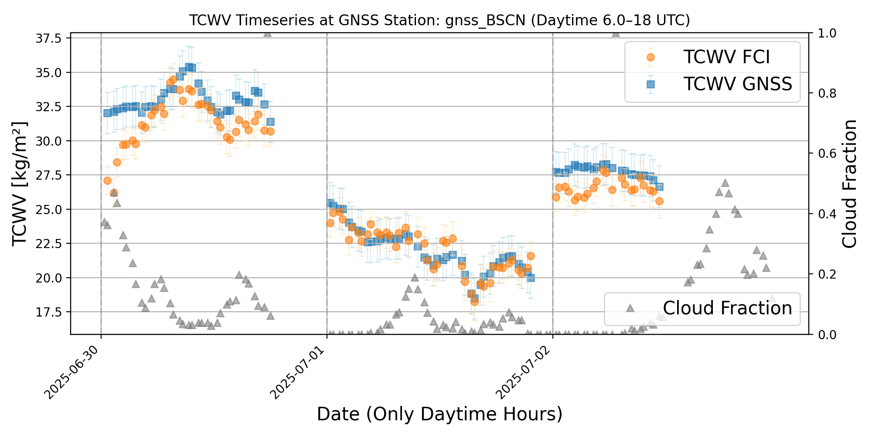
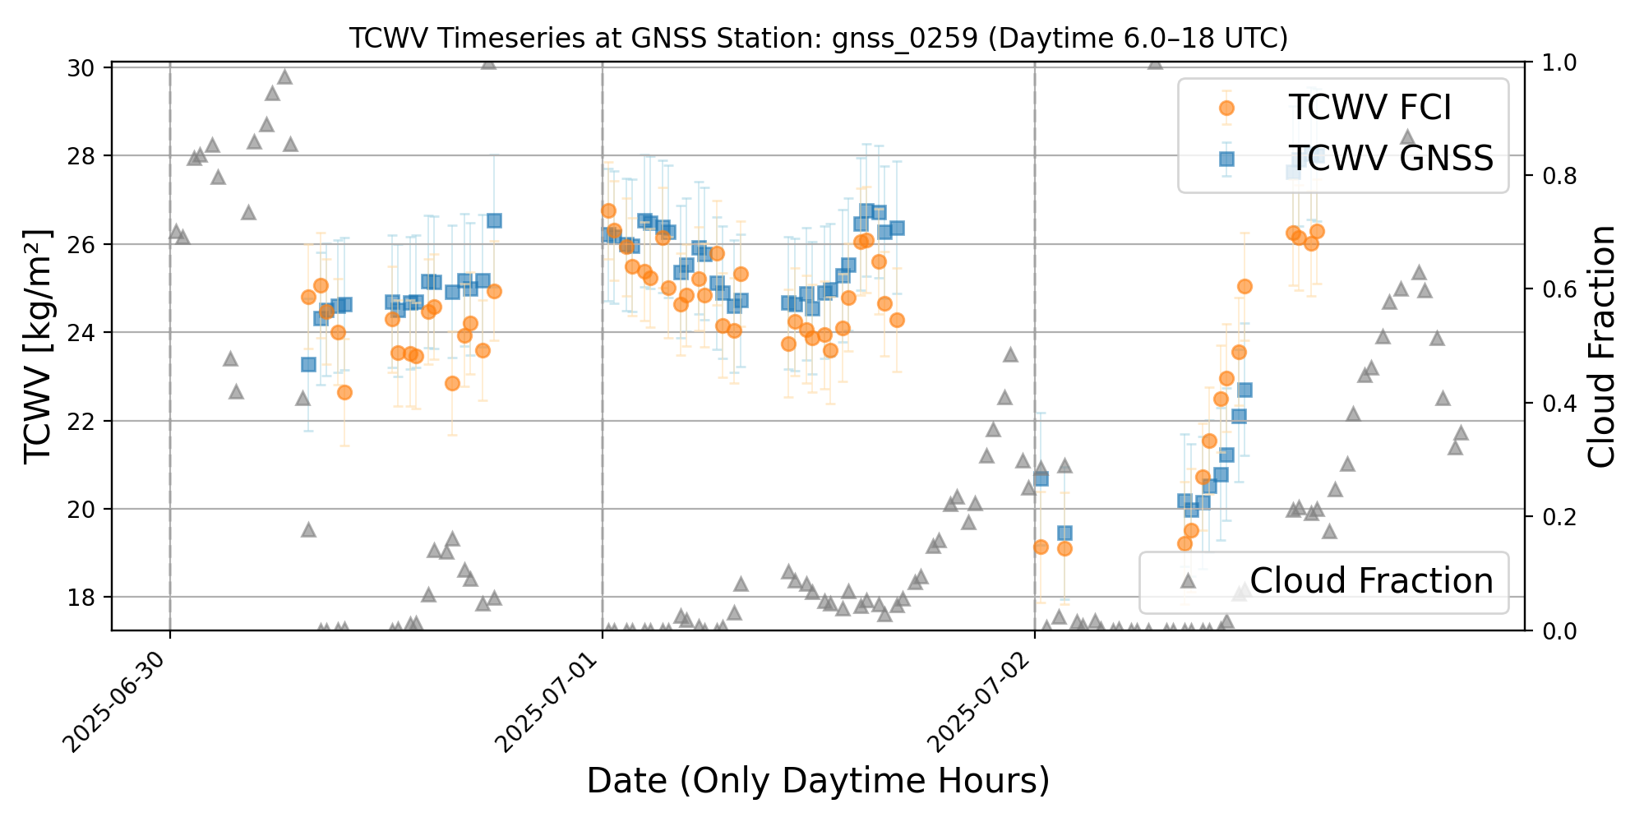
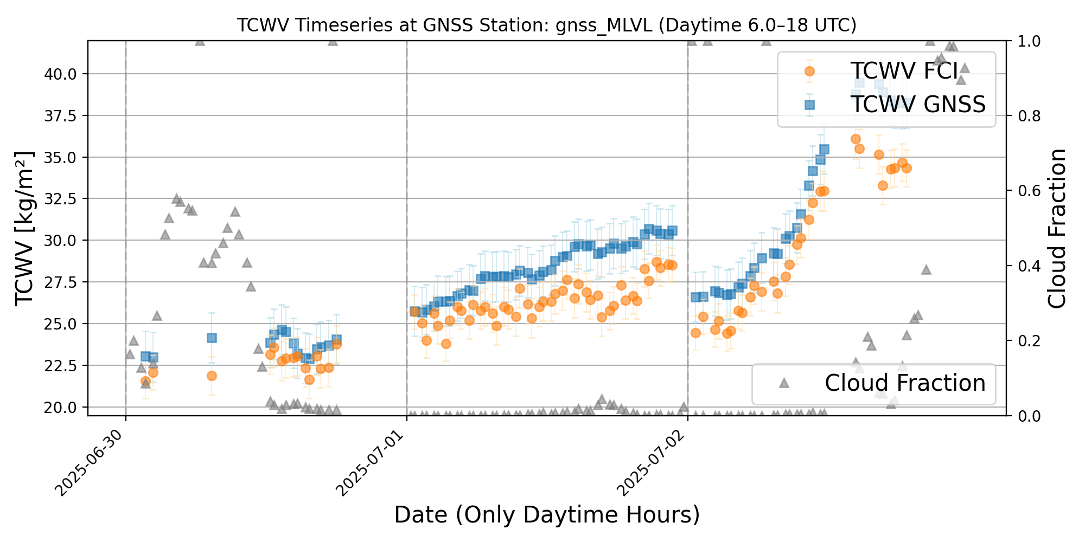
MTG-FCI TCWV temporal evolution and validation

Slide 13
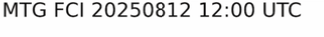
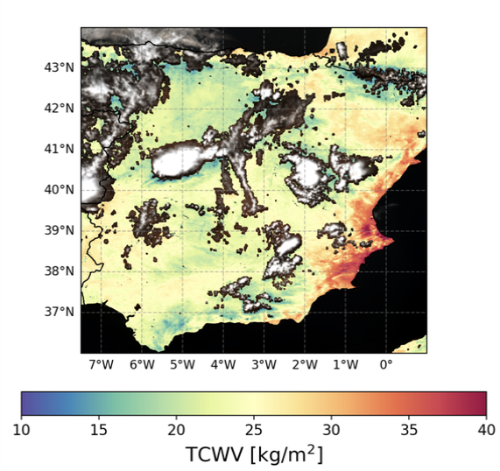
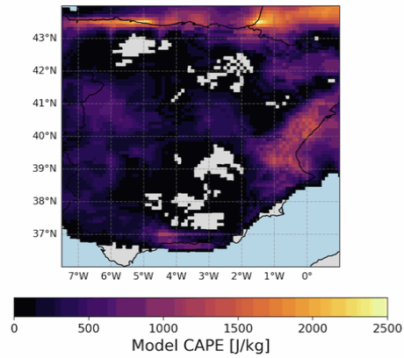
Case 12 August 2025

Slide 14
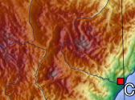
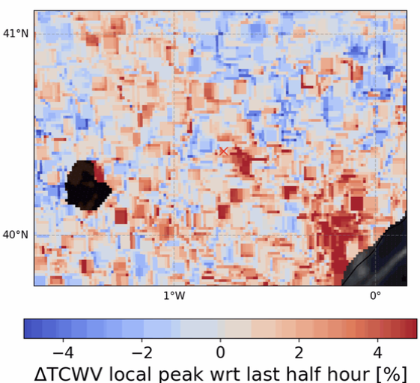
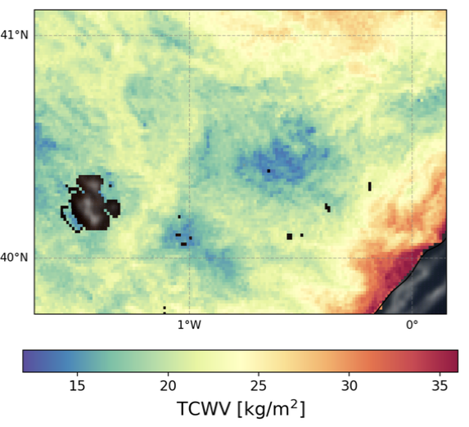
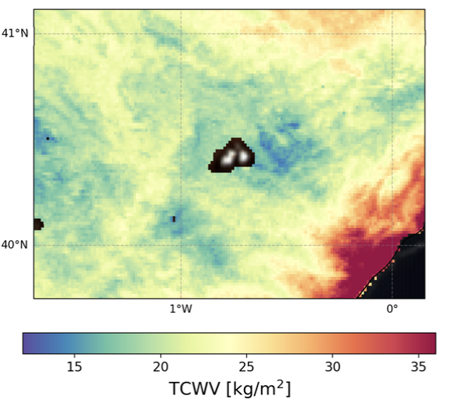
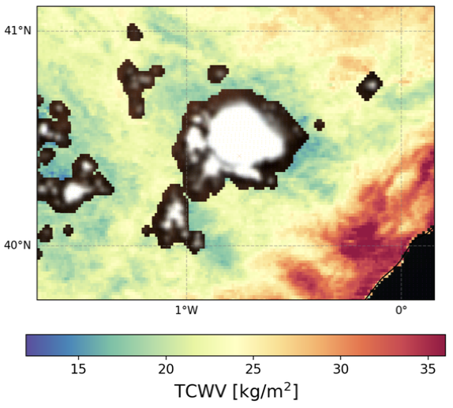
Case 12 August 2025
Topography map *
TCWV tendency at 08.30 UTC
08:00 UTC
09:30 UTC
11:00 UTC
near
surface
wind
* https://upload.wikimedia.org/wikipedia/commons/3/3c/Spain_topo.jpg

Slide 15
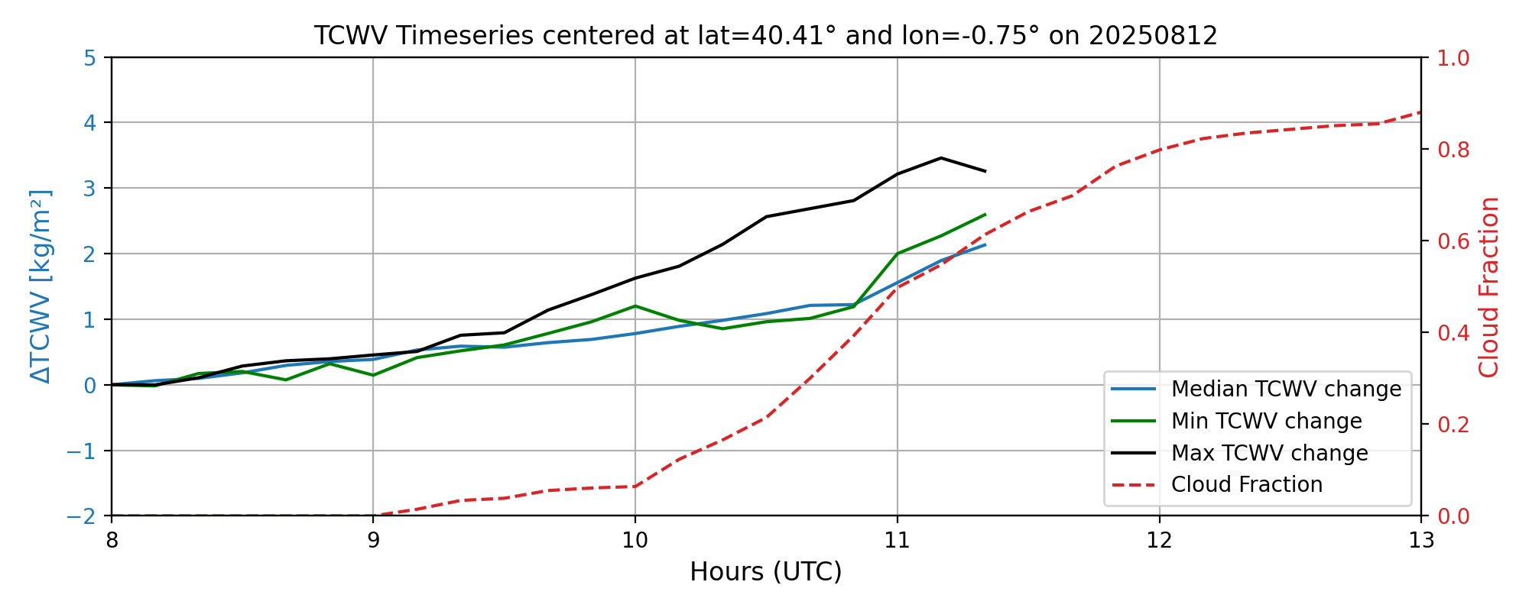
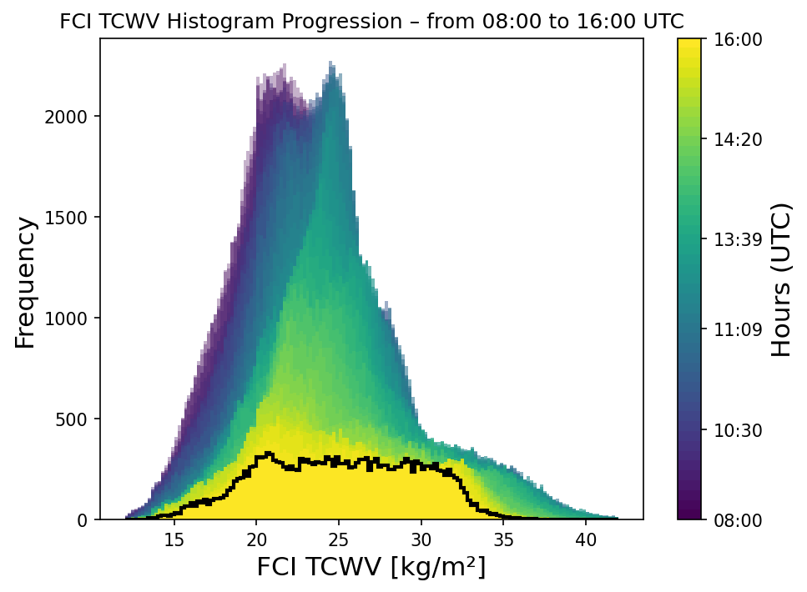
Case 12 August 2025
08:00 UTC
09:30 UTC
11:00 UTC
near
surface
wind
* https://upload.wikimedia.org/wikipedia/commons/3/3c/Spain_topo.jpg

Slide 16
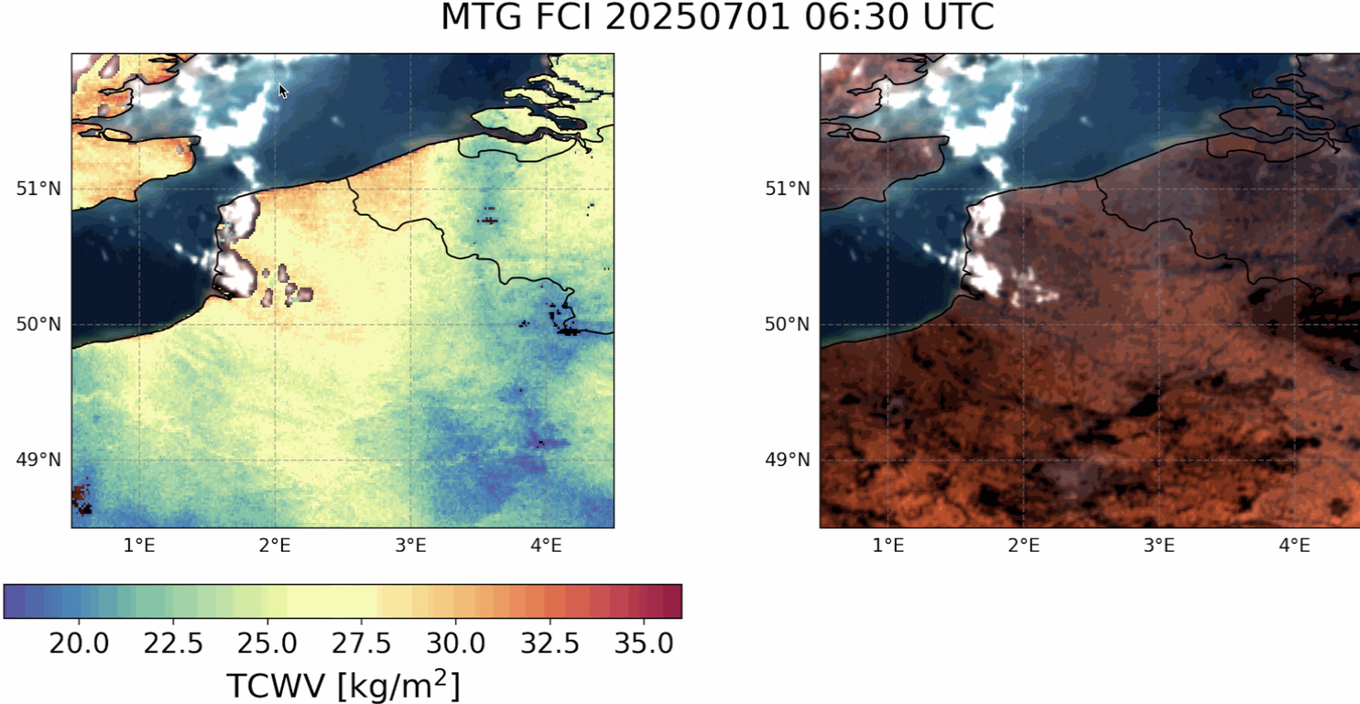
Case 1 July 2025
near
surface wind
near
surface wind
near
surface
wind
near
surface
wind
wind at 700 hPa
wind at 700 hPa

Slide 17
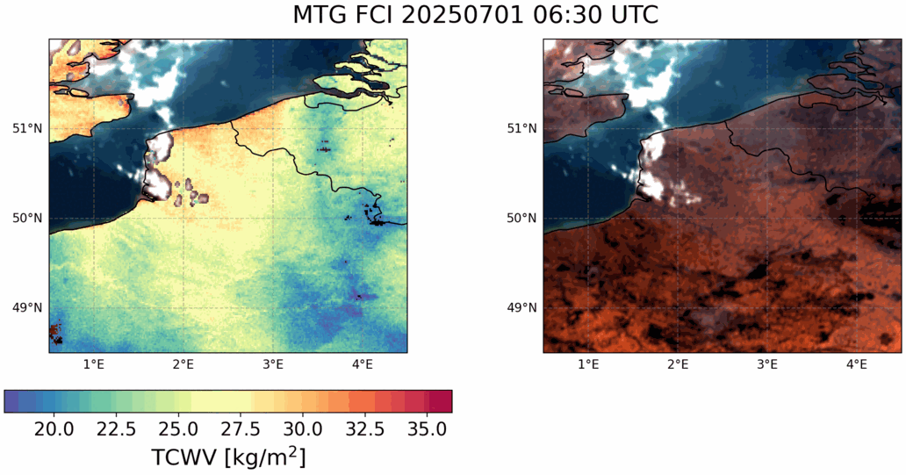
Case 1 July 2025
near
surface wind
near
surface wind
near
surface
wind
near
surface
wind
wind at 700 hPa
wind at 700 hPa

Slide 18
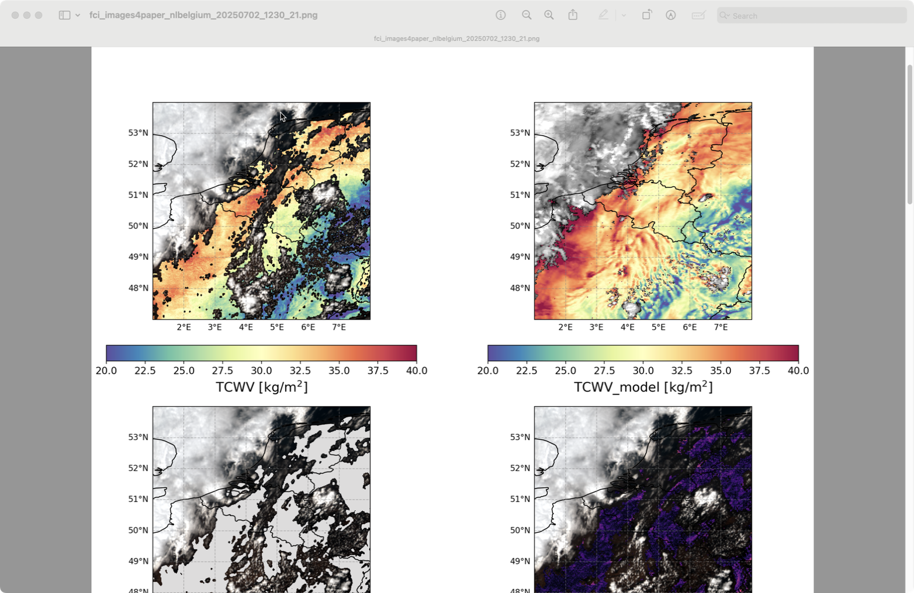
Case 2 July 2025
Large hail (ESWD reports)
MTG FCI 12.30 UTC
ICON-D2 12.00 UTC

Slide 19
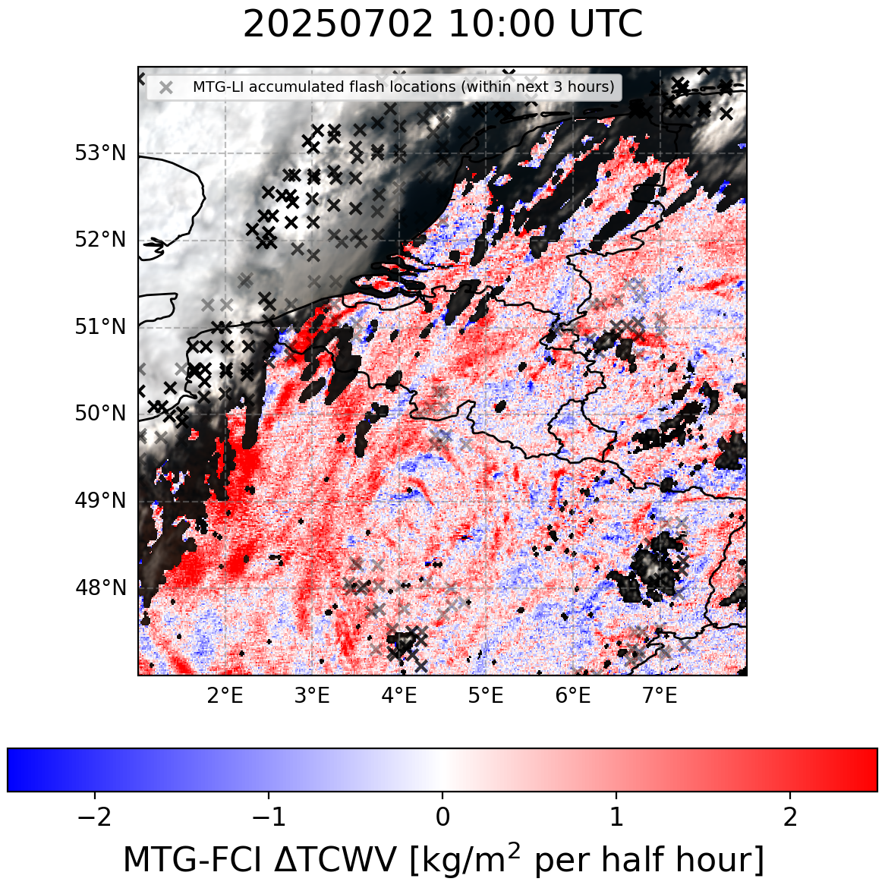
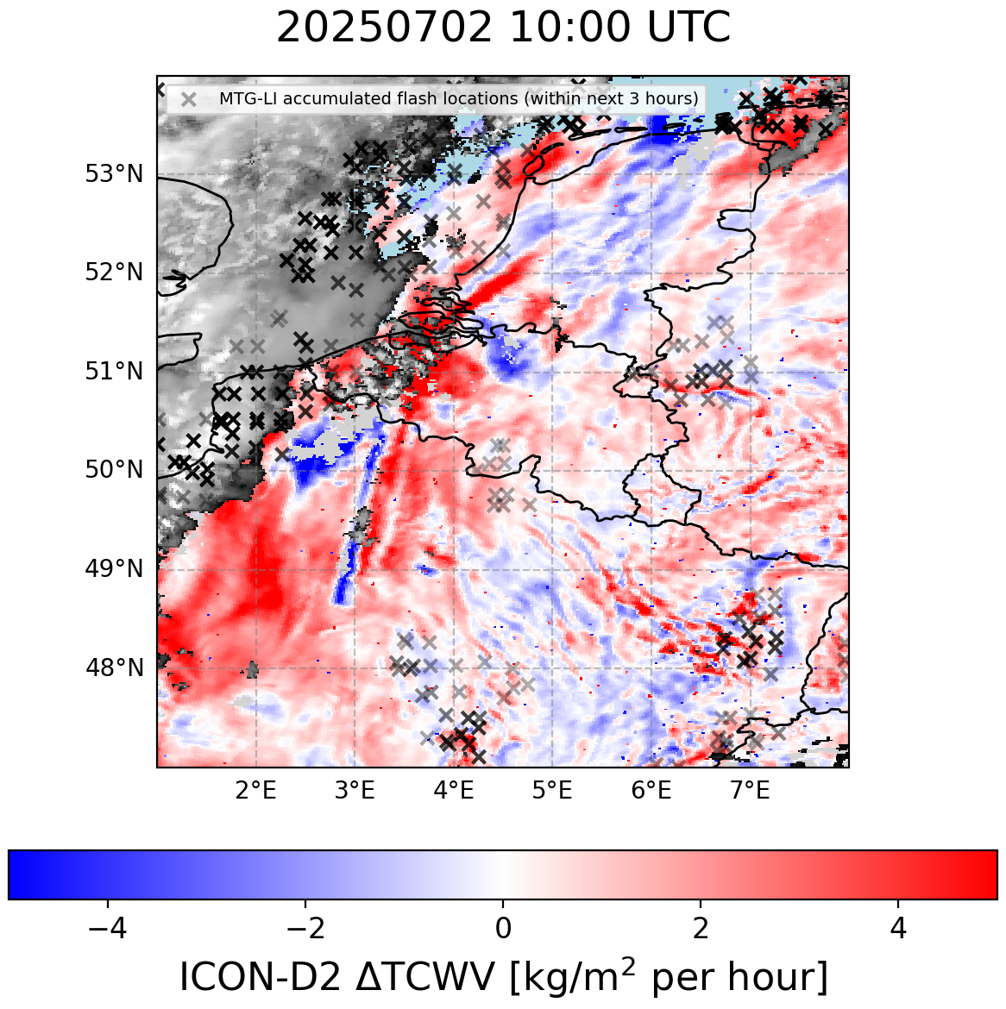
Case 2 July 2025
MTG-FCI TCWV tendency
ICON-D2 TCWV tendency

Slide 20
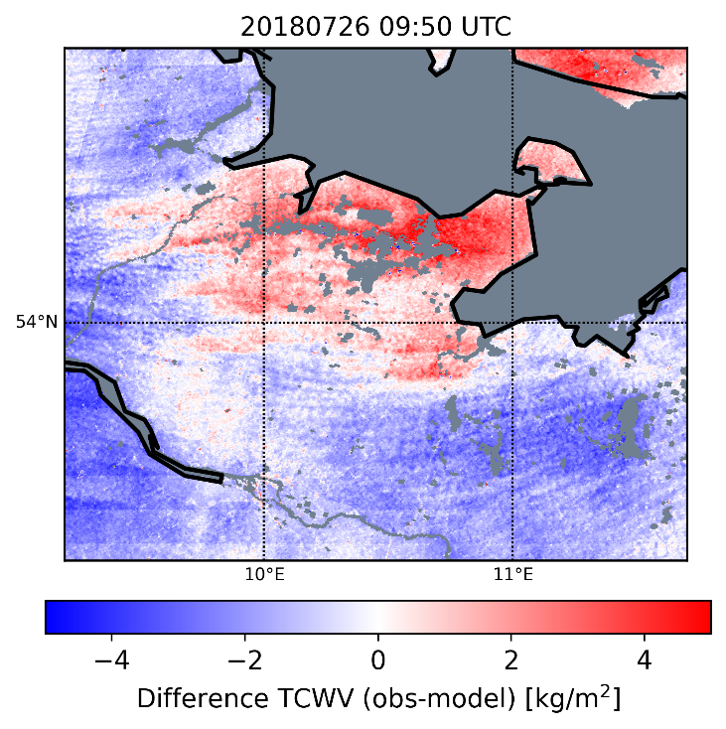
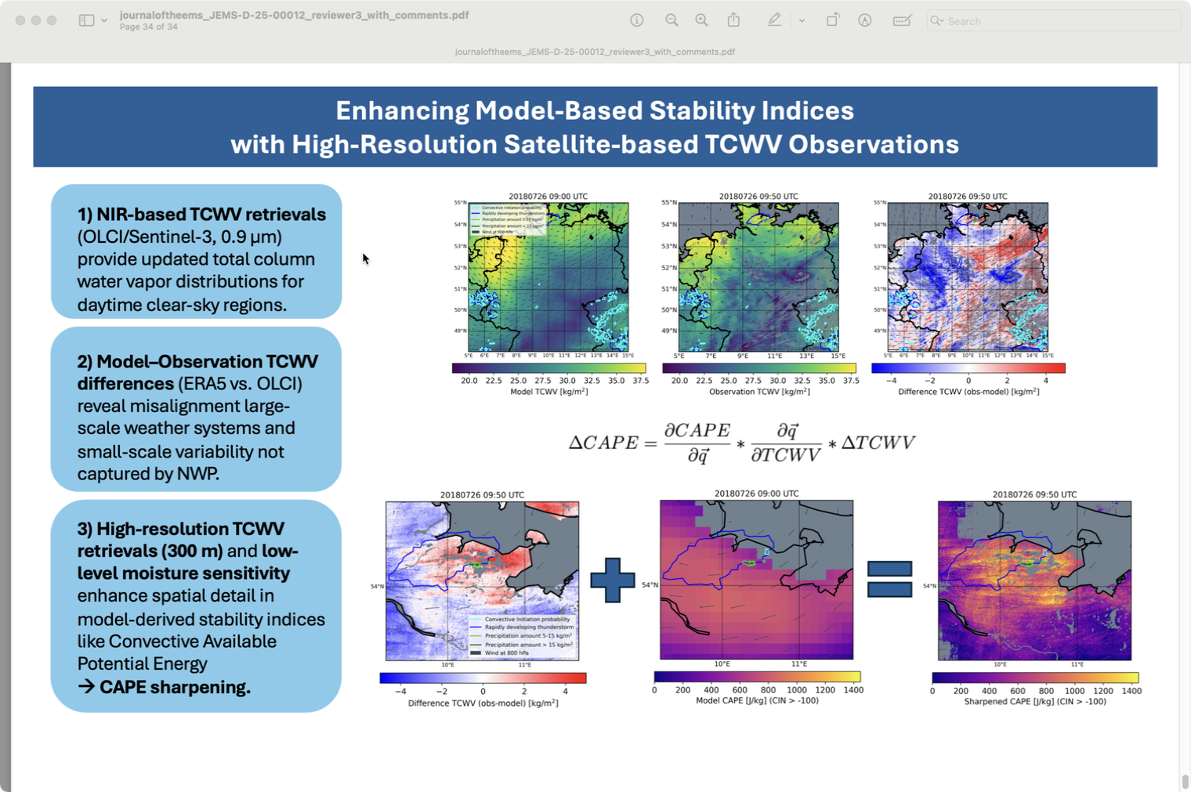
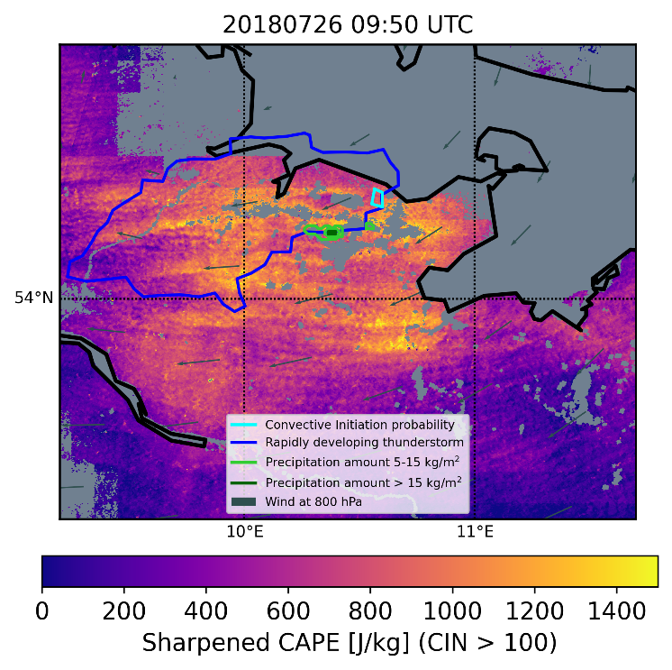
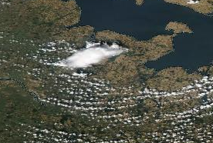
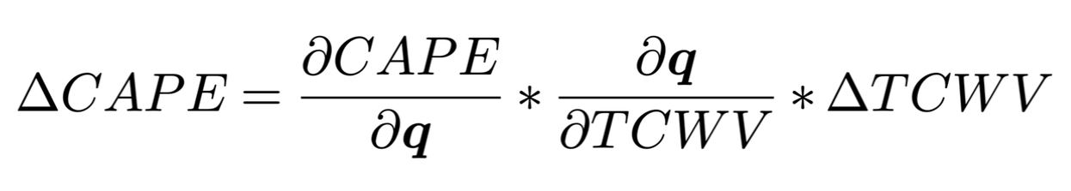
CAPE Sharpening
Can we feed in our information on TCWV distributions into computations of instability indices that provide information on convective potential?
1) NIR-based TCWV retrievals
provide update of TCWV with spatial detail
2) Model–Observation TCWV differences
reveal misalignment large-scale weather systems and small-scale variability not captured by NWP
3) CAPE Sharpening
enhance spatial detail in model-derived stability indices like CAPE/CIN
(Carbajal Henken et al., 2025, accepted in JEMS)
MODIS-Aqua at 11.50 UTC

Slide 21
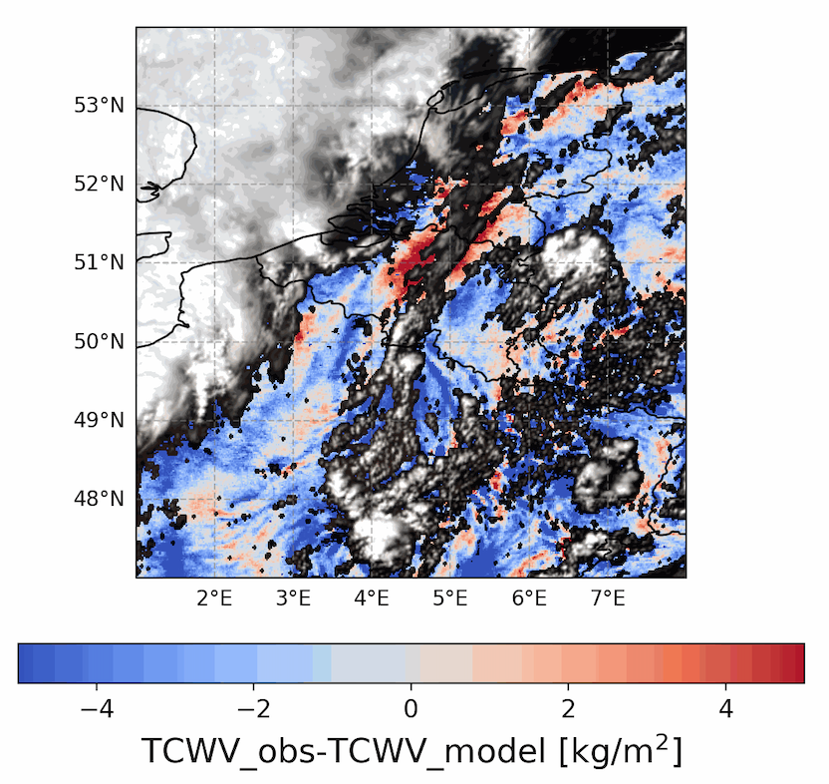
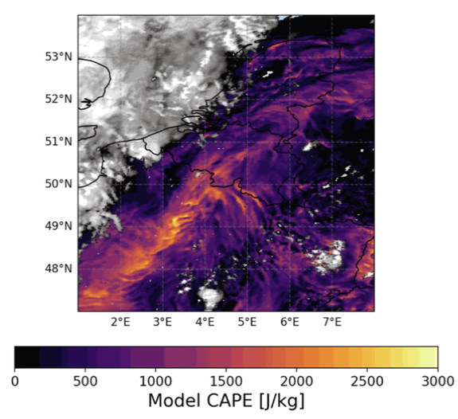
Case 2 July 2025
12:30 UTC
12:00 UTC
ΔTCWV (MTG-FCI – ICON-D2)
ICON-D2 CAPE

Slide 22
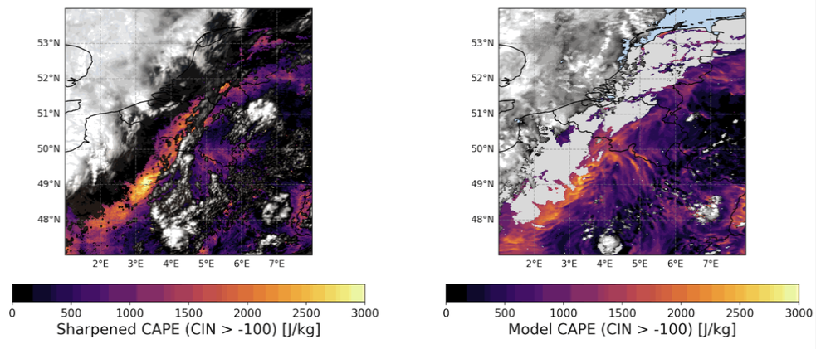
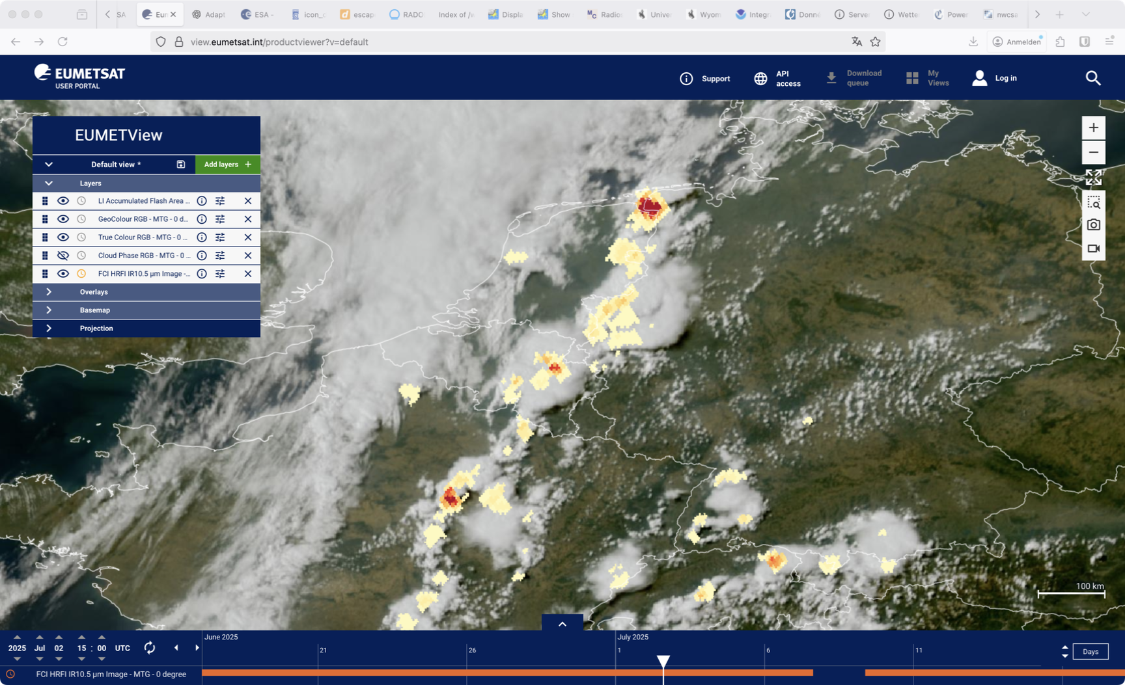
Case 2 July 2025
12:30 UTC
12:00 UTC
Sharpened MTG-FCI CAPE
ICON-D2 CAPE
MTG FCI True Colour RGB + MTG LI AFA
15 UTC
Source: EUMETVIEW

Slide 23
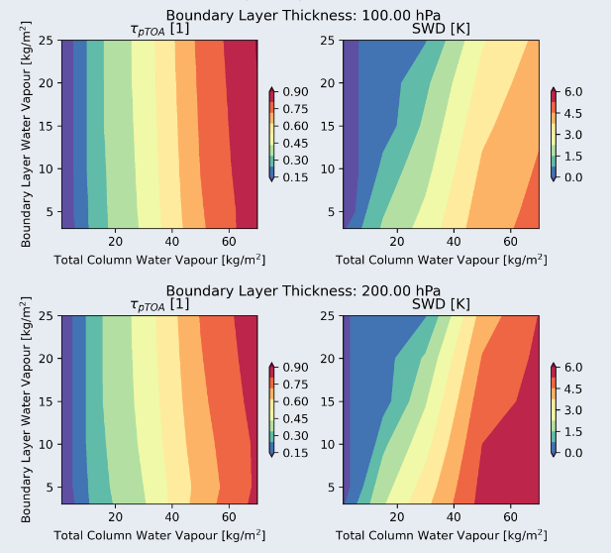
Outlook
Ongoing fine-tuning and validation
Combining FCI TCWV with MTG-LI lightning and precipitation data, looking at heavy precipitation/severe weather events and statistical relation to preceding moisture field distributions
Further exploration of CAPE sharpening approach
NIR: 0.9μm/0.86μm
TIR:
11μm - 12μm
Towards information on boundary layer WV estimates
→ Poster 23: ECSS2025-277 Jan El Kassar

Slide 24
Thank you
for your attention!

Slide 25
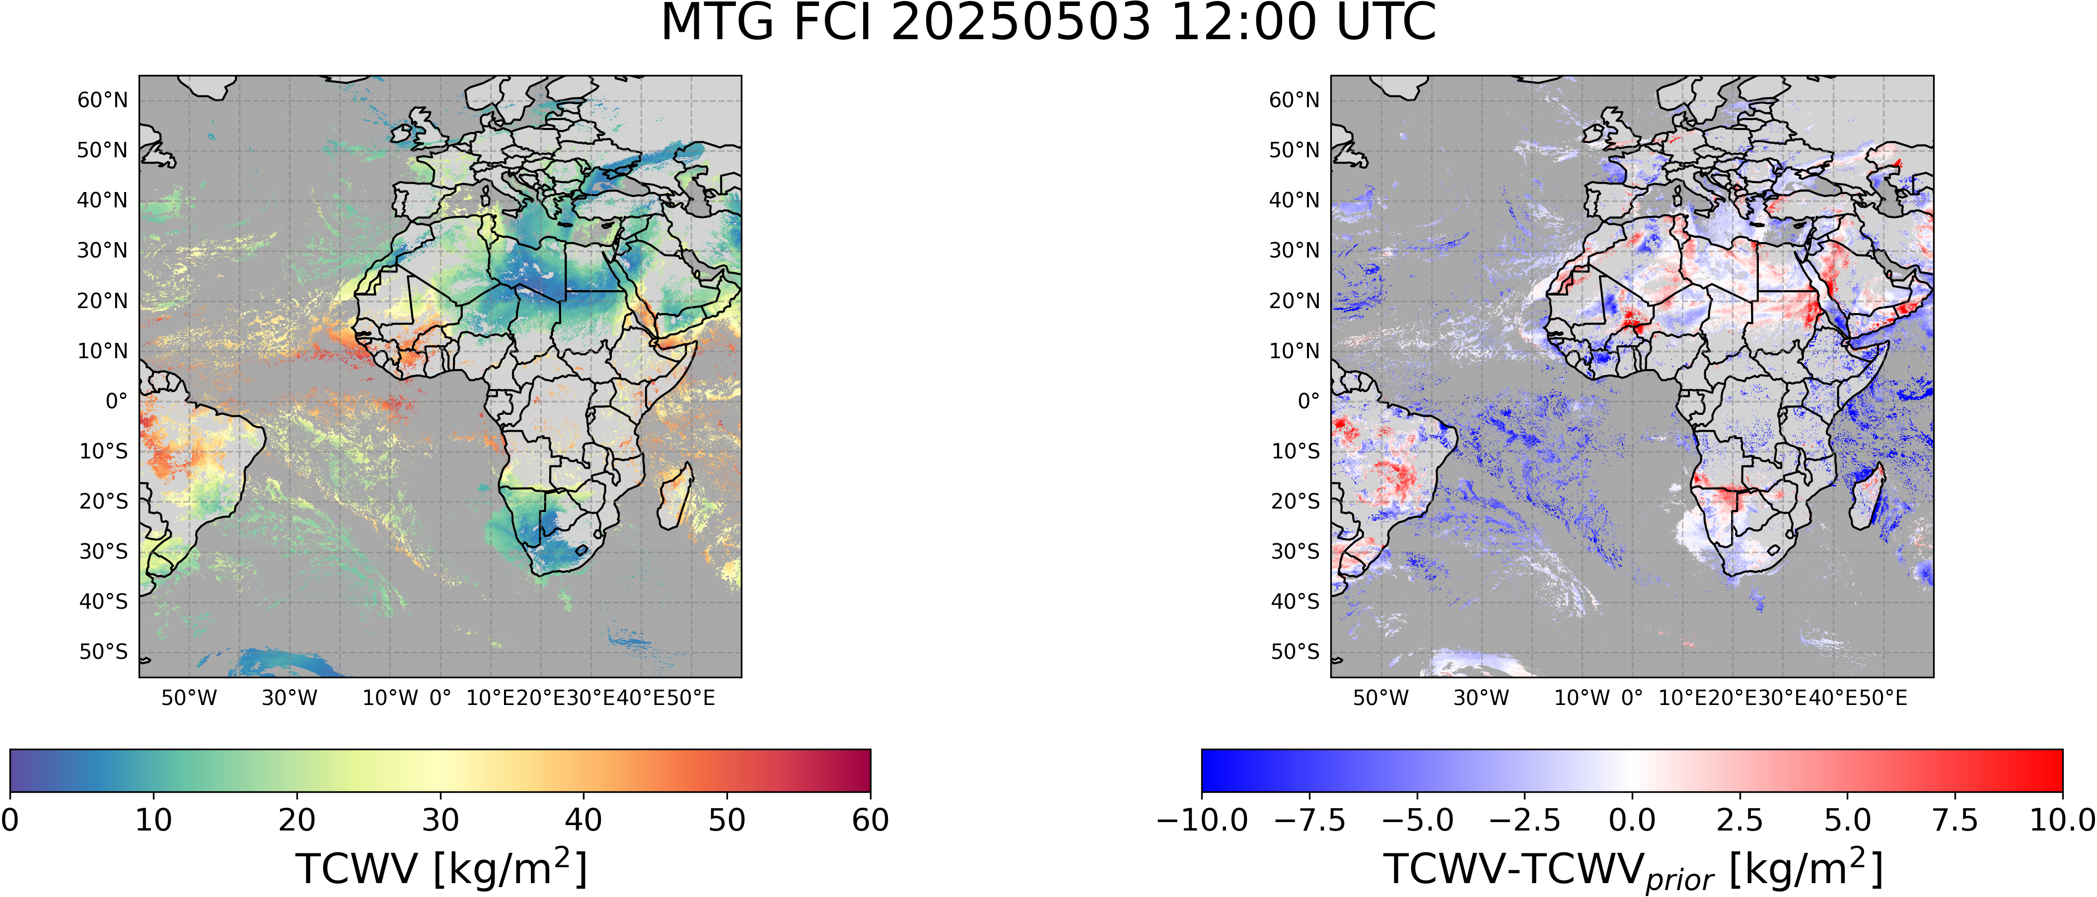
MTG-FCI TCWV Retrieval

Slide 26
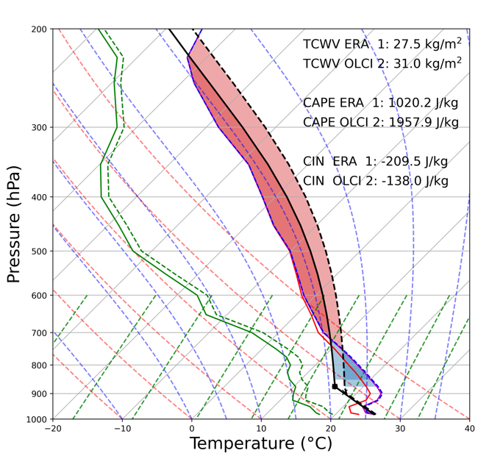
CAPE Sharpening
EL
Increase TCWV
CAPE:
Positive buoyancy
CIN:
Negative buoyancy
Environmental profile
Parcel
profile
LFC
Figure created with the use of metpy
T-skew, log-p diagram (metpy)

