Slide 1

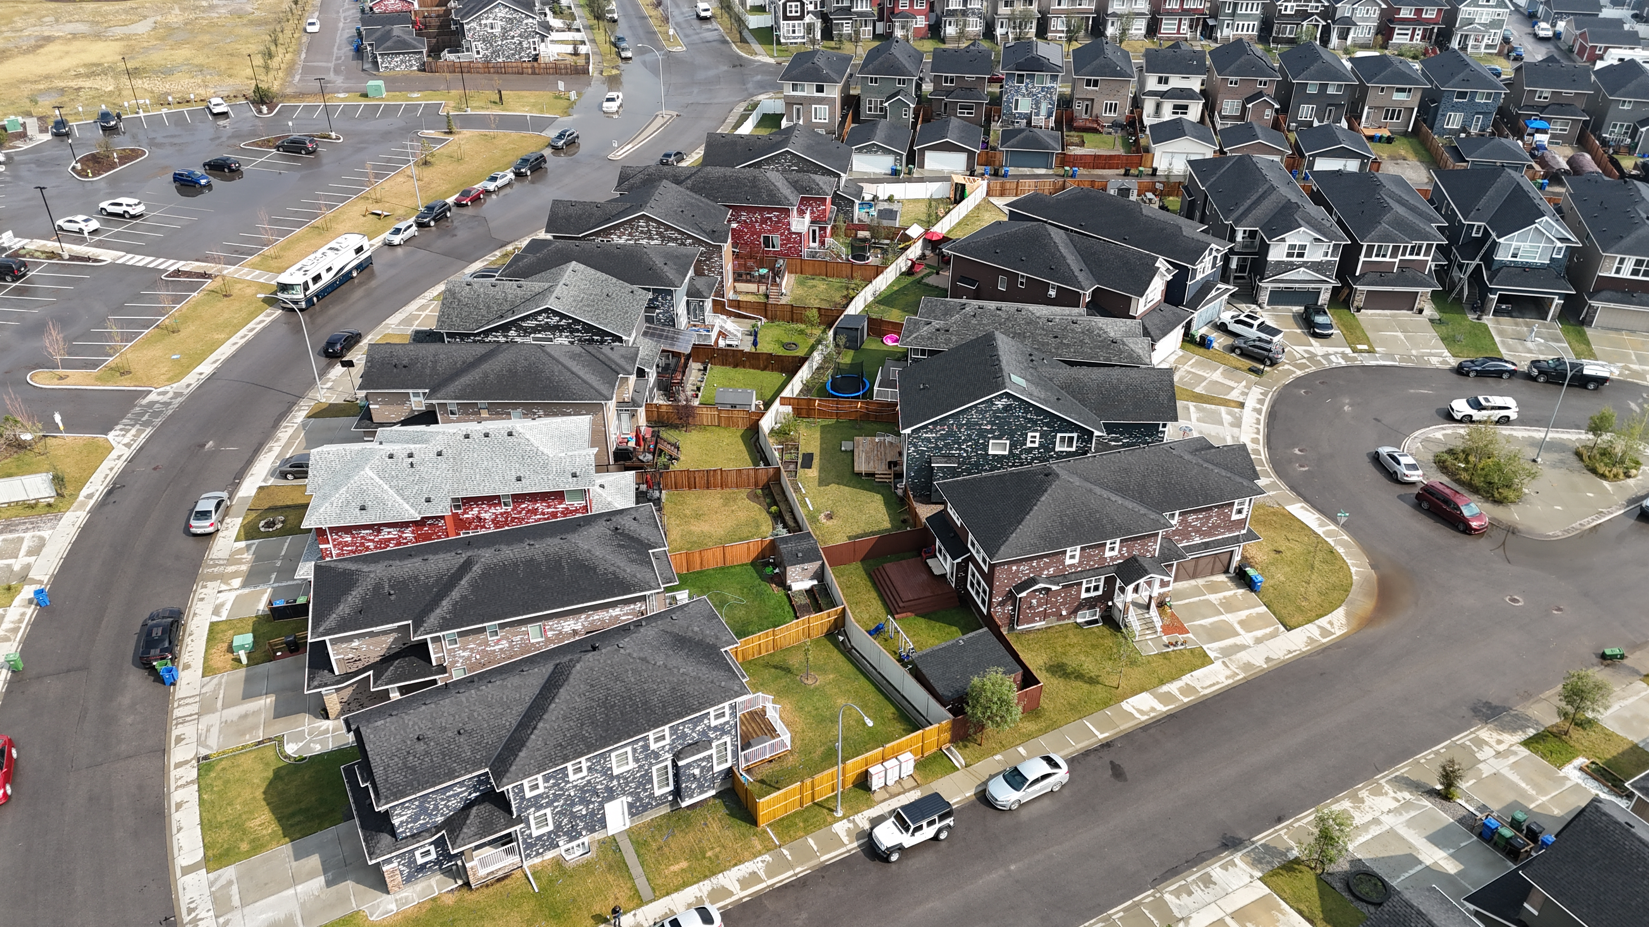
Forensic Damage Assessment of a $3 Billion Urban Hailstorm
August 5, 2024 – Calgary, Alberta, Canada
Simon Eng, Research Meteorologist, NHP
Dr. Julian Brimelow, Director, NHP
Jack Hamilton, Field Coordinator, NHP
Areez Habib, UAV Team Lead, NHP
Dylan Painchaud-Niemi, Research Meteorologist, NTP
Tobias Schmidt, Research Meteorologist, NHP
12th European Conference on Severe Storms – Nov 21, 2025

Slide 2
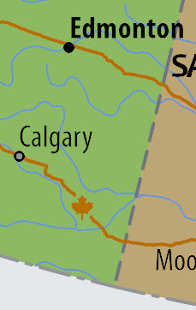
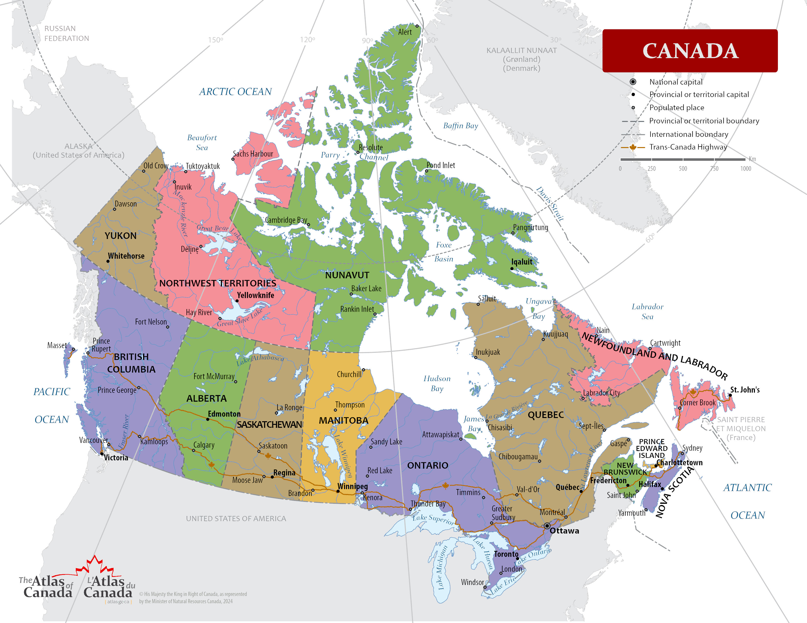
Event Context
© NRCan 2022
Aug 5, 2024, Calgary Hailstorm
Notes:
Source: The Atlas of Canada, Reference Maps, Canada Political Division. NRCan 2022. https://natural-resources.canada.ca/maps-tools-publications/maps/atlas-canada/reference-maps

Slide 3
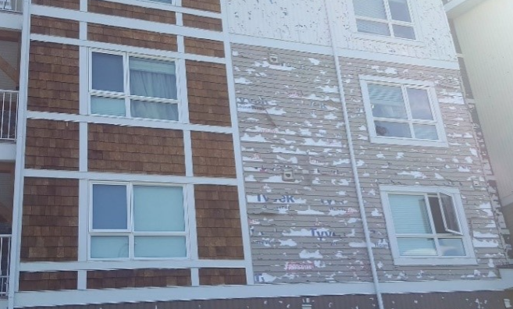
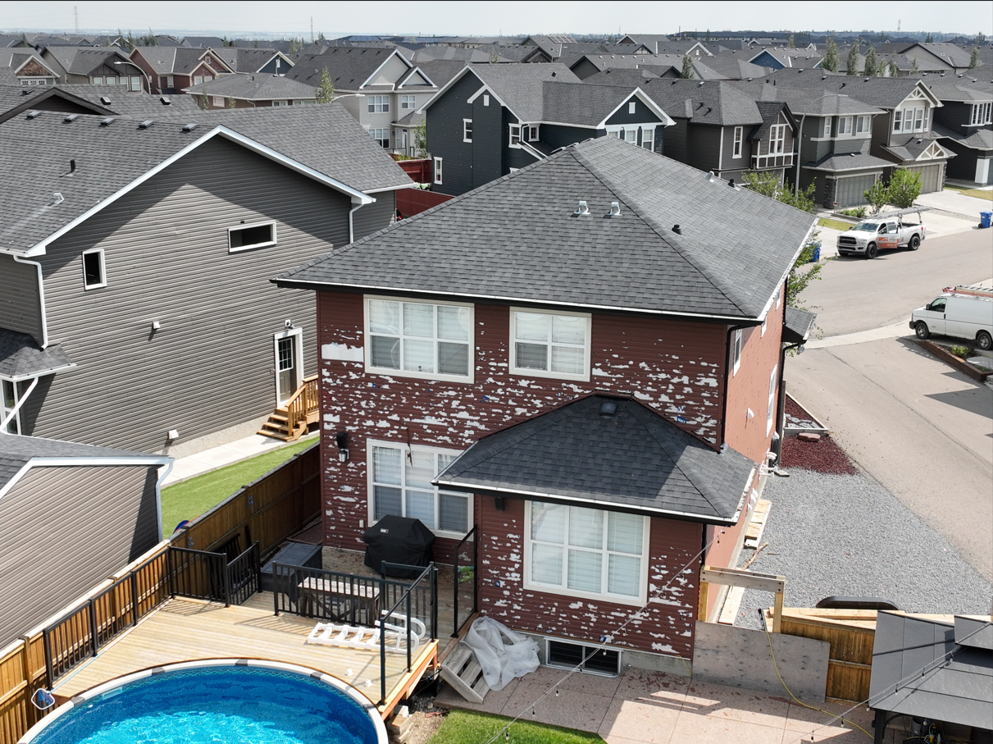
$1.3 Billion (CDN)
€ 842 Million
Calgary’s Hail Problem
City of ~1.3 million people
  ~4th largest city in Canada
Over $6 Billion (CDN) in insured losses in 5 years (over € 4.1 Billion)
Wind-driven hail events “WHE”
Of 30+ hail damage surveys – every high-cost event was a WHE
Calgary, AB
June 13, 2020
Calgary, AB
Aug 5, 2024
$3.29 Billion (CDN)
€ 2.22 Billion
Aug 5, 2024, Calgary Hailstorm

Slide 4
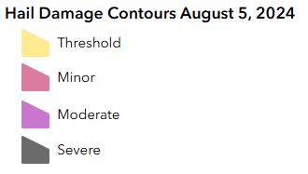
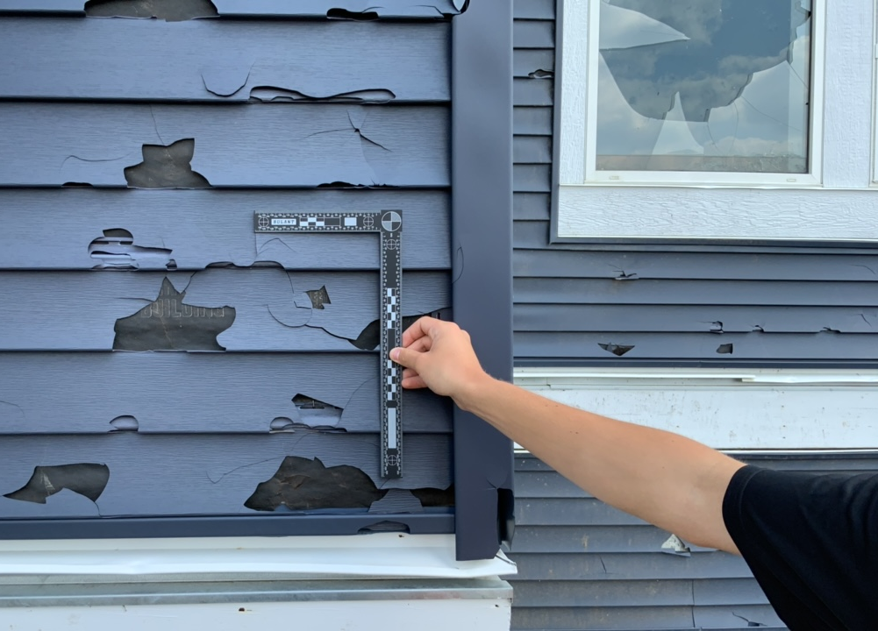
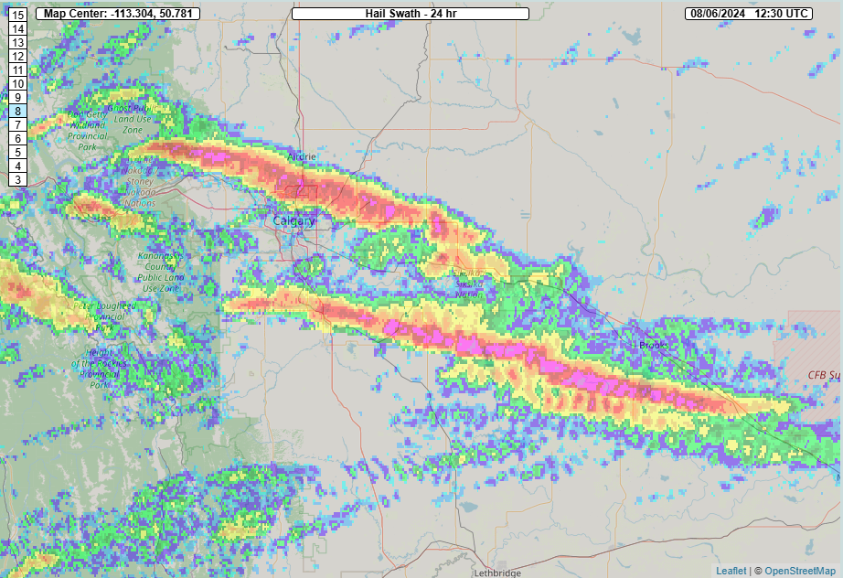
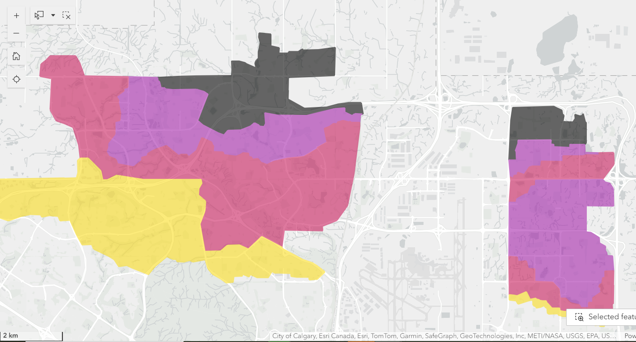
Event Overview
North Calgary
~3-5 km
Strathmore
Brooks
Calgary
Okotoks
Bow City
Radar Max Est Size of Hail
NSSL MRMS
Aug 5, 2024, Calgary Hailstorm

Slide 5
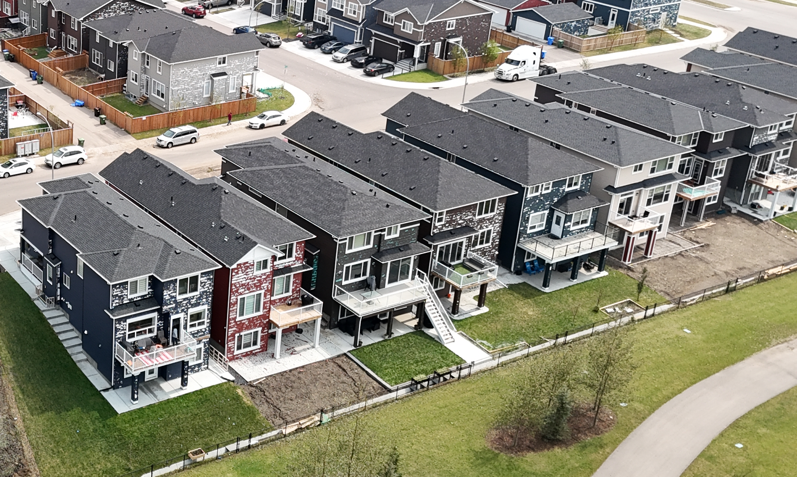
Rapid Urban Damage Survey
Purpose – Asset impacts & meteorological documentation
Approach:
  Preliminary scouting
  Survey – 3 Teams:
    Ground + drone;
    >1000 km, 5 days;
    49 drone flights;
    >100 witnesses.
Aug 5, 2024, Calgary Hailstorm

Slide 6
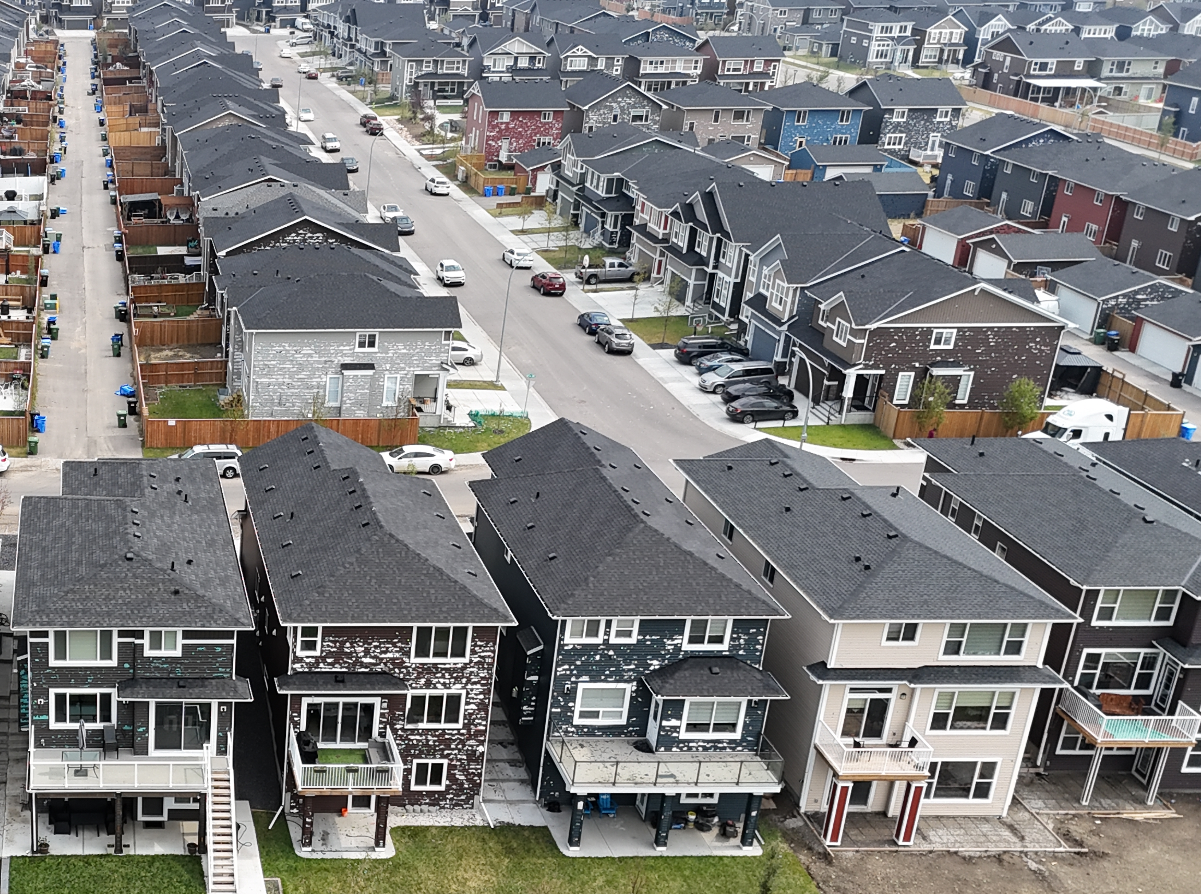
Follow-Up Damage Surveys
Additional ground surveys:
  June ‘25 Training
Phone Surveys:
  Industrial/commercial Sites
  Roofing contractors
  Human and animal injuries
Satellite Review
Aug 5, 2024, Calgary Hailstorm

Slide 7
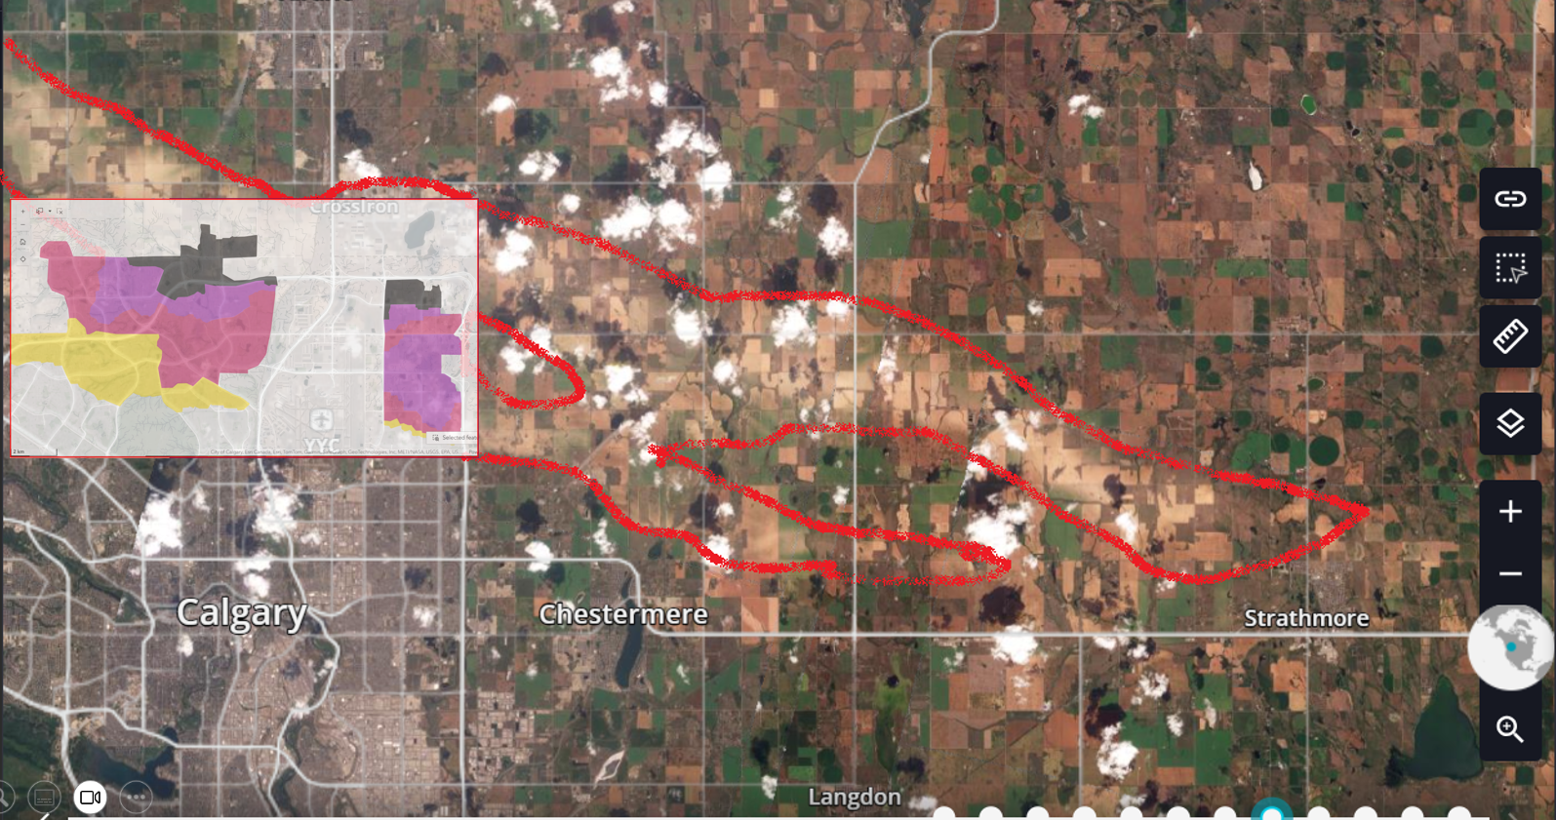
Visible Satellite Imagery - Planet Labs
© Planet Labs PBC (2024)
Aug 5, 2024, Calgary Hailstorm

Slide 8
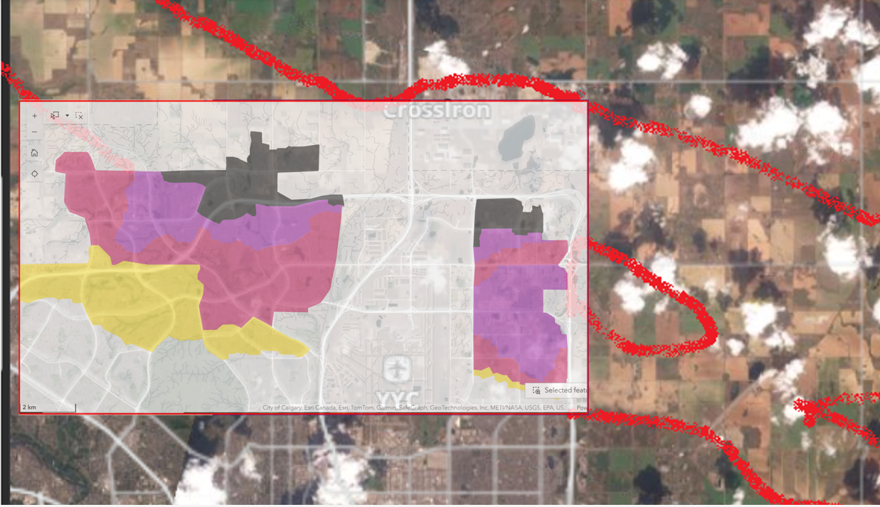
Visible Satellite Imagery - Planet Labs
© Planet Labs PBC (2024)
Aug 5, 2024, Calgary Hailstorm

Slide 9

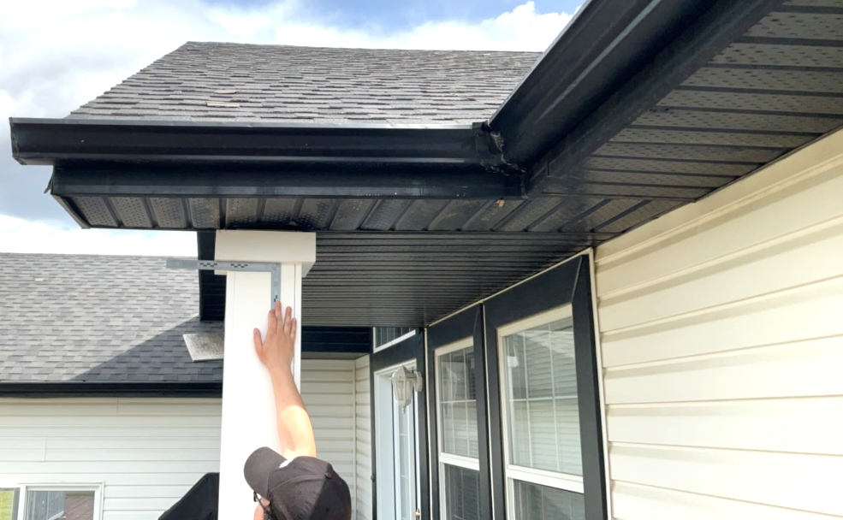
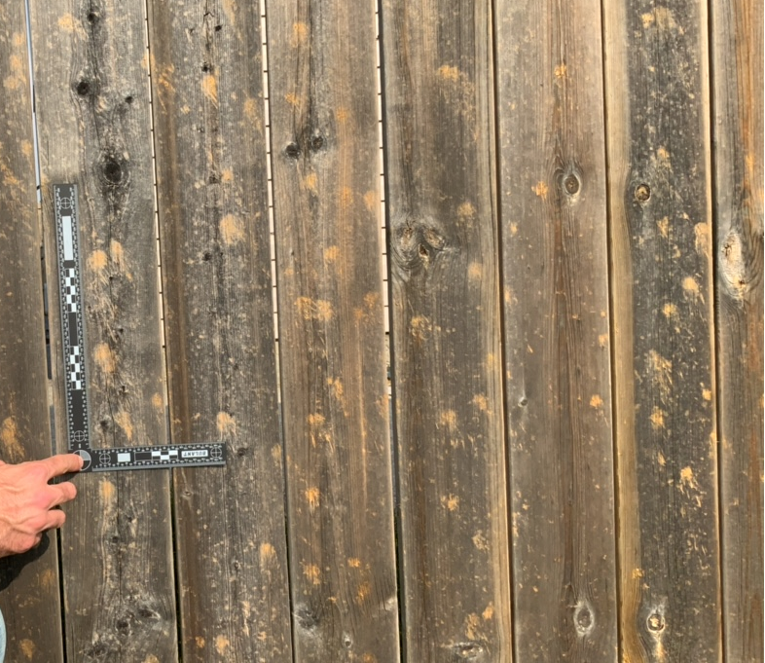
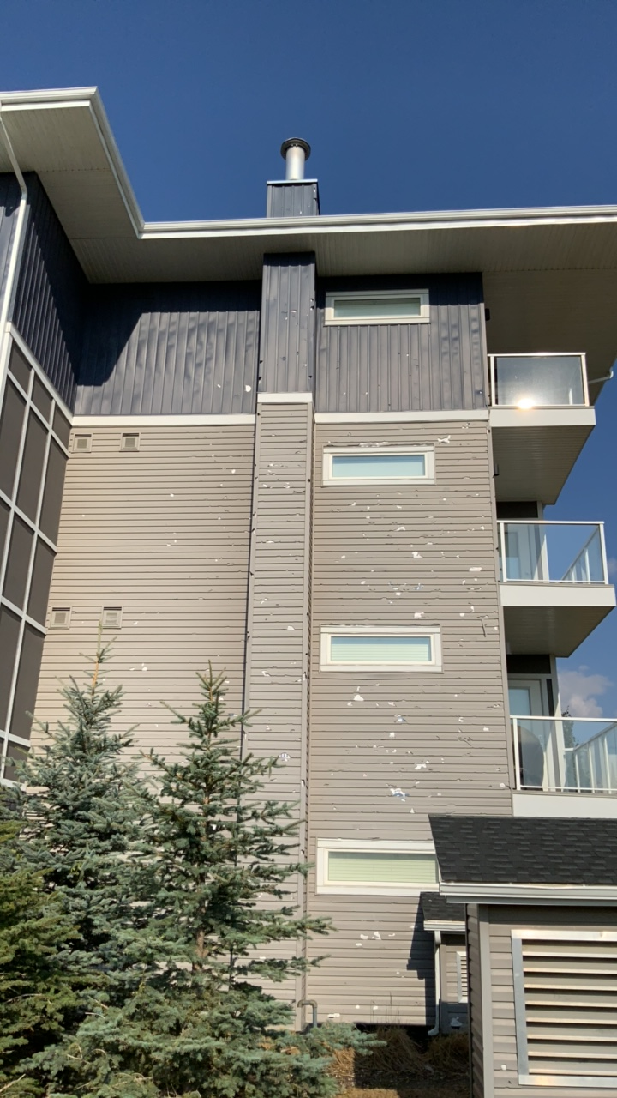
Determining Hailstone Impact Angles:
Roof overhangs, hail “shadows” (Calotescu et al. 2024)
Surface marks as planar projections (Marshall, pers. comm.)
Aug 5, 2024, Calgary Hailstorm

Slide 10
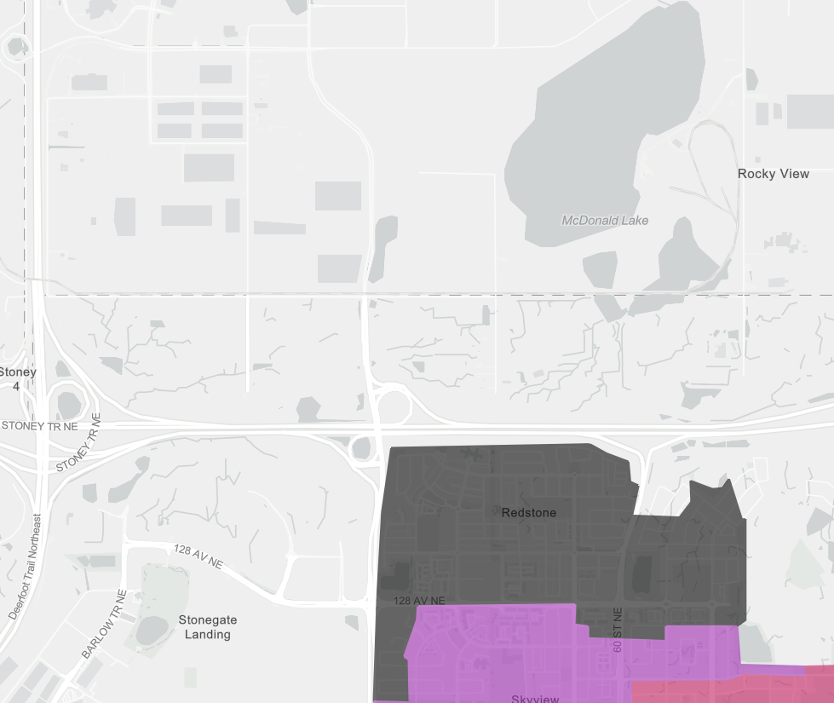
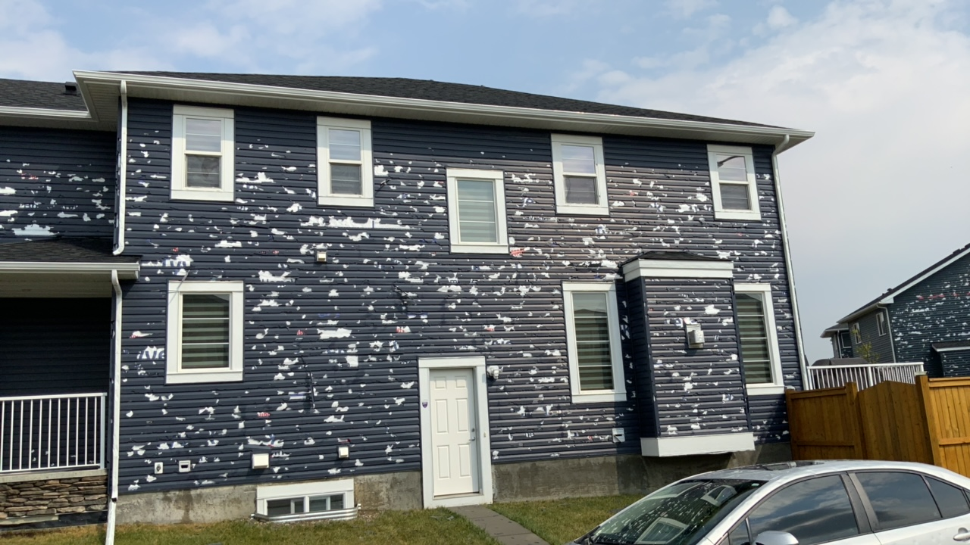
Lateral Impacts
Signs of microburst scale divergence
Aug 5, 2024, Calgary Hailstorm

Slide 11
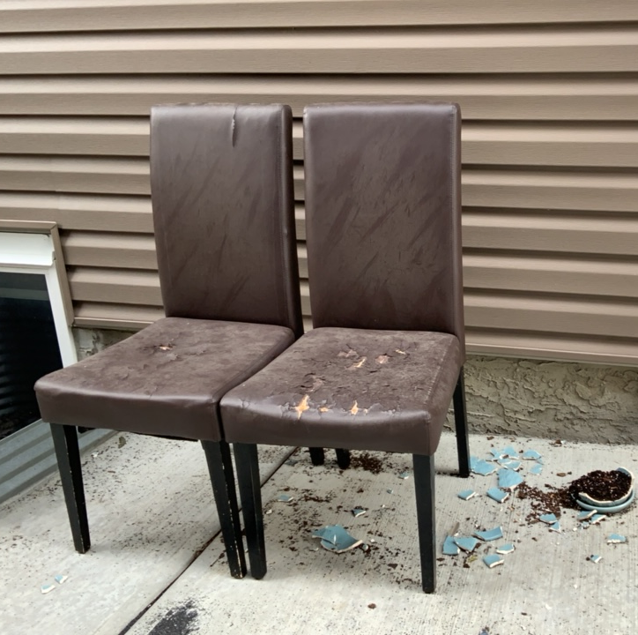
Fall Angle
Some deviations > 45°
  Possible entrainment into storm-scale flow?
58°
66°
40°
41°
44°
36°
33°
Aug 5, 2024, Calgary Hailstorm

Slide 12
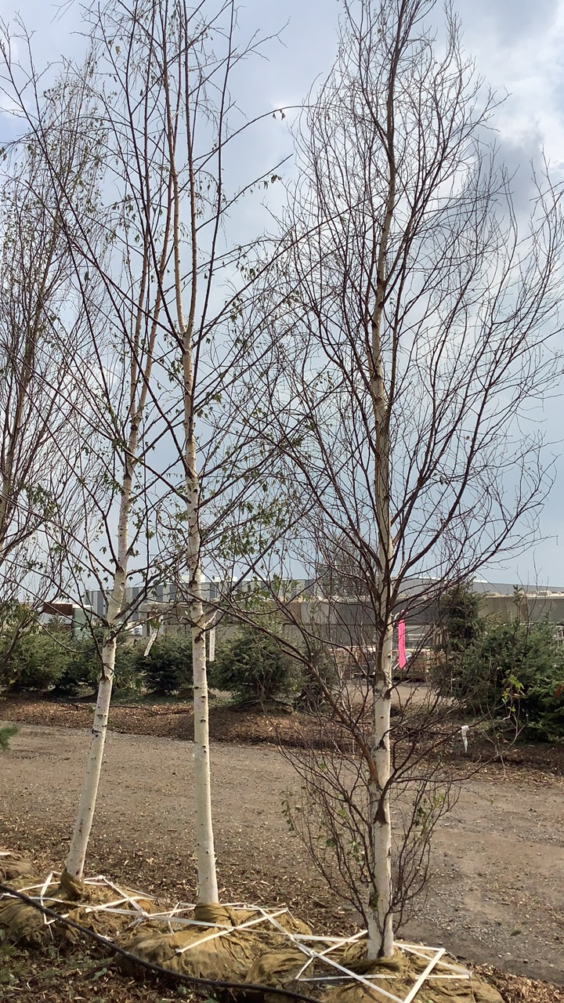
Damage Indicators
Eventual hail damage scale (Eng et al., P101):
Impact data collected on:
Buildings – roofing, cladding, windows
Vehicles – ground and air
Vegetation - trees, crops and landscaping
Animals and Humans
Aug 5, 2024, Calgary Hailstorm

Slide 13
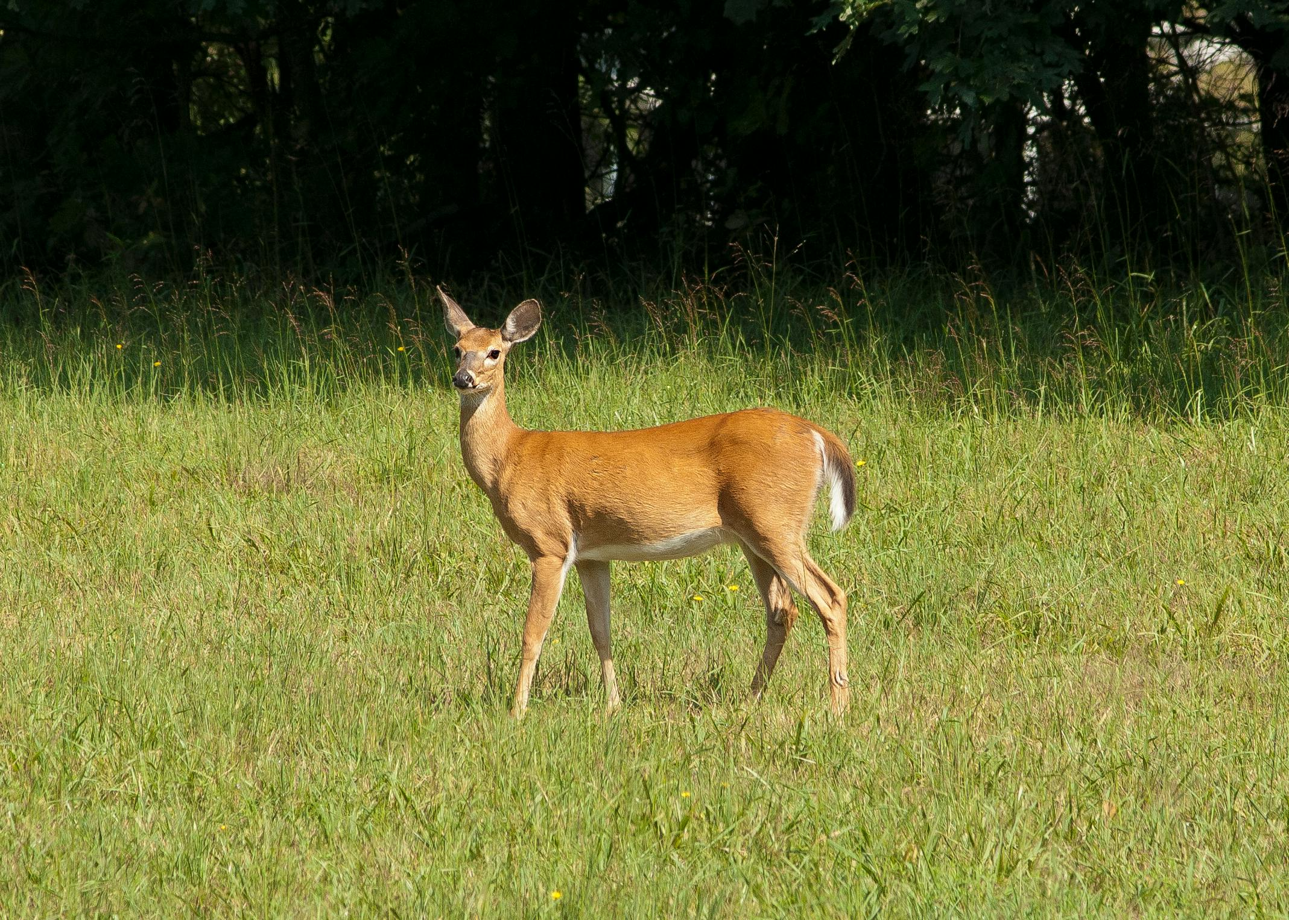

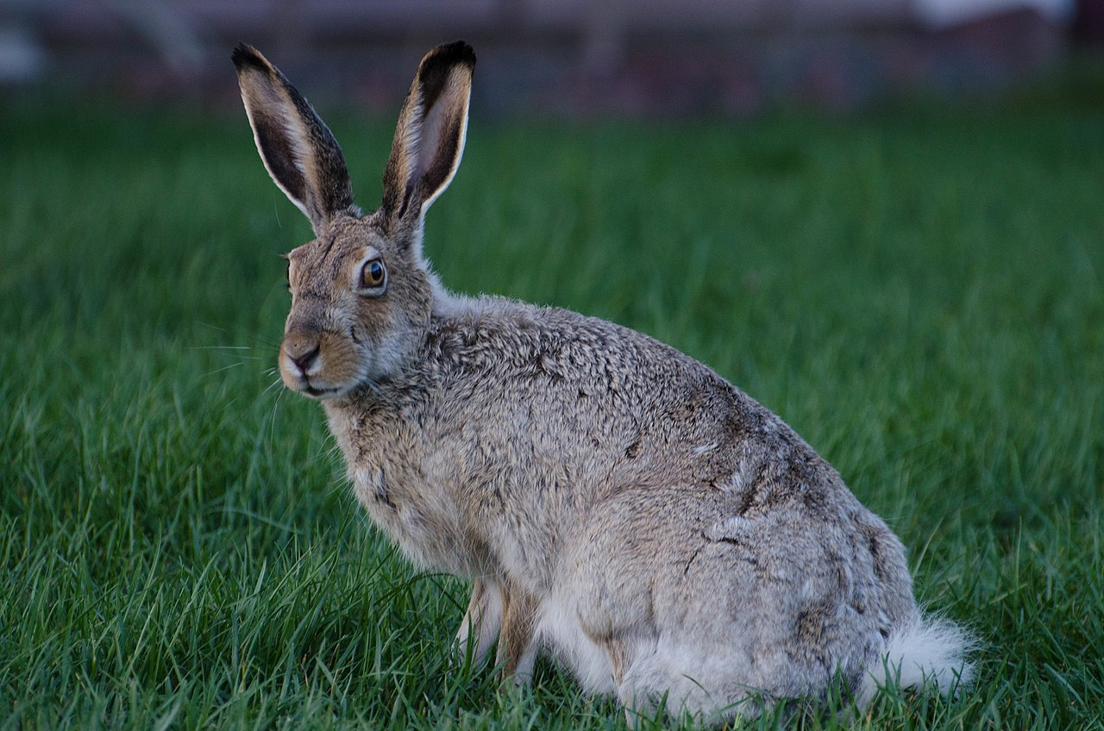
Human and Animal Impacts
Calgary Storm:
Minor human injuries, no hospital visits
Small animal traumatic injuries, fatalities
Large animal injuries reported in areas E of Calgary
Bow City Storm:
Confirmed injuries to medium animals
Large animal fatalities reported
Large >45 kg
Medium 5 to 45 kg
Small <5 kg
Aug 5, 2024, Calgary Hailstorm

Slide 14
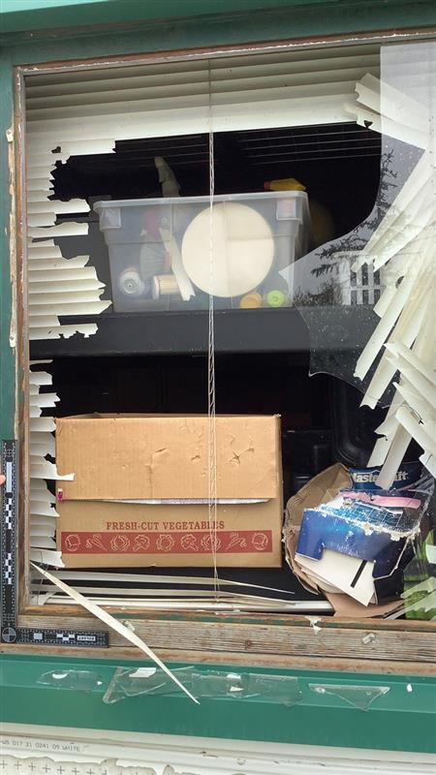
Preliminary Adaptation Findings
Multi-pronged approach needed:
  Roofing and siding products.
    Wind-driven hail vs. current standards.
  Windows – challenge.
  Vehicle sheltering, including sides.
Calgary will be hit again.
  Climate change, sprawl, material costs, etc.
  There are bigger storms out there…
Aug 5, 2024, Calgary Hailstorm

Slide 15
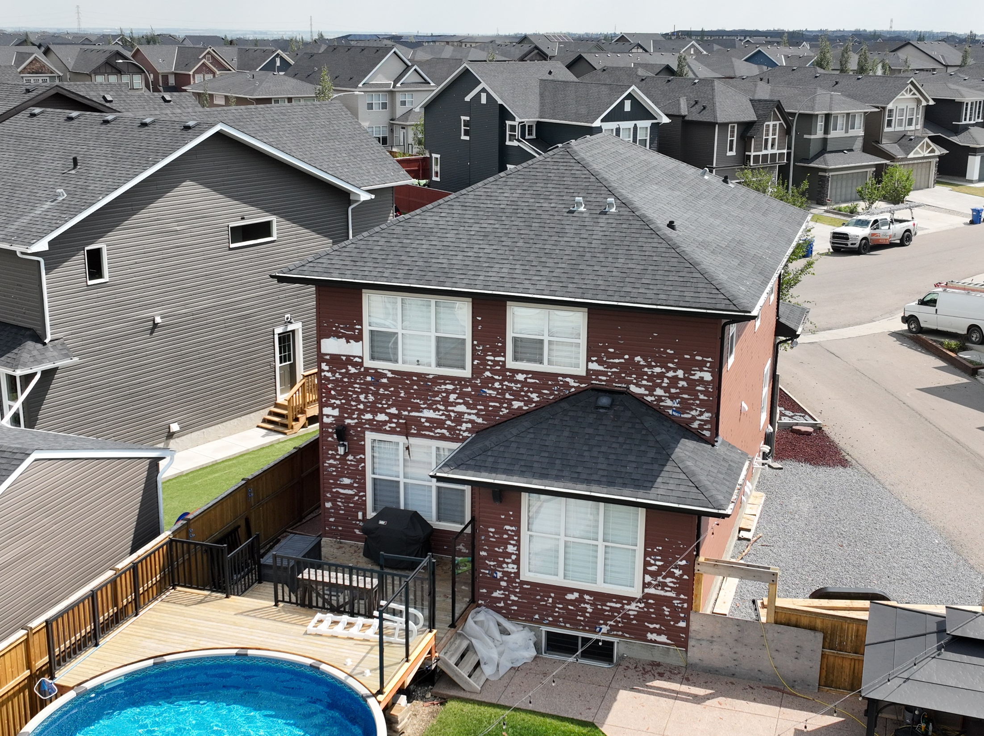
Thank you for your attention!
Questions?
Email: SEng24@uwo.ca
Social Media:
@westernunhp.bsky.social
Aug 5, 2024, Calgary Hailstorm

Slide 16


