Slide 1



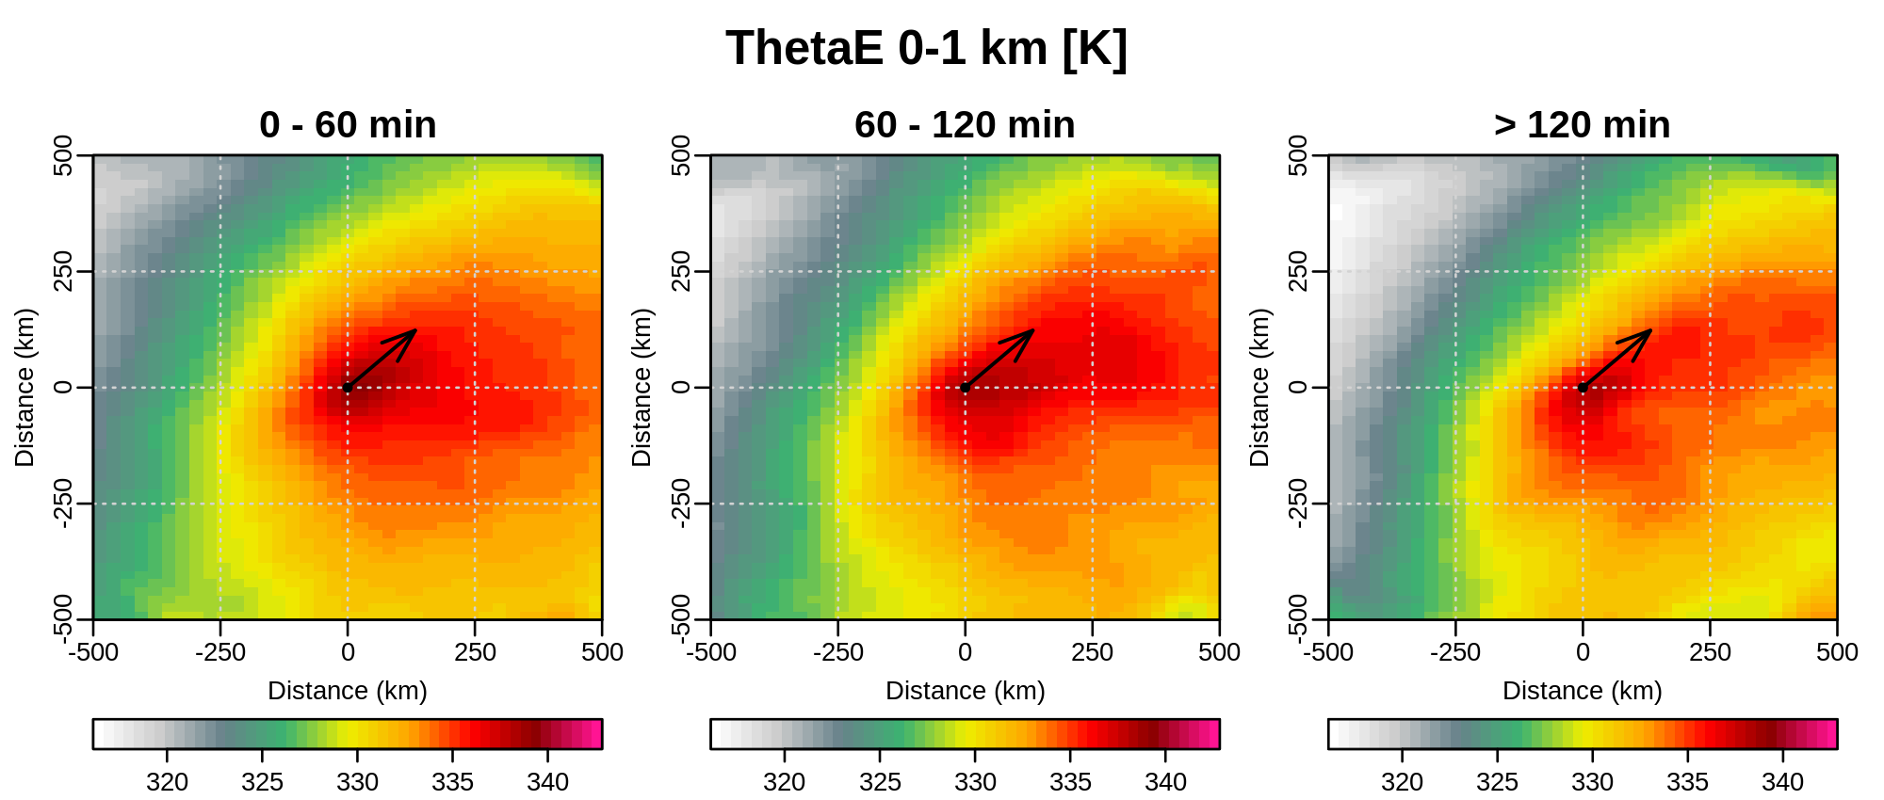
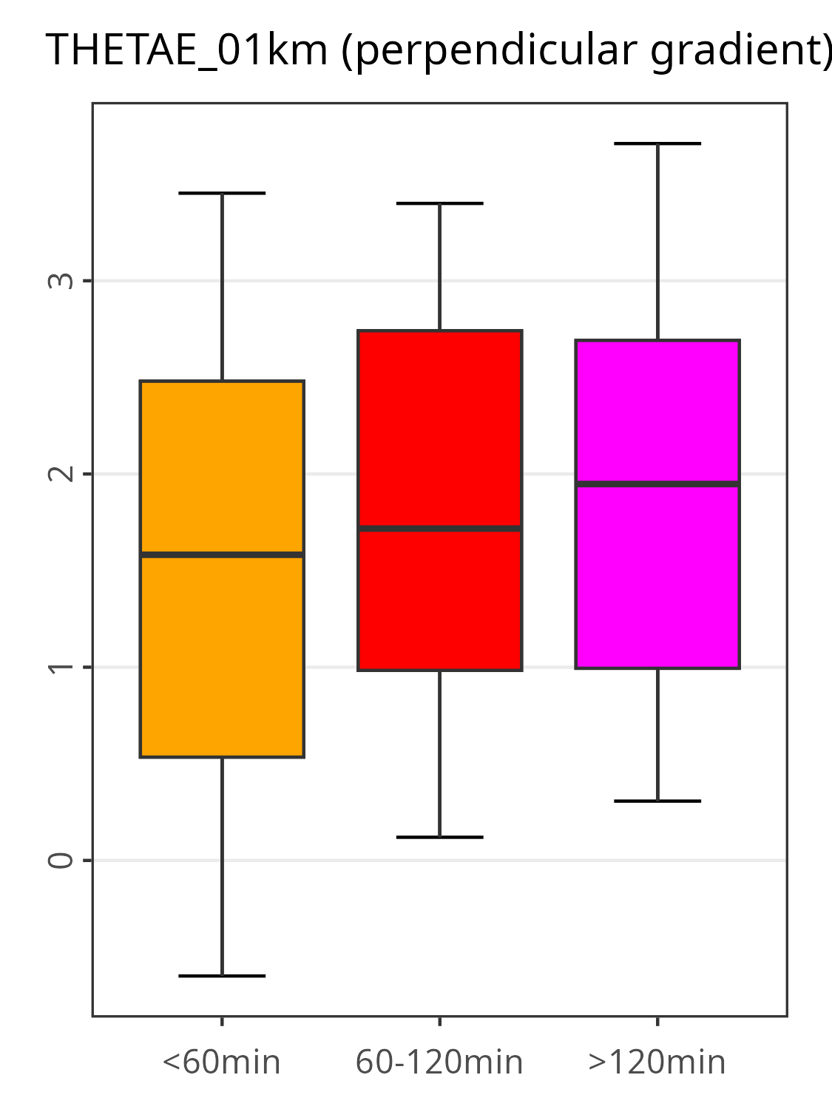
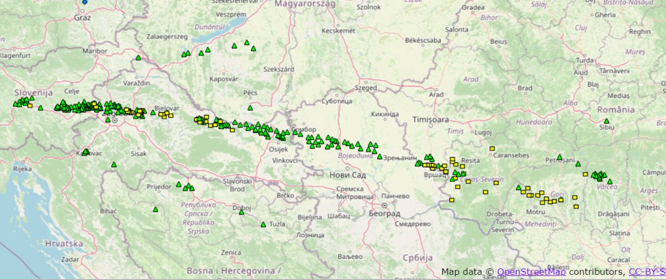
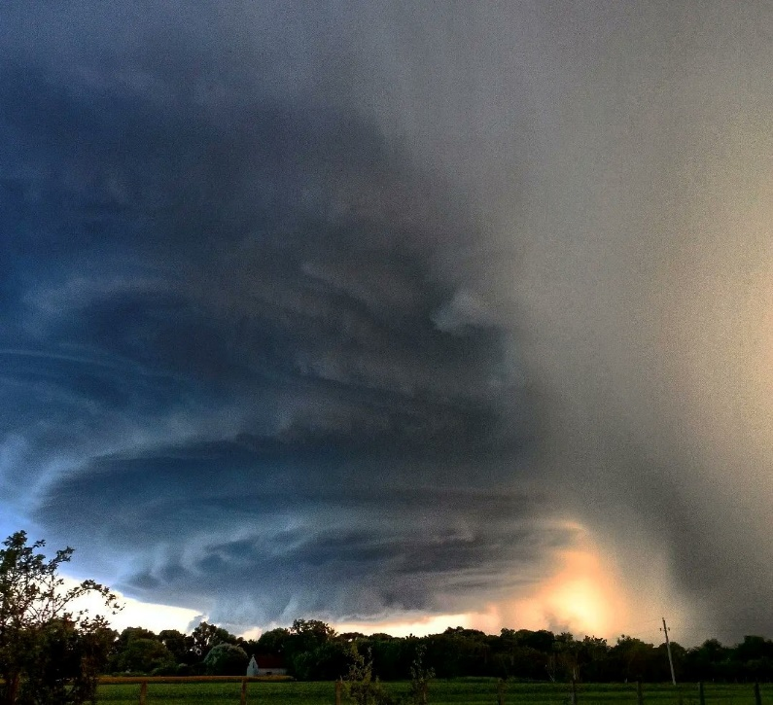
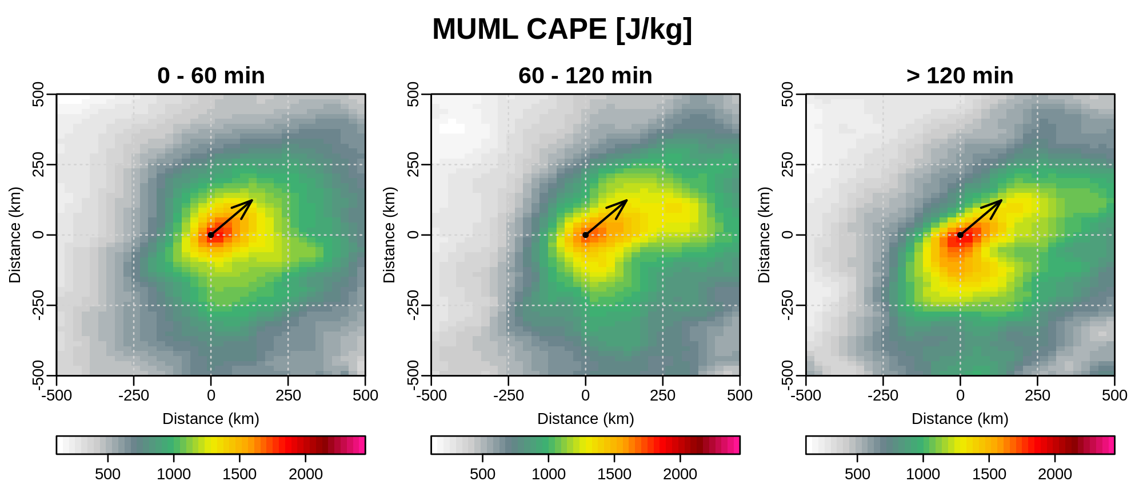
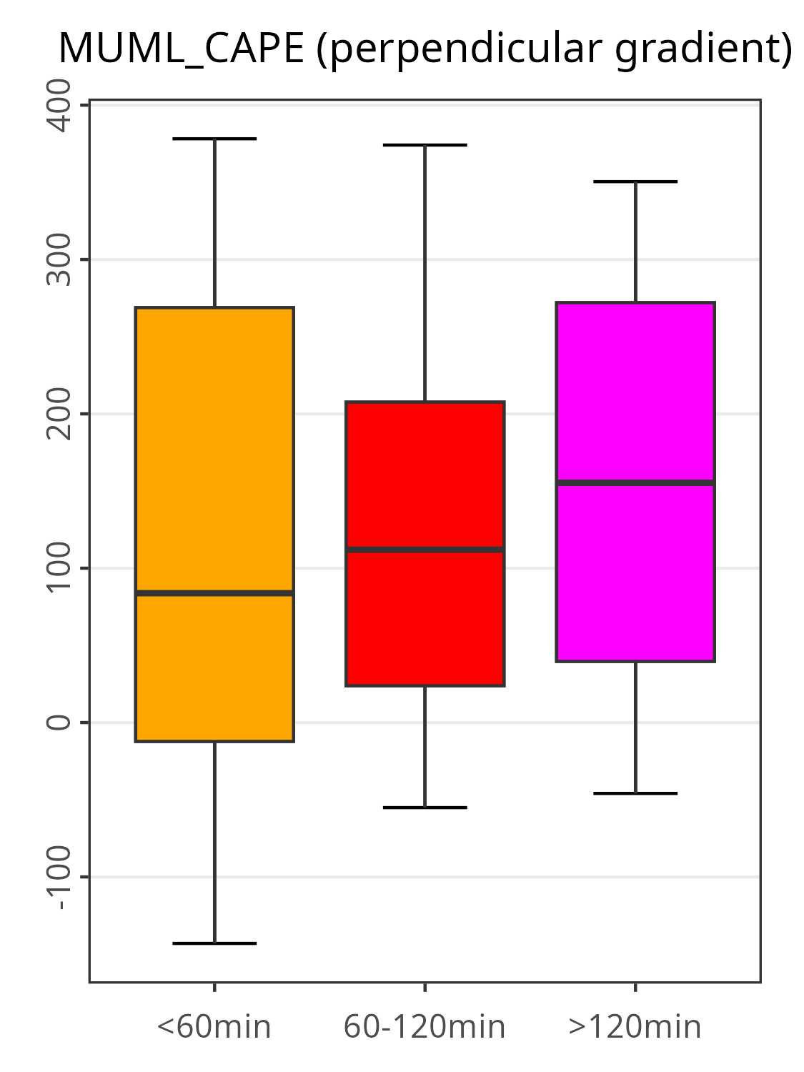

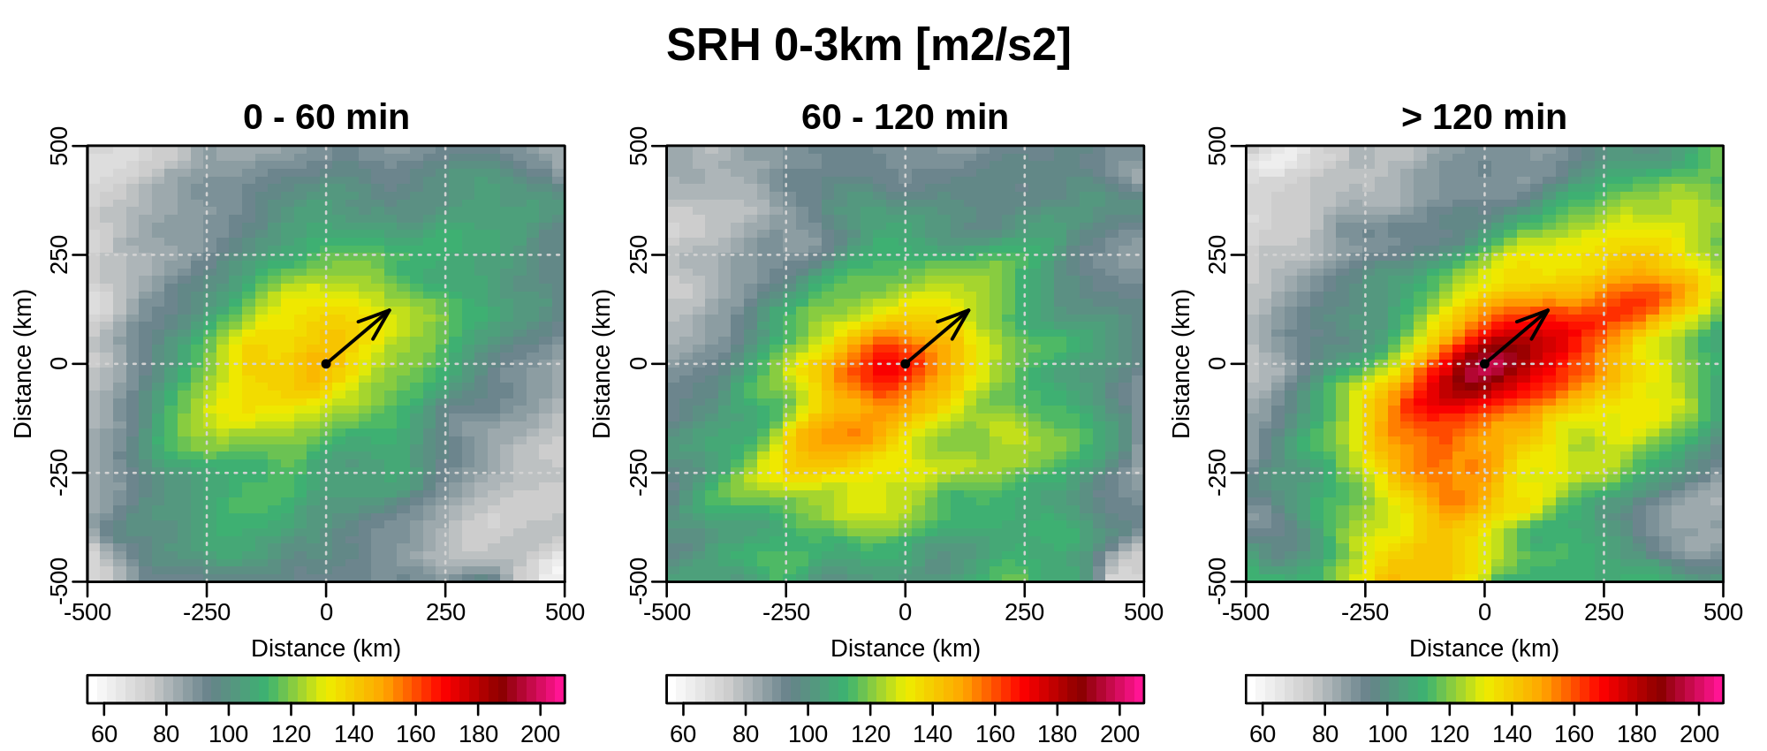
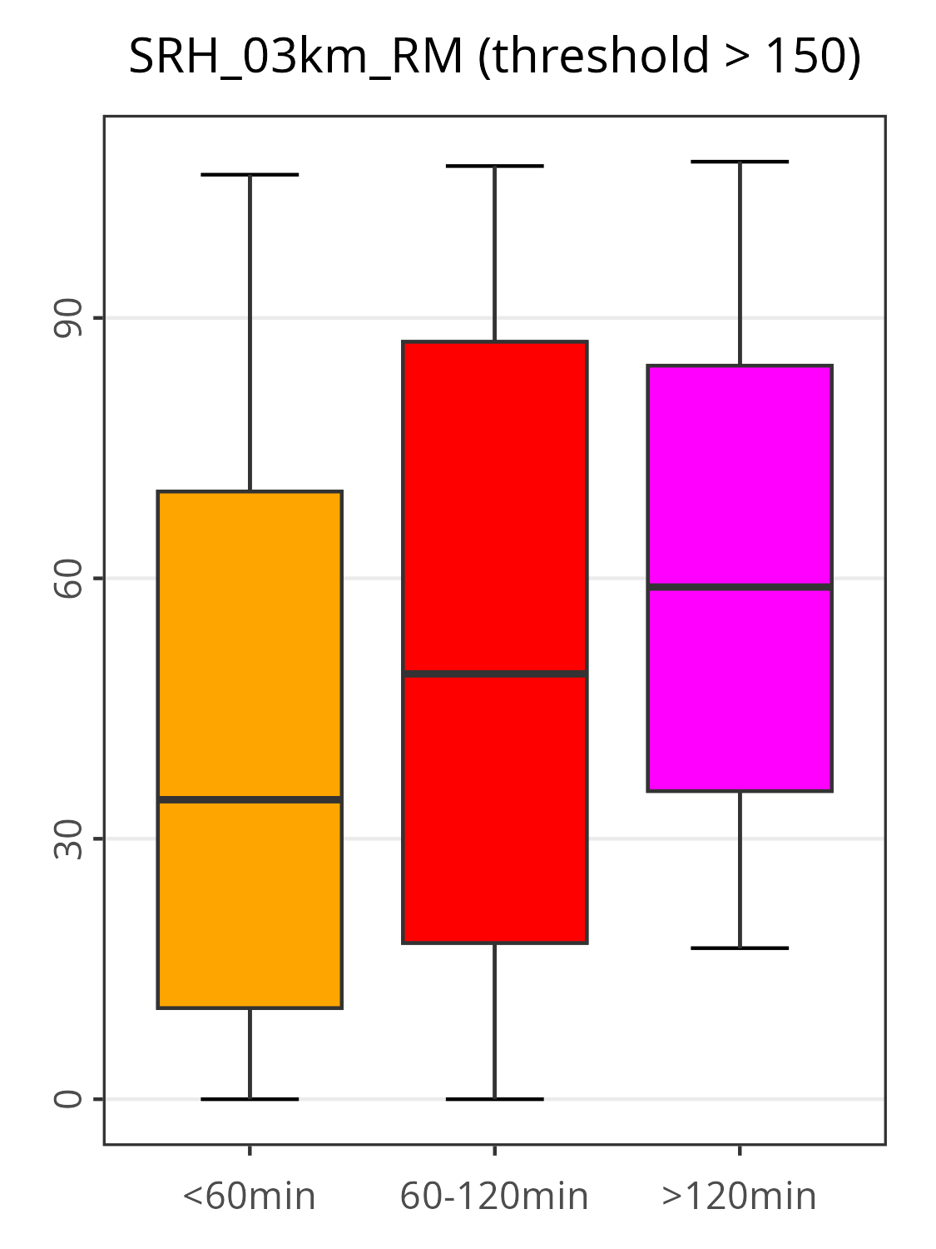
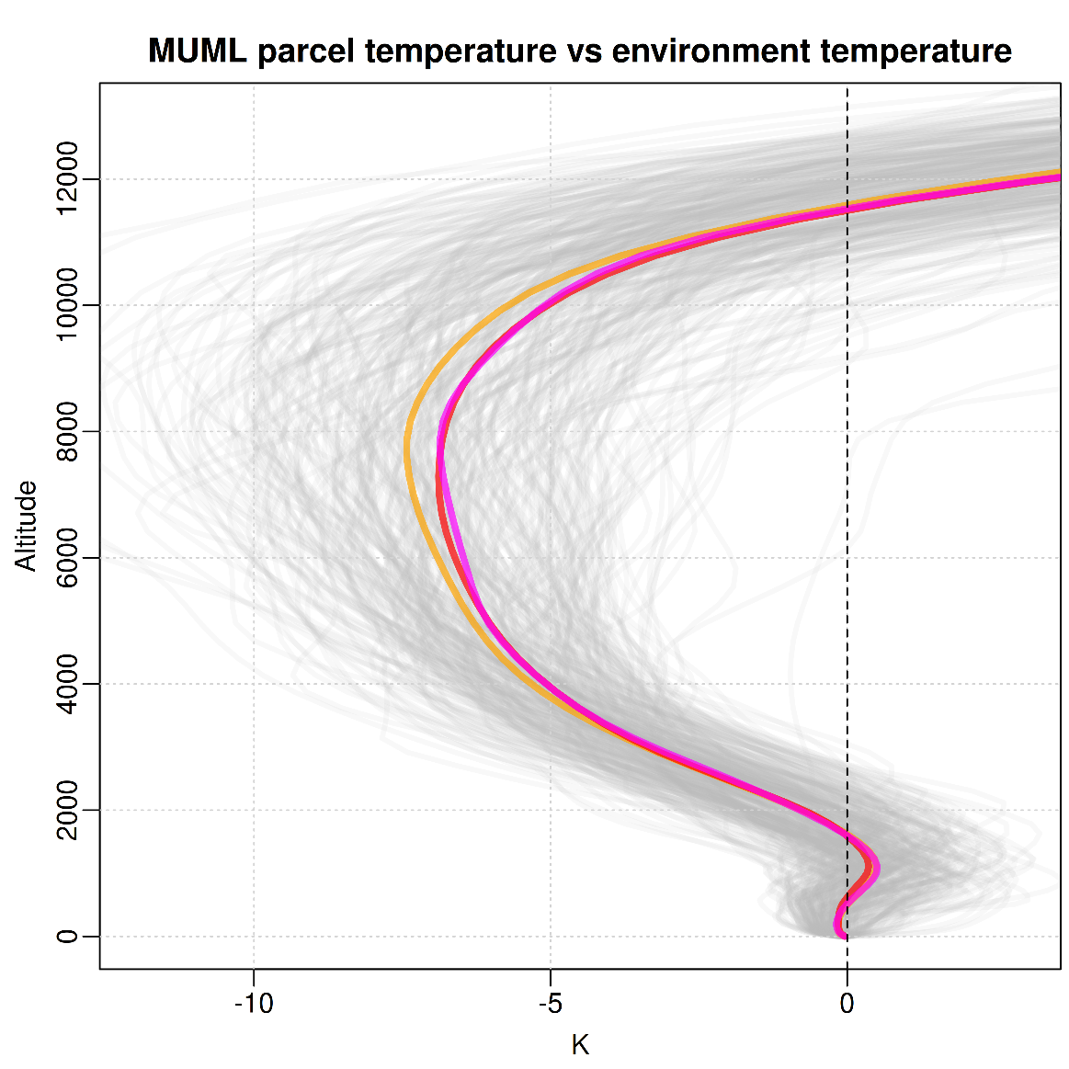
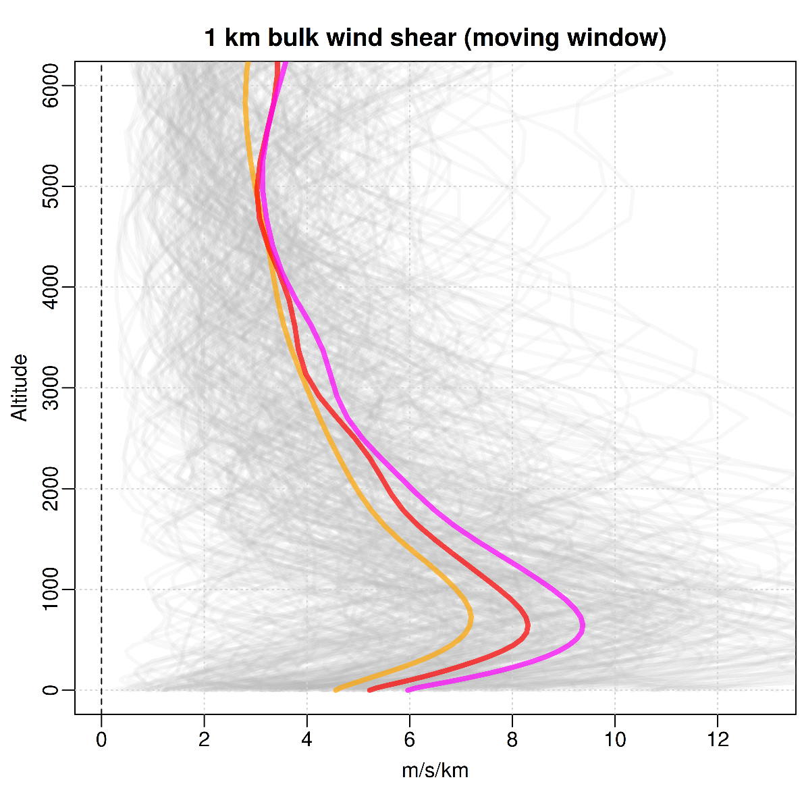
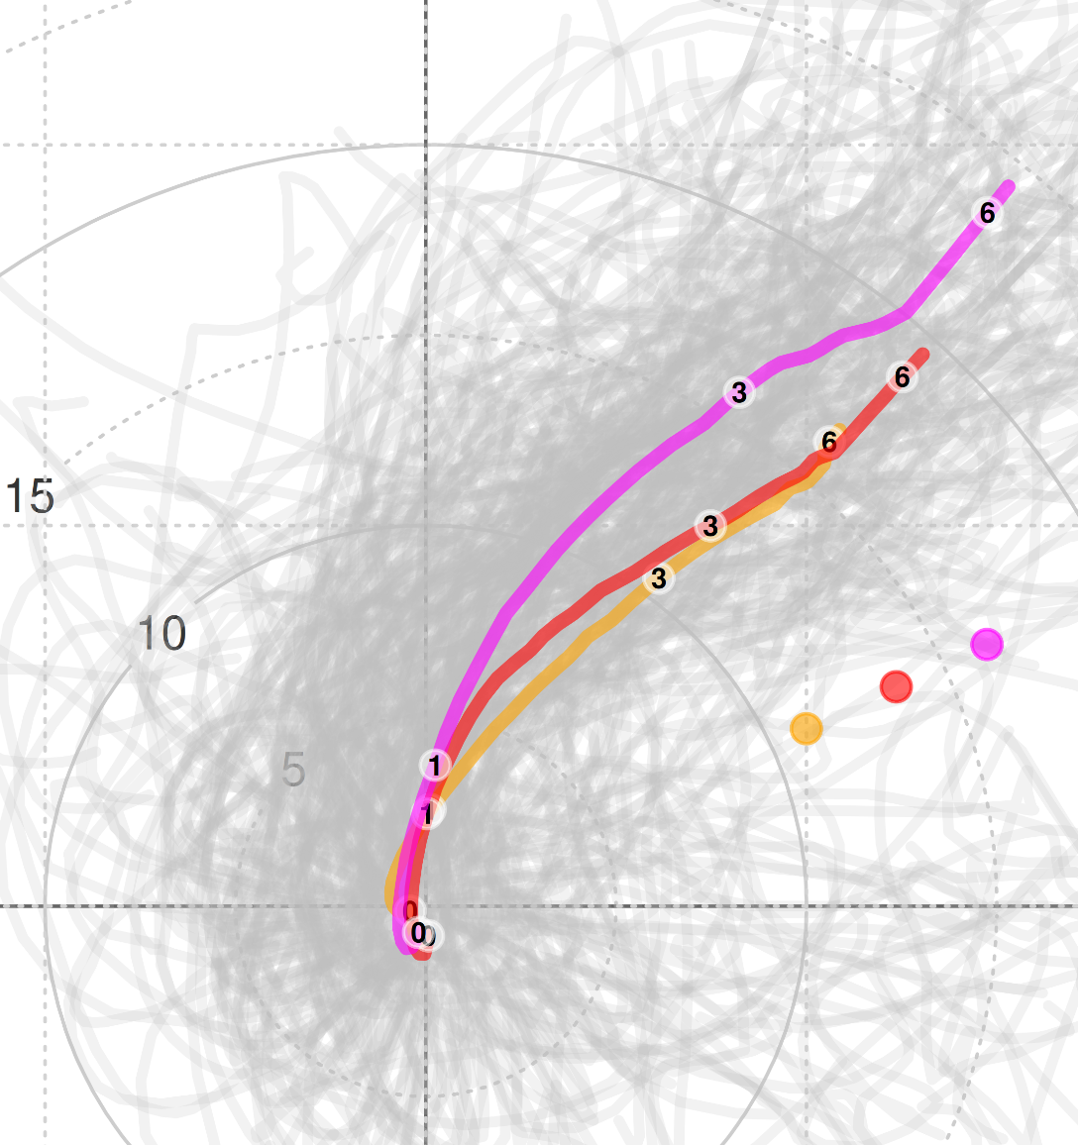
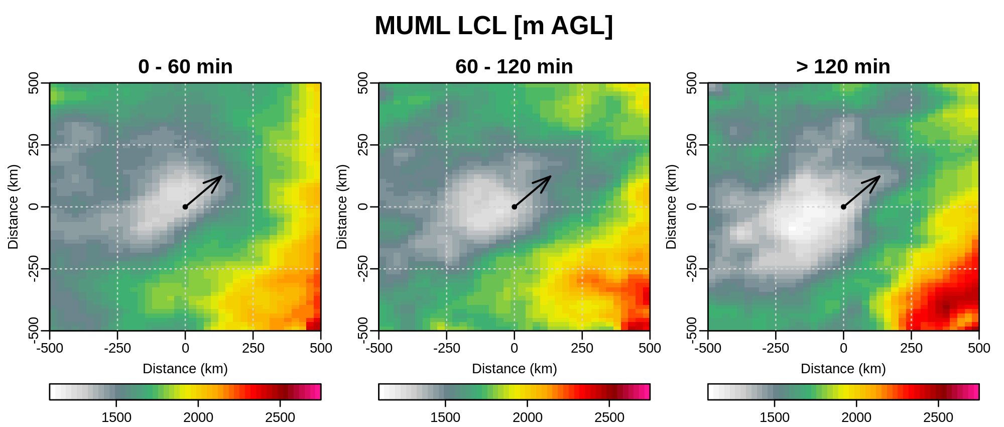
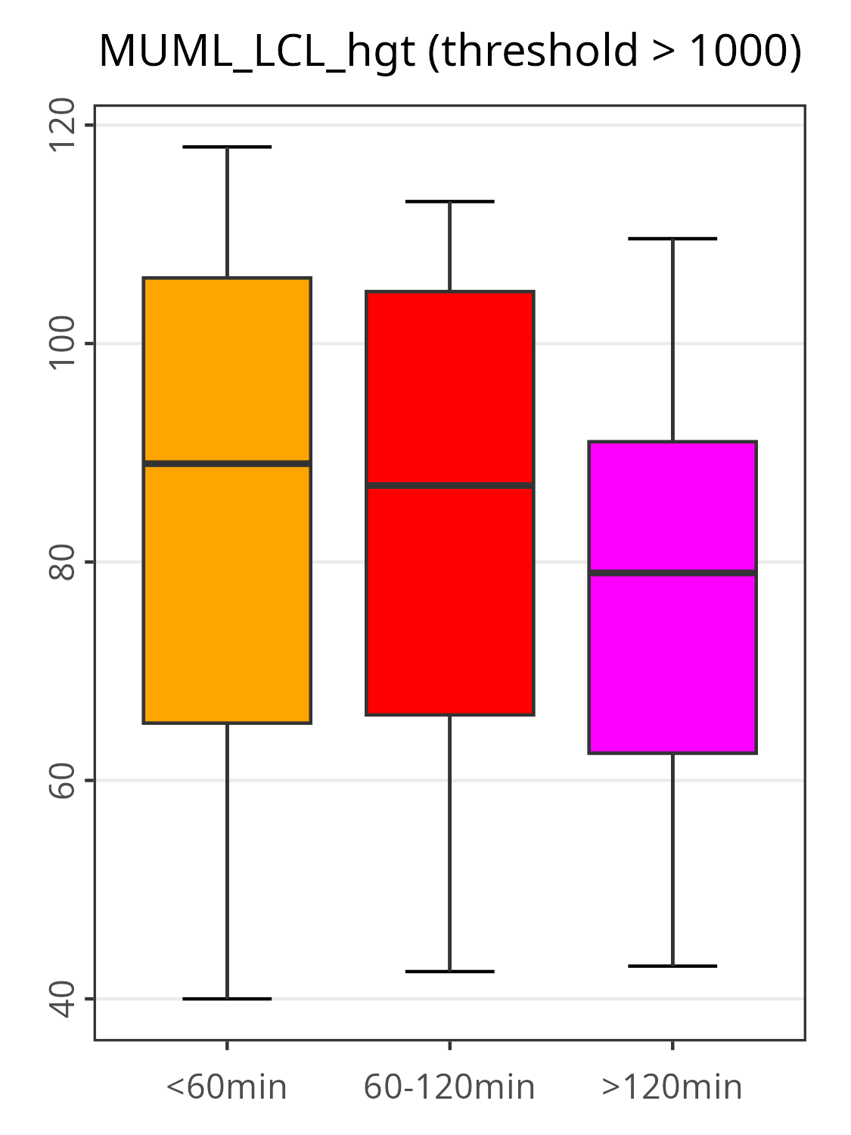
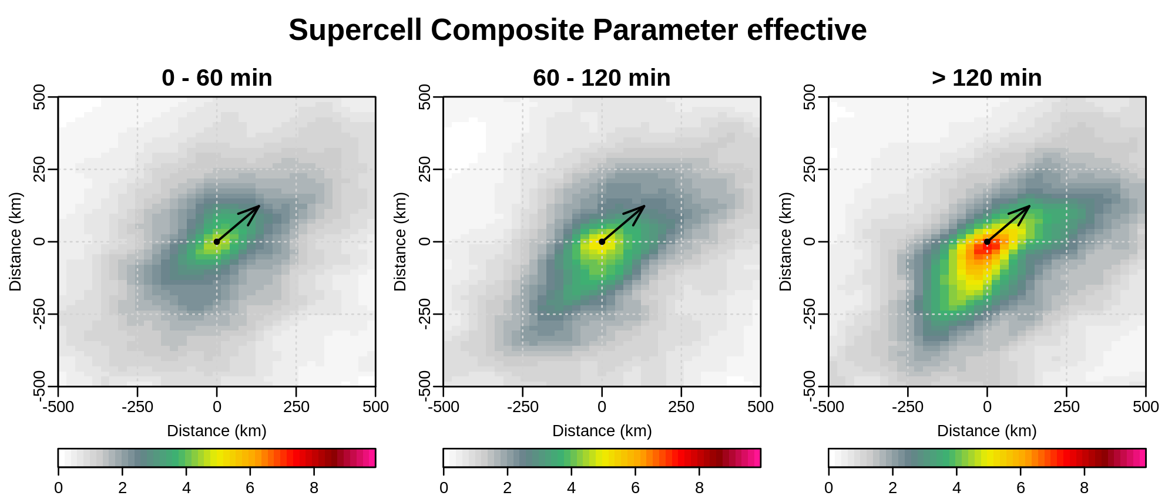
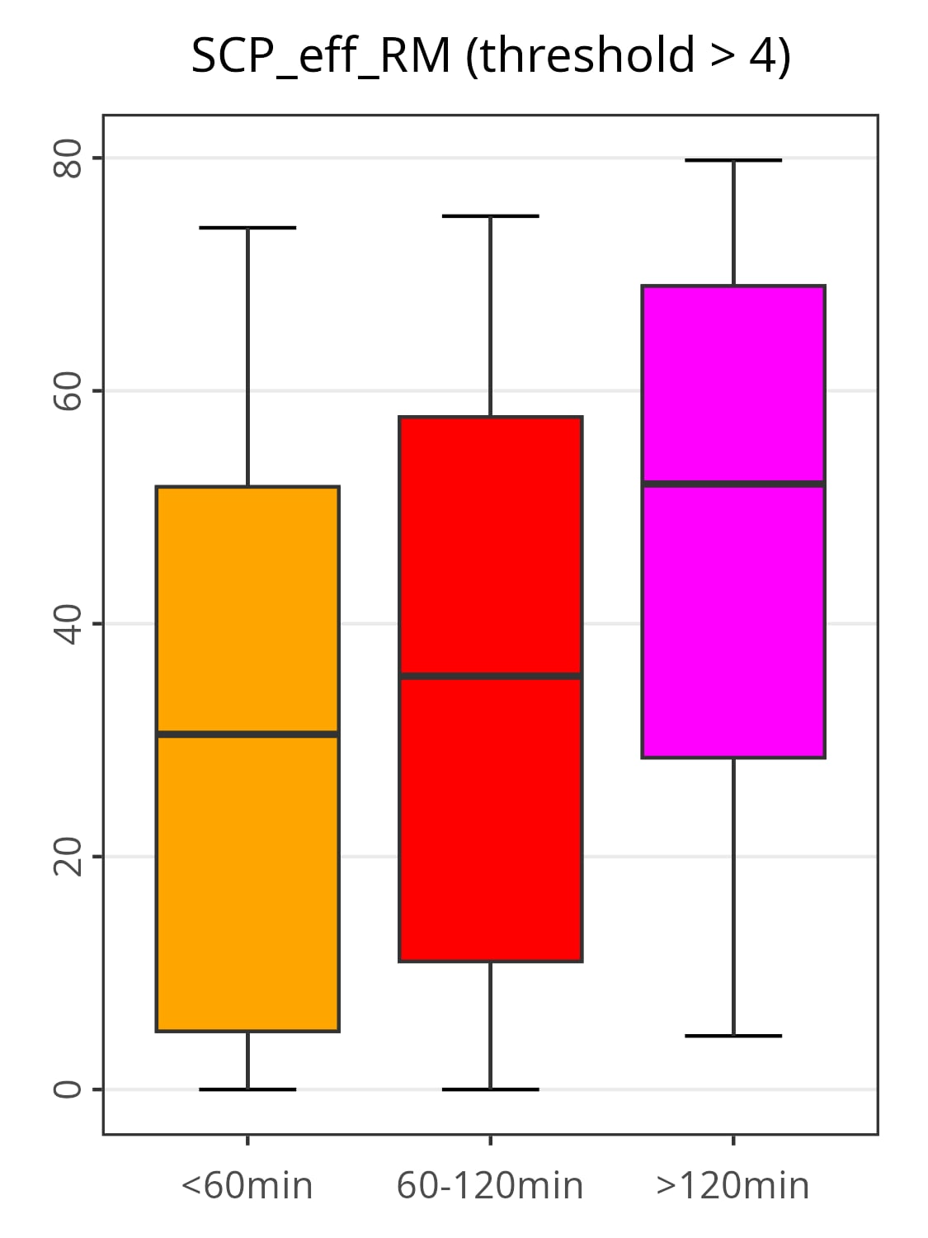
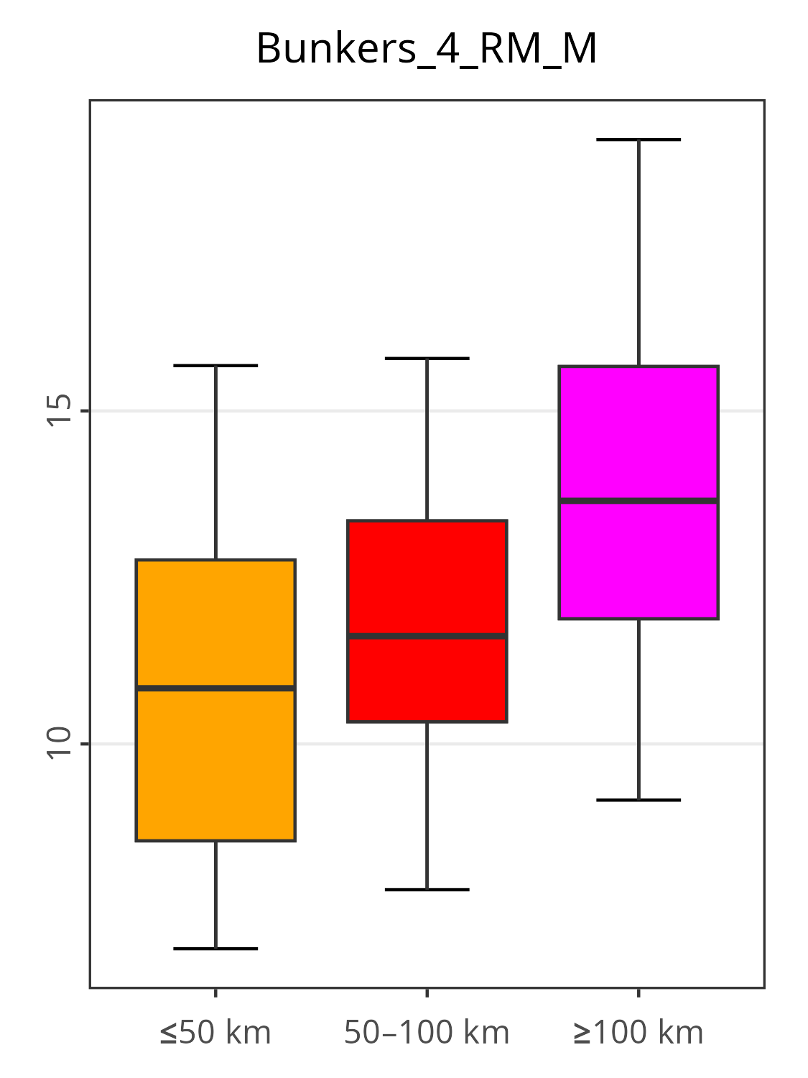
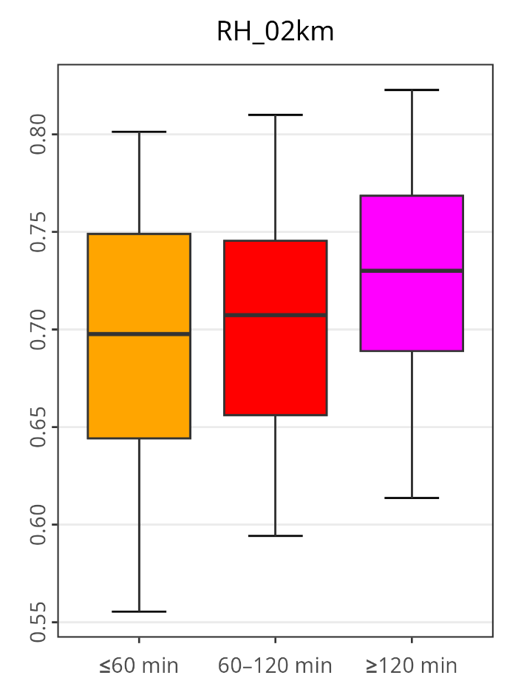
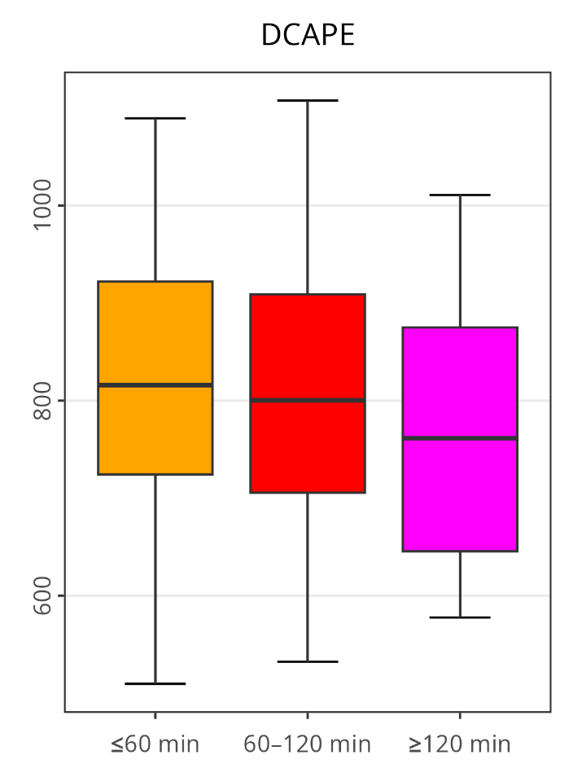
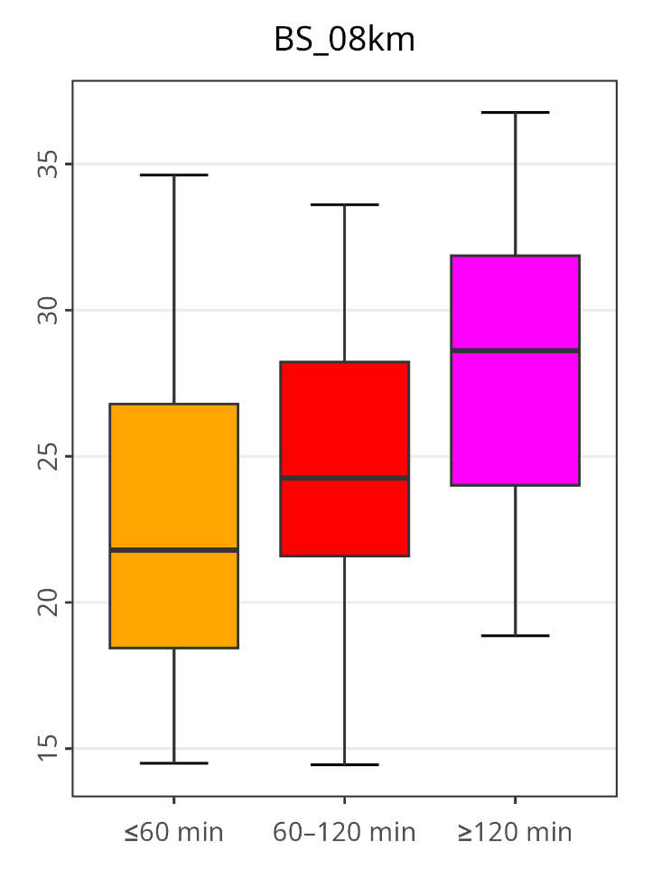
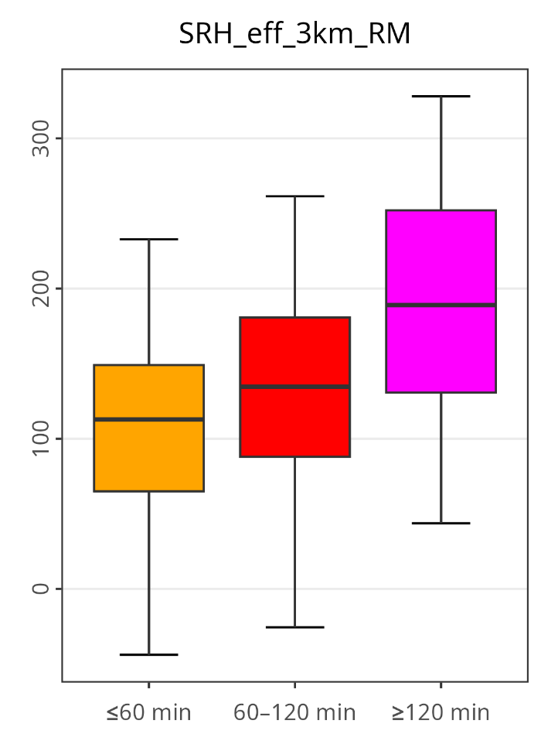
Anything from 10 to 686 km, or what influences the hail swath length in supercells?
Tomáš Púčik¹, Mateusz Taszarek², Pieter Groenemeijer¹,Francesco Battaglioli³
1. European Severe Storm Laboratory Science & Training, Wiener Neustadt, Austria 2. Adam Mickiewicz University, Poznan, Poland 3. European Severe Storm Laboratory e.V., Wessling, Germany
Introduction
Spatial patterns in the storm environments
A hailstorm’s damage potential depends, besides the hail size spectrum, on the area impacted by the hail swath.
We study how to best model the duration and the hail swath length of storms with 5+ cm hail in Europe from 2021 to 2024, yielding 315 cases.
We use the perspective of parameters describing conditions at a single point, as well as the spatial pattern of the mesoscale environment of the storm.
We derive the duration and the length of the hailstorm using ESWD storm reports.
Environments are studied using the ERA-5 reanalysis, from which convective parameters were calculated with the thundeR software package.
The storm motion was estimated using radar data.
Longer-lived hailstorms have a stronger low-level theta-e gradient nearby. See the quantification of the gradient in ThetaE values perpendicular to the storm motion on the box plot on the right:
CAPE differences are very subtle among the three categories, but there is a slightly stronger CAPE gradient ahead of longer-lived hailstorms:
Storm-relative helicity is higher and values ≥ 150 m²/s² cover larger area for longer-lived hailstorms. Number of gridpoints exceeding the threshold increases with increasing longevity:
LCL stays lower in the path of the longer-lived hailstorms. Larger area has lower LCLs:
SCP is higher for longer-lived hailstorms. Furthermore, the area with favourable conditions for supercells covers larger area in case of longer-lived hailstorms, as shown by box plot on the right:
686 km, 9h 15 minutes
Hailstorm with the longest track in the dataset.
K
J/kg
Mean profiles and hodographs
SRH ≥ 150 m²/s² in 150 km radius
0 - 49 km: 162 cases
50 - 99 km: 76 cases
100+ km: 77 cases
Mean hodographs
increasing
buoyancy
number of gridpoints
storm motions (from origin)
LCL ≥ 1000 m in 150 km radius
Maximum buoyancy for hailstorms was similar for short- and long-tracked storms.
Longer tracked hailstorms occur with stronger mid-level shear and faster storm motion.
The largest differences in shear magnitude exist in the layer from 800 to 1800 m.
number of gridpoints
2 most skillful parameter combinations
Duration: SRH 0-3 km + max. bulk shear, SRH 0-3 km + MUCIN
Hail swath length: storm motion + SRH 0-3 km, storm motion + SRH1-6 km,
SCP ≥ 4 in 150 km radius
Box plots
Storm motion (m/s)
Hail swath length is determined by the storm motion and the storm duration.
Hailstorm duration (lifetime) tends to be longer with
decreasing cold pool potential
increasing deep-layer shear and
increasing storm-relative helicity
number of gridpoints
Conclusions and further work
Longer-lived and longer-tracked hailstorms associated with stronger shear, faster storm motion, weaker cold pool potential and larger areas with favourable environment. They also feature stronger low-level boundaries.
Ongoing work: comparing the forecast skill of parameters representing single point, spatial extent of favourable environments and the gradients.
0 - 59 min: 146 cases
60 - 119 min: 86 cases
120+ min: 83 cases
Relative humidity 0-2 km (fraction)
Downdraft CAPE (J/kg)
0-8 km bulk shear (m/s)
0-3 km SRH using real motion (m²/s²)
Acknowledgements
Pucik’s and Groenemeijer’s contributions were supported by grant P33113-N from the Austrian Science Foundation, Taszarek’s by grant 2020/39/D/ST10/00768 from the Polish National Science Centre. Battaglioli’s was supported by grant 17648-185-23 from the Federal Ministry of Research, Technology and Space of Germany. We are very thankful to all volunteers collecting severe weather reports to the ESWD.
12th European Conference on Severe Storms, Utrecht, Netherlands 17 – 22 November 2025

