Slide 1



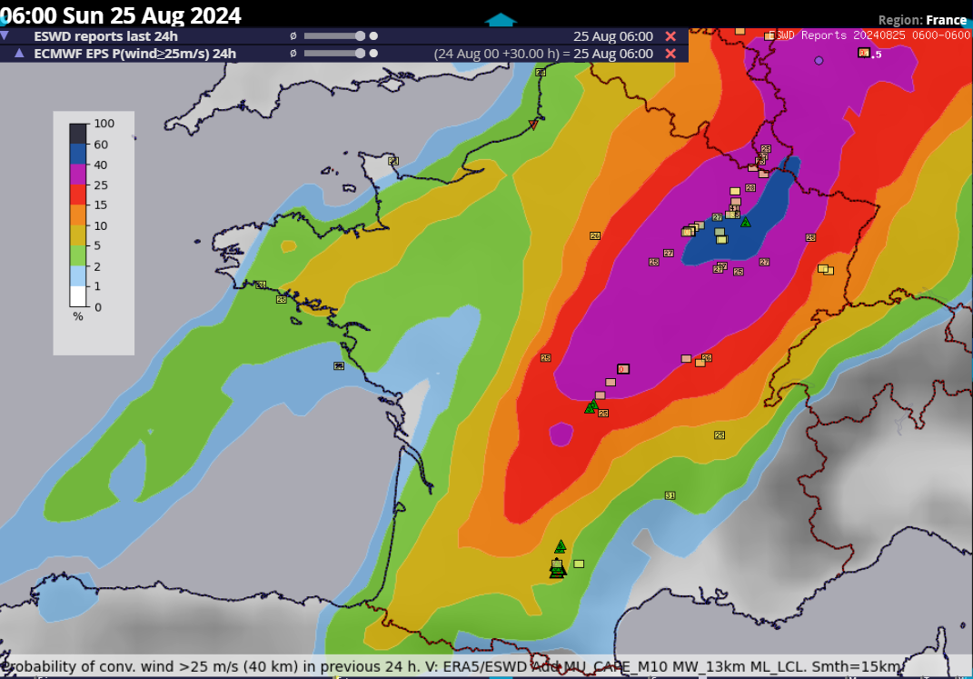
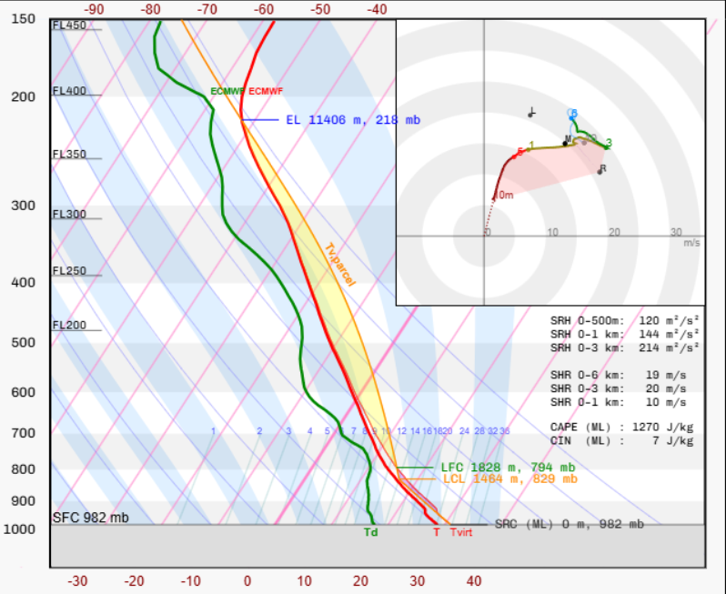
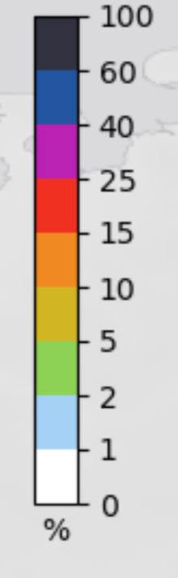
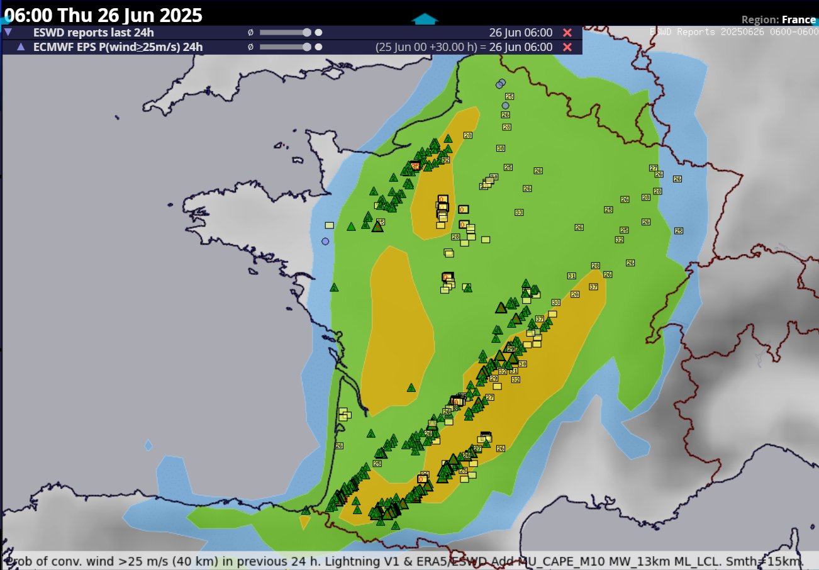
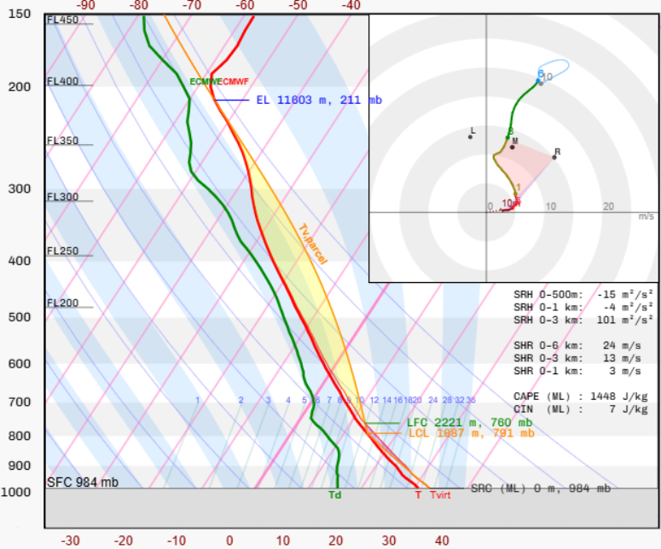
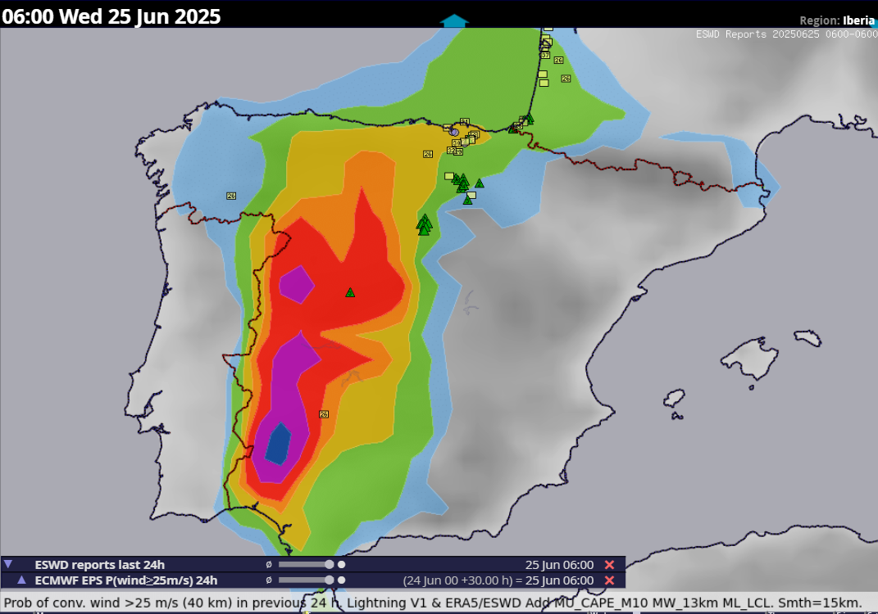
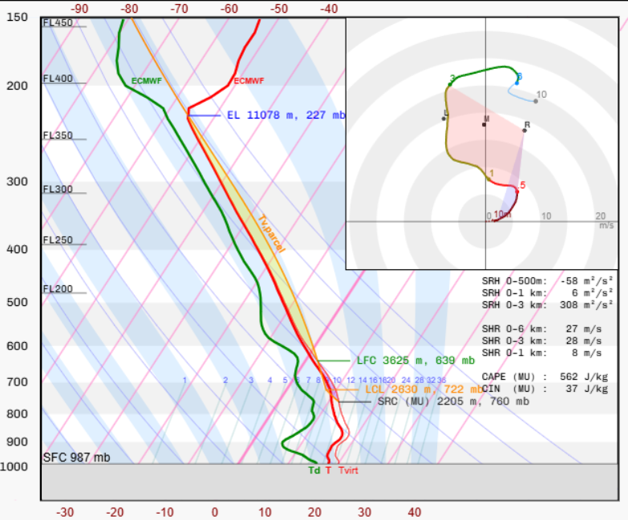
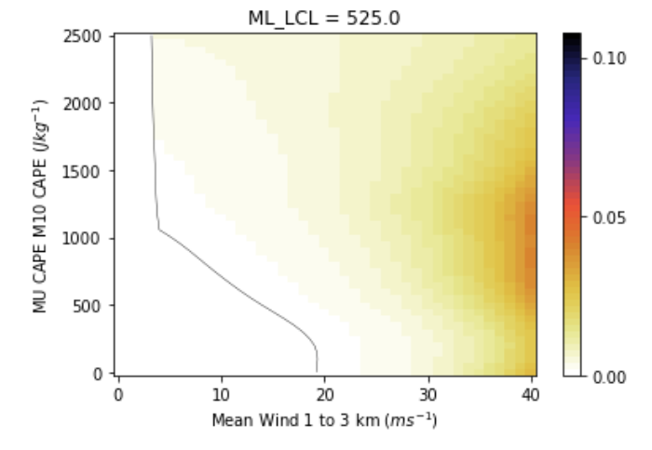
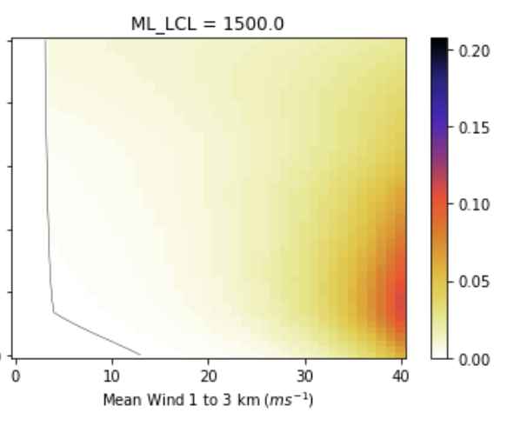
Challenges of developing AR-CHaMo for
severe convective wind gust forecasting
Tomáš Púčik¹, Francesco Battaglioli², Pieter Groenemeijer¹, Ivan Tsonevsky³, Andreea Bărăscu⁴ , Mateusz Taszarek⁵
1. European Severe Storm Laboratory Science & Training, Wiener Neustadt, Austria, 2. European Severe Storm Laboratory e.V., Wessling, Germany, 3. European Centre for Medium-Range Weather Forecasts, Reading, United Kingdom, 4. University of Bucharest, Faculty of Physics, Bucharest, Romania, 5. Adam Mickiewicz University, Poznan, Poland
Introduction
Do you want to follow up on the topic? Send an e-mail to tomas.pucik@essl.org
Model application on various cases
We have developed Additive Logistic Regression Models (AR-CHaMo) for convective severe wind gust forecasting. The model uses predictors derived from NWP forecasts, and yield a probability of severe wind gusts.
This poster illustrates the challenges encountered with the model development and evaluation of the model using the case studies.
Two main challenges that have been encountered:
Which severe wind reports to include from the European Severe Weather Database (ESWD), the Storm Prediction Centre (SPC) and the Bureau of Meteorology (BOM). Each database approaches severe wind reporting differently.
There are various modes of severe convective wind gust production
1. Very strong mean wind in the lower troposphere regardless of CAPE
2. Rear inflow jets in moderate to high CAPE/shear environment
3. Downbursts in disorganized convection
4. Downbursts in rear-flank downdraft of supercells
How to best capture ingredients for each of these modes?
Very good forecast (severe wind gusts up to 41 m/s):
Lightning observations from the
High probability was driven mainly by strong mean wind around 20 m/s. Probability was also slightly increased due to the high LCL.
Too low probability (widespread severe wind gusts up to 38 m/s):
Low probability was driven mainly by weak mean wind around 12 m/s. Otherwise, the environment was very conducive to severe wind gusts: moderate CAPE, high LCL and strong deep-layer shear.
Too high probability (no severe wind gusts in southwestern Spain):
High probability was driven mainly by strong mean wind around 18 m/s. Otherwise, the environment overall was not conducive to severe wind gusts with stable boundary layer and rather low CAPE.
Severe wind gust reports
Multiple supercells
and one bow echo
Severe wind gust reports used for modelling
Multiple supercells
and bow echoes
We decided to only accept the reports of measured wind gusts (both EU and US) and the wind gusts with F1 or stronger damage rating (only for EU).
Estimated wind gusts (US) and unrated wind damage reports (EU) were not used.
Filtering results in a strong reduction of training data from the ESWD. Fraction of wind gusts with measurements is smaller in summer, because severe wind events are smaller in spatial scale. Thus, filtering causes an overrepresentation of wintertime gusts.
Large hail reports
Many elevated storms in southern Spain
Conclusions and ongoing work
Severe wind gust databases have issues, such as overestimation of the gusts in the Storm Data for the U.S. (Edwards et al. 2018) or changing fraction of different data contents in ESWD reports over years for Europe
Current model suffers from probability being driven almost purely by magnitude of mean flow almost regardless of CAPE magnitude or LCL height.
Our goal is to cover the situations resulting in severe wind gusts also in weak mean flow, such as downbursts or rear inflow jets in bow echoes.
We are trying to reach the goal by increasing the fraction of ESWD reports used for training, using measure of vertical wind shear besides the mean wind and use mixed-layer parcel instead of most-unstable for CAPE.
How to best deal with severe wind gusts caused by elevated storms?
Developed model
Probability of severe wind gusts increases strongly with increasing mean wind.
Probability of severe wind gusts increases weakly with increasing CAPE or LCL height.
Acknowledgements
Pucik’s and Gronemeijer’s contributions were supported by grant P33113-N from the Austrian Science Foundation, Battaglioli’s by grant 17648-185-23 from the Federal Ministry of Research, Technology and Space of Germany and Taszarek’s by grant 2020/39/D/ST10/00768 from the Polish National Science Centre. The work was also supported by the ECMWF funded project “Application of logistic convective hazard models to ECMWF EPS reforecasts”. We are very thankful to all volunteers collecting severe weather reports to the ESWD.
12th European Conference on Severe Storms, Utrecht, Netherlands 17 – 22 November 2025

