Slide 1
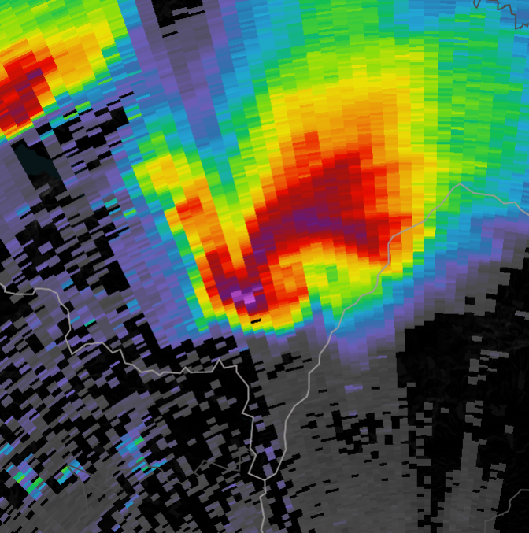
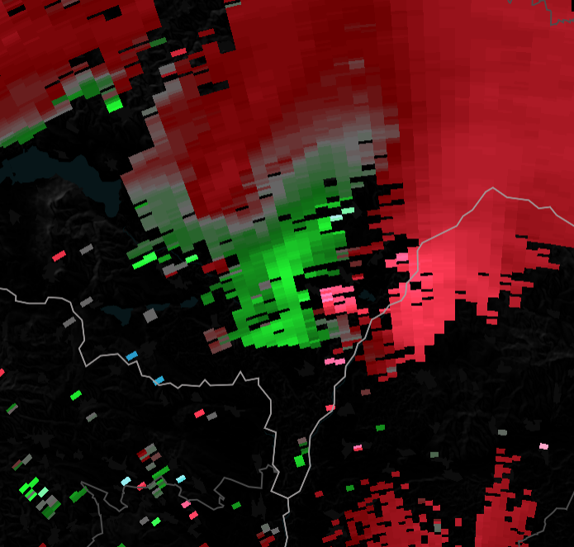
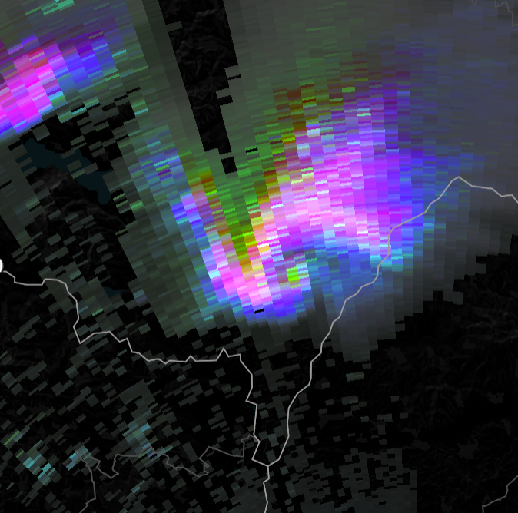
How well can European radars detect supercells and tornadoes?
Bram van ‘t Veen
Pieter Groenemeijer
Tomáš Púčik

Slide 2
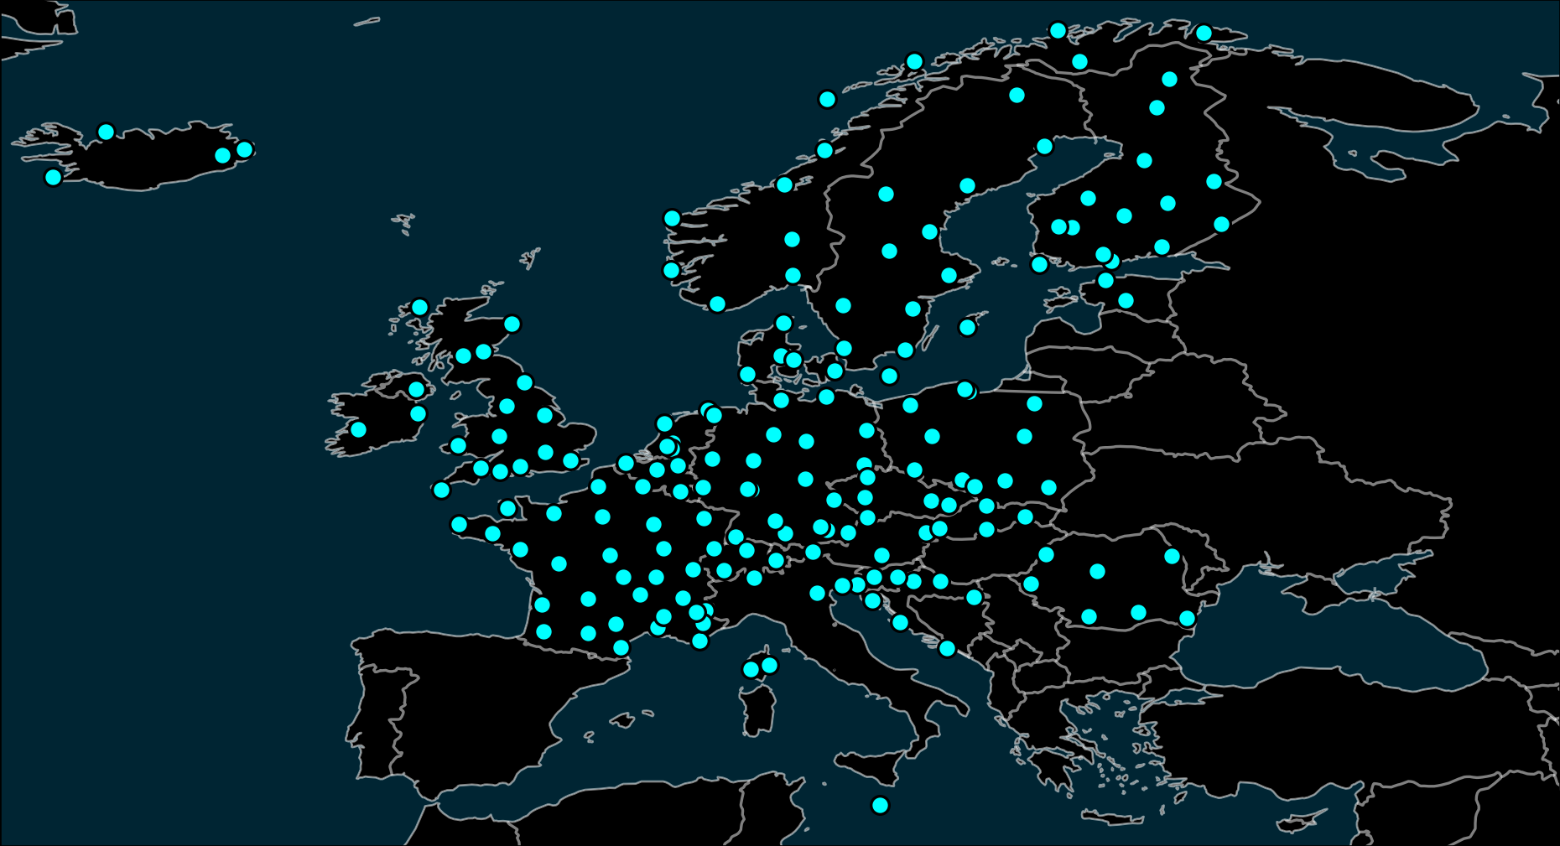
Radars in Europe
*
* radar sites that ESSL has access to permanently or for case studies

Slide 3
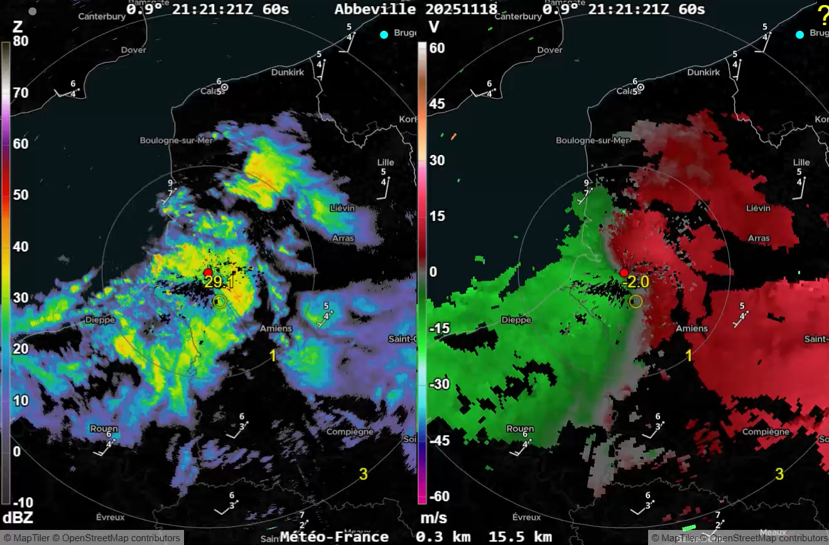
The ESSL Radar Displayer
VIDEO SHOWING CAPABILITIES AND SPEED COMES HERE
Technical
Maplibre ensures quick GPU-based data rendering
Custom WebP-based data format for fast compression and decoding
Data requests in 1 or 2 hour chunks speeds it up further

Slide 4
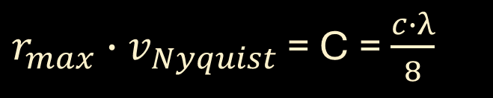
Doppler quality in Europe
A radar's range r_{max} and the maximum velocity it can measure v_{Nyquist} can be varied at each other‘s expense
Their product is a constant:
speed of light
radar wavelength
$r_{max}∙$ $v_{Nyquist}$ = C = $\frac{c∙λ}{8}$
They can be varied by changing the Pulse Repetition Frequency
Using 2 PRFs (dual or staggered PRF) can extend v_{Nyquist}

Slide 5
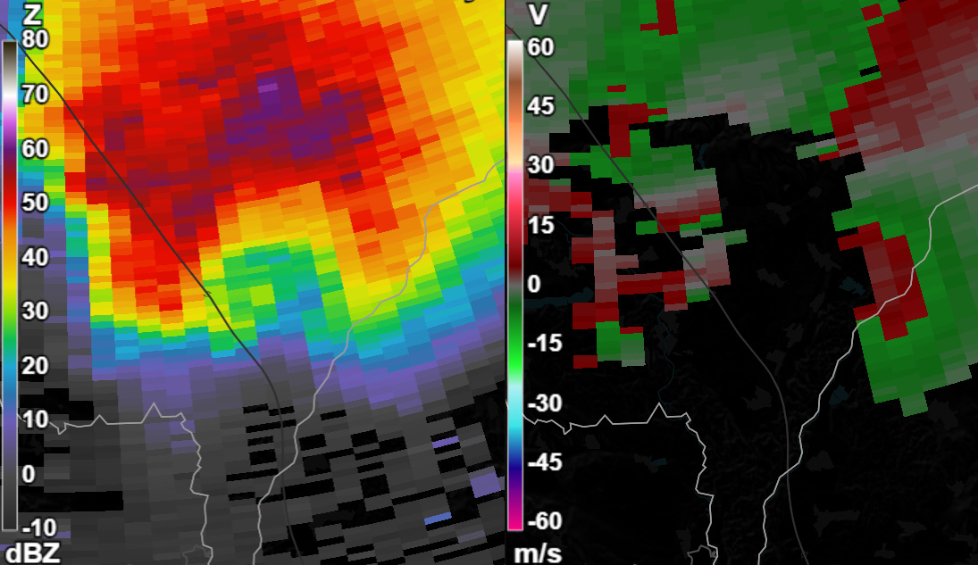
Doppler quality of Europe's C-band radars
Different radar configurations in Europe
Varying doppler quality: “pretty good” to “unusable”
Reflectivity
Radial velocity

Slide 6
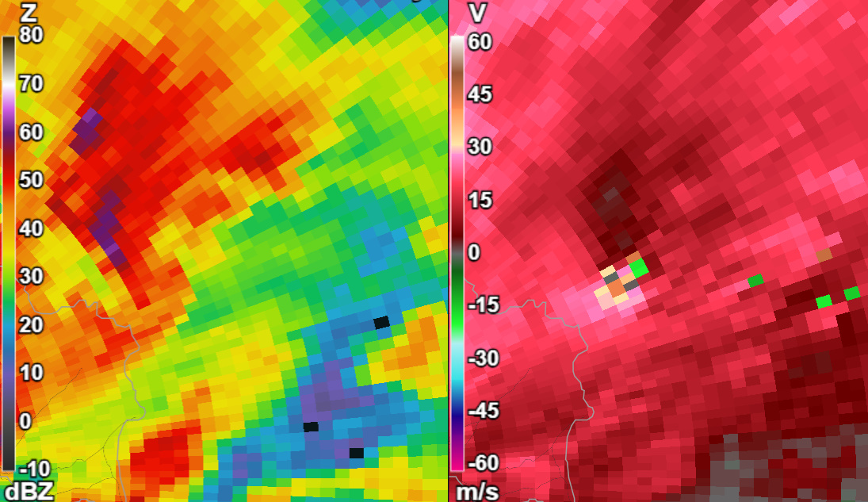
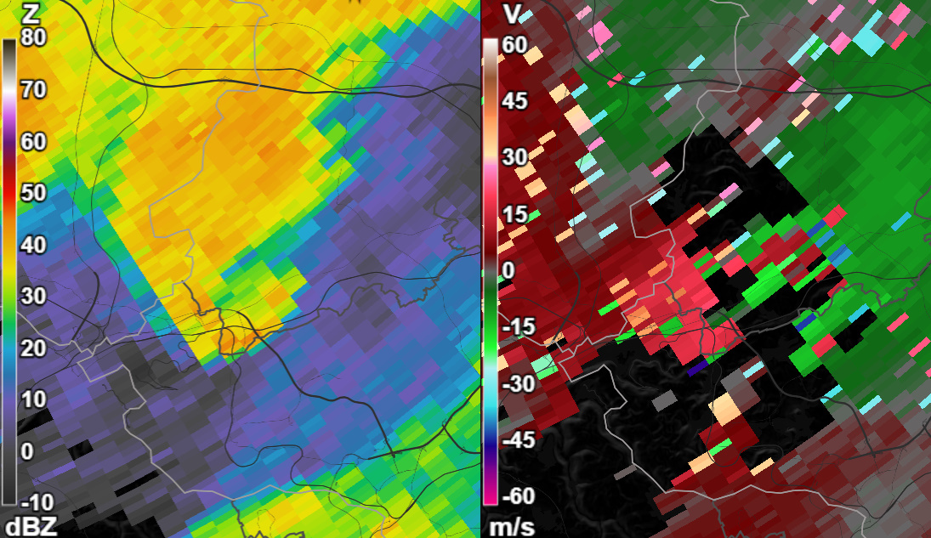
Doppler quality of Europe's C-band radars
Different radar configurations in Europe
Varying doppler quality: “pretty good” to “unusable”
Reflectivity
Radial velocity
dual PRF with few errors

Slide 7
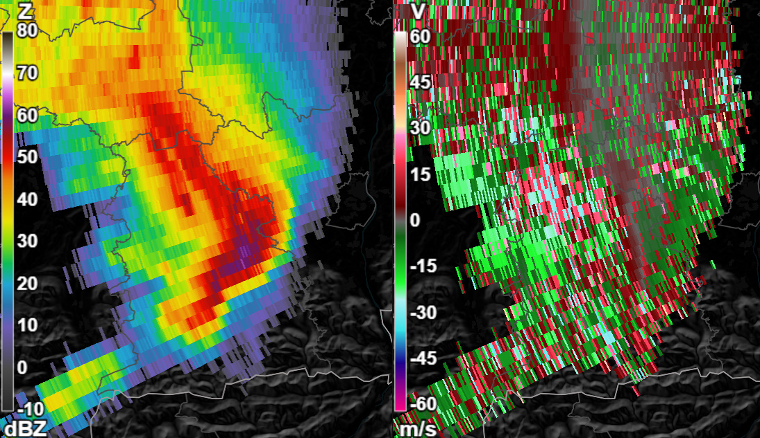
Doppler quality of Europe's C-band radars
Different radar configurations in Europe
Varying doppler quality: “pretty good” to “unusable”
Reflectivity
Radial velocity
dual PRF with many errors

Slide 8
Doppler quality of Europe's C-band radars
Aliasing errors always occur for single & dual PRF configurations
Important corrections are possible, if number of errors is small
Reflectivity
Radial velocity

Slide 9
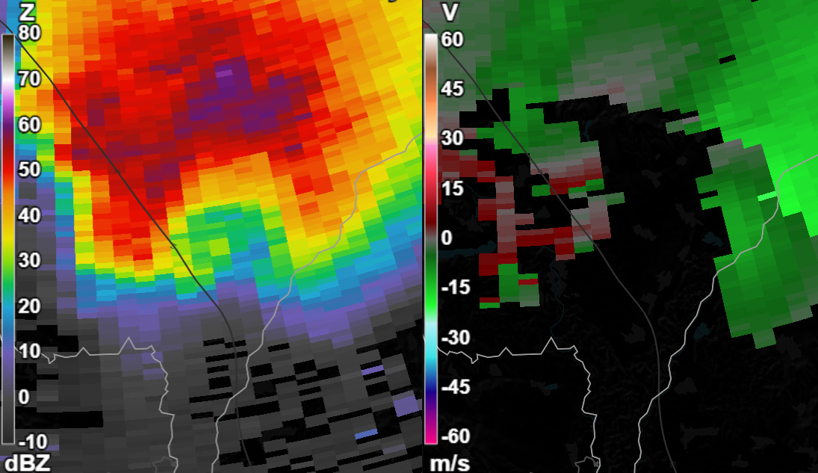
Doppler quality of Europe's C-band radars
Aliasing errors always occur for single & dual PRF configurations
Important corrections are possible, if number of errors is small
Reflectivity
Radial velocity
(corrected)

Slide 10
Doppler quality of Europe's C-band radars
Aliasing errors always occur for single & dual PRF configurations
Important corrections are possible, if number of errors is small
Reflectivity
Radial velocity

Slide 11

Doppler quality of Europe's C-band radars
Aliasing errors always occur for single & dual PRF configurations
Important corrections are possible, if number of errors is small
Reflectivity
Radial velocity
(corrected)

Slide 12
Doppler quality of Europe's C-band radars
Aliasing errors always occur for single & dual PRF configurations
Important corrections are possible, if number of errors is small
Reflectivity
Radial velocity

Slide 13
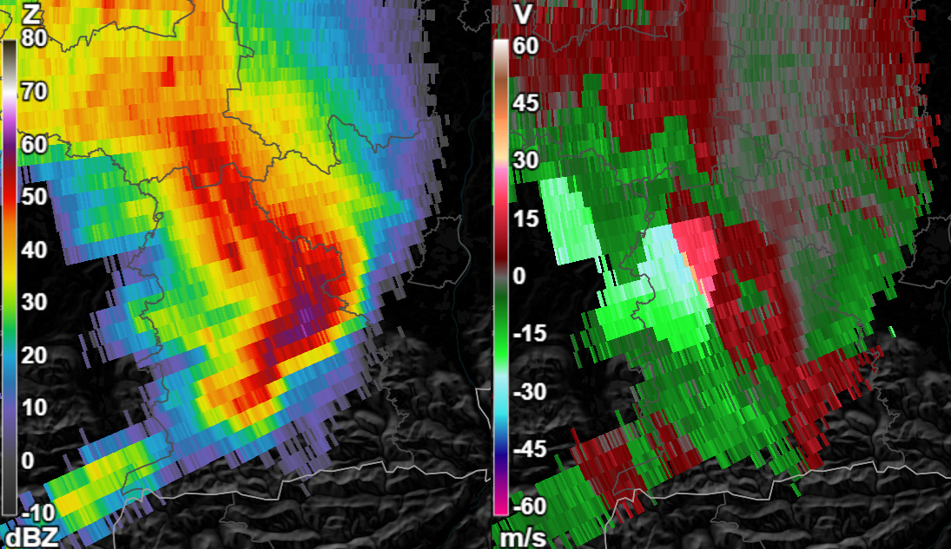
Doppler quality of Europe's C-band radars
Aliasing errors always occur for single & dual PRF configurations
Important corrections are possible, if number of errors is small
Reflectivity
Radial velocity
(corrected)

Slide 14
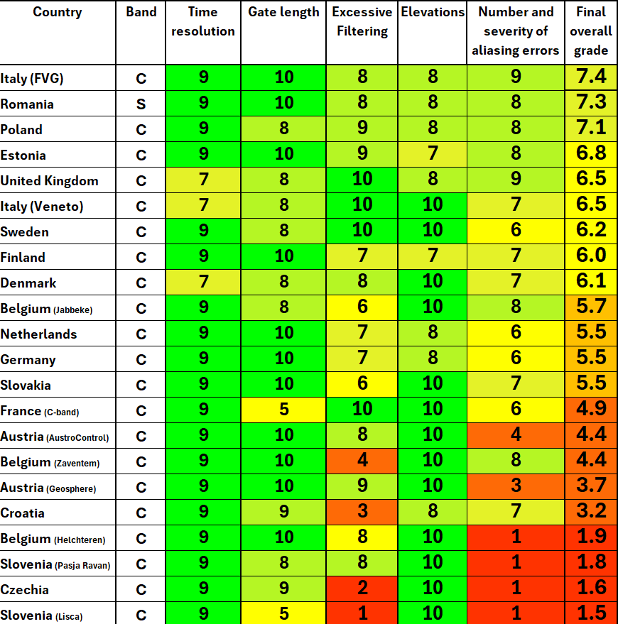
Ranking of radar configurations for circulation detection
Used historical tornado cases
Subjectively ranked appearance on radar
Assigned grades (0 – 10) to 5 aspects:
Time resolution
Spatial resolution
Presence of excessive filtering
Available elevation angles
Number of aliasing errors

Slide 15

Main suggestions for improvement
Filtering:
Don’t filter velocity based on signal quality
Prevent too agressive clutter filtering
Reliable velocity data:
Use dual PRF, optimally with a 3:2 PRF ratio
Ensure the high Nyquist velocity = 15 m/s or higher
Our poster “Ranking the radars”
QR-CODE 2 COMES HERE

Slide 16
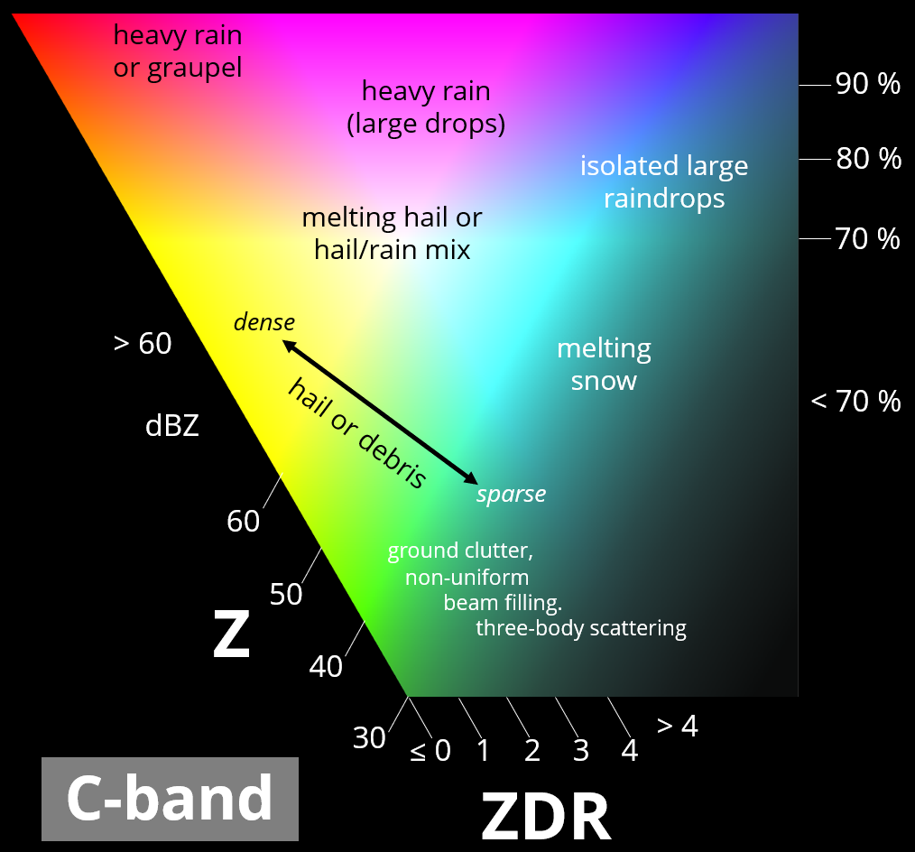
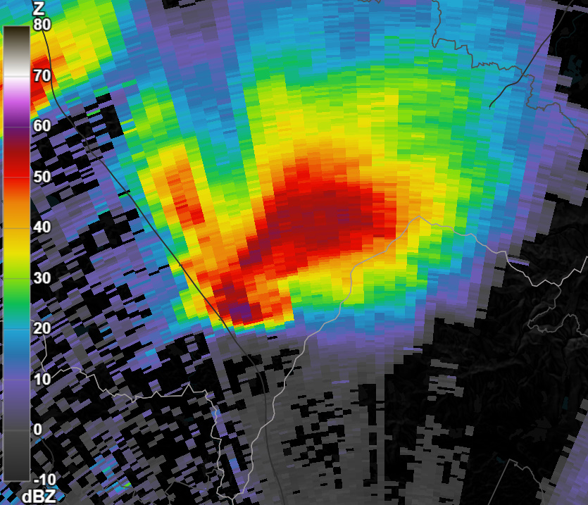
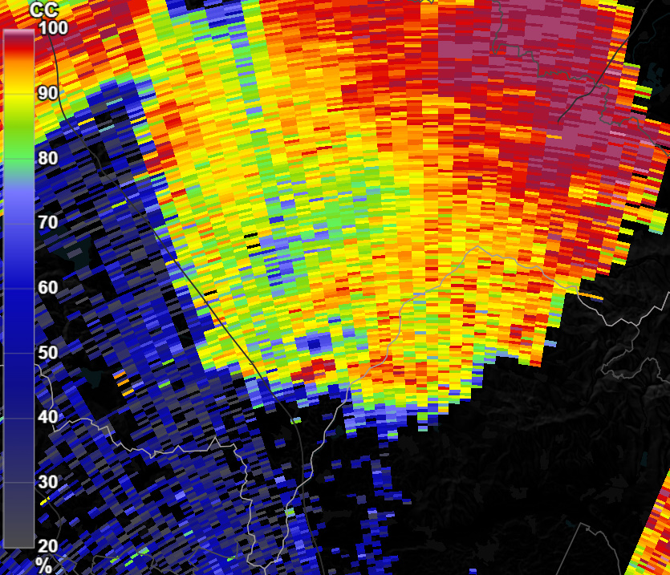
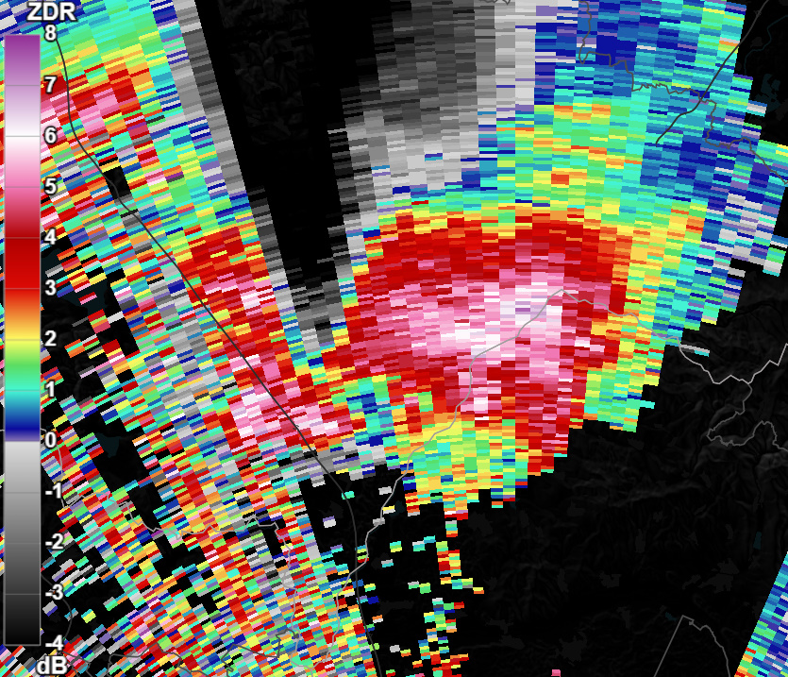
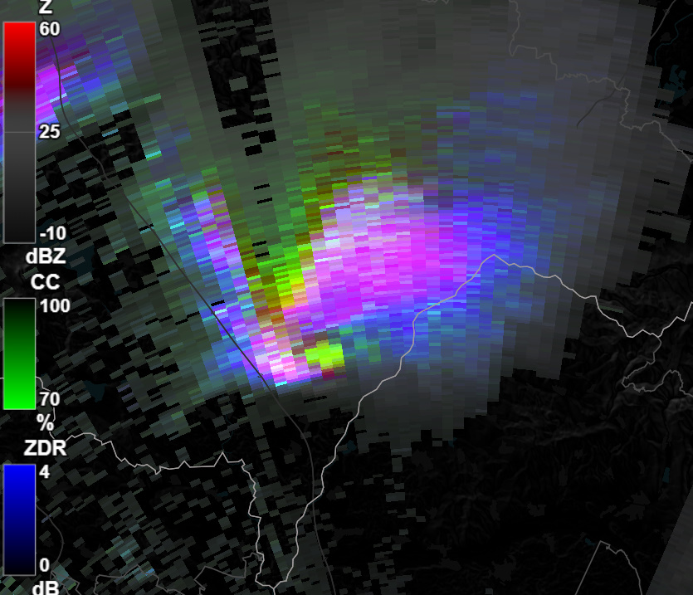
Polarimetric RGB
Combines Z, ZDR, and CC ( = RhoHV )
Helps judging collocation of signatures
CC

Slide 17
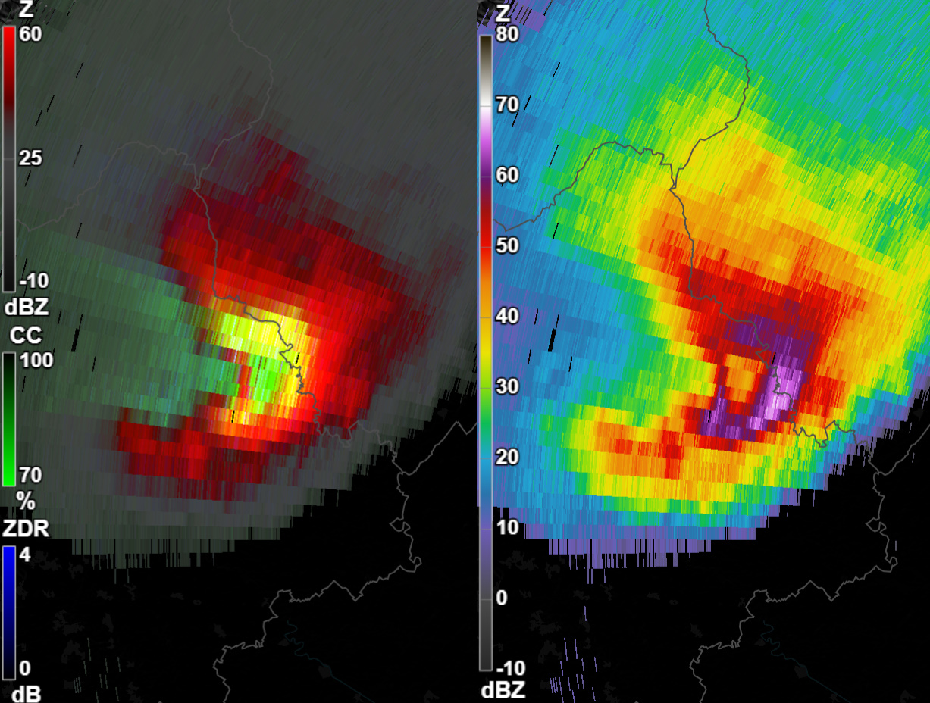
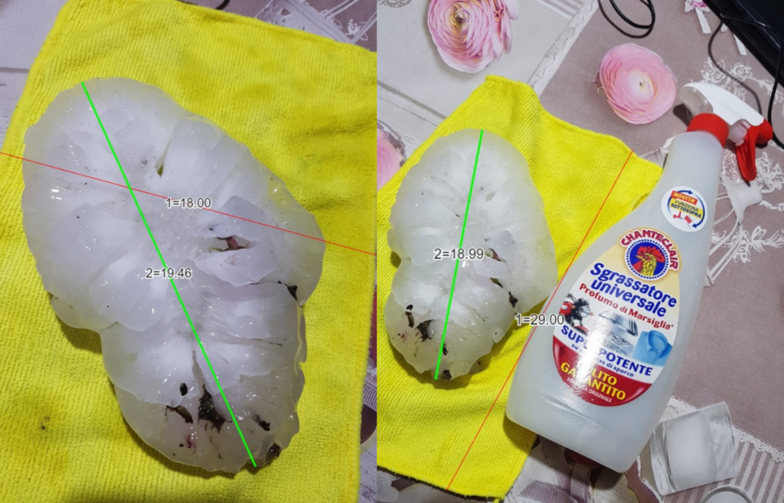

Polarimetric RGB: C-band
RGB
Reflectivity
Our poster on the RGB
15 minutes before 19 cm hailstone in Italy
Photo: Tornado in Italia – Marilena Tonin
Data: ARPA-FVG

Slide 18
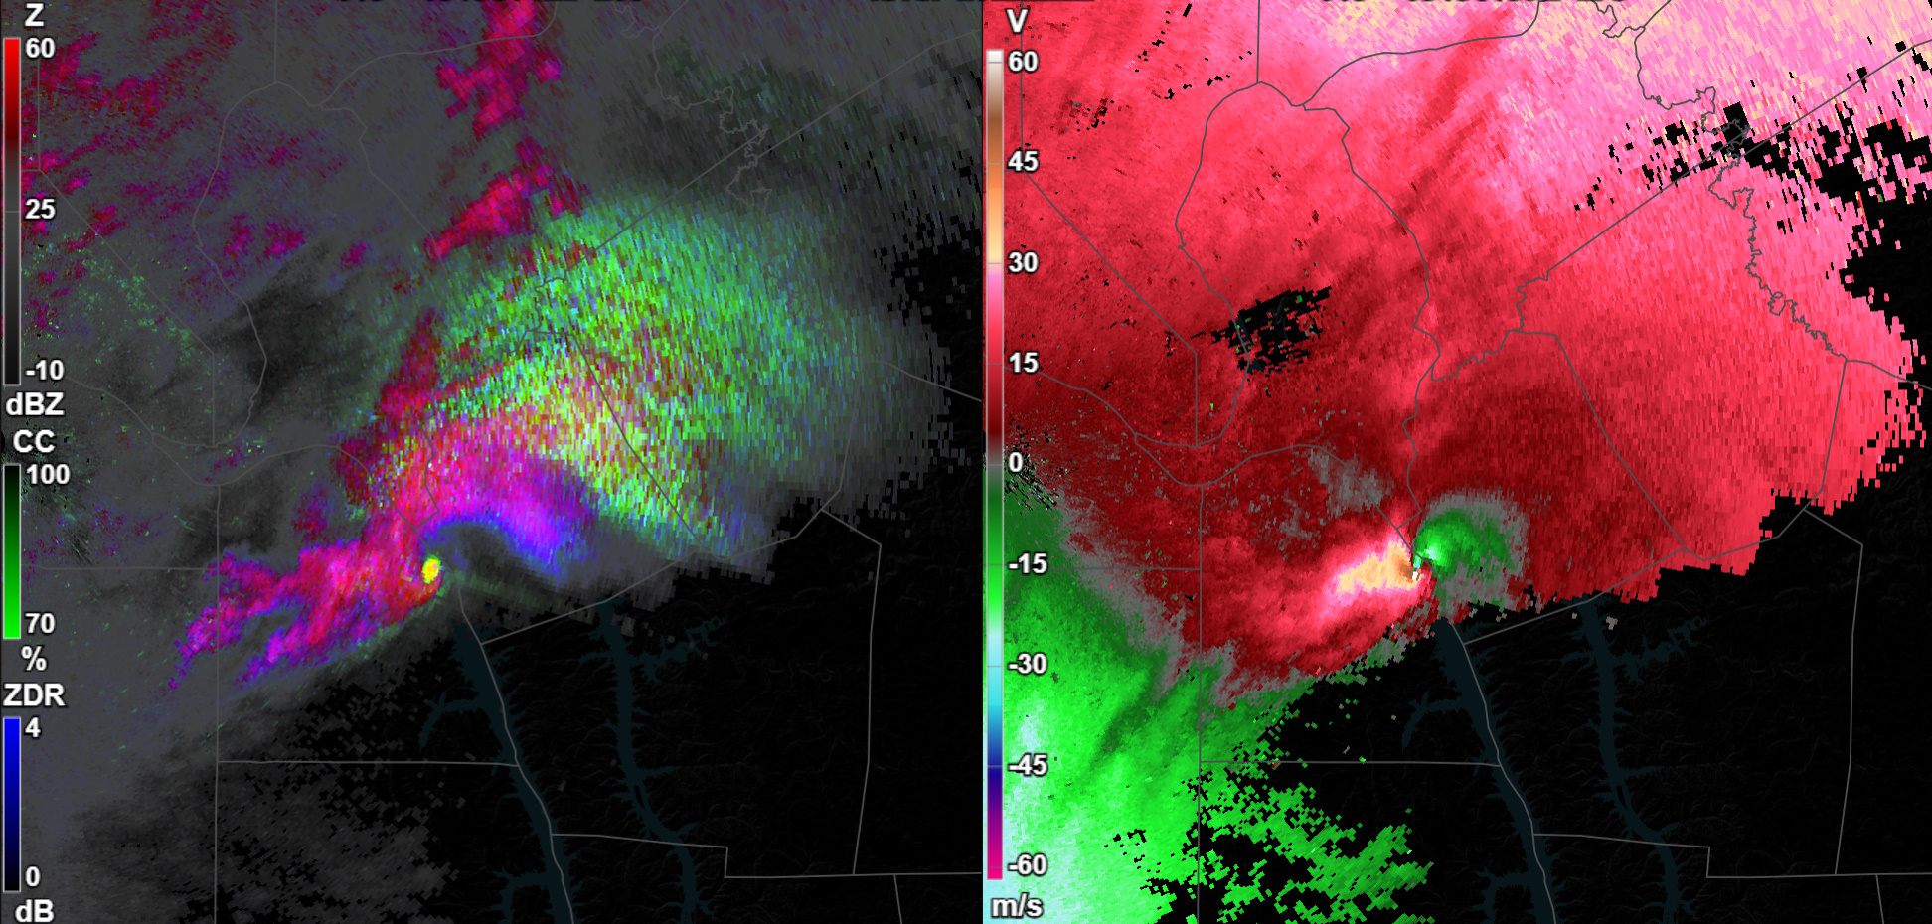
Thank you!
Acknowledgements:
The weather services that provided data as Open Data or for research/education use
ESWD volunteers to collocate the radar data with storm reports
Dr Matthew Kumjian (Penn. State) for assisting us with interpreting polarimetric radar data
All participants to Radar Workshop in Dec 2024 and the 2025 ESSL Testbeds for their feedback
Veillette et al (2023) for the their “Deep Learning–Based Velocity Dealiasing“ post-processing algorithm that we used in sequence with our own algorithm
Access to the Radar Displayer and Weather Data Displayer can be licensed from ESSL Services GmbH

