Slide 1

A new pathway for tornadogenesis exposed by numerical simulations of supercells in turbulent environments Paul Markowski Department of Meteorology & Atmospheric Science Penn State University
Acknowledgments:
George Bryan, Johannes Dahl, Ying Pan, Matt Parker, Yvette Richardson, Rich Rotunno, Lou Wicker, George Young, U.S. National Science Foundation

Slide 2
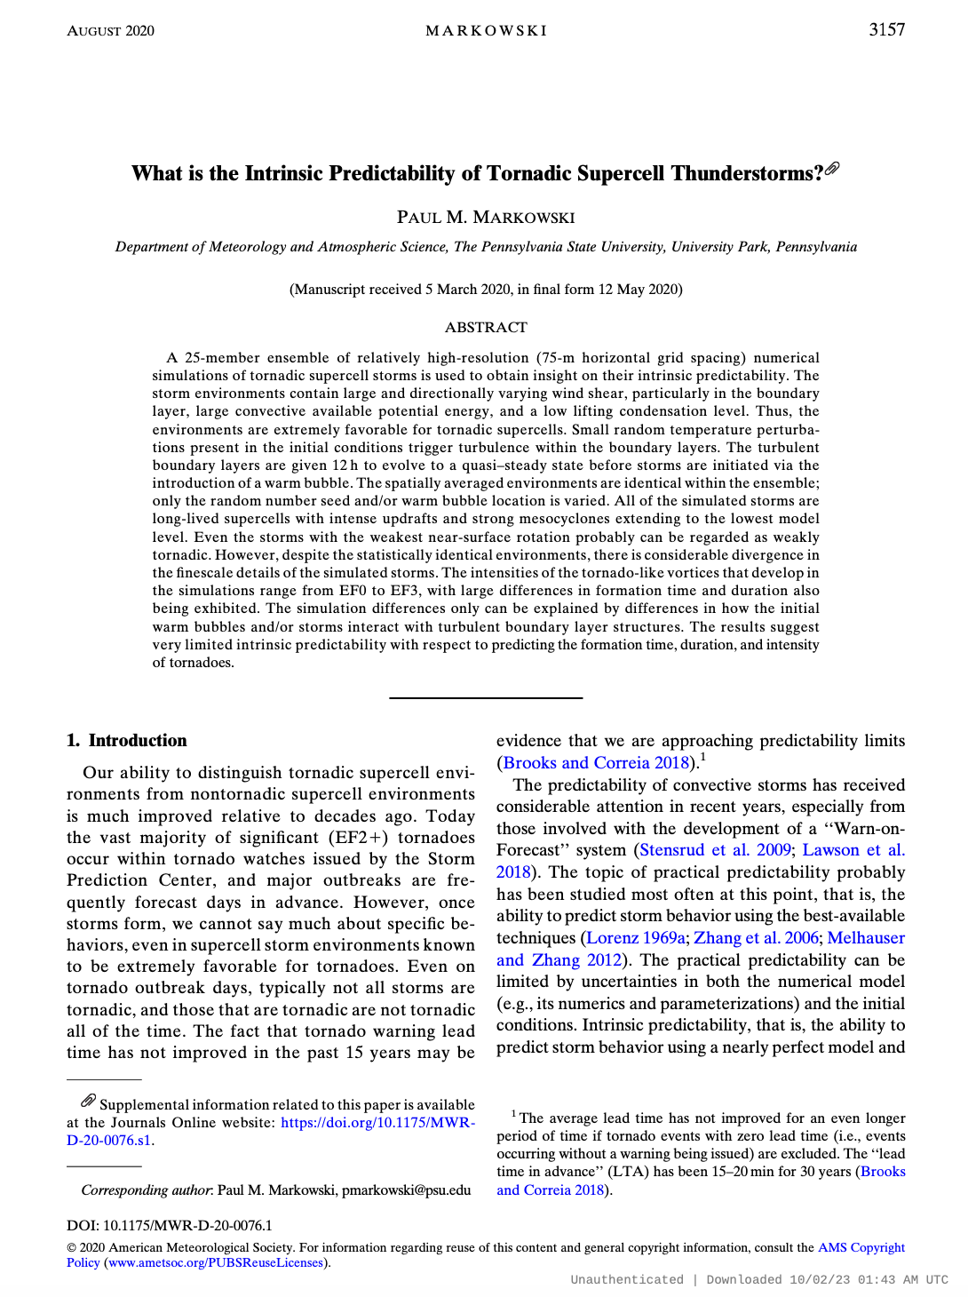
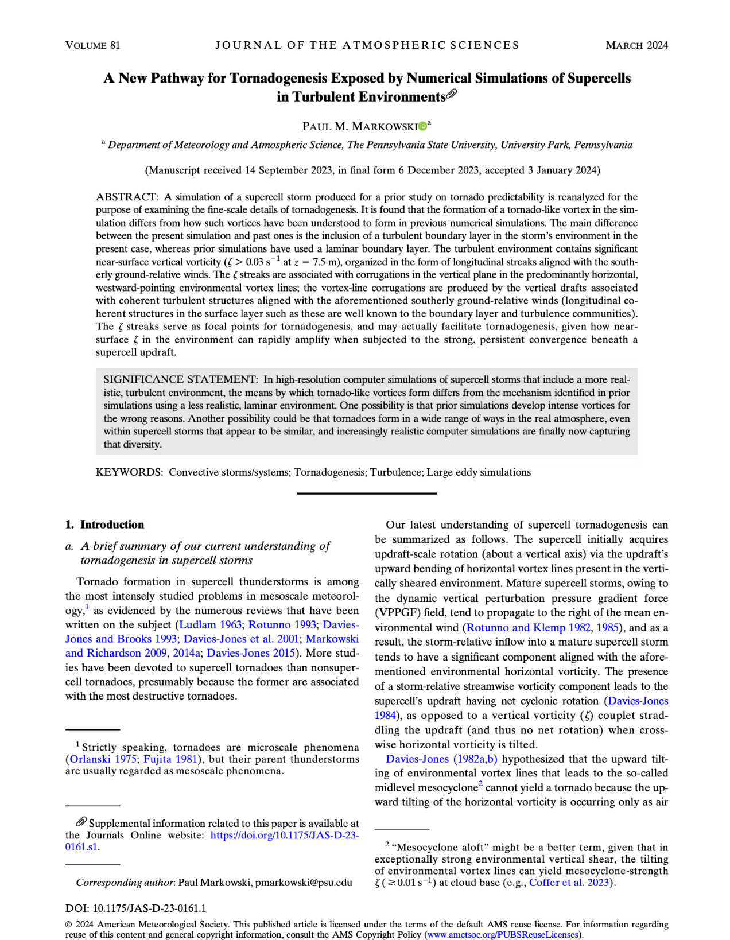
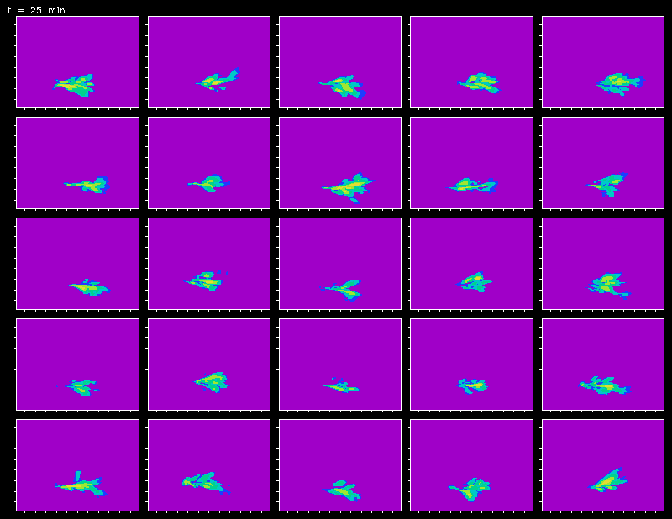
The focus of the 2020 MWR article was merely predictability (specifically, how does a turbulent environmental boundary layer reduce predictability), not how the tornadoes formed.
EF2
EF2
EF3
EF1
EF1
EF1
EF2
EF1
EF3
EF1
EF2
EF1
EF0
EF1
EF1
EF0
EF1
EF1
EF2
EF3
EF1
EF1
EF1
EF3
EF1

Slide 3
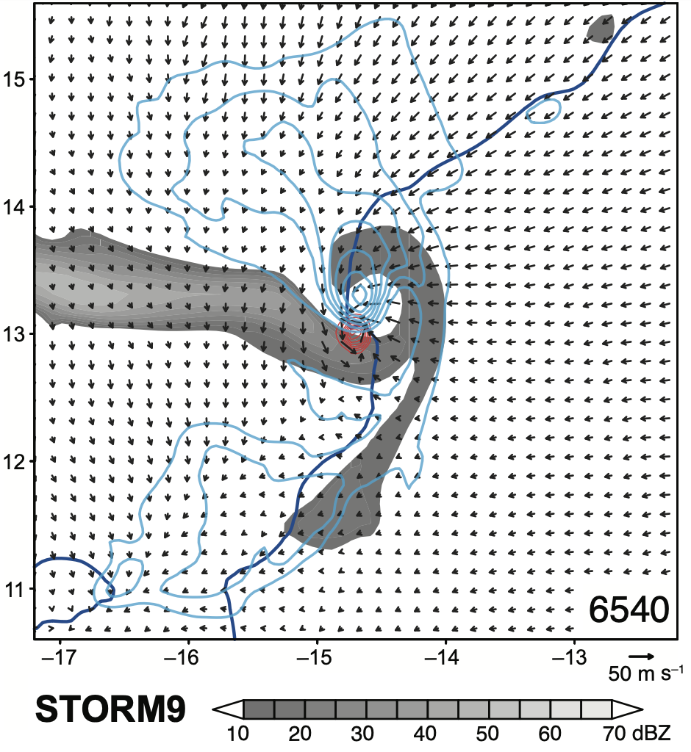
The focus of the 2020 MWR article was merely predictability (specifically, how does a turbulent environmental boundary layer reduce predictability), not how the tornadoes formed.
w isotachs
gust front
At the time, I had no reason to think the way that the tornadoes formed differed from our existing understanding—nothing in the appearance or evolution of the simulated supercells is unusual.
STORM 9
isovorts
EF3

Slide 4
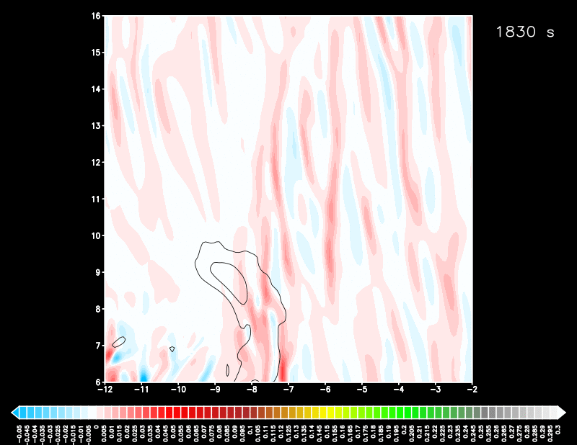
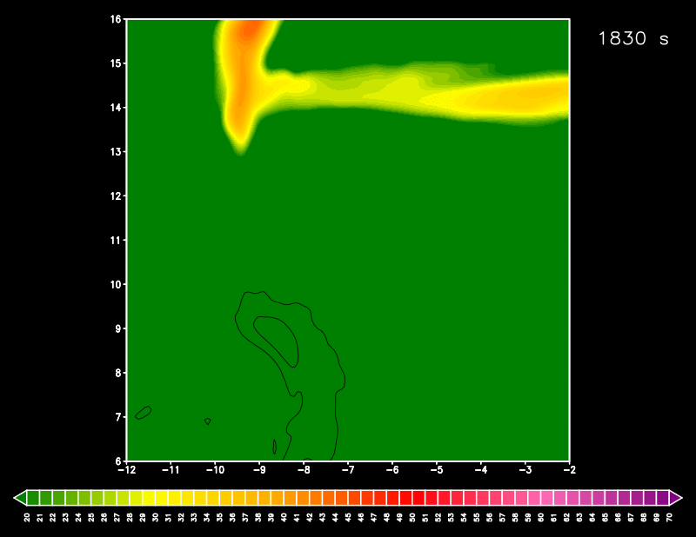
After a few failed tries, the TLV forms at approximately 6250 s
Near-surface vertical vorticity and low-level vertical velocity
reflectivity
Color shading:
ζ at z = 7.5 m
Black contours:
w at z = 522 m
(5, 10, 15, … m s^{–1})
Heavy blue line:
gust front proxy
(θ’_{ρ} = –0.25 K)
TLV = “tornadolike vortex”
terminology used because the grid spacing cannot resolve what many believe makes a vortex a “tornado” (e.g., corner flow, extreme vertical velocity next to the surface)
ζ_{7.5 m}
–0.05
0.00
0.05
0.10
0.15
0.20
0.25
0.30 s^{–1}

Slide 5
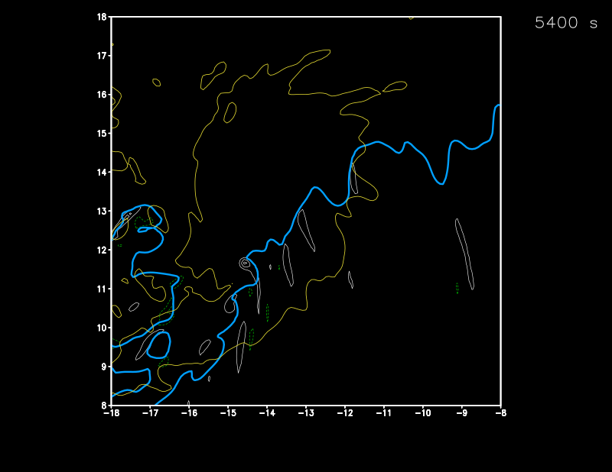
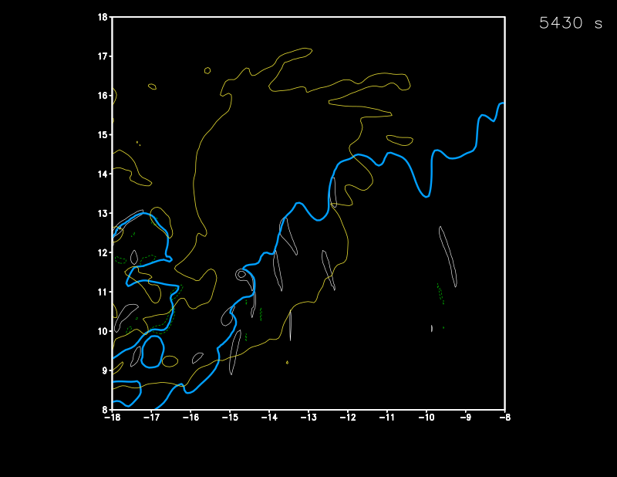
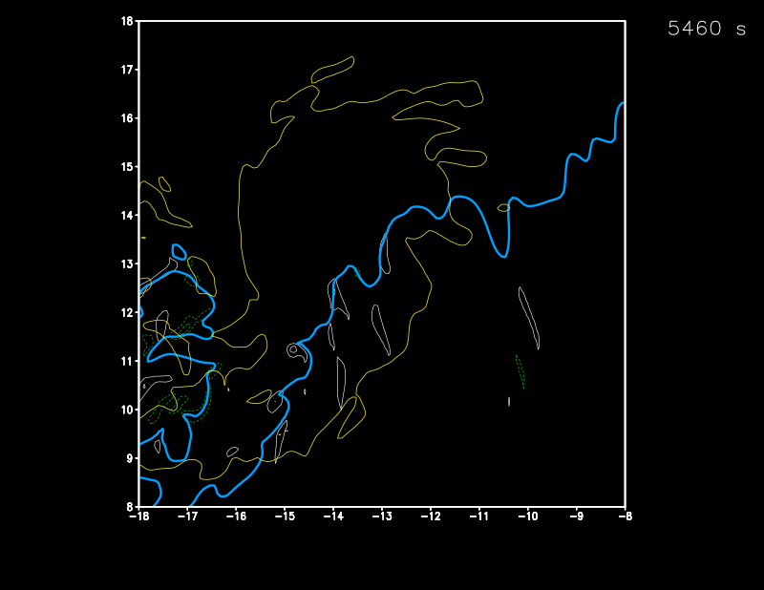
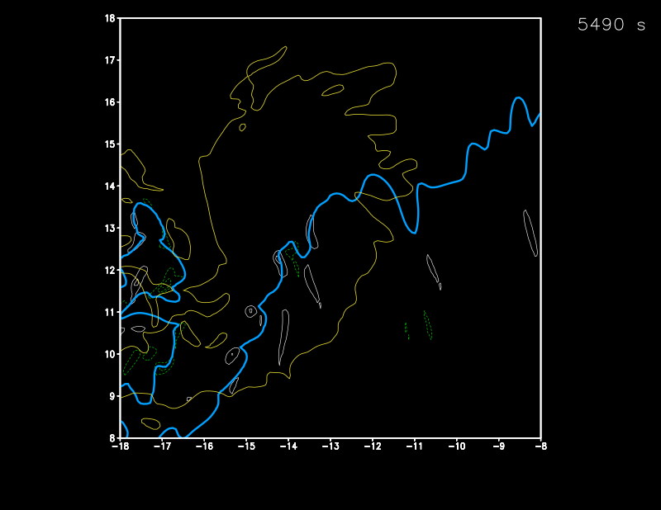
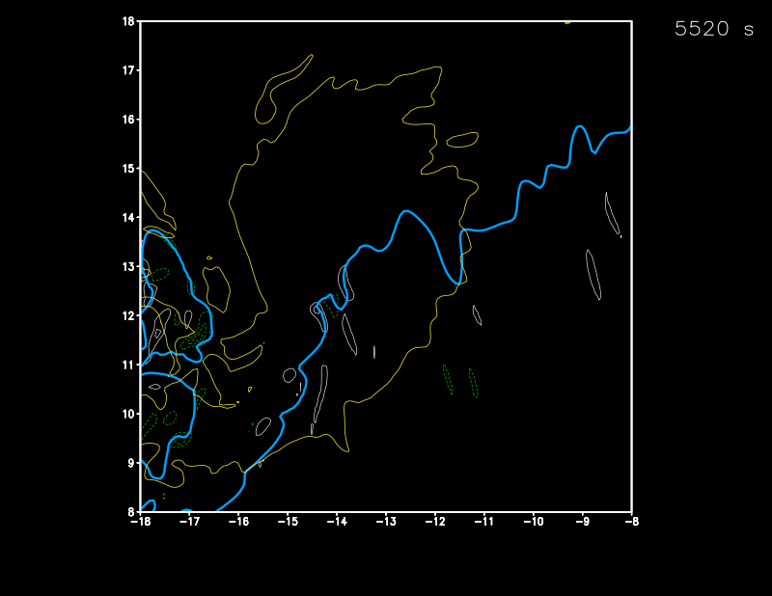
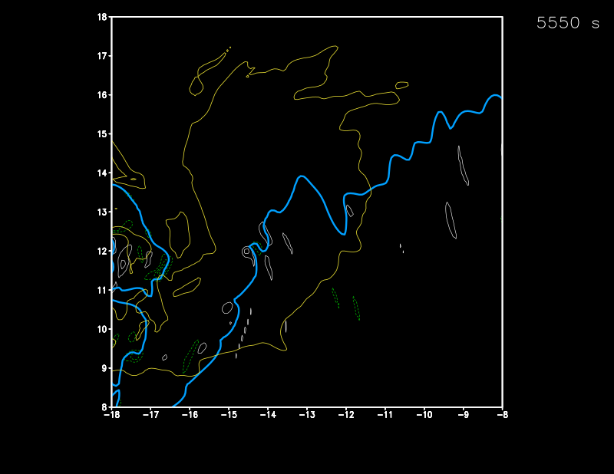
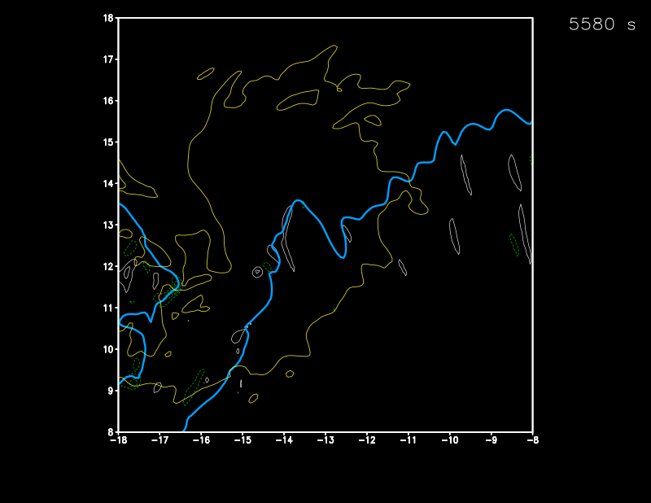
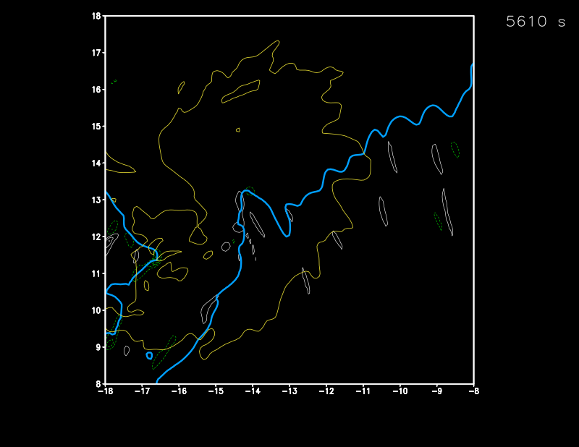
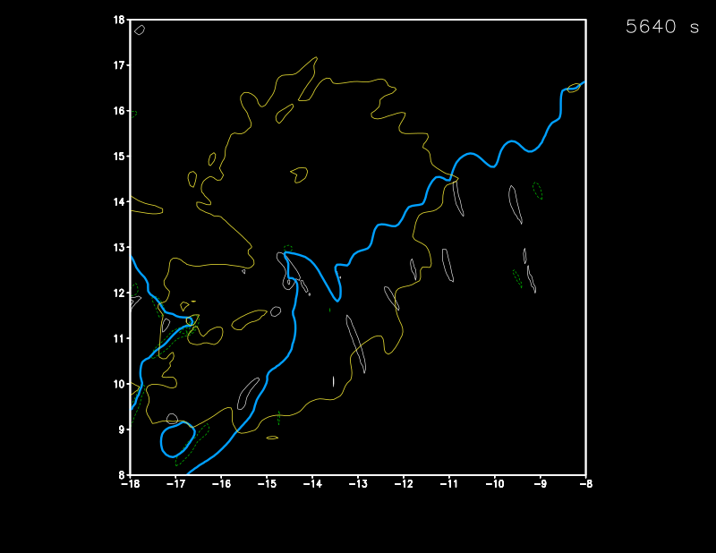
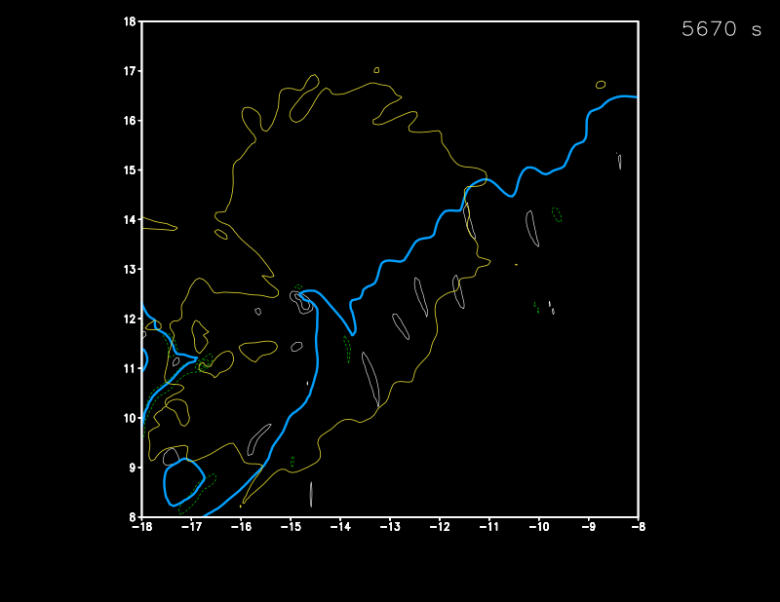
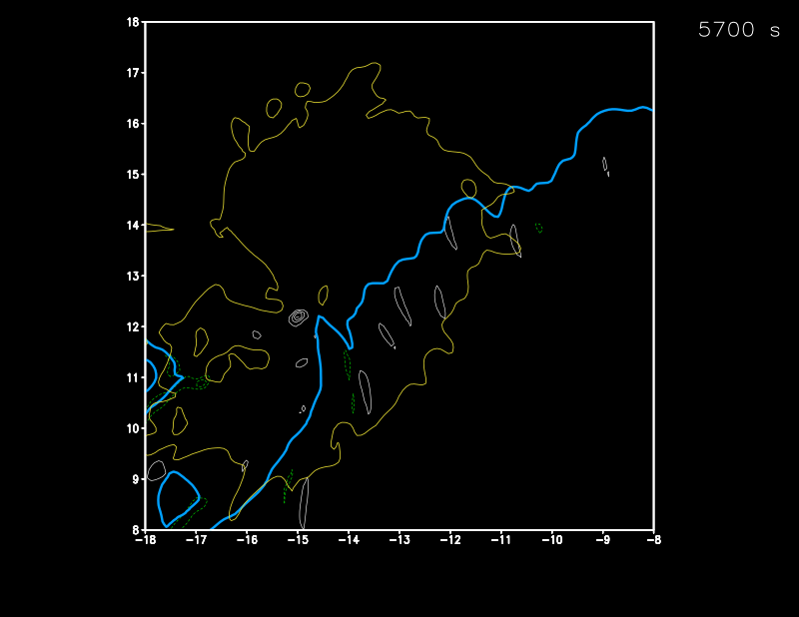

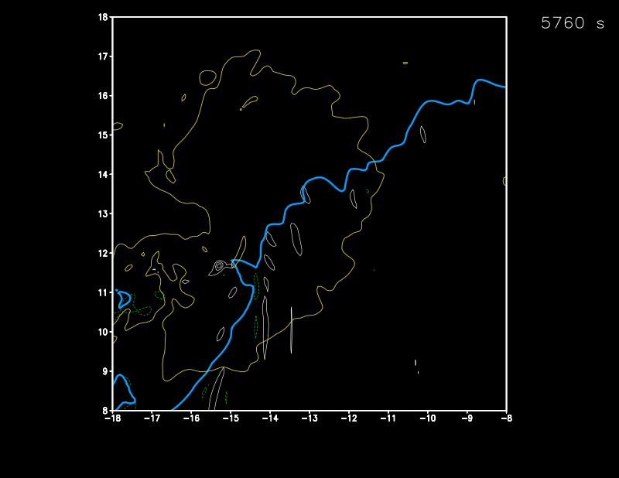
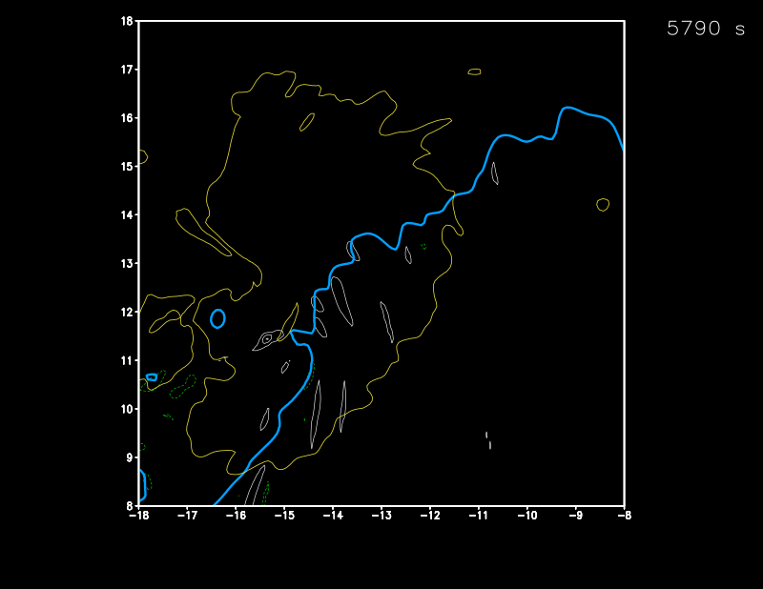
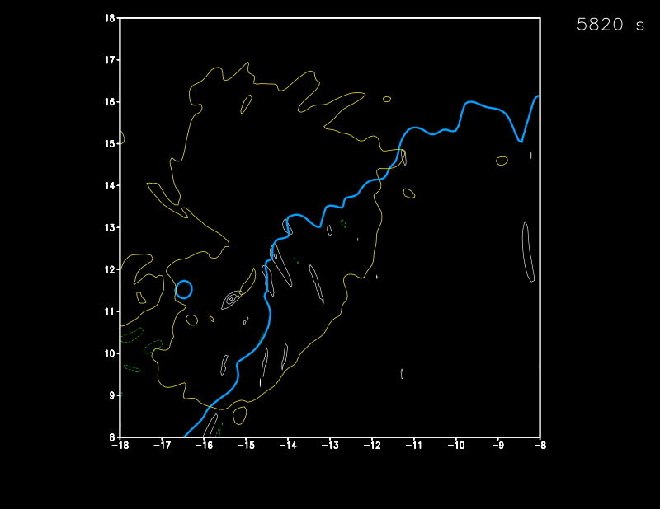
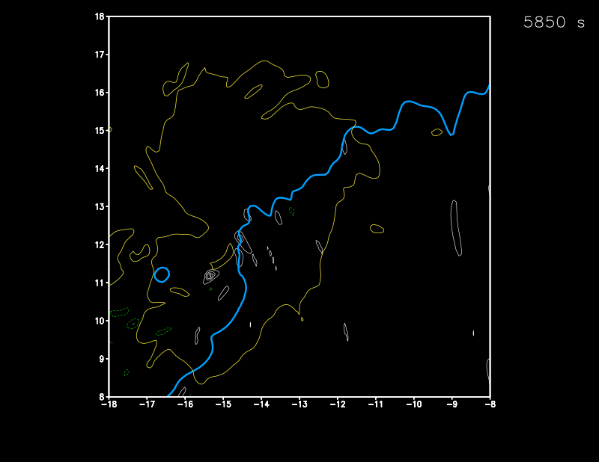
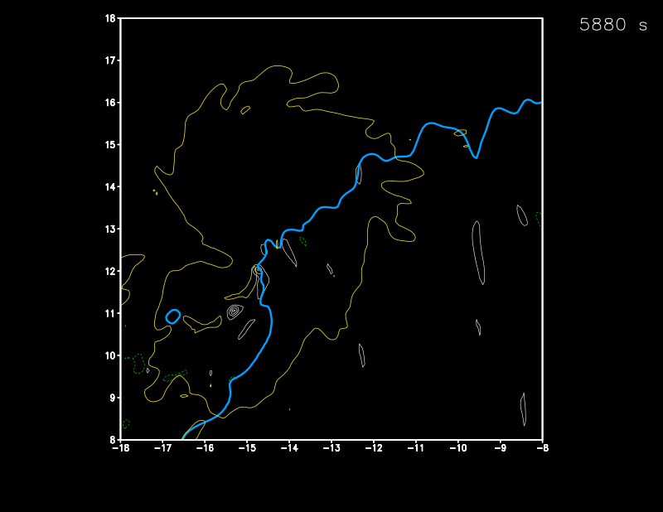
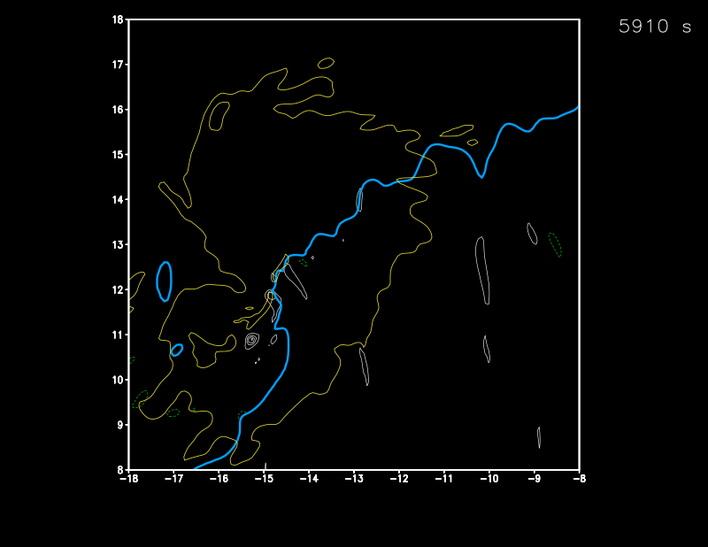
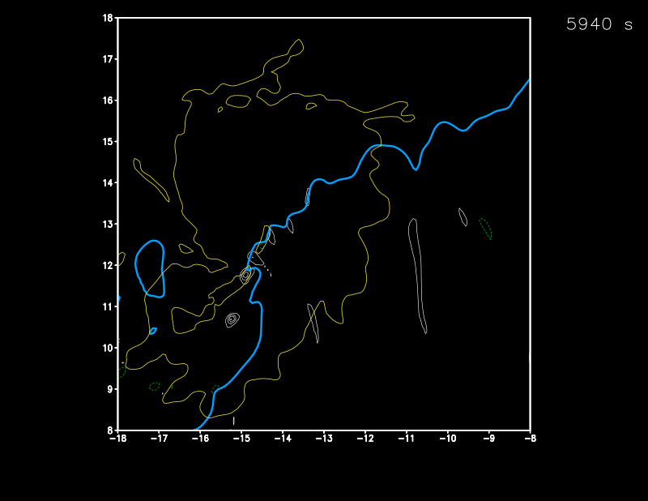
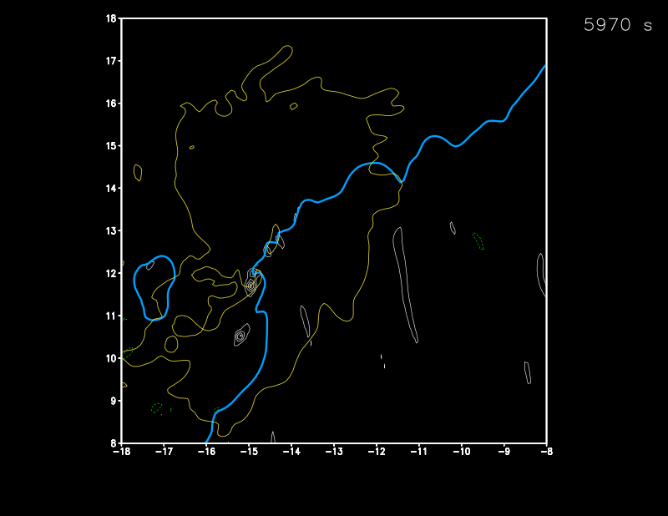
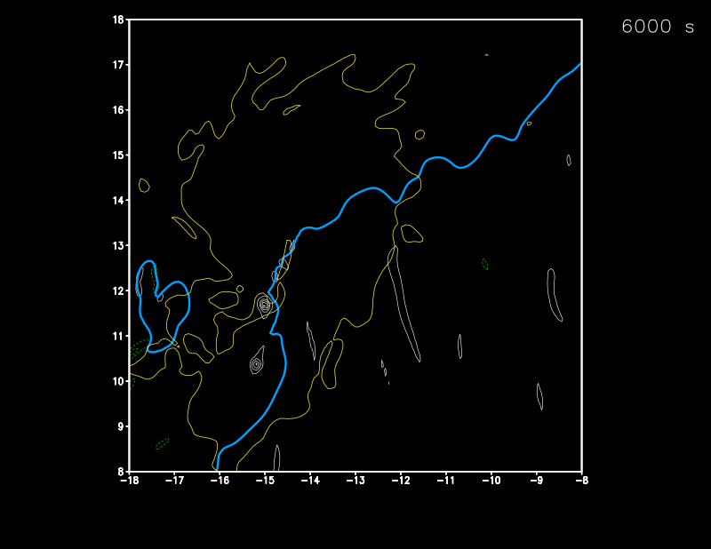
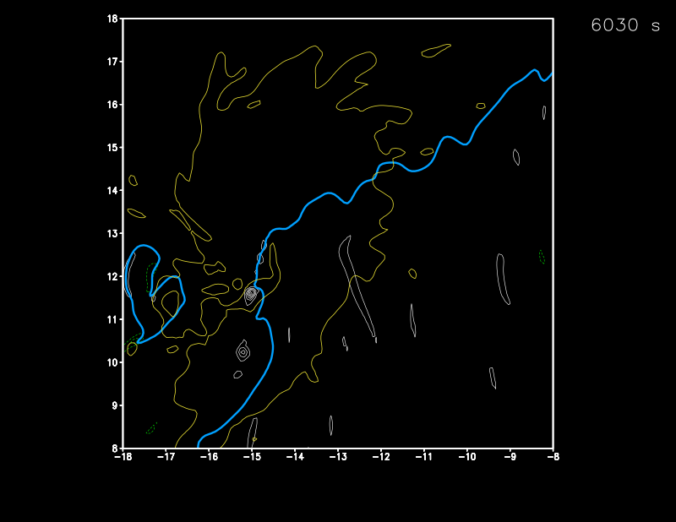
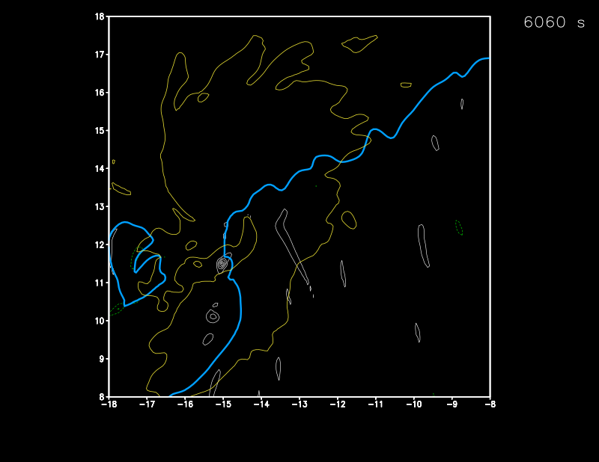
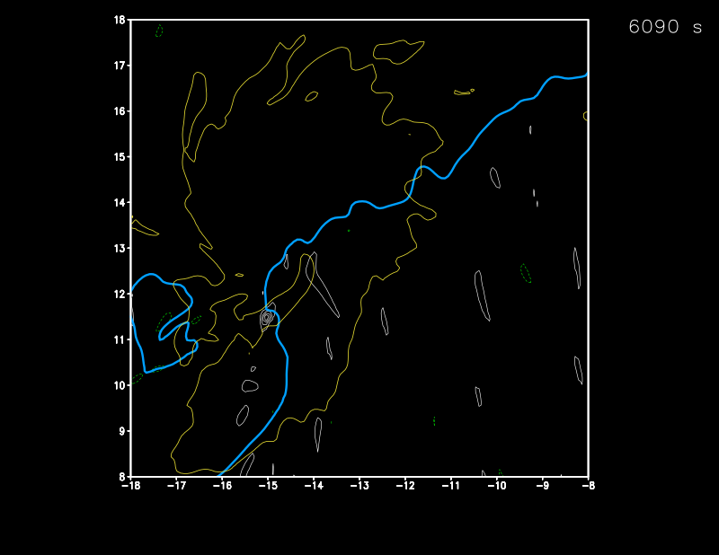
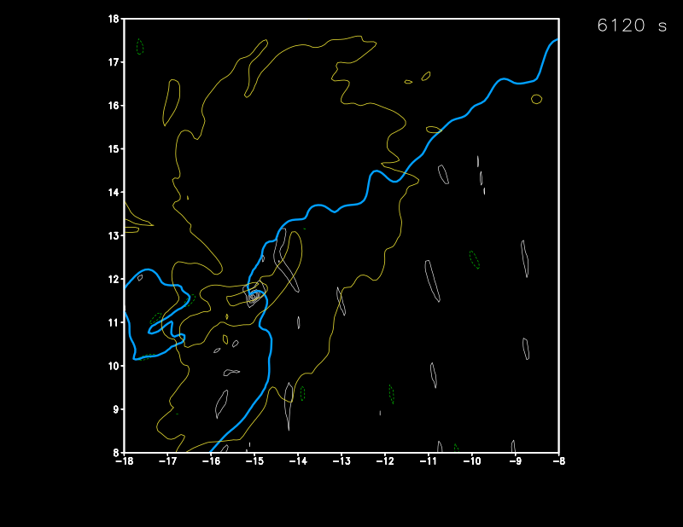
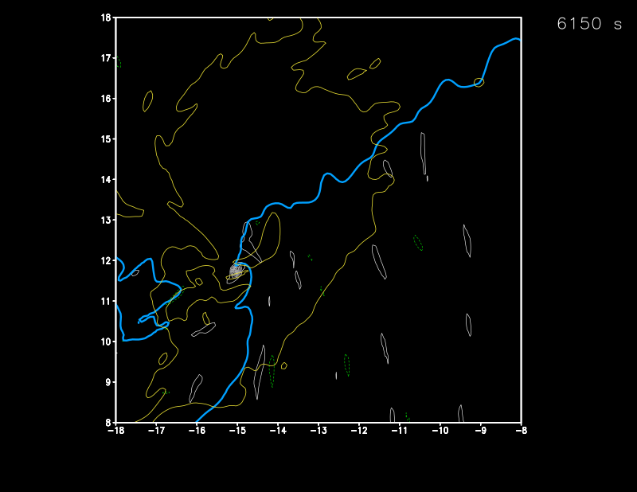
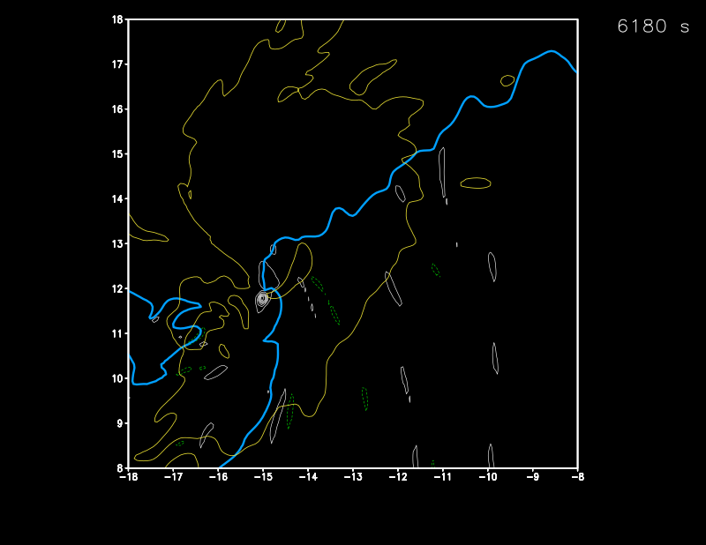
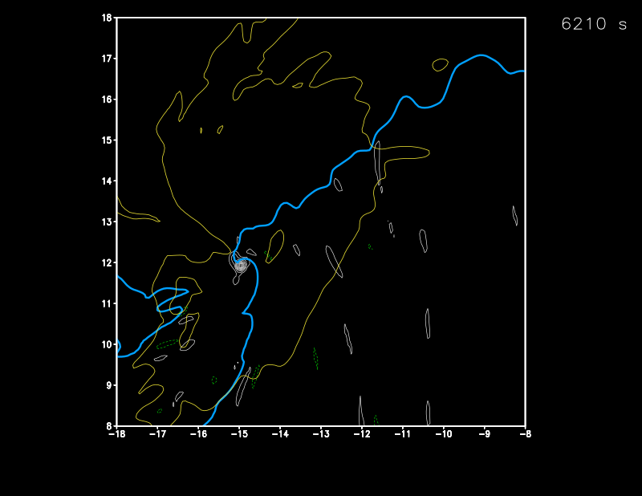
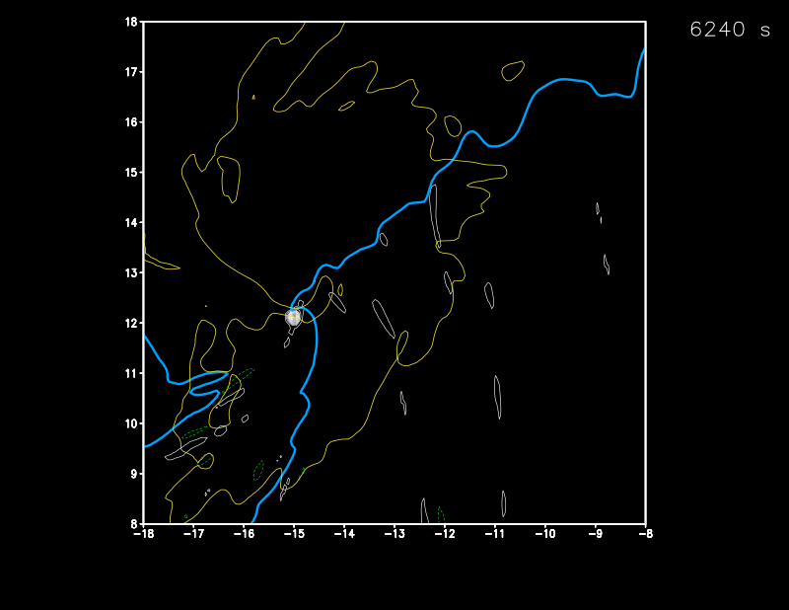
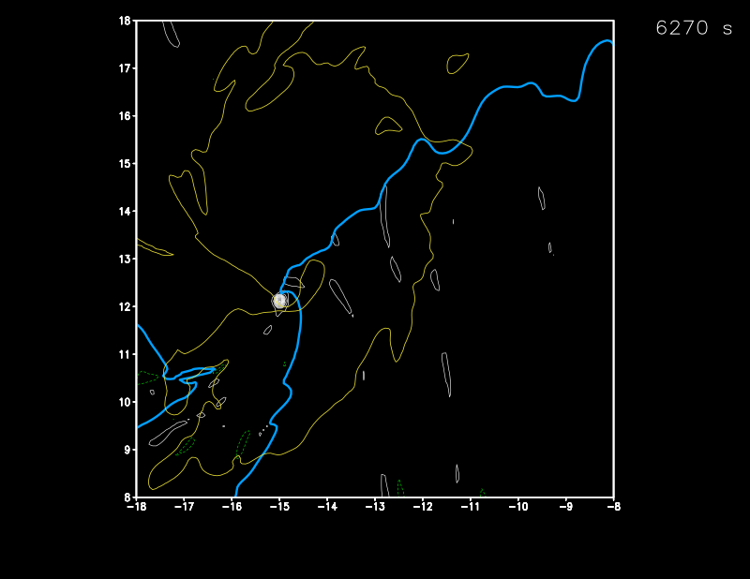
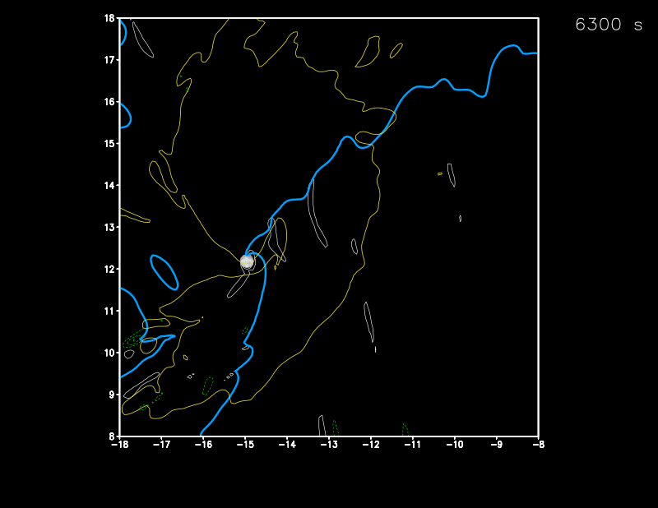
takeaway: surface-layer ζ streaks serve as nodes for TLV formation
w = 3 m s^{–1} at z = 522 m
+ζ at z = 7.5 m
(0.02, 0.06 s^{–1})
–ζ at z = 7.5 m
(–0.06, –0.02 s^{–1})
gust front
(θ’ = –0.25 K)

Slide 6
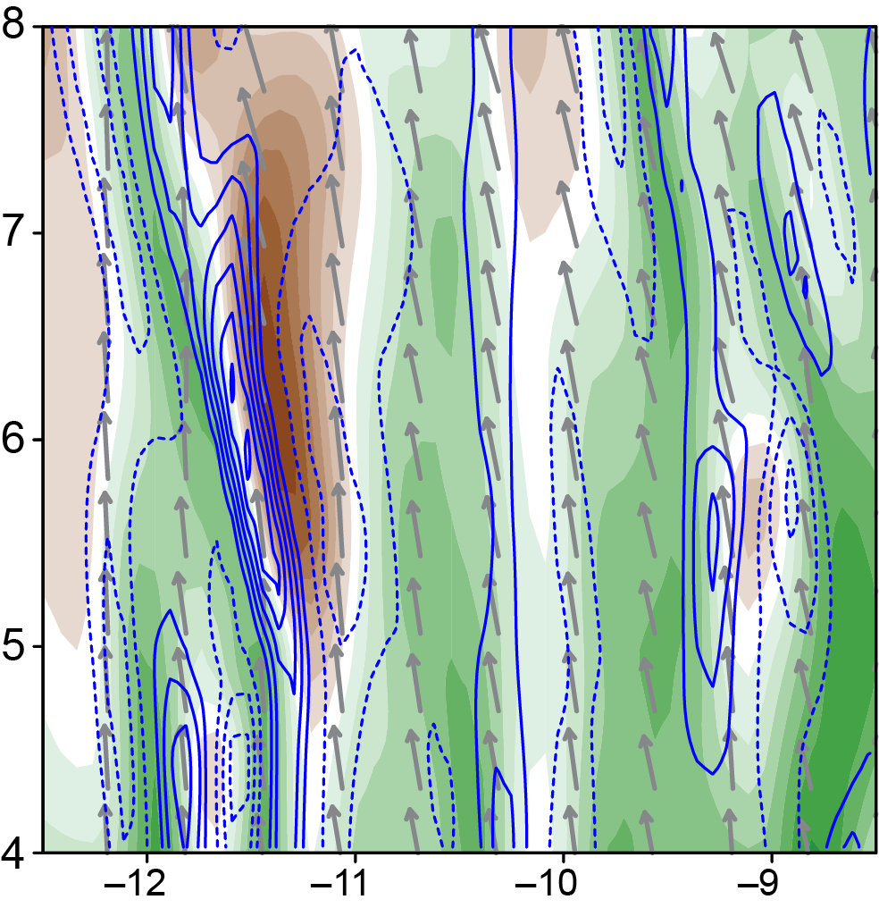
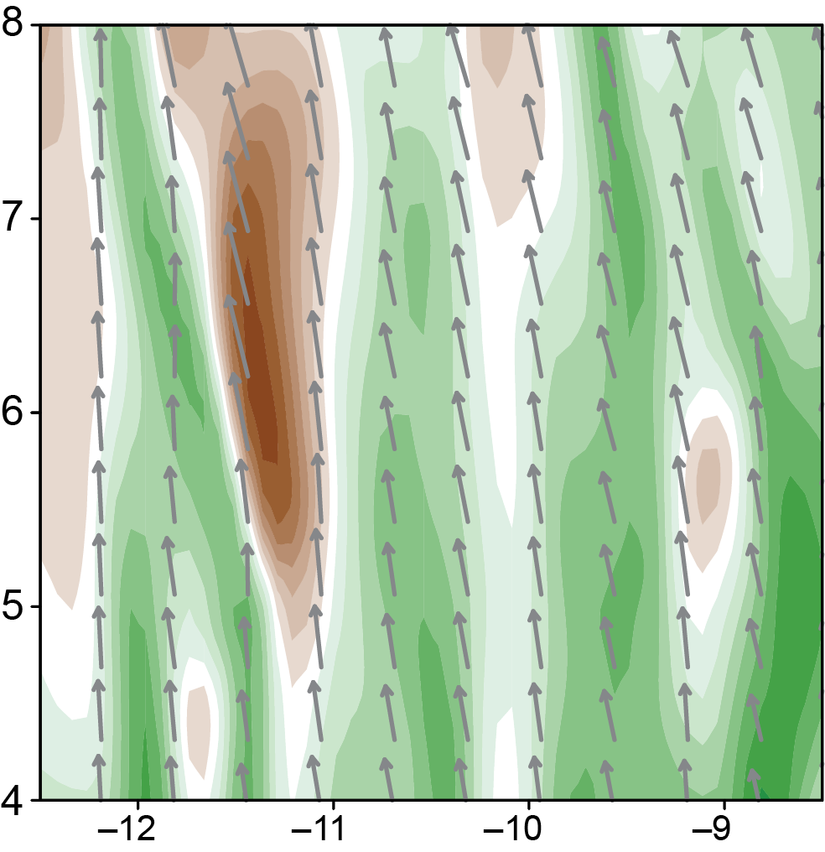
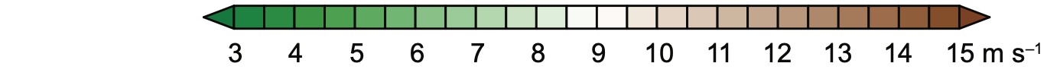
What is the origin of the ζ streaks?
ζ
(every
0.005 s^{–1})
Velocity streaks are aligned with the ground-relative mean wind: faster horizontal speeds in downdrafts and slower horizontal speeds in updrafts (e.g., Robinson 1991; Khanna and Brasseur 1998; Young et al. 2002)
The horizontal wind speed streaks likewise imply the presence of ζ streaks a ¼-wavelength out of phase with the horizontal wind speed streaks
SLOW
FAST
horizontal wind speed at 7.5 m

Slide 7
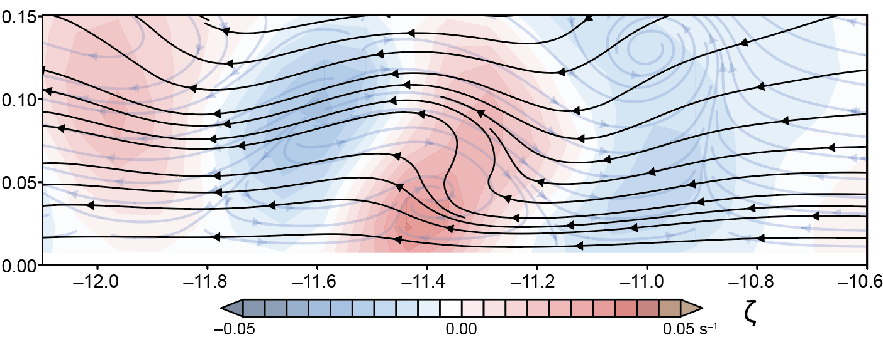
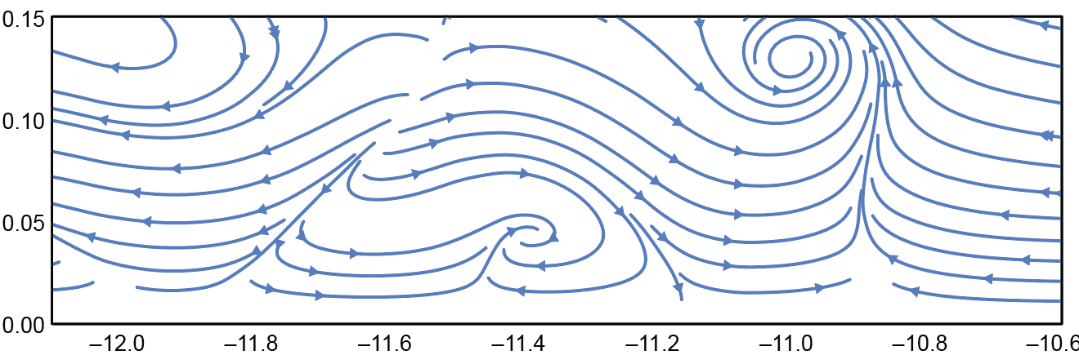
What is the origin of the ζ streaks?
ζ
(every
0.005 s^{–1})
streamlines
vortex lines
SLOW
FAST
horizontal wind speed at 7.5 m

Slide 8
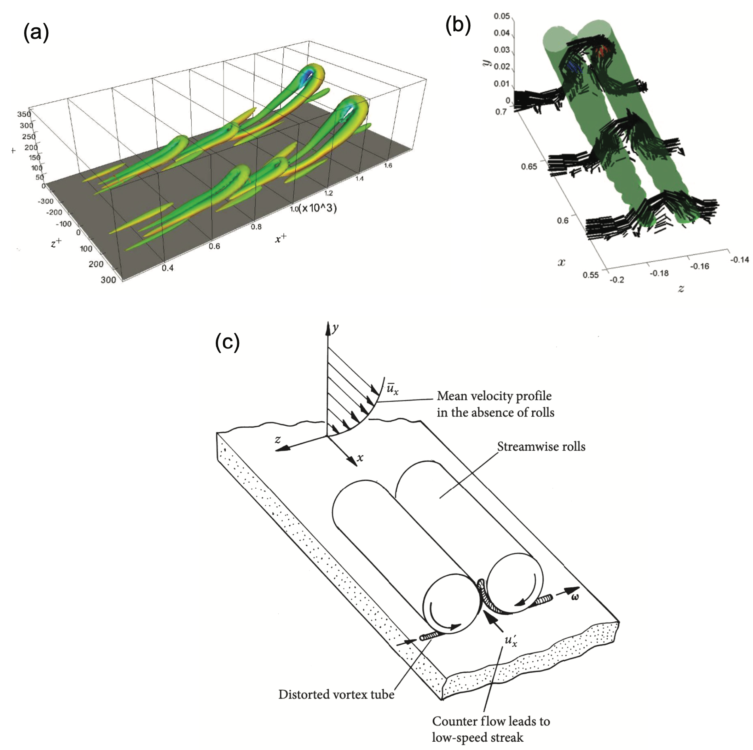
What is the origin of the ζ streaks?
Benard (2011)
Eitel-Amor et al. (2015)
streamlines
vortex lines
Davidson (2015)

Slide 9
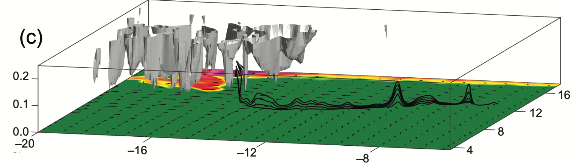
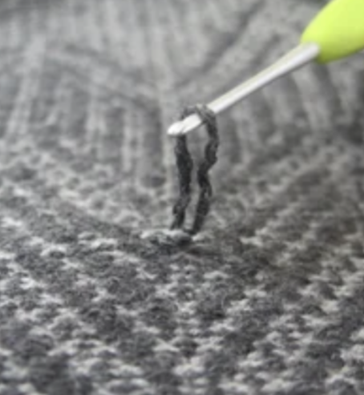
What is the origin of the ζ streaks?
updraft
vortex lines
EAST
SOUTH

Slide 10
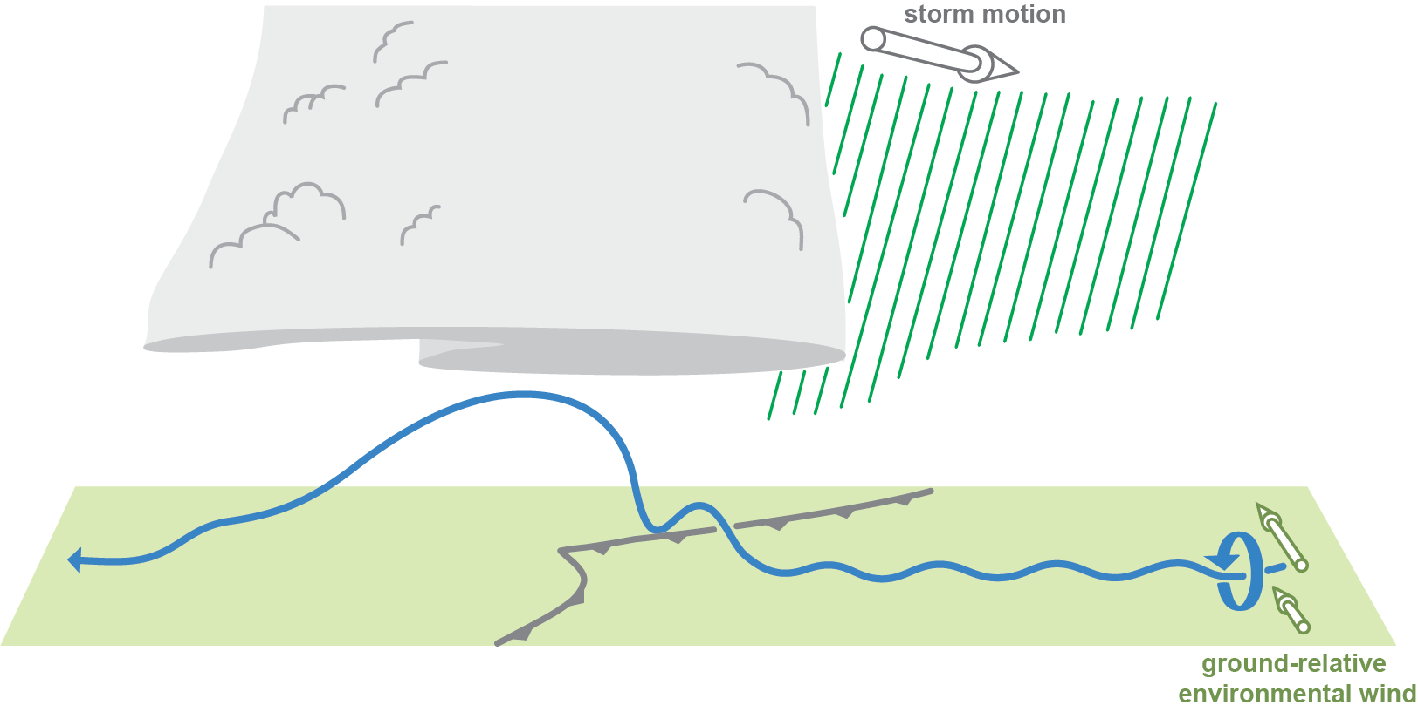
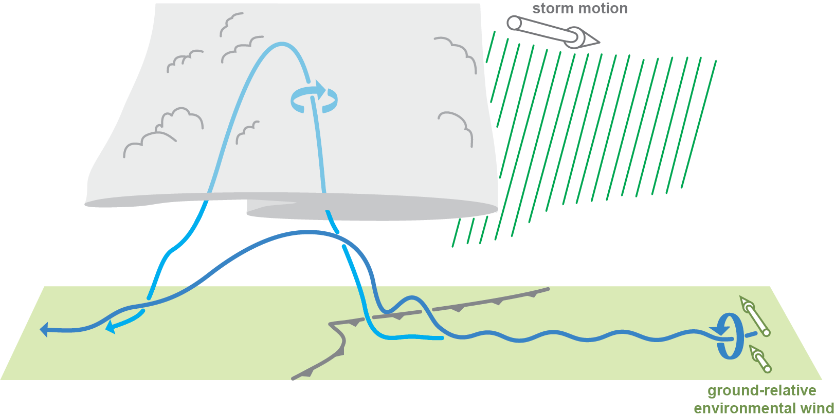
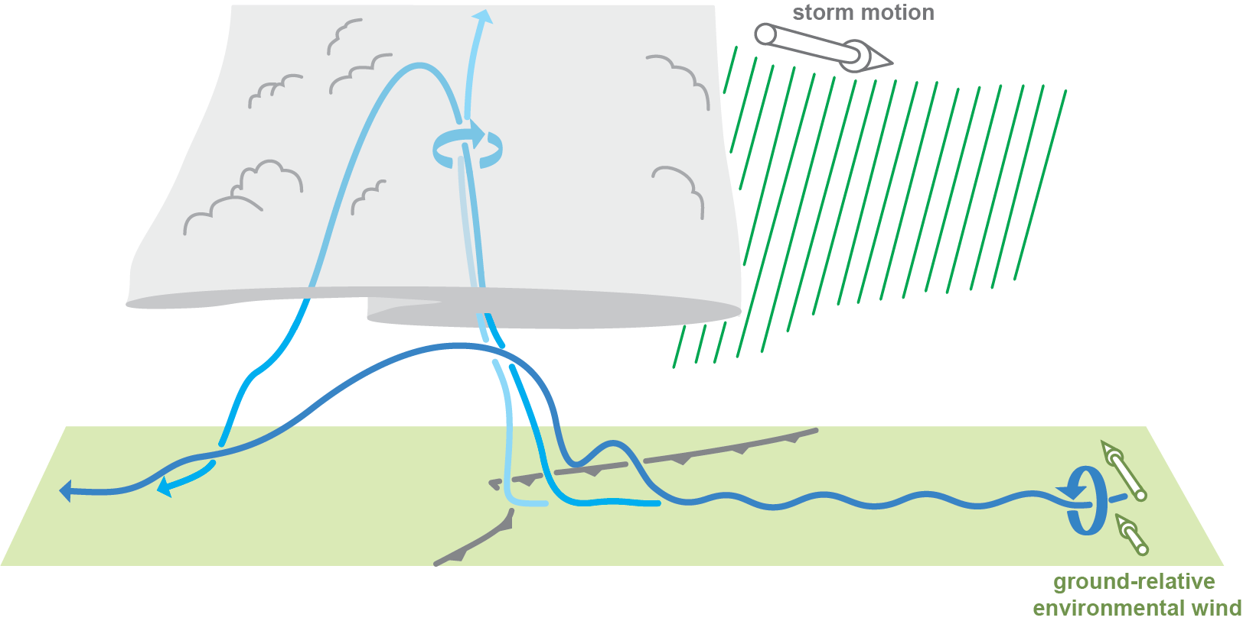
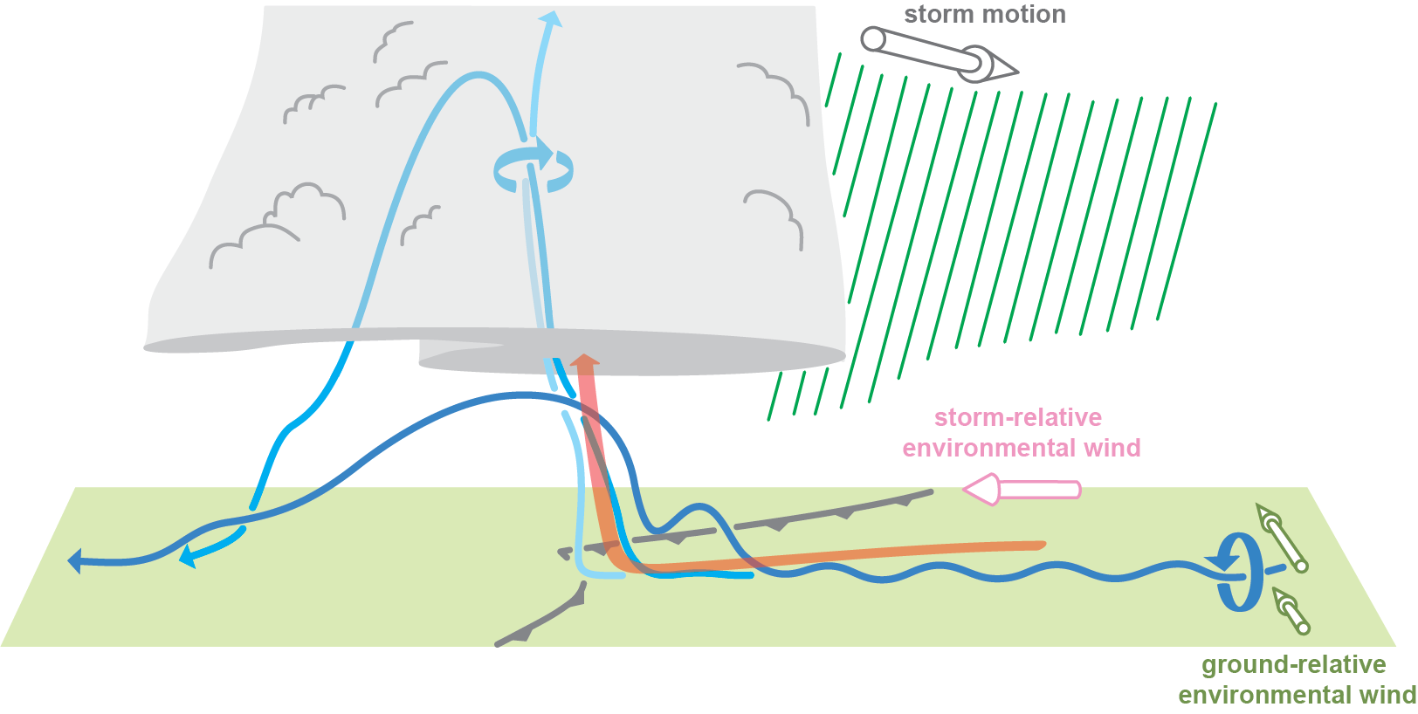
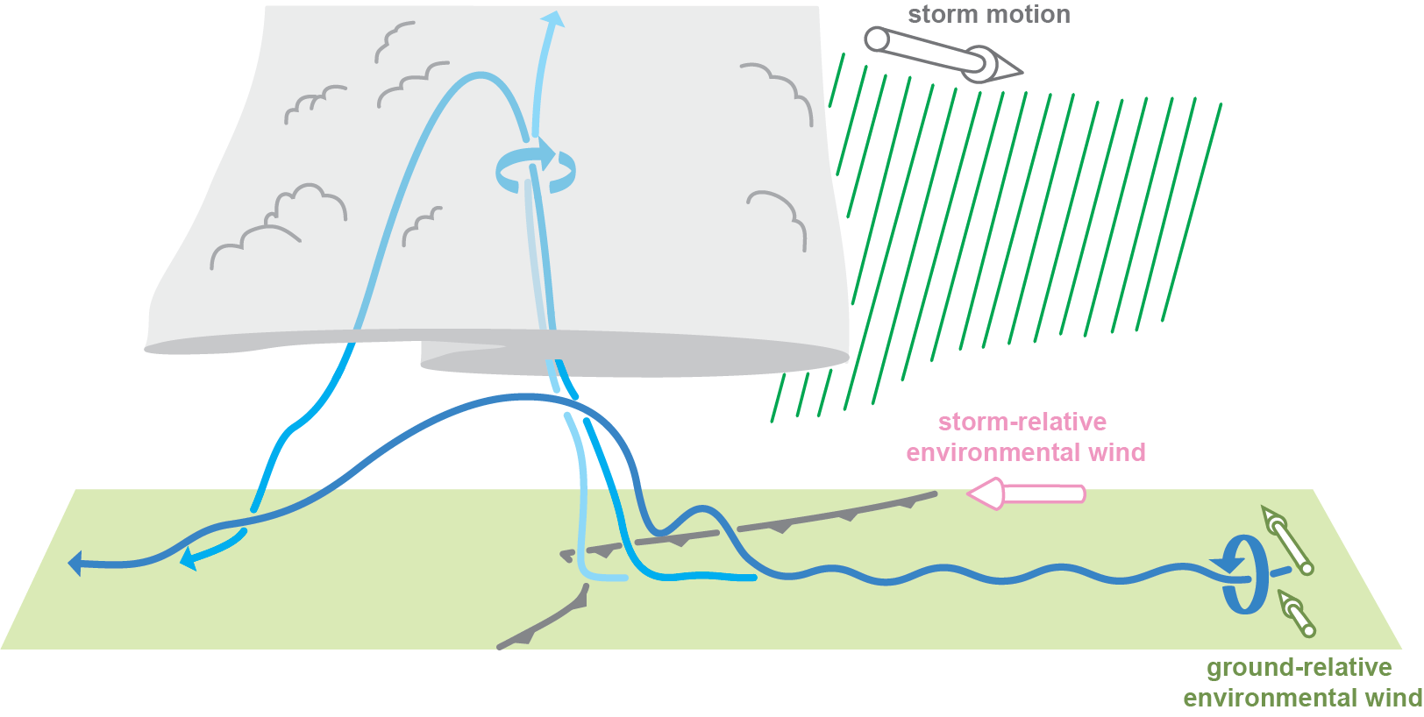
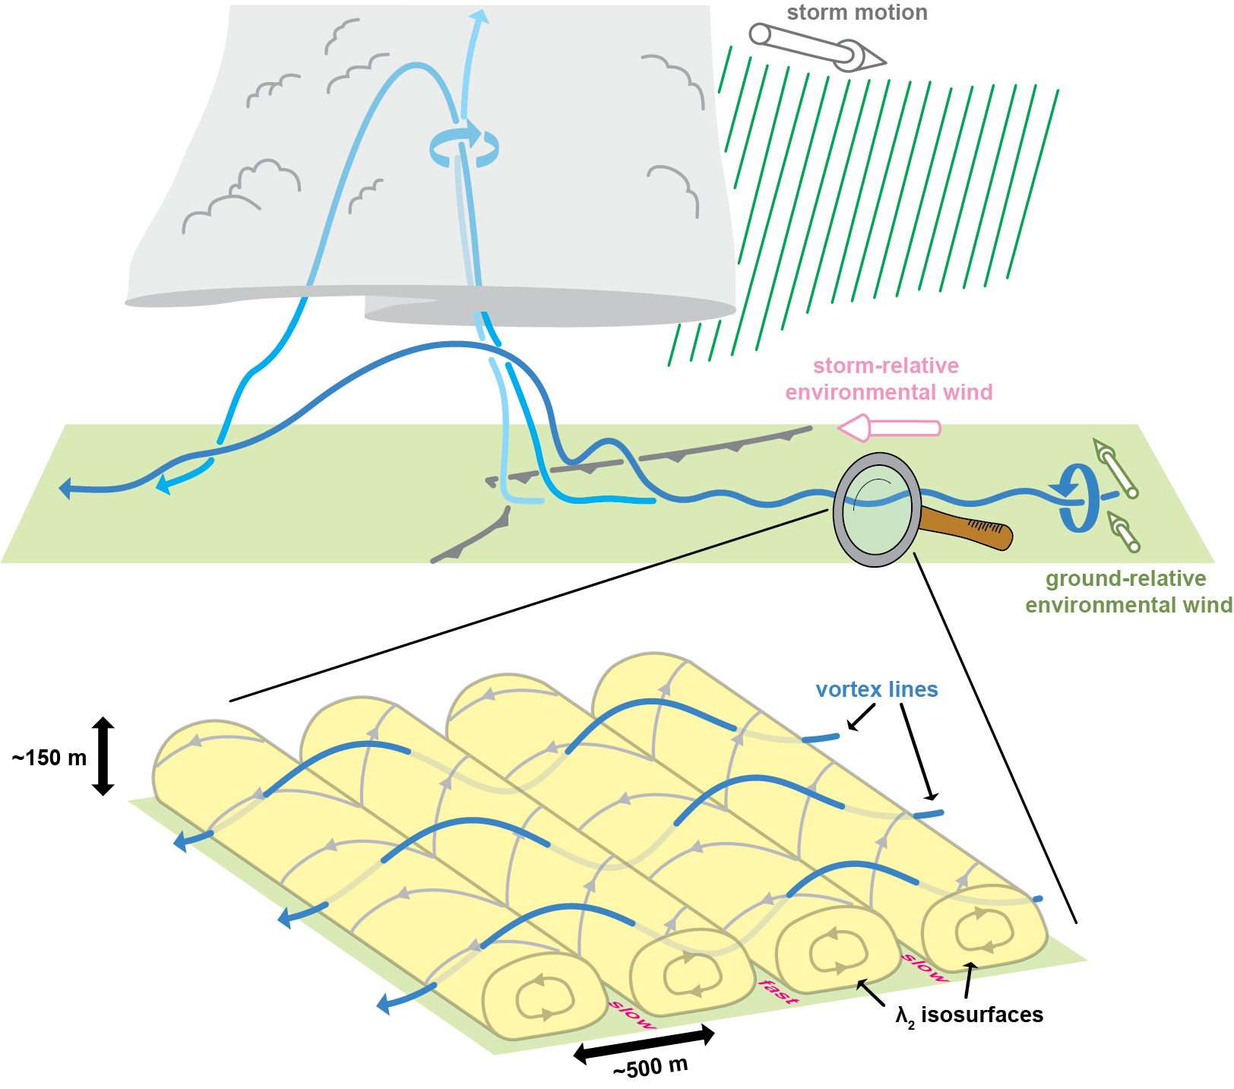





STORM9 Summary
Trajectories into the developing TLV are initially from the environmental side of the gust front, but later feed the vortex from both the cool and warm sides of the gust front, though at no point in the lifecycle of the TLV is baroclinic vorticity generation a significant source of circulation for the TLV.
The updraft draws environmental vortex lines (with corrugations) upward.
The mean environmental vorticity in the surface layer is almost purely streamwise in the storm’s reference frame.
Thus, the tilting of the vortex lines ends up resulting in positive ζ being co-located with strong upward accelerations, thereby rapidly intensifying the cyclonic rotation.
Parcels that pass through the developing TLV during and just prior to genesis
ζ = 0.01, 0.02, 0.04,
0.06, 0.08, … s^{–1}
Parcels that pass through the TLV after genesis
ζ = 0.01, 0.02, 0.04,
0.06, 0.08, … s^{–1}
The presence of large, “preexisting,” near-surface ζ in the environment ahead of the storm is key: the positive near-surface ζ perturbations associated with the longitudinal streaks serve as seeds for TLV formation as they are overrun by the supercell updraft.
within the ζ streaks, positive (negative) ζ as large as 0.04 (0.03) s^{–1} is present as low as z = 7.5

Slide 11

How does the vorticity maximum end up on the cool side of the gust front?
gust front
boundary-relative translation

Slide 12

Is there a wall cloud?
blue trajectories: enter wall cloud
red trajectories: enter incipient TLV
The parcels feeding the wall cloud indeed originate in the cool, humidified outflow, but the developing ζ maximum at cloud base is displaced slightly away from the cloud-base lowering.
If this subtlety were to exist in a real storm, it might be difficult to observe without extremely careful stereophotogrammetric observations.
[My take: supercell cloud bases frequently have chaotic motions that can make it difficult to pin down the precise position of ζ_{max} within the cloud base until a funnel has formed]
gray shading: cloud at z = 1.21 km
red shading: 𝜁 ≥ 0.1 s⁻¹ at z = 0.93 km

Slide 13
“20th Century-Style” simulation
A simulation using the same environmental hodograph and sounding, but a laminar, horizontally homogeneous boundary layer with a free-slip lower boundary
Motivating questions:
Does the tornado form via the “standard, baroclinic mechanism”?
If so, then where does the baroclinic mechanism vanish to when a turbulent environmental boundary layer is included?
YES

Slide 14


“20th Century-Style” Simulation
Summary: An EF4 (83.2 m s^{–1}) TLV forms; it develops on the cool side of the gust front, as in prior simulations in which the baroclinic mechanism has been implicated.
Parcels that pass through the developing TLV during and just prior to genesis
ζ = 0.01, 0.02, 0.04,
0.06, 0.08, … s^{–1}
ζ_{7.5 m}
–0.05
0.00
0.05
0.10
0.15
0.20
0.25
0.30 s^{–1}

Slide 15
“20th Century-Style” simulation
A simulation using the same environmental hodograph and sounding, but a laminar, horizontally homogeneous boundary layer with a free-slip lower boundary
Motivating questions:
Does the tornado form via the “standard, baroclinic mechanism”? YES
If so, then where does the baroclinic mechanism vanish to when a turbulent environmental boundary layer is included?

Slide 16
“20th Century-Style” simulation
A simulation using the same environmental hodograph and sounding, but a laminar, horizontally homogeneous boundary layer with a free-slip lower boundary
Motivating questions:
Does the tornado form via the “standard, baroclinic mechanism”? YES
If so, then where does the baroclinic mechanism vanish to when a turbulent environmental boundary layer is included?
It seems plausible that TLV formation merely happens where the most “accessible” near-surface ζ is found—though there is near-surface ζ in the outflow in the STORM9 simulation, the environmental air has even larger near-surface ζ, so this is where ζ amplification initially occurs.
In the 20th Century-style simulation, the only near-surface ζ is found in the cool air, and so TLV genesis occurs there.
The near-surface horizontal vorticity also is larger in the environment than in the forward-flank outflow in the STORM9 simulation; the opposite is the case in the 20th Century-style simulation.
And once the tornado is established, we might expect that air just comes from almost everywhere, regardless of the simulation configuration

Slide 17


Low-level horizontal vorticity fields
“20th Century-Style” Simulation
STORM9 from Markowski (2020)
(free-slip lower BC)
(semi-slip lower BC)

Slide 18
Final remarks
It would seem that at least one of the following must be true:
Prior supercell simulations that have used laminar, horizontally homogeneous environmental boundary layers develop TLVs (if their resolution permits), and perhaps also near-surface mesocyclones, for the wrong reasons
The Markowski (2020) supercell simulations develop TLVs for the wrong reasons
Supercell tornadoes form in a wide range of ways in the real atmosphere, even within supercells that appear to be similar, and increasingly realistic numerical simulations are finally now capturing that diversity (if true, additional environmental ingredients might be worthy of consideration in tornado forecasting)

Slide 19
Final remarks
If the ζ streaks actually facilitate TLV formation in real storms, tornado forecasting could perhaps be improved by considering whether environmental conditions might favor coherent turbulent structures in the surface layer
For example, surface wind speed and surface heat flux would likely be relevant
U.S. storm chasers frequently (and eagerly) await the early evening transition (sometimes termed “6 o’clock magic”), which marks the end of the time of day with a strong positive surface heat flux (surface-layer streaks are most likely to be observed in windy conditions without a strong surface heat flux)
Curiously, in a prior study (Markowski et al. 2003), ground-relative winds were found to be as good a discriminator between tornadic and nontornadic supercells as more popular forecasting parameters, with faster winds being more favorable for tornadoes

Slide 20
Final remarks
The environmental parameters heavily relied upon for discriminating between tornadic and nontornadic supercells—for example, low LCLs and strong low-level shear—would still be highly relevant if surface-layer processes in the turbulent environment are important
For example, excessive outflow (more likely in high-LCL environments) that repeatedly undercuts the updraft would likely be disruptive to the reorientation and amplification of vorticity originating in the environmental surface layer
A lack of strong low-level shear would imply a weak upward-directed dynamic vertical pressure-gradient force, which would seem to be unfavorable for the uplifting of near-surface environmental vortex lines

Slide 21


Parker (2023): “coherent vorticity sources that produce longer-wavelength structures are likely to be the most supportive of tornadogenesis”

Slide 22
Final remarks
Regardless of the answer to the provocative statement (“… it would seem that at least one of the following must be true…”), the findings at the very least, illustrate the need for
Continued efforts to improve microphysical parameterizations used in numerical models, or at least explore their performance in simulations in which a large fraction of the turbulence is resolved
Continued efforts to improve the handling of near-surface turbulence (including the lower boundary condition)
The inclusion of additional processes (e.g., radiative transfer, surface heat and moisture fluxes, ground fluxes) that are routinely presumed to be of secondary importance, but might alter conceptual models in unexpected ways
Continued pursuit of methods for obtaining volumetric buoyancy observations in supercell storms (e.g., swarms of small balloon-borne sensors and UAS), given the cold pool differences between the 20th Century-style simulation and simulations with a turbulent environment

Slide 23


The cold pools are rather different, despite the microphysics scheme being identical.
“20th Century–Style” Simulation
Simulation with turbulent environment
reflectivity contours (10, 20, …,60 dBZ)
ζ contours (0.04, 0.08, … , 0.48 s^{–1})
gust front proxy (–0.25 Κ θ’_{ρ} contour )

Slide 24
Final remarks
Regardless of the answer to the provocative statement (“… it would seem that at least one of the following must be true…”), the findings at the very least, illustrate the need for
Continued efforts to improve microphysical parameterizations used in numerical models, or at least explore their performance in simulations in which a large fraction of the turbulence is resolved
Continued efforts to improve the handling of near-surface turbulence (including the lower boundary condition)
The inclusion of additional processes (e.g., radiative transfer, surface heat and moisture fluxes, ground fluxes) that are routinely presumed to be of secondary importance, but might alter conceptual models in unexpected ways
Continued pursuit of methods for obtaining volumetric buoyancy observations in supercell storms (e.g., swarms of small balloon-borne sensors and UAS), given the cold pool differences between the 20th Century-style simulation and simulations with a turbulent environment

Slide 25
Simulation without latent cooling (NOCOOL)
no evaporation; melting and sublimation are allowed to occur, but don’t cool the air;
no gust front
Motivating question:
Is the gust front’s interaction with the ζ streaks key?
The answer appears to be “no.”

Slide 26


black contours w at z = 522 m (5, 10, 15, … m s^{–1})
gust front proxy (heavy blue contour)
ζ at 7.5 m shaded
Summary: An EF2 (49.5 m s^{–1}) TLV forms despite the lack of a gust front and outflow (negative buoyancy is of course present within precipitation owing to hydrometeor mass, but there is no outflow emanating from a cool, high-pressure region as in a realistic storm)
STORM 9 from Markowski (2020)
NOCOOL Simulation
ζ_{7.5 m}

Slide 27
Simulation without latent cooling (NOCOOL)
no evaporation; melting and sublimation are allowed to occur, but don’t cool the air;
no gust front
Motivating question:
Is the gust front’s interaction with the ζ streaks key?
The answer appears to be “no.”

Slide 28


Simulation without latent cooling (NOCOOL)
no evaporation; melting and sublimation are allowed to occur, but don’t cool the air;
no gust front
Motivating question:
Is the gust front’s interaction with the ζ streaks key?
The answer appears to be “no.”
Curiously, the NOCOOL storm, even though it produces a TLV, lacks a mesocyclone in the 200–1000-m layer!
STORM 9 from Markowski (2020)
NOCOOL Simulation
z =739 m
TLV
TLV

