Slide 1


The severe to extreme storm over Bosnia and Herzegovina in July 2023
MSc Duško Mrkonjić, RHMZ RS, Republic of Srpska, Bosnia & Herzegovina

Slide 2
ABSTRACT
In July 2023, the western Balkans were strucked by a series of supercells and squall lines, that resulted in several fatalities, numerous injuries, and extensive property damage. In each of these cases, a trough at the 500 mb level enabled intursion of the colder air mass from Northern Europe, which collided with a warmer air mass from the south. This interaction, combined with surface heating and high Convective Available Potential Energy (CAPE) and a low Lifted Index (LI), led to development of cumulonimbus (Cb) clouds, which caused significant damage.
These atmospheric instabilities produced hailstones exceeding 5 cm in diameter, wind gusts between 15-25 m/s (locally even stronger), heavy localized rainfall, and intense lightning activity. For most days with severe to extreme weather phenomena, numerical weather models provided accurate forecasts.

Slide 3
The model Weather Research and Forecasting (WRF) with ARW core version 4.3.3., configured with Thompson microphysics and a horizontal resolution of 8 x 8 km, initialized with GFS data at 12 UTC on July 17, 2023 (UCAR.edu), predicted the 500 mb trough and associated jet stream to be located farther west and north than the actual location.
The forecast started on July 17 2023 at 12 UTC for 102 hours, to July 20 at 18 UTC. In this case the output interval was 1 hour.
The WRF model was run for: 1.) Mean sea level pressure (MSLP) (mb),
2.) Geopotential height and temperature at 500 hPa and
3.) Wind and geopotential at 300 hPa.
However, on July 18 2023, the Weather Research and Forecasting (WRF) with ARW core version 4.3.3 underestimated the event.
In reality, the squall line affected most parts of northern Croatia, Bosnia and Herzegovina, southwestern Serbia and Montenegro moving quickly from the Alps.
As a result, real-time radar and satellite monitoring proved to be crucial for tracking the system. RGB composites, along with WV, Cloud tops and IR satellite channels, were particularly effective in monitoring the squall line on that day. Most of the supercells and instabilities observed during July 2023 followed a similar trajectory, originating over the Alps and progressing toward the Balkans and the Pannonian Plain.

Slide 4
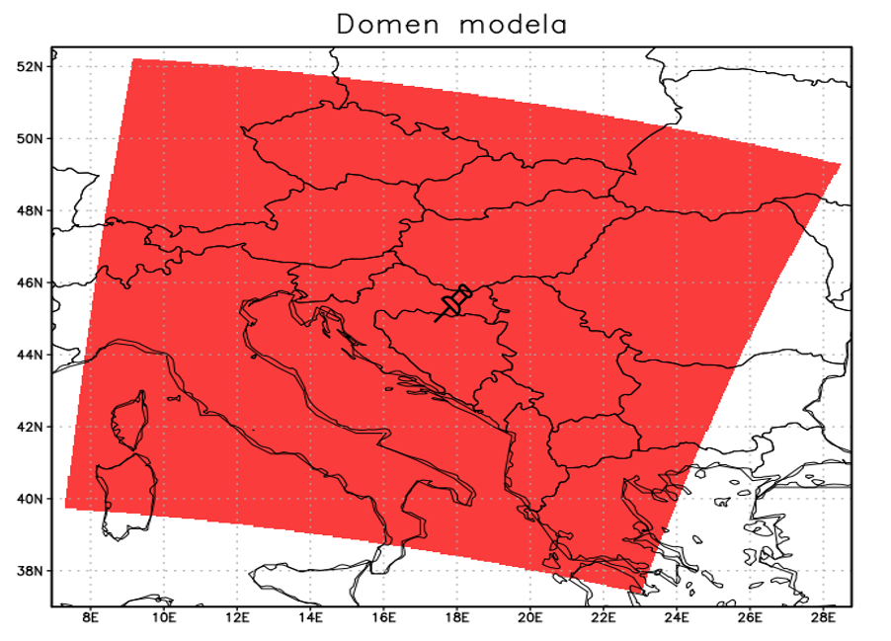
In this work, the WRF model with ARW core was run with GFS data for 102 hours, with start of model at 12 UTC on 17.07.2023., with a spatial resolution 8 x 8 km, for simulation of intensive development of cumulonimbus clouds, that were rapidly moving from the Alps to the western and central Balkans. Central point of model was 45ºN and 17ºE, and domain was from 6º56’ to 28º46’ E and from 37º to 52º32’ N (Figure 1).
Figure 1 Domain of model.

Slide 5
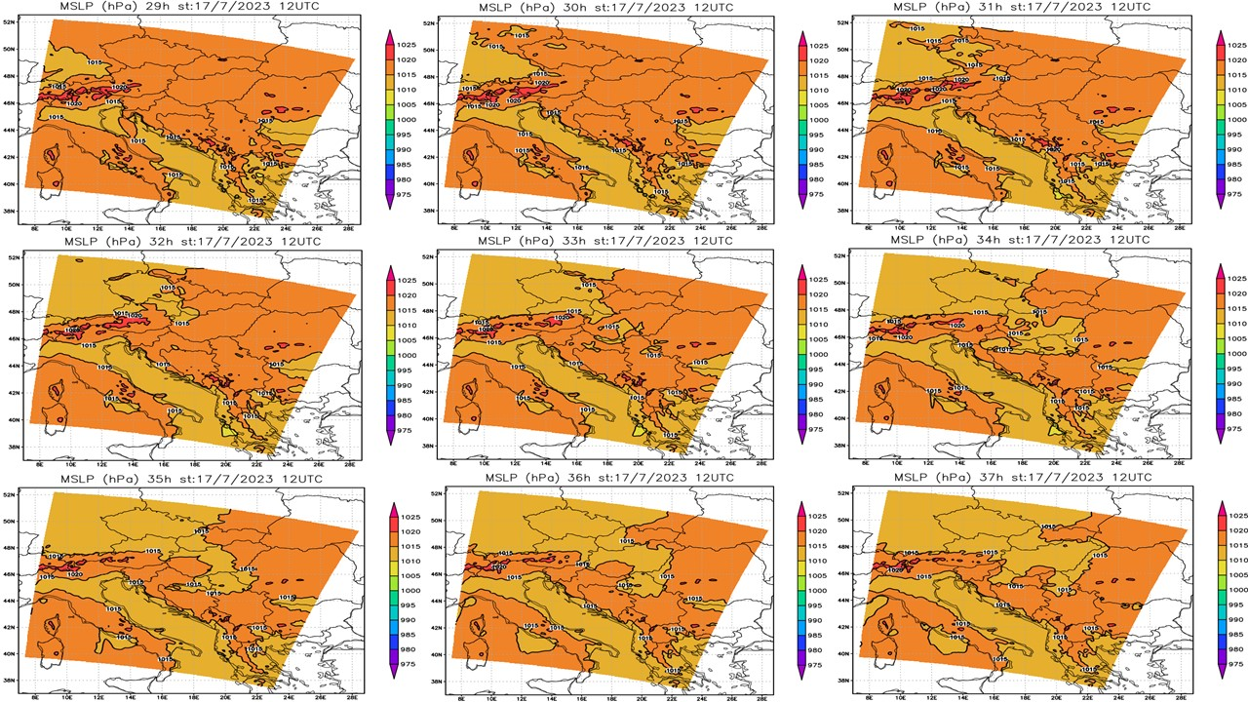
Figure 2 represents the forecasted values for Mean sea level pressure (MSLP) (mb) in the period before and during the passage of squall line on the territory of Bosnia and Herzegovina.
Figure 2 The modeled values of MSLP (mb).

Slide 6
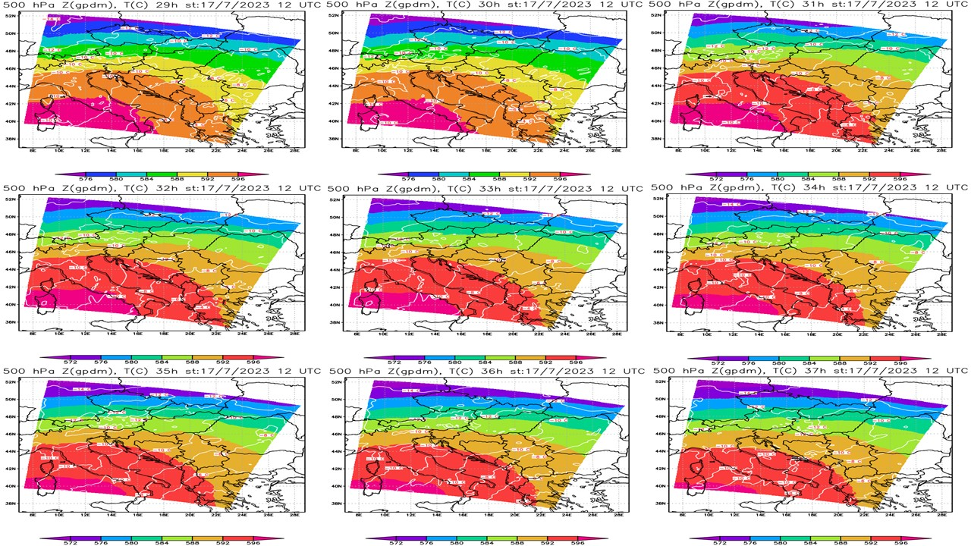
Figure 3 represents the forecasted values for Geopotential height and temperature at 500 hPa in the period and during the passage of squall line on the territory of Bosnia and Herzegovina.
Figure 3 The modeled values of Geopotential height and temperature at 500 hPa.

Slide 7
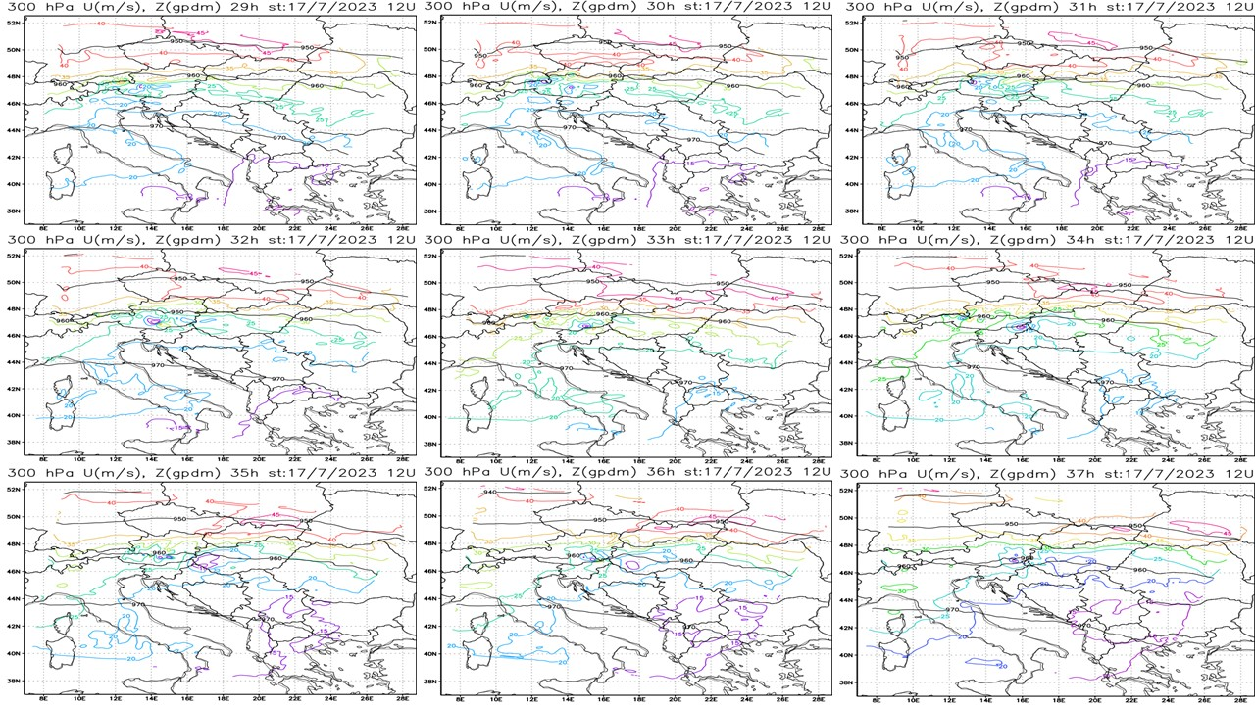
Figure 4 represents the forecasted values for Wind and geopotential at 300 hPa in the period and during the passage of squall line on the territory of Bosnia and Herzegovina.
Figure 4 The modeled values for Wind and geopotential at 300 hPa.

Slide 8
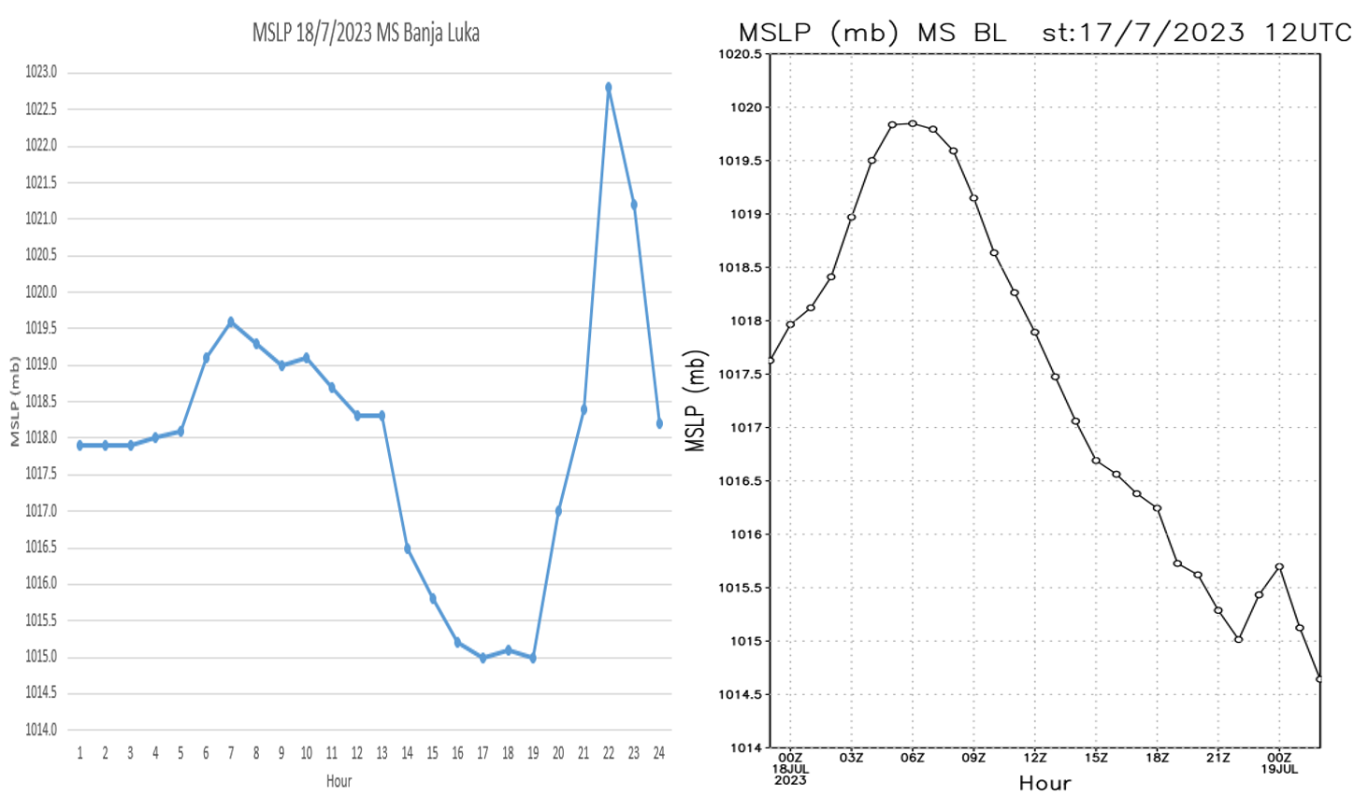
Modeled values for MSLP for MS Banja Luka, were nearly the same till evening, but after 17 UTC, model underestimated the values of MSLP. Figure 5 shows measuremented and modeled values for MSLP on MS Banja Luka at July 18 2023.
Figure 5 The measuremented (RHMZ RS) and modeled (WRF model) values for MSLP on MS Banja Luka at July 18 2023.

Slide 9
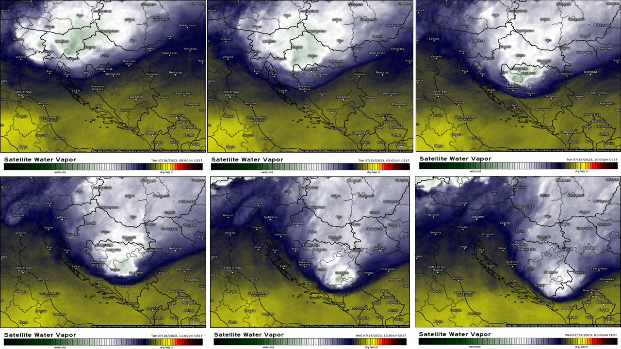
Figure 6 represents satellite images of WV channel, how storm was moving in the evening hours 18/19.07.2023.
Figure 6 WV satellite channel from 20 CET on July 18, 2023 to 01 CET on July 19, 2023. (Meteologix.com).

Slide 10
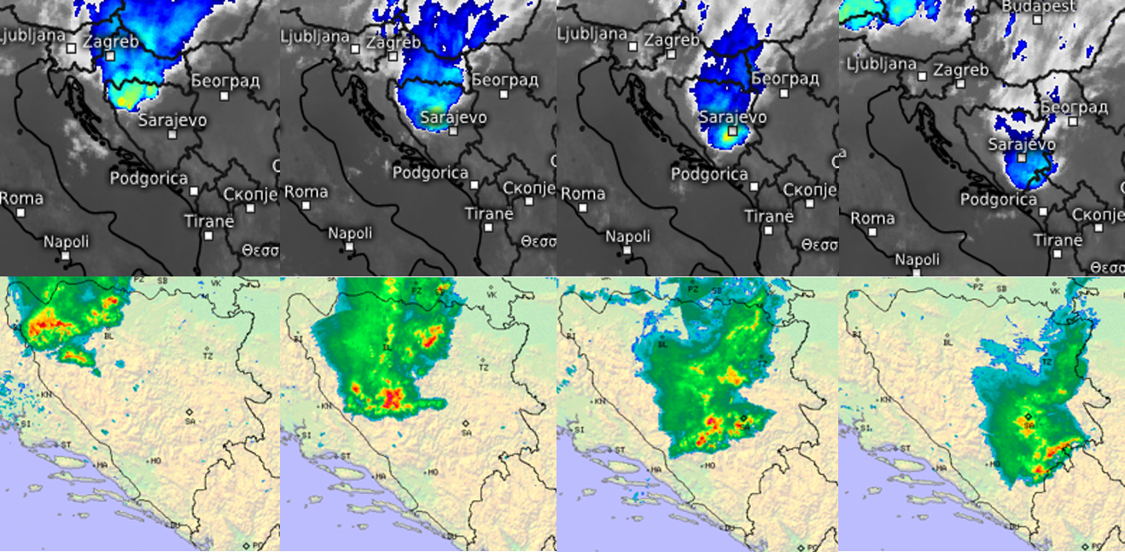
The real-time radar (source: DHMZ) and satellite (source: meteologix) monitoring proved to be crucial for tracking this frontal zone. RGB composites, along with WV, cloud tops (used for the poster) and IR satellite channels, were particulary effective in monitoring the squall line on that day.
Figure 7 Real-time satellite (Meteologix.com) and radar (DHMZ) images at 22 and 23 CET on 18/07/2023 and at 00 and 01 CET on the next day.

Slide 11
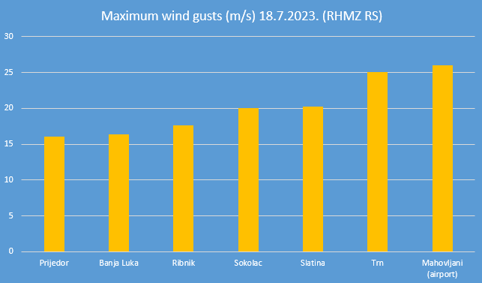
This storm resulted some hazards: 1) strong, even severe wind gusts,
2) heavy rain showers and intense lightening activity and
3) localy occurence the hail.
Figure 8 Maximum wind gusts of the event (RHMZ RS).
This wind gusts caused extensive property damage. Many roofs of the houses and buildings collapsed, localy trees were uprooted and fell on cars on some places.

Slide 12
Conclusion
In this presentation, modeled values of meteorological variables using WRF model were compared with real events using radar and satellite imageries. Some deviations of meteorological variables were observed. Also, differences were noticed between the forecasted MSLP and the actual observed, before the start of the event. The main conclusion is that forecasts made by meteorological models can sometimes differ from actual events.

Slide 13
References
UCAR, https://www.ucar.edu
WRF Users Guide, https://homepages.see.leeds.ac.uk/~lecrrb/wrf/aRWUsersGuide.pdf
RHMZ RS, https://rhmzrs.com/
DHMZ, Državni hidrometeorološki zavod Republike Hrvatske, https://meteo.hr/index.php
Meteologix, Meteologix.com

Slide 14
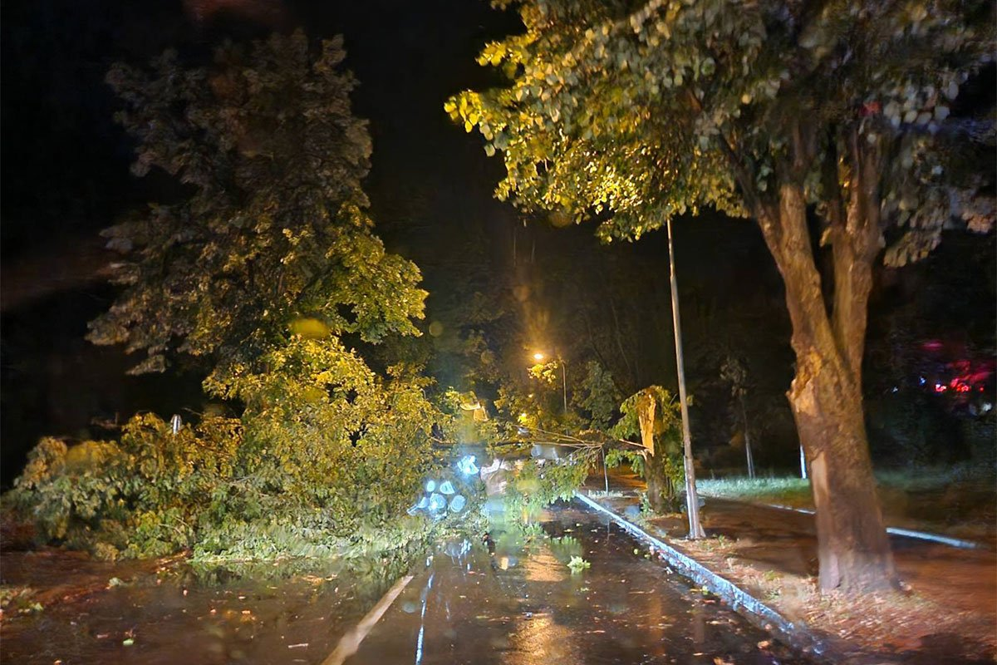
Thank You for Your attention
Figure 8 A fallen tree at street in Banja Luka in the evening hours at 18.07.2023.
(source: Nezavisne.com).

