Slide 1
Probabilistic flood forecasts within a time horizon
Gabriele Coccia⁽¹⁾⁽²⁾ and Ezio Todini⁽¹⁾⁽²⁾
⁽¹⁾University of Bologna, Bologna, Italy
⁽²⁾ Idrologia e Ambiente s.r.l, Napoli, Italy

Slide 2
THE NEED FOR PROBABILISTIC FORECASTS
WITHIN A TIME HORIZON
Emergency managers deal with a big uncertainty about the evolution of the future events,
This uncertainty must be quantified in terms of a probability distribution
Developing Predictive Uncertainty Processors that try to answer to the emergency managers questions, providing them a basis on which take their decisions

Slide 3
THE NEED FOR PROBABILISTIC FORECASTS
WITHIN A TIME HORIZON
Which is the probability that the water level will be higher than the dykes one at the hour 24th?
Which is the probability that the river dykes will be exceeded exactly at the hour 24th?
Which is the probability that the river dykes will be exceeded within the next 24 hours?

Slide 4
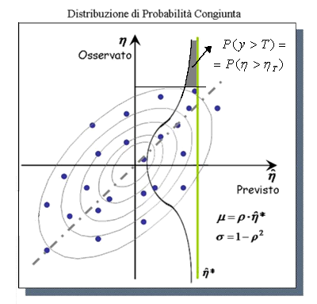
MODEL CONDITIONAL PROCESSOR: BASIC CONCEPTS
1) Conversion from the Real Space to the Normal Space using the NQT
2) Joint Pdf is assumed to be a Normal Bivariate Distribution (or 2 Truncated Normal Distributions)
3) Predictive Uncertainty is obtained by the Bayes Theorem
BI-VARIATE
Joint and Conditioned Pdf
a
UNIVARIATE
Image of the observed values
a
UNI-VARIATE
Image of the forecasted values
4) Reconversion of the obtained distribution from the Normal Space to the Real Space using the Inverse NQT
Todini, E.: A model conditional processor to assess predictive uncertainty in flood forecasting, Intl. J. River Basin Management, 6 (2), 123-137, 2008.
G. Coccia and E. Todini: Recent Developments in Predictive Uncertainty Assessment Based on the Model Conditional Processor Approach, HESSD, 7, 9219-9270, 2010

Slide 5
MCP: MULTI-MODEL APPROACH
THE BASIC PROCEDURE CAN BE EASILY EXTENDED TO MULTI-MODEL CASES
N+1-VARIATE
UNIVARIATE
N-VARIATE
N = NUMBER OF MODELS

Slide 6
MCP: MULTI-TEMPORAL APPROACH
The basic and multi-model approaches, as most of the existing processors, juast answer to the question:
Which is the probability that the water level will be higher than the dykes one at the hour 24th?
Following Krzysztofowicz (2008), the procedure can be generalized including all the available forecasts within the entire time horizon.
A MULTI-VARIATE Predictive Distribution is so obtained, which accounts for the joint PU of the observed variable at each time step.
Krzysztofowicz, R.: Probabilistic flood forecast: exact and approximate predictive distributions, Research Paper RK0802, University of Virginia, September 2008.

Slide 7
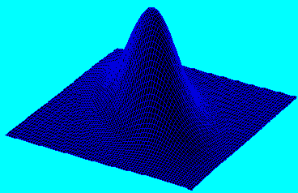
MCP: MULTI-TEMPORAL APPROACH
With respect to the multi-model approach, the dimension of all the distributions involved in the Bayesian formulation is multiplied by the number of time steps.
(N+1) ∙ T - VARIATE
T - VARIATE
N ∙ T - VARIATE
Observ. at 12 hours
N = NUMBER OF MODELS
T = NUMER OF TIME STEPS
Observ. at 24 hours

Slide 8
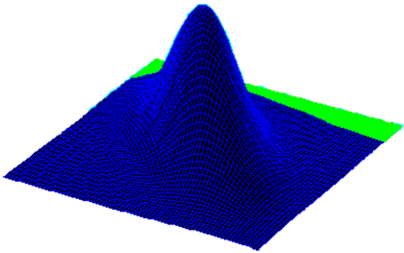
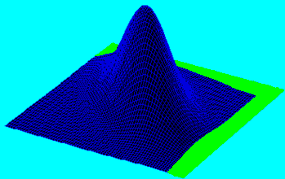
MCP: MULTI-TEMPORAL APPROACH
Probability to exceed a water level a within the time horizon of T time steps
Within 24 h
Within 12 h
Cumulative Exceeding Probability
12 h
12 h
24 h
24 h

Slide 9
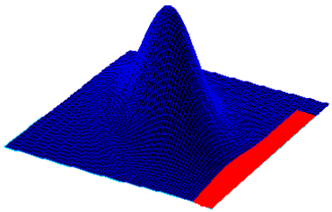
MCP: MULTI-TEMPORAL APPROACH
Exact Exceeding time (T*) probability
12 h
24 h

Slide 10
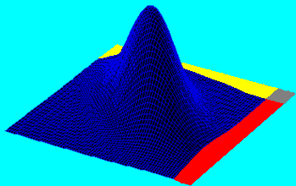
MCP: MULTI-TEMPORAL APPROACH
12 h
24 h
Which is the probability that the water level will be higher than the dykes one at the hour 24th?
RED + GREY
Which is the probability that the river dykes will be exceeded within the next 24 hours?
RED + GREY + YELLOW
Can be obtained also with the basic and multi-model approaches since it does not depend on the state of the variable at 12 hours
Which is the probability that the river dykes will be exceeded exactly at the hour 24th?
RED

Slide 11
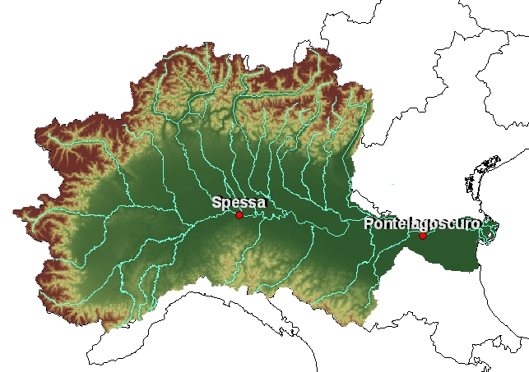
APPLICATION: MCP with MULTI-TEMPORAL
PO RIVER AT PONTELAGOSCURO and PONTE SPESSA
01/05/2000
30/06/2004
20/01/2009
MCP: CALIBRATION VALIDATION
Available data, provided by the Civil Protection of Emilia Romagna Region, Italy:
Forecasted hourly levels: forecast lead time 24 h.
Observed hourly levels

Slide 12
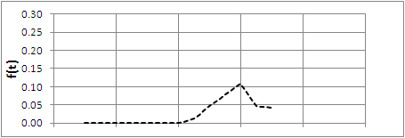
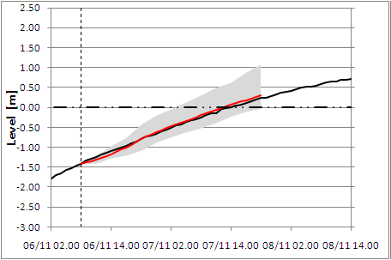
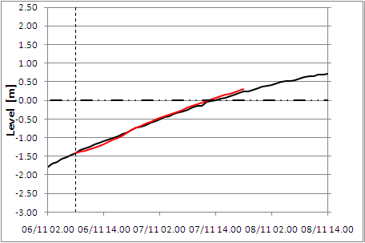
PROBABILITY FORECASTS WITHIN A TIME HORIZON
Pontelagoscuro Station (24 h)
Exceeding Time Probability
P(T*)
Cumulative Exceeding Probability
90% Uncertainty Band
Deterministic Forecast

Slide 13
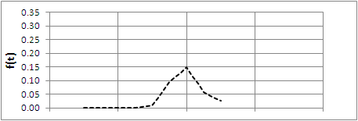
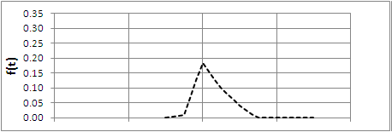
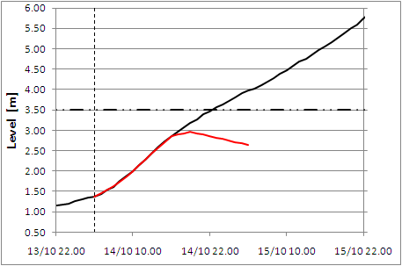
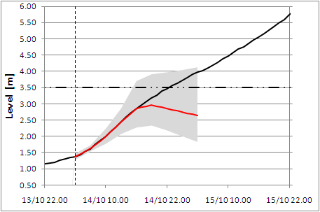
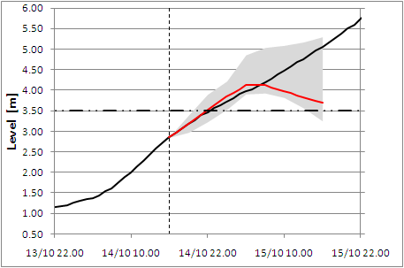
PROBABILITY FORECASTS WITHIN A TIME HORIZON
Ponte Spessa Station (24 h)
Exceeding Time Probability
P(T*)
P(T*)
Cumulative Exceeding Probability
90% Uncertainty Band
Deterministic Forecast

Slide 14
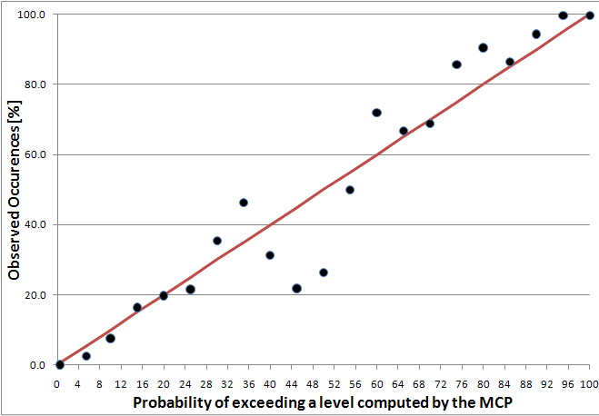
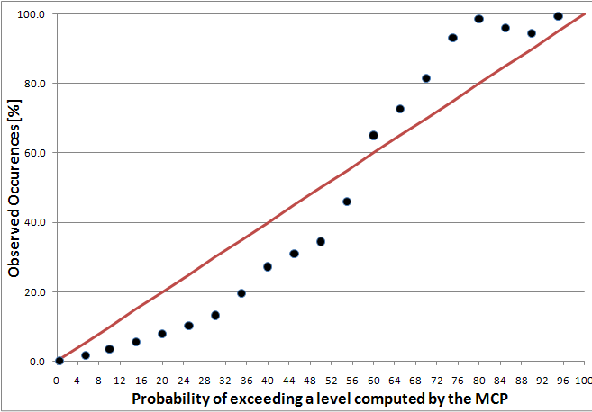
PROBABILITY FORECASTS WITHIN A TIME HORIZON
VERIFICATION: If the probability value provided by the processor is correct, considering all the cases when the exceeding probability takes value P, the percentage of observed exceeding occurrences must be equal to P.
Ponte Spessa Station (24 h)
VALIDATION
CALIBRATION
Red Line = Perfect beahviour
Computed with a 5% discretization

Slide 15
CONCLUSIONS
Most of the existing Uncertainty Processors do not account for the evolution in time of the forecasted events.
The presented multi-temporal approach allows to identify the joint predictive distribution of all the forecasted time steps, recognizing and reducing the time errors.
Important information are added to the Predictive Uncertainty, such as the probability to have a flooding event within a specific time horizon and the exact flooding time probability.
The comparison of predicted and observed flooding occurrences verified that, a part small errors due to the unavoidable approximations, the methodology computes the flooding probability with good accuracy.

Slide 16
THANK YOU FOR YOUR ATTENTION AND YOUR PATIENCE

Slide 17
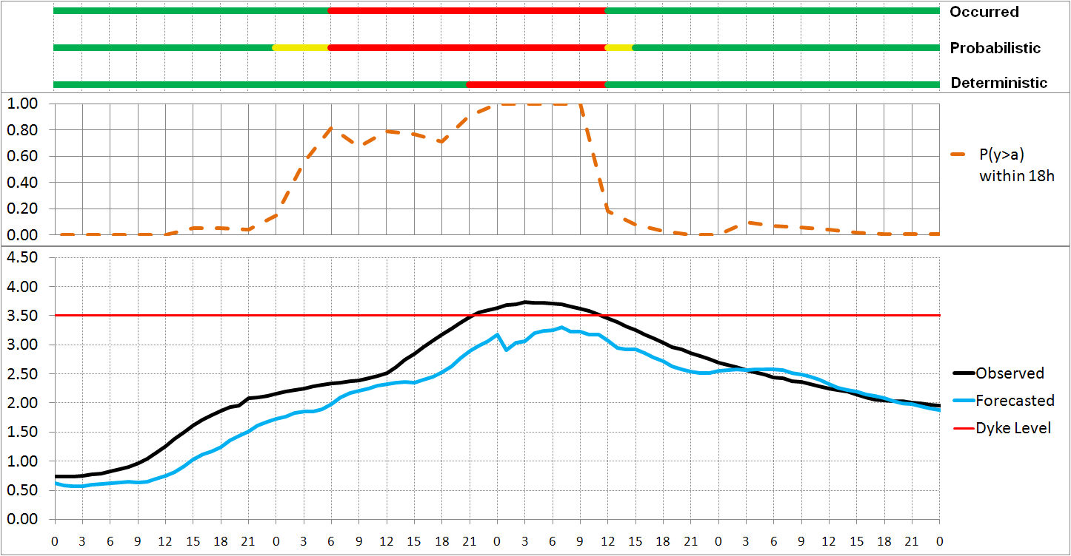
PROBABILITY FORECASTS WITHIN A TIME HORIZON
The information about the time allows systematic
time errors to be identified and corrected
Ponte Spessa Station (18 h)

