Slide 1
Comparative Study of the Global Ionospheric Behavior During Solar Cycles 22-23 and 23-24 Minima
-- OUTLINE --
- Light Description of solar minimum and geomagnetic effects
Some vTEC results
Some NmF2 results
Initial hmF2 results
Conclusions
Eduardo A. Araujo-Pradere^{1,2}, Dominic Fuller-Rowell^{1,3}, Rob Redmon³, Rodney Viereck², Tim Fuller-Rowell^{1,2}
(1) CIRES-Univ. of Colorado, (2) SWPC-NOAA, (3) NGDC-NOAA

Slide 2
F10.7 ADJUSTED INDEX

Slide 3
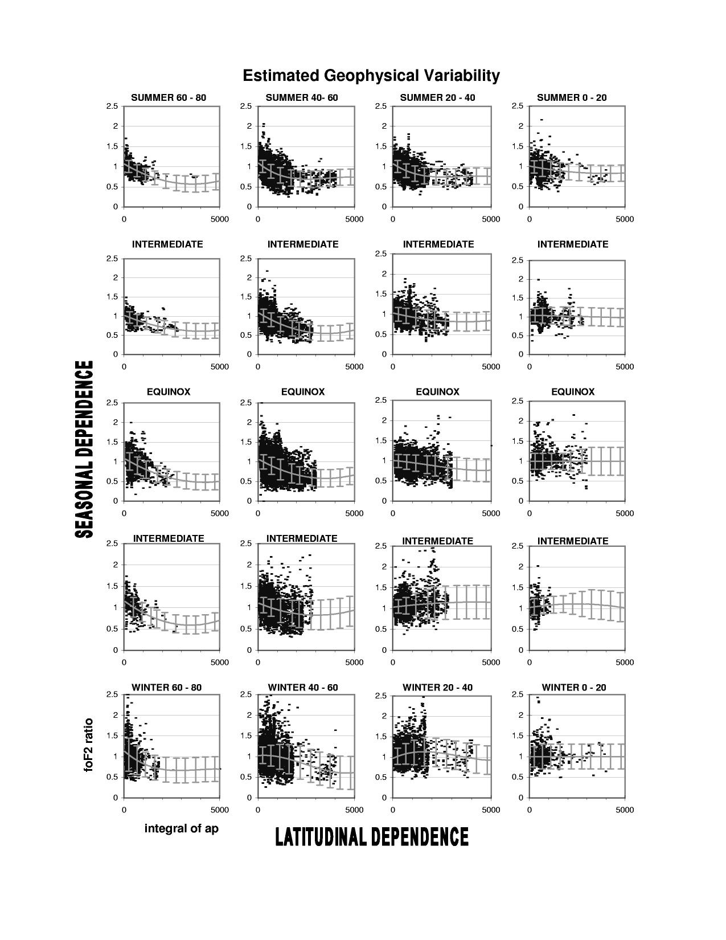
-
-
GEOMAGNETIC DEPENDENCY OF THE IONOSPHERIC RESPONSE
-
-
-
-
-
+
-
+
OBSERVED VALUE
foF2 RATIO =
MONTHLY MEAN
(1 = quiet conditions)

Slide 4
mean molecular mass latitudinal structure
40º
40º
summer pole
equator
winter pole
solar driven circulation, quiet conditions (kp = 0)
quiet conditions (kp = 2⁺)
perturbed conditions (kp = 7)

Slide 5
IONOSPHERE: COMPARATIVE STUDY (minimum 22-23 vs minimum 23-24
Results for vTEC (using two methods, a data assimilation scheme using ~200 stations, and a thin layer approach with data from 1 station)
Results for NmF2
In all cases the correspondent IRI output is included.
Initial Results for hmF2 (very, very initial…)

Slide 6
METHODOLOGY
FULL MONTH OF DATA RETRIEVED AT THE HIGHER RESOLUTION AVAILABLE (for the three parameters)
MINIMUM AMOUNT OF POINTS = 10
AVERAGE VALUES CALCULATED AT EACH TIME VALUE
A “MEAN DAY” OBTAINED
STANDARD DEVIATION FROM ALL VALUES CALCULATED FOR EACH AVERAGE, REPRESENTED AS THE ERROR BAR AT EACH POINT

Slide 7
Vertical TEC (vTEC)

Slide 8
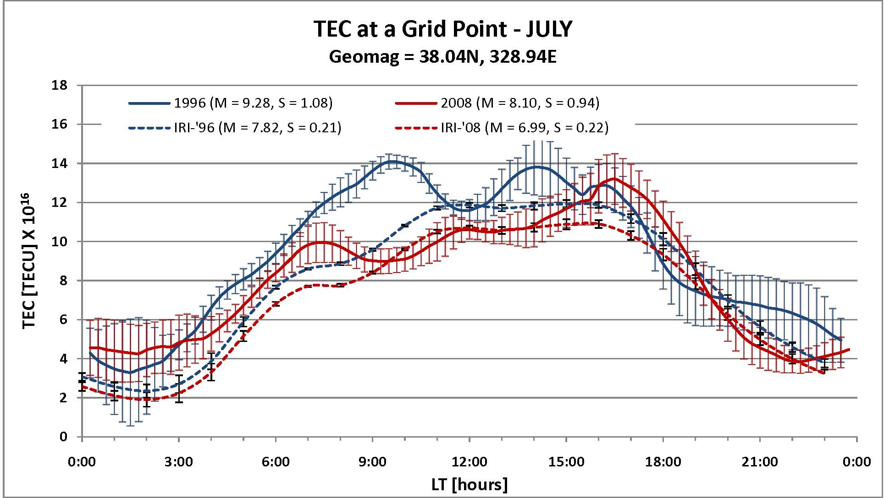

Slide 9
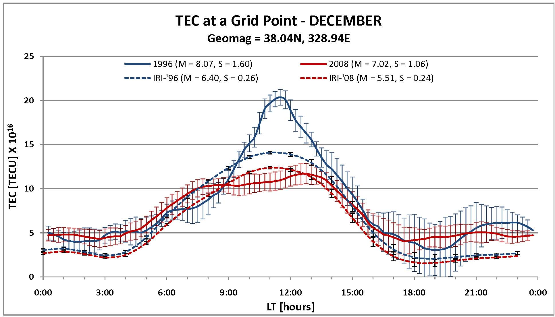

Slide 10
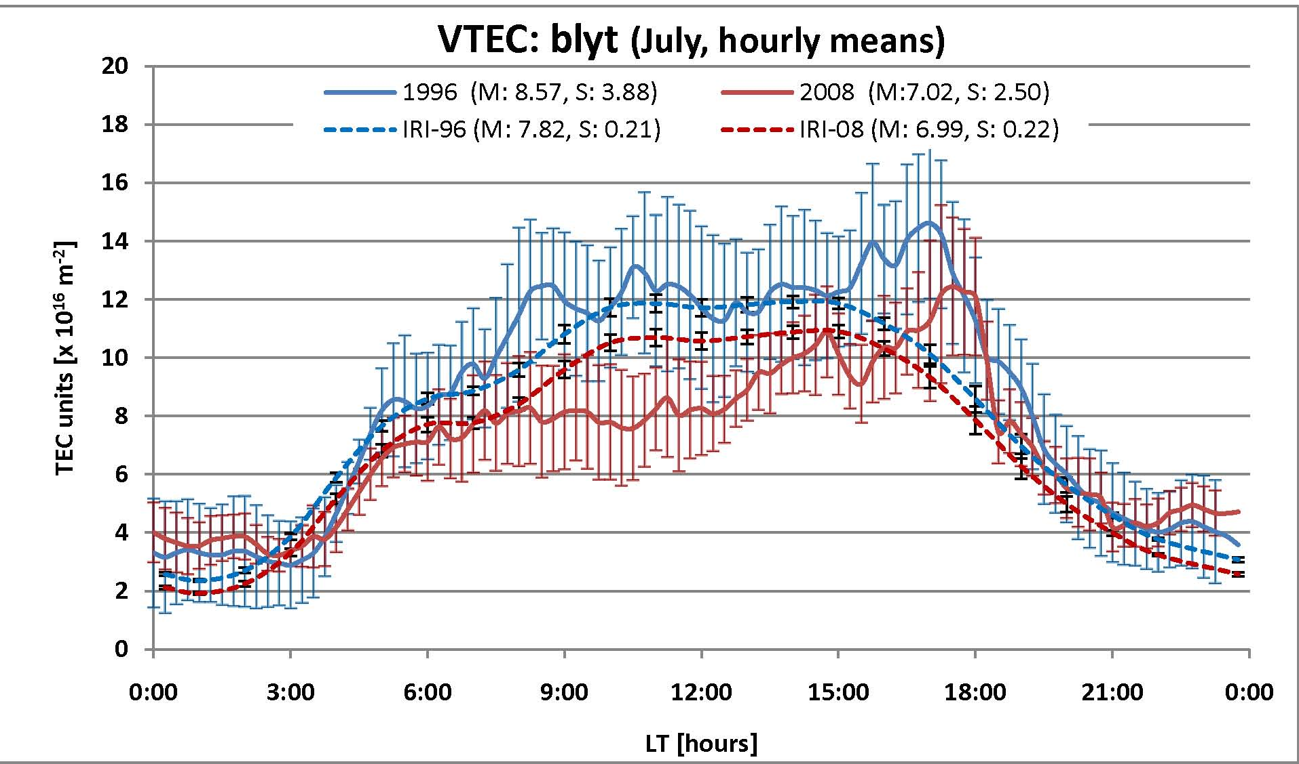

Slide 11
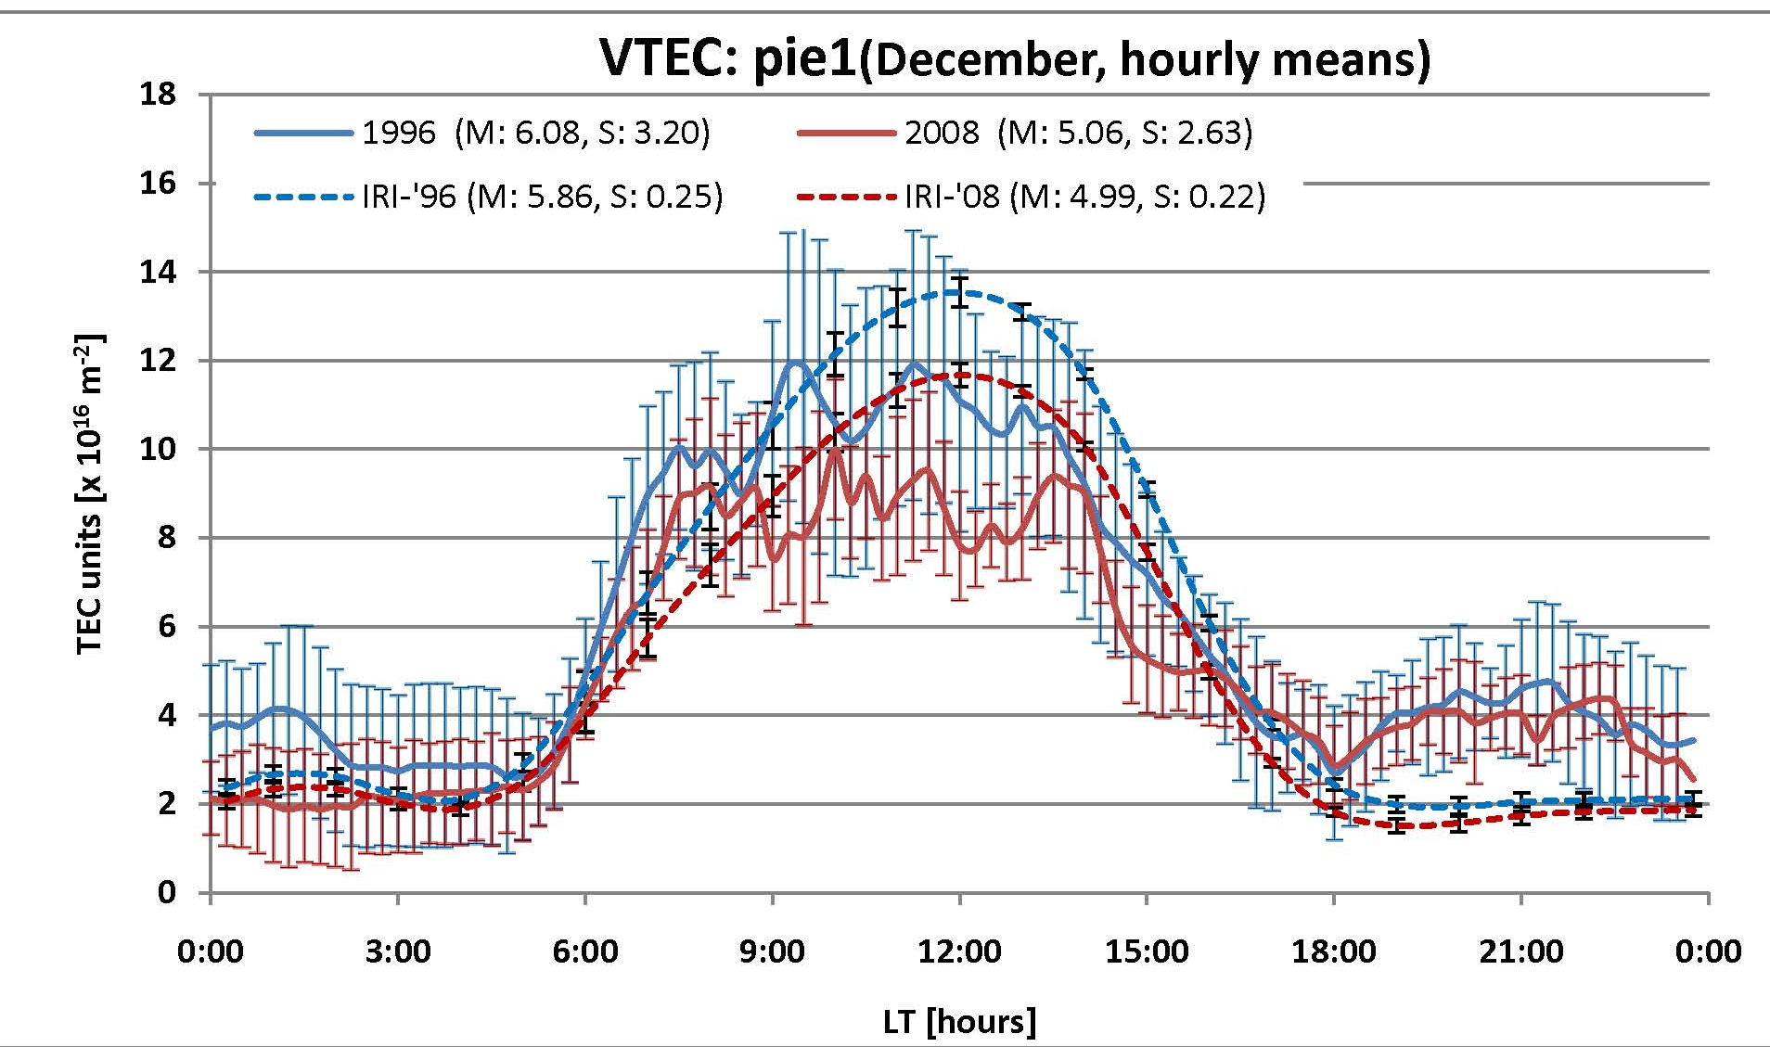

Slide 12
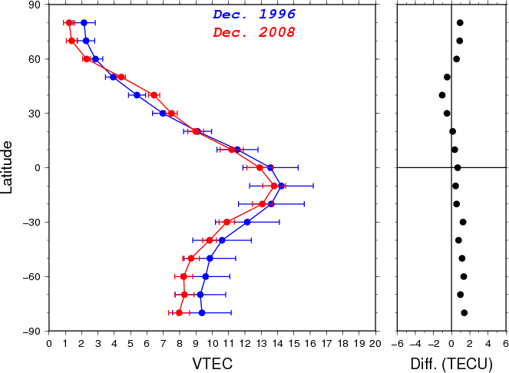
Extracted from CODE Global Ionospheric maps
(GIMs IONEX format)
Courtesy of Nicolas Bergeot
Royal Observatory of Belgium

Slide 13
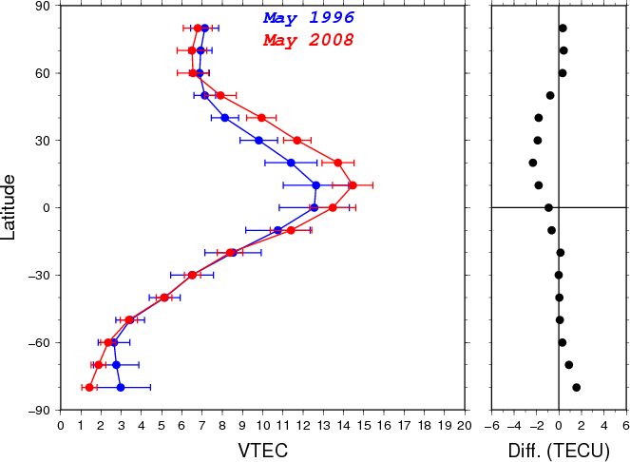
Extracted from CODE Global Ionospheric maps
(GIMs IONEX format)
Courtesy of Nicolas Bergeot
Royal Observatory of Belgium

Slide 14
IONOSPHERE: COMPARATIVE STUDY vTEC Partial Conclusions:
Similar data values, from minimum to minimum, for night side
Day side reflects the minimum to minimum differences, consistently showing lower values for the latest minimum (possibly due to a reduction in production resulting from the observed 15% decrease in EUV radiation )
Small changes obtained highly dependent on analysis method.

Slide 15
Peak Concentration (NmF2)

Slide 16
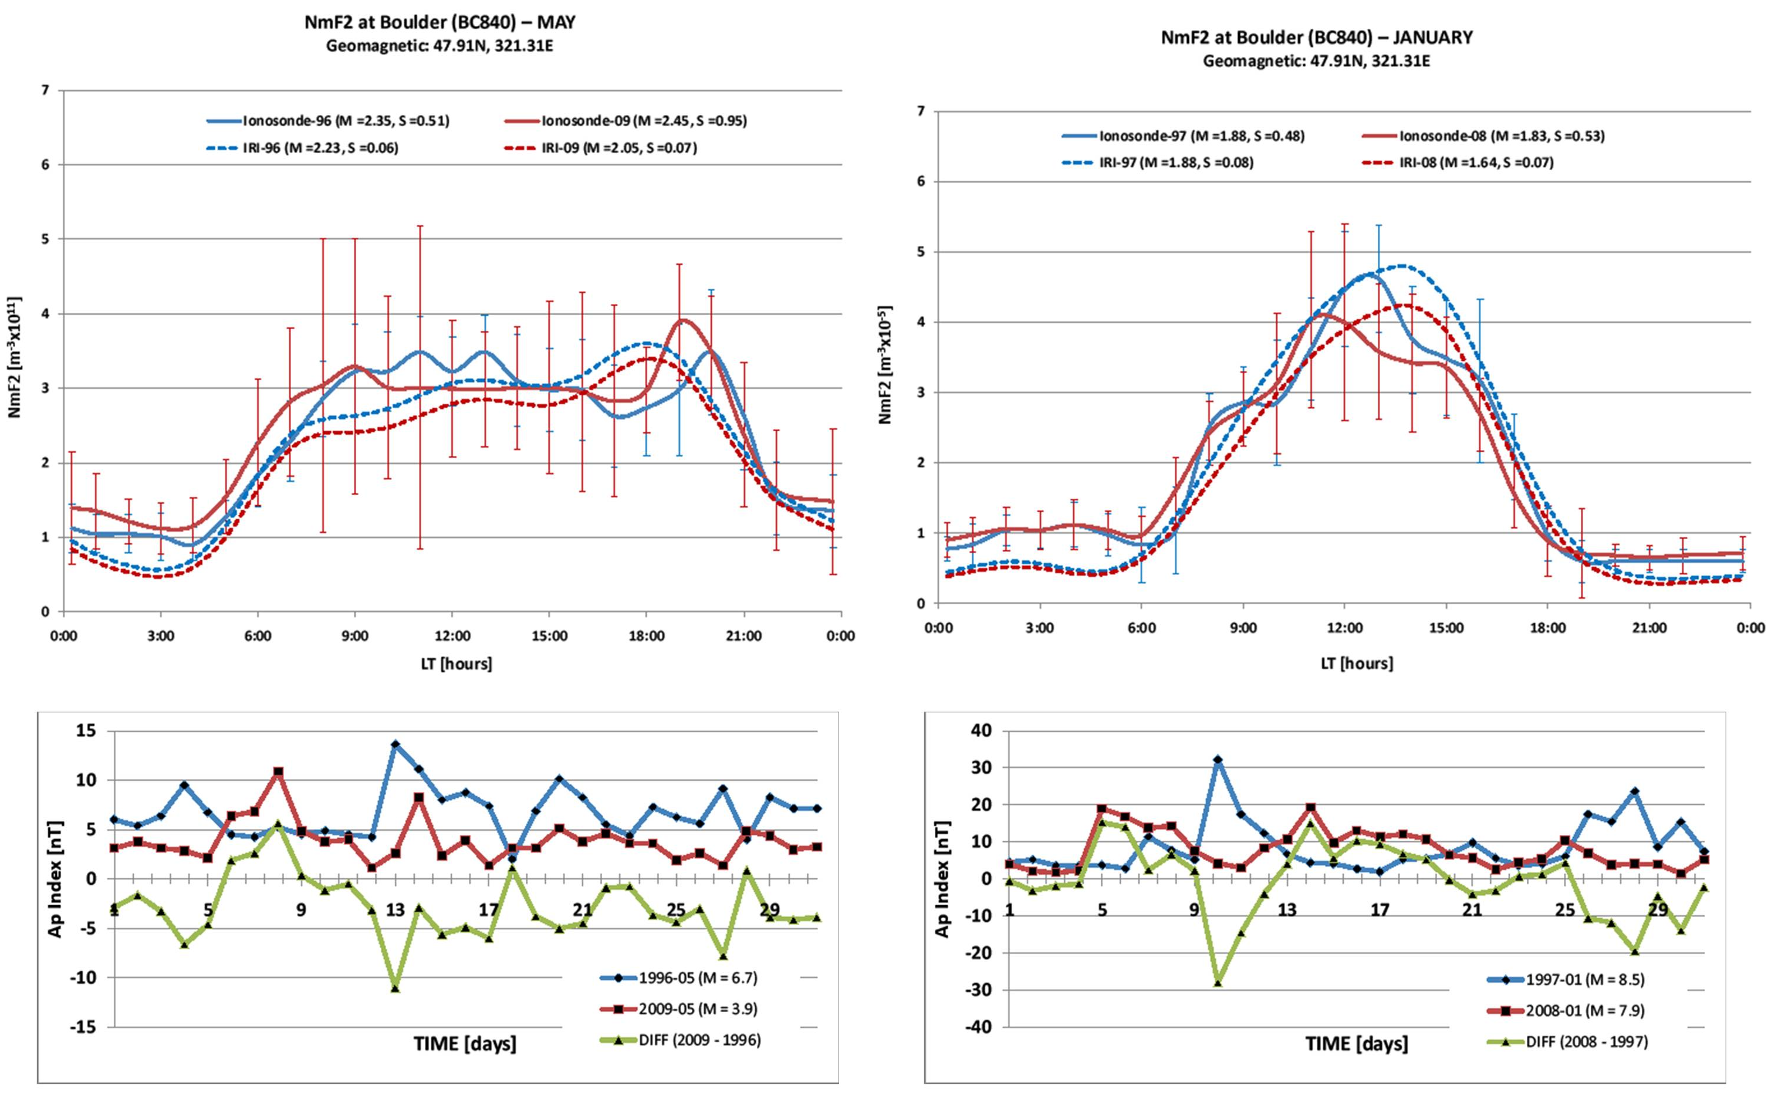
NmF2 at Boulder (BC840)
-MAY- Geomagnetic: 47.91N, 321.31E -JAN-
Obs-96 (M=2.35, S=0.51)
IRI-96 (M=2.23, S=0.06)
Obs-09 (M=2.45, S=0.95)
IRI-09 (M=2.05, S=0.07)
Obs-96 (M=1.88, S=0.48)
IRI-96 (M=1.88, S=0.08)
Obs-09 (M=1.83, S=0.53)
IRI-09 (M=1.64, S=0.07)

Slide 17
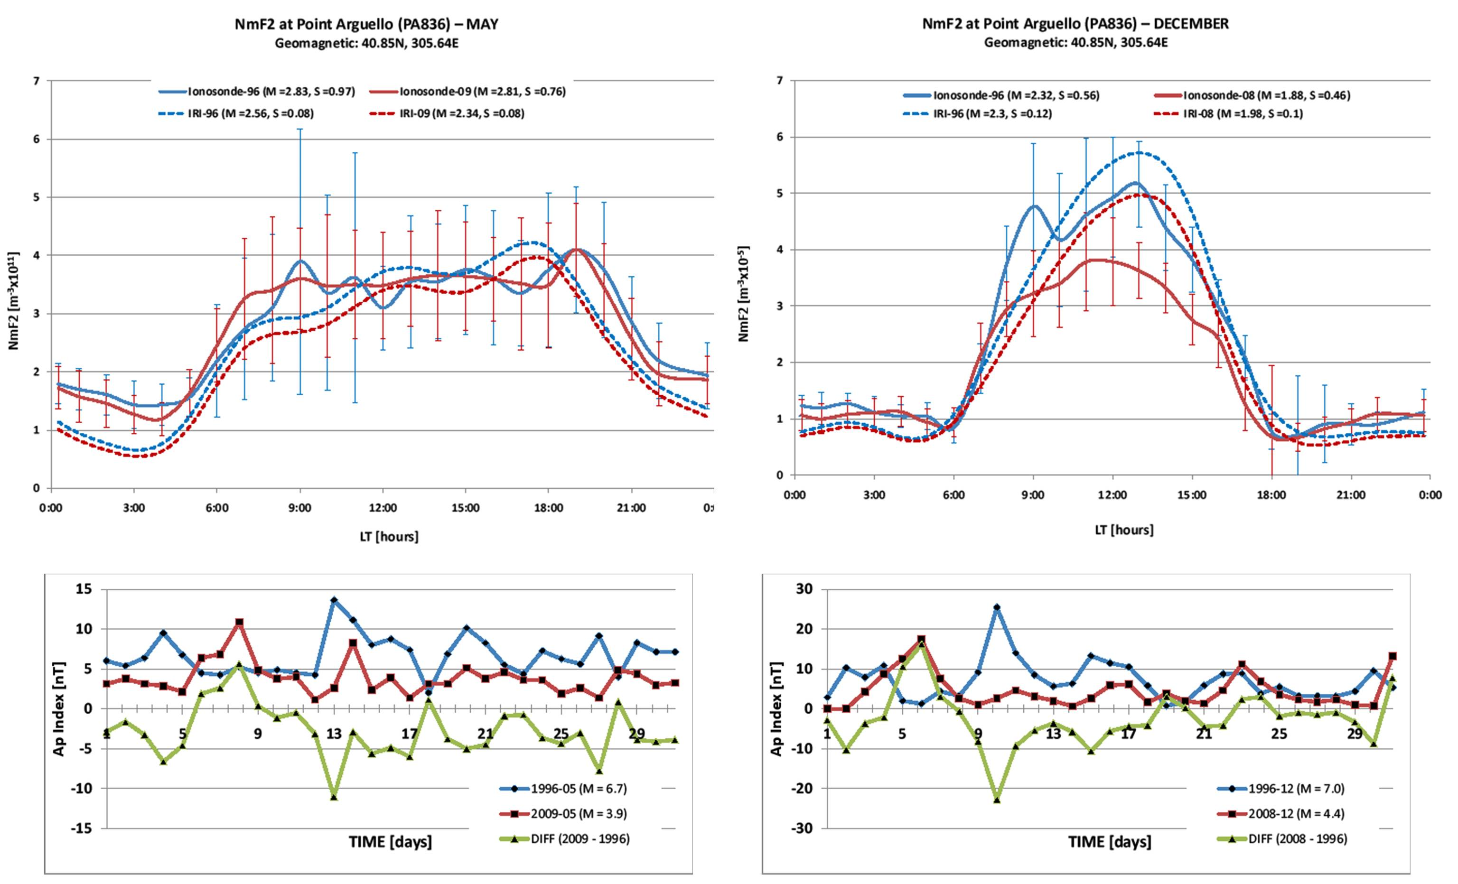
NmF2 at Point Arguello (PA836)
-MAY- Geomagnetic: 40.851N, 305.64E -DEC-
Obs-96 (M=2.83, S=0.97)
IRI-96 (M=2.56, S=0.08)
Obs-09 (M=2.81, S=0.76)
IRI-09 (M=2.34, S=0.08)
Obs-96 (M=2.32, S=0.56)
IRI-96 (M=2.30, S=0.12)
Obs-09 (M=1.88, S=0.46)
IRI-09 (M=1.98, S=0.10)

Slide 18
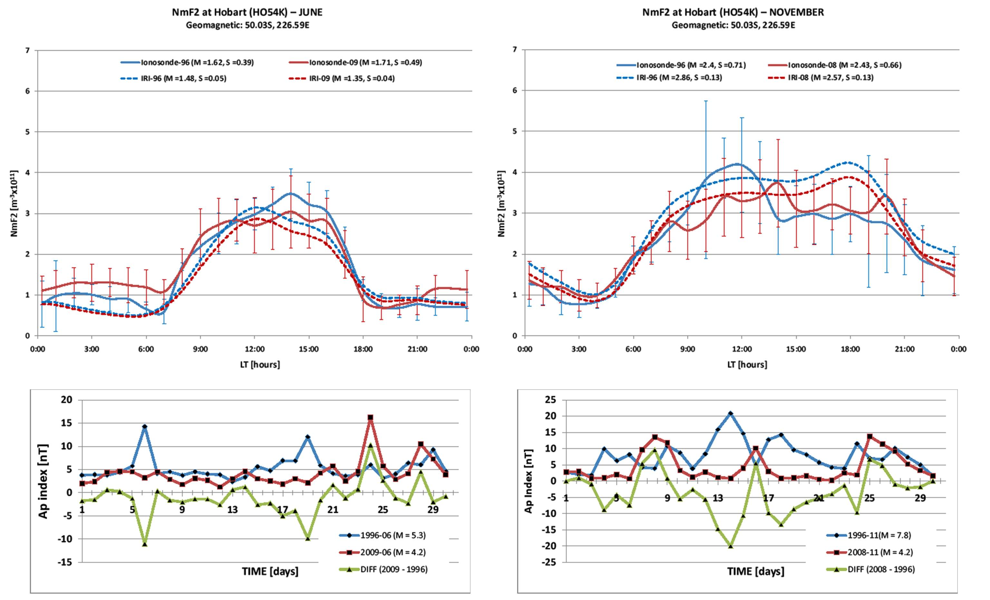
NmF2 at Hobart (HO54K)
-JUN- Geomagnetic: 50.03S, 226.59E -NOV-
Obs-96 (M=1.62, S=0.39)
IRI-96 (M=1.48, S=0.05)
Obs-09 (M=1.71, S=0.49)
IRI-09 (M=1.35, S=0.04)
Obs-96 (M=2.40, S=0.71)
IRI-96 (M=2.86, S=0.13)
Obs-09 (M=2.43, S=0.66)
IRI-09 (M=2.57, S=0.13)

Slide 19
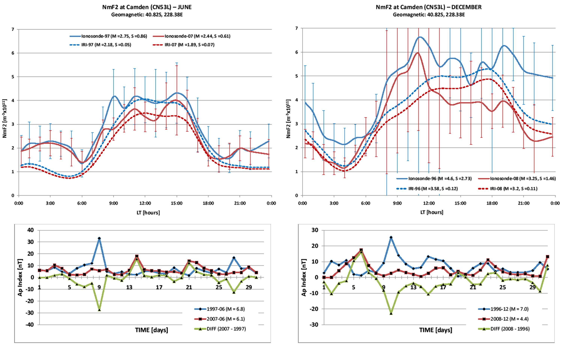
NmF2 at Camden (CN53L)
-JUN- Geomagnetic: 40.82S, 228.38E -DEC-
Obs-96 (M=2.75, S=0.86)
IRI-96 (M=2.18, S=0.05)
Obs-09 (M=2.44, S=0.61)
IRI-09 (M=1.89, S=0.07)
Obs-96 (M=4.60, S=2.73)
IRI-96 (M=3.58, S=0.12)
Obs-09 (M=3.25, S=1.46)
IRI-09 (M=3.20, S=0.11)

Slide 20
IONOSPHERE: COMPARATIVE STUDY NmF2 Partial Conclusions:
Similar data values, from minimum to minimum, for night side
Day side reflects the minimum to minimum differences, but lacks of any consistency (higher, similar, lower values). May be explained by the movement of the plasma caused by electric fields or neutral-wind interactions

Slide 21
Peak height (hmF2)

Slide 22
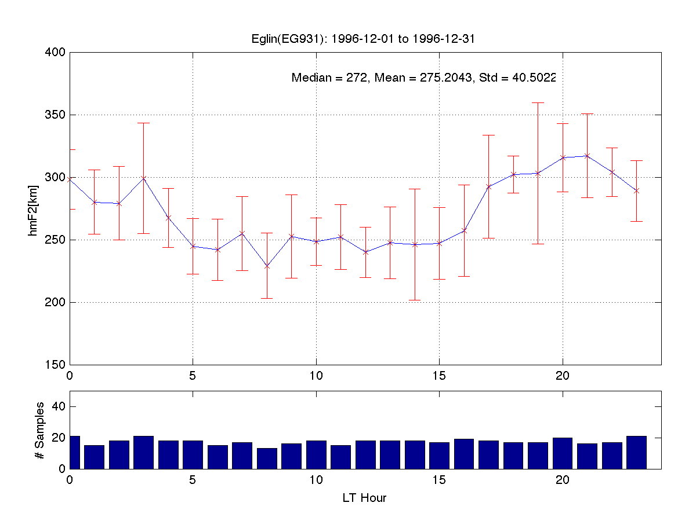
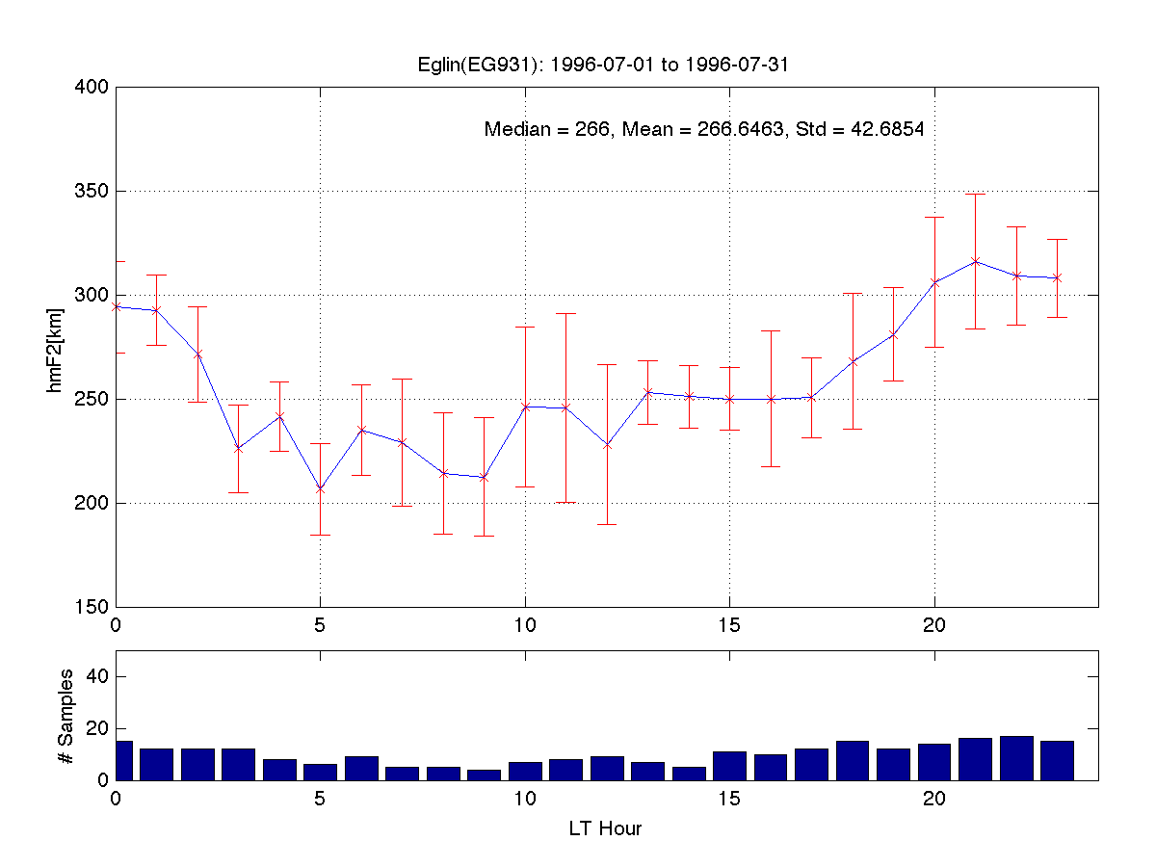
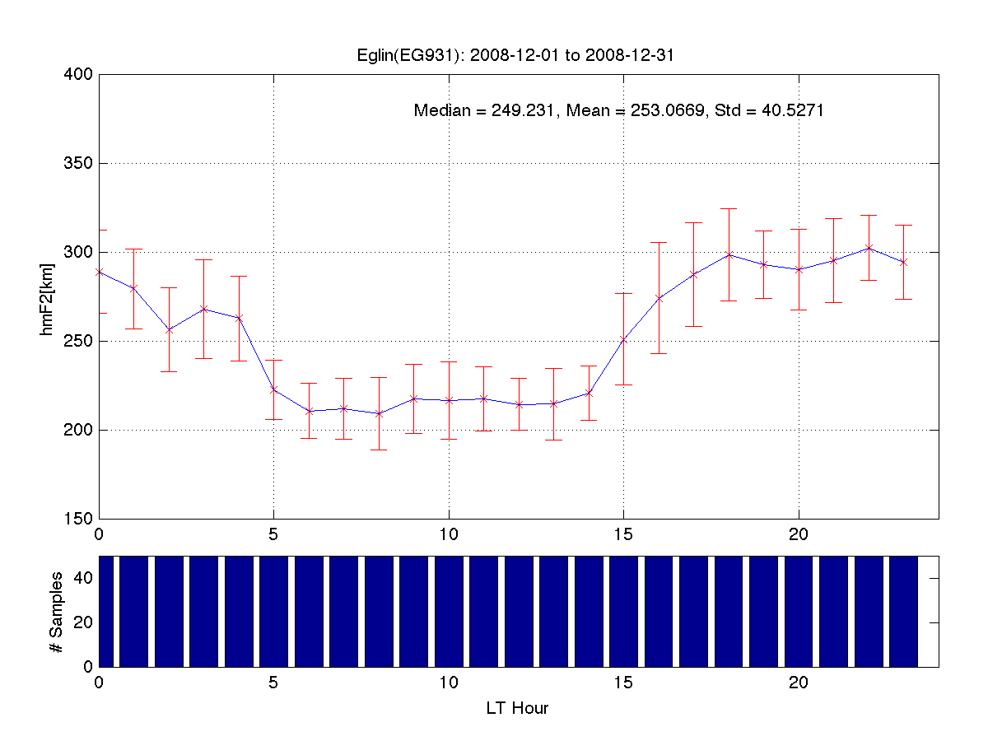
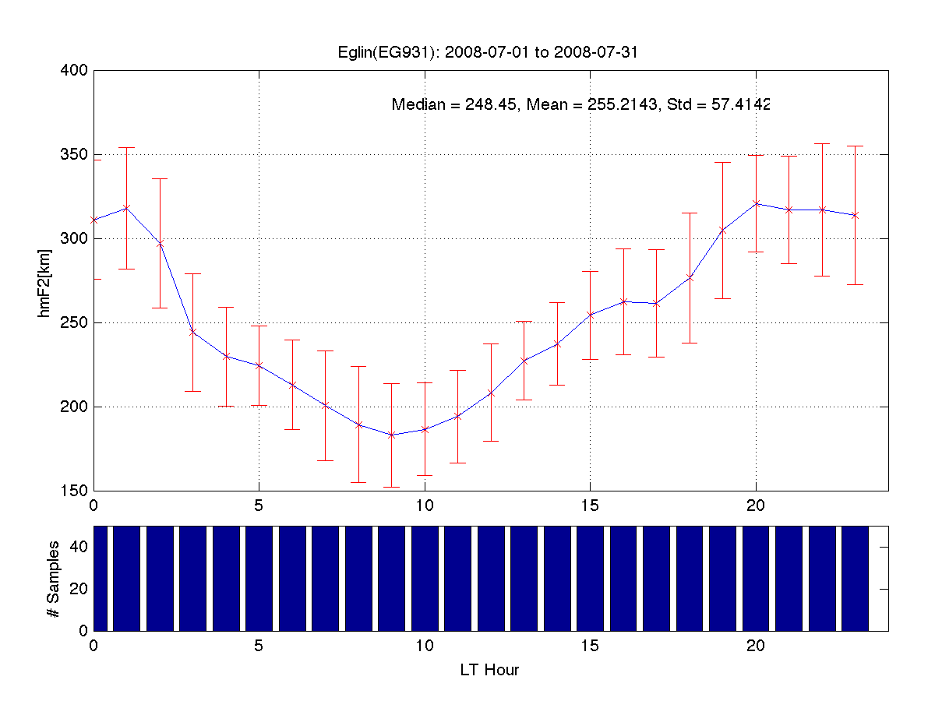

Slide 23
 | 1996 (minimum 22-23) |  |  | 2008 (minimum 23-24)
MONTH | MEDIAN | MEAN | STDEV | MEDIAN | MEAN | STDEV
JAN | 257.00 | 259.47 | 36.74 | 264.70 | 271.66 | 44.10
FEB | 257.00 | 261.21 | 35.79 | 269.85 | 278.39 | 45.53
MAR | 257.00 | 265.19 | 38.58 | 269.30 | 281.41 | 48.39
APR | 258.00 | 266.36 | 40.13 | 263.75 | 273.71 | 44.50
MAY | 263.00 | 268.94 | 40.16 | 266.20 | 272.30 | 50.17
JUN | 261.00 | 267.44 | 44.59 | 261.70 | 263.82 | 52.57
JUL | 266.00 | 266.65 | 42.69 | 248.45 | 255.21 | 57.41
AUG | 265.50 | 270.45 | 43.89 | 250.36 | 252.25 | 45.15
SEP | 266.00 | 265.49 | 37.76 | 248.93 | 251.31 | 41.50
OCT | 282.00 | 278.14 | 33.50 | 248.94 | 259.48 | 39.98
NOV | 283.50 | 285.03 | 39.29 | 256.34 | 258.50 | 41.66
DEC | 272.00 | 275.20 | 40.50 | 249.23 | 253.07 | 40.53
AVERAGES | 265.67 | 269.13 | 39.47 | 258.15 | 264.26 | 45.96
 | DIFFERENCE 2008 - 1996
MONTH | MEDIAN | MEAN
JAN | 7.70 | 12.19
FEB | 12.85 | 17.19
MAR | 12.30 | 16.22
APR | 5.75 | 7.34
MAY | 3.20 | 3.36
JUN | 0.70 | -3.62
JUL | -17.55 | -11.43
AUG | -15.14 | -18.20
SEP | -17.08 | -14.18
OCT | -33.06 | -18.65
NOV | -27.16 | -26.53
DEC | -22.77 | -22.14
Annual | -7.52 | -4.87
Higher for 23-24
Height of the peak concentration – hmF2
Eglin AFB
Coordinates: 30°29N 086°32W
Lower for 23-24

Slide 24
IONOSPHERE: COMPARATIVE STUDY hmF2 Partial Conclusions:
?

Slide 25
FINAL CONCLUSIONS (1):
The solar control over the ionospheric behavior is not linear, and the ionospheric response to minimum 23-24 shows a complex picture.
The small changes obtained from minimum to minimum are highly dependent on analysis method.
vTEC present a consistent decrease of the mean day values and the variability for minimum 23-24
NmF2 shows an inconsistent behavior, with cases in which the average values were lower, and other cases where the values were similar and even higher for minimum 23-24

Slide 26
FINAL CONCLUSION:
This mixed behavior of the ionospheric parameters could indicate the depletion of the total ionospheric plasma content through less EUV ionization, while the more complex ionization at the F-region peak (NmF2), may be explained by the movement of the plasma caused by electric fields or neutral-wind interactions, which could suggest that
LESS PLASMA WAS CREATED DURING THE 23-24 MINIMUM, BUT THAT THE PEAK DENSITY WAS MORE SENSITIVE TO THE GLOBAL PLASMA DYNAMICS.

