Slide 1

Analysis impacts on GPS reference frame realizations
Thomas Herring,
Department of Earth, Atmospheric and Planetary Sciences,
MIT, Cambridge, MA
tah@mit.edu

Slide 2
Overview
Examine effects on the reference frame realization using GPS of the treatment of solar radiation forces:
  Non-constant radiation pressure model needed (Y center-of-mass) but too free introduces noise in Z center-of-mass).
Spend most time on imbedding regional networks into global references frames.
  We will compare plate boundary position estimates when network imbedded into global reference frame network and see impact on velocity estimates
Notes:
The effects of in-accurate modeling of GPS satellite orbits still poses problems for long- and short-term realizations of both global and regional reference frames. Evidence of these deficiencies comes from the sensitivity of the estimates of the origin of the reference frame to the treatment of once-per-revolution orbit parameters, and the appearance of draconic periods (i.e, periods associated with the Sun being in the orbit plane of a satellite) in position time series. Each of these phenomena is likely related to radiation forces on the satellites. We examine the effects of the treatment of GPS satellite orbits on the realization of terrestrial reference frames and the effects that these treatments have on regionally dense networks of GPS sites realized in these frames. In addition to the direct effects of solar radiation, the albedo of the Earth leads to perturbing forces on the satellites. These variable forces have lead to many different methods of estimating the effects of solar radiation pressure on the GPS satellite orbits. There is an impact of the methods used to estimate the effects of radiation pressure forces on the terrestrial frame realization. In particular, the recovery of the location of the center of mass of the Earth is greatly affected by the treatment of once-per-revolution type radiation parameters. On the other hand, terrestrial scale is not so affected by these parameterizations. Terrestrial scale is affected mostly by the treatment of the phase center variations and location of the phase center on the satellites. We investigate if the impact of once-per-revolution parameterization can be reduced with integration of longer GPS orbital arcs. We also examine the impact of the orbit and reference frame treatments when regional data sets are incorporated into a global reference frame. Here we specifically examine results from some regional networks such as the Plate Boundary Observatory (PBO), which includes the 1000-station GPS network spread across the United States.

Slide 3
Radiation Parameter Treatment
The most difficult orbit perturbations to model in GPS analyses are the effects of radiation forces on the satellites.
  Separated into Direct, Y-bias and an orthogonal component (B-axis).
  In addition, once-per-revolution (OPR) or stochastic variations in these radiations forces are often needed.
  Albedo effects can also be important
Problem arise because these once-per-revolution effects correlate strongly with the origin of the orbit frame and with rates of change of orientation parameters.
Some examples showing need for OPR terms but also “noise” they introduce.

Slide 4
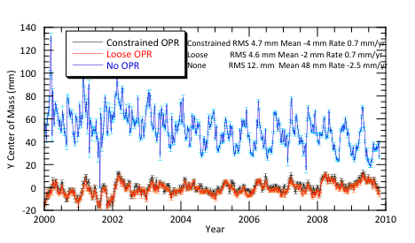
Y Center of Mass estimate
Importance of once-per-rev (OPR) terms can be seen here. Large bias in Y (and X)
Notes:
NOTE: loose and constrained very similar

Slide 5
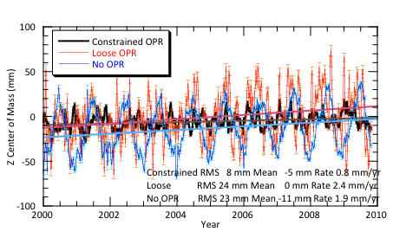
Z Center of Mass estimates

Slide 6
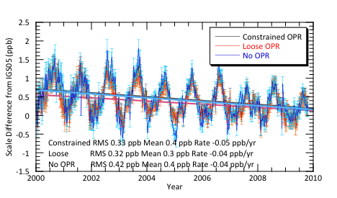
OPR Radiation effects on Scale estimate
Again little effect of treatment on scale (periodic signal is thought to be loading related)

Slide 7
Transferring ITRF to Regional Networks
Examine merging regional network into global TRF frame. Use the NSF Plate Boundary Observatory (PBO) network merged with the MIT IGS final processing network
PBO has ~1000 stations, MIT network ~240 stations.
PBO processing available in SINEX generated by:
  Central Washington University (CWU) Gypsy/Oasis
  New Mexico Tech (NMT) GAMIT
  Subtle point: CWU solution has no EOP, NMT does: Affects rotation when networks merged.
  IGS05 reference sites in NA/Pacific couple the networks
PBO processing uses fixed IGS final orbits; orbit is free in the MIT network

Slide 8
Testing methodology
Ideally in merging networks, the position time series estimates should not depend on which network a site was in (i.e., all regional sites should behave as if the sites were in the global network). Previous studies have shown that is not always the case.
Analysis here: Decouple some common sites and compare solutions from each network to see they have the same characteristics. Due to different processing (data editing, software differences we don’t expect exact agreement but differences should be small compared to standard deviations of estimates).
Example: Pietown with it decoupled and with MacDonald Observatory and all non-North American sites decoupled.

Slide 9
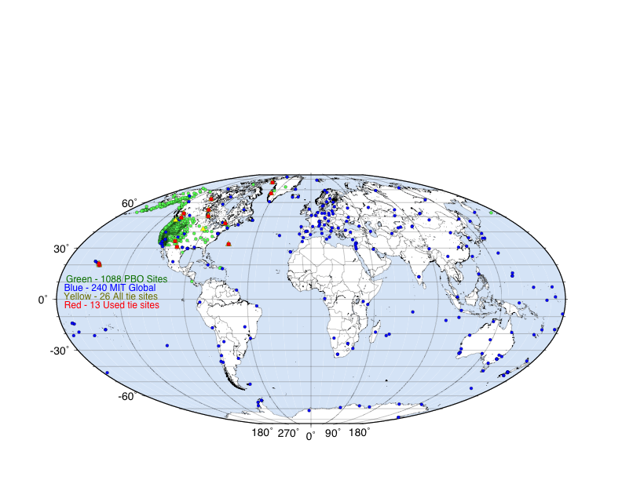
Networks (March 05, 2011)

Slide 10
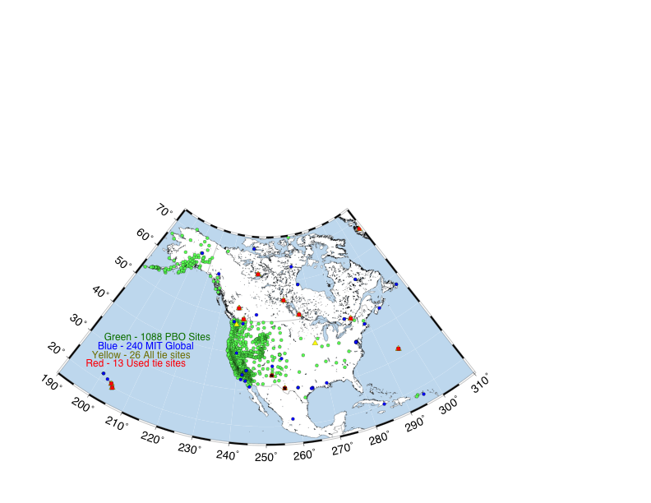
PBO Specific Region
PIE1
MDO1

Slide 11
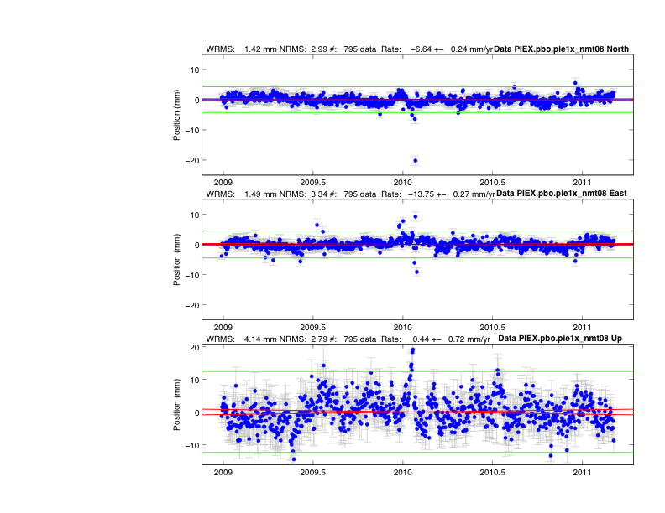
PIE Town (NMT)
Global Net
(Outliers have been retained to show site dependent).
(Some outliers will be due to processing problems).

Slide 12
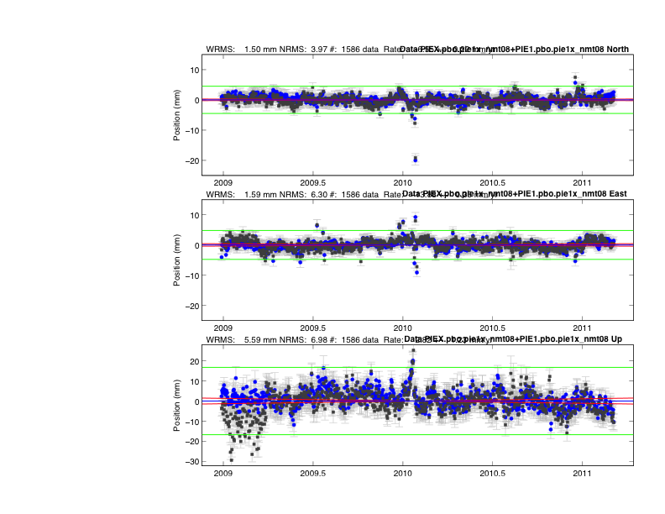
PIE Town
Global Net
PBO Site (NMT)
Outliers are common to both analyses, except height in early 2009: Processing problem at NMT)

Slide 13
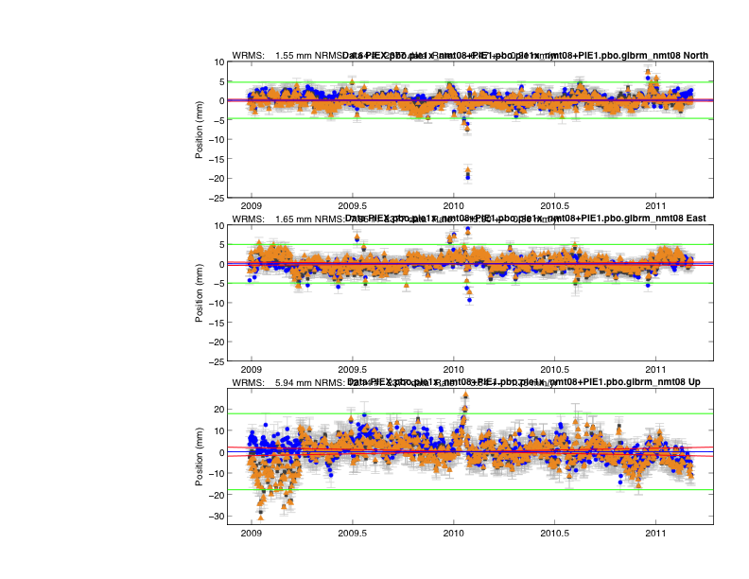
PIE Town
Global Net
PBO Site (NMT)
PBO Site (NMT) “Non-NA sites and McDonald decoupled)

Slide 14
PIE Town (CWU)
Global Net

Slide 15
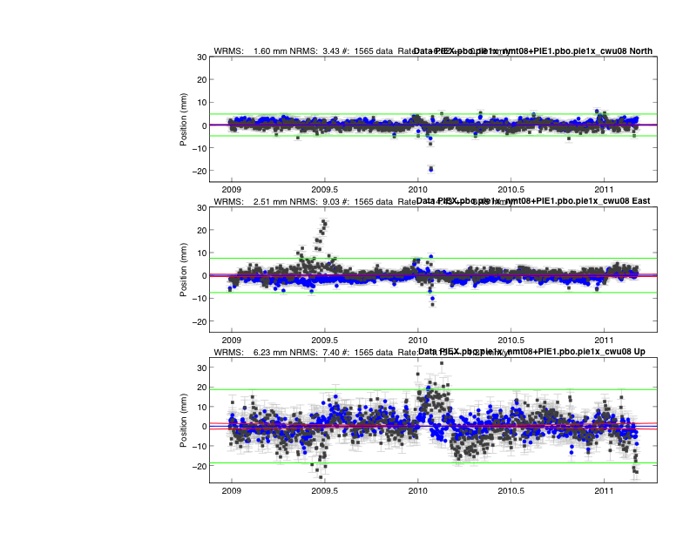
PIE Town (CWU)
Global Net
PBO Site (CWU). There are some processing problems here. This is now different program. See similar differences to NMT processing in PBO solution.
Ambiguity fixing problem
Notes:
Ambiguity resolution; difference just as large to NMT processing

Slide 16
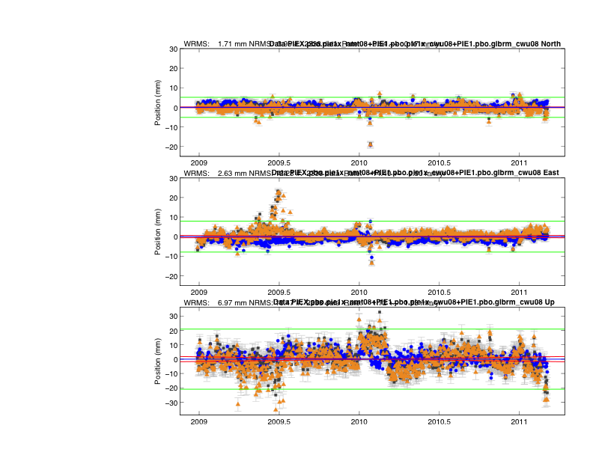
PIE Town (CWU)
Global Net
PBO Site (CWU). There are some processing problems here
PBO site (CWU). Non-NA sites removed (little effect)
Notes:
Ambiguity resolution; difference just as large to NMT processing

Slide 17
Velocity Estimates for PIE Town
Consistency of velocity with correlated noise model for velocity uncertainties
Analysis V North V East V height
GLB -6.59 ± 0.23 -13.78 ± 0.25 0.30 ± 0.61
NMT PBO -6.52 ± 0.23 -14.07 ± 0.29 0.49 ± 0.85
NMT NOG -6.28 ± 0.25 -13.96 ± 0.27 0.57 ± 0.77
CWU PBO -6.76 ± 0.17 -14.20 ± 0.43 0.09 ± 1.48
CWU NOG -6.47 ± 0.22 -13.75 ± 0.36 1.17 ± 1.91
RMS 0.18 0.19 0.40 (mm/yr)
RMS of estimates is comparable to the uncertainty of differences.
CWU-NMT differences for this site are similar to differences above.

Slide 18
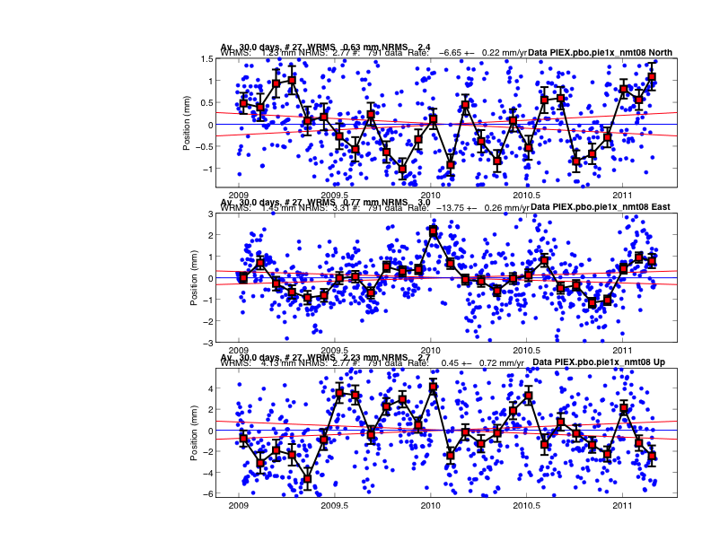
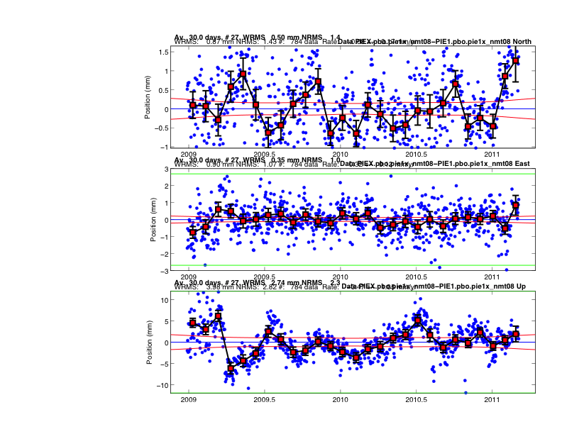
Example difference
East NMT: Top global; bottom Difference from PBO (NMT)
30 day averages shown. Differences within error bars

Slide 19
Conclusions
Treatment of once-per-revolution (OPR) radiation parameters has a major effect on recovery of origin of GPS reference frame Z-component.
Satellite antenna phase center locations (relative to center of mass of spacecraft) mostly effect terrestrial scale where as treatment of OPR radiation terms have little effect.
Our analysis of PBO results merged with a global network show that only regional sites are needed to tie the networks. One possible explanation as to why this differs with some earlier results is that in our approach we do not pre-align solutions to a TRF. This alignments happens as we merge networks before TRF alignment and thus accommodates deviations in site motions from secular motion.

Slide 20
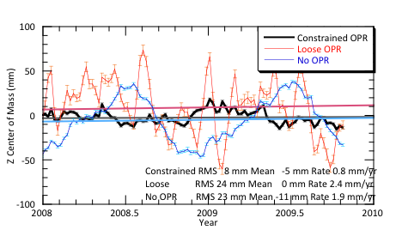
Zoom 2-years of Z CoM

