Slide 1
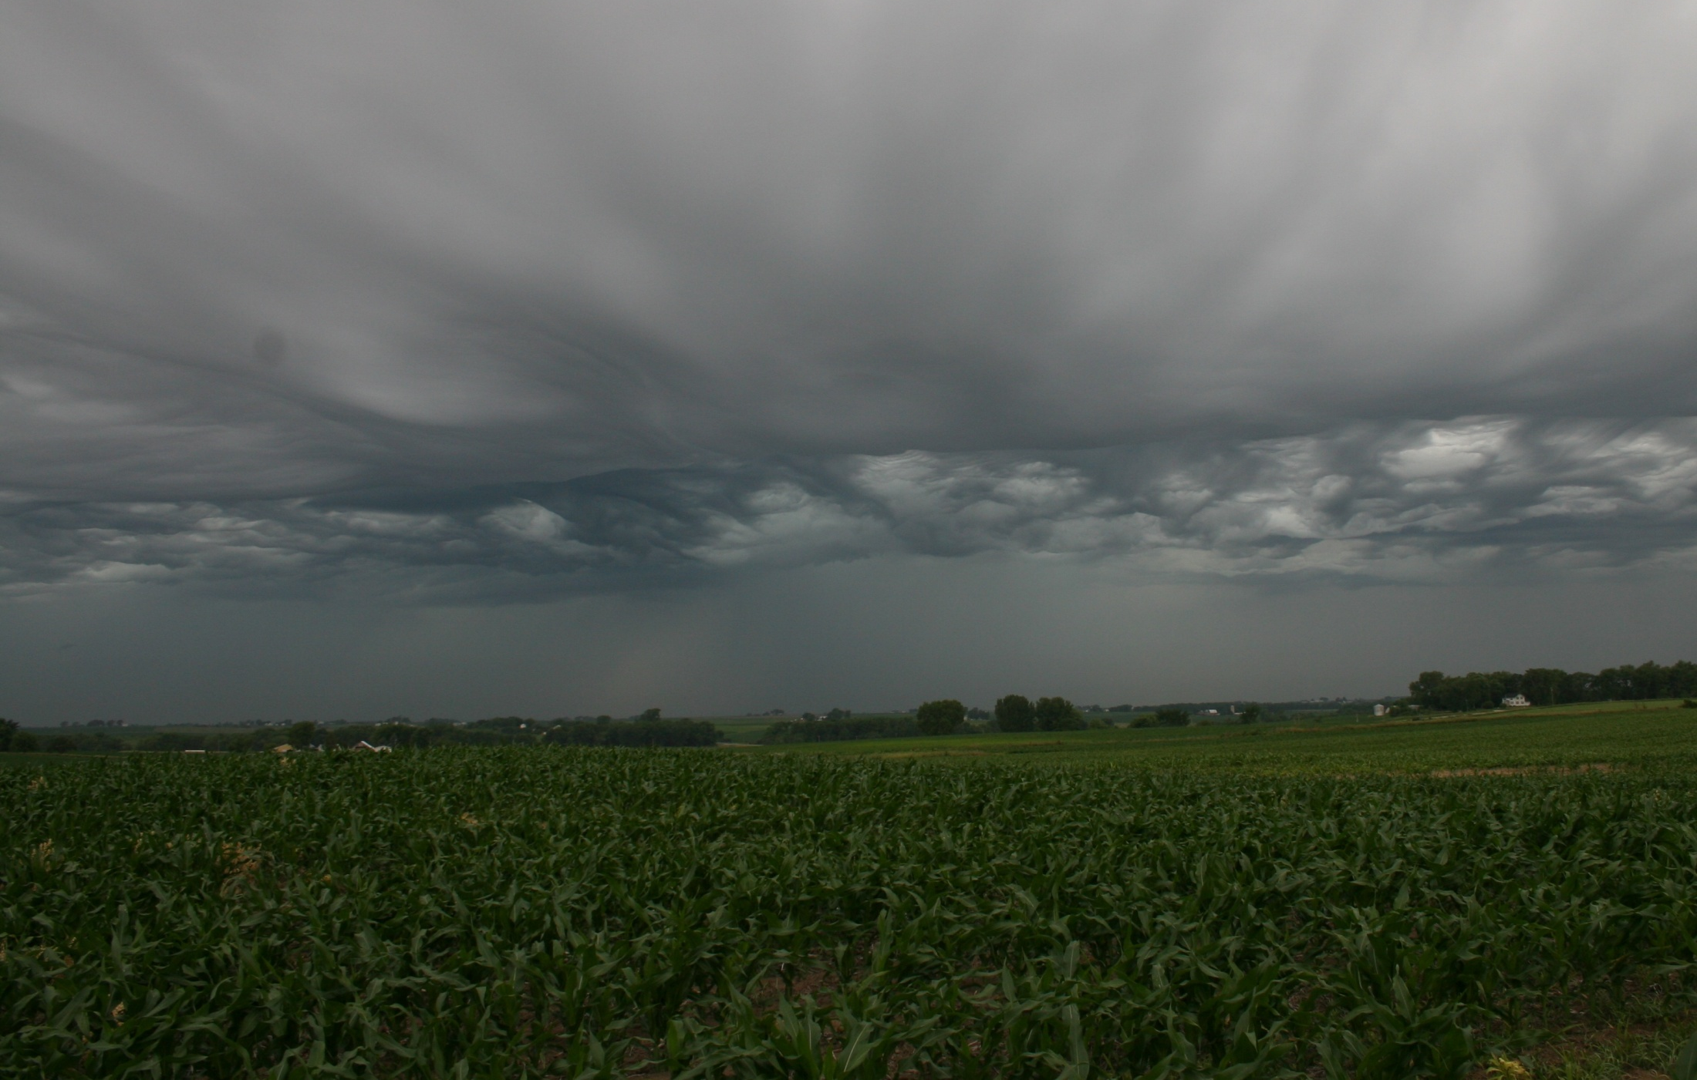


Transformation of the rainfall drop-size distribution and diameter-velocity relations by the maize canopy
R. P. M. Frasson
(renato-frasson@uiowa.edu)
W. F. Krajewski

Slide 2
Introduction
Rainfall above
the canopy
Atmosphere
Modify:
Rain amount
Drop size distribution
Velocity
distribution
Maize
canopy
Direct
throughfall
Dripping
Stemflow
Storage
Ground
Soil erosion
Soil moisture recharge

Slide 3
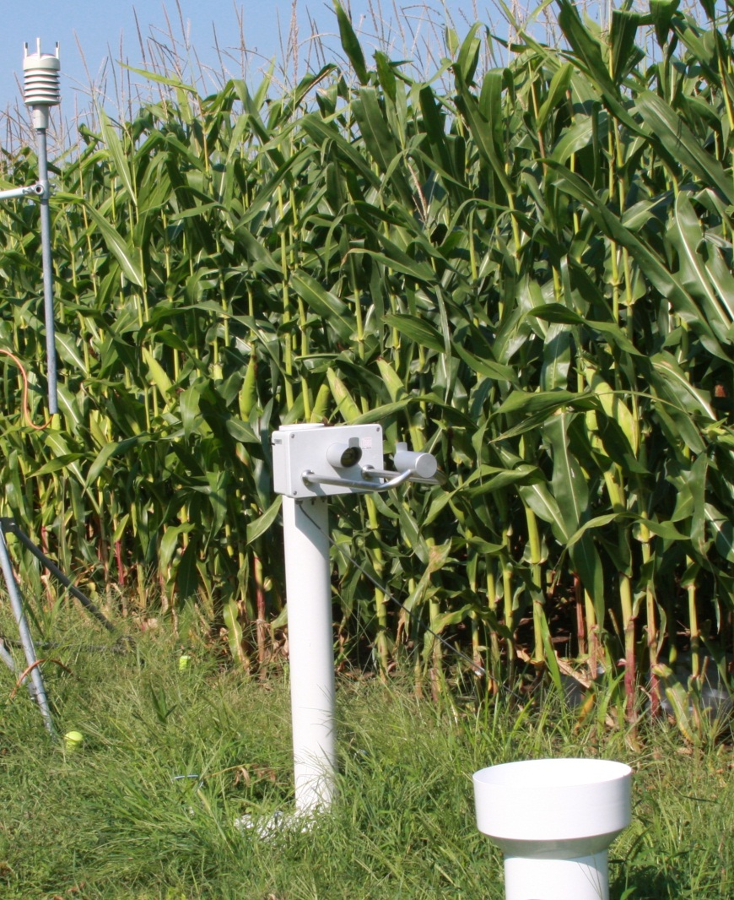
Methodology
Top view
0.94m
Reference Disdrometer
Throughfall disdrometer
7 plants/m
1m

Slide 4
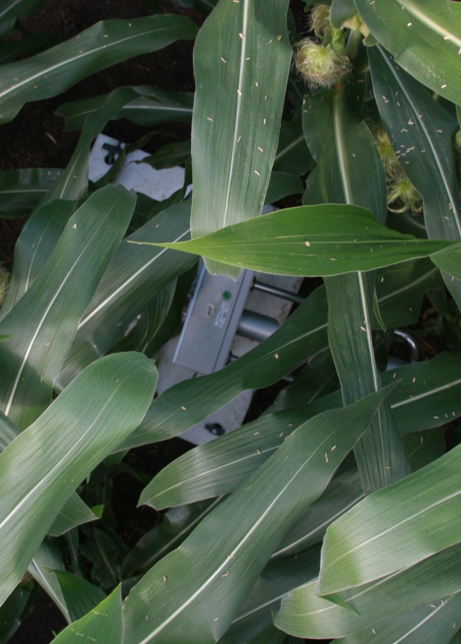
Canopy Characteristics:
13 leaves
Height: 240cm
LAI: 6.1
Gap fraction: 0.09

Slide 5
Rainfall dataset
Collected between 14 July and 28 August 2009:
  12 storms with accumulation > 1mm,
  10 storms with accumulation >10mm,
  5.8 million drops recorded by the reference disdrometer (D₅₀ =2.75mm),
  2.7 million drops recorded by the throughfall disdrometer (D₅₀ =3.75mm).

Slide 6
Rain drop interception
Heterogeneous interception with respect to drop size.
  I: Bouncing/Rolling
  II: Ratio approaches
  gap fraction
  III: Dripping
  IV: Converges to gap
  fraction
I
II
IV
III

Slide 7
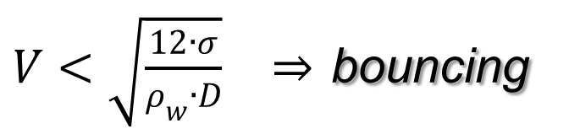
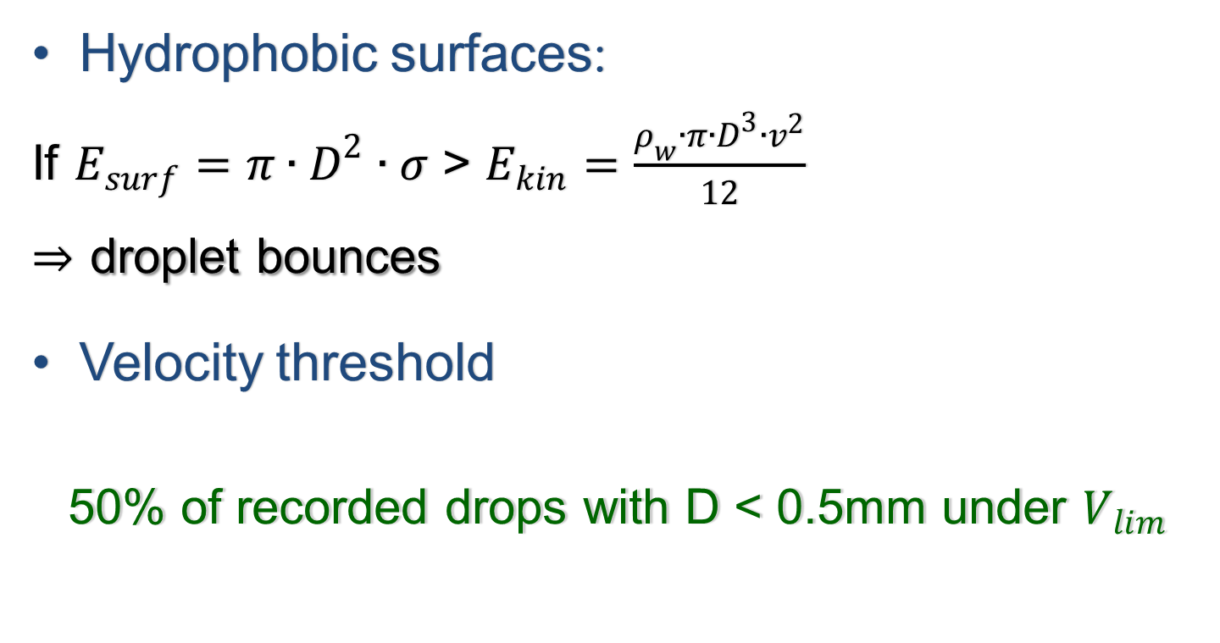
Area I: Bouncing threshold
Hydrophobic surfaces:
If $E_{surf}=π∙D^{2}∙σ$ > $E_{kin}=\frac{ρ_{w}∙π∙D^{3}∙v^{2}}{12}$
$⇒$ droplet bounces
Velocity threshold
  50% of recorded drops with D < 0.5mm under $V_{lim}$
$V<\sqrt{\frac{12∙σ}{ρ_{w}∙D}}$ $⇒$ bouncing

Slide 8
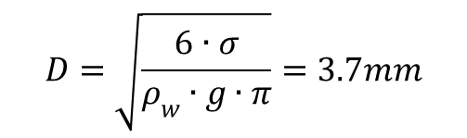
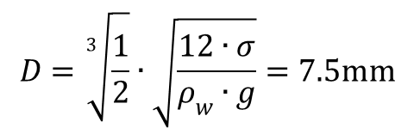
Area III: Dripping thresholds
Case A:
  Attachment length L ≈ equivalent volume diameter D.
$$D=\sqrt{\frac{6∙σ}{ρ_{w}∙g∙π}}=3.7mm$$
Case B:
  L ≈ circumference of a semi-sphere with equivalent volume diameter D.
$$D=\sqrt[3]{\frac{1}{2}}∙\sqrt{\frac{12∙σ}{ρ_{w}∙g}}=7.5mm$$

Slide 9
Diameter-velocity measurements

Slide 10
Modification of the diameter-velocity relation
Gunn and Kinzer terminal velocity
2.0m
1.0m
0.3m
Drop acceleration calculation after Wang, P.K. and Pruppacher, H.R., 1977. Acceleration to terminal velocity of cloud and raindrops. Journal of Applied Meteorology, 16(3): 275-280.

Slide 11
Future work
Investigate how wind affects the throughfall-rainfall ratio;
Create a multi-layer rainfall partitioning model to compute:
  Stemflow;
  Throughfall (including DSD and its moments);
  Canopy storage.

Slide 12
Conclusion
Canopy interception efficiency is function of D.
  Throughfall D₅₀ = 3.75 mm vs reference 2.75 mm
Increase in N(4mm>D>4.5mm) under the canopy. Velocity measurements confirm they originate from canopy.
Ability to measure drop sizes and velocities
  Refining mechanistic modeling of soil erosion.

Slide 13
Thank you for your time and attention!!

