Slide 1
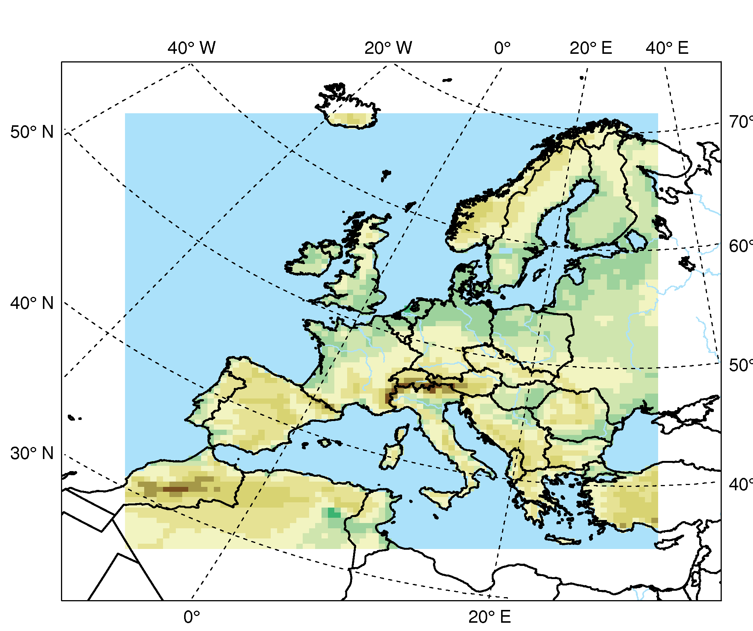
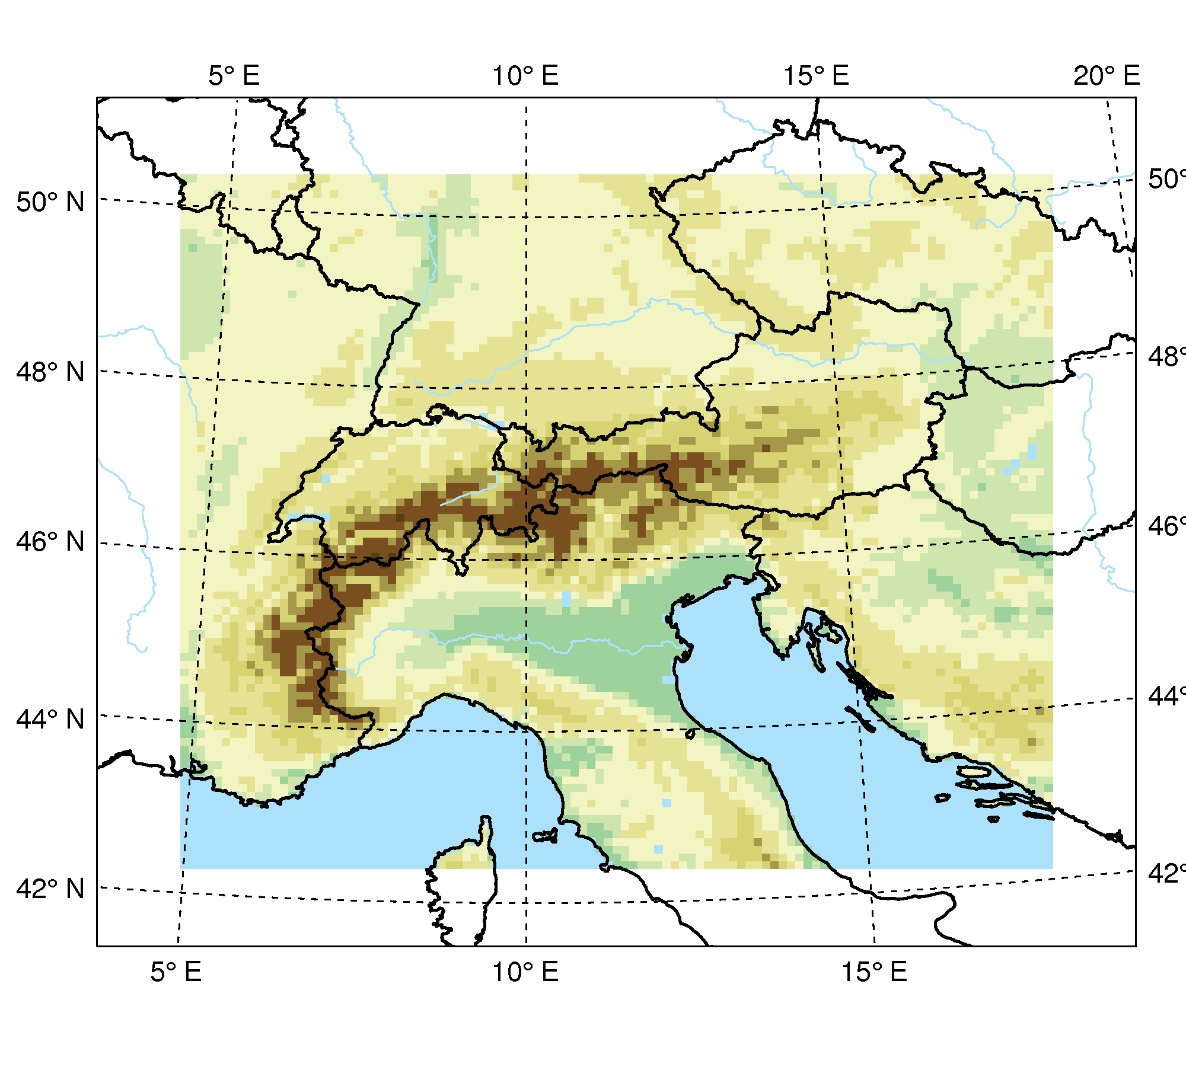
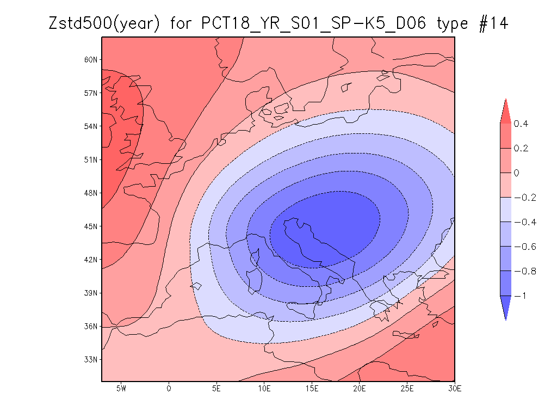
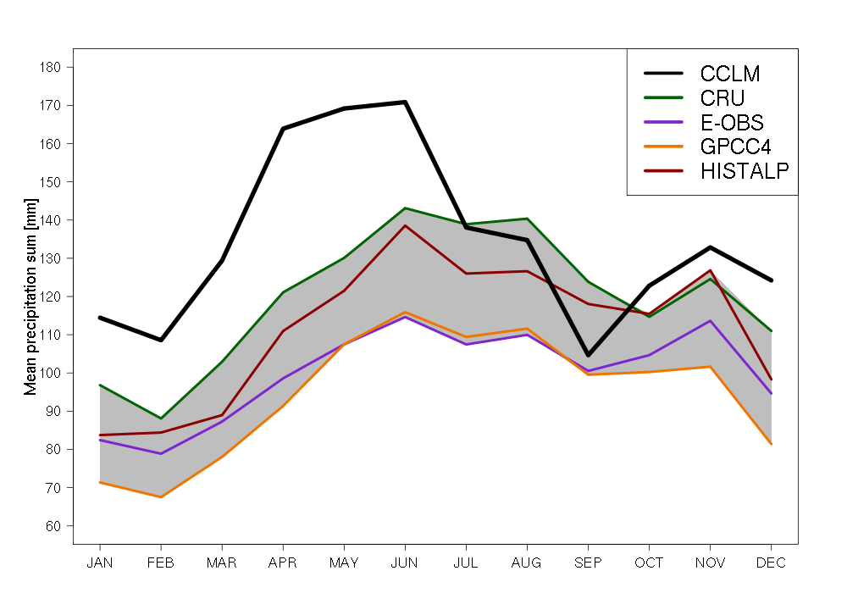
EVACLIM – a process orientated evaluation of climate simulations for Europe and the Greater Alpine Region
Klaus Haslinger, Ivonne Anders, Maja Zuvela-Aloise, Michael Hofstätter, Wolfgang Schöner
Zentralanstalt für Meteorologie und Geodynamik (ZAMG), Climate Research Department, Vienna, Austria – www.zamg.ac.at
Introduction
Results
CCLM
HISTALP
CCLM
HISTALP
To assess future climate impacts in Austria high resolution data sets for past, present and future climate are required. These imperative data sets shall be provided by the project "reclip:century" in cooperation with other Austrian research institutions. The main objective of the project is to provide a data set for climate impact research including an assessment of the uncertainties. Due to limitation in projects budget, man power and time, this last part can only contain basic evaluation.
The ZAMGs project EVACLIM is a one year project with focus on the evaluation of the ERA40 hindcast simulations for the time period 1961-2000 for Europe (50km, see figure 1) and for the Greater Alpine Region (GAR, 10km, see figure 1). The evaluation of the 50km run was limited to simple bias calculation between model output and observations on a monthly and seasonal basis. The evaluation of the 10km run is more detailed. In comparison to the HISTALP dataset biases, trends, correlations, seasonal cycles and pattern correlations have been calculated on a monthly basis. The high resolution STARTCLIM dataset on a daily temporal resolution has been used to investigate for example frequency distributions for different classifications e.g. different levels of altitude as well as weather patterns and extreme values.
Trends:
15-year floating trends are well reproduced in winter.
Summer: an extreme overestimation of temperature in the first years of the simulation produces an overall negative trend which contradicts the observations.
→ Possible reason: Initialisation problem of soil water content?
Correlation and altitude:
Figure 5 shows the altitude of every grid box plotted against the correlation of temperatures from CCLM and STARTCLIM observations.
Transitional seasons: the correlations show quite high values just slightly dropping with altitude.
Winter: the correlation is decreasing rapidly with higher altitude.
Summer: interestingly correlation is lower in lowland areas.
Fig. 4: 15-year floating trends in winter (DJF, left panel) and summer (JJA, right panel), CCLM and HISTALP, 1961-2000
DJF
MAM
JJA
SON
50km
10km
Extreme precipitation:
Winter: general underestimation apart from central alpine areas
Spring: similar to the winter pattern with slightly more areas of overestimation
Summer: the pattern in summer is somehow deviating from the other seasons with overall overestimation and to some extent underestimation in the Southeast
Autumn: pattern quite similar to winter
Fig. 5: Seasonal dependence of temporal correlation of surface temperature and altitude. Correlation was computed between daily CCLM and STARTCLIM-data, 1961-2000
Fig. 1: Simulation area of the European domain (left panel) and the Greater Alpine Region domain (GAR) (right panel)
Weather patterns:
Figure 7 shows a typical weather pattern with cyclonic activity over the Adriatic Sea and the related bias in precipitation, days with values > 1mm and precipitation sums > 20mm.
General overestimation in the North/Southern Stau
Insufficient days with RR > 1mm precipitation sums except for the Western and Southern Alps
Rainfall > 20mm overestimated in the Northern Stau
Fig. 6: Extreme precipitation: differences between CCLM and STARTCLIM for seasonal daily precipitation sums above the 98th percentile, 1961-2000, [mm/d]
Precipitation bias [mm]
Bias in days with RR > 1mm [%]
Precipitation bias (RR > 20mm) [%]
Uncertainties in gridded observation datasets
Fig. 7: Weather pattern: low pressure system over the Adriatic Sea and mean monthly frequency: precipitation (RR) bias [mm], bias in days with RR > 1mm [%] and heavy precipitation bias (RR > 20mm), 1961-2000
Conclusions
Fig. 2: Range of mean seasonal rainfall sums of four precipitation datasets (CRU, E-OBS, GPCC4, HISTALP) relative to the mean [%]
Considerable disparities between different observational datasets – largest differences in the summer months and at high altitudes
Contradicting trend signals between simulation and observation dependent on the season – a sign of initialisation?
Temporal correlation shows interesting patterns when plotted against altitude with a seasonal dependence
Extreme precipitation above the 98th percentile shows a heterogeneous pattern but similar for all seasons except summer with some overestimation in the mountains and underestimation in the Southeast.
Cyclonic activity over the Adriatic Sea causes an overestimation of rainfall in the Alpine Stau regions originating in an overestimation of heavy precipitation > 20mm.
Evaluation results of climate simulations are strongly reliant on the quality of the reference data.
The seasonal rainfall range of four precipitation datasets (CRU, E-OBS, GPCC4, HISTALP) is displayed in figure 2, showing large areas of spread exceeding 100% relative to the mean, especially in alpine regions.
Figure 3 shows the annual cycle of precipitation above 800m sea level of the CCLM hindcast and the spread between observations, with remarkable ranges of nearly 40mm/month during summer.
References
Contact Information
Uppala, S.M. et al. (2005): The ERA-40 re-analysis. Quart. J. R. Meteorol. Soc., 131, 2961-3012. doi:10.1256/ qj.04.176.
Auer I., Böhm R., Jurkovic A., Lipa W., Orlik A., Potzmann R., Schöner W., Ungersböck M., Matulla C., Briffa K., Jones P.D., Efthymiadis D., Brunetti M., Nanni T., Maugeri M., Mercalli L., Mestre O., Moisselin J.-M., Begert M., Müller-Westermeier G., Kveton V., Bochnicek O., Stastny P., Lapin M., Szalai S., Szentimrey T., Cegnar T., Dolinar M., Gajic-Capka M., Zaninovic K., Majstorovic Z., Nieplova E. (2007): HISTALP – Historical instrumental climatological surface time series of the greater Alpine region 1760-2003. International Journal of Climatology 27: 17-46.
Haylock, M.R., N. Hofstra, A.M.G. Klein Tank, E.J. Klok, P.D. Jones, and M. New (2008): A European daily high-resolution gridded data set of surface temperature and precipitation for 1950-2006. J. Geophys. Res., 113, D20119, doi:10.1029/2008JD010201
Schneider U., Fuchs T., Meyer-Christoffer A. and Rudolf B. (2008): Global Precipitation Analysis Products of the GPCC. Global Precipitation Climatology Centre (GPCC), DWD, Internet Publikation, 1-12.
Klaus Haslinger
Climate Research Department
Zentralanstalt für Meteorologie und Geodynamik (ZAMG)
Vienna, Austria
phone: 0043 1 36026 2290
e-mail: klaus.haslinger@zamg.ac.at
Fig. 3: Annual cycle of monthly mean precipitation sums (1961-2000) above 800m sea level from CCLM hindcast simulations (black) from four precipitation datasets (CRU, E-OBS, GPCC4, HISTALP; colored lines) and the range of the observations shaded in grey

