Slide 1
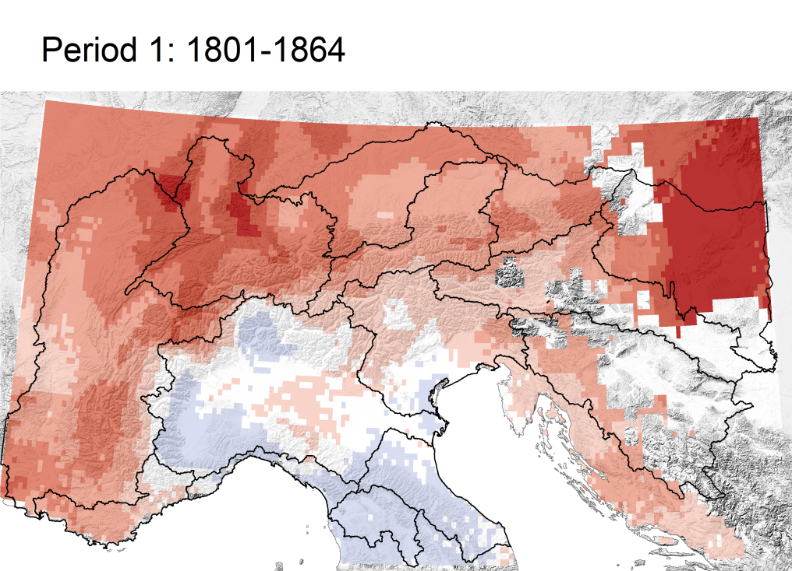
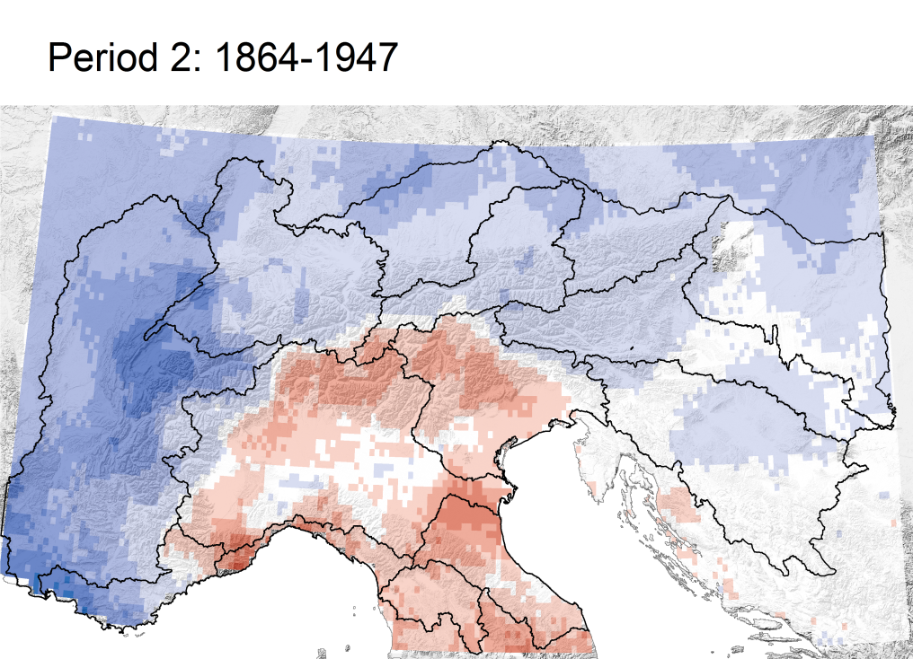
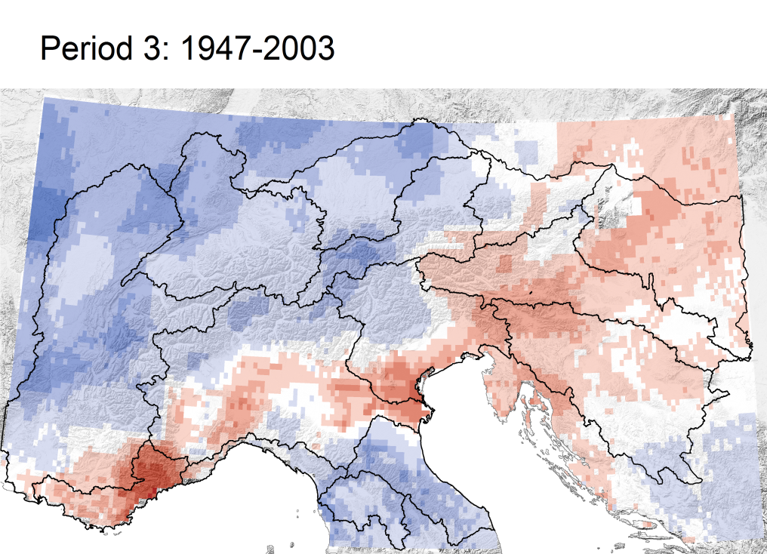
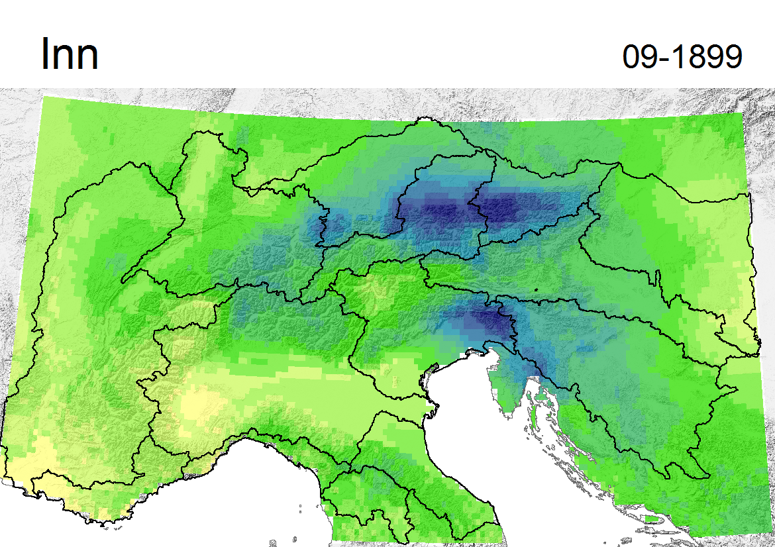
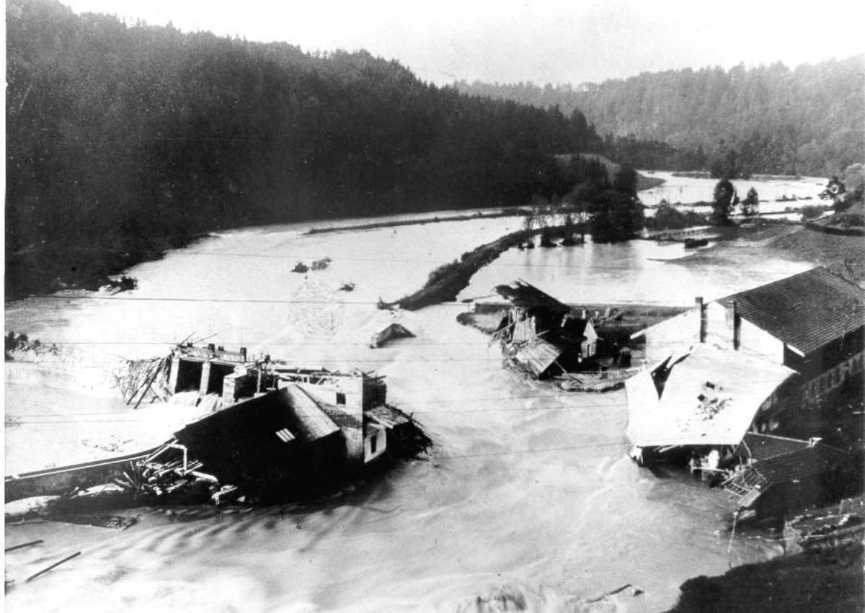
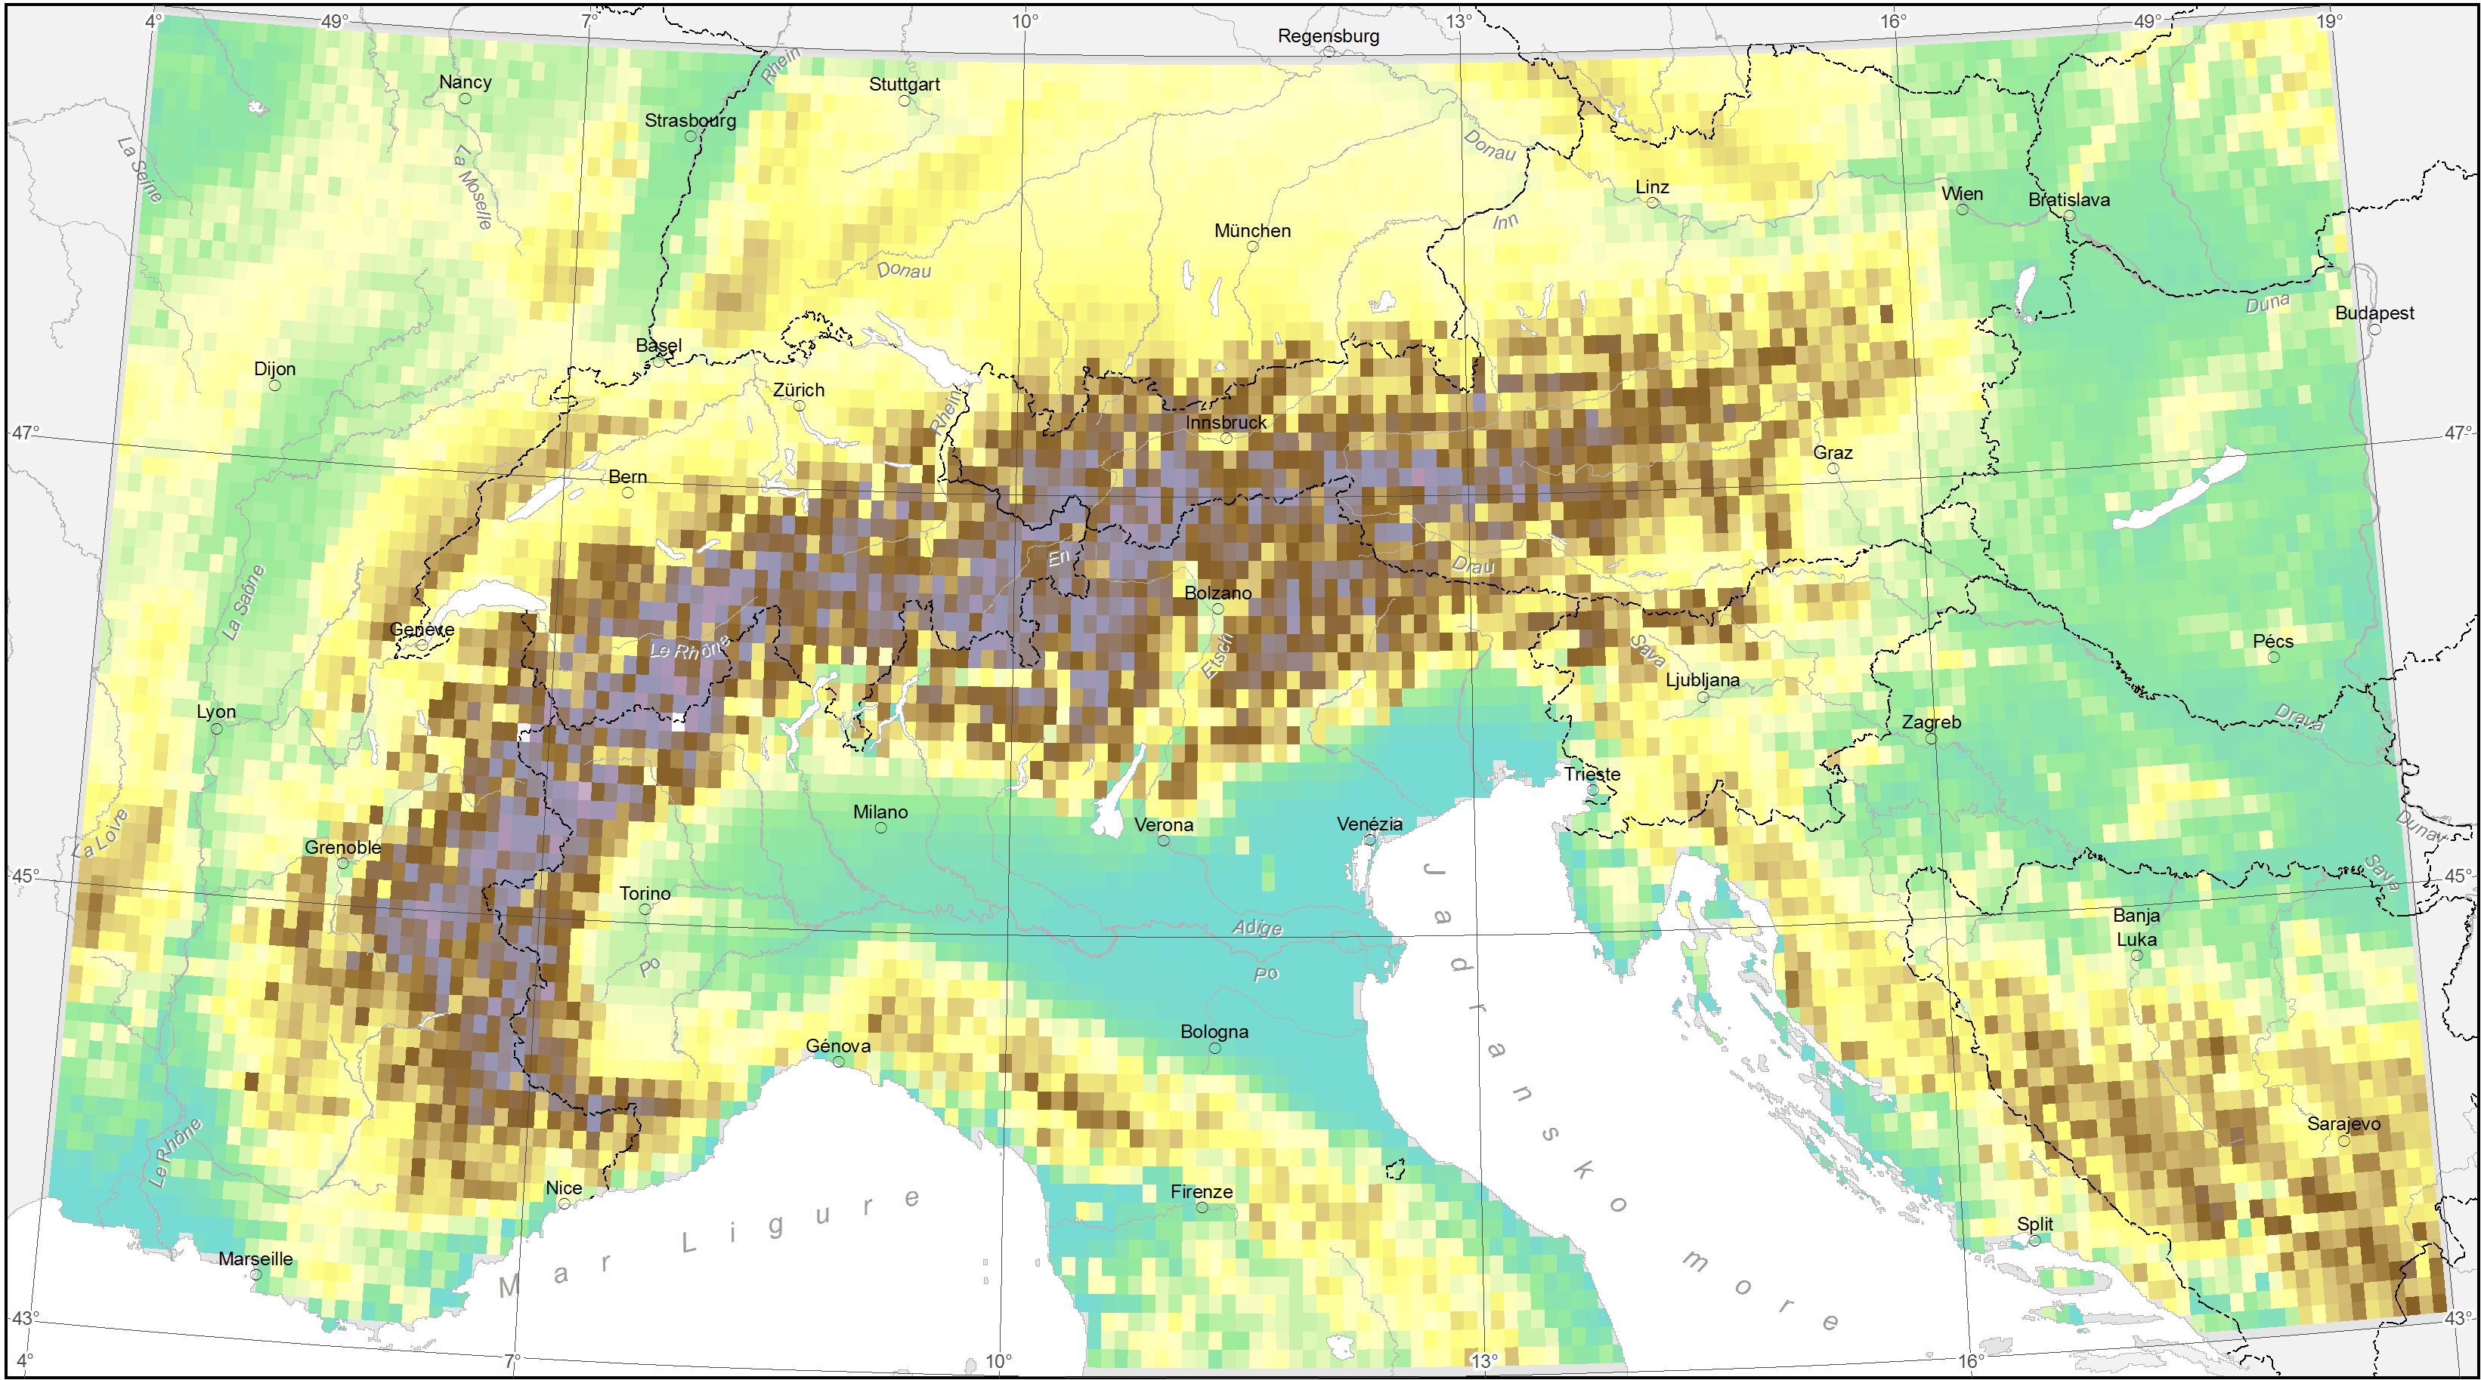
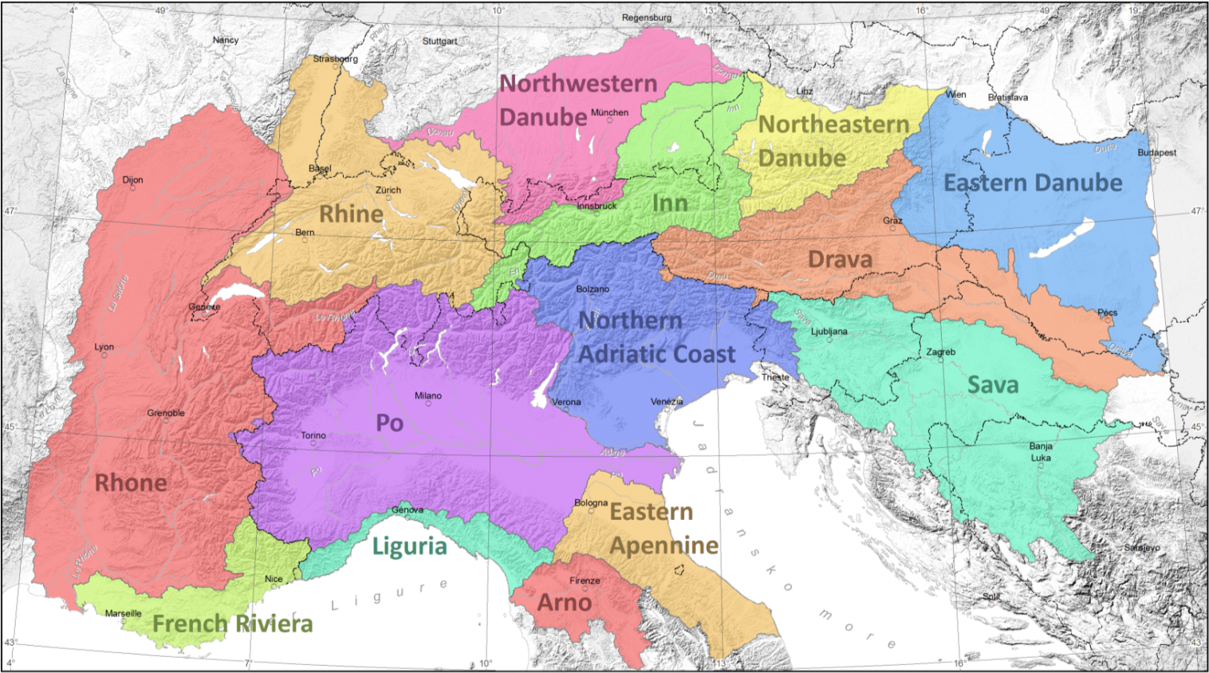
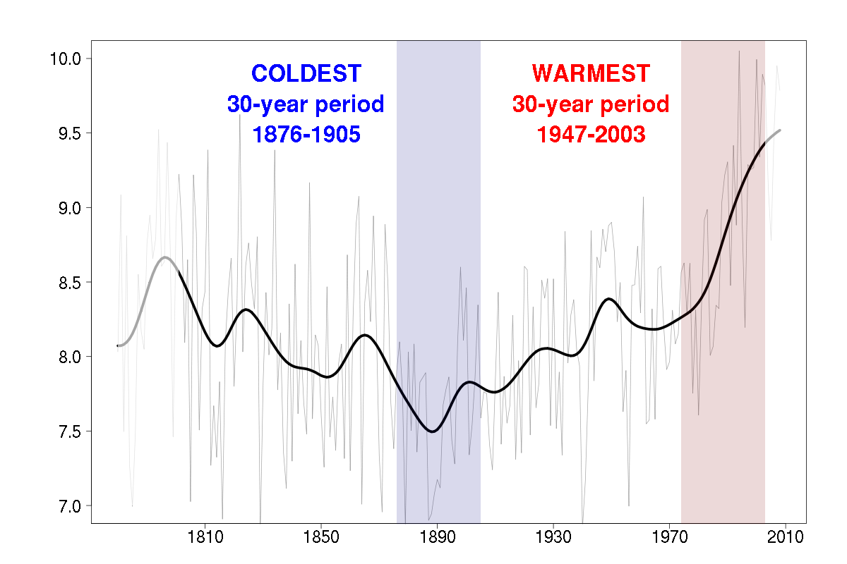
Solid and liquid precipitation in major river catchments originating in the European Alps
Klaus Haslinger, Barbara Chimani, Reinhard Böhm
Zentralanstalt für Meteorologie und Geodynamik (ZAMG), Climate Research Department, Vienna, Austria – www.zamg.ac.at
Introduction
Trend sub periods
Extreme events
To assess future climate change it is important to investigate and understand climate variations of the past. Therefore high quality datasets of observed climate are required. The project HISTALP (Auer et al. 2007) aims to provide high quality data on a monthly temporal resolution from 1760 onwards. This dataset consists of nearly 200 station time series distributed over the Greater Alpine Region (GAR, see figure 1). Here we show some of the results of our analysis of solid and liquid precipitation regarding major river catchments originating in the European Alps.
[%]
Fig. 3: Trend in total precipitation for 3 trend sub periods as indicated above
Data/Methods/Investigation Areas
Three trend sub periods have been identified using the smoothed time series to detect absolute minima. Due to the different characteristics of the basins two different trend reversals are apparent in the data (see figure 4), one around 1864, the other around 1947.
Figure 3 shows the trend at each grid point in these three periods. Most obvious is the negative trend in the first period over the whole region except for Italy which is completely reversed in the second period. The third period shows predominantly positive trends, except for the East, the Po plain and the French Riviera.
http://www.wwa-ro.bayern.de/hochwasser/historische_hochwasserereignisse/index.htm
In the course of the HISTALP activities new high resolution (5 arcmin) gridded datasets of solid and liquid precipitation were recently produced, spanning from 1800 until 2003 on a monthly basis (Chimani et al. 2010). An update until 2010 is in progress.
Fig. 7: Precipitation pattern of the devastating flood happening in September 1899 (left) and the impact on the Inn (right)
Usually extreme events in precipitation are associated with high intensities and short durations. So the temporal resolution for analysis should be at least an a daily basis. But this dataset described here on a monthly timescale has the ability to detect major floods in historic times as well, although in a somewhat limited sense.
Figure 7 shows one example of many detected floods in the monthly dataset. Visible is the precipitation pattern of September 1899 and the damage on infrastructure along the river Inn caused by the subsequent flooding. It is very likely that this enormous precipitation sums were caused by persistent rainfall connected to strong cyclonic activity over the Adriatic Sea. Such patterns show mostly intermediate to high but not extreme rainfall intensities, but constant precipitation over days can lead to far beyond average monthly rainfall sums.
Fig. 4: Assessment of trend periods by detection of absolute minima in the filtered time series
Fig. 1: Surface orography in 5 arcmin resolution (left) and river catchments (right) in the GAR
Conclusions
Figure 1 shows the surface orography and spatial resolution of the dataset on the left hand side and the investigated river catchments on the right hand side. The gridded fields were aggregated to mean values for each catchment. These time series of solid and liquid precipitation are the basis for the further analysis of long term trends, changes in the annual cycle, trend periods and extreme events.
For the computation of trends a simple linear regression on time series was applied, the significance of these trends was detected using the non parametric Mann-Kendall trend test.
Changes in the annual cycle
To assess the impact of observed climate change on the annual cycle of precipitation in river basins the coldest and warmest 30-years period within the last 200 years in the GAR were compared.
Figure 5 shows the smoothed time series of mean annual temperatures in the GAR. Shaded in blue and red are the periods for which mean annual circles were calculated. In general the typical patterns of the annual cycle are preserved.
Trends of liquid and solid precipitation over long time periods show different behavior dependent on the location. South of the Main Alpine Ridge a consistent decrease in precipitation is apparent. By contrast the Northern catchments show a decrease towards the middle of the 1860s which is displaced by a positive trend until 2003.
The warming trend since the end of the 19th century caused a slight modification in the annual cycle of precipitation. The northwestern catchments show an increase of rainfall in winter, whereas southern and eastern basins faced a reduction of the precipitation peaks in the warm season. Solid precipitation is reduced in the cold season with a minor shift of monthly peak values.
To some extend it is possible to link historic floods to maximum monthly precipitation amounts, baring in mind the uncertainty emerging from the unknown rainfall cause.
Currently we are working on an update extending the dataset until 2010.
Results
Long term trends
Mean Temperature [°C]
Fig. 5: The coldest and warmest 30-year periods since 1801
References
TOTAL
Chimani B., Böhm R., Matulla C., Ganekind M. (2010): Development of a longterm dataset of solid/liquid precipitation, Advances in Science and Research, 6, 39-43
Chimani B., Matulla C., Böhm R., Hofstätter M. (2010): A new high resolution absolute Temperature Grid for the Greater Alpine Region back to 1780, International Journal of Climatology, submitted
Auer I. et al (2007): HISTALP – Historical instrumental climatological surface time series of the greater Alpine region 1760-2003. International Journal of Climatology, 27, 17-46
Fig. 2: Time series of total, liquid and solid precipitation and the linear trend 1801-2003, annual values and 30-year low pass filter; the trend values apply to the whole period, big numbers indicate significant trends
SOLID
Fig. 6: Mean annual cycle of total precipitation for the coldest and warmest period
Contact Information
The long term trends for four of the 14 catchments of the region are shown in figure 2. The basins of Rhine and Rhone show a similar behavior with decreasing trends until 1860 and increasing trends afterwards. The catchment of the Sava is characterized by a maximum of precipitation around 1920 but with an overall decreasing trend since 1801. The Po basin shows a decreasing long term trend as well, but since the 1940s a positive trend occurs.
In the Rhine and Rhone catchments an increase in cold season precipitation is apparent. The Po basin shows little alterations except for a slight increase of the maxima and a shift of the summer minimum. The Sava basin faced an overall reduction in precipitation in the warm season with a strong reduction of the autumn peak. The solid fraction shows an overall decrease, strongest in the cold season. In the Rhine and Rhone basins a shift from two peaks (Dec., Mar.) to one peak (Feb.) in solid precipitation is evident.
Klaus Haslinger
Climate Research Department
Zentralanstalt für Meteorologie und Geodynamik (ZAMG), Vienna, Austria
phone: 0043 1 36026 2290
e-mail: klaus.haslinger@zamg.ac.at

