Slide 1

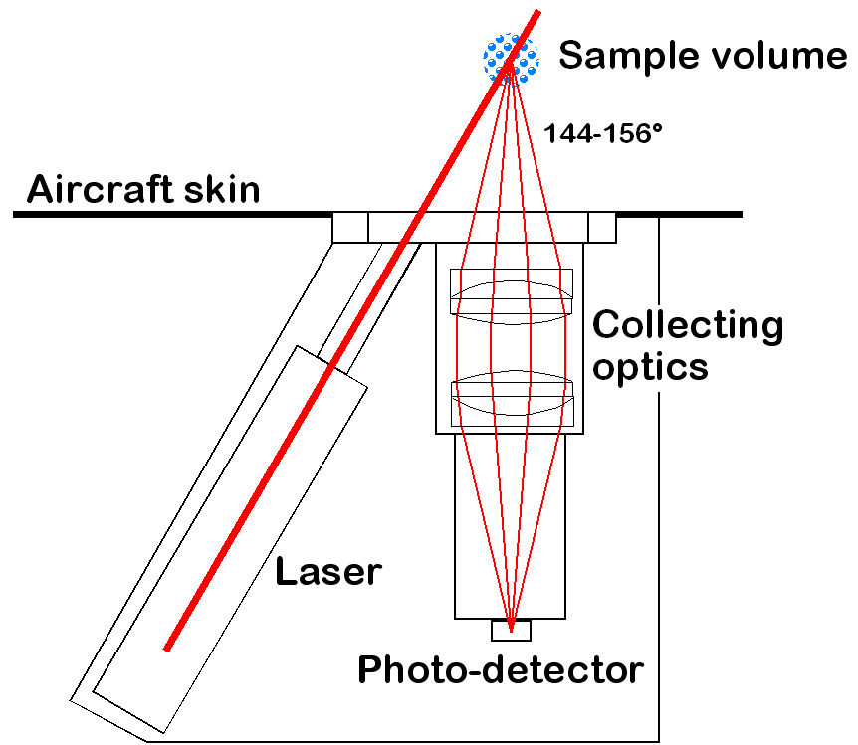
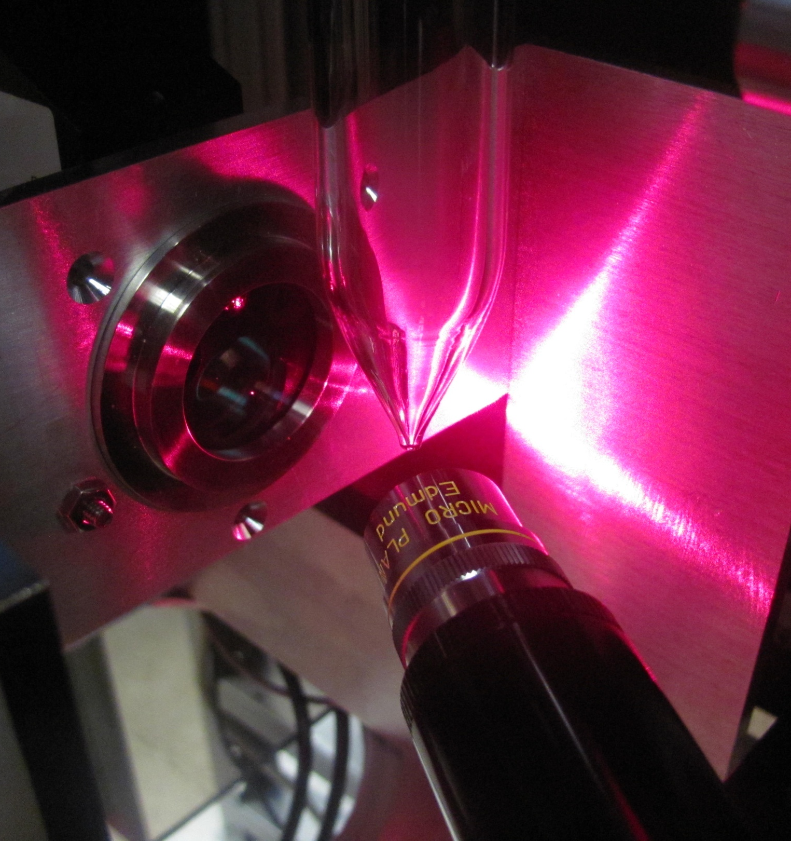
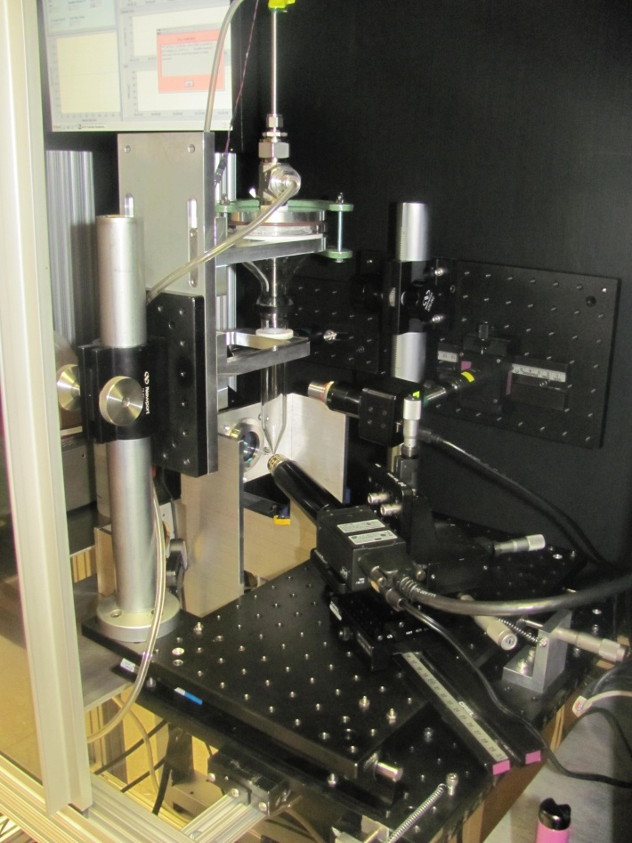
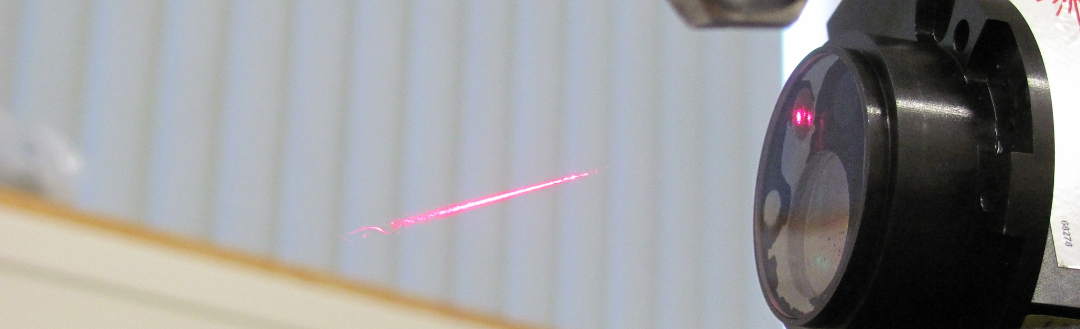
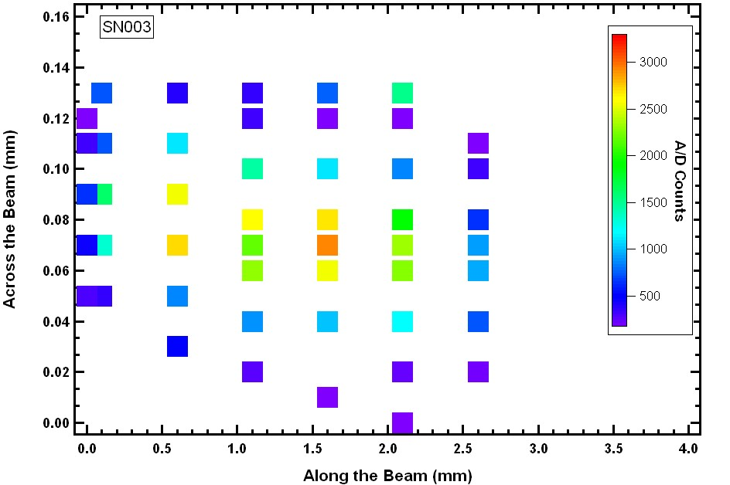
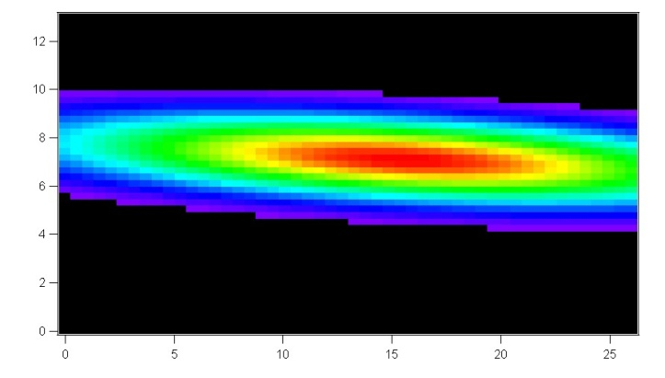
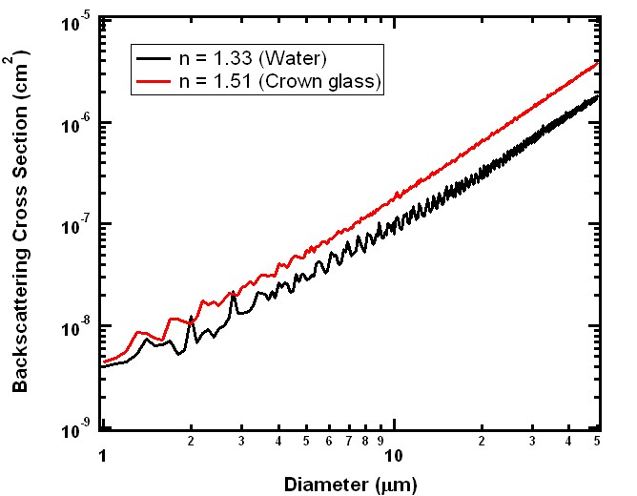
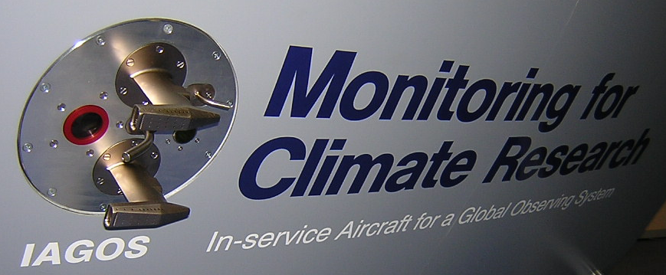
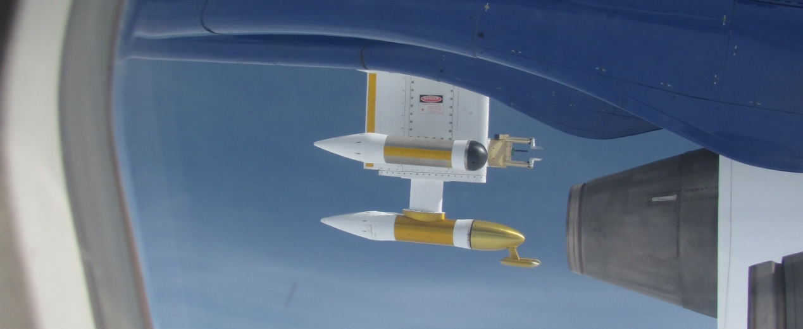


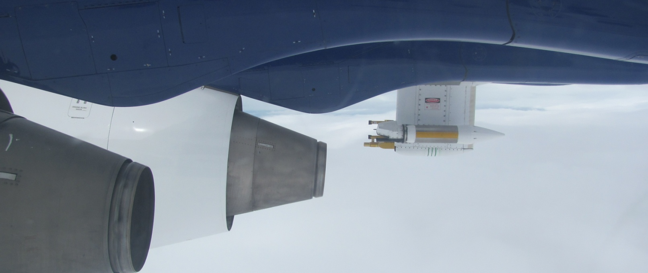
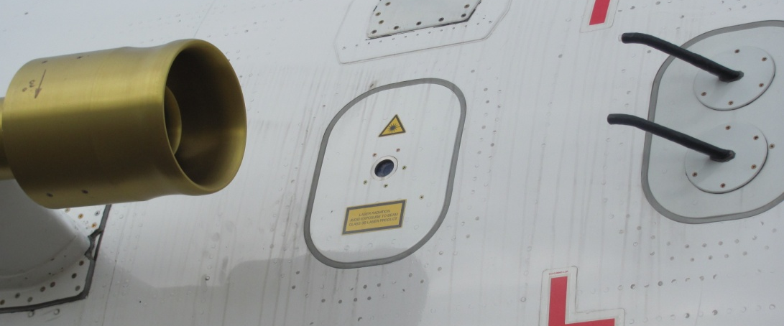
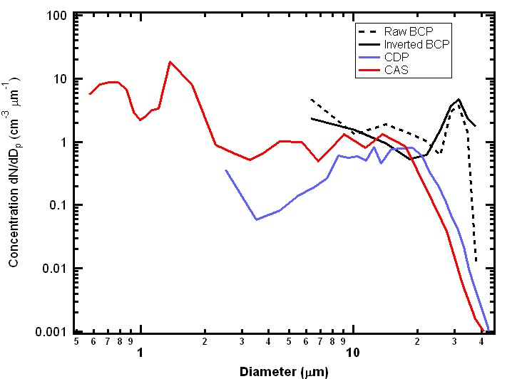
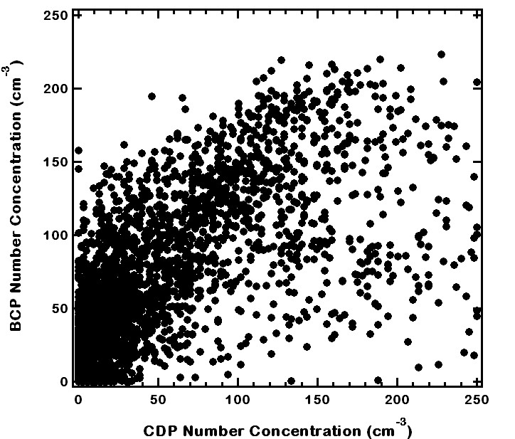






In-board detection of cloud on commercial aircraft: using the BCP in IAGOS
K M Beswick¹, M W Gallagher¹, D Baumgardner², P Nedelec³, S Devereau⁴, S Lance⁵
Abstract
BCP: Principle of operation
Data Inversion
Beam Mapping
The IAGOS-ERI instrument packages fitted to commercial airliners require knowledge of cloud presence in order to ensure accurate analysis and interpretation of the suite of chemical measurements made by the packages. The long-term commercial viability of running IAGOS depends to a great extent on the use of lightweight instruments wherever possible and minimising drag from inlet systems. Also paramount is the need for reliability and the ability to yield quantitatively useful information for use in atmospheric research.
Currently the IAGOS instrument packages use the Backscatter Cloud Probe (BCP-100 Version 1), manufactured by Droplet Measurement Technologies (DMT). The BCP uses proven laser-based technology common to a number of widely used DMT instruments e.g. the Cloud Droplet Probe CDP-100. With miniaturised electronics, and using an open path approach, the lightweight BCP allows the instrument to be mounted entirely within the body of the aircraft with no external components. Backscattered light in the 144-156° cone is collected, amplified and digitised into 10 or 20 size bins corresponding to optical sizes of 5-75µm diameter. The open-path optics used in the BCP present difficulties in identifying and correctly sizing droplets which pass incompletely through the sample volume. Inversion techniques are used on the BCP to provide the best calibration of the recorded signal. The BCP has been modified to IAGOS requirements, with a separate optics cap allowing the probe to be dismounted independently of other instruments in the IAGOS package. This reduces potential downtime for both the IAGOS package and the airliner to which it is fitted.
The first flight tests for the BCP were carried out successfully on the UK FAAM BAe 146 research aircraft, where it was compared with standard cloud spectrometer instruments, including the DMT CDP, the SPEC 2D-S and a DMT total water hot wire instrument. A wide range of conditions were sampled, from low level stratus to high level cirrus. Whilst reliably detecting liquid droplets, the instrument also showed the potential for detecting the presence of small ice particles in the cloud. Although IAGOS only required the BCP to show the presence of cloud, the BCP droplet spectra compared well with the other instruments, despite the probe measuring within the aircraft boundary layer. The first BCP to be operational on an IAGOS package will shortly be in service on a Lufthansa Airbus A340 aircraft.
Particles pass through an open-path laser beam
Scattered light in the 144-156° cone is collected by photo-detector
Intensity of back-scattered light is dependent on: size, composition and shape of particle; wavelength, intensity and shape of laser beam
Signal is amplified, digitised and sized into 10 or 20 size bins, size range 5-75µm diameter
Probe consists of optical head, separate electronics control box, optics mounting cap
Many optical particle and droplet measuring instruments use a “qualifier” in the optics system to remove out-of-focus and off-axis droplets from the processed data
To minimise instrument size and complexity, the BCP uses an off-axis collection angle to automatically exclude out-of-focus droplets
Only droplets that pass through the centre of the focussed laser beam will give a peak signal. Laser intensity distribution is Gaussian, so the light scattered from individual particles will also have a Gaussian distribution
This results in broadening of the measured spectrum, as will droplet-size dependent sample volume and non-uniform laser beam intensity
The true ambient size distribution can be estimated from the BCP signal by applying a standard inversion routine
The inversion models theoretical Mie scattering cross sections, and the measured sample area and probability density function (PDF)
The PDF for the BCP has been derived using a precisely positioned stream of monodispersed droplets of known diameter
Beam mapping is an accurate and comprehensive method for the calibration of an optical particle/droplet counter
Uses a stable stream of droplets of known diameter passing through the instrument sample volume
The droplet stream can be positioned to an accuracy of at least 2µm
The system uses a commercial piezo-electric drop generator to create monodispersed droplets
The droplets then pass through an evaporation tube – this accelerates the drops, and the size is altered by changing the residence time in the tube
The effects of droplet size (up to 40 µm) and speed (up to 45 ms⁻¹) can be determined
The droplets are accurately sized photographically using a “glares” technique
The BCP was mapped at a facility made available by NOAA
The flow tube tip and sizing camera positioned close to the BCP sample volume
water and air supplies
Evaporation tube, containing droplet generator
diagnostic camera
sizing camera
precision X-Y adjustable platform
Droplet spray shows the BCP sample volume
BCP laser Gaussian intensity distribution
Mie Scattering cross section
Scattering intensity in the BCP laser beam for a single droplet size
Test Flights
Results
IAGOS Background
As part of the IAGOS testing schedule for the BCP, a number of flights were made on the UK FAAM BAe 146 research aircraft. A number of different cloud regimes were encountered.
A number of other cloud instruments were available for comparison with the BCP. Principle amongst these were the other DMT instruments - CDP and CAS
Preliminary results for flight B553
First stage of inversion applied to data, based on beam mapping
BCP clearly responds to cloud at times when other probes indicate cloud presence
Number concentrations agree well with CDP and CAS for overlapping size range
BCP appears to oversize – this will be corrected in future with a modification to the inversion – but spectrum shape reasonable
BCP reacts to ice in cirrus cloud
Date | Flight | Details
7/9/2010 | B551 | Evolution of polluted layer advecting across North Sea covering the hours before and after sunrise
9/9/2010 | B552 | Tracking the pollution plume of a large cargo ship in the North Sea, with exposure to sea spray
14/9/2010 | B553 | Detailed microphysical measurements in cumulus, cirrus and stratiform cloud, straight and level radials centred on radar at Chilbolton
14/9/2010 | B554 | Companion flight to B554 with multiple cloud penetrations at different levels using saw-tooth flight levels
15/9/2010 | B555 | Development of cumulus towers off the north coast of Scotland, with penetrations of the same cloud at different heights
16/9/2010 | B556 | Development of cumulus towers off the north coast of Scotland
CDP and other instruments on FAAM 146 port wing
Brief IAGOS History
Successor to MOZAIC
Currently incorporates CARIBIC
IAGOS implemented in two stages:
DS – Design Study: test new instruments,
and initial integration into packages
ERI – European Research Infrastructure –
implementation of the IAGOS packages onto
Airbus A340 aircraft; 20 aircraft envisaged
Suite of measurements:
CO, CO₂, CH₄, O₃, NOx, NOy, H₂O, aerosol,
liquid water
Collaboration between research, airlines and
aircraft manufacturers
15 years of data across the world – significant
long-term data set, with many important
research findings
CAS and other instruments on FAAM 146 starboard wing
cumulus
cirrus
Other flights
Inversion to be fully applied
Initial results similar to Flight B553 – number concentration histories compare well qualitatively with CDP and CAS
BCP on third starboard window panel on FAAM 146
Summary
BCP fulfils design brief to act as “cloud indicator”
Performance of BCP shows potential to give cloud spectra comparable to standard cloud instruments
BCP will be improved and developed to indicate liquid, ice and dust
Contact Information
¹ SEAES, University of Manchester, Oxford Road, Manchester, M13 9PL, United Kingdom, www.seaes.manchester.ac.uk
² DMT, 5710 Flatiron Parkway, Boulder, Colorado, USA 80301, www.dropletmeasurement.com
³ Laboratoire d’Aérologie- CNRS, 14 Avenue Edouard Belin, 31400 Toulouse, France, www.aero.obs-mip.fr
⁴ FAAM, Cranfield University, Cranfield, Bedford, MK43 0AL, United Kingdom, www.faam.ac.uk
⁵NOAA ESRL Chemical Sciences Division, 325 Broadway, Boulder, CO 80305 USA
Acknowledgements
Supported in the UK by the NERC and FAAM.
Certification and instrument installation was carried out
by FAAM
Creative Commons Attribution License CC-BY

