Slide 1
Air quality and climate impacts of biofuel cultivation
¹ Kirsti Ashworth, Nick Hewitt, Oliver Wild
² Gerd Folberth
¹ Lancaster Environment Centre, Lancaster University
² Met Office Hadley Centre

Slide 2
AIR QUALITY
CLIMATE
OZONE
AEROSOLS
VOCs
Cultivation

Slide 3
Methodology

Slide 4
Biofuel scenarios
Scenario | Description | Area
Control | CMIP5 SSTs | -
 | IGBP vegetation dataset

Slide 5
Biofuel scenarios
Scenario | Description | Area (Mha)
Control | AMIP SSTs | -
 | IGBP vegetation dataset
SRCs | Extra-tropics | 92
 | Crops/grasses replaced

Slide 6
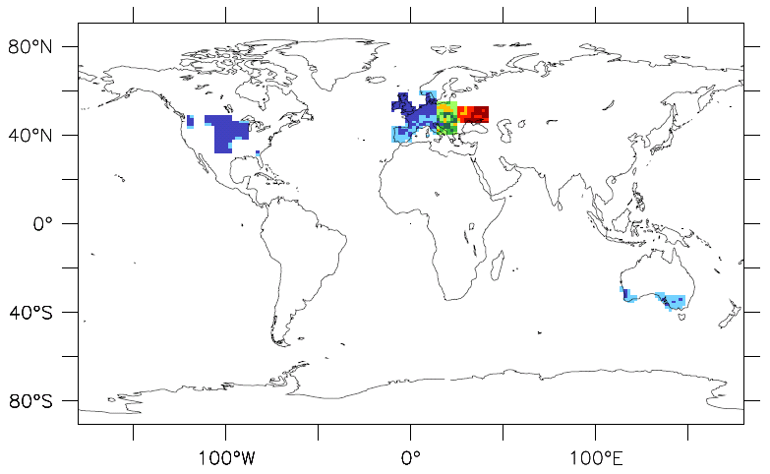

Slide 7
Biofuel scenarios
Scenario | Description | Area (Mha)
Control | AMIP SSTs | -
 | IGBP vegetation dataset
SRCs | Extra-tropics | 92
 | Crops/grasses replaced
Oil Palm | Tropics (~ 15°S to 15°N) | 69
 | Broadleaf trees replaced

Slide 8
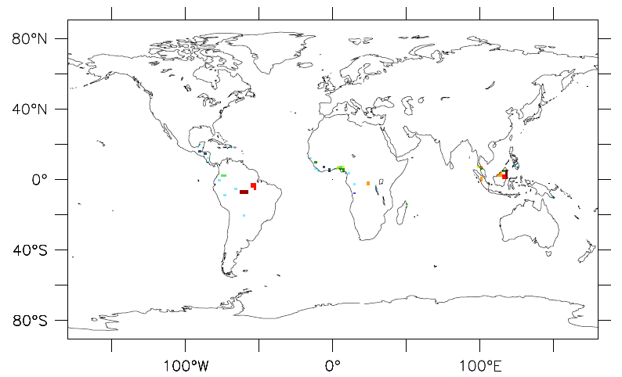

Slide 9
Biofuel scenarios
Scenario | Description | Area (Mha)
Control | AMIP SSTs | -
 | IGBP vegetation dataset
SRCs | Extra-tropics | 92
 | Crops/grasses replaced
Oil Palm | Tropics (~ 15°S to 15°N) | 69
 | Broadleaf trees replaced

Slide 10
Biofuel scenarios
Scenario | Description | Area (Mha)
Control | AMIP SSTs | -
 | IGBP vegetation dataset
SRCs | Extra-tropics | 92
 | Crops/grasses replaced
Oil Palm | Tropics (~ 15°S to 15°N) | 69
 | Broadleaf trees replaced
+ NOx | Processing and fertiliser | 69

Slide 11
Results

Slide 12
Global analysis
 | SRCs | Oil Palm + NOx

Slide 13
Global analysis
 | SRCs | Oil Palm + NOx
Fossil fuel replaced | 1 % | 1 %

Slide 14
Global analysis
 | SRCs | Oil Palm + NOx
Fossil fuel replaced | 1 % | 1 %
Δ isoprene | + 1% | + 1%

Slide 15
Global analysis
 | SRCs | Oil Palm + NOx
Fossil fuel replaced | 1 % | 1 %
Δ isoprene | + 1% | + 1%
Climate impacts

Slide 16
Global analysis
 | SRCs | Oil Palm + NOx
Fossil fuel replaced | 1 % | 1 %
Δ isoprene | + 1% | + 1%
Climate impacts | - | -

Slide 17
Global analysis
 | SRCs | Oil Palm + NOx
Fossil fuel replaced | 1 % | 1 %
Δ isoprene | + 1% | + 1%
Air quality

Slide 18
Global analysis
 | SRCs | Oil Palm + NOx
Fossil fuel replaced | 1 % | 1 %
Δ isoprene | + 1% | + 1%
Air quality | - | -

Slide 19
Regional analysis
 | SRCs | Oil Palm + NOx

Slide 20
Regional analysis
 | SRCs | Oil Palm + NOx
Region | Europe | SE Asia

Slide 21
Regional analysis
 | SRCs | Oil Palm + NOx
Region | Europe | SE Asia
Planted area (Mha) | 69 | 27

Slide 22
Regional analysis
 | SRCs | Oil Palm + NOx
Region | Europe | SE Asia
Planted area (Mha) | 69 | 27
Fuel yield (Mt/y) | 110 | 110

Slide 23
Regional analysis
 | SRCs | Oil Palm + NOx
Region | Europe | SE Asia
Planted area (Mha) | 69 | 27
Fuel yield (Mt/y) | 110 | 110
Total area (Mha) | 1400 | 1350

Slide 24
Regional analysis
 | SRCs | Oil Palm + NOx
Region | Europe | SE Asia
Planted area (Mha) | 69 | 27
Fuel yield (Mt/y) | 110 | 110
Total area (Mha) | 1400 | 1350
Δ O₃ (ppbv) | +0.2 | +0.2

Slide 25
Regional analysis
 | SRCs | Oil Palm + NOx
Region | Europe | SE Asia
Planted area (Mha) | 69 | 27
Fuel yield (Mt/y) | 110 | 110
Total area (Mha) | 1400 | 1350
Δ O₃ (ppbv) | +0.2 | +0.2
Peak Δ O₃ (ppbv) | +0.4 | +0.25

Slide 26
July SEAsia NOx

Slide 27
July EU SRC

Slide 28
Regional analysis
 |  | SRCs | Oil Palm + NOx
 | Region | Europe | SE Asia
Area | Δ O₃ (ppbv) | +0.2 | +0.2
 | Peak Δ O₃ (ppbv) | +0.4 | +0.25

Slide 29
Regional analysis
 |  | SRCs | Oil Palm + NOx
 | Region | Europe | SE Asia
Area | Δ O₃ (ppbv) | +0.2 | +0.2
 | Peak Δ O₃ (ppbv) | +0.4 | +0.3
Veg

Slide 30
Regional analysis
 |  | SRCs | Oil Palm + NOx
 | Region | Europe | SE Asia
Area | Δ O₃ (ppbv) | +0.2 | +0.2
 | Peak Δ O₃ (ppbv) | +0.4 | +0.3
Veg | Δ O₃ (ppbv) | +0.3 | +0.9

Slide 31
Regional analysis
 |  | SRCs | Oil Palm + NOx
 | Region | Europe | SE Asia
Area | Δ O₃ (ppbv) | +0.2 | +0.2
 | Peak Δ O₃ (ppbv) | +0.4 | +0.3
Veg | Δ O₃ (ppbv) | +0.3 | +0.9
 | Peak Δ O₃ (ppbv) | +0.7 | +1.2

Slide 32
Conclusions

Slide 33
Any questions?

Slide 34
Workshop
Biogenic VOC emissions models and their applications
May 17th-18th, Lancaster
More info and to register: www.lec.lancs.ac.uk/bvoc

