Slide 1
Added Value of Convection-Resolving Climate Simulations (CRCSs)
Submitted to: Climate Dynamics
Andreas F. Prein¹, Andreas Gobiet¹, Martin Suklitsch¹ , Heimo Truhetz¹, Naumen K. Awan¹ , Klaus Keuler², Goran Georgievski²
¹Wegener Center for Climate and Global Change (WEGC) and Institute for Geophysics, Astrophysics, and Meteorology (IGAM), Institude of Physics, University of Graz, Graz, Austria
²Chair Environmental Meteorology, Brandenburg Technological University, Cottbus, Germany
EGU 2012, 27.04.2012

Slide 2
Basics & Motivation
Advantages of Convection Resolving Climate Simulations (CRCSs)
Grid spacing < ~4 km → resolve deep convection explicitly
Improved orography and surface fields
Scientific Questions
?
Find possible added value in convection resolving simulations compared to coarser gridded simulations
?
Establish dataset which depicts model deficits and promotes model development

Slide 3
Data and Models
Nesting Strategy
IFS* 25 km → D2 10 km
D2 10 km → D3 3 km CRCS
*Integrated Forecasting System (IFS) from ECMWF (update every 3 hour)
D2
D3

Slide 4
Data and Models
RCM Ensemble
RCM | Institute | Acronym | Nesting Strategy of 10 km-3 km
CCLM 4.0 | WEGC | CCLM4.0 | One-way
CCLM 4.8 | BTU Cottbus | CCLM4.8 | One-way
WRF 2.2.1 | WEGC | WRF | Two-way
MM5 3.7.4 | WEGC | MM5 | Two-way
Time Periods
Two Seasons: JJA 2007 and DJF 2007-08
Reference Data
Integrated Nowcasting through Comprehensive Analysis (INCA)
(Haiden et al. 2011); Central Institute for Meteorology and Geodynamics (ZAMG)
Hourly data on a 1 x 1 km grid in Austria

Slide 5
What we will see
Better timing of precip. peak in JJA diurnal cycle
Increase in JJA precip. due to amplification of afternoon peak
JJA
Convec-tion
Added value in CRCS:
Intensity
Spatial fraction and scale
Added
Value
Increase of global radiation
Global
Radiation

Slide 6
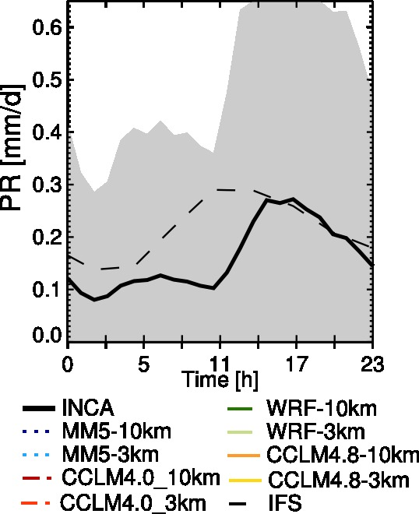
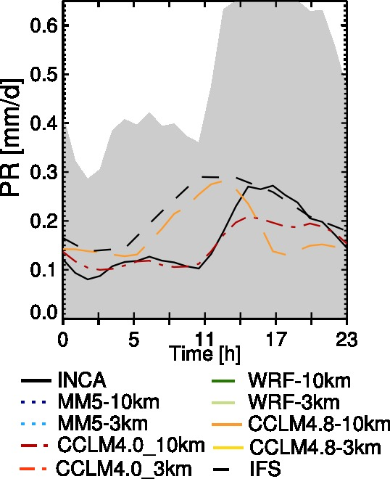
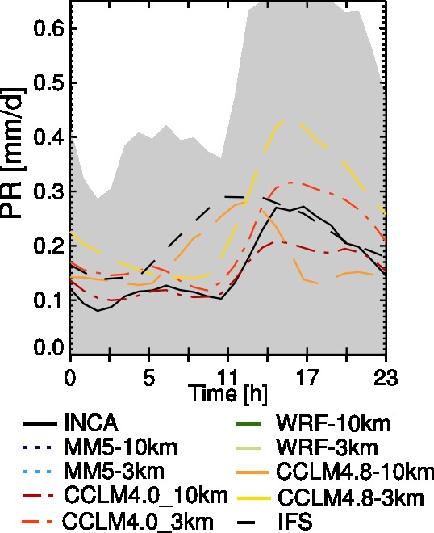
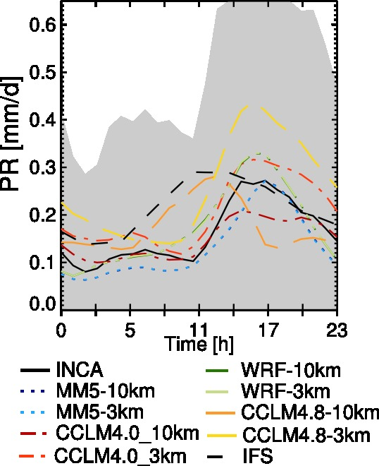
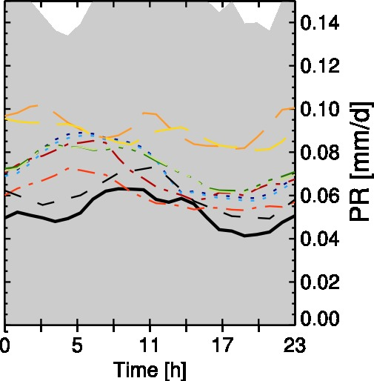
PR: Timing & Amplification
Average diurnal cycle of precipitation
JJA
DJF

Slide 7
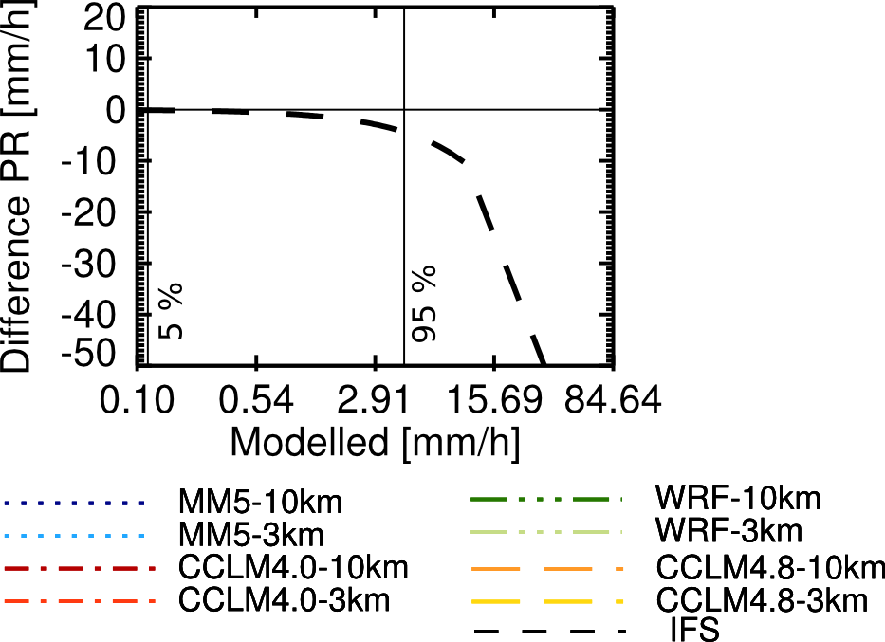
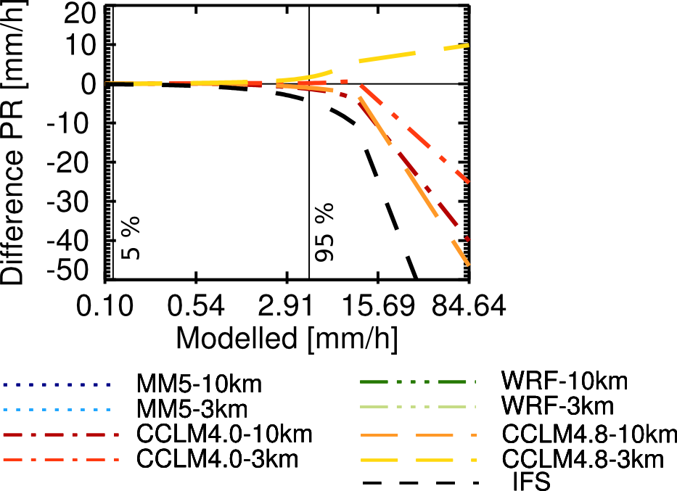
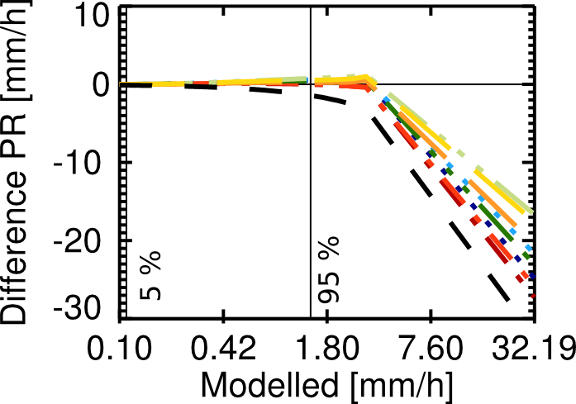
PR: Extremes
Quantile Differences
JJA
DJF

Slide 8
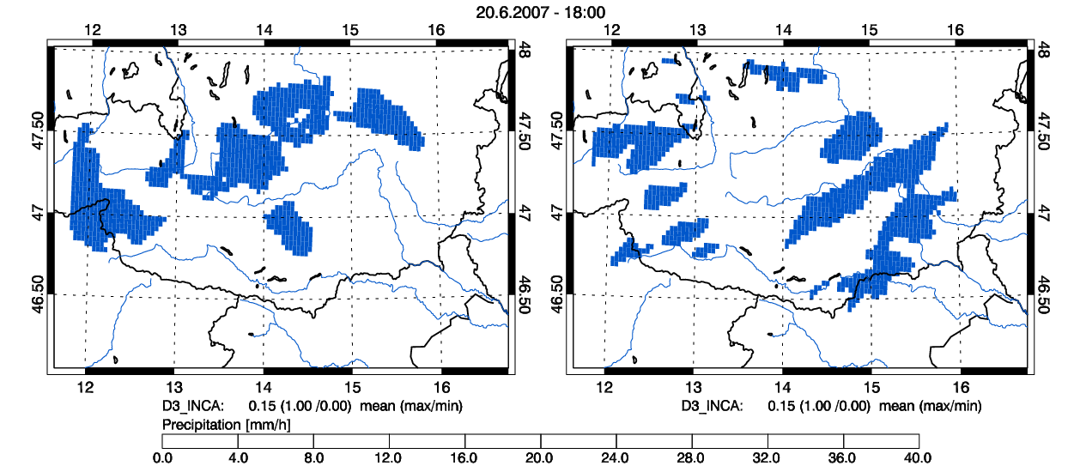
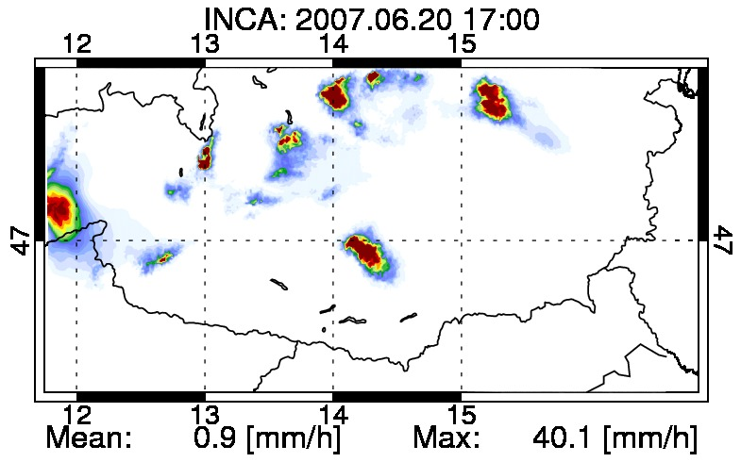
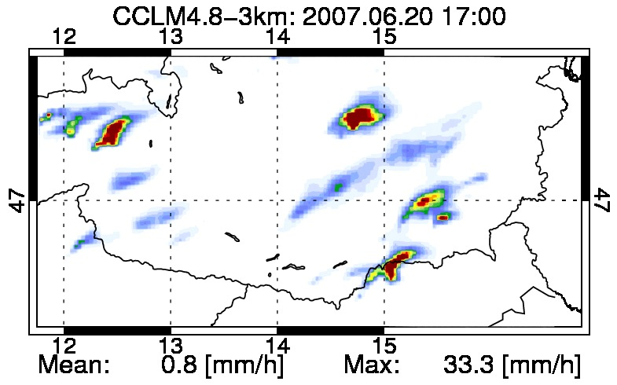
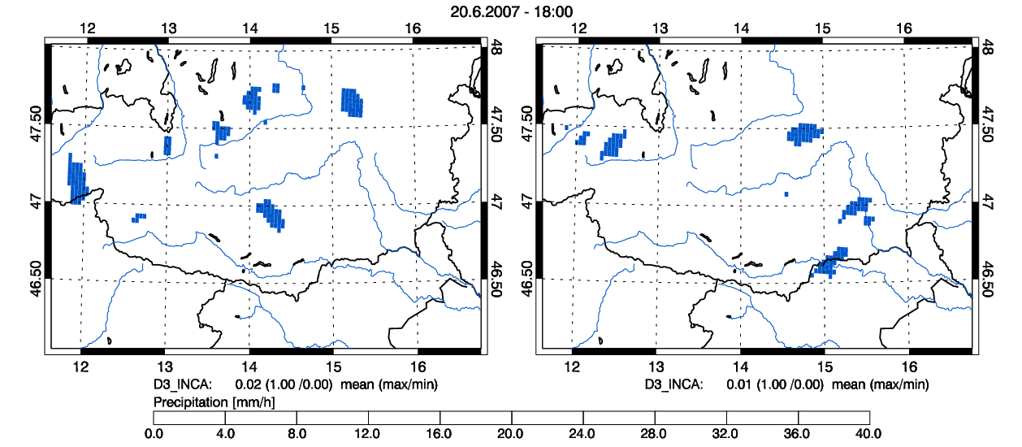
PR: Fractions
Fractions Skill Score Roberts, N. M. and H. W. Lean (2008)
Reference: 1 km
CCLM4.8-3km Simulation
1 mm/h threshold
8 mm/h threshold

Slide 9
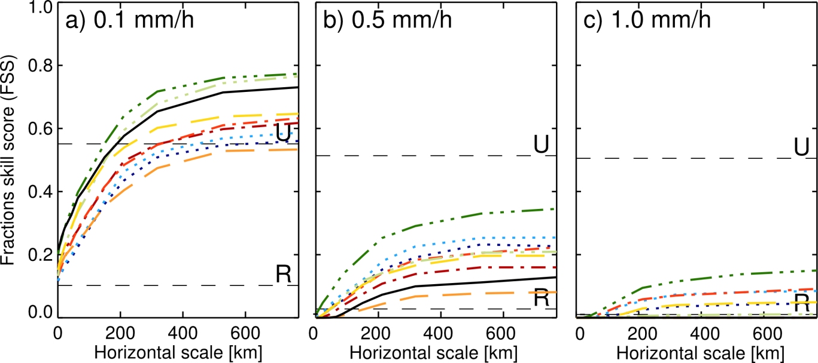
PR: Fractions
Fractions Skill Score
JJA
DJF

Slide 10
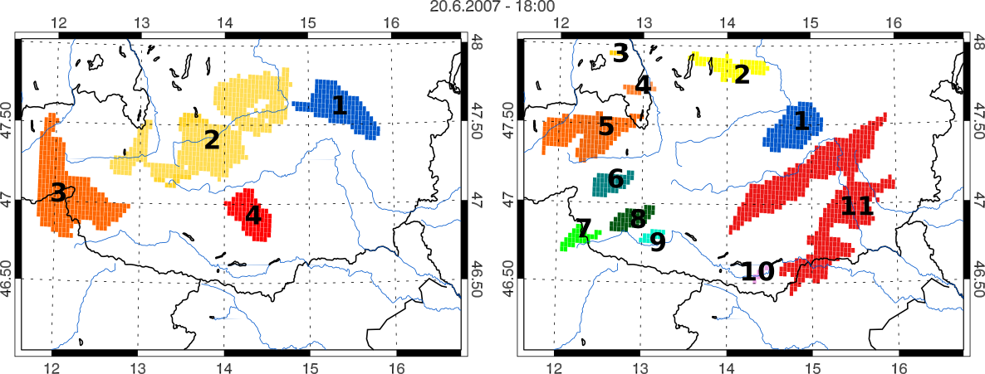
PR: Structures
Structure, Amplitude, Location (SAL) evaluation
Wernli H et al. (2008)
Reference: 1 km
CCLM4.8-3km Simulation
CCLM4.8-10km
CCLM4.8-3km
Structure of precip. Objects get more realistic in 3 of 4 CRCSs
DJF
JJA

Slide 11
Global Radiation (GL)
+14 % in JJA
+5 % in DJF
Smaller and denser clouds lead to increase of global radiation

Slide 12
Take Home
Improved JJA diurnal cycle (convective processes)
Extremes values are more realistic (impact studies)
Timing
&
Extremes
Smaller and/or more peaked objects (more realistic in ¾ cases)
Improved fractional coverage of precip.
Spatial
Properties
Search added value at small scales
Do not average temporally/spatially
Added value not found in bias
Easier to find in JJA and in complex terrain
Guideline

Slide 13
Literature
Thank you for your attention!
Acknowledgements
Prein A.F. , A. Gobiet, M. Suklitsch, H. Truhetz, N.K. Awan , K. Keuler, G. Georgievski (2012), Added Value of Convection-Resolving Climate Simulations, submitted to Climate Dynamics
Haiden T. et al. (2011): ‘The Integrated Nowcasting through Comprehensive Analysis (INCA) system and its validation over the Eastern Alpine region’. In: Weather Forecas. DOI: 10.1175/2010WAF2222451.1, in Press.
Prein A.F. and A. Gobiet (2011): Deﬁning and Detecting Added Value in Cloud Resolving Climate Simulations. WegCenter Report, 39, WegCenter Verlag, Graz, Austria, ISBN 978-3-9502940-6-4.
Prein A.F., H. Truhetz, M. Suklitsch, A. Gobiet (2011): Evaluation of the Local Climate Model Intercomparison Project (LocMIP) simulations. WegCenter Report, 41, WegCenter Verlag, Graz, Austria, ISBN 978-3-9502940-8-8.
Roberts N.M. and H.W. Lean (2008): ‘Scale-selective veriﬁcation of rainfall accumulations from high-resolution forecasts of convective events’.In: Mon. Wea. Rev. 136.1, pp. 78–97.
Wernli H., Paulat M., Hagen M., Frei C. (2008): SAL-A Novel Quality Measure for the Verification of Quantitative Precipitation Forecasts. Mon. Weather Rev, 136.11, pp. 4470–4487

