Slide 1
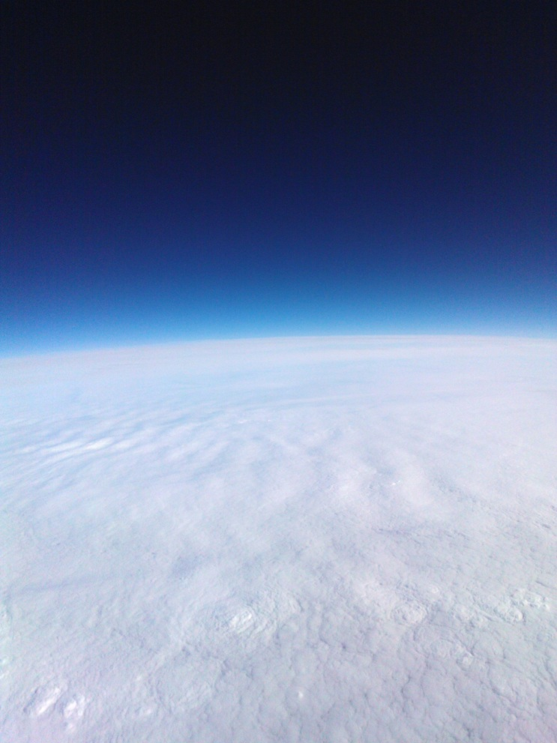
Rapid Development of Bespoke Unmanned Platforms for Atmospheric Science
András Sóbester
Steven Johnston
James Scanlan
Elizabeth Hart
Neil O’Brien
ASTRA initiative (@SotonASTRA)
Aeronautics, Astronautics & Computational Engineering Unit
Notes:
Please use the dd month yyyy format for the date for example 11 January 2008. The main title can be one or two lines long.

Slide 2
Atmospheric Science Through Robotic Aircraft
“ASTRA investigates new technologies for making low cost observations of the physical parameters of the atmosphere”
Rapid development cycle: from definition (weight, volume, power and exposure requirements of the payload) to flight testing in ~1-2 weeks -> Rapid response and accelerated instrument development cycle
www.soton.ac.uk/~astra
@SotonASTRA, @ASobester

Slide 3
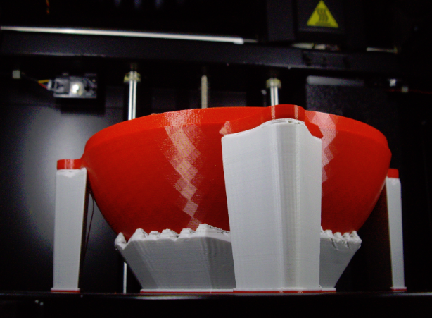
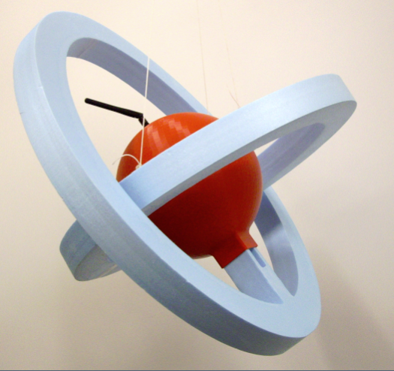
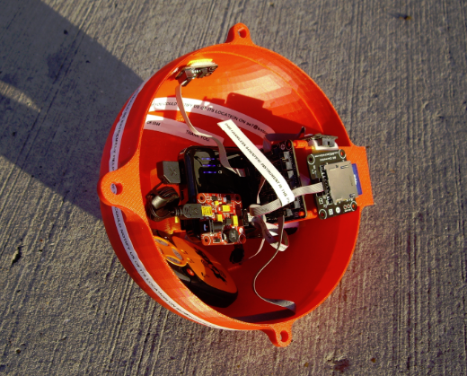
Rapid Development Cycle through Additive Manufacturing and Rapid Electronic Prototyping
www.soton.ac.uk/~astra
@SotonASTRA, @ASobester

Slide 4
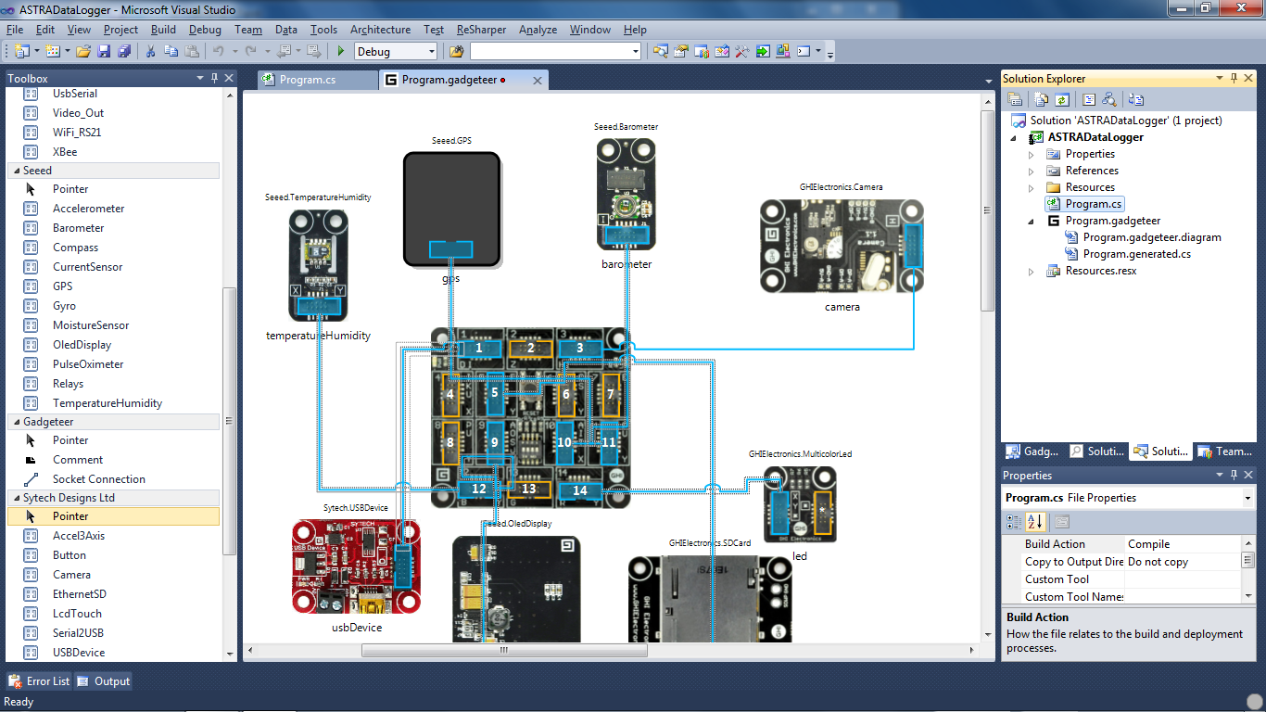
Rapid Development Cycle through Additive Manufacturing and Rapid Electronic Prototyping
www.soton.ac.uk/~astra
@SotonASTRA, @ASobester

Slide 5
Rapid Development Cycle through Additive Manufacturing and Rapid Electronic Prototyping
www.soton.ac.uk/~astra
@SotonASTRA, @ASobester

Slide 6
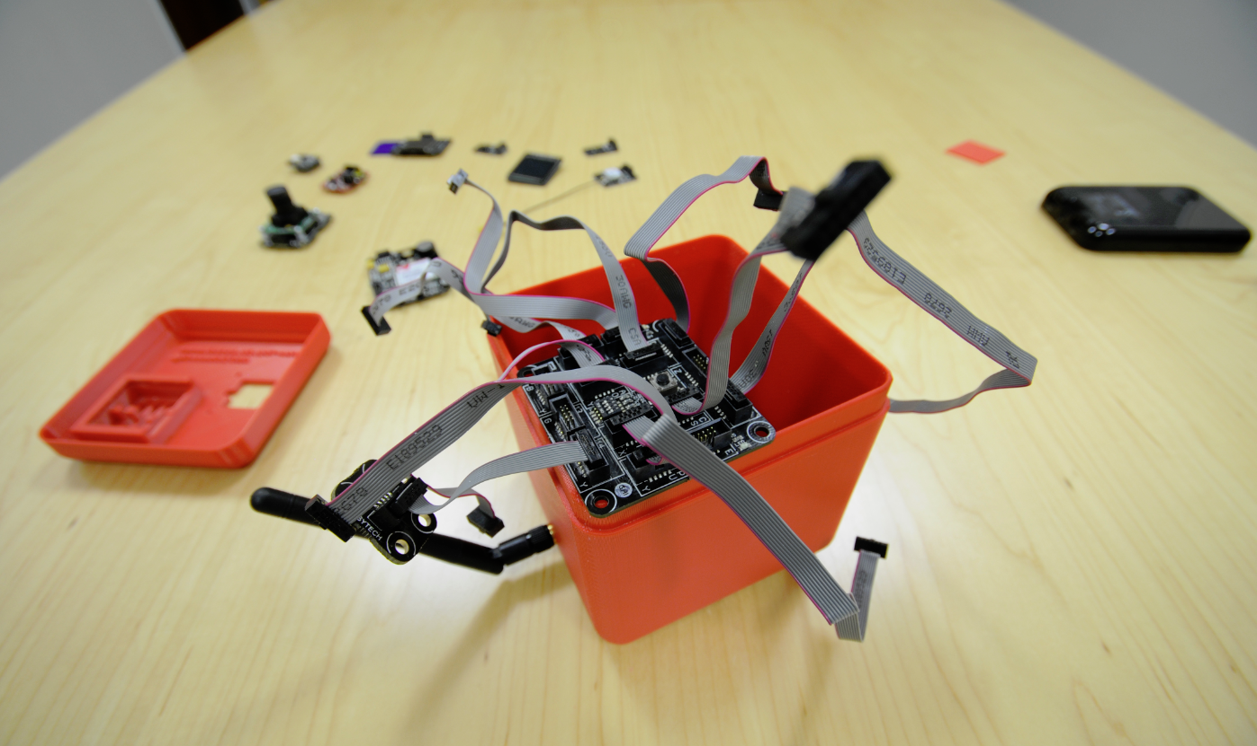
Rapid Development Cycle through Additive Manufacturing and Rapid Electronic Prototyping
www.soton.ac.uk/~astra
@SotonASTRA, @ASobester

Slide 7
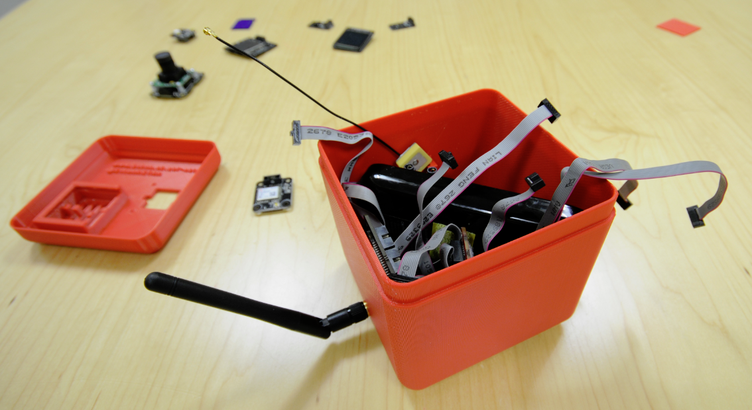
Rapid Development Cycle through Additive Manufacturing and Rapid Electronic Prototyping
www.soton.ac.uk/~astra
@SotonASTRA, @ASobester

Slide 8
Rapid Development Cycle through Additive Manufacturing and Rapid Electronic Prototyping
www.soton.ac.uk/~astra
@SotonASTRA, @ASobester

Slide 9
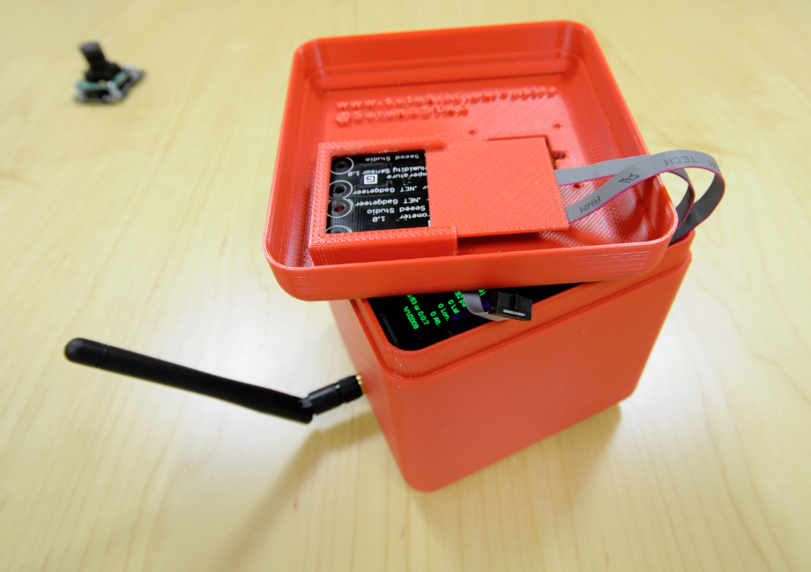
Rapid Development Cycle through Additive Manufacturing and Rapid Electronic Prototyping
www.soton.ac.uk/~astra
@SotonASTRA, @ASobester

Slide 10
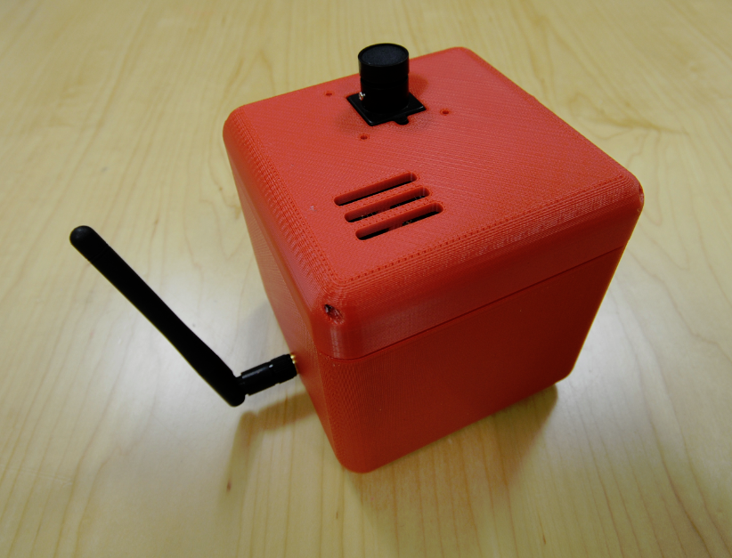
Rapid Development Cycle through Additive Manufacturing and Rapid Electronic Prototyping
www.soton.ac.uk/~astra
@SotonASTRA, @ASobester

Slide 11
Other Rapid Prototyped ‘Pods’…
www.soton.ac.uk/~astra
@SotonASTRA, @ASobester

Slide 12
Other Rapid Prototyped ‘Pods’…
www.soton.ac.uk/~astra
@SotonASTRA, @ASobester

Slide 13
Probabilistic Trajectory Modelling for Mission Planning and Fast Recovery
www.soton.ac.uk/~astra
@SotonASTRA, @ASobester

Slide 14
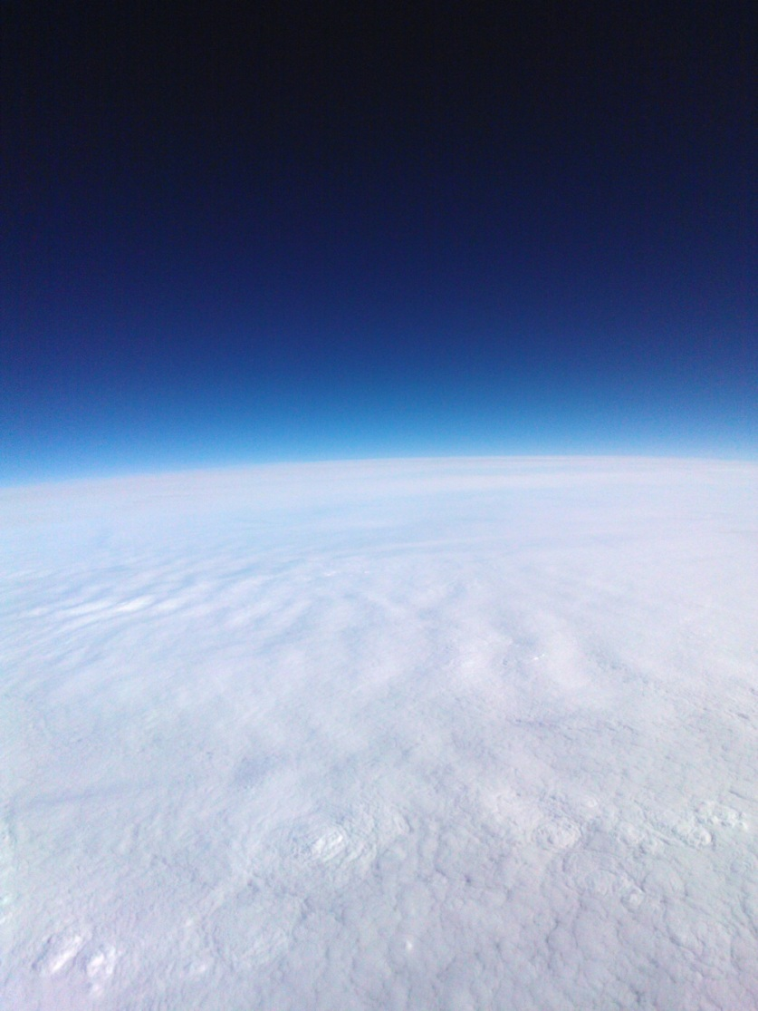
Imaging missions…
Internal gravity wave clouds over South Wales
www.soton.ac.uk/~astra
@SotonASTRA, @ASobester

Slide 15
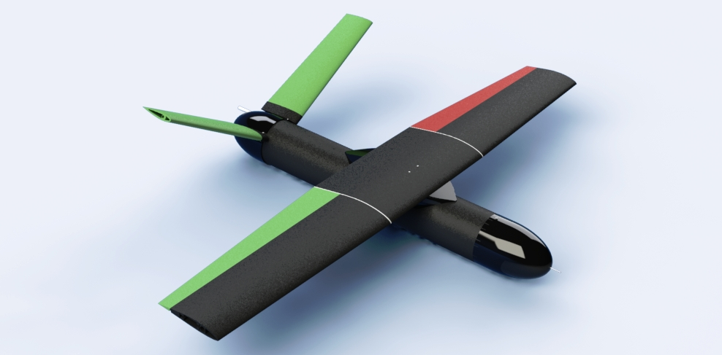
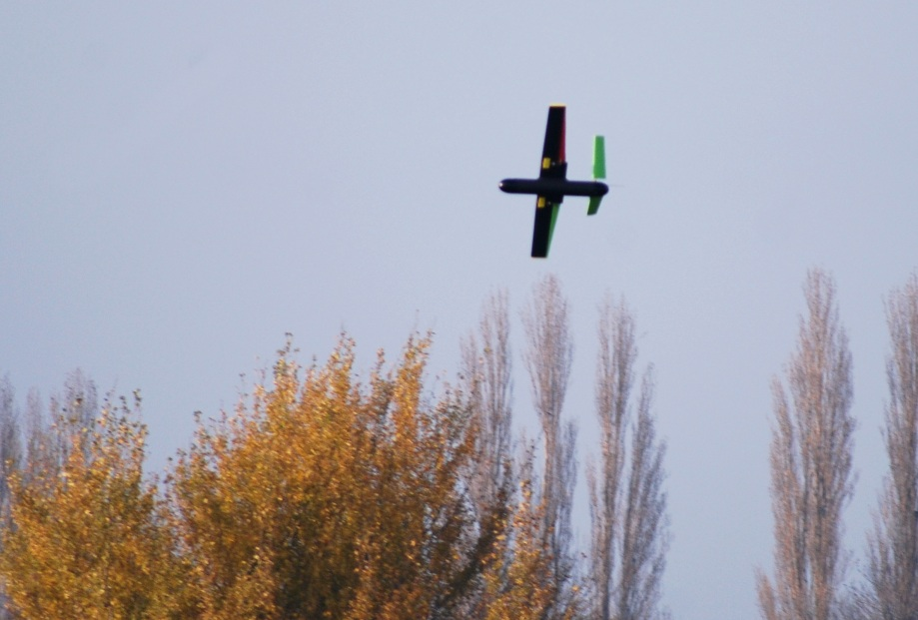
ASTRA Mk1 balloon/aircraft-launched glider
www.soton.ac.uk/~astra
@SotonASTRA, @ASobester

Slide 16
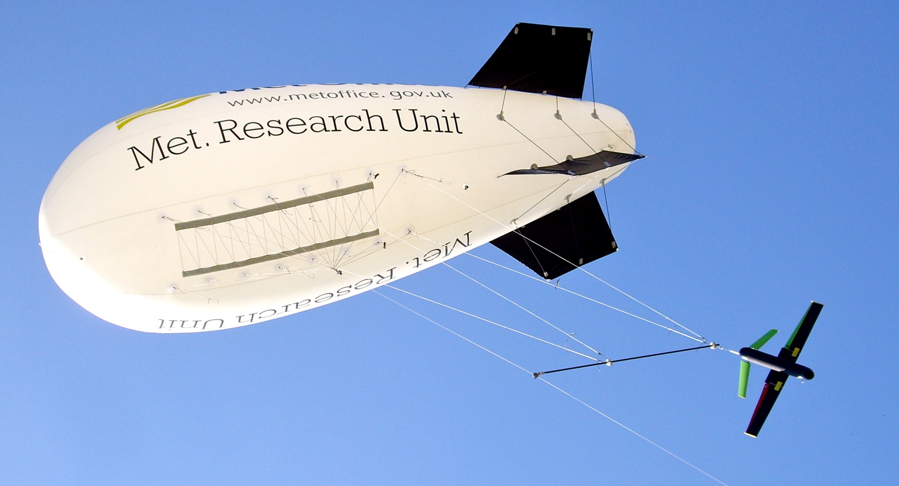
ASTRA Mk1 balloon/aircraft-launched glider
www.soton.ac.uk/~astra
@SotonASTRA, @ASobester

Slide 17
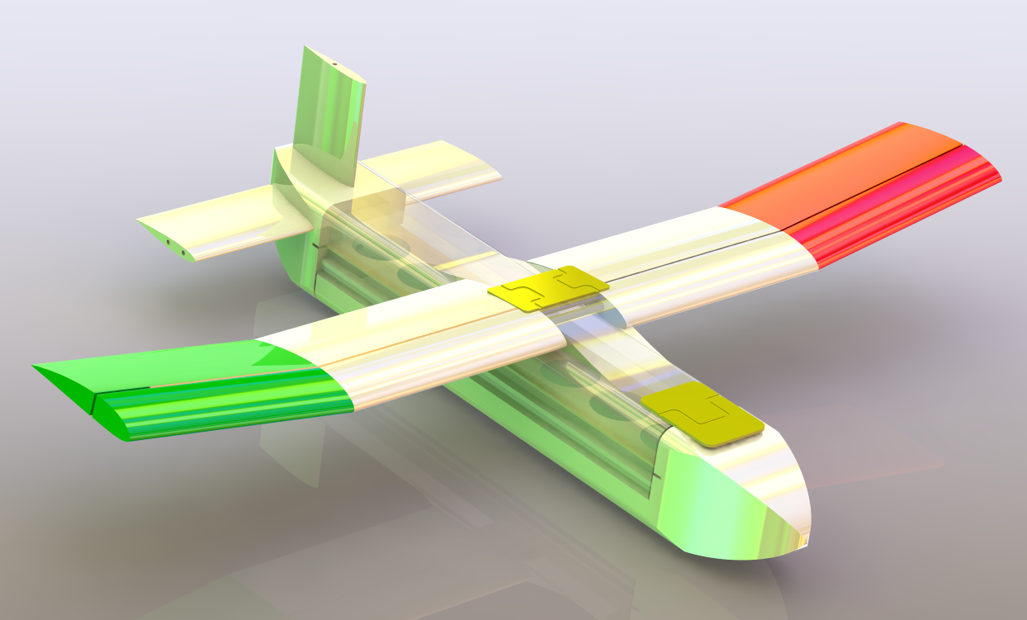
ASTRA Mk2 balloon/aircraft-launched glider
www.soton.ac.uk/~astra
@SotonASTRA, @ASobester

Slide 18
ASTRA Mk2 balloon/aircraft-launched glider
www.soton.ac.uk/~astra
@SotonASTRA, @ASobester

Slide 19
ASTRA Mk2 balloon/aircraft-launched glider
www.soton.ac.uk/~astra
@SotonASTRA, @ASobester

Slide 20
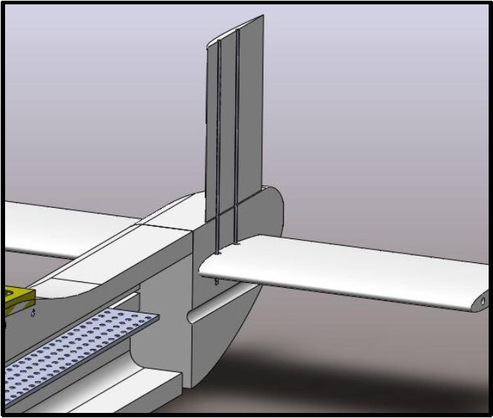
ASTRA Mk2 balloon/aircraft-launched glider
www.soton.ac.uk/~astra
@SotonASTRA, @ASobester

Slide 21
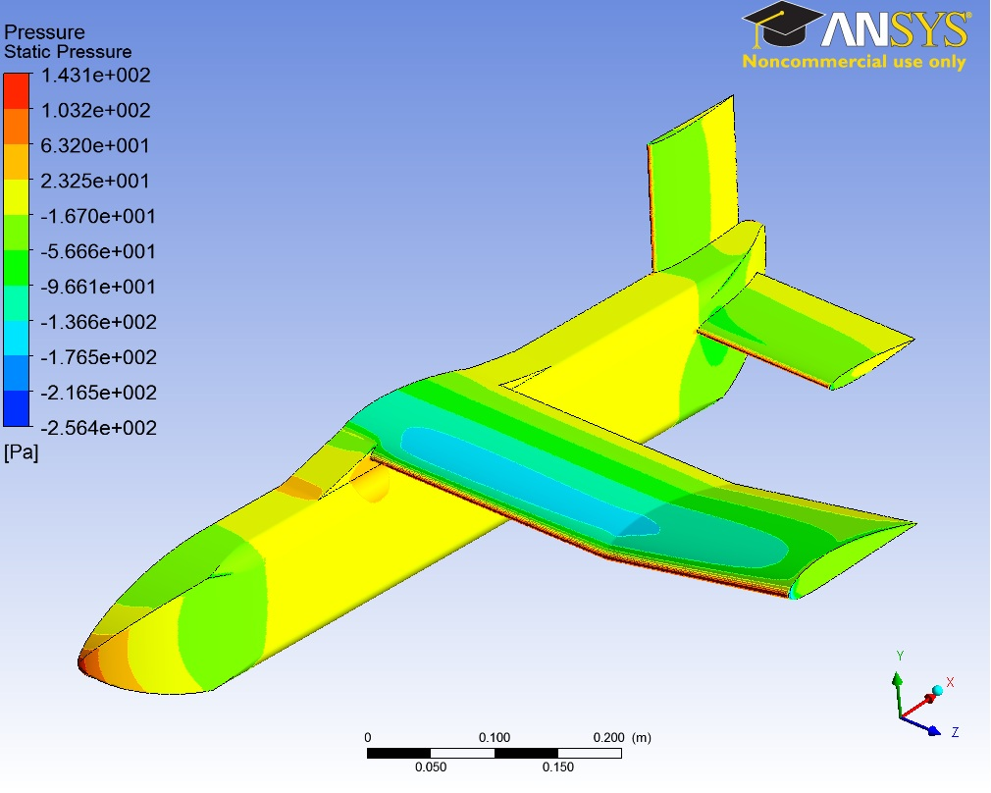
ASTRA Mk2 balloon/aircraft-launched glider - analysis
www.soton.ac.uk/~astra
@SotonASTRA, @ASobester

Slide 22
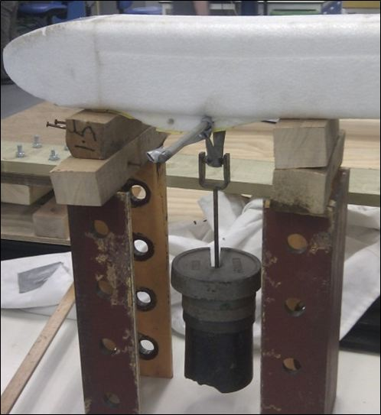
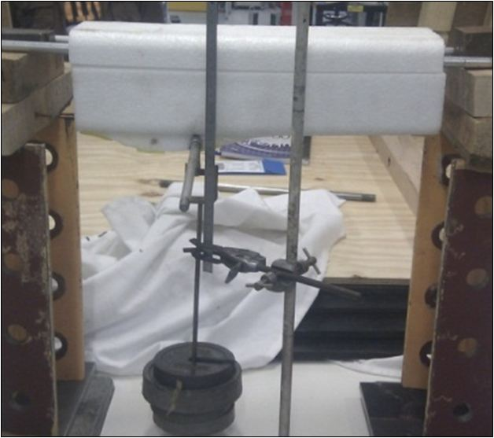
ASTRA Mk2 balloon/aircraft-launched glider – static testing
www.soton.ac.uk/~astra
@SotonASTRA, @ASobester

Slide 23
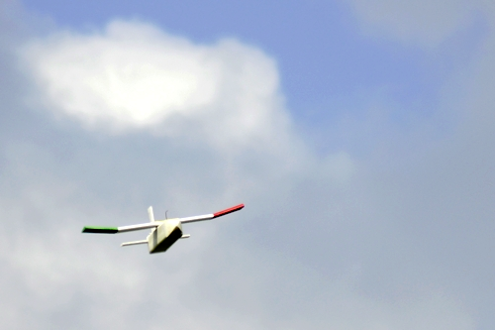
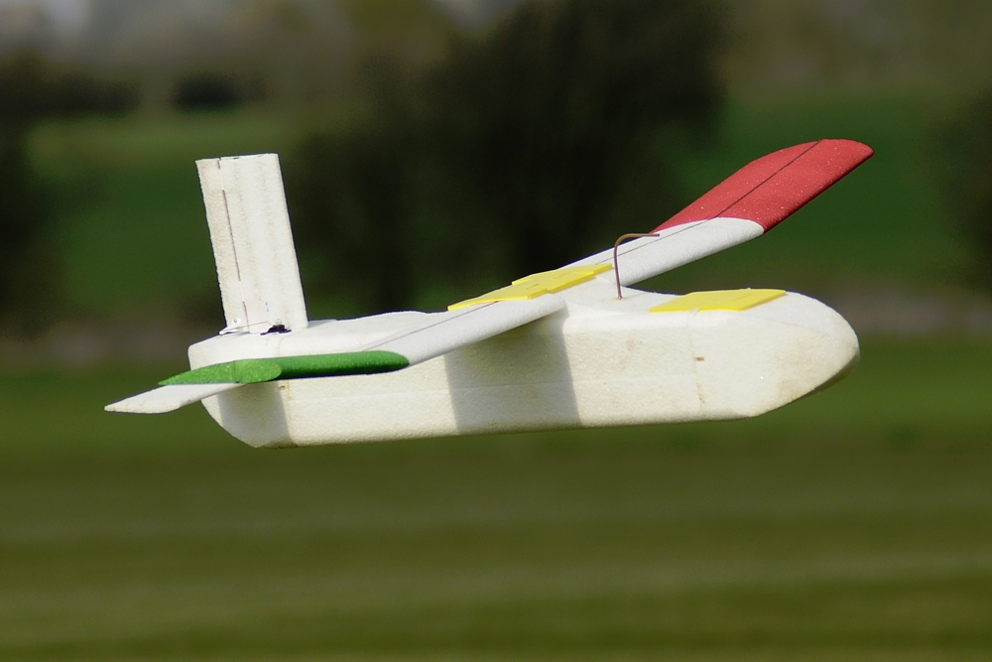
ASTRA Mk2 balloon/aircraft-launched glider – flight testing
www.soton.ac.uk/~astra
@SotonASTRA, @ASobester

Slide 24
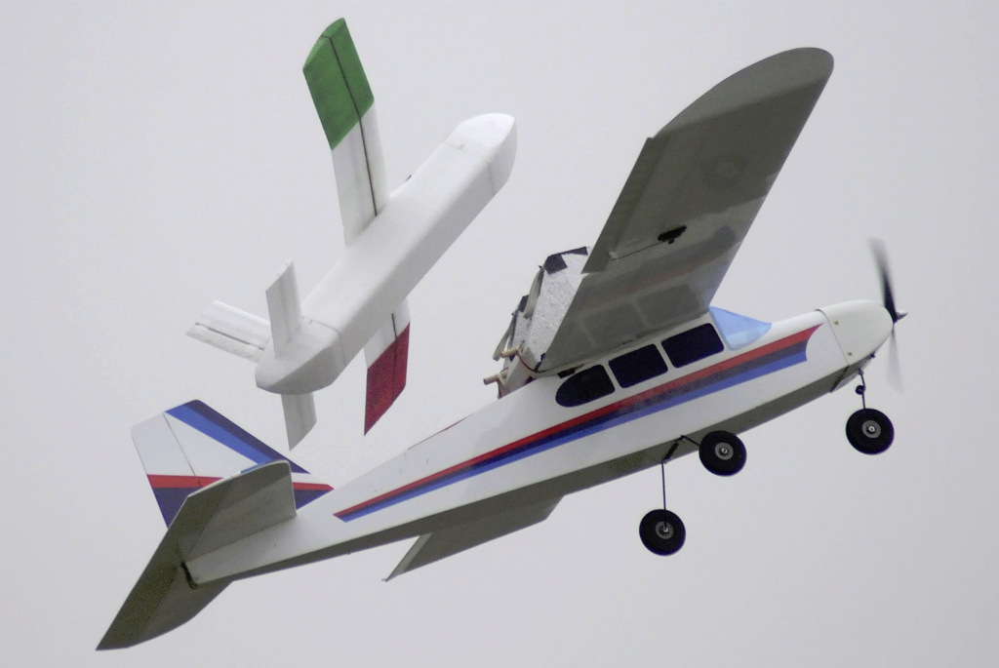
ASTRA Mk2 balloon/aircraft-launched glider – ‘mother ship technique’
www.soton.ac.uk/~astra
@SotonASTRA, @ASobester

Slide 25
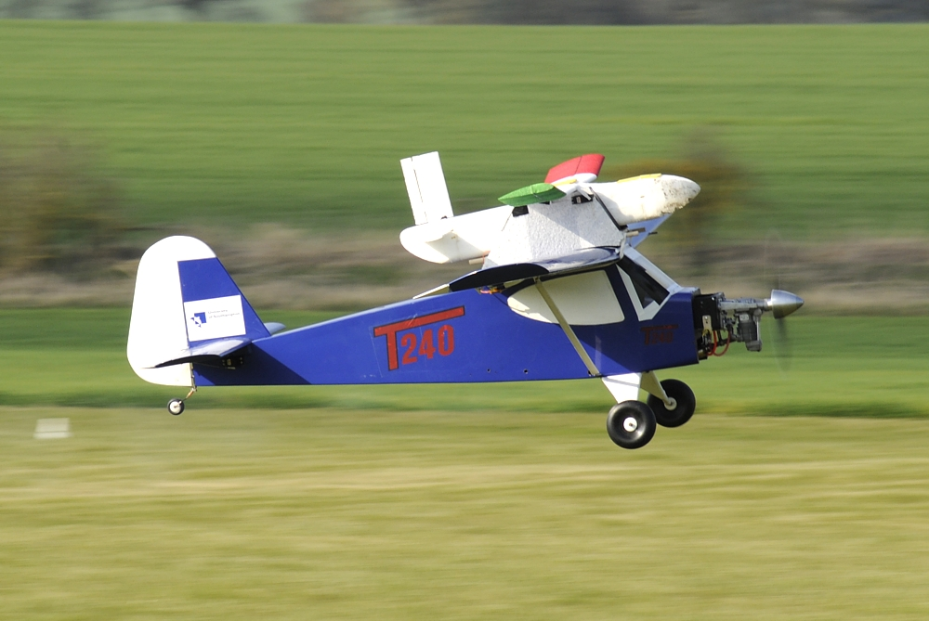
ASTRA Mk2 balloon/aircraft-launched glider – ‘mother ship technique’
www.soton.ac.uk/~astra
@SotonASTRA, @ASobester

Slide 26
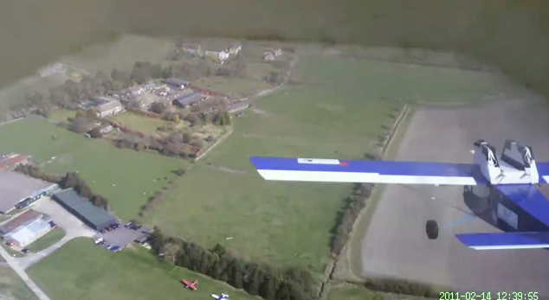
ASTRA Mk2 balloon/aircraft-launched glider – ‘mother ship technique’
www.soton.ac.uk/~astra
@SotonASTRA, @ASobester

Slide 27
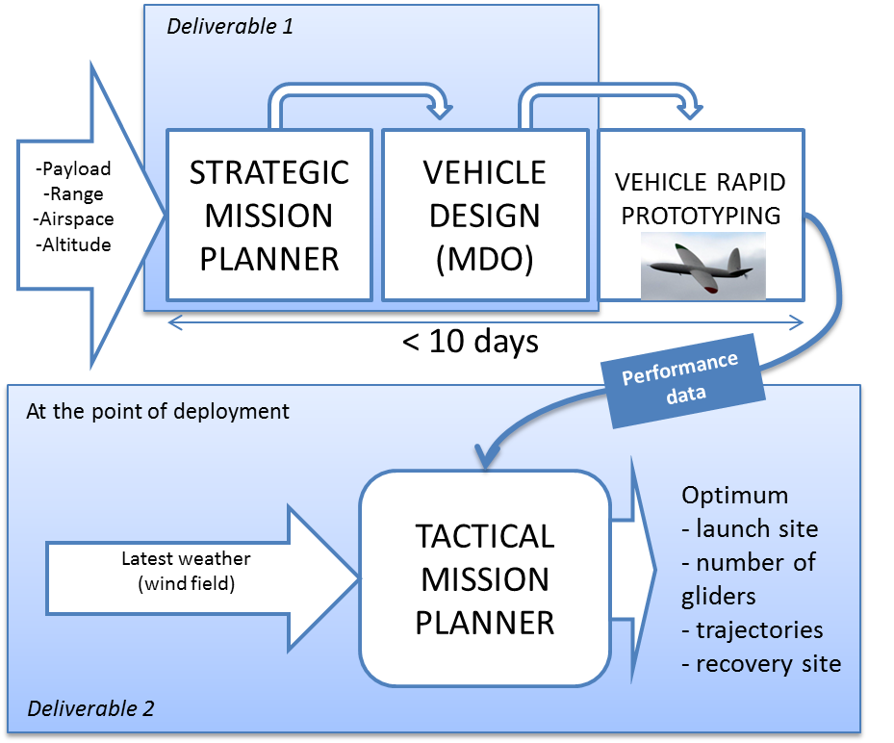
Glider Fleet Design and Deployment
www.soton.ac.uk/~astra
@SotonASTRA, @ASobester

