Slide 1

Data Reuse and Transparency in the Data Lifecycle
Steven Worley
Doug Schuster
National Center for Atmospheric Research
Boulder, CO USA

Slide 2
Topics
Data Reuse and Transparency
What are these data features?
Why are they important?
Archiving practices
Access practices

Slide 3
What are these data features?
Data reuse implies:
  Expanding usage beyond intended primary community
  Maintaining reference datasets and building many products from them
Data transparency implies:
  Reproducibility - ability to reproduce data files or products for users
  Traceability – tagging and preserving access details

Slide 4
Why are Reuse and Transparency Important?
Data centers/providers are expected to support fact-based outcomes:
Traditionally for science/research
Now also for policy makers, community leaders, individual citizens, and commercial interests.
Notes:
Sphere of responsibility has expanded

Slide 5
Supporting New Reuse and Transparency
Decisions by policy makers
  Traceable open access sources
Actions by community leaders
  Planning for societal services
    Emergencies, water, energy, etc.
Usage by citizens and educators
  Inquisitive science, family activities, safety
  Science learning
Collaborative commercial applications
  Tighter coupling between engineering and science
    Wx forecasts for wind energy production
    Energy companies contribute mesoscale observations

Slide 6
Archiving practices
Curation that assures data authenticity
  Preserve original data formats, to the max. extent possible.
    Maintaining 100% content and accuracy – serious challenge
Use a “rich” metadata standard
  A local standard?
  Generate discipline and cross-discipline standards
    E.g. ISO, DIF, etc.
Create multiple copies
  Data files, metadata, documentation, and software
  Disaster recovery – not a secondary concern

Slide 7
Archiving practices
Collection completeness and integrity
  Closely monitor data work flow
    Account for every file
  Read every file
    Gather, check, preserve metadata
  Compute and preserve file checksums
Maintain dataset lineage / provenance
  Use approved processes to delete datasets (never?)
  Establish tiered “level of service” for data
    Move old / superseded versions to lower level
  Keep all metadata on the highest tier – discoverable!

Slide 8
Archiving practices
Explicit data version tracking
  Sometimes, internal to files
  Always, within data management system
  Include notations in all documentation
Establish Digital Object Identifiers (DOIs)
  Two-way linkage between publications and data
  Promotes easy path for follow-on research from publications
  Leverages skills / facilities of libraries – richer knowledge base
  Create data family tree connections
Notes:
ARK’s, PURL’s, and handles

Slide 9

Dataset Family Tree Example
Global and Regional Atmospheric and Ocean Re-analyses
NCEP/NCAR, NARR, ERA-40, ERA-Interim, 20CR, OARCA
NOC Surf. Flux
(1973-2009)
WASwind
(1950-2009)
Etc.
Ocean Clouds
(1900-2010)
JMA SST
(1871-2011)
HadSLP
(1871-2011)
HadISST
(1871-2011)
NOAA OI SST
(1981-2011)
NOAA ERSST
(1854-2011)
International Comprehensive Ocean Atmosphere Data Set (ICOADS)
Global marine surface observations (1662-2011)
Notes:
Parent - ICOADS
Children – whole or partially derived from ICOADS
Grand Children – derived from ICOADS and the Children

Slide 10
Dataset Family Tree - Evolution
Grand Child
Child
Child
Grand Child
Parent
Data Center Centric
Parent
Challenges:
System of immutable IDs – DOIs?
Multi-institution preservation commitment
Transparency across institutions, accepted standards/governance
Promote discovery by sharing metadata, OAI-PMH
Future, knowledge-based discovery and access via ontologies within semantic web
Web Centric

Slide 11
Access Practices
User Identification – key to reproducibility
Record all data access transactions
  Who received what and when
  Log product creation constraints from GUIs and web services
  Log software IDs used for product creation
Benefits
  Reproduce a data access process
  Feedback to users about data changes
  Use metrics imply how to improve access
Notes:
Constraints - Space, time, parameters, format translations
Feedback example: JRA-25, 1900 files out of 1M,
Liability, security of user ID information

Slide 12
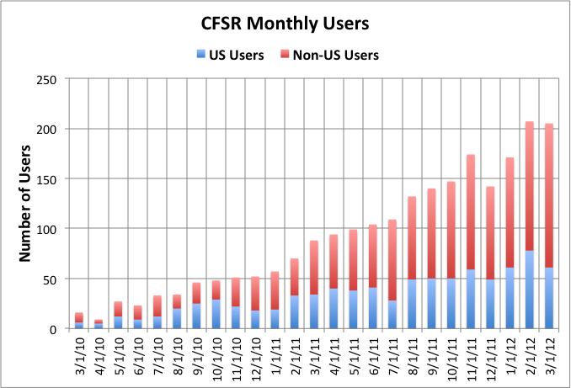
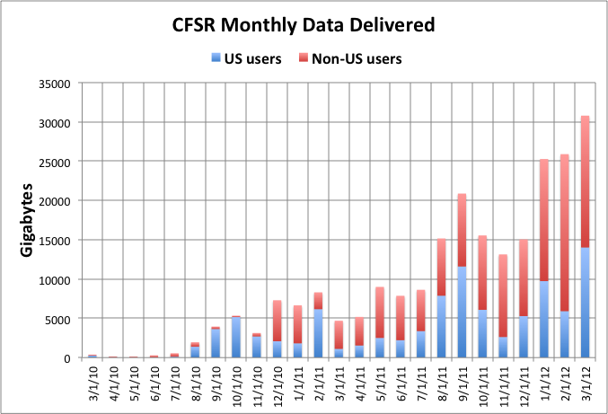
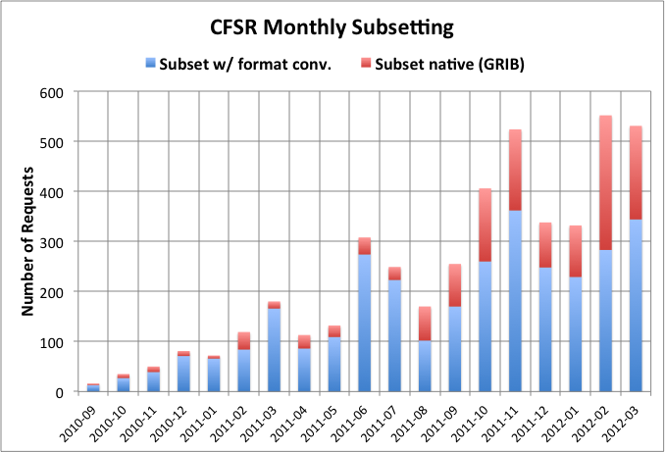
Metrics Example
CFSR 6hrly, GRIB2, 1979-2011, 75TB, 28K fields/time step, 168K files
63% of users are non-US
Now exporting 25+ TB monthly
Track User activity:
- who accessed what and when
Subsetting, now
~500 requests/month
Notes:
COM || DSS || EDU || GOV || MIL || NCAR || ORG || OTHER || UNIV
CFSR 6-hrly, 75 TB, 28K fields/time step, 168K files

Slide 13
Conclusions
Data reuse and transparency are rapidly expanding in importance
Many “best practices” in archive management support reuse and transparency
Archive access monitoring is necessary for transparency, reproducibility, and traceability
Need significant improvement in linking data family trees and data to publications to advance reuse and transparency

Slide 14
Research Data Archive at NCAR http://rda.ucar.edu/

