Slide 1
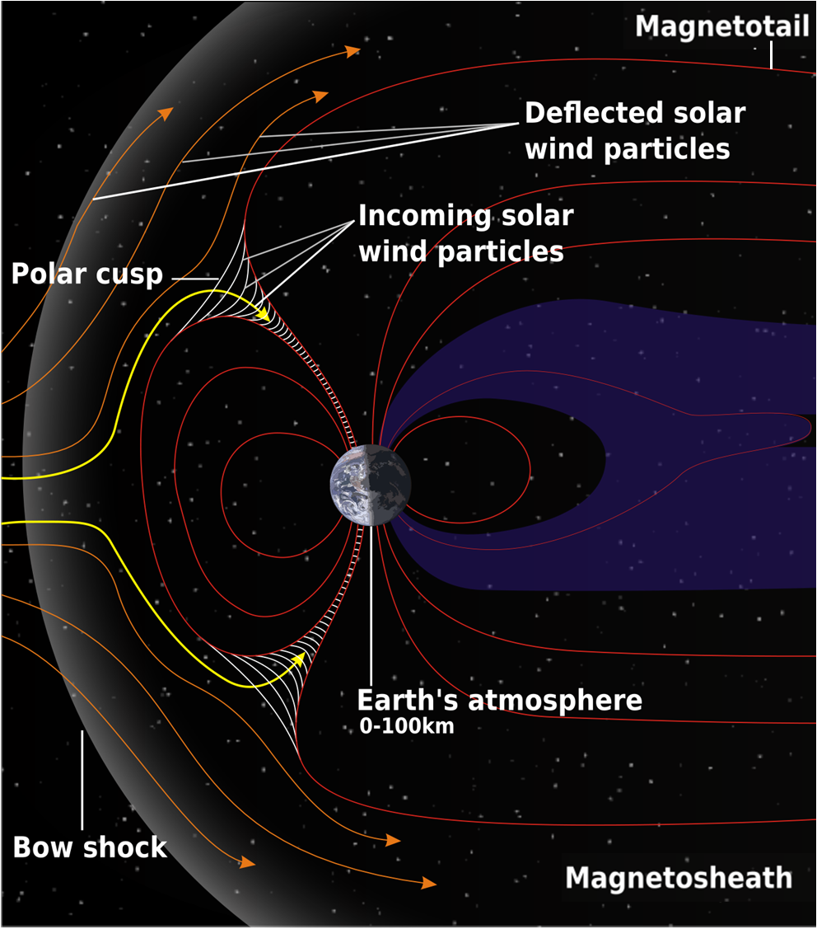
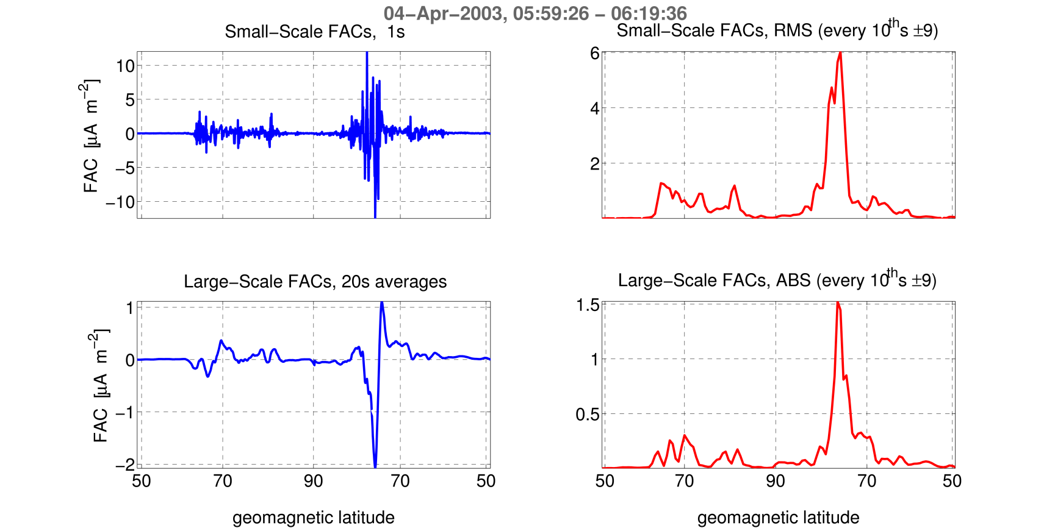
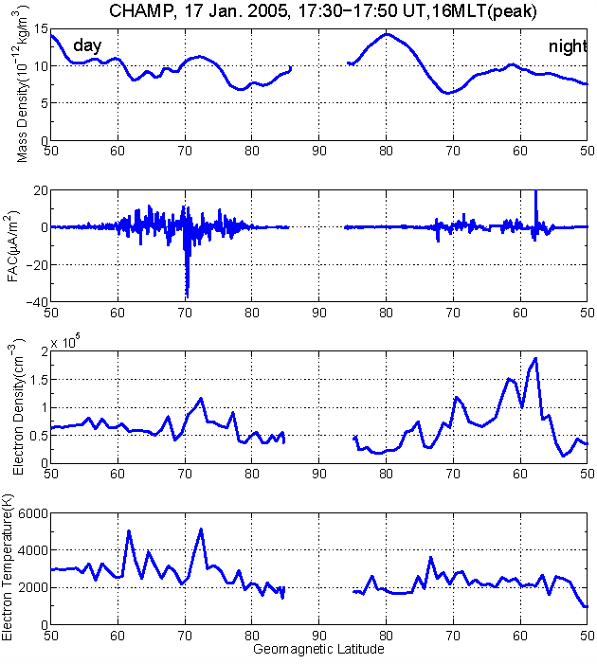
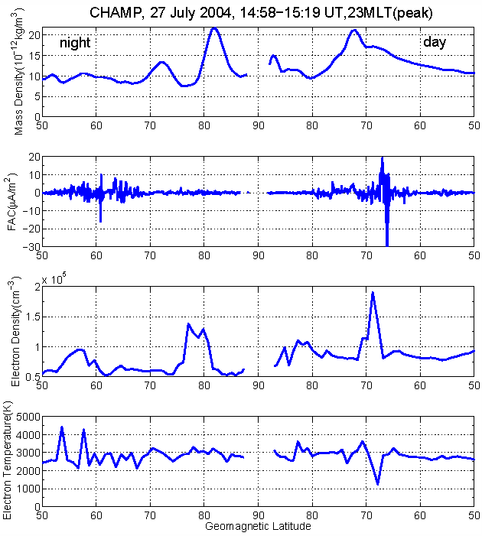
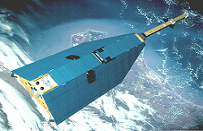
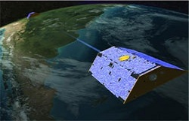
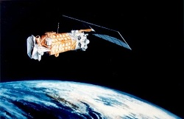
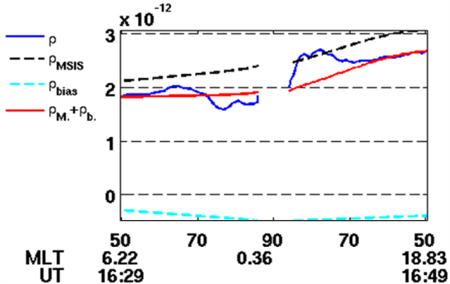
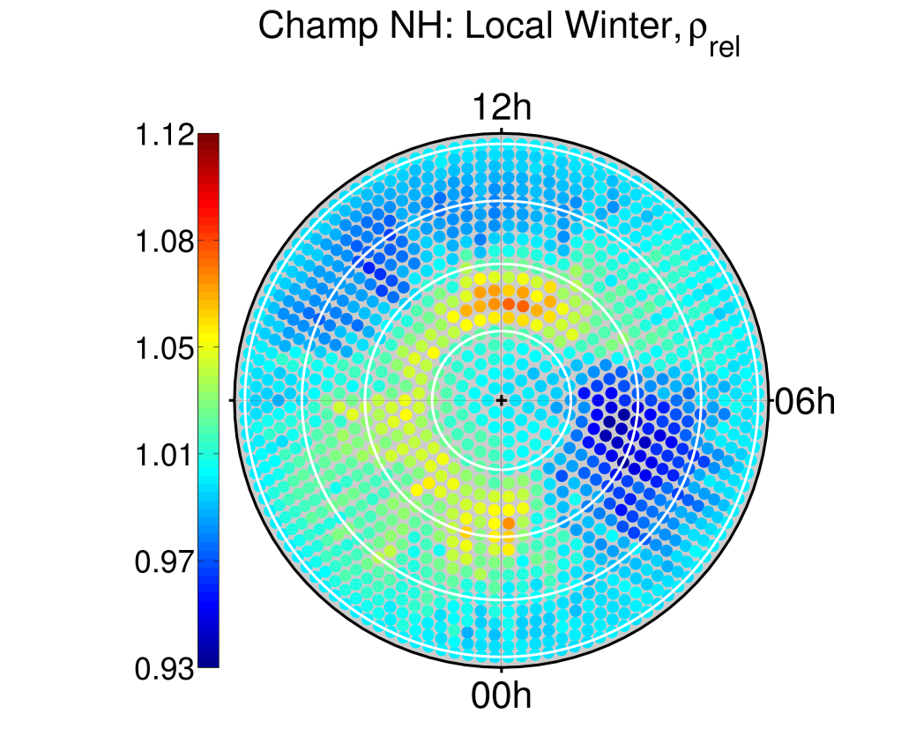
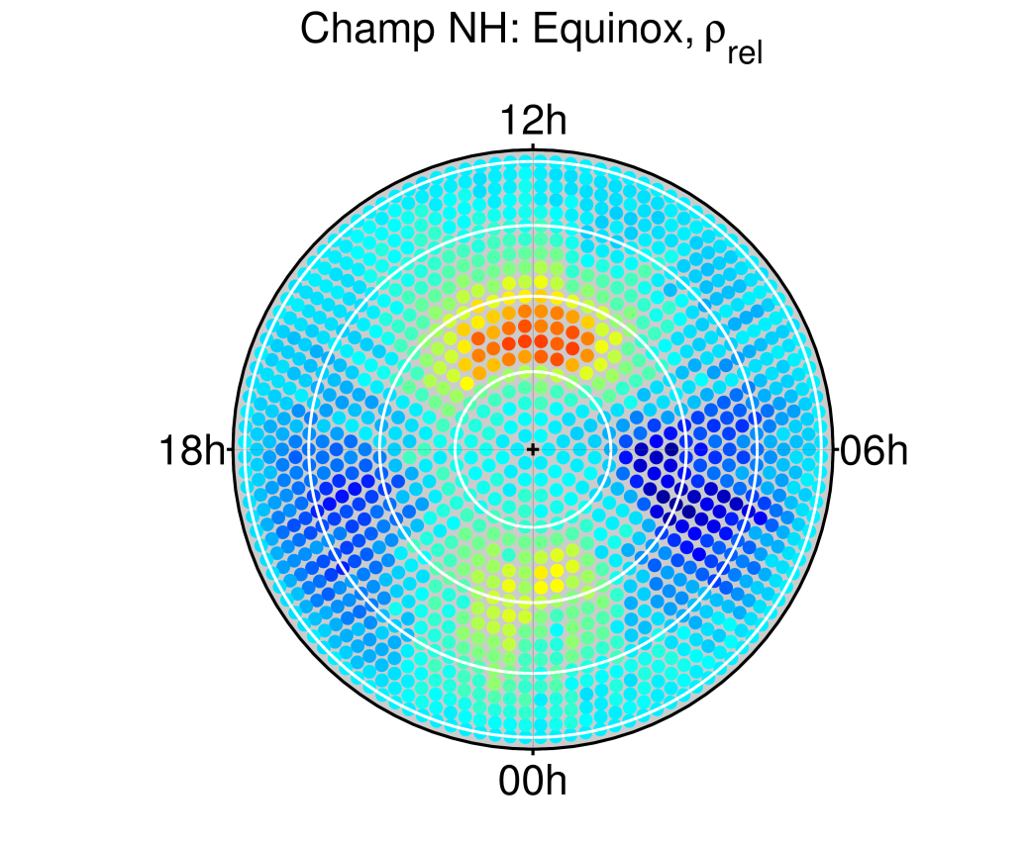
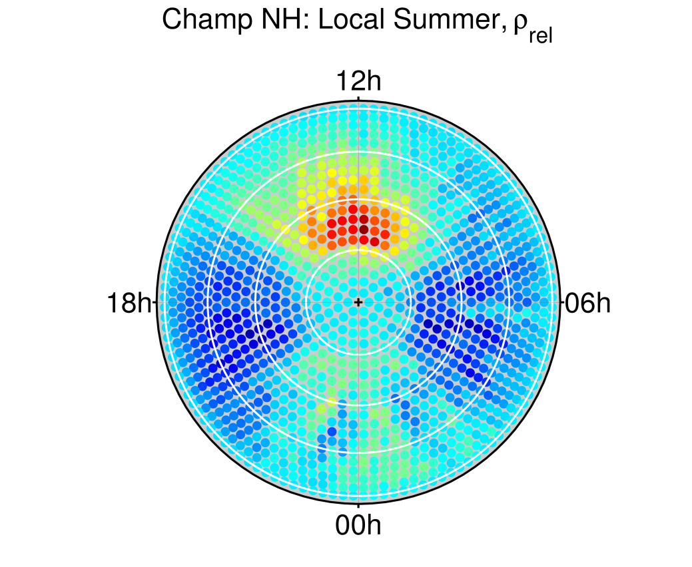
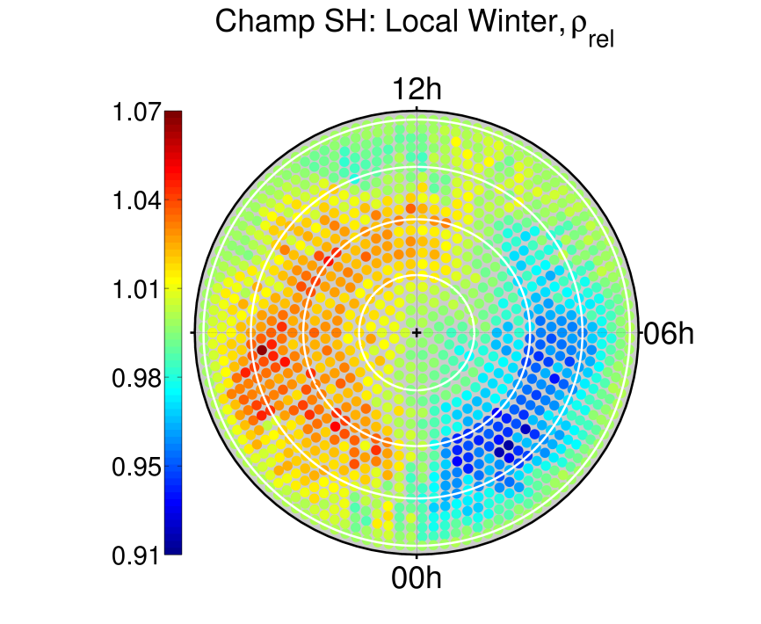
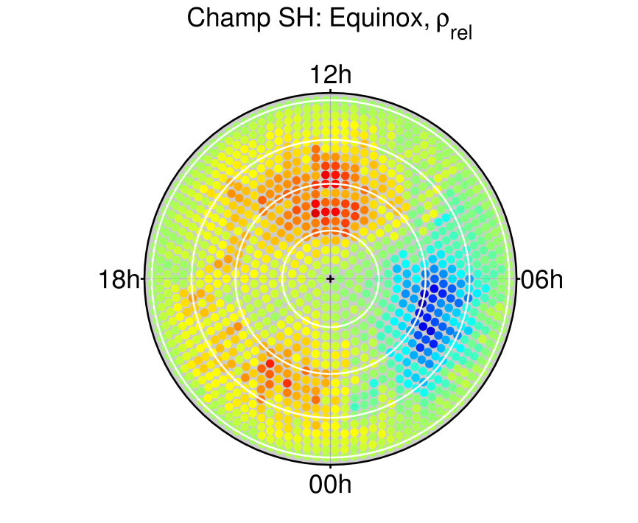
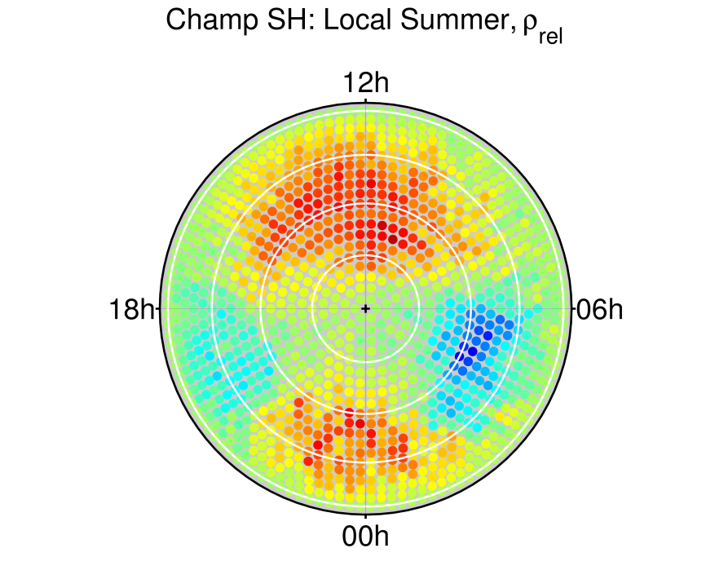
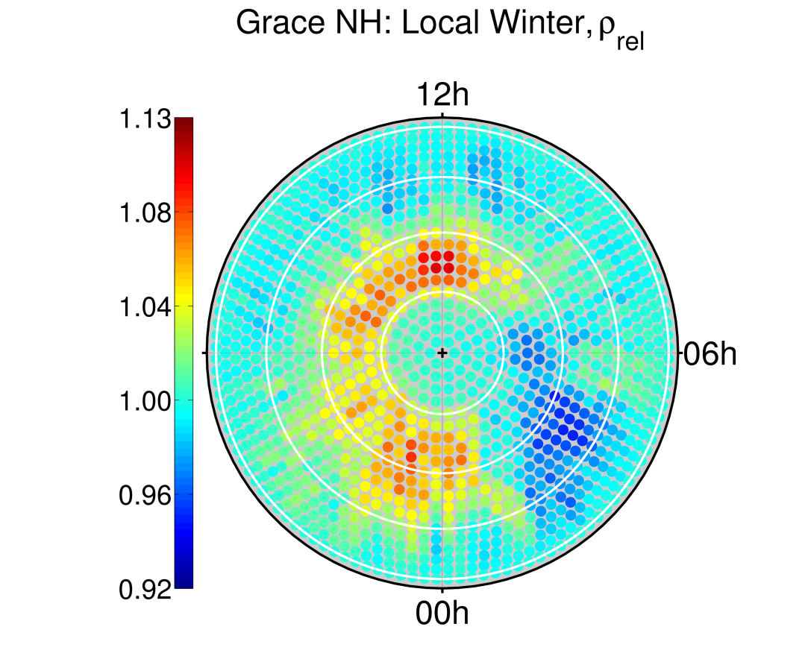
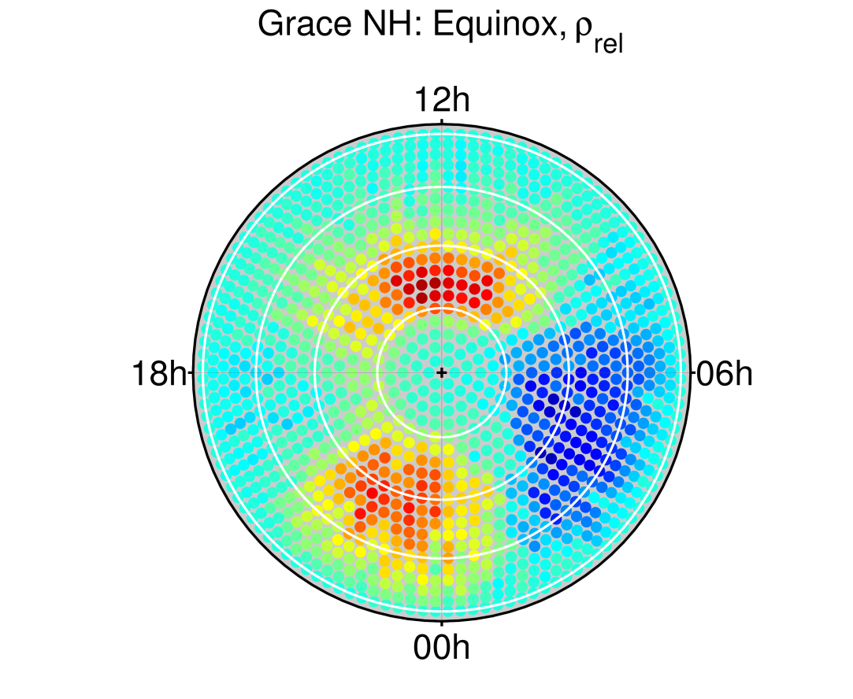
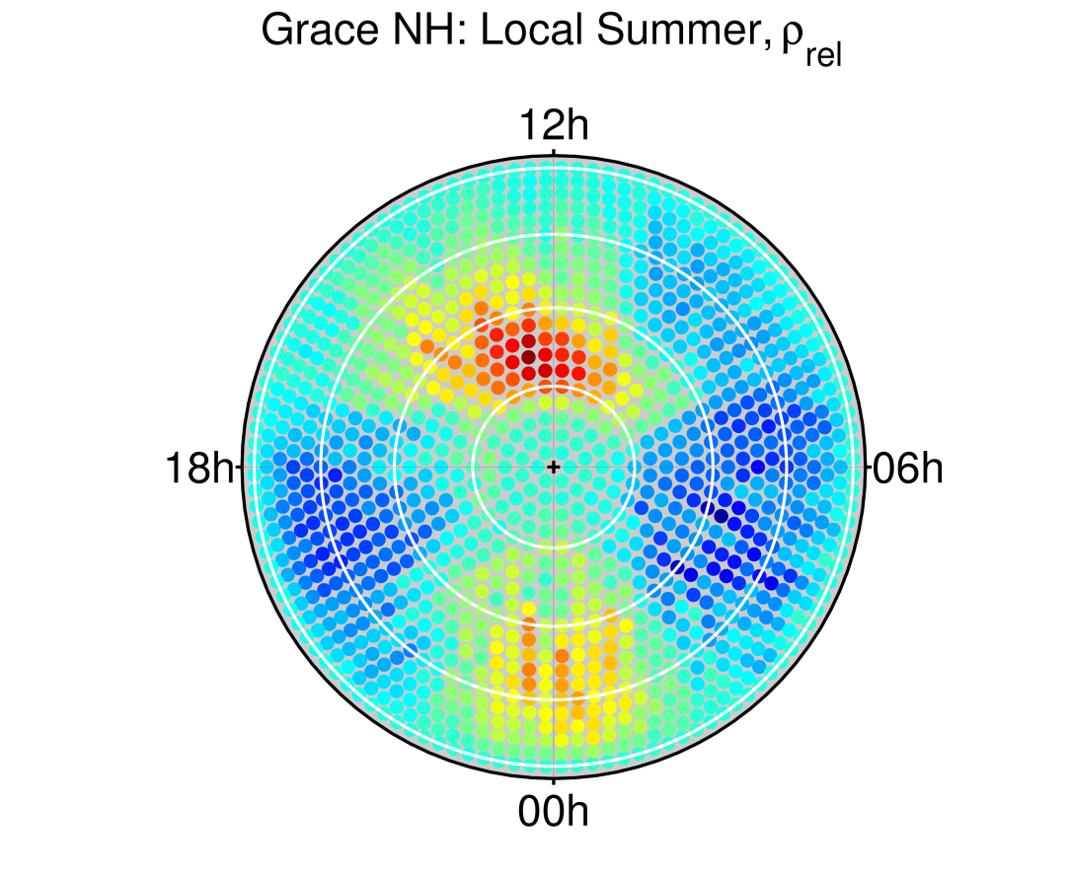
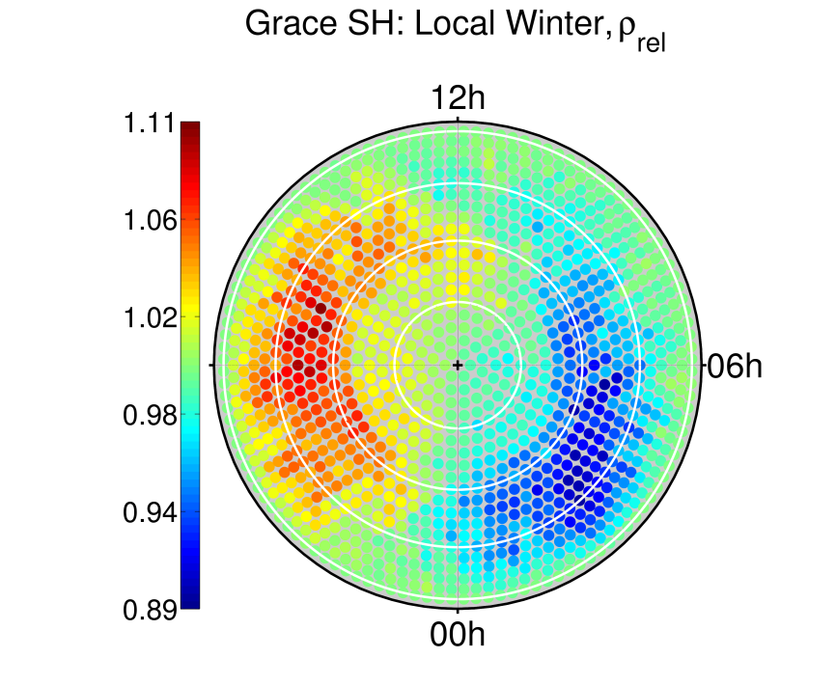
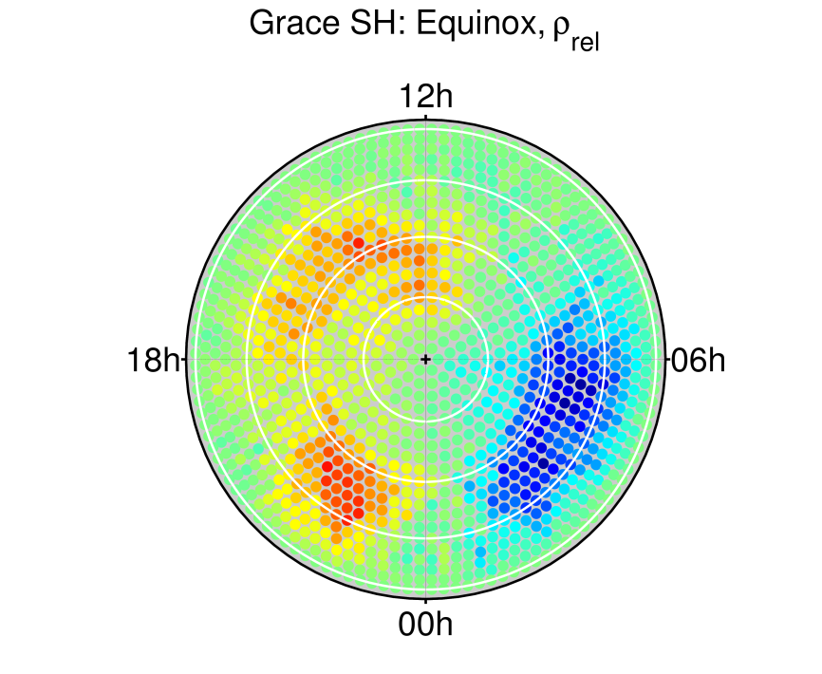
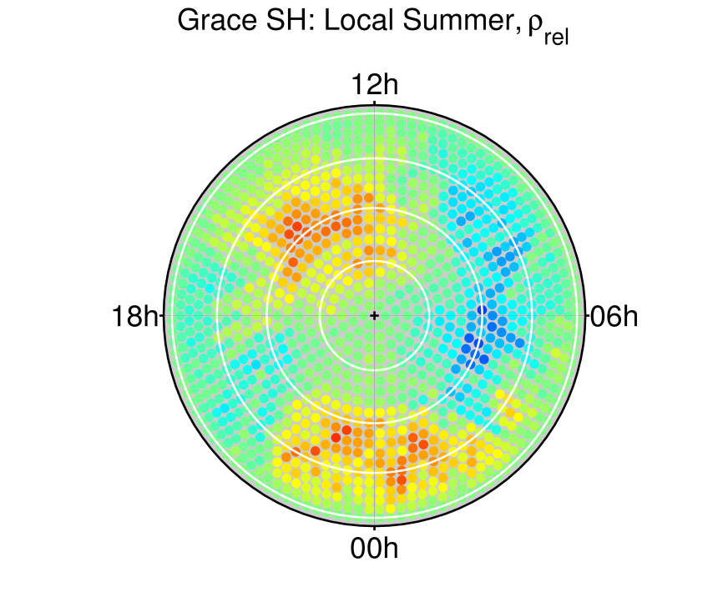
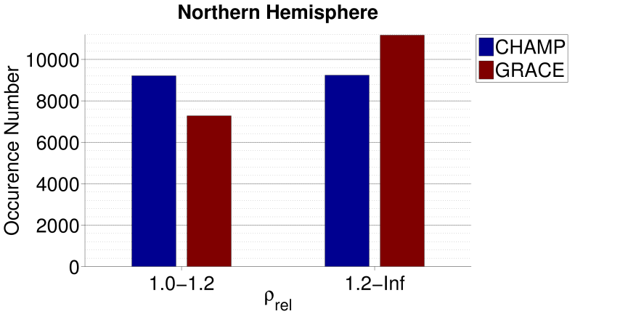
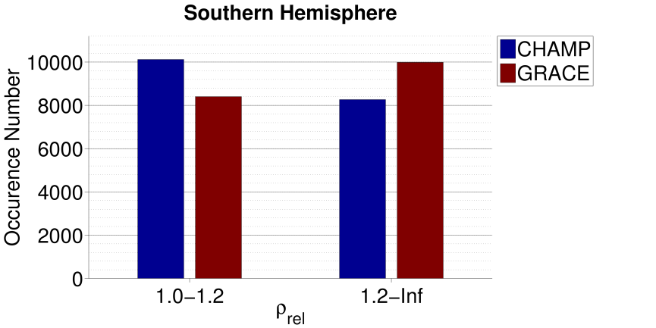
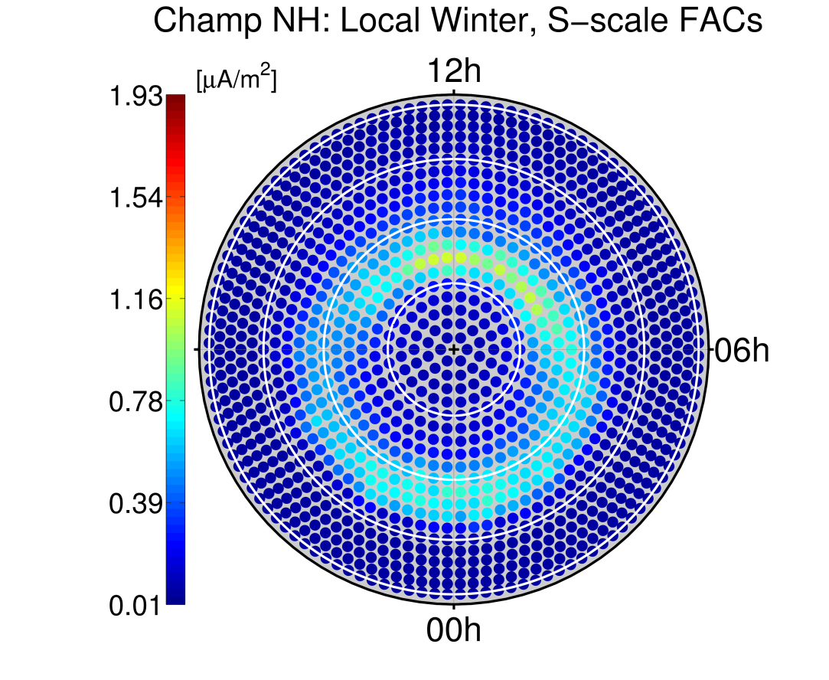
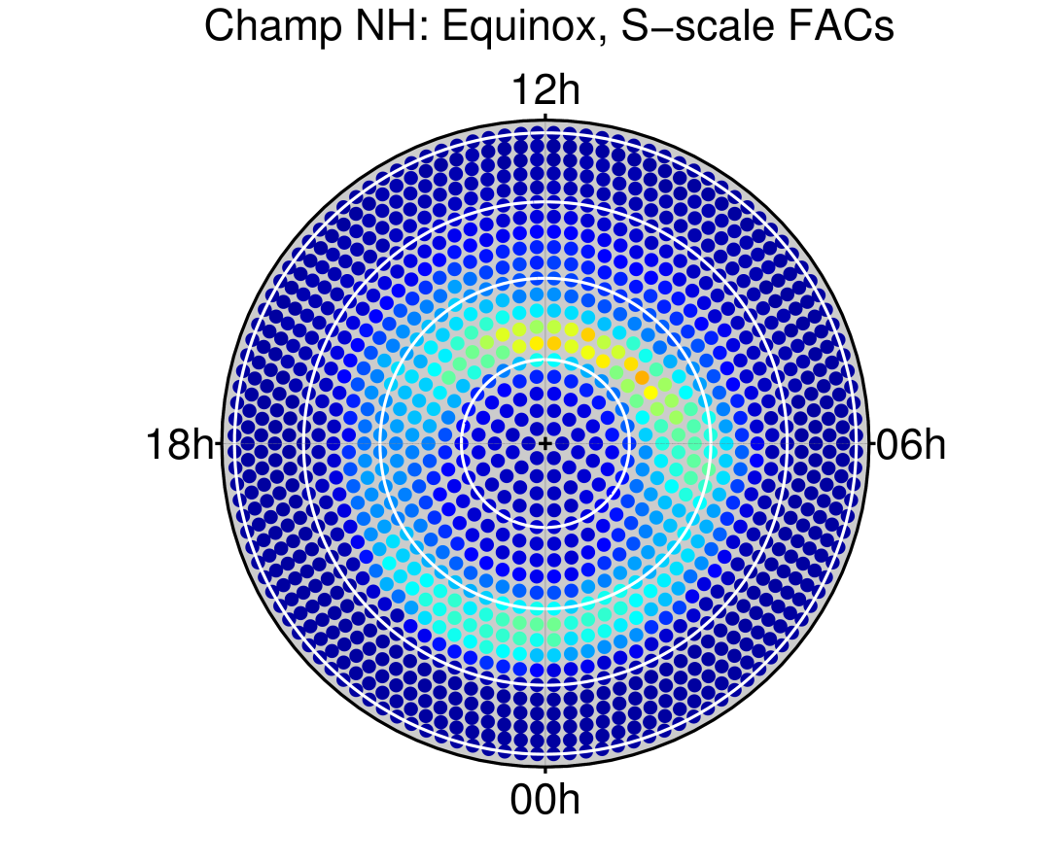
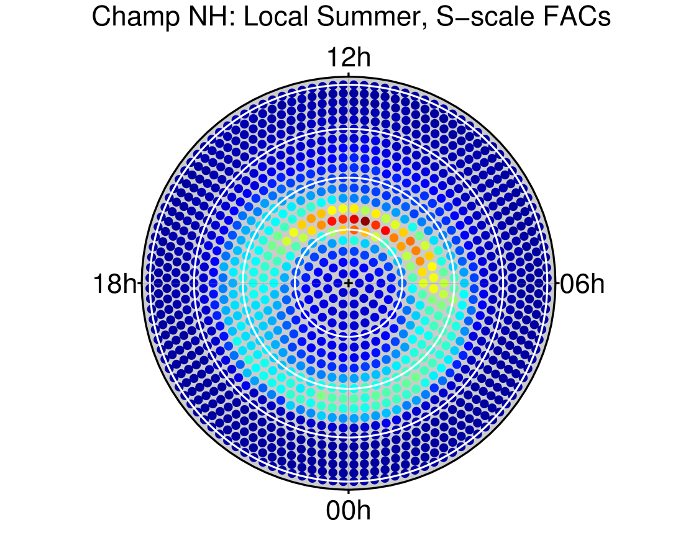
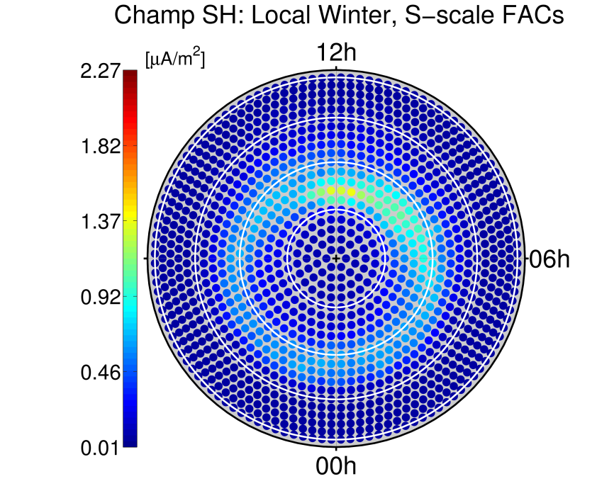
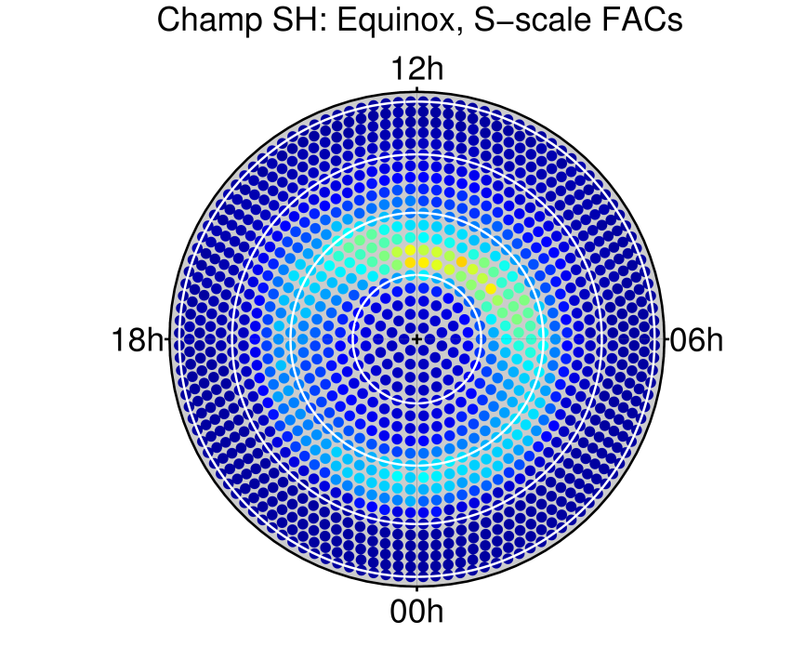
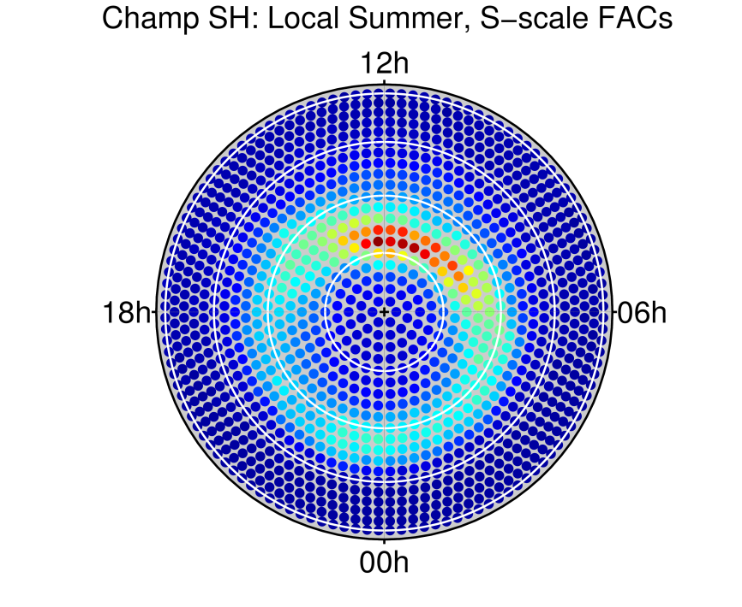
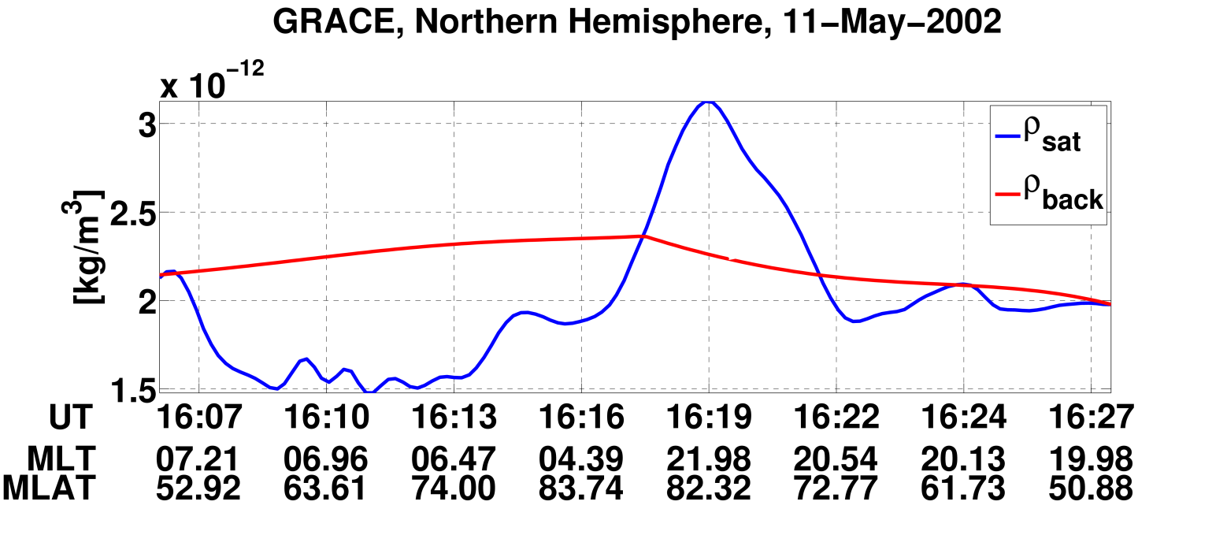
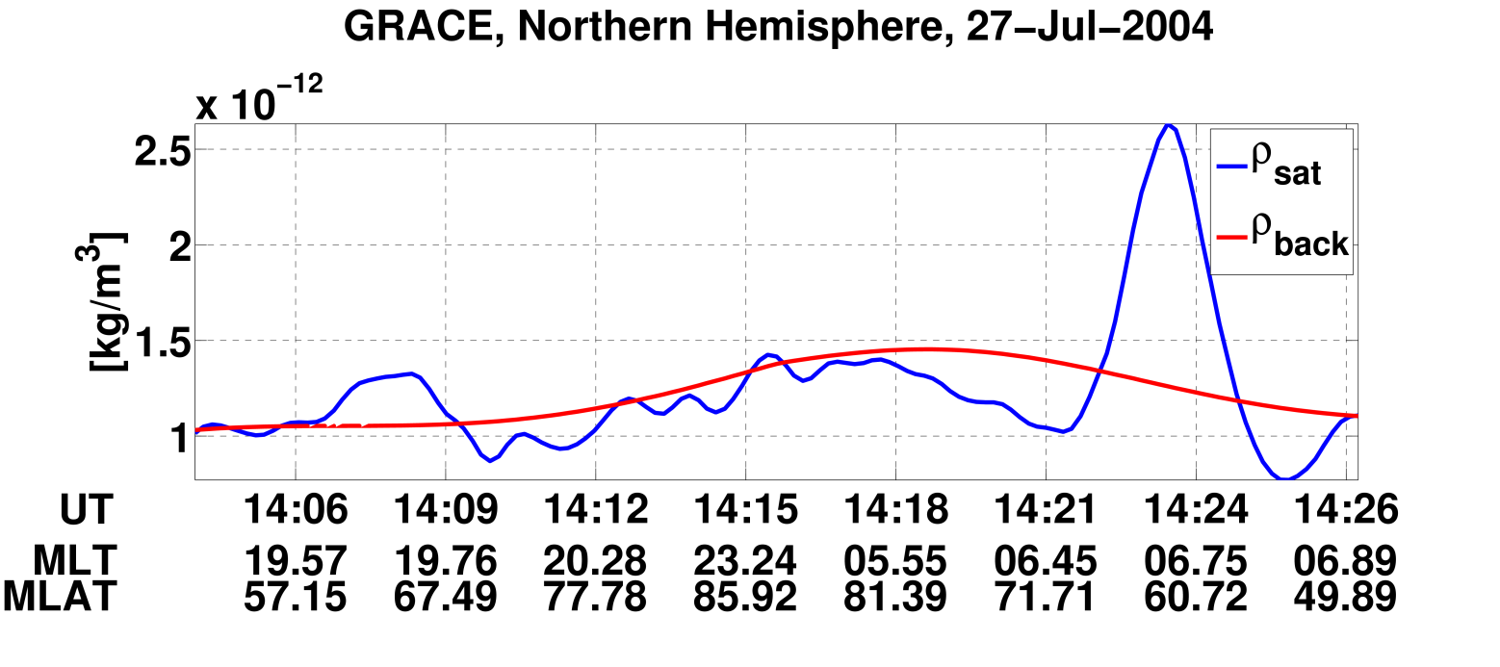
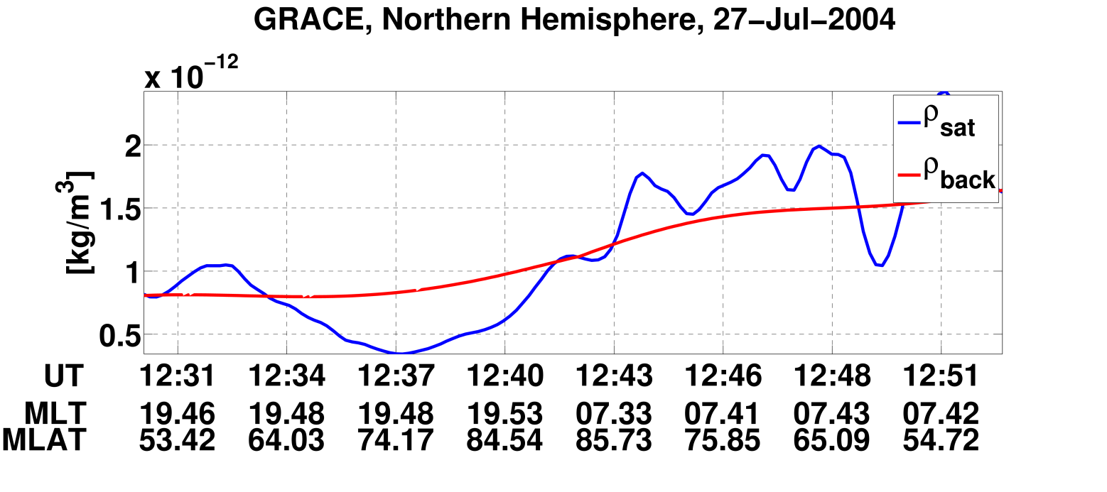
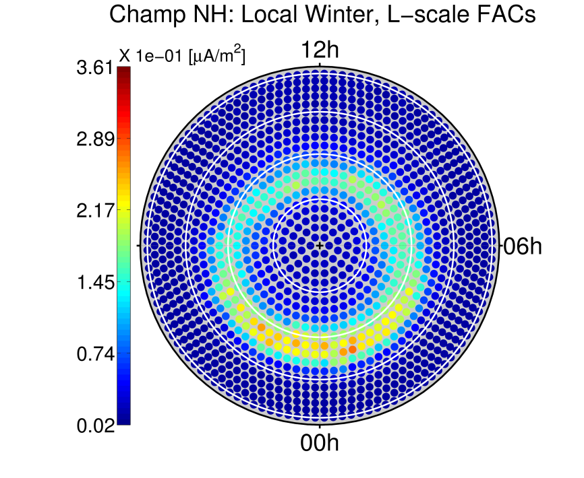
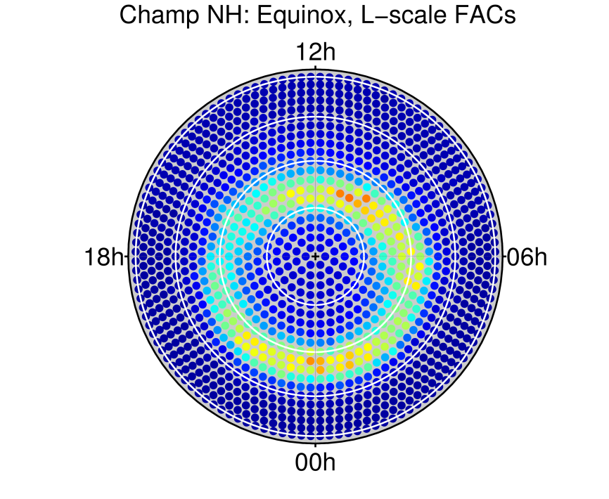
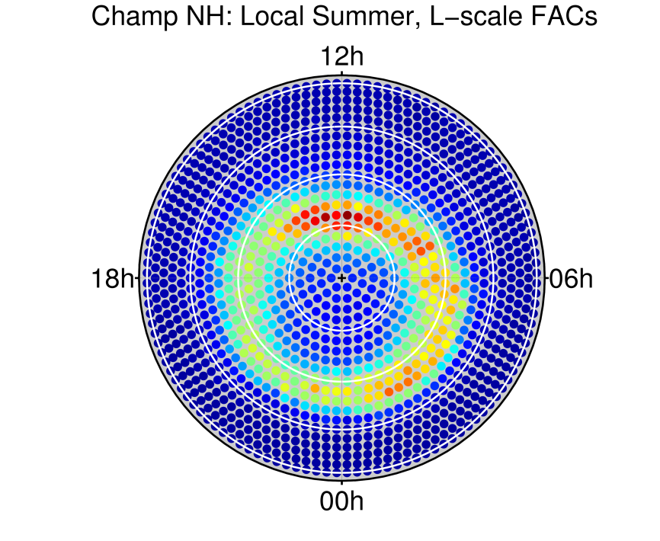
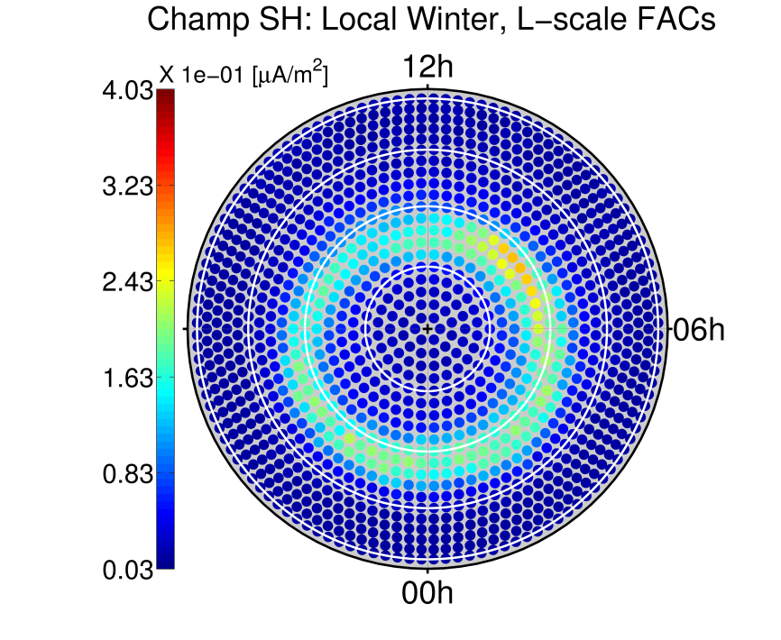
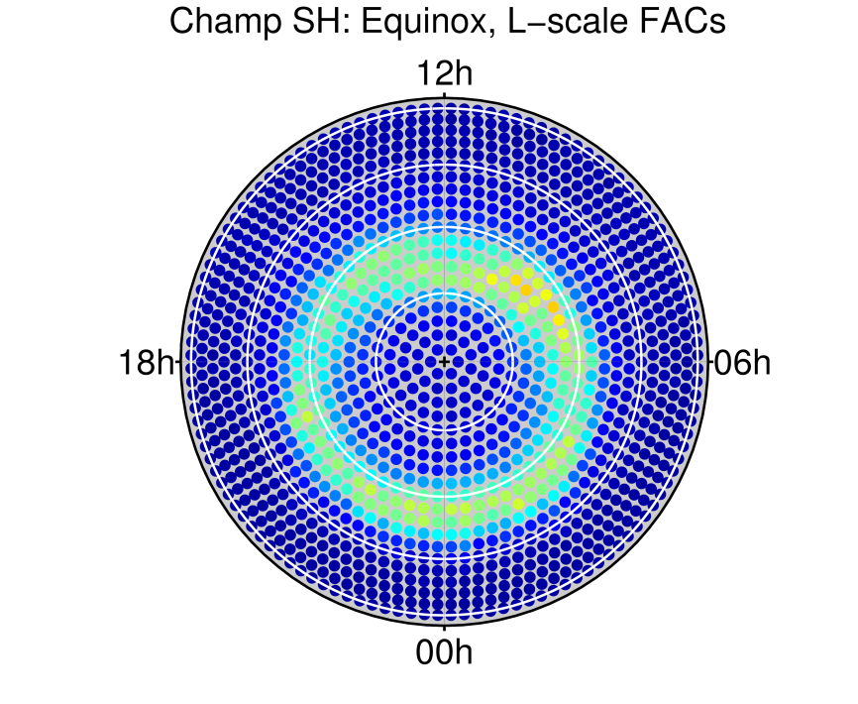
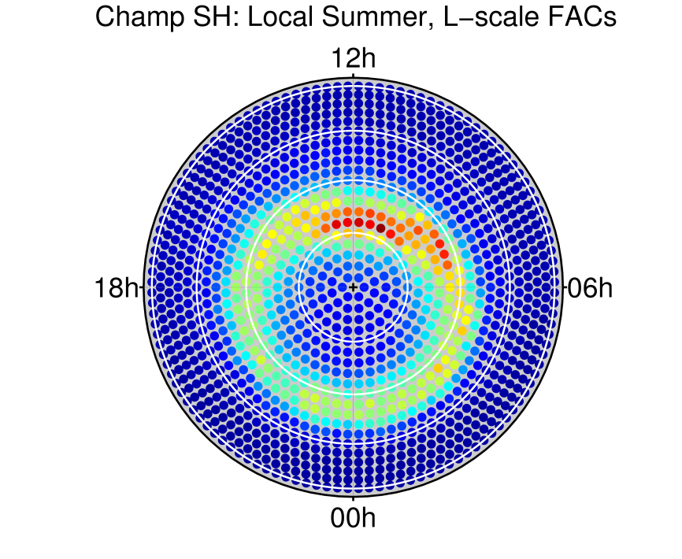
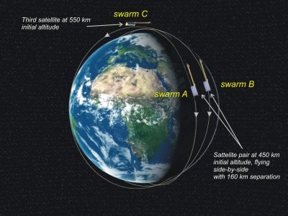
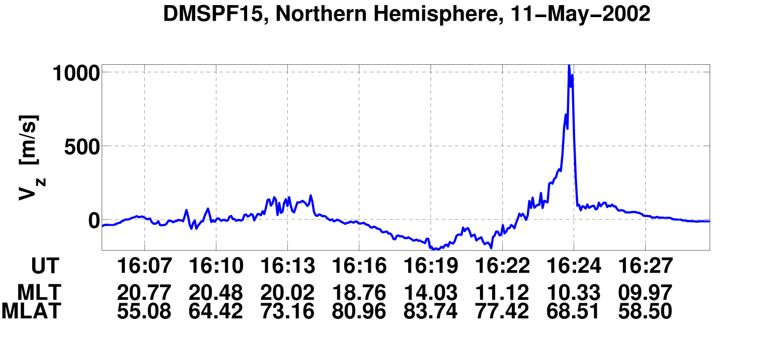
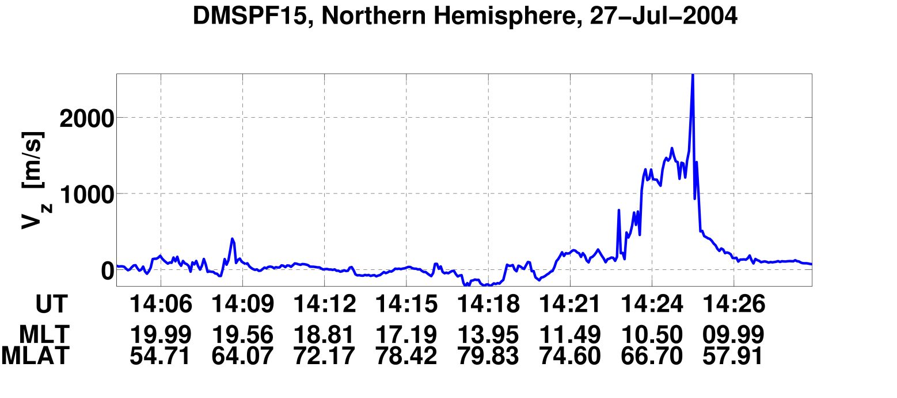
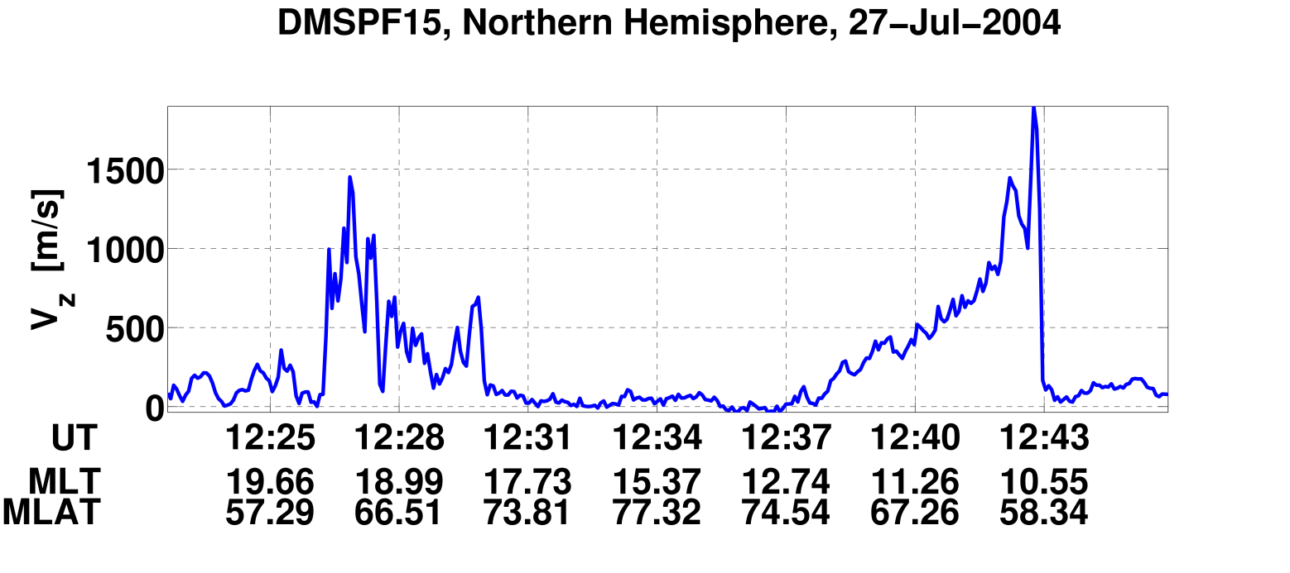


The thermospheric mass density anomaly at polar latitudes: a comparison of
CHAMP and GRACE observations
Guram N. Kervalishvili, Hermann Lühr
GFZ German Research Centre For Geosciences, Section 2.3, Earths Magnetic Field, Telegrafenberg, D-14473 Potsdam
Motivation
Cusp Region: Density Enhancemets &
Small-scale FACs
Field-Aligned Currents (FACs)
Data Sources:
ª http://thermosphere.tudelft.nl/acceldrag/
^{b} http://cindispace.utdallas.edu/DMSP
^{c} GFZ German Research Centre for Geosciences (Patricia Ritter)
For the first time direct comparison of the thermospheric mass density anomaly observations at polar latitudes obtained from the accelerometers on board the satellites CHAMP & GRACE are presented. A systematic survey of the anomalies is based on the statistical analysis of both spacecraft observation data during the 4 years (Mar/02 – Mar/06), but only for calendar dates at which both satellite recordings are available.
One possible mechanism for creating density anomalies during geomagnetic storm time can be the ion upflow at polar altitudes. Therefore a comparison with DMSP (F13 & F15) spacecraft observations during magnetic storms (Dst < -100 nT) are also presented.
Cusp density anomalies were presented for the first time in 2004 by Lühr et al.^{[1]}, where authors draw attention to the one to one correspondence between density enhancements and the occurrence of small-scale FACs
Storm-time related density enhancements and field-aligned currents: 2010 by Liu et al.^{[2]}
Ampere-Maxwell law:
z component & no multipoint measurements^{[3]}:
Main Objectives
Cusp
Location
Single Orbit Based Comparison: GRACE & DMSP
  Is there a particular thermospheric signature related to ion outflow?
  Mass density enhancements: any coincidence with ion upflow in
  polar cap, cusp, and auroral region?
Statistical Survey: CHAMP & GRACE
  Are mass density enhancements more pronounced at higher altitudes?
  Is there a correlation with Small or/and Large-scale FACs?
Satellites
CHAMPª (400km)
GRACEª (500km)
DMSP^{b} (830km)
CHAMP: ρ_{N} & ρ_{MSIS}, FACs (large-scale & small-scale)^{c}
GRACE: ρ_{N} & ρ_{MSIS}
DMSP: V_{z}
RESULTS
CHAMP & GRACE
Summary
Mass Density: Definition of Δρ And ρ_{rel} ^{[4]}
Northern Hemisphere
Southern Hemisphere
Single Orbit Based Comparison: Northern and Southern Hemispheres
Polar Cap
Mass density: not coincident with ion upflow
Ion flow: correlation with polar rain (downward)
Cusp
Good coincidence between mass density and ion upflow enhancement
Good agreement in MLT
Auroral Region
Mass density: no enhancement
Ion flow: enhancement
Statistical Survey
Density enhancements are more pronounced at higher altitudes
Density peak location: dayside cusp
Local summer: clear cusp signature
Northern Hemisphere: confined cusp
Grace: shifted peak center
Small-scale FACs: strong seasonal variation
Large-scale FACs:
Strong seasonal variation in cusp, but not in nightside region
Seems to be distributed along the auroral oval
Northern Hemisphere
GRACE
Secondary smaller peak location: nightside
Small-scale FACs
Correlation with ρ_{rel} in cusp, but not in other regions for local winter
Southern Hemisphere
CHAMP & GRACE
Secondary smaller peak location: nightside
Small-scale FACs
Correlation with ρ_{rel} in cusp, but not in other regions
CHAMP: Mass Density ρ_{rel}
CHAMP: Mass Density ρ_{rel}
Season Definitions: Northern Hemisphere
Local Winter
Equinox
Local Summer
1st Jan ±65 Days
1st Apr/Oct ±32/32 Days
1st Jul ±65 Days
GRACE: Mass Density ρ_{rel}
GRACE: Mass Density ρ_{rel}
Density Enhancement: CHAMP vs GRACE
Comparison of ρ_{rel}: Northern and Southern Hemispheres
CHAMP: Small-scale FACs
CHAMP: Small-scale FACs
GRACE & DMSP (F13 & F15)
Northern Hemisphere
Grace: Mass Density
CHAMP: Large-scale FACs
CHAMP: Large-scale FACs
future Plans
  EISCAT: search for ion upflow events
  Qualification of outflow intensity
  Multi-satellite Swarm^{d}: ESA's magnetic field mission
DMSP
OTHER
EISCAT
GRACE
DMSP: Vertical Velocity
    For details see:
    EGU General Assembly 2012
    Exhibition Entrance Hall, Ground Floor –
    Yellow Level, #34 German Swarm Project Office
    ^{d} http://www.esa.int/esaLP/ESA3QZJE43D_LPswarm_0.html
CHAMP
Local Winter
Equinox
Local Summer
Local Winter
Equinox
Local Summer
References
Polar Cap
Cusp
Auroral Region
Statistical survey over four years (Mar/02 – Mar/06) of the relative mass density anomaly ρ_{rel} , small and large- scale FACs of the Northern (left) and Southern (right) Hemisphere presented in a geomagnetic latitude-magnetic local time (MLT) frame
[1] Lühr, H., Rother, M., Köhler, W., Ritter, P., et al. Geophys. Res. Lett., 2004
[2] Liu, R., Lühr, H., & Ma, S. Y. Ann. Geophys., 28, 165-180, 2010
    [3] Wang, H.; Lühr, H. & Ma, S.Y. J. Geophys. Res., AGU, 2005, 110, A03306
[4] Rentz, S. & Lühr, H. Ann. Geophys., 26, 2807-2823, 2008
Comparison of GRACE and DMSP single orbit observations during geomagnetic storms^{[2]} over four years (2002–2005)
www.gfz-potsdam.de
EGU 2012-1605 Session ST3.4

