Slide 1
The fascinating side of dirt: Soil and the global environment course
Faculty of Land and Food Systems
Centre for Teaching and Learning Technology
S. Grand¹, M. Krzic¹, C. Crowley², G. Lascu², J. Rosado²
¹Faculty of Land and Food Systems
²Centre for Teaching and Learning Technology
University of British Columbia, Vancouver, BC, Canada
sgrand@interchange.ubc.ca

Slide 2
Faculty of Land and Food Systems
Centre for Teaching and Learning Technology
Objectives
New approach to introductory soil course
Student response
Elements of success
Limitations and improvements

Slide 3
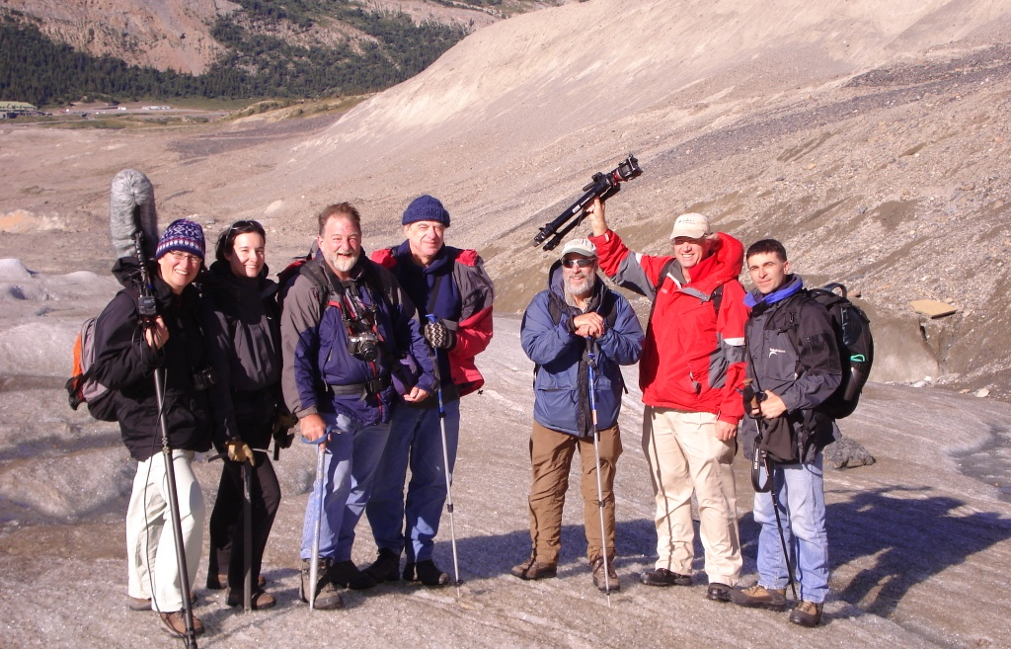
Faculty of Land and Food Systems
Centre for Teaching and Learning Technology

Slide 4
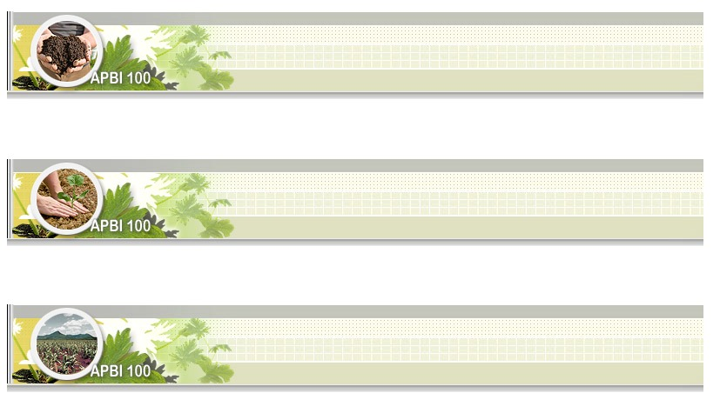
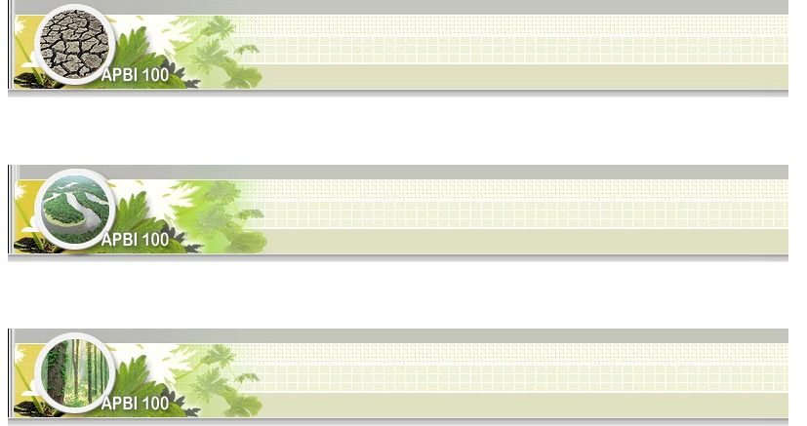
Faculty of Land and Food Systems
Centre for Teaching and Learning Technology
1. The living skin of the earth
4. Global soil quality
2. Underground ecosystems
5. Healthy watersheds
3. Soil and food security
6. Soil and climate change

Slide 5
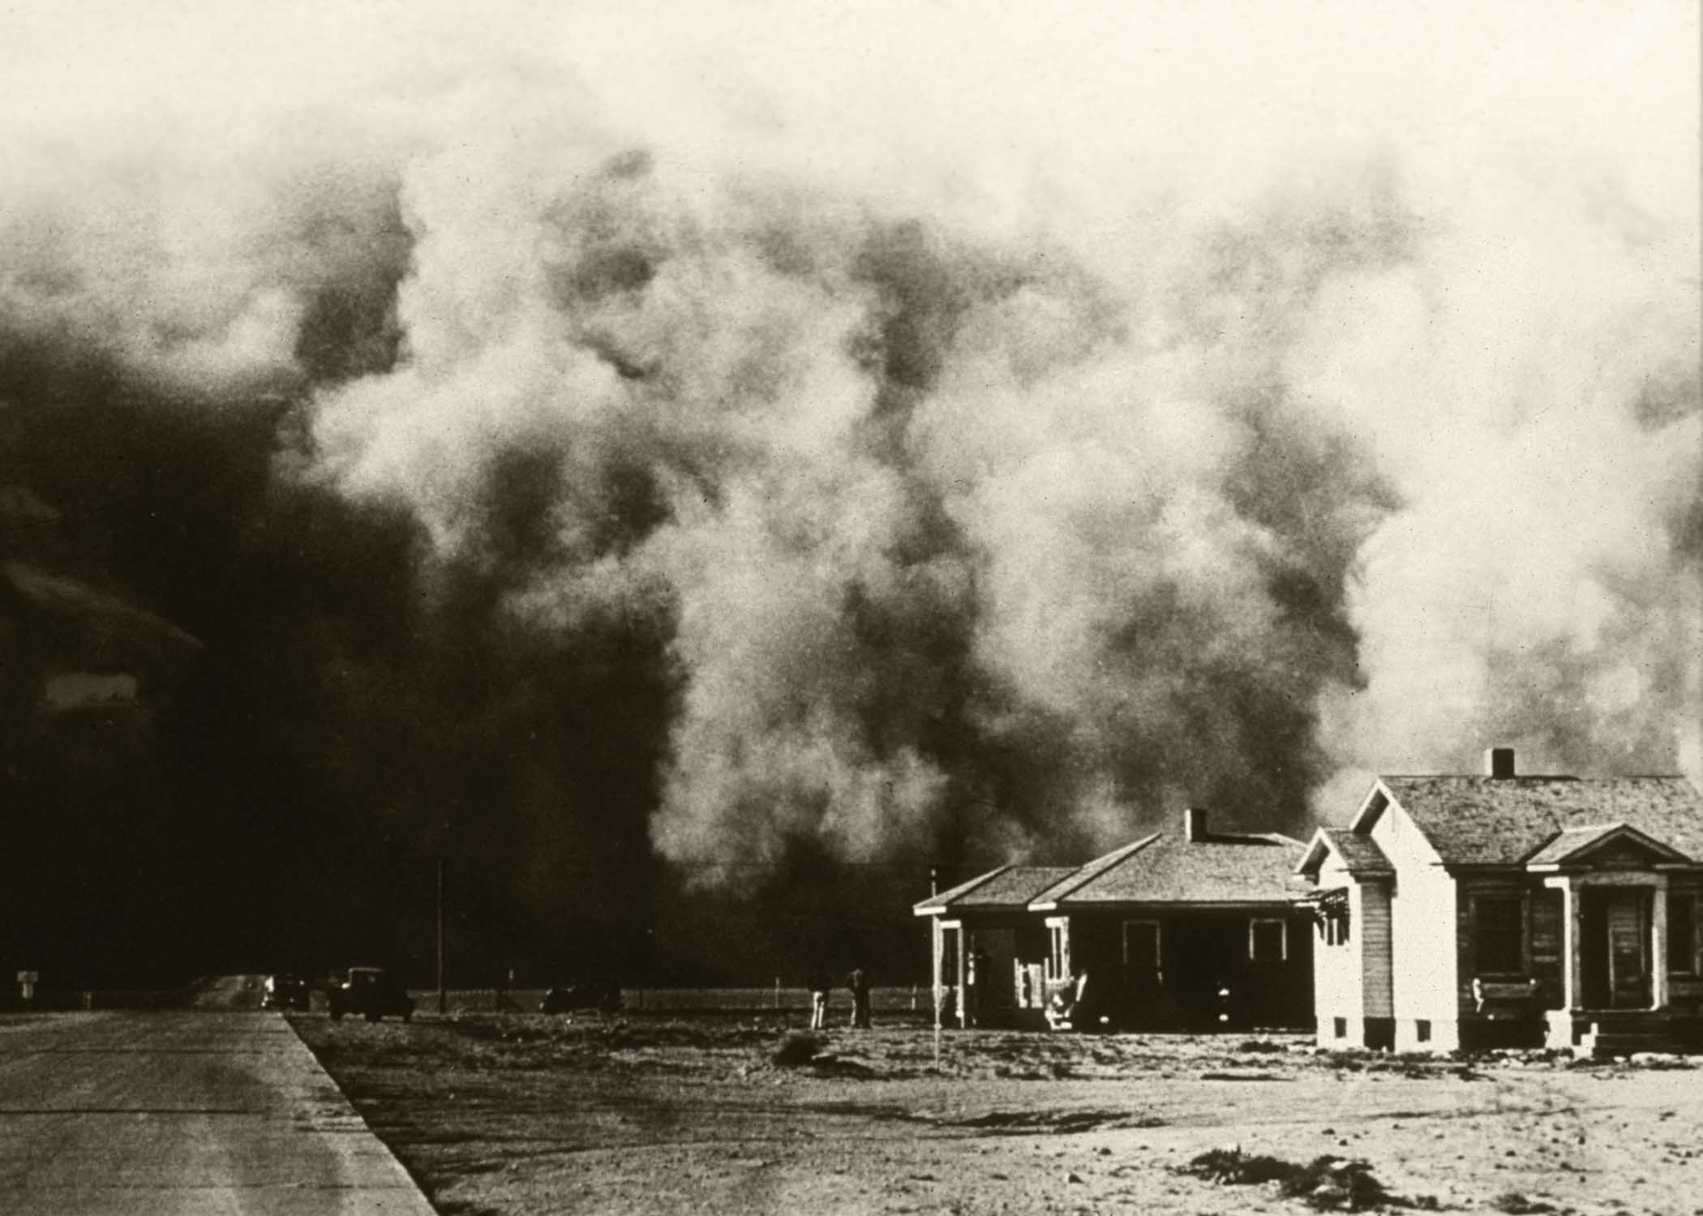
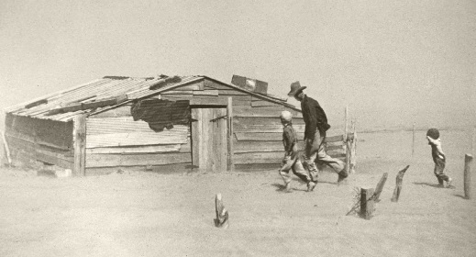
Faculty of Land and Food Systems
Centre for Teaching and Learning Technology
Approach
Focus on the link between soil and environmental sustainability
NRCS picture gallery

Slide 6
Faculty of Land and Food Systems
Centre for Teaching and Learning Technology
Approach
No pre-requisite
Online
Multimedia

Slide 7
Faculty of Land and Food Systems
Centre for Teaching and Learning Technology
Would you recommend this course to others? Please state why or why not. | Yes. The whole course was what I came to UBC for. This was the one course that pushed me through first year and was very mind stimulating!
 | Of course! The only course I thoroughly enjoyed, and has taught me so much about soil and the environment! A great building block for future learning at UBC!
 | Yes! I seriously think this should be a mandatory class at this point in human history - while technical and scientific, it really drives home a holistic understanding of the earth under our feet, something that we are in dire need of today. Make it a required elective for graduation! Make it a high school course! Cram it down their throats!
 | Yes. It is quite interesting to learn how the Earth is 'operated.' You can feel some gratitude towards soil (and nature) while reading the course material. Which is fantastic.
 | yes because i think soil system is important in our society and its very interesting course. i got to know more about soil system.

Slide 8
Faculty of Land and Food Systems
Centre for Teaching and Learning Technology

Slide 9
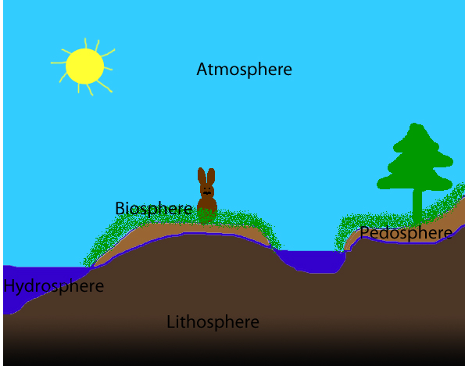
Faculty of Land and Food Systems
Centre for Teaching and Learning Technology

Slide 10
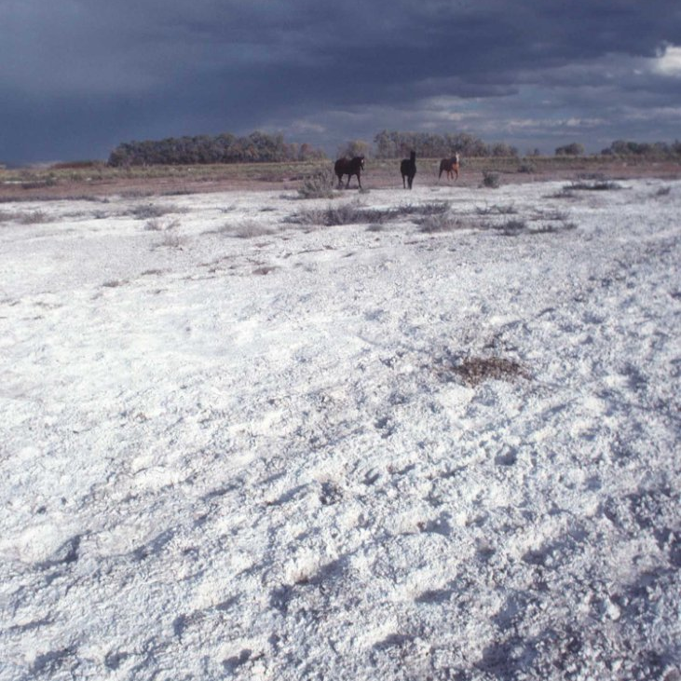
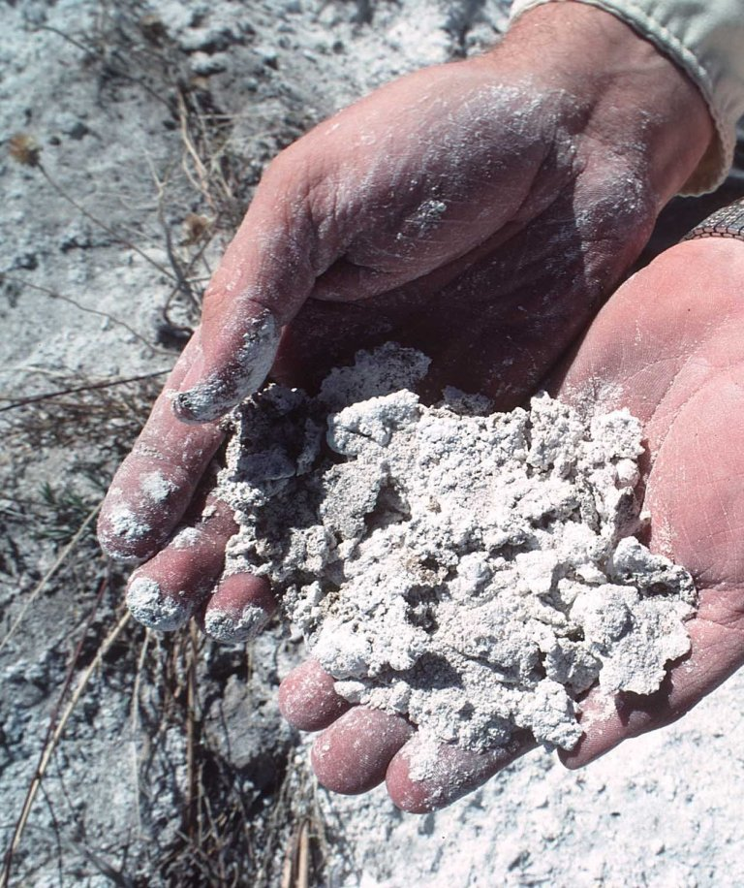
Making soil relevant
Faculty of Land and Food Systems
Centre for Teaching and Learning Technology

Slide 11
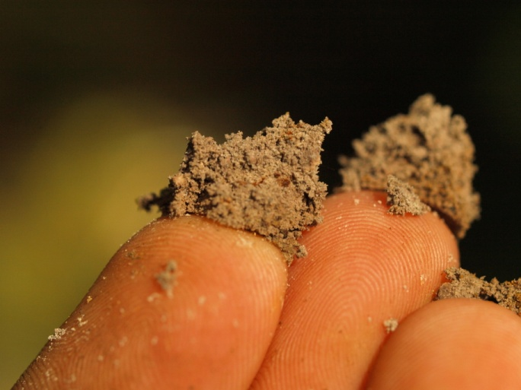
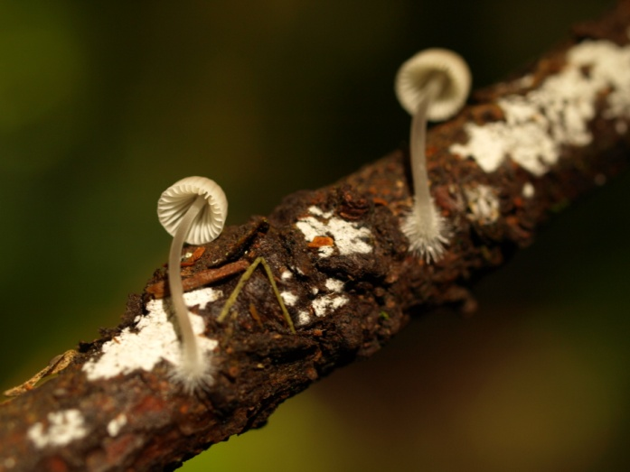
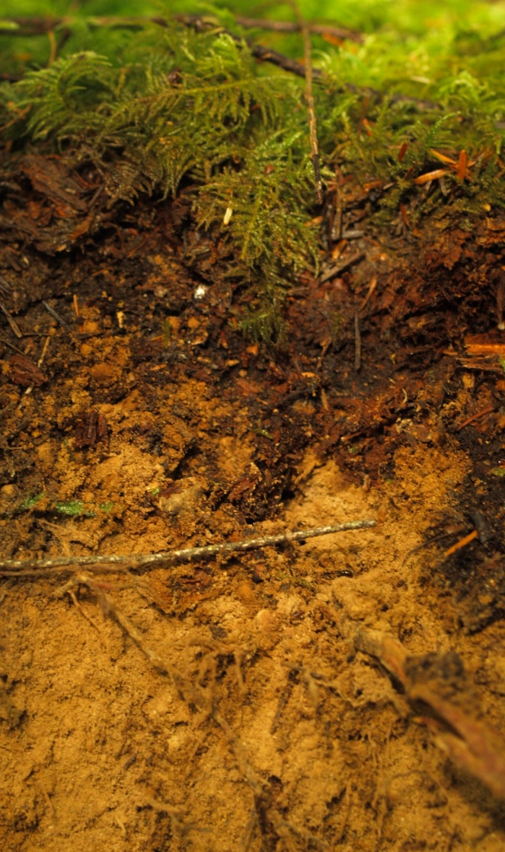
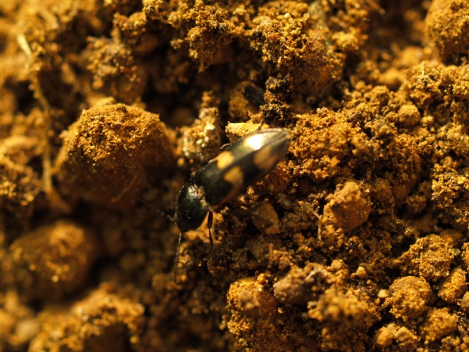
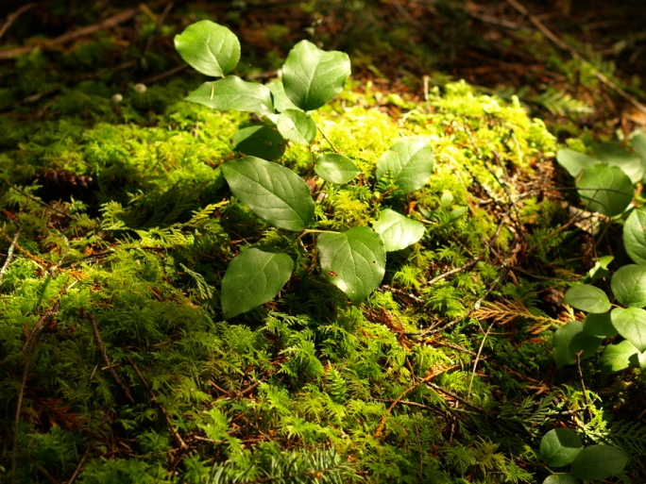
Connecting to the natural world
Faculty of Land and Food Systems
Centre for Teaching and Learning Technology

Slide 12
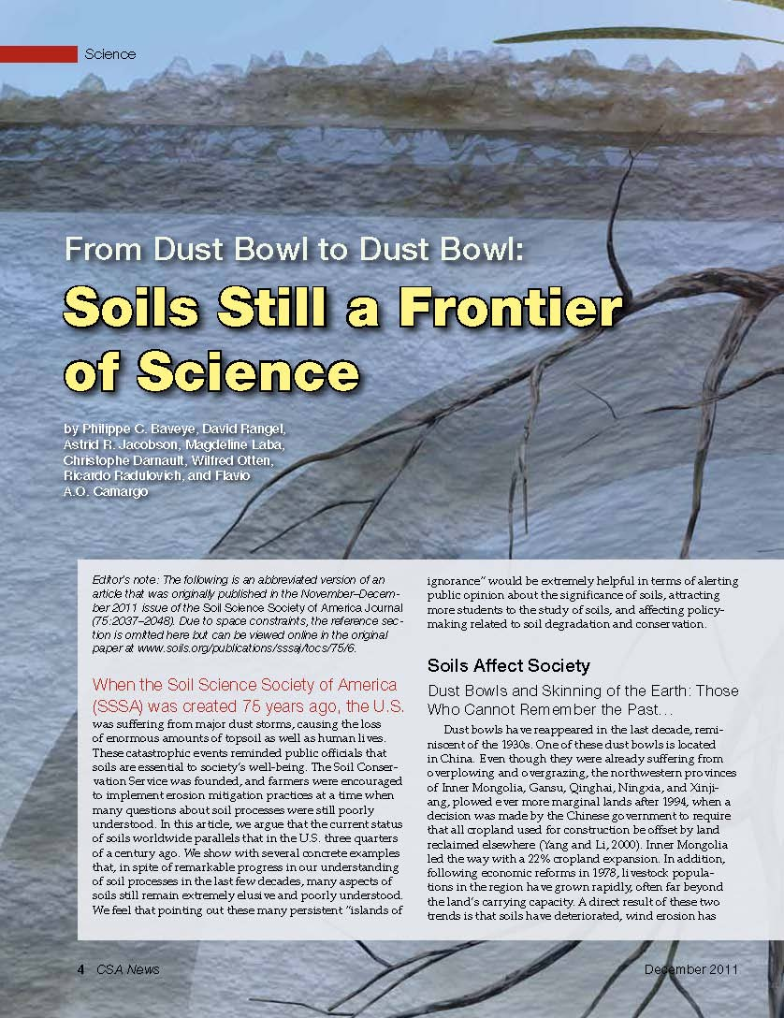
Building a learning community
Faculty of Land and Food Systems
Centre for Teaching and Learning Technology

Slide 13
Formative quizzes
Faculty of Land and Food Systems
Centre for Teaching and Learning Technology
The C horizon of a soil profile is also called:
The regolith
The solum
The topsoil
The subsoil
The parent material
The bedrock

Slide 14
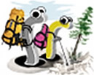
Learning outcomes
Faculty of Land and Food Systems
Centre for Teaching and Learning Technology
Appreciation of the link between soil and environmental issues
Understanding of basic soil processes
Environmental and scientific literacy
Critical analysis skills
Communication skills

Slide 15
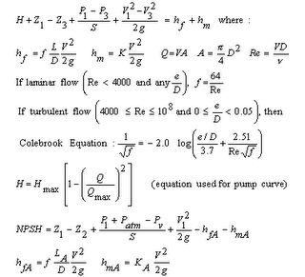
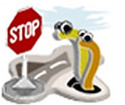
Shortcomings
Faculty of Land and Food Systems
Centre for Teaching and Learning Technology

Slide 16
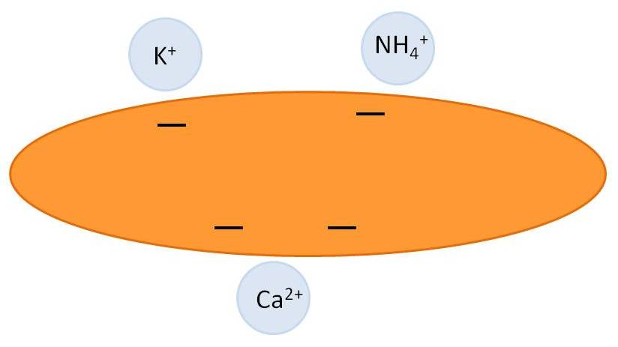
Improvement?
Faculty of Land and Food Systems
Centre for Teaching and Learning Technology

Slide 17
Conclusion
Faculty of Land and Food Systems
Centre for Teaching and Learning Technology
Well-received online introductory soil science course
Appearance
Relevance
Field exposure
Interaction
Improvements
Quantitative skills

Slide 18
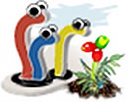
Acknowledgements
Faculty of Land and Food Systems
Centre for Teaching and Learning Technology
Dr. Maja Krzic
Chris Crowley
Gabriel Lascu
Josefina Rosado
Special thanks to the French Association for Soil Study (AFES) for financial support

Slide 19
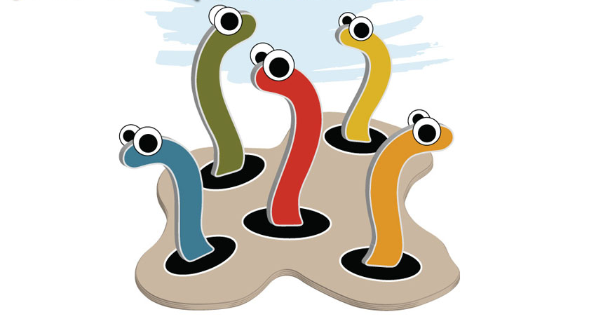
Questions?
Faculty of Land and Food Systems
Centre for Teaching and Learning Technology
Stephanie Grand sgrand@interchange.ubc.ca

