Slide 1

Non-parametric data-based approach for the quantification and communication of uncertainties in river flood forecasts
Niels Van Steenbergen
Patrick Willems
KULeuven – Hydraulics Division
EGU General Assembly, Vienna, April 2012
Session NH1.6/HS4.7

Slide 2


Outline
Introduction
Methodology
Communication
Conclusion

Slide 3
Introduction
Flood forecasting models of Flanders Hydraulics Research
Navigable waterways in Flanders, Belgium
48h time horizon
Deterministic results (water levels & discharges)
Hydrological (NAM), hydrodynamic (Mike11) & rainfall forecasts => subject to uncertainties
=> Methodology to quantify and visualise uncertainty

Slide 4
Methodology
Statistical analysis of model error
Non-parametric approach
Data-based (historical simulation results)
Case study:
Ghent Channels
Catchment | River / Channel | Location
Demer | Demer | Aarschot
 | Demer | Zichem
Yser | Yser | Lo-Fintele
 | Channel Nieuwpoort - Duinkerke | Veurne
Dender | Dender | Overboelare
Bruges Polders | Channel Ghent-Ostend | Steenbrugge
 | Channel Ghent-Ostend | Varsenare
 | Channel Ghent-Ostend | Plassendale
Ghent Channels | Lys Channel | Deinze
 | Ringvaart | Evergem
Lys | Lys | Menen
Nete | Grote Nete | Hulshout
Scheldt | Scheldt | Antwerp
Bruges Polders
Scheldt
Nete
Lys
Upper Scheldt

Slide 5
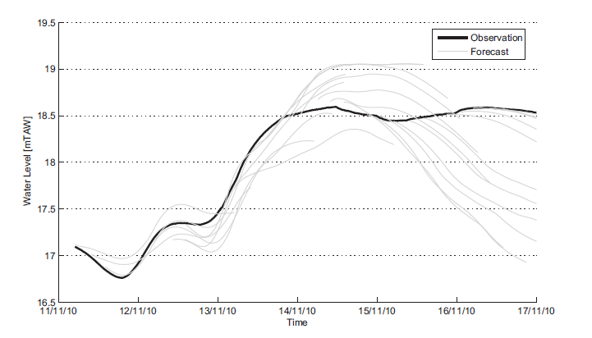
Methodology
Statistical analysis of model error
Non-parametric approach (no predef. prob. distr.)
Data-based (historical simulation results)

Slide 6
Methodology
Observation
Water Level
Time

Slide 7
Methodology
Observation
Simulation
Water Level
TOF1
TOF2
TOF3
TOF4
Time

Slide 8
Methodology
Residuals
Observation
Simulation
Water Level
TOF1
TOF2
TOF3
TOF4
Time

Slide 9

Methodology
Residuals
Observation
Simulation
4
3
2
1
Value Class
2 3 4 5
Time Horizon Class
Time

Slide 10
Methodology
Residuals
Observation
Simulation
4
3
2
1
 | 1 | 2 | 3 | 4 | 5
1
2
3
4
Value Class
2 3 4 5
Time Horizon Class
Time

Slide 11
Methodology
97.5
 | 1 | 2 | 3 | 4 | 5
1
2
3
4
Percentile [%]
50
2.5
0
Residuals [m]
Bias correction
95% confidence interval

Slide 12
Methodology
97.5
Percentile [%]
50
Value Class
3D error matrix
Percentile
2.5
Time Horizon Class
0
Residuals [m]
Bias correction
95% confidence interval

Slide 13
Methodology
3D error matrix

Slide 14
Methodology
Value Class
3D error matrix
Percentile
Water Level
Time Horizon Class
Time

Slide 15
Methodology
ALARM Level
ALERT Level
Exceedance Probability
Water Level
Time
Time

Slide 16
Communication
Simple
Easy to understand
Larger public
Time independent
No decision making
Linguistic
Technical
Precise
Larger Public (without reference)
Time independent
No decision making
Numerical
Time (in)dependent
Precise
Decision making
Water managers
Difficult
Interpretation
Graphical

Slide 17

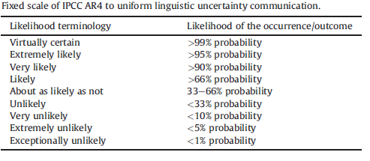
Communication
Linguistic

Slide 18
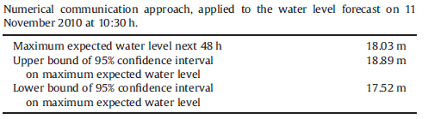
Communication
Numerical

Slide 19
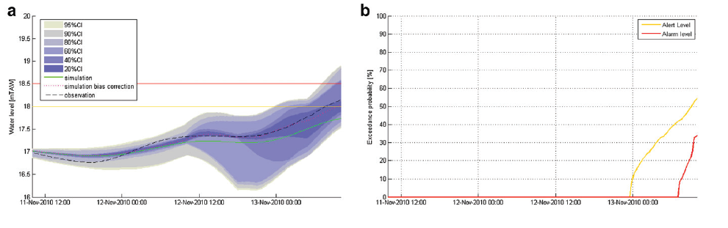
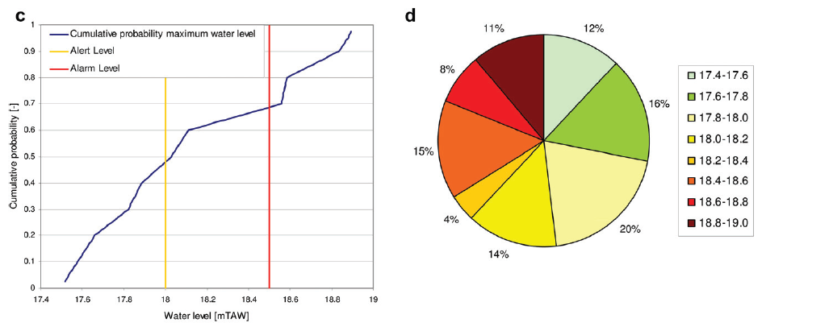
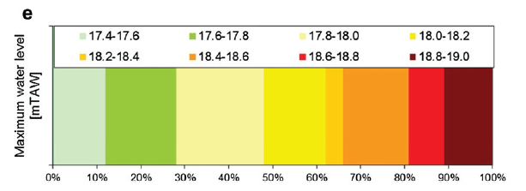
Communication
Graphical

Slide 20
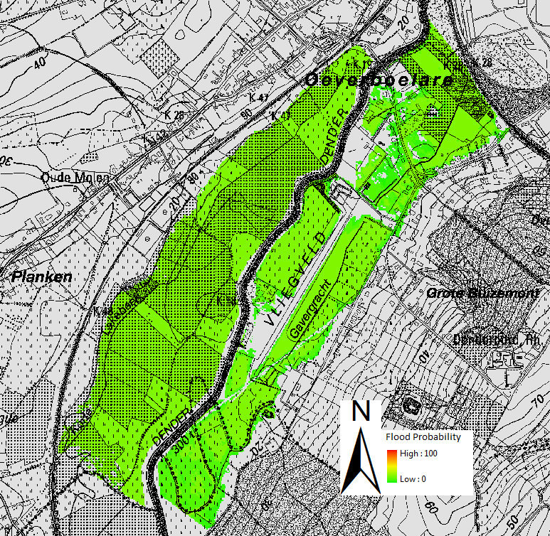
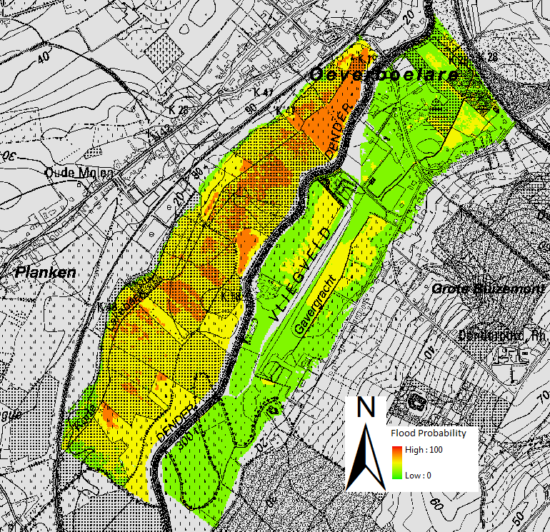
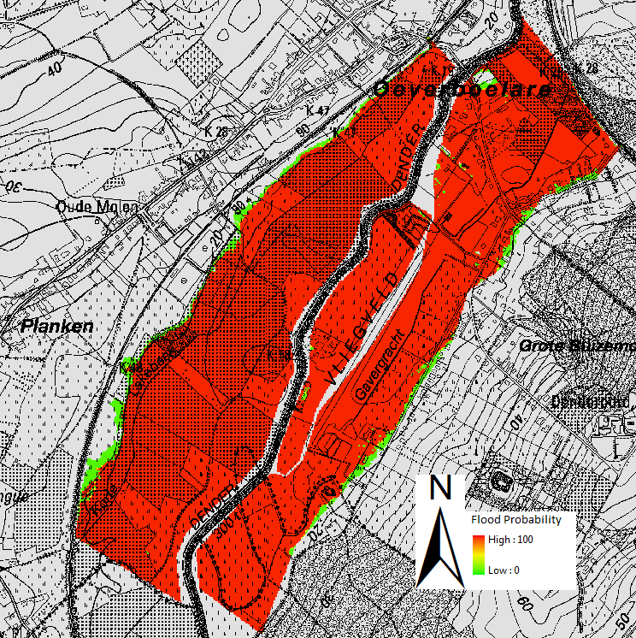
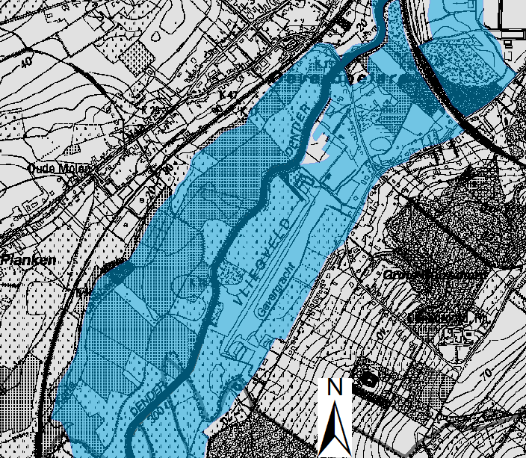
Communication
Probabilistic flood maps
13/11/2010 05:00
13/11/2010 10:00
14/11/2010 01:00

Slide 21
Conclusion
Simple, but efficient method
Total uncertainty (not only input)
More information compared with deterministic results
Different communication strategies

Slide 22
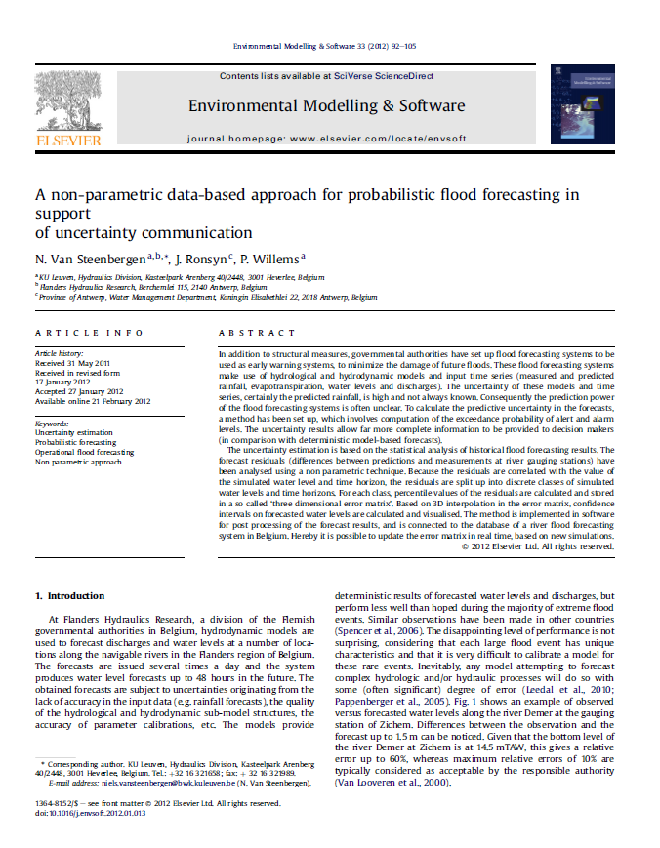
Questions??
Contact: niels.vansteenbergen@bwk.kuleuven.be
For more information: Van Steenbergen N., Ronsyn J., Willems P. (2012). A non-parametric data-based approach for probabilistic flood forecasting in support of uncertainty communication. Environmental Modelling & Software 33, 92-105.

