Slide 1
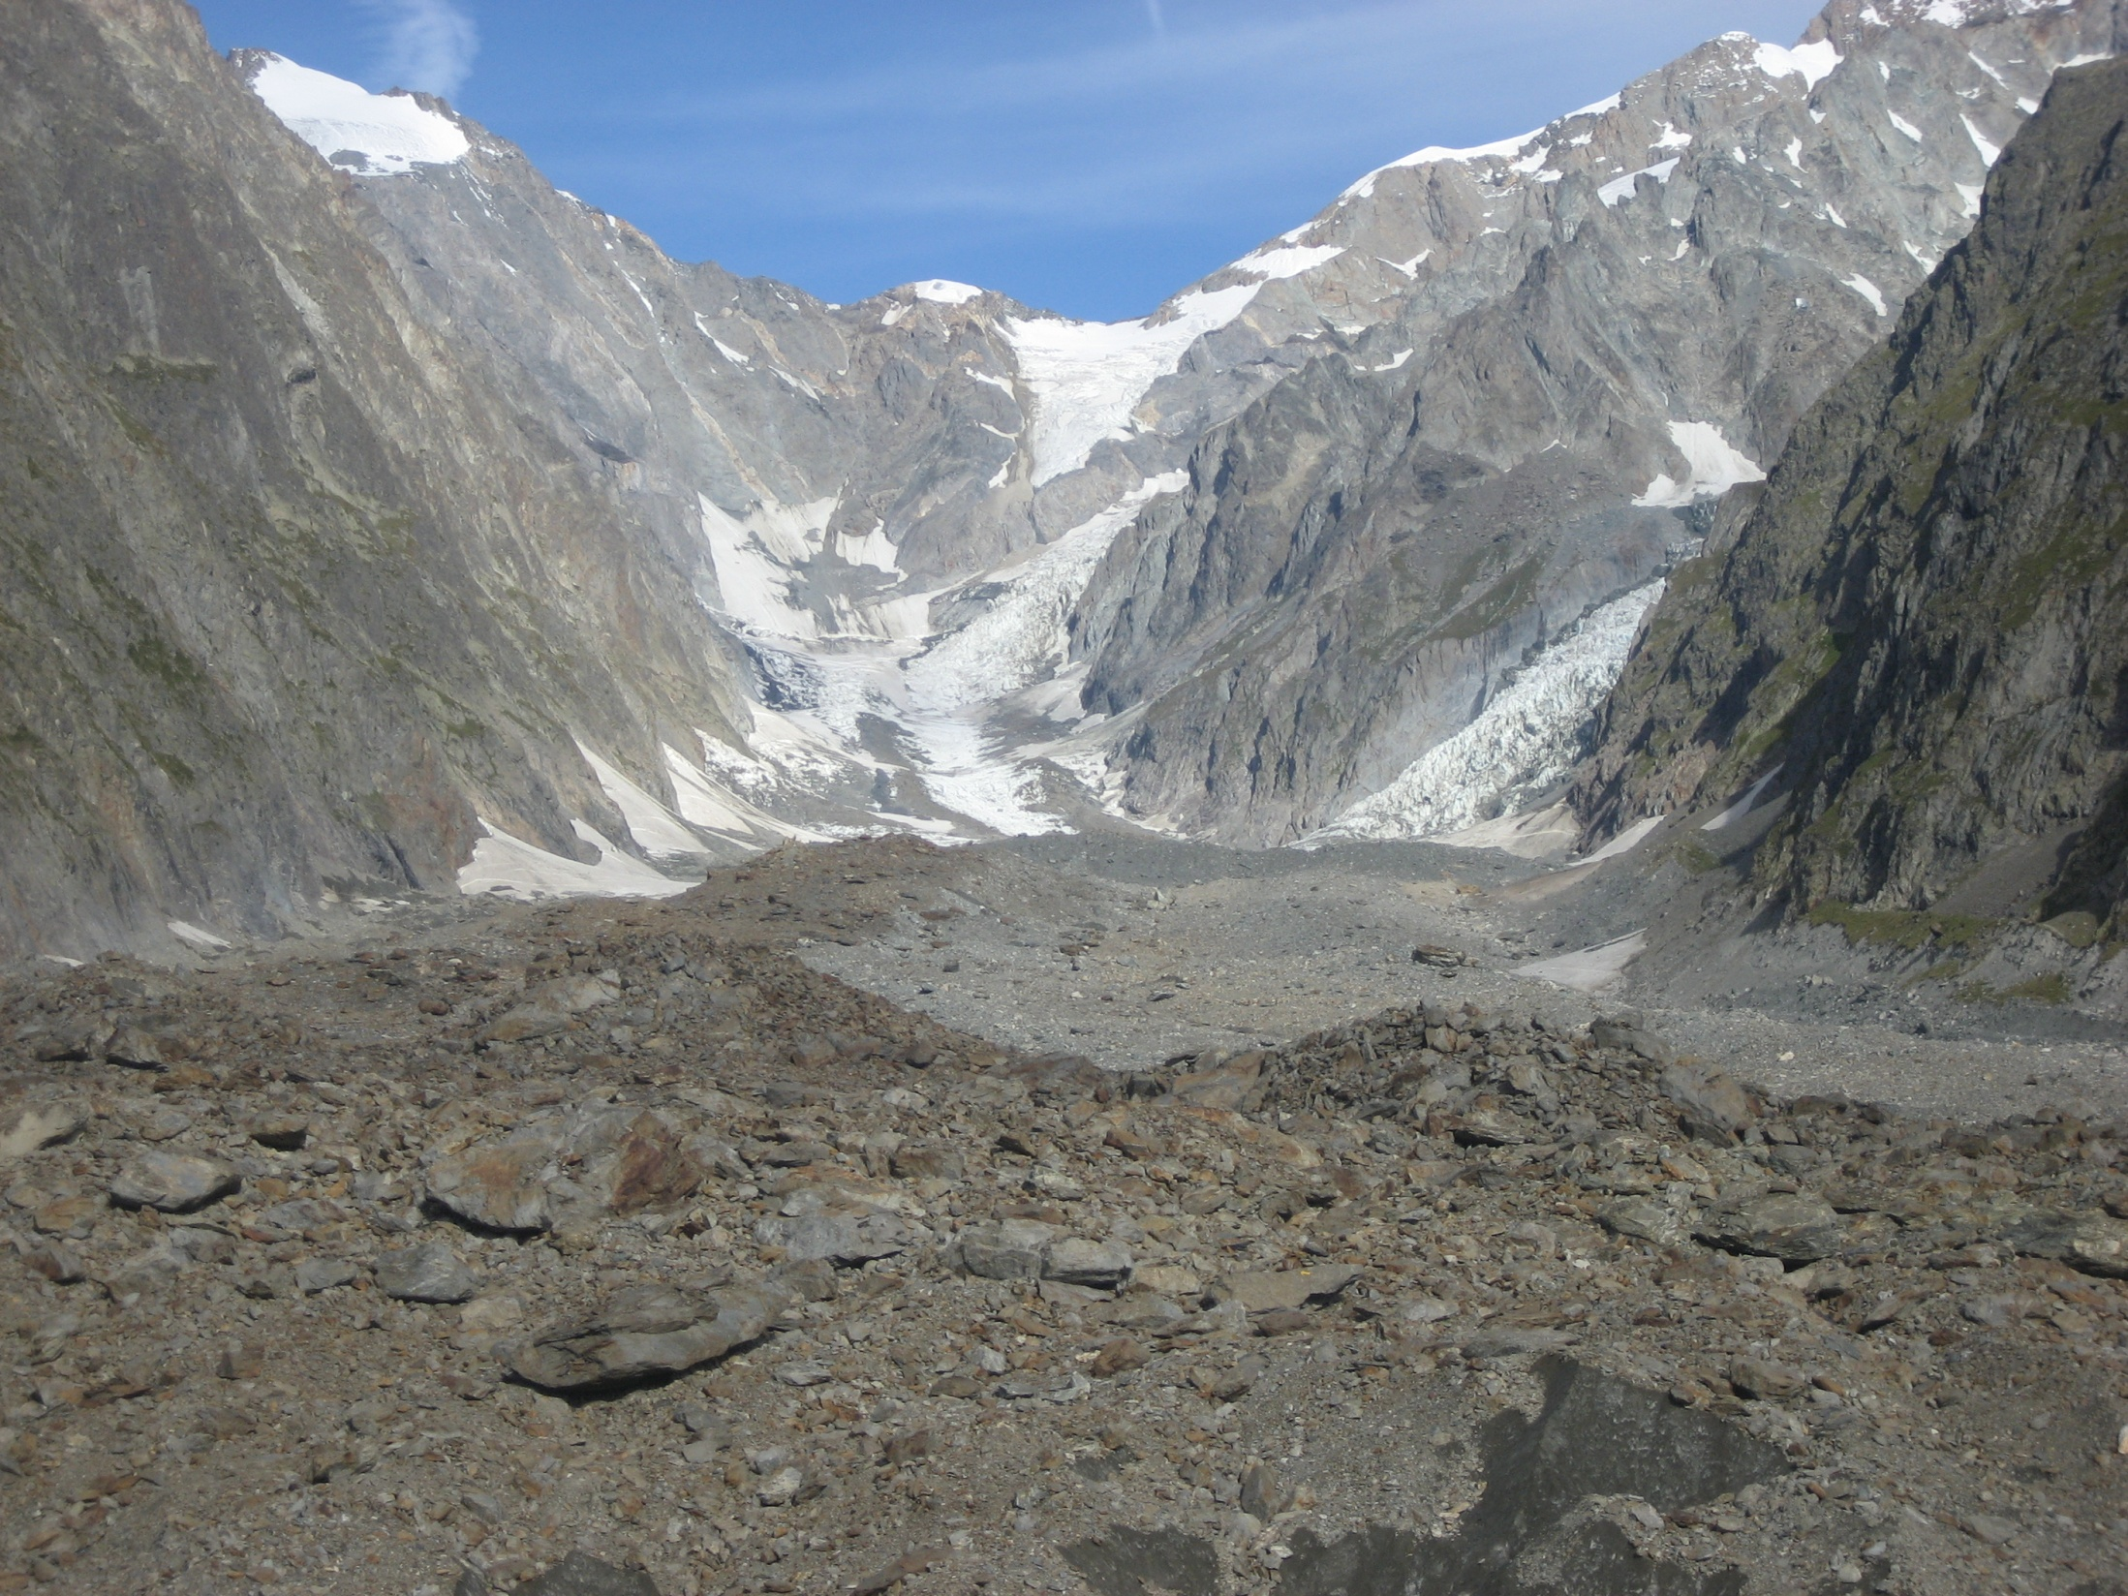
The influence of supraglacial debris cover on glacier hydrology: Miage Glacier, Italy.
Catriona Fyffe
Ben Brock, Martin Kirkbride and Doug Mair

Slide 2
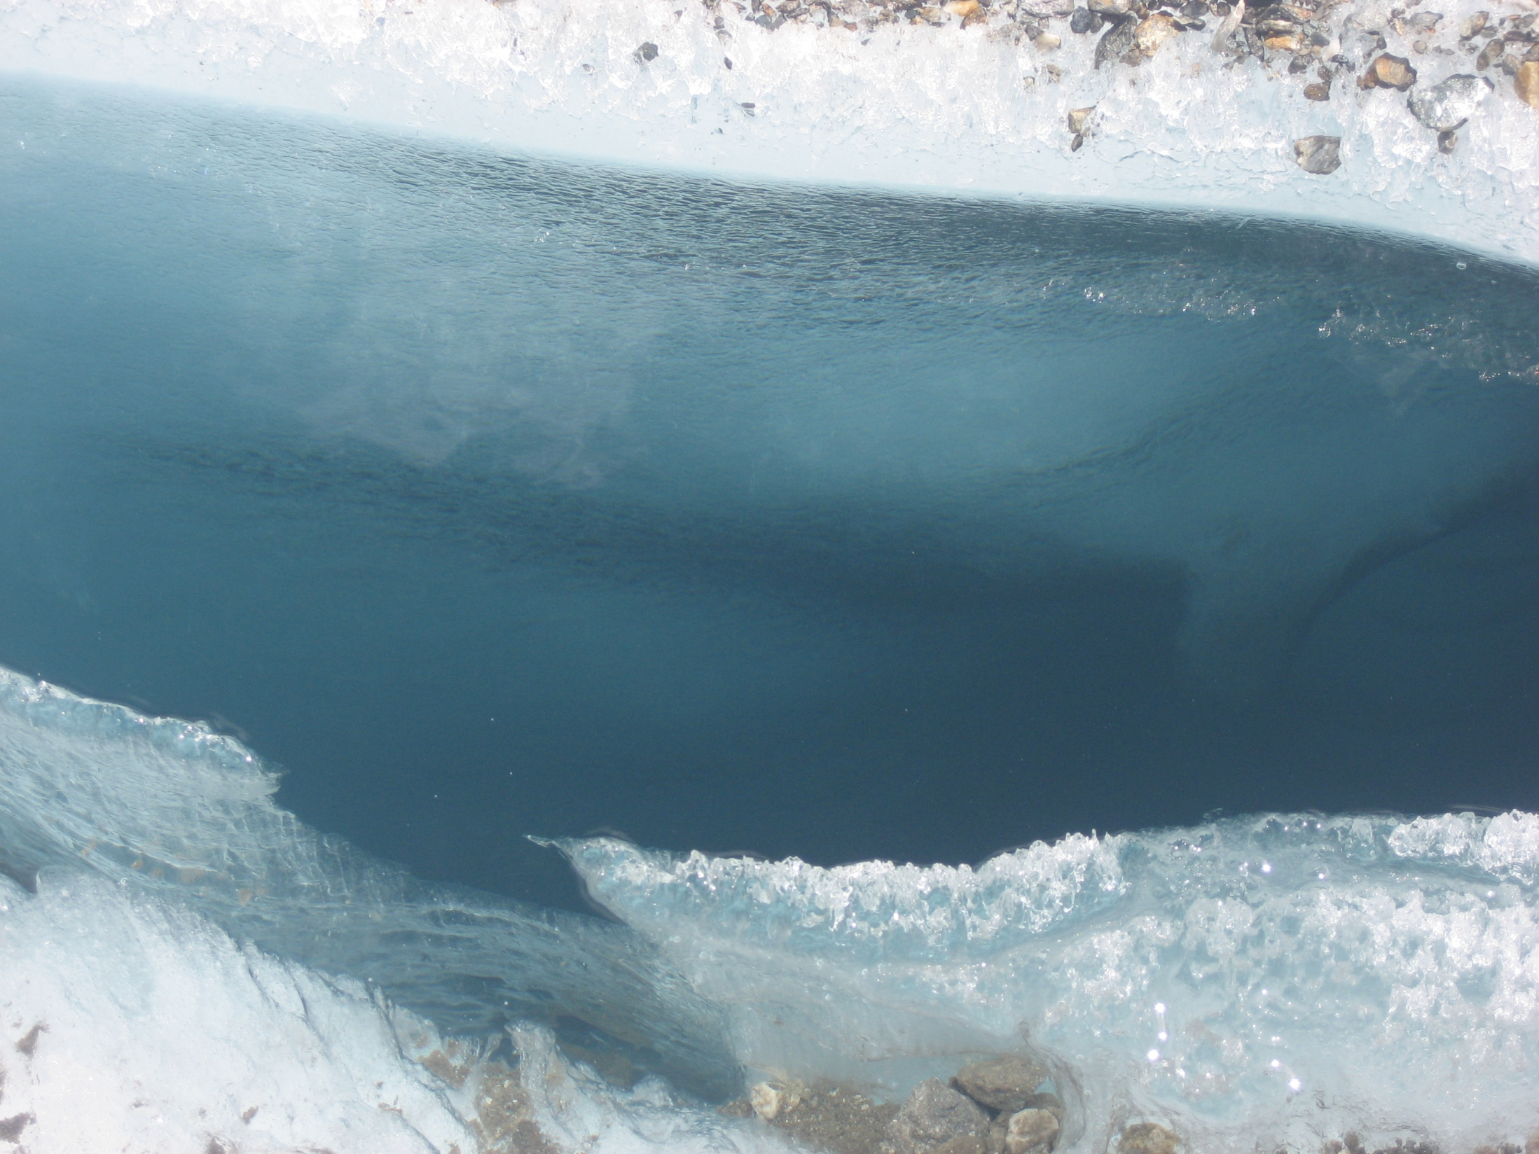
Aims
1. Understand the influence of the debris on the structure and evolution of the hydrological drainage network.
2. Understand the influence of the debris the water balance of the glacier.

Slide 3
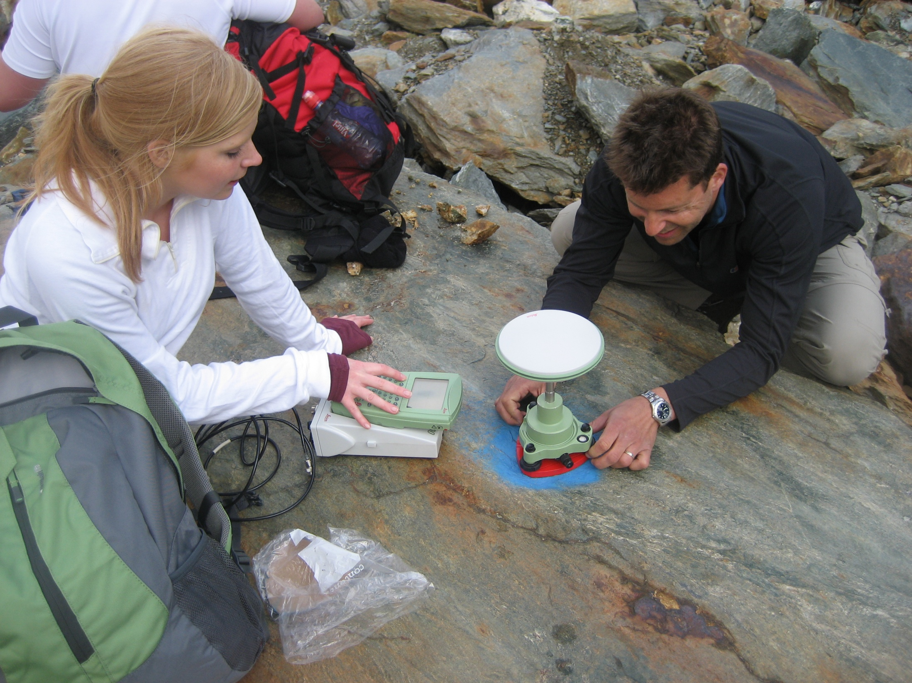
Methodology
Glacier velocity measurements using a Leica differential GPS
Dye tracing
Analysis of proglacial stream water (for suspended sediment concentration, pH, conductivity, temperature, bicarbonate and sulphate ion concentration)
Weather data from three automatic weather stations, with a rain gauge at upper and lower, and a lysimeter at the lower station
Ablation stake measurements and melt modelling
Pressure transducer on the proglacial stream

Slide 4
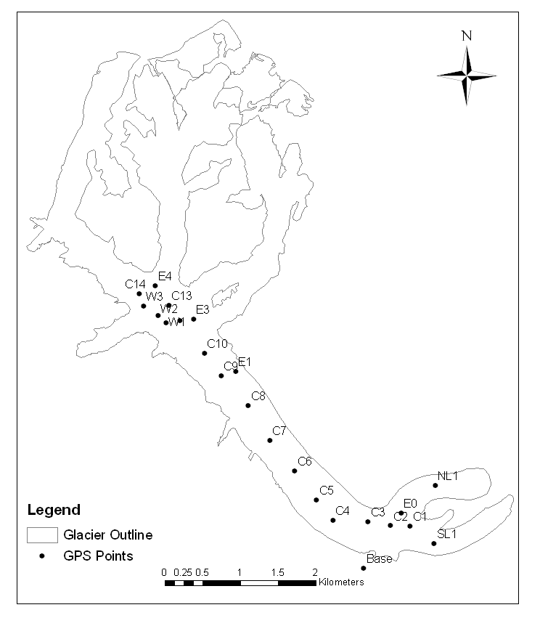
Instrument Setup
Notes:
The Miage Glacier is situated in the Western Italian Alps and drains the western side of Mont Blanc. It has an area of 10.5 km² and a thick debris cover over its main tongue (mean thickness 0.25 m, Foster et al. (in press)). Left hand map shows dye injection points and met stations, right hand map shows GPS points.

Slide 5
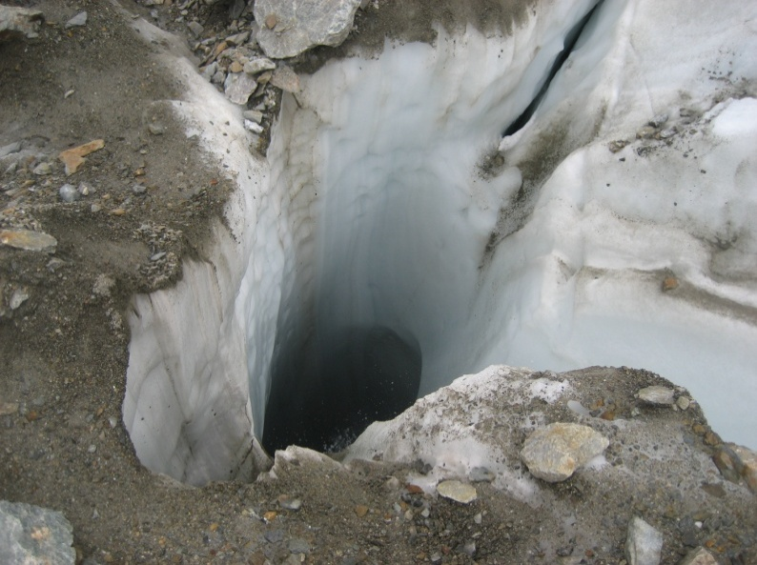
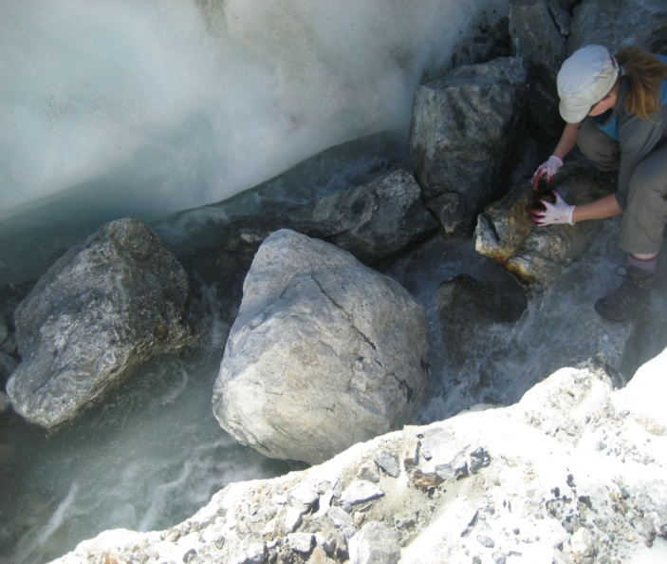
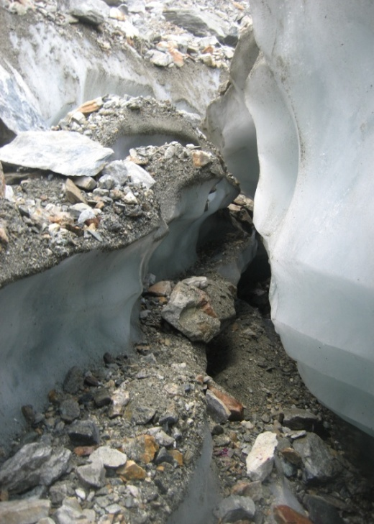
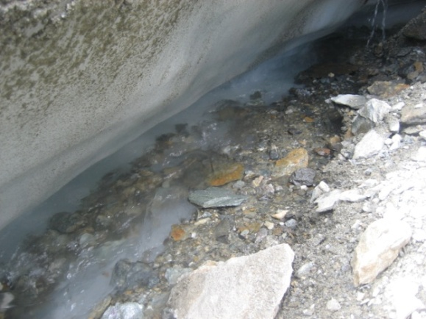
Supraglacial hydrology
S14: 0.62 m³s⁻¹, 1.52 ms⁻¹
S12: 0.18 m³s⁻¹, 0.46 ms⁻¹
S5 (above): 0.030 m³s⁻¹,
0.19 ms⁻¹
S7 (left): 0.019 m³s⁻¹ , 0.24 ms⁻¹

Slide 6
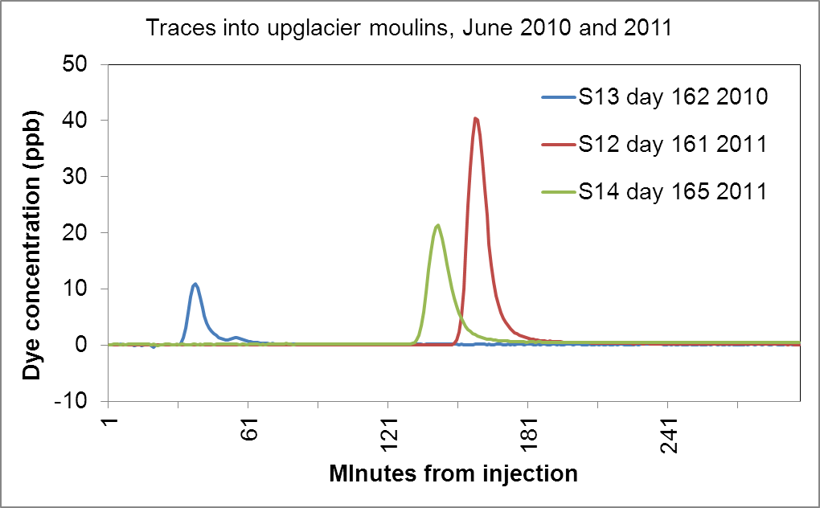
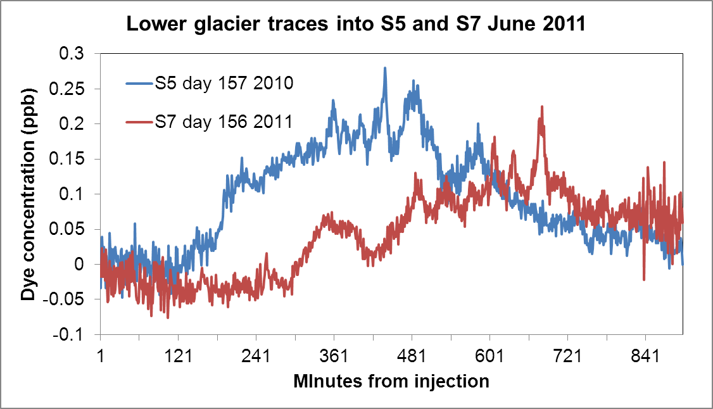
Englacial and subglacial system in June
Upglacier traces fast and peaked, even in early June when upper glacier snow covered – indicative of conduit system:
S12: 0.52 ms⁻¹, 87%
S13: 0.83 ms⁻¹, 86%
S14: 0.48 ms⁻¹, 84%
Lower glacier traces, slower than upper glacier, some multipeaked – indicative of distributed system:
S1: 0.067 ms⁻¹, 17%
S3: 0.19 ms⁻¹, 3.9%
S5: 0.070 ms⁻¹, 37%
S7: 0.073 ms⁻¹, 16%

Slide 7
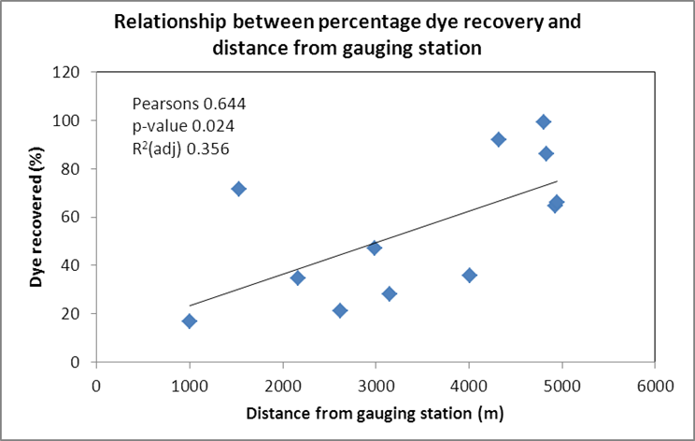
Overall structure
Clear increase in trace velocity with distance up-glacier
Percentage dye recovery high for top 5 moulins (~80%), and lower (~40%) on lower glacier
Notes:
On Haut Glacier d’Arolla, trace velocity decreased up-glacier, most steeply at the channel head in between the conduit and up-glacier distributed system, which is marked by the snowline and follows its retreat up-glacier (Nienow et al., 1998).
On the Miage, the upper glacier is channelized early, with trace velocities
Channelised systems are efficient and have high percentage dye recovery whereas distributed systems have a lower percentage dye recovery. This may be accentuated by the sediment layer beneath the lower glacier, allowing water to be lost to storage.

Slide 8
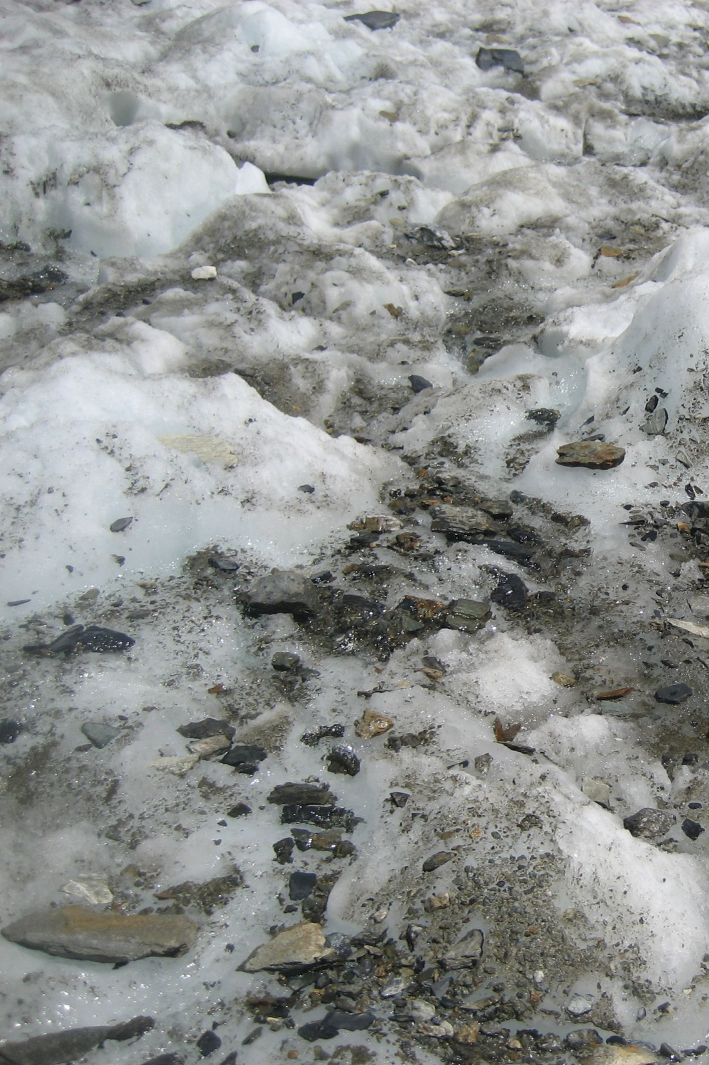
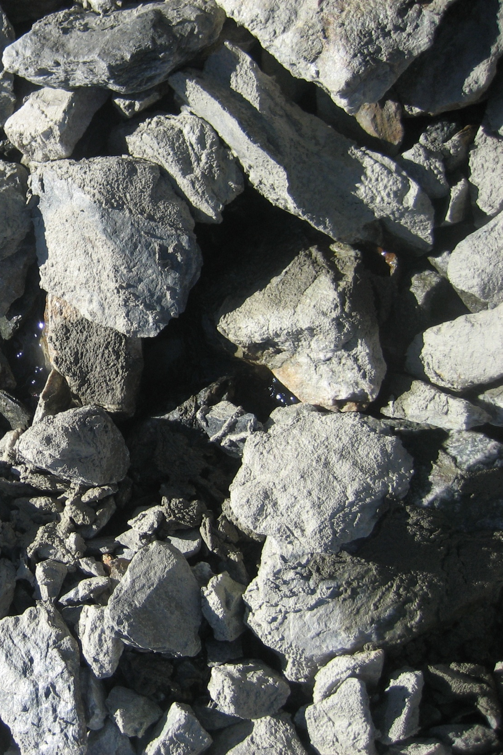
Why channelised early upglacier?
Why less efficient downglacier?
On the upper glacier:
Larger melt inputs, even early in season
Focussed by valley systems
Larger input streams
Able to cause channelization early in the season
Evidence of supraglacial lake drainage accelerating opening of conduit system
On the lower glacier:
Melt inputs lower
Hummocky topography
Gives small, slow streams
Inputs at any given point are not large enough to create an efficient link between the local inputs and the main channel system

Slide 9
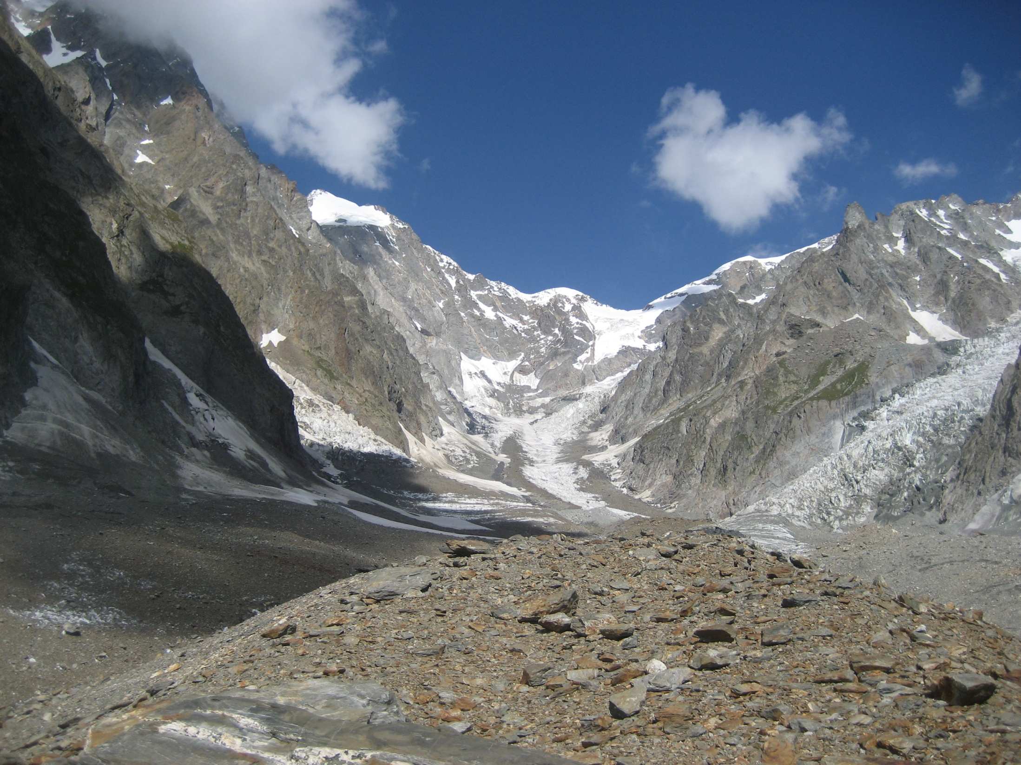
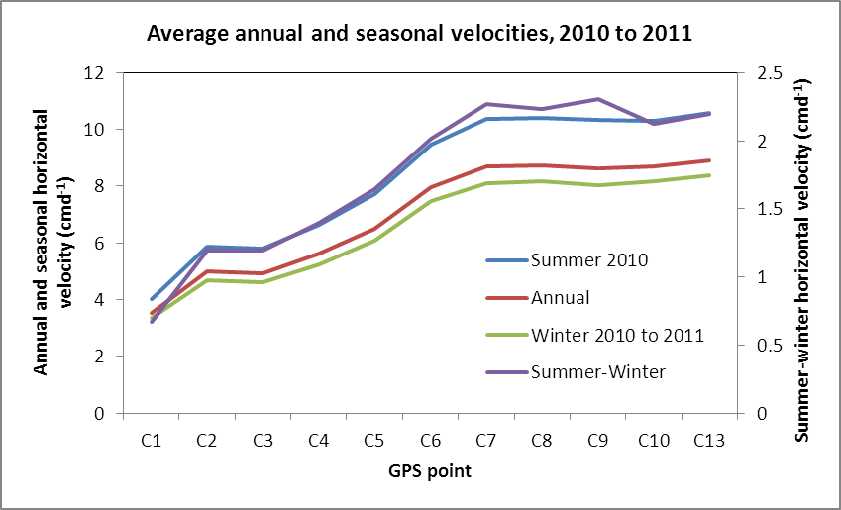
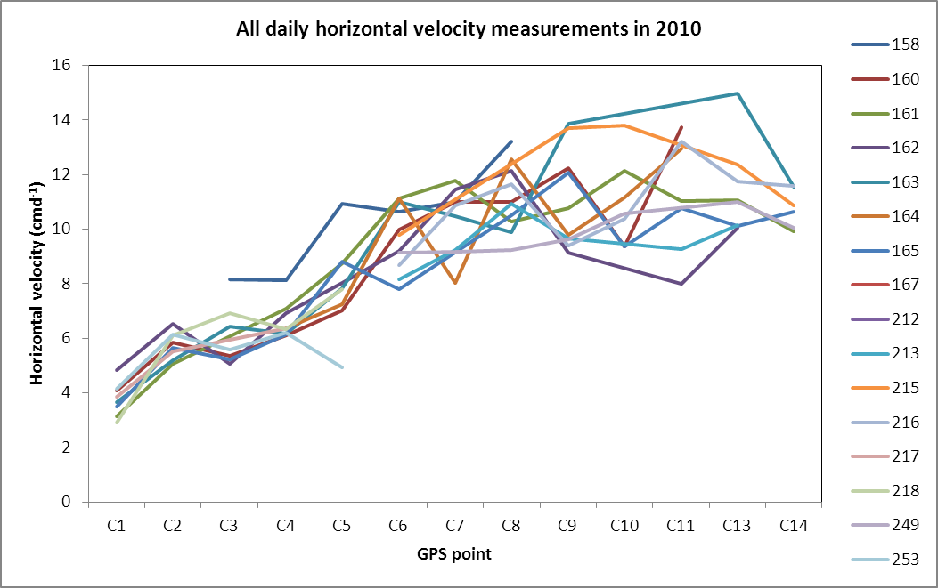
Overall Glacier Dynamics
On the upper glacier velocities are faster and there is greater variation in velocity and in the difference between summer and winter velocities.
On the lower glacier, velocities are slower, with smaller difference between summer and winter, and smaller variability in velocity
Only on day 158 2010 did the lower glacier speed up by as much as the upper glacier can.
Notes:
Overall glacier velocity pattern due to changes in the width of the valley
Summer velocities greater than winter velocities
Greater difference between summer and winter, and greater variability in velocity on upper glacier, similar to other debris-covered glaciers (Baltoro Glacier, (Mayer et al, 2006); Khumbu Glacier (Scherler et al., 2008))
Low velocities and lower variability on lower glacier despite distributed system which usually results in faster velocities. Due to small inputs which can be accommodated without a speed up.
Only on day 158 2010 did the lower glacier speed up by as much as the upper glacier can. Upper glacier system may not have been channelised yet, or inputs v. large = influx of water through distributed system all the way to lower glacier

Slide 10
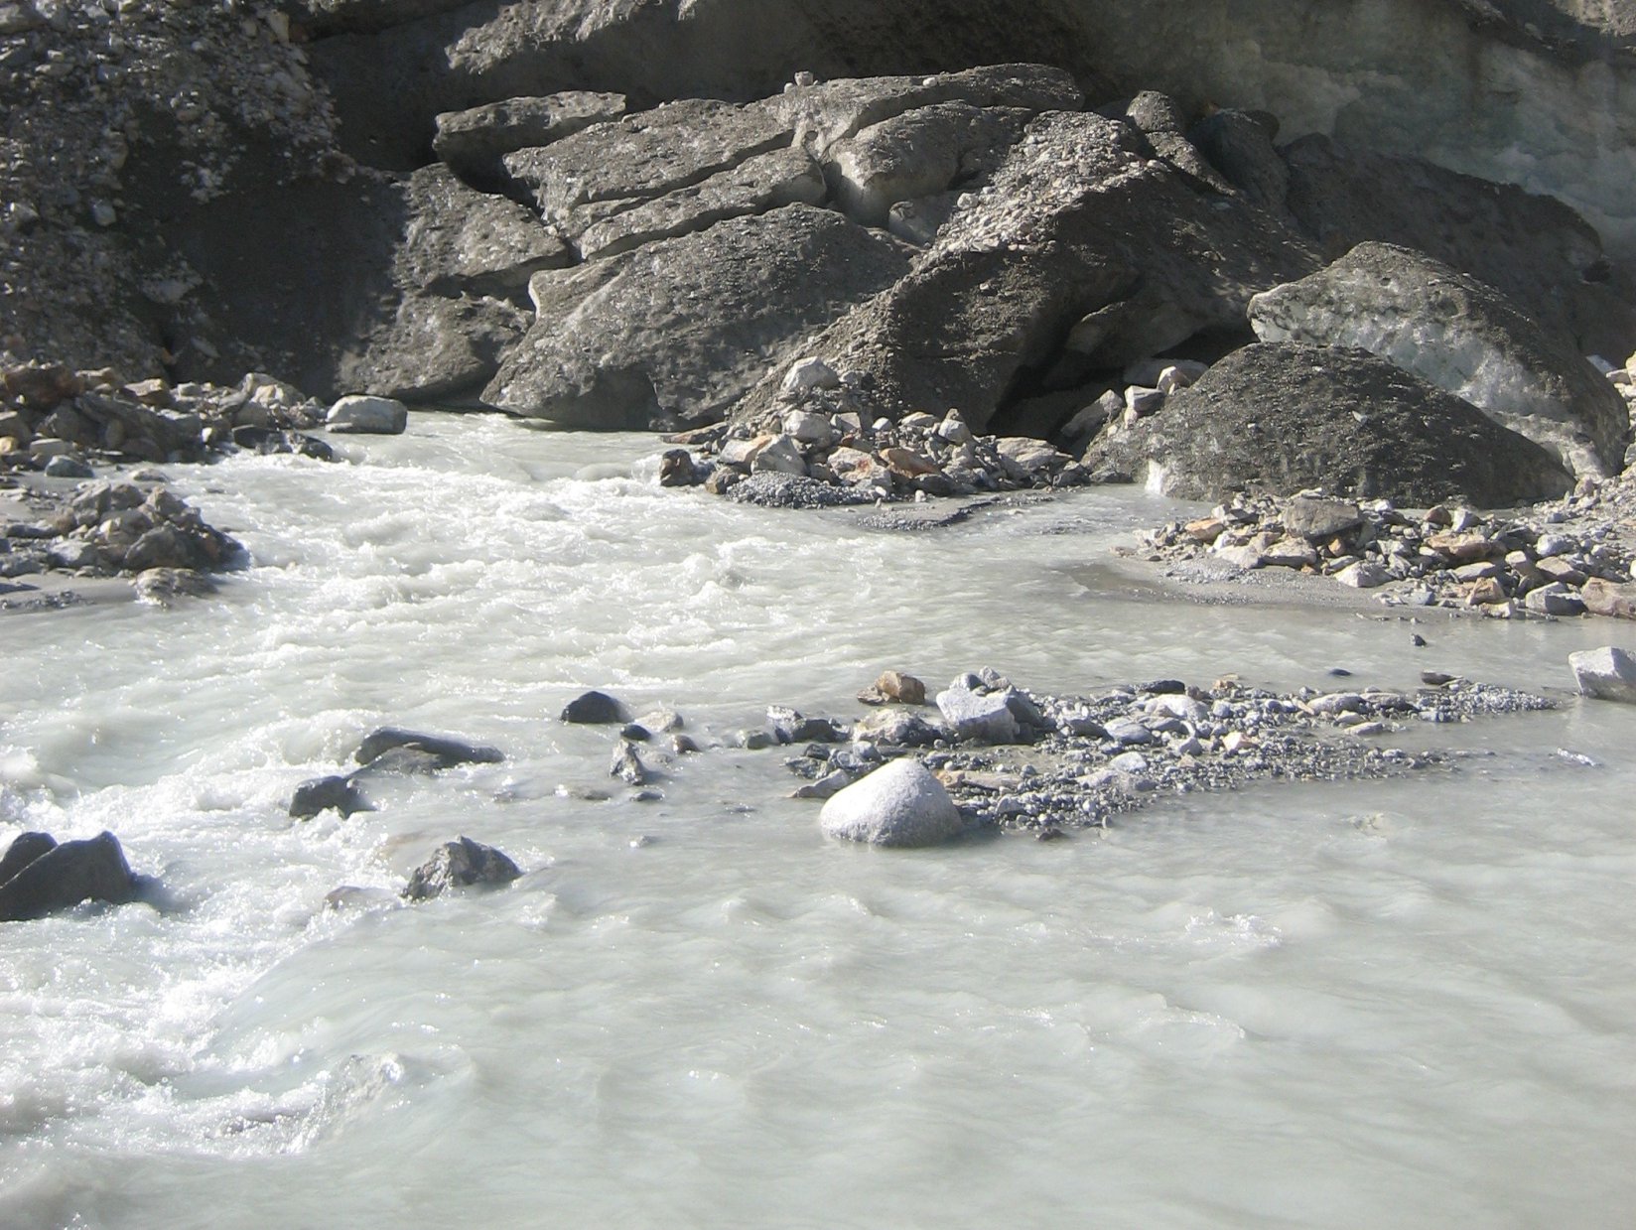
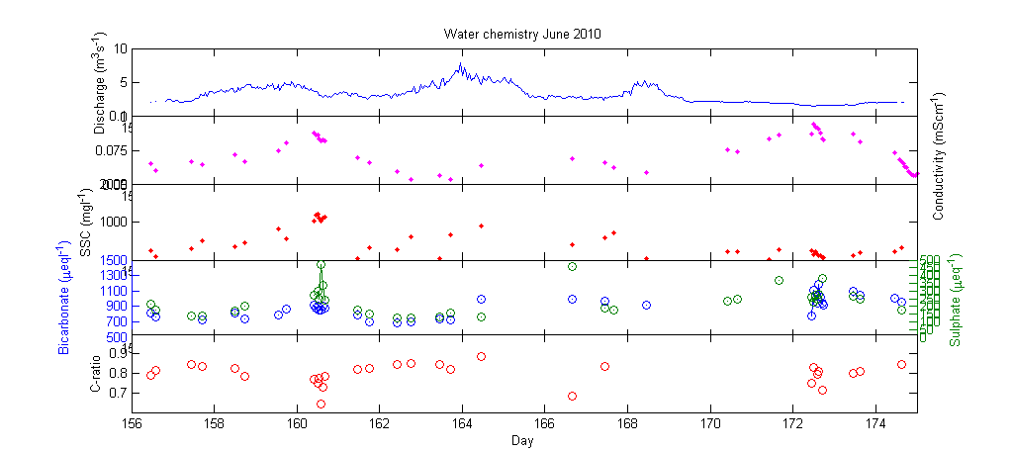
On day 160 (when discharges fall after speed-up on day 158): marked increase in conductivity, SSC, Bicarbonate and Sulphate, along with low C-ratio. Shows a pulse of ion and sediment rich water.
Evidence for flushing out of subglacial water in the distributed system by meltwater, which is most evident when peak flow falls and distributed system drains. Indicates water flowed though a large area of the bed, mobilised sediment and came into contact with basal water with a long residence time.

Slide 11
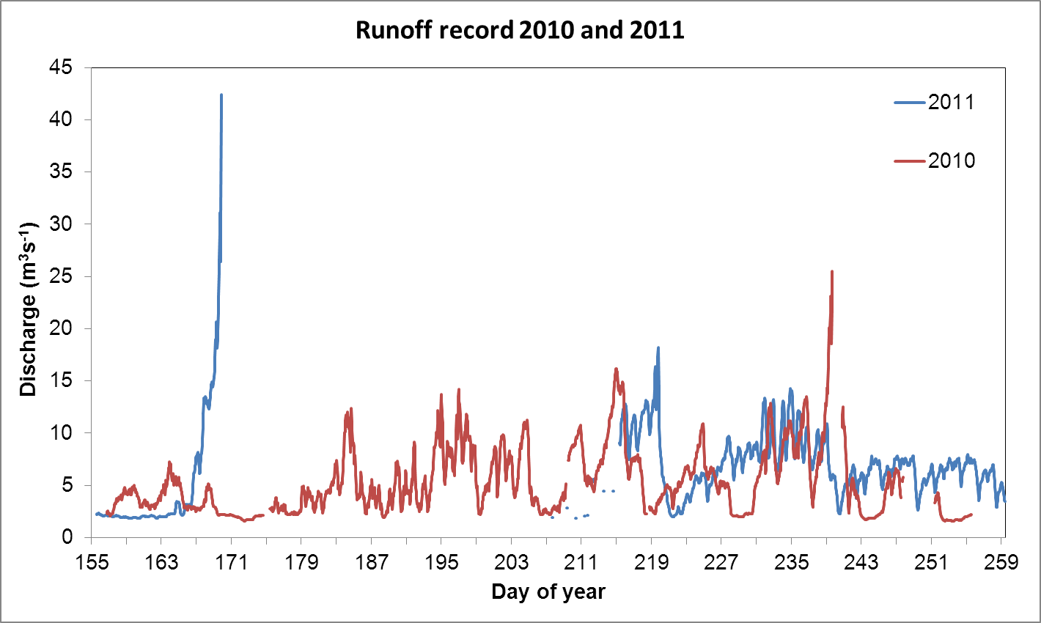

Slide 12
Runoff characteristics
The lag time ranged from 7 hours during July when there was a diurnal signal and discharges were high, to 24 hours in August when no diurnal cycle was apparent.
These lag times are longer than that calculated similarly for the Haut Glacier d’Arolla (Swift et al., 2005) and may be due to the attenuation of the diurnal signal by the debris, longer supraglacial and subglacial travel times.
Notes:
Graph of average discharge for 10 day periods using 2010 data.
Shows lack of a diurnal cycle, except during July.
Statistical analysis of discharge with air temperature can be used to give the lag time between melt and discharge.

Slide 13
Conclusions
Influence of debris on structure of the hydrological system?
On lower glacier
thick debris reduces melt
Supraglacial stream formation is inhibited
Supraglacial streams are small and slow flowing
The englacial and subglacial network is slower and less efficient
But higher on the glacier clean ice melt is still routed efficiently because stream inputs are large even early in the season
Impact on runoff?
Less clear diurnal signal, and longer lag times

Slide 14
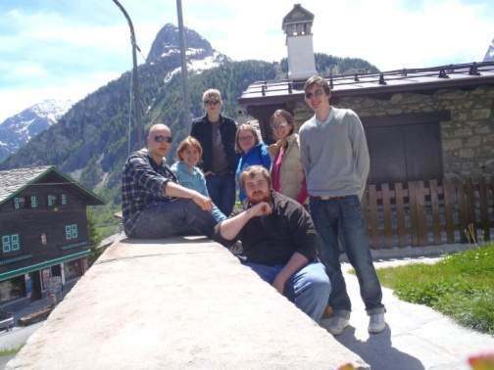
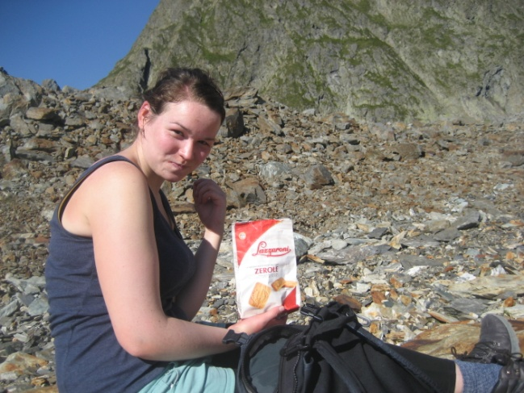
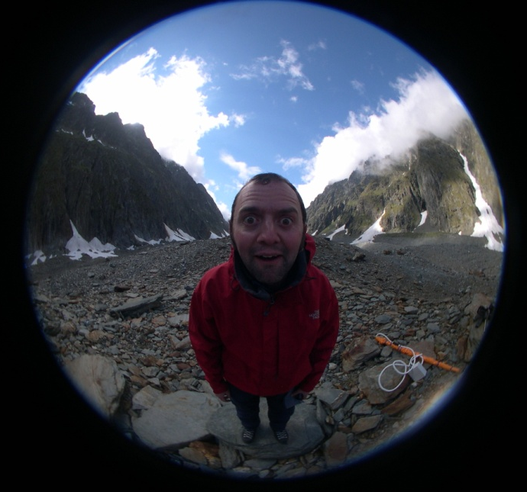
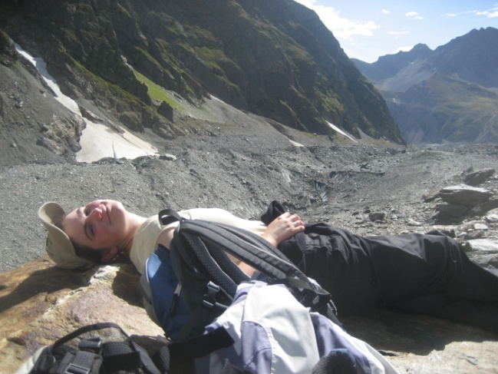
Acknowledgements
Thanks to:
The department of Geography and Environmental Science for their studentship, J. Holden for the loan of a fluorometer, D. Mair and P. Nienow for the loan of a Kovax ice drill, F. Brunier from Regione Autonoma Valle d'Aosta for providing air pressure data, F. Diotri from Agenzia Regionale per la Protezione dell’Ambiente for providing a 2005 DEM of the glacier, NERC GEF loan 917 for the loan of 2 dGPS receivers in June 2010, Northumbria University for the loan of loggers and a fluorometer, Marco Vagliasindi from the Fondazione Montagna Sicura, La Palud, for logistical support, Scottish Crop Research Institute for the loan of a Campbell logger, Milan University for the use of their stake network and ablation data, students from the Universities of Dundee, Northumbria, Aberdeen, and Cambridge, and L. Gilbert for fieldwork support, T. Reid for being a fieldwork and Matlab guru…and of course my supervisors Ben Brock and Martin Kirkbirde

