Slide 1
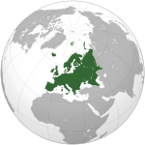
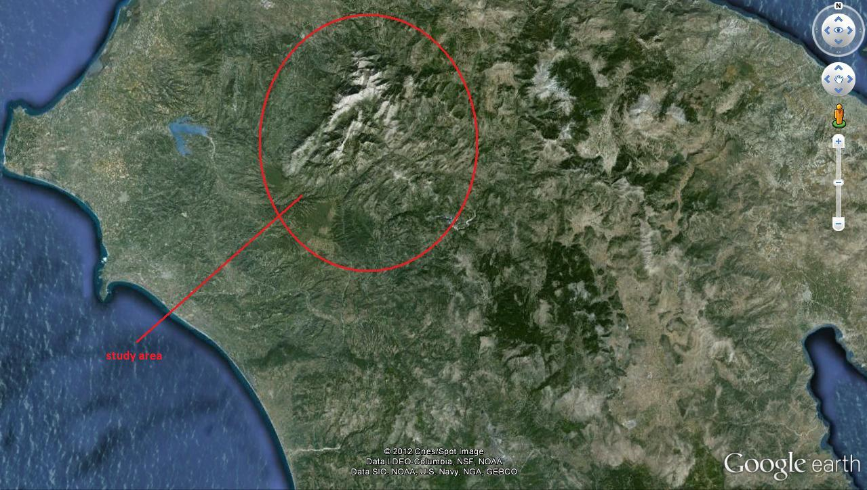
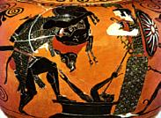
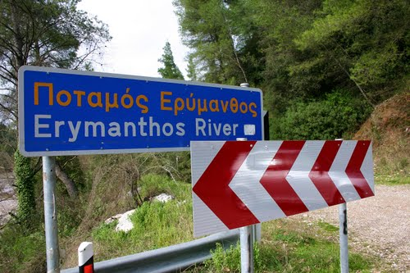
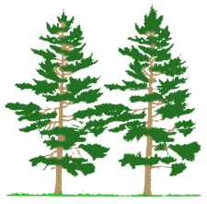
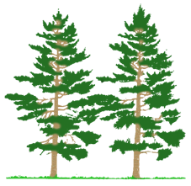
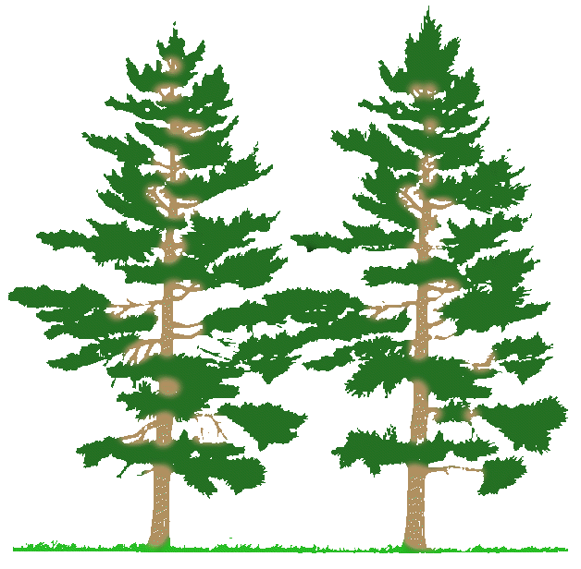
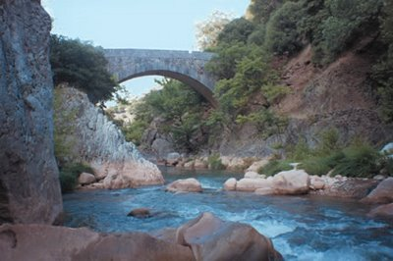
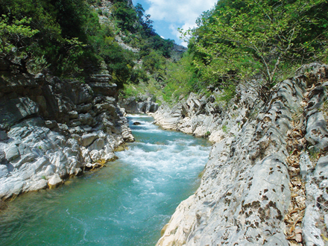
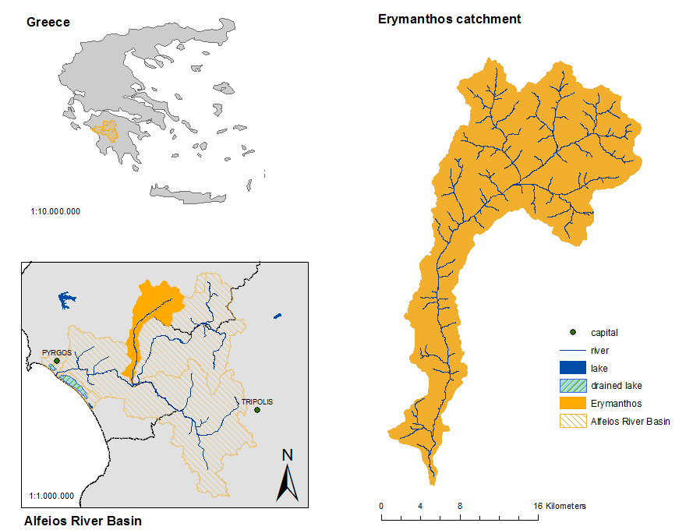
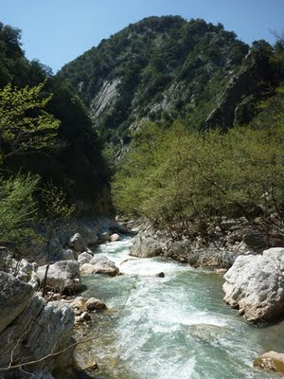
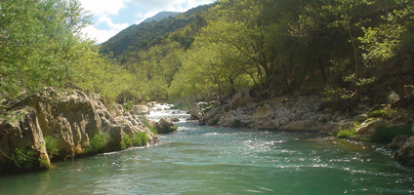
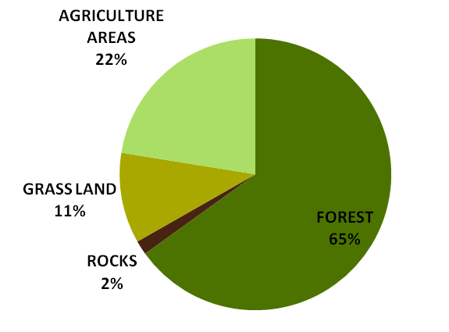
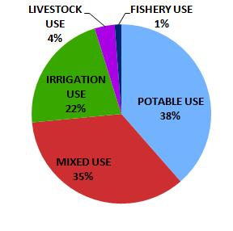
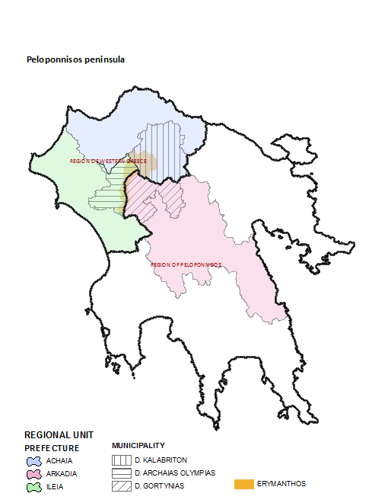
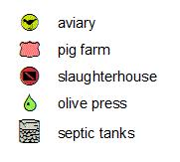
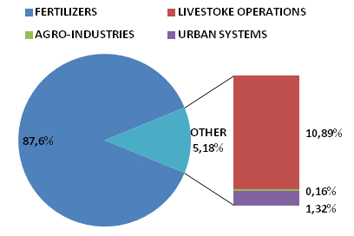
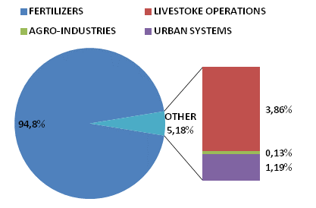
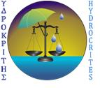
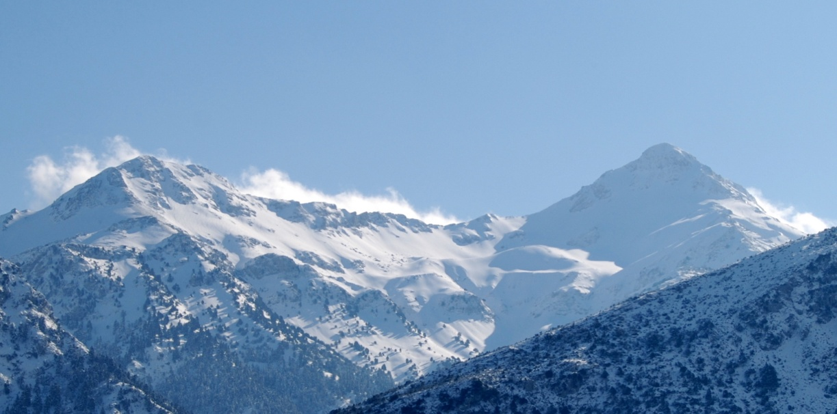
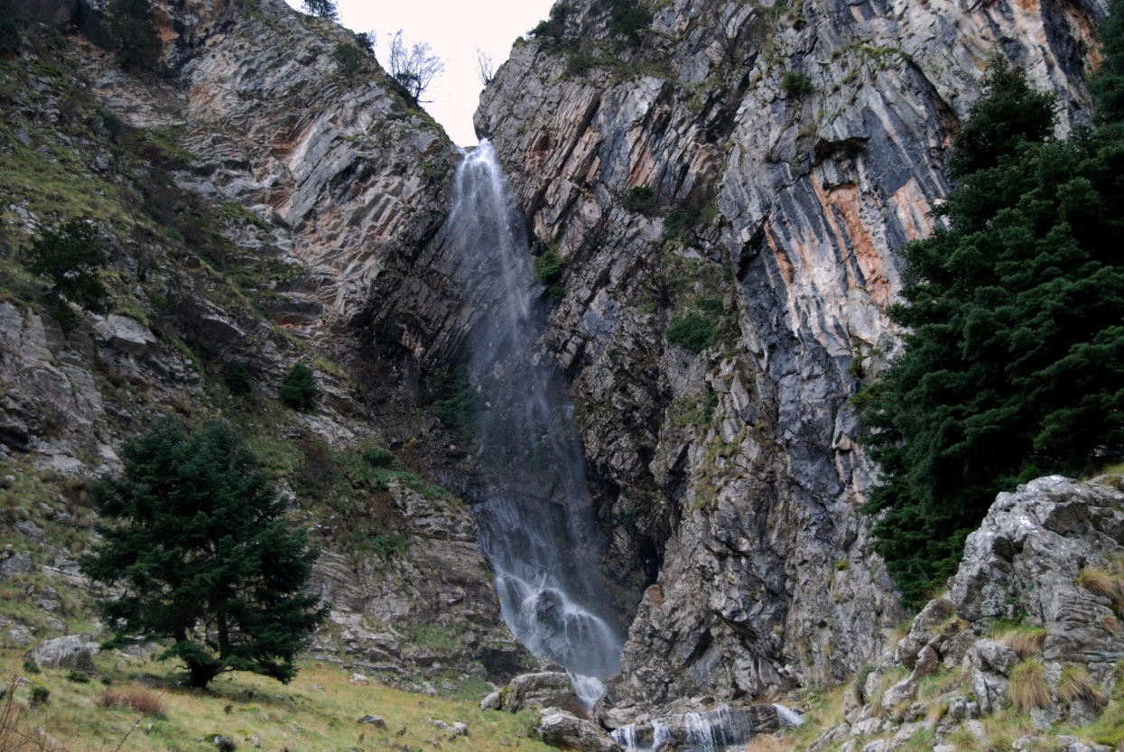
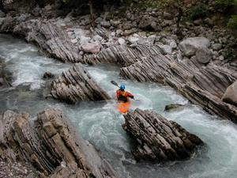
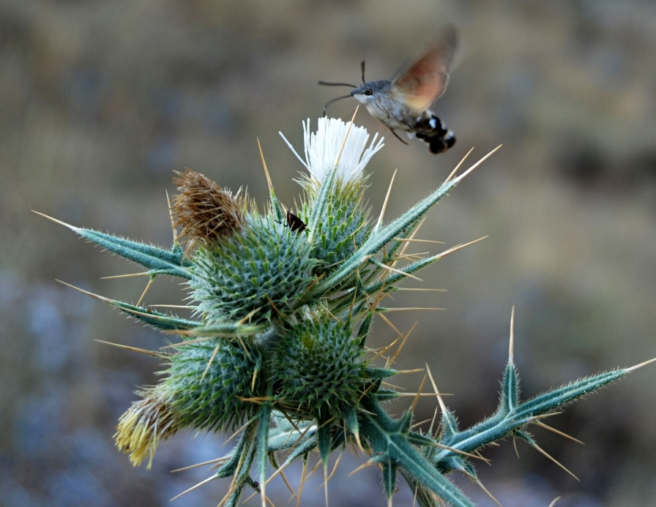
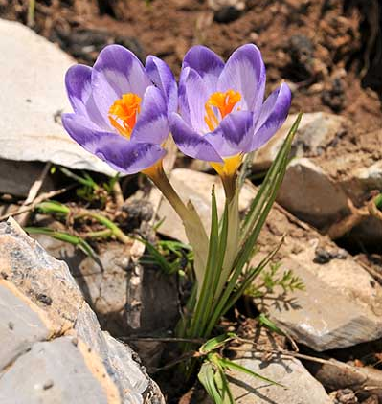
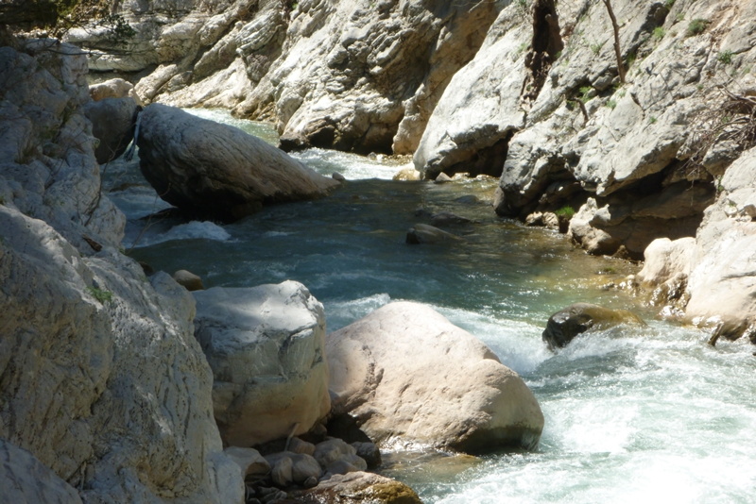
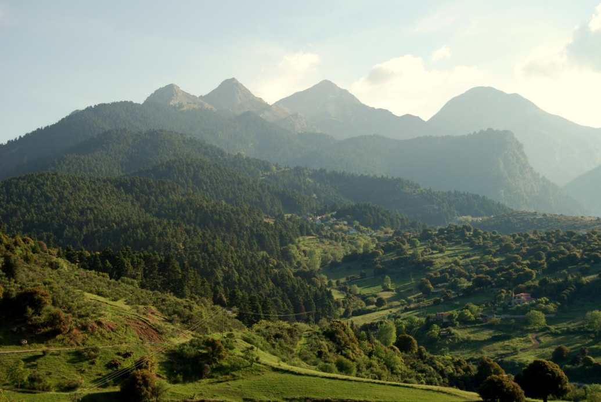
Proposing buffer zones and simple technical solutions for safeguarding river water quality and public health M.V. Podimata , E.S. Bekri and P.C. Yannopoulos Environmental Engineering Laboratory
Department of Civil Engineering, University of Patras, Greece
yannopp@upatras.gr
Case study: Erymanthos sub-basin Location: Alfeios River Basin
Peloponnisos Peninsula, Greece
SUMMARY
Alfeios River Basin (ARB) constitutes one of the major hydrologic basins of Peloponnisos Peninsula in Southern Greece. It is drained by Alfeios River and its tributaries, such as Lousios, Ladhon, Erymanthos, Kladheos, Selinous, Enipeus, etc. The present study focuses on Erymanthos sub-basin, since Ileia Prefecture is dependent on Erymanthos River for its community water supply. Erymanthos R. is vulnerable to pollution due to pressures provoked by human activities. The basin settlements lack of wastewater treatment and disposal systems. Recognizing the importance of clean water for a healthy community, a developing economy, and a sustainable environment, buffer zones and small technical works could be integrated as cost-effective and health-safeguarding solutions.
FINDINGS AND MEASURES
Riparian buffer zones are intended to delay run-off and prevent direct movement of nutrients and other pollution factors into the surface water. Buffer zones are formed after constructing small-case ditch blocks.
The preferred size of a buffer zone is variable, depending on each case. The real size of a buffer zone is often the result of negotiations between the various stakeholders and depends on the availability of land. It is therefore crucial that all stakeholders are fully involved in defining the buffer zone area [1].
Riparian fencing (constructing fence along streams to limit or eliminate the access of sheep or other livestock to waterways) is an alternative / supplementary option.
Hercules capturing the Erymanthian Boar
(4th Labor)
Proposed solutions
Population distribution
Topography
GENERAL DESCRIPTION OF ERYMANTHOS SUB-BASIN
AREA | 361.42 Km²
POPULATION | 7,273 inh.
DISCHARGE | 10 m³/sec (winter)
MEAN ALTITUDE | 861 m
MEAN SLOPE | 35.3 %
PRECIPITATION | 1,200 mm
Aspects of Erymanthos R.
by NGO Erymanthos
Buffer zone
Riparian fence
Corine Land Uses
Springs
Criteria
Erymanthos R.
geomorphology
technology
feasibility
sustainability
Ditch block
CONCLUSIONS
This study suggests:
suitable buffer zones in areas with high pollution risk, and
simple technical works
AIMS
The goal of this study is to detect areas with high pollution risk and suggest a) the location of suitable buffer zones and b) simple technical works in order to prevent direct polluting discharges into the main channel of Erymanthos R. The above systems could also act supportively in groundwater enrichment, forest protection and soil erosion prevention [1].
in order to prevent the main channel of Erymanthos R. from direct polluting discharges. Authors believe that the results of the study could assist authorities and engineers to design and develop strategies of improving river water quality and safeguarding public health. The proposed measures may be applicable to other catchments, as well.
ADMINISTRATIVE REFORM OF ERYMANTHOS SUB-BASIN
1 | DECENTRALIZED ADMINISTRATION OF PELOPONNISOS, WESTERN GREECE & IONION ISLANDS
2 | REGIONS
3 | REGIONAL UNITIES
3 | MUNICIPALITIES
28 | MUNICIPAL APARTMENTS
REFERENCES
1. Haycock, N., Burt, T., Goulding, K., Pinay, G. (2001) Buffer zones; their processes and potential in water protection, Haycock Associated Limited, Hertfordshire, UK.
2. U.S. Environmental Protection Agency, (1988), Design Manual: Constructed Wetlands and Aquatic Plant Systems for Municipal Wastewater Treatment (available on-line), http://www.epa.gov/owow/wetlands/pdf/design.pdf Accessed 10.02.2012.
3. Pythagoras II - Category 2.6.1.xiii, Environment (2008) Development of Low Cost Methodologies for Quick Prediction and Monitoring of River Pollution, funded by the European Social Fund (ESF) and the Operational Program for Educational and Vocational Training II (EPEAEK II), period 2005-2007, Principal Investigator P.C. Yannopoulos.
4. Yannopoulos, P.C., Manariotis, I.D., Ziogas, A.I., Kaleris, V.K. (2007) Methodology of river pollution assessment and preliminary results, in Proc. of 32nd IAHR Congress on Harmonizing the Demands of Art and Nature in Hydraulics, 1 -6/07/2007, Venice, Italy.
APPROACH
In Greece, small communities and rural areas cannot afford the costs of advanced and specialized centralized wastewater systems, which require a trained and qualified staff and increased cost of maintenance, whereas their populations may be too spread out to make this solution a realistic option.
A viable and interesting alternative could be the decentralized natural systems that use relatively more land and require lower energy use and labor costs [2]. Based on previous studies [3], buffer zones are proposed in order to overcome the problem of contaminating water supply in the catchment that lacks of wastewater treatment and disposal systems.
Point pollution
sources
Non-point pollution
sources
Water uses
The water supply project for Ileia Prefecture from Erymanthos R. (started on May 2011) covers the needs of 51,600 people. It includes a central piping network of 107 km, a water treatment refinery and storage tanks.
Domestic
Irrigational
Livestock
Aquaculture
Agro-industrial
Recreational
Nitrogen [3,4]
Pollution load 2,554.4 ∙ 10³ kg/y
Pollution factor C_{N}= 0.015
ACKNOWLEDGMENTS
We would like to make statement of gratitude for assistance in producing the present work to the Greek Scholarship Foundation and Heracleitus II. The present work is supported by HYDROCRITES University Network. For further details visit http://www.hydrocrites.upatras.gr
Erymanthos Mt (L) Mougila peak 2100m
(R) Olenos peak 2224m by S. Kalogeropoulos
Tsapournia's waterfalls
Rafting in Erymanthos R.
Macroglossum stellatarum
Crocus sieberi
Erymanthos R.
Erymanthos area
Phosphorus [3,4]
Pollution load 567.8 ∙ 10³ kg/y
Pollution factor C_{P}= 0.111
EGU 2012 SESSION: HS7.3/CL2.9/NP1.3

