Slide 1
Transport of root-derived CO₂ via the transpiration stream affects aboveground tree physiology
Jasper Bloemen, Mary Anne McGuire, Doug P. Aubrey, Robert O. Teskey and Kathy Steppe
Laboratory of Plant Ecology, Ghent University
Coupure links 653, B-9000 Ghent, Belgium
Jasper.Bloemen@UGent.be
EGU 2012 - Jasper Bloemen - 25 April 2012

Slide 2
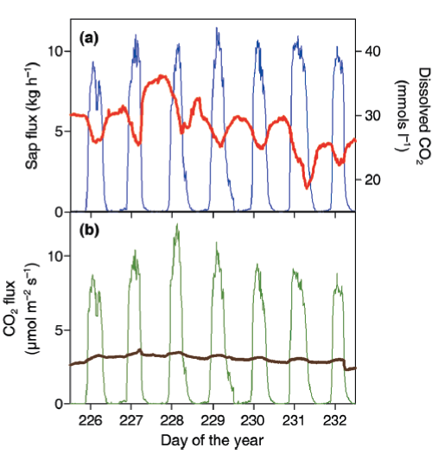
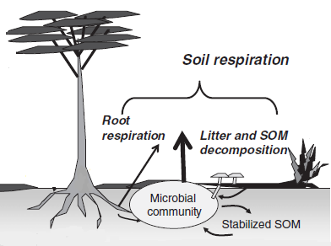
Introduction
How accurate are efflux-based estimates of soil respiration?
Adapted from Trumbore (2006)
Aubrey & Teskey (2009)
EGU 2012 - Jasper Bloemen - 25 April 2012
2/13

Slide 3
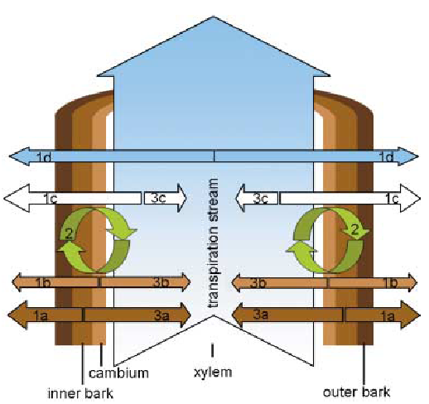
Introduction
Internal transport of root-derived CO₂
Contributes to high CO₂ concentrations observed inside trees
Range: <1-26 % (atmospheric CO₂ concentration C. 0.04%)
Impact on tree physiology
Assimilation internally
Efflux to the atmosphere
Transport with the transpiration stream
Fate of internally transported root-derived CO₂?
Teskey et al. (2008)
EGU 2012 - Jasper Bloemen - 25 April 2012
3/13

Slide 4
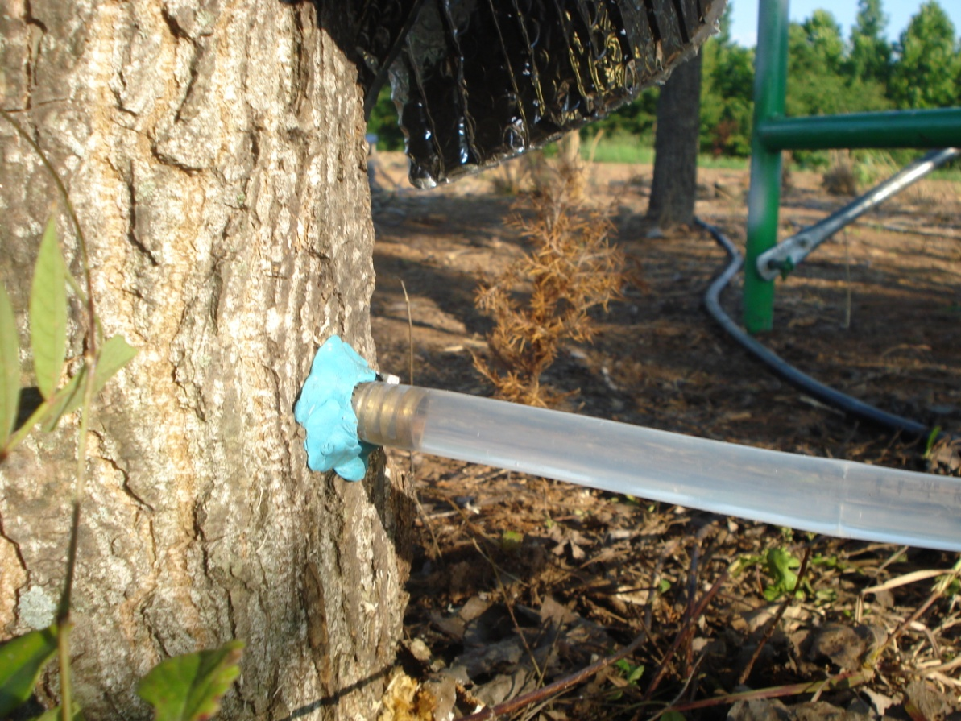
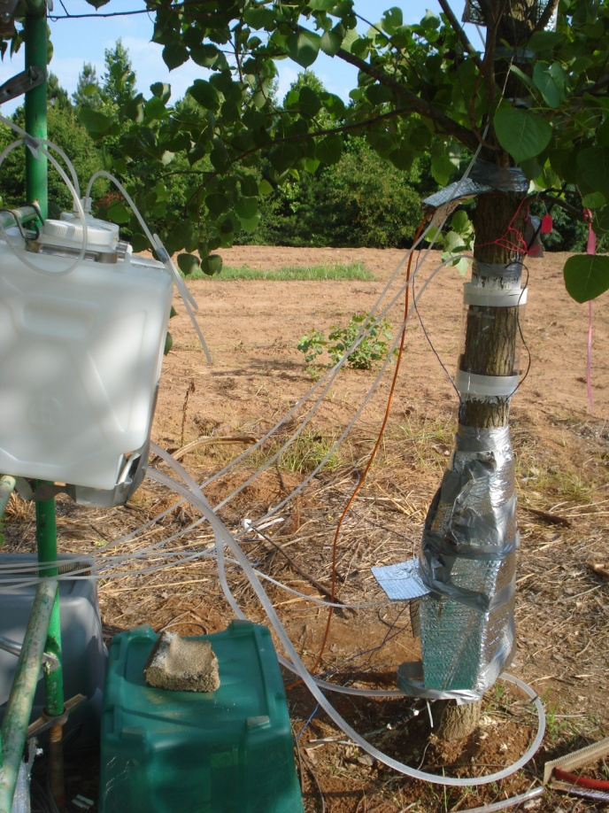
¹³C experiment
infusion of ¹³C labeled solution as a surrogate for root-derived CO₂ transport in trees
Label infusion conc. | Solution infused (l) | ¹³C uptake (g) | Solution infused/ Total sap flow (%)
Low | 40.5 | 0.7 | 26.1
High | 45.0 | 6.8 | 25.5
EGU 2012 - Jasper Bloemen - 25 April 2012
4/13

Slide 5
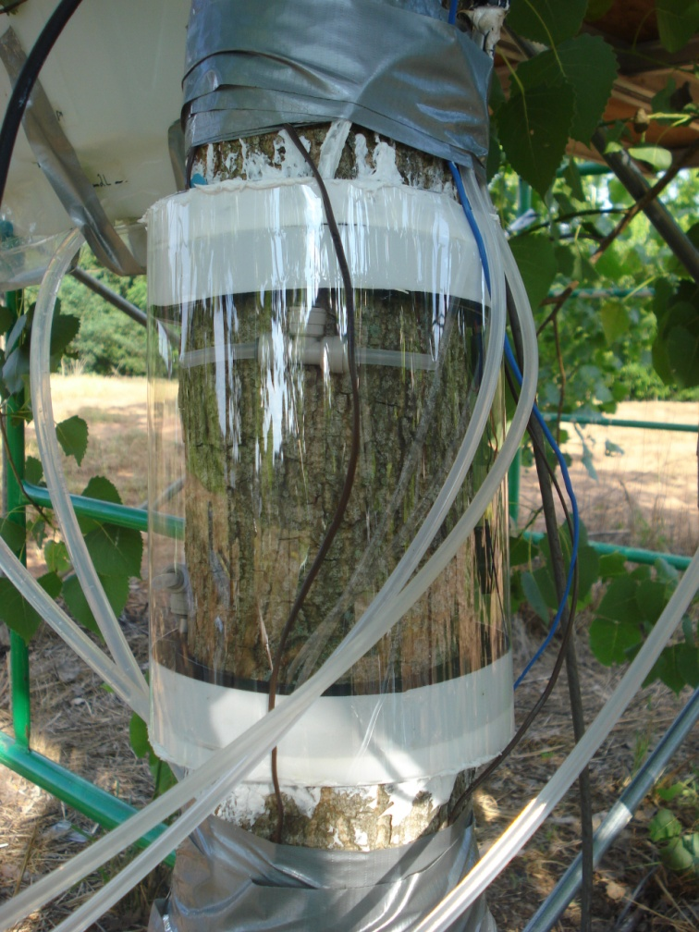
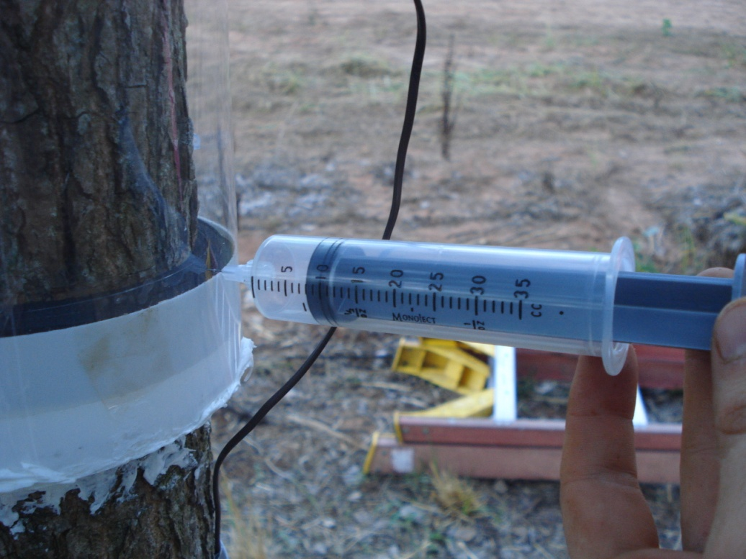
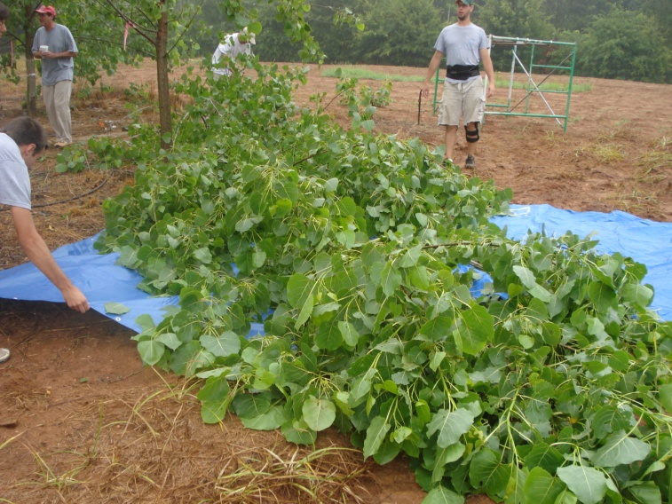
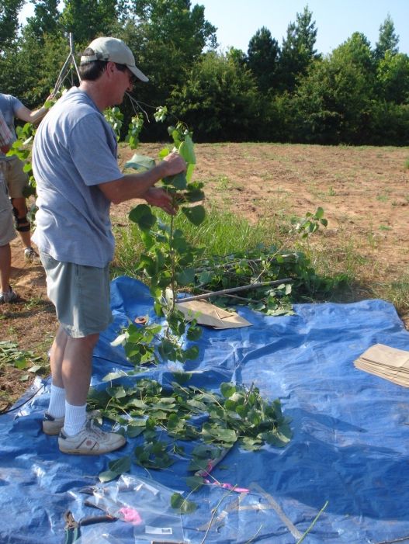
¹³C experiment
Gas and tissue sampling for ¹³C analysis
EGU 2012 - Jasper Bloemen - 25 April 2012
5/13

Slide 6
Results
¹³C enrichment of the different tree organs
EGU 2012 - Jasper Bloemen - 25 April 2012
6/13

Slide 7
Results
¹³C enrichment of stem tissue components
EGU 2012 - Jasper Bloemen - 25 April 2012
7/13

Slide 8
Results
¹³C enrichment of leaf tissue components
EGU 2012 - Jasper Bloemen - 25 April 2012
8/13

Slide 9
Results
Up scaling of tissue carbon isotope data
Largest amount of ¹³C was assimilated in the xylem
Stem
Tissue | ¹³C assimilated (g)
Bark | 0.024 (0.001)
Xylem | 0.064 (0.002)
Branch
Tissue | ¹³C assimilated (g)
Bark | 0.120 (0.003)
Xylem | 0.140 (0.005)
Smaller amounts of ¹³C were assimilated in the leaves
Relative to ¹³C uptake, more ¹³C label was assimilated under low label treatment
EGU 2012 - Jasper Bloemen - 25 April 2012
9/13

Slide 10
Results
Diffusion of ¹³C via stem and branch CO₂ efflux
EGU 2012 - Jasper Bloemen - 25 April 2012
10/13

Slide 11
Results
Assimilation and efflux of ¹³C relative to ¹³C uptake:
Mass balance approach
EGU 2012 - Jasper Bloemen - 25 April 2012
11/13

Slide 12
Conclusions
Conclusions on internal transport of root-derived CO₂
Transport of root-derived CO₂ in tree stems
Impact on plant carbon assimilation and CO₂ efflux to the atmosphere
Assimilation of root-derived CO₂
Internal recycling of respired CO₂ in stem, branches and leaves
Results underestimate the assimilation of internally transported CO₂
Aboveground efflux of root-derived CO₂
Most of the root-derived CO₂ is expected to diffuse to the atmosphere
Up to 47% of root-derived CO₂ diffuses from aboveground tissues
Efflux-based estimates of above- and belowground respiration are inaccurate
EGU 2012 - Jasper Bloemen - 25 April 2012
12/13

Slide 13
Thank you for your attention
Jasper Bloemen
Laboratory of Plant Ecology
Ghent University
Coupure links 653, B-9000 Ghent, Belgium
www.plantecology.ugent.be
Jasper.Bloemen@UGent.be
EGU 2012 - Jasper Bloemen - 25 April 2012
13/13

