Slide 1
EGU 2012, Vienna Session NH1.1/AS1.16
Application of a rule-based system for flash flood forecasting taking into account climate change scenarios in the Llobregat basin
Marc Velasco, CETaqua

Slide 2
Table of contents
Introduction
IMPRINTS project
Llobregat basin
Data used
Rule based system
Results and discussion
Conclusions

Slide 3
Introduction
Generate future discharge series in two sub-basins of the Llobregat river, to assess the changes in terms of occurrence and intensity of flash floods
An operational rule-based system
Observations and hydrological data to calibrate it
A downscaling of future climate scenarios as input data of the system
A probabilistic assessment of the exceedances to study the future discharge series

Slide 4
IMPRINTS project
IMPRINTS project
IMproving Preparedness and RIsk maNagemenT for flash floods and debriS flow events
EC 7th Framework Programme project
19 partners
42 months (it finishes next september)
Objectives
Improve preparedness and the operational risk management of FF & DF
Produce methods and tools to be used by practitioners of the emergency agencies and utility companies
Produce a prototype of the operational platform designed to be used around the EU

Slide 5
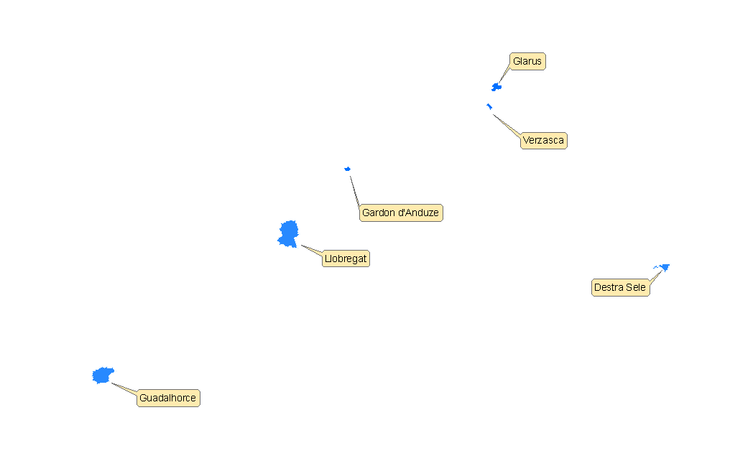
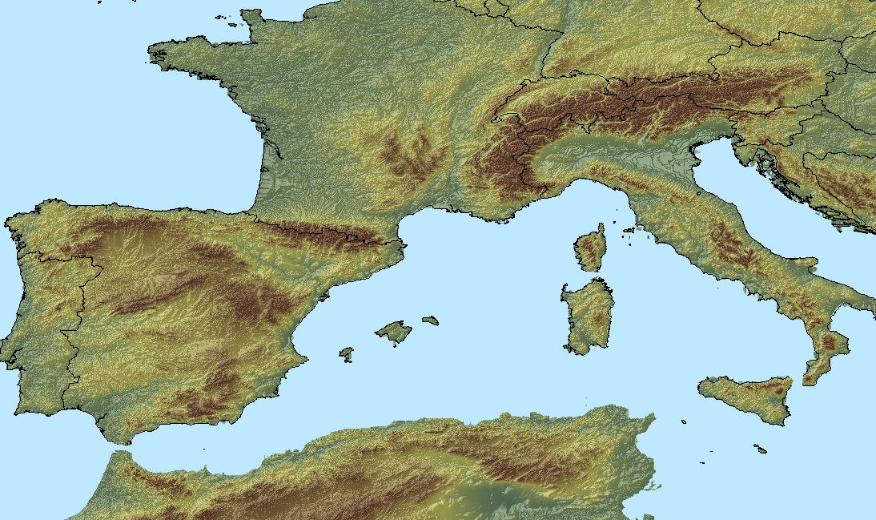
IMPRINTS project

Slide 6
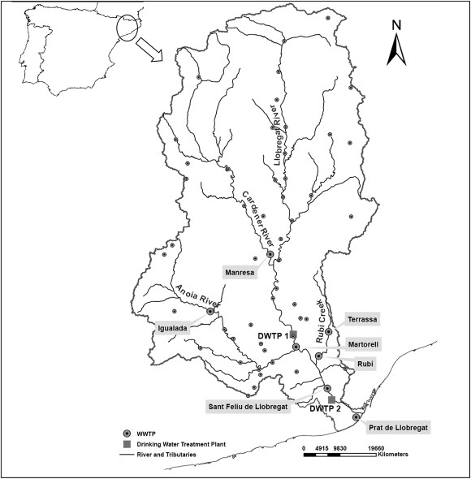
Llobregat basin
Located in the NE of Spain
Area of the basin: 4958 km²
River length: 156,6 km
Maximum elevation: 1259 m
Mean discharge of ≈ 20 m³/s
Mediterranean climate
Annual rainfall of ≈ 700 mm
Rainfall events of 200 mm in 24 h
Floods occur generally in autumn

Slide 7
Data used
Control period (1980 – 2008)
Future scenarios (2011 – 2100)
Precipitation
Observations from local rain gauges
Discharge
HBV hydrological model outputs using the precipitation series as an input
Precipitation
SMC downscaling data corrected using ARCON historical database
Scenarios A2 and B1
Used as input of the RBS
Used for the calibration and validation of the RBS

Slide 8
Rule based system
Forecasting system that allows to link real-time observed values with expected hazard in probabilistic terms
Simplification of a hydrological model with shorter lead times
Operational use: issue warnings
Considering high percentiles to represent extreme events
Governing variables for FF
Antecedent soil moisture
Forecasted rainfall
$$Q=a·P_{L360}+b·P_{N24}+c$$

Slide 9
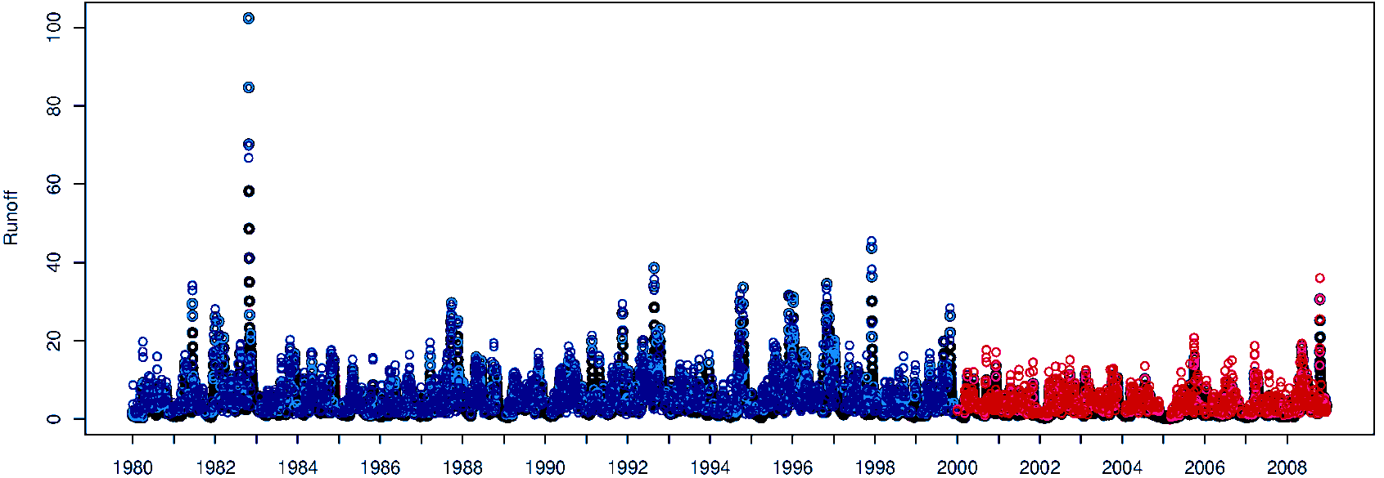
Rule based system
Calibration period
1980 – 1999
Validation period
2000 - 2008
Sub basin | a | b | c | R²
Alt Llobregat | 0.377 | 0.256 | 0.425 | 0.833
Anoia | 0.128 | 0.220 | 0.095 | 0.881
Calibration (blue) and verification (red) periods for the Alt Llobregat sub-basin, considering a 15 days backstep, 0.8 quantile and 20 years of calibration. In black, the HBV discharge values.

Slide 10
Results and discussion
Methodology
Running the RBS with future precipitation series
Assessment of the discharge series, following a Peak Over Threshold approach
Extremes occurrence
Number of exceedances
Extremes intensity
Fitting a Generalized Pareto distribution to the exceedances, and plotting the discharge – return period relationships
To compare the control and future exceedances, a fixed threshold is established
Sub-basin | Threshold (m³/s)
Alt Llobregat | 26.5
Anoia | 11.5

Slide 11
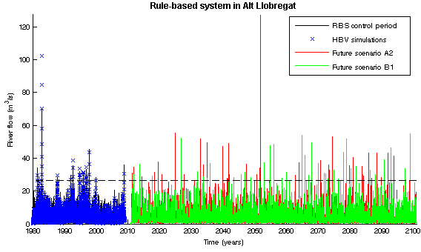
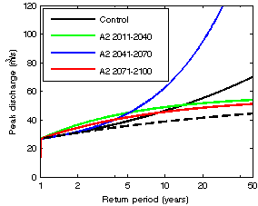
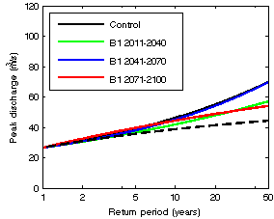
Results and discussion
Alt Llobregat basin
Occurrence
High generalized increase
Intensity
A high extreme in the control makes it difficult to draw conclusions
Period | # POT per year (for each sub-period)
Control (1980-2009) | 0.86 | 2011-2040 | 2041-2070 | 2071-2100
Scenario A2 (2011-2100) |  | 1.23 | 1.63 | 1.07
Scenario B1 (2011-2100) |  | 0.53 | 1.20 | 1.10
GP distribution fitted to the POT discharge values of the Alt Llobregat sub-basin for the control (1980-2009) and future periods for the A2 (left) and B1 (right) scenarios.
Time series of the discharge values in the Alt Llobregat sub-basin.

Slide 12
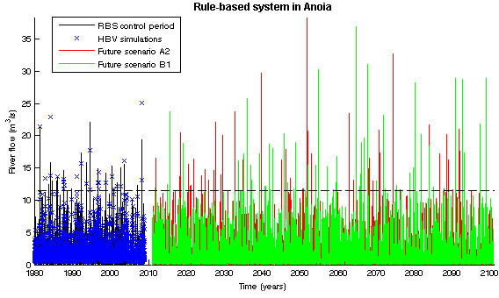
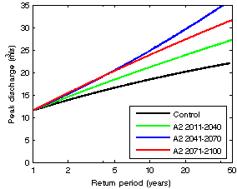
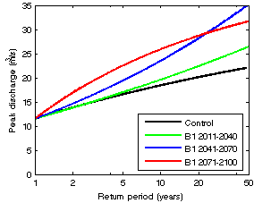
Results and discussion
Anoia basin
Ocurrence
Moderate increase
Two exceptions
Intensity
Generalized increase
Even for the exceptions
Period | # POT per year (for each sub-period)
Control (1980-2009) | 0.86 | 2011-2040 | 2041-2070 | 2071-2100
Scenario A2 (2011-2100) |  | 0.93 | 0.93 | 0.53
Scenario B1 (2011-2100) |  | 0.80 | 1.07 | 0.87
GP distribution fitted to the POT discharge values of the Anoia sub-basin for the control (1980-2009) and future periods for the A2 (left) and B1 (right) scenarios.
Time series of the discharge values in the Anoia sub-basin.

Slide 13
Results and discussion
Comparing the results of the two sub-basins
An increase in both occurrence and intensity of flash floods occurs
The trends are slightly different in each sub-basin
Alt Llobregat
high increase in occurrence, no clear results in intensity
Anoia
Moderate increase in occurrence, high increase in intensity
It is not possible to obtain a general trend for the whole Llobregat basin, in terms of spatial variability
FF are very local hazards, and hence should be studied locally

Slide 14
Conclusions
A RBS has been used to assess future scenarios
Although its main use is operational, it allows to easily assess the future behaviour of flash floods
An increase in both occurrence and intensity of FF is obtained for the two sub-basins
Discharge values strongly depend on the future precipitation scenarios
Uncertainties associated to climate science are transferred to this study
Results should be used with care. Still, management strategies should take the wide range of plausible scenarios into account

Slide 15
Questions?
Thank you very much for your attention!

Slide 16
IMPRINTS project
Floods are the major natural hazard in Europe
Mountainous areas and Mediterranean regions have the following aggravating factors:
Steep slopes
High spatial and temporal variability
Heavy rain intensities
Highly torrential phenomena
Mediterranean and Alpine basins are the test-bed basins of the IMPRINTS project

Slide 17
WP9 Dissemination of project results (UPC-CRAHI)
Activity 1: Probabilistic early warning systems
Activity 3:
Practitioners’ tools
WP1
Improving
short-term rainfall forecasting
(MeteoSwiss)
WP2
Developing probabilistic FF & DF early warning systems
(JRC)
WP6
Specifications for practitioners’ tools
(SCHAPI)
Activity 2:
Advanced probabilistic forecasting systems
WP3
Integrated probabilistic FF & DF forecasting system
(ULanc)
Activity 5: Dissemination and management
WP7
Developing practitioners’ tools
(HYDS)
WP5
Assessing impact of future changes
(CETAQUA)
WP4
Rule-based probabilistic FF & DF forecasting system
(UPC-GITS)
WP8 Testing the practitioners’ tools
(UPC-CRAHI)
Activity 4: Verification on the test-beds
WP10 Project Management (UPC-CRAHI)

Slide 18
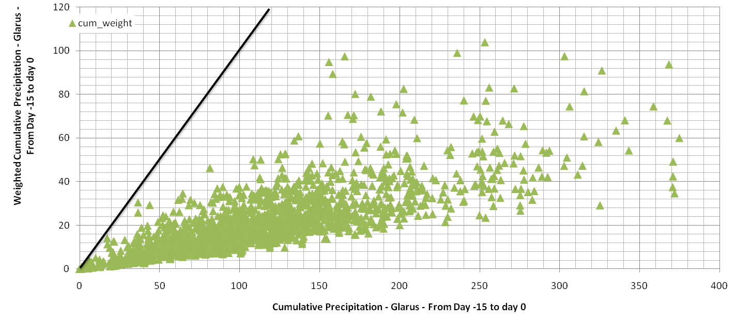
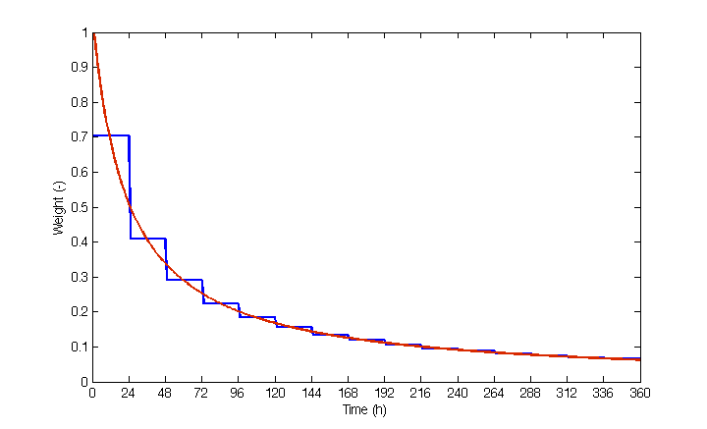
Antecedent soil moisture
PL360
Weightning function
$$P_{d}=\sum_{m=1}^{d}{Pm·\frac{1}{24}·\sum_{n=1}^{24}{\frac{1}{ 1+\frac{\left(n−1\right)+\left(d−1\right)·24}{24}}}}$$

Slide 19
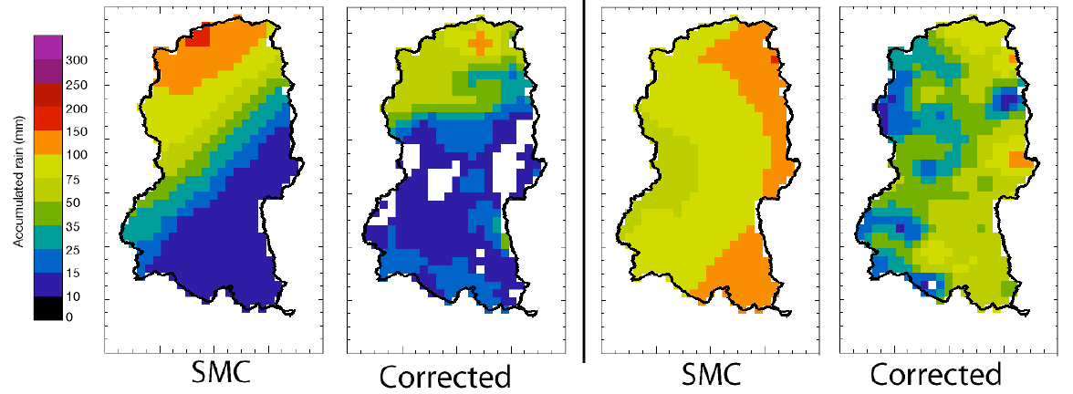
SMC downscaling
Bias correction with ARCON database

Slide 20
Data used
Control period (1980 – 2008)
Precipitation
Observations from local rain gauges
Discharge
HBV hydrological model outputs using the precipitation series as an input
Future scenarios (2010 – 2100)
Precipitation
SMC downscaling data corrected using ARCON historical database
Used for the calibration and validation of the RBS
Used as input of the RBS

