Slide 1
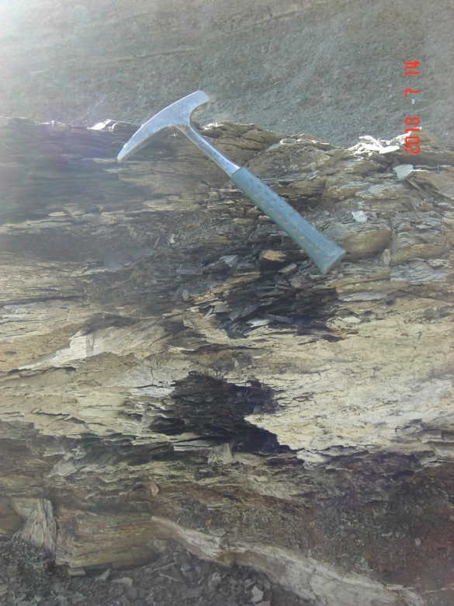
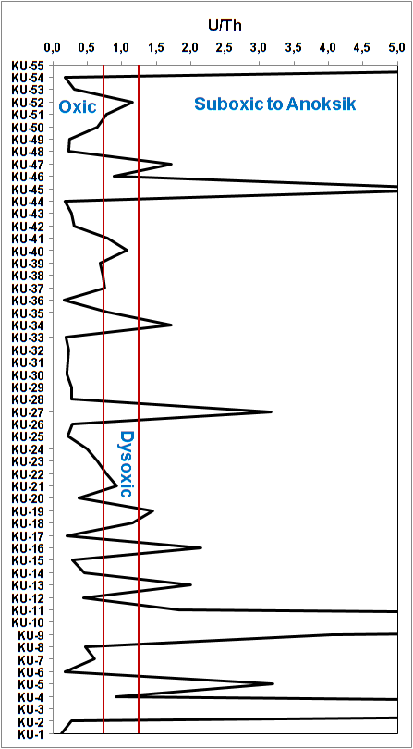
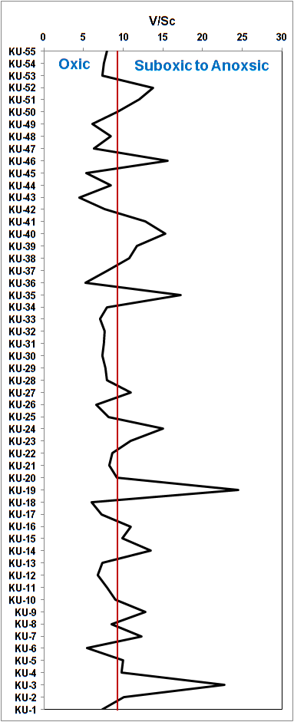
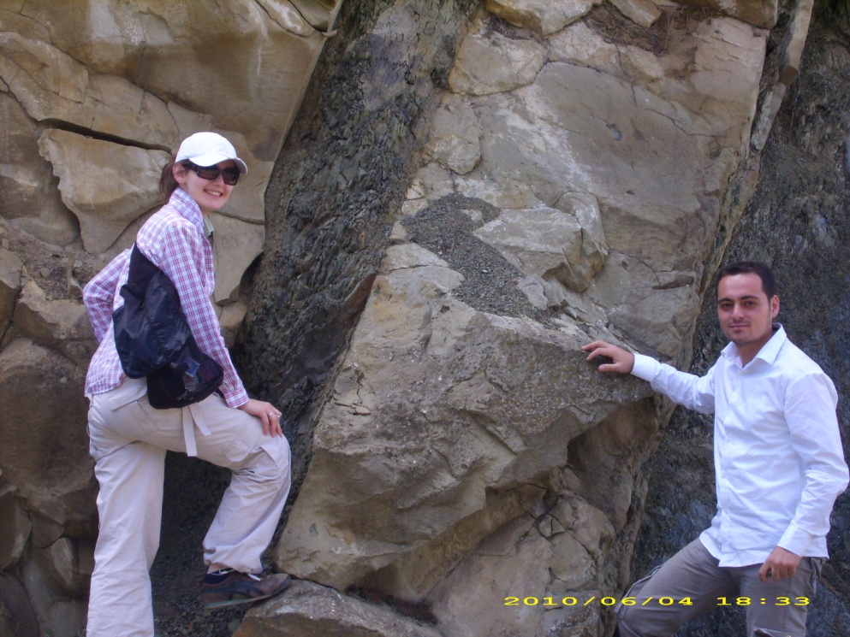
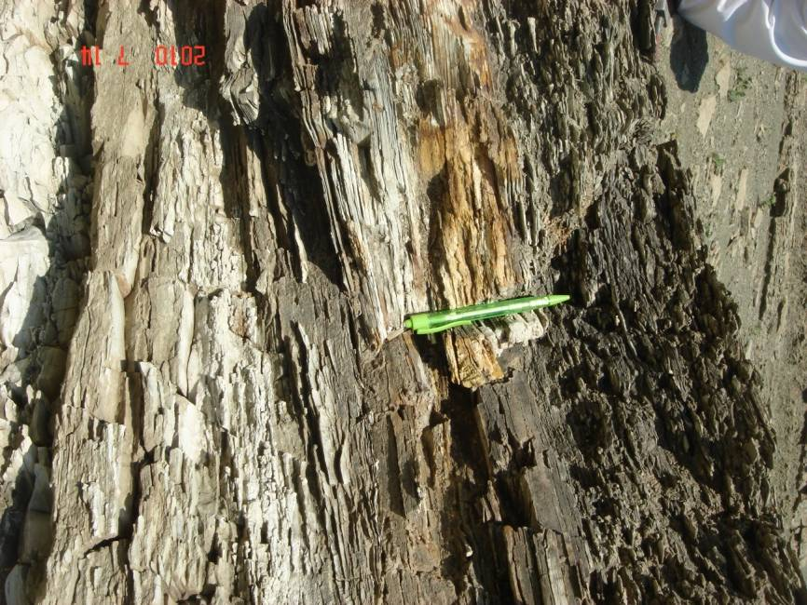
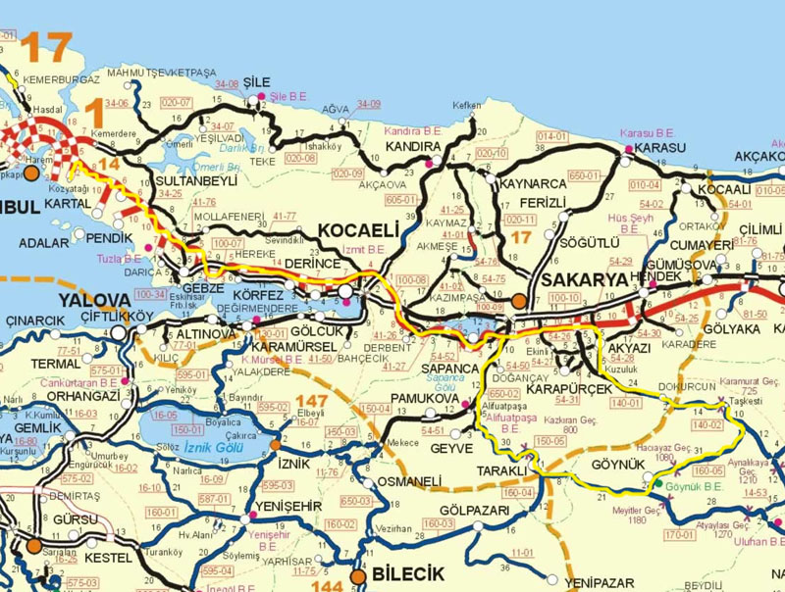
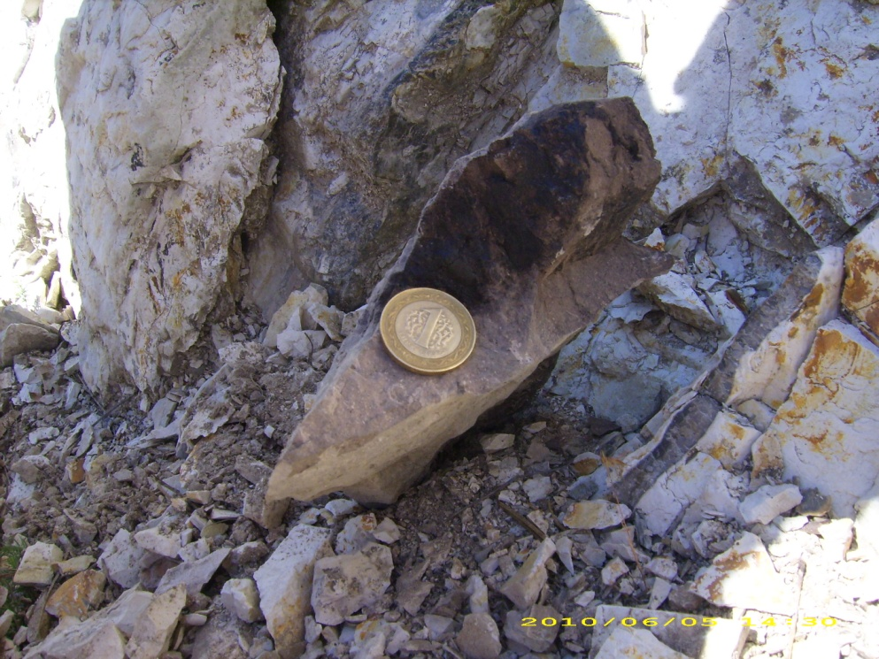
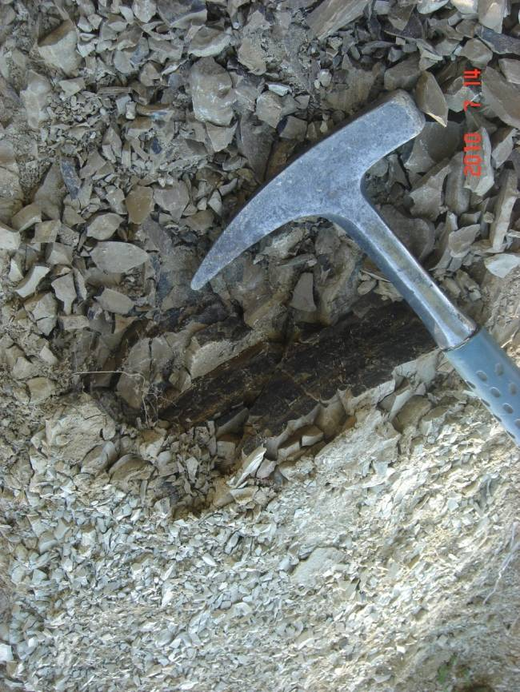
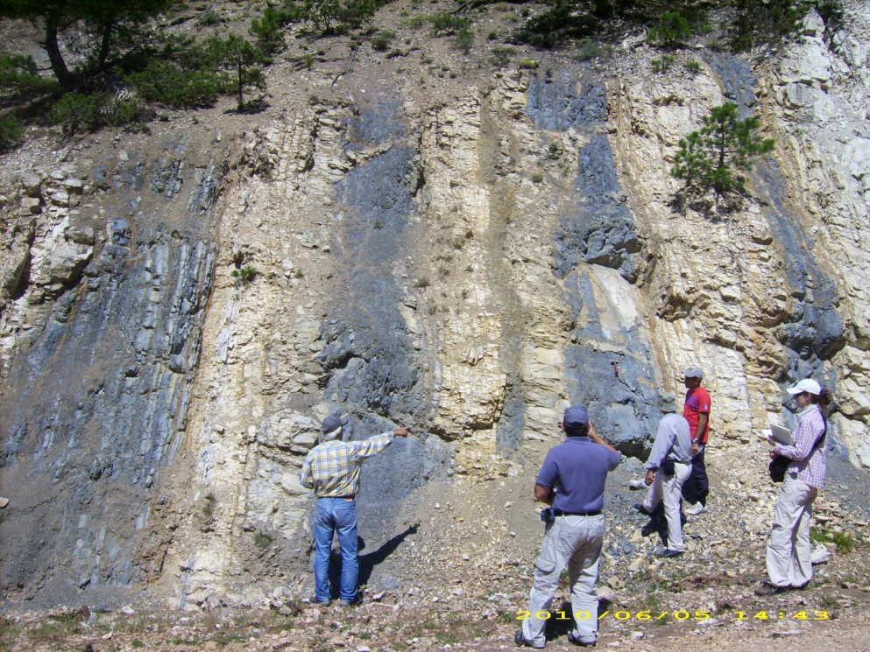
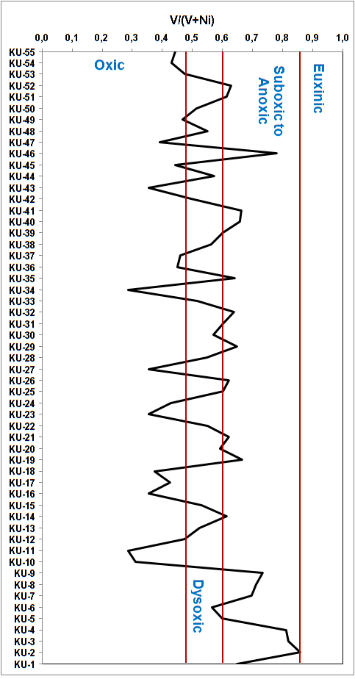
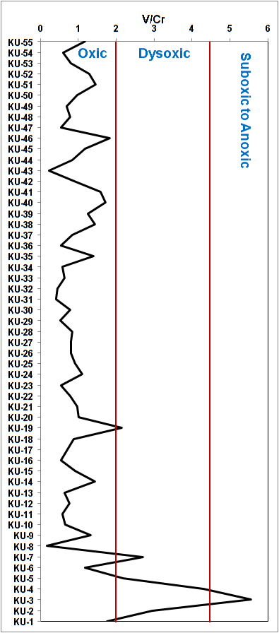
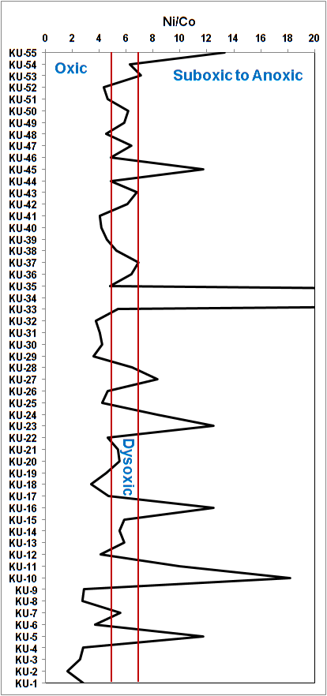
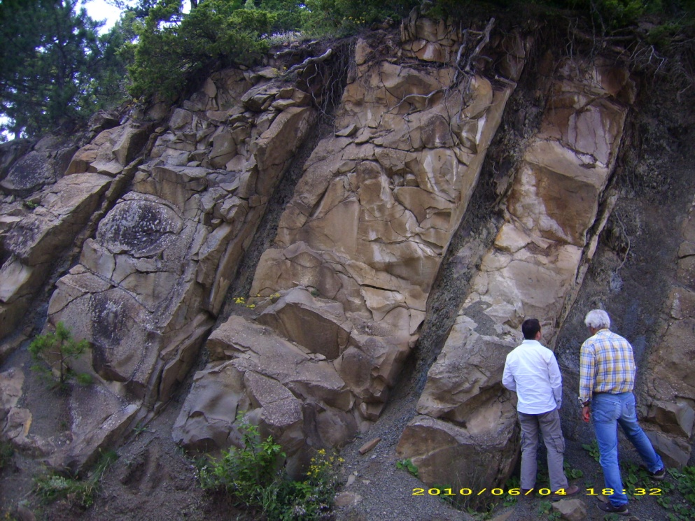
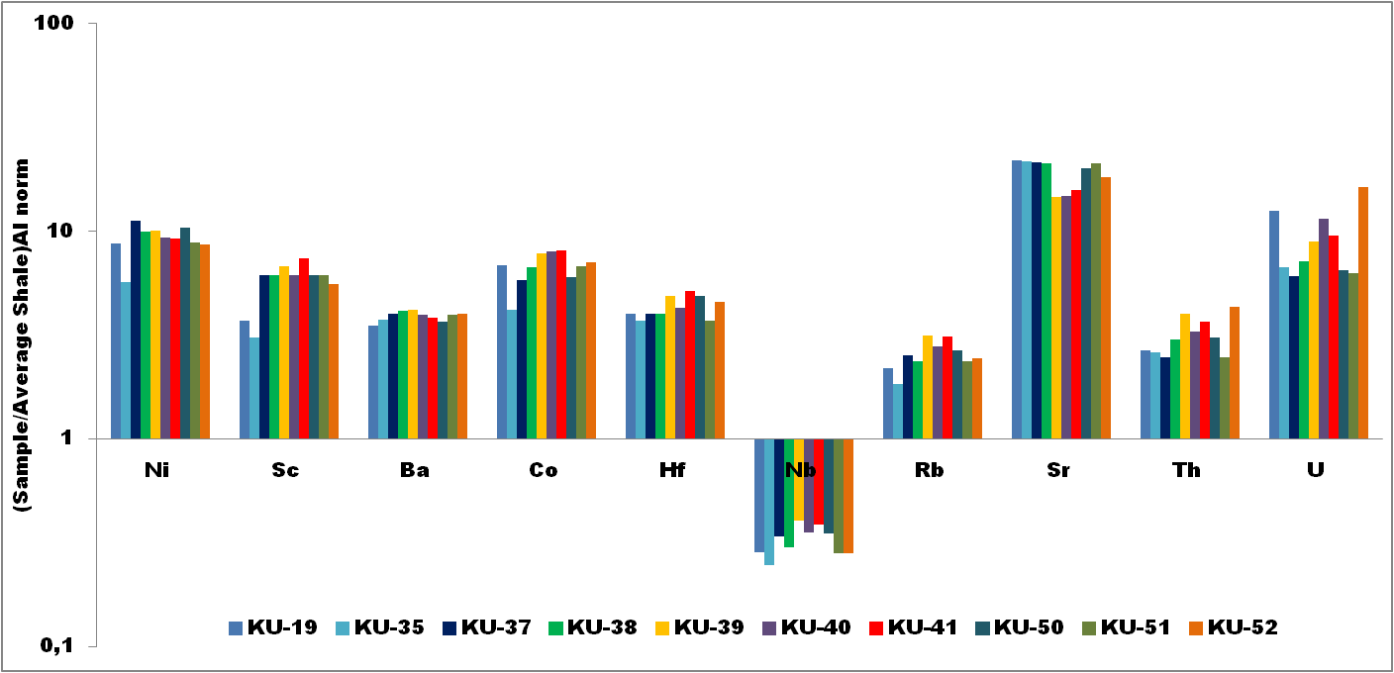
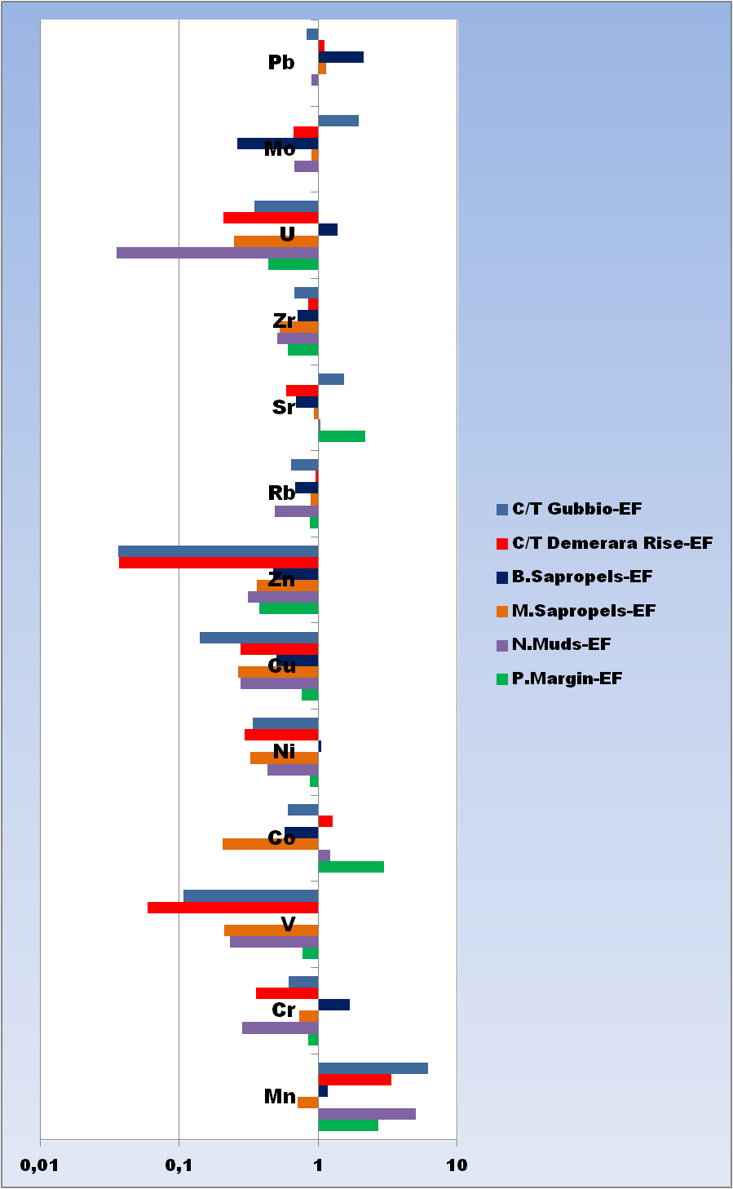
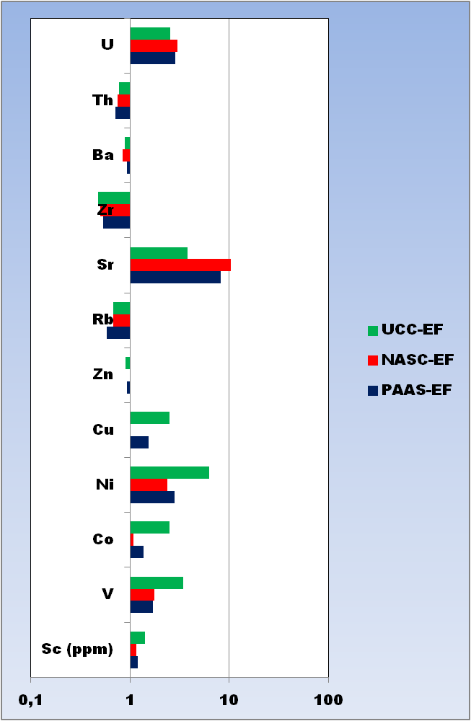
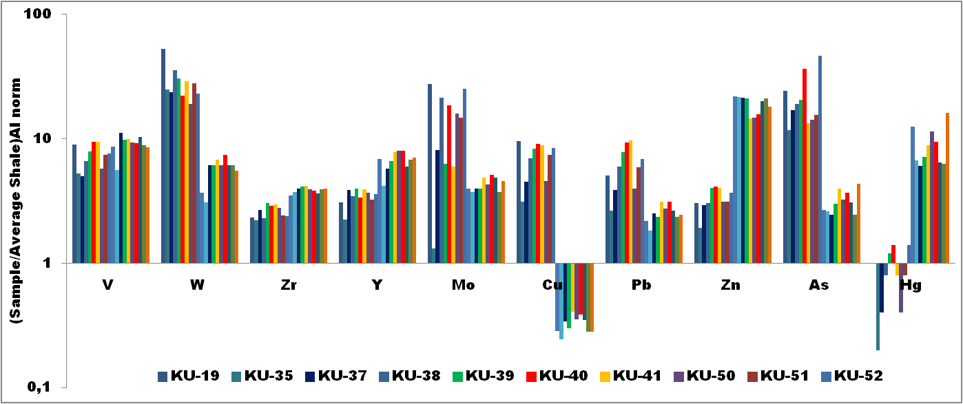
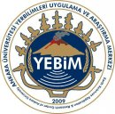
Hilal ENGiN¹, Ali SARI¹, Sükrü KOC¹ ¹Ankara University Department of Geological Engineering, TURKEY e-mail: hilal_engin@yahoo.com
REDOX SENSITIVE TRACE ELEMENT ENRICHMENTS OF ORGANIC MATTER RICH ROCKS (KÜRNÜÇ–GÖYNÜK/BOLU, TURKEY)
Introduction
Bituminous shales are fine-grained and organic matter rich rocks, also known as oil shale, black shale, bituminous shale etc. Depending on the amount of organic matter bituminous shale colors range from gray to black.
Elements are divided into three groups as detritial (Al, Ti, Ga, Zr, Sc), carbonate (Ca, Mg, Mn, Sr) and the ones associated with organic matter (Ag, Mo, Zn, Ni, Cu, Cr, V) (Vine ve Tourtelot, 1970). Enrichment factor (EF) is calculated using the following formula (Brumsack 2006, Ross ve Bustin 2009) and these calculations are used by various researchers (Calvert ve Pedersen 1993, Rimmer 2004).
EF_{element} = (Element/Al)_{sample} / (Element/Al)_{shale}
If the EF>1, the element enrichment is available. In contrast, EF<1 elements are depleted.
Study area (Göynük) is located in northwestern Turkey, in the Black Sea region. Kızılçay Formation and its Kabalar Member (Paleocene-Eocene) contain organic matter rich rocks which are the subject matter of this study. The rock types are determined as bituminous marl and dolomitic oil shales. The TOC values of our organic matter rich rocks range from 2,52%-8,38% and the kerogen type is found out to be Type I.
Results
Depending on the amount of oxygen content in the water column marine systems evaluated as oxic (>2 ml/l O₂), suboxic (0,2-2 ml/l O₂ ve <1 µmol/L H₂S), anoxic (<0,2 ml/l O₂) or euxinic (0 ml/l O₂) (Edwards, 1985; Tyson ve Pearson, 1991; Algeo and Maynard, 2004). According to some element ratios in our study area, redox conditions are variable but in general dominated by oxic and suboxic conditions.
Organic matter rich sediments are enriched in especially redox sensitive trace elements and sulfide forming trace metals (Warning ve Brumsack 2000, Arnaboldi and Meyers 2003, Brumsack 2006). Rocks in our study area enriched for trace elements like Co, Ni, Mo, V, Sr, Th, U, Rb, Pb, As, Zr, and Hf and while our organic matter rich rocks also enriched in some elements according to the depositional environments such as PAAS, NASC, UCC, but some of our rocks show some elements are depleted according to some depositional environments such as B. Sapropels, M. Sapropels, N. Muds, P. Margin, and C/T Demerara Rise, and C/T Gabbio.
Objectives
In this study, our objectives are;
to determine the redox conditions of depositional environment,
to determine element enrichments of organic matter rich rocks.
References
Discussion
Algeo, T.J., Maynard, J.B., 2004. Trace–Element Behavior and Redox Facies in Core Shales Of Upper Pennsylvanian Kansas-Type Cyclothems. Chemical Geology, 206, 289 – 318.
Arnaboldi, M., Meyers, P.A., 2003. Geochemical evidence for paleoclimatic variations during deposition of two Pliocene sapropels from the Vrica section, Calabria. Palaeogeography, Palaeoclimatology, Palaeoecology 190, 257–271.
Edwards, B.D., 1985. Bioturbation in a dysaerobic, bathyal basin:California borderland. In: Curran, H.A. (Ed.), Biogenic Structures: Their Use in Interpreting Depositional Environments.
Spec. Publ.-SEPM, vol. 35, pp. 309– 331.
Hatch, J.R. and Leventhal, J.S., 1992, Relationship between inferred redox potential of the depositional environment and geochemistry of the Upper Pennsylvanian (Missourian) Stark Shale Member of the Dennis Limestone, Wabaunsee County, Kansas, U.S.A. Chemical Geology, 99, 65–82.
Jones, B. and Manning, D.A.C., 1994. Comparison of geological indices used for the interpretation of palaeoredox conditions in ancient mudstones. Chemical Geology 111, 111-129.
Kimura, H. and Watanabe, Y., 2001. Oceanic anoxia at the Precambrian-Cambrian boundary. Geology, 21, 995-998.
Brumsack, H.-J., 2006. The trace metal content of recent organic carbon-rich sediments: implications for Cretaceous black shale formation. Palaeogeography Palaeoclimatology Palaeoecology, 232, 344–361.
Calvert, S.E., Pedersen, T.F., 1993. Geochemistry of Recent oxic and anoxic marine sediments: implications for the geological record. Marine Geology, 113, 67– 88.
Rimmer, S.M., 2004. Geochemical paleoredox indicators in the Devonian Mississippian black shales, Central Appalachian Basin (USA). Chemical Geology, 206, 373–391.
Ross, D.J.K., Bustin, R.M., 2009.Investigating the use of sedimentary geochemical proxies for paleoenvironment interpretation of thermally mature organic-rich strata: Examples from the Devonian–Mississippian shales, Western Canadian Sedimentary Basin. Chemical Geology, 260, 1-19.
Tyson, R.V., Pearson, TH., 1991. Modern and ancient continental shelf anoxia: an overview. In: Tyson, R.V., Pearson, T.H. (Eds.), Modern and Ancient Continental Shelf Anoxia, Geol. Soc. Spec. Pub., vol. 58. pp. 1 – 24.
Vine, J.D., and Tourtelot, E.B., 1970. Geochemistry of black shale deposits-a summary report. Economic Geology, 65, 253-272.
Warning, B., Brumsack, H.-J., 2000. Trace metal signatures of Mediterranean sapropels. Palaeogeography Palaeoclimatology Palaeoecology, 158, 293–309.
Some trace element ratios such as Ni/Co, V/Cr, V/(V+Ni), V/Sc, and U/Th have been used to evaluate paleoredox conditions (Hatch and Levental, 1992; Jones and Manning, 1994; Kimura ve Watanabe, 2001).
 | Oxic | Dysoxic | Suboxic to Anoxic | Euxinic
Ni/Co¹ | < 5 | 5 – 7 | > 7
V/Cr¹ | < 2 | 2 – 4.25 | >4.25
V/(V+Ni)² | < 0.46 | 0.46 – 0.60 | 0.54 – 0.82 | > 0.84
U/Th¹ | < 0.75 | 0.75 – 1.25 | > 1.25
V/Sc³ | < 9.1
¹ Jones and Manning (1994)
² Hatch and Levantal (1992)
³Kimura ve Watanabe (2001)

